Slide 1
Massive General Relativity
Gregory Gabadadze
NYU
(C. de Rham, GG, 2010)
(C. de Rham, GG, L. Heisenberg, D. Pirtskhalava, 2010)
(C. de Rham, GG, A.J. Tolley 2010)
(works in progress)

Slide 2
Motivation:
Construct a classical ghost-free massive extension of
General Relativity (fundamental question of classical FT)
Mass = Hubble parameter today; technically natural; study cosmic self-acceleration due to graviton mass
Screening of large scale sources such as vacuum energy: the cosmological constant problem

Slide 3
Important for our work (and for this talk) milestones:
A linear theory of massive spin-2 with 5 dof (Fierz and Pauli, 1939)
No continuous limit of FP to massless theory (van Dam, Veltman; Zakharov, 1970)
Continuity can be restored due to nonlinearities (Vainshtein, 1972)
The nonlinearities introduce the sixth dof (ghost) (Boulware, Deser, 1972)
Theories from extra dimensions (DGP 2000 and its extensions) and their
connection with massive gravity (Deffayet, Dvali, GG, Vainshtein, 2001)
The sixth mode (BD ghost) can be conveniently identified in the decoupling limit of a covariant 4D theory (Arkani-Hamed, Georgi, M. Schwartz, 2002)
No sixth mode in the decoupling limit of DGP, the cubic Galileon
(Luty, Porrati, Rattazzi, 2003), and its generalizations 2008 ->

Slide 4
Massive gravity beyond Fierz-Pauli (FP) action:
A guiding principle for the coefficients of the nonlinear terms?
Are these infinite number of terms an expansion of something?
Anything interesting for cosmology?

Slide 5
Massive gravity beyond Fierz-Pauli (FP) action:
A guiding principle for the coefficients of the nonlinear terms?
YES: absence of ghost in the decoupling limit (C. de Rham, GG)
Are these infinite number of terms an expansion of something?
YES: resummation once the above condition satisfied (C. de Rham, GG, A.J. Tolley)
Anything interesting for cosmology?
We think so (C. de Rham, GG, L. Heisenberg, D. Pirtskhalava), also works in progress

Slide 6
A toy model: massive Abelian gauge field
No symmetry. Very naively, 4 dof from 4 components of B; however, no time derivative of B_0, hence, only 3 dof
The 3 dof can be identified in either the Lagrangian or Hamiltonian formalisms; we use the Stuckelberg trick:

Slide 7
The Lagrangian is invariant w.r.t. simultaneous transformations of A and pi. Gauge fixing A leaves 2 dof in it, pi ads as 3rd, helicity-0, dof
In the decoupling limit this is more manifest:
two helicity-1 states are decoupled from helicity-0
(the latter decouples from conserved sources)

Slide 8
Illustrative terms for helicity-0 of massive GR
A generic choice of the nonlinear terms: ill-defined Cauchy problem due to the cubic term → BD ghost on local backgrounds
A special choice of the nonlinear terms well-defined Cauchy problem → no BD ghost on local backgrounds

Slide 9
Covariant formulation of massive gravity
Introduce four scalar fields
In the Unitary Gauge:

Slide 10
Invariant Lagrangian in terms of tensors g and H
where

Slide 11
Stuckelberg fluctuations :
Decoupling limit:
Dropping the helicity-1 mode (for simplicity) and focusing
on the helicity-0

Slide 12
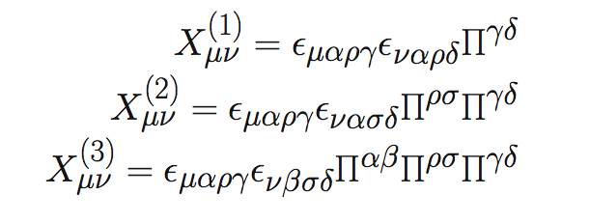
The exact Lagrangian in the decoupling limit:
The Lagrangian is exactly invariant under linear diffeomorphisms, as well as under the shift and Galilean transformations of the helicity-0

Slide 13
Cosmology in the decoupling limit: scales <<1/H
Modified Einstein equation:
Equation for the helicity-0 mode (schematic form)
A solution:

Slide 14
This is selfaccelerated solution: restoring powers of m at scales <<1/H
where H is proportional to m
Introducing matter one gets the Friedmann equation:
In this approximation identical to LambdaCDM

Slide 15
Fluctuations above the selfaccelerated solution :
Resulting Lagrangian for the fluctuations:
No ghost for a broad range of the two parameters
Fluctuation for the helicity-0 decoupled from sources in the linearized approximation, hence predictions very close to those of LambdaCDM
Expected to deviate from LambdaCDM by nonlinear and nearly the Hubble scale effects

Slide 16
Degravitation:
(Dvali, GG, Shifman 2002)
(Arkani-Hamed, Dimopoulos, Dvali, GG, 2002)
(Dvali, Hofmann, Khoury, 2007)
(C. de Rham, GG, L. Heisenberg, D. Pirtskhalava, 2010)
A flat solution for an
arbitrary vacuum energy

Slide 17
However, there is the fifth force problem
On this solution the Vainshtein scale is determined
by the vacuum energy itself
Fluctuations of the helicity-0 become strong at a certain high UV scale, and the Vainshtein screening is postponed to unacceptable short distance scales
Degravitation could have taken place in early universe when fifth force was not measured, however, not clear how to match this solution to ordinary cosmology

Slide 18
Resummation of the infinite series of nonlinear terms:

Slide 19
A “simplest” example of the resumed Lagrangian
Here, K is an independent field; the constraint from the
Lagrange multiplier has an exact solution

Slide 20
Resummed Hamiltonian
Very special coefficients, maintain the Hamiltonian constraint in the quartic order (easiest to see is to redefine the shift)

Slide 21
What is the exact cosmology of the resummed theory?
Works in progress
G. D’Amico, C. de Rham, S. Dubovsky, GG, D. Pirtskhalava, A.J. Tolley
(what follows is some preliminary discussions)

Slide 22
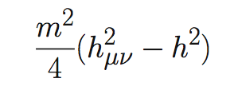
There is no exactly homegeneous and isotropic cosmology:
1. Linearized Fierz-Pauli theory
This term in the action (in the unitary gauge) leads to the following consequence of the Bianchi identities:

Slide 23
Assuming homogeneity (in the unitary gauge) implies:
Hence no homogeneous and isotropic solutions except Minkowski
There can exist homogeneous but not isotropic;
or isotropic but not homogeneous (or both non’s).

Slide 24
There is no exactly homegeneous and isotropic cosmology:
2. Full theory (the resummed Lagrangian)
Variations of the above Lagrangian w.r.t. N and a necessarily lead to:
Fundamental reason: absence of BD ghost imposes a constraint which
is not compatible with exactly FRW metric. However, evolution can be
approximately FRW before reaching large scales.

Slide 25
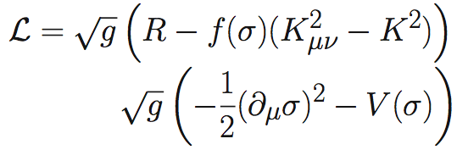
So far we’ve discussed hard mass. Dynamically generated mass:
VEV of sigma determines the mass (V could even be zero)
There exist a choice of f and V for which the sigma fluctuations are also Galileons (resulting in two Galileons coupled to a tensor field)
FRW solutions possible, the constraint determines sigma, however, the evolution never transitions to that of the hard mass theory, the dynamical mass theories are very different.

Slide 26
Conclusions:
Strong theoretical evidence that Massive General Relativity exists as a consistent ghost-free classical theory (decoupling limit Lagrangian; Hamiltonian constraint in quartic order).
It has ghost-free selfaccelerated solution in the decoupling limit; also has a degravitating solution.
Interesting novel cosmology (inhomogeneous and/or anisotropic) at very large scales.

