Slide 1
July 2010, Nordita
Lattice Effects on Vortex Dynamics
Assa Auerbach, Technion, Israel
Vortex transport theory
lattice Bosons
Strangeness of Half filling
The Gauged torus
Vortex wavefunctions, mass, and vspin.
Hall effect
AA, Daniel P. Arovas and Sankalpa Ghosh, Phys. Rev. B74, 64511, (2006).
G. Koren, Y. Mor, AA, and E. Polturak, Phys. Rev. B76, 134516, (2007).
Netanel H. Lindner and AA, Phys. Rev. B81, 054512, (2010).
Netanel H. Lindner AA and Daniel P. Arovas, Phys. Rev. Lett. 101, 070403 (2009),
+ in preparation.

Slide 2
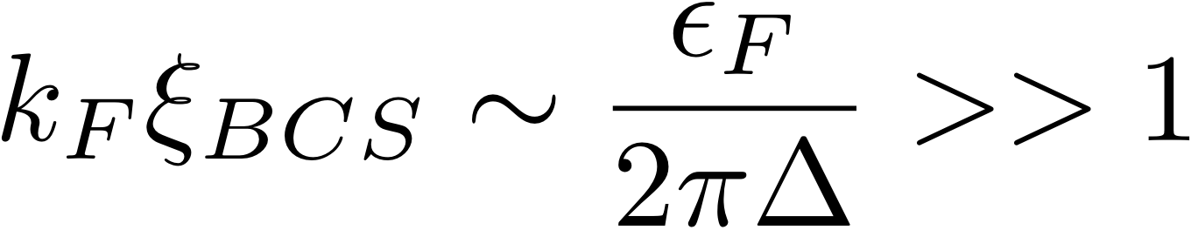
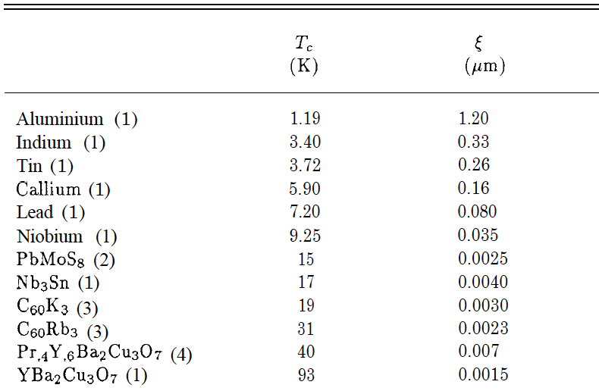
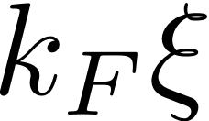


BCS vs “Bosonic” Superconductors
number of CdGM core states
Guy Deutscher & Bok 1993
BCS ground state
~1000
BCS,
Bardeen Stephen
large cores
~100
~10
~1
“Bosonic”
Few core
states
BaFe_{1.8}Co_{0.2}As₂
Yi Yin et. al. 2009
0.0027

Slide 3

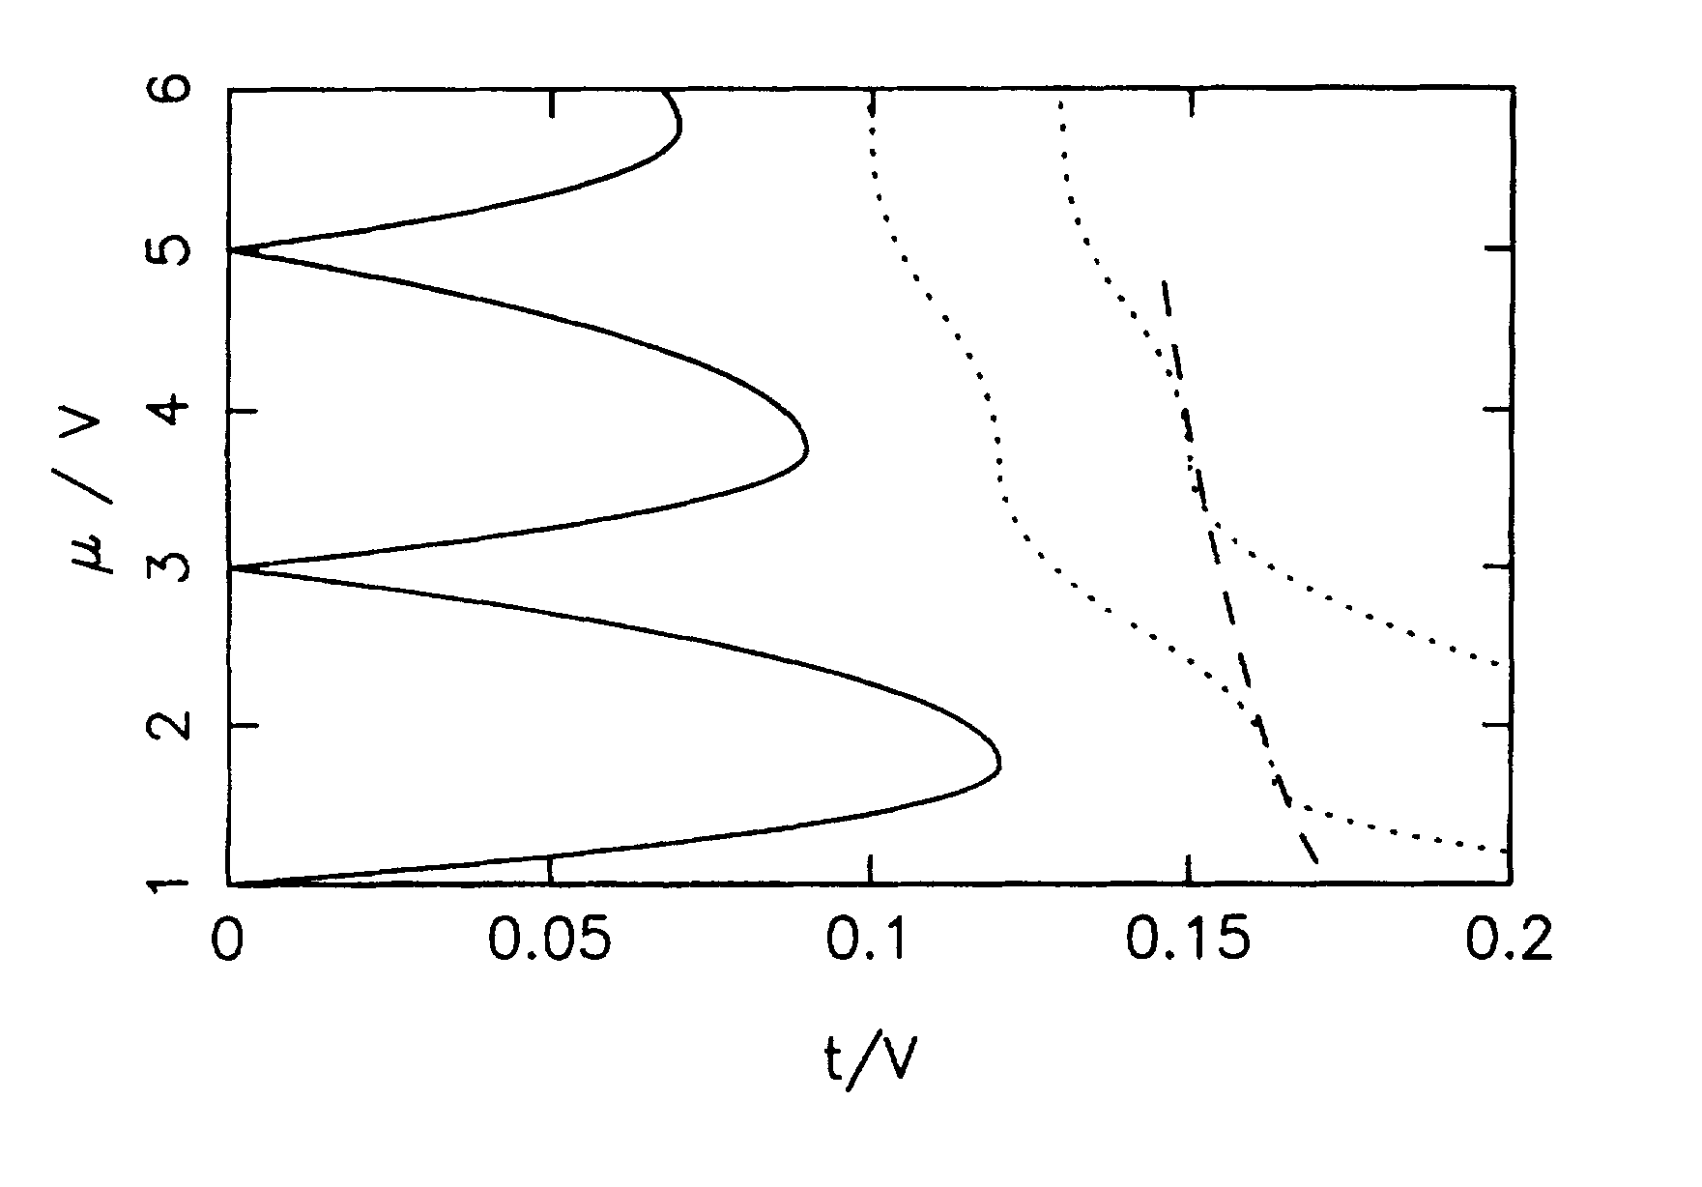


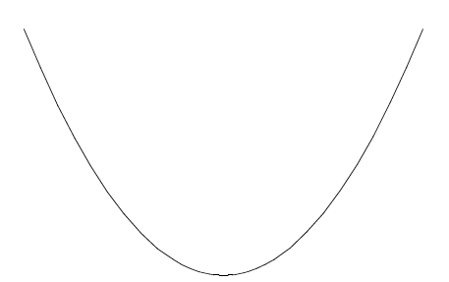
Lattice bosons
Bose Hubbard Model
Zimanyi et. al. Phys. Rev. B 50 (1994)
Mott insulators
QCP
charge order
superfluid
phase order
S=1/2 , XY model
S=1, XY Model: relativistic GP
truncate
truncate

Slide 4
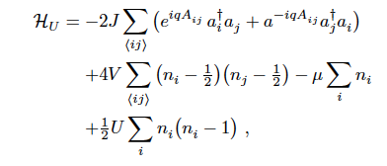

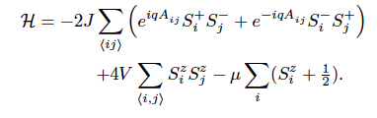
Hard Core Bosons
dangerous around
n=1/2
HCB are different than free bosons
S=1/2 Quantum XY model representation

Slide 5

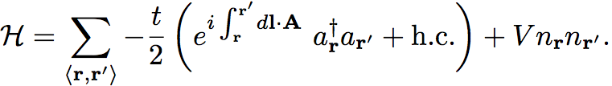
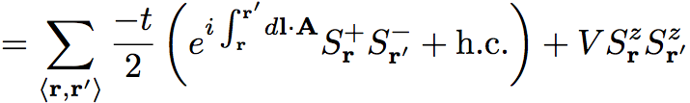
Hard Core Bosons = Quantum spins
Hard core bosons
S=1/2, XXZ model
superfluid
V < t
half filling
charge density wave
V > t

Slide 6




Properties of XXZ model
(classical) Mean field theory
superfluid density
charge conjugation
0
1
Half filling has maximal stiffness
At half filling the Hall conductivity vanishes
Hall conductivity is antisymmetric about half filling

Slide 7
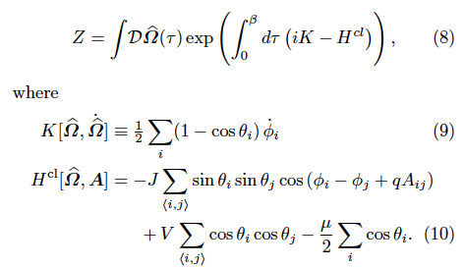

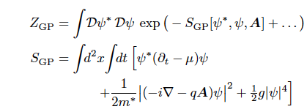
Semiclassical theory
Spin coherent states path integral
Berry phases:
Low density theory

Slide 8

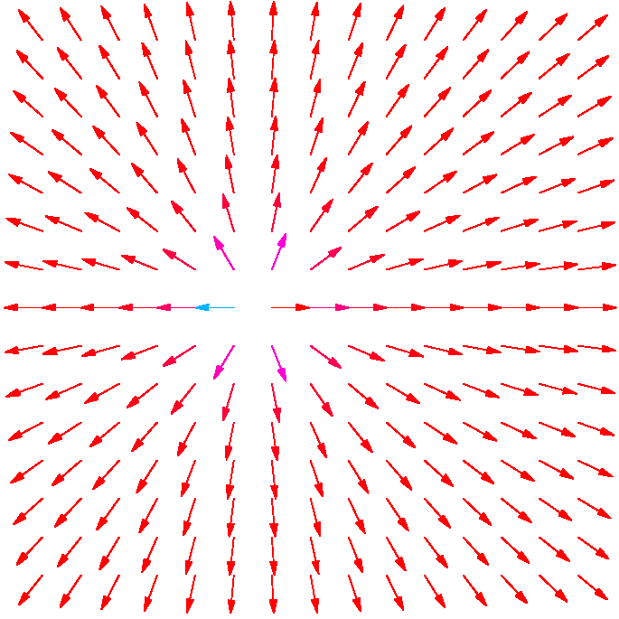




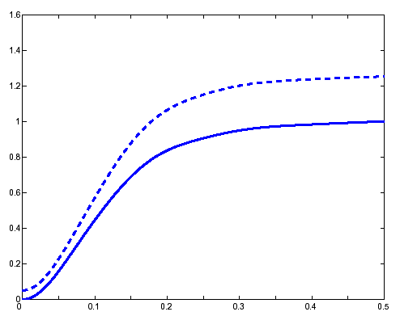



A Vortex in Gross Pitaevskii theory
coherence lengthscale
One flux quantum in the system
Vortex (approx.) solution:
large core depletion
0
1
2
3
4
5

Slide 9
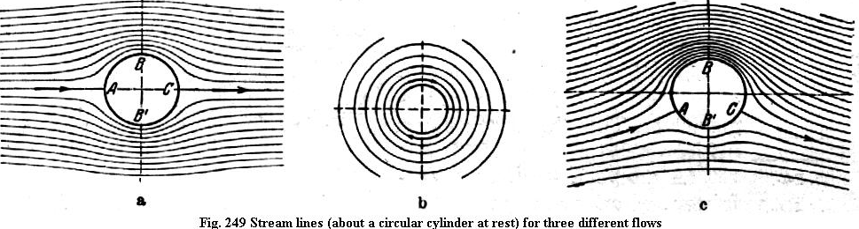
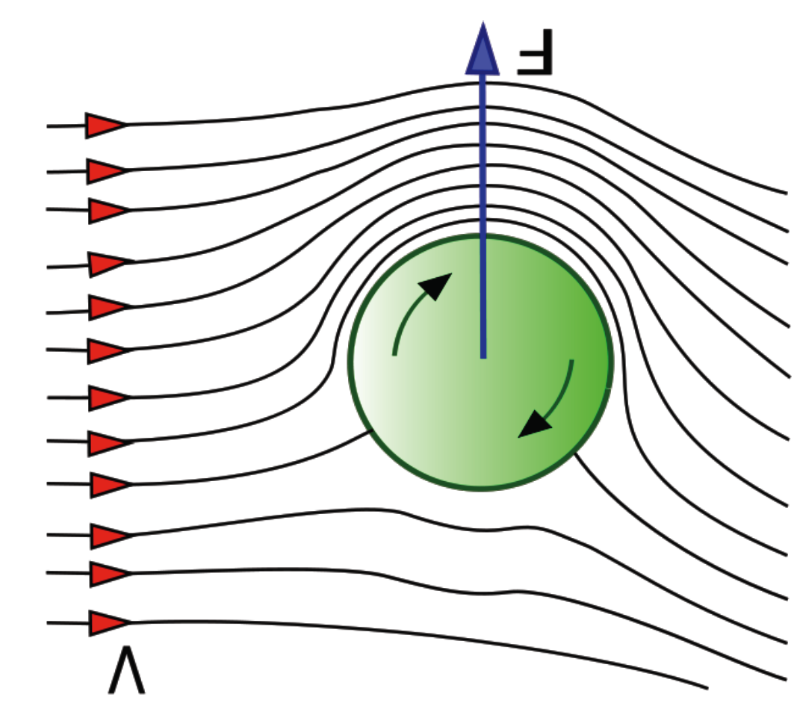
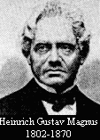

Magnus hydrodynamics
F
F
Current →
V

Slide 10




Classical Vortex Dynamics
Semiclassical (smooth potential) dynamics, without tunneling:
No dissipation
No potential: vortices ‘Go with the Flow’
E_{H}
F
V

Slide 11




Vortex Motion induced EMF
vorticity current
V
Multiple moving
vortices create a stress field
=Hydrodynamic `Lorentz’ field

Slide 12





Vortex Tunneling between pinning potentials
spatially varying potentials can induce vortex tunneling
1
2
Vortex tunneling rate:
Bogoliubov theory yields:
AA, D.P. Arovas, S. Ghosh, Phys Rev B 74, 2006
effective ‘mass’

Slide 13
Summary: 2D Continuum with weak scattering
1. Vortices localize on equipotential contours and drift with the superflow.
2. GP equation cannot treat short range potential effects.
3. Short range (lattice) potentials delocalize vortices (make them ‘’quantum’’).

Slide 14


Hard Core Bosons at Half filling – Breakdown of GP theory
Analogue of the quantum antiferromaget:
Anisotropic, gauged, non linear sigma model
relativistic (2nd order) dynamics

Slide 15



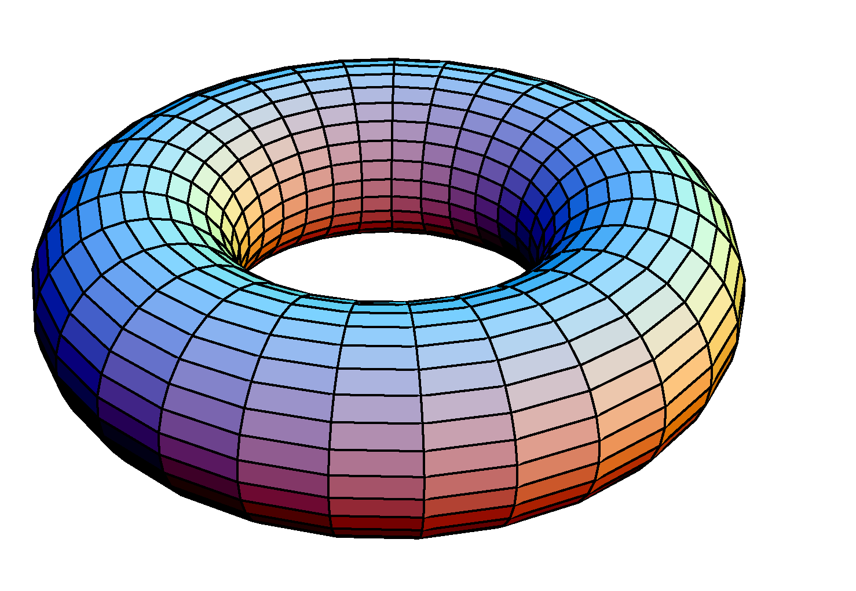


The Gauged Torus
torus penetrated by uniform field
lines of zero flux
2 Aharonov-Bohm fluxes
center of vorticity
one vortex
The semiclasical vortex feels a confining potential
around Rv

Slide 16

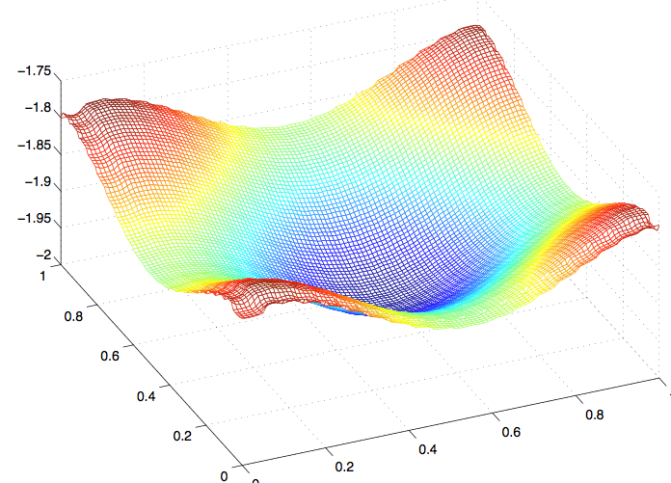



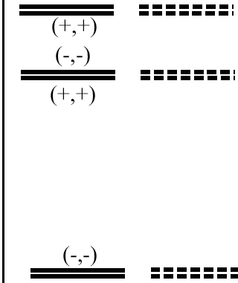

Extracting the vortex hopping rate
Vortex Harper hamiltonian
vortex confining potential
magnus field = boson density
variational calculation
-6.98
Fitting the Vortex hopping to exact diag.
-7.11
Vortex mass = boson mass at half filling
-7.72

Slide 17
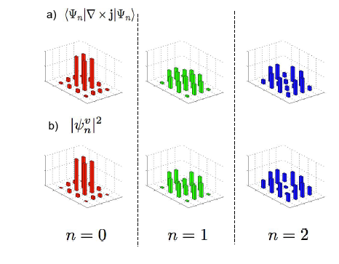
Vortex wavefunctions vs. vorticity density
Vorticity density
(HCB, exact)
Single vortex wavefunction
(Harper model)

Slide 18
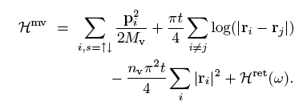

Quantum Melting
Multivortex hamiltonian = Bose coloumb liquid
Magro and Ceperley: Wigner solid melts at
Therefore, the vortex lattice should quantum melt at
Quantum Vortex liquid: not Bose condensed!

Slide 19

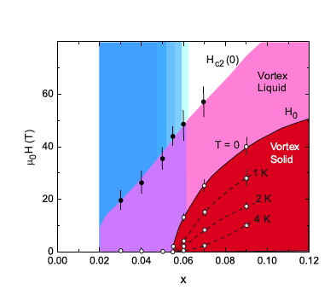
Quantum melting in cuprates
Nature Physics 3, 311-314 (2007)
strong
diamagnetism
A quantum phase:
Vortex condensate?
Vortex metal?
T_{m}
classical
H
T_{m} decreases with field. (Non classical)

Slide 20



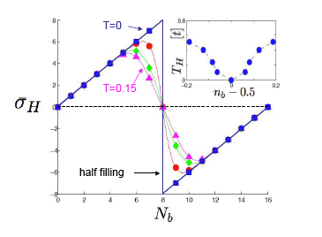
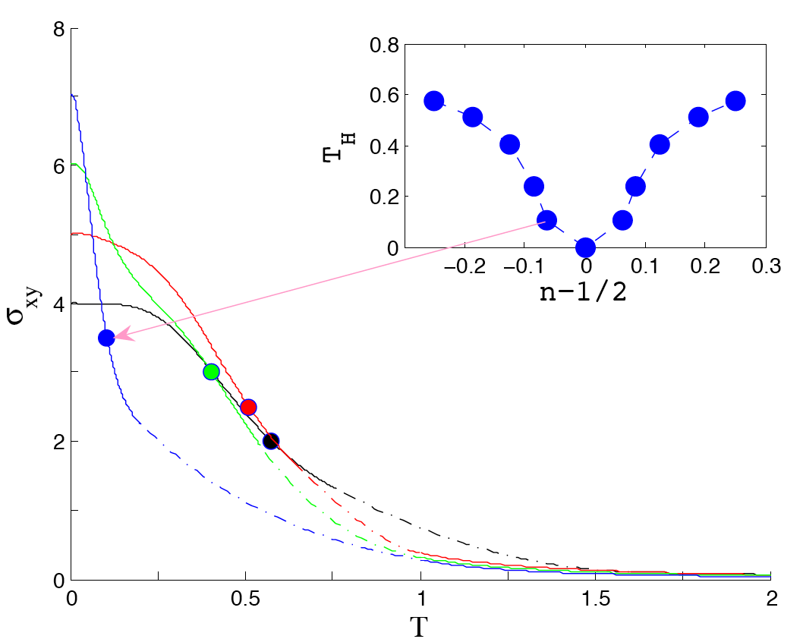
Hall conductivity
Lindner, AA, Arovas, PRL (2009), +preprint
Thermally averaged Chern numbers
“Hall temperature”
T
Quantum Critical point?

Slide 21


The strangeness of Half Filling
Magnus dynamics (no dissip.)
Magnus force
hole current
particle current
Charge conjugation symmetry:
vanishing Hall conductivity

Slide 22
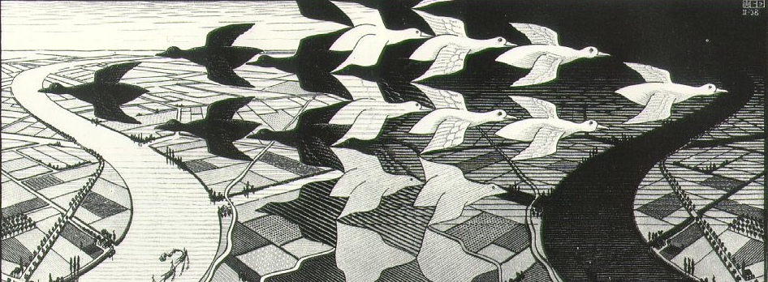
Escher, Day and Night, 1938

Slide 23
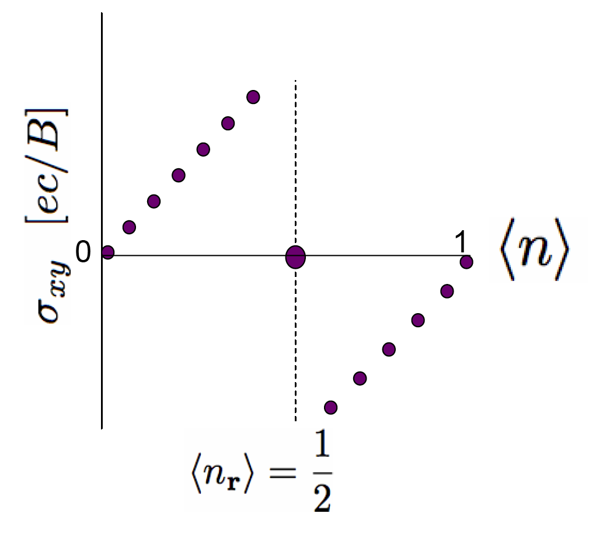


Magnus field reversal
a)
b)

Slide 24
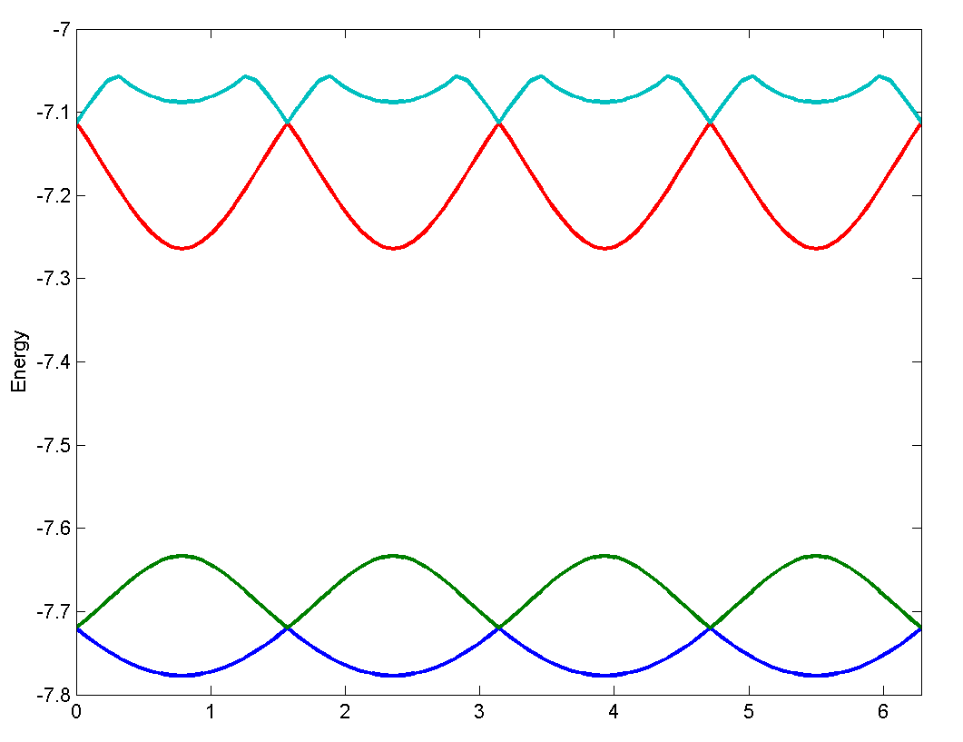


Vortex degeneracies
Netanel accidentally found the spectrum of a vortex at half filling
to be ‘infested’ with two-fold degeneracies.....
Odd number of vortices
Theorem:
1. Degeneracies correspond vorticity center on all lattice sites.
2. At degeneracies: all the states are even-fold degenerate (doublets).
Proof:
construct a non commuting algebra of symmetries

Slide 25



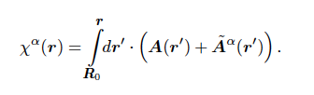
The Pi operators
1. reflection about
2. charge conjugation
3. gauge transformation

Slide 26

The Pi operators
Point group* symmetries
For odd vorticity
=> All states are doubly degerenate
*For one vortex, there are no translational symmetries on finite tori

Slide 27
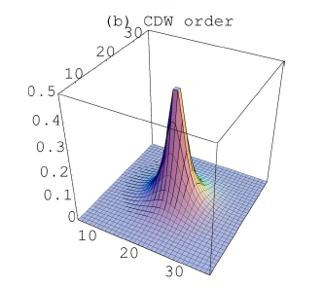
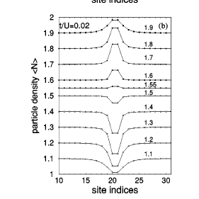
charge distributions
Phys Rev A 69 (2004)
v-spin up
staggered charge density
at half filling
Multiple species of vortex condensates were discussed by:
Lannert, Fisher, Senthil, PRB (01)
Tesanovic, PRL 93 (2004),
Balents, Bartosch, Burkov, Sachdev, and Sengupta, PRB 71, 144508 (2005).

Slide 28
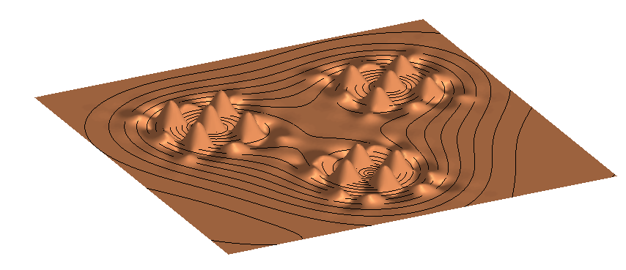
Illustration of 3 vortices with v-spin
Implications of v-spins:
order: CDW (supersolid) in the vortex lattice
Low temperature entropy of v-spins

Slide 29
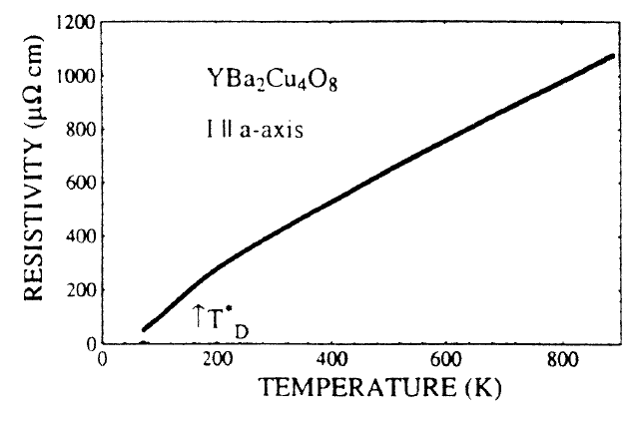

`Bad Metal’
Breakdown of Boltzmann theory
conventional metal
Emery & Kivelson `Bad Metal’ behavior

Slide 30
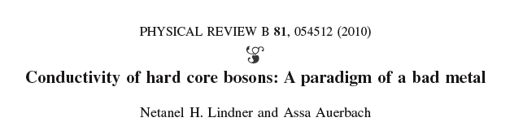
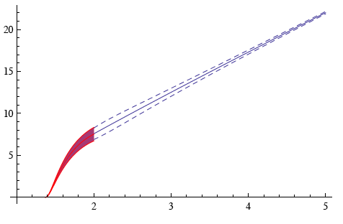





High temperature resistivity
vortex plasma theory
Halperin- Nelson
“Bad Metal”: strongly scattered vortices
linear increase, no resistivity saturation

Slide 31
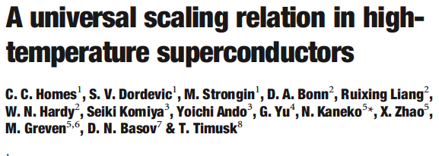
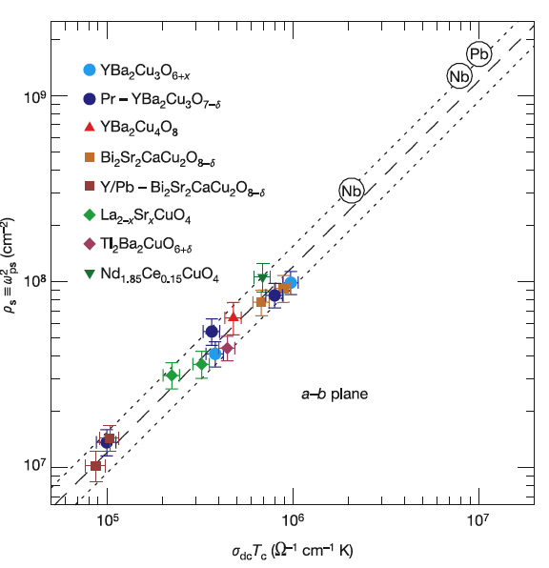
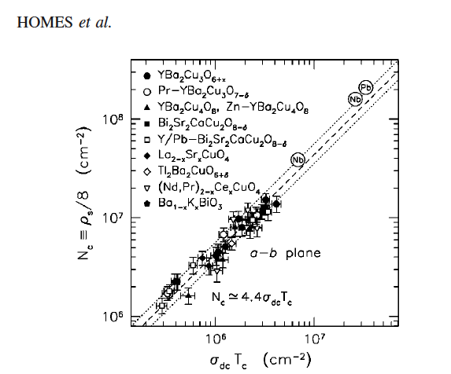
“Homes Law”

Slide 32

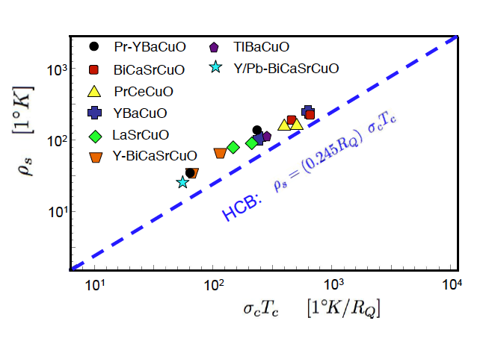
“Homes law” of HCB
Data: Homes et. al.

Slide 33
Summary
Vortex tunneling enabled by pinning sites in 2D.
Lattice scattering enhances quantum melting of the vortex lattice phase.
Hall effect reverses sign at half filling, where Vortices acquire spin-half (“V-spin”) degeneracies.
Free vortices strongly scatter to produce “bad metal” resistivity.

Slide 34




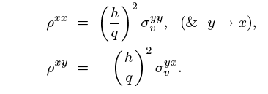
Vortex-Charge Duality
density of induced vortices
Vortex driving (Magnus) field
Vortex Induced EMF
Vortex Transport Equation
Boson resistivity
Vortex conductivity

