Slide 1
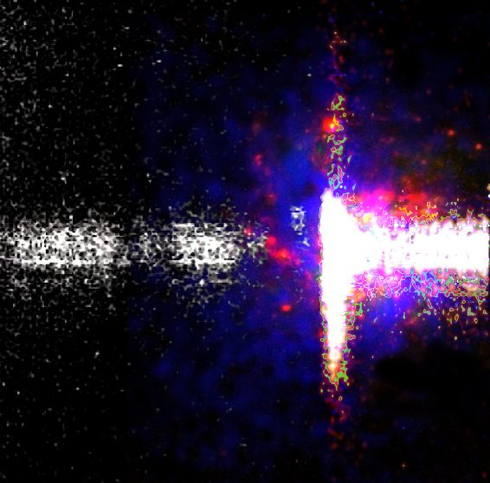
Observational constraints on Lyman alpha escape from galaxies at z=0 – 2.2
Göran Östlin
Department of Astronomy, Stockholm University
& Oskar Klein Centre for Cosmoparticle physics
Sweden

Slide 2
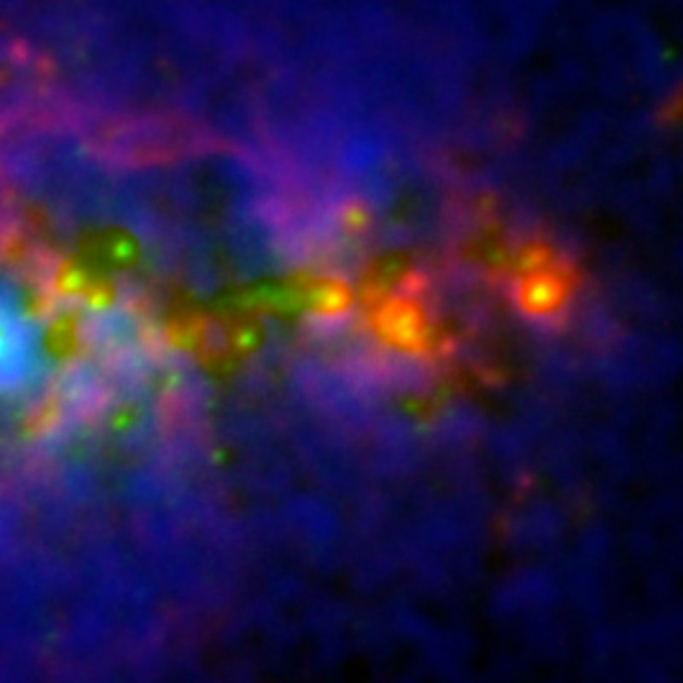
Contributors
Angela Adamo, Stockholm
Hakim Atek, IAP (Paris)
Jean-Michel Deharveng, Marseille
Daniel Kunth, IAP
Claus Leitherer, STScI
Miguel Mas-Hesse, CSIC-INTA, Madrid
Matthew Hayes, Geneva
Artashes Petrosian, Byurakan obs.
Daniel Schaerer, Geneva

Slide 3
Contents
Observational studies based on Lyα and Hα observations:
HST imaging of z0 starbursts
GALEX + ground based spectroscopy of Lyα sources at z~0.3
VLT narrow band imaging of Lyα and Hα at z=2.2

Slide 4
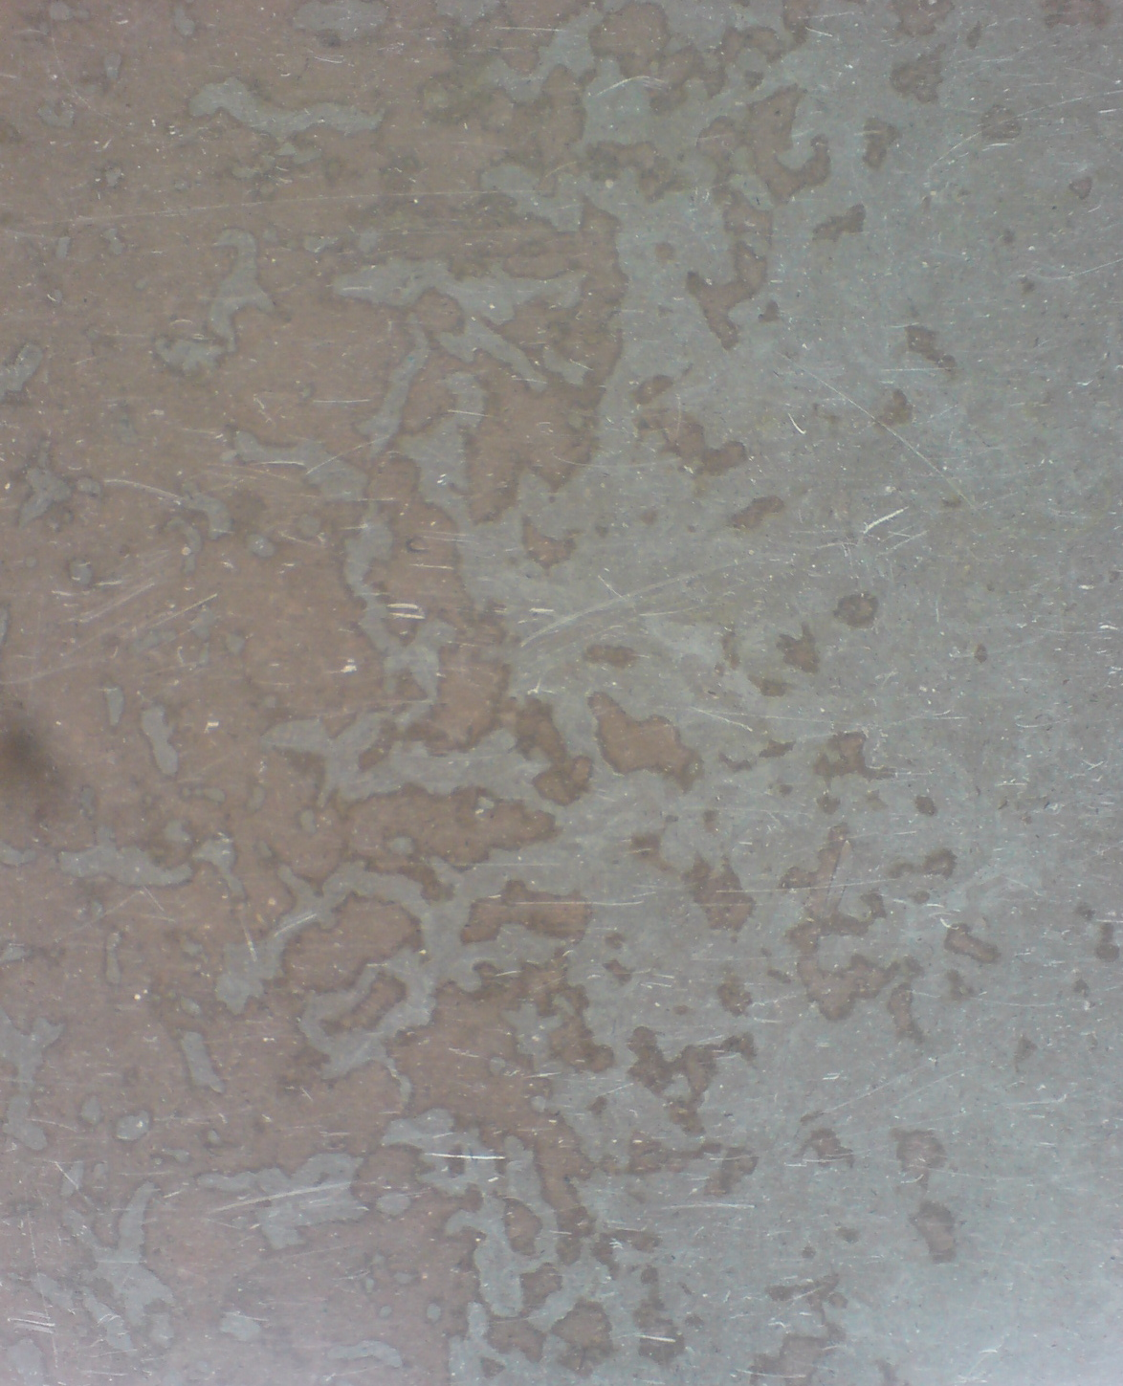
Reionisation ?
or…
marble floor at AlbaNova !

Slide 5
Why do Lyman alpha imaging? Background
YES
Lyman alpha in theory strongest recombination line, up to one third of inosining photons may be reprocessed to Lya
Young galaxies should hence be bright in Lyα
Lyman alpha can be observed from ground for z > 2
Hence a potentially powerful tool to study galaxy formation and reionisation
BUT
Early studies with IUE of local galaxies showed Lyα to be unexpectedly weak – Why?
Lyα/Hβ values incompatible with observed reddening
Early blind high-z surveys did not, until 1998, yield much
Lyα is a resonant line and resonant scattering would make line radiative transfer sensitive to even small amounts of dust
L

Slide 6
Why do Lyman alpha imaging? Background…
PROGRESS
High resolution spectroscopic studies with HST/GHRS revealed importance of ISM kinematics (Kunth et al 1994, Lequeux et al. 1995):
P-Cyg profiles
Neutral ISM absorption lines
➔ Lyα needs to be pushed out
High-z surveys targeting fainter levels and larger fields have during the last decade been very successful
BUT
To use Lyα as reionisation probe we need to understand the relation between ionisation and observed radiation, i.e the escape of Lyα photons

Slide 7
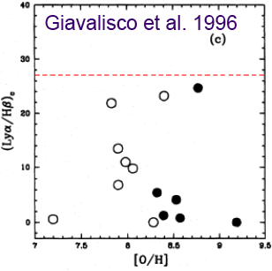
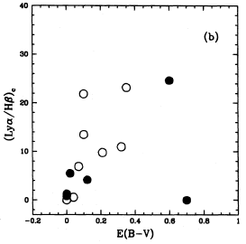
Why do Lyman alpha imaging? Examples
Local star forming galaxies (IUE):
Lyα is weak and cannot be corrected for extinction
NB. Extinction ’corrected’ values

Slide 8
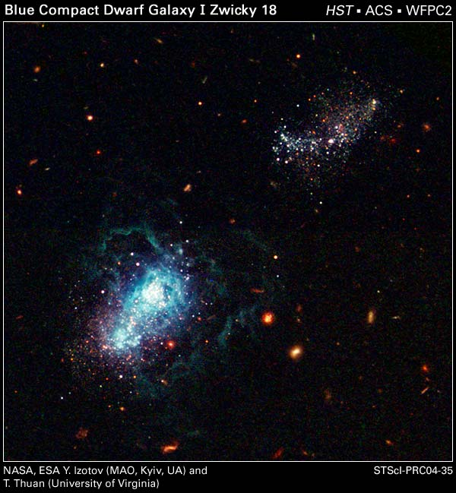
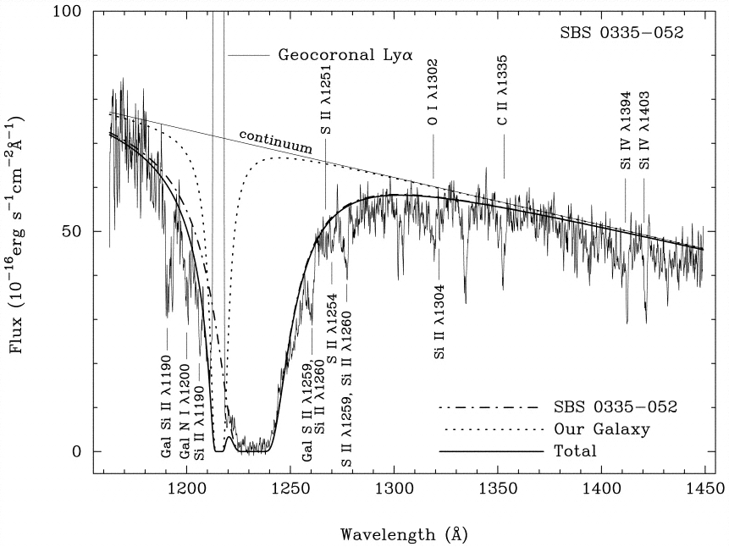
Why do Lyman alpha imaging? Examples…
IZw18, the galaxy with the most
Metal-poor and dust-poor ISM
Known is a damped absorber !
Also SBS0335-052 ⬇
Can the Lyα photons scatter out of the spectroscopic aperture?

Slide 9
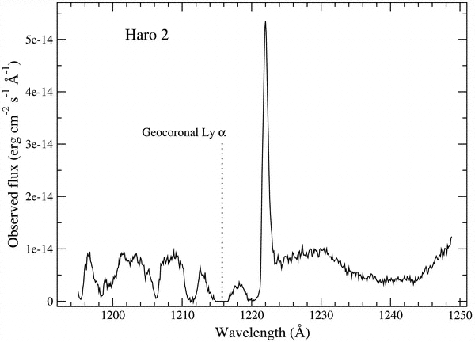
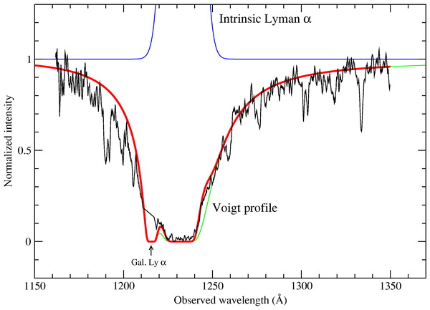
Lya emission and absorption
Why do Lyman alpha imaging? Examples…
After production (in HII region)‏
Emission
Absorption?
Absorption?
Haro 2 (STIS) SBS 0335-052 (STIS)‏
Mas-Hesse et al. 2003
Resonance scattering
→ emission & absorption need not be local!

Slide 10
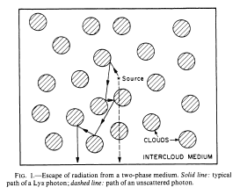
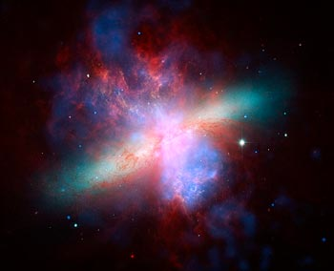
Why do Lyman alpha imaging? Examples…
A (dusty) multiphase medium can in fact also enhance Lyα (Neufeld 1991)
Where do Lyα come out?
Can boost EW
Edge on starburst
Think M82

Slide 11
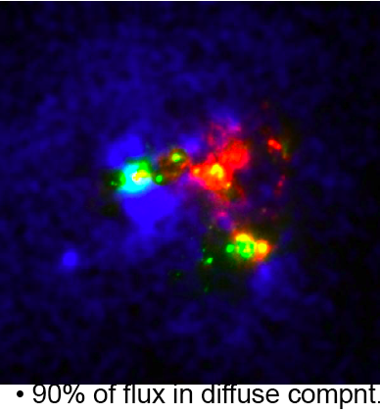
Why do Lyman alpha imaging?
Imaging of Lyα in the local universe can be done with HST
ACS/SBC (narrowband Lyα and long pass filters) and STIS
While Imaging cannot reveal ISM effects, it allows to:
Study the spatial distribution of Lyα
Indentify large scale diffuse Lyα
emission from resonant scattering
Study Lyα as a vs local conditions:
Ionising stellar population age
luminosity
Dust

Slide 12
Lyα Regulation and observation
Physical properties
Dust
HI ( distribution & kinematics )‏
Vary on small (<< kpc) scales
Coupled to the star-formation process
viewing geometry
How do the Lya photons that do escape escape?
Observations
High-z img. global flux & EW
spec. global line profiles + F & EW
Low-z spec. IUE ~global line profile
HST localised studies
No HI rec.
lines
HI Rec.
lines

Slide 13
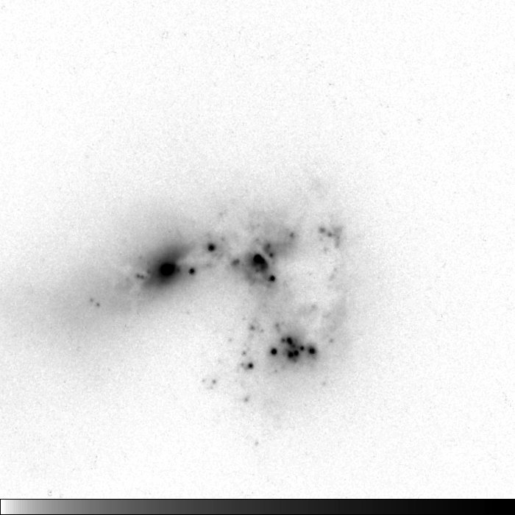
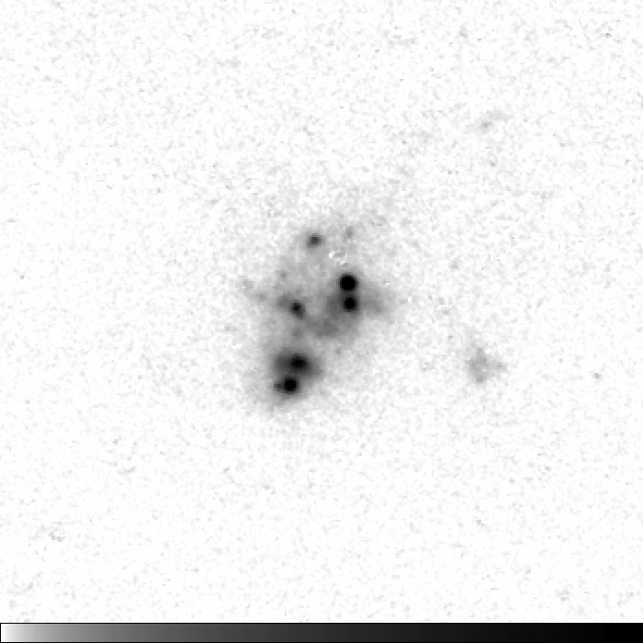
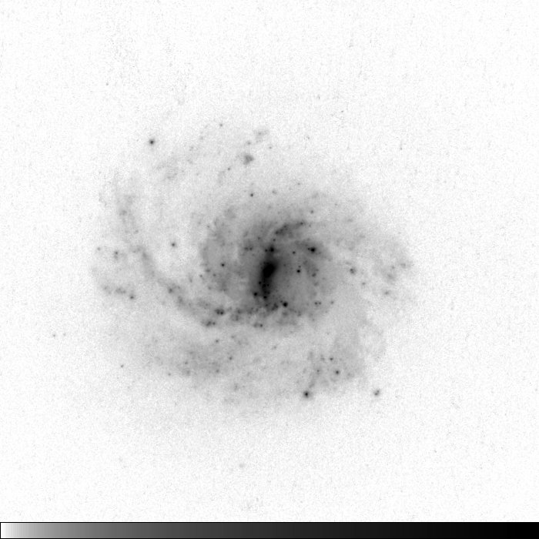
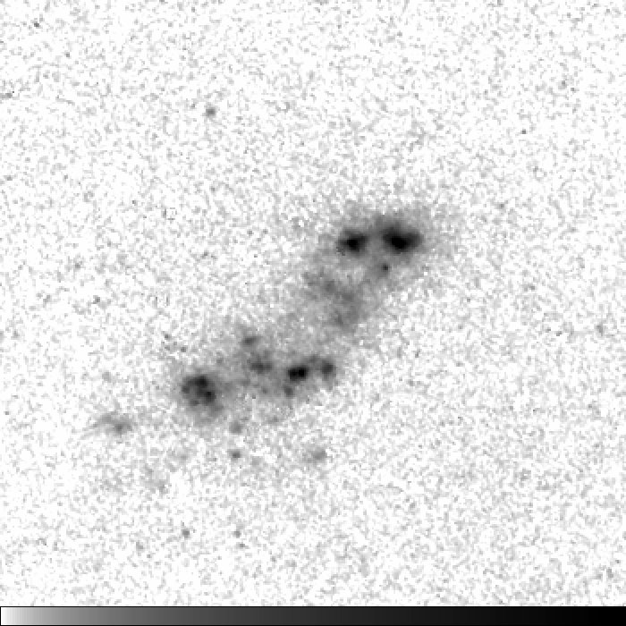
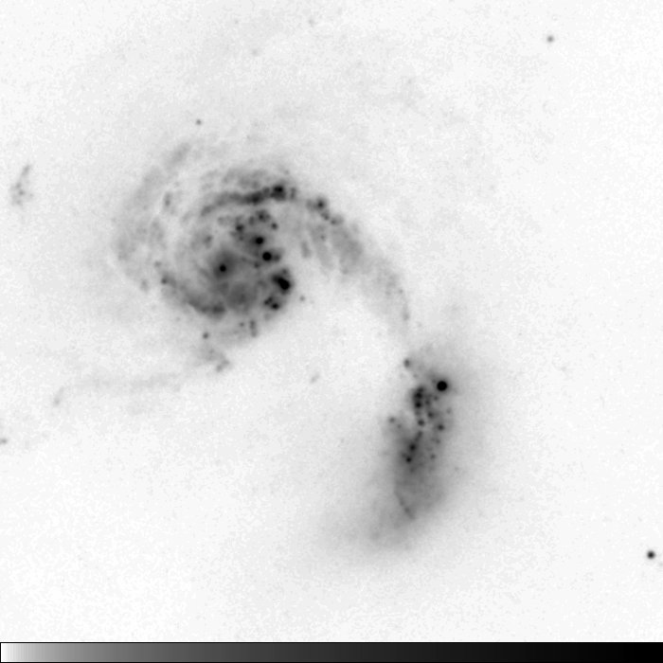
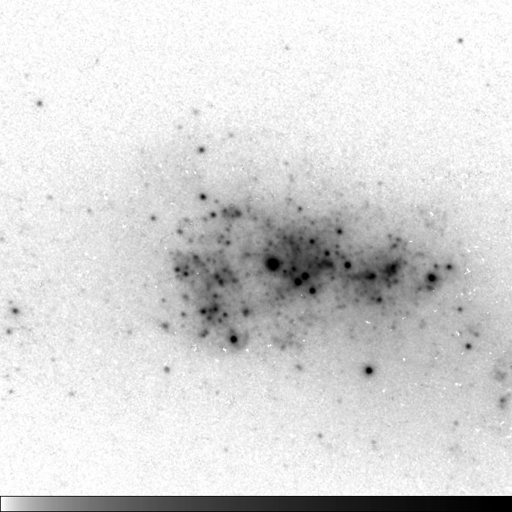
HST/ACS Lyα Imaging - a pilot study
Haro 11
17
SBS 0335
1.1
6 galaxies
40 orbits with HST
30 with ACS/SBC
10 with HRC & WFC
0.03” sampling
Span a range of
morphology
metallicity
dust
Luminosity
Emitters AND absorbers
Emitters with range of Lyα
profiles (evolutionary stages)
Z
SFR
M_{B}
-20
7.9
-17
7.3
IRAS 08
14
Tol 65
0.3
HST / ACS / F550M
-21
8.7
-15
7.6
NGC 6090
18
ESO 338
5
-21
8.8
-19
7.9

Slide 14
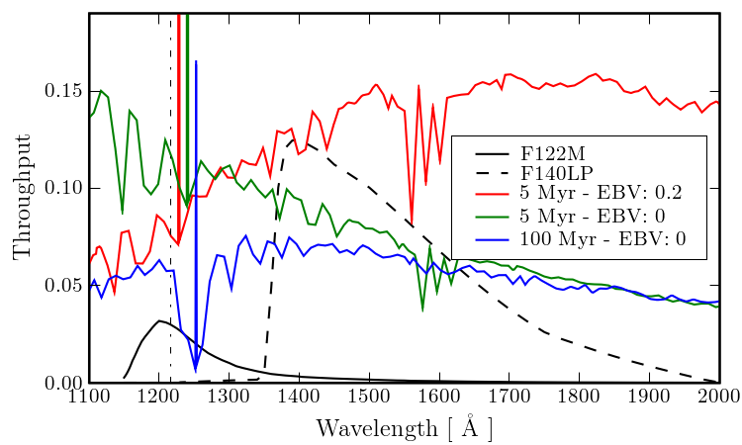
Continuum subtraction – the issue
Strong continuum evolution between F140LP and F122M
Galactic E(B-V)‏
Galactic HI
Stellar age
E(B-V)‏
★ Lya absorption
CTN -- Continuum throughput normalisaton
factor that scales F140LP to F122M
Look up
Figure out

Slide 15
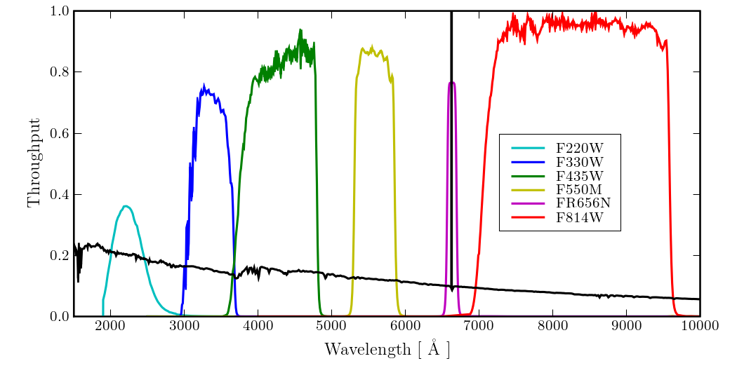
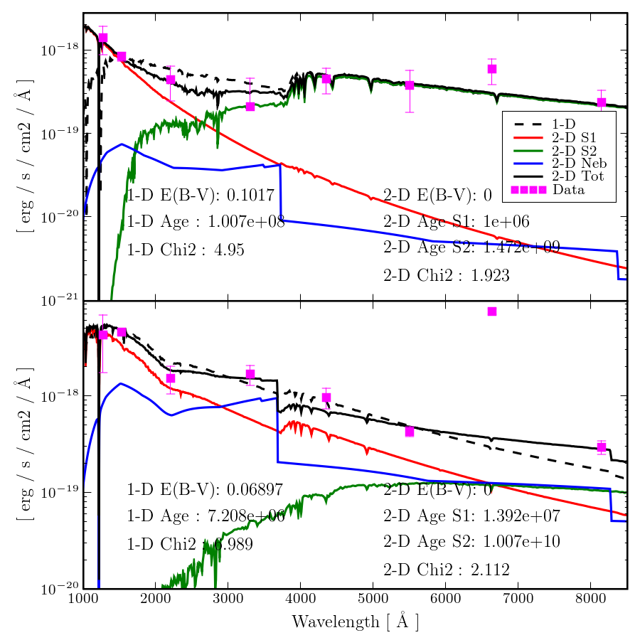
Continuum subtraction – the solution
Additional observations:
ACS Broadband 2000 Å to 8000Å
(avoiding strongest emission lines)
Narrowband Ha
Model stellar continuum using
SB99 (Leitherer et al 1999) Fit:
Stellar age
E(B-V)‏
2 stellar + nebular gas spectra
Maps:
}
β and 4000 Å break
Stellar age
Photometric mass
E(B-V)‏
Ha
CTN
Lya
Hayes et al 2009, AJ 138, 911

Slide 16
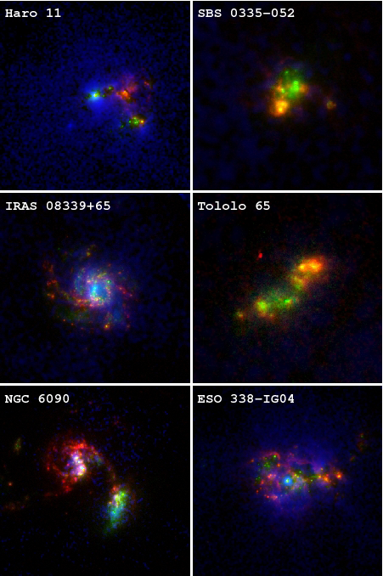
Lyα imaging results:
Blue = Lyα
Green = 1500Å continuum
Red = Hα
Östlin, Hayes, Kunth et al 2009, AJ 138, 923
Images available on www
Hayes et al 2009, AJ in press

Slide 17
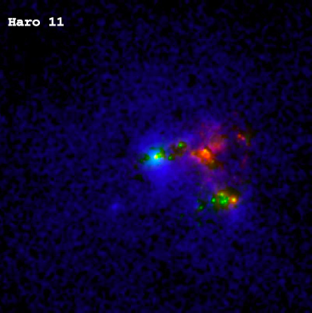
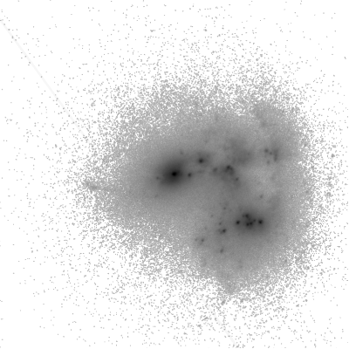
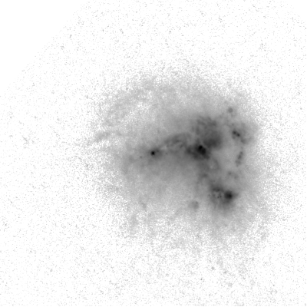
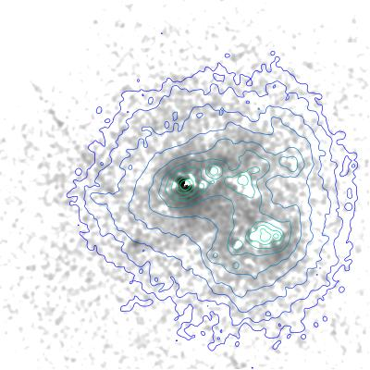
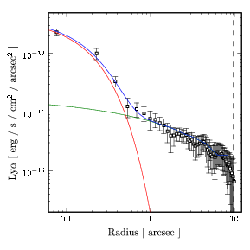
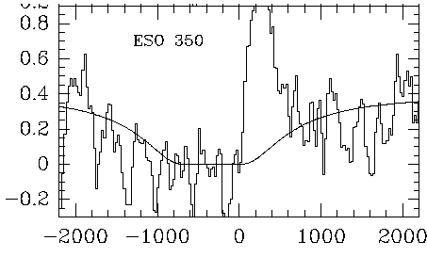
Results: Individual: Haro 11
FUV
Hα
Lyα
Net Lyα emitter
Lyα does NOT resemble FUV
Lyα does NOT resemble Hα
90% of flux in diffuse compnt.
(15”x15” or 6x6 kpc)
(Hayes et al. 2007; Östlin et al. 2009)‏

Slide 18
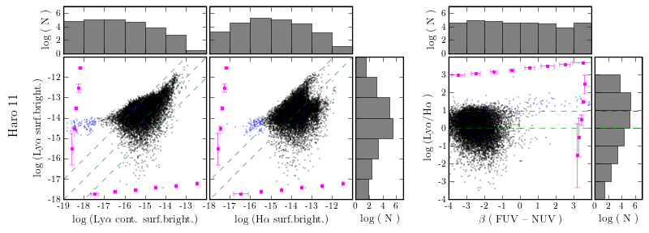
Results: Individual: Haro 11
FUV
Hα
Lyα
Notes:
At bright lya: Lya spans region between ~recombination value + approx equal :-> porous medium, dust, small scales

Slide 19
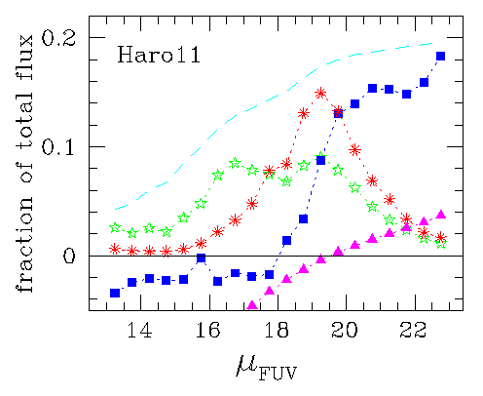
Results: Individual: Haro 11
FUV
Fraction of emitted flux vs. SB ( FUV )‏
★ UV
* Hα
■ Lyα
-- area
Hα
Lyα
(Östlin et al. 2009)‏
Ha peak offset from FUV to low SB
Lya peak further offset
Notes:
At bright lya: Lya spans region between ~recombination value + approx equal :-> porous medium, dust, small scales

Slide 20
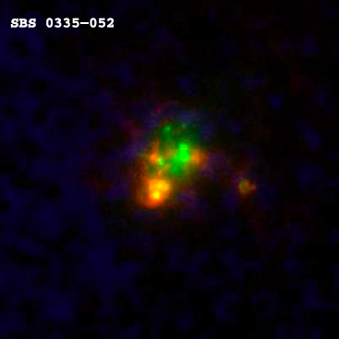
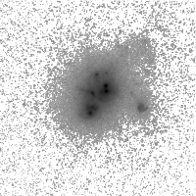
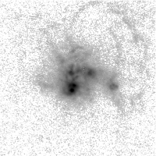
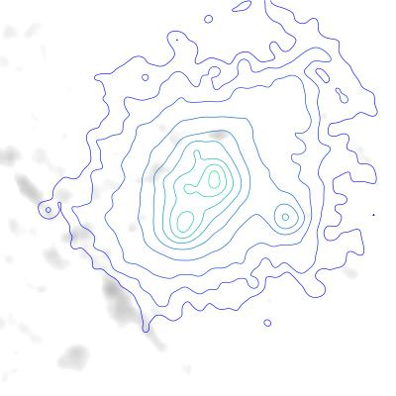
Results: individual: SBS 0335-052
FUV
Hα
Lyα
Net Lyα absorber
(Östlin et al. 2009)‏

Slide 21
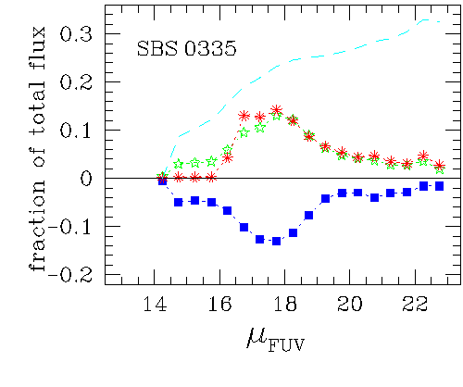
Results: individual: SBS 0335-052
FUV
Fraction of emitted flux vs. SB ( FUV )‏
★ UV
* Hα
■ Lyα
-- area
Hα
Lyα
(Östlin et al. 2009)‏
Ha follows FUV tightly
Lya almost exact mirror

Slide 22
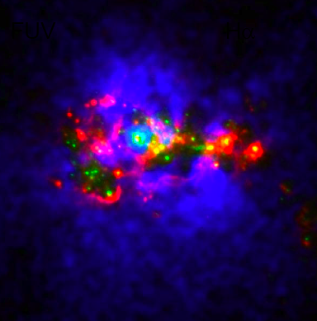
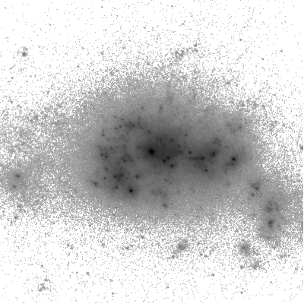
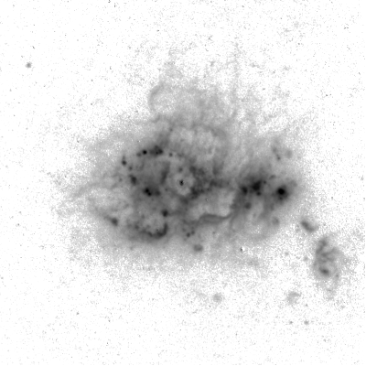
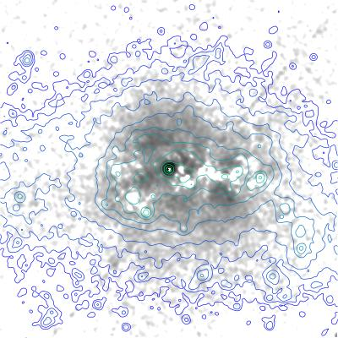
Results: individual: ESO 338-IG04
FUV
Hα
Lyα
Net Lyα emitter
Lyα largely symmetric around one knot

Slide 23
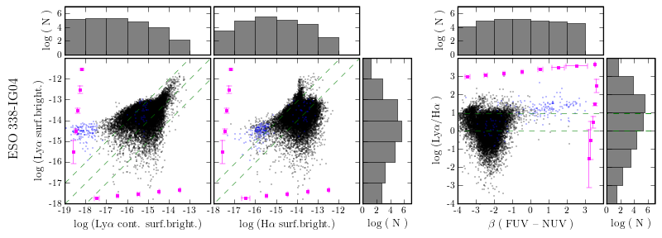
Results: individual: ESO 338-IG04
FUV
Hα
Lyα

Slide 24
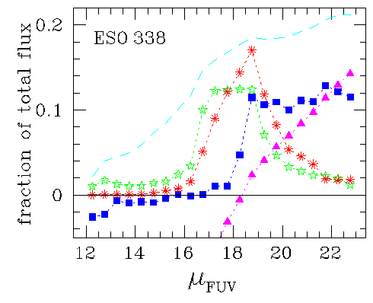
Results: individual: ESO 338-IG04
FUV
Fraction of emitted flux vs. SB ( FUV )‏
★ UV
* Hα
■ Lyα
-- area
Hα
Lyα

Slide 25
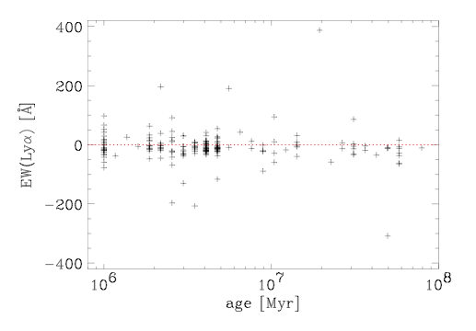
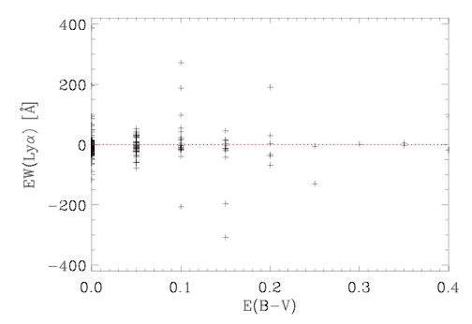
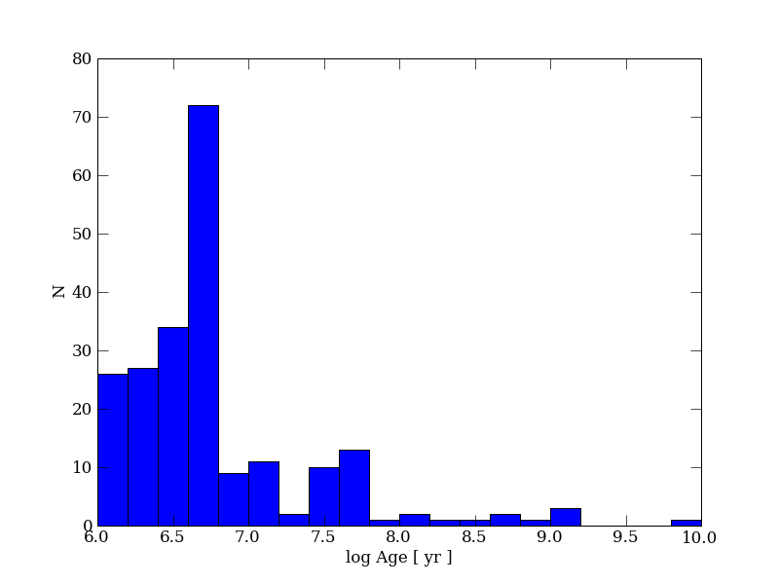
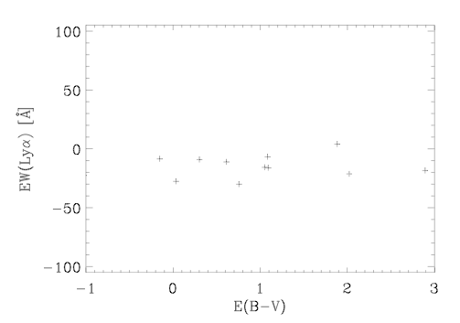
Super Star Clusters in ESO 338-04
SED
Br-gamma
Adamo, Hayes, Östlin et al in prep

Slide 26
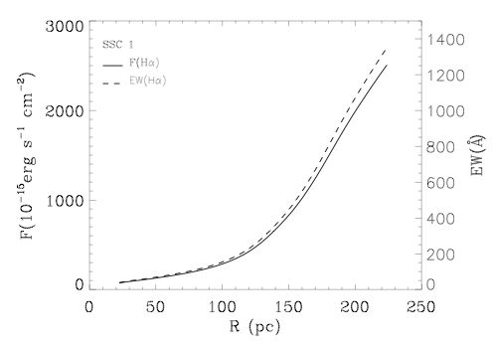
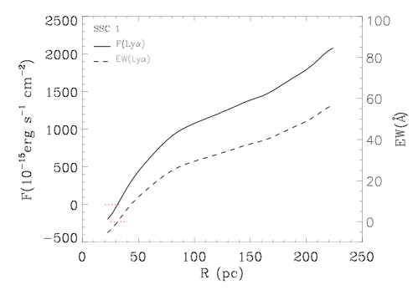
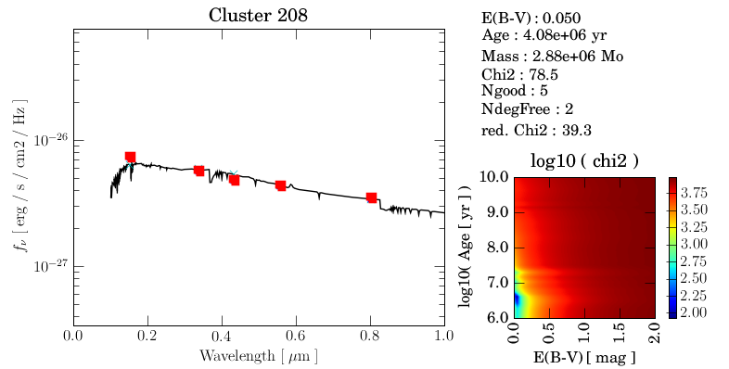
SSCs in ESO 338-04 – whats going on?

Slide 27
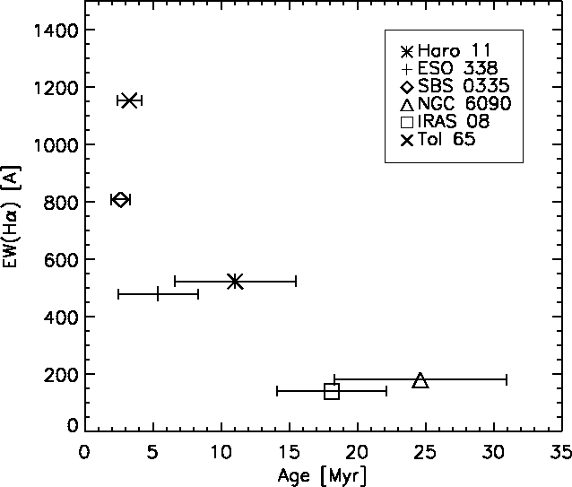
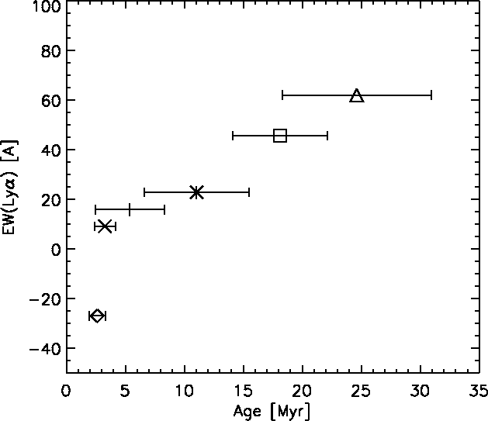
Lyman alpha escape an evolutionary process?
Global values
(Atek et al. 2008, A&A 488, 491)

Slide 28
Results Hα/Hβ, Haro 11 Regulation factors
Diffuse emission component independent
of the dust
Emission from knot C with E(B-V) ~ 0.4
Absorption from A with E(B-V) ~ 0.2
Lyα/Hα above the theoretical value
(8.7 case B extinction corrected)
→ Enhanced Lyα/Hα ratio !!
Atek et al. 2008
Notes:
28

Slide 29
Results: global
Comparison with Galex z~0.3 sample
Atek et al. 2009, arXiv:0906.5349
Name
Haro 11
SBS 0335
IRAS 08
Tol 65
NGC 6090
ESO 338
E(B-V)‏
0.07
0.04
0.03
0.11
0.19
0.08
f_{esc}
0.037
-0.20
0.14
0.053
0.027
0.13
f_{esc,c}
0.18
0.28
0.28
0.16
0.13
0.40

Slide 30
Results: global
Name
Haro 11
SBS 0335
IRAS 08
Tol 65
NGC 6090
ESO 338
W(Hα)‏
[ Å ]
705
1434
195
1300
314
570
W(Lyα)‏
[ Å ]
15.6
-36.8
39.2
15.5
28.3
28.1
Starburst99 model, continous SFR
Equivalent widths anticorrelated !

Slide 31
Summary of low-z Lyα imaging results
First calibrated Lyα maps produced
spatial resolution ~10 - 20 pc
available at: http://ttt.astro.su.se/projects/Lyman-alpha/
Östlin et al 2009, AJ 128, 923
Substantial evidence for Lyα resonant scattering presented:
morphologies, scattering halos, extended emission
Local super-recombination values
Lyα emission from old and/or dusty regions
No direct correlation with nebular dust parameter
Low escape fractions (< 20%) -- dust corrections fail (<50%)‏
Anti-correlation between Hα and Lyα ???
Small, hand-picked sample - Demonstrates the need for
a detailed, statistically significant investigation

Slide 32
GALEX sources at z ≈ 0.3
GALEX wide field grism spectroscopy has detected 96 Lyα emitters at z = 0.2 – 0.35
As close as we get to a blank Lyα survey at low z
Follow up spectroscopy with ESO/NTT of 24 sources, targetting Hα and Hβ
Derive escape fractions using
Balmer emission line decrement
NB. Lyα selected so escape
fractions likely biased to high
values
Atek et al. 2009, arXiv 0609.5349

Slide 33
DoubleBlind
A. Adamo
H. Atek
M. Hayes
D. Kunth
E. Leitet
C. Leitherer
J.M. Mas-Hesse
J. Melinder
G. Östlin
D. Schaerer
A. Verhamme
A super-deep, combined
Lyα and Hα survey at z=2

Slide 34
DoubleBlind :: Survey Overview
Blind survey for H-alpha and Lyman-alpha emitting galaxies at z=2.2
Ha : VLT/HAWK-I NB2090
Lya : VLT/FORS1 Custom
GOODS-S centered on UDF 7.5 x 7.5 arcmin
Both probe the same volume. Any sample average properties not subject to cosmic variance
Deep! Ha :: 16 hours online :: SFR=1.8 Mo/yr @ 5 sig Lya :: 16 hours online :: SFR=1.8 Mo/yr @ fesc=0.1
X-corr with GOODS-MUSIC U to 24 mum SEDs // phot-z = 2.2

Slide 35
Luminosity Functions
LF(Ha)
LF(Lya)

Slide 36
Merging the Luminosity Functions
LF(Lya) = LF(Ha) x 8.7

Slide 37
Merging the Luminosity Functions
LF(Lya) = LF(Ha) x 8.7
Monte Carlo Statistical error on L
Fit global f_esc le Delliou+06 z=3 sem.analyt f_esc=2%
Nagamine+08 z=3 cosmol. SPH f_esc=10%

Slide 38
Merging the Luminosity Functions
LF(Lya) = LF(Ha) x 8.7
Monte Carlo Statistical error on L
Fit global f_esc le Delliou+06 z=3 sem.analyt f_esc=2% . Nagamine+08 z=3 cosmol. SPH f_esc=10% (4.5 +/- 1) %
Sample averaged based on entire luminosity density in both lines
Hayes+ 09 in prep

Slide 39
Individual Objects
objects in Ha & Lya? 6
Lya/Ha ~ case B? 2
f_esc ~ E(B—V)? 4
significant RT attenuation 1
10 x too bright in Lya 1
EW(Lya) simple with dust? 5
10 x too high in EW(Lya) 1
c.f. evidence for anti-
correlation, Ostlin+ 2009
SEDFIT E(B—V) --- NOT nebular

Slide 40
Individual Objects

Slide 41
DoubleVision
Super deep narrowband Ha and Lya observations obtained in GOODS-S
~ 80 emission line candidates found
Only 6 in both lines
4 objects have f_esc vs E(B-V) on simple dust attenuation curve 1 significantly below
1 significantly above
LF comparison finds sample-averaged f_esc (Lya) = 4.5%
Need: larger sample and more redshifts

Slide 42
Summary on Lyα escape fractions
Local starbursts have f_{esc,Lyα} ranging from <0 to 14%
Resonant scattering imporant for Lyα escape
Dust corrections inadequate to exlain the low f_{esc,Lyα}
Calibrated Lyα maps (10 pc resolution) available at
http://ttt.astro.su.se/projects/Lyman-alpha/
Östlin et al 2009, AJ 128, 923
z~0.3 GALEX grism Lya sample has f_{esc,Lyα}=2 to 100%
Atek et al. 2009, arXiv.0906.5349
DoubleBlind combined Lyα and Hα survey at z=2.2
First statistical determination of f_{esc,Lyα}= 4.5%
Hayes et al. 2009, in prep

