Slide 1
Probing the IGM with UKIDSS
Mitesh Patel
Co-Authors: Steve Warren, Daniel Mortlock, Bram Venemans, Richard McMahon, Paul Hewett, Chris Simpson, Rob Sharpe
m.patel06@imperial.ac.uk

Slide 2
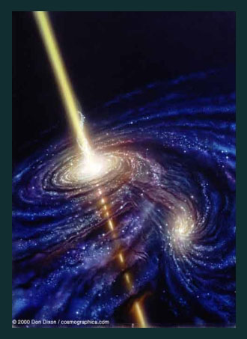
Quasars

Slide 3
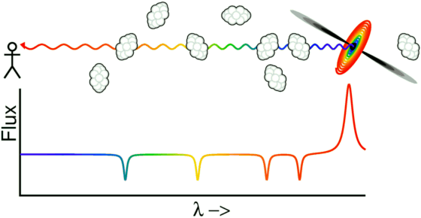
Finding high redshift objects...
Neutral hydrogen clumps absorb hydrogen at the clump redshift
Produces absorption blueward of the emission redshift

Slide 4
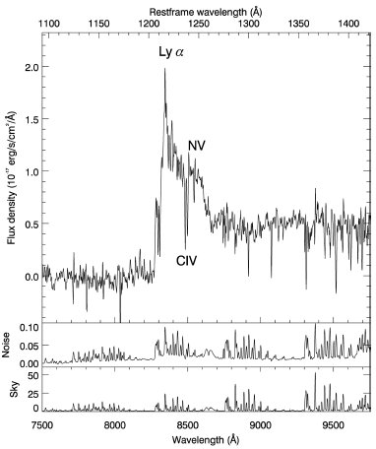
Finding high redshift objects...
Neutral hydrogen clumps absorb hydrogen at the clump redshift
Produces absorption blueward of the emission redshift
Many clumps leads to complete absorption blueward of Lyα
Lyα forest
Venemans et al. (2007)

Slide 5
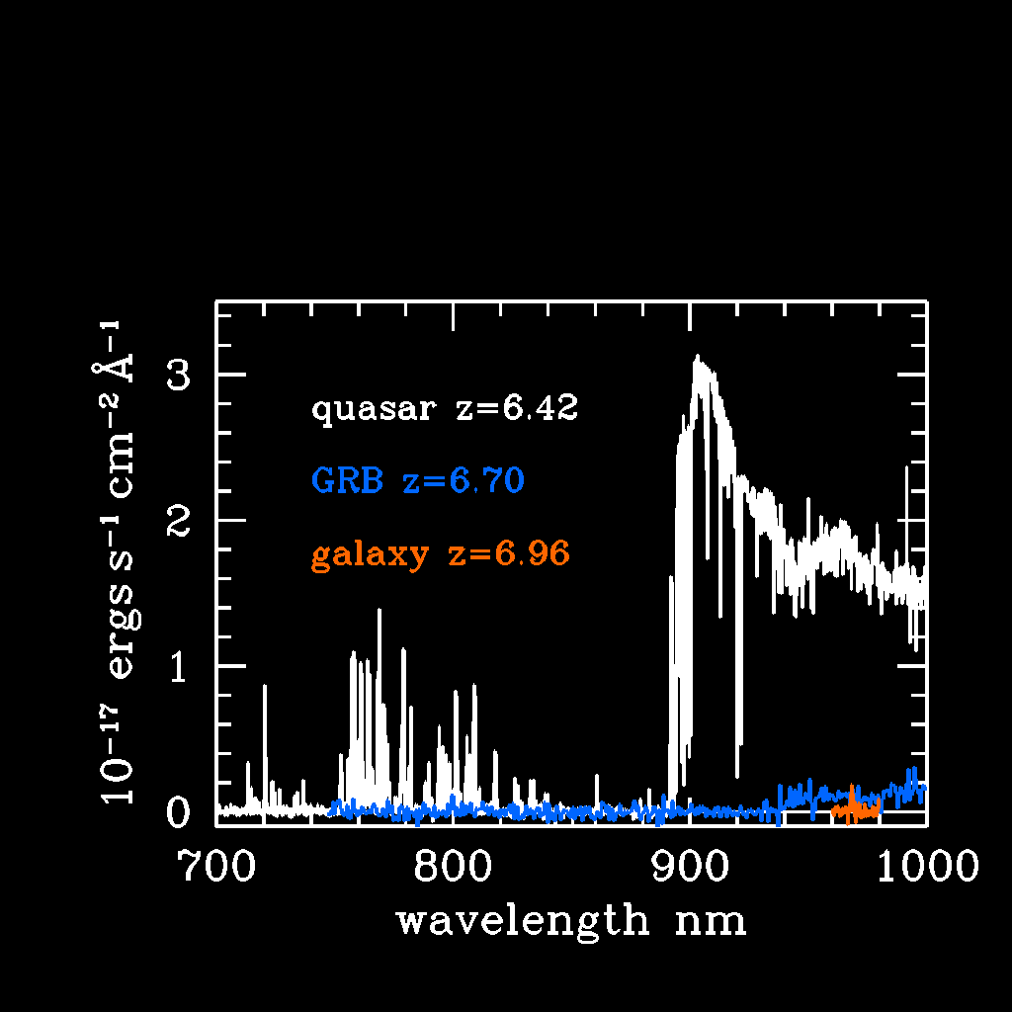
Fan et al. (2006)

Slide 6
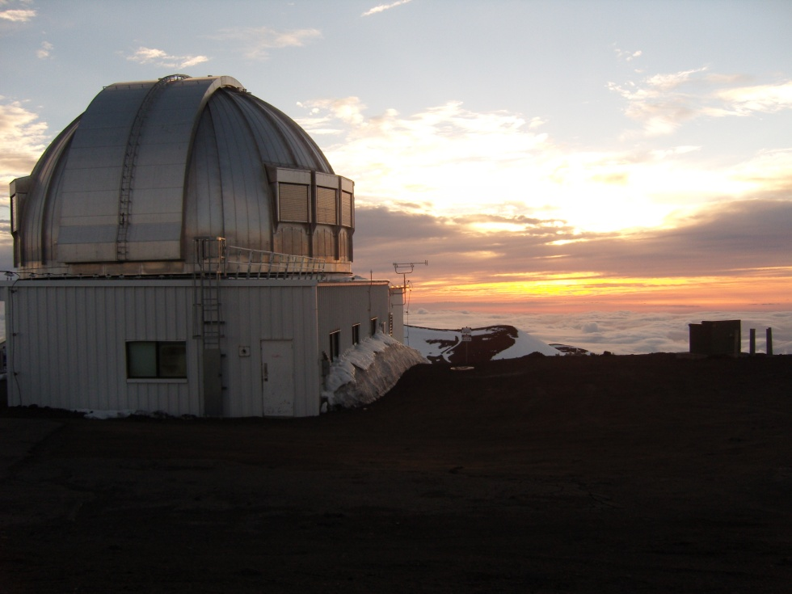
UKIDSS
Optical surveys are limited to z-band dropouts
UKIRT Infra-red Deep Sky Survey
Wide field Imager
At least 3 magnitudes deeper than 2MASS in J,H and K
Consists of 5 mini-surveys
Galactic Clusters Survey (GCS)
Galactic Plane Survey (GPS)
Deep Extragalactic Survey (DXS)
Ultra Deep Survey (UDS)
Large Area Survey (LAS)
www.ukidss.org

Slide 7
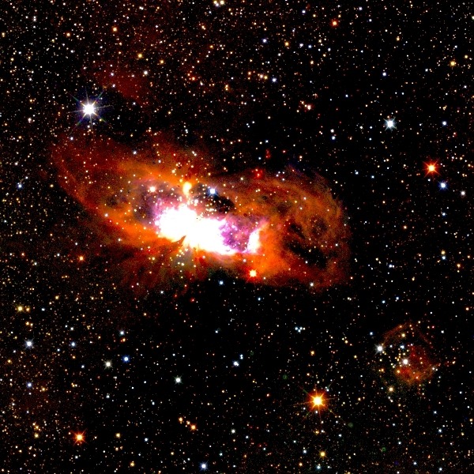
HII Ionised Region
http://surveys.roe.ac.uk/wsa/index.html

Slide 8
Large Area Survey
Observes Y (20.2), J (19.6), H (18.8) and K (18.2)
Aims to cover 4000 deg²
Area also covered by SDSS
DR5: observed 1270 deg² in all four bands

Slide 9
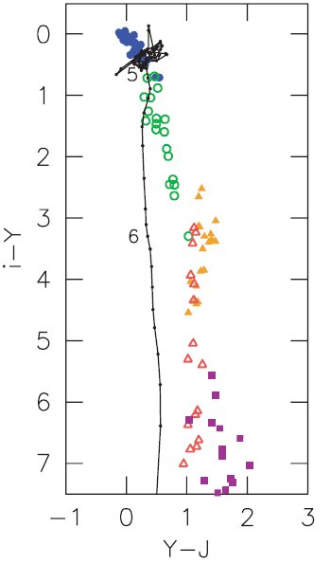
Finding quasars with UKIDSS
Use models by Hewett & Madison (2005) and look at expected colours
Use both SDSS and UKIDSS tables
Find objects with red i-Y colours and blue Y-J colours
Hewett et al. (2006)

Slide 10
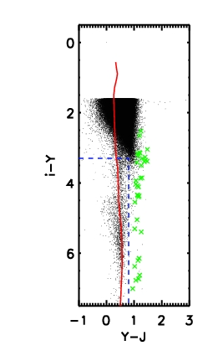
Finding quasars with UKIDSS
Use models by Hewett & Madison (2005) and look at expected colours
Use both SDSS and UKIDSS tables
Find objects with red i-Y colours and blue Y-J colours
Hewett et al. (2006)

Slide 11
Selected Candidates

Slide 12
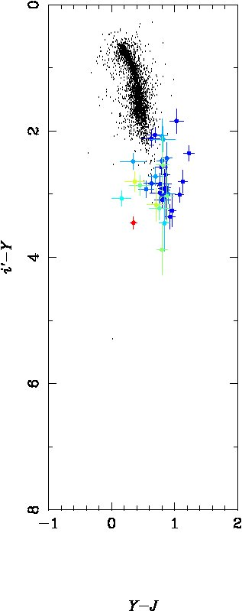
Selected Candidates

Slide 13
ULAS J1319+0950 – GMOS-S Spectra
Mortlock et al. (2009)
z = 6.127

Slide 14
Power Law Fitting
F α ν^{0.32}

Slide 15
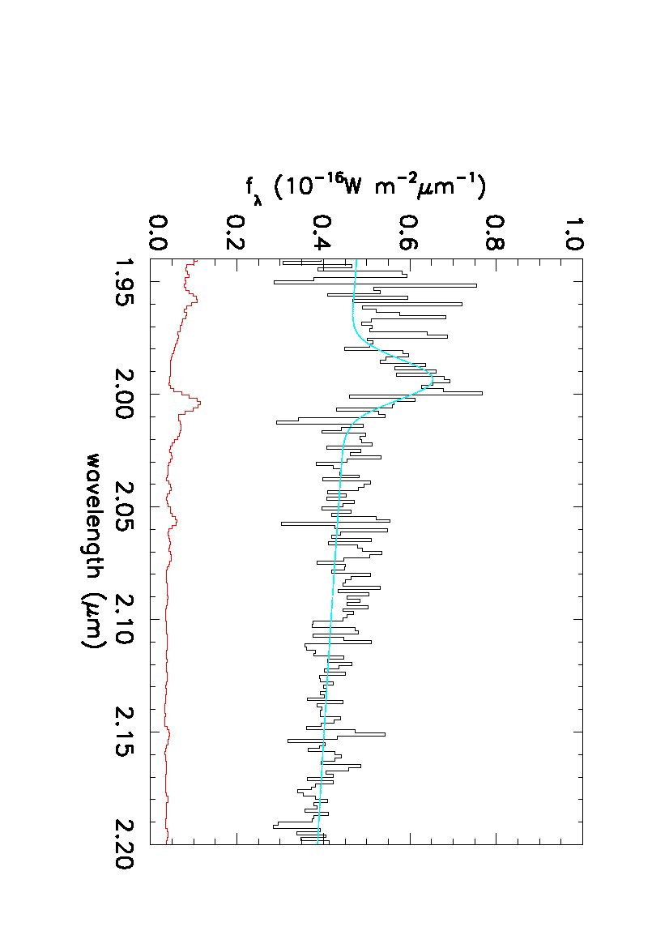
Fit Details
Mg II (2798 A)
Central Wavelength = 19940 +/- 12 A
EW = 14 A
Redshift = 6.127 +/- 0.004

Slide 16
J1207+0630
DR 5 candidate
Re-observed in Y + J
Confirmed quasar-like colors

Slide 17
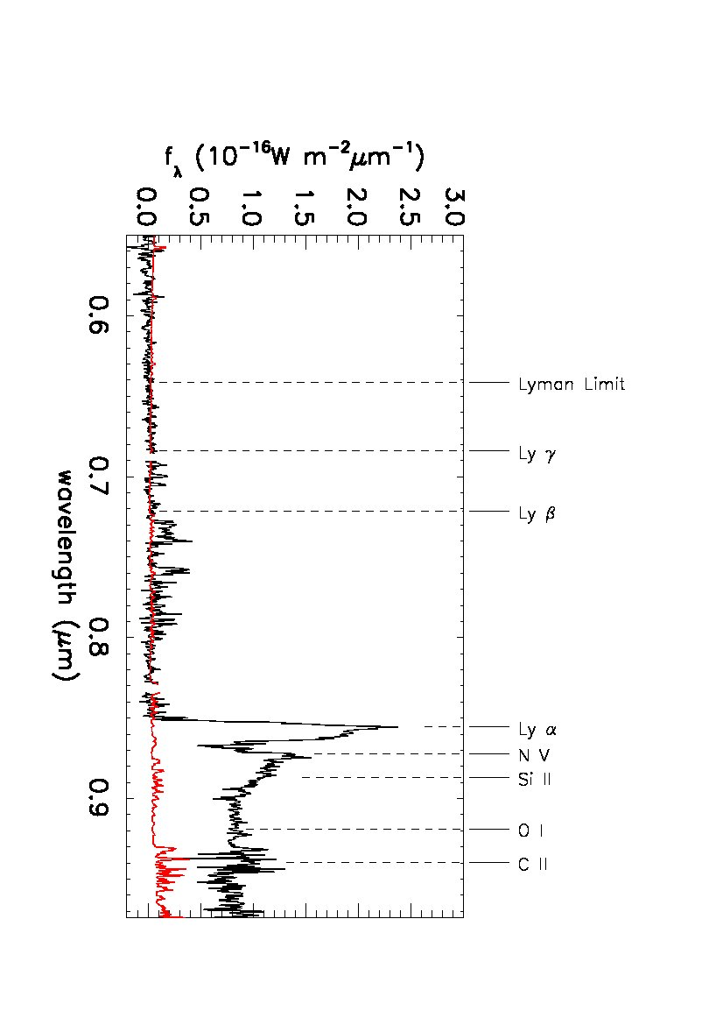
J1207+0630
DR 5 candidate
Re-observed in Y + J
Confirmed quasar-like colors
Redshift = 6.04 from Lyα
Warren et al. (in prep)

Slide 18
Transmitted Flux Ratio
SDSS found a number of quasars
Follow the analysis of Fan et al. (2006)
Fit a power law to the quasar continuum
Select an upper limit redshift not affected by Lyα
Take a region size of Δz = 0.15
Measure the ratio of the original flux to the absorbed flux
Take multiple regions, up to a lower limit at Lyβ

Slide 19
Transmitted Flux Ratio
Fan et al. (2006)
Fit a power law to the quasar continuum
Select an upper limit redshift not affected by Lyα
Take a region size of Δz = 0.15
Measure the ratio of the original flux to the absorbed flux
Take multiple regions, up to a lower limit at Lyβ

Slide 20
Transmitted Flux Ratio
Fan et al. (2006)
Fit a power law to the quasar continuum
Select an upper limit redshift not affected by Lyα
Take a region size of Δz = 0.15
Measure the ratio of the original flux to the absorbed flux
Take multiple regions, up to a lower limit at Lyβ

Slide 21
Effective Optical Depth
τ = -ln (tfr)
Fan et al. (2006)

Slide 22
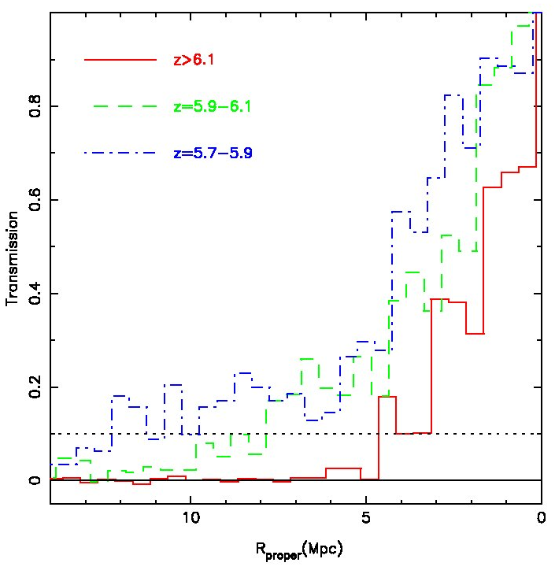
Proximity Region
As the IGM gets more neutral, the absorption nearer Lyα gets stronger
Damping wings of the absorption affect the Lyα line
As we go to higher redshifts we expect a sharper cut-off between the emission line and the forest
Fan et al. (2006)

Slide 23
Proximity Region
Fan et al. (2006)

Slide 24
Estimating Completeness
We use quasar models created by Paul Hewett (see Hewett et al., 2006 and references therein)
Select a redshift and Y magnitude and use the model colours at that redshift to give i, z and J magnitudes.
Randomly place objects in UKIDSS and SDSS frames (i.e. introduce `observational’ errors)
Determine the number of objects selected as quasar candidates using a simple selection area or the probability algorithm

Slide 25
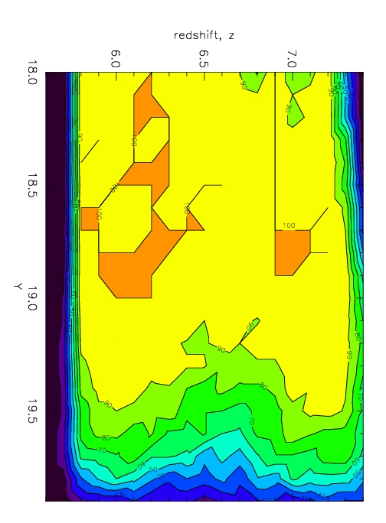
Completeness

Slide 26
Hewett et al. (2006)

Slide 27
Completeness

Slide 28
Estimated Numbers of Quasars
We found two quasars (z=6.04 and z=6.13) and have rediscovered two others (z=5.82 and z=5.93)
By extrapolating the quasar luminosity function to higher redshifts and accounting for the estimated completeness we expect:
A 5.8<z<7.2 quasar every 160 deg²
A 6.4<z<7.2 quasar every 480 deg²
So, from DR5 (Y+J: 1359 deg²) we expect:
8.3 +/- 2.9 z = 5.8-7.2 quasars 4 found
2.9 +/- 1.7 z = 6.4-7.2 quasars 0 found

Slide 29
Summary part 1
Quasars are ideal probes for determining when re-ionisation occurred
The UKIDSS quasars have similar properties to other SDSS quasars
UKIDSS should find z~7 quasars
Continue to analyse DR5
Waiting for DR6...

Slide 30
Gamma Ray Bursts

Slide 31
Gamma Ray Bursts: pros and cons
Pros:
GRBs can be bright – some can be seen up to z~10!
GRBs can occur anywhere
If the host galaxy is not luminous, we can probe the IGM up to z_{host}
Can probe unpopulated regions i.e. where structure has not had time to form
Cons:
Have to be quick!
GRBs are situated in galaxies > absorption close to Lyα may be due to neutral hydrogen in the host galaxy

Slide 32
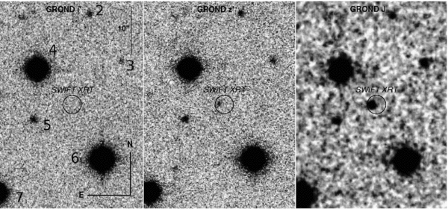
GRB 080913 – Greiner et al. (2009)
Discovered by Swift in September 2008
Found to be a i band dropout
Greiner et al. (2009)

Slide 33
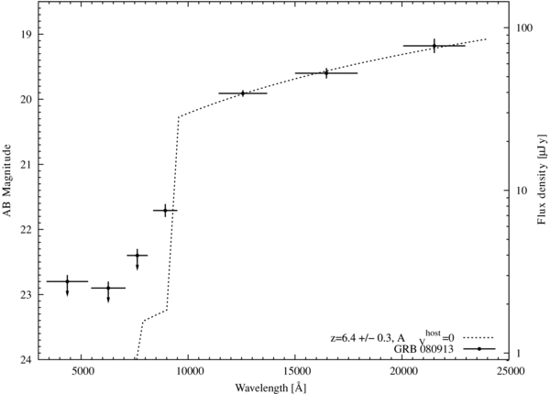
GRB 080913 – Greiner et al. (2009)
Discovered by Swift in September 2008
i band dropout
Greiner et al. (2009)

Slide 34
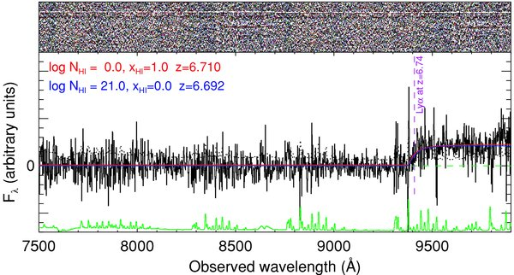
GRB 080913 – Greiner et al. (2009)
Optical spectroscopy taken at the VLT with FORS2
Taken at the end of the night > only one usable 30 min exposure taken
Greiner et al. (2009)

Slide 35
GRB 080913 – New analysis
Data was also taken 3 nights later - 7x 1800s exposures
Signal to noise of both nights are similar
By combining the two nights, we can significantly increase the signal to noise

Slide 36
GRB 080913 – New analysis
Patel et al. (in prep.)

Slide 37
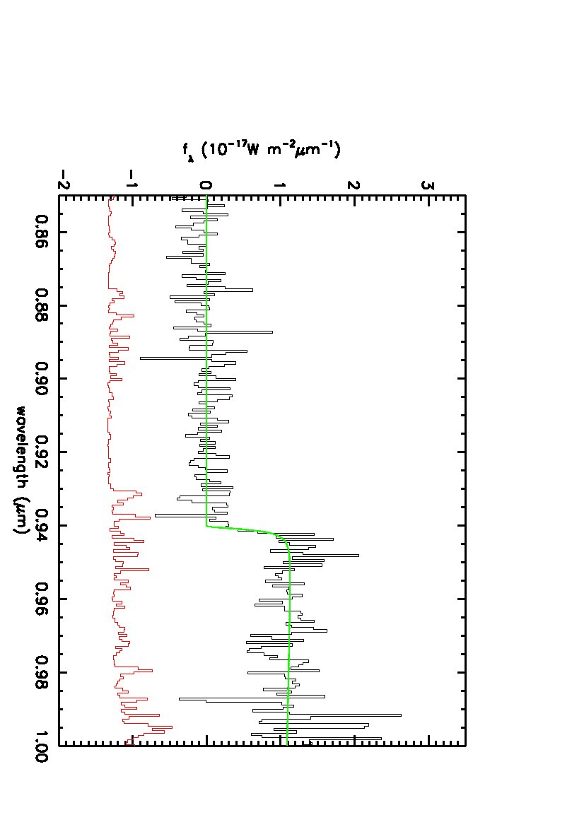
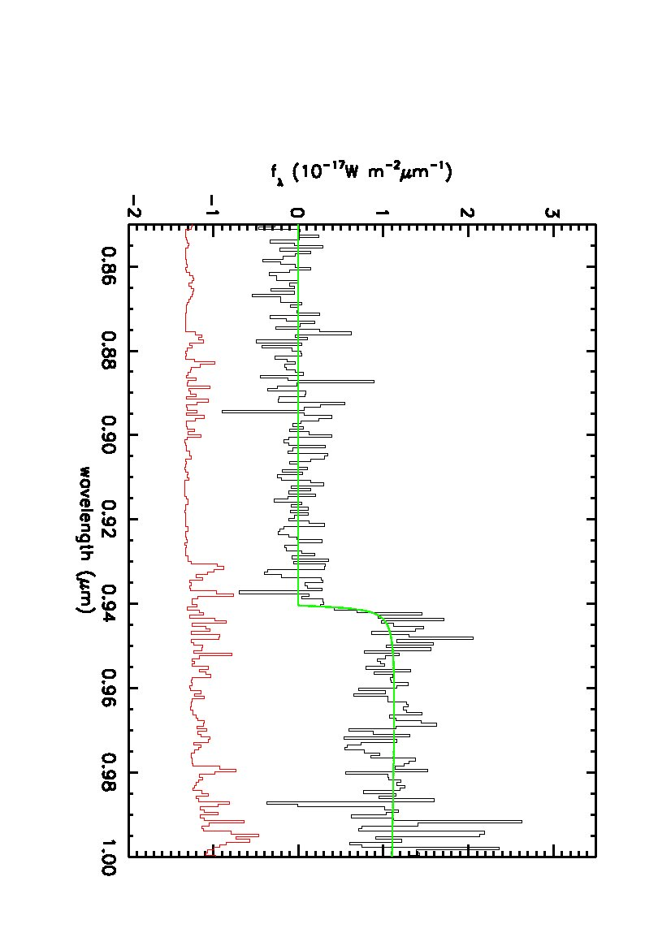
GRB 080913 – DLA or IGM?
Best-fit model
DLA:
Log (N_{HI}) = 19.85
z_{DLA} = 6.731
IGM:
x_{HI} = 0.21
z_{IGM} = 6.737

Slide 38
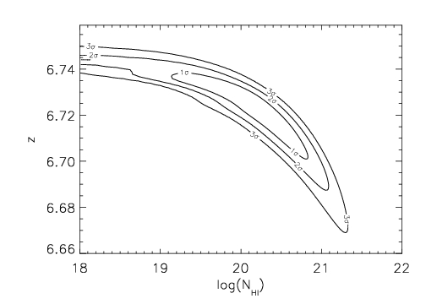
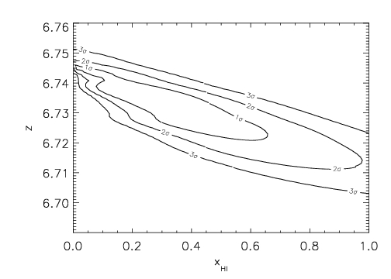
GRB 080913 – DLA or IGM?
Best-fit model
DLA:
Log (N_{HI}) = 19.85
z_{DLA} = 6.731
IGM:
x_{HI} = 0.21
z_{IGM} = 6.737

Slide 39
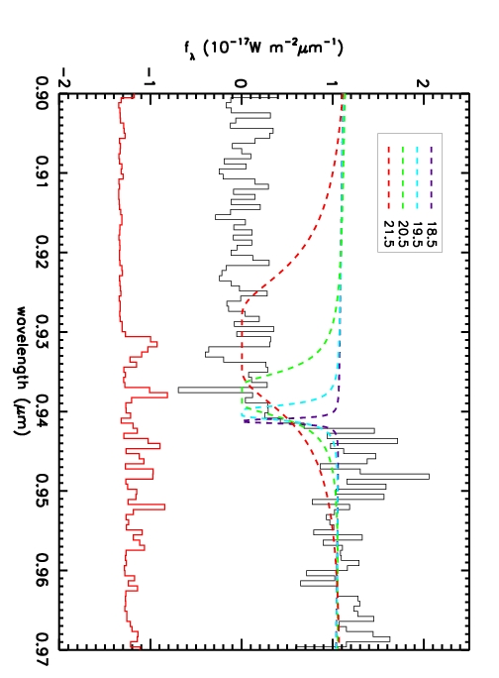
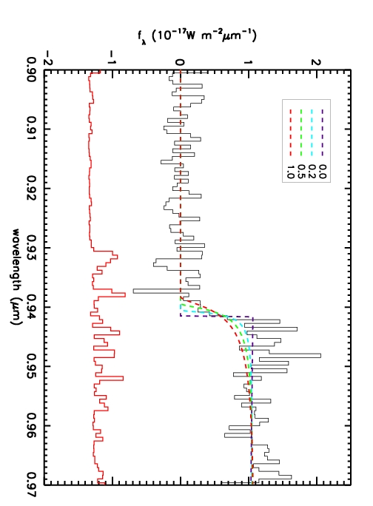
GRB 080913 – DLA or IGM?

Slide 40
GRB 080913 – Neutral fraction at z~6.7
Assume IGM model
Assume a uniform prior on the redshift and marginalise
x_{HI} < 0.69 at z~6.7 with 90% confidence
z=6.3 GRB gives x_{HI} < 0.60 with 95% confidence (Totani et al., 2006)

Slide 41
GRB 080913 – Detection of Si II?
Search for absorption in the continuum by placing a gaussian at each pixel and determining the S/N
Found a peak in S/N at ~9743A
This could be a Si II absorption line (1260A, rest wavelength)
Gives z_{Si II} = 6.733

Slide 42
Summary part II
GRB 080913 detected at 6.7
New reduction of observations reveals a sharper continuum break
We can infer x_{HI} < 0.69 at z~6.7 with 90% confidence
GRBs may provide more insights into the high redshift universe as more distant GRBS are found

Slide 43
Any Questions?

