Slide 1
Why Y?
Exploiting the Hirota Integrable Dynamics of AdS/CFT
« Integrability in Gauge and String Theory »
NORDITA, Stockholm, Juin 29, 2010
Vladimir Kazakov
(ENS, Paris)
Collaborations with
N.Gromov
S.Leurent,
Z.Tsuboi

Slide 2
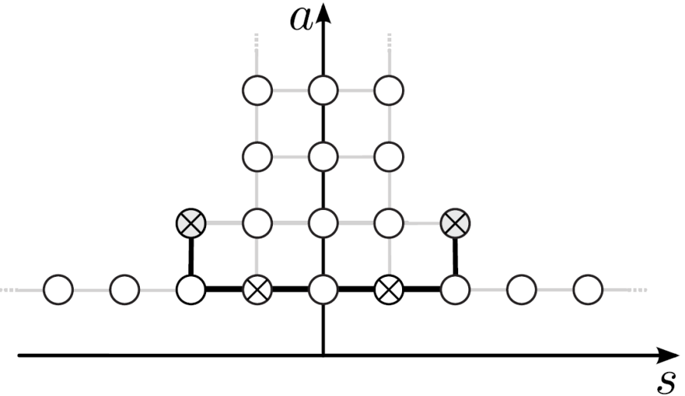
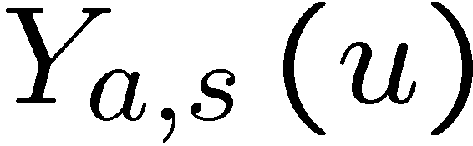
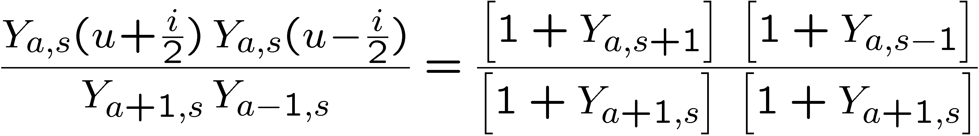
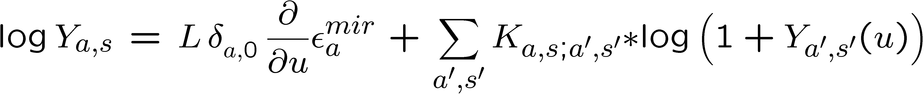
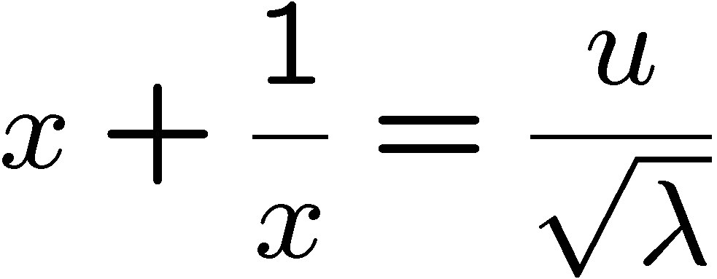
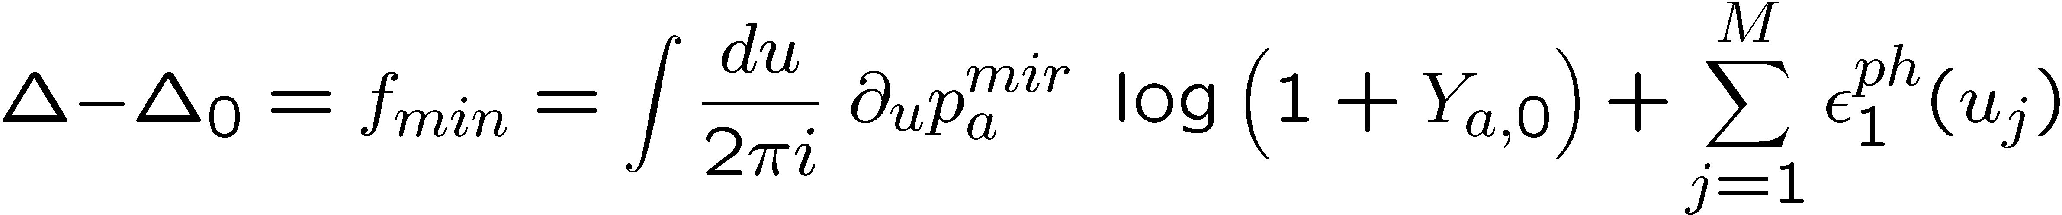
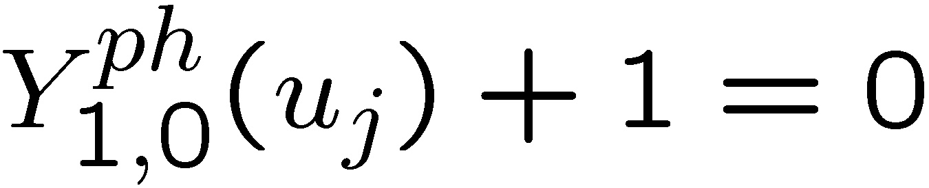
Y-system for excited states of AdS/CFT
Gromov,V.K.,Vieira
T-hook
TBA form
Bombardelli,Fioravanti,Tateo
Gromov,V.K.,Kozak,Vieira
Arutyunov,Frolov
Dispersion :
Extra eq (inherited from Z₄ symmetry of classical string):
Gromov,V.K.,Kozak,Vieira
Cavaglia,Fioravanti,Tateo
Anomalous dimensions:
Bethe eq.:

Slide 3
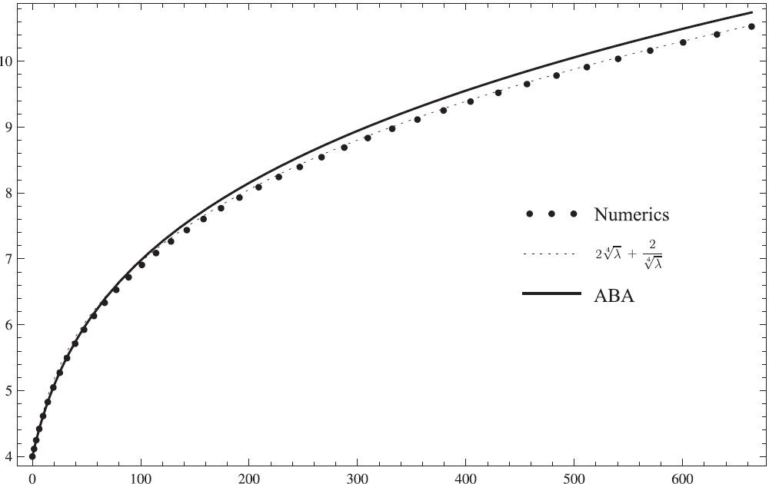


Konishi dimension numerics and various checks for Y-system
Beisert, Eden,Staudacher
ABA
Gubser,Klebanov,Polyakov
Gubser
Klebanov
Polyakov
Y-system numerics
Gromov,V.K.,Vieira
Confirmed by Frolov
Some controversy:
Roiban, Tseytlin (1)
(string calculations in progress)
millions of 4D Feynman graphs!
5 loops and BFKL from string
Bajnok,Janik,Lukowski
Lukowski,Rej,Velizhanin,Orlova
Arutyunov, Frolov
Balog, Hegedus
Fiamberti,Santambrogio,Sieg
Minahan,Ohlsson,Sax,Sieg
4 loops from SYM
Fiamberti,Santambrogio,Sieg,Zanon
Velizhanin
4 loops from string
Bajnok,Janik
Gromov,V.K.,Vieira
Y-system passes all known tests
Notes:
3

Slide 4
Y-system looks very simple and universal!
Similar systems of equations in all known integrable σ-models
What are its origins? Could we have guessed it without TBA?
Can we “solve” it and reduce to a finite system of NLIE’s?

Slide 5
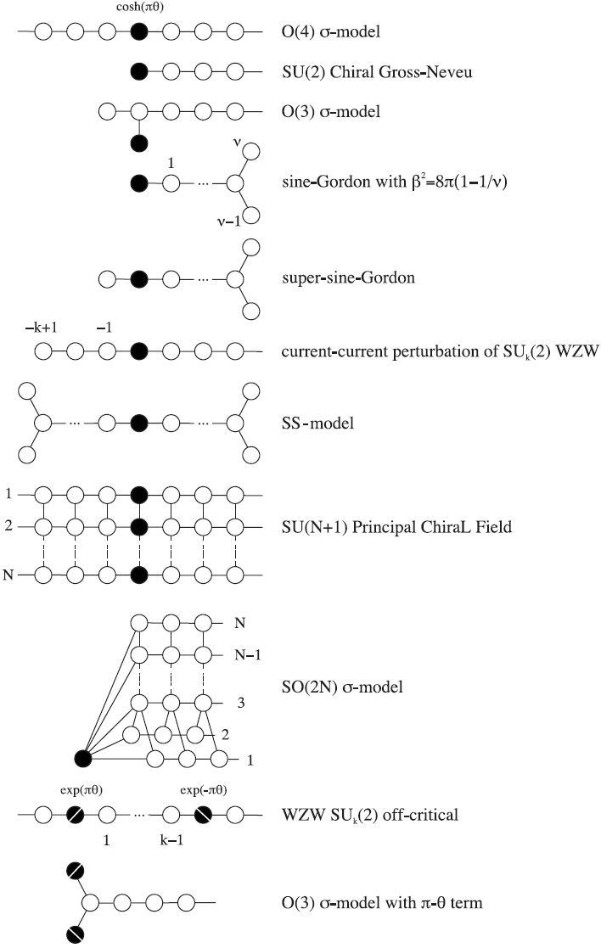
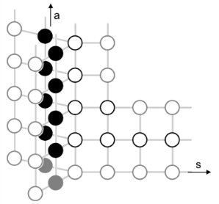
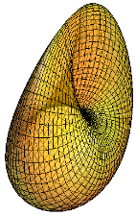
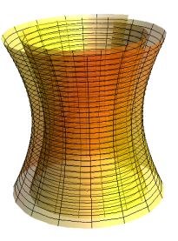

Y-systems for other σ-models
New AdS/CFT’s : new Y-systems
3d ABJM model: CP³ x AdS₄, …
Gromov,V.K.,Vieira
Bombardelli,Fiorvanti,Tateo
Gromov,Levkovich-Maslyuk

Slide 6
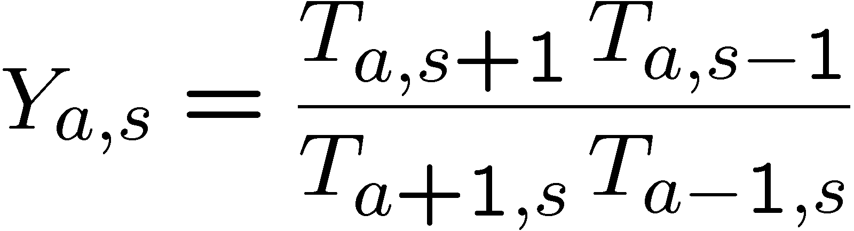
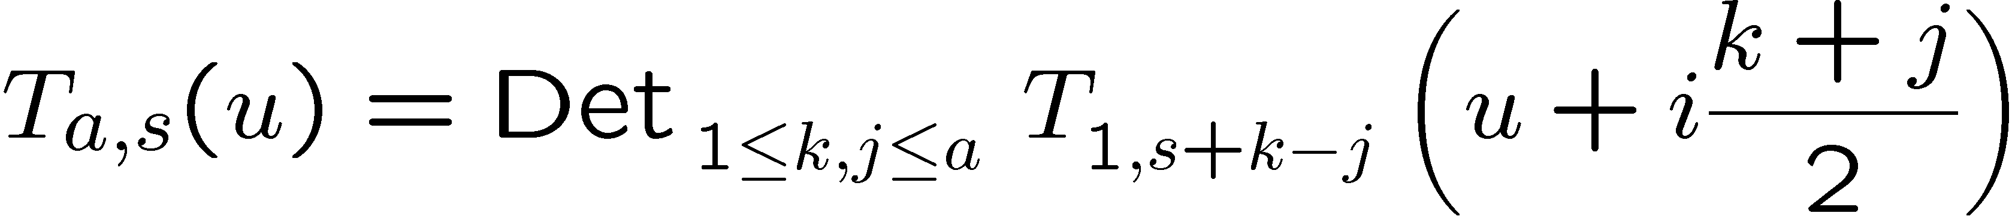
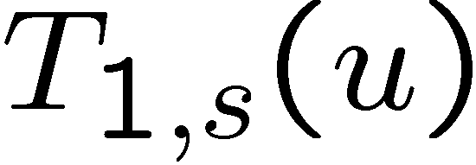
Y-system and Hirota eq.: discrete integrable dynamics
Relation of Y-system to T-system (Hirota equation)
(the Master Equation of Integrability!)
Discrete classical integrable dynamics!
General solution in half-plane lattice:
a
s
For spin chains :
Bazhanov,Reshetikhin
V.K.,Vieira

Slide 7

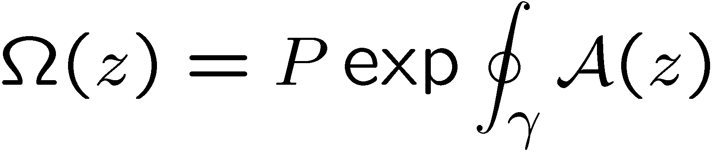


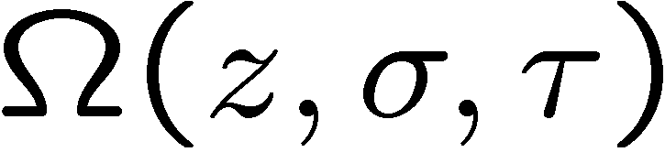

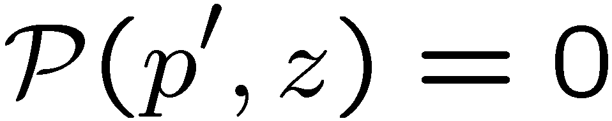
Classical integrability of superstring on AdS₅×S⁵
String equations of motion and constraints can be recasted
into zero curvature condition for Lax connection
depending on a spectral parameter
Mikhailov,Zakharov
Bena,Roiban,Polchinski
Monodromy matrix
encodes infinitely many conservation lows
Finite gap method can be applied
world sheet
Its,Matveev,Dubrovin,Novikov,Krichever
Algebraic curve for quasi-momenta:
V.K.,Marshakov,Minahan,Zarembo
Beisert,V.K.,Sakai,Zarembo
Gromov,Vieira
Notes:
7

Slide 8


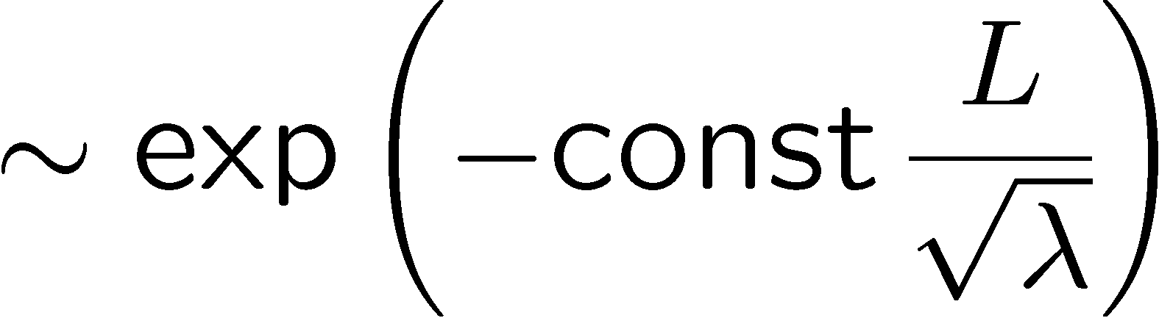

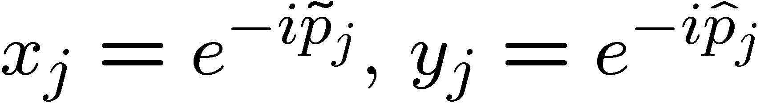
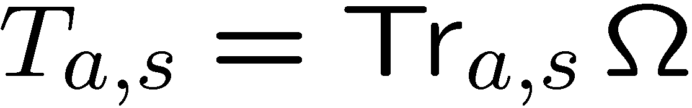
Quasiclassical solution of AdS/CFT Y-system
Gromov
Gromov,V.K.,Tsuboi
Limit: large strings/operators , strong coupling, large momenta:
Explicit u-shift in Hirota eq. dropped (only slow parametric dependence)
(Quasi)classical solution - su(2,2|4) character !
To fix group element : compare a,|s| →∞ asymptotics
with ABA, valid with accuracy
Result: 8 eigenvalues ↔ quasimomenta :
Quasiclassical (1-loop) energy - same as from algebraic curve, e.g.
Gromov,Vieira
Notes:
8

Slide 9
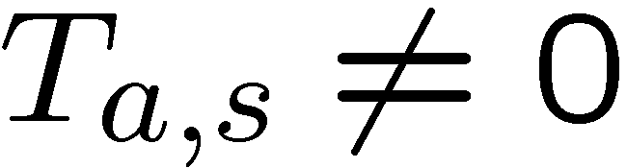
(Super-)group theoretical origins
A curious property of gl(N) representations with rectangular Young tableaux:
×
=
+
a-1
×
a
×
a-1
s
s
s-1
s+1
For characters – simplified Hirota eq.:
Boundary conditions for Hirota eq.: gl(K|M) representations in “fat hook”:
a
λ_{a}
(a,s)
fat hook
(K,M)
λ₂
λ₁
s
Solution: Jacobi-Trudi formula for GL(K|M) characters

Slide 10

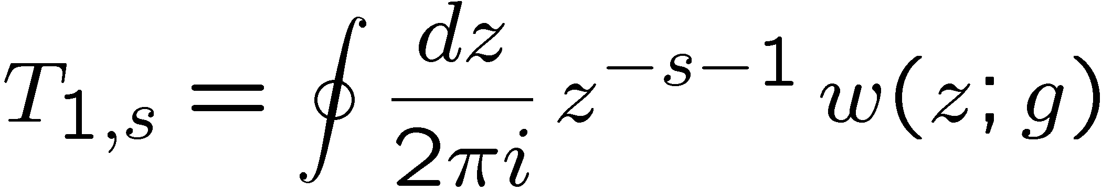
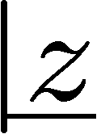
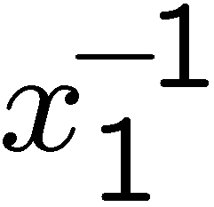
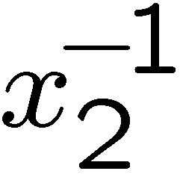
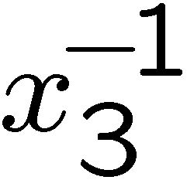
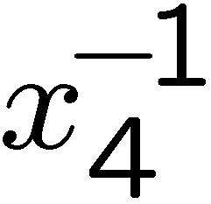
Super-characters: Fat Hook of U(4|4) and T-hook of SU(2,2|4)
Generating function for symmetric representations:
SU(4|4)
SU(2,2|4)
a
a
s
s
∞ - dim. unitary highest weight representations of u(2,2|4) !
Kwon
Cheng,Lam,Zhang
Gromov,V.K.,Tsuboi

Slide 11
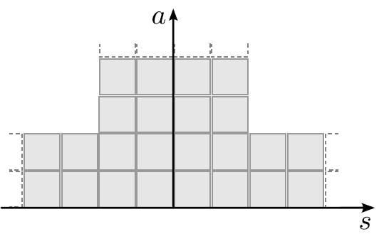
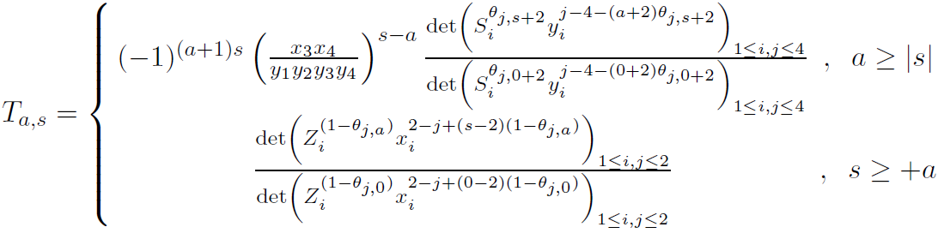

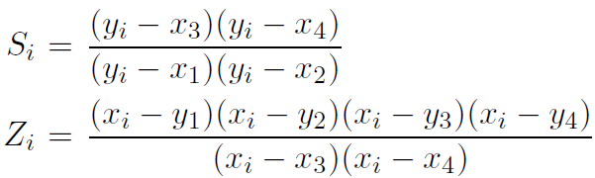
Character solution of T-hook for u(2,2|4)
Gromov, V.K. ,Tsuboi
Solution in finite 2×2 and 4×4 determinants
(analogue of the 1-st Weyl formula)
Generalization to full Y-system with spectral parameter is possible!
Should help to reduce AdS/CFT system to a finite system of equations.

Slide 12
Ergo, for any sigma model…
The origins of the Y-system are entirely algebraic:
Hirota equation for characters in a given “hook”.
Add the spectral parameter dependence… and solve Hirota equation!
Analyticity in spectral parameter u is the most difficult part of the problem.

Slide 13
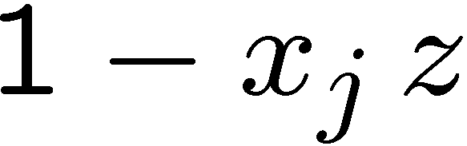
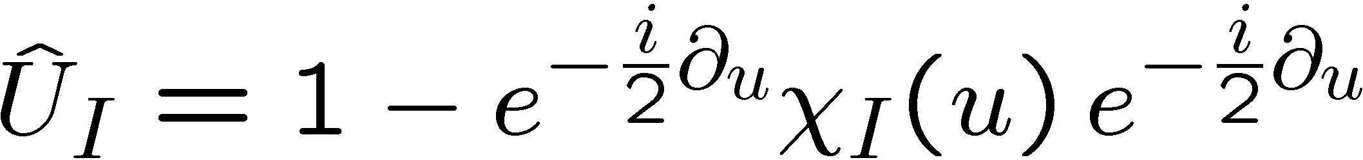
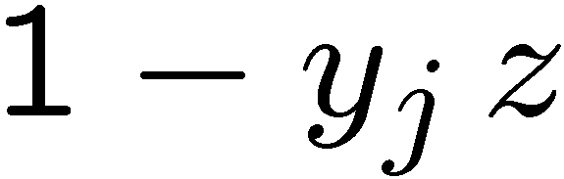


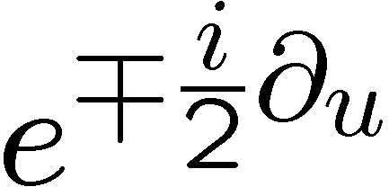
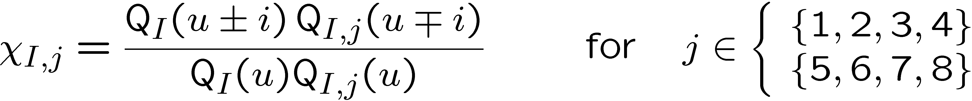

Solving full quantum Hirota in U(2,2|4) T-hook
Tsuboi
Hegedus
Gromov,Tsuboi,V.K.
Replace in gen. function:
Generating functional:
Change of grading (Weyl reflection):
- expansion in
Parametrization in Baxter’s Q-functions

Slide 14
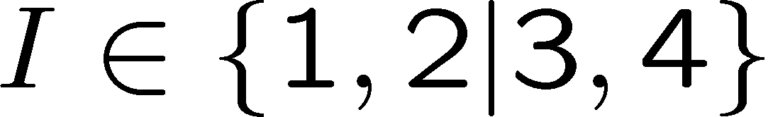





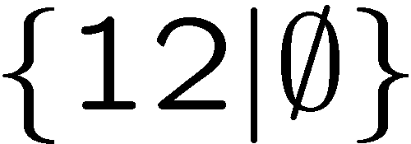
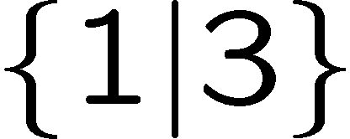

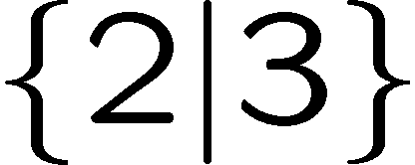

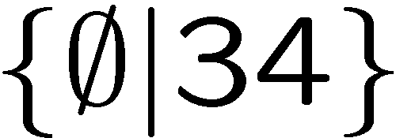
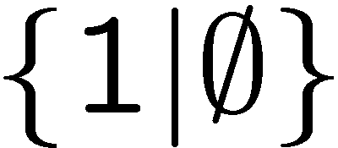
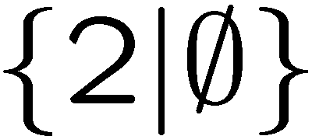
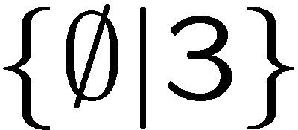
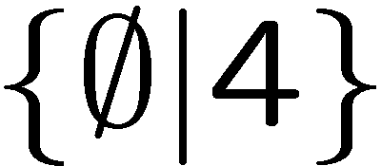
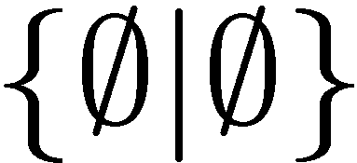
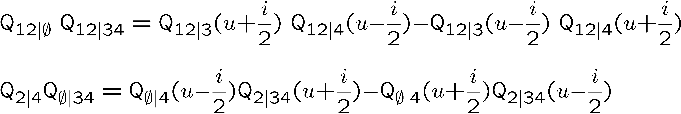
QQ-relations (Plücker identities)
Example: u(2|2)
Hesse diagram
Tsuboi
(for Q’s)
E.g.
bosonic
fermionic
All Q’s can be expressed through a few basic ones by determinant formulas
QQ-relations – quantum version of Weyl symmetry
Tsuboi
V.K.,Sorin,Zabrodin
Gromov,Vieira
Tsuboi,Bazhanov

Slide 15
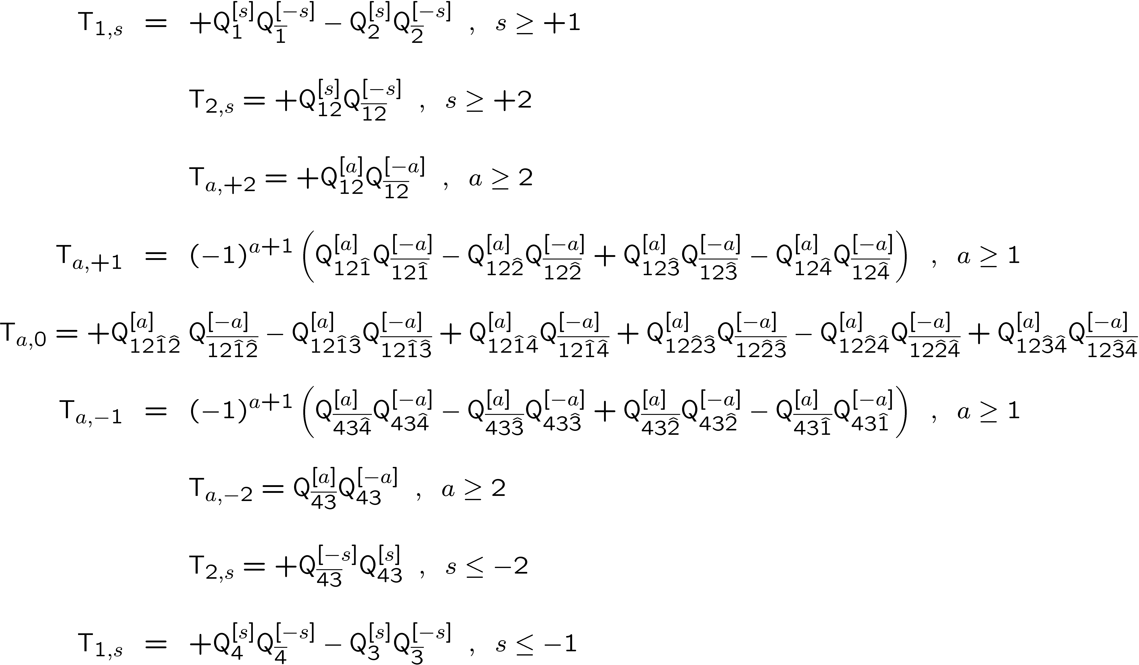
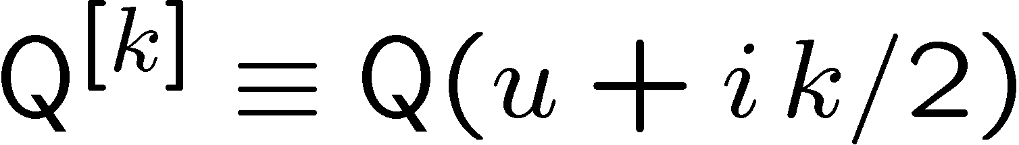
Wronskian solution of AdS/CFT Y-system in T-hook
Gromov,Tsuboi,V.K.,Leurent

Slide 16
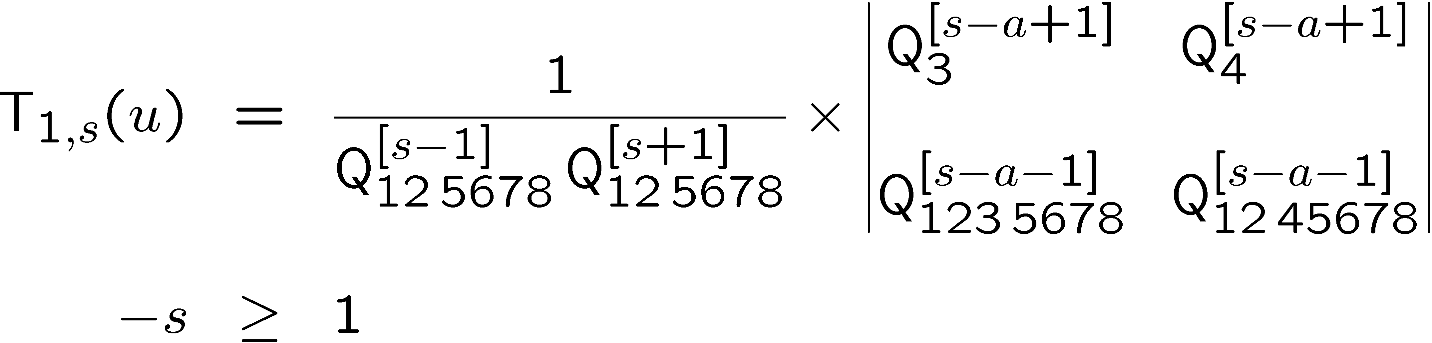

Another form of wronskian solution in -hook
T
Tsuboi
Gromov,Tsuboi,V.K.,Leurent
(to appear)
All 2⁸ Q-functions expressed through any 8 basic ones due to QQ-relations
Knowing their analyticity in spectral parameter we can reduce
the AdS/CFT Y system to a finite system of NLIE’s

Slide 17








An inspiring example: SU(N) principal chiral field at finite volume
Gromov,V.K.,Vieira
V.K.,Leurent
Y-system Hirota dynamics in a strip of width N in (a,s) plane.
a
General Wronskian solution in a strip:
Krichever,Lipan,
Wiegmann,Zabrodin
s
Finite volume solution: finite system of NLIE,
N-1 TBA eqs. with for densities
Numerics for
low-lying states N=3
V.K.,Leurent
polynomials
fixing a state
jumps
by

Slide 18










Towards NLIEs of AdS/CFT…
Gromov, V.K.,Leurent,Tsuboi,Volin
(work in progress)
The infinite chain of equations:
Fast decay
Solved at once by the ansatz:
Where f can be found by iterations
Very similar chain of equations:
Solved at once by the ansatz:
Log scale!
As a result the total number of
equations is 2*cutoff for massive
nodes!

Slide 19
Conclusions
Y-system for exact spectrum of planar AdS/CFT is still only a conjecture but it has passed many important checks.
Hirota dynamics – the most complete approach. Wronskian solutions – a step to a finite system of NLIEs for AdS/CFT
Could help with related topics: OPE’s, gluon amplitudes in N=4 SYM, etc.
Where does this integrability come from in SYM? Why Y?

Slide 20
END

Slide 21

Y-system for excited states of AdS/CFT
Gromov,V.K.,Vieira
T-hook
TBA form
Extra eq (inherited from Z₄ symmetry of classical string):
Gromov,V.K.,Vieira
Bombardelli,Fioravanti,Tateo
Gromov,V.K.,Kozak,Vieira
Arutyunov,Frolov
Anomalous dimensions:
Bethe eq.:

Slide 22





Back to asymptotic Bethe eqs. and S-matrix: L→∞
Gromov,V.K.,Vieira
From TBA:
It is a spin chain limit:
T-system splits into two SU(2|2)_{L,R} wings:
Solving this discrete Laplace eq. in (a,u)-variables we get
zero mode
(dressing factor…)
transfer matrices of SU(2|2)
(fixed from analyticity)
Notes:
22

Slide 23



Asymptotic Bethe Ansatz L → ∞
Fixing fundamental T_{1,±1} from SU(2|2)_{L,R} symmetry and analyticity
1
2
3
Beisert
Defs:

Slide 24







Reality, Crossing and ABA
Reality of Y’s :
We can see that:
We represent (WHY?!) :
…and get from reality of
the crossing relation
ABA
Beisert,Eden,Staudacher,
Janik Volin

Slide 25


Unitary highest weight representations of T-hook of non-compact superalgebra u(M₁,M₂|N)
Kwon
Cheng,Lam,Zhang
Generators:
Dual basis :
Simple roots:
Cartan matrix :
Highest weight Λ for u(2,|4|,2)
a
s-2
Unitarity :

Slide 26





Unitary non-compact representations of T-hook for u(1,1)
highest
weight
Solution of Hirota for U(1,1) characters

Slide 27






Fateev,Onofri,Zamolodchikov’93
Y-system and Hirota equation for principal chiral field
Gromov,V.K.,Vieira’09
a
SU(2)_{L}
SU(2)_{R}
s
Notes:
27

Slide 28






Determinant representation and gauge transformation
Gromov,V.K.,Vieira’09
Determinant solution of Hirota eq.
, Krichever,Lipan,Wiegmann, Zabrodin’97
Gauge transformations
Leaves Y’s and Lax pair invariant!

Slide 29


Lax pair and Baxter relation
Krichever,Lipan,Wiegmann, Zabrodin’97
Solution: linear Lax pair (discrete integrable dynamics!)
Baxter relations
Definition:
Wing exchange symmetry:
Q(R) are interpreted (in different gauges) as Baxter functions for R(L) wing
Notes:
29

Slide 30








Analyticity and ground state solution Q=1
Solution: we assume T₀(x), Φ(x )=T₀(x+i/2+i0) and T₋₁(x):
- Baxter eq.
- “Jump” eq.
relates T₀ and Φ to T₋₁(x) through analyticity:
sea filled by
virtual particles
T₀(x)
T_{k} have no singularities on real axis
TBA eq. for Y₀ is the final non-linear integral eq. for T₋₁
Notes:
30

Slide 31




U(1)-states
Bethe equation for particle rapidities:
real zeroes:
Our solution generalizes to
The same TBA eq. for Y₀ solves the problem
Equivalent to the L↔ R-symmtery:

Slide 32


Finite gap method for classical superstring
Algebraic curve for quasi-momenta:
Cuts (gaps) connecting Riemann sheets define the motion
Quantization: Cuts consist of condensed Bethe roots
carrying the quanta of excitations.
V.K.,Marshakov,Minahan,Zarembo
Beisert,V.K.,Sakai,Zarembo
Gromov,Vieira
Notes:
32

Slide 33




S-matrix and integrable superspin chain
p₂
p₂
p₁
p₁
L
1
2 ……..
p₃
p₃
Minahan,Zarembo
Beisert,Staudacher,Kristjansen
Light cone gauge breaks the global and world-sheet Lorentz symmetries :
psu(2,2|4)
su(2|2)
su(2|2)
S-matrix of AdS/CFT via bootstrap à-la A.&Al.Zamolodchikov (Hubbard R-matrix!)
Ŝ_{PSU(2,2|4)}(p₁,p₂) = S₀²(p₁,p₂) × Ŝ_{SU(2|2)} (p₁,p₂) ×Ŝ_{SU(2|2)} (p₁,p₂)
Staudacher
Beisert
Janik
Analyticity properties (very complicated!), dictated by the exact one particle
dispersion relation:
Santambrogio,Zanon
Beisert,Dippel,Staudacher
N.Dorey

Slide 34


Asymptotic Bethe Ansatz (ABA)
p_{j}
p₁
p_{M}
This periodicity condition is diagonalized by nested Bethe ansatz
Energy of state
finite size corrections,
important for short operators!
Results: ABA for dimensions of long YM operators (e.g., cusp dimension).
Beisert,Eden,Staudacher

Slide 35


N=4 SYM as a superconformal 4D QFT
Operators
Correlators:
non-trivial functions
of ‘tHooft coupling λ!

Slide 36










Bound states and TBA in AdS/CFT
Rapidities of particles (Bethe roots) labeled by su(2,2|4) Dynkin nodes:
Gromov,V.K.,Vieira
Bombardelli,Fioravanti,Tateo
Gromov,V.K.,Kozak,Vieira
Arutyunov,Frolov
complex -plane
N.Dorey
Roots form bound states
Takahashi bound states
for Hubbard model
densities of bound states
TBA equations from minomum of free energy at finite temperature T=1/L
a
Bound states organized in T-hook
Can be brought to universal Y-system!
s
Notes:
36

Slide 37








SYM is Dual to Supersting σ-model on AdS5 ×S⁵
Super-conformal N=4 SYM symmetry PSU(2,2|4) → isometry of string target space
Coset on
fermions
target space
AdS time
world sheet
Metsaev-Tseytlin action
Dimension of YM operator
Energy of a string state

Slide 38


Yang-Yang TBA for finite size (Al.Zamolodchikov trick)
2d vacuum: dense gas of virtual (mirror) “particles” on large circle R
Excited states: a few physical particles added
Ambjorn,Janik,Kristjansen
Arutyunov,Frolov
world sheet
physical particles on
small space circle L
Large R : mirror momenta localize
on poles of S-matrix → bound states
Notes:
38

Slide 39


Solution of SU(N)_{L} x SU(N)_{R} principal chiral field at finite size
N-1 TBA equations fix N-1 spectral densities
Numerics for
low-lying states N=3
V.K.,Leurent
To appear
Infinite Y-system reduced to a finite
number of non-linear integral equations

Slide 40




Solving full quantum Hirota in U(2,2|4) T-hook
Replace in gen. function:
Generating functional
Q-function parametrization (analogue of Baxter functions)
Tsuboi
Gromov,Tsuboi,V.K.,Leurent
(to appear)

Slide 41


QQ-relations (Plücker identities)
bosonic
fermionic
All Q’s can be expressed through a few basic ones by determinant formulas
Tsuboi
V.K.,Sorin,Zabrodin
Gromov,Tsuboi,V.K.,Leurent
(to appear)
Example: u(2|2)
Hesse diagram

Slide 42

Integrability in AdS/CFT
Integrability for QFT in dimensions D>2?
Early example from QCD: Lipatov’s reggeon Hamiltonian.
Possible for some SYM’s at D=3,4… Based on AdS/CFT duality to 2D superstring ϭ-models on AdS-type backgrounds
String ϭ-models in light-cone gauge look like “massive non-relativistic” 2D QFT’s
All popular 2D integrability tools applicable: S-matrix, asymptotic Bethe ansatz (ABA), Thermodynamic Bethe Ansatz (TBA) for finite size spectrum, etc.
.... Y-system (for planar AdS₅/CFT₄ , AdS₄/CFT₃ ,...)
T-hook
Conjecture: it calculates anomalous dimensions of all local operators in planar N=4 SYM at any coupling
Y-system as Hirota integrable dynamics
Gromov,V.K.,Vieira
Notes:
42

Slide 43
Towards NLIE for AdS/CFT: Solution of T-system in -hook
T
Tsuboi
Gromov,Tsuboi,V.K.,Leurent
(to appear)
All 2⁸ Q-functions expressed through any 8 basic ones due to QQ-relations
Knowing their analyticity in u we can reduce the AdS/CFT Y system to a finite
system of NLIE’s

Slide 44


Slide 45
Quasiclassical solution of AdS/CFT Y-system
Classical limit: highly excited long strings/operators, strong coupling:
Explicit u-shift in Hirota eq. dropped (only slow parametric dependence)
(Quasi)classical solution - su(2,2|4) character of monodromy matrix!
Gromov
Gromov,V.K.,Tsuboi
(Quasi-)classics restored entirely from the Y-system!
The asymptotic Bethe ansatz
also follows from Y-system
SU(2|2)
SU(2|2)
SU(2,2|4)
Notes:
45

