Slide 1
Nvidia / CUDA
Applicability and problems
by the example
Hans Hacker

Slide 2
Outline
Programming Model
Hardware Implementation
Memory Issues
Toolkit / SDK
Examples
mod2am
mod2as
Conclusion

Slide 3
Programming Model
Define Kernels – run by N-threads in parallel
threadIdx (3 dimensional vector)
much like rank in MPI
Forms a thread block
Multiple blocks form a 1D- or 2D-grid
blockIdx

Slide 4
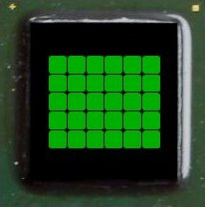
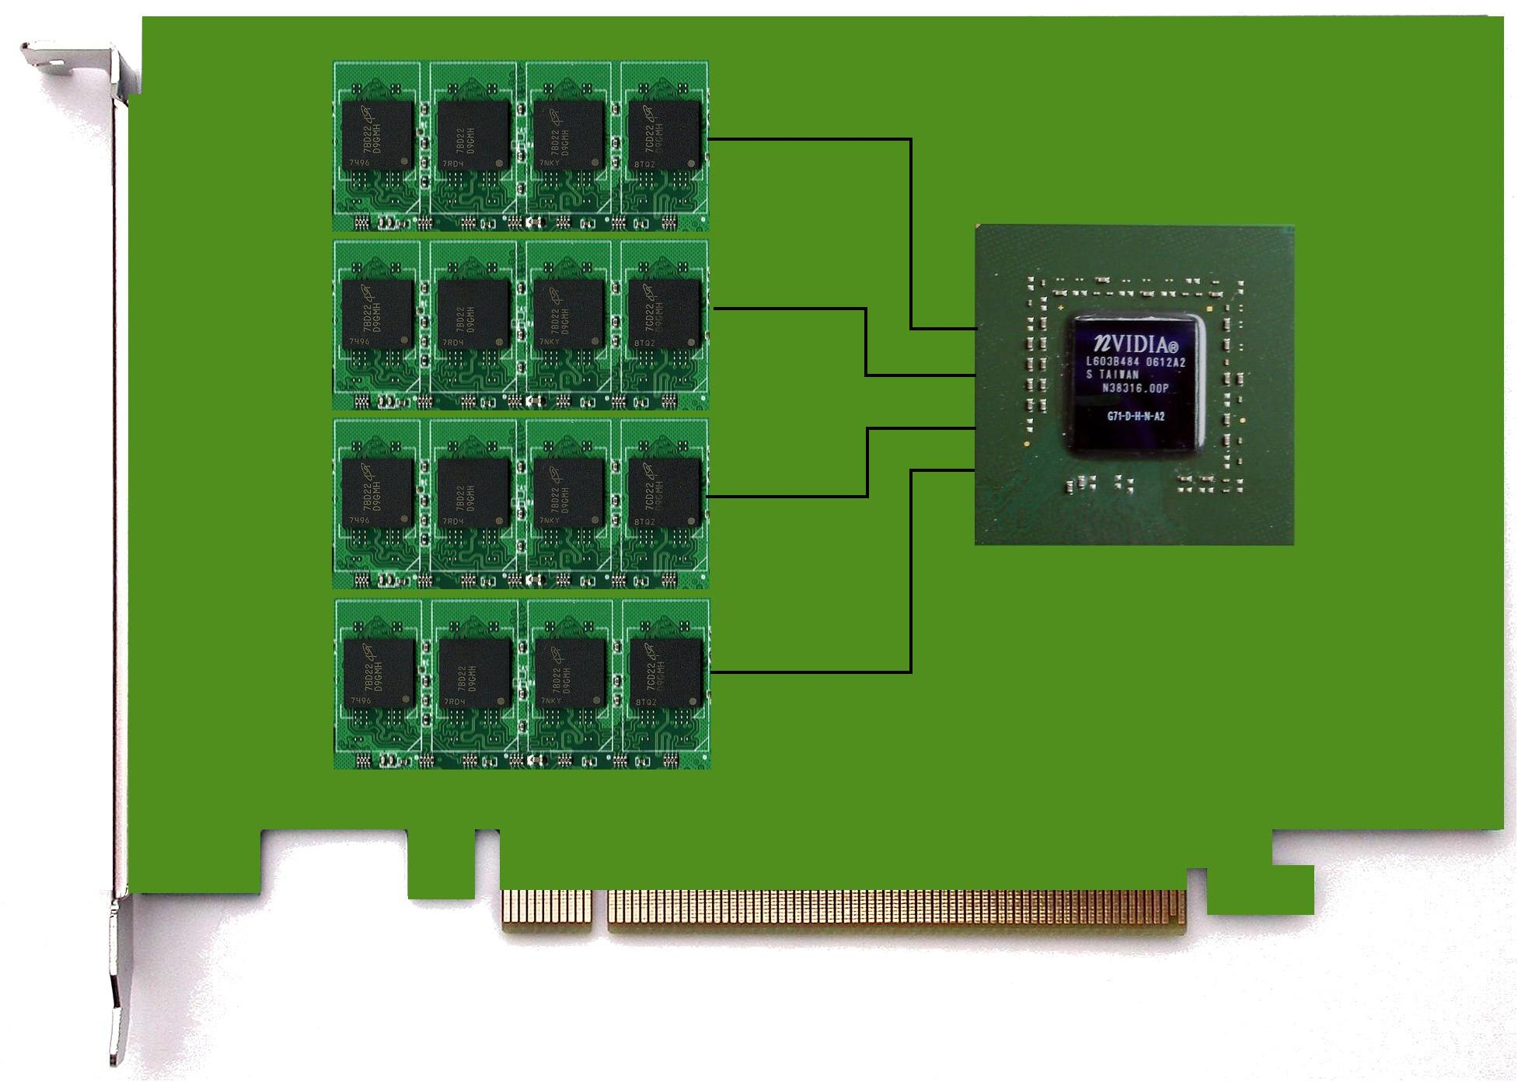
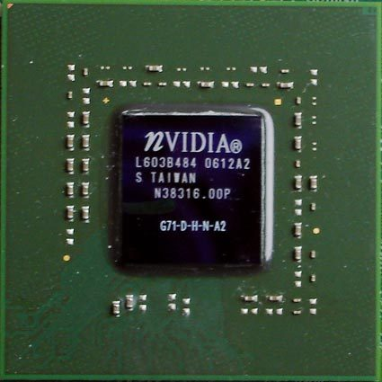
Hardware Implementation
Nvidia – Tesla C1060
GT200
4 GB
GDDR3
102GB/s
PCIe x16 (gen 2)
(8 GB/s)

Slide 5
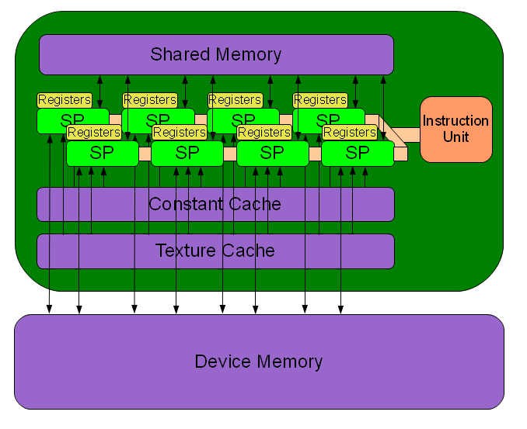
Hardware Implementation

Slide 6
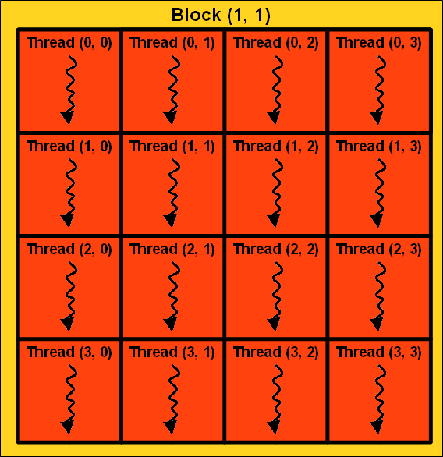
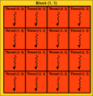
// Kernel definition
__global__ void MatAdd(float A[N][N], float B[N][N], float C[N][N]) {
int i = blockIdx.x * blockDim.x + threadIdx.x;
int j = blockIdx.y * blockDim.y + threadIdx.y;
C[i][j] = A[i][j] + B[i][j];
}
int main() {
// Kernel invocation
dim3 dimBlock(4, 4);
dim3 dimGrid( N / dimBlock.x, N / dimBlock.y );
MatAdd<<<dimGrid, dimBlock>>>(A, B, C);
}

Slide 7
Hardware Implementation
SIMT – single-instruction multiple-thread
32 threads of each block are grouped as WARP
All threads of a WARP execute the same line of code simultaneously
Divergence (e.g. branches) is expensive
Memory accesses are coalesced and issued for each half-WARP

Slide 8
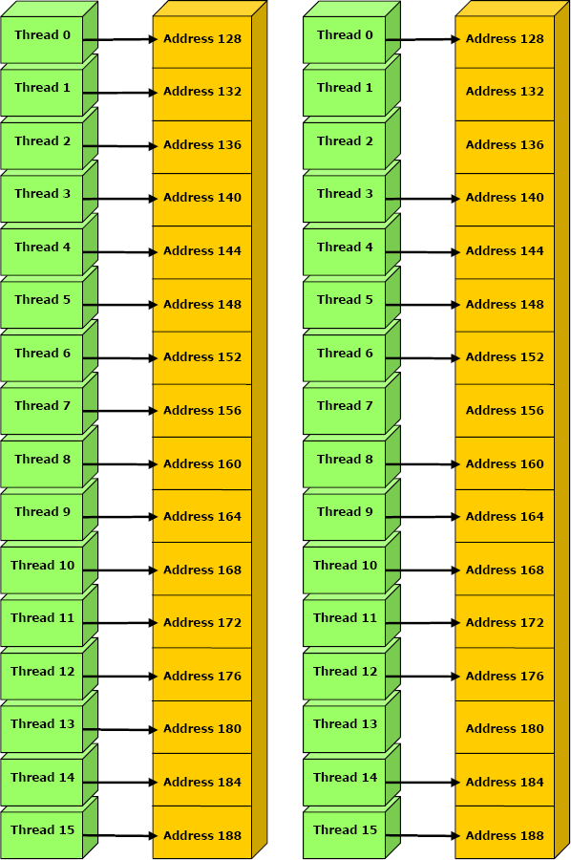
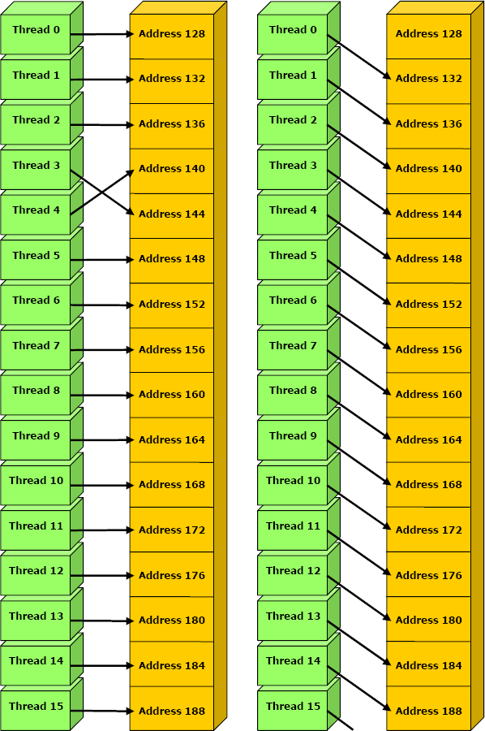
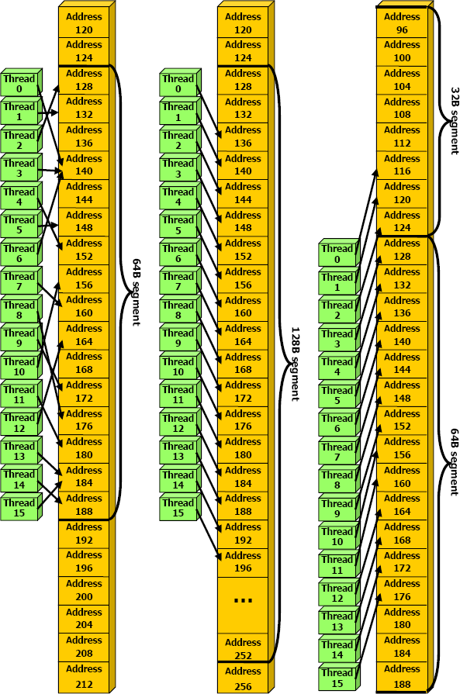
Memory Issues – Global Memory
Compute capability < 1.2
Compute capability > 1.2
Pictures taken from Nvidia – CUDA Programming Guide

Slide 9
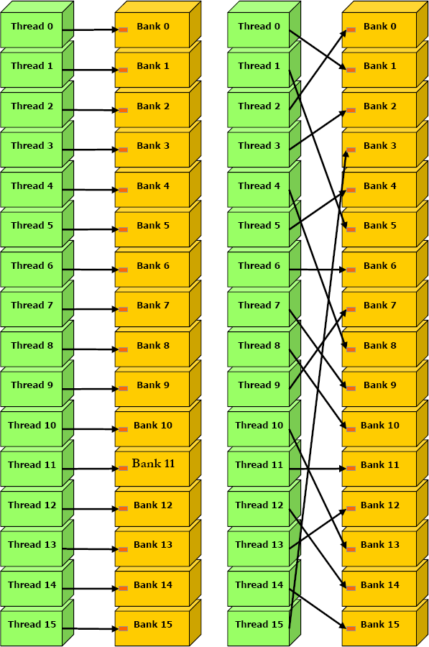
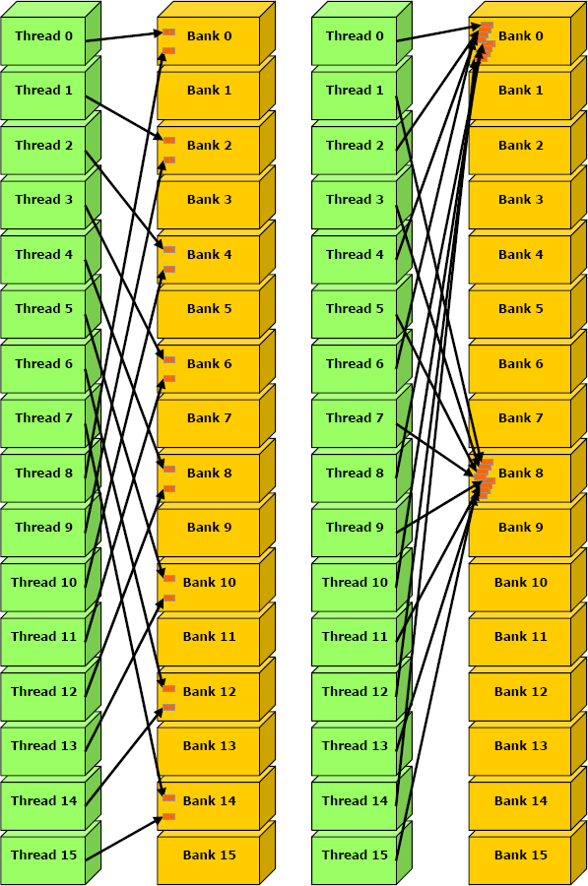
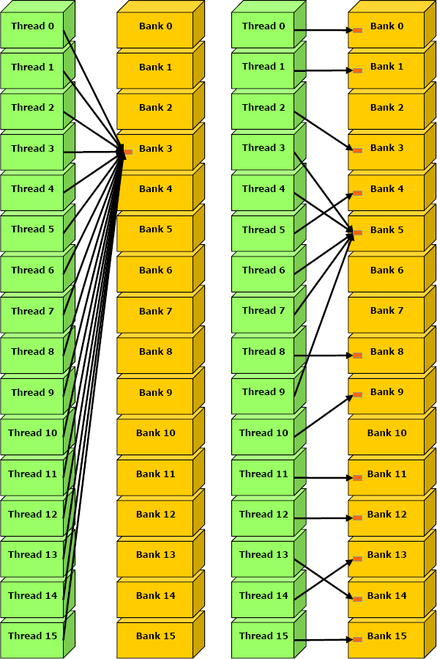
Memory Issues – Shared Memory
no bank conflict
no bank conflict
2-way bank conflict
8-way bank conflict
no bank conflict
no or
2-way bank conflict
Pictures taken from Nvidia – CUDA Programming Guide

Slide 10
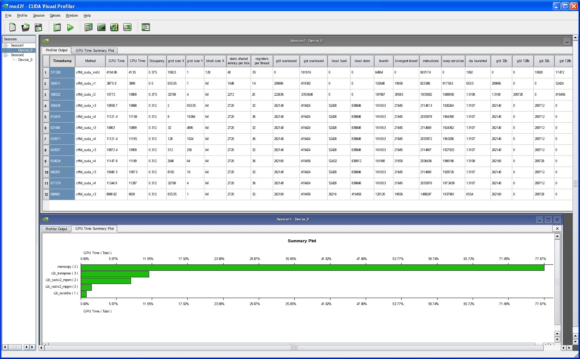
Toolkit / SDK
Compiler / Debugger / Profiler
SDK with ready to use Examples

Slide 11
Examples – mod2am
SP example from SDK
DP problems
‘-arch=sm_13‘
Bank conflicts in shared memory
Usage of cuBLAS – SP/DP
Column major (use transpose feature)
Transpose-kernel from SDK
Memory Pinning

Slide 12
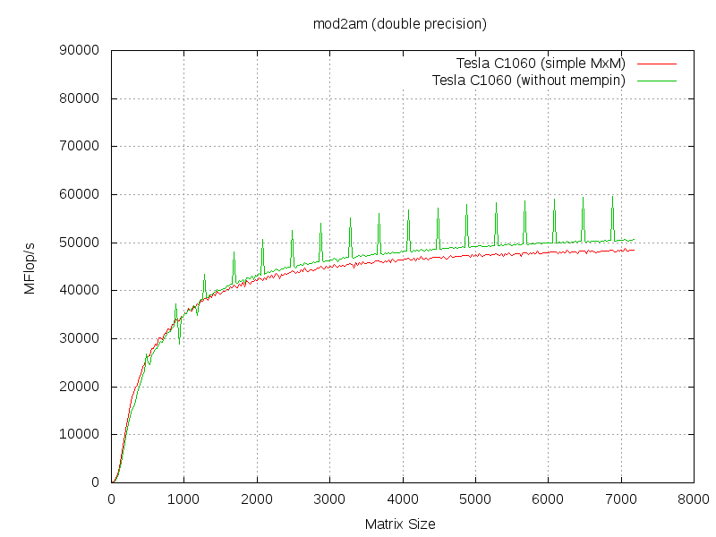
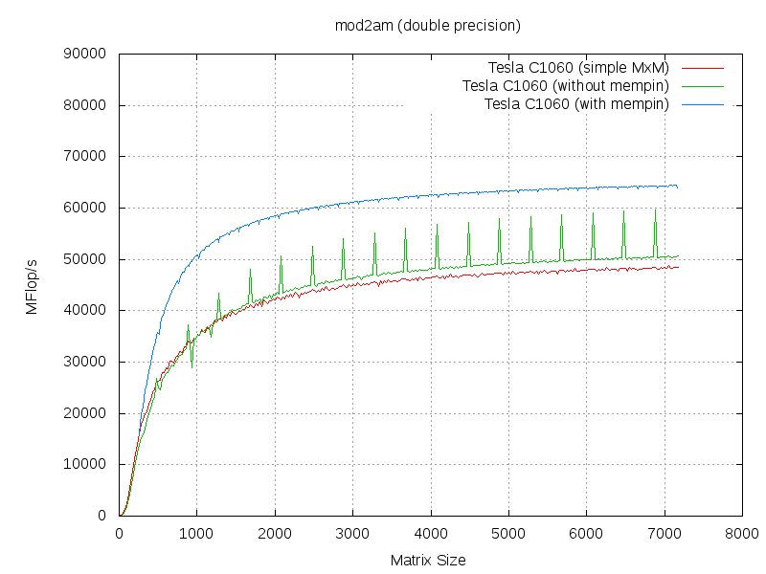
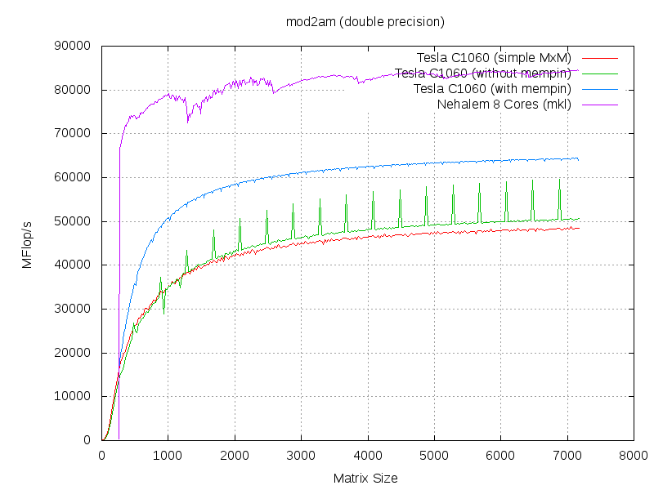

Slide 13
Examples – mod2as
Example from Cuda Zone* (CSR kernel)
Efficient reduction (using WARP-concept)
Texture cache
Memory pinning
// parallel reduction in shared memory
if ( lane < 16) vals [ threadIdx.x ] += vals [ threadIdx.x + 16];
if ( lane < 8) vals [ threadIdx.x ] += vals [ threadIdx.x + 8];
if ( lane < 4) vals [ threadIdx.x ] += vals [ threadIdx.x + 4];
if ( lane < 2) vals [ threadIdx.x ] += vals [ threadIdx.x + 2];
if ( lane < 1) vals [ threadIdx.x ] += vals [ threadIdx.x + 1];
// first thread writes the result
if ( lane == 0)
y[ row ] += vals [ threadIdx.x ];
* "Efficient Sparse Matrix-Vector Multiplication on CUDA" by Nathan Bell and Michael Garland

Slide 14
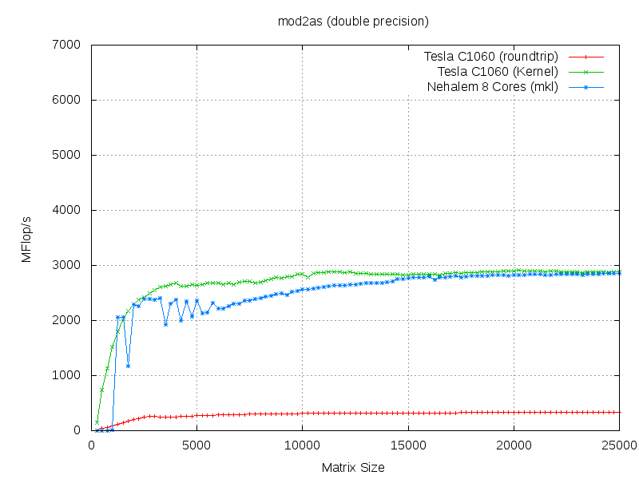
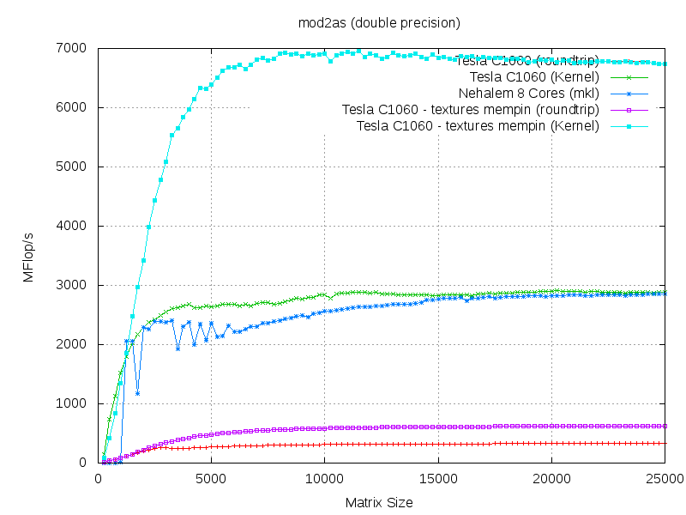

Slide 15
Conclusion
PRO
Easy to learn C “add-on”
Fast and efficient
for suitable problems or
if SDK example available
CON
Still too unstable for reliable usage
Too many issues to think about
Not general purpose

Slide 16
Thank you …
… any Questions?

Slide 17
Examples – mod2f
32 vs. 24bit integer operations issue
float4/double2 issue
Access to shared memory slow
Rather (re-)calculate intermediates (registers)
Avoid branches using predefined vectors

