Slide 1
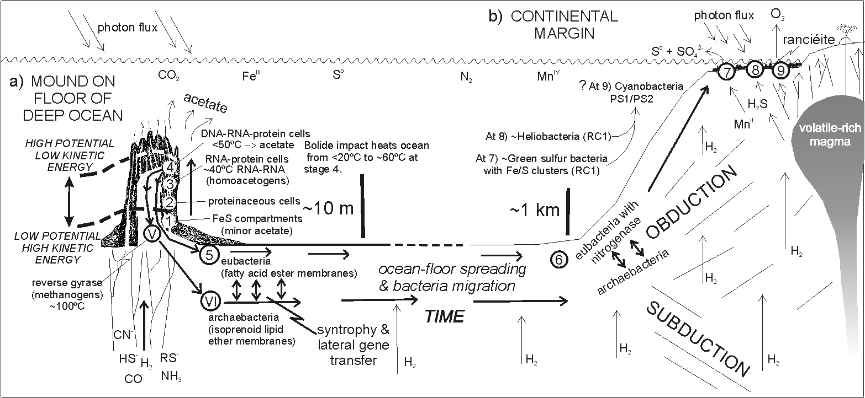
    Why does life start, What does it do,
    Where will it be?
CaMn₄O₈ &
MnOOH
The Hadean Carbonic Ocean
At 8) Protocyanobacterium (RC 1 & RC2I)
MoS₄²⁻
Chemosynthesis ← atmospheric CO₂ → Oxygenic photosynthesis
H₂ from H₂O (Fe⁰,Fe²⁺) ☒ H₂ from H₂O (~CaMn₄O₅)
Michael J Russell, JPL/Caltech

Slide 2
THE INITIAL CONDITIONS AT ~4.3Ga
A tempestuous
Hadean waterworld
UV, solar wind,
cosmic rays
and very weak
magnetic field
Credit: Minik Rosing

Slide 3
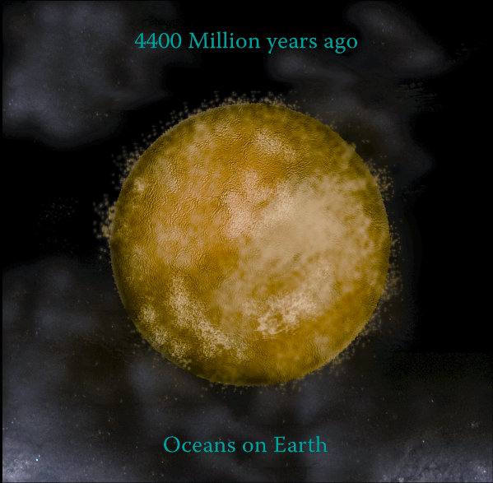
On this tempestuous Hadean waterworld
methane and ammonia were
vestigial in the atmosphere,
and no land so no “warm little pond”
UV, solar wind,
cosmic rays but
weak magnetic
field

Slide 4

Getting the initial conditions
and the physics right
Susan Henry

Slide 5
The Earth produced hydrogen
from some of this water
H₂

Slide 6
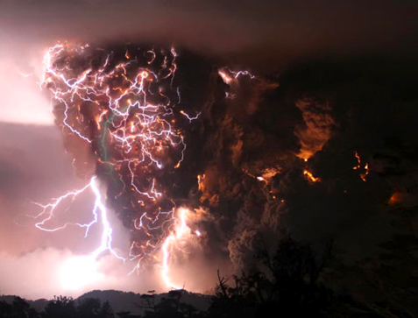
and volcanic CO₂ >> S₈, SO₂, NO, P₄O₁₀
Chaiten volcano, Chile, photo credit: Carlos Gutierrez

Slide 7
So the atmosphere was carbon dioxide (CO₂)

Slide 8
The atmosphere was carbon dioxide (CO₂)
and the ocean was carbonated water,
i.e. acidic (pH 5.5)

Slide 9
Earth had an oxidized CO₂, NO, S⁰ SO₂, & Fe^{III} exterior
and a reduced “electron rich”,
alkaline interior (Fe^{II}/Fe⁰ → H₂)
rather like an autotroph

Slide 10
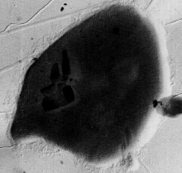
4H₂ + CO₂ CH₄ + 2H₂O
e.g., a methanogen_→
or electrochemical cell

Slide 11

4H₂ + CO₂ CH₄ + 2H₂O
So can we imagine life just
“bubbling off” from the surface?→

Slide 12
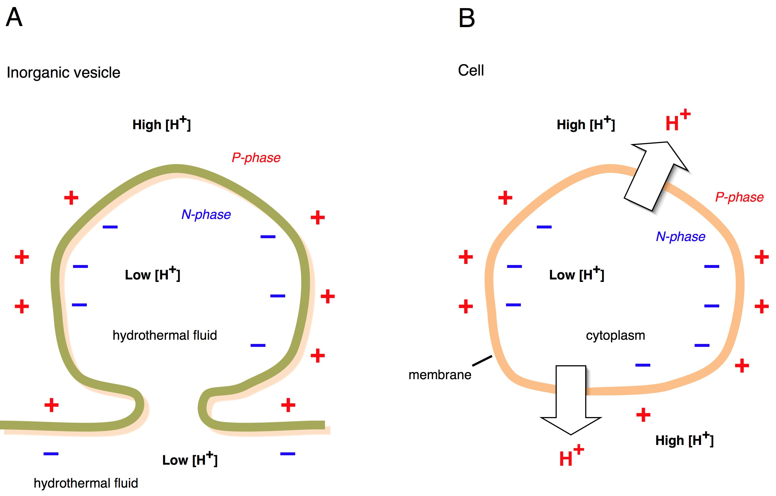
The bubbling off of life from the Earth’ solid surface
Left: Ambient protonmotive force across the boundary of hydrothermal mound and LUCA
Right: The proton-motive force of living cells descended from LUCA
Lane et al. 2010, BioEssays, 32, 271; Based on Russell et al. 1994, JME, 39, 231 &
Nitschke & Russell 2009, JME, 69, 481

Slide 13
& 4H₂ + CO₂ CH₄ + 2H₂O
Hydrogen plus carbon dioxide
react slowly to produce
methane

Slide 14
& 4H₂ + CO₂ CH₄ + 2H₂O
and have the potential to produce acetate
4H₂ + 2CO₂ CH₃COOH + 2H₂O

Slide 15
Reactions that are quickened to LIFE

Slide 16
Reactions that are quickened to LIFE
but where?

Slide 17
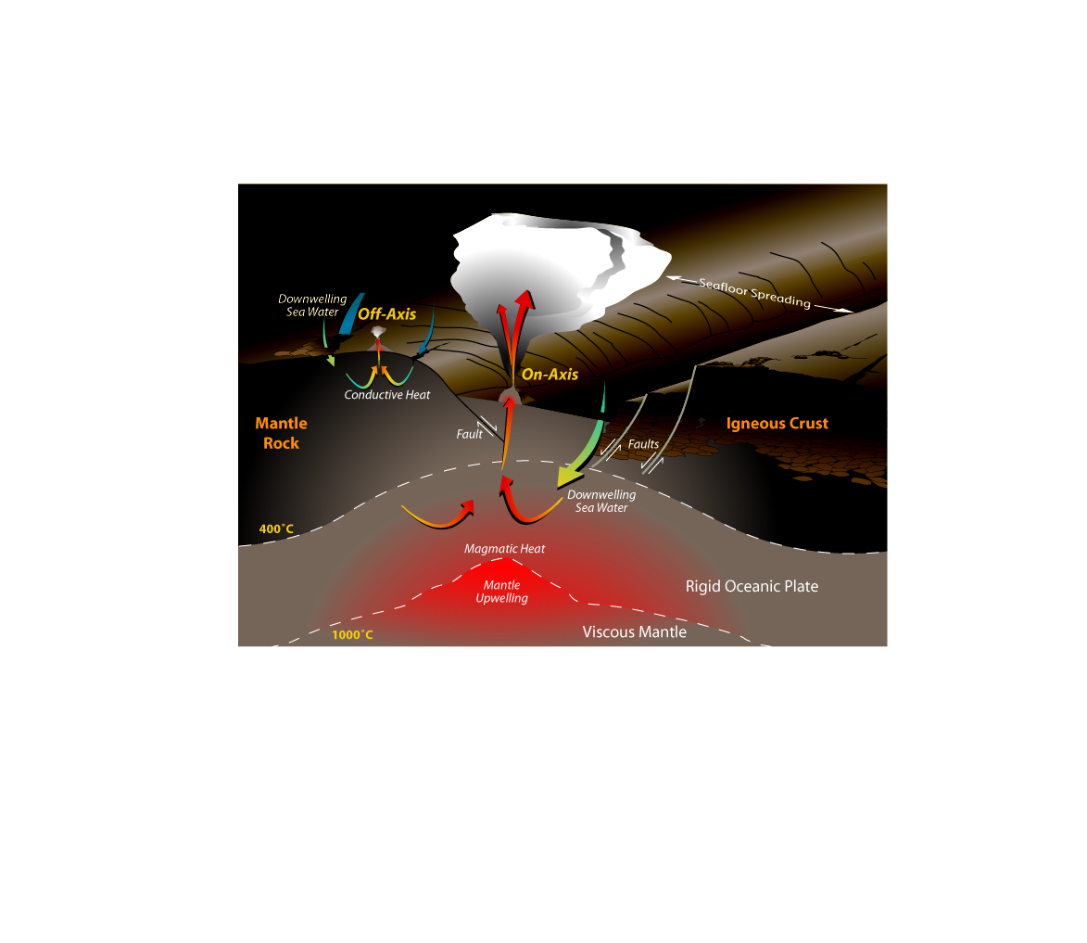
Ocean
Acidic on-axis
400°C springs
Fe,Zn,Ni,Co
Exothermic and
From W. Bach

Slide 18
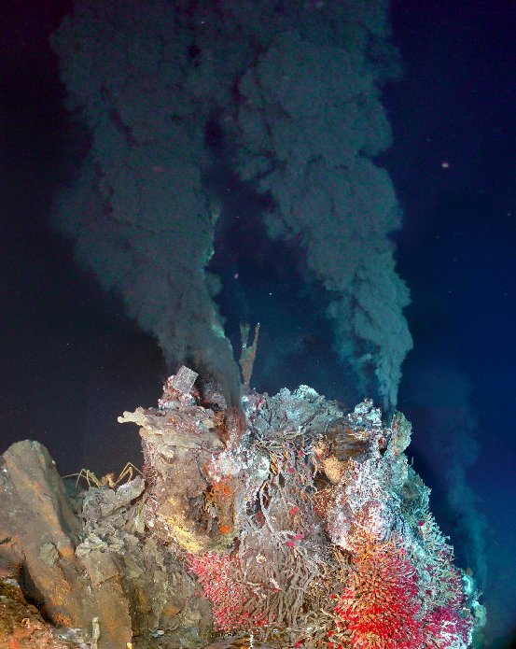
Although they’re too hot, too acidic, too oxidized & too spasmodic for emergent life,
400°C springs do provide the trace elements (Fe, Ni, Zn, Mo, W, Co) that may be sequestered by metalloenzymes
°
iii
,
Endeavor, NE Pacific
Credit: Delaney & Kelley

Slide 19
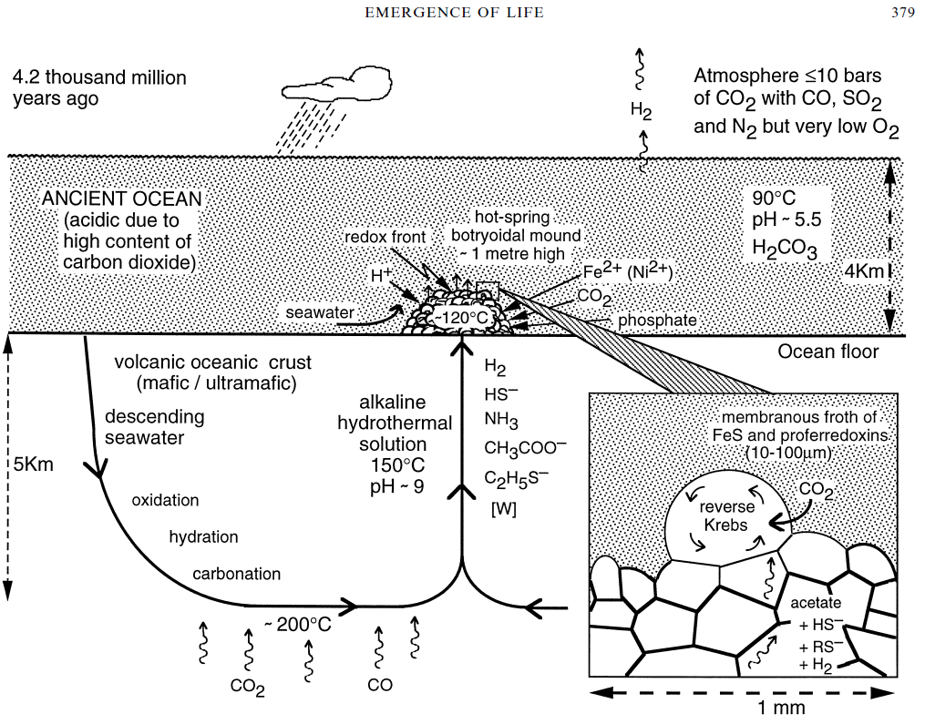
We have suggested that life emerged in cooler,
alkaline springs away from oceanic spreading centers
e.g., Russell & Hall
1997 Geol. Soc.
London, 154, 377
i.e., from a low entropy feed

Slide 20
Ocean
Main energy discharge
at alkaline off-axis site
Exothermic serpentinization
From W. Bach

Slide 21
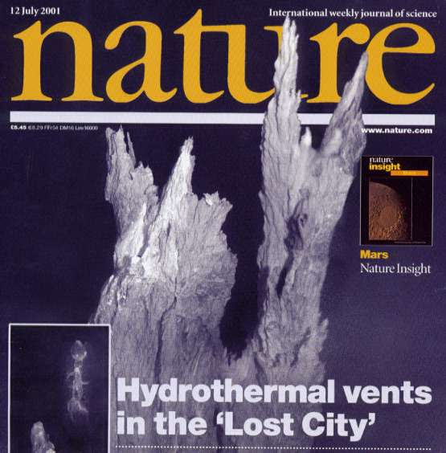
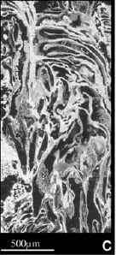
ALKALINE SUBMARINE SPRING
CaCO₃
Mg(OH)₂
pH ≤12
T ≤94°C
H₂ ≤15mmol
CH₄ ≤2mmol
>30,000 years
Kelley et al. 2001, Nature 412, 145
& Science 2005, 307,1428-1434.
Martin et al. 2008,
Nature Microbiol. Rev.
6, 805-814.
compartments

Slide 22
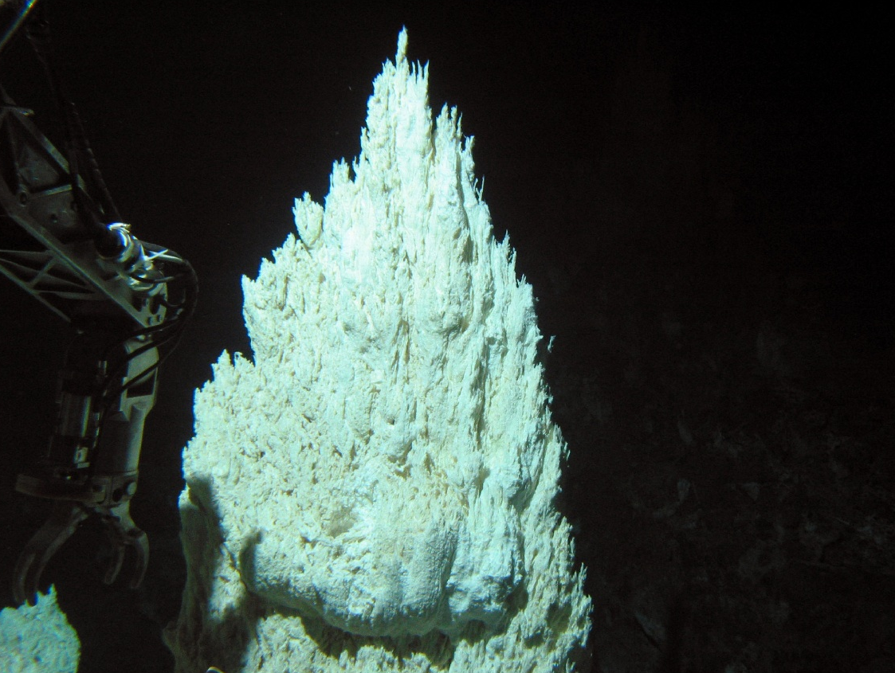
Credit:
& Deb Kelley
Lost City
CH₄:H₂
1:10
Martin et al. 2008,
Nature Microbiol Rev 6, 805

Slide 23

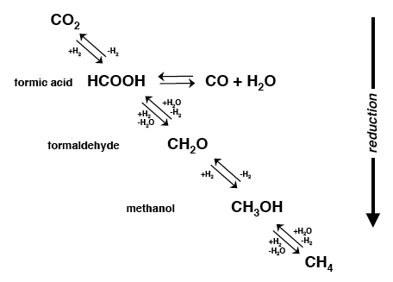
SERPENTINITE
Mg_{2.85}Fe_{0.15}Si₂O₅(OH)₄
olivine + water → magnetite + serpentine + alkali + H₂↑
3MgFeSiO₄ + 4H₂O → 3SiO₂ + Fe₃O₄ + 3Mg²⁺ + 6OH⁻ + H₂↑
and CH₄
Single carbon redox reactions during serpentinization
Seewald et al. 2006
GCA 70, 446

Slide 24
“Uphill” geochemical
path
“Downhill”
geochemical path
Slow reduction from
CO₂ to CH₄ during serpentinization
(a geochemical ‘siphon’)
Acetogenic path
    Recast from Maden 2000
    Biochem. J. 350, 609
Methanogenic
path
Reductions & hydrogenations→

Slide 25
formate
Geochemical
path
ionic
gradient
Favored by high temperature
and relatively low H₂ and pH
and tungsten pterin
Acetogenic path
‘quickened’ parallel reduction pathways
from CO₂ to CH₄
(a biochemical ‘vortex’)
Methanogenic
path
    Recast from Maden
    2000, Biochem. J. 350, 609
    Yung et al. J Cosmol. 5,1121

Slide 26
ATP
Favored by higher H₂ and pH but lower temperatures and molybdenum pterin
Acetogenic paths
by addition of CO-
-CH₃ → CH₃COO⁻
.
Single-pass reduction
pathways from CO₂ to CH₃COO⁻
(biochemical ‘vortex’)
Methanogeni
cath
    Recast from Maden
    2000, Biochem. J. 350, 609;

Slide 27
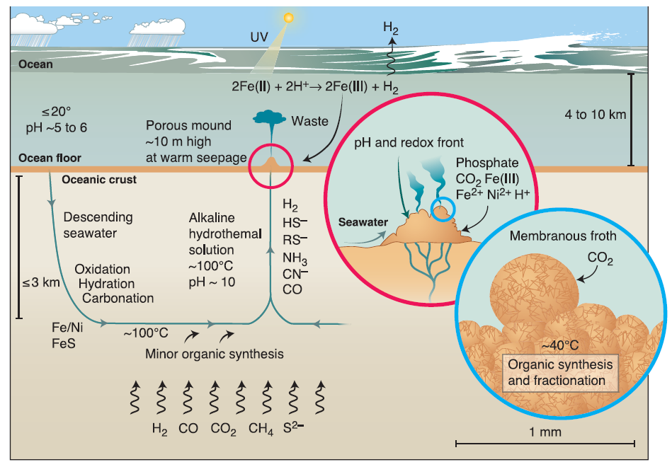
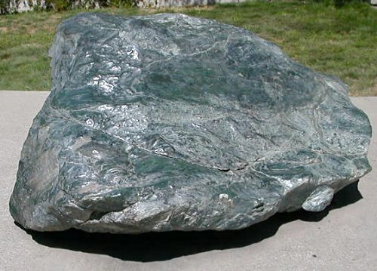
Capping and quickening serpentinization reactions
1-10 bars CO₂
waste
.
H₂ > CH₄ > HCOO⁻ ↑
FeS
brittle to
ductile
SERPENTINIZATION
Russell
2003
Science
302, 580
This system maximises entropy
Kleidon & Lorenz 2005,
Springer Verlag
Notes:
SCIENCE FIGURE

Slide 28
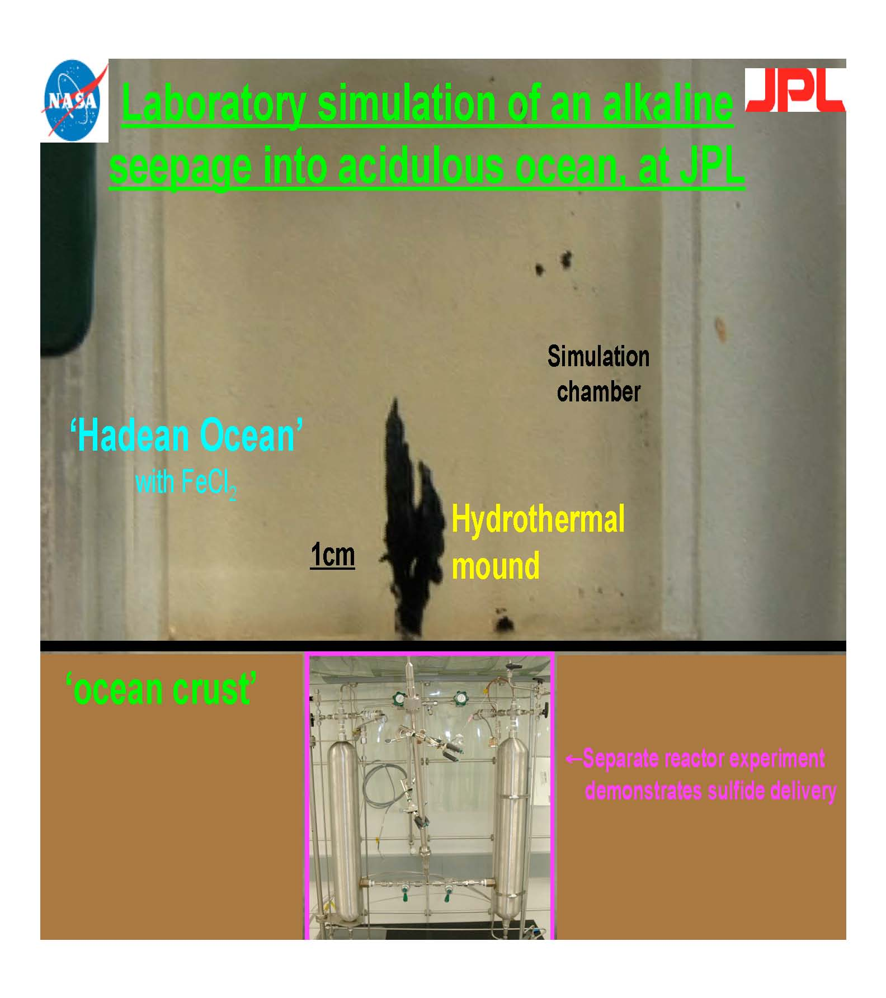
NAI
Mielke et al.

Slide 29
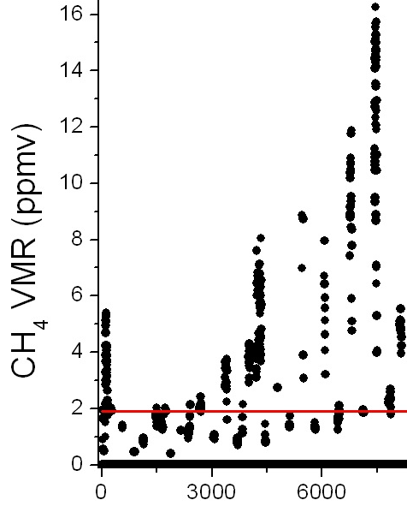
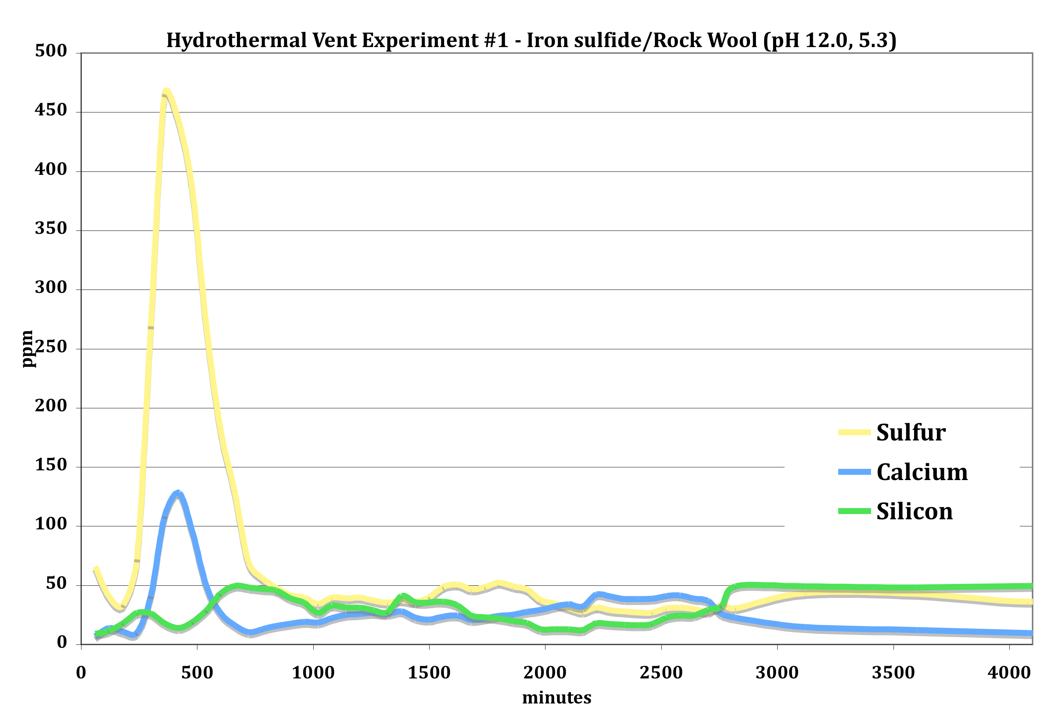
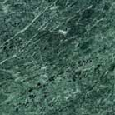
NAI
CH₄
HS⁻
HS⁻
Minor formate &
trace acetate
SERPENTINIZATION
Vance, Mielke, Kanik,
Christensen, Russell
Mielke, Kidd, Vance,
Kanik, Russell

Slide 30

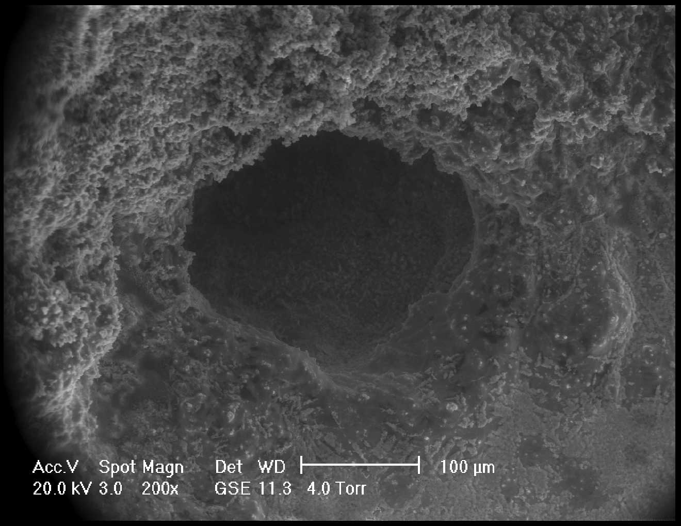
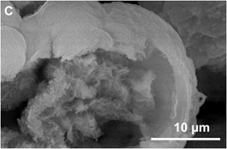
THE FIRST COMPARTMENTS
1-10 bars CO₂
methane,
waste
.
H₂ > CH₄ > HCOO⁻ ↑
brittle to
ductile
SERPENTINE
Russell
2003
Science
302, 580
This system maximises entropy
Kleidon & Lorenz 2005,
Springer Verlag
Notes:
SCIENCE FIGURE

Slide 31
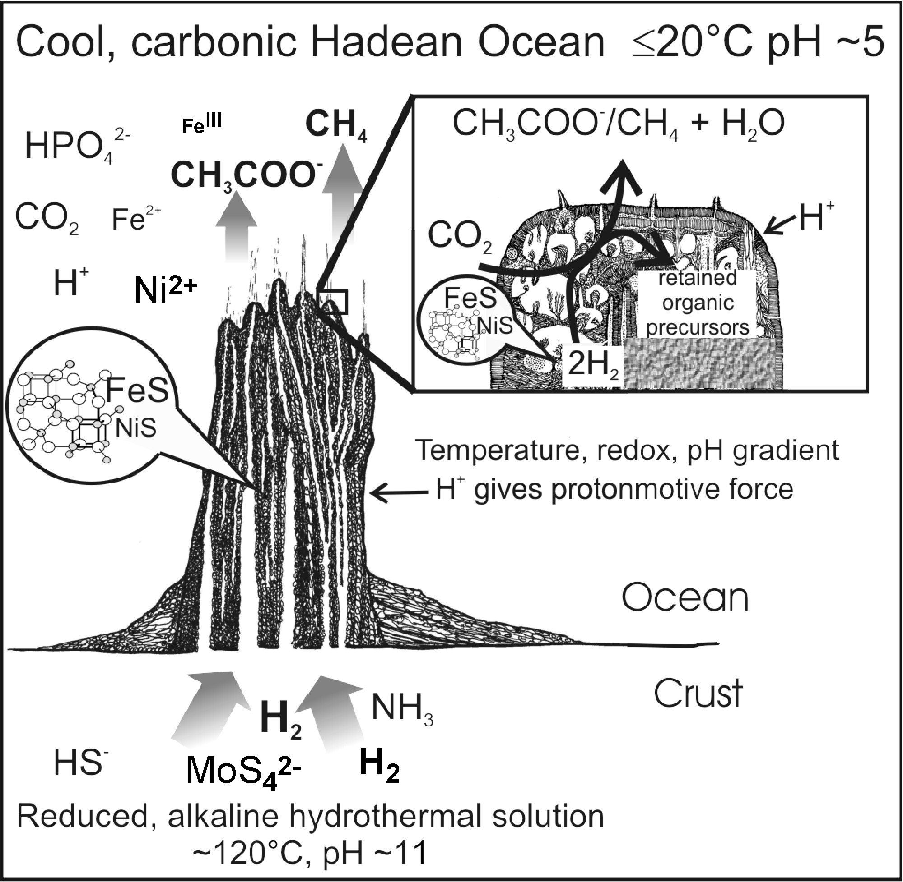
The Rocky Roots of the Acetyl-Coenzyme-A Pathway
NO/HNO₃
S₀
The hatchery of life
← H⁺ gives protonmotive force
& pyrophosphate??
[H⁺ + 2HPO₄²⁻ → HP₂O₇³⁻ + H₂O]
Ocean
Russell & Martin 2004 TIBS, 29, 358-363
Nitschke & Russell, JME, 69, 481
Crust
MoS₄²⁻ WS₄²⁻
CN⁻
Holm, Neubeck, GeochemTrans

Slide 32
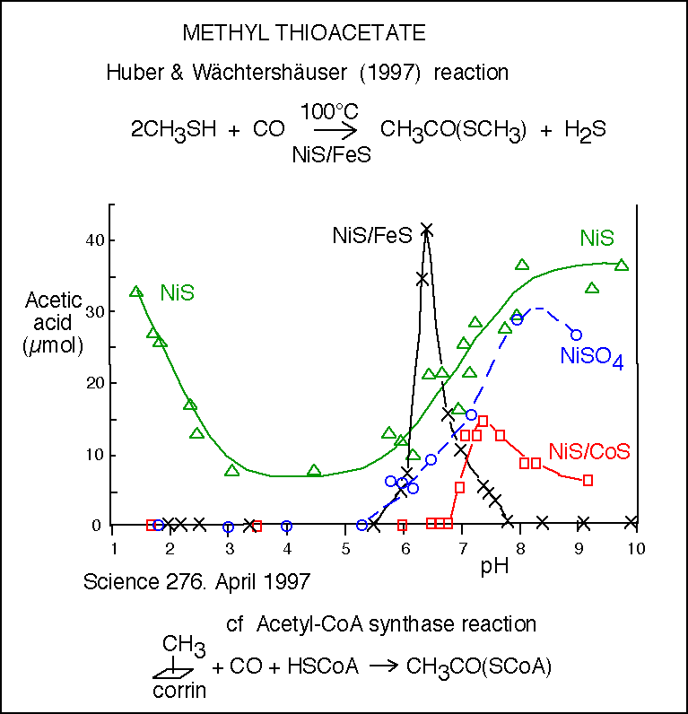
Assembly of methyl thioacetate
Promoted by
alkaline conditions
NB.
Nickel sulfate
is also an effective catalyst so that the “pyrite-pulled” mechanism is irrelevant here

Slide 33
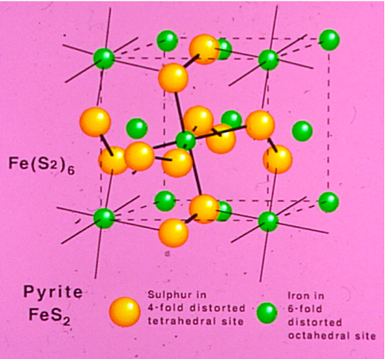

Slide 34
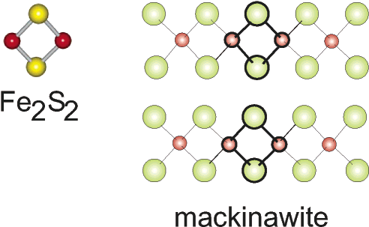
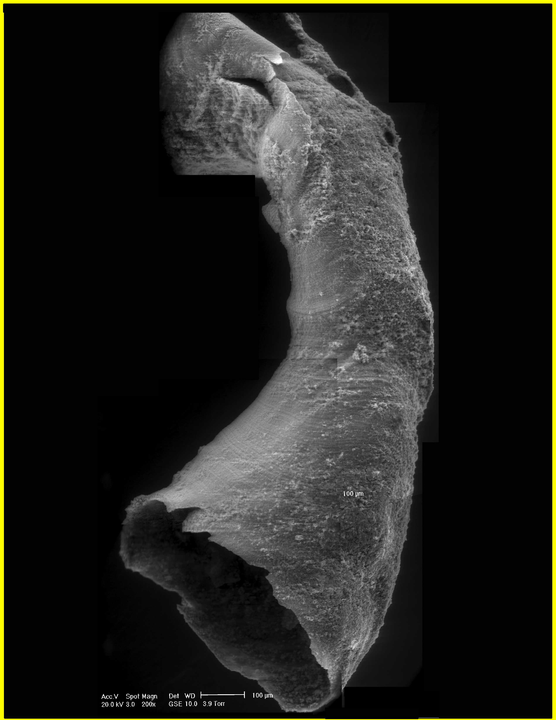
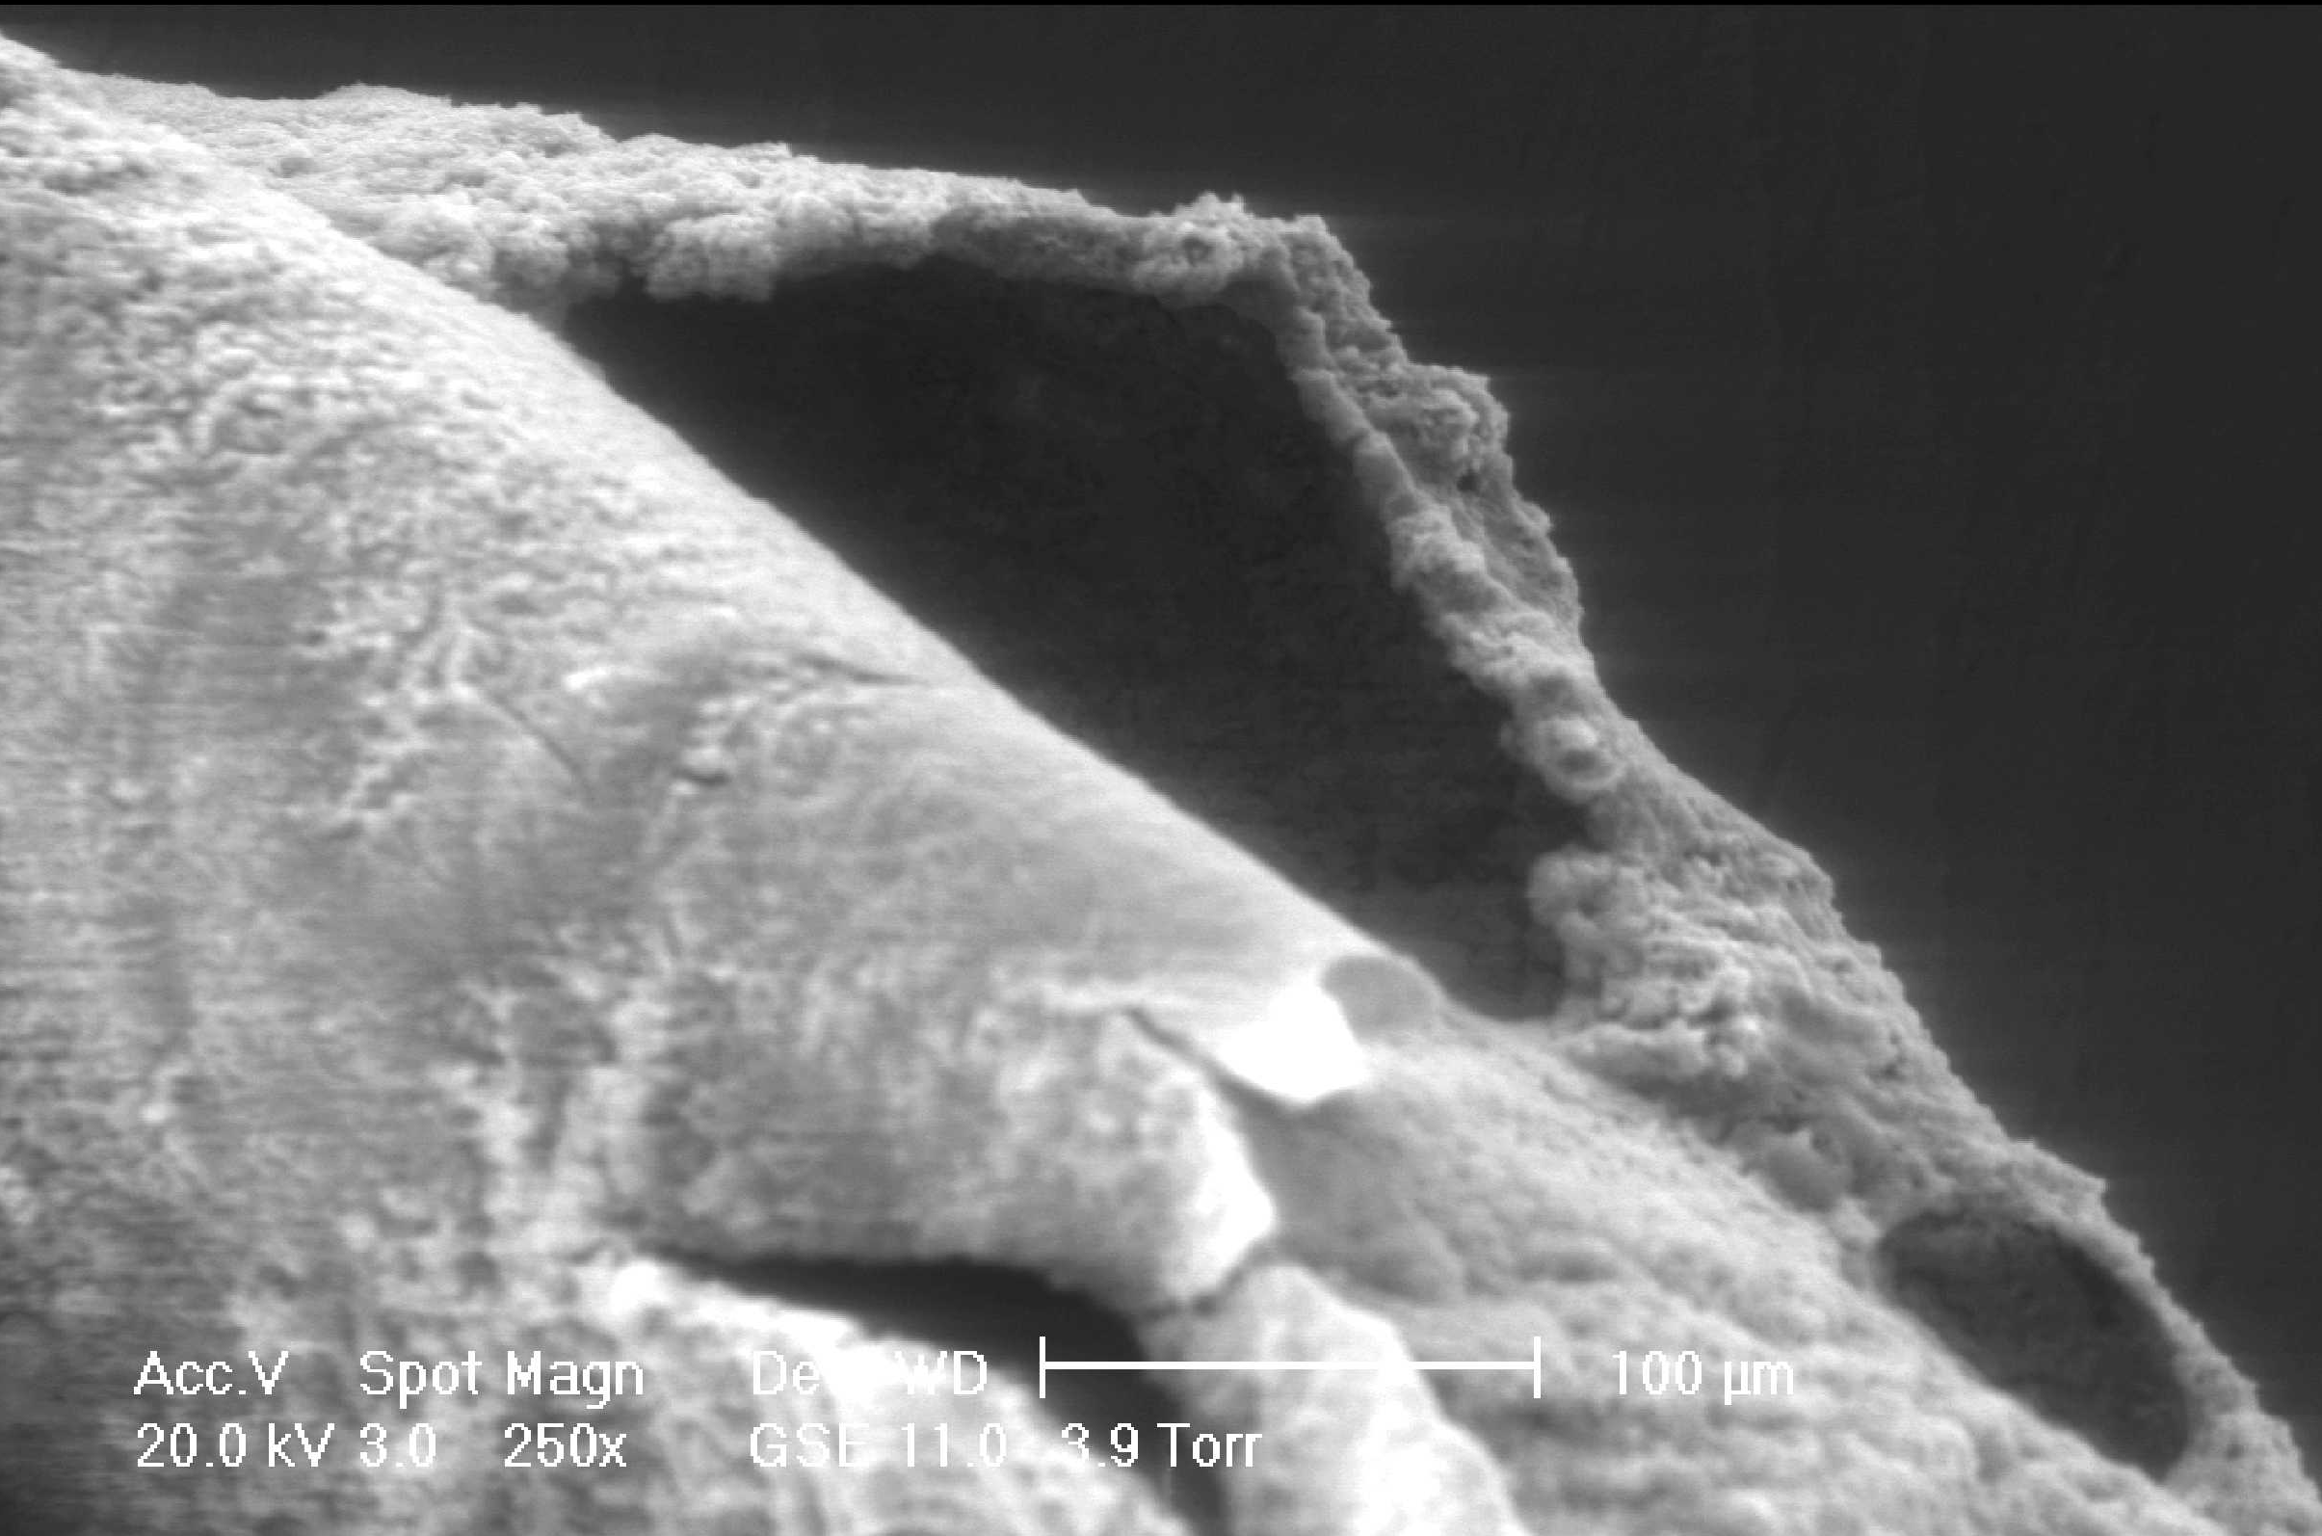
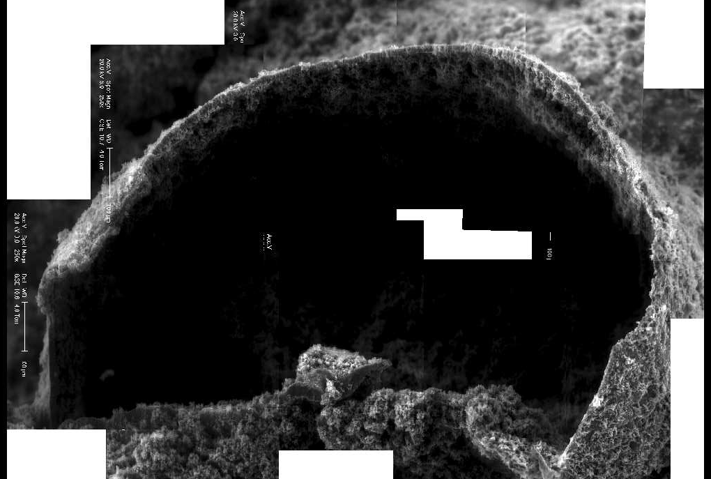
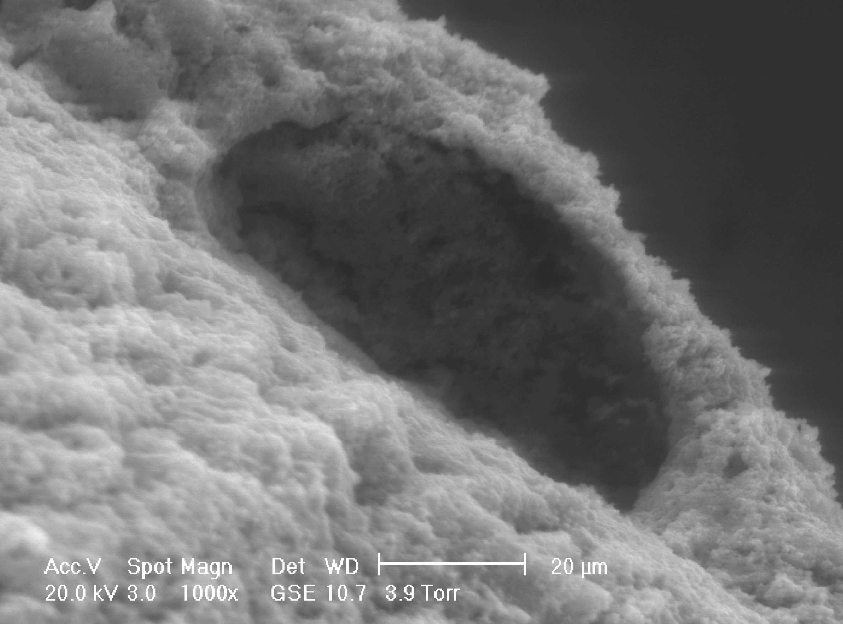
Mackinawite (FeS) comprises a portion of the first membrane
S
100μm
Fe
20μm

Slide 35
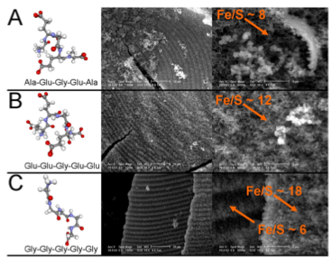

Slide 36
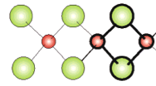
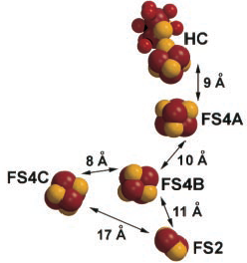
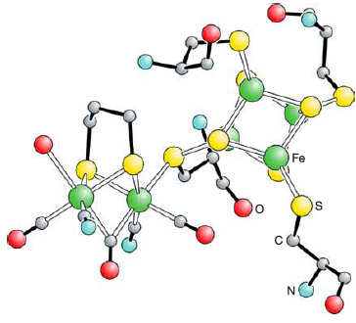
Could mackinawite act as a proto-hydrogenase?
H₂ ⇔ 2H⁺ + 2e⁻
S
S
S
mackinawite
Fe
Fe
Fe
S
S
S
Composite structure of hydrogenase
from Clostridium & Desulfovibrio
Tard et al., 2005 Nature 433, 610
Peters et al, Science 1998, 282:1853

Slide 37
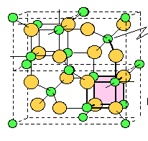
External H⁺ could oxidize mackinawite (FeS) to
greigite (Fe₃S₄) in the membrane
Greigite [Fe₅NiS₈]
Ni
semiconducting
& ferrimagnetic
Rickard et al. 2001, EPSL, 189, 85
Russell & Hall 2006 GSA Memoir, 198, 1

Slide 38
Greigite compared to acetyl co-A synthase (ACS)
Greigite [Fe₅NiS₈]
Fe
Ni
S
Volbeda and Fontecilla-Camps 2005,
Cordination Chemistry Reviews, 249,1609-19

Slide 39
Acetyl-Coenzyme-A
Synthetase (ACS)
assembles:
N
N
-CH₃ + -CO ⇒ H₃CCO-
as Ni⁰ ←→ Ni^{II}
CO
CH₃
Volbeda & Fontecilla-Camps 2005
Coordin. Chem Rev. 249,1609

Slide 40
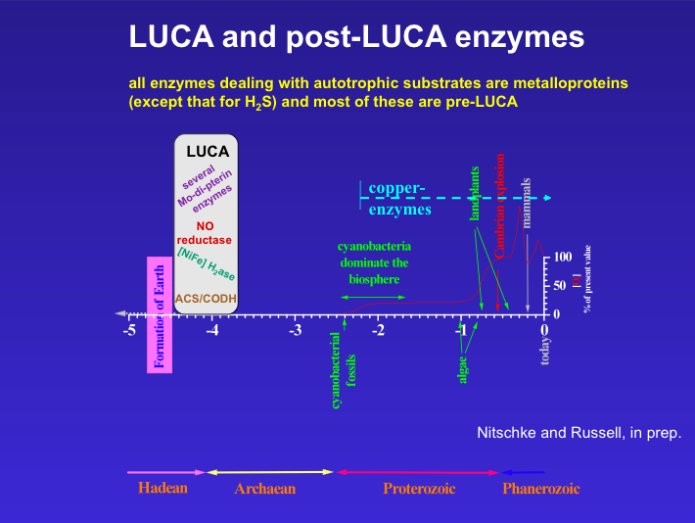

Slide 41
Amino acid synthesis
by reductive amination of α-keto acids with FeS/Fe(OH)₂
60
% yield
Tyr (17h@75°C)
Huber and Wächtershäuser
2003 Tetra Lett. 44, 1695
pK_{b(ammonium)} = 9.25
also Bishop et al. 1997
Morrowitz et al. 1995
OLEB 27, 319/25, 395
but @ low pH
Ala
(20h@50°C)
50
%
40
%
Phe
(17h @75°C)
30
%
20
%
Glu (72h@50°C)
10
8
9
10
pH

Slide 42
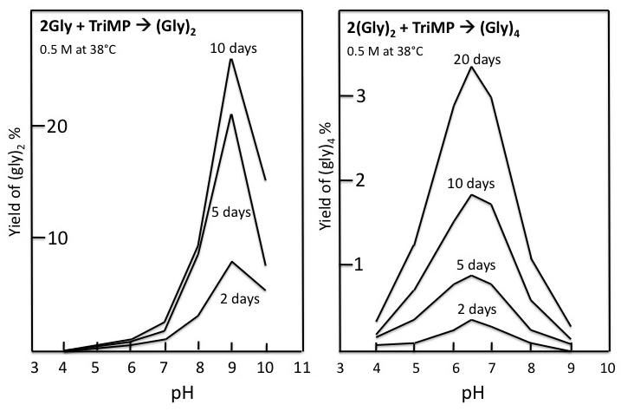
Condensation of oligoglycines with trimetaphosphate
2 Gly + TriMP → (Gly)₂
0.5 M at 38°C
2 (Gly)₂ + TriMP → (Gly)₄
0.5 M at 38°C
3
20
Yield of (gly)₄ %
Yield of (gly)₂ %
2
10
4
5
6
7
8
9
10
4 5 6 7 8 9 10
pH
Yamanaka et al. 1988
OLEB 18, 165
pH

Slide 43
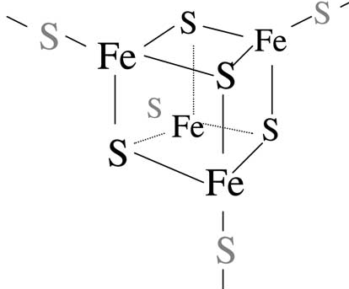
The beginning of the peptide takeover?
Fe₃S₄ “egg” bound to RLRLR nest (cf. a ferredoxin)
S
Fe
S
S
NH
NH
S
Amino acid
O
NH
NH
O
O
O
O
Milner-White & Russell 2008 Biology Direct, 3, 3

Slide 44
Phosphate (PO₄³⁻) “egg” in an LRLR peptide nest
O
O
H
P
N
HN
O
O
Peptide nest
O
O
O
(cf. the P-loop GXXXXGKX )
Milner-White & Russell 2008 Biology Direct, 3, 3

Slide 45
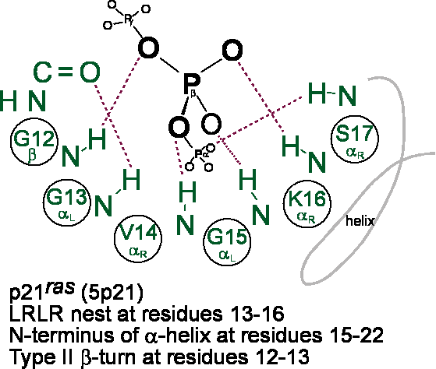

Slide 46
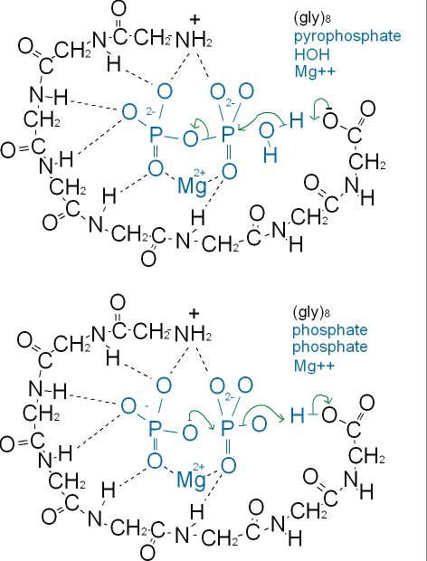
How short peptides may catalyze phosphoryl transfer
cf. H⁺-pyrophosphatase
MgP₂O₇²⁻ + RCOO⁻ → MgPO₄⁻ + RCOOPO₃²⁻
Carboxyl group acts as base
H⁺ + MgPO₄⁻ +HPO₄²⁻ → MgP₂O₇²⁻ + H₂O
Carboxyl group acts as acid
Sequence in the peptidyl transferase site
of the ribosome
PNVRGVAMNAVDHPFGGG
Milner-White, Russell, J. Cosmol. 10
http://journalofcosmology.com/Abiogenesis100.html

Slide 48
Reaction generates H₂ & CO₂
Reaction generates formate?
Other reductions are downhill
Andrews et al. 1997 Microbiol, 143, 3633
Nitschke & Russell, JME, 69, 481,

Slide 49
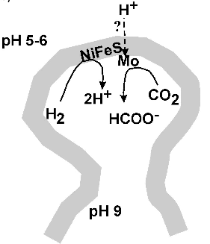
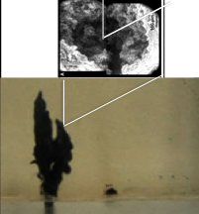
The Rocky Roots of the Acetyl-Coenzyme-A Pathway
The hatchery of life
NO/HNO₃
S₀
← H⁺ gives protonmotive force
& pyrophosphate??
[H⁺ + 2HPO₄²⁻ → HP₂O₇³⁻ + H₂O]
Ocean
Crust
MoS₃²⁻ WS₃²⁻
Russell & Martin 2004 TIBS 29, 358-363, Nitschke & Russell, JME, 69, 481-496

Slide 50
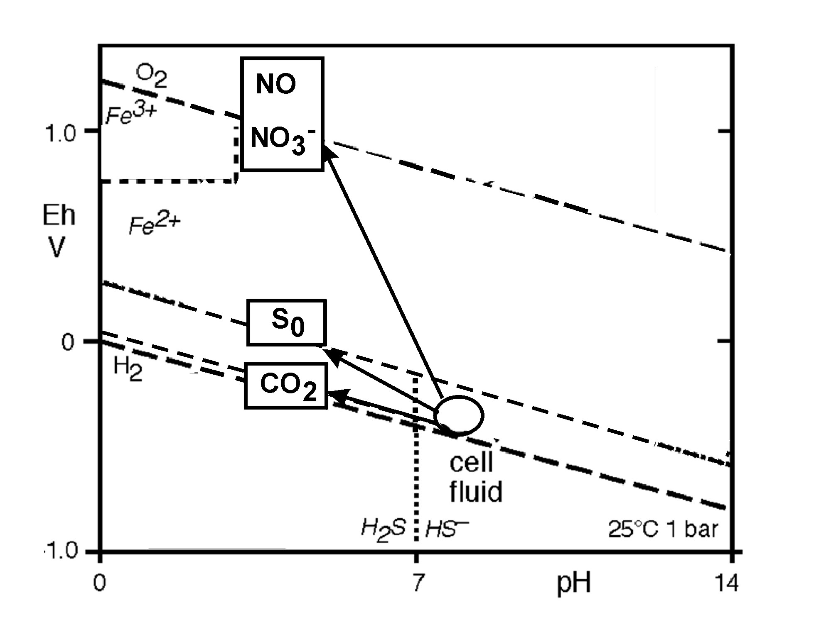
Provision of energy (and H₂) through respiration:
via a Mo cofactor one electron is transfer to high potential electron acceptor leaving the other high energy electron to reduce CO₂ to COO⁻ and the hydride generates HCOO⁻
Mo^{IV} ⇒ Mo^{V} ⇒ Mo^{VI}
Fe^{III}
Ducluzeau et al. 2009, TiBS, 34, 9
Nitschke & Russell, JME, 69, 481

Slide 51
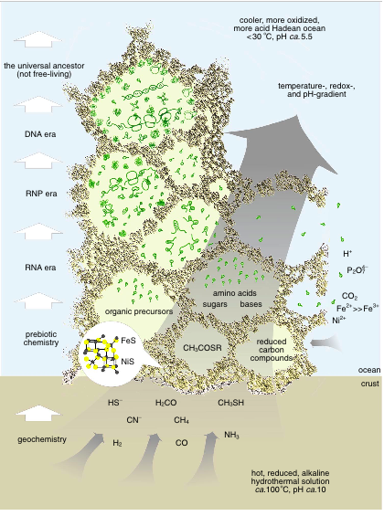
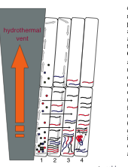
An RNA-reactor for
the emergence of life
Koonin, 2007, PNAS, 104, 9105
Martin, Russell, 2003, Trans R Soc London
B362, 1887
Baaske et al. PNAS, 104, 9346

Slide 52
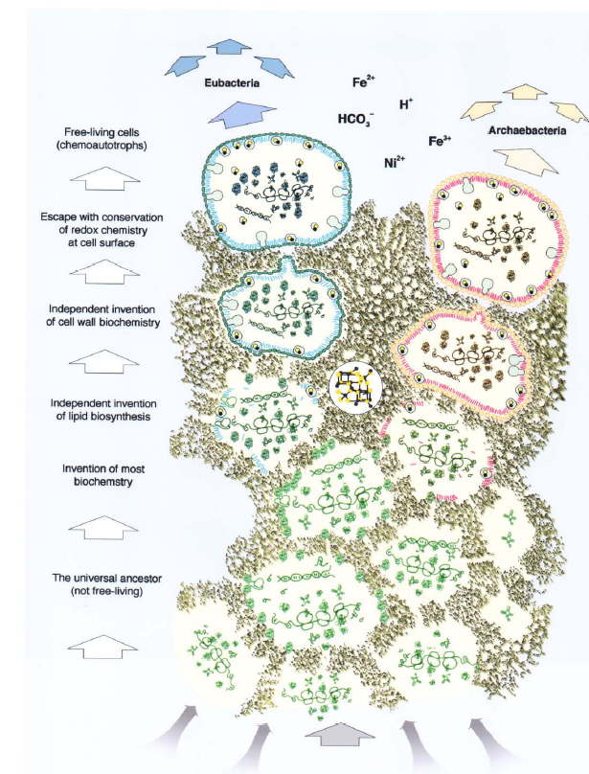
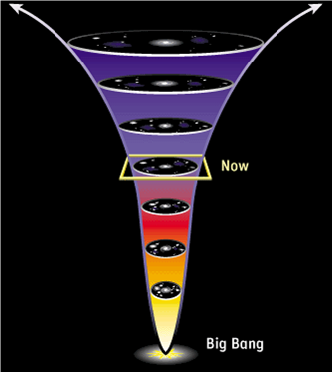
EMERGENCE OF DISSIPATIVE STRUCTURES
COSMOS
BIOS
bacteria
archaea
Sean Carroll, 2010
From Eternity to Here
Martin & Russell,
2003, Trans R Soc
Nitschke & Russell, 2010
J. Cosmol, 10, 3200
Koonin, 2007,
Biology Direct
Biochemistry
Proton-motive force
~~~~~discontinuity~~~~~
Geochemistry
~50°C
~80°C
Pre-Big Bang Universe

Slide 53
CO₂ hydrogenation mechanisms quicken, complexify & tend to take over with time
Serpentinization (redox and heat) → CH₄
------------------------------------life emerges----------------------------------
2. Bacterial acetogenesis (H₂, pmf, ATP) → CH₃COO⁻
3. Archae-methanogenesis (H₂, pmf, Co-B, Co-M)→ much CH₄
4. Archaeal then bacterial sulfate reduction → H₂S + CH₃COO⁻
5. Bacterial oxygenic photosynthesis (photons) → O₂

Slide 54
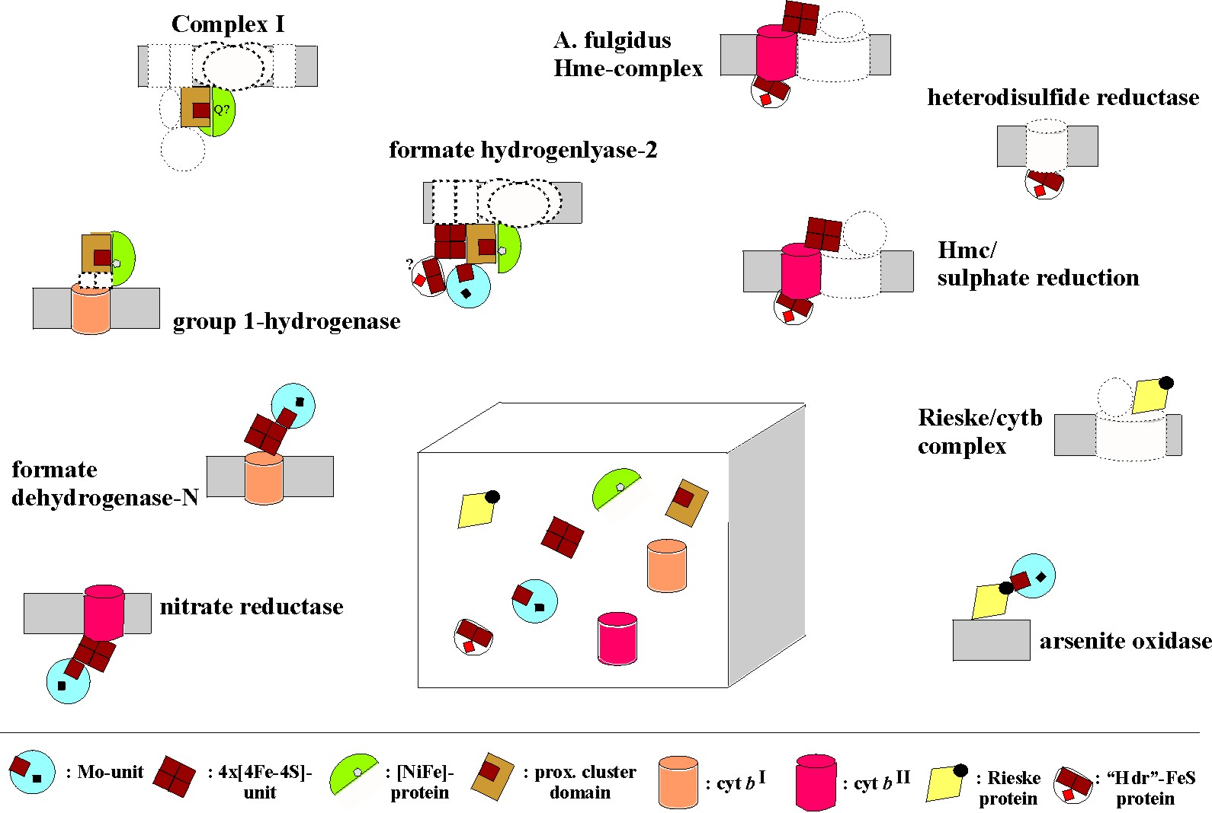
“The redox protein construction kit”
Baymann et al. (2003) Phil.Trans. R. Soc. B 358, 267-274

Slide 55
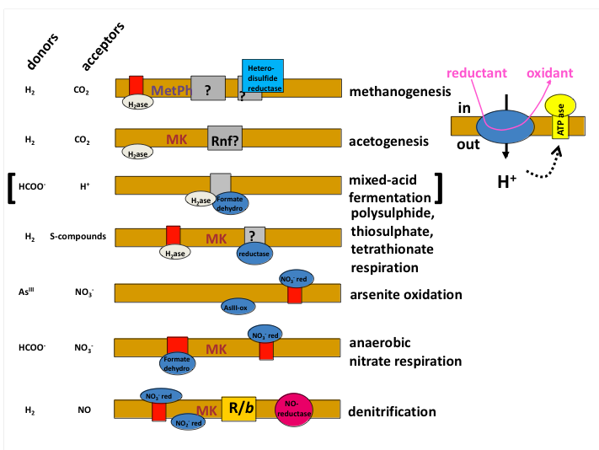

Slide 56
“The redox protein construction kit”
Baymann et al. (2003) Phil.Trans. R. Soc. B 358, 267-274

Slide 57
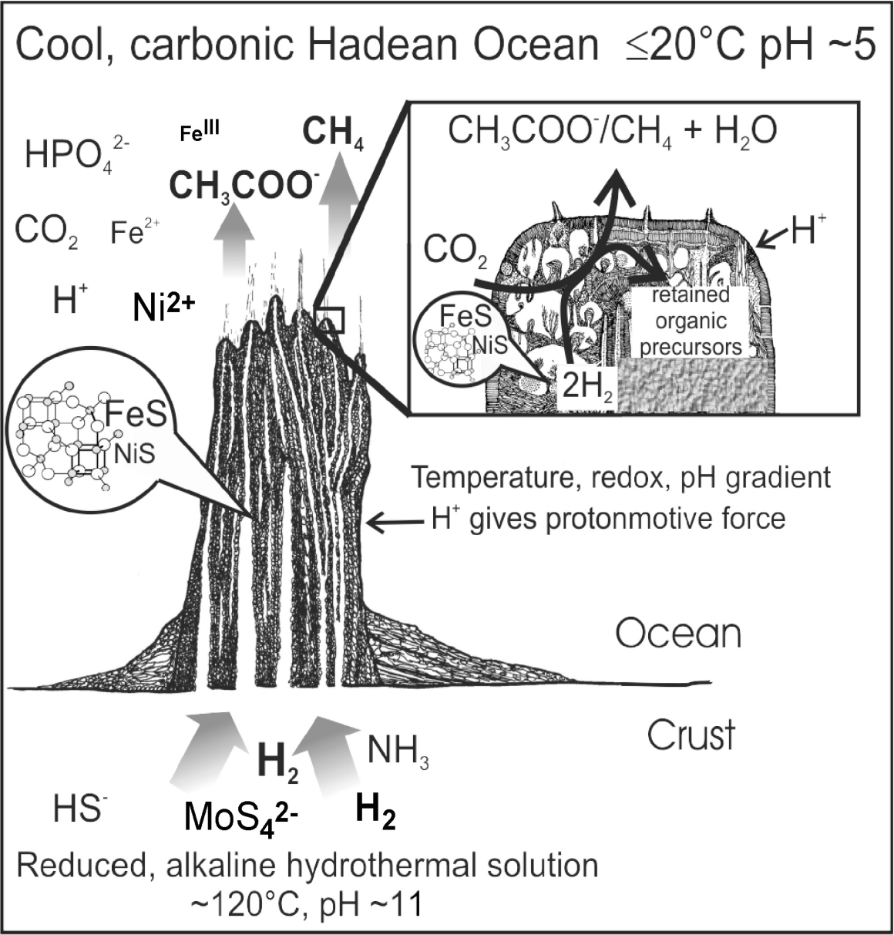
NO/HNO₃
S₀
donors
Hetero-
disulfide
reductase
H₂
CO₂
MetPh
?
?
methanogenesis
H₂ase
H₂
CO₂
MK
Rnf?
acetogenesis
[
H₂ase
]
HCOO⁻
H⁺
mixed-acid
fermentation
H₂ase
Formate
dehydro
polysulphide,
thiosulphate,
tetrathionate
respiration
H₂
S-compounds
MK
?
← H⁺gives protonmotive force
& pyrophosphate??
[H⁺+ 2HPO₄²⁻→ HP₂O₇³⁻ + H₂O]
H₂ase
reductase
As^{III}
NO₃⁻
NO₃⁻ red
arsenite oxidation
Ocean
AsIII-ox
HCOO⁻
NO₃⁻
MK
NO₃⁻ red
anaerobic
nitrate respiration
Formate
dehydro
H₂
NO
NO₃⁻ red
MK
R/b
NO-
reductase
denitrification
Crust
NO₂⁻ red
MoS₄²⁻ WS₄²⁻
The energy metabolism pathways predicted by molecular phylogeny
to be ancient correspond mostly to those of the alkaline vent model

Slide 58
Did small catalysts replicate?
R is nicotinamide nucleotide or a congener
N is its complement.
Yarus, M. 2010, in RNA world IV, T. Cech, R. Gesteland, J. Atkinset, eds. CSH Lab
Notes:
Templating gets you control..

Slide 59
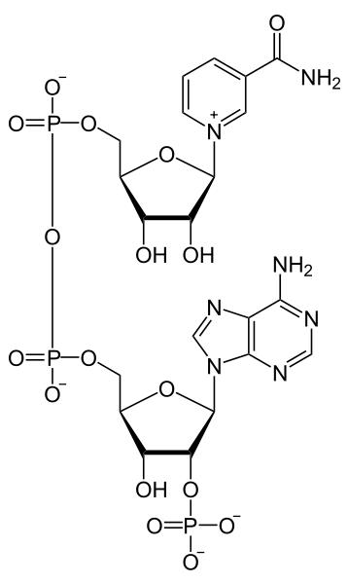
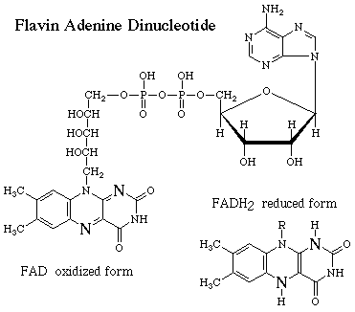
Possible base pairing with cofactors
⇐ Pairs with A or U
Pairs with U ⇒
A
⇐ Pairs with U
“U”
⇐ Pairs with A
FAD NADP
Notes:
There is only one successful replication chemistry’’’ (Benner); because these are small replication is now very simple.

Slide 60

Polymerase chain reaction by convection
and thermophoretic accumulation
GLASS COVER SLIP
SILICONE
IR
accumulation of DNA ↑
Braun et al., 2003, Physical Review Letters 91, 158103.

Slide 61
also
α-FeO(OH)
catalyzes
CO + OH⁻
→ HCOO ⁻
(Elsner et al. 2004 Env Sci Tech 38 2058-2066)

Slide 62

Baaske et al. PNAS, 104, 9346

Slide 63


Thermophoretic concentration
of polymers
Baaske et al. PNAS, 104, 9346

Slide 64
Reductive acetyl-coenzyme-A pathway to acetate (credit: Georg Fuchs)
H₄folate + pmf
6 [H] + ATP
Mo-directed→
CO₂
[CH₃ ]
Co(FeS)P
2 H₂O
ACS
CH₃CO~SCoA
2 [H]
CoA(SH)
Ni(FeS)-directed→
CO₂
[ CO]
H₂O
CODH
Fuchs, G. (1989). in Autotrophic Bacteria,
Schlegel & Bowien, p. 365, WI, Science Tech.

Slide 65
Reductive acetyl-coenzyme-A pathway to acetate (credit: Georg Fuchs)
H₄folate + pmf
6 [H] + ATP
Mo-directed→
CO₂
[CH₃ ]
Co(FeS)P
2 H₂O
ACS
CH₃CO~SCoA
2 [H]
CoA(SH)
Ni(FeS)-directed→
CO₂
[ CO]
H₂O
CODH
Fuchs, G. (1989). in Autotrophic Bacteria,
Schlegel & Bowien, p. 365, WI, Science Tech.
Cellular carbon

Slide 66
Reductive acetyl-co-A pathway to acetate
CH₃COO⁻ acetate waste
ATP energy
ADP
CH₃COOPO₃²⁻
H₄folate
6 [H] + ATP
HOPO₃²⁻
⁻SCoA
Mo-directed→
CO₂
[CH₃ ]
Co(FeS)P
2 H₂O
ACS
CH₃CO~SCoA
2 [H]
CoA(SH)
Ni(FeS)-directed→
CO₂
[ CO]
H₂O
CODH
+ ATP from pmf
Fuchs, G. (1989). in Autotrophic Bacteria,
Schlegel & Bowien, p. 365, WI, Science Tech.
Gaidos et al. (2009) The ISME Journal 3, 486
Cellular carbon

Slide 67
Early (hot) reductive acetyl-co-A pathway to methane
H⁺ + H₄MPT
6 [H]
W-directed→
CO₂
[CH₃ ]
2 H₂O
ACS
CH₃CO~SCoA
2 [H]
CoA(SH)
Ni(FeS)-directed→
CO₂
[ CO]
H₂O
CODH
Fuchs, G. 1989, in Autotrophic Bacteria,
Schlegel & Bowien, WI, Science Tech.
Cellular carbon

Slide 68
Early (hot) reductive acetyl-co-A pathway to methane
waste
CH₄
Ni^{II}
2H⁺ + 2ē
ADP + P_{i}
CoMSSCoB
CoMS•SCoB
Θ
ATP
energy
for cell
H⁺
H⁺
Ni^{I}
Ni^{III}-CH₃
2H⁺/
2Na⁺
H⁺ + H₄MPT
HSCoM
HSCoB
6 [H]
H⁺
W-directed→
CO₂
[CH₃ ]
Co^{III}-CH₃
CH₃~SCoM
2 H₂O
ACS
CH₃CO~SCoA
2 [H]
CoA(SH)
Ni(FeS)-directed→
CO₂
[ CO]
CODH
Co^{I}
H₂O
Grabarse et al. 2001, J Mol Biol 309, 315 &
Fuchs, G. 1989, in Autotrophic Bacteria 365
Cellular carbon

