Slide 1
keV sterile neutrino Dark Matter as alternative to the TeV scale
Alexander Merle
Royal Institute of Technology (KTH)
Theoretical Particle Physics (Prof. T. Ohlsson)
Stockholm, Sweden
Based on: JCAP 1101: 034, 2011 (Lindner, AM, Niro)
JCAP 1107: 023, 2011 (AM & Niro)
“TeV Particle Astrophysics 2011“
05 August 2011

Slide 2
keV sterile neutrino Dark Matter as alternative to the TeV scale
nTEV
Alexander Merle
Royal Institute of Technology (KTH)
Theoretical Particle Physics (Prof. T. Ohlsson)
Stockholm, Sweden
Based on: JCAP 1101: 034, 2011 (Lindner, AM, Niro)
JCAP 1107: 023, 2011 (AM & Niro)
“TeV Particle Astrophysics 2011“
05 August 2011

Slide 3
keV sterile neutrino Dark Matter as alternative to the TeV scale
nTEV
Alexander Merle
Royal Institute of Technology (KTH)
Theoretical Particle Physics (Prof. T. Ohlsson)
Stockholm, Sweden
Thanks to J. Bergström & P. Scott for pointing that out to me!!!
Based on: JCAP 1101: 034, 2011 (Lindner, AM, Niro)
JCAP 1107: 023, 2011 (AM & Niro)
“TeV Particle Astrophysics 2011“
05 August 2011

Slide 4
Don‘t forget to say: THANK YOU!!!

Slide 5
Don‘t forget to say: THANK YOU!!!
I am sooo grateful to my collaborators:

Slide 6
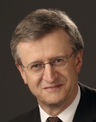
Don‘t forget to say: THANK YOU!!!
I am sooo grateful to my collaborators:
Manfred Lindner
Viviana Niro

Slide 7
Contents:
Warm DM vs. Cold DM
A Randall-Sundrum Model
Soft breaking of L_{e}-L_{μ}-L_{τ} symmetry
A Model based on Froggatt-Nielsen
Conclusions

Slide 8
1. Introduction

Slide 9
1. Introduction
Cold Dark Matter (CDM) is not the only DM:

Slide 10
1. Introduction
Cold Dark Matter (CDM) is not the only DM:
Hot Dark Matter (HDM) with mass below 1 keV is excluded by structure formation

Slide 11
1. Introduction
Cold Dark Matter (CDM) is not the only DM:
Hot Dark Matter (HDM) with mass below 1 keV is excluded by structure formation
HOWEVER: Warm Dark Matter (WDM) with mass of several keV is okay with computer simulations
Bode, Ostriker, Turok: Astrophys. J. 556 (2001) 93

Slide 12
1. Introduction
Cold Dark Matter (CDM) is not the only DM:
Hot Dark Matter (HDM) with mass below 1 keV is excluded by structure formation
HOWEVER: Warm Dark Matter (WDM) with mass of several keV is okay with computer simulations
also model-independent data analyses point into the WDM direction
Bode, Ostriker, Turok: Astrophys. J. 556 (2001) 93
De Vega, Sanchez: Mon. Not. Roy. Asron. Soc. 404 (2010) 885
Papastergis et al.: 1106.0710 [astro-ph.CO]

Slide 13
1. Introduction
Candidate motivated by particle physics: sterile neutrino with mass of a few keV

Slide 14
1. Introduction
Candidate motivated by particle physics: sterile neutrino with mass of a few keV
right-handed (=SM-singlet) neutrinos most probably needed anyway for neutrino masses

Slide 15
1. Introduction
Candidate motivated by particle physics: sterile neutrino with mass of a few keV
right-handed (=SM-singlet) neutrinos most probably needed anyway for neutrino masses
right-handed scale is not really fixed (e.g. not connected to EWSB) ➔ could easily be at keV

Slide 16
1. Introduction
Candidate motivated by particle physics: sterile neutrino with mass of a few keV
right-handed (=SM-singlet) neutrinos most probably needed anyway for neutrino masses
right-handed scale is not really fixed (e.g. not connected to EWSB) ➔ could easily be at keV
interesting connections to low energy neutrino experiments and to neutrino model building

Slide 17
1. Introduction
Candidate motivated by particle physics: sterile neutrino with mass of a few keV
right-handed (=SM-singlet) neutrinos most probably needed anyway for neutrino masses
right-handed scale is not really fixed (e.g. not connected to EWSB) ➔ could easily be at keV
interesting connections to low energy neutrino experiments and to neutrino model building
To be investigated here!

Slide 18
1. Introduction
Production mechanisms:

Slide 19
1. Introduction
Production mechanisms:
Non-thermal production (νMSM):
Asaka, Blanchet, Shaposhnikov: Phys. Lett. B631 (2005) 151
Asaka, Laine, Shaposhnikov: JHEP 0701 (2007) 091

Slide 20
1. Introduction
Production mechanisms:
Non-thermal production (νMSM):
Primordial abundance/inflaton decay:
Asaka, Blanchet, Shaposhnikov: Phys. Lett. B631 (2005) 151
Asaka, Laine, Shaposhnikov: JHEP 0701 (2007) 091
Anisimov, Bartocci, Bezrukov: Phys. Lett. B671 (2009) 211
Bezrukov, Gorbunov: JHEP 1005 (2010) 010

Slide 21
1. Introduction
Production mechanisms:
Non-thermal production (νMSM):
Primordial abundance/inflaton decay:
thermal overproduction & entropy dilution:
Asaka, Blanchet, Shaposhnikov: Phys. Lett. B631 (2005) 151
Asaka, Laine, Shaposhnikov: JHEP 0701 (2007) 091
Anisimov, Bartocci, Bezrukov: Phys. Lett. B671 (2009) 211
Bezrukov, Gorbunov: JHEP 1005 (2010) 010
Bezrukov, Hettmansperger, Lindner: Phys. Rev. D81 (2010) 085032

Slide 22
1. Introduction
BE CAREFUL WITH TERMINOLOGY:

Slide 23
1. Introduction
BE CAREFUL WITH TERMINOLOGY:
SCENARIO
MODEL

Slide 24
1. Introduction
BE CAREFUL WITH TERMINOLOGY:
Provides a framework that includes keV sterile neutrinos
SCENARIO
examples: νMSM, gauge extensions,...
➔ provide all features needed for phenomenological calculations
MODEL

Slide 25
1. Introduction
BE CAREFUL WITH TERMINOLOGY:
Provides a framework that includes keV sterile neutrinos
SCENARIO
examples: νMSM, gauge extensions,...
➔ provide all features needed for phenomenological calculations
Explains the appearance and the mass pattern of keV ν‘s
MODEL
examples: to be discussed here ➔ provide an “explanation“ for what is measured

Slide 26
2. A Randall-Sundrum Model

Slide 27
2. A Randall-Sundrum Model
first strong model for keV sterile ν DM: “Dark Matter from Split Seesaw“ (Kusenko, Takahashi, Yanagida: Phys. Lett. B693 (2010) 144)

Slide 28
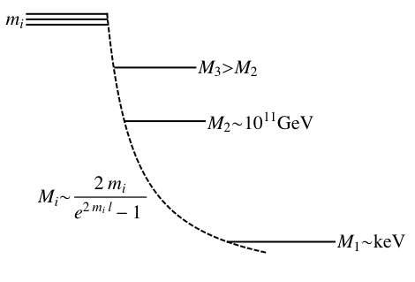
2. A Randall-Sundrum Model
first strong model for keV sterile ν DM: “Dark Matter from Split Seesaw“ (Kusenko, Takahashi, Yanagida: Phys. Lett. B693 (2010) 144)

Slide 29
2. A Randall-Sundrum Model
first strong model for keV sterile ν DM: “Dark Matter from Split Seesaw“ (Kusenko, Takahashi, Yanagida: Phys. Lett. B693 (2010) 144)
idea: use the splitting between SM brane and hidden brane
heavy neutrinos on hidden brane, only exponentially suppressed effect on SM brane
explains M₁~keV << M₂~10¹¹ GeV < M₃

Slide 30
2. A Randall-Sundrum Model
first strong model for keV sterile ν DM: “Dark Matter from Split Seesaw“ (Kusenko, Takahashi, Yanagida: Phys. Lett. B693 (2010) 144)
idea: use the splitting between SM brane and hidden brane
heavy neutrinos on hidden brane, only exponentially suppressed effect on SM brane
explains M₁~keV << M₂~10¹¹ GeV < M₃

Slide 31
2. A Randall-Sundrum Model
first strong model for keV sterile ν DM: “Dark Matter from Split Seesaw“ (Kusenko, Takahashi, Yanagida: Phys. Lett. B693 (2010) 144)
idea: use the splitting between SM brane and hidden brane
heavy neutrinos on hidden brane, only exponentially suppressed effect on SM brane
explains M₁~keV << M₂~10¹¹ GeV < M₃

Slide 32
2. A Randall-Sundrum Model
result:

Slide 33
2. A Randall-Sundrum Model
result:

Slide 34
2. A Randall-Sundrum Model
result:
4D RH-mass

Slide 35
2. A Randall-Sundrum Model
result:
v_{B-L} determines the natural size of the N_{R} mass
4D RH-mass

Slide 36
2. A Randall-Sundrum Model
result:
exponential suppression due to bulk profile
v_{B-L} determines the natural size of the N_{R} mass
4D RH-mass

Slide 37
2. A Randall-Sundrum Model
result:
exponential suppression due to bulk profile
v_{B-L} determines the natural size of the N_{R} mass
4D RH-mass
➔ Extreme splitting between N_{R}-masses!!! ✔

Slide 38
2. A Randall-Sundrum Model
result:
exponential suppression due to bulk profile
v_{B-L} determines the natural size of the N_{R} mass
4D RH-mass
➔ Extreme splitting between N_{R}-masses!!! ✔
light neutrinos:

Slide 39
2. A Randall-Sundrum Model
result:
exponential suppression due to bulk profile
v_{B-L} determines the natural size of the N_{R} mass
4D RH-mass
➔ Extreme splitting between N_{R}-masses!!! ✔
light neutrinos:
seesaw works: (e^{2ml}-1)-terms cancel between λ² and M_{R}

Slide 40
3. Soft breaking of L_{e}-L_{μ}-L_{τ} symmetry

Slide 41
3. Soft breaking of L_{e}-L_{μ}-L_{τ} symmetry
first model explaining keV sterile ν DM with L_{e}-L_{μ}-L_{τ} symmetry: Lindner, AM, Niro; JCAP 1101: 034, 2011

Slide 42
3. Soft breaking of L_{e}-L_{μ}-L_{τ} symmetry
first model explaining keV sterile ν DM with L_{e}-L_{μ}-L_{τ} symmetry: Lindner, AM, Niro; JCAP 1101: 034, 2011
Grimus & Lavoura [JHEP 0009: 007, 2000]: L_{e}-L_{μ}-L_{τ} for 3 light & 2 heavy neutrinos ➔ already shows the desired spectrum for light neutrinos

Slide 43
3. Soft breaking of L_{e}-L_{μ}-L_{τ} symmetry
first model explaining keV sterile ν DM with L_{e}-L_{μ}-L_{τ} symmetry: Lindner, AM, Niro; JCAP 1101: 034, 2011
Grimus & Lavoura [JHEP 0009: 007, 2000]: L_{e}-L_{μ}-L_{τ} for 3 light & 2 heavy neutrinos ➔ already shows the desired spectrum for light neutrinos
Our model: application of the same symmetry to the heavy sector ➔ generates just the splitting that is desired

Slide 44
3. Soft breaking of L_{e}-L_{μ}-L_{τ} symmetry
first model explaining keV sterile ν DM with L_{e}-L_{μ}-L_{τ} symmetry: Lindner, AM, Niro; JCAP 1101: 034, 2011
Grimus & Lavoura [JHEP 0009: 007, 2000]: L_{e}-L_{μ}-L_{τ} for 3 light & 2 heavy neutrinos ➔ already shows the desired spectrum for light neutrinos
Our model: application of the same symmetry to the heavy sector ➔ generates just the splitting that is desired
F=L_{e}-L_{μ}-L_{τ}: global U(1)-symmetry, f_{k} transforms as e^{iΦ} f_{k} with Φ=const.

Slide 45
3. Soft breaking of L_{e}-L_{μ}-L_{τ} symmetry
first model explaining keV sterile ν DM with L_{e}-L_{μ}-L_{τ} symmetry: Lindner, AM, Niro; JCAP 1101: 034, 2011
Grimus & Lavoura [JHEP 0009: 007, 2000]: L_{e}-L_{μ}-L_{τ} for 3 light & 2 heavy neutrinos ➔ already shows the desired spectrum for light neutrinos
Our model: application of the same symmetry to the heavy sector ➔ generates just the splitting that is desired
F=L_{e}-L_{μ}-L_{τ}: global U(1)-symmetry, f_{k} transforms as e^{iΦ} f_{k} with Φ=const.
➔ only symmetry-preserving combinations of fields are allowed!

Slide 46
3. Soft breaking of L_{e}-L_{μ}-L_{τ} symmetry
total Majorana mass term:

Slide 47
3. Soft breaking of L_{e}-L_{μ}-L_{τ} symmetry
total Majorana mass term:

Slide 48
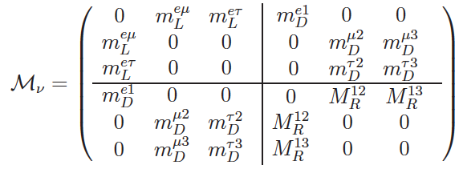
3. Soft breaking of L_{e}-L_{μ}-L_{τ} symmetry
total Majorana mass term:
➔ mass matrix:

Slide 49
3. Soft breaking of L_{e}-L_{μ}-L_{τ} symmetry
total Majorana mass term:
➔ mass matrix:

Slide 50
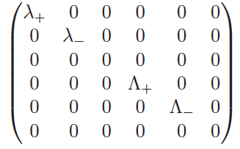
3. Soft breaking of L_{e}-L_{μ}-L_{τ} symmetry
eigenvalues of M_{ν}:

Slide 51
3. Soft breaking of L_{e}-L_{μ}-L_{τ} symmetry
eigenvalues of M_{ν}:

Slide 52
3. Soft breaking of L_{e}-L_{μ}-L_{τ} symmetry
eigenvalues of M_{ν}:
➔ light neutrino spectrum: (0,m,m) ➔ nearly okay (degeneracy...)

Slide 53
3. Soft breaking of L_{e}-L_{μ}-L_{τ} symmetry
eigenvalues of M_{ν}:
➔ light neutrino spectrum: (0,m,m) ➔ nearly okay (degeneracy...)
➔ heavy neutrino spectrum: (0,M,M) ➔ N₁ massless instead of keV

Slide 54
3. Soft breaking of L_{e}-L_{μ}-L_{τ} symmetry
eigenvalues of M_{ν}:
➔ light neutrino spectrum: (0,m,m) ➔ nearly okay (degeneracy...)
➔ heavy neutrino spectrum: (0,M,M) ➔ N₁ massless instead of keV
HOWEVER: flavour symmetries must always be broken for phenomenological reasons ➔ this will lift the massless states and destroy the degeneracy
(similar idea: Shaposhnikov, Nucl. Phys. B763 (2007) 49)

Slide 55
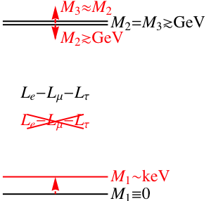
3. Soft breaking of L_{e}-L_{μ}-L_{τ} symmetry
scheme:

Slide 56
3. Soft breaking of L_{e}-L_{μ}-L_{τ} symmetry
scheme:
IDEA: since the symmetry is not phenomenologically valid, it must be broken ➔ “soft breaking terms“ (no Λ²-divergences) that must be SMALLER than the symmetry-preserving terms

Slide 57
3. Soft breaking of L_{e}-L_{μ}-L_{τ} symmetry
scheme:
IDEA: since the symmetry is not phenomenologically valid, it must be broken ➔ “soft breaking terms“ (no Λ²-divergences) that must be SMALLER than the symmetry-preserving terms

Slide 58
3. Soft breaking of L_{e}-L_{μ}-L_{τ} symmetry
scheme:
IDEA: since the symmetry is not phenomenologically valid, it must be broken ➔ “soft breaking terms“ (no Λ²-divergences) that must be SMALLER than the symmetry-preserving terms
EFFECT: these terms will give the previously massless state N₁ a small mass, and the will also lift the degeneracy between N₂ & N₃ ➔ just what was desired!

Slide 59
3. Soft breaking of L_{e}-L_{μ}-L_{τ} symmetry
problem: one can choose the soft-breaking terms more or less arbitrarily, but any choice will only have a small effect

Slide 60
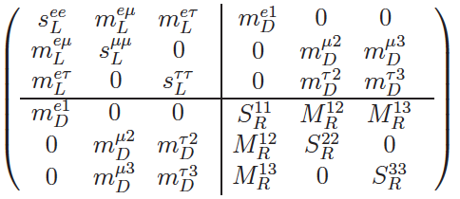
3. Soft breaking of L_{e}-L_{μ}-L_{τ} symmetry
problem: one can choose the soft-breaking terms more or less arbitrarily, but any choice will only have a small effect
➔ example:

Slide 61
3. Soft breaking of L_{e}-L_{μ}-L_{τ} symmetry
problem: one can choose the soft-breaking terms more or less arbitrarily, but any choice will only have a small effect
➔ example:
➔ eigenvalues:

Slide 62
3. Soft breaking of L_{e}-L_{μ}-L_{τ} symmetry
problem: one can choose the soft-breaking terms more or less arbitrarily, but any choice will only have a small effect
➔ example:
s << m_{L}-m_{D}²/M_{R} & S << M_{R}
keV neutrino
➔ eigenvalues:

Slide 63
4. A Froggatt-Nielsen Model

Slide 64
4. A Froggatt-Nielsen Model
Froggatt-Nielsen mechanism to explain the spectrum: AM & Niro, JCAP 1107: 023, 2011

Slide 65
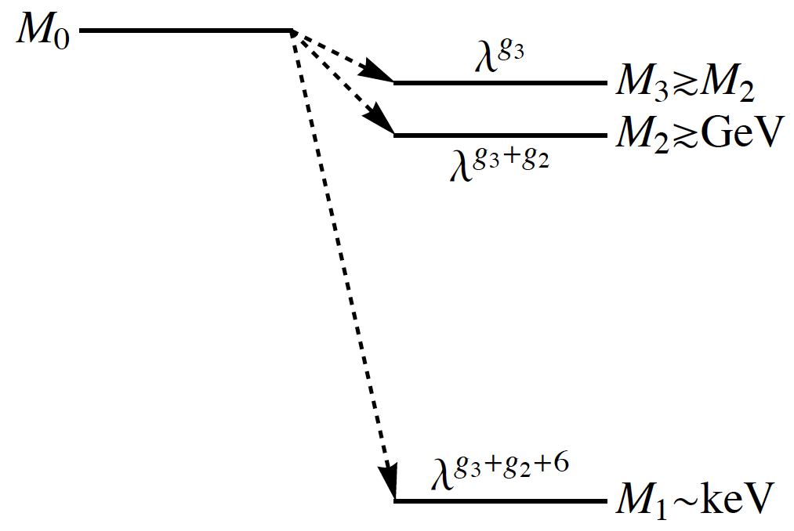
4. A Froggatt-Nielsen Model
Froggatt-Nielsen mechanism to explain the spectrum: AM & Niro, JCAP 1107: 023, 2011
IDEA:
we can use the Froggatt-Nielsen mechanism to suppress a higher mass scale
leads naturally to a split mass spectrum

Slide 66
4. A Froggatt-Nielsen Model
Froggatt-Nielsen mechanism to explain the spectrum: AM & Niro, JCAP 1107: 023, 2011
IDEA:
we can use the Froggatt-Nielsen mechanism to suppress a higher mass scale
leads naturally to a split mass spectrum

Slide 67
4. A Froggatt-Nielsen Model
Froggatt-Nielsen mechanism to explain the spectrum: AM & Niro, JCAP 1107: 023, 2011
IDEA:
we can use the Froggatt-Nielsen mechanism to suppress a higher mass scale
leads naturally to a split mass spectrum

Slide 68
4. A Froggatt-Nielsen Model
Froggatt-Nielsen mechanism to explain the spectrum: AM & Niro, JCAP 1107: 023, 2011
IDEA:
we can use the Froggatt-Nielsen mechanism to suppress a higher mass scale
leads naturally to a split mass spectrum
keV neutrino

Slide 69
4. A Froggatt-Nielsen Model
Froggatt & Nielsen: Nucl. Phys. B147, 277 (1979)

Slide 70
4. A Froggatt-Nielsen Model
Froggatt & Nielsen: Nucl. Phys. B147, 277 (1979)
idea: the different generations are differently charged under a new U(1)_{FN} symmetry
in addition, there is a high energy sector of fermions and scalars; the latter develop VEVs to break the symmetry
this leads to multiple seesaw-like diagrams:

Slide 71
4. A Froggatt-Nielsen Model
Froggatt & Nielsen: Nucl. Phys. B147, 277 (1979)
idea: the different generations are differently charged under a new U(1)_{FN} symmetry
in addition, there is a high energy sector of fermions and scalars; the latter develop VEVs to break the symmetry
this leads to multiple seesaw-like diagrams:

Slide 72
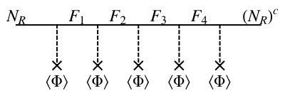
4. A Froggatt-Nielsen Model
Froggatt & Nielsen: Nucl. Phys. B147, 277 (1979)
idea: the different generations are differently charged under a new U(1)_{FN} symmetry
in addition, there is a high energy sector of fermions and scalars; the latter develop VEVs to break the symmetry
this leads to multiple seesaw-like diagrams:

Slide 73
4. A Froggatt-Nielsen Model
Froggatt & Nielsen: Nucl. Phys. B147, 277 (1979)
idea: the different generations are differently charged under a new U(1)_{FN} symmetry
in addition, there is a high energy sector of fermions and scalars; the latter develop VEVs to break the symmetry
this leads to multiple seesaw-like diagrams:
integrating out the heavy fermions leads to:
m~M λ^{f+g}, where λ=<Θ>/Λ

Slide 74
4. A Froggatt-Nielsen Model
Froggatt & Nielsen: Nucl. Phys. B147, 277 (1979)
idea: the different generations are differently charged under a new U(1)_{FN} symmetry
in addition, there is a high energy sector of fermions and scalars; the latter develop VEVs to break the symmetry
this leads to multiple seesaw-like diagrams:
integrating out the heavy fermions leads to:
m~M λ^{f+g}, where λ=<Θ>/Λ
suppression!!!

Slide 75
4. A Froggatt-Nielsen Model
crucial point: the FN-charges of the RH-neutrinos drop out in the seesaw formula, like any global U(1)

Slide 76
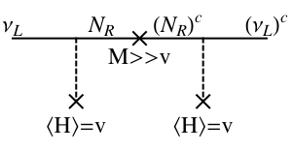
4. A Froggatt-Nielsen Model
crucial point: the FN-charges of the RH-neutrinos drop out in the seesaw formula, like any global U(1)

Slide 77
4. A Froggatt-Nielsen Model
crucial point: the FN-charges of the RH-neutrinos drop out in the seesaw formula, like any global U(1)
e^{-ig}

Slide 78
4. A Froggatt-Nielsen Model
crucial point: the FN-charges of the RH-neutrinos drop out in the seesaw formula, like any global U(1)
e^{ig}
e^{-ig}

Slide 79
4. A Froggatt-Nielsen Model
crucial point: the FN-charges of the RH-neutrinos drop out in the seesaw formula, like any global U(1)
e^{ig}
e^{-ig}
seesaw mechanism guaranteed to work (no keV problem)!

Slide 80
4. A Froggatt-Nielsen Model
crucial point: the FN-charges of the RH-neutrinos drop out in the seesaw formula, like any global U(1)
e^{ig}
e^{-ig}
seesaw mechanism guaranteed to work (no keV problem)!
light neutrino mass matrix only depends on the charges of ν_{L}

Slide 81
4. A Froggatt-Nielsen Model
Froggatt-Nielsen charge assignment is not as arbitrary as it may look, when combined with other requirements (in the context of keV neutrinos!):

Slide 82
4. A Froggatt-Nielsen Model
Froggatt-Nielsen charge assignment is not as arbitrary as it may look, when combined with other requirements (in the context of keV neutrinos!):
needs two FN-fields to combine predictivity and CP

Slide 83
4. A Froggatt-Nielsen Model
Froggatt-Nielsen charge assignment is not as arbitrary as it may look, when combined with other requirements (in the context of keV neutrinos!):
needs two FN-fields to combine predictivity and CP
incompatible with left-right symmetry

Slide 84
4. A Froggatt-Nielsen Model
Froggatt-Nielsen charge assignment is not as arbitrary as it may look, when combined with other requirements (in the context of keV neutrinos!):
needs two FN-fields to combine predictivity and CP
incompatible with left-right symmetry
excludes bimaximal mixing from neutrino sector

Slide 85
4. A Froggatt-Nielsen Model
Froggatt-Nielsen charge assignment is not as arbitrary as it may look, when combined with other requirements (in the context of keV neutrinos!):
needs two FN-fields to combine predictivity and CP
incompatible with left-right symmetry
excludes bimaximal mixing from neutrino sector
GUTs: favors SU(5), disfavors SO(10)

Slide 86
4. A Froggatt-Nielsen Model
Froggatt-Nielsen charge assignment is not as arbitrary as it may look, when combined with other requirements (in the context of keV neutrinos!):
needs two FN-fields to combine predictivity and CP
incompatible with left-right symmetry
excludes bimaximal mixing from neutrino sector
GUTs: favors SU(5), disfavors SO(10)
disfavors democratic Yukawa couplings

Slide 87
4. A Froggatt-Nielsen Model
Froggatt-Nielsen charge assignment is not as arbitrary as it may look, when combined with other requirements (in the context of keV neutrinos!):
needs two FN-fields to combine predictivity and CP
incompatible with left-right symmetry
excludes bimaximal mixing from neutrino sector
GUTs: favors SU(5), disfavors SO(10)
disfavors democratic Yukawa couplings
nice feature: RGE-effects negligible (due to tiny y_{D})

Slide 88
5. Conclusions

Slide 89
5. Conclusions
keV sterile neutrinos are an interesting alternative to Cold Dark Matter

Slide 90
5. Conclusions
keV sterile neutrinos are an interesting alternative to Cold Dark Matter
up to now: scenarios rather than models

Slide 91
5. Conclusions
keV sterile neutrinos are an interesting alternative to Cold Dark Matter
up to now: scenarios rather than models
Randall-Sundrum model: exp-suppression

Slide 92
5. Conclusions
keV sterile neutrinos are an interesting alternative to Cold Dark Matter
up to now: scenarios rather than models
Randall-Sundrum model: exp-suppression
L_{e}-L_{μ}-L_{τ}: soft breaking makes massless N_{R} massive

Slide 93
5. Conclusions
keV sterile neutrinos are an interesting alternative to Cold Dark Matter
up to now: scenarios rather than models
Randall-Sundrum model: exp-suppression
L_{e}-L_{μ}-L_{τ}: soft breaking makes massless N_{R} massive
Froggatt-Nielsen: multiple seesaw-like diagrams

Slide 94
5. Conclusions
keV sterile neutrinos are an interesting alternative to Cold Dark Matter
up to now: scenarios rather than models
Randall-Sundrum model: exp-suppression
L_{e}-L_{μ}-L_{τ}: soft breaking makes massless N_{R} massive
Froggatt-Nielsen: multiple seesaw-like diagrams
all models: deep connections between Dark Matter and light neutrino sector

Slide 95
5. Conclusions
keV sterile neutrinos are an interesting alternative to Cold Dark Matter
up to now: scenarios rather than models
Randall-Sundrum model: exp-suppression
L_{e}-L_{μ}-L_{τ}: soft breaking makes massless N_{R} massive
Froggatt-Nielsen: multiple seesaw-like diagrams
all models: deep connections between Dark Matter and light neutrino sector
➔ We can look forward to more interesting ideas!!!

Slide 96
THANK YOU!!!

