Slide 1
New Parallel Programming Languages for HPC
Iris Christadler, Leibniz Supercomputing Centre, Germany
August 2011, PDC/KTH Summer School

Slide 2
Outline
The free lunch is over Multicore CPUs are ubiquitous
Hardware accelerators New languages enter the HPC world
The quest for a parallel language Examples of emerging languages
Reality Check 2D Stencil Computation

Slide 3
The free lunch is over
“But if you want your application to benefit from the continued exponential throughput advances in new processors, it will need to be a well-written concurrent application. And that’s easier said than done, because not all problems are inherently parallelizable and because concurrent programming is hard.”
The Free Lunch Is Over A Fundamental Turn Toward Concurrency in Software By Herb Sutter [http://www.gotw.ca/publications/concurrency-ddj.htm]

Slide 4
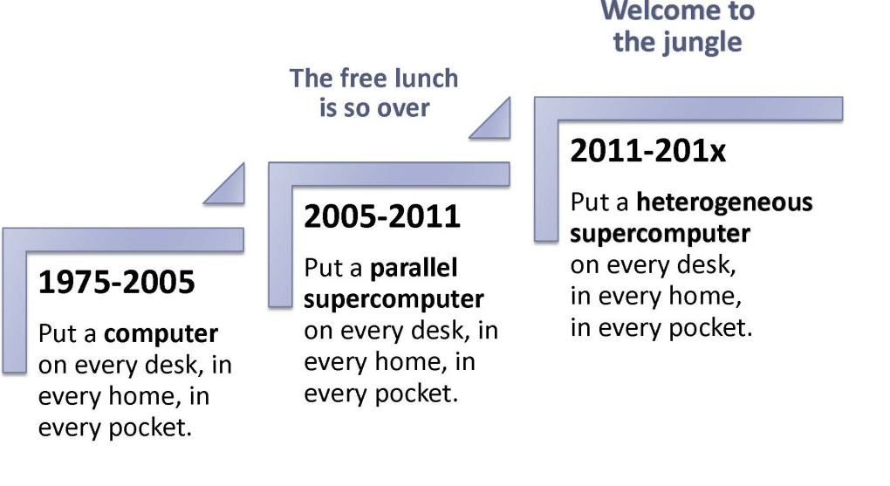
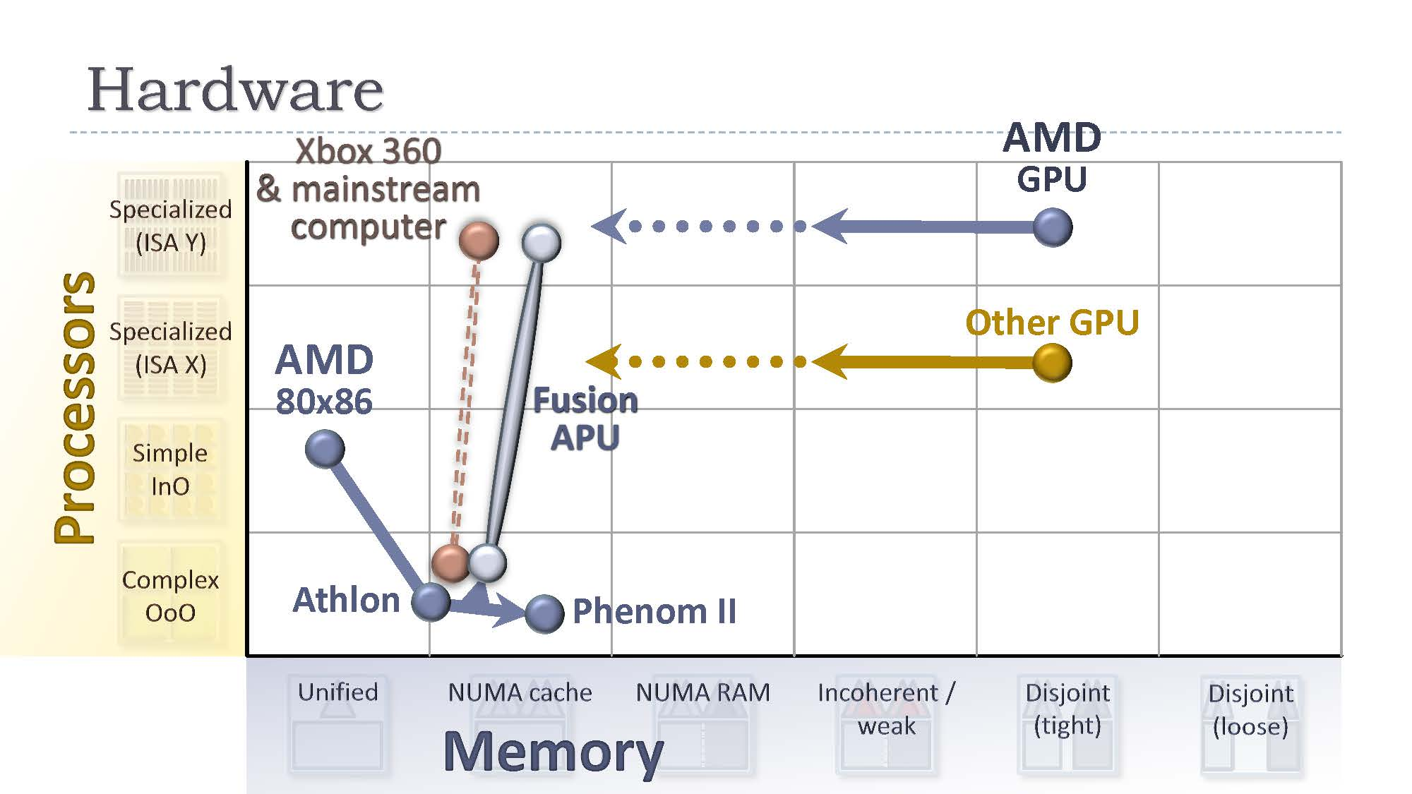
Herb Sutter in 2011
Heterogeneous Parallelism at Microsoft By Herb Sutter [http://developer.amd.com/afds/assets/keynotes/4-Sutter_Microsoft-FINAL.pdf]

Slide 5
top500.org
# | Site (Country) | Computer (CPU/GPU) | Vendor | Cores | Rmax
1 | RIKEN (Japan) | “K computer“ (SPARC64 VIIIfx 2.0GHz) | Fujitsu | >500k | 8.16 PFs
2 | Tianjin (China) | “Tianhe-1A” (Intel X5670 2.93Ghz 6C, Nvidia GPU) | NUDT | ~180k | 2.57 PFs
3 | Oak Ridge NL (US) | “Jaguar” (Opteron 6C 2.6 GHz) | Cray | ~220k | 1.76 PFs
4 | NSCS (China) | “Nebulae” (Intel X5650, Nvidia Tesla C2050) | Dawning | ~120k | 1.27 PFs
5 | Tokyo Institute of Technology (Japan) | “TSUBAME 2.0” (G7 Xeon 6C X5670, Nvidia GPU) | NEC/HP | ~73k | 1.19 PFs
Images: www.top500.org
Notes:
Are the BlueGenes special purpose machines?
The machines are getting bigger and bigger… how many cores, MTBF, are the codes scaling
Job sizes at the LRZ machine
Capacity vs. capability computing
Scheduling modules in Europe compared to the U.S.

Slide 6
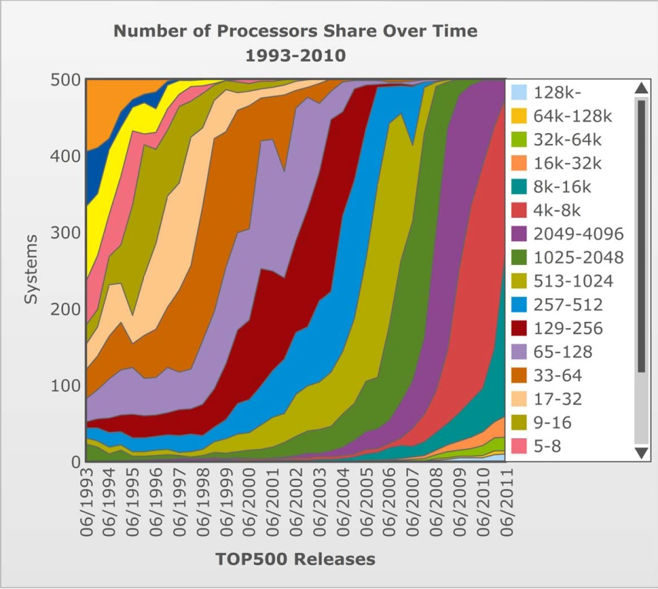
top500.org
June 2011
Images: www.top500.org
Notes:
Are the BlueGenes special purpose machines?
The machines are getting bigger and bigger… how many cores, MTBF, are the codes scaling
Job sizes at the LRZ machine
Capacity vs. capability computing
Scheduling modules in Europe compared to the U.S.

Slide 7
My favorite “Dongarra” slides
[http://www.netlib.org/utk/people/JackDongarra/SLIDES/dongarra-isc2004.pdf]
[http://www.netlib.org/utk/people/JackDongarra/SLIDES/sc09-exascale-panel.pdf]
Notes:
Manfred’s Comment: From an HPC point of view, isn't it the complexity (1000s of cores) which requires new programming models in the first place? I agree however fully with the fact that RC is becoming more viable with new models. But I believe RC is having kind of a free ride on HPCs scaling problems :-) .
One slide further he mentions UPC and CAF as alternatives

Slide 8
Hardware Accelerators
New languages enter the HPC world

Slide 9
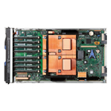
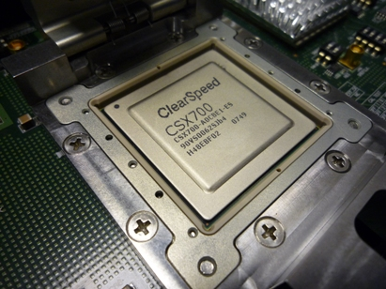
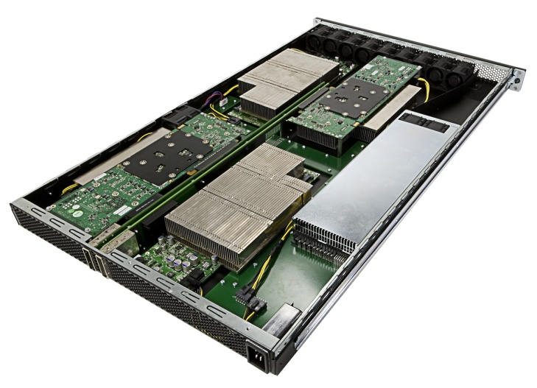
PRACE-PP Prototypes (2008/9)
PowerXCell8i (8 SPUs)
205 GF sp
102 GF dp
ClearSpeed CSX700
96 GF dp
CATS 700 (12 CSX700)
1.152 TF dp
QS22 blade (16 SPUs)
410 GF sp
205 GF dp
C1060 GPU
~1 TF sp
78 GF dp
2.53GHz Nehalem-EP
20 GF sp
10 GF dp
8 N-EP cores
162 GF sp
81 GF dp
S1070 “Tesla”
~4 TF sp
312 GF dp
Notes:
Clearspeed: The CSX700 processor consists of two processing arrays, with 96 processing elements in each array. The processing elements each contain a 32/64-bit floating point Multiplier, a 32/64-bit floating point Adder, 6 Kbytes of SRAM, an Integer ALU and a 16-bit integer MAC.[7] It currently sells its CSX700 processor on a PCI express add-in card with 2GB of RAM, named the Advance e710.

Slide 10
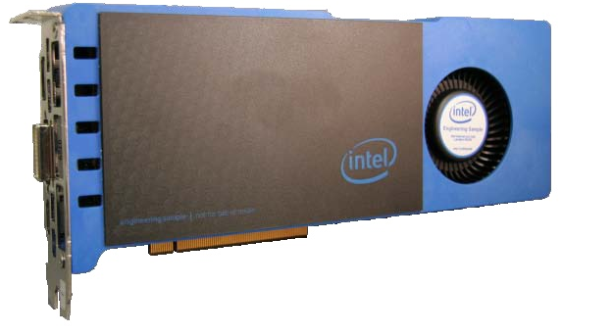
PRACE-PP ext. (2010)
Intel MIC architecture
“Knights Ferry”
32 cores @ 1.2 GHz
4 threads/core
8 MB shared coherent cache
1-2 GB GDDR5
http://download.intel.com/pressroom/ archive/reference/ISC_2010_Skaugen_keynote.pdf
“Knights corner”
1st MIC product
22nm process
>50 cores
2.53GHz Nehalem-EP
20 GF sp
10 GF dp
C2070 GPU
1.0 TF sp
0.5 TF dp
S2070 “Fermi”
4 TF sp
2 TF dp
8 N-EP cores
162 GF sp
81 GF dp
Notes:
Knights Ferry: The Intel® MIC architecture is derived from several Intel projects, including "Larrabee" and such Intel Labs research projects as the Single-chip Cloud Computer.

Slide 11
Pros and Cons for HWA
Pros:
HWA can help to tackle research problems (in many cases they are simply less expensive than traditional solutions)
HWA help to shrink the physical footprint of systems
HWA can help to reduce the power consumption both of the machine and the cooling system
Cons:
You need to make use of them, otherwise they simply waste energy
HWA will probably increase the error-rate
HWA are no solution for scalability problems
HWA are difficult to program (?)

Slide 12
The quest for a parallel language
Examples of emerging languages

Slide 13
Overview
CUDA
OpenCL
CAPS hmpp
PGI Comp.
C++ AMP
…
CELL
Titanium
UPC
CAF
GPUs
Fortress
Chapel
X10
PGAS
HWA
DARPA HPCS
KNF
map reduce
Super-scalar Cilk
ArBB
…
CPU
misc
Clear-speed

Slide 14
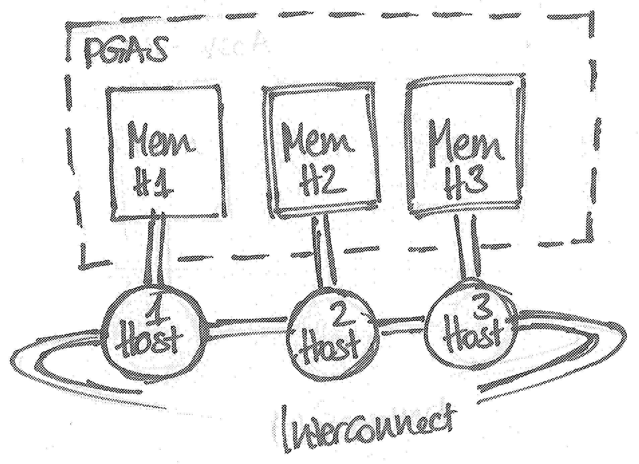
PGAS Partitioned Global Address Space language
The concept and it’s different implementations
UPC vs. CAF: some fundamental differences
Performance improvements?
Ease-of-use?
Hardware support (in the interconnect)

Slide 15
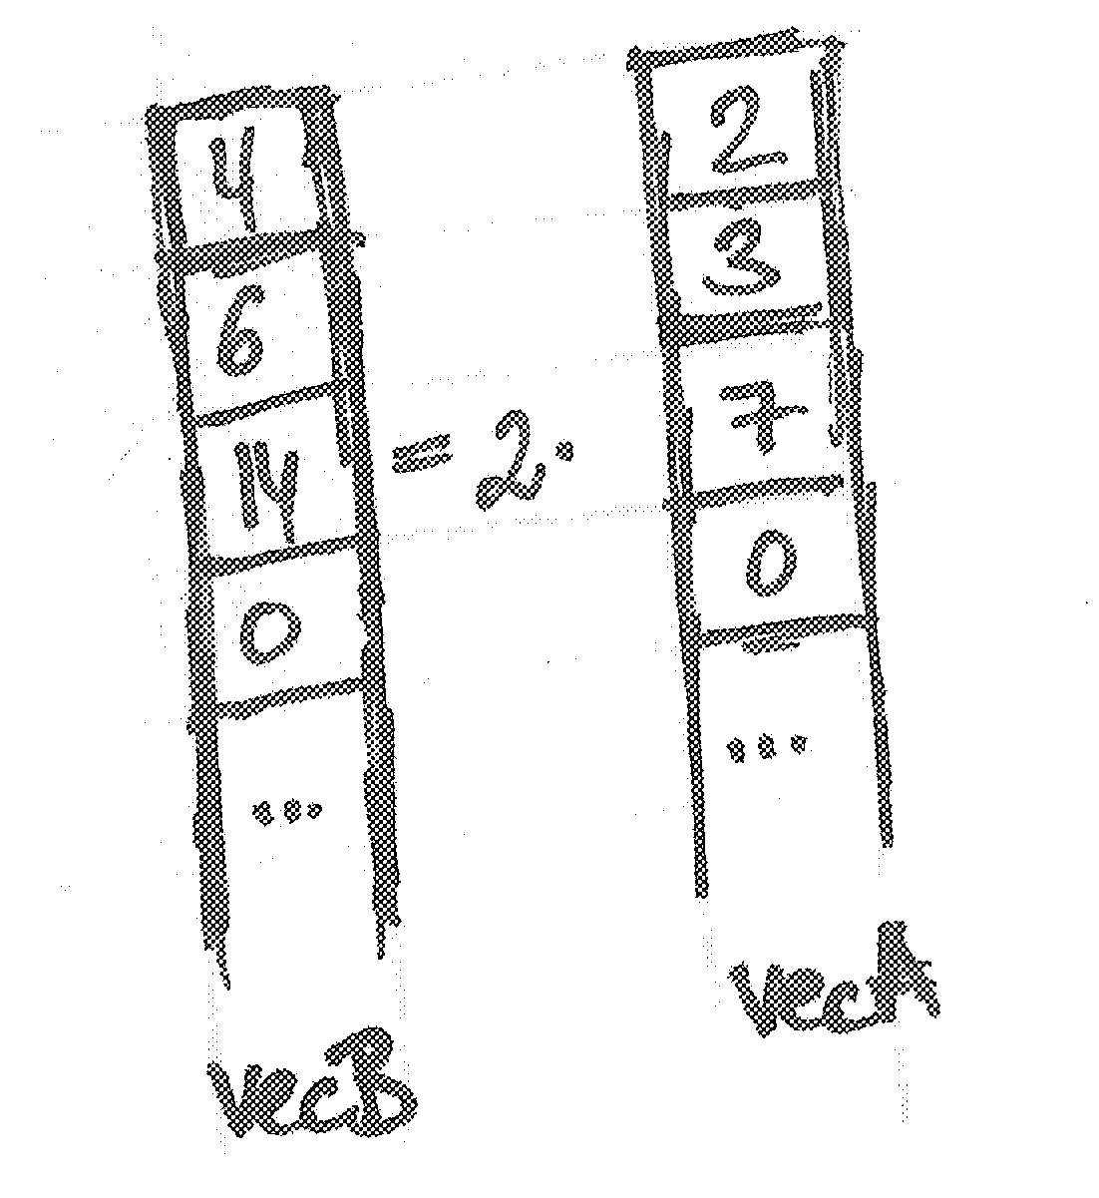
UPC Unified Parallel C – a PGAS example
# include <upc.h>
# define CHUNK (int) (N/THREADS)
shared [CHUNK] double vecA[N];
shared [CHUNK] double vecB[N];
...
int main () {
...
if (MYTHREAD == 0) {
printf(“Main thread\n");
}
...
upc_barrier;
upc_forall (j=0; j<N; j++; &vecA[j]) {
vecB[j] = 2*vecA[j];
}
upc_barrier;
...
}

Slide 16
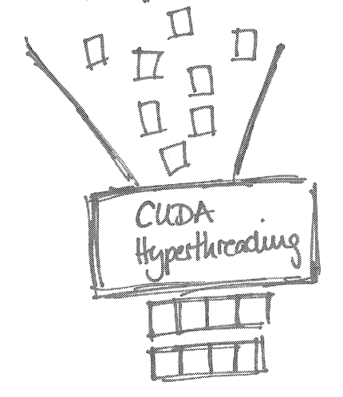
CUDA The Compute Unified Device Architecture for Nvidia GPUs
host code:
// allocate memory on gpu
cudaMalloc (ptr, size);
cudaMemcpy (dst, src, size, dir:host2dev);
// launch kernel
kernel<<<gridSize, blockSize>>> (funcParams);
// copy results back
cudaMemcpy (...,...,..., dir:dev2host);
cudaFree;
device code:
__global__ void kernel(float* vecA, float* vecB, int height, int width){
unsigned int x = blockIdx.x*blockDim.x + threadIdx.x;
unsigned int y = blockIdx.y*blockDim.y + threadIdx.y;
if (x < width && y < height) {
vecB[y*width+x] = 2*vecA[y*width+x];
}
}
GPGPU programming de-facto standard
Small lightweight kernels
Parallelization through hyper-threading
Hiding cache misses and latency through threading

Slide 17
CAPS hmpp GPGPU programming using simple directives
#pragma hmpp kernel codelet, target=CUDA,
args[vecA, height, width].io= in, args[vecB].io=inout
void kernel (float *vecA, float *vecB, int height, int width)
for (x= 0; x<width; x++)
for (y= 0; y<height; y++)
vecB[y*widht+x]= 2*vecA[y*width+x];
}
int main() {
...
#pragma hmpp kernel allocate
...
#pragma hmpp kernel advancedload, args[vecA,vecB,...]
...
#pragma hmpp kernel callsite &
#pragma hmpp kernel args[...].advancedload=true
kernel (&vecA, &vecB, height, width);
...
#pragma hmpp kernel release
}
What is CAPS hmpp?
Similar to the PGI acc. compiler approach
Similarities with OpenMP
Possibilities & Limitations

Slide 18
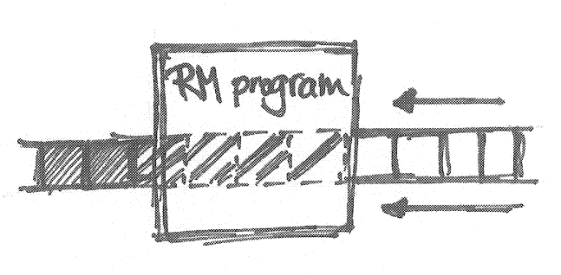
RapidMind An outdated language
#include <rapidmind/platform.hpp>
using namespace RapidMind;
int main () {
...
// declaration
Array<2, Value4f> vecA;
Array<2, Value4f> vecB;
...
Program kernel= BEGIN {
// program definition
In<Value4f> a;
Out<Value4f> b;
b= 2*a;
} END;
...
// program call
vecB = kernel(vecA);
...
}
„Array computing“/ “data stream computing”
RapidMind offered backends for: Cell, Cuda, GLSL, x86
RapidMind team now working on Intel ArBB (see next slide)

Slide 19
ArBB The successor of Rapidmind
#include <arbb.hpp>
using namespace arbb;
void nVec (dense<f64> a, dense<f64>& b) {
b= 2*a;
}
int main () {
std::vector<double> a_orig(size_t …);
...
// declaration & binding if necessary
dense<f64> a, b;
bind(a, &a_orig[0], a_orig.size());
...
// program call
call (nVec)(a, b);
...
}
Is a “generalized vector parallel programming solution“ for multicore and many-core architectures
Combines Intel Ct and RapidMind technology
Supports many different coding styles

Slide 20
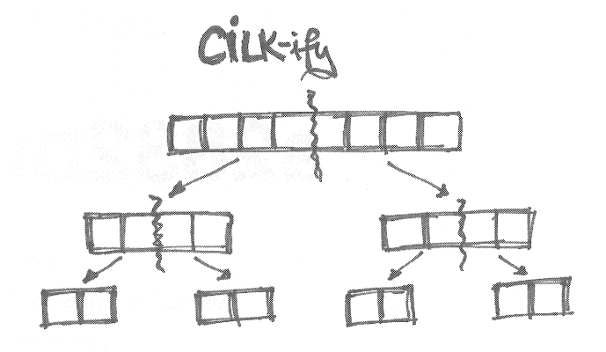
Cilk Automatic parallelization through recursive procedures
cilk double kernel(float *vecA, float *vecB, int i0, int i1){
if ((i1-i0) == 1) {
vecB[i0]= 2*vecA[i0];
return;
}
else {
int im= (i0+i1) / 2;
float vecL, vecR;
vecL= spawn kernel(&vecA, &vecB, i0, im);
vecR= spawn kernel(&vecA, &vecB, im, i1);
sync;
return;
}
}
Cilk int main() {
...
spawn kernel(...);
sync;
...
}
Automatic parallelization and load balancing (!) through recursion
Divide-and-conquer style programming
Needs an adaptation of many algorithms

Slide 21
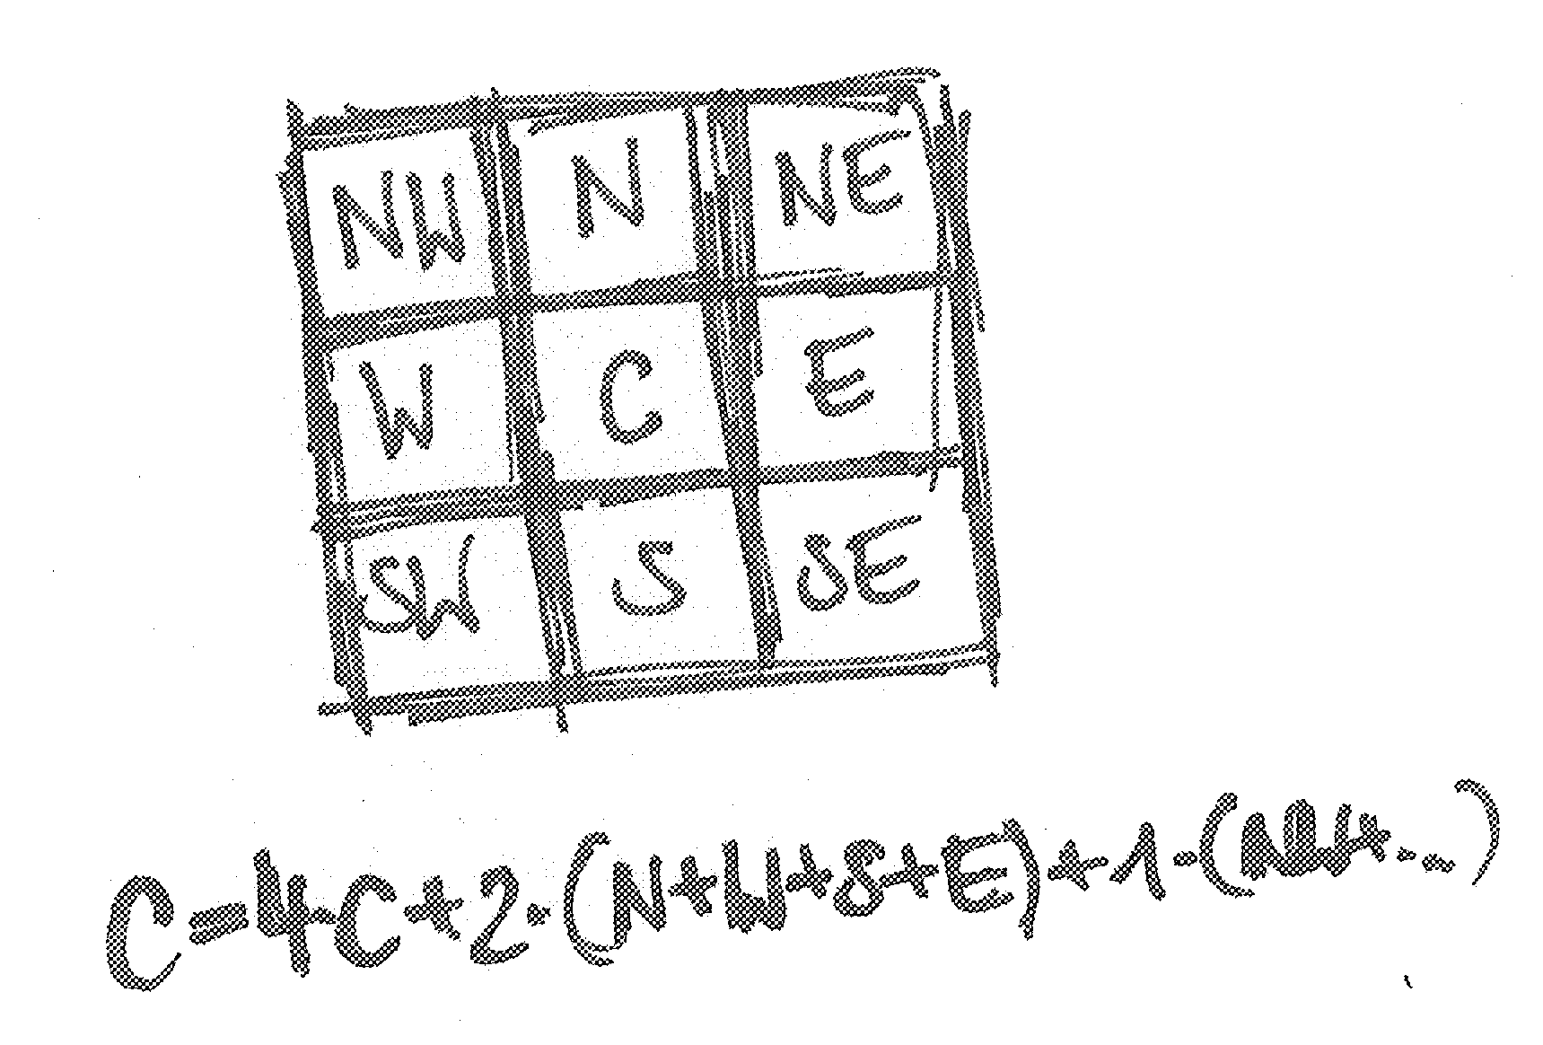
REALITY Check
2D Stencil Computation

Slide 22
Wrap-Up
There is a need for a new parallel paradigm (in HPC & the rest of the IT-world)
Hardware accelerators have shown that HPC-folks are willing to use new languages if the performance gain is large enough
Languages & paradigms:
UPC
CUDA
CAPS hmpp
ArBB
Cilk
For more information please have a look at the PRACE Deliverables D6.6 and D8.3.2 (www.prace-project.eu)

Slide 23
Thank you for your attention!
Contact details: Iris Christadler (christadler@lrz.de), LRZ, Germany

