Slide 1
WP2 – Dissemination and Training
Mihai Duta, OeRC

Slide 2
WP2 Overview
Objectives:
disseminate widely the results of the ScalaLife project, maximising the impact on future LS activities and developments;
provide effective training to promote the scalable software developed the project.
Task | Description | Coordinator
T2.1 | Analysis of Needs and Detailed Planning | Anne Trefethen (OeRC)
T2.2 | Web Presence | Helmut Satzger (LRZ)
T2.3 | Outreach | Lilit Axner (KTH)
T2.4 | Training | Mihai Duta (OeRC)
T2.5 | WP Management | Mihai Duta (OeRC)

Slide 3
WP2 Deliverables
 | Deliverable | Due
D2.1 | Dissemination Plan | 6
D2.2 | Training Plan | 12
D2.3 | Dissemination Report and Updated Plan | 18
D2.4 | Training Material | 18
D2.5 | Training Report and Updated Plan | 24
D2.6 | Training Material Updated | 24
D2.7 | Final Report | 36

Slide 4
Dissemination
Dissemination ensures good visibility of the project at international level and distribute the results of the project widely and efficiently within the European LS community.
The project results to disseminate are:
competitive speed and scalability demonstrated by the project pilot codebases (Gromacs and Dalton) on small-to-medium systems;
libraries and APIs to facilitate the easy exploitation of acceleration hardware (e.g. GPGPUs) or of low-level message-passing communication to reduce the MPI latency;
new standards for LS data storage and exchange;
the creation of the Competence Center, which will provide an expert service for the LS community and be the main vehicle for knowledge transfer.

Slide 5
Dissemination
The initial Dissemination Plan (D2.1) was submitted at the end of the 1st half year of the project
discusses the dissemination vehicles
sets performance targets
The plan is reviewed by the following Dissemination Report and Updated Plan, due in a year.
Dissemination vehicles:
the creation of a Web Portal
the organisation of International Events
the issue of regular Newsletters
the distribution of Outreach Material
the organisation of Training

Slide 6
Web Portal
At the moment the portal
represents the main project hub, thus enabling the collaboration between project members
acts as the central information centre for the project, announcing upcoming training events, meetings, project news, achievements, etc.
acts as the gateway to the Competence Center
In future, it will also
provide access to software tools and related training material and provides access to best-practice guides
provide general information on HPC and on existing and emerging technologies relevant to the Life sciences
support a community collaborative environment, exchange of information and expert advice

Slide 7
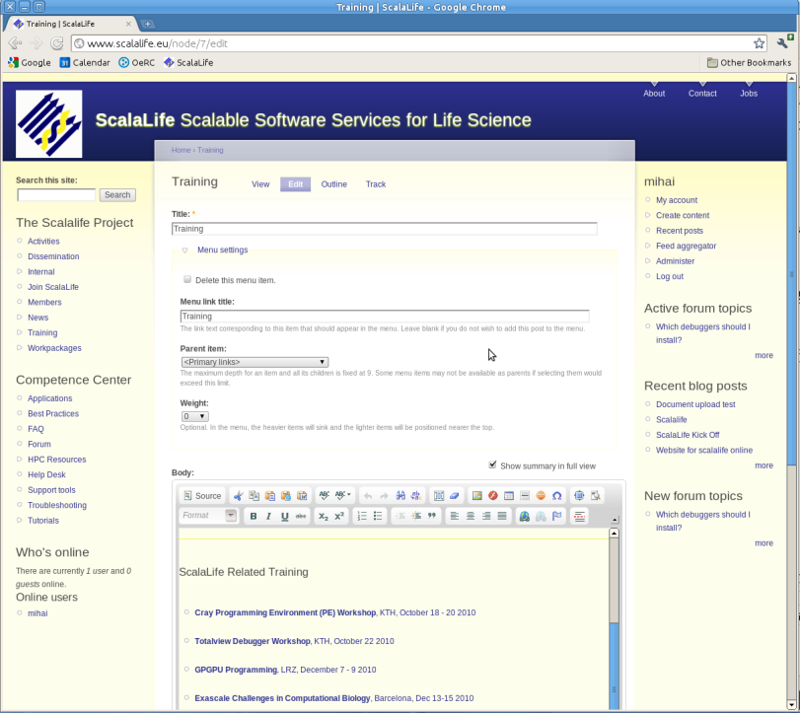
Web Portal
The initial design of the Web Portal, finalised very early in the project, already provides a lot of essential functionality.
The variation of web traffic during the 1st six months of the project.

Slide 8
International Events
ScalaLife has already been present at:
The 8th e-Infrastructure Concertation Meeting (Geneva, Nov 2010), one of the FP7 projects present
Supercomputing Conference 2010 (New Orleans, Nov 2010)
“Exascale Challenges in Computational Biology” conference (Barcelona, Dec 2010)
ScalaLife will continue to be present at future events:
Dates | Place | Event | Website | ScalaLife
11-12/04/2011 | Vilnius, Lithuania | European Grid Infrastructure User Forum 2011 | uf2011.egi.eu | Dissemination material
13-14/04/2011 | Helsinki, Finland | DEISA PRACE Symposium 2011 | www.deisa.eu | Dissemination material
01-03/06/2011 | Tsukuba, Japan | ICCS 2011 International Conference on Computational Science | www.iccs-meeting.org | Dissemination material
19-23/06/2011 | Hamburg, Germany | ISC International Supercomputing Conference 2011 | www.supercomp.de/isc11 | Booth (BSC, LRZ)
10-13/09/2011 | Vienna, Austria | The EMBO Meeting | www.the-embo-meeting.org | Poster
12-18/11/2011 | Seattle, USA | SC Supercomputing 2011 | sc11.supercomputing.org | Booth (BSC, LRZ)
21-23/11/2011 | Barcelona, Spain | ICREA Network Medicine Meeting |  | Poster + link
05-08/12/2011 | Stockholm, Sweden | 7th IEEE International Conference on e-Science | www.escience2011.org | Dissemination material

Slide 9
Collaborations
Intended collaborations:
CECAM – an application is submitted later this year (April?); if successful, this grant will be used to organise the 1st ScalaLife International Workshop
MAPPER – this is yet to be organised
Considered:
INCF neuroinformatics project (www.incf.org)
DigiGirlz project (Microsoft)
Planned and confirmed:
The Erina+ project (www.erinaplus.eu)

Slide 10
Outreach Material
Newsletter:
bi-annual, reports on the WPs and project in general
first newsletter already released at the end of Feb 2011
Outreach Material:
standard material – the basic ScalaLife informative and advertising material used at events:
brochures, project presentations, press releases, posters and flyers
branding: logos, colour schemes
non-standard:
online video presentations
Erik Lindahl “Introduction to Molecular Modelling”, Gromacs workshop, Helsinki
ScalaLife presentation, MGMS meeting, Oxford
collaborative sites

Slide 11
Dissemination Channels
main channel – the ScalaLife Web Portal
the ScalaLife information mailing list
the web sites and communities of external projects with which ScalaLife collaborates
the communities of Gromacs and Dalton users (which are planned to become integrated within the Competence Centre)
conferences at which ScalaLife participates
training events
announcement(s) on www.thedigitalscientist.org and www.hpcwire.org

Slide 12
Feedback
Feedback is crucial for the development and organisation of training and dissemination:
participants at all training events are asked to provide ratings and comments
users rate the quality of online material (tutorials, guides, video) and offer suggestions
The project has to have an acknowledgement policy, which should be adhered to by all users of its products:
standard acknowledgement text to be used in publications
users should report publications back to project, so ScalaLife can have an extra measure of the effectiveness of dissemination.

Slide 13
Performance Targets
To performance of dissemination during the next year will be assessed using the following targets:
the creation of initial online tutorials and training material;
the creation of initial best practice guides;
the creation and organisation of the help desk;
the formulation of the acknowledgement policy;
participation at all the events and conferences proposed.
Tentative timeline proposed for some key targets:
Target | Completion
Initial online tutorials and training material | 31/03/2011
Initial best practice guides | 31/03/2011
Help desk | 31/08/2011
Acknowledgement policy | 31/08/2011

Slide 14
Performance Metrics
Quantitative criteria to measure effectiveness of dissemination:
The ScalaLife grant application to CECAM is successful;
The first ScalaLife International Workshop is organised successfully as part of the CECAM grant;
The number of participants at the First ScalaLife International Workshop;
The uptake of the Competence Centre;
The number of LS software users who open user trial accounts as part of the Competence Centre;
The number of LS software users who try the online tutorials, online training material and best practice guides;
The number of LS software users who use the help desk;
The number of downloads of optimised (base-code) binaries;
The number of acknowledgements in scientific publications.

Slide 15
Training
Tightly linked to dissemination, the its role of training is twofold
general: train LS scientists to include HPC practices into their routine
specific: train LS software users and developers to use the results of the project (base codes, libraries)
Training will take place in two forms:
training events, both specific to ScalaLife and general training
online material (tutorials, best practice guides)
The Training Plan (D2.2) is due at the end of the 1st project year
Training is backed up by
user support (help desk, competence centres)
hardware provision (provided through the competence centre)
software provision (optimised binaries)

Slide 16
Training Events
ScalaLife Specific Training:
ScalaLife-related training:
Date | Institute | Event
24-26/01/2011 | LRZ | Introduction to Molecular Modelling on Supercomputers
21-23/02/2011 | KTH | PRACE Scientific Seminar
06-08/04/2011 | MGMS, OeRC | “Membrane Proteins:Structure and Function”, ScalaLife Presentation
27/02/2012-02/03/2012 | LRZ | ScalaLIfe Winter School
Date | Institute | Event
18-20/10/ 2010 | KTH | Cray Programming Environment Workshop
22/10/2010 | KTH | Totalview Debugger Workshop
07-09/12/2010 | LRZ | GPGPU Programming
13-15/12/2010 | IRB, BSC, INB | Exascale Challenges in Computational Biology
13-14/01/2011 | LRZ | Scientific 3D-Animation with Blender
09-10/06/2011 | LRZ | NWChem Training tutorial
…/07/2011 | OeRC | CUDA GPU Programming Course

Slide 17
Training
Creation of good-quality training material and best practice guides is key to the success of the Competence Centre. But ScalaLife needs to offer something on top of manuals and peer advice.
Some general aspects to cover:
understanding HPC (modern hardware, options available, etc.)
MPI processes and threads
inter-node communication
impact of accelerators
formulation of LS problem, choice of models and algorithms (Gromacs – mostly PME, Dalton – ?)
What is the best format? (Very) short user guides?

Slide 18
Training
Technical aspects to cover:
cluster execution
fat node clusters, threaded MPI
using GPGPUs
problem tuning
experimenting with scaling
load balancing: Gromacs processes for PME and PP (automatic), Dalton (?)
other parameters influencing message size
What is the best format? Detailed step-by-step examples, which users could try on hardware provided through the Competence Centre.

Slide 19
Risks and Concerns
CECAM application is not successful. Solution: the 1st International Workshop should be organised under this assumption.
Low interest in online tutorials and best-practice guides. Solution: material should be diverse and continually updated.
The production of software libraries and APIs is yet uncertain and depends on several factors.
The effort going into producing good (online) training material is large:
video tutorials should ideally be like the TotalView videos
who is going to write new material?
Online training via the Competence Centre must be backed by a minimal user support, which requires manpower.

