Slide 1
GENERAL ASPECTS OF
MESOSCOPIC TRANSPORT: II
Jonathan Bird
Electrical Engineering,
University at Buffalo,
Buffalo NY, USA

Slide 2
GENERAL ASPECTS OF
MESOSCOPIC TRANSPORT II
1-D Mesoscopic Systems … Revisited
A Ballistic Model for 1-D Conductance
1-D Conductance Quantization
Observing 1-D Conductance Quantization
Where is the Resistance?

Slide 3
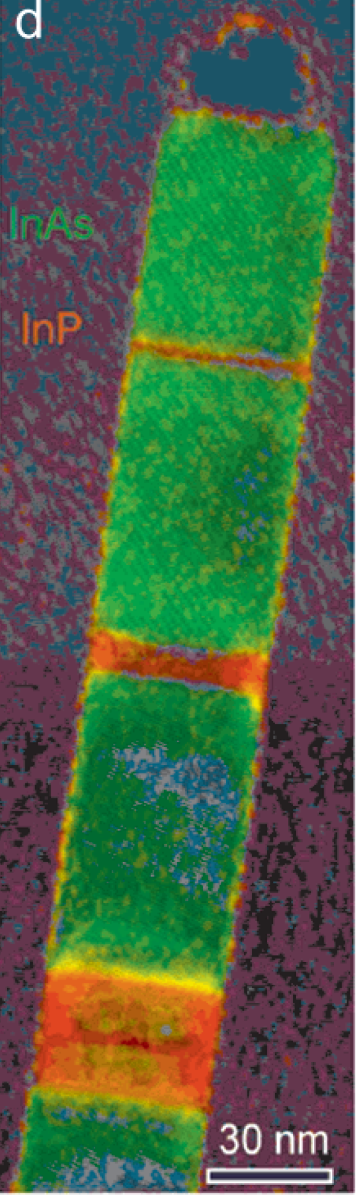
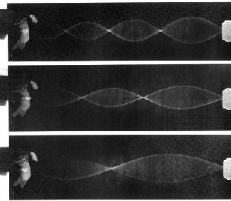
Lateral CONFINEMENT in
1-D Wires QUANTIZES Motion into SUBBANDS
ASSUME HARMONIC LATERAL CONFINEMENT
INTEGER n IS THE 1-D SUBBAND INDEX
y
2.
1.
x
3.
FREE MOTION ALONG THE LENGTH OF THE WIRE

Slide 4
FILLING 1-D Subbands
(at LOW Temperatures)
E_{n}(k_{y})
E_{F}
E₃
E₂
E₁
k_{y}
N: NUMBER OF OCCUPIED SUBBANDS

Slide 5
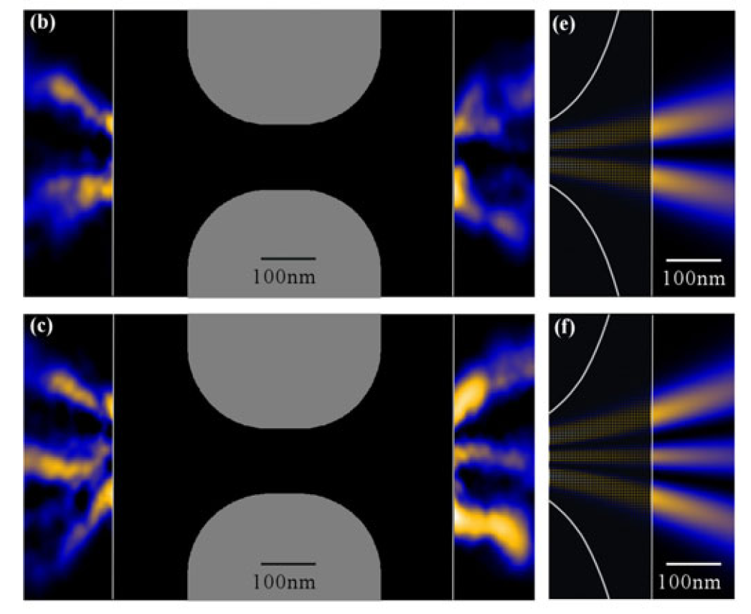
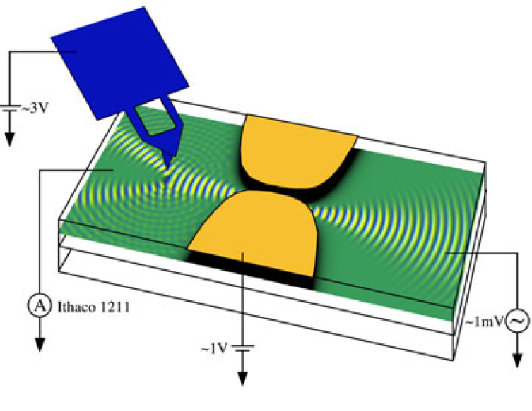
FILLING 1-D Subbands
(at LOW Temperatures)
B. J. LeRoy
J. Phys.: Cond. Matt. 15, R1835 (2003)
Observation With Scanning Probe

Slide 6
GENERAL ASPECTS OF
MESOSCOPIC TRANSPORT II
1-D Mesoscopic Systems … Revisited
A Ballistic Model for 1-D Conductance
1-D Conductance Quantization
Observing 1-D Conductance Quantization
Where is the Resistance?

Slide 7
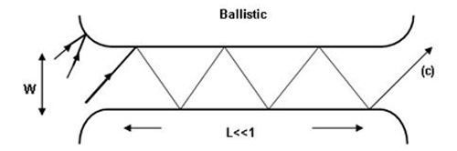
BALLISTIC Model for 1-D
Conductance (V_{sd} = 0)
SOURCE
RESERVOIR
DRAIN
RESERVOIR
EACH RESERVOIR IS CHARACTERIZED BY A UNIQUE CHEMICAL POTENTIAL (FERMI ENERGY)
EACH RESERVOIR INJECTS CARRIERS WITH ENERGIES UP TO THIS CHEMICAL POTENTIAL
SINCE TRANSPORT IN THE WIRE IS BALLISTIC ALL ENERGY RELAXATION MUST TAKE PLACE IN THE RESERVOIRS

Slide 8
BALLISTIC Model for 1-D
Conductance (V_{sd} = 0)
y
x
E_{n}(k_{y})
CARRIERS INJECTED FROM SOURCE HAVE POSITIVE k_{y} WHILE THOSE INJECTED FROM DRAIN HAVE NEGATIVE k_{y}
CARRIERS INJECTED FROM A PARTICULAR RESERVOIR PRESERVE THEIR MOMENTUM DUE TO THEIR BALLISTIC MOTION
WITH NO APPLIED SOURCE-DRAIN VOLTAGE THE NET CURRENT IS ZERO DUE TO CANCELLATION OF CARRIER MOMENTA
E_{F}
k_{y}

Slide 9
BALLISTIC Model for 1-D
Conductance (V_{sd} > 0)
SOURCE
RESERVOIR
DRAIN
RESERVOIR
WITH SOURCE-DRAIN VOLTAGE APPLIED RESERVOIRS HAVE DISTINCT ELECTRO-CHEMICAL POTENTIALS
NET CURRENT ARISES DUE TO THE DIFFERENT CARRIER FLUXES INJECTED FROM THE TWO RESERVOIRS
CURRENT CAN BE CALCULATED BY TREATING THE CONDUCTANCE AS A TRANSMISSION PROBLEM

Slide 10
BALLISTIC Model for 1-D
Conductance (V_{sd} > 0)
V_{sd}
Gnd
E_{n}(k_{y})
NET CURRENT
FROM UNCOMPENSATED
CARRIERS IN THIS WINDOW
E_{F} +
eV_{sd}
E_{F}
k_{y}

Slide 11
GENERAL ASPECTS OF
MESOSCOPIC TRANSPORT II
1-D Mesoscopic Systems … Revisited
A Ballistic Model for 1-D Conductance
1-D Conductance Quantization
Observing 1-D Conductance Quantization
Where is the Resistance?

Slide 12
Computing the 1-D
Conductance
NET CURRENT
FROM UNCOMPENSATED
CARRIERS IN THIS WINDOW
E_{F} +
eV_{sd}
E_{F}
Excess charge per unit length PER OCCUPIED SUBBAND:
ASSUMES SMALL V_{sd} TO AVOID NEED TO INTEGRATE OVER DoS!
ONLY STATES WITH POSITIVE MOMENTUM CONSIDERED

Slide 13
Computing the 1-D
Conductance
CURRENT carried by the excess charge in EACH subband:
Since the GROUP VELOCITY:
We obtain the CURRENT:
NOTE THE CANCELLATION
OF ENERGY TERMS!

Slide 14
Computing the 1-D
Conductance
We note that the current is INDEPENDENT of subband index
- this is the concept of EQUIPARTITION of current
The TOTAL current is therefore simply obtained by multiplying
by the NUMBER of occupied subbands (N):
We finally obtain the QUANTIZED conductance:

Slide 15
GENERAL ASPECTS OF
MESOSCOPIC TRANSPORT II
1-D Mesoscopic Systems … Revisited
A Ballistic Model for 1-D Conductance
1-D Conductance Quantization
Observing 1-D Conductance Quantization
Where is the Resistance?

Slide 16
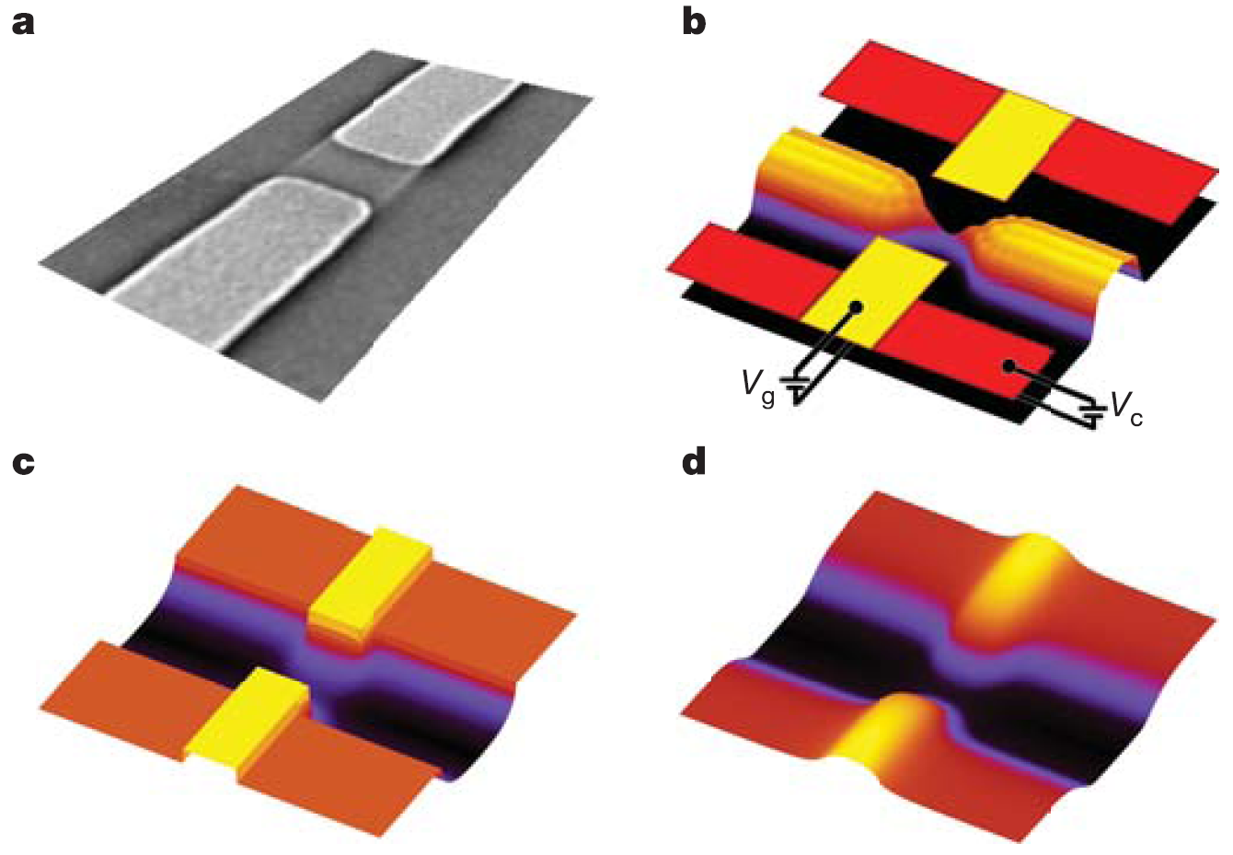
Archetypal 1-D Conductor:
QUANTUM POINT CONTACT (QPC)
DEVICE CONSISTS OF A PAIR OF SPLIT METAL GATES FORMED ON THE SURFACE OF A HIGH-MOBILITY HETEROJUNCTION
APPLICATION OF NEGATIVE VOLTAGE TO THE GATES DEPLETES 2DEG UNDERNEATH AND FORMS A QPC IN THE GAP BETWEEN THEM
QPC WIDTH – AND SO NUMBER OF OCCUPIED SUBBANDS – CAN BE TUNED IN SITU VIA THE GATE VOLTAGE
NOTE THE PRESENCE OF THE SADDLE BARRIER AT THE CENTER OF THE QPC
QPC GATES
DENSITY
POTENTIAL PROFILES
T. Rejec & Y. Meir, Nature 442, 900 (2006)

Slide 17
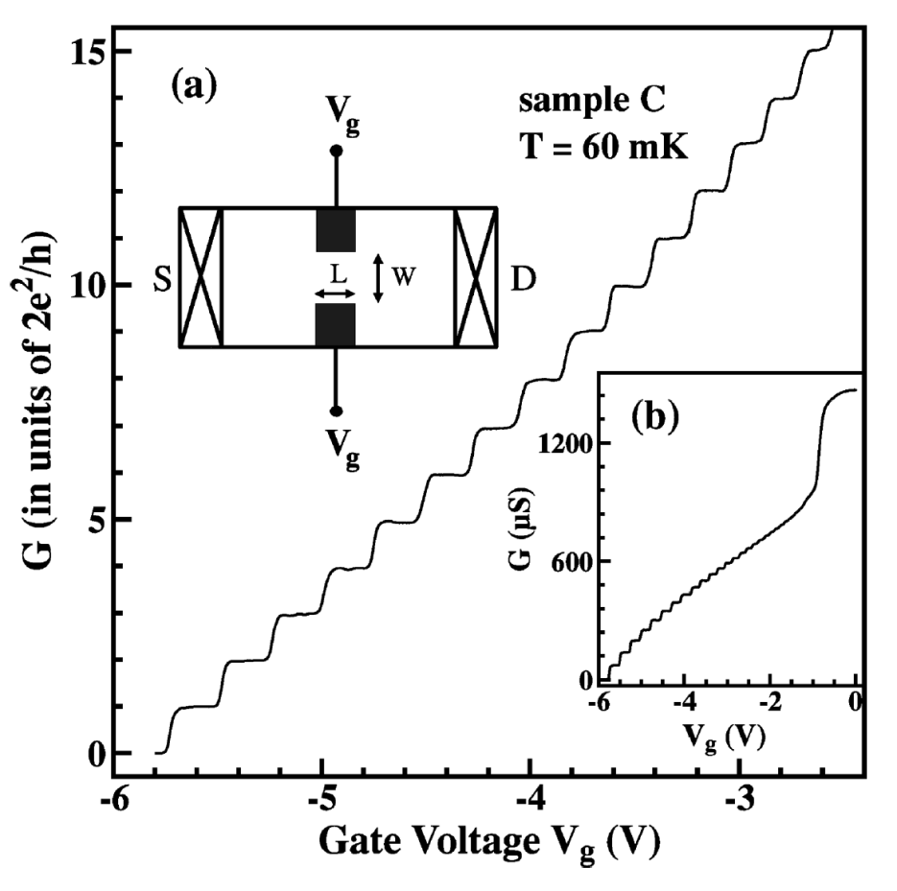
QUANTIZED Conductance
Of QPCs
CONDUCTANCE DECREASES IN INTEGER UNITS OF 2e²/h AS THE GATE VOLTAGE IS MADE MORE NEGATIVE!
EACH STEP-LIKE DECREASE SIGNIFIES A DECREASE IN THE NUMBER OF OCCUPIED SUBBANDS BY ONE AS THE WIDTH DECREASES
K. J. Thomas et al.
Phys. Rev. B 58, 4846 (1998)

Slide 18
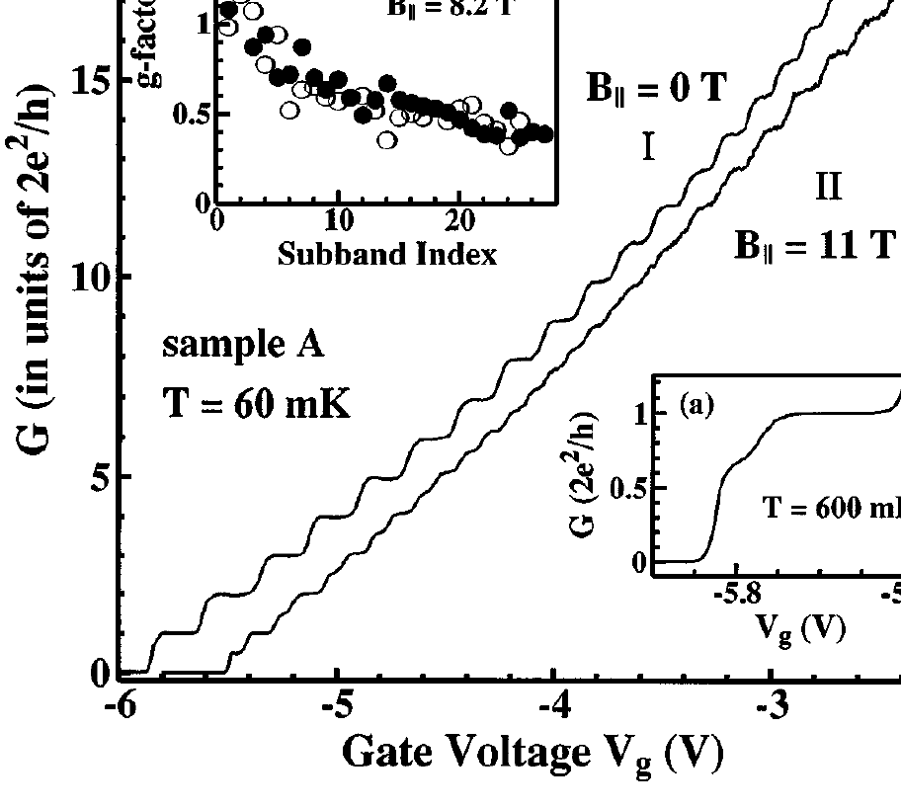
SPIN SPLITTING of 1-D
Conductance Quantization
PRE-FACTOR OF TWO FROM PRESUMED SPIN DEGENERACY
E_{n}(k_{y})
E_{n}(k_{y})
K. J. Thomas et al.
Phys. Rev. Lett. 77, 135 (1996)
k_{y}
k_{y}

Slide 19
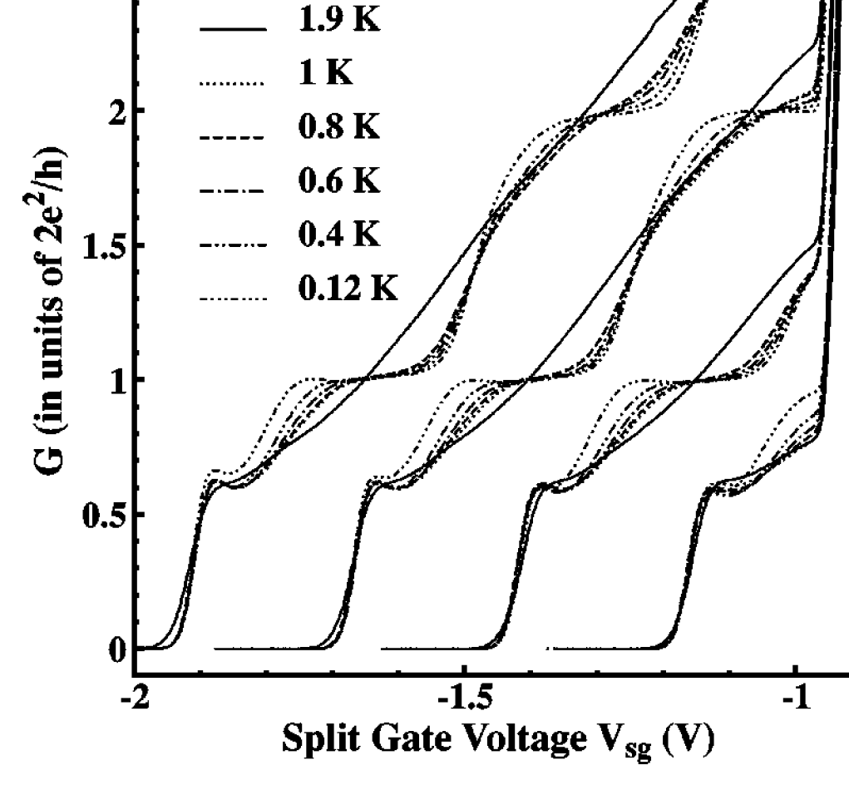
THERMAL Averaging of
Conductance Quantization
K. J. Thomas et al., Phys. Rev. B 61, R13365 (2000)
E_{n}(k_{y})
E_{F}
hω_{ο}
k_{y}
QUENCHED Once k_{B}T > hω_{ο}

Slide 20
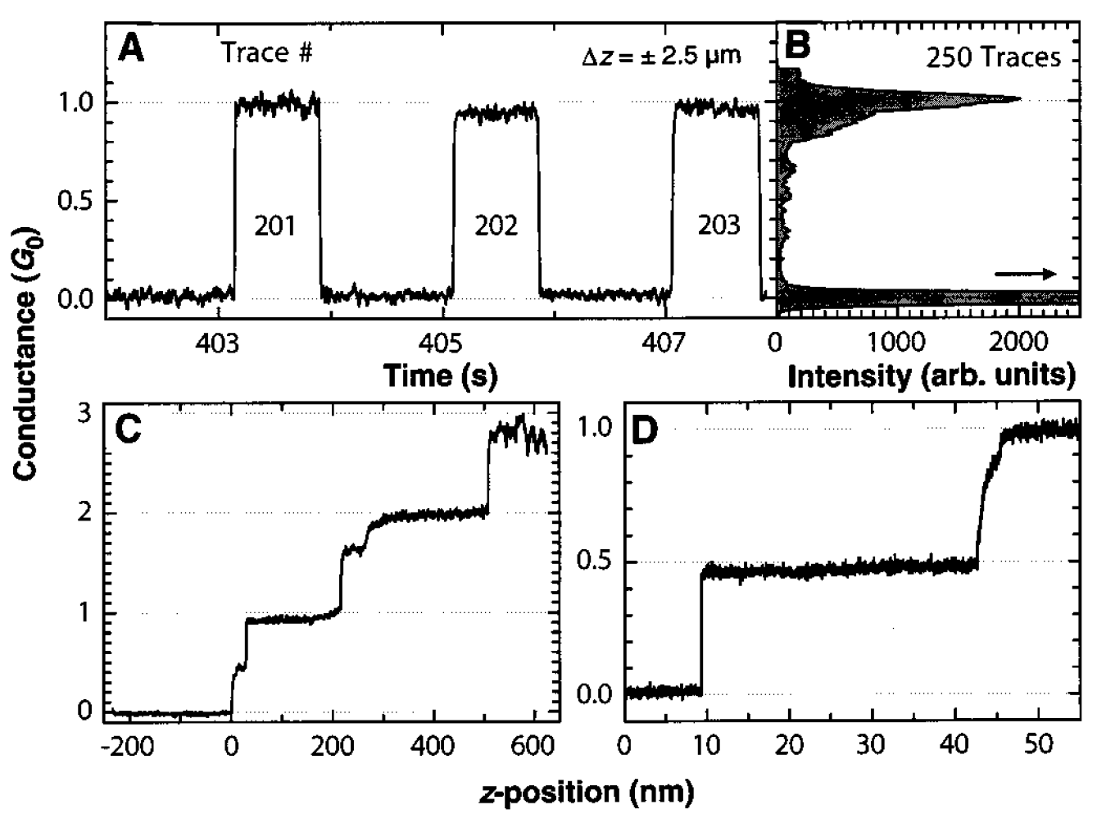
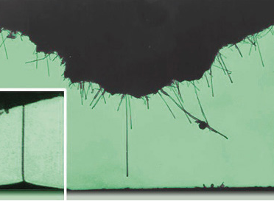
OTHER Observations:
Carbon Nanotubes
S. Frank et al., Science 280, 1744 (1998)
Quantization at ROOM Temperature!

Slide 21
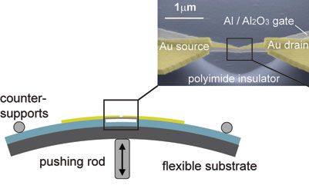
OTHER Observations:
Mechanical BREAK JUNCTIONS
ADDITIONAL Plateaus Observed!

Slide 22
GENERAL ASPECTS OF
MESOSCOPIC TRANSPORT II
1-D Mesoscopic Systems … Revisited
A Ballistic Model for 1-D Conductance
One-Dimensional Conductance Quantization
Observing 1-D Conductance Quantization
Where is the Resistance?

Slide 23
HOLD ON a Minute!
WHERE is the Resistance?!
Since there is NO scattering within ballistic wires we might expect the conductance TO be INFINITE?
INSTEAD however we know that it takes FINITE quantized values
FOR A SINGLE-SUBBAND QPC THE RESISTANCE IS AROUND 13 kOHMS – NOT AN INSIGNIFICANT AMOUNT!
WHERE DOES THIS RESISTANCE COME FROM
NO DISSIPATION IN HERE …
SO NO RESISTANCE???

Slide 24
Quantized Conductance is
a CONTACT RESISTANCE!
RESERVOIRS THAT SOURCE AND SINK CARRIERS TO CONDUCTOR MAY BE VIEWED AS SUPPORTING AN INFINITE NUMBER OF SUBBANDS
WHEN CURRENT FLOWS FROM THE RESERVOIRS TO THE CONDUCTOR IT MUST THEREFORE BE REDISTRIBUTED INTO A MUCH SMALLER NUMBER OF SUBBANDS
THIS MODE MISMATCH IS THE SOURCE OF THE QUANTIZED RESISTANCE

Slide 25
VOLTAGE-DROP in a
MACROSCOPIC Conductor
V
Gnd
V
0
x

Slide 26
VOLTAGE-DROP in a
BALLISTIC Conductor
V
V/2
0
x
VOLTAGE DROPPED AT ENDS!!!

Slide 27
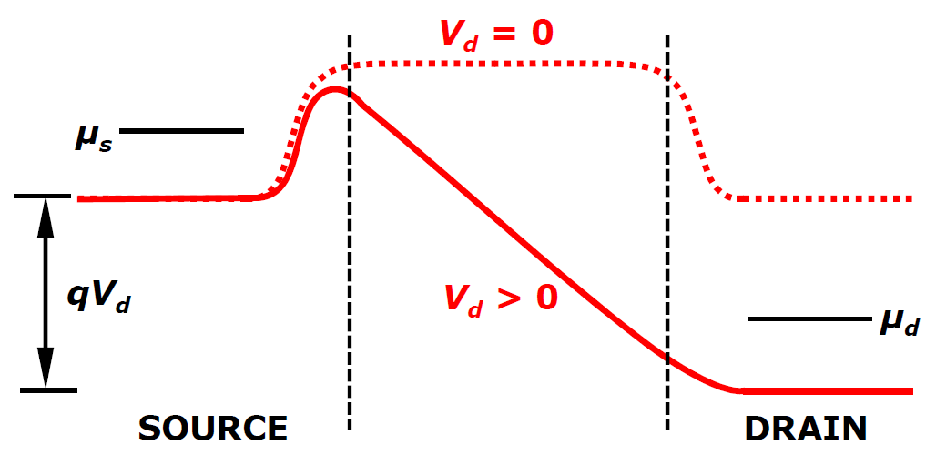
VOLTAGE-DROP in a
BALLISTIC Conductor
ON THE PREVIOUS SLIDE WE MADE AN AD-HOC ASSUMPTION THAT THE “CONTACT RESISTANCE” IS THE SAME AT BOTH ENDS OF THE QPC
THIS SEEMS TO BE SATISFIED IN GENERAL
THE EXCEPTION ARISES WHEN THE QPC IS VERY CLOSE TO PINCH-OFF
IN THIS SITUATION THE VOLTAGE IS TYPICALLY DROPPED LARGELY AT THE DRAIN END
THIS IS REMINISCENT OF THE SITUATION IN MODERN MOSFETs

