Slide 1
GENERAL ASPECTS OF
MESOSCOPIC TRANSPORT: I
Jonathan Bird
Electrical Engineering,
University at Buffalo,
Buffalo NY, USA

Slide 2
GENERAL ASPECTS OF
MESOSCOPIC TRANSPORT I
An Introduction to Mesoscopics
Some Features of Mesoscopic Systems
Some Common Mesoscopic Phenomena
Realizing Mesoscopic Systems
1-D Mesoscopic Systems

Slide 3
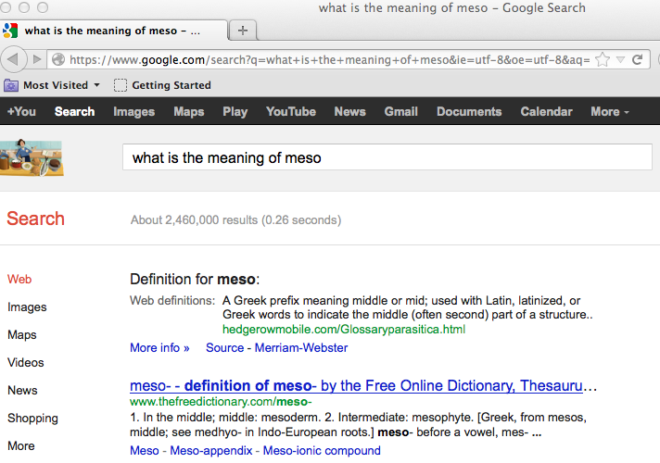
What does “MESOSCOPIC” mean?

Slide 4

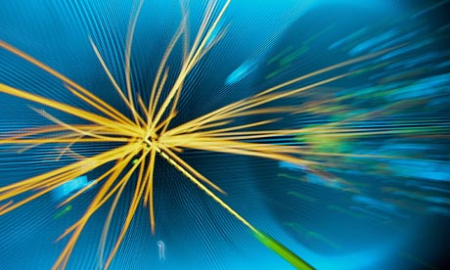
MESOSCOPIC PHYSICS – concerns the physical description of systems that are INTERMEDIATE between the macroscopic and microscopic realms

Slide 5
GENERAL ASPECTS OF
MESOSCOPIC TRANSPORT I
An Introduction to Mesoscopics
Some Features of Mesoscopic Systems
Some Common Mesoscopic Phenomena
Realizing Mesoscopic Systems
1-D Mesoscopic Systems

Slide 6
What are the GENERAL
FEATURES of Mesoscopic Systems?
Typically (not always) contain LARGE numbers of particles – reminiscent of classical systems …
… But, the QUANTUM character of these particles is strongly apparent
➔Exhibit pronounced effects due to QUANTUM
INTERFERENCE & ENERGY QUANTIZATION
➔MANY-BODY effects …

Slide 7
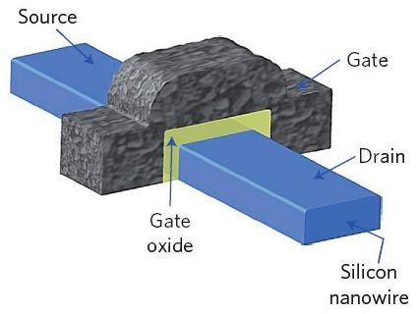
Semiconductor devices:
ARCHETYPAL mesoscopic system
FEW THOUSAND ELECTRONS
IN ACTIVE REGION OF DEVICE

Slide 8
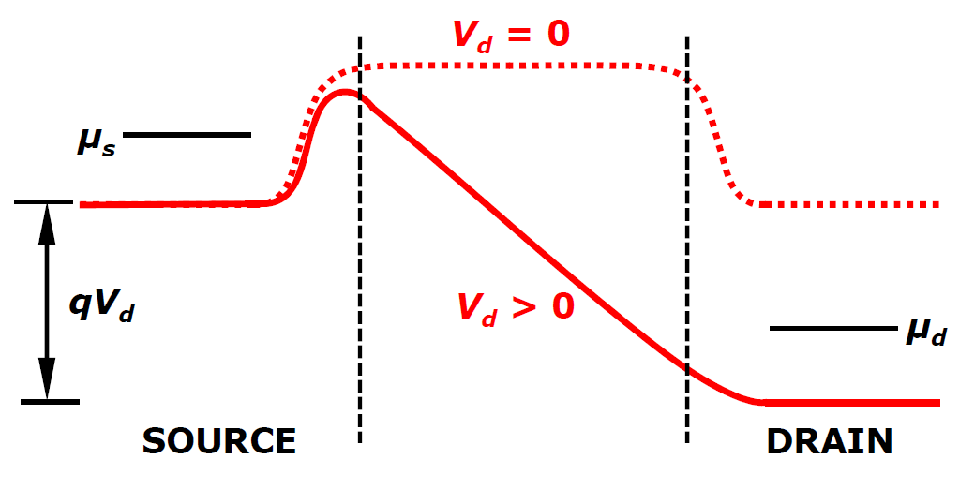
Device current calculated
in a TRANSMISSION approach –
the LANDAUER formula
DEVICE

Slide 9
GENERAL ASPECTS OF
MESOSCOPIC TRANSPORT I
An Introduction to Mesoscopics
Some Features of Mesoscopic Systems
Some Common Mesoscopic Phenomena
Realizing Mesoscopic Systems
1-D Mesoscopic Systems

Slide 10
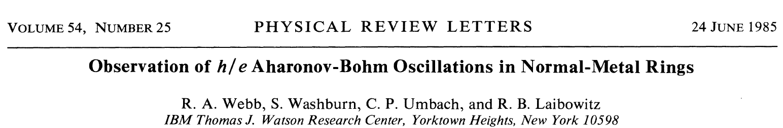
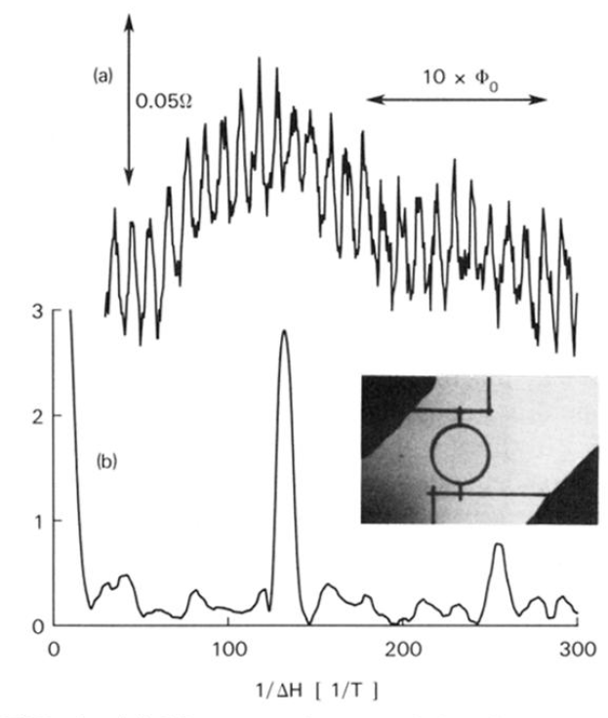
QUANTUM INTERFERENCE
Due to COHERENT wave transport

Slide 11
ENERGY QUANTIZATION
due to spatial confinement of carriers

Slide 12
SINGLE-ELECTRON control
of currents in nanostructures

Slide 13
GENERAL ASPECTS OF
MESOSCOPIC TRANSPORT I
An Introduction to Mesoscopics
Some Features of Mesoscopic Systems
Some Common Mesoscopic Phenomena
Realizing Mesoscopic Systems
1-D Mesoscopic Systems

Slide 14
Mesoscopic Devices Can
Be Realized via TWO Distinct Approaches
TOP-DOWN methods utilize standard approaches of semiconductor micro-fabrication to perform NANOSCALE patterning of semiconductors or metals
BOTTOM-UP approaches exploit NATURAL nanostructures that form via SELF-ASSEMBLY

Slide 15
TOP-DOWN Approaches:
Two-Dimensional Electron Gas (2DEG)
MOST COMMONLY BASED ON GaAs/AlGaAs HETEROJUNCTION
FORMED BY GROWING AlGaAs ON TOP OF GaAs
AlGaAs HAS A LARGER BANDGAP THAN THAT OF GaAs AND IS DOPED n-TYPE WITH AN EXCESS OF ELECTRONS
PRIOR TO HETEROJUNTION FORMATION FERMI LEVEL IN THE TWO MATERIALS IS DIFFERENT
E_{c}
E_{F}
E_{c}
E_{F}
E_{v}
E_{v}
AlGaAs
GaAs

Slide 16
TOP-DOWN Approaches:
Two-Dimensional Electron Gas (2DEG)
AT THERMAL EQUILIBRIUM THE FERMI LEVEL IS ALIGNED AT A CONSTANT POSITION ACROSS THE TWO MATERIALS
THIS IS ACHIEVED BY THE TRANSFER OF ELECTRONS FROM THE AlGaAs TO THE GaAs
THE RESULTING BAND BENDING – IN COMBINATION WITH THE BAND OFFSETS – RESULTS IN THE FORMATION OF A NARROW POTENTIAL WELL
CARRIER MOTION IN THE WELL IS CONFINED NEAR THE INTERFACE FORMING A 2DEG
ΔE_{c}
E_{c}
Accumulation
Layer
E_{F}
Depletion
Region
ΔE_{v}
E_{v}
AlGaAs
GaAs

Slide 17
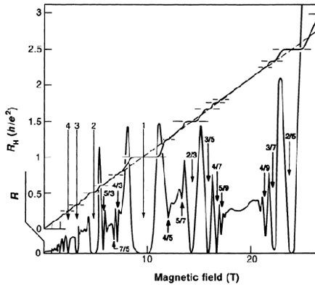
TOP-DOWN Approaches:
Two-Dimensional Electron Gas (2DEG)
THE 2DEG FORMED IN A HETEROJUNCTION CAN EXHIBIT SUPERIOR ELECTRICAL CHARACTERISTICS
REMOVAL OF DOPANTS FROM CONDUCTING LAYER RESULTS IN EXCELLENT LOW-TEMPERATURE MOBILITY
MEAN FREE PATH FOR TRANSPORT CAN EXCEED A HUNDRED MICRONS AT LOW TEMPERATURES!
ALLOWS THE EXPLORATION OF A VARIETY OF NOVEL MESOSCOPIC TRANSPORT PHENOMENA

Slide 18
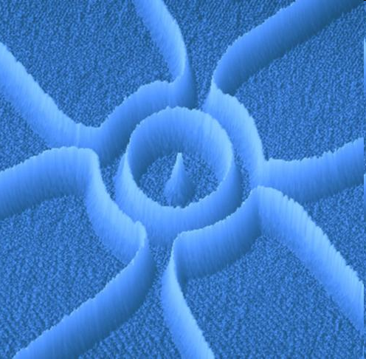
TOP-DOWN Approaches:
Two-Dimensional Electron Gas (2DEG)
Ensslin Group
ETH Zurich
Easily PATTERNED to Form Mesoscopic Devices

Slide 19
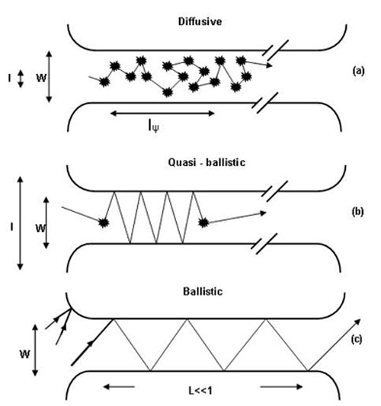
LONG Mean-Free Path
Allows BALLISTIC Transport

Slide 20
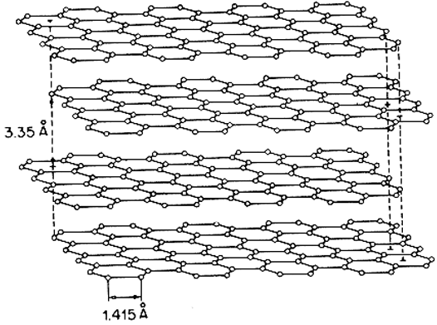

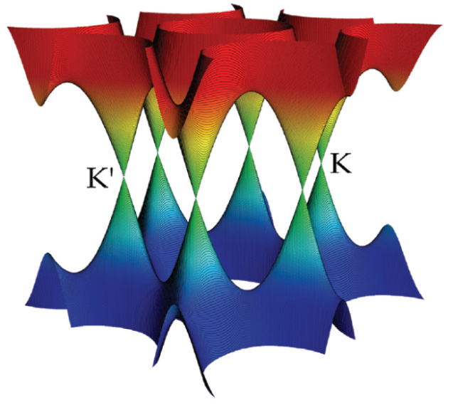
BOTTOM-DOWN 2DEG:
GRAPHENE

Slide 21
GENERAL ASPECTS OF
MESOSCOPIC TRANSPORT I
An Introduction to Mesoscopics
Some Features of Mesoscopic Systems
Some Common Mesoscopic Phenomena
Realizing Mesoscopic Systems
1-D Mesoscopic Systems

Slide 22
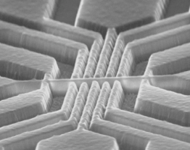
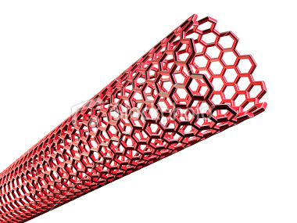
1-D Wires Can Be Realized
By Top-Down OR Bottom-Up Methods
Etched Nanowire
Carbon Nanotube

Slide 23
Exhibit UNIQUE Density of
States That Governs Electrical & Optical Properties
k_{x} = 0
k_{x}
−k_{F}
+k_{F}
DoS OF PURELY 1-DIMENSIONAL –
NON-INTERACTING - ELECTRONS

Slide 24
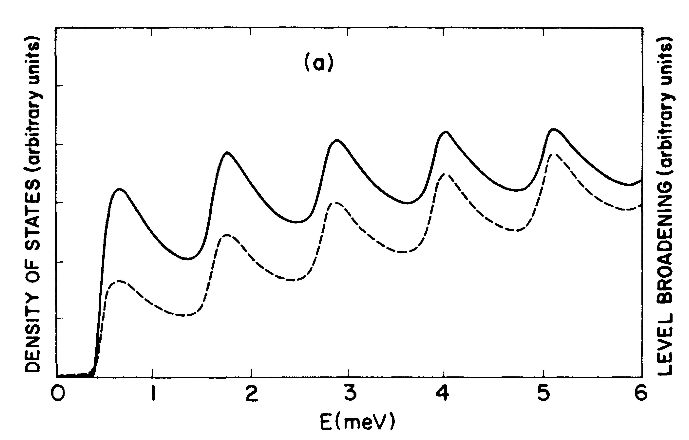
In Real Systems DoS
Follows from a SUM Over Multiple
1-D SUBBANDS
K. F. Berggren et al.
PRB 37, 10118 (1988)

Slide 25
In Real Systems DoS
Follows from a SUM Over Multiple
1-D SUBBANDS

Slide 26
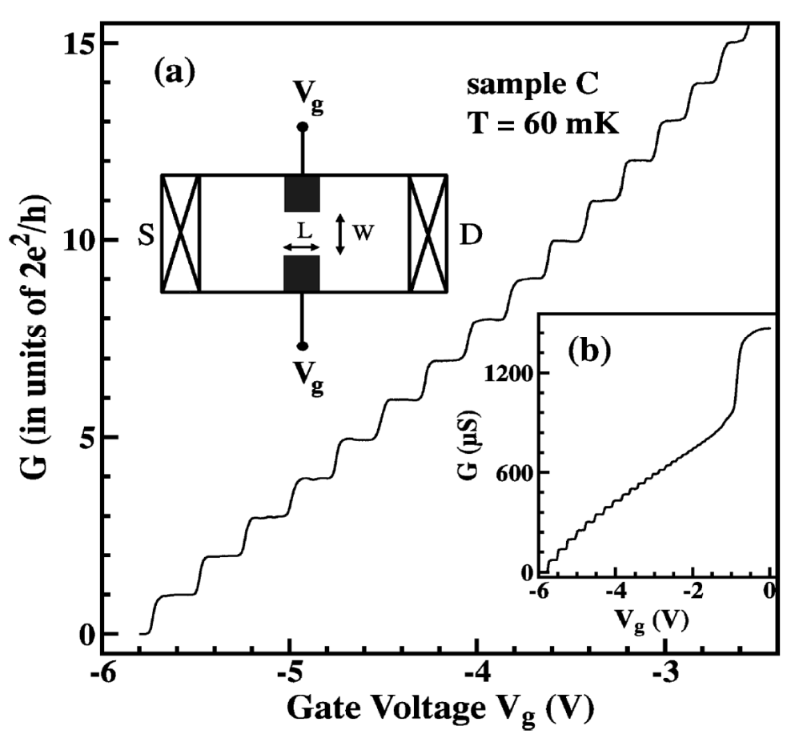
1-D DoS Responsible for a
Unique Conductance QUANTIZATION
Pepper Group
Cambridge (U.K.)

