Slide 1
GENERAL ASPECTS OF
MESOSCOPIC TRANSPORT: III
Jonathan Bird
Electrical Engineering,
University at Buffalo,
Buffalo NY, USA

Slide 2
GENERAL ASPECTS OF
MESOSCOPIC TRANSPORT III
1-D Conductance Quantization … Revisited
Non-Linear Conductance of QPCs
Bias-Spectroscopy Techniques*
Breakdown of Conductance Quantization*
And Now for Something Completely … New
* UNFORTUNATELY, NO TIME FOR THIS TODAY

Slide 3
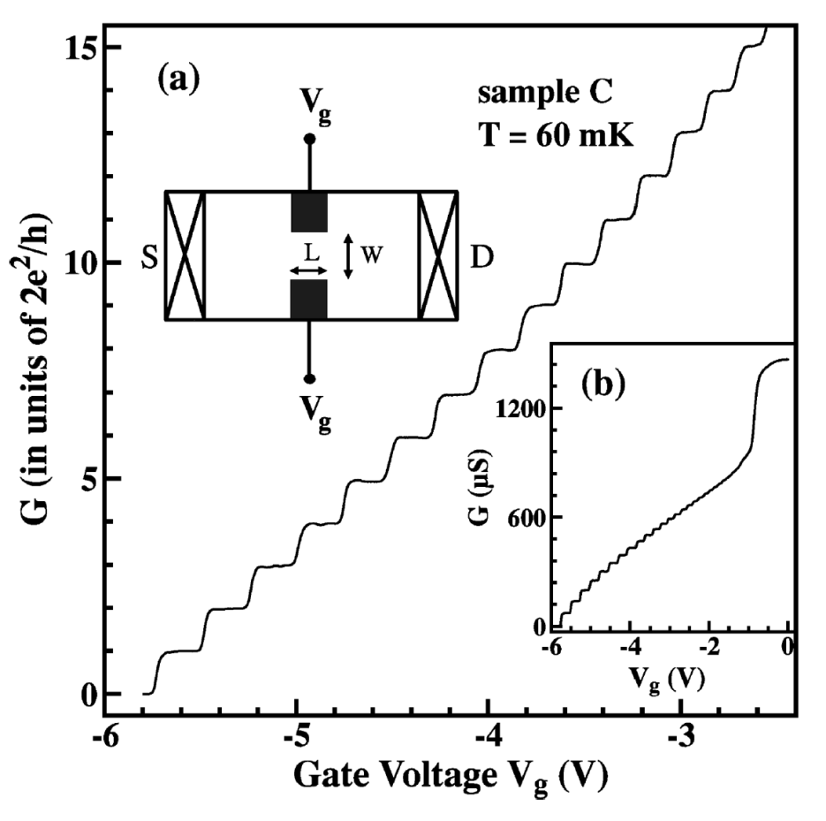
LINEAR Conductance of
QPCs QUANTIZED in units of 2e²/h
K. J. Thomas et al.
Phys. Rev. B 58, 4846 (1998)

Slide 4
LINEAR Conductance of
QPCs QUANTIZED in units of 2e²/h
Take excess charge per unit length PER OCCUPIED SUBBAND:
ASSUMES SMALL V_{sd} TO AVOID NEED TO INTEGRATE OVER DoS!
This allows us to obtain the CURRENT:
But What About LARGE Voltages?

Slide 5
GENERAL ASPECTS OF
MESOSCOPIC TRANSPORT III
1-D Conductance Quantization … Revisited
Non-Linear Conductance of QPCs
Bias-Spectroscopy Techniques*
Breakdown of Conductance Quantization*
And Now for Something Completely … New
* UNFORTUNATELY, NO TIME FOR THIS TODAY

Slide 6
A Model for the VOLTAGE
DROP Across a QPC
1. V_{sd} = 0
μ_{s}
μ_{d}
2. V_{sd} > 0
BARRIER LOWERED HERE
μ_{s}
(1 – β)qV_{sd}
βqV_{sd}
qV_{sd}
μ_{d}

Slide 7
QPC Current For SINGLE
Subband Under Bias
1. Current due to SINGLE electron is ev_{g}/L
E_{n}(k_{y})
μ_{d}
μ_{s}
2. Current due to ALL electrons between
k & k + dk
3. Thus the TOTAL current
k_{d}
k_{s}
k_{y}
= 0 WHEN V_{sd} = 0 SINCE k_{d} = –k_{s}

Slide 8
QPC Current For SINGLE
Subband Under Bias
1. With V_{sd} applied the integral becomes
E_{n}(k_{y})
βqV_{sd}
μ_{s}
(1 – β)
qV_{sd}
μ_{d}
2. Since the integrand is just eV_{sd} the
DIFFERENTIAL CONDUCTANCE
k_{d}
k_{s}
k_{y}
JUST WHAT WE
HAD BEFORE!

Slide 9
QPC Current For SINGLE
Subband Under STRONG Bias
1. Now only carriers from ONE reservoir
contribute to the current
2. The current is then written as
E_{n}(k_{y})
μ_{s}
3. So the corresponding differential
conductance becomes
μ_{d}
k_{d}
k_{s}
k_{y}
NO LONGER QUANTIZED!

Slide 10
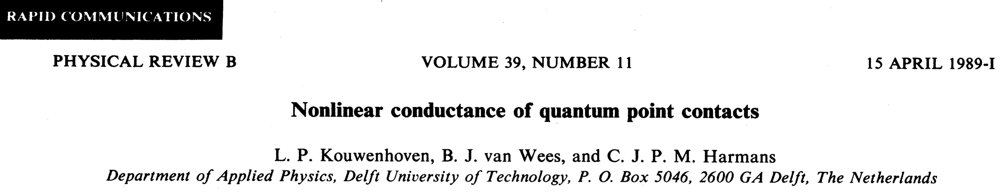
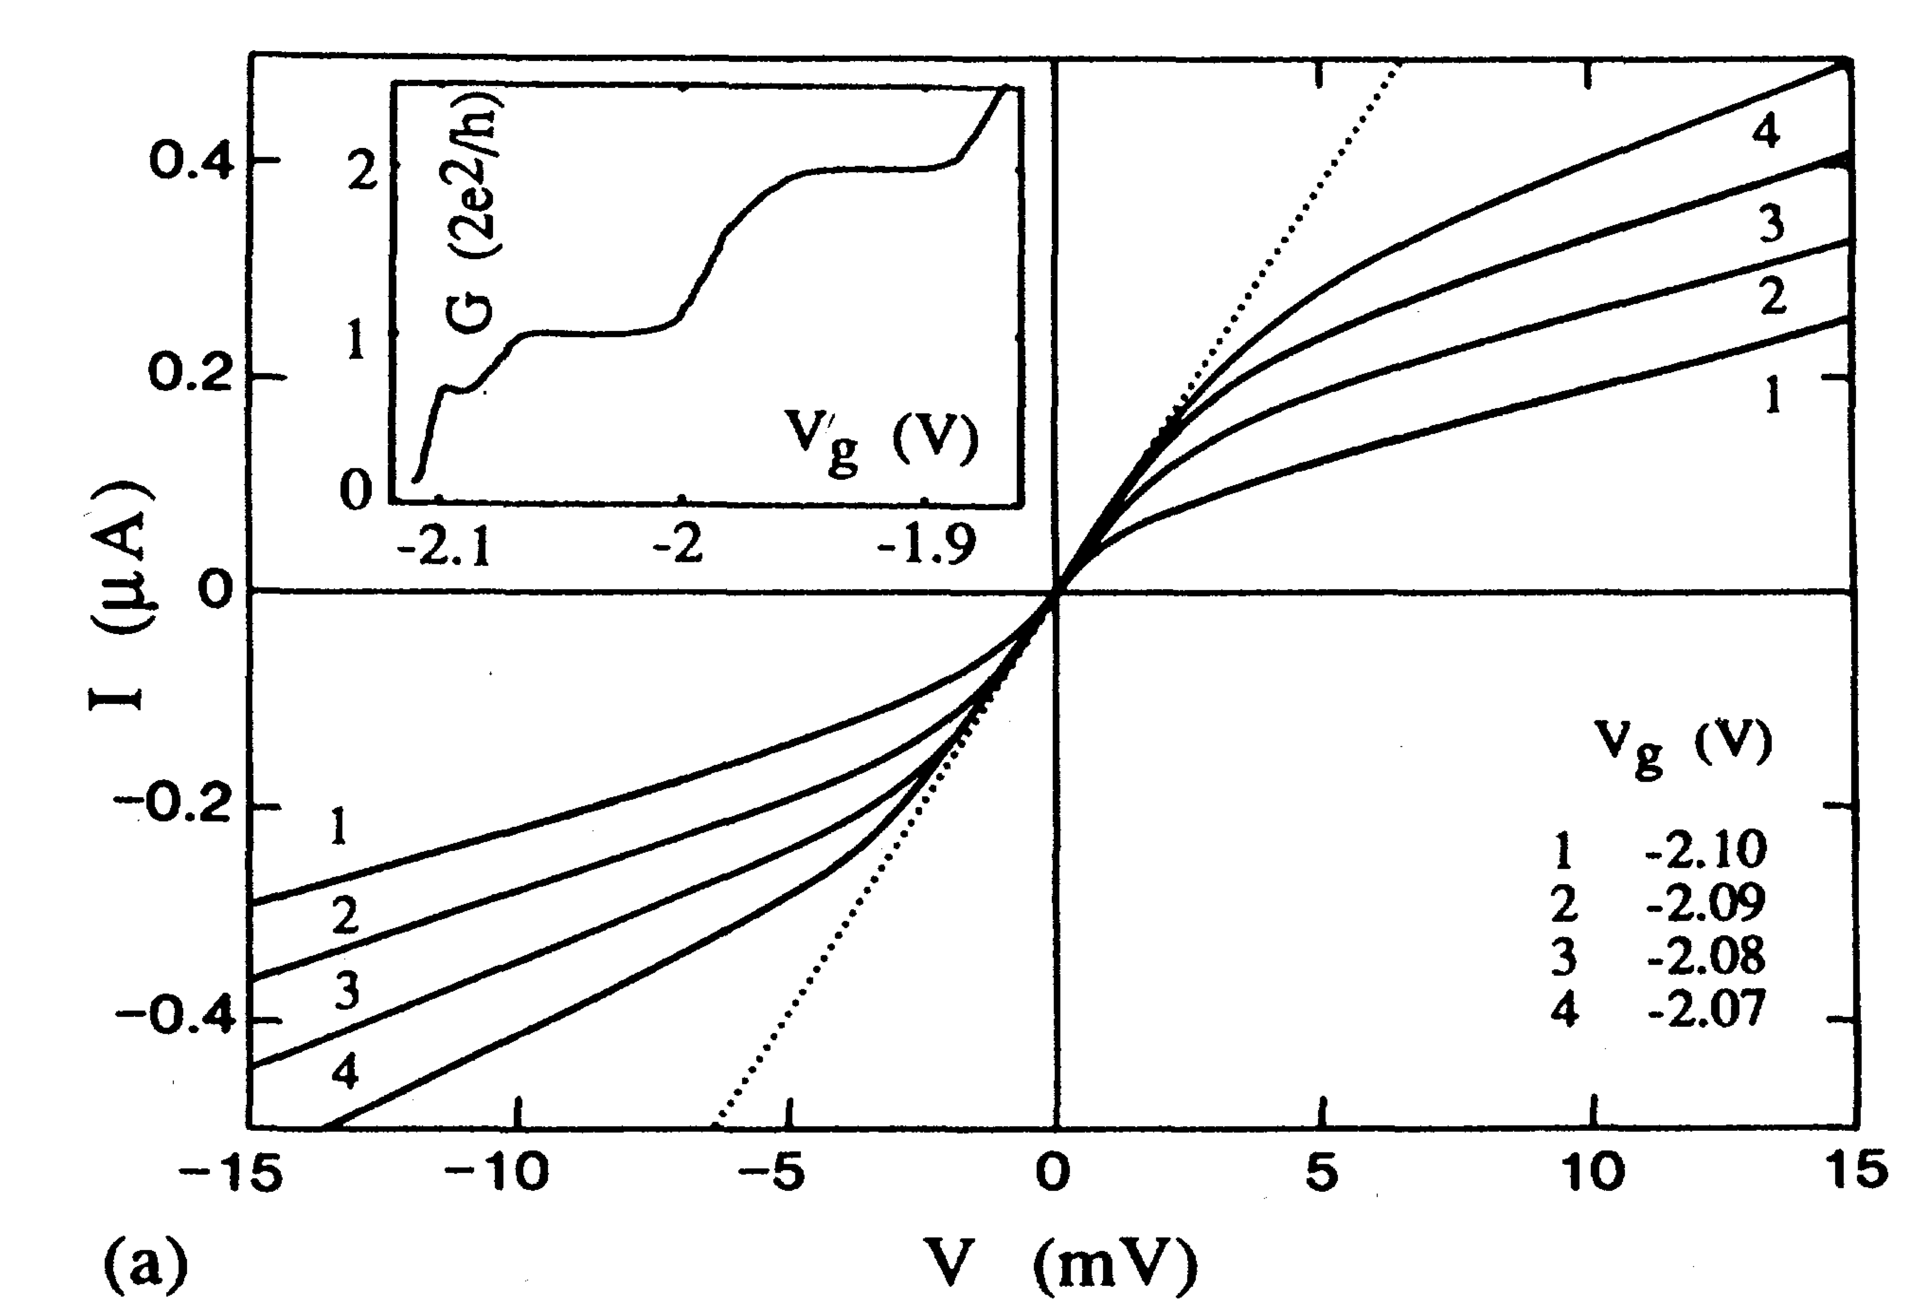
QPC Current For SINGLE
Subband Under STRONG Bias

Slide 11
HALF-PLATEAUS For A
SYMMETRIC Voltage Drop (β = ½)
A. Kristensen et al., Phys. Rev. B 62, 10950 (2000)

Slide 12
HALF-PLATEAUS Near
PINCH-OFF (β << ½)
μ_{s}
(1 – β)qV_{sd}
βqV_{sd}
qV_{sd}
μ_{d}
A. Kristensen et al., Phys. Rev. B 62, 10950 (2000)

Slide 13
GENERAL ASPECTS OF
MESOSCOPIC TRANSPORT III
1-D Conductance Quantization … Revisited
Non-Linear Conductance of QPCs
Bias-Spectroscopy Techniques*
Breakdown of Conductance Quantization*
And Now for Something Completely … New
* UNFORTUNATELY, NO TIME FOR THIS TODAY

Slide 14
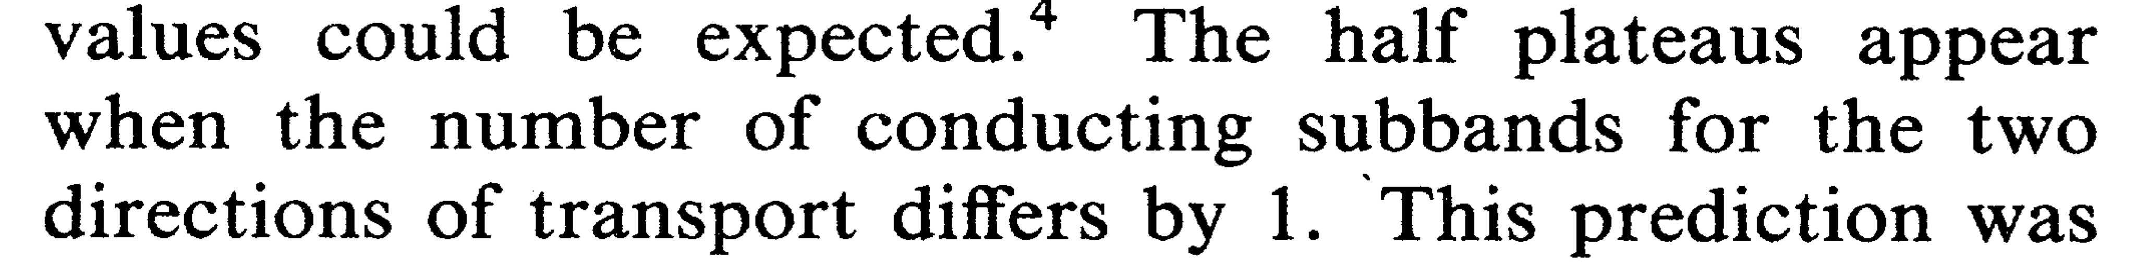
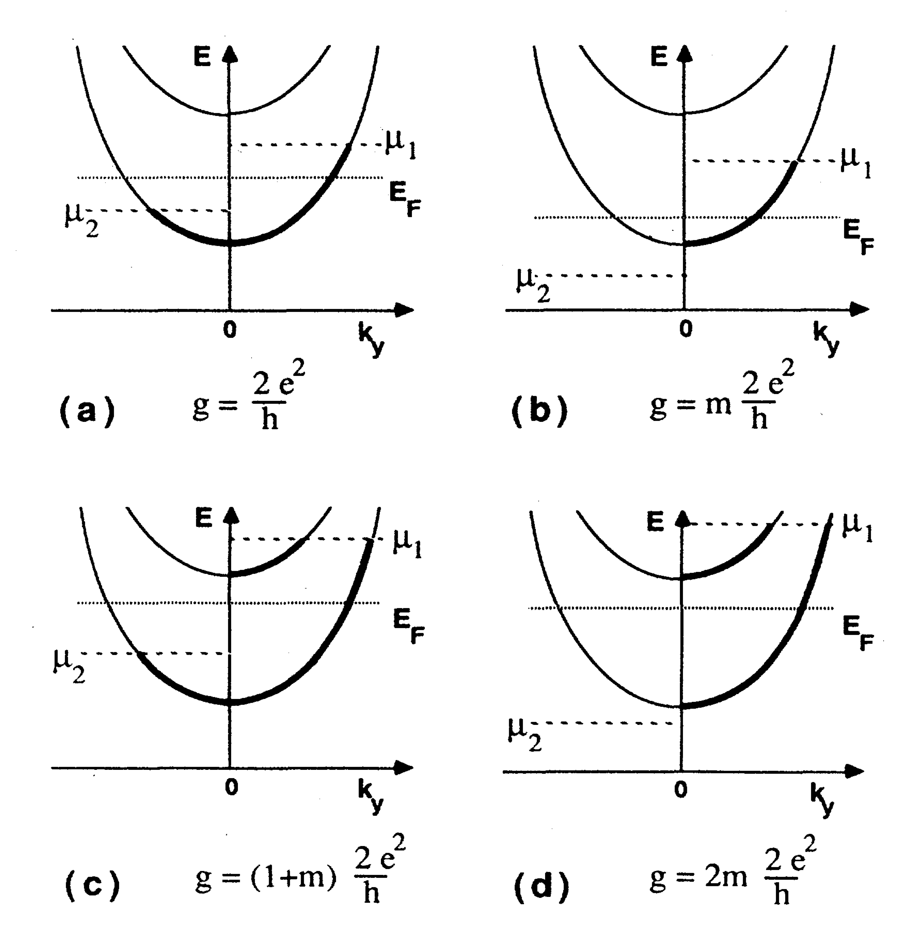
Determination of 1-D
Subband SPACING
N. K. Patel et al., Phys. Rev. B 44, 13549 (1991)
L. P. Kouwenhoven et al., Phys. Rev. B 39, 8040 (1991)

Slide 15
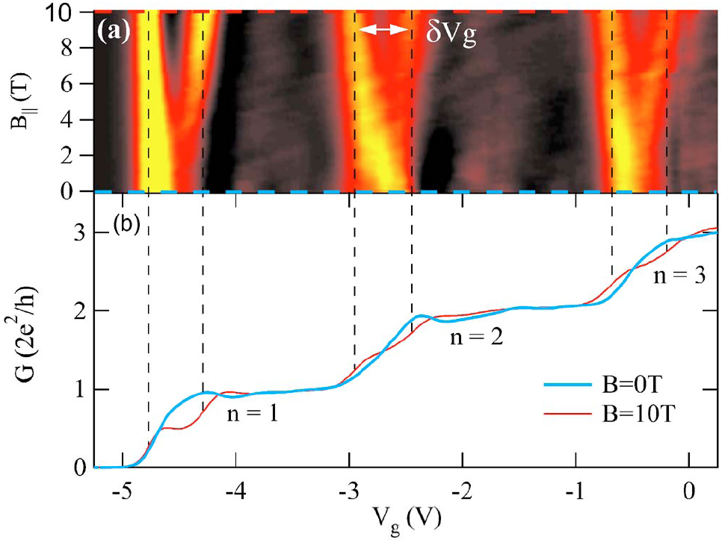
Determination of 1-D
Subband SPACING
LOW TRANS-
CONDUCTANCE
HIGH TRANS-
CONDUCTANCE
T. P. Martin et al., Appl. Phys. Lett. 93, 012105 (2008)
Make Use of TRANSconductance

Slide 16
Determination of 1-D
Subband SPACING
Δ = 6 meV
A. Kristensen et al., Phys. Rev. B 62, 10950 (2000)
Make Use of TRANSconductance

Slide 17
Determination of 1-D
Subband SPACING
Typical subband spacings in the range of a
FEW meV – dependent on STRUCTURE
Subband spacing typically INCREASES as gate
confinement is made stronger
Bias-Spectroscopy can also be used to
investigate ZEEMAN splitting of the subbands
MORE NEXT WEEK FROM ADAM MICOLICH!

Slide 18
GENERAL ASPECTS OF
MESOSCOPIC TRANSPORT III
1-D Conductance Quantization … Revisited
Non-Linear Conductance of QPCs
Bias-Spectroscopy Techniques*
Breakdown of Conductance Quantization*
And Now for Something Completely … New
* UNFORTUNATELY, NO TIME FOR THIS TODAY

Slide 19
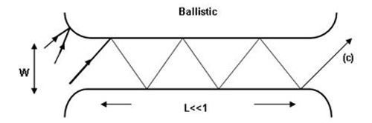
So Far We Have ASSUMED
NO Scattering Within the QPC
SOURCE
RESERVOIR
DRAIN
RESERVOIR
ELECTRONS TRAVELING TO RIGHT MUST COME FROM SOURCE
ELECTRONS TRAVELING TO LEFT MUST COME FROM DRAIN
Allowed SIMPLISTIC Assumption of PERFECT Transmission

Slide 20
Disorder in QPCs Causes
SCATTERING Between Subbands
Current in EACH channel now determined by TRANSMISSION
COEFFICIENT
PROBABILITY FOR
TRANSMISSION VIA
n^{th} SUBBAND
PROBABILITY FOR
TRANSMISSION FROM
SUBBAND “n” TO
SUBBAND “m”
Current Now SAMPLE Dependent

Slide 21
Disorder in QPCs Causes
SCATTERING Between Subbands
Calculating TOTAL Current Yields LANDAUER FORMULA
SAMPLE DEPENDENT
TRANSMISSION
PROBABILITY
TRANSMISSION PROBABILITY DEPENDS STRONGLY ON THE NATURE OF THE DISORDER INSIDE THE QPC AND IS ALSO STRONGLY ENERGY DEPENDENT
CONSEQUENTLY THE CONDUCTANCE IS NO LONGER NECESSARILY QUANTIZED

Slide 22
A Simple Limit – FIXED
Transmission Per Subband
CONTACT-
RELATED
RESISTANCE
DISORDER-
RELATED
RESISTANCE
CAN NEVER
BE ZERO
CAN
BE ZERO
RESISTANCE G_{C}⁻¹ IS AN UNAVOIDABLE QUANTUM CONTACT RESISTANCE
RESISTANCE G_{D}⁻¹ IS A SAMPLE-DEPENDENT CONTRIBUTION TO THE TOTAL RESISTANCE

Slide 23
GENERAL ASPECTS OF
MESOSCOPIC TRANSPORT III
1-D Conductance Quantization … Revisited
Non-Linear Conductance of QPCs
Bias-Spectroscopy Techniques*
Breakdown of Conductance Quantization*
And Now for Something Completely … New
* UNFORTUNATELY, NO TIME FOR THIS TODAY

Slide 24
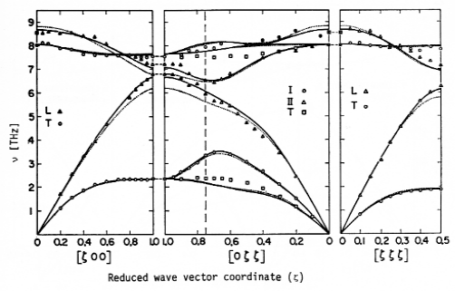
OPTICAL Phonon Emission
at LARGE Voltages
35 meV
GaAs PHONON SPECTRUM

Slide 25
PHONON EMISSION FOR Si
E. Pop, Nano. Res. 3, 147 (2010)

Slide 27
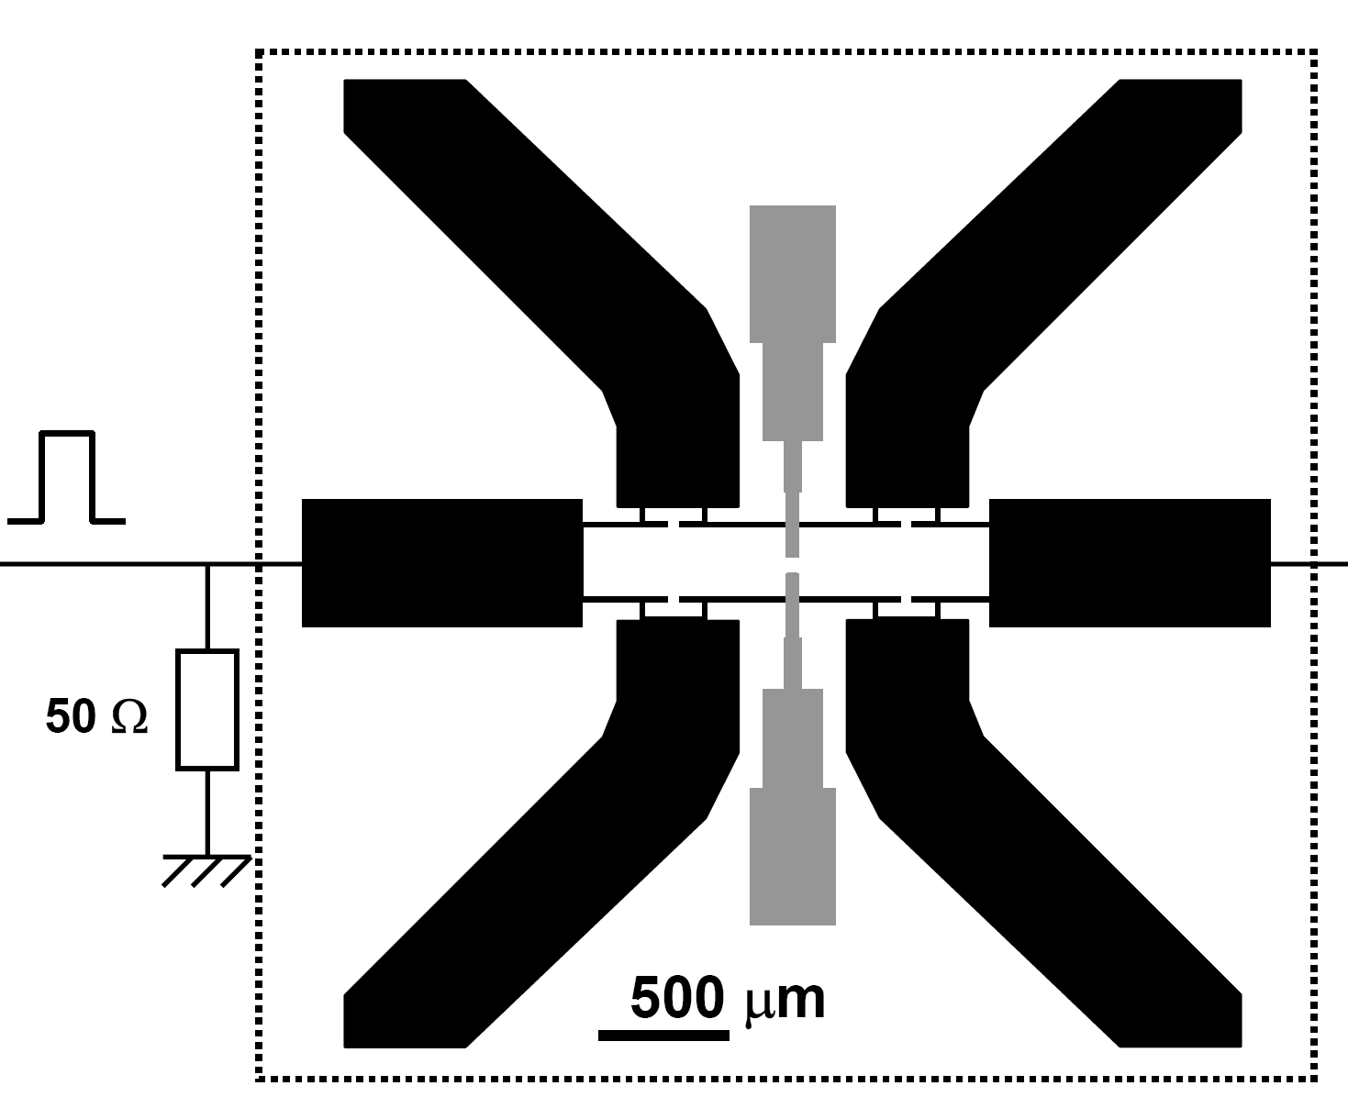
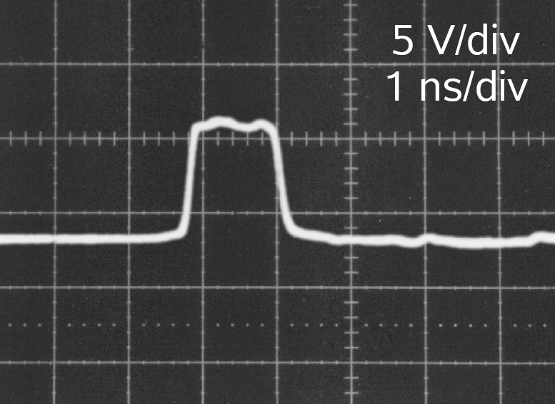
Our Study - TRANSIENT
Non-Linear Transport in QPCs

Slide 28
Our Observations:
1. REGIMES of Transient Response
QUASI-2D LIMIT
QUASI-1D LIMIT
1D LIMIT

Slide 29
Our Observations:
2. COMPLEX Rise/Fall Times
RISE TIME
FALL TIME
2 x 2e²/h

Slide 30
Our Observations:
3. Conductance PINNING at 2e²/h!

Slide 31
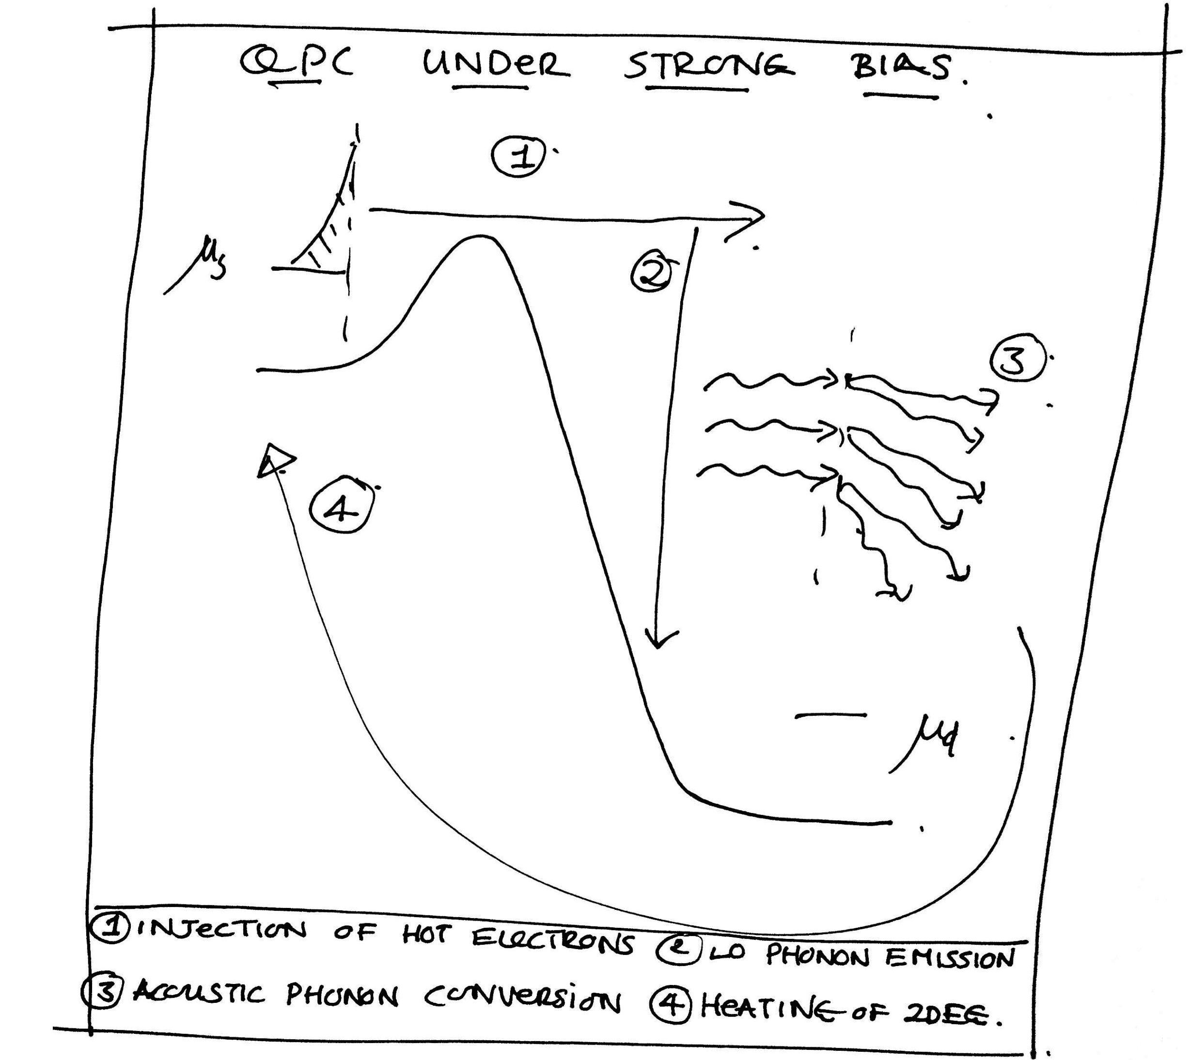
THEORETICAL Model:
PHONON-Induced Subband Mixing

Slide 32
THEORETICAL Model:
PHONON-Induced Subband Mixing
Mixing Results in MODIFICATION
of Subband Structure

Slide 33
Mixing Results in MODIFICATION
of Subband Structure

Slide 34
In Other Words … Conductance Quantization is RESTORED at High Bias!!!

