Slide 1
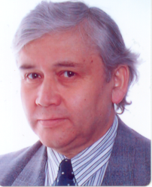
Erfarenhet av laserfysik att Manne Siegbahn Laboratory
Dr Guillermo Andler
Jag disputerade 1982 i Moskva i Kvantoptik (laserfysik/optoelektronik). Från 1986 jobbar jag på MSL, där jag var med och byggde HF accelerations kavitet för CRYRING. För närvarande jobbar jag med olika frågor vid DESIREE.

Slide 2
På MSL fick jag möjlighet att installera tre hög effekt lasrar som senare har används för experimenten i atomfysik vid CRYRING. Behovet av hög laser intensitet i experimental region (E-cooler) styrde utveckling av optiska fällor för laser pulser.
” Optical Traps with Active Media for High Power Laser Pulses”
Abstract: Development of optical traps for storing high power laser pulses and tuning of these pulses to a high repetition frequency of several tens of MHz has been done at our laboratory. In the optical traps we implemented a dye laser amplifier and pumped it synchronously by an external source and tested it for performance. So far selected pulses of the stored laser pulse could be amplified by typical factors of 200. Already now, we obtain an increase of the efficiency of the optical traps around 25 times as compared to a single passage of the laser pulse through the experimental section.
Development of a seeded dye laser for intra-cavity applications shows that the generated power of the seeded well defined wavelength inside of the cavity can have an efficiency as high as 20% of the pump power.
Introduction
Laser Ring
Linear Storage Device
Laser ring with an implemented amplifier
Linear Storage Device with an implemented amplifier
Seeded Dye Laser for Intracavity Experiments
Conclusions

Slide 3
Introduction
Schema av befintliga laser system vid CRYRING.
Laser Induced Recombination(LIR) Experiments demands delivering and focusing of high power inside the e-cooler, where ions and electrons interact by the influence of laser field, creating neutral particles in the recombination process. The Laser Duty factor is low. Some Schemas for reusing the energy in Optical Traps around the e-cooler are presented:
1. Optical Laser Ring.
2. Linear Storage Device.
3. Seeded Laser for IntracavityExperiments.
Fig.1. Layout of CRYRING with high power lasers for Laser Induced Recombination Experiments

Slide 4
Parametrar av befintliga laser system tillgängliga för experimenter vid CRYRING.
Table 1. Parameters of the high power laser systems available for LIR
Laser type | Excimer laser (Lambda Physik LPX220) | Dye laser (Lambda Physik LPD3002) | Nd: YAG laser (Quanta-Ray DCR-3) | Nd: YAG laser (Spectra-Physics GCR-270) | Optical Parametrical Oscillator (Spectra-Physics MOPO-730)
Active medium | XeCl | Organic dye | Nd:YAG crystal | Nd:YAG crystal | BBO crystal Beta Barium Borate
Wavelength [nm] | 308 | 400-800nm 2-nd harm: 200-400nm | 1st: 1064 | 1st: 1064 | Signal:400-700
 |  |  | 2nd: 532 | 2nd: 532 | Idler: 700-2000
 |  |  | 3th: 355 | 3th: 355
Pulse Energy [mJ] | 250 | 10 - 25 | 1st: 1000 | 1st: 2000 | 100
 |  |  | 2nd: 350 | 2nd: 1200
 |  |  | 3th: 100 | 3th: 420
Maximum rep rate[Hz] | 200 | Determ. by pump source | 1 - 10 | 30 | 30
Pulse length,[ns] | 7 - 10 | 7 - 10 | 5 - 10 | 5 - 10 | 5 - 7

Slide 5
LIR Experiment vid elektron kylaren vid CRYRING.
Experimental section in the e-cooler at CRYRING and transport of laser beam
Excimer laser
Ion beam
FS1
Dye laser
M2
M1
FS2
M3
M5
M4
Power-meter
Fig.2. Layout of the optical path for the laser beam during the transport and detection setup. M1, M2, M3, and M4 are highly reflecting mirrors, M5 is a thin quartz mirror, FS1 and FS2 are the focusing systems, and SBD is the surface barrier detector.

Slide 6
De optiska system som finns för intrakavitetsexperiment baseras på optiska elementer optimerade till en våglängd opch i de flesta fallet fungerar i infrared området av våglängden. De optiska fällan för hög effektlasrar som vi föreslår är bredbandig.
The known optical systems, developed to increase the power in the interaction region, are designed for one wavelength or for an small band of wavelengths. In the most of the cases for interaction of high power pulses with electron beams. For these cases it is possible to use polarization sensitive plates designed to work in an small band of wavelengths to get high reflection of the polarized injected laser beam. The most of these schemas works in the NIR (wavelength around 1 micron).
For Laser Induced Recombination at CRYRING, we need a system which can inject and handle a high power laser pulse in a broad band of wavelengths (400 – 800 nm). For this purpouse a Wollaston Prism in combining setup seems to be the best choise as injecting element.

Slide 7
Laser Ring
Schema av Optisk fälla som består av en Wollaston prisma, fyra speglar, fokuserande linsar och en Pockel Cell.
The Optical Laser Ring consists of an electro-optical switch, 4 high reflecting mirrors and a focusing system. A Wollaston prism and a Pockels cell driven by a high voltage pulser form the electro-optical injector. The Pockels cell rotates the plane of polarization of the (vertically) incoming beam by 90 ⁰. Between two pulses the Pockels cell is inactive until the next pulse from the source comes. The Wollaston prism combines the paths of orthogonally polarized beams (the vertically polarized pulse from the laser source and the horizontally polarized circulating in the ring). These pulse paths are aligned to propagate collinearly after the Wollaston prism.
M3
M4
Table 2. Optical Losses in the Ring
FS
Exp.Section
PC
Optical
element
[%]
WP
M5
M2
M1
Wollaston prism
4
HVP
Pockels Cell
4
PD
Focusing
System
4
High Power Laser
HR mirrors
4*1
Total Opt.Losses
16
Fig.7. Layout of the laser ring. FS- Focusing System, PC- Pockels cell, WP- Wollaston prism, PD- Photodiode, HVP- High Voltage Pulser, and BS- Beam splitter.

Slide 8
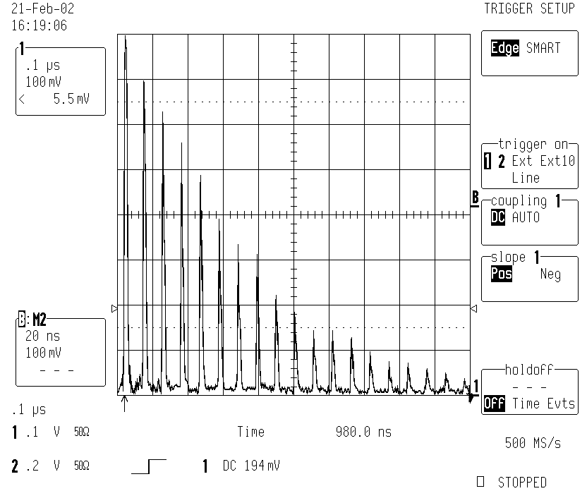
Lagrad hög effekt laser puls i en optisk ring.
Stored pulse in the Optical Laser Ring
HVP
Fig.8. Photo-Diode signal showing the number of times the laser pulse passes through the beam splitter plate. Physical dimension of the ring was about 12 m.
Table 3. Accumulated power in the Optical Laser Ring
Integrated Power, one pass configuration
1mJ trapped pulse
Integrated power Optical Laser Ring

Slide 9
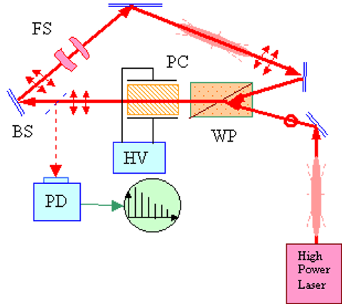
Three mirrors configuration of the laser ring
Table 4. Optical Losses in a 3 mirrors Ring
Optical element |  | [%]
Wollaston prism |  | 4
Pockels Cell |  | 4
Focusing System |  | 4
HR mirrors |  | 3*1
Total Opt.Losses |  | 15
Fig.9. Layout of the laser ring with three mirrors. FS- Focusing System, PC- Pockels cell, WP- Wollaston prism, PD- Photodiode, HVP- High Voltage Pulser, and BS- Beam Splitter.
Integrated power Optical Laser Ring with 3 mirrors
Schema av Optisk fälla i form av en ring bestående av tre speglar.

Slide 10
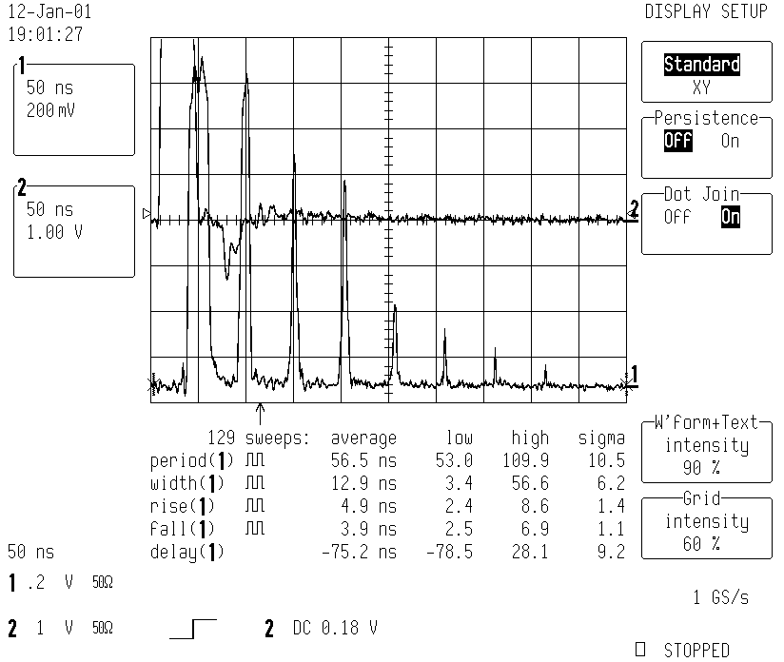
Tids synchronisation av ingående hög effekt laser puls och hög spänning puls som öppnar Pockels cell för injektion i optiska fällan.
Synchronization of Pockels Cell for the Three mirrors configuration of the laser ring
Fig.10. Nd:YAG-Dye laser pulse travelling around the laser ring(Ch1).1:1000 Monitoring signal from the high voltage pulser (Ch 2).

Slide 11
Förslag på en optisk laser ring omkring e-kylaren för LIR experiment.
Proposed Laser Ring around the e-cooler
Table 5. Optical Losses of a ring around e-cooler
M3
M4
Experimental section: Ion beam, e-beam and laser beam
Electron Beam
Optical
element
[%]
FS
Wollaston p.
4
PC
WP
Pockels Cell
4
Neutral
particles
M5
M2
M1
Foc.System
4
HR mirrors
4*1
Ion Beam
Dye
Laser
Optical vac. Windows, without AR coatings
2*8
Fig. 11. Layout of the optical path for the proposed LIR-experiments with a Optical Laser Ring. WP - Wollaston Prism, PC - Pockels Cell, FS - Focusing System, M1, M2, M3, M4 - High Reflecting mirrors.
Air Pollution 0.9%/m,16m
0.9*16
Excimer
Laser
Total Losses
50
Integrated power for the ring around the e-cooler

Slide 12
Schema av lineärt Optisk fälla bestående av en Wollaston prisma, två speglar, fokuserande linsar och en Pockel Cell.
Linear Storage Device
A Linear Storage Device for high power laser pulses and its possible application in intracavity experiments has been studied. An excimer dye laser pulse has been injected with help of a Wollaston prism and a synchronized Pockels cell into an optical trap formed by two high reflecting mirrors in a linear configuration. It has been shown that this optical configuration is almost as effective as the optical laser ring.
Table 6. Optical Losses in a Linear Storage Device
PD2
PC
M3
Optical element |  | [%]
Wollaston prism |  | 2*4
Pockels Cell |  | 2*4
Focusing System |  | 2*4
HR mirrors |  | 2*1
Total Opt.Losses per turn |  | 26
WP
BS
M2
M1
FS
HVP
PD1
Excimer-dye laser
Fig.12. Linear Storage Device. WP-Wollaston Prism, PC-Pockels Cell, HVP-High Voltage Pulser, PD-PhotoDiode, FS-Focusing System, BS-Beam Splitter, M1, M2, M3-High Reflecting Mirrors.

Slide 13
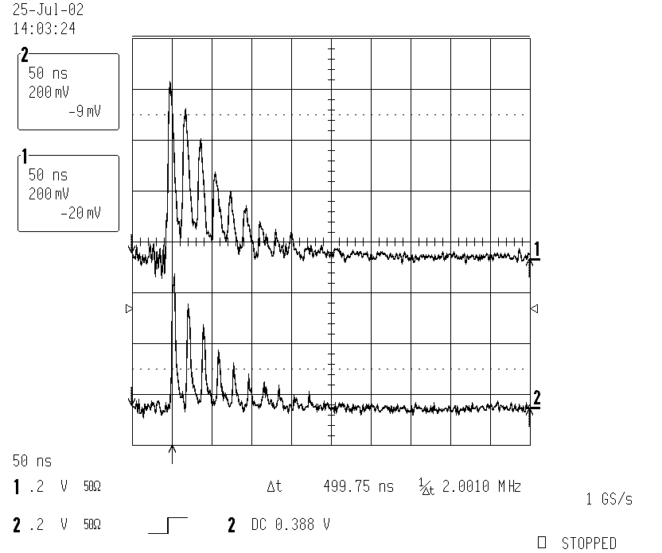
Lagrade puls in a lineär Optisk fälla:fotodiode signaler av pulsar gående i båda riktningar.
Stored pulse in the Linear Storage Device
Fig.13. Photodiode signals (2.85 m)
  Ch.1. Photodiode PD1.
  Ch.2. Photodiode PD2.
Integrated power in Linear Optical Device

Slide 14
Förslag av en Optisk fälla omkring e-kylaren for LIR experiment
Proposed Linear Storage Device around the e-cooler
Electron Beam
M2
Experimental section: Ion beam, e-beam and laser beam
Table 7. Optical Losses in Linear Storage Device around e-cooler
FS
PC
WP
M3
Optical Dev.
[%]
Neutral
particles
Wollaston p.
2*4
M4
M1
Pockels Cell
2*4
Ion Beam
Foc.System
2*4
Dye
Laser
HR mirrors
3*1
Optical vac. Windows, without AR coatings
4*8
Fig. 14. Layout of the Linear Storage Device for LIR-experiments. WP - Wollaston Prism, PC - Pockels Cell, FS - Focusing System, M1, M2,M3,M4 - High Reflecting mirrors.
Excimer
Laser
Air Pollut. 0.9%/m,3m
0.9*3
Integrated power for the ring around the e-cooler
Total Losses
62

Slide 15
Optiska förluster i fälla.
Optical Losses in the Traps
In the Optical Laser Ring the pulse energy decreases about 17 % per turn, when losses in air pollution are negligible(good air filtering in the laser room and small dimensions of the ring, 6 - 12 m, for Test bench). But for a larger ring around the experimental section in e-cooler in CRYRING, with a perimeter of about 20 - 25 meters, and where it is almost impossible to filter the air, the air pollution losses are an important factor. The measured optical losses at each optical component are presented in Table 8.
Table 8. Measured optical losses in the elements used for optical traps
Optical Elements | Wollaston Prism | Pockels Cell | Focusing System | High Reflecting Mirrors | Optical Windows uncoated | Optical Windows coated | Air Pollution
Losses [%]

Slide 16
Losses in the Laser Ring
Förluster i en Optisk fälla för lagrade puls.
Fig.15. Losses in the Optical Ring for 10 % and 20 % losses.
Discrepances in measured losses (around 10- 15 %) can be explained in difficulties to align the optical path of the ring with space instabilities of the laser source. Real optical losses were around 13-14 %, in configuration with four HR mirrors.

Slide 17
Accumulating Factor of the Optical Traps
in dependence of Optical Losses
Parameter of losses:
where are the optical losses in %.
The accumulating factor takes into account the energy of the trapped pulse at each turn and the number of turns with useful power that can survive inside the optical trap, can be written as:

Slide 18
Accumulating factor of the storage device
Fig.16. Accumulating Factor of an Optical Storage Device as function of the number of turns for different optical losses.
Fig.17. Accumulating Factor of an Optical Storage Device as function of optical losses.

Slide 19
The integrated power in "the storage device" can be expressed as the product of the power in the “One pass configuration” and the Accumulating Factor of the storage device.
Enhancement Factor of the optical storage device, defined as the ratio between the integrated power in the storage device and the power in one pass configuration, is strongly dependent of optical losses and directly proportional to the Accumulating Factor:

Slide 20
Table 9. Enhancement Factor for some optical traps
Optical Trap | Used optical elements | Losses | Para-meter | Accum. Factor | Enhanc. Factor
Opt.Las. Ring |  | 14% | 0.86 | 6.8 | 6.8
Opt.Las. Ring + e-cooler |  | 33% | 0.67 | 3.03 | 3.0
Lin.Sto. Dev. Collinear |  | 22% | 0.78 | 4.3 | 4.3
Lin.Sto. Dev. + e-cooler |  | 32% | 0.68 | 3.0 | 3.0

Slide 21
Enhancement Factor for the Linear Storage Device
In the linear storage device the power seen at beam splitter is formed by two train of
pulses going in opposite directions: forward and backward. So that the Enhancement
Factor will be different:
1. Collinear case: The train of laser pulses goes in forward direction:
2. Anti-collinear case: The train of pulses goes in backward direction:
represents the complementary losses seen by the laser pulse when going from experimental section (or BS) to M2 passing twice the FS.
3. General case, both trains of pulses give contribution to the integral energy :

Slide 22
Table 10. Enhancement Factor of the Linear Storage Device
Complementary Optical losses in backward direction: |  | 0.95
Train of pulses in forward direction |  | 4.3
Train of pulses in backward direction |  | 4.09
Summa of back and forward train of pulses |  | 8.39

Slide 23
Optical Traps with different layout but with about the same losses will have about the same Enhancement Factor. No special differences in between, as the Enhancement Factor depends in firts place of optical losses in the used elements.
In case of the linear storage device the laser pulse has to go twice through the Wollaston prism and Pockels cell, that means higher losses, but on the other side it is possible to use both trains of pulses (back and forward train of pulses) in the experimental section, so that the Enhancement Factor will be about twice higher.
The lay-out to be used has to depend on the application in an special experiment.
Improvement of the Enhacement factor for the special case of a laser ring around the e-cooler at CRYRING will be to use better air filtering or filtered air blowed pipes in between mirrors. Improve the losses in the optical windows using anti-reflecting coatings.

Slide 24
Laser Ring With an Implemented Amplifier
A dye laser amplifier has been implemented into the laser ring. A selected turn of the stored laser pulse could be amplified by typically a factor of 200. The efficiency of the Optical Laser Ring with an amplifying cell increases around 23 times as compared to a single passage of the laser pulse through the experimental section.
FS2
ES
PC
AC
WP
HVP
GDG2
FS1
PD2
PD1
Nd:YAG
Laser
Excimer-dye laser
GDG1
Fig.18. Optical Laser Ring with Amplifying Cell (AC) pumped by the 2nd harmonic of the Nd: YAG laser. FS- Focusing System, PC- Pockels cell, WP- Wollaston prism, PD- Photodiode, and HVP- High Voltage Pulser.

Slide 25
Stored and Amplified pulse in the Optical Laser Ring
13-turn
HVP
Fig. 19. (a) Stored excimer-dye laser pulse in the Optical Laser Ring. (b)Ch.2. Amplified 13th turn of the stored laser pulse. The timing pulse of the pump pulse from the Nd: YAG laser is indicated in Ch.1.

Slide 26
Power considerations for the Laser Ring with Amplifier
The laser ring with an amplifying cell inactive (not pumped), had about 25% total optical losses per turn.
Table 11. Optical Losses of the Laser Ring with Implemented Amplifier
Optical Losses in the Laser Ring with a monitoring beam splitter |  | 17%
Optical Losses in the Amplifying cell |  | 8%
Optical Losses in the Las. Ring with a mon. beam splitter and Amplifying cell |  | 25%

Slide 27
The Amplification Parameter of the storage device can be defined as the ratio of power stored and amplified at the m-turn and power accumulated with the amplifier no pumped:
The Efficiency of the storage device with an amplifying cell, pumped at the "m" turn, can be defined as the ratio of the power stored and amplified and the power in one pass configuration:
The Efficiency of the storage device can be expressed as a product of the Enhancement Factor and the Amplification Parameter:
The Enhancement Factor of the storage device:
The Amplifying factor:
The Energy of the trapped laser pulse at the "m" turn reduced by optical losses:

Slide 28
Table 12. Efficiency of the Laser Ring with Amplifier pumped at the 13th turn
Optical Losses |  | 25%
Parameter of Losses |  | 0.75
Parameter of Losses at the 13th turn reduced by optical losses |  | 0.024
Gain of the dye amplifier pumped at the 13th turn (measured) |  | 200
Energy of injected beam |  | 0.5mJ
Energy of 13th turn before amplification reduced by losses |  | 0.024mJ
Accumulating Factor upp to 12th turn |  | 3.87
Accumulating Factor for the 13th turn and upp: |  | 3.99
Accumulated Power in Opt.Las. Ring with no-pumped amplifier |  | 20mW
Accumulated Power in Opt.Las. Ring with pumped amplifier |  | 115mW
Efficiency of Opt.Las.Ring with amplifier pumped at the 13th turn |  | 23

Slide 29
A comparison of the optical laser ring with and without pumped amplifier (Amplification Parameter), allows us to conclude that the implemented dye amplifier increases the effective power inside the optical laser ring by about 6 times:
The optical laser ring with the implemented amplifier allow us to gain in total a factor of about 23 in power in comparison with a single passage of the pulse (Efficiency)

Slide 30
Efficieny of Optical Trap
Improvement of the Efficiency of the optical system demands increasing of the Gain of the amplifying media and optimization of optical losses
Fig.20. Efficiency of the Optical Trap in dependence of the Gain of amplifying media and optical losses.

Slide 31
Linear Storage Device with an amplifying cell
An Amplifying Cell has been introduced into the Linear Storage Device. The Efficiency of the linear storage device with an amplifying cell was about 24 times compared with the one pass configuration, where back and forward train of lasers pulses were taking into account. The performance of the storage device depends basically on the optical losses and gain in the amplifying media.
A dye cell has been used as amplifying media.
The injected pulse is travelling twice through all the optical elements inside the trap, which means higher losses but on the other side the stored pulse pass twice the experimental section.

Slide 32
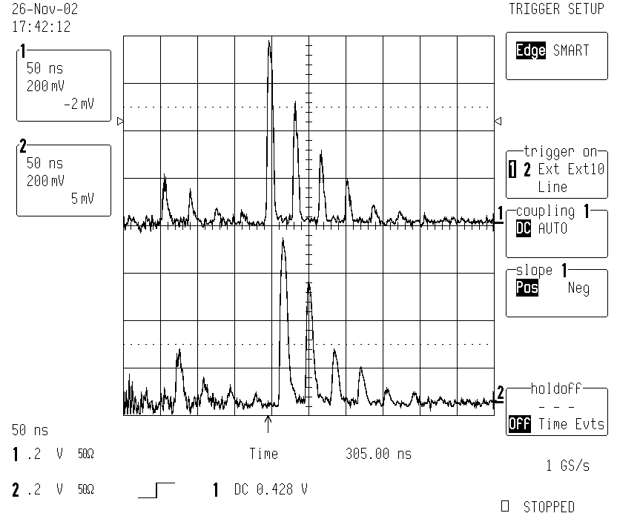
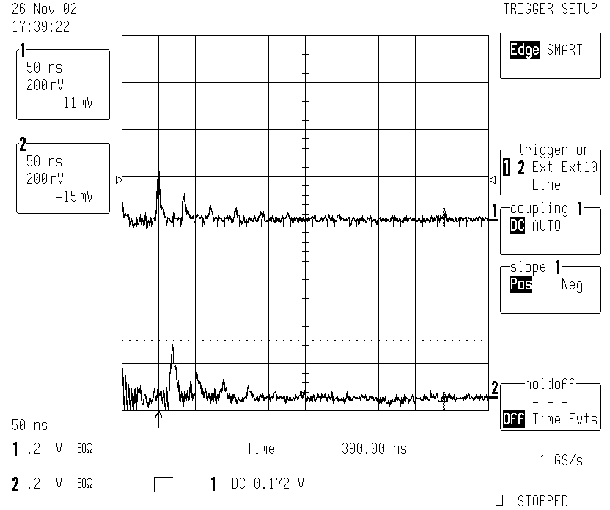
Linear Storage Device with Amplifying Cell
a.
PD2
Nd:YAG
2nd harm
M2
FS
PC
M3
BS
AC
WP
M1
HVP
Power
meter
5-turn
PD3
b.
PD1
Excimer-dye laser
Fig.21. Linear Storage Device with implemented Amplifying Cell (AC). WP-Wollaston Prism, PC-Pockels Cell, HVP-High Voltage Pulser, PD-PhotoDiode, FS-Focusing System, BS-Beam Splitter, M..- High Reflecting Mirrors
Fig.22. Photodiode signals.
a. Amplifying Cell pumped by the Nd:YAG laser.
b Without pump of Amplifying Cell.

Slide 33
Power considerations for the Linear Storage Device with Implemented Amplifier
In the linear storage device we have to consider that the power seen at the beam splitter is formed by two train of pulses going in opposite directions: forward and backward. So that the Accumulated power, pumped at the m-th turn, seen at the experimental section will be different for different cases.
1. Collinear case, train of pulses going in forward direction:
2. Anti-collinear case, train of pulses going in backward direction:
3. General case, both trains (back and forward) of pulses can be used:

Slide 34
Losses in Linear Storage Device with Amplifying Cell
Table 13. Optical Losses of the Linear Storage Device with Amplifier
Optical Losses in the Linear Storage Device with a monitoring beam splitter in one turn |  | 30%
Optical Losses in the Amplifying cell |  | 8%
Optical Losses in the Linear Storage Device with a mon. beam splitter and Amplifying cell |  | 46%

Slide 35
Table 14. Efficiency of the Linear Storage Device with Implemented Amplifier
Parameter of Losses |  | 0.54
Param reduced at the 5th turn |  | 0.085
Gain of the dye amplifier pumped at the 5th turn (measured) |  | 50
Energy of the injected pulse |  | 1.0mJ
Energy of the pulse at 5th turn before amplification |  | 0.085mJ
Energy of the pulse at 5th turn after amplification |  | 4mJ
Accum. Factor upp to 4th turn |  | 2.1
Accum. Factor for 5thturn upp: |  | 2.33
Accum.Power at beam splitter for forward pulse train |  | 120mW
Accum.Power at beam splitter for backward pulse train |  | 114mW
Total Power seen at Experimental Section (Beam Splitter) Back/Forw |  | 234mW
Total Efficiency of the storage device with an amplifying cell |  | 23

Slide 36
Amplification Parameter , defined as the ratio between accumulated power with the amplifier pumped at the 5th turn and accumulated power with the amplifier no pumped.
1. Collinear case, train of pulses going in forward direction:
2. Anti-collinear case, train of pulses going in backward direction:
3. General case, both trains of pulses (back and forward) can be used:
A gain of about 50 in the amplifier, gives an amplification of about 10 in power

Slide 37
Power Measurements in Linear Storage Device with Amplifier
MB
Nd:YAG
2nd harm
FS
PC
M3
BS
M2
AC
WP
M1
HVP
PDM
MF
PD3
Excimer-dye laser
Power
meter
Fig.23. Power Measurements in the Linear Storage Device with an implemented Amplifying Cell (AC)- WP-Wollaston Prism, PC-Pockels Cell, HVP-High Voltage Pulser, PD-PhotoDiode, FS-Focusing System, BS-Beam Splitter, M.. - High Reflecting Mirrors.

Slide 38
Table 15. Power Measurements in the Linear Storage Device with Amplifier
One Pass Configuration |  | 0.1mW
Linear Storage Device with amplifier no pumped |  | 0.3mW
Linear Storage Device with amplifier pumped, collinear case |  | 1.5mW
Linear Storage Device with amplifier pumped, summa of collinear and anti-collinear |  | 2.8 mW

Slide 39
Table 16. Enhancement Factor, Amplification Parameter and Efficiency of the Linear Storage Device with an Implemented Amplifier, based on measurements
Parameter | Based on measurements | Computed
Enhancement Factor
Amplification Parameter, collinear case
Efficiency, collinear case
Total Efficiency, general case

Slide 40
The time separation between two laser turns can be done as short as 7 ns depending on the dimension of the storage device and the planning use of the device.
Implementing an amplifying medium could be possible to have very high laser intensity in the interaction region with an amplification factor of more than 200.
The enhancement factor for the linear storage device with 46% optical losses is 2.3, and the Total Efficiency of the linear storage device with an amplifying cell with an amplification factor of about 50 is 23.
The efficiency of the optical storage device depends in first place of optical losses and the possible amplification we can get from the amplifier .
The proposed electro-optical device in different configurations could be a good solution in different kind experiments with thin optical target, where it is necessary to increase the level of measuring signal by increasing the accumulated power.
In case of LIR experiments the Doppler shift for the collinear and anti-collinear pulses has to be taken into account.
The choose of the configuration for trapping a high power laser pulse, to use depends of the particular case, as the efficiency of both proposed configurations are about the same.

Slide 41
Seeded Dye Laser for Intracavity Experiments
A Seeded Dye Laser synchronously pumped by the 2-nd harmonic of a Nd:YAG laser has been designed and experimentally tested. The seeding signal used was the well defined narrow linewidth output laser signal from an Excimer-dye laser system. Power considerations show that the intracavity laser power that can be used for experiments inside of the cavity can have an efficiency as high as 20% of the pump power. The wavelength and bandwidth is fully controlled by the wavelength and bandwidth of the well designed resonator from the seeding laser.
In a laser, most of the excited laser energy is concentrated inside of the resonator, especially in a dye laser where a retro-reflecting grating and a high reflecting mirror are used. Without complementary optical elements, the bandwidth of the laser emission will be broad and will depend on the number of lines/mm of the grating. A seeding laser signal can control the bandwidth keeping the high level of intra-cavity power that can be used for photon interactions in a thin optical target (atomic or molecular beam, ion beam, etc) that is introduced in the cavity.
A host dye laser transversally pumped by the 2nd harmonic of a Nd:YAG laser has been seeded by an excimer dye laser with narrow linewidth
, .

Slide 42
The host dye laser was composed by a diffraction grating in Littrow retro-reflecting mounting (1200 lines/mm), a high reflecting mirror and a dye cell (R6G in Methanol: resonator adjusted at 586 nm, around the maximum of the emission spectrum).
Pulsed
Wavemeter
Photo-
diode
Dye cell
Grating
ES
Mirror
Dye
Laser
2-rd harm
Nd:YAG
Power meter
Excimer
Laser
Nd:YAG
Laser
Delay
Fig. 24. Optical layout of the seeded dye laser, pumped by the 2nd harmonic of the Nd:YAG and seeded by the excimer dye laser. ES denotes a possible experimental section.
No efforts were made to decrease the linewidth, in order to use as much as possible of the generated intracavity power.

Slide 43
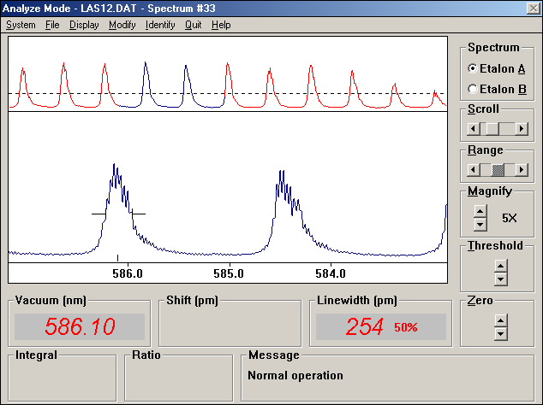
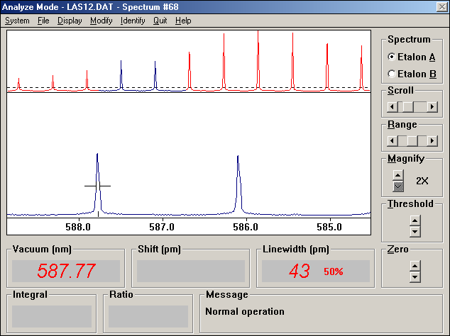
Spectrum of generation of the host dye laser
Fig.25. Host dye laser generation: Not seeded: ,
Seeded: ; .

Slide 44
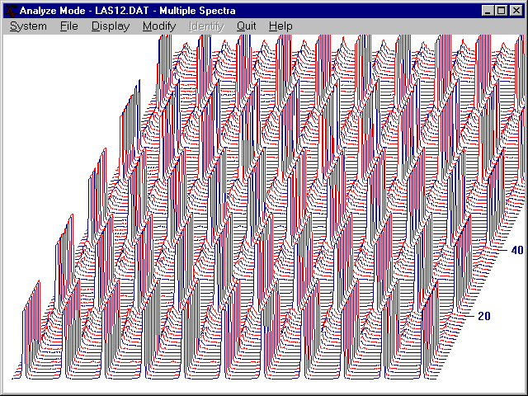
Histogram of generation of the host dye laser
Fig. 26. Histogram of the seeded and unseeded host dye laser, synchronously pumped by the 2-nd harmonic of the Nd:YAG laser and seeded by the narrow linewidth signal from the Excimer-dye laser system. For comparison it has been taken 10 shoots seeded and ten shots unseeded.
It has been shown that seeding a host dye laser formed by a retro-reflecting in Littrow configuration grating, an active dye cell and a high reflecting mirror, the wavelength and linewidth of generation can be fully controlled by the seeding laser.

Slide 45
Measurements of the intracavity power in the host dye laser
Measurements of power inside of the host dye laser cavity were done with help of a beam splitter plate (8% reflection) for different pumping energies.
The ratio between pump energy and laser energy excited inside the optical cavity was about 20%.
In the case of a normal dye laser the output power has an efficiency no more than 10 % in the best case for the case of narrow bandwidth. Everything depends on the pumping arrangements and number of amplifiers. Just the quantum oscillator has some % of efficiency and in order to improve the efficiency of the all laser, some quantum amplifiers are needed: low signal amplifier and large signal one (last stage).
Fig.27. The energy excited inside of the host laser cavity in dependence of the pumping energy of the 2-nd harmonic of the Nd:YAG laser.

Slide 46
It has been shown that seeding a host dye laser formed by a retro-reflecting in Littrow configuration grating, an active dye cell and a high reflecting mirror, can develop inside of the cavity an energy with an efficiency more than 20%, and with the wavelength and linewidth fully controlled by the seeding laser.
As it has been pointed out, this efficient laser energy can be used for intracavity experiments.

Slide 47
Proposed layout for Intracavity LIR experiments with a seeded host dye laser
Grating
Experimental section: Ion beam, e-beam and laser beam
FS
FS
HR mirror
HR-mirror
2-rd harm
Nd:YAG
Dye
Laser
Excimer
Laser
Master
Generator
Nd:YAG
Laser
Delay
Fig.28. Layout of the optical path for the proposed Intracavity LIR-experiment with a seeded dye laser.

Slide 48
            Conclusions
1. The storage devices provide optical systems that recirculate the laser pulse increasing the repetition rate of the used laser system to about 10 MHz determined by the optical path length in the ring. The length of the pulse train is limited by optical losses. The reported lifetime of the laser pulse inside the ring was about 5000ns, enhancing the integrated laser power in the interaction region by a factor of 4.
We have amplified the injected and stored laser pulse from the excimer-dye laser system in an optical ring and in a Linear Setup. The stored high power laser pulse could be amplified by 30-200 times by a complementary inserted amplifying cell with the proper dye concentration pumped by an external synchronized laser source. With that device we could increase the integrated laser power in the interaction region by an additional factor of 6. By choosing different delays, we can amplify the stored laser pulse at different turns, which is an advantage in case of time resolved experiments.
3. It has been shown that seeding a host dye laser formed by a retro-reflecting in Littrow configuration grating, an active dye cell and a high reflecting mirror, can develop inside of the cavity an energy with an efficiency more than 20%, and with the wavelength and linewidth fully controlled by the seeding laser. This efficient laser energy can be used for intracavity experiments.

Slide 49
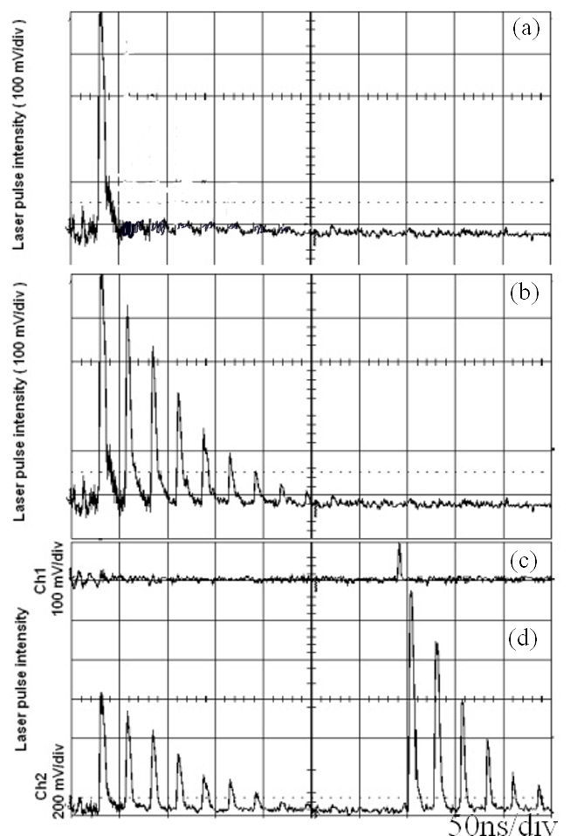
The optical laser ring with the implemented amplifier allows us to gain a factor of
about 23 in comparison with single passage of the laser pulse through an optical thin
experimental section.
One Pass Configura-tion | Integrated Power
Optical Laser Ring | Integrated Power | Enhancement Factor
Optical Laser Ring with Amplifier | Integrated Power |  | Efficiency
One pass configuration
Optical Laser Ring
Optical Laser Ring with Amplifier
Fig.29. Photodiode signal from the laser pulse for different configurations.

