Slide 1
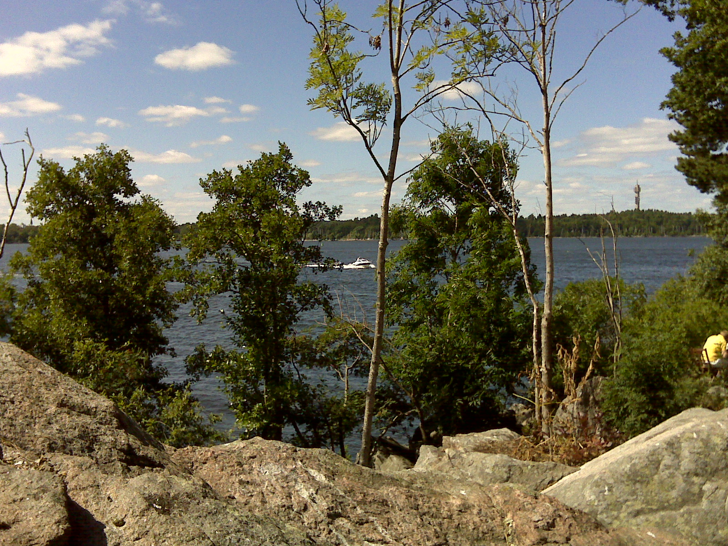
SUSY post LHC-8: what’s excluded, what’s not
Alan Barr

Slide 2
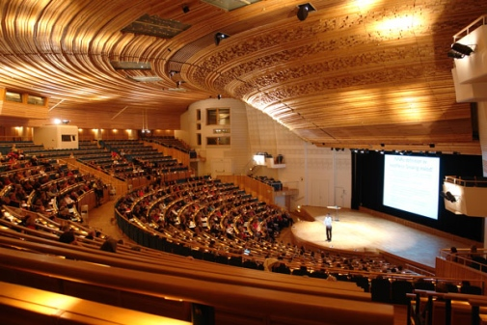

Slide 3
Review: O. Buchmueller, EPS, 24 July

Slide 4
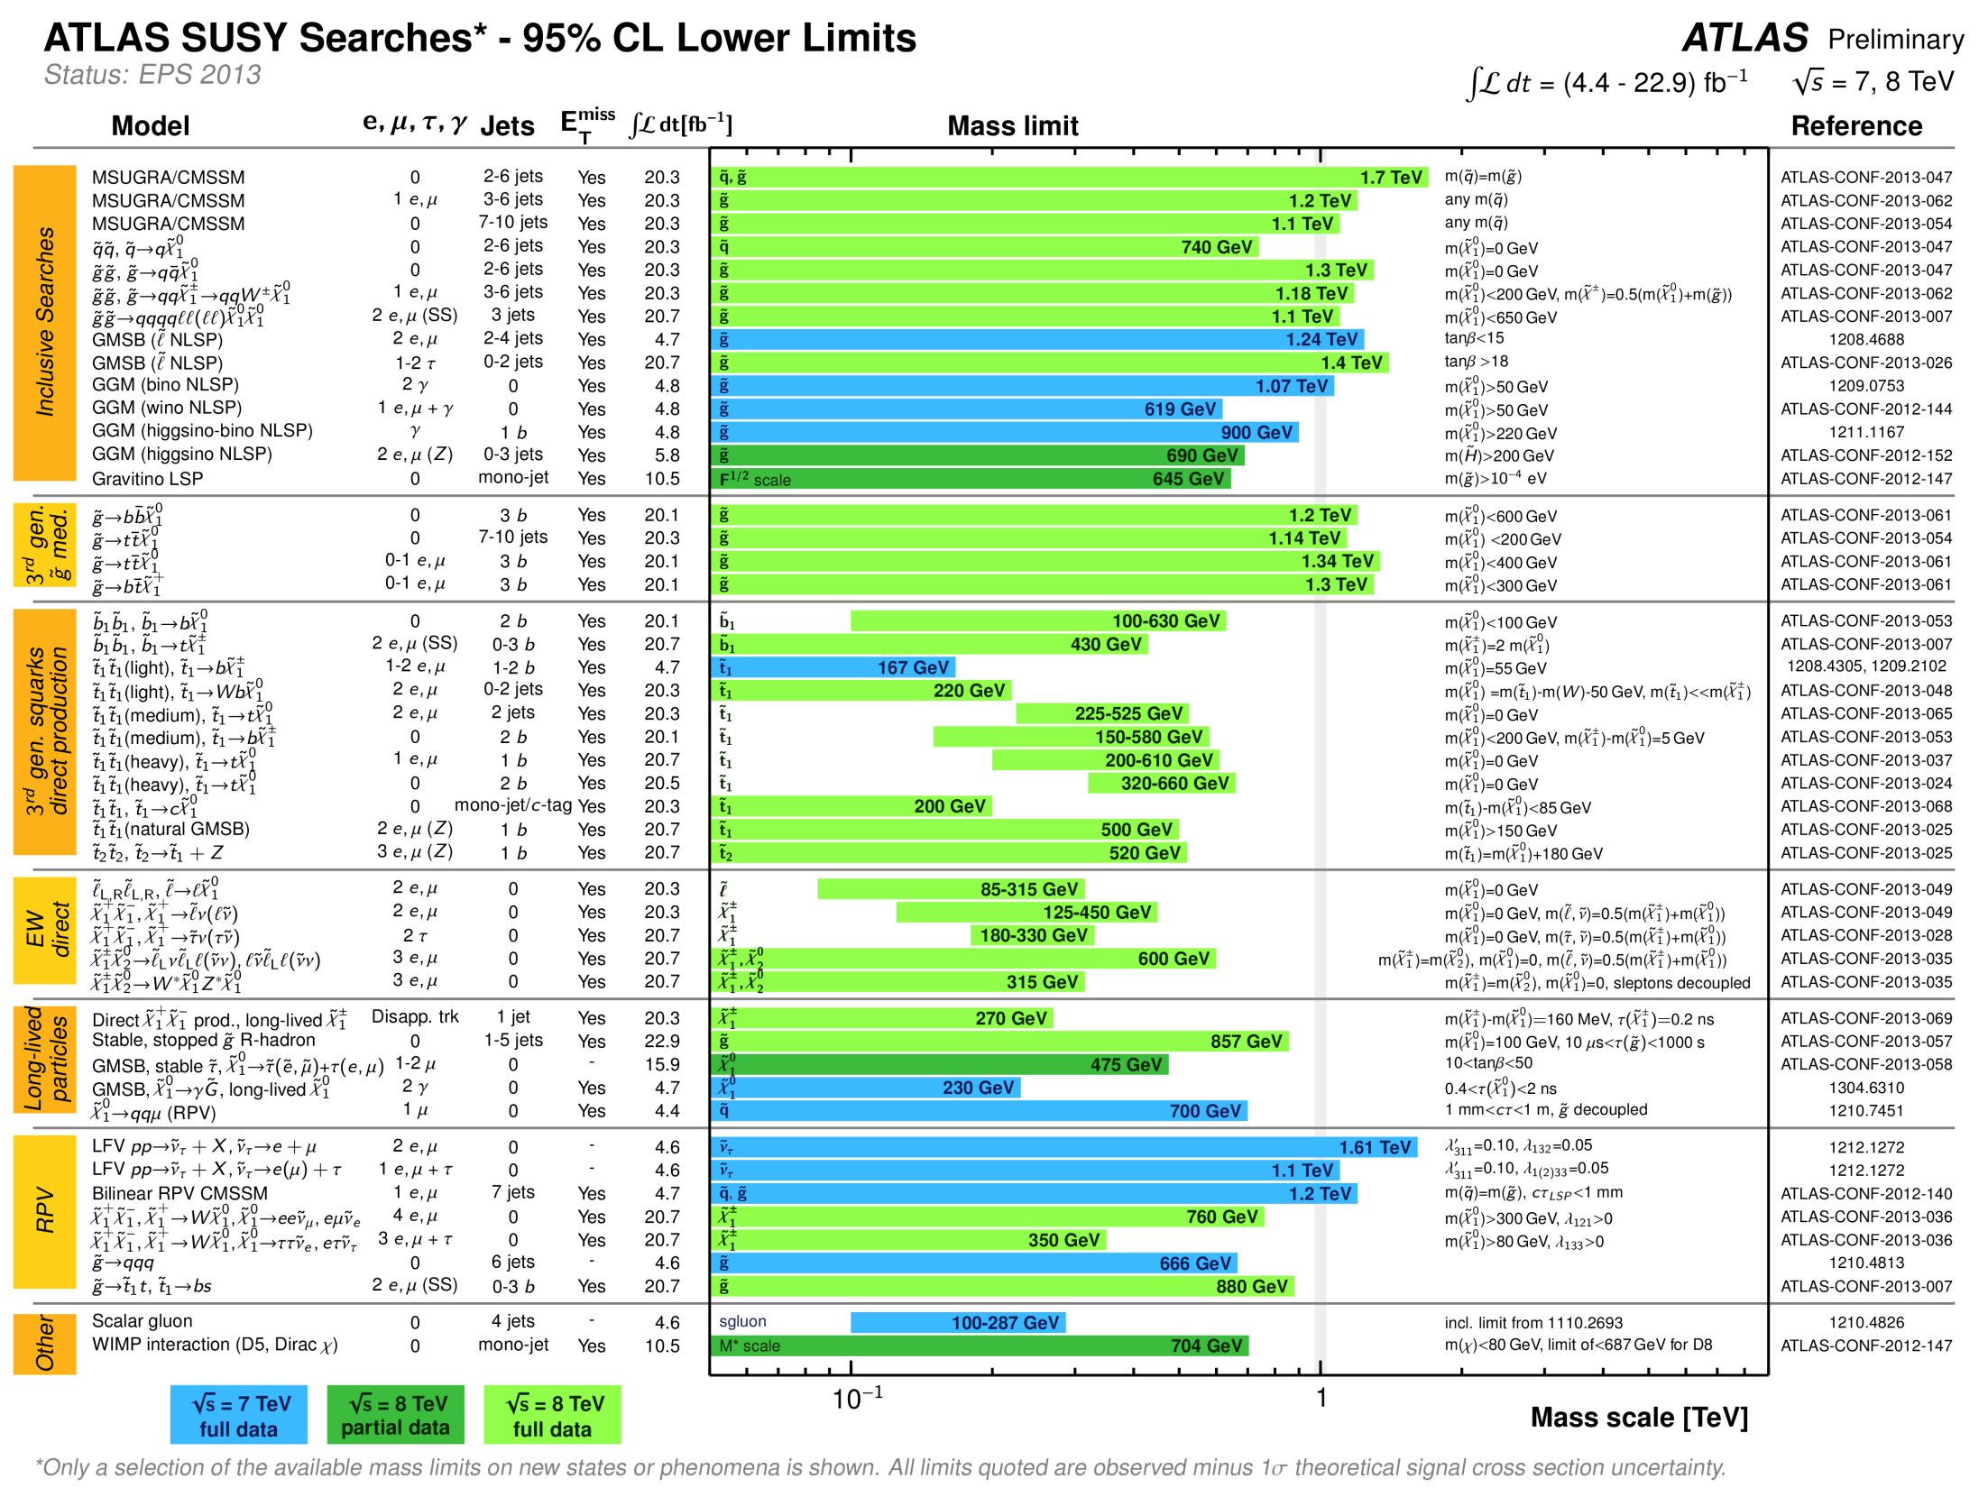
Notes:
Purpose of these plots:
1) Interpretation
2) Benchmarking
Experiments compete to search for higher mass particles
Higher reach reflects “performance”
Operational efficiency
Sensitivity to invisibles
Particle ID
Kinematic discriminants
Statistical techniques

Slide 5
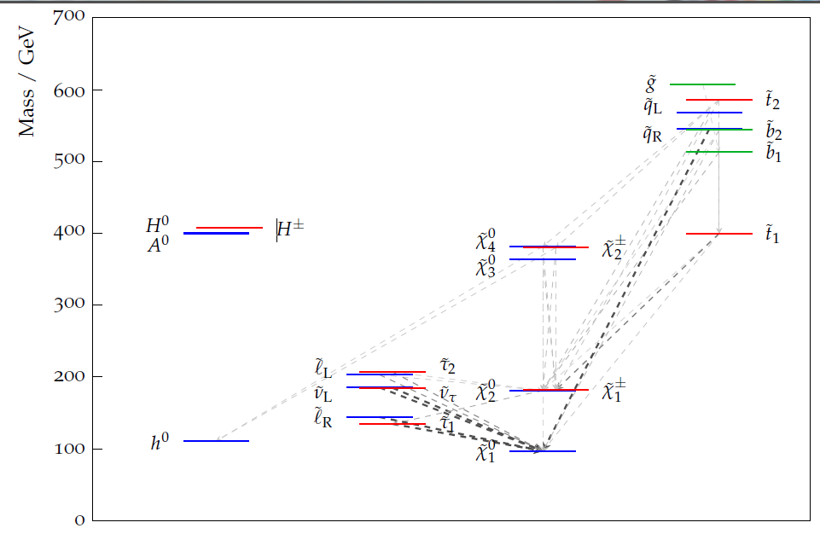
A “typically” model
Notes:
Complicated - lots of decay final states

Slide 6
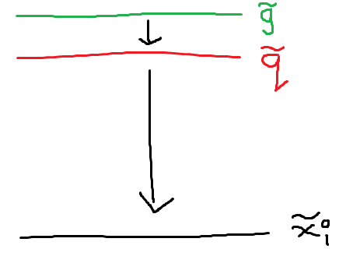
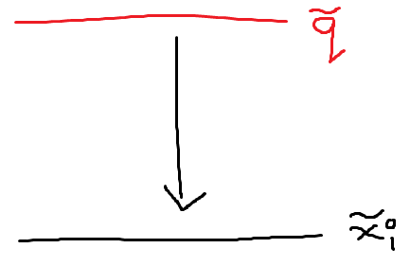

Slide 7
Jet
Jet
P_{T}^{miss}

Slide 8
A great deal of careful analysis later…
Different Signal Regions

Slide 9
The experimentalists’ job could (should?) stop there
We provide the maximum cross-section for new physics
Everything from this point basically can be done by interested theorists

Slide 10
LSP mass
500 GeV
Allowed
Excluded
0
500 GeV
1 TeV
Squark mass

Slide 11
…but what about…
non-degeneracy of squarks?

Slide 12
Notes:
Complicated - lots of decay motefinal states

Slide 13
LSP mass
500 GeV
Eight-fold squark degeneracy
One squark only
0
500 GeV
1 TeV
Squark mass

Slide 14
…but what about…
squarks far from gluinos?

Slide 15
Squark Mass
2.5 TeV
2 TeV
M(LSP) = 700 GeV
Massless LSP
1 TeV
Gluino Mass
1 TeV
1.5 TeV
2 TeV

Slide 16
…but what about…
competing decay chains?

Slide 17
Simplified model interpretations typically assume 100% BR

Slide 18
1305.6921
SLAC group : Cahill-Rowley et al

Slide 19
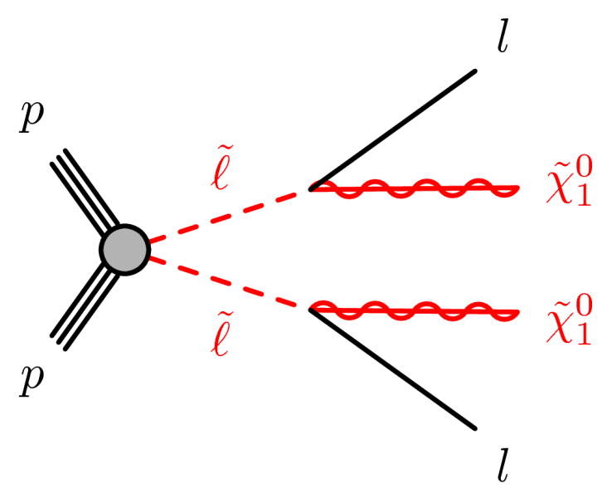
Sleptons?

Slide 20
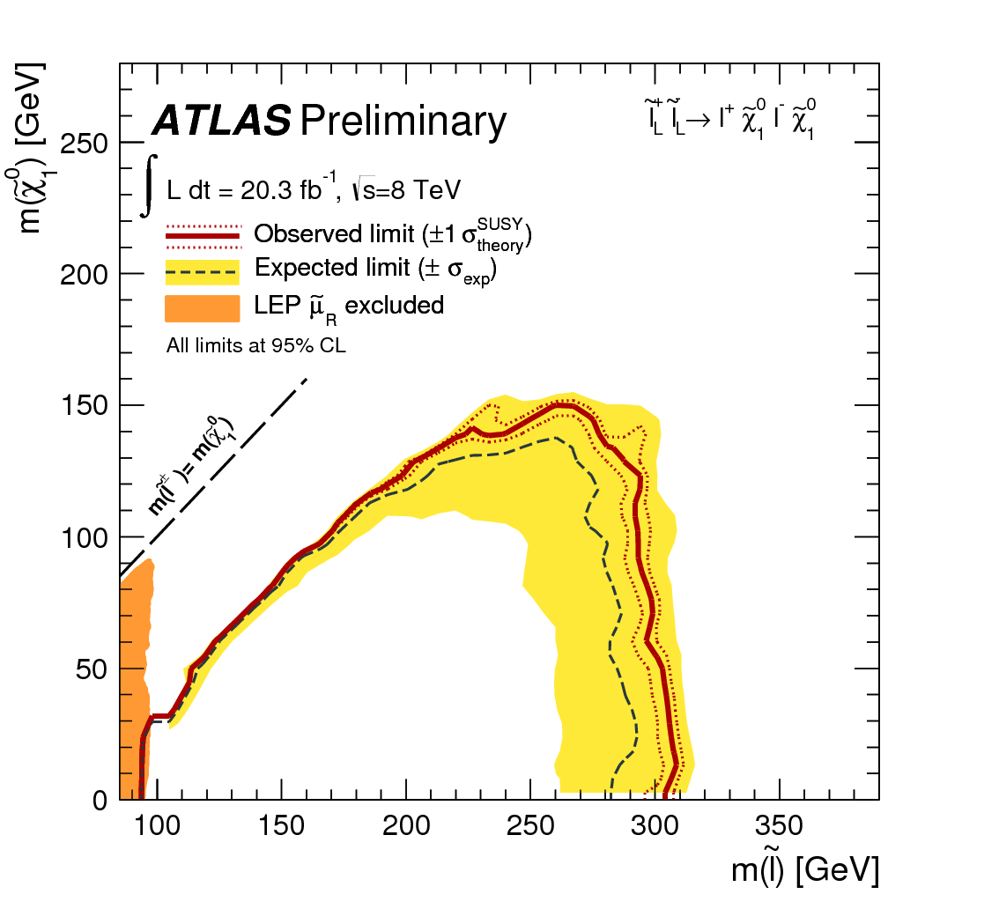
Left sleptons

Slide 21
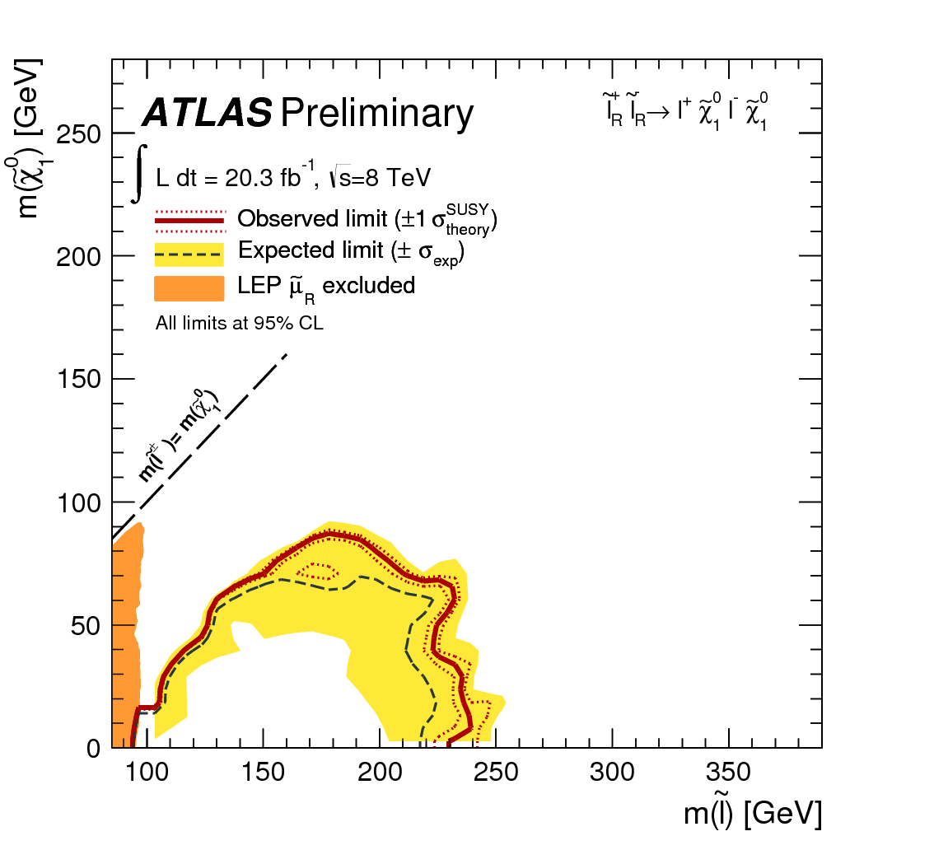
Right sleptons

Slide 22
(
Intermezzo
It’s very easy to discovery things which are not there
Many examples…

Slide 23
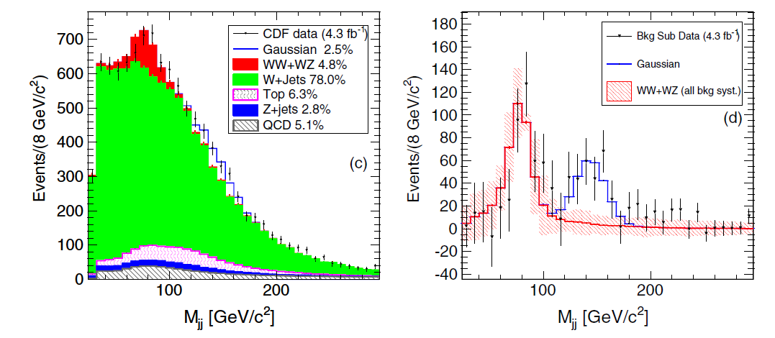
PRL 106, 171801 (2011)
CDF: new resonance?
CDF W + dijet analysis 2011
4 Apr 2011

Slide 24
CDF: CERN Seminar Tuesday 23rd July

Slide 25
)

Slide 26
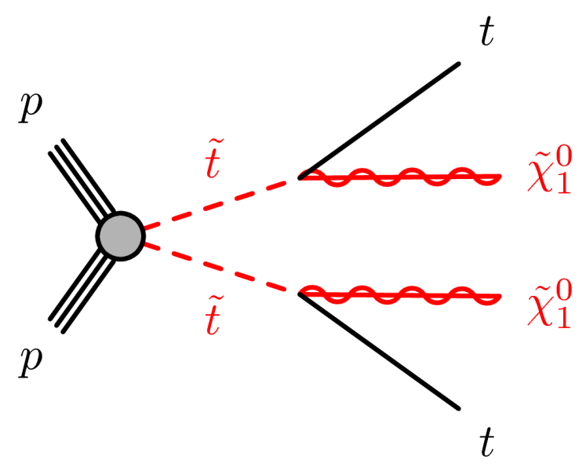
Stop squarks

Slide 27
LSP mass
c + LSP
b + W + LSP
300
t + LSP
200
100
0
200
400
600
Stop mass (GeV)

Slide 28
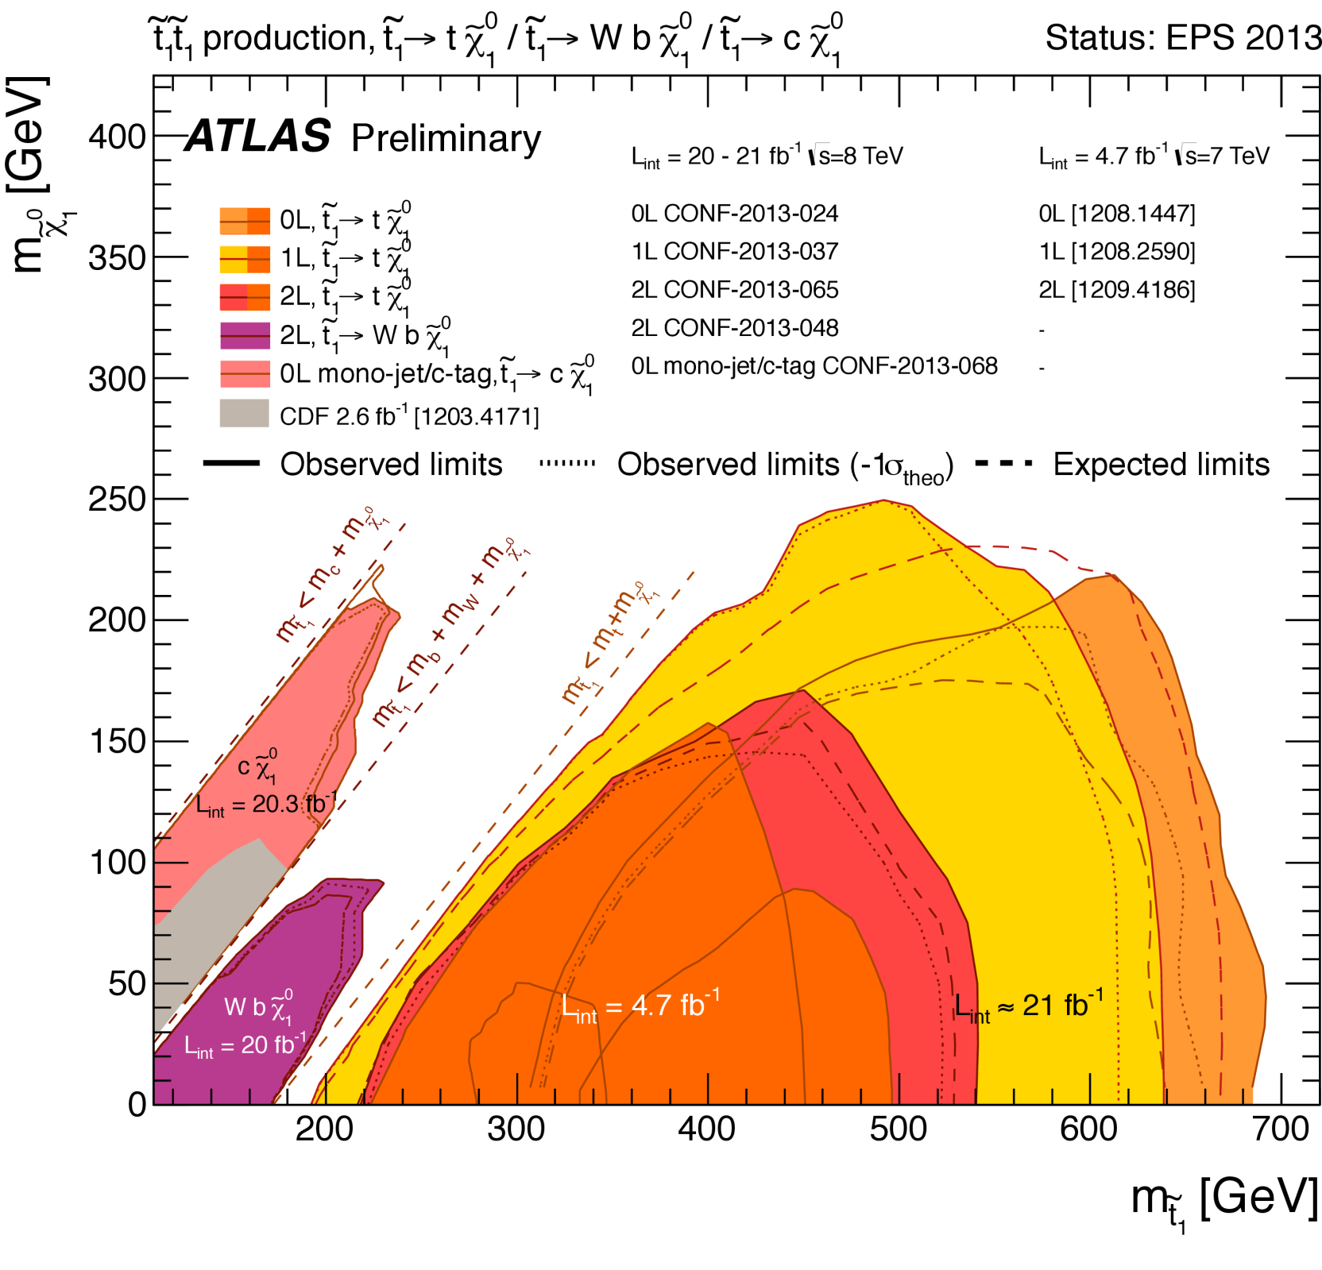

Slide 29
Look at pMSSM exclusions…

Slide 30
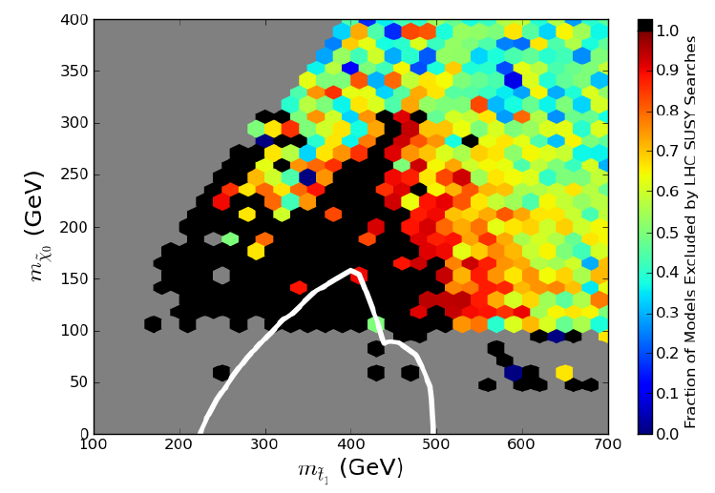
More sensitivity in pMSSM than for simplified model ??
1305.6921
SLAC: Cahill-Rowley et al

Slide 31
?

Slide 32
B Jet
B Jet
P_{T}^{miss}

Slide 33
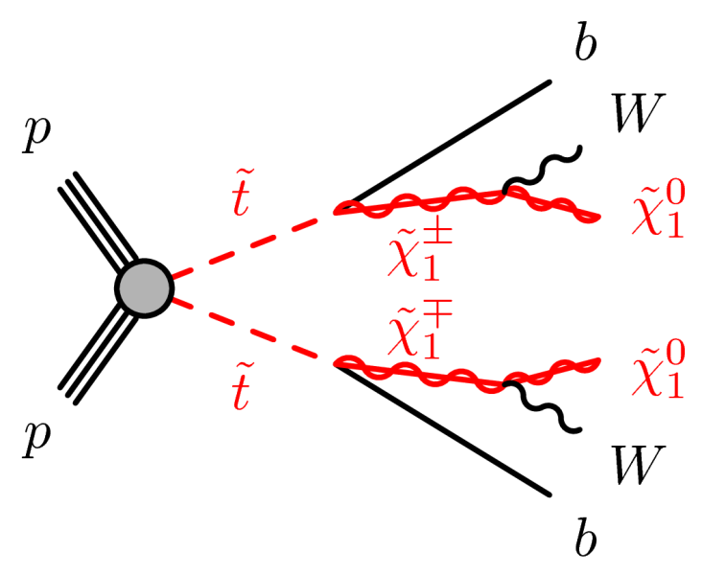
Competing b + b + MET final state often more sensitive (in pMSSM)

Slide 34
Stop Squark
B-jet
Chargino
Neutralino

Slide 35
In this case a competing decay process extended the reach!
➔ Hard to draw very general conclusions

Slide 36
Where are the gaps?
Near-degenerate particles
Low cross sections
Decays split between chains
Combinations of these
Or… help us find others!

Slide 37
Beyond the LHC
Luminosity of LHC at 1%
Energy 8/14 of final design energy
Lots more to do….

Slide 38
LHC: lumi upgrade?
300/fb ➔ 3000 /fb
Stop Squarks
Squarks and gluinos
Sleptons and gauginos
http://cds.cern.ch/record/1472518/files/ATL-PHYS-PUB-2012-001.pdf

Slide 39
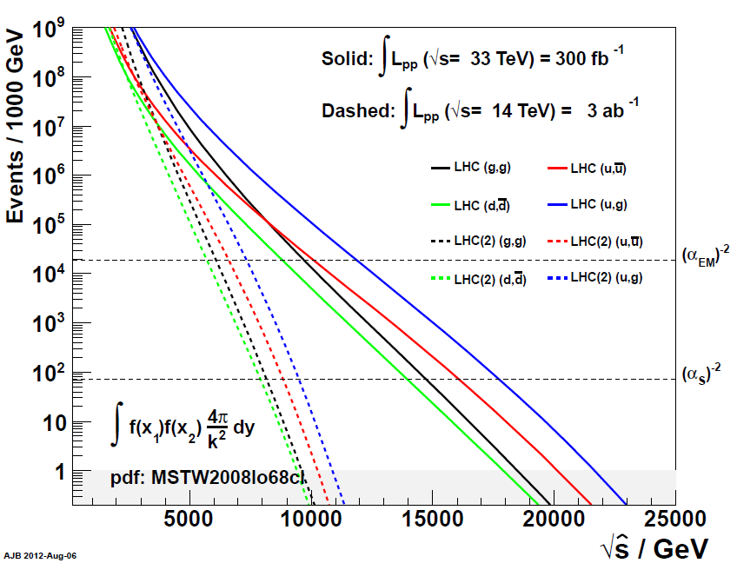
VLHC?
A 33 TeV machine?

Slide 40
An e+ e- machine – the ILC?
LSP mass
ILC ONLY?
LHC LUMI UPGRADE
Slepton mass

Slide 41
Summary
LHC experiments very sensitive to many BSM scenarios – excellent operation
Limits inevitably depend on model assumptions
Simplified models are models
Do test your own models
Help us find gaps

Slide 42
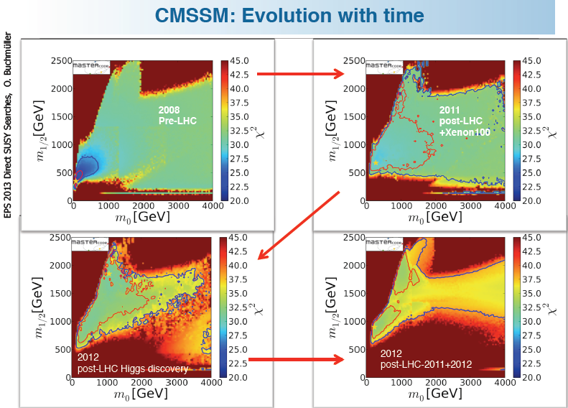

Slide 44
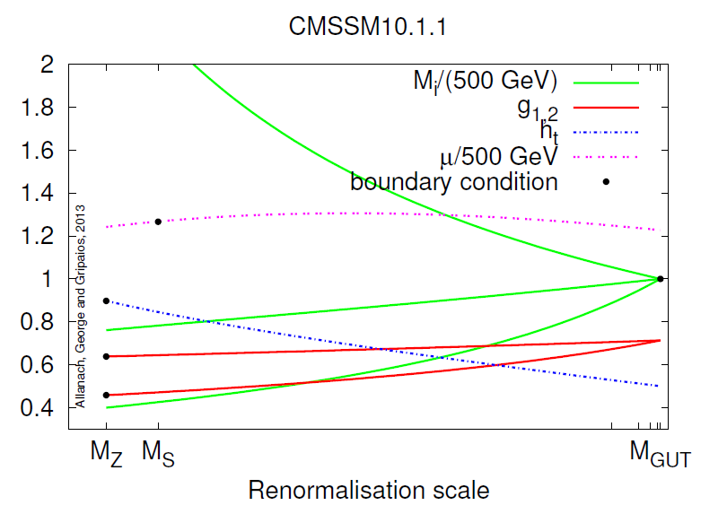
Allanach, George, Gripaios
arXiv:1304.5462
Non-linear constraints at several different scales. Non-linear evolution

Slide 45
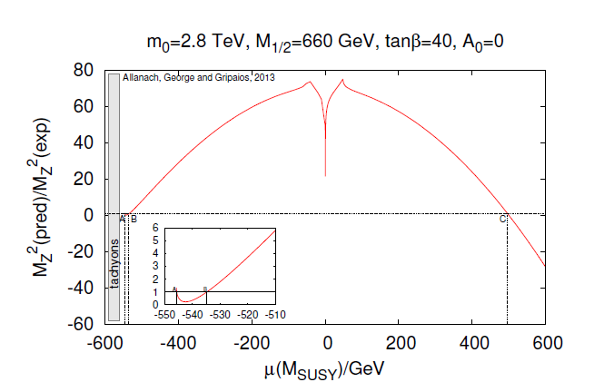
Multiple solutions for particle masses at a single “point”

Slide 46
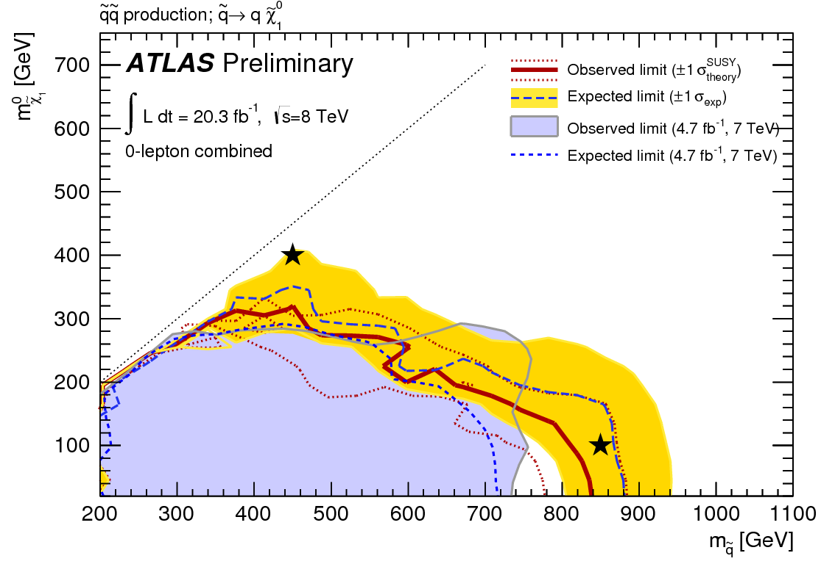

Slide 47
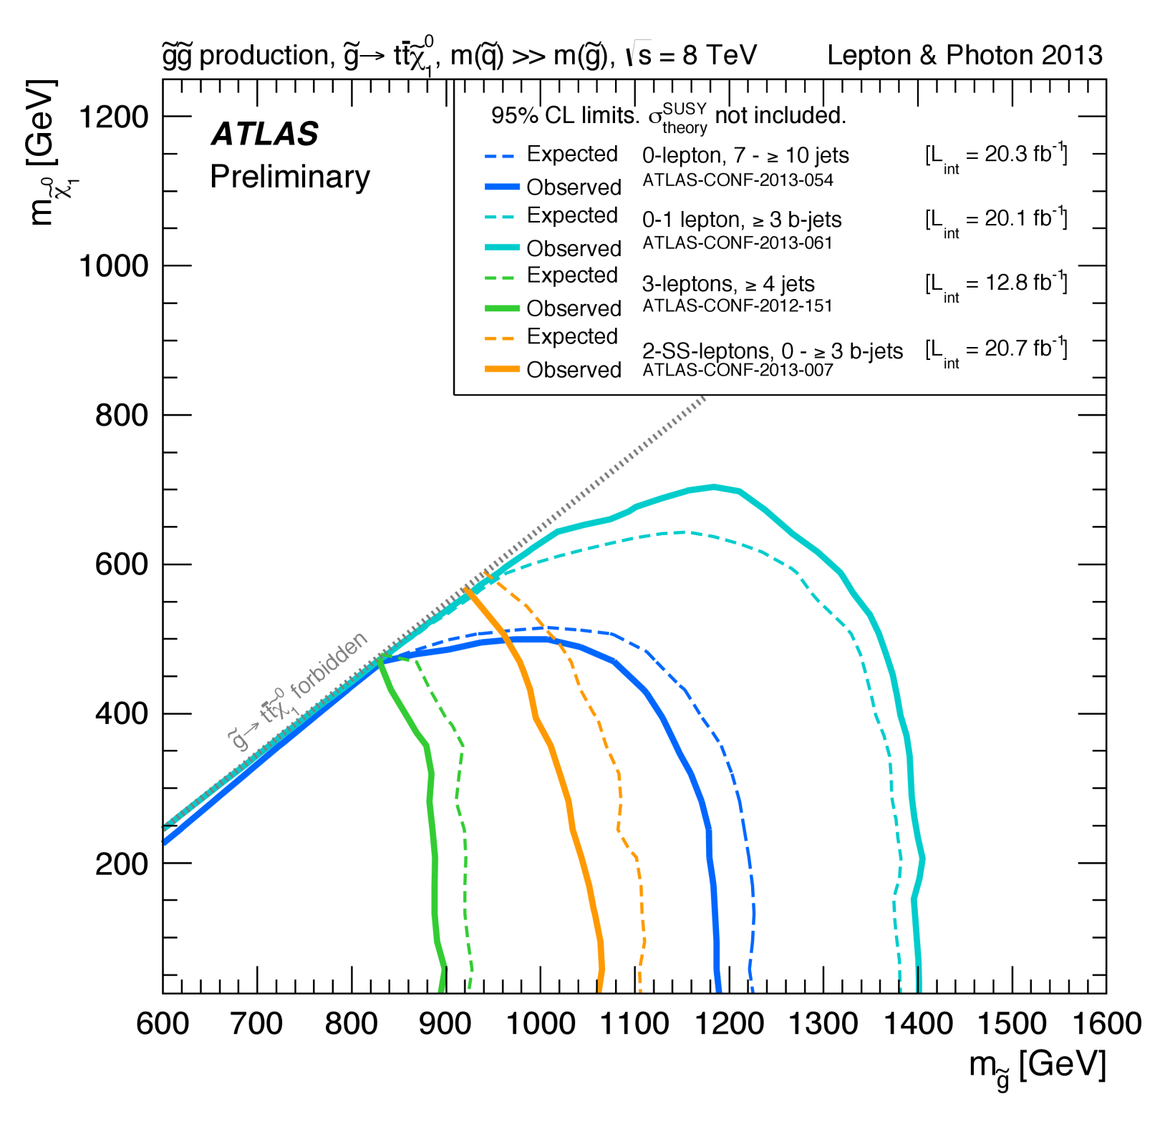

Slide 48
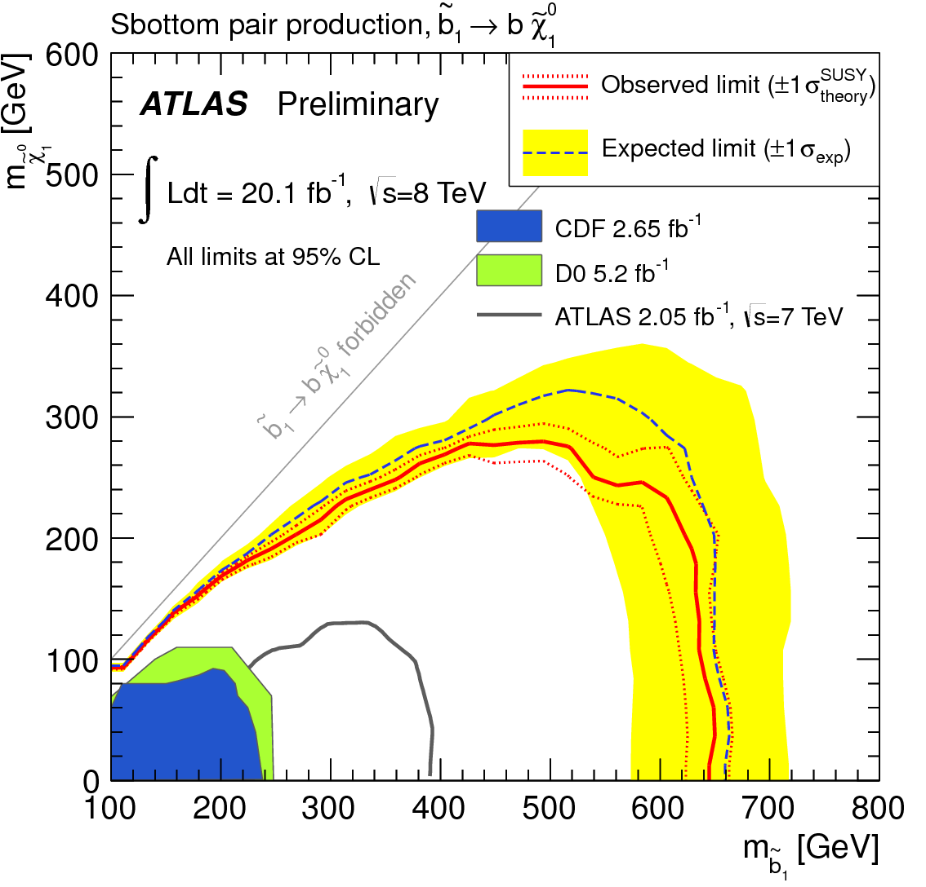

Slide 49
