Slide 1
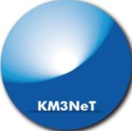
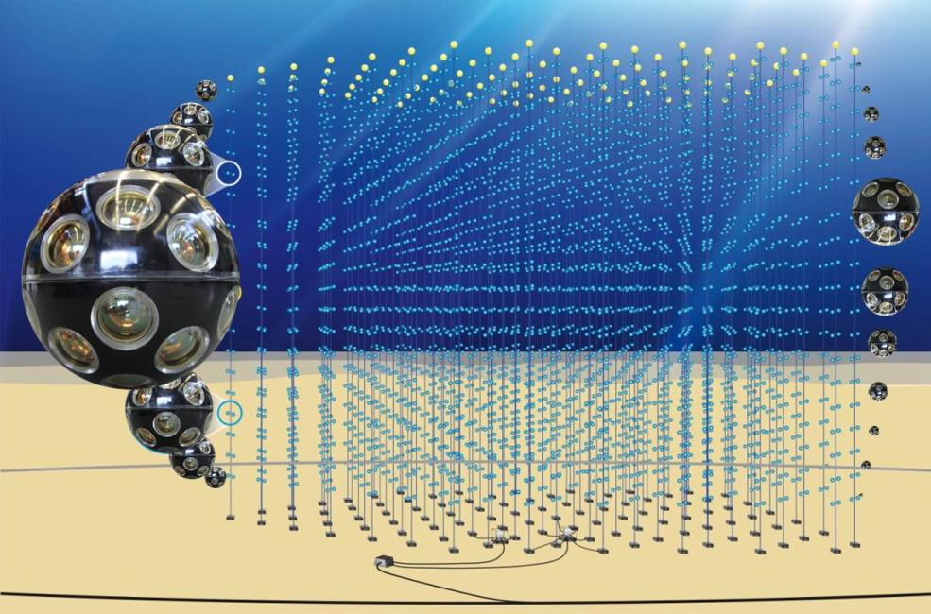
Power network in large area detectors
Eric Heine, Nikhef KM3NeT power coordinator,
on the behalf of the KM3NeT collaboration

Slide 2

Contents
KM3NeT Research Infrastructure
Site floor networks
Technical aspects of a large area power network:
  AC vs DC
  Conversions
  Load behavior
  Grounding
  Fuse regime
  On/Off procedures
Status implementation KM3NeT power networks
Acknowledgements

Slide 3
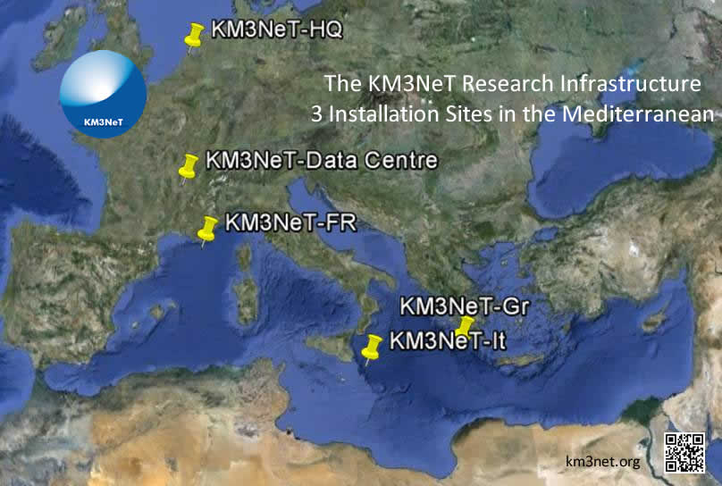
KM3NeT Research Infrastructure
KM3NeT-Fr, coast of Toulon, 38 km, 2500 m
KM3NeT-It, Capo Passero, Sicily, 100 km, 3500 m
KM3NeT-Gr, Pylos <30 km, 3000 < 5000 m

Slide 4
KM3NeT-Fr Network
38 km from shore,
2500 m depth
10 W / DOM, 1000 W / ESS
Phase 1; 7 kW from shore

Slide 5
KM3NeT-It Network
100 m
100 km from shore,
3500 m depth
10 W / DOM, 15 W / floor
Phase 1; 9 kW from shore

Slide 6
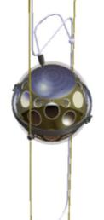


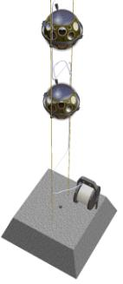

Technical aspects
Proven technology
Cost effective
Simple
Reliable
Flexible
AC vs DC
Conversions
  AC/DC
  Voltage level
Load behavior
  DC loads
  Constant power
Grounding
Fuse regime
On/Off procedures

Slide 7
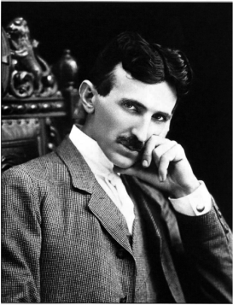
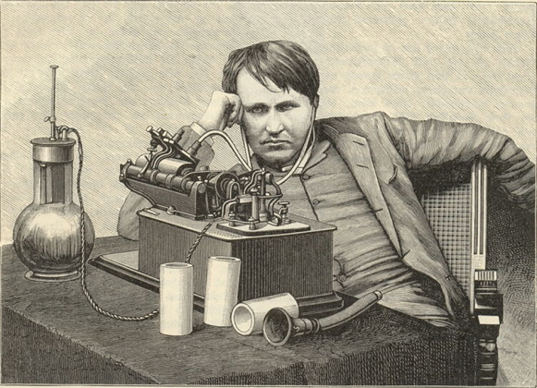
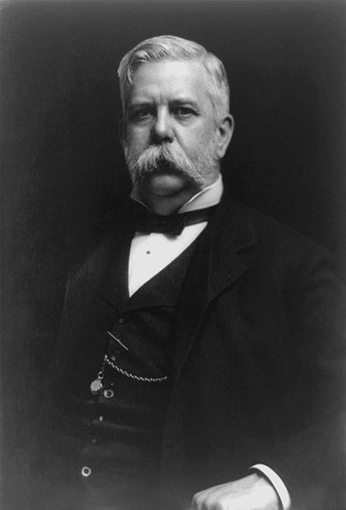
AC - DC
War of currents
1850 - 1900
Nikola Tesla
AC
Thomas Edison
DC
220-240 V at 50 Hz became the standard in Europe.
Some cities continued to use DC well into the 20th century. In central Helsinki, there was a DC network in existence up until the late 1940s, and in the 1960s, Stockholm's dwindling DC network was eliminated.
George Westinghouse
https://en.wikipedia.org/wiki/War_of_Currents

Slide 8
AC or DC in long cables
Losses
AC cable : (I_{load}+ I_{Crms})² (R+ jωL) + I_{Crms}² /jωC
Skin effect, proximity effect
DC cable : I_{load}²R
Isolation
Cable isolation depends on peak voltage: U_{peak}=U_{ac} √2=U_{dc}
P=I_{ac}·U_{ac}=I_{dc}·U_{dc}
A DC cable can transfer √2 more power.
PFC
Load
AC concept
Load
DC concept
e.g. Transfer efficiency @ 6.5 kW off shore, 3.5 kV on shore
  AC: 33%, DC: 96% @ 100 km cable
  AC: 85%, DC: 98% @ 38 km cable
E.Heine, H.Z.Peek, “Power distribution”, 2003; 2003 http://www.vlvnt,nl/proceedings/

Slide 9
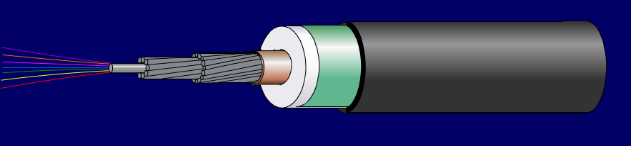
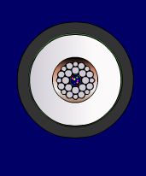
Main Electro Optical Cable
Alcatel OALC xx 27mm LWP (light weight protected)
Fibers
Stainless steel tube
2 layers steel wire strands + water blocking compound
conductor of welded copper
HDPE diam. 17 mm
metal tape with overlap
PE sheath for additional abrasion and fish bite protection diam. 27.5 mm
KM3NeT-Fr KM3NeT-It
OALC 7 OALC 3
36 Fibre 20
4 kV 10
AC type DC
38 km 100
R = 0.7 Ω/km cable
L= 0.4 mH/km cable
C= 180 nF/km cable
N.B. One wire + sea return

Slide 10
AC – DC conversion
Classic
current
voltage
Classic:
more harmonic noise
higher I²R losses (3 x)
PFC (Power Factor Correction)
constant power load
voltage and current in phase
dilivered
power
PFC
voltage
current
I
U
control
C
~200kHz
C
delivered power

Slide 11
DC – DC conversion
input circuit
switching circuit
rectifying circuit
output circuit
boost converter
transformer isolated converter
+
+
+
+
control
-
~200kHz
control
~200kHz
-
-
-
Use:
KM3NeT-It KM3NeT-Fr
Shore-subea 10kVdc 4kVac
To detection unit 375Vdc 400Vac
Detection unit 375Vdc 375Vdc
Sensor 12Vdc 12Vdc
http://www.emersonnetworkpower.com/en-US/Brands/Netsure/ensys-400v-dc/Pages/400v-dc-technology.aspx
400V DC Microgrid Small Scale Demo System for Telecom and Datacom Applications, VICOR, Presented at INTELEC 2012

Slide 12
Load behavior
transformer isolated converter
+
+
Stablized voltage output ≈ constant power load
-
Network voltage↓=Network current↑=Cable loss↑
control
~200kHz
-
feed back
load
P1
V0 = source voltage [V]
V1 = load voltage [V]
P0 = source power [W]
P1 = load power [W]
I = current [A]
L = length of connection [m]
r = connection resistance [Ω/m]
V1
I1
L1
Pn
Vn
In
Ln
Pn+1
[V]
source
Vn+1
Vn> ½V0]

Slide 13
Grounding
Prevent any circuit from a floating situation
ESD
isolation
Use one (1) low ohmic grounding point
e.g. 100 Ohm at source side
Avoid ground currents
electrolytic corrosion effects
signal/noise ratio

Slide 14
Fuse regime
Main purpose: Prevent fault propagation
̴
= fuse
DU
̴
DOM
18x
̴
DOM
̴
̴
̴
MVC
̴
JB
̴
Base
̴
̴

Slide 15
Status
KM3NeT-Fr
  Caclulation model
  Start up
  Shore station components
  Node design
Status KM3NeT-It
  Calculation model
  Progress in situ
  Power components
  Junction box design
Detection unit
  VEOC DC/DC converter

Slide 16
KM3NeT-Fr

Slide 17
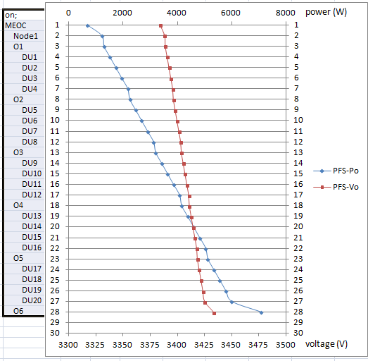
Start - up
Time
Increasing shore voltage to keep node output constant
After timeout automatic switch on

Slide 18
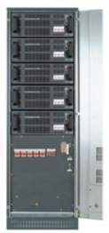
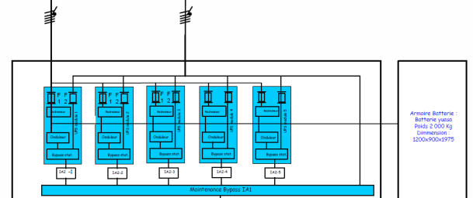
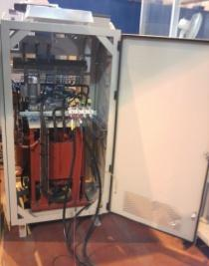
Power Feed Station
Main grid
Presently we have 3 x 30kVA modules
We can supply one full node
Battery
UPS
Micvar 3kW
Micvar 3kW
Thermo-magnetic circuit breaker
Thermo-magnetic circuit breaker
Thermo-magnetic circuit breaker
HV transf.
Variable power 54kVA
230V / 1 033 V – 3 720 V
Thermo-magnetic circuit breaker
Thermo-magnetic circuit breaker
Self
Adjustable compensation inductance
From 1,1H to 1,47H
Self.
Thermo-magnetic circuit breaker
Outlets
(phone, computer, …) 230V, 16A
Lighting 230V, 500W
3 air conditioning 230V, 15kW
Seabed network1
Seabed network 2

Slide 19
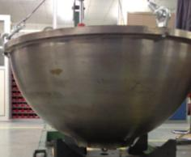
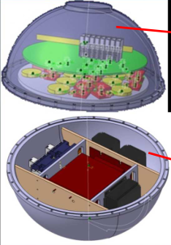
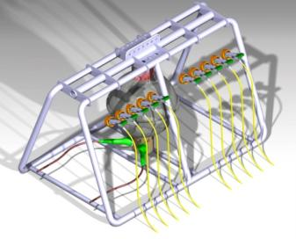
Node progress

Slide 20
KM3NeT-It
Preleminary
cable lengths

Slide 21
Junction Box design
Rosanna Cocimano

Slide 22
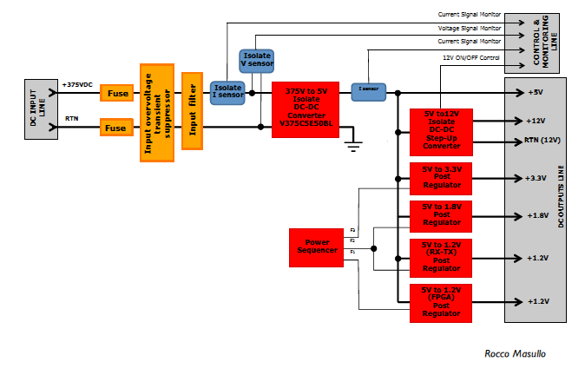
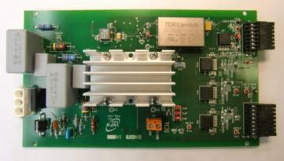
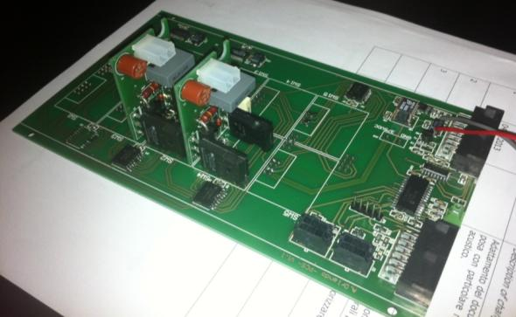
Power components
400 V to 12, 5, 3V3
<50 W
400 V, 2 A breaker
Angelo Orlando

Slide 23
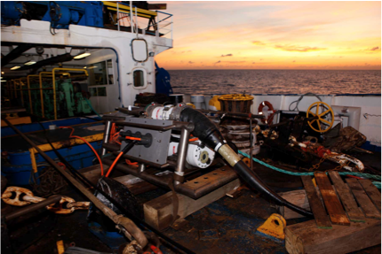
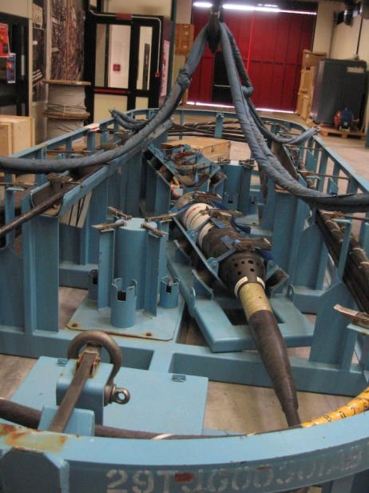
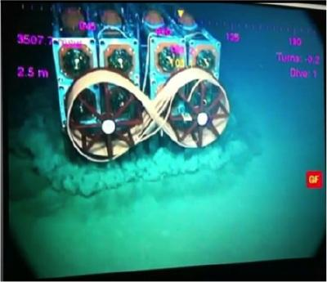
Progress
MVC, deployed and working
New CTF production
Proto tower deployed and working

Slide 24
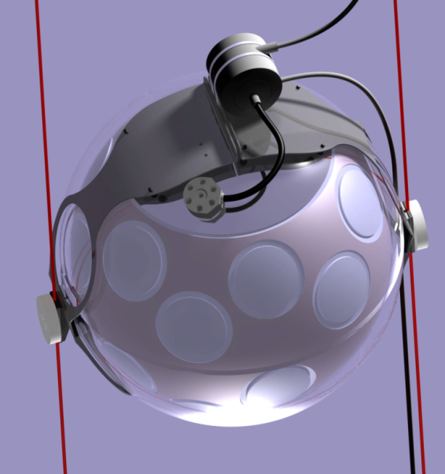
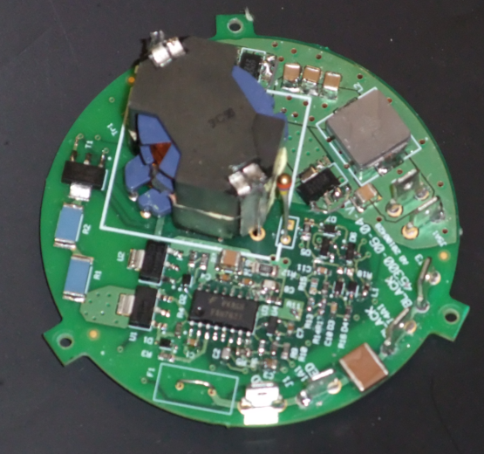
VEOC DC/DC converter
400 V to 12 V
2 – 15 W
4000 V isolation in/out
70 mmø x 30 mm
In oil up to 60 MPa
Galvanic barrier between
DOM and backbone cable

Slide 25
Summary
Reliable calculation model for KM3NeT power system available
Components have been defined
KM3NeT-Fr (38 km off-shore)
  AC upto the base of the Detection Unit
  Main cable delivered and ready for deployment
KM3NeT-It (100 km off-shore)
  DC only
  Existing network being expanded
KM3NeT-Gr (<30 km off-shore)
  Design will be similar to that of KM3NeT-Fr

Slide 26

Acknowledgement
I would like to thank my colleagues in the KM3NeT collaboration;
Rosanna Cocimano, Angelo Orlando and Riccardo Pappaleo of LNS/INFN, Stephane Theraube, Jean-Jacques Destelle and Patrick Lamare of CPPM,
Paul Timmer of Nikhef
for all their interactions on this subject. (… and everybody I forgotten)
The pictures shown in this paper are from several presentations given in the KM3NeT collaboration meetings.

