Slide 1


Long-term optical background measurements in the
Capo Passero deep-sea site
Maria Grazia Pellegriti– INFN, LNS
for the Nemo collaboration
VLVnT13 - 5-7 August 2013 AlbaNova University Center

Slide 2
Outline
The tower deployment on March 2013
The Nemo tower instrumentation
Rate monitoring
Oceanografic instruments measurements
Conclusions
VLVnT13
M.G. Pellegriti INFN-LNS

Slide 3
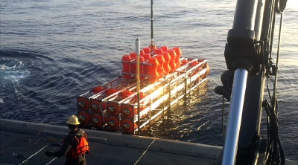
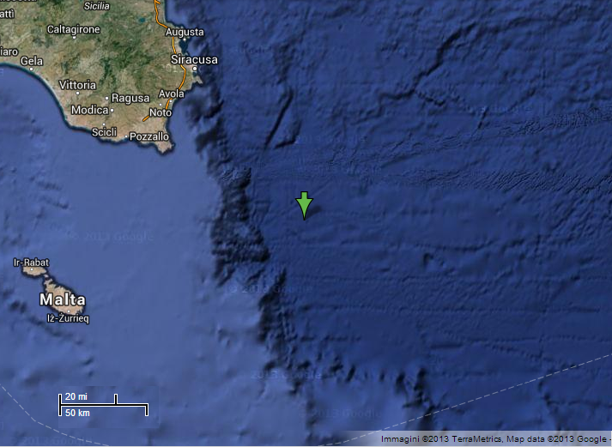
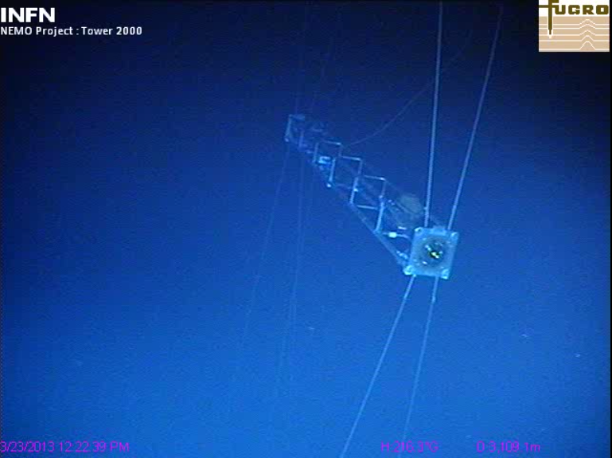
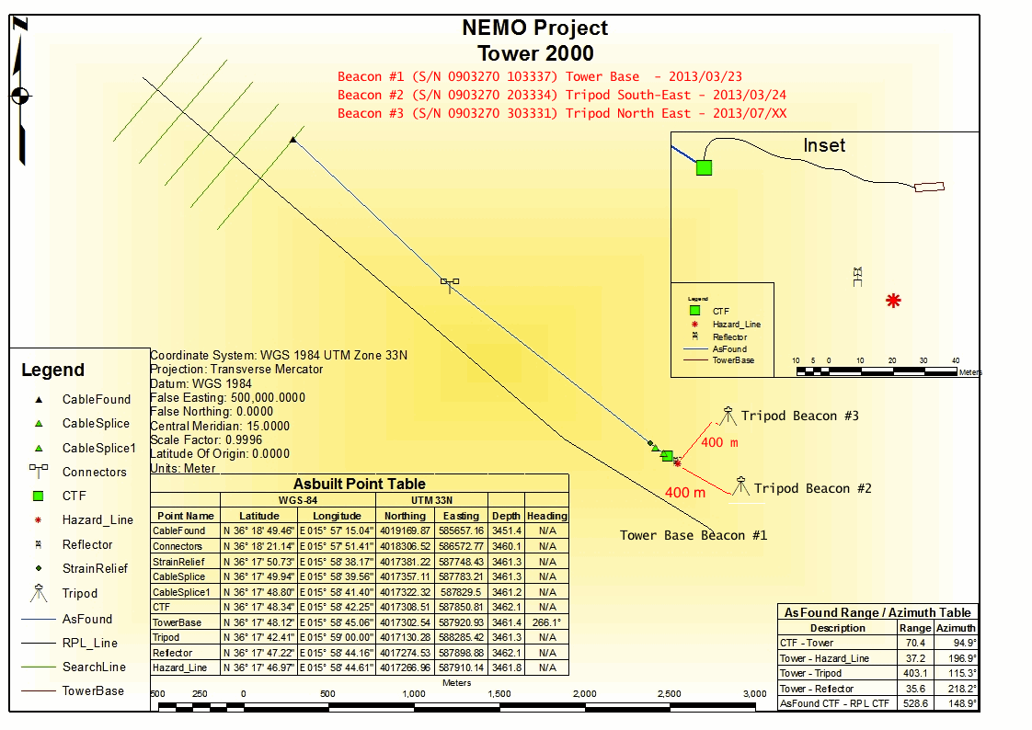
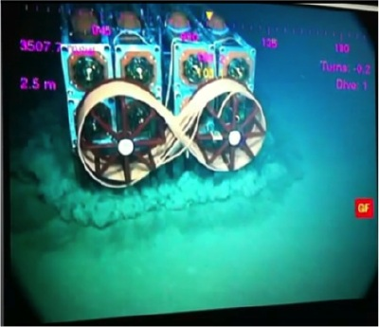
23/03/2013 - the tower deployment
Deployment of the NEMO-Phase2 Tower from the “Nautical Tide”
Capo Passero
+36° 17' 48.12", 15° 58' 57.00"
100 km
Inspecting the tower with the ROV
The tower touches the sea-bottom at 3500m depths

Slide 4
The NEMO Phase-2 tower: main components
4 OMs/floor
2 acoustic sensors
8 floors
8 m bars, vertical dist. = 40 m, H_{tot} = 450 m
32 OM, 16 acoustic sensors for positioning and bioacoustics (see talk of S. Viola)
oceanographic instrumentation
VLVnT13
M.G. Pellegriti INFN-LNS

Slide 5
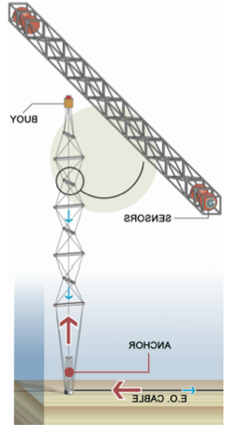
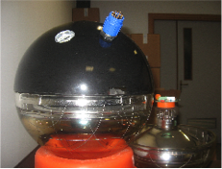
Off-Shore DAQ
Floor Control Module (FCM)
The OM sphere contains:
→10 inch PMT (Hamamatsu R70t81)
Threshold at 0.3 s.p.e.
→ The voltage supply circuit
→The Front End Module (FEM)
→Optical system for timing Calibration
Buoy
Optical
Module
(PMT+FEM)
The FEM digitizes the PMT analog signals, encodes and transmits the data to the Floor Control Module (FCM).
The signal is sampled by using two 8-bit Fast ADC running at 100 MHz (for low power dissipation) staggered by 5ns.
To match the PMT dynamic range to the ADC input, the signal level is shifted and compressed by a non-linear circuit.
Timing allignment is perfomed by using a fast optical pulser, driven by a control module, which generates short duration pulses emitted by a blue LED (sub-nasecond accuracy for offsets determination)
Anchor
E.O.Cable
off-shore
VLVnT13
M.G. Pellegriti INFN-LNS

Slide 6



DAQ and slow control
Floor Control Module (FCM)
Ethernet FCM
(eFCM)s
twin boards
Acoustics
Buoy
Optical
Module
(PMT+FEM)
Laser
to TriDAS (Trigger and Data Acq)
see talk of F. Simeone
Ethernet conn.
to Slow Control (Data Manager,
Database, Storage)
Anchor
DWDM
Mux
E.O.Cable
off-shore
on-shore
VLVnT13
M.G. Pellegriti INFN-LNS

Slide 7
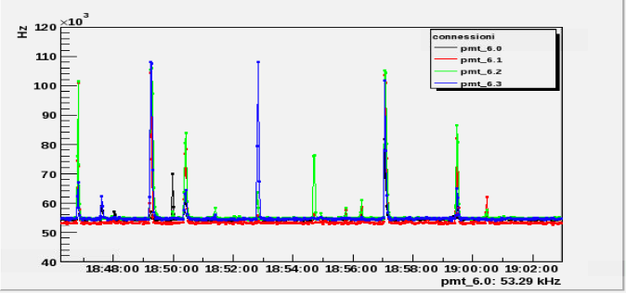
PMT Counting rate
Instantaneous rate from TriDAS
Average rate from slow control
consistency checks to use average rates for monitoring
Dead time ∼ 0
for rates < 100kHz
saturation effects
above 120 kHz
15 minutes
Δt
Data rates are sampled once per second by the front-end electronics
Rate measured in a time window ∆t=10ms
No “dead time” effects
10 ms
1s
VLVnT13
M.G. Pellegriti INFN-LNS

Slide 8
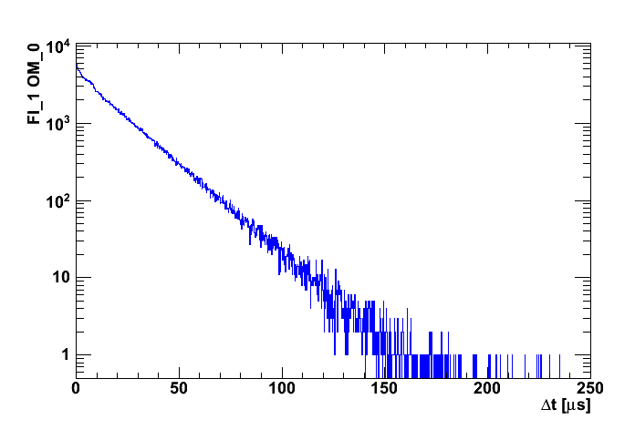
Distribution of time differences between
consecutive hits
Run 412 File 0, file duration ~2h43m
Floor 1 PMT1
counts
VLVnT13
M.G. Pellegriti INFN-LNS

Slide 9
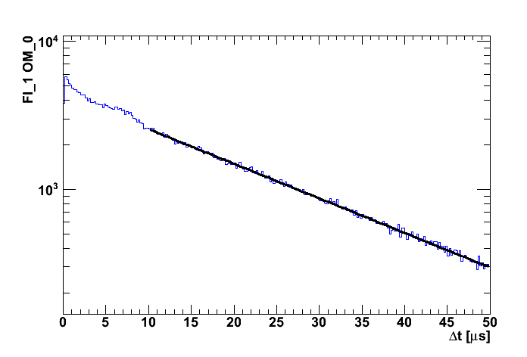
Rates from single events
Run 412 File 0, file duration ~2h43m
Floor 1 PMT1
dN/dt = A e^{-Δt/τ}
1/τ = -53.7±0.2 kHz
counts
Type-II
AfterPulses
Similar behavior and values in all OMs
for details on After Pulses see talk of V. Giordano
VLVnT13
M.G. Pellegriti INFN-LNS

Slide 10
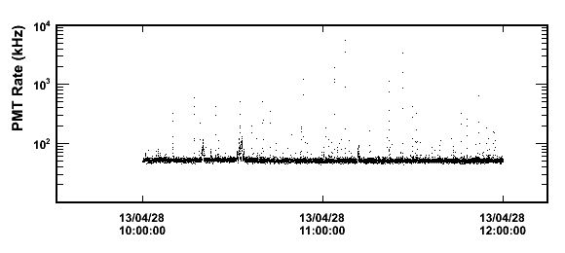
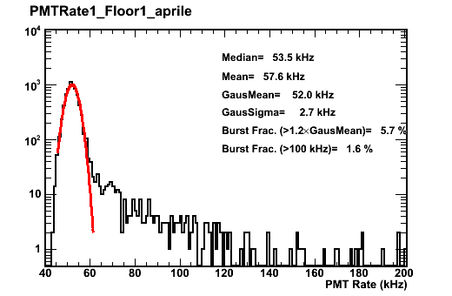
Average rates from slow control
Run 412 File 0, file duration ~2h43m
  Baseline value = 52 kHz
Floor 1 PMT1
  Burst _{>100 kHz} = 1.6%
rate occurrence
VLVnT13
M.G. Pellegriti INFN-LNS

Slide 11
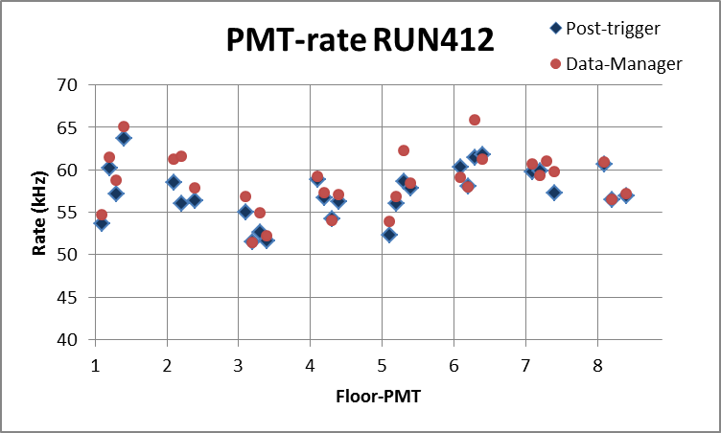
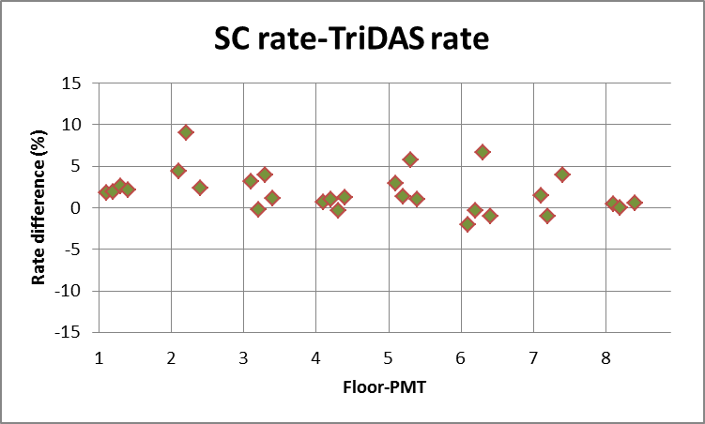
Consistency test between Slow control (SC) and TriDAS rates
TriDAS
SC
S.C. and Tridas rates values show similar behavior
→Percentage differences are lower then 4% in most cases.
S.C. rates are systematically larger, this is probably due to the type II after-pulse effect.
VLVnT13
M.G. Pellegriti INFN-LNS

Slide 12
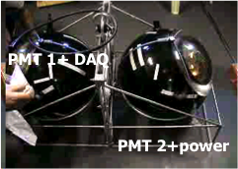
“Old” background rate measurements
NEMO 2005 results at 3500m depth in Capo Passero
Instant rate [kHz]
Two 8” PMTs
Threshold at 0.3 s.p.e.
First 48 hours after deployment data were collected for 5’ each 30’
Baseline 29.5 ± 2.5 kHz
Rare and sporadic events with
“instant rate” > 150kHz
Instant rate [kHz]
VLVnT13
M.G. Pellegriti INFN-LNS
12

Slide 13
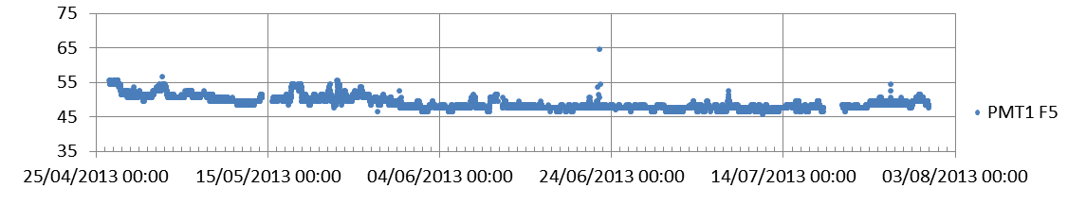
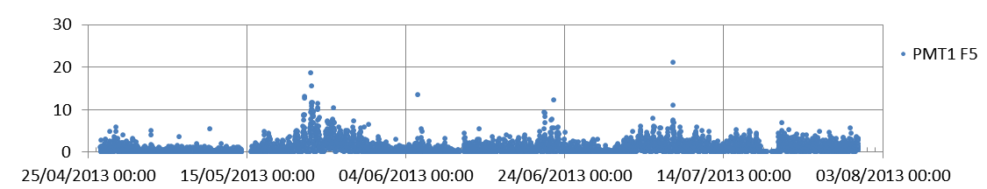
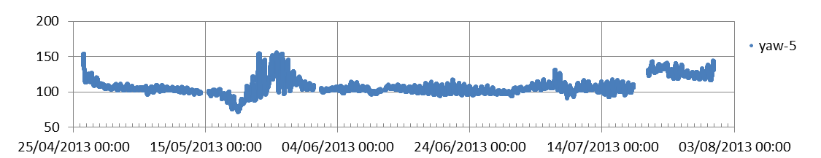
Long term behavior of the background rates
Baseline (kHz)
Burst fraction > 100 kHz (%)
Floor heading (a.u.)
Time (days)
3-months
VLVnT13
M.G. Pellegriti INFN-LNS

Slide 14
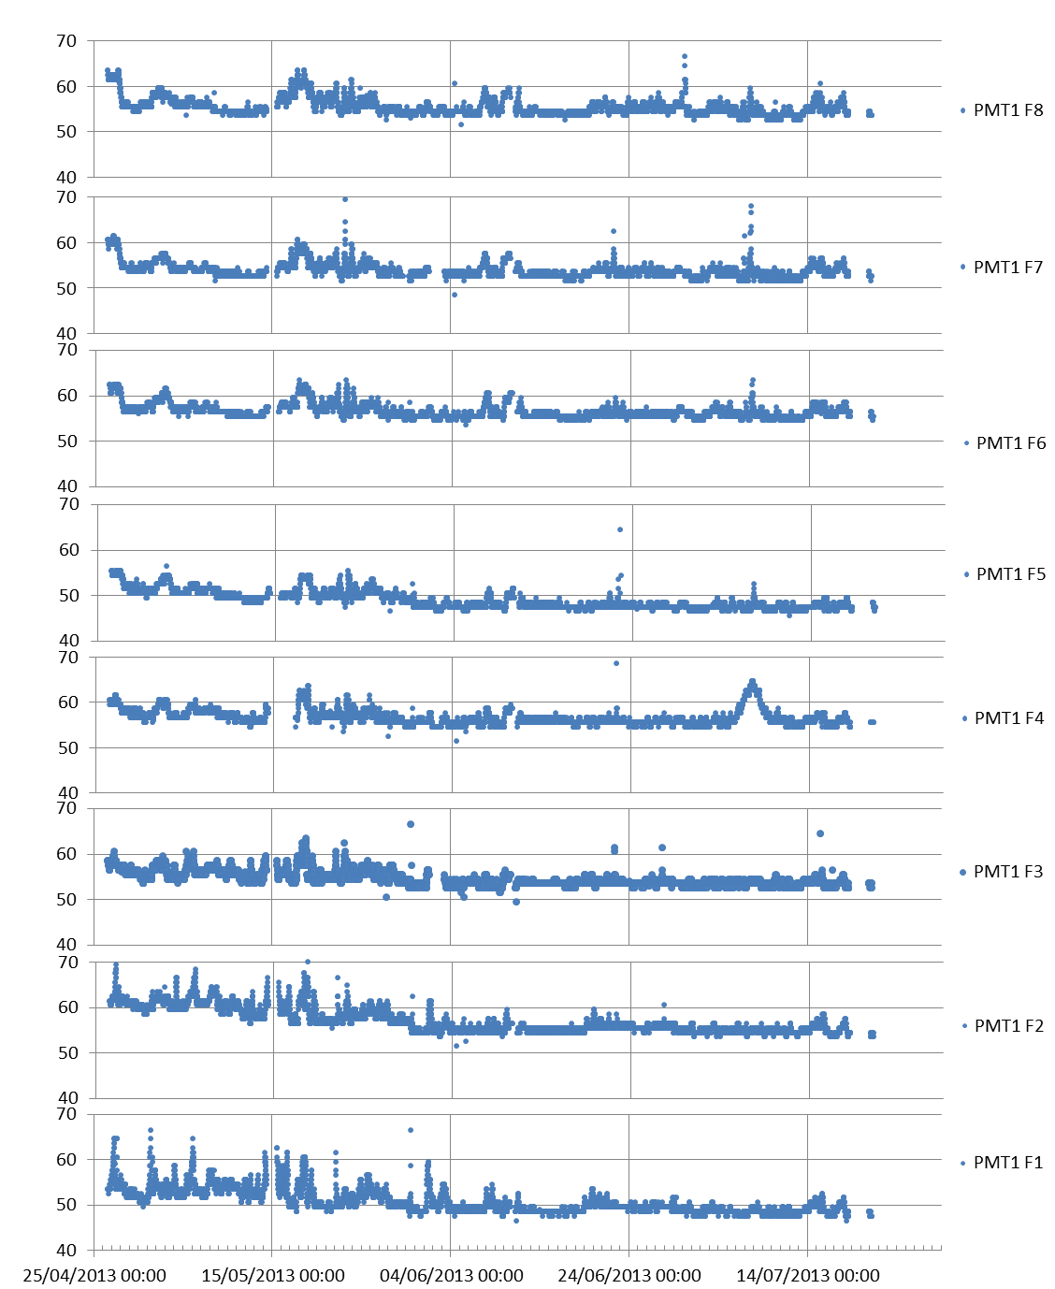
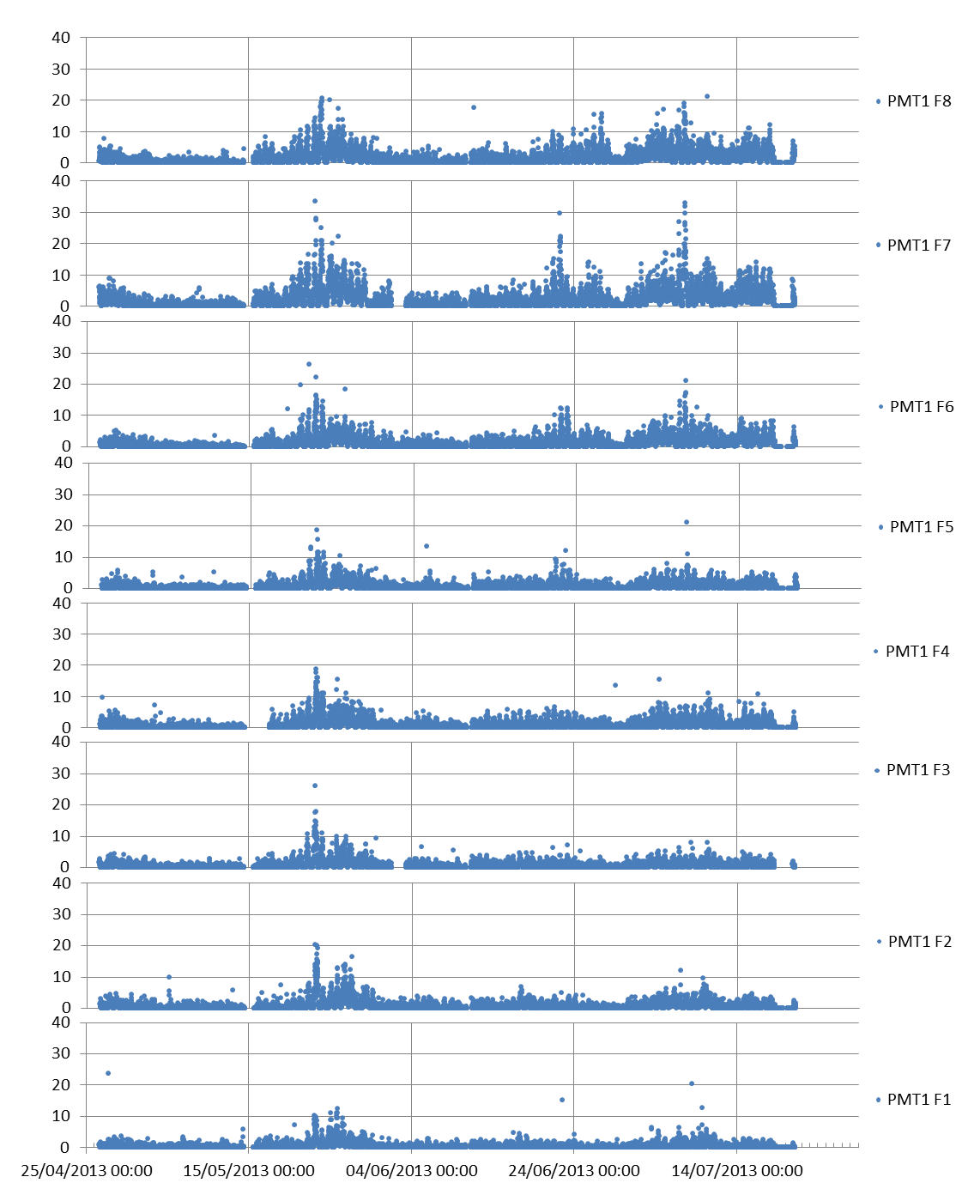
Background rates floor panoramic
FLOOR8 – PMT1
FLOOR8 – PMT1
FLOOR7 – PMT1
FLOOR7 – PMT1
FLOOR6 – PMT1
FLOOR6 – PMT1
FLOOR5 – PMT1
FLOOR5 – PMT1
Baseline (kHz)
Burst fraction > 100 kHz (%)
FLOOR4 – PMT1
FLOOR4 – PMT1
FLOOR3 – PMT1
FLOOR3 – PMT1
FLOOR2 – PMT1
FLOOR2– PMT1
FLOOR1 – PMT1
FLOOR1 – PMT1
Time (days)
Time (days)
Horizontally outwards looking PMTs

Slide 15
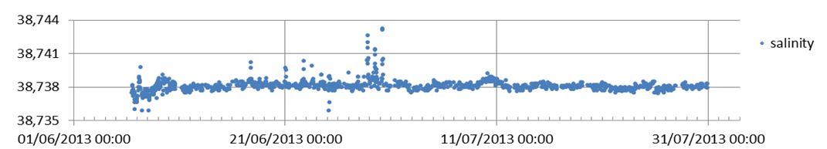
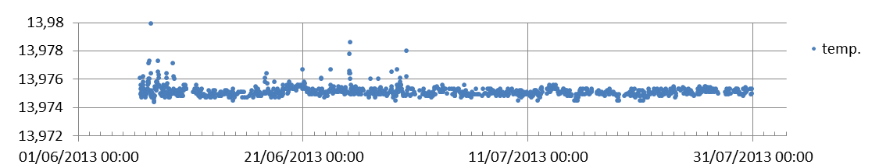
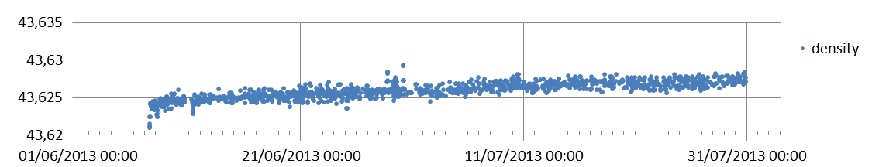
Oceanografic instruments – CTD probes
Conductivity
Conductivity (mS/cm)
Temperature
CTD (Floor 1)
10 m sampling
Temperature (°C)
Density
Density (kg/m3)
Time (days)
Current-meter data analysis in progress

Slide 16
Summary
On March the 23rd a 8-storey tower was deployed at 3500m depth and 100 km off-shore Capo Passero
Long term rate monitoring
  Very low background rates (about 60kHz)
  →compatible with a ⁴⁰K background with few bioluminescence bursts
Next steps
  →Correlation between rates and the other instrumentation outputs (compass, CTD, current-meter)
  →Long term monitoring of the site properties
VLVnT13
M.G. Pellegriti INFN-LNS

