Slide 1
Sensitivity of the KM3NeT detector to neutrino fluxes from Galactic point-like sources
A. Trovato et al. for the KM3NeT collaboration,
LNS-INFN, Catania (Italy)
Presented by Paul Kooijman

Slide 2
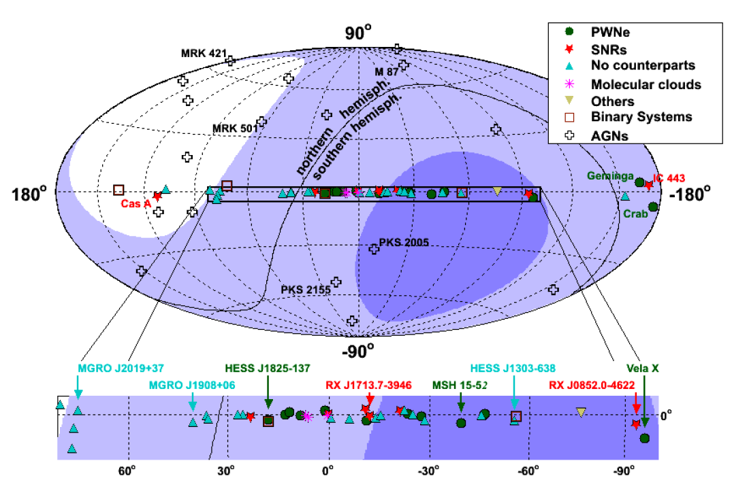
KM3NeT Neutrino Telescope
KM3NeT: a multi-km³ sized Neutrino Telescope in the Mediterranean Sea
Cherenkov technique: ν_{μ} CC interaction is the “golden channel”
Focus on tracks coming from below ➔ KM3NeT can observe most of the galactic plane including the galactic center
Our Galaxy is KM3NeT prime field of operation

Slide 3
High Energy Gamma observation
The Galactic plane contains the possibly brightest source of neutrinos in the sky. High intensity gamma spectra measured by Fermi LAT, HESS, MAGIC, VERITAS….
High-energy gammas of leptonic or hadronic origin? If gammas are originated from π⁰ decay also neutrinos should be present.
FERMI collaboration (Nature 2013): “Clear pion-decay signature in IC443 and W44 SNR”
Estimate of neutrino spectrum based on high-energy gamma observation
High energy gamma measurement needed.

Slide 4
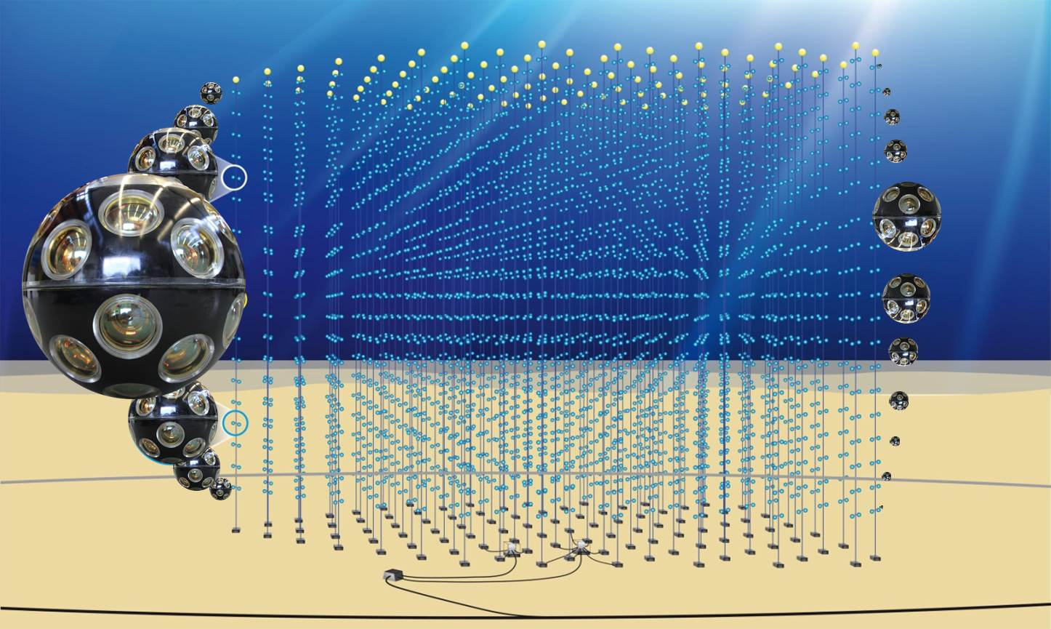
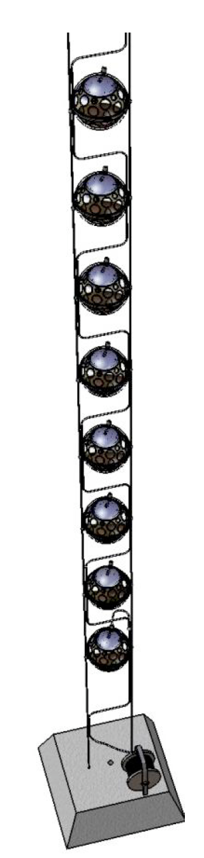
An artist impression of KM3NeT
3D-array of
optical sensors
Simulated detector:
2 building blocks with 310 DUs
20 DOMs/DUs
40 m DOM spacing
~1 km DU height
12400 DOMs
Optical Module (DOM):
multi-PMT ➔ 31 3” PMTs
Detection Unit (DU)
Optical Module (DOM) = pressure resistant glass sphere containing PMTs and electronics
Detection Units (DU) = vertical string like structures hosting DOMs, environmental sensors, …

Slide 5
Simulation codes
Neutrino generator + propagation of secondary particles
Codes from Antares modified for a km³-scale detector
Trigger, Hit Selection and Reconstruction radically modified to exploit Multi-PMT capabilities
Light generation and propagation ➔ hits on the detector
⁴⁰K Background hits + electronics
Reconstruction code
Fitted direction + quality fit parameter + N_{hit}+ fit error

Slide 6
Simulation codes
Neutrino generator + propagation of secondary particles
Codes from Antares modified for a km³-scale detector
Trigger, Hit Selection and Reconstruction radically modified to exploit Multi-PMT capabilities
Light generation and propagation ➔ hits on the detector
Trigger and hit selection based on space-time coincidences between hit on the same OM (hit amplitude neglected)
⁴⁰K Background hits + electronics
Hit accepted in a reduced PMT field of view
Reconstruction code
Sky scanning with a grid of 3° by 3°
Fitted direction + quality fit parameter + N_{hit}+ fit error
Four consecutive fitting procedures, three of them based on a maximum likelihood fit

Slide 7
Simulation codes
Neutrino generator + propagation of secondary particles
Codes from Antares modified for a km³-scale detector
Trigger, Hit Selection and Reconstruction radically modified to exploit Multi-PMT capabilities
Light generation and propagation ➔ hits on the detector
⁴⁰K Background hits + electronics
Reconstruction code
Λ>-7
Fitted direction + quality fit parameter + N_{hit}+ fit error

Slide 8
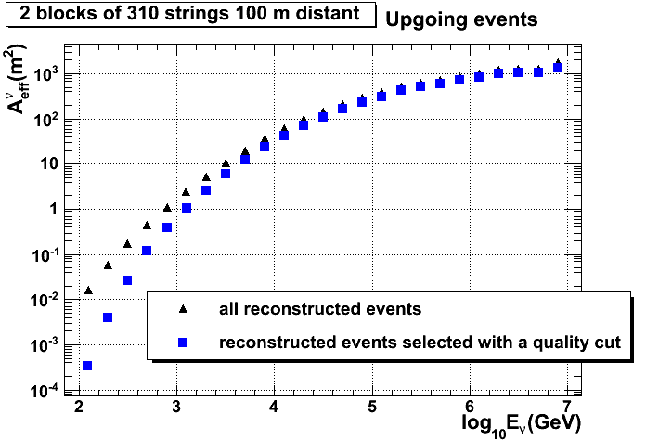
Effective area
The number of signal and background events depends on the νeffective area:
Λ>-7

Slide 9
Analysis
Statistical technique required to distinguish a neutrino source signal
from the background of atmospheric neutrinos (atmospheric muons not considered in this analysis)
Binned method:
analyze the fluctuations on the number of events detected inside a search cone around the source position, assuming a Poisson distribution of the events
Unbinned method:
Maximize a likelihood ratio to evaluate the probability that a set of events is compatible with the hypothesis of “signal+background” instead of background only
Figures of merit:
Discovery potential (signal flux required to obtain an observation at a significance level of 5σ, or 3σ, in 50% of the experiments)
Sensitivity (average upper flux limit that can be given on a neutrino flux model from a source in case of no signal detection; Feldman-Cousins approach used)

Slide 10
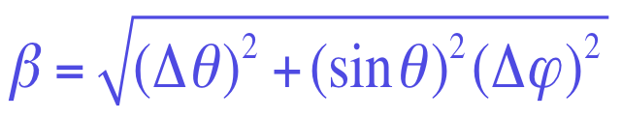
Binned method
Discovery potential and sensitivity minimized selecting events with cuts on:
R_{bin}: angular radius of the search cone centred on the source
∧=logL/N_{DOF} (goodness of fit criterion)
N_{hit}: number of hits used to reconstruct the event (related to the neutrino energy)
(angular fit error)

Slide 11
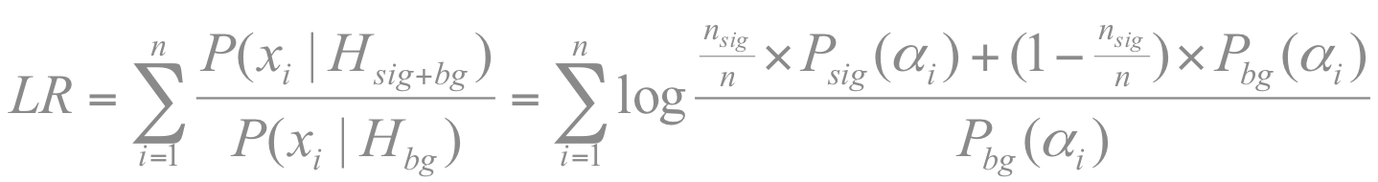
Unbinned method
Number (n) of expected background events in the detector for a chosen time window calculated with the cuts fixed from the binned analysis
Probability density function for signal (P_{sig}) and background (P_{bg}) events estimated from the MC as a function of the distance from the source α
Many background samples with n events created and for each sample the maximum value of likelihood ratio LR found (n_{sig} is a free parameter):
LR evaluated for samples containing only bkg events and for samples with signal events added to the bkg events
LR used as a test statistic
hypothesis of signal+background
hypothesis of background only

Slide 12
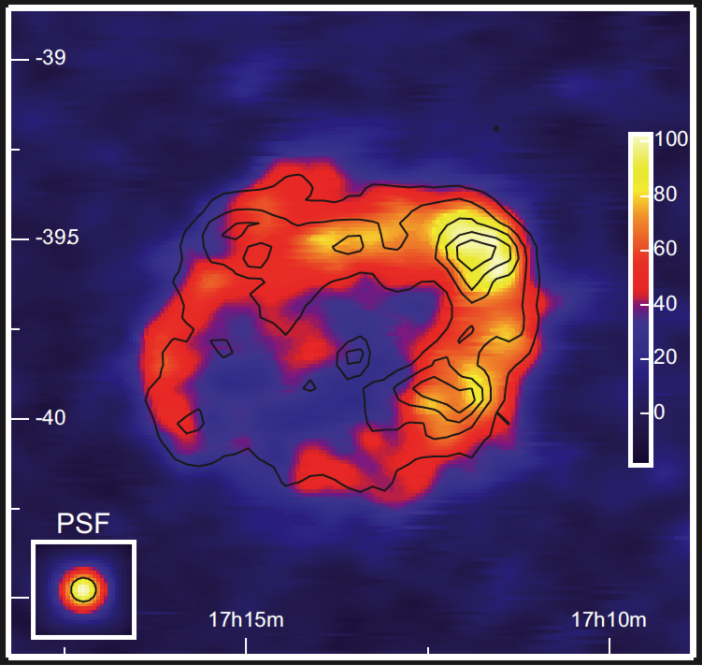
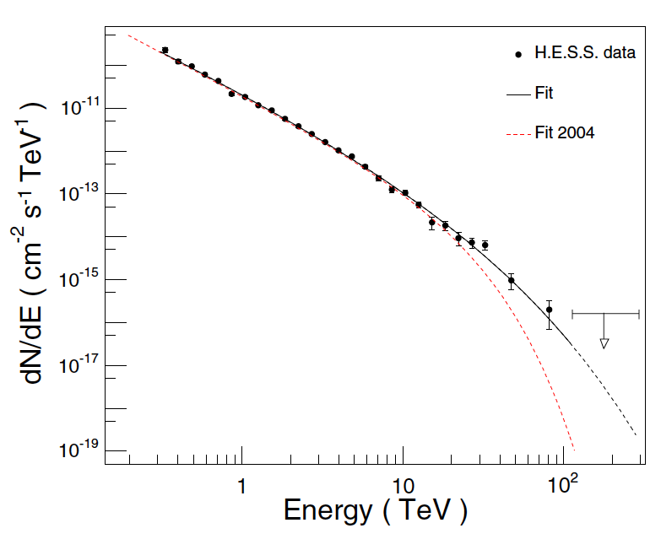
RX J1713.7-3946
HESS data
Good reference case:
High γ-ray flux measured
γ-ray spectrum measured up to about 100 TeV
Visible for about the 75% of the time by KM3NeT
Source simulated as a neutrino emitting homogeneous disk of 0.6° radius and a neutrino spectrum calculated following Kelner et al., PRD 74 (2006) 034018 (100% hadronic emission)

Slide 13
RX J1713.7-3946
Binned analysis
Binned analysis
Unbinned analysis:
4.8 years at 5σ
1.6 years at 3σ
Neutrino flux at 1 TeV estimated from Kelner et al.
Number of years required to claim a discovery as a function of DU distance
Flux sensitivity (90% CL) at 1 TeV as a function of DU distance (time=1 year)
Best performance found for a detector with an average inter-DU distance of 100 m:
➔ Discovery of RXJ1713.7-3946 after about 5 observation years

Slide 14
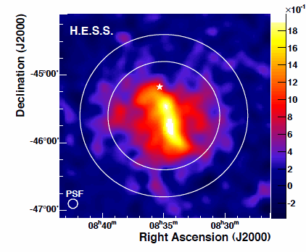
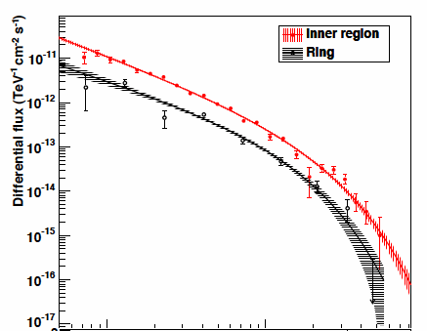
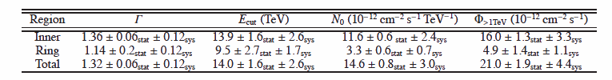
Vela X
Vela X: Pulsar Wind Nebula at δ=-45.6°
First VHE γ-ray emission reported by HESS in 2006
New analysis in 2012 (Aharonian et al. A&A 548 (2012) A38)
➔ higher flux and harder energy spectrum
Inner region: 0.8°
Ring: 0.8°-1.2°
dΦ/dE= N₀(E/1TeV)^{-Γ}exp(-E/E_{cut})

Slide 15
Vela X
Source simulated as a neutrino emitting homogeneous disk of 0.8° radius (inner region)
Neutrino spectrum derived using the Vissani prescription* (hypothesis of transparent source and 100% hadronic emission)
* F.L. Villante and F. Vissani, PRD 78 (2008) 103007; F. Vissani and F.L. Villante, NIM A588 (2008) 123; F. Vissani, Astr. Phys. 26 (2006) 310
dΦ_{ν}/dE_{ν}= N * (E_{ν}/1TeV)^{-Γ}exp(-E_{ν}/E_{cut})
N = 0.72 10⁻¹⁴ GeV⁻¹s⁻¹cm⁻²
Γ= 1.36
E_{cut}= 7 TeV
Preliminary results with a binned analysis (100 m DU distance):
➔ Discovery at 5σ(3σ) after 3.3 (1.2) observation years

Slide 16
Conclusions and perspective
Optimization aiming at the detection of galactic point-like sources using as test cases RXJ1713.7-3946 and Vela X
At least the more intense galactic point-like source within reach of KM3NeT in few years of operation
Work in progress: Consideration of more realistic source morphologies extrapolated from the HE gamma-ray maps, study of other sources, stacking analysis

Slide 17

Conclusions and perspective
Optimization aiming at the detection of galactic point-like sources using as test cases RXJ1713.7-3946 and Vela X
At least the more intense galactic point-like source within reach of KM3NeT in few years of operation
Work in progress: Consideration of more realistic source morphologies extrapolated from the HE gamma-ray maps, study of other sources, stacking analysis
KM3NeT technology has been developed ➔Validation process of DOM and DUs ongoing
New reference detector defined taking into account technical constraints (6 building blocks of 115 DUs each, 18 DOM/DU, 38 m DOM spacing, 90 m DU spacing)
Funds available to start the construction

