Slide 1
Light Propagation in the South Pole Ice
Dawn Williams
University of Alabama
VLVNT 2013
Stockholm, Sweden

Slide 2
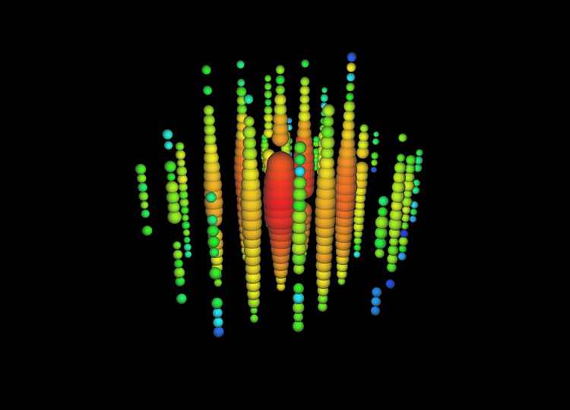
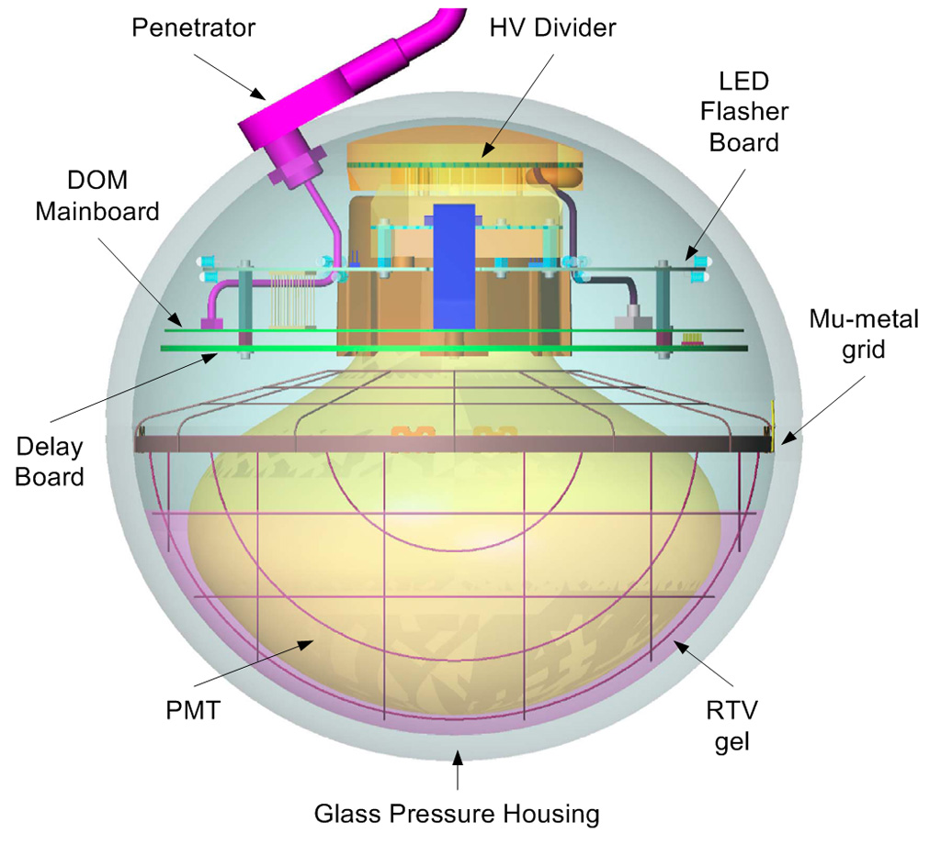
From neutrino to DOM
Photons undergo scattering and absorption in ice
Modeling the light propagation in ice is critical to reconstructing the properties of IceCube events

Slide 3
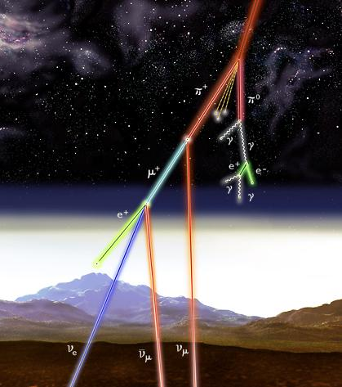
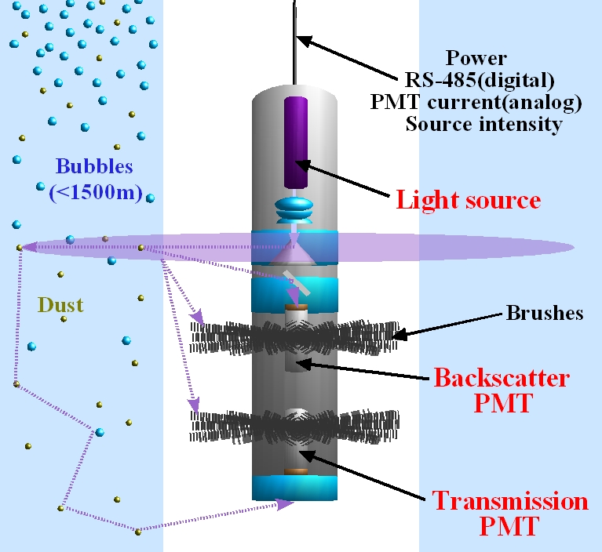
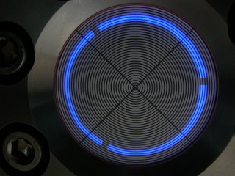
IceCube Calibration Devices
One camera located at the bottom of a string near the center of IceCube
(see talk by Per Olof Hulth, this session)
Dust logger (8 locations)
Muons from cosmic ray-induced air showers
2 nitrogen laser “standard candles”
12 LED flashers aboard each DOM

Slide 4
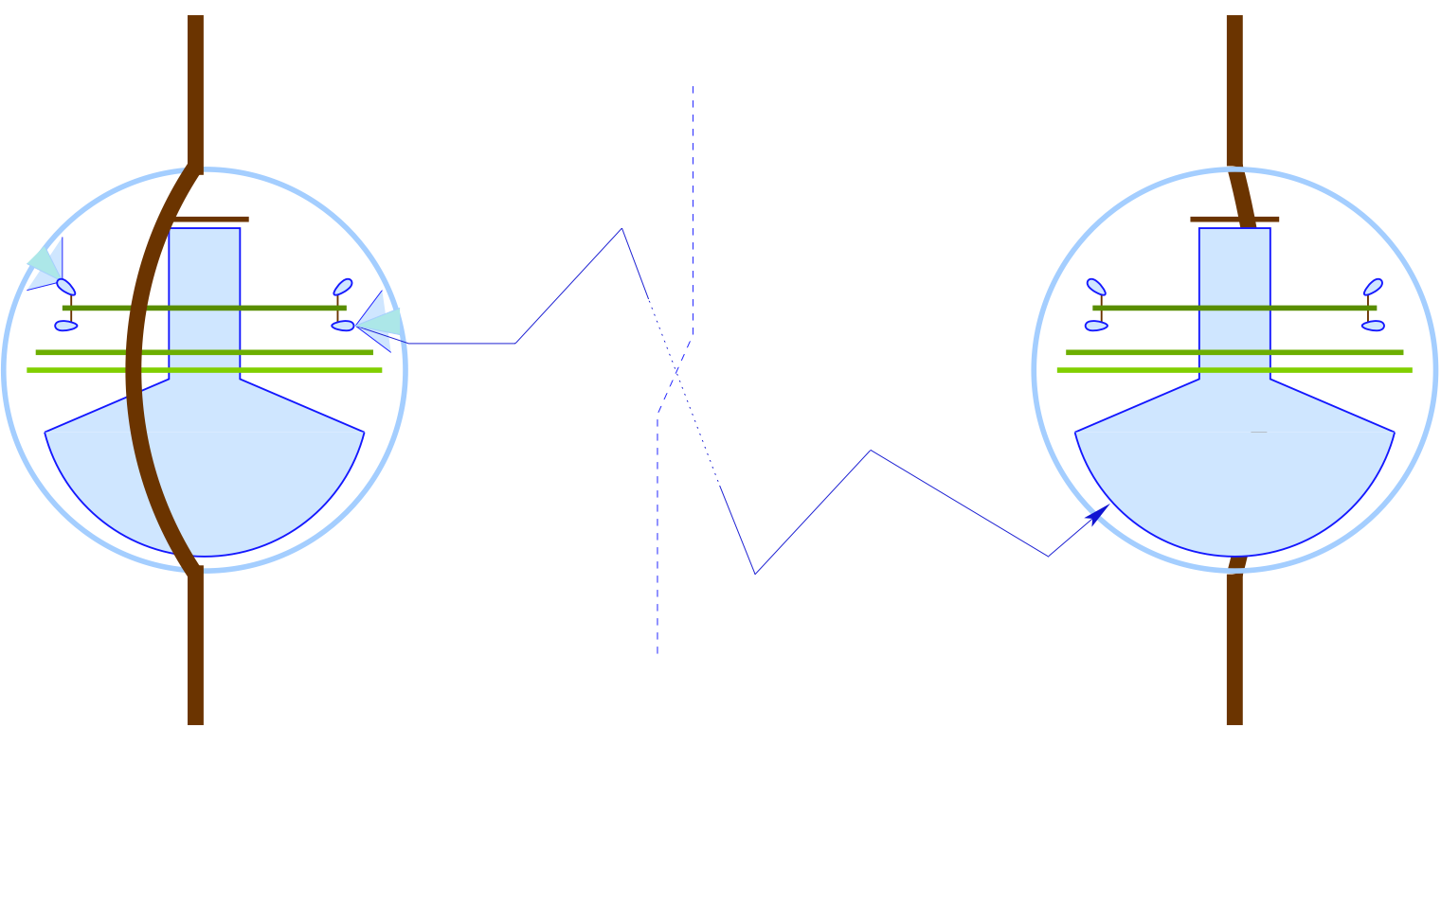
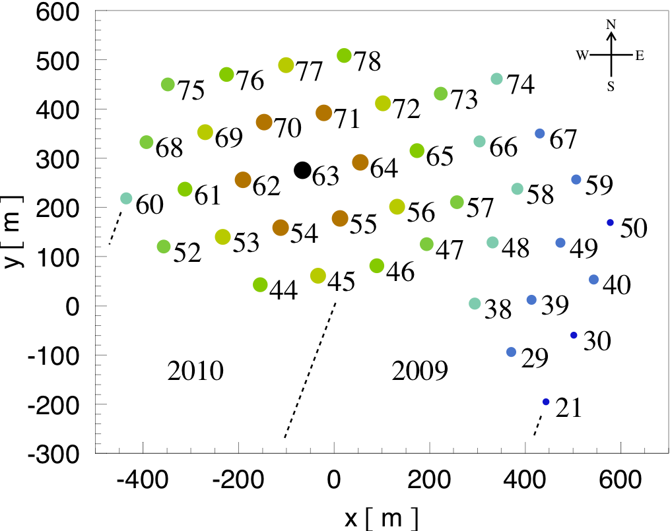
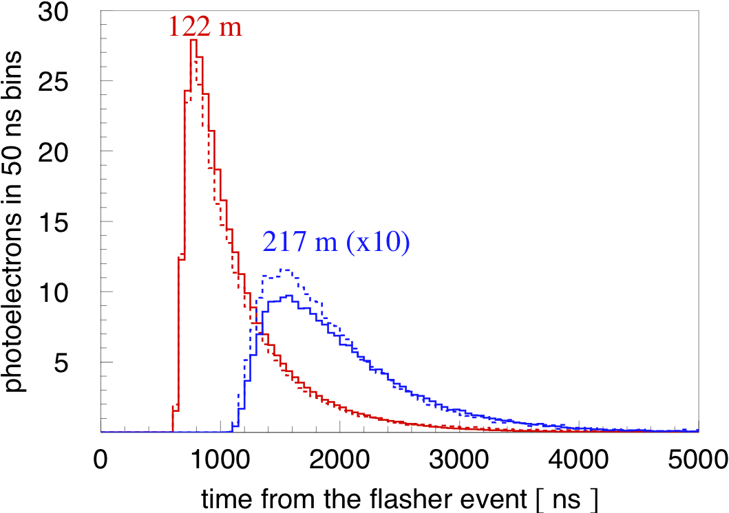
Flasher Measurements in IceCube
Solid: data
Dashed: simulation
Flasher data collected in 2008 during IceCube construction
40 strings active
Received charge vs. time from flashing DOMs, collected by neighboring DOMs

Slide 5
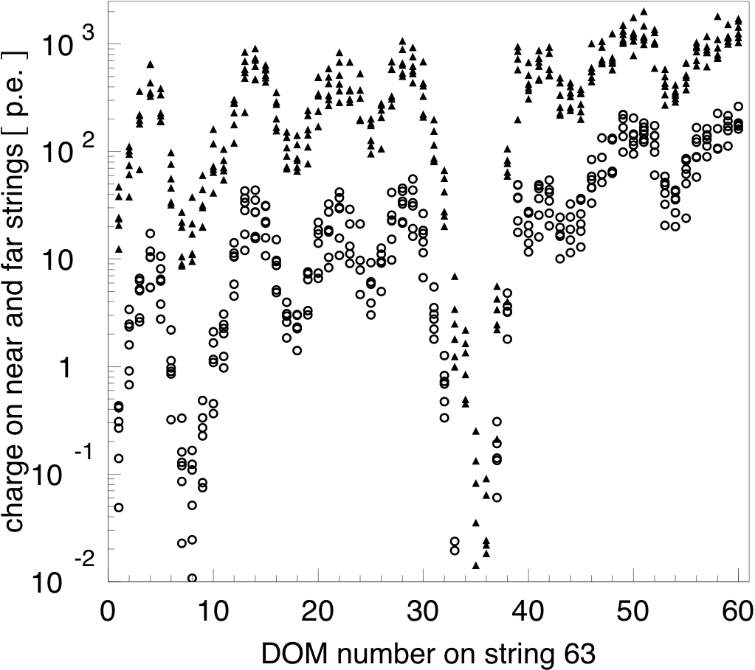
Received charge vs. depth
Depth increases with DOM number from 1450 m (DOM 1) to 2450 m (DOM 60)
Received charge is plotted for flasher at the same depth as the receiver
Strong depth-dependent variations => depth-dependent scattering and absorption due to layers of dust in the ice
Triangles: receivers ~120 m away
Circles: receivers ~215 m away

Slide 6
Simulation
Direct photon propagation with Photon Propagation Code (PPC)
Geometric scattering coefficient b : distance between successive scatters is 1/b
Effective scattering coefficient b_{e}
Absorption coefficient a : distance travelled by photon before absorption is 1/a
Divide detector into 100 10-m layers in depth, fit to a and b_{e} in all layers (200 parameters)
Simulate many values of a and b_{e}, find best fit to data using likelihood method
θis the angle between scatters

Slide 7
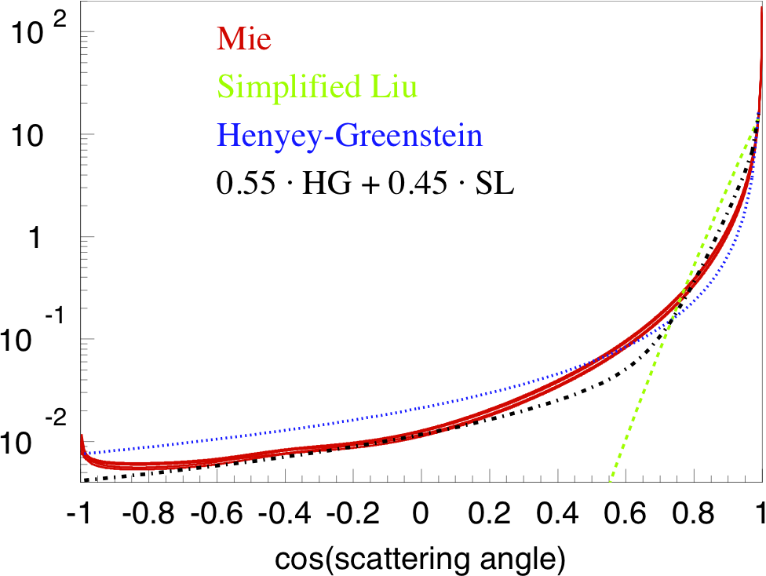
Scattering Function
Simplified Liu:
Henyey-Greenstein:
Mie:
Describes scattering on acid, mineral, salt, and soot with concentrations and radii at South Pole
Use linear combination of simplified Liu and Henyey-Greenstein models to approximate Mie Scattering

Slide 8
Hole Ice Model
Sensitivity vs. photon angle with respect to PMT axis
Melted and re-frozen “hole ice” introduces additional scattering
Effective scattering length of 50cm in the hole (under study)
modeled as a change in the effective angular sensitivity of the DOM

Slide 9
Results: SPICE Mie SPICE = South Pole Ice model
Absorption
Scattering
Gray band: range allowed by uncertainties: ±10%
Aartsen et al., Nucl.Instrum.Meth. A711 (2013) 73-89

Slide 10
Likelihood
Likelihood functions using charge information only (left) and both charge and time information (right)

Slide 11
Comparison with Dust Log Data, Tilt
Dust log data shows that dust layers in ice are tilted
Effective scattering from dust log agrees with value from flashers
Comparison of simulation to 2012 flasher data over 200 m from string 63, shows strong effect from dust layer tilt

Slide 12
Delta T from Muons
Comparison of difference in arrival times at neighboring DOMs on a string

Slide 13
Anisotropy in Scattering
Ratio of simulated (SPICE Mie) charge to data on strings surrounding the flashing string
Maxima of ratio histograms vs. azimuth

Slide 14
Anisotropy

Slide 15
Ice Model with Anisotropy: SPICE Lea
Absorption
Scattering
D. Chirkin, ICRC 2013

Slide 16
Model error improvement
SPICE Mie flasher data/simulation comparison
SPICE Lea comparison

Slide 17
Comparison with Muon Data
Data
SPICE Mie simulation
Ratio of data to simulation
Direction of maximum charge agrees with data from flashers

Slide 18
Summary
Ice at the South Pole has complex depth- and x-y-dependent variations
Model fit to flasher data using direct photon propagation shows good agreement with data
Many more studies are ongoing
Using flasher data at multiple locations in the detector
Using multi-wavelength flasher data
Direct simulation of the hole ice

