Slide 1
PORFIDO
Physical Oceanography by RFID Outlook
INFN-LNF
Orlando Ciaffoni, Marco Cordelli, Roberto Habel, Agnese Martini, Luciano Trasatti
Use neutrino telescopes infrastructure
(power, communication)
for oceanographic measurements
Notes:
I will talk of PORFIDO, a sensor for oceanographic variables installed on the neutrino telescope. This sensor uses RFID technology (Radio Frequency IDentification), and uses the power and network Data transmission of the telescope

Slide 2
Neutrino Telescope : a great opportunity for oceanografy
No batteries
No devices have to be resurfaced
Data collected in real time and continous
But need
minimize interference
Minimize point of failure
Notes:
The construction of a neutrino telescope is a great opportunity for oceanography because it provides the possibility of taking data in real time and continuously without the need to use batteries and recover devices. But it is very important to minimize the interferences with the main purpose of the telescope, and do not add points of failure as extra connectors or penetrators.
For this reason we have investigated the RFID tecnology.

Slide 3
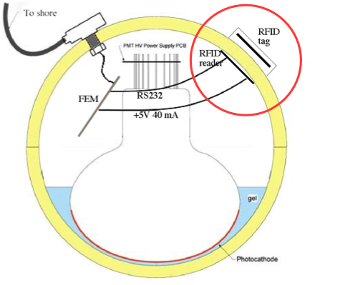
Optical Module with PORFIDO probe schematic
FCM
FCM
Notes:
We built PORFIDO as seen: the sensor, potted in a two-component epoxy is glued to the outside of the sphere. Inside the sphere, the reader is positioned on the glass in front of the sensor and connected to the the optical module electronic via an RS232 serial interface.
The reader gives power and takes the data from the sensor on the other side of the glass using RF and comunicates with the shore Through the link used by the optical module the optical module
4 PORFIDOs, assembled in this way, are installed into 4 optical modules in the tower of NEMO II PASE deployed in Capo Passero near Catania in Sicily.

Slide 4
PORFIDO
RFID communication through OM glass without connectors
Very little interference with detector
Very little bandwidth to-from shore
Very little power
data rate controlled from shore
Notes:
RFID technology allows you to communicate through the glass of OM as shown in the previous slide without the need for extra connector or penetrator so that no more points of failure are added.
The bandwidth required for taking data is very small, only a few bytes from the shore to send commands to the reader and a few bytes of data sent from the reader to the shore for each operation of data taking
Very little power is required, only 50 mA at 5 V for 200 ms only during the data taking. The data taking rate is controlled from the shore in this way is controlled the power and the bandwidth used

Slide 5
Tag - WISP
Passive (no batteries)‏
Includes temperature sensor
can add new sensors
Notes:
This is the WISP as we have received from Seattle Research Team INTEL
The RFID (Radio Frequency IDentification) is a technology that has been developed for access control, and is spreading widely in this and other fields.
The tag is a passive device that does not need batteries or power cords, sends a message of identification to the reader when it receives the request
Wisp is an intelligent tag capable of reading sensors and send to the reader the data detected embedded in the message ID standard.
The temperature sensor, included in the WISP, is was used in the first implementation.
But WISP has a completely open architecture, so that other sensors can be easily implemented within PORFIDO

Slide 6
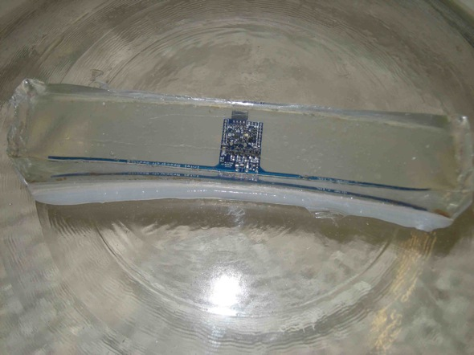
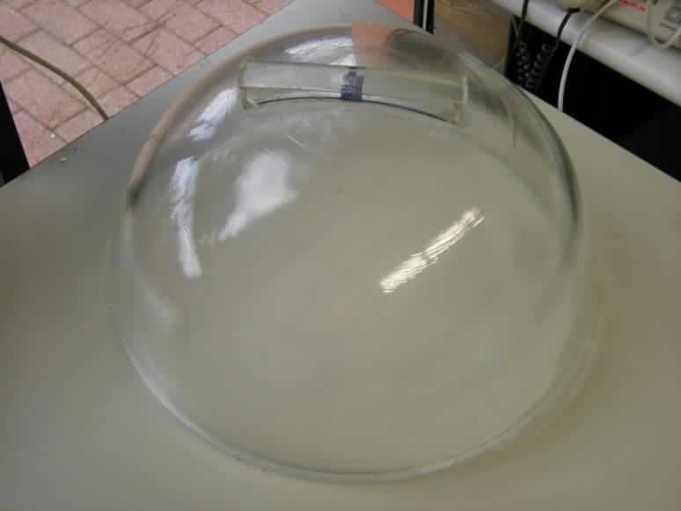
potted in epoxy
Notes:
We tried to use it as it is, we potted it in epoxy and glue it on the sphere.
We ran a long series of tests to verify the feasibility of the system

Slide 7
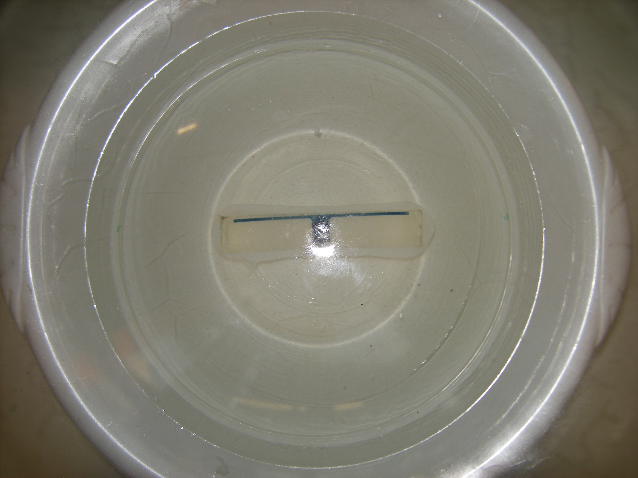
Salt Water
Notes:
The first test was to verify that the salt water does not prevent the tag to run. We put the half sphere, with the tag glued on, in salt water simulating sea water.
The tag has continued to operate.

Slide 8
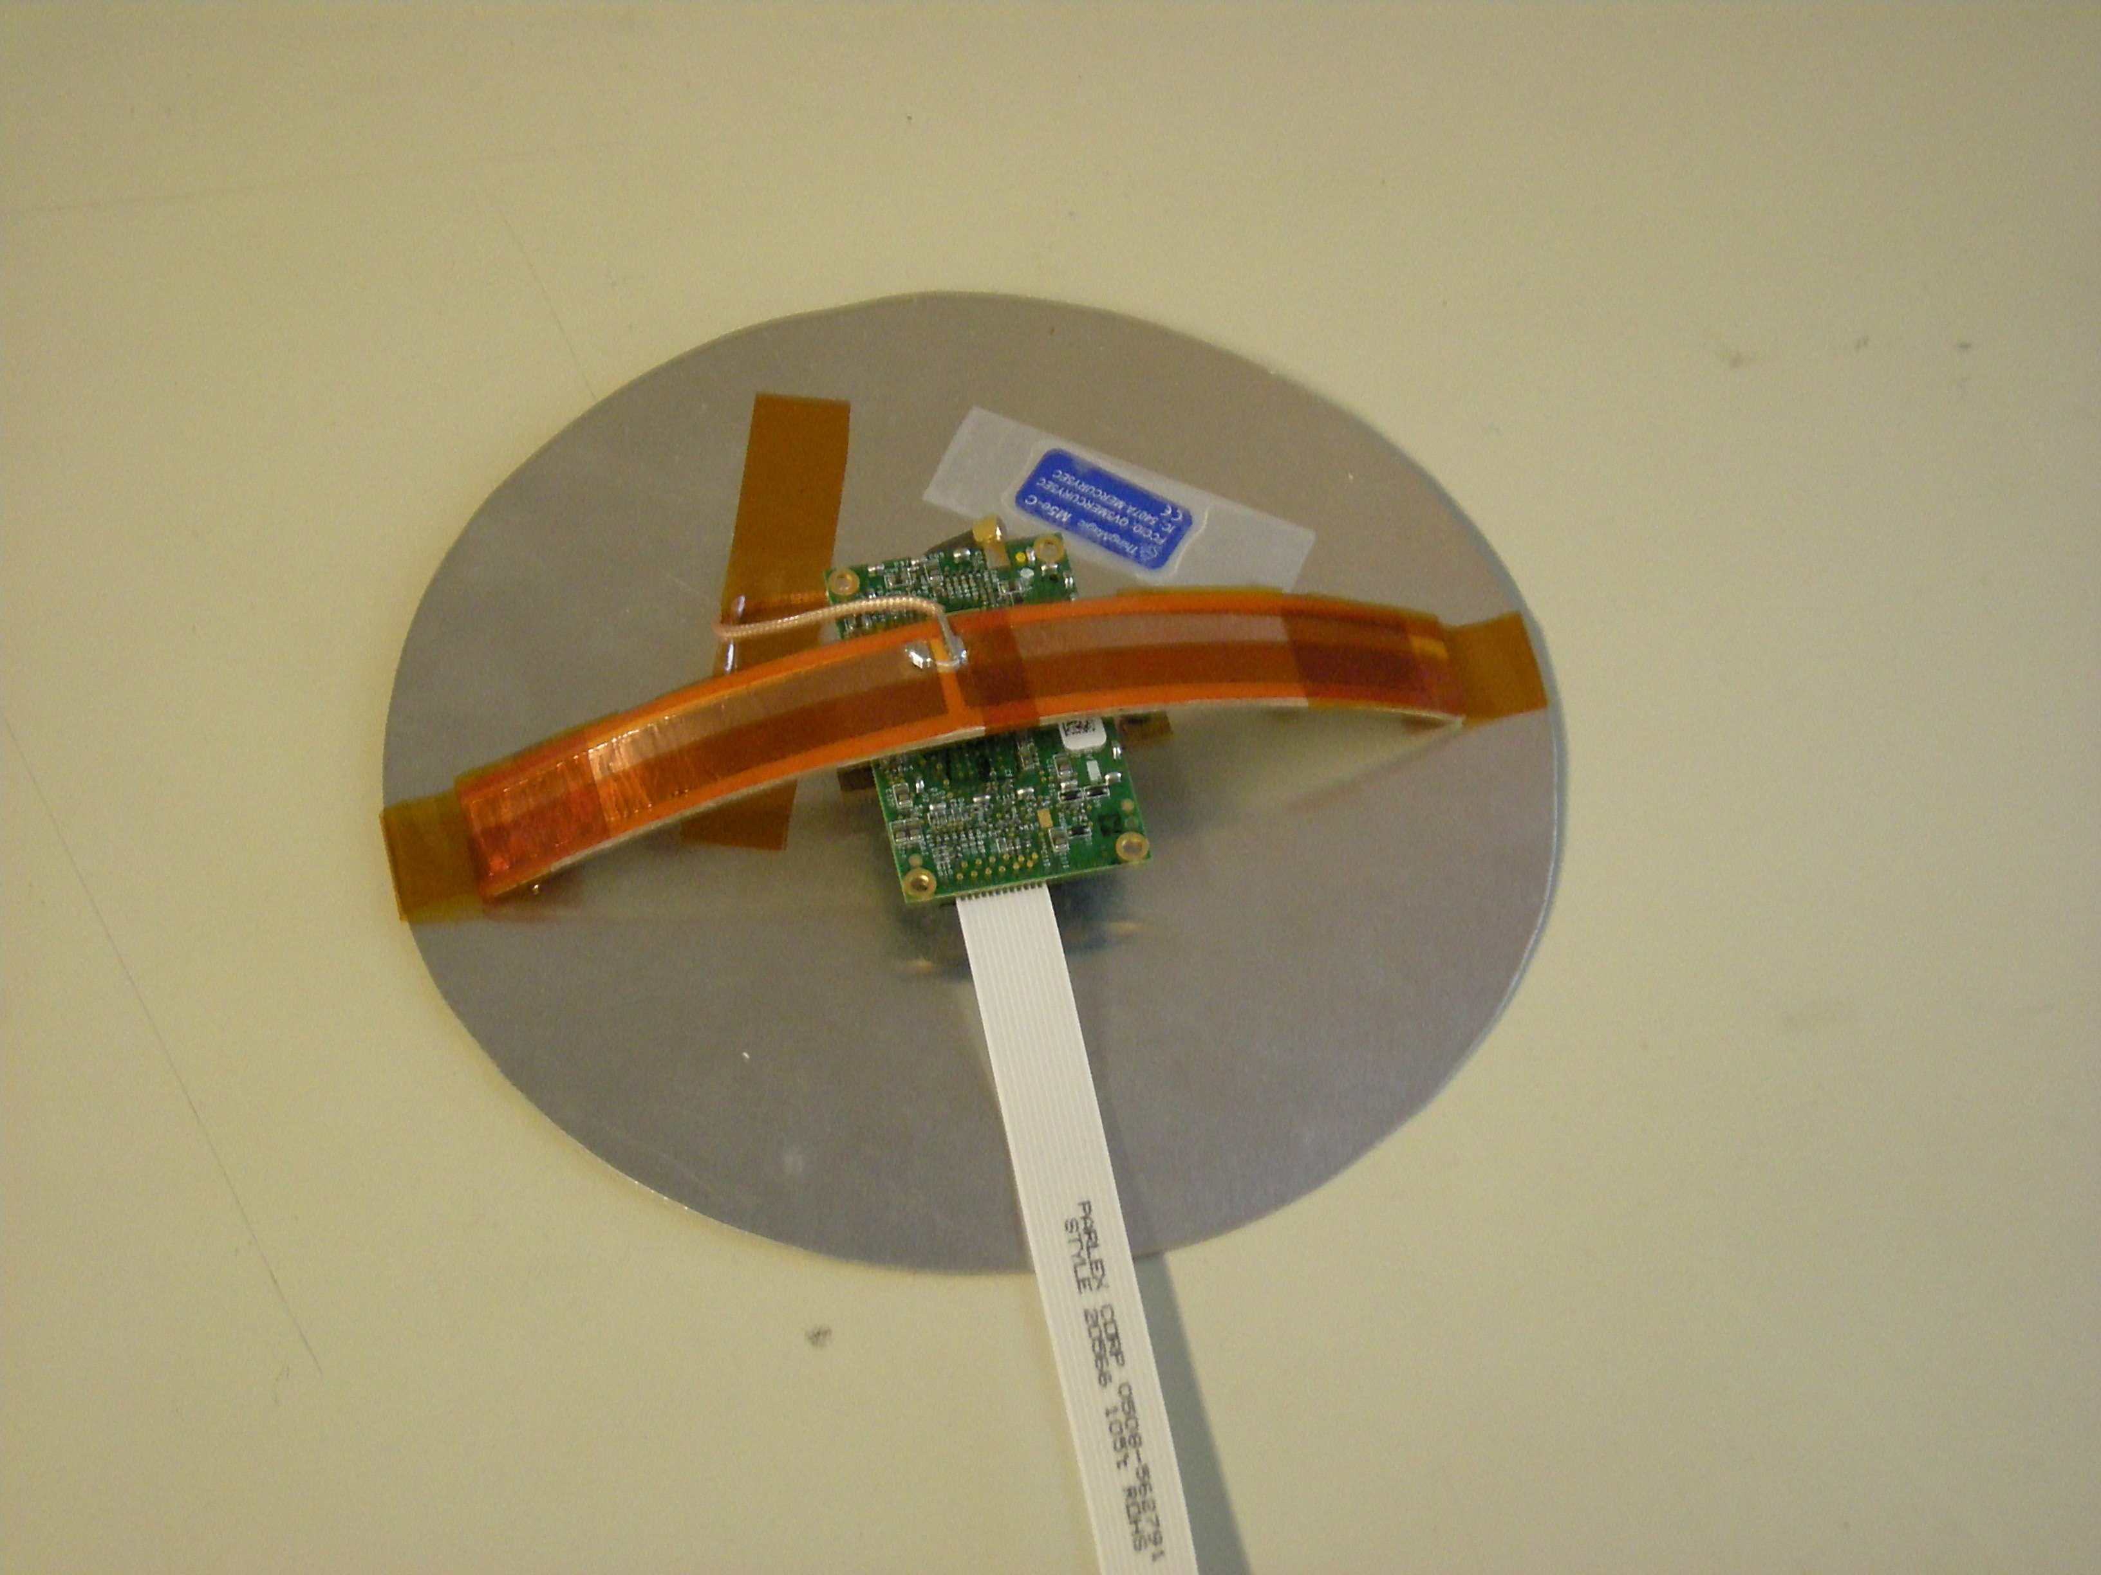
First Reader assembly
Notes:
The second test was the RF interference. The reader with the dipole antennas has been assembled with a shield to RF interference and installed in the optical module. The tests do not highlight any interaction

Slide 9
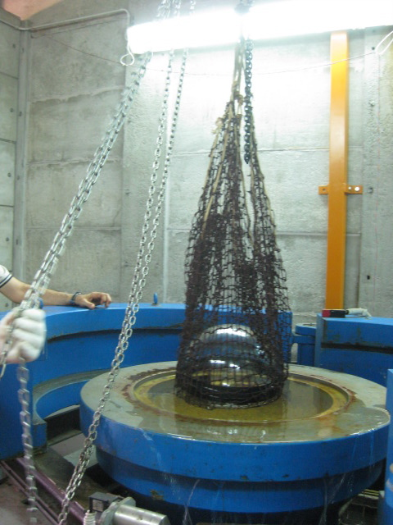
LNS pressure test
Notes:
We also tested the effects of pressure on PORFIDO. For this we have connected a reader to a data logger and a series of batteries. We placed the reader system into the sphere of optical module with the tag potted and glued outside. We put it in the hyperbaric chamber of the LNS, and with the help of colleagues in Catania we have brought pressure to 400MPa, equivalent to a depth of 4000m. The data analisys did not detect any malfunction.

Slide 10
PORFIDO for KM3 – Phase II
Notes:
Tests have demonstrated the feasibility of PORFIDO.
But during these tests we noticed that the dipole antennas are very difficult to manage because they are very sensitive to conductive materials in the surrounding area
But an emitter and a receiver at a distance of only 12 mm (thickness of the sphere) and with glass in the middle, is more similar to a capacitor of a transmitter - receiver pair.
So we cut the wings of WISP and removed the dipole antennas of the reader and we replaced them with two capacitors built using square copper pads, 25x25 mm2, opposite one another on the two sides of the glass.
The results were excellent: the whole system is much more stable, immune to the presence of metal in the surrounding space so it is possible to reduce the RF power, also the size of the tag are reduced to the size of the reader (70mmx40mm)

Slide 11
PORFIDO on the DOM
A very similar version can be installed on the DOM
Notes:
We also built PORFIDO for the DOM of KM3NeT. In this case, the space available for PORFIDO is smaller and the reader must be installed in a different way on how it is in the optical module of NEMO PHASE II
The reader is placed vertically in a cylinder with copper pads that are not square but two halves of a disk placed on top of the cylinder. The same pads are connected to WISP outside the sphere.

Slide 12
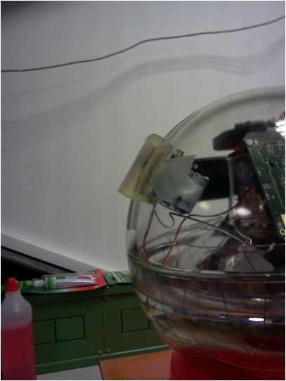
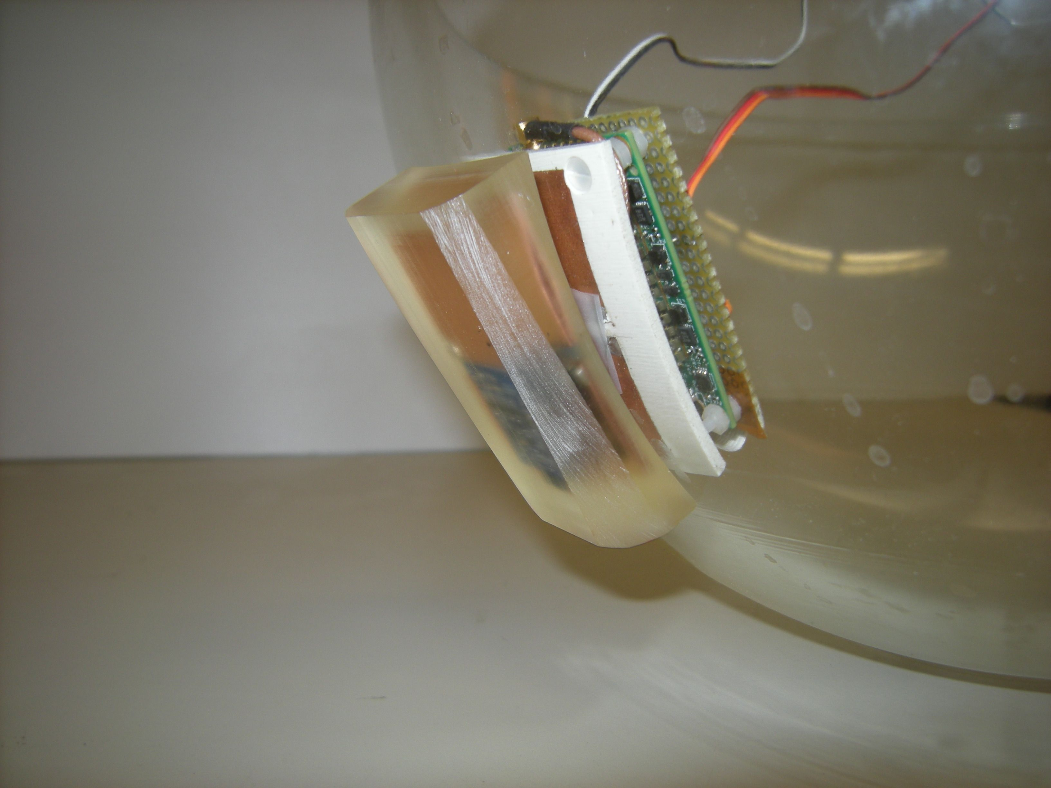
PORFIDO on the OM
Notes:
These are some pictures that show different phases of the installation of PORFIDO into the Optical Module

Slide 13
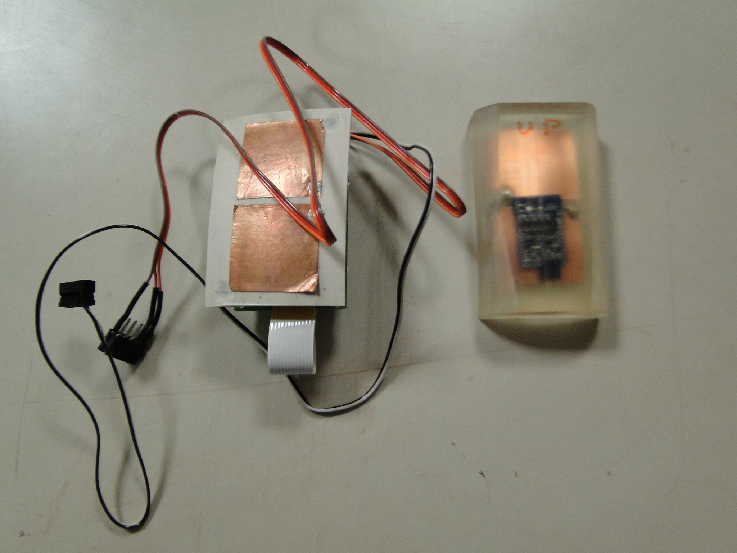
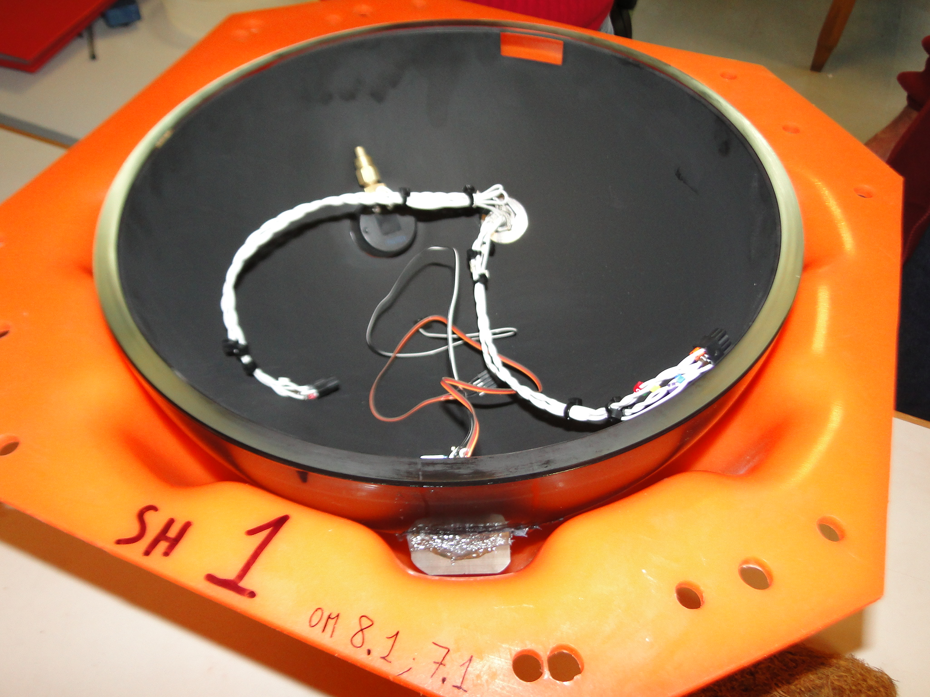
PHASE II
- 4 PORFIDO probes have been installed on 4 OMs
Notes:
This is the actual PORFIDO as it was installed in 4 of the Optical Module of the tower of NEMO Phase II
The four PORFIDO are now working at the Capo Passero site.

Slide 14
PHASE II
tested communication and
power reduced to 50 mA @ 5V
only used a built-in thermometer with
an accuracy of ±1 ˚C to test the system
KM3Net-Italia
we need a thermometer with
an accuracy of ±0.001 ˚C and a
salinity meter with a resolution of ~1ppm
This allows to follow the movements of water
masses
Notes:
The 4 PORFIDO deployed with the tower of NEMO Phase II use the built-in thermometer that has a very low accuracy (+ / - 1 degree Celsius)
This precision is not useful for oceanography, but this is sufficient to test the system and demonstrate that the probe can operate as it does since April in the italian site of Capo Passero
The next step is the deployment of twelve PORFIDO in the KM3NeT-Italy project. But in the new PORFIDO we have to integrate a thermometer with an accuracy of a thousandth of a degree, and a salinity meter with a resolution of ~ 1 part per million. These sensors are required to follow the movements of the masses of water

Slide 15
sensors
we have tested a 24 bit ADC-Thermistor thermometer assembled on a breadboard and obtained an accuracy of ~±0.001 ˚C and <2 mA@3.3V
building PC board
testing inductive salinity meter: need ~1 ppm
Notes:
For the realization of the sensor with this accuracy we tested a 24-bit ADC.
We have assembled this ADC with a thermistor thermometer on a breadboard. The results are good. We achieved an accuracy of a thousandth of a degree. the power required is less than 2 mA at 3.3V.
Now we build a PC board
We are also studying and testing a inductive salinity meter that is immune to the corrosive effects of sea water to which they are subject conductive salinity meter. The required precision is 1 part per million. We hope to build it in the near future ...

Slide 16
KM3Net-Italy
in the km3Net-Italy OM PORFIDO will be the same as Phase II
but with a better sensor
-We will want to put PORFIDO’s on different floors of the towers,
because the vertical distribution will give more information.
-We will only want to put them on widely spaced towers.
-12 PORFIDO’s have been approved for km3Net–italy
Notes:
The next step are 12 PORFIDO that will be installed on 4 towers.
The PORFIDO are the same NEMO PHASE II, but with a better sensor
They will be installed on different floors to have a vertical distribution and on towers distant from each other to have a horizontal distribution of the data in order to allow oceanographers to study the movements of the columns of water

