Slide 1

Development of a multi-PMT optical module for PINGU
L. Classen, O. Kalekin, U. Katz,
J. Reubelt, M. Tselengidou
VLVNT 2013, Stockholm
PINGU
05.08.2013
Notes:
Hello. I Lew Classen, PhD in Erlangen on multi-PMT modules for PINGU, Lets look at the stuff…

Slide 2

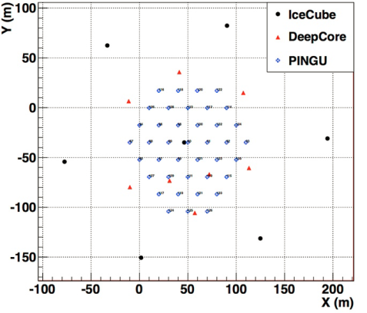
PINGU
Precision IceCube Next Generation Update
40 additional strings
standard optical modules
opportunity for module R&D
energy limit ~ GeV
neutrino mass hierarchy
low-mass WIMPs
example configuration
physics goals
Grant 2013
Notes:
After IceCube and DeepCore, idea: increase resolution and decrease energy limit -> denser infill, goal: investigation of mass hierarchy, dark matter and R&D, one of R&D efforts are multi-PMT DOMs

Slide 3
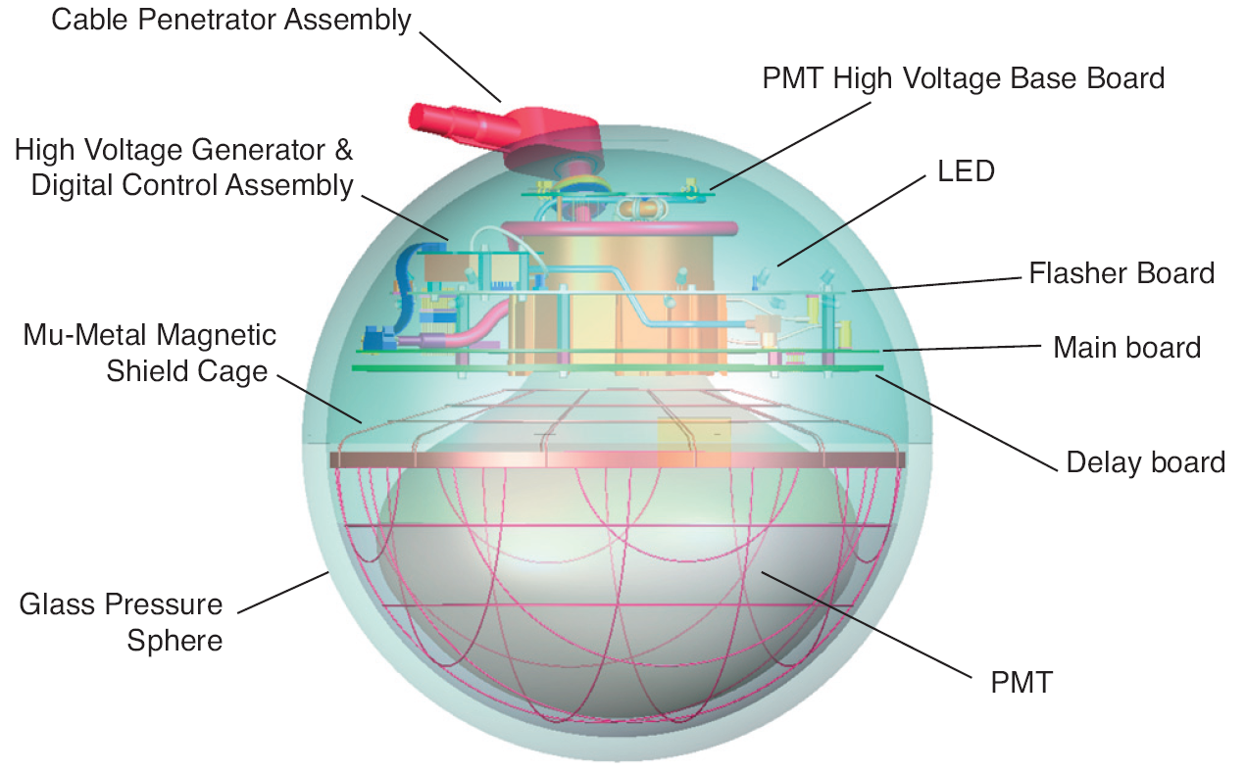
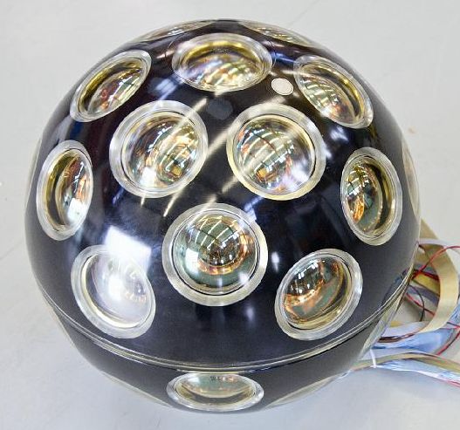
Multi-PMT module
IceCube & DeepCore | KM3NeT
13 inch sphere | 17 inch sphere
1 × 10 inch PMT | 31 × 3 inch PMT
www.teilchenwelt.de
Notes:
on left: DOM used by IceCube, DeepCore & PNGU right: multi-PMT DOM from KM3NeT, see main difference: one big PMT vs. many smaller PMTs per DOM, fly’s eye configuration

Slide 4
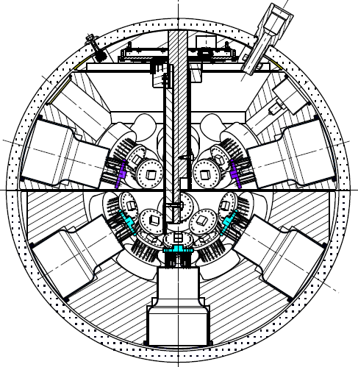
Advantages
superior photo-electron counting:
from number of hit PMTs, rather than signal waveform
angle of signal acceptance up to 4π
direction sensitivity
no magnetic shielding needed
increase of sensitive area
similar overall price
per photocathode area
KM3NeT 2011
Notes:
Why do that? -> Approach has some attractive features, such as photon counting from number of hit PMTs, direction sensitivity, increase of sensitive area
, all these advantages come at low extra cost, price/area similar. Especially the huge sensitive area makes it an interesting candidate for use it in MICA and for PINGU as R&D

Slide 5
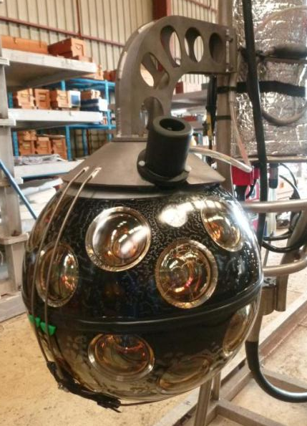
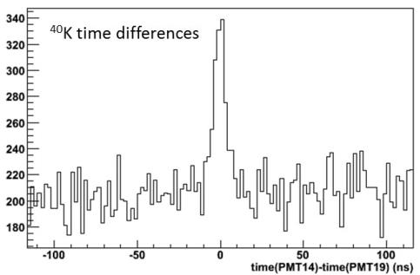
PPM-DOM
first multi-PMT DOM deployed
mounted on instrumentation line
at Antares site
opportunity of in-situ calibration
KM3NeT 2013
Notes:
Good news: This concept can now prove itself: pre-production model (made from ETEL PMTs) installed at Antares instrumentation line, now collecting data. Good opportunity to do in-situ calibration of inter-PMt timing from nearby potassium-40 decays. Also possible to my tracks with one DOM already

Slide 6
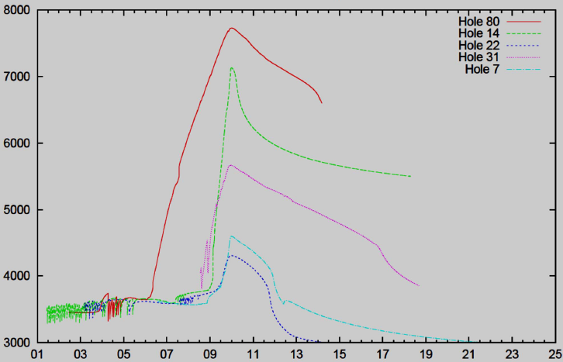
Adaptation for ice
maximum diameter: ~13 inch
temperature: - 35°C
overpressure during refreezing
reuse of 3-inch PMTs & low voltage bases
Price 2002
pressure [psi]
redesign of vessel
time [d]
Benson 2012
Notes:
Can’t just plug KM3NeT DOM into ice,

Slide 7
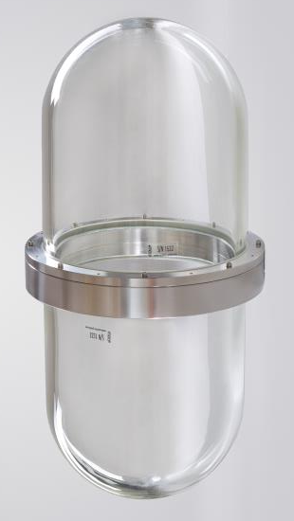
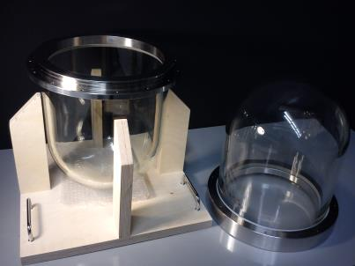
Cylindrical vessel
stainless steel flanges & titanium screws
wall thickness up to 18 mm
rated for 700 bar (≈ 10 000 psi)
mass (f/m): 28.2 kg/22.5kg
360 mm
785 mm
65 mm
male
female
332 mm
390 mm (= 15.4″)
Notes:
That’s what came out: Cylinder vessel with hemispherical ends, connected by steel flange& screws; 390mm = 15,35inch; 332mm = 13,07inch; quite heavy; thickness varies due to production process;
Now that we know real dimensions let’s see what we can build from it…

Slide 8
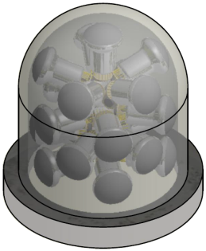
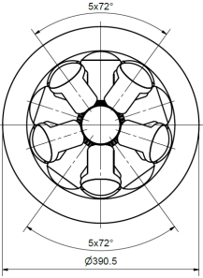
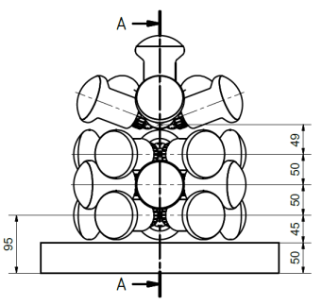
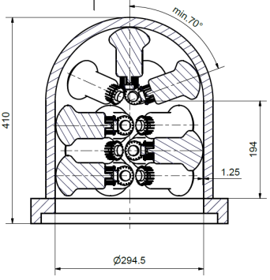
mDOM interior
segmented cylindrical vessel
41× 3” PMT
main electronics in center
~ four times larger photocathode area
than standard IceCube DOM
Notes:
Let’s fill in the PMTs: very crowded but 5 per layer fit in -> 21 PMTs per half cylinder; one slot left free for connector -> 41 PMTs in total; now designing holding structure, main board will be placed in center
If you do so, there comes out something like this: “mDOM”, Consists of glass cylinders with hemispherical caps, held together by metal ring structures, simulations show stability at 700 bar, sensitive area corresponds to 5 10” PMTs, length adjustable by further central segments, main advantage HUGE cathode, see dimensions, some have changed since last time

Slide 9
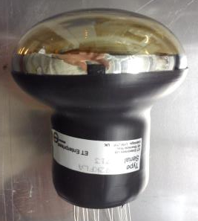
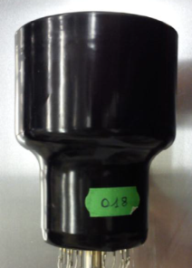
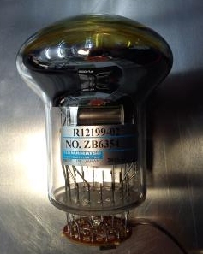
PMT candidates
testing in Amsterdam, Catania, Erlangen, Patros
R12199 | D792KFL | XP53B20
Hamamatsu | ET Enterprises | HZC
180x | 12x | 2x
Notes:
Current PMT candidates, started with flat PMTs, now both mushroom-shaped for better timing; right: New Chinese manufacturer, bought Photonis equipment. Prototypes being tested by different KM3NeT collaborators

Slide 10
PMT testing status
requirements (KM3NeT)
quantum efficiency @ 470 nm | > 20%
transit time spread (σ, FWHM) | < 2 ns, < 4.6 ns
gain | > 2 ∙ 10⁶
supply voltage | < 1400 V
dark count rate @ 15°C | < 1.5 kHz
peak to valley ratio | > 3
length | < 120 mm
outer diameter | ≤ 82 mm
Hamamatsu
ETEL
HZC
talk by Leonora
talk by Kalekin
Notes:
Tested against predefined requirements (some of them shown here); PMTs optimized and now Hama & ETEL fulfill requirements, HZC started later, still too noisy
For details on test procedures and results see talks by Leonora & Oleg Kalekin in photodetection session

Slide 11
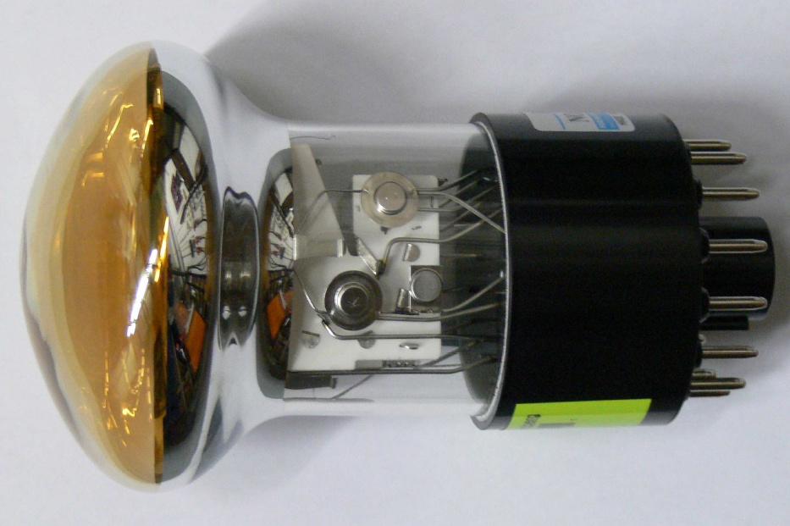
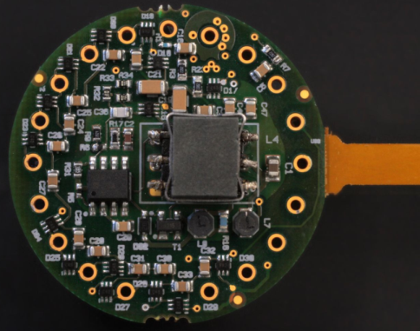
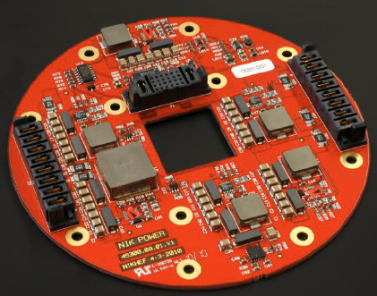
Readout principle
from analogue signal to time stamped data (talks by Real & Calvo)
time
voltage
threshold
base
FPGA & clock
signal word
start time
duration
PMT id
NIKHEF 2012
+1.5 V
voltage
time
Notes:
let me show you the way of the signal now: start: analogue waveform from PMT, ASIC on base applies threshold, converts to step signal,
then collected by OCTOPUS board, sent to main logic board, contains FPGA & clock (shore synchronized) & TDC, converts to digital “word”, sent to shore via fiber, have to think how to integrate into ice cube cable (twisted pair driver?)

Slide 12
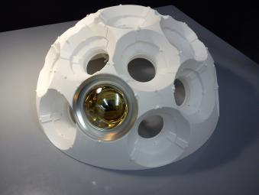
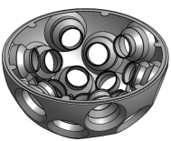
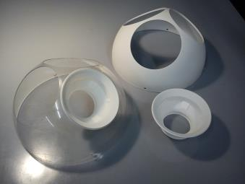
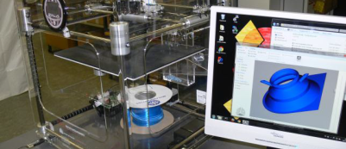
Holding structure
3D printing / rapid prototyping
adequate precision
low price (prototyping)
segmentation possible
high flexibility
alternatives considered for mass production
Notes:
Have a look at holding structure: After tests with foam -> 3d printing; advantages: precise, cheap & more flexible; for prototyping: bought PLA jet printer; laser sintering for “mass” production (PPM DOM); gain experience; very flexible -> good for PINGU;
For mass production also alternative approaches
measured radioactivity for plastic material -> no significant activity in one day in E range of XXX, made of PLA or abs plastic
Vitrovex = borsilicate 3,3 glass = DURAN

Slide 13
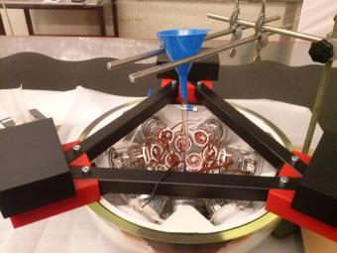
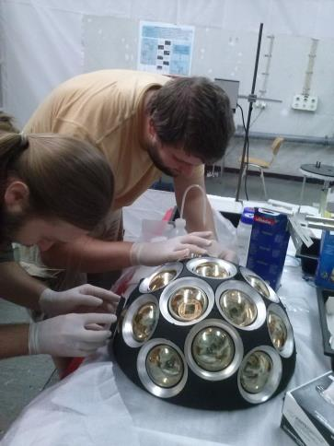
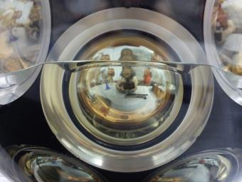
Module integration
Notes:
learn & optimize gel handling (2 component Wacker 612); vacuum chamber for gel degassing; PMT dummies for tests; started assembling first Km3NeT DOM; Valuable experience for later mDOM intergration

Slide 14
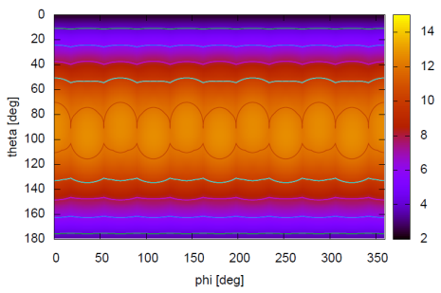
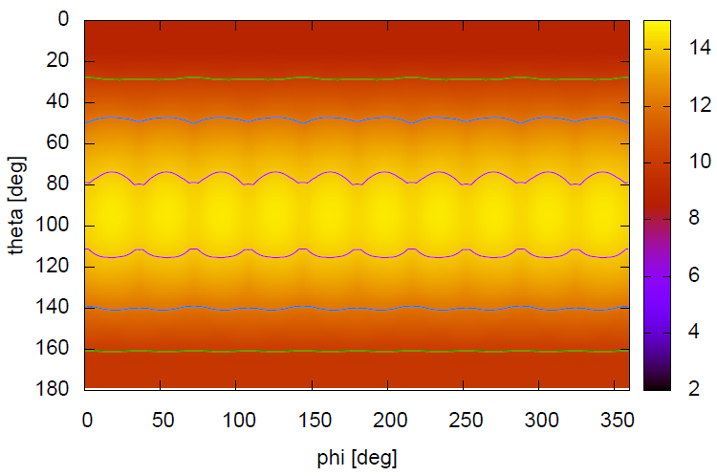
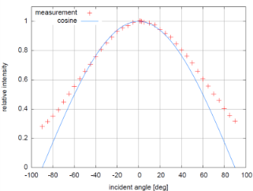
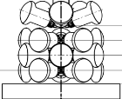
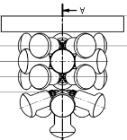
Angular acceptance
41 PMT mDOM
flat vs. measured PMTs
area scaled in single PMT effective areas (1 PMT ≈ 50 cm² )
flat PMT
12
10
8
measured PMT
14
12
10
Notes:
Access angular acceptance of mDOM, here first approach: flat PMTs (effective area - cos) in air, little bit more sophisticated: measure intensity(angle), insert into script -> see effect; Simulations will be refined ; Later will check with real mDOM prototype; also useful for detector simulations

Slide 15
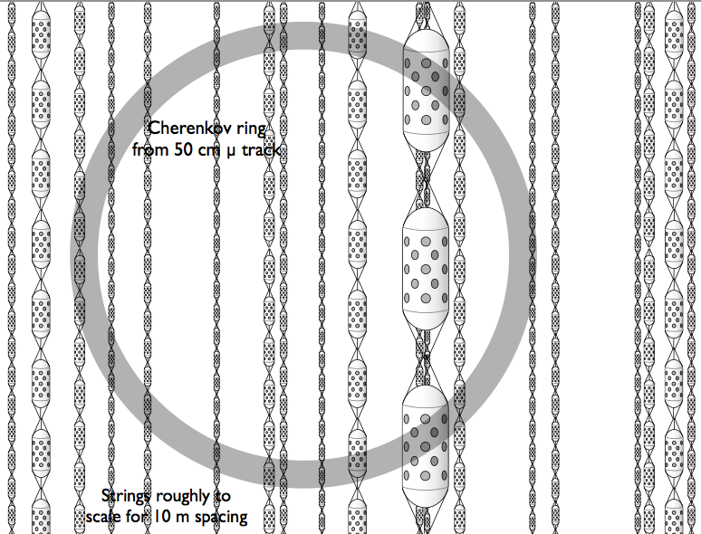
MICA
Megaton Ice Cherenkov Array
denser instrumentation
new optical module technology
physics goals
energy threshold ~ 10 MeV
Cherenkov ring imaging
supernova neutrinos
proton decay
Grant 2011
Notes:
That’s what mDOMs are for: denser infill -> Cherenkov ring imaging

Slide 16
Detector simulations
different detector configurations
number of strings 20 – 41
common detector properties
string spacing | 7 m
OMs per string | 151
OM spacing | 2 m
height | 300 m
location | 2148 – 2448 m*
framework | IceTray
ice model | SPICE-Mie
decay propagation physics | GEANT4
photon propagation | CLSim
* z ∈ [-500 m; -200 m]
Notes:
Recently started corresponding simulations, here some properties & first outcomes, location below dust layer

Slide 17
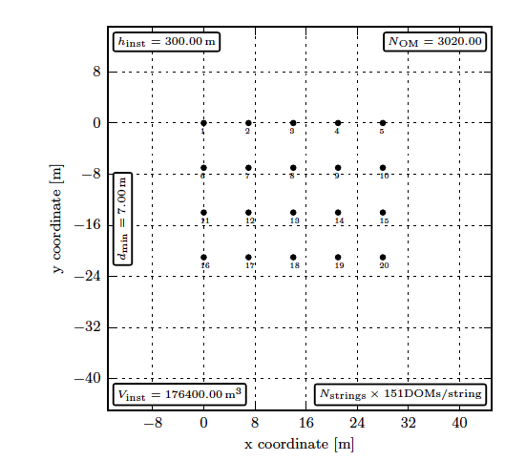
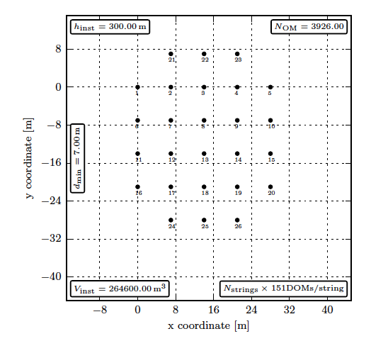
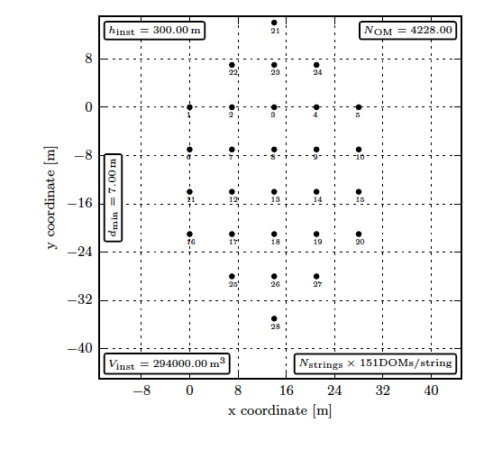
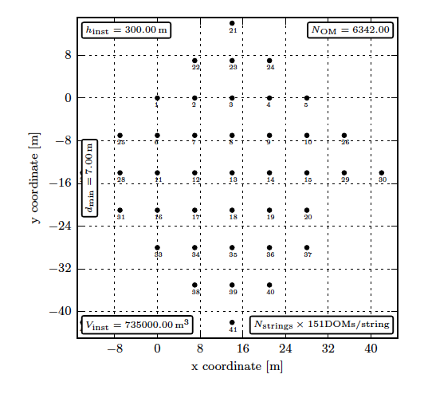
Simulated footprints
OrA
20 strings
OctA
26 strings
HexA
28 strings
LaSqA
41 strings
Notes:
see different detector footprints

Slide 18
Proton decay simulation
10 proton decays generated inside cylinder
radius 10 m
x₀ = 10 m
y₀ = -10 m
z ∈ [-490 m; -210 m]
p
e⁺ + π⁰
γγ
configuration | number of strings | number of OMs | hits / decay
OrA | 20 | 3020 | 2688
OctA | 26 | 3926 | 3592
HexA | 28 | 4228 | 3724
LaSqA | 41 | 6191 | 4354
Notes:
started with proton decay via this channel, first numbers indicate that simulation routine works

Slide 19
Next steps…
radioactivity of holder & glass
low temperature behaviour
adaptation of electronics
design holding structure
build prototype for testing
Notes:
here our plans to proceed on the way a first prototype; actually measurements for 1&2 done but yet but results ambiguous…

Slide 20
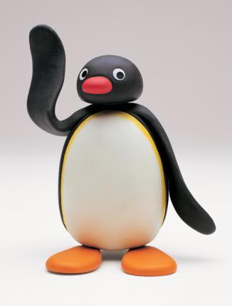

Thank you for your attention!
© The Pygos Group

Slide 21
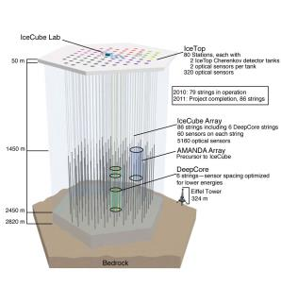
Picture graveyard
requirements (KM3NeT)
quantum efficiency @ 470 nm | > 20%
transit time spread (σ, FWHM) | < 2 ns, < 4.6 ns
gain | > 2 ∙ 10⁶
supply voltage | < 1400 V
dark count rate @ 15°C | < 1.5 kHz
cathode response inhomogeneity | < 10%
peak to valley ratio | > 3
length | < 120 mm
outer diameter | ≤ 82 mm
talk by Leonora
Hamamatsu
ETEL
HZC
talk by Kalekin

