Slide 1
The Relational DB System of KM3NeT
Arnauld Albert (Université de Haute Alsace)
Cristiano Bozza (Università di Salerno / INFN)
on behalf of
The KM3NeT Collaboration
presented by
Uli Katz (University Erlangen-Nuremberg / ECAP)

Slide 2
The Relational DB System of KM3NeT
Presentation plan
Relational DB approach
System architecture
DB performance
Web access to relational DB
Conclusions
Arnauld Albert, Cristiano Bozza / KM3NeT Collaboration – speaker Uli Katz – VLVν T 2013
2

Slide 3
The Relational DB System of KM3NeT
Part 1: Relational DB approach
Arnauld Albert, Cristiano Bozza / KM3NeT Collaboration – speaker Uli Katz – VLVν T 2013
3

Slide 4
The Relational DB System of KM3NeT
Relational DB
Tables
Data defined in an intrinsic way
Independent of algorithms, OS, data analysis software
Adding/changing/removing new types of information can be done in few seconds, no DST reformatting!
Long-term projects are quite often forced to “bow” to changing technology and standards in IT (both for SW and HW) – a flexible data storage technique helps!
Relationships
Views
Arnauld Albert, Cristiano Bozza / KM3NeT Collaboration – speaker Uli Katz – VLVν T 2013
4

Slide 5
The Relational DB System of KM3NeT
Relational DB
Tables
Relationships
Views
Logical constraints and consistency checks
Inserting data that violates rules is made impossible
Logical relationships are naturally supported to tag single records as well as complex datasets, and can be used to set-up (pre)filtered extractions
Relationships are a natural data-map, not only in a tree fashion (directory structure) but also cross-branch: simplify identification and retrieval of interesting data
Arnauld Albert, Cristiano Bozza / KM3NeT Collaboration – speaker Uli Katz – VLVν T 2013
5

Slide 6
The Relational DB System of KM3NeT
Relational DB
Tables
Relationships
Views
Flexible data representation
Data can be read accessing tables directly or views
Hide sensible information (e.g. passwords) without restructuring the data logic
Produce reports that summarize relevant data
Inserting data into views: simplify insertion code when logical relationships are complex – code running IN the DB sets records up correctly
Arnauld Albert, Cristiano Bozza / KM3NeT Collaboration – speaker Uli Katz – VLVν T 2013
6

Slide 7
The Relational DB System of KM3NeT
Additional features
Transactional integrity: prevent incomplete writes
Security implemented at high granularity level (single record, single field)
Error reporting through clear exception stacks, application-extendable
Tailored allocation of CPU and disk resources using priority schemes (official/urgent processing, low priority R&D, etc.)
Arnauld Albert, Cristiano Bozza / KM3NeT Collaboration – speaker Uli Katz – VLVν T 2013
7

Slide 8
The Relational DB System of KM3NeT
Part 2: System architecture
Arnauld Albert, Cristiano Bozza / KM3NeT Collaboration – speaker Uli Katz – VLVν T 2013
8

Slide 9
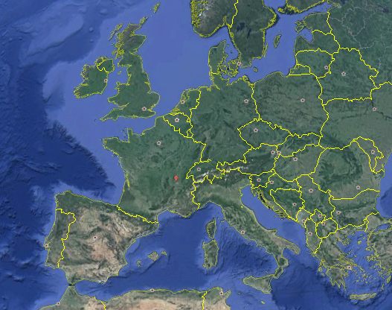
The Relational DB System of KM3NeT
Main site: KM3NeT DB at CCIN2P3 (Lyon)
DB Server: Oracle Database Server
Other sites with partial mirrors/replicas, close to KM3NeT detectors, can be easily set up using remote Database links (Oracle technology)
Arnauld Albert, Cristiano Bozza / KM3NeT Collaboration – speaker Uli Katz – VLVν T 2013
9

Slide 10
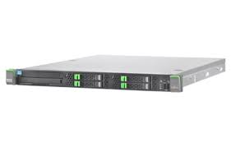
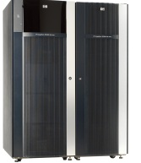
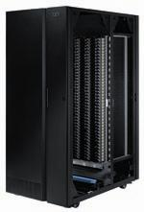
The Relational DB System of KM3NeT
KM3NeT DB @ CCIN2P3
3 servers in Real Application Cluster configuration
Share connections, provide fault tolerance, share CPU load for data selection/formatting to client
Mirrored disk array
Allocated capacity: 700 GB Much more available, will be extended as soon as neede
Daily backup
Arnauld Albert, Cristiano Bozza / KM3NeT Collaboration – speaker Uli Katz – VLVν T 2013
10

Slide 11
The Relational DB System of KM3NeT
Distributed DB infrastructure
Oracle DB Link
Native TCP(S) connection (no network SW required)
Represent portions of remote data locally,or transfer them over the network
Replication jobs handled at DB level
KM3NeT DB
(CCIN2P3)
DBLink
DBLink
DBLink
Purpose of local DB
Reduce criticality of network link to main DB without introducing different technology
DB Toulon
DB Capo Passero
DB Pylos
Arnauld Albert, Cristiano Bozza / KM3NeT Collaboration – speaker Uli Katz – VLVν T 2013
11

Slide 12
The Relational DB System of KM3NeT
Distributed DB infrastructure
Preventing conflicts and inconsistencies among remote DB’s
Intrinsic numbering
Conventional numbering
Physical objects, e.g. components: a numbering conflict is a mistake that must be corrected
Activities, configurations,
slow control datasets, …
Toulon
Capo Passero
Pylos
Each DB generates IDs in its sequence, but can merge data from any
sequence. Letter-prefixed code prevent overlaps.
No performance downgrade.
Seq. A
Seq. B
Seq. C
A0301463
B0020776
C0020776
Arnauld Albert, Cristiano Bozza / KM3NeT Collaboration – speaker Uli Katz – VLVν T 2013
12

Slide 13
The Relational DB System of KM3NeT
Overview of DB schema
Derived from ANTARES DB
Persons
Institutions
Runsetup Plans
Operations
Runsetup
Sites
DAQ Logs (Slow Ctl)
Parameters
Components
Tests
DAQ Events
Test results
Calibrations
Each ballon actually involves (1∼4 tables)
Arnauld Albert, Cristiano Bozza / KM3NeT Collaboration – speaker Uli Katz – VLVν T 2013
13

Slide 14
The Relational DB System of KM3NeT
DB-based detector management
Runsetup: logically consistent set of operating parameters
Runsetup plan: define in what configuration the detector is expected to be at a specific time
The optimal runsetup might even change over time
RS #1 (optimal)
RS #2 (high noise)
RS #3 (optimal)
RS #2 (high noise)
RS #4 Calibration
RS #3 (optimal)
Runsetup type: optimal, downgraded (high noise), calibration, …
Arnauld Albert, Cristiano Bozza / KM3NeT Collaboration – speaker Uli Katz – VLVν T 2013
14

Slide 15
The Relational DB System of KM3NeT
DB-based detector management
Runsetups, parameters
Run Control
Cache
Feedback data
KM3NeT DB
Feedback data
Trigger system
The RunControl reads configuration from the DB and applies them
The RunControl writes feedback about operating conditions to the DB
A local cache is used to prevent the WAN link to become critical
Cache managed by Application Web server (see next slides)
Sampling frequency: 0.1 Hz, Full detector: 120 strings
Estimated data rate: 0.8 TB/year
Arnauld Albert, Cristiano Bozza / KM3NeT Collaboration – speaker Uli Katz – VLVν T 2013
15

Slide 16
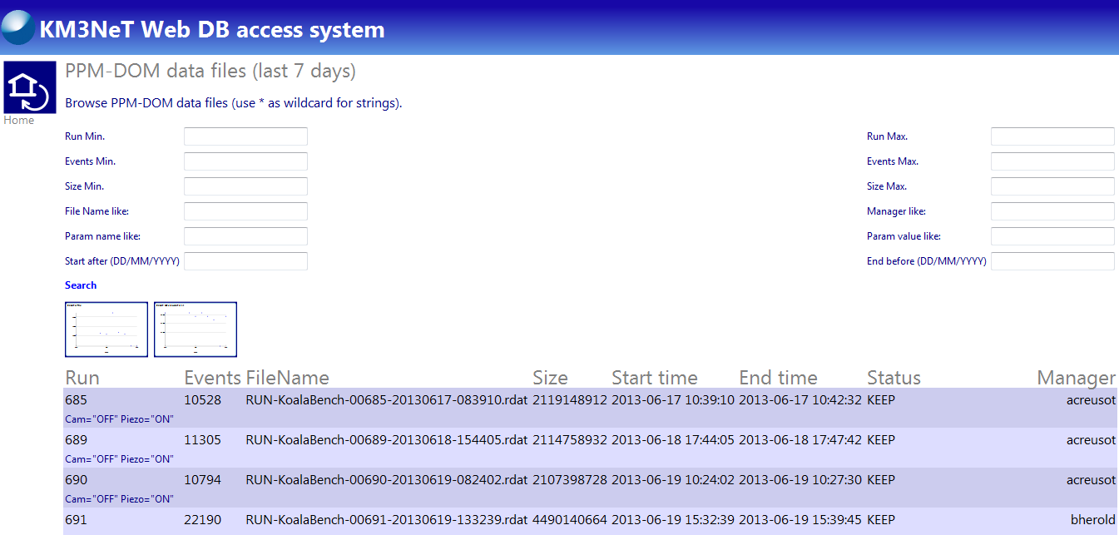
The Relational DB System of KM3NeT
DB-based detector management
Already working:
Bookkeeping of PPM DOM test line data at ANTARES site
Interactive querying as well as pre-defined reports supported
Run#
File size
Start time
End time
Events
Manager
DAQ Parameters
Arnauld Albert, Cristiano Bozza / KM3NeT Collaboration – speaker Uli Katz – VLVν T 2013
16

Slide 17
The Relational DB System of KM3NeT
By-products of DB-based experiment management
The DB hosts (in encrypted form) credentials for all IT services
KM3NeT DB
(CCIN2P3)
Google Drive (document sharing)
Other IT services …
SVN/TRAC (SW Management)
Wiki pages
Generate, maintain and track the author list
Arnauld Albert, Cristiano Bozza / KM3NeT Collaboration – speaker Uli Katz – VLVν T 2013
17

Slide 18
The Relational DB System of KM3NeT
Part 3: DB Performance
Arnauld Albert, Cristiano Bozza / KM3NeT Collaboration – speaker Uli Katz – VLVν T 2013
18

Slide 19
The Relational DB System of KM3NeT
Real performance of a relational DB system
Disk speed
CPU speed
Network speed
DB schema / SQL data access profile
Client/server communication
“Do not ask what a DB system can do for you:
ask what you can do to obtain maximum performance from a DB system”*
*… with a reasonable amount of effort, of course!
Arnauld Albert, Cristiano Bozza / KM3NeT Collaboration – speaker Uli Katz – VLVν T 2013
19

Slide 20
The Relational DB System of KM3NeT
Benchmarks of DB test systems
A: 8 core server with 16 GB RAM + SAS-attached (SATA-to-SAS) RAID6 storage (48 TB online) – quoted 15÷20 k€ (without backup)
B: One storage device + cluster of 3 RAC servers (at CCIN2P3)
Dataset size: 11.9 GB
Server | Test | Network connection | Data flow (MB/s) | Network speed (Mbps) | Test duration (s)
A | Local write | N/A | 34 | N/A | 363
B | Local write | N/A | 24 | N/A | 507
A | Local read | 1Gbps LAN | 131 | N/A | 93
A | LAN write | 1Gbps LAN | 34 | 272 | 363
A | LAN read | 1Gbps LAN | 97 | 779 | 127
A | WAN read | 100Mbps WAN | 10.4 | 83 | >500
Arnauld Albert, Cristiano Bozza / KM3NeT Collaboration – speaker Uli Katz – VLVν T 2013
20

Slide 21
The Relational DB System of KM3NeT
Benchmarks of DB test systems
A: 8 core server with 16 GB RAM + SAS-attached (SATA-to-SAS) RAID6 storage (48 TB online) – quoted 15÷20 k€ (without backup)
B: One storage device + cluster of 3 RAC servers (at CCIN2P3)
Dataset size: 11.9 GB
Server | Test | Network connection | Data flow (MB/s) | Network speed (Mbps) | Test duration (s)
A | Local write | N/A | 34 | N/A | 363
B | Local write | N/A | 24 | N/A | 507
A | Local read | 1Gbps LAN | 131 | N/A | 93
A | LAN write | 1Gbps LAN | 34 | 272 | 363
A | LAN read | 1Gbps LAN | 97 | 779 | 127
A | WAN read | 100Mbps WAN | 10.4 | 83 | >500
Arnauld Albert, Cristiano Bozza / KM3NeT Collaboration – speaker Uli Katz – VLVν T 2013
21

Slide 22
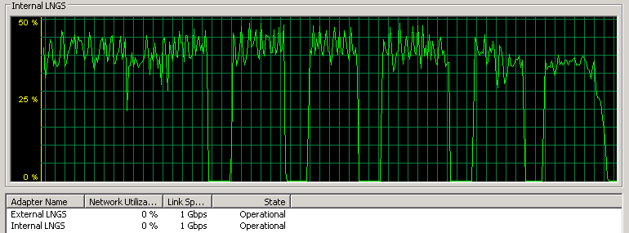
The Relational DB System of KM3NeT
Network usage profile 1/2
Sustained LAN data flow (writes on server configuration A)
34 MB/s
“Holes”: 2GB extension when storage limit is exceeded – a similar slowdown, although “continuous”, would also be present in some file systems
Can be reduced/avoid by datafile preallocation (this hardware can reach 50 MB/s)
Arnauld Albert, Cristiano Bozza / KM3NeT Collaboration – speaker Uli Katz – VLVν T 2013
22

Slide 23
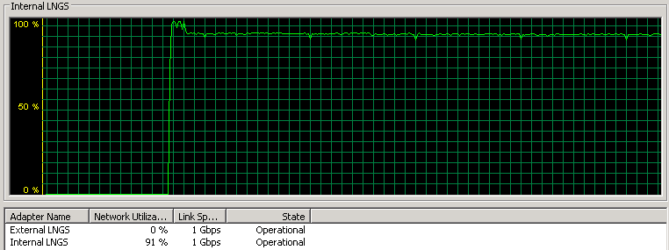
The Relational DB System of KM3NeT
Network usage profile 2/2
Sustained LAN data flow (reads on server configuration A)
1Gbps saturated!
Arnauld Albert, Cristiano Bozza / KM3NeT Collaboration – speaker Uli Katz – VLVν T 2013
23

Slide 24
The Relational DB System of KM3NeT
Performance outlook
34 MB/s on a single machine
1.02 PB/year data flow (write only, no read)
150 TB/year envisaged for full detector (trigger-filtered data)
The performance of a single DB server is such that in principle all data could be stored in relational shape
In this back-envelope computation, no time is allocated for reading
A more realistic simulation should involve multiple copies, synchronized servers, etc.
Interesting field for R&D, not implying any decision yet
Arnauld Albert, Cristiano Bozza / KM3NeT Collaboration – speaker Uli Katz – VLVν T 2013
24

Slide 25
The Relational DB System of KM3NeT
Part 4: Web access to relational DB
Arnauld Albert, Cristiano Bozza / KM3NeT Collaboration – speaker Uli Katz – VLVν T 2013
25

Slide 26
The Relational DB System of KM3NeT
need to link Oracle client
requires SQL knowledge
requires network knowledge
User program
DB
User program
User program
Let’s put a Web server as intermediate layer for data access
Web server ⇒ Application Server with Web interface
User program
User program
Application Web server
User program
DB
wget script or HTTP library : ubiquitous!
no SQL knowledge required
Arnauld Albert, Cristiano Bozza / KM3NeT Collaboration – speaker Uli Katz – VLVν T 2013
26

Slide 27
The Relational DB System of KM3NeT
Web server ⇒ Application Server with Web interface
wget http://weburl.km3net/pmtvoltage._?start=20130603& end=20130606&fmt=root
Linux, MacOS, Windows
Server name
Data type
Selection and format
Select data and encode them on-the-fly in the desired format
If the software changes, data do not need to be reprocessed
The Web Application Server uses optimized SQL to access the DB
wget http://weburl.km3net/pmtvoltage._?start=20130603& end=20130606&fmt=root& stage=/sharedir/proc/job1/
In a batch processing environment (cluster, Grid, Cloud), data might be staged to a convenient area
Long-lasting data extractions can also be monitored (HTML page, XML companion file)
Arnauld Albert, Cristiano Bozza / KM3NeT Collaboration – speaker Uli Katz – VLVν T 2013
27

Slide 28
The Relational DB System of KM3NeT
Web server ⇒ Application Server with Web interface
In a batch processing environment (cluster, Grid, Cloud), data might be staged to a convenient area
DB
Application Web server
Lightweight
user programs
The Cloud
Processing Jobs
The Grid
Arnauld Albert, Cristiano Bozza / KM3NeT Collaboration – speaker Uli Katz – VLVν T 2013
28

Slide 29
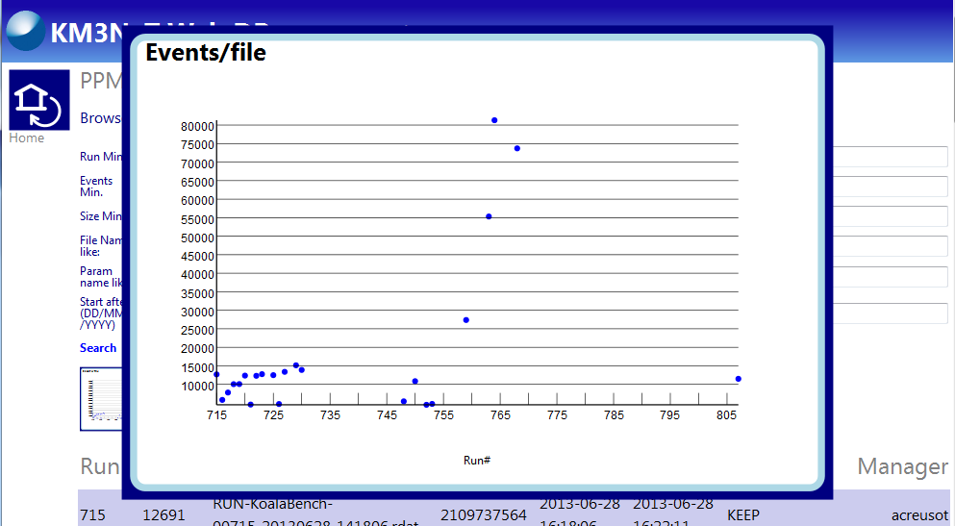
The Relational DB System of KM3NeT
Web server ⇒ Application Server with Web interface
As a by-product, we also get a GUI interface!
Monitoring plots are generated on-the-fly, on-demand
Arnauld Albert, Cristiano Bozza / KM3NeT Collaboration – speaker Uli Katz – VLVν T 2013
29

Slide 30
The Relational DB System of KM3NeT
Summary
Arnauld Albert, Cristiano Bozza / KM3NeT Collaboration – speaker Uli Katz – VLVν T 2013
30

Slide 31
The Relational DB System of KM3NeT
Summary
KM3NeT will exploit the flexibility and safety offered by the relational DB technology, building on the ANTARES experience and extending the range of application
The DB system is born to work in a geographically distributed scenario
The core DB is hosted at CCIN2P3, with a cluster of machines
Access through HTTP and a dedicated Application Web server provides easy and high-performing access to browsers and HTTP-capable SW,
helping integration of DB into Grid/Cloud computing models
Benchmarks of common servers show that Gbps-range throughputs can be achieved with moderate costs – intriguing possibilities!
The Application Web server also provides a GUI that is being increasingly used for several management and reporting purposes
Arnauld Albert, Cristiano Bozza / KM3NeT Collaboration – speaker Uli Katz – VLVν T 2013
31

Slide 32
The Relational DB System of KM3NeT
Backup slides
Arnauld Albert, Cristiano Bozza / KM3NeT Collaboration – speaker Uli Katz – VLVν T 2013
32

Slide 33
The Relational DB System of KM3NeT
Relational DB
Error reporting
Transactions
Prevent partial/incomplete writes or reads
In a scenario with frequent writes and multiple readers, data may appear inconsistent if reads and writes occur concurrently
Hide all data being written until the write action is complete (they appear “all at once”)
Data write cannot be partially successful (either write everything or nothing)
Arnauld Albert, Cristiano Bozza / KM3NeT Collaboration – speaker Uli Katz – VLVν T 2013
33

Slide 34
The Relational DB System of KM3NeT
Relational DB
Error reporting
Transactions
Data insertion/modification errors handled in detail
Trying to violate constraints produces fully documented exception stacks
Application or user-defined rules can be added to standard rules, along with their own error codes
Arnauld Albert, Cristiano Bozza / KM3NeT Collaboration – speaker Uli Katz – VLVν T 2013
34

Slide 35
The Relational DB System of KM3NeT
Relational DB
Security
Security
Access permissions can be tuned with the granularity of a single column (datafield) in a table and at the level of single records using views
Privileges required (and managed) for all actions, with high level of detail – prevent also mistakes by unexperienced users!
Safety
Arnauld Albert, Cristiano Bozza / KM3NeT Collaboration – speaker Uli Katz – VLVν T 2013
35

Slide 36
The Relational DB System of KM3NeT
Relational DB
Security
Security and safety
In order to enforce integrity, a relational DB has to implement data safety and fault tolerance from the very beginning
Mirroring (Replication)
Corrupt datablock detection
Transaction logging
Transaction log archiving and re-play
Stand-by database (for disaster recovery, e.g. major hardware failures)
Safety
Arnauld Albert, Cristiano Bozza / KM3NeT Collaboration – speaker Uli Katz – VLVν T 2013
36

Slide 37
The Relational DB System of KM3NeT
Relational DB
Resource Management
CPU, disk and network usage monitoring and optimization
Relational DB’s can implement easily complex indexing systems
There is a lot of code running and activity going on even in an apparently quiescent DB!
(Self) optimizing access code can improve performances by orders of magnitude
Users and groups can be put in different priorities (e.g. urgent or “official” data processing, R&D, etc.) and assigned tailored, dynamic fractions of the available resources
Arnauld Albert, Cristiano Bozza / KM3NeT Collaboration – speaker Uli Katz – VLVν T 2013
37

Slide 38
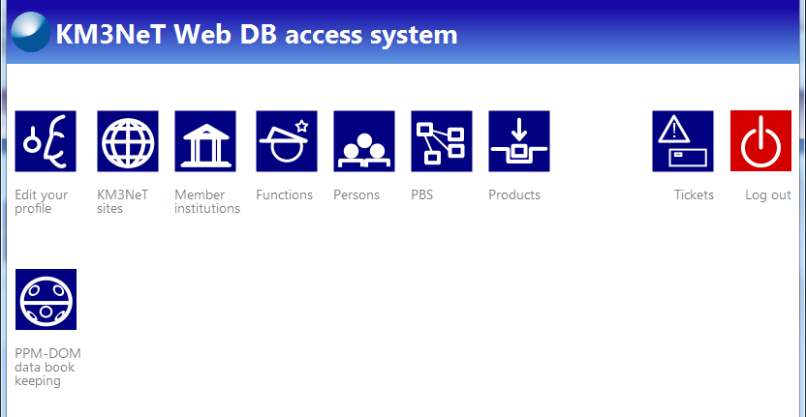
The Relational DB System of KM3NeT
Main page of Web interface for DB
Arnauld Albert, Cristiano Bozza / KM3NeT Collaboration – speaker Uli Katz – VLVν T 2013
38

Slide 39
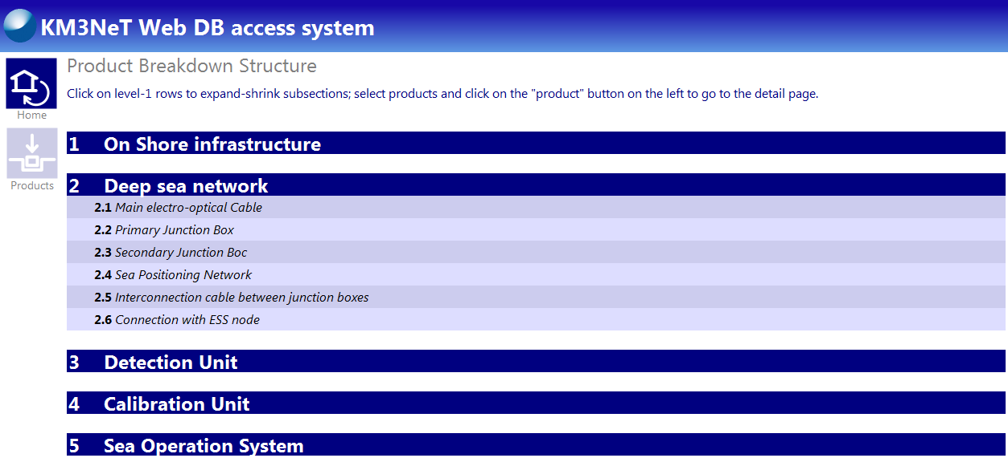
The Relational DB System of KM3NeT
Detector structure managed by DB + Web interface
Arnauld Albert, Cristiano Bozza / KM3NeT Collaboration – speaker Uli Katz – VLVν T 2013
39

