Slide 1
Time to Digital Converters for KM3NeT Data Readout System
David Calvo y Diego Real
IFIC (CSIC – Universidad de Valencia)
VLVNT 2013

Slide 2
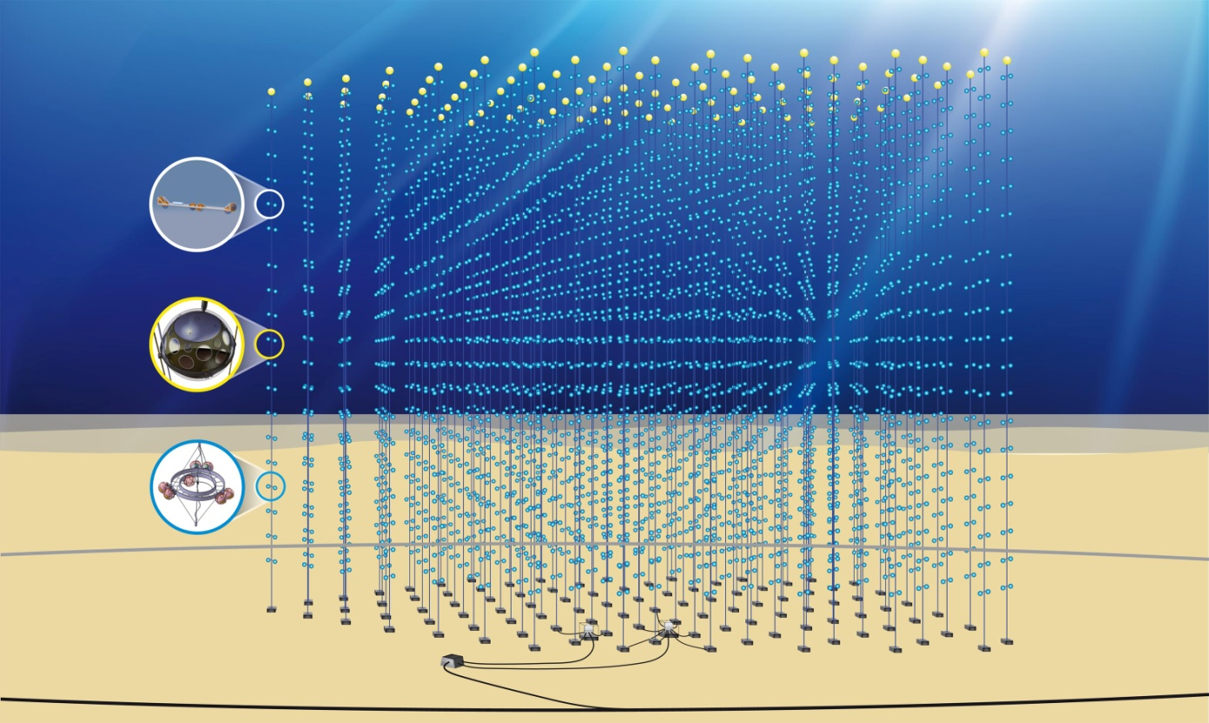
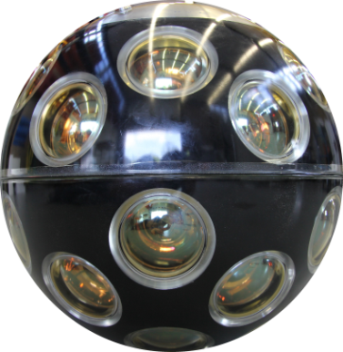
KM3NeT: ARTIST IMPRESSION
640 strings
20 DOM/string
12800 DOMs
~ 860m
Volume: ~5 km³
100m
12,800 DOMs in the deep sea at 3-5 km depth
with point-to-point connection to shore

Slide 3
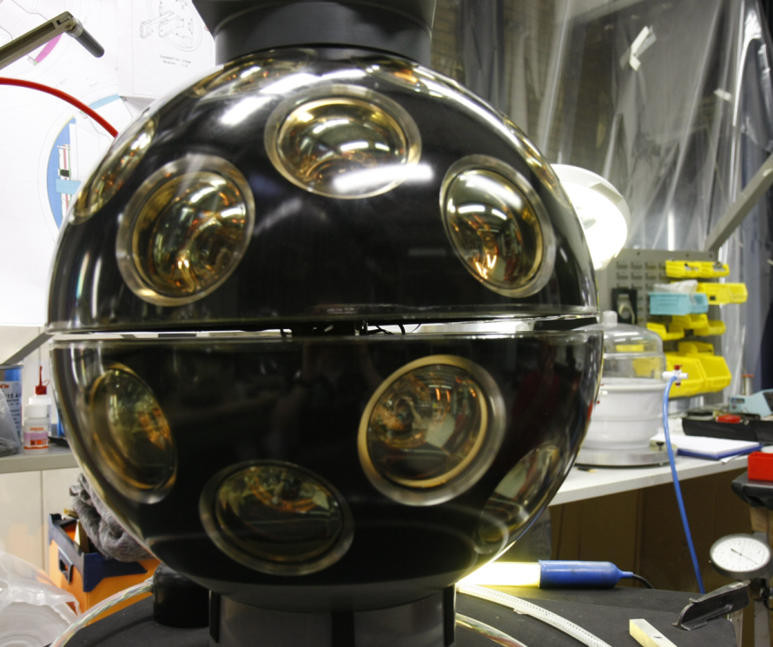
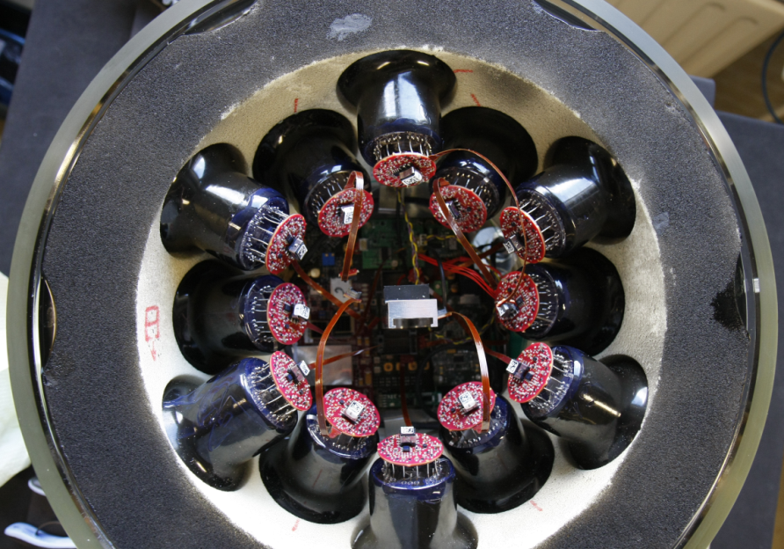
KM3NeT DIGITAL OPTICAL MODULE (DOM)
Lower Hemisphere
19 PMTs
Upper Hemisphere
12 PMTs
Central Logic Board
(CLB)
PMT Base:
High Voltage Supply
Analog Front-End

Slide 4
KM3NeT CENTRAL LOGIC BOARD (CLB)
Readout 31 PMT’s with 1 ns resolution
“Knowledge” of absolute time (1 ns resolution)
Data pushed from PMTs to Shore Station
I2C: Compass, Tilt
Other IO: Temp, Nano beacon, Acoustics
Firmware must be reconfigurable
Low Power
Low Cost
Part of a scalable system (with respect to the complete detector)
Highly reliable

Slide 5
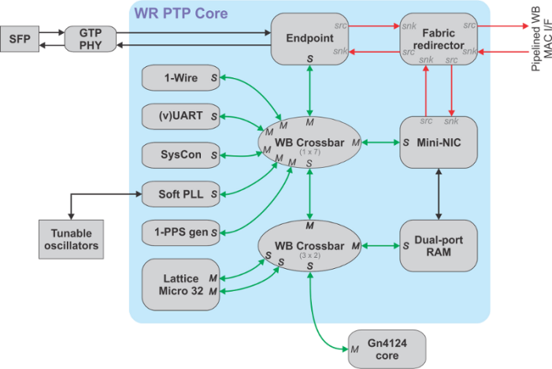
KM3NeT CENTRAL LOGIC BOARD (CLB)
IP/UDP Packet Buffer
Stream Selector (IPMUX)
31 TDCs
Start Time Slice UTC &
Offset counter since
Fifo
TDC0
Time Slice Start
RxPacket
Buffer
64KB
RxPort 1
31 PMTs
Rx Stream Select
RxPort 2
Fifo
TDC
30
Rx_mac2buf
Rx_buf2data
Flags
RxPort_m
Management
& Control
State Machine
S
Pause Frame
Management
& Config.
ADC
Fifo
Hydrophone
TxPacket
Buffer
32KB
TxPort 1
Management
& Control
Tx Stream Select
TxPort 2
S
Tx_pkt2mac
Tx_data2buf
Multiboot
Flags
TxPort_m
S
Management
& Control
S
Nano
Beacon
M
M
M
S
M
WB Crossbar
(1x8)
M
M
M
M
M
M
Debug LEDs
M
M
2nd CPU
LM32
S
S
S
S
S
Xilinx
Kintex-7
MEM
S
SPI
UART
I2C
I2C
GPIO
WB Crossbar
(3x2)
S
M
S
M
Data
UTC time & Clock (PPS, 125 MHz)
Compass
Control
Point to Point interconnection
SPI
Flash
Debug RS232
Temp
Tilt
Wishbone bus

Slide 6
KM3NeT CENTRAL LOGIC BOARD (CLB)
IP/UDP Packet Buffer
Stream Selector (IPMUX)
31 TDCs
Start Time Slice UTC &
Offset counter since
Fifo
TDC0
Time Slice Start
RxPacket
Buffer
64KB
RxPort 1
31 PMTs
Rx Stream Select
RxPort 2
Fifo
TDC
30
Rx_mac2buf
Rx_buf2data
Flags
RxPort_m
Management
& Control
State Machine
S
Pause Frame
Management
& Config.
ADC
Fifo
Hydrophone
TxPacket
Buffer
32KB
TxPort 1
Management
& Control
Tx Stream Select
TxPort 2
S
Tx_pkt2mac
Tx_data2buf
Multiboot
Flags
TxPort_m
S
Management
& Control
S
Nano
Beacon
M
M
M
S
M
WB Crossbar
(1x8)
M
M
M
M
M
M
Debug LEDs
M
M
2nd CPU
LM32
S
S
S
S
S
Xilinx
Kintex-7
MEM
S
SPI
UART
I2C
I2C
GPIO
WB Crossbar
(3x2)
S
M
S
M
Data
UTC time & Clock (PPS, 125 MHz)
Compass
Control
Point to Point interconnection
SPI
Flash
Debug RS232
Temp
Tilt
Wishbone bus

Slide 7
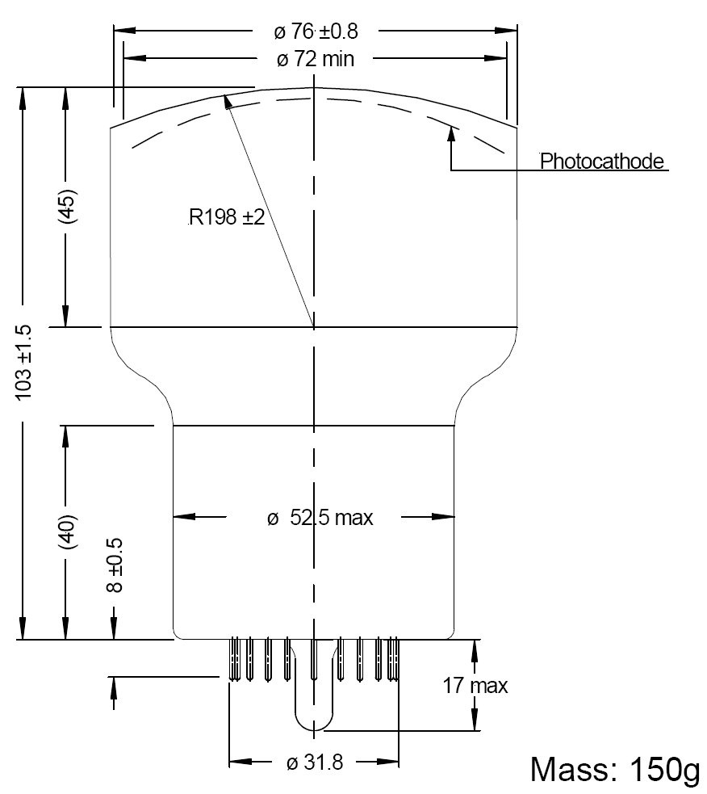
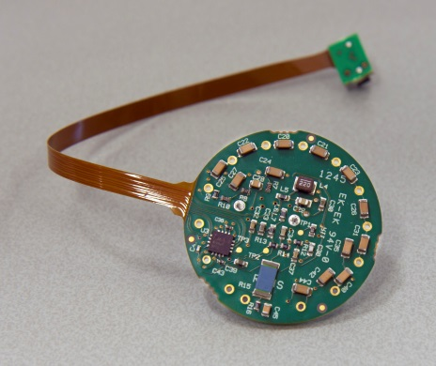
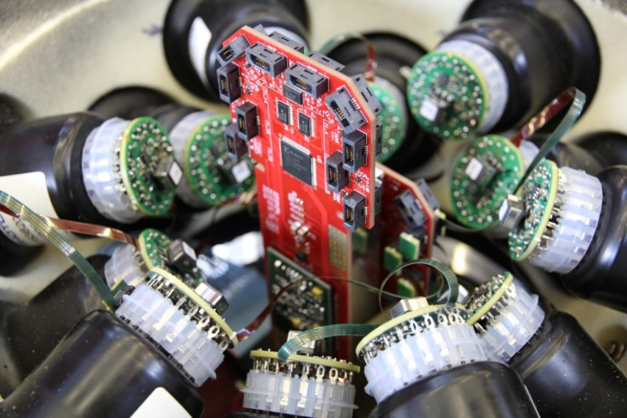
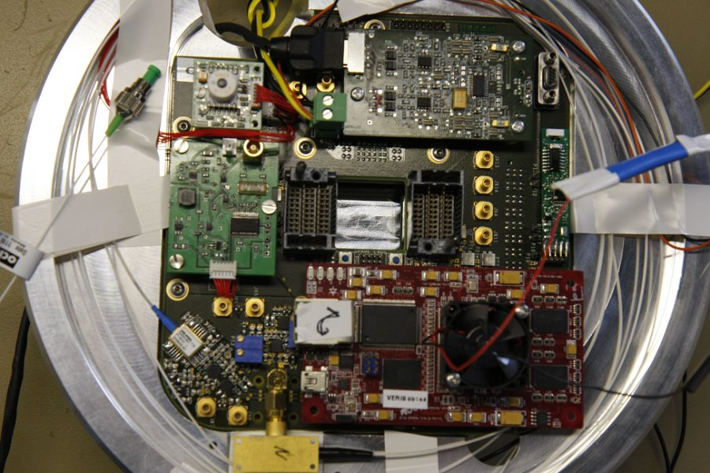
PMT SIGNAL ADAPTATION
3 inch PMTs
OCTOPUS
KINTEX-7
TDC
Photons
LVDS
14.5 m
PMT
PMT BASE
OCTOPUS
BOARD
CLB
100 m
<105
Junction box
~60 m
Link cables
2500 m depth
7

Slide 8
TIME TO DIGITAL CONVERTER (TDC): INTRODUCTION
Precise measurements of time intervals (TI) are frequently needed in many
applications in science and industry.
It has been widely used in many applications such as particle detection and time of fly in high energy physics, laser range finder, frequency counter, etc.
It used to be designed in ASIC but due to the complex design process and high cost, from 1995 are being designed in FPGA.
In a simple case shown in figure , the TI is measured between the leading edges of two electrical pulses or between rising edge and falling edge of electrical pulses received from the detectors of some physical events
The TDC performs conversion of a time interval TI into a digital (binary) word, frequently displayed in the decimal form. Therefore a TI measurement is also called a time-to-digital converter (TDC).
Start counter
Stop counter

Slide 9
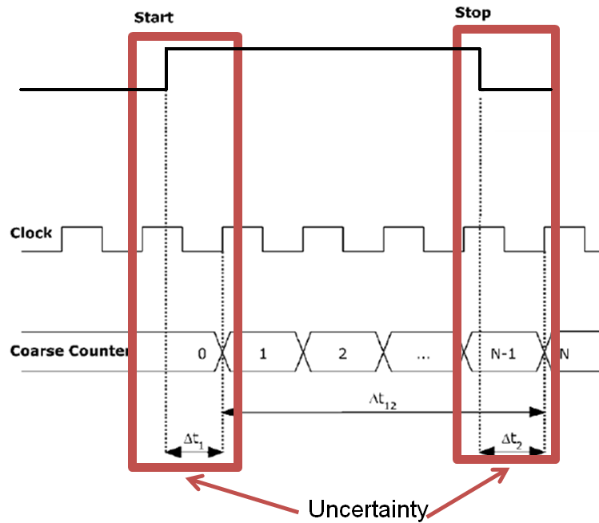
TDC: REQUIREMENTS
Design and implementation of high resolution, Low power and wide dynamic range time to digital converter (TDC) in Field Programmable Gate Array (FPGA)
Implement TDC for achieving 1 ns time resolution required for the experiment.
Input signal

Slide 10
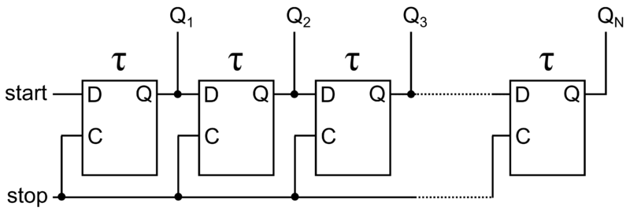
TDC: DIFFERENT ARCHITECTURES
Analogue methods (Better accuracy) :
Ramp interpolator (Analogue to Digital Converter)
Start and stop signals enable and disable the charge of capacitor
Charge of capacitor proportional to time interval
Digital Methods (More flexibility in integrated circuits):
Vernier:
Two slightly detuned oscillators
Start their signals with start and stop event
When leading edges coincides measure ends
Tapped delay line:
Cells (D-flip-flop) with well
defined delay
Start signal is delayed
Stop signal latches all flip-flops

Slide 11
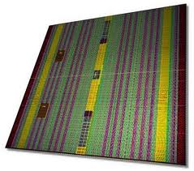
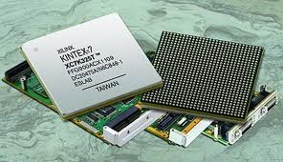
TDC: XILINX KINTEX-7 CAPABILITIES
Serializer / Deserializer primitve
within IO blocks (ISERDES)
Low resources. Logic no needed
No external devices
Low power consumption
Accuracy enough for 1 ns.
Input/Output Blocks

Slide 12
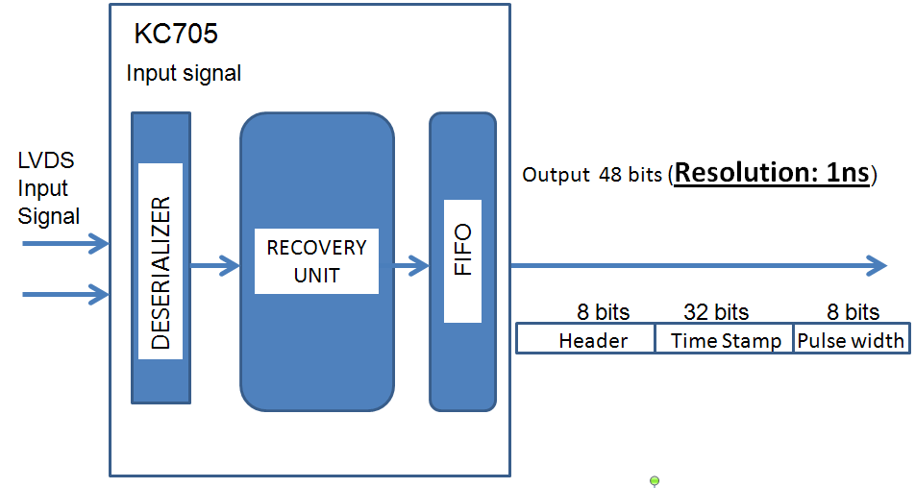
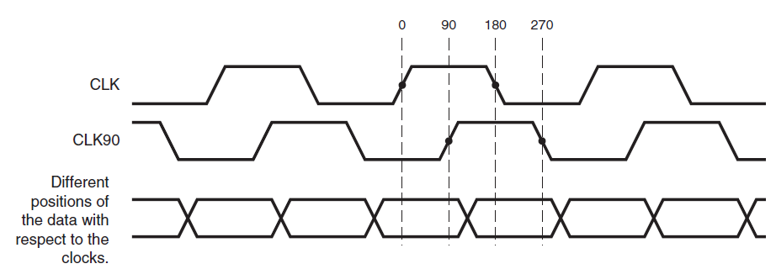
TDC: OVERSAMPLING TECHNIC
Notes:
12

Slide 13
TDC: TECHNICAL INFORMATION
31 Channels
Input signals:
Data (LVDS)
Two 250 MHz clocks
48 bits output:
8 bits header
32 bits time stamp
8 bits pulse width
Resolution: 1 ns
Death time: 4 ns
Notes:
13

Slide 14
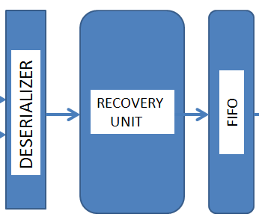
KM3NeT: 31 TDC CHANNELS
Enable Interface
KC705
Ch.1
LVDS
Input
Signal
Ch.1
Ch.2
Output
(48 bits)
MULTIPLEXER
PC
SIGNAL DISTRIBUTION
Ch.31
Ch.31
Notes:
14

Slide 15
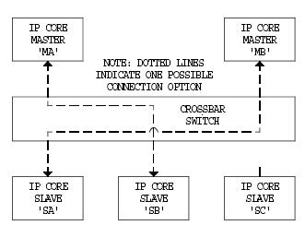
TDC CORE CONTROL
Open source – portable
Wihsbone bus compatible:
Open source
Logic bus
Crossbar connection with slaves
Embedded
TDC Wishbone slave properties:
Enable/Disable the whole core
Enable/Disable each channel
Notes:
15

Slide 16
TDC: EXAMPLE TEST
Enable Interface
KC705
Well-known pattern
Ch.1
ML605
LVDS
Input
Signal
Ch.1
Ch.2
Output
(48 bits)
MULTIPLEXER
PC
SIGNAL DISTRIBUTION
Ch.31
Ch.31
Notes:
16

Slide 17
TDC: PATTERNS TO TEST
CHANNEL 1
CHANNEL 2
Jitter = 0.3 ns
Notes:
17

Slide 18
TDC: PATTERN TO TEST
Patterns replicated 250 times
1000 pulses x channel
CHANNEL 1
CHANNEL 2
Notes:
18

Slide 19
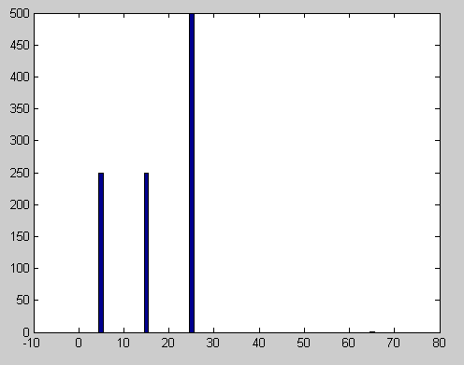
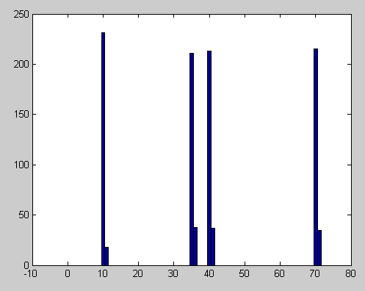
TDC: RESULTS
CHANNEL 1
CHANNEL 2
Pulse width
counts
counts
ns
ns
Notes:
19

Slide 20
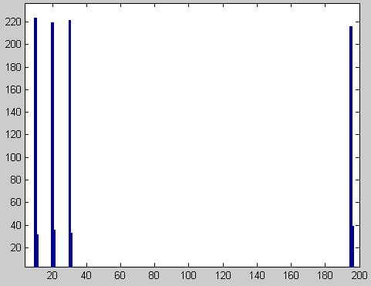
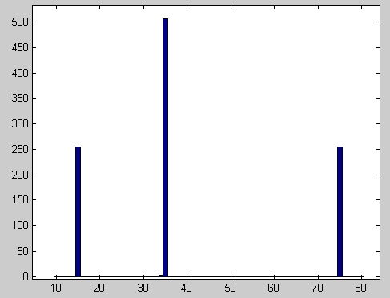
TDC: RESULTS
CHANNEL 1
CHANNEL 2
Time between pulses
counts
counts
ns
ns
Notes:
20

Slide 21
CONCLUSIONS
Taking advantage of Xilinx technology to implement a high resolution Time
to Digital Converters.
4XOversampling method with two 250 MHz clocks
TDC architecture implemented with low resources occupancy and 1 ns of
resolution
31 TDC channels integrated into LM32 microprocessor as wishbone salve:
Enable interface controlled by LM32
Successful tests
Notes:
21

Slide 22
THANKS FOR YOUR ATTENTION!
Notes:
22

