Slide 1


Results from the IceCube video camera system at 2455 meters ice depth
Per Olof Hulth
Department of Physics
Stockholm University

Slide 2
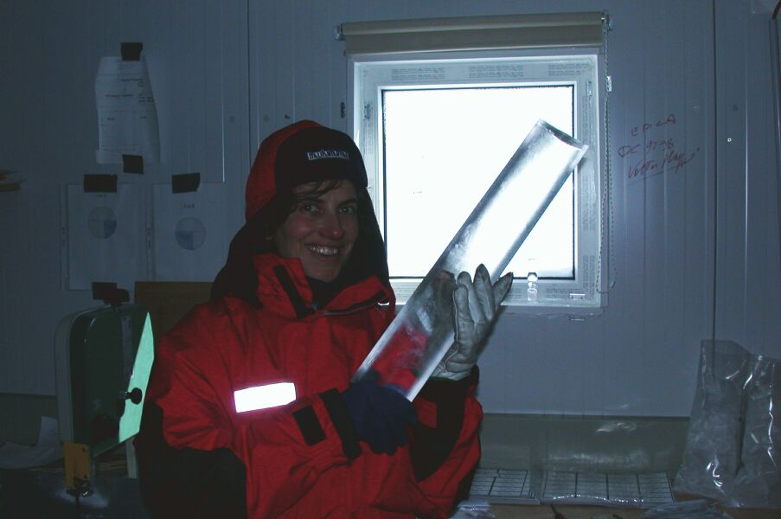
South Pole ice
Glacier ice is not frozen water, it is compressed snow!
At large depth (1400 m at South Pole) and low temperature the trapped air bubbles and the ice creates a new crystal “Clathrate hydrate” (air hydrates). The air molecules are trapped inside cages of hydrogen bonded water molecules
The ice has memories from the atmosphere – dust layers, thin volcanic ash layers, etc.
The ice at 2500 m is ≈ 90000 y old.

Slide 3
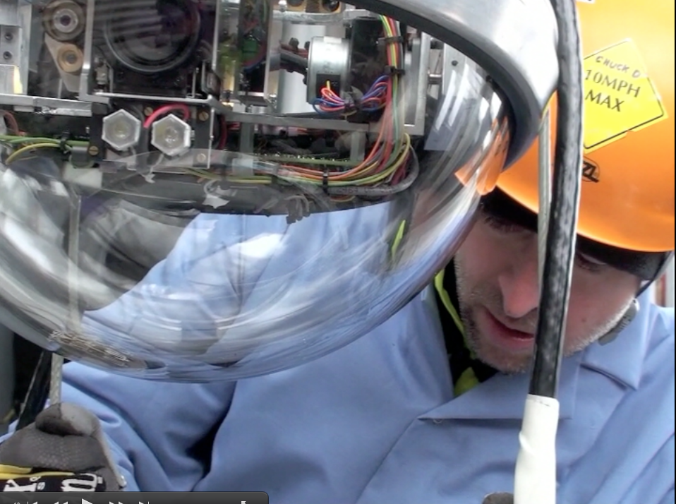
Swedish camera system
We developed in Stockholm a camera system which was deployed in the last deployed string of IceCube.
Two movable cameras 5.8 m above each other between the bottom DOM and the string weight.
Each camera equipped with two LED lamps and three lasers (red, blue, green).
A short movie about the camera deployment and refreezing can be fetched at:
www.fysik.su.se/~hulth/IceCube/Icecube_camera_deployment_18_Dec_2010.m4v

Slide 4
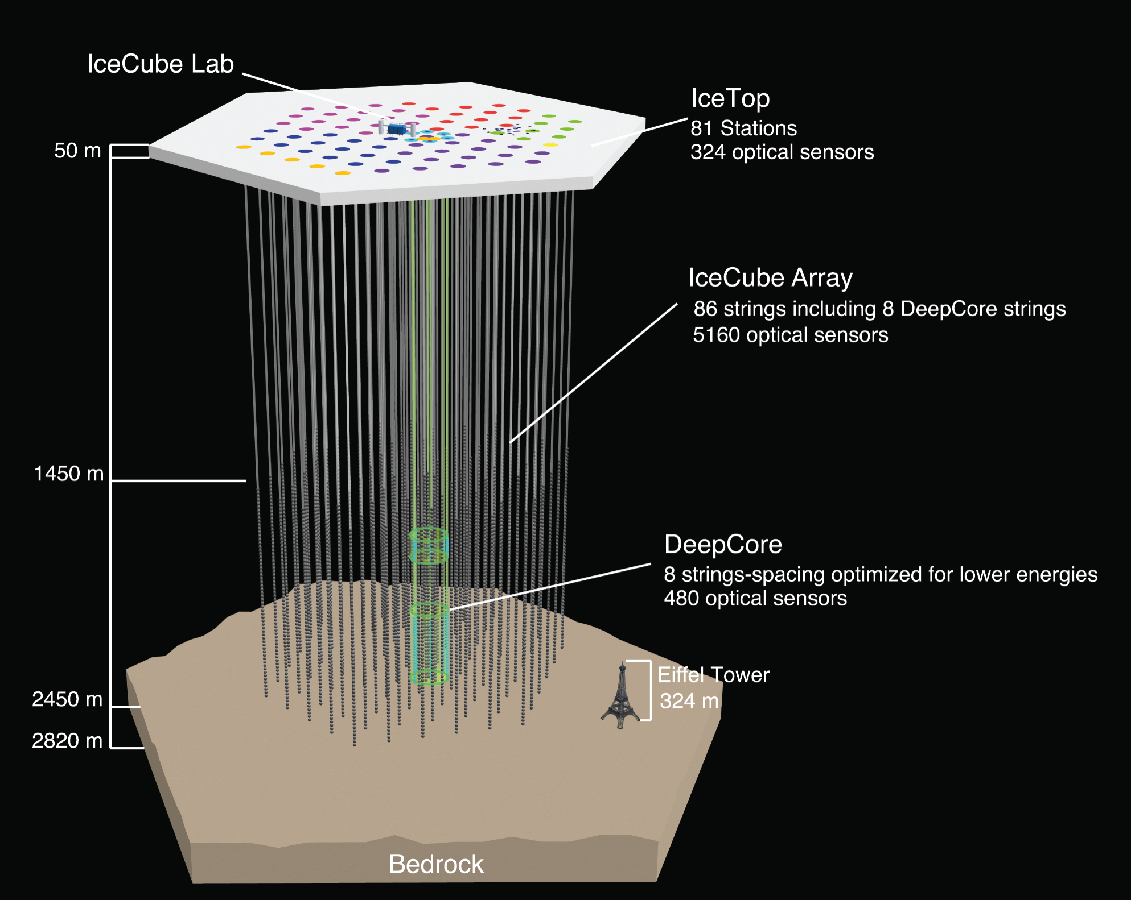

Slide 5
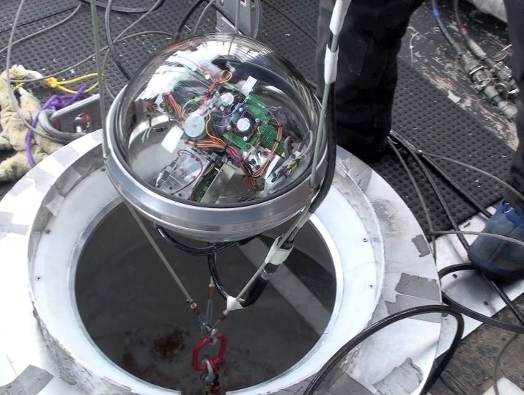

Slide 6
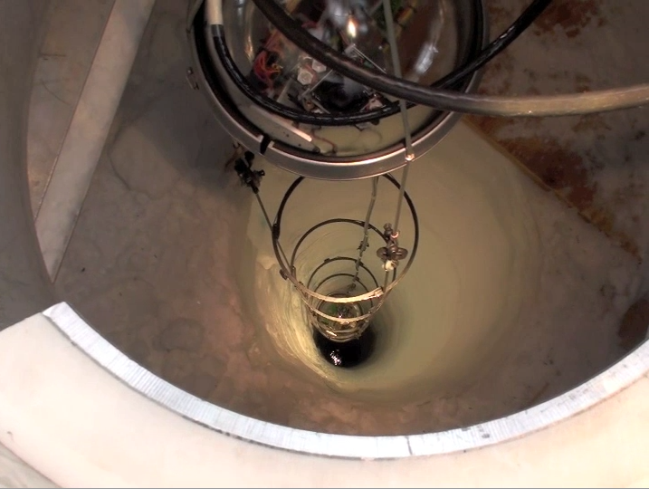

Slide 7
Chad Finley
Chad Finley

Slide 8
Chad Finley
Chad Finley

Slide 9
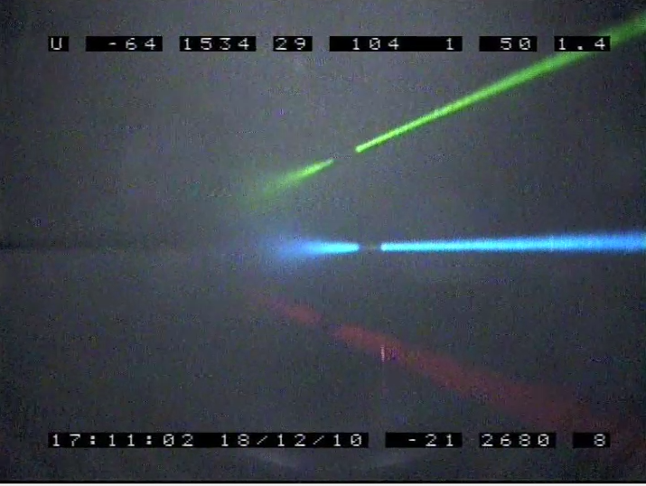
New ice in hole very transparant!

Slide 10
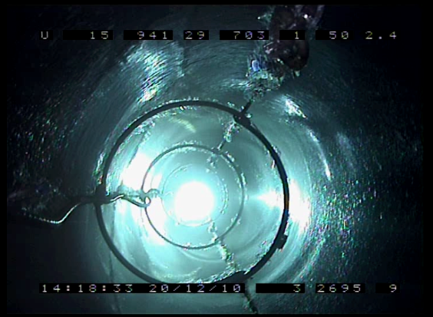
Two days after deployment

Slide 11
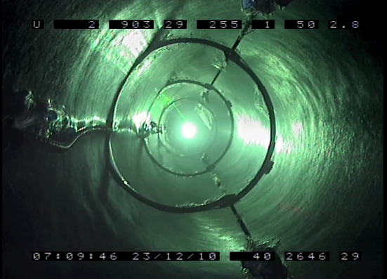
Five days after deployment

Slide 12
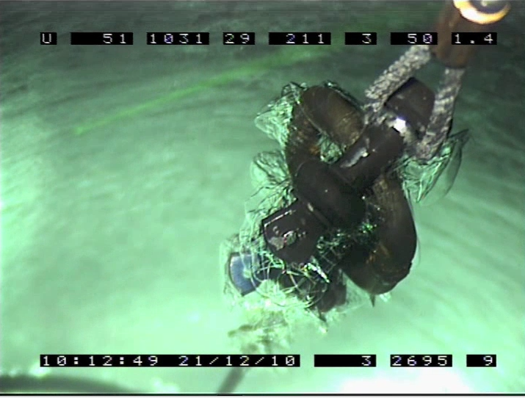
Ice structures

Slide 13
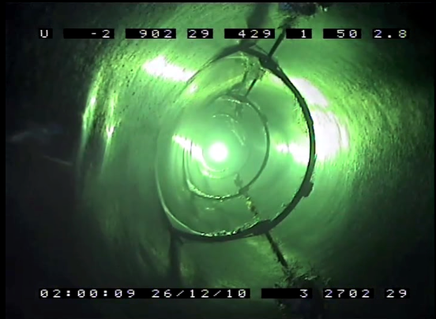
Eight days after deployment

Slide 14
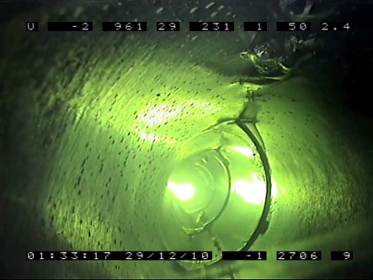
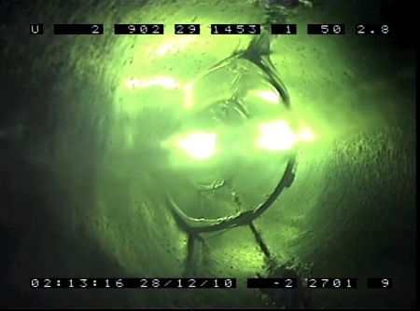
Eleven days after deployment

Slide 15
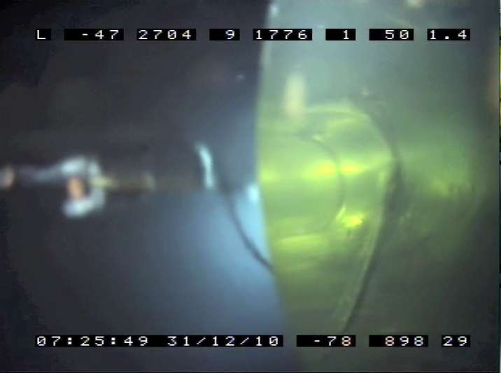
Thirteen days after deployment
New ice
Unfrozen hole

Slide 16
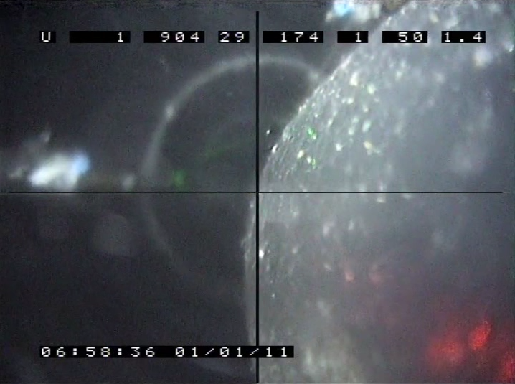
Fourteen days after deployment

Slide 17
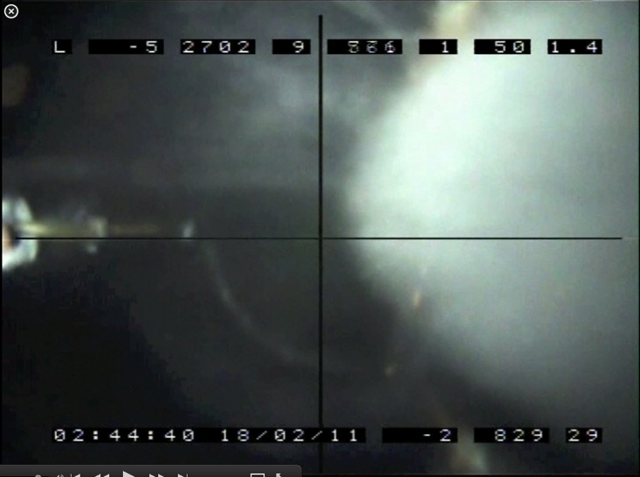
Final situation

Slide 18
Central column in the frozen hole

Slide 19

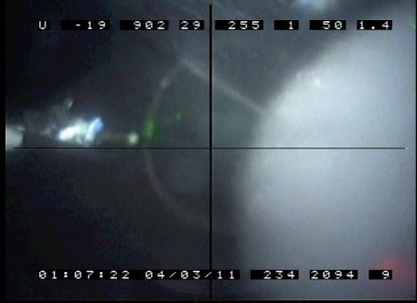
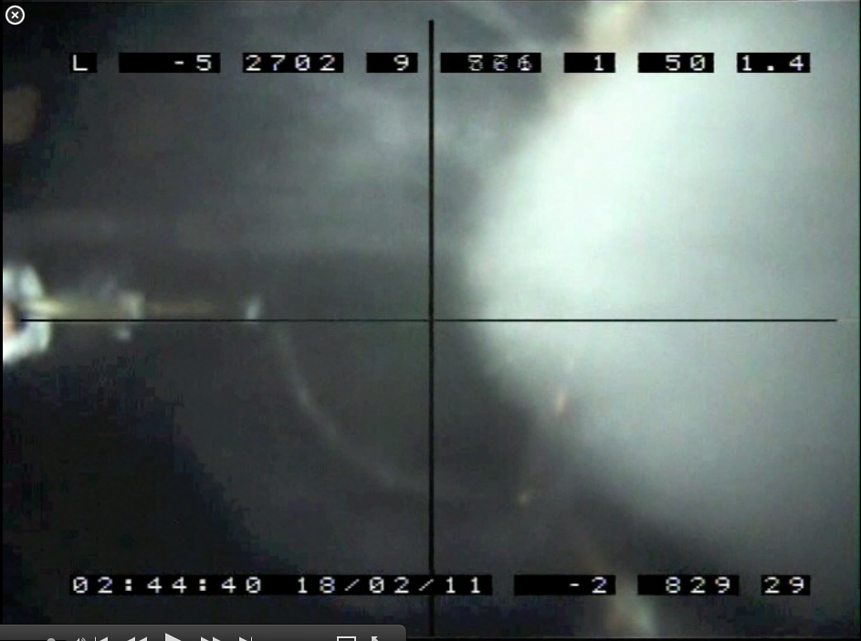
Old ice
Old ice
Central core
Clear new ice
Bubbly ice

Slide 20
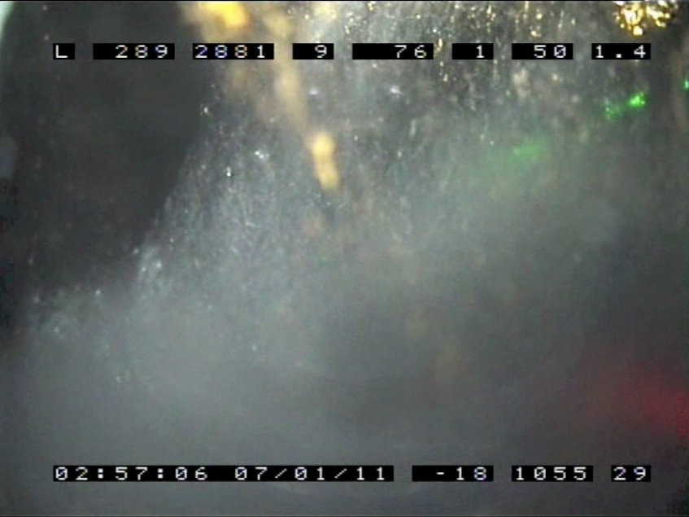
Visible air bubbles (?) in the centre column

Slide 21
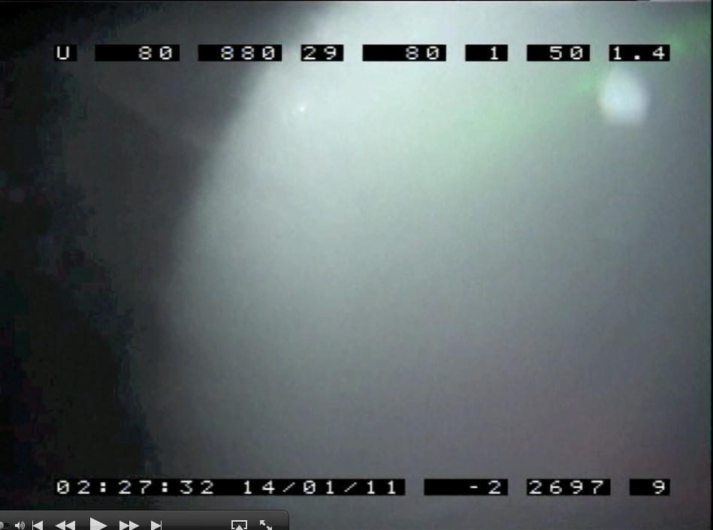
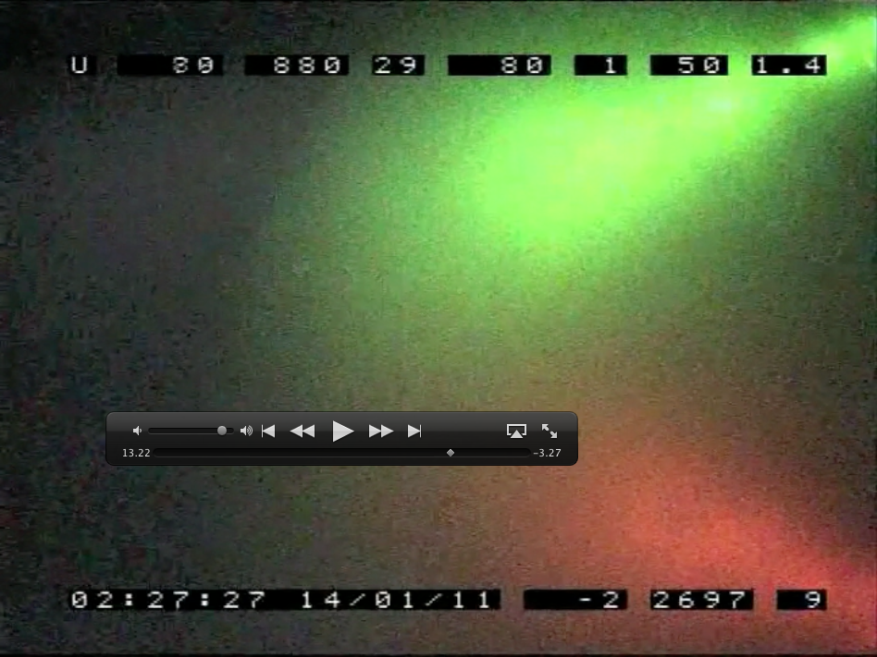
Scattering of light in central column

Slide 22
How large is the central column?
New clean ice frozen to the centre of the camera ≈17 cm
Assuming 17 cm clean ice and a 50 (60) cm hole gives ≈ 16 (26) cm diameter of the central column….

Slide 23
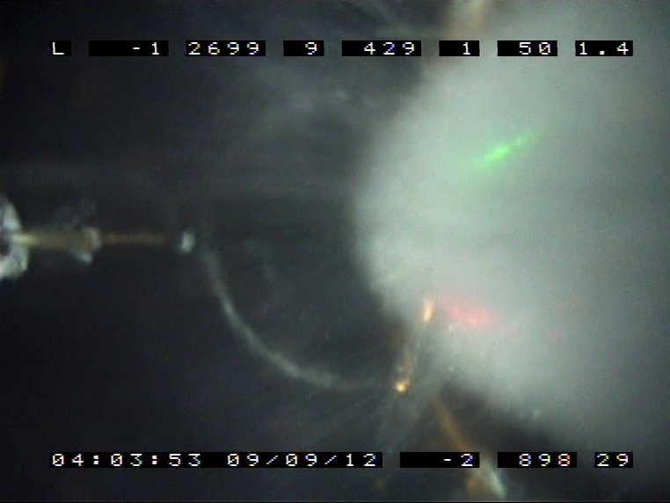
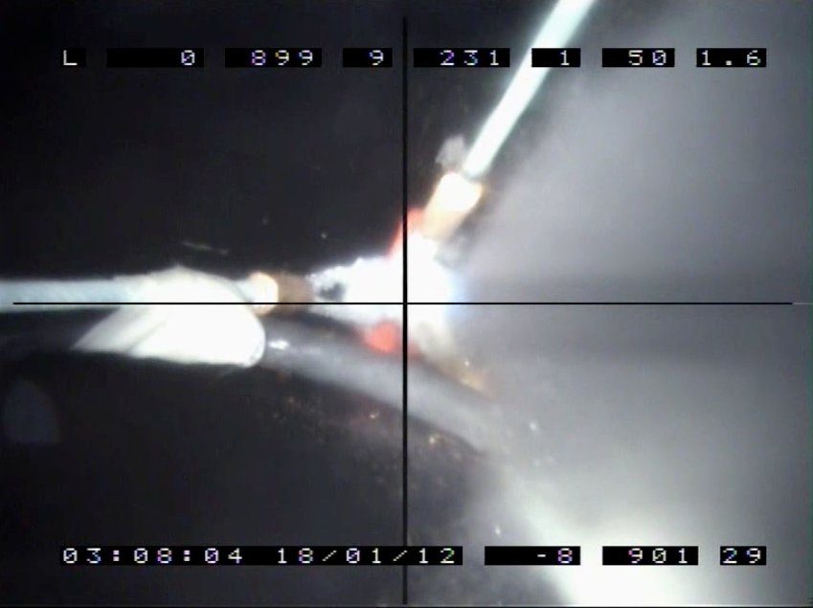
Problems with central bubbly column
Looking up
Looking up
The central white column gives an asymmetry for a DOM angular acceptance
Looking down
Looking down

Slide 24
Fissures in the hole ice

Slide 25
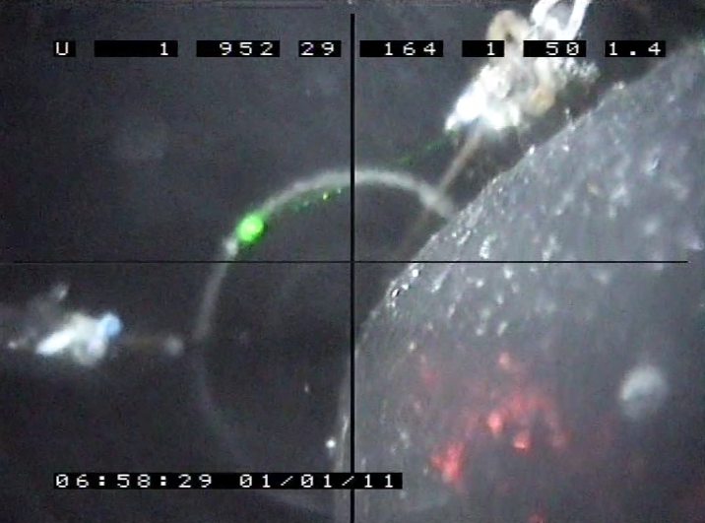
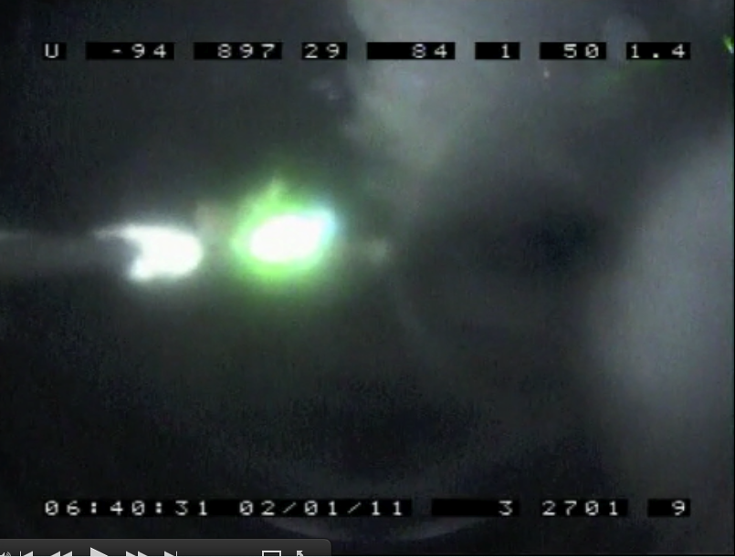
Fissures structures in the new ice!
2011-01-01
2011-01-02

Slide 26
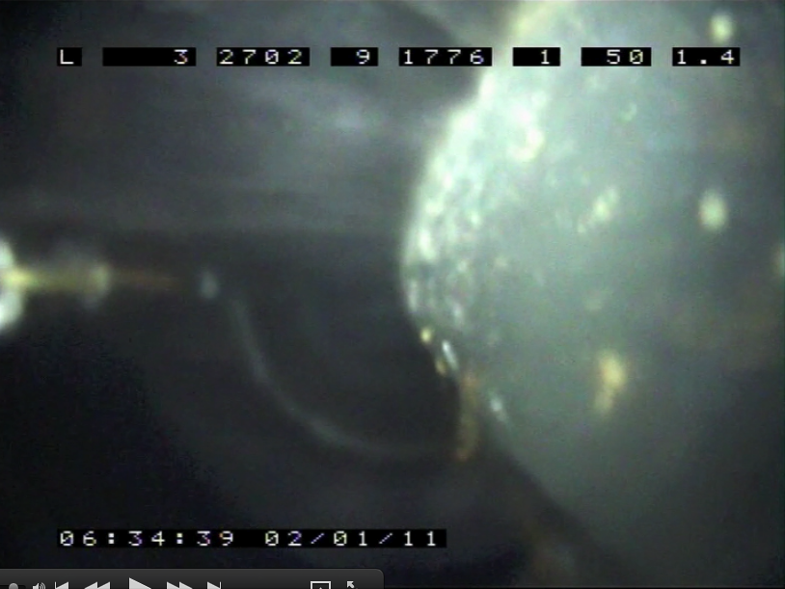
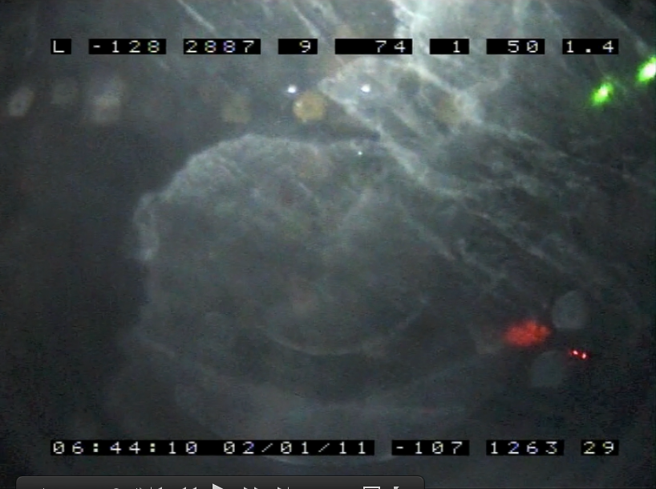
Lower camera looking up

Slide 27
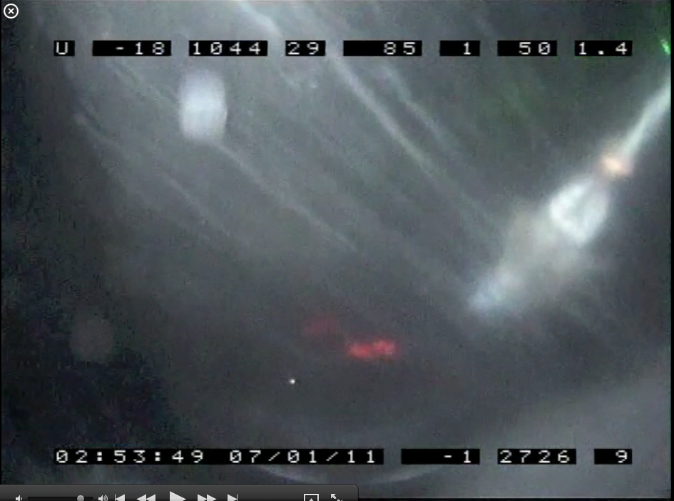
The fissures are thin structures

Slide 28
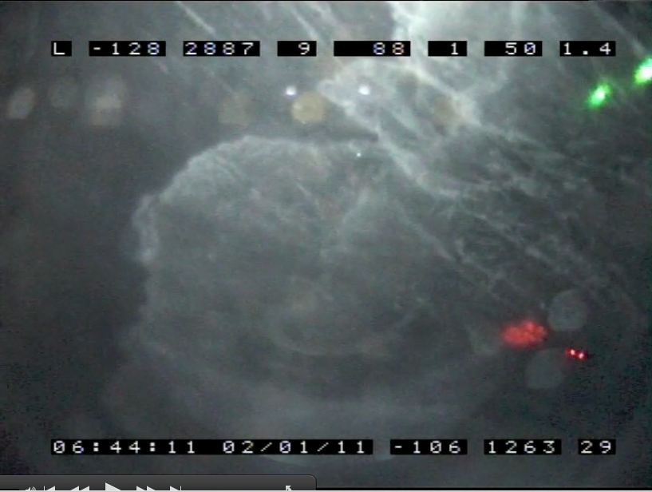
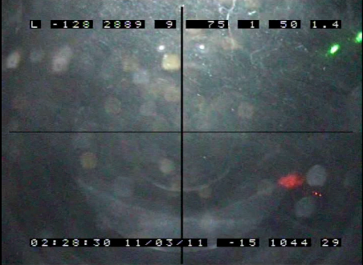
Changes of the fissures in the new ice

Slide 29
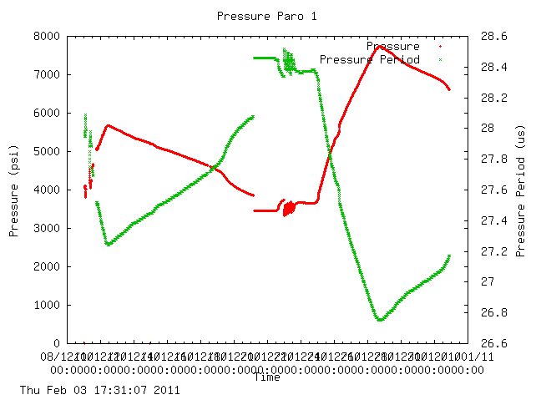
Pressure during freezing
We measured a maximum pressure of 530 bars during the freezing phase.
Could even be higher.
The water in the hole has to “move the glacier a few cm” in order to become ice. (but compressibility)

Slide 30
Reduce the pressure
-55° C
Hole freezes stopping the water to move
up. Highest DOM will block
The water too.
Keep the hole above the detector open as long as possible.
Wider hole?
Electrical heater down the hole?
IceCube
PINGU/MICA
-20°C

Slide 31
Dust?

Slide 32
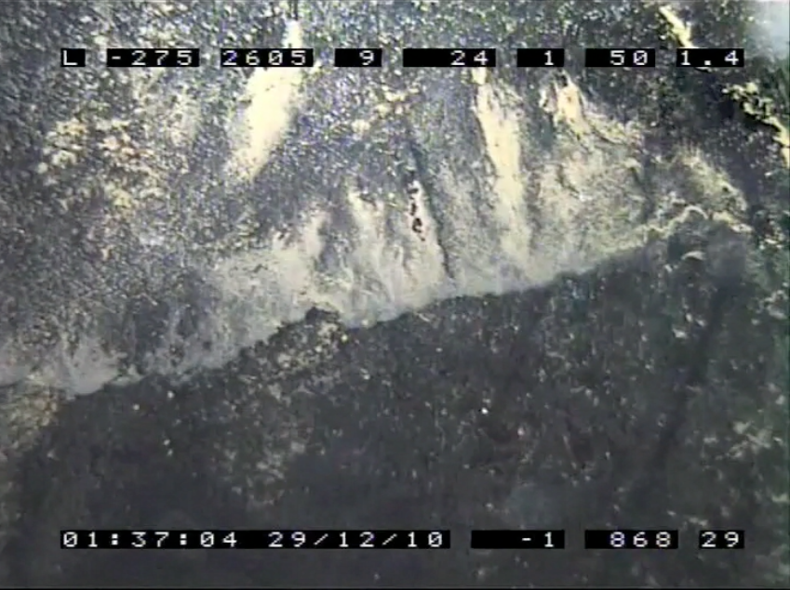
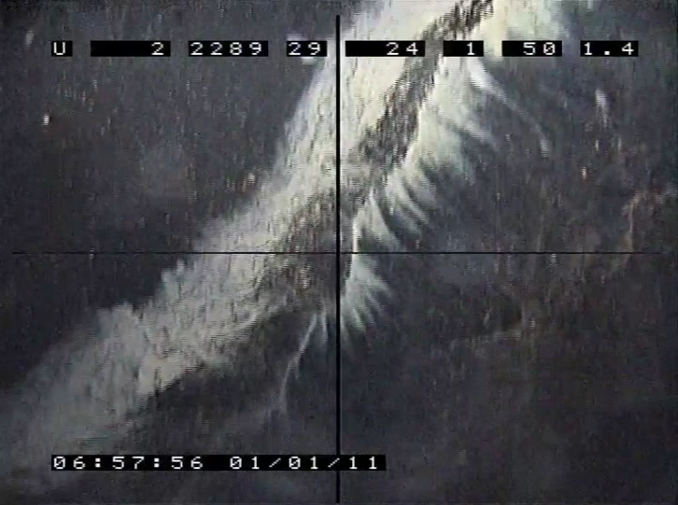
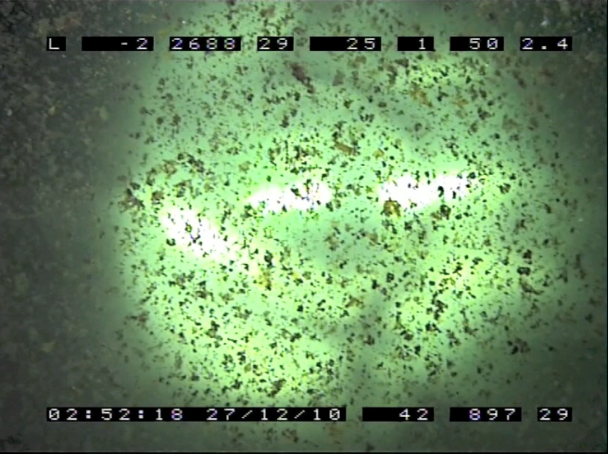
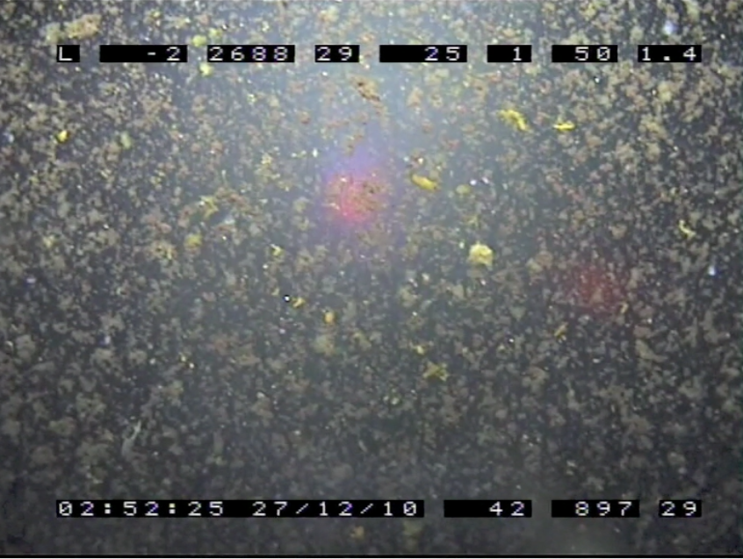
Dust on upper camera half spheres!??

Slide 33
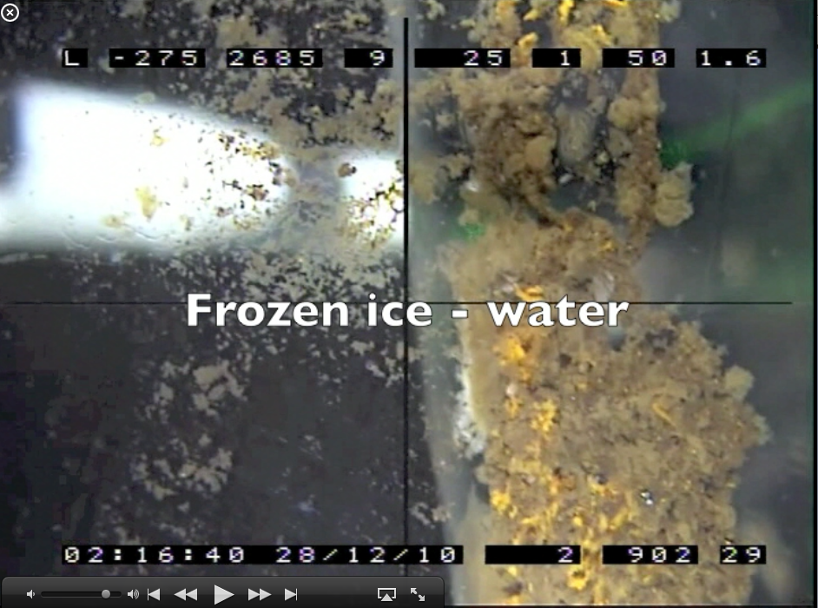
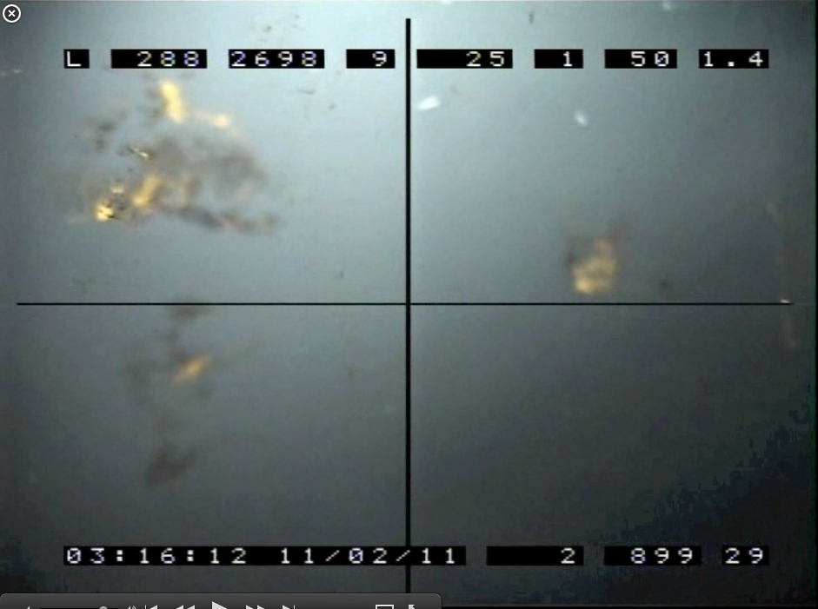
“Dust” is “removed” from glass/ice surface!
2010-12-28
2011-02-18

Slide 34
What is the “dust”?
We have about 700 m³ of melted ice in form of water in the hole!
Very small concentration of impurities in the snow might be seen if density > water…
Dirt from the drilling system? Most probably.
Clathrates? We have different gases in the trapped air CO₂, CH₄ etc
?

Slide 35
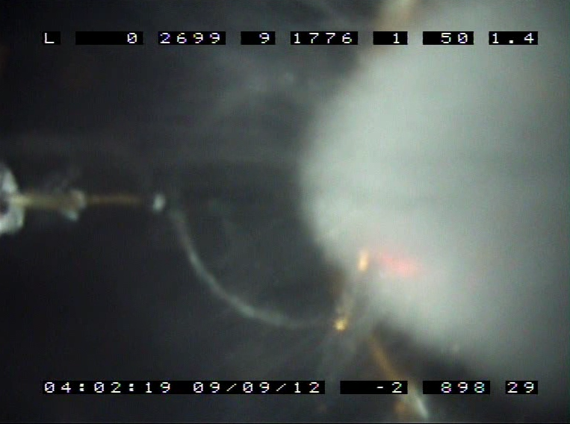
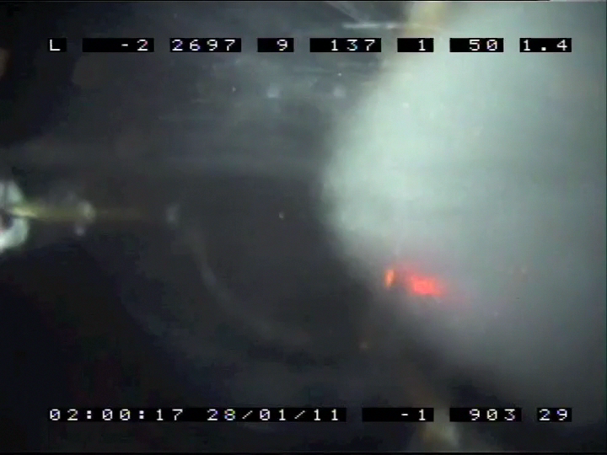
Long time ice structure changes?

Slide 36
Summary
Hole frozen completely after ≈ 15 days.
Fissures in new ice.
Central column with large scattering of light
“Dust” on glass surface has to a large extent disappeared during freezing. But what is it?
No observed changes of the ice structure since two years.
The cameras are still working but upper camera not able to look above horizon.

Slide 37
Open questions
Is the hole 80 at the camera depth unique or have all DOMs similar dust…?
What is the maximum pressure during freezing?
Is the ice structure still changing?

Slide 38
Possible actions for next drilling
Degas the water in the hole to get rid of the air – to reduce the size of the central column
Keep the hole open as much as possible in the upper part in order to reduce the maximum pressure in the hole.
Filter the drilling water for dust during drilling.
Deploy several new cameras to learn more.

