Slide 1
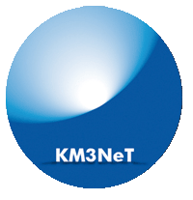
Proposal of a new generation of Laser Beacon for Time Calibration in the KM3NeT Neutrino Telescope
Diego Real
IFIC (CSIC – Universidad de Valencia)
VLVnT13 - Very Large Volume Neutrino Telescope Workshop 2013
Stockholm, 5 August 2013

Slide 2
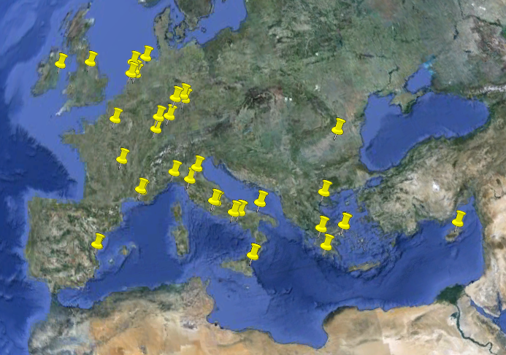
KM3NeT Collaboration
14.5 m
100 m
IFIC, Valencia
UPV, Valencia
UPC, Barcelona
Junction box
~60 m
Link cables
40 Institutes
2
VLVnT13 Stockholm , 05-08-2013
2

Slide 3
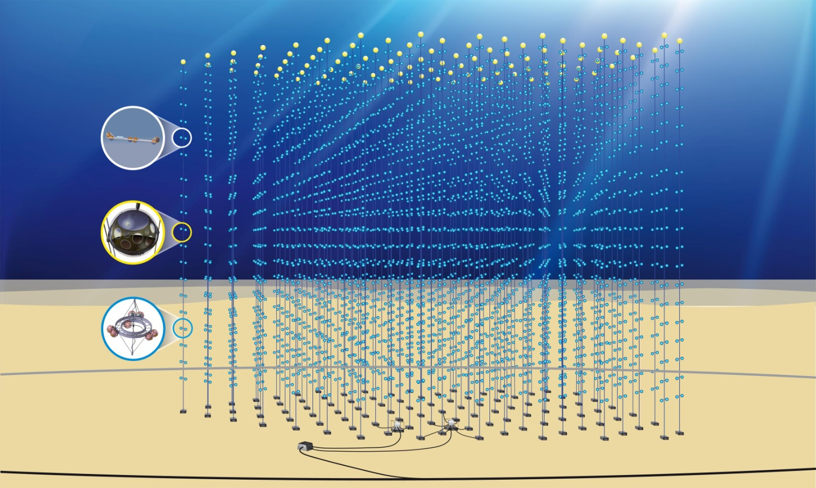
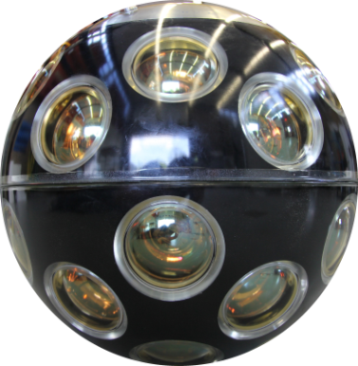
KM3NeT Neutrino Telescope
Volume: ~5 km³
640 strings
18 DOM/string
11520 DOMs
14.5 m
~ 860m
100 m
Junction box
12,800 DOMs in the deep sea at 3-5 km depth
with point-to-point connection to shore
~60 m
Link cables
2500 m depth
100m
3
VLVnT13 Stockholm , 05-08-2013
3

Slide 4
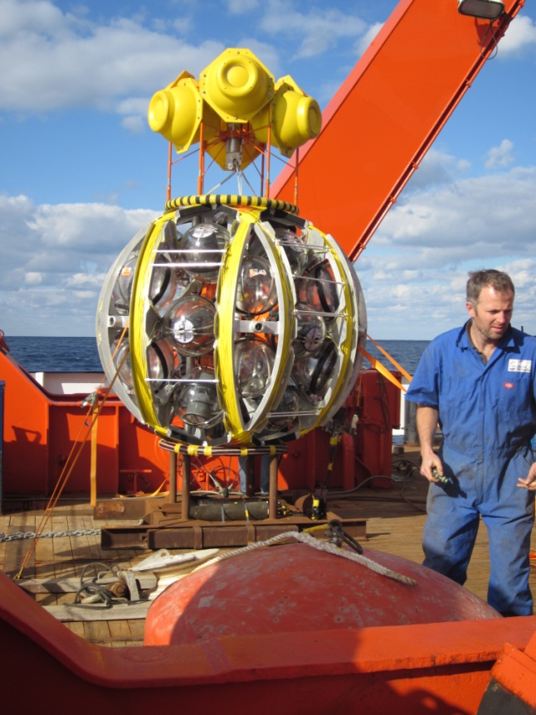
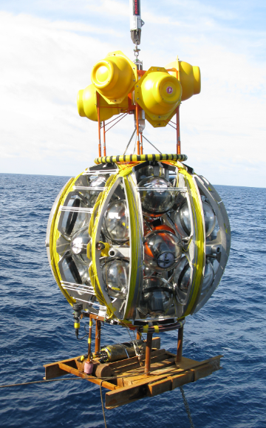
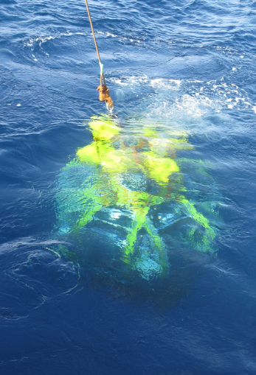
Deployment Of KM3NeT Detection Units
14.5 m
100 m
640 string with optical sensors
in the deep sea at 3-5 km depth
Junction box
~60 m
Link cables
2500 m depth
4
VLVnT13 Stockholm , 05-08-2013
4

Slide 5
KM3NeT Time Calibration System (I)
The experience from the previous projects shows that a system of external light sources with a known emission time ensures the time calibration and provides measurements of the optical water properties.
Decoupling the intra/inter detection unit (DU) calibration seems the best solution.
The calibration constants are obtained putting all the information together.
5
VLVnT13 Stockholm , 05-08-2013
5

Slide 6
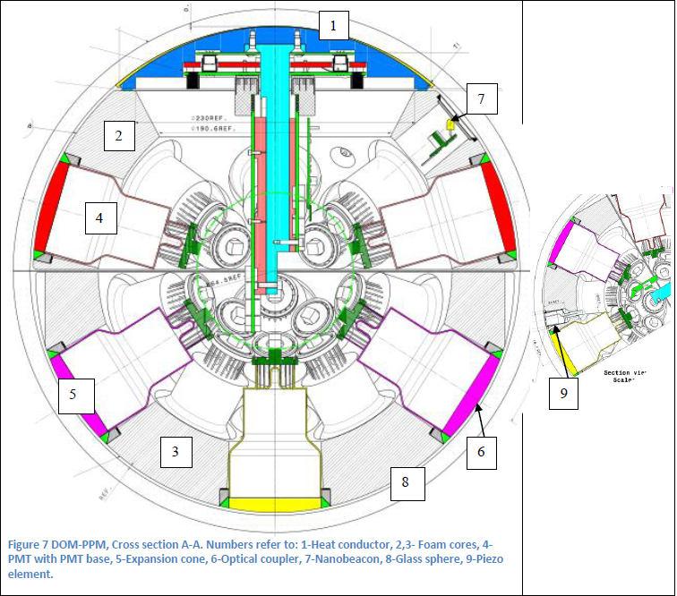
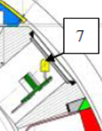
KM3NeT Time Calibration System (II)
Decoupling within the same Detection Unit (intra- D.U.) and between D.U. (inter-D.U.) calibration systems
INTRA D.U. Calibration (See David’s talk):
One Nanobeacon per Digital Optical Module. Looking upwards
14.5 m
100 m
Junction box
~60 m
Link cables
2500 m depth
6
VLVnT13 Stockholm , 05-08-2013
6

Slide 7
KM3NeT Time Calibration System (III)
Decoupling within the same D.U. (intra- D.U.) and between D.U. (inter-D.U.) calibration systems
INTER D.U. Calibration:
One Laser Beacon every 8 D.U
14.5 m
Laser Beacons @ 532 nm
Higher in intensity and shorter pulses < 1 ns
More expensive but less redundancy required
Tunable by Liquid Crystal Optical attenuator
Collimated beam -> Diffusion device needed
100 m
Junction box
~60 m
Link cables
2500 m depth
7
VLVnT13 Stockholm , 05-08-2013
7

Slide 8
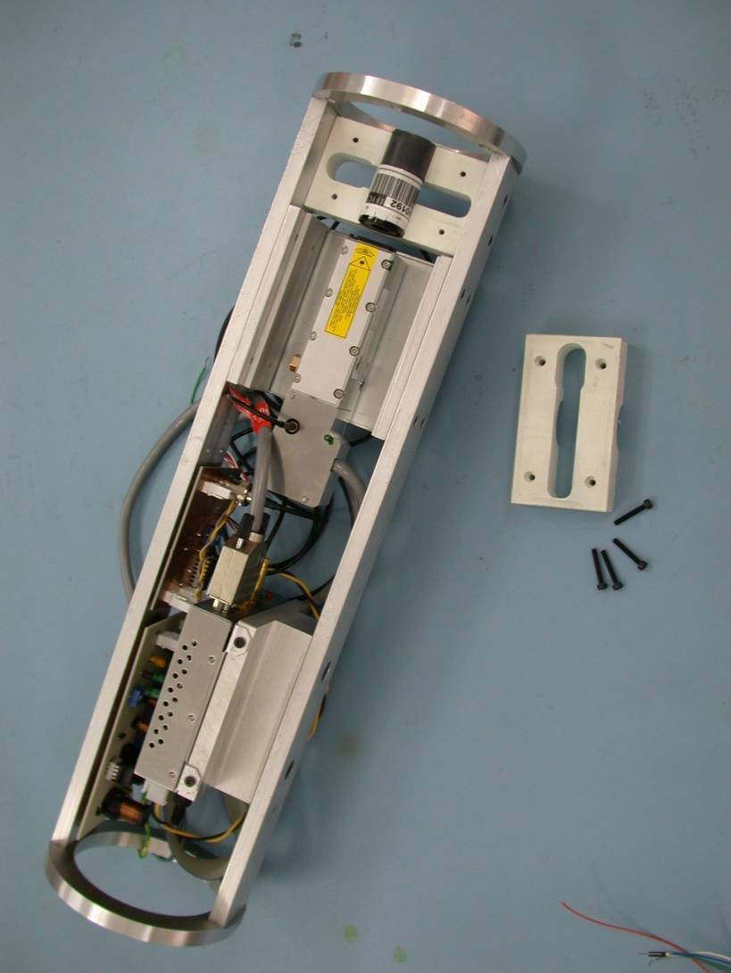
Laser Beacon Description
LASER BEACON:
Titanium Container
Internal Mechanics
Connector
Laser Head
Built-in Photodiode
Antibiofouling system
The Voltage Controller Optical Attenuator
14.5 m
100 m
~60 m
Link cables
2500 m depth
8
VLVnT13 Stockholm , 05-08-2013
8

Slide 9
Laser Beacon Mechanics
Cylinder of 650 mm high and 142 mm of diameter
Made in Titanium grade 5 (Ti6AI4V) to avoid marine corrosion
Composed of three different pieces:
The cylindrical tube
The lower cap (connector cap)
The upper cap with the anti-biofouling system
Designed to resist up to 5000 meters deep
Pressure test at 400 bars
14.5 m
100 m
Pressure
(bars)
Junction box
~60 m
Link cables
2500 m depth
Time (hh:mm:ss)
VLVnT13 Stockholm , 05-08-2013
9
9

Slide 10
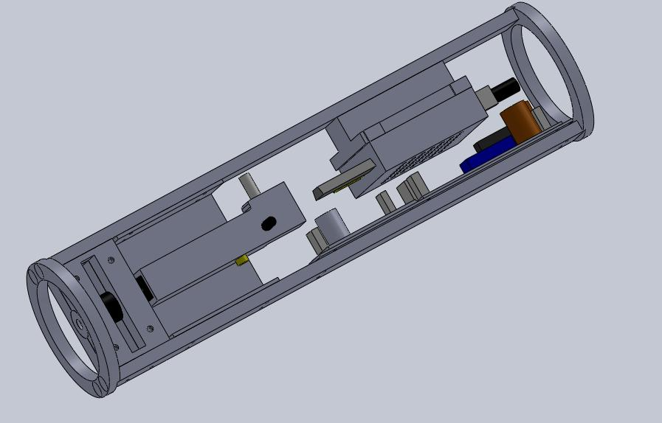
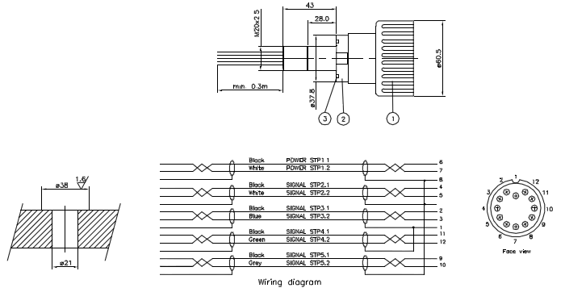
Internal Mechanics And Connector
Inner mechanics:
Provides the structure where the different devices of the laser beacon are integrated
Internal mechanics developed in aluminum
two aluminum rings joined together by two aluminum beams
14.5 m
Connector :
Made in titanium grade 5 from MacArtney
Allows connection between the LB and the D.U
100 m
Junction box
~60 m
Link cables
2500 m depth
VLVnT13 Stockholm , 05-08-2013
10
10

Slide 11
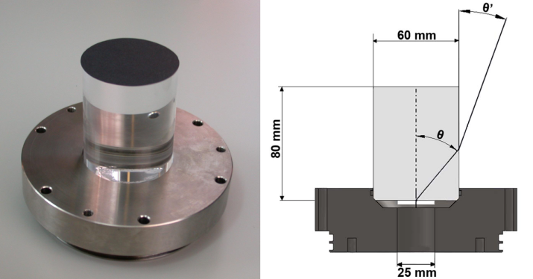
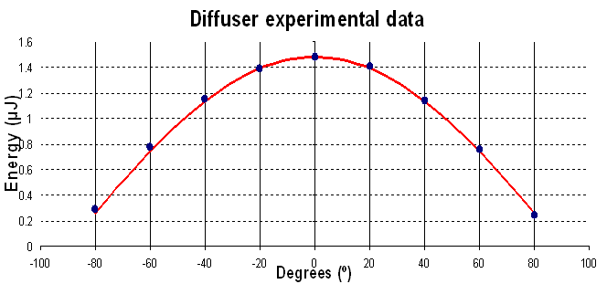
The Anti-Biofouling System
The cylinder quartz
pressure-resistant quartz
refractive index 1.4585
60 mm x 80 mm
Inserted 10 mm into the upper titanium cap
Possible to illuminate photo-sensors located at a horizontal distance of 200 m and 50 m above the seabed.
Diffuser
model 48010 from ORIEL (Flashed opal diffuser)
Thickness of 2.2 mm
Diameter of 25 mm.
Lambertian distribution
14.5 m
100 m
Junction box
~60 m
Link cables
2500 m depth
VLVnT13 Stockholm , 05-08-2013
11
11

Slide 12
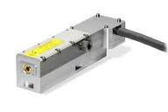
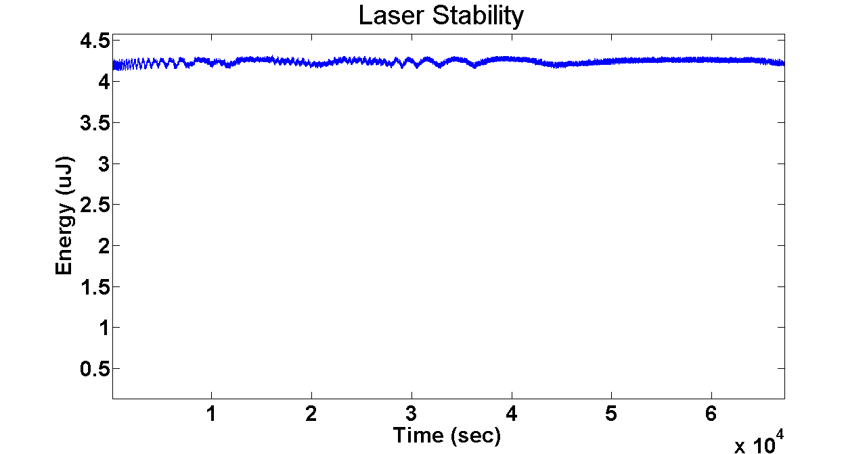
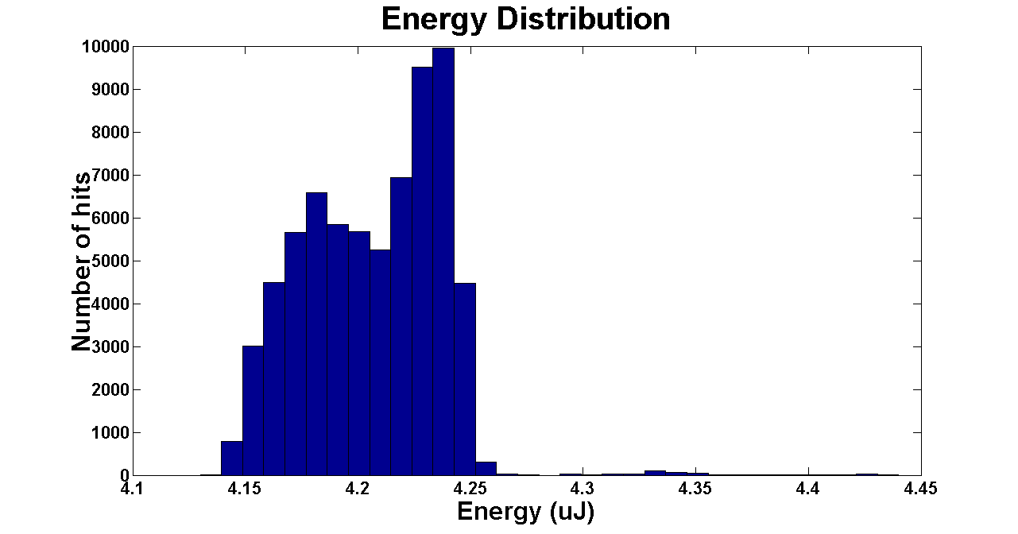
KM3NeT Laser Beacon Tests Head (I)
Diode pumped Q-switched Nd-YAG laser
Short pulses. FWHM ~ 400 ps
Energy per pulse of 3.5 µJ (manufacturer)
4.15v – 4.25 µJ measured in laboratory
14.5 m
100 m
Junction box
~60 m
Link cables
2500 m depth
VLVnT13
12
12
Stockholm , 05-08-2013

Slide 13
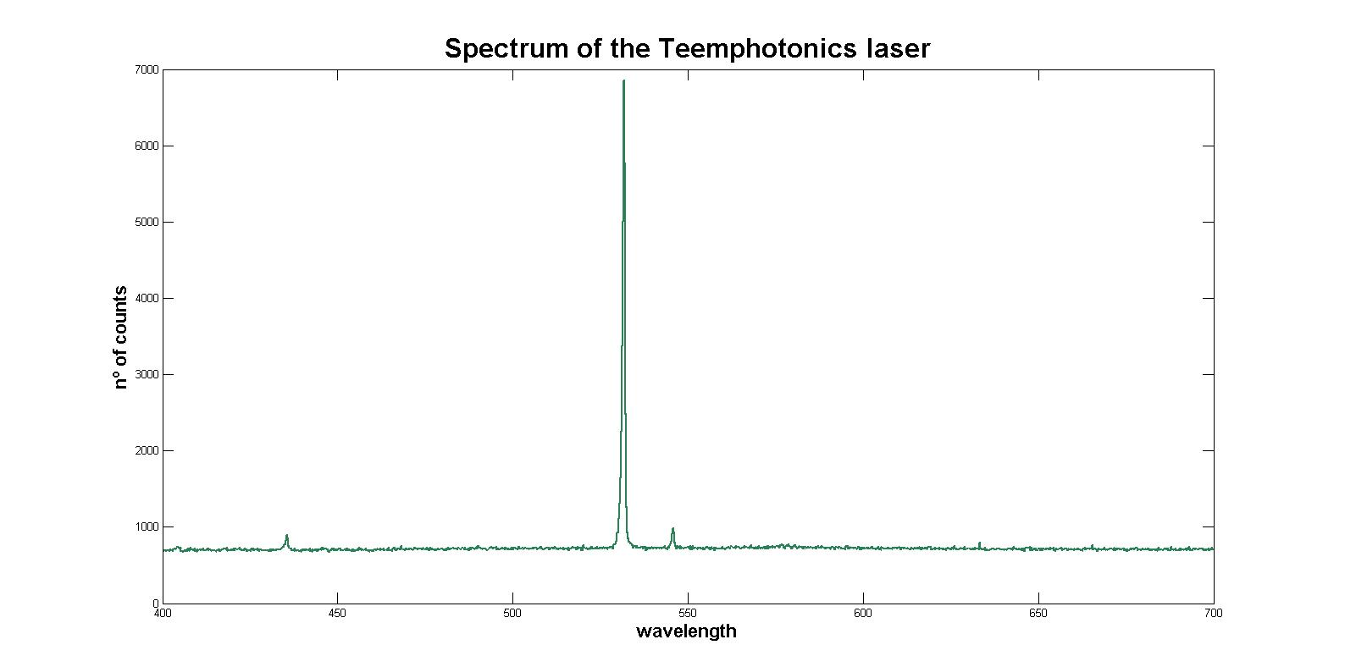
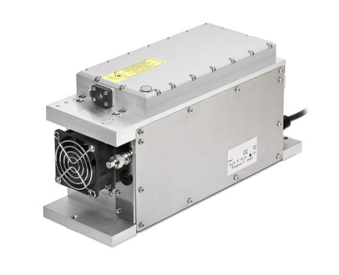
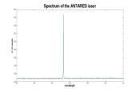
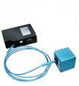
KM3NeT Laser Beacon Tests Head (II)
Green @ 532 nm
Measurements carried out with the Spectrometer Ocean Optics HR4000
The laser presents the main spectrum at 532 nm as expected
14.5 m
100 m
Junction box
~60 m
Link cables
2500 m depth
VLVnT13
13
13
Stockholm , 05-08-2013

Slide 14
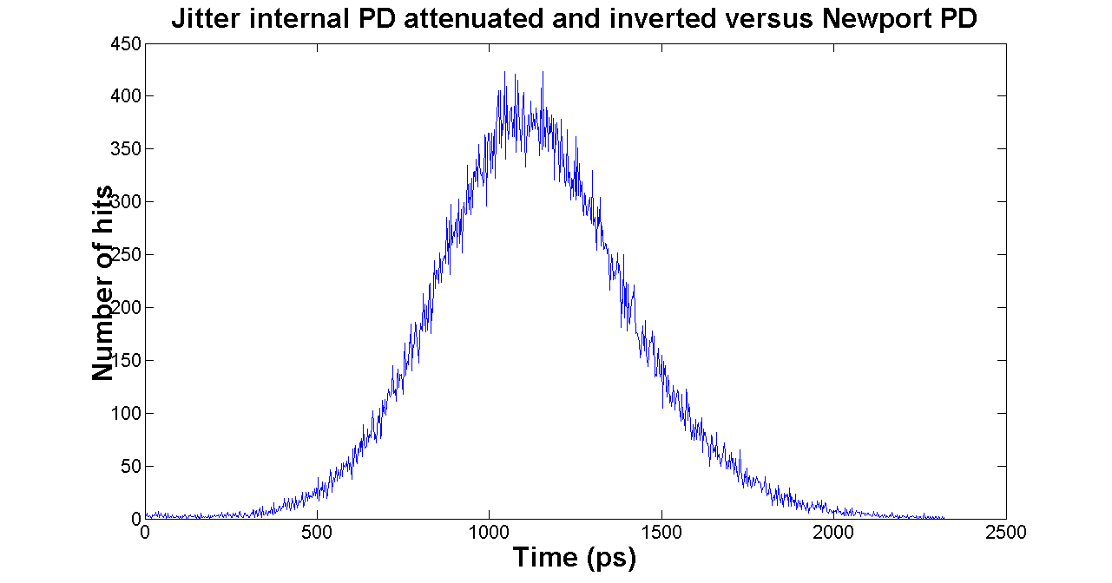
Built-In Photodiode
A jitter the laser pulse emission time of a few hundred nanoseconds
Internal Built-in photodiode that provides the exact time of the laser light emission (0.5 ns)
The read-out system to acquire the photodiode signal of the laser is not located in the laser container but in the D.U where the LB is connected
14.5 m
The jitter of the internal photodiode has been measured using an external photodiode (Newport 812-20 photodiode with a rise time lower than 200 ps) directly illuminated by the laser beam
The FWHM of the measured built-in photodiode jitter is lower than 550 ps
100 m
Junction box
~60 m
Link cables
2500 m depth
VLVnT13
14
14
Stockholm , 05-08-2013

Slide 15
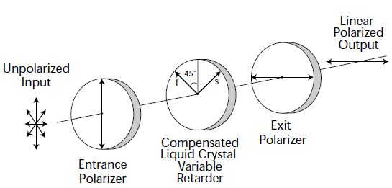
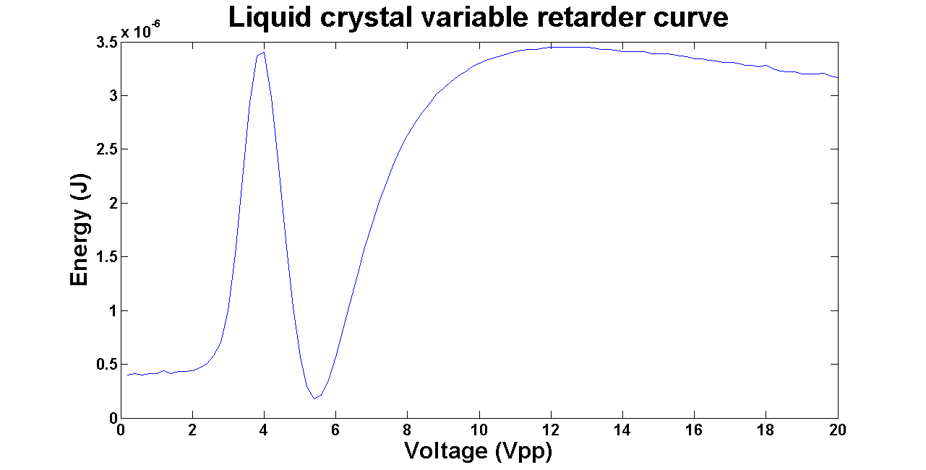
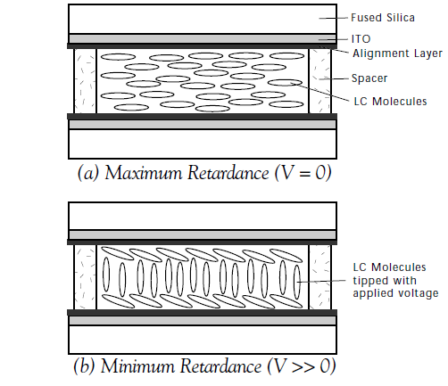
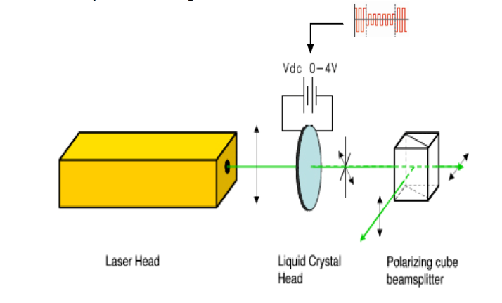
The Voltage Controller Optical Attenuator
14.5 m
Unlike LED sources the amount of light emitted by the laser is fixed
A voltage-controlled optical attenuator using a liquid crystal variable retarder located in the beam path is used
a beam-splitting polarizing cube is used since they have a higher damage threshold to laser exposure than standard linear polarizer
The model used is optimized to work in the 420 to 680 nm range
100 m
Junction box
~60 m
Link cables
2500 m depth
VLVnT13
15
Stockholm , 05-08-2013
15

Slide 16
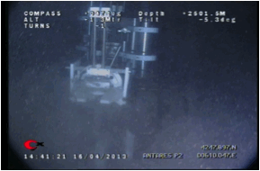
KM3NeT Laser Beacon Tests
1 laser beacon integrated in the ANTARES IL13
1 laser beacon integrated in the KM3NeT “Nemo Tower Phase II”
14.5 m
Both use a 3.5 µJ the laser head STG-03E-1S0 from Teemphotonics which emits light with a wavelength of 532 nm after frequency doubling of the original Nd-YAG wavelength of 1064 nm
100 m
Junction box
~60 m
Link cables
2500 m depth
VLVnT13
16
16
Stockholm , 05-08-2013

Slide 17
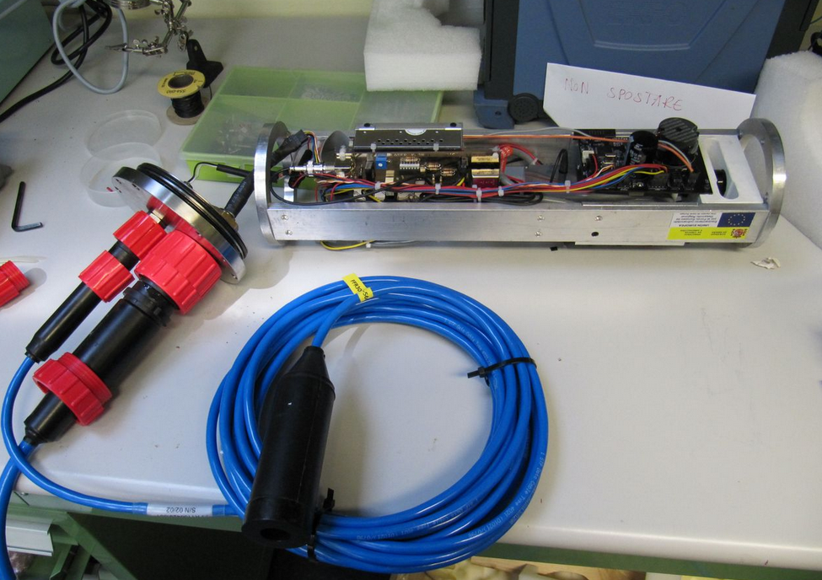
KM3NeT Laser Beacon Developments
14.5 m
100 m
Junction box
~60 m
Link cables
2500 m depth
VLVnT13
17
17
Stockholm , 05-08-2013

Slide 18
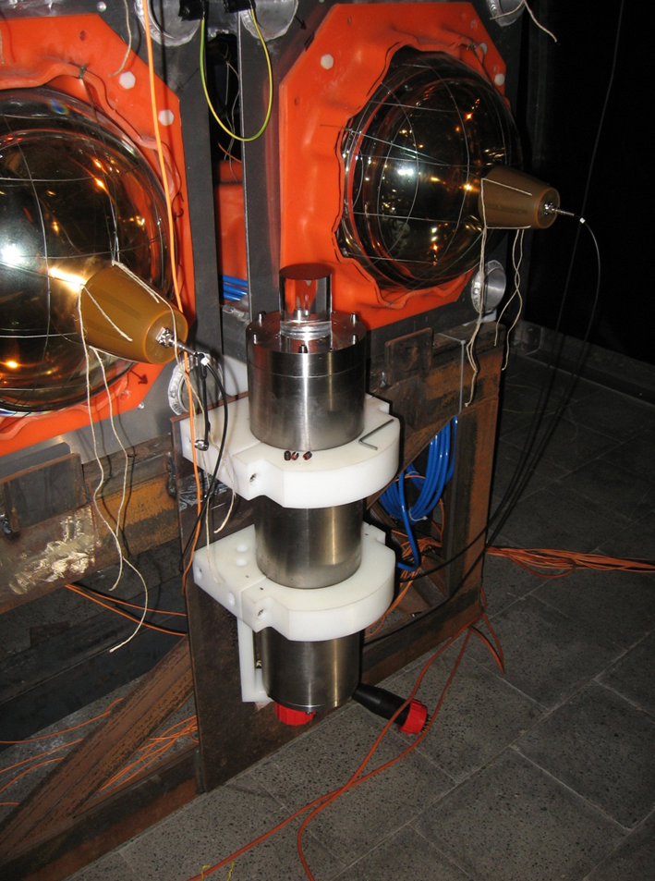
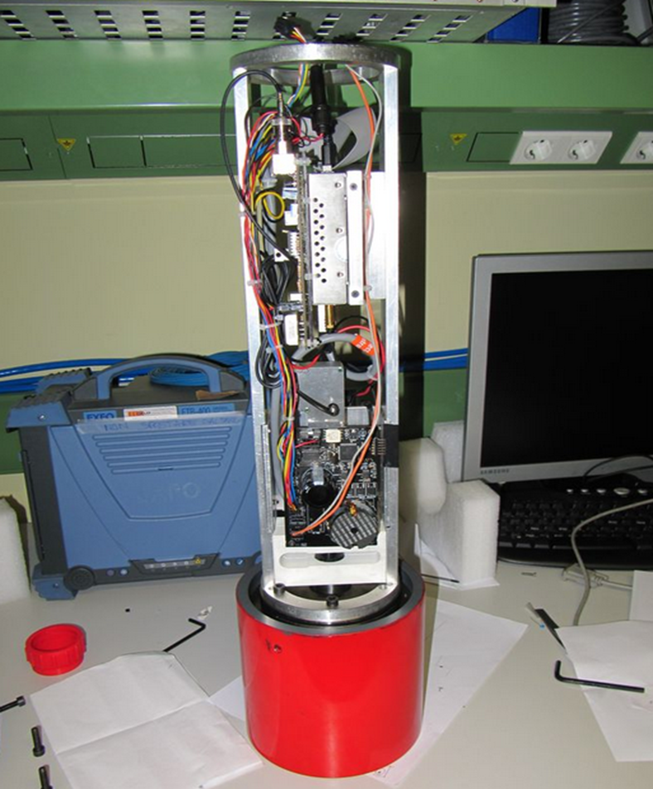
KM3NeT Laser Beacon Developments
14.5 m
100 m
Junction box
~60 m
Link cables
2500 m depth
VLVnT13
18
18
Stockholm , 05-08-2013

Slide 19
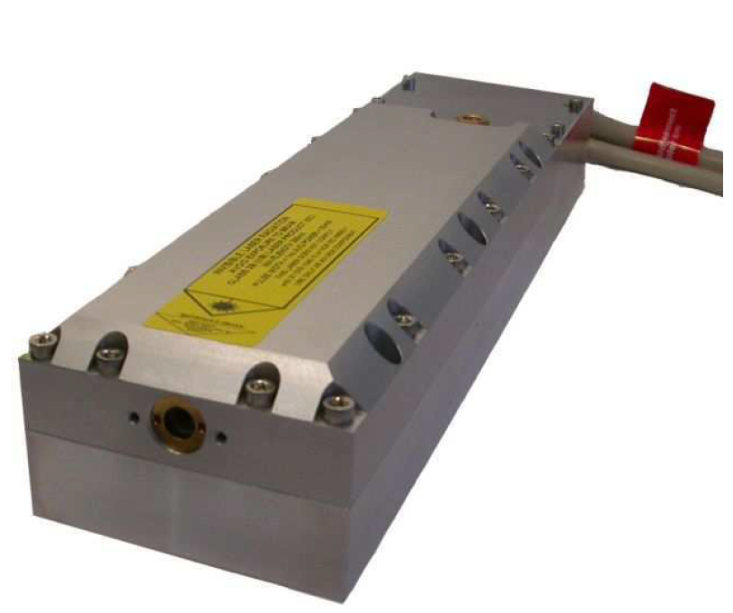
KM3NeT Laser Beacon Developments
New laser head. More powerful
25 µJ per pulse versus 3.5 µJ of previous head.
14.5 m
100 m
Junction box
~60 m
Link cables
2500 m depth
VLVnT13
19
19
Stockholm , 05-08-2013

Slide 20
Conclusions
1 laser beacon integrated in the ANTARES IL13 (3.5 µJ)
1 laser beacon integrated in “ KM3NeT Nemo Tower Phase II” (3.5 µJ)
Proposal to use a new laser head for KM3NeT.
More powerful with 25 µJ per pulse
VLVnT13
20
20
Stockholm , 05-08-2013

