Slide 1
The electronics readout and data acquisition system of the KM3NeT Neutrino Telescope
Diego Real, IFIC Spain, KM3NeT Electronics Coordinator
VLVnT13 - Very Large Volume Neutrino Telescope Workshop 2013
Stockholm, 5 August 2013

Slide 2
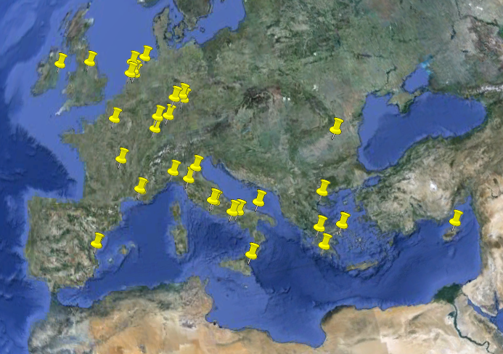
KM3NeT Collaboration
14.5 m
100 m
IFIC, Valencia
UPV, Valencia
UPC, Barcelona
Junction box
~60 m
Link cables
40 Institutes
2
VLVnT13 Stockholm , 05-08-2013
2

Slide 3
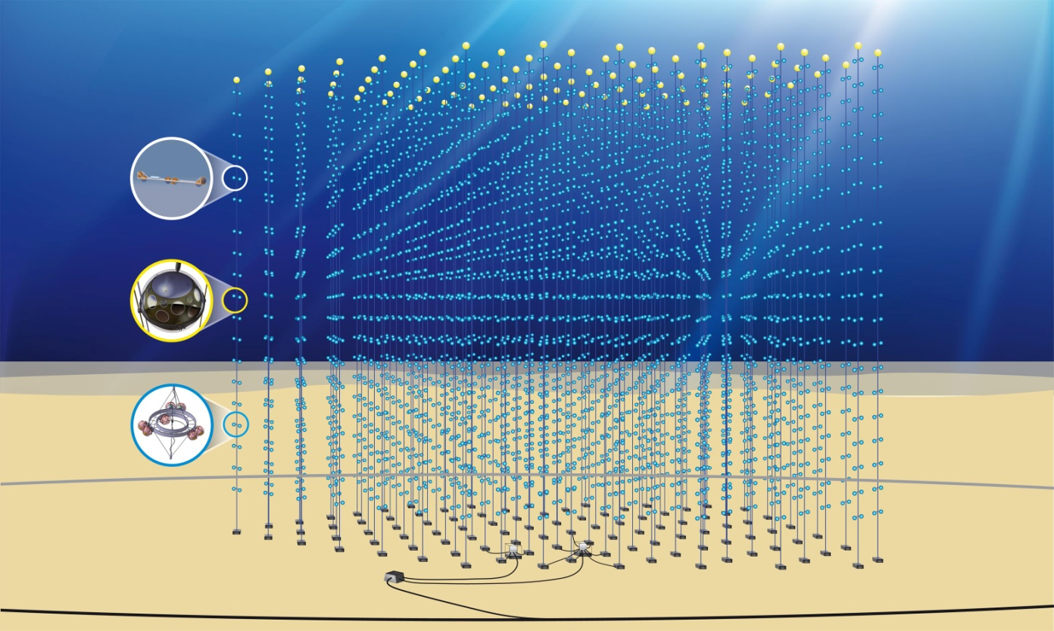
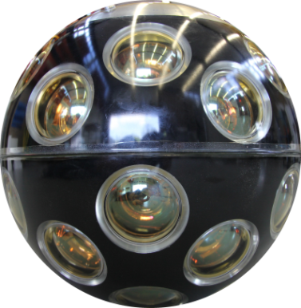
KM3NeT Neutrino Telescope
Volume: ~5 km³
640 strings
18 DOM/string
11520 DOMs
14.5 m
~ 860m
100 m
Junction box
12,800 DOMs in the deep sea at 3-5 km depth
with point-to-point connection to shore
~60 m
Link cables
2500 m depth
100m
3
VLVnT13 Stockholm , 05-08-2013
3

Slide 4
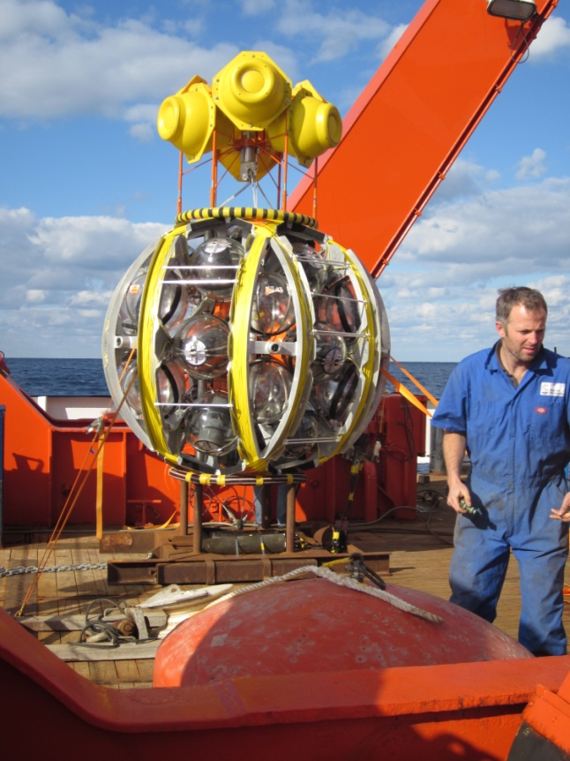
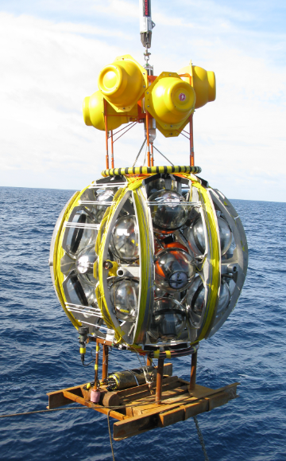
Deployment Of KM3NeT Detection Units
14.5 m
100 m
640 string with optical sensors
in the deep sea at 3-5 km depth
Junction box
~60 m
Link cables
2500 m depth
4
VLVnT13 Stockholm , 05-08-2013
4

Slide 5
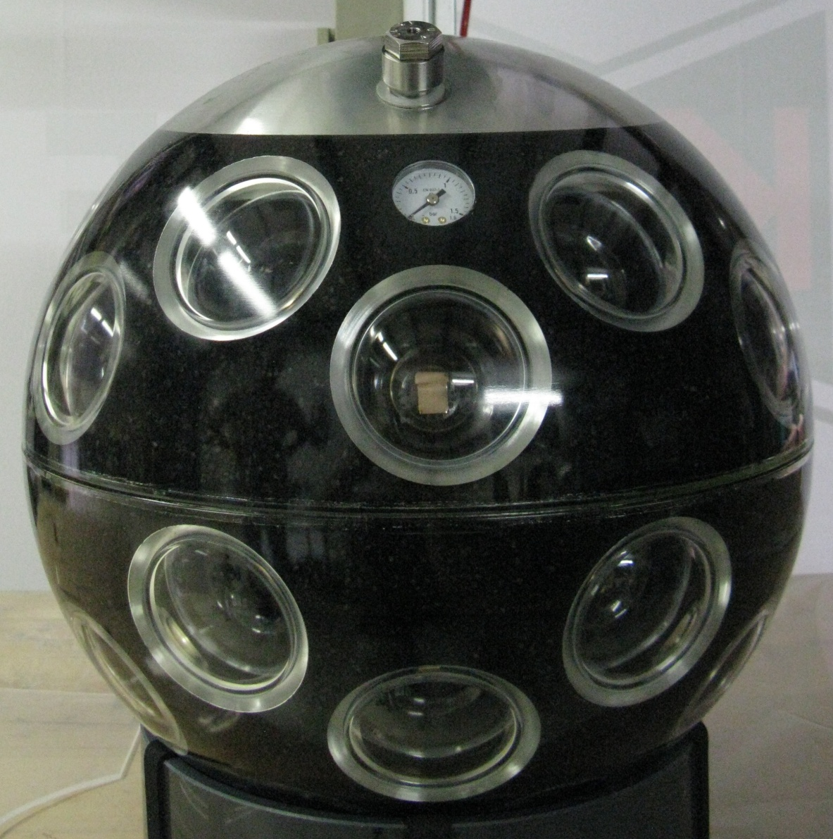
KM3NeT Digital Optical Module
31 x 3” PMT
19 Lower Hemisphere
12 Upper Hemisphere
14.5 m
Contains Read Out and
Control/Command Electronics for
PMT and instrumentation
100 m
Junction box
~60 m
Link cables
2500 m depth
5
VLVnT13 Stockholm , 05-08-2013
5

Slide 6
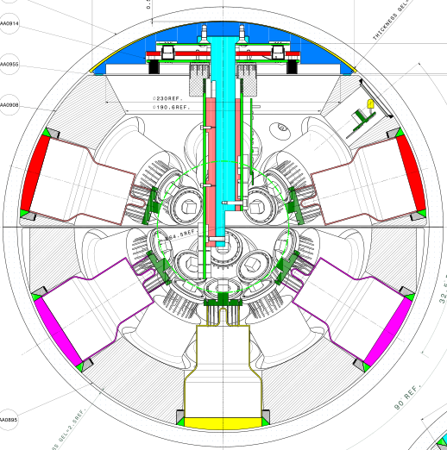
Electronics Boards In The KM3NeT-DOM
Cooling System
Power board
Central Logic Board
31 PMTs
Octopus boards
PMT Bases
14.5 m
100 m
Junction box
~60 m
Link cables
2500 m depth
6
VLVnT13 Stockholm , 05-08-2013
6

Slide 7
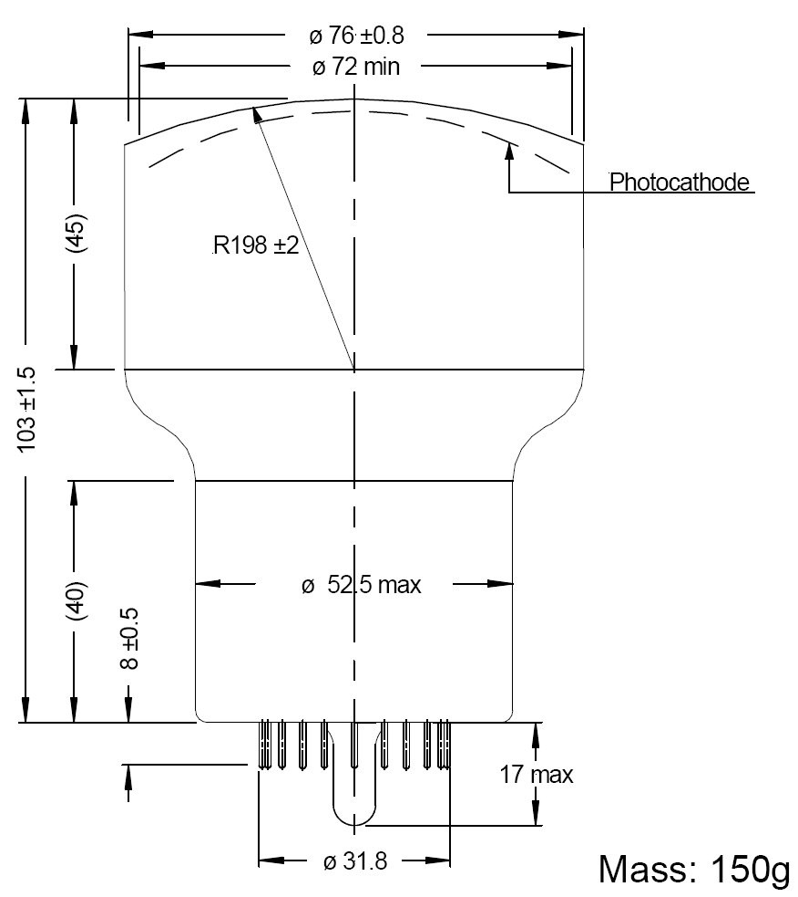
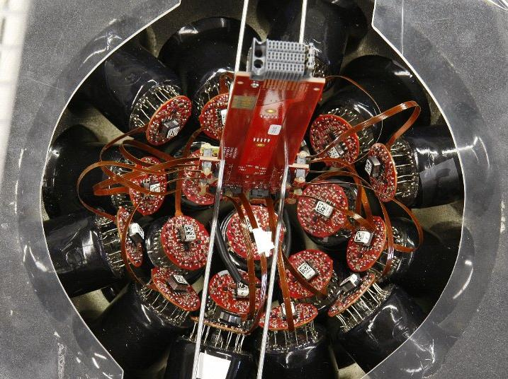
KM3NeT PMT Bases
14.5 m
<105
100 m
Junction box
~60 m
dimensions in mm
Link cables
2500 m depth
7
VLVnT13 Stockholm , 05-08-2013
7

Slide 8
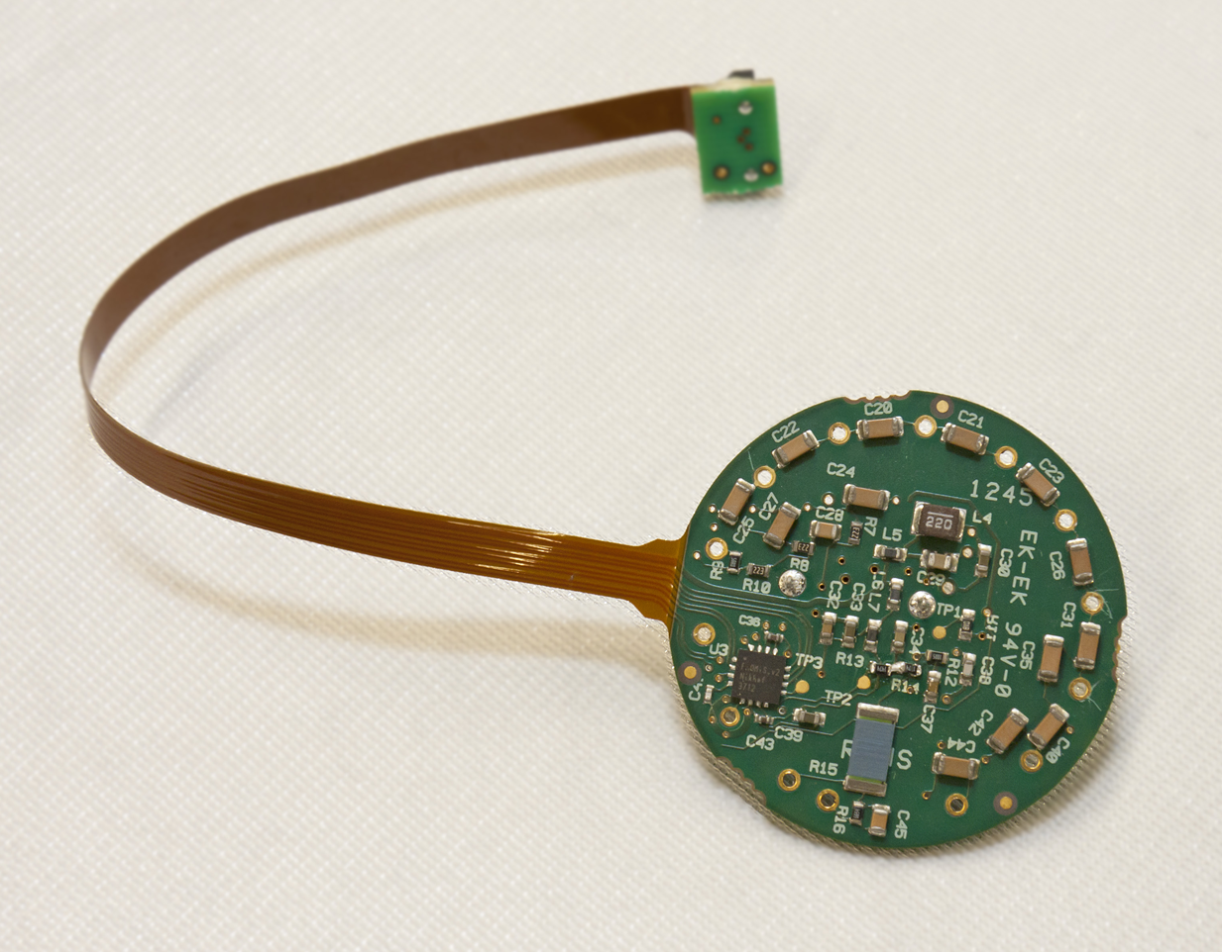
PMT Bases Features
Adjustable HV (800-1400V)
Low power (4,5mW)
ASIC with pre-amplifier and discriminator
Connection to the signal collection boards done by flexible PCB
LVDS output signal
14.5 m
100 m
Junction box
~60 m
Link cables
2500 m depth
8
VLVnT13 Stockholm , 05-08-2013
8

Slide 9
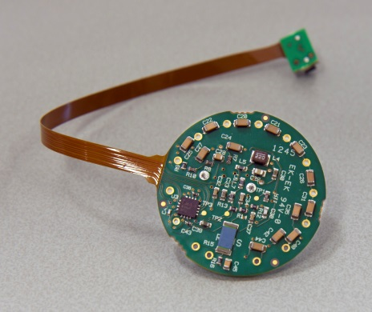
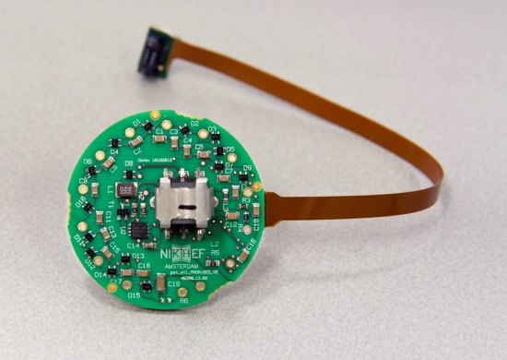
PMT Bases Schematics
3 inch PMTs
PMT-base
Photons
LVDS
Comparator
Pre- amp
Switch
+
Sense
Circuit
14.5 m
6.5us
Pulse
generator
Analog
Buffer
Current
controlled
Oscillator
Driver
Threshold DAC
Cockroft
Walton
HV
I²C
I²C
Decoder
+ ID Control
Current
Sense
Opamp
HV DAC
ID (OTP)
Clock
Feedback
PROMiS_v2
100 m
3V3
supply
Junction box
~60 m
Discrete
Components
Link cables
CoCo_v2
2500 m depth
ETEL bases with the chips
9
VLVnT13 Stockholm , 05-08-2013
9

Slide 10
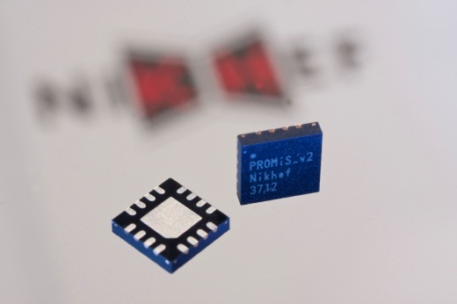
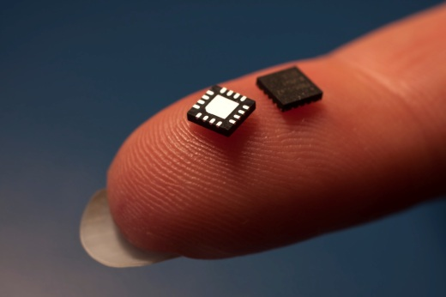
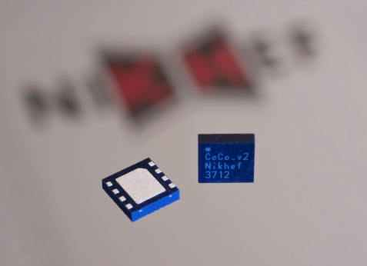
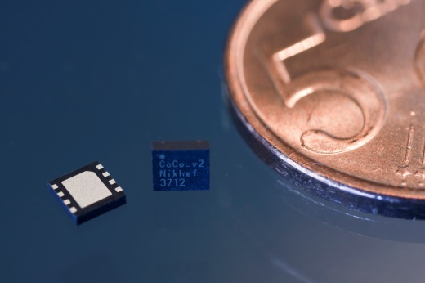
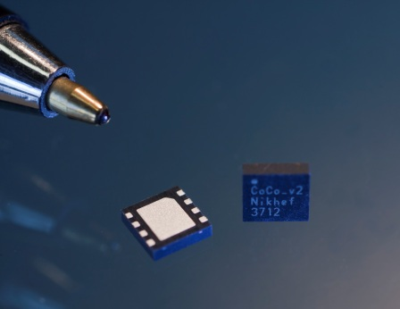
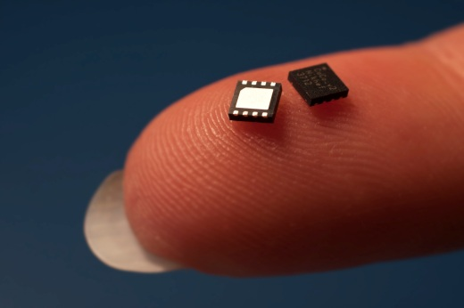
COCO And PROMIS Chips
14.5 m
100 m
Junction box
~60 m
Link cables
2500 m depth
VLVnT13 Stockholm , 05-08-2013
10

Slide 11
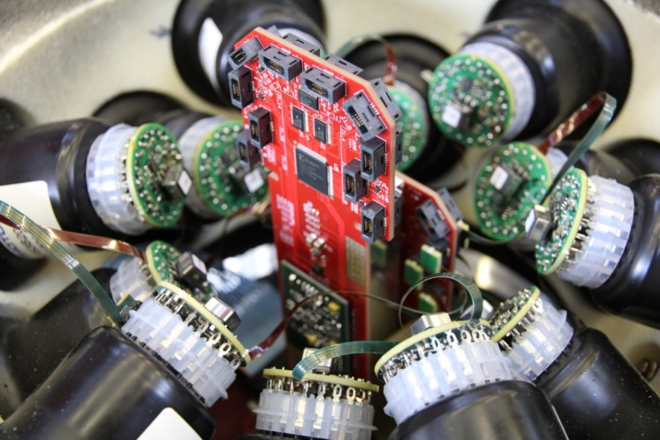
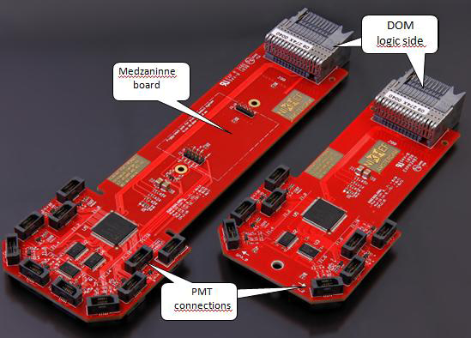
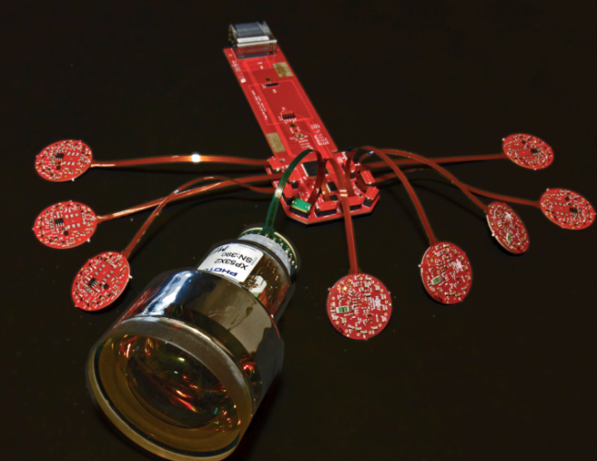
Octopus Board
14.5 m
Collect PMT bases signals and conduce them to the Central Logic Board
Delivers power for individual PMT HV base
Provide I2C communication with the Central Logic Board
100 m
Junction box
~60 m
Link cables
2500 m depth
VLVnT13 Stockholm , 05-08-2013
11

Slide 12
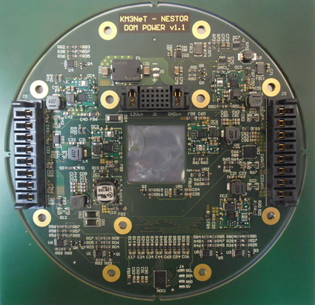
Power Board
Convert 12V from the external break Out Box to voltages for the DOM
Isolated from the CLB in order to avoid ElectroMagnetic Interferences
VLVnT13 Stockholm , 05-08-2013
12

Slide 13
Specs For The KM3NeT Central Logic Board
Specifications
Readout 31 TDC’s with 1 ns resolution (See David’s talk)
“Knowledge” of absolute time (1 ns resolution) – White Rabbit
Data pushed from PMTs to Shore Station
I2C: PMT-HV, Threshold, Compass, Tilt
Other IO: Temp, Nanobeacon, Acoustics, Piezo
Firmware must be reconfigurable
Low Power
Low Cost
Part of a scalable system (with respect to the complete detector)
Highly reliable
14.5 m
100 m
Junction box
~60 m
Link cables
2500 m depth
VLVnT13 Stockholm , 05-08-2013
13

Slide 14
Time Synchronization And Data Transfer
WHITE RABBIT
Main features of a White Rabbit network:
Transparent, high-accuracy synchronization
Low-latency, deterministic data delivery
Designed for high reliability
Control and timing
International collaboration
Based on well-known technologies
Open Hardware and Open Software
14.5 m
Ethernet
100 m
+
Determinism & Reliability
Junction box
~60 m
+
Synchronization
Link cables
2500 m depth
VLVnT13 Stockholm , 05-08-2013
14

Slide 15
Soft Microprocessor
1.- Open source – portable
2- Well documented
3.- White Rabbit uses it
4.- Wihsbone compatible
Embedded
Best at:
deterministic execution
configurable memory bus
small and fast
LM32 @ 62.5 Mhz
No operating system
Lower power consumption
VLVnT13 Stockholm , 05-08-2013
15

Slide 16
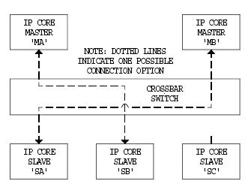
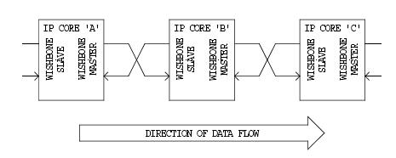
Bus System
WHISHBONE
Wishbone is intended as a "logic bus“
It does not specify electrical information or the bus topology
Instead, the specification is written in terms of "signals", clock cycles, and high and low levels
Open source
The Wishbone Bus is used by many designs in the OpenCores project
Possible interconnections:
Point to Point
Shared bus
Pipelined
Crossbar switch -> The one selected (Used also in WRPC)
VLVnT13 Stockholm , 05-08-2013
16

Slide 17
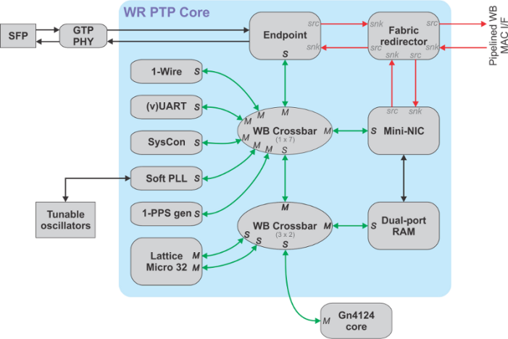
Block Diagram Of FPGA Functionalities
IP/UDP Packet Buffer
Stream Selector (IPMUX)
31 TDCs
Start Time Slice UTC &
Offset counter since
Fifo
TDC0
Time Slice Start
RxPacket
Buffer
64KB
RxPort 1
31 PMTs
Rx Stream Select
RxPort 2
Fifo
TDC
30
14.5 m
Rx_mac2buf
Rx_buf2data
Flags
RxPort_m
Management
& Control
State Machine
S
Pause Frame
Management
& Config.
ADC
Fifo
Hydrophone
TxPacket
Buffer
32KB
TxPort 1
Management
& Control
Tx Stream Select
TxPort 2
S
Tx_pkt2mac
Tx_data2buf
Multiboot
Flags
TxPort_m
S
Management
& Control
S
Nano
Beacon
M
M
M
S
M
WB Crossbar
(1x8)
M
M
M
M
M
M
Debug LEDs
M
M
2nd CPU
LM32
S
S
S
S
S
100 m
S
SPI
UART
I2C
I2C
GPIO
MEM
WB Crossbar
(3x2)
S
M
S
M
Junction box
Data
UTC time & Clock (PPS, 125 MHz)
Compass
~60 m
Control
Point to Point interconnection
SPI
Flash
Debug RS232
Temp
Tilt
Wishbone bus
Link cables
Xilinx Kintex-7 FPGA
2500 m depth
VLVnT13 Stockholm , 05-08-2013
17

Slide 18
PMT Signal Path
IP/UDP Packet Buffer
Stream Selector (IPMUX)
31 TDCs
Start Time Slice UTC &
Offset counter since
Fifo
TDC0
Time Slice Start
RxPacket
Buffer
64KB
RxPort 1
31 PMTs
Rx Stream Select
RxPort 2
Fifo
TDC
30
14.5 m
Rx_mac2buf
Rx_buf2data
Flags
RxPort_m
Management
& Control
State Machine
S
Pause Frame
Management
& Config.
ADC
Fifo
Hydrophone
TxPacket
Buffer
32KB
TxPort 1
Management
& Control
Tx Stream Select
TxPort 2
S
Tx_pkt2mac
Tx_data2buf
Multiboot
Flags
TxPort_m
S
Management
& Control
S
Nano
Beacon
M
M
M
S
M
WB Crossbar
(1x8)
M
M
M
M
M
M
Debug LEDs
M
M
2nd CPU
LM32
S
S
S
S
S
Xilinx
Kintex-7
S
SPI
UART
I2C
I2C
GPIO
100 m
MEM
WB Crossbar
(3x2)
S
M
S
M
Junction box
Data
UTC time & Clock (PPS, 125 MHz)
Compass
~60 m
Control
Point to Point interconnection
SPI
Flash
Debug RS232
Temp
Tilt
Wishbone bus
Link cables
2500 m depth
VLVnT13 Stockholm , 05-08-2013
18

Slide 19
Instrumentation Data Path
IP/UDP Packet Buffer
Stream Selector (IPMUX)
31 TDCs
Start Time Slice UTC &
Offset counter since
Fifo
TDC0
Time Slice Start
RxPacket
Buffer
64KB
RxPort 1
31 PMTs
Rx Stream Select
RxPort 2
Fifo
TDC
30
14.5 m
Rx_mac2buf
Rx_buf2data
Flags
RxPort_m
Management
& Control
State Machine
S
Pause Frame
Management
& Config.
ADC
Fifo
Hydrophone
TxPacket
Buffer
32KB
TxPort 1
Management
& Control
Tx Stream Select
TxPort 2
S
Tx_pkt2mac
Tx_data2buf
Multiboot
Flags
TxPort_m
S
Management
& Control
S
Nano
Beacon
M
M
M
S
M
WB Crossbar
(1x8)
M
M
M
M
M
M
Debug LEDs
M
M
2nd CPU
LM32
S
S
S
S
S
Xilinx
Kintex-7
S
SPI
UART
I2C
I2C
GPIO
100 m
MEM
WB Crossbar
(3x2)
S
M
S
M
Junction box
Data
UTC time & Clock (PPS, 125 MHz)
Compass
~60 m
Control
Point to Point interconnection
SPI
Flash
Debug RS232
Temp
Tilt
Wishbone bus
Link cables
2500 m depth
VLVnT13 Stockholm , 05-08-2013
19

Slide 20
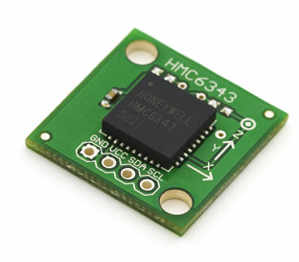
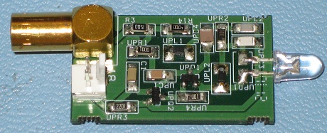
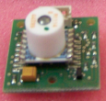
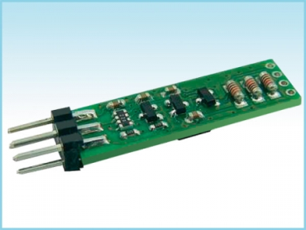
Instrumentation
AES3 (Audio Engineering Society) protocol
I²C (Inter Integrate Circuit) bus
14.5 m
Hydrophone
Piezo
Nanobeacon
Compass sensor + Tilt-meter sensor
Temperature sensors (located on the CLB)
HV base 3” PMT configuration (across the Octopus boards)
100 m
Junction box
~60 m
Link cables
VLVnT13 Stockholm , 05-08-2013
20

Slide 21
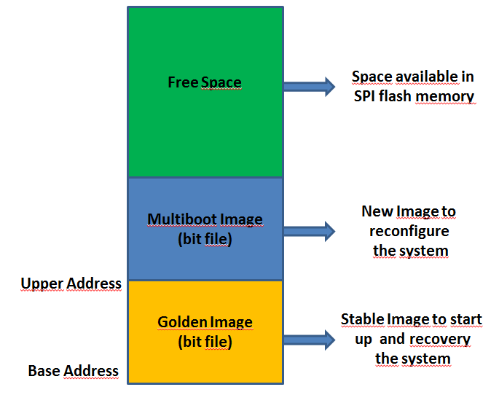
Booting The KM3NeT-DOM
FPGA SPI flash memory
Multiboot
VLVnT13 Stockholm , 05-08-2013
21

Slide 22
KM3NeT On Shore Station
Server1
192.16.x.1
Server2
192.16.x.2
Server n
192.16.y.z
Servers may be
used for storage and
Pre-processing
Switch
Server
Server
Buffers
Server
Server
GPS
10MHz
Shore
PPS
WR Switch
WR Switch
Sub Sea
DOM
1
DOM
2
DOM
16
DOM
12798
DOM
12799
DOM
12800
Each DOM synchronizes to the absolute time (using White Rabbit)
Each DOM receives a look up table with IP addresses while configuring the detector.
Fixed Ip stored on the nodes can be also used
All DOMs start at an absolute point in time which was communicated via a command over the White Rabbit network
All DOMs start their first time-slice at exactly the same time
All data is IP/UDP formatted and passed to the IP number corresponding to the time slice
After ‘n’ time slices, first PC is again selected to process the data
Time Slice
Time Slice
IP
IP Address
Time Slice
1
IP
192.16.x.1
2
192.16.x.2
:
:
n
192.16.y.z
VLVnT13 Stockholm , 05-08-2013
22

Slide 23
On Shore Station Data Path
ReferenceClock
Start
PTP
Broadcast
Buffer
Buffer
Tx
SFP
Buffer
Time Stamp t₁
DOM
Buffer
SFP
Time Stamp t₄
Rx
Optical
Network
t₄ Stop1
ϕ: DDMTD
DOM
SFP
t₄ Stop2
Time Stamp t₄
Rx
ϕ: DDMTD
DOM
SFP
t₄ Stop3
Time Stamp t₄
Rx
ϕ: DDMTD
DOM
SFP
t₄ Stop4
Time Stamp t₄
Rx
Shore Station interface
ϕ: DDMTD
Main Electrical Optical Cable
(MEOC)
40 km long in KM3NeT-Fr/Gr
100 km long in KM3NeT-It
VLVnT13 Stockholm , 05-08-2013
23

Slide 24
Conclusions
Readout/DAQ of KM3Net – DOM using:
White Rabbit protocol:
Ethernet + Synchronization (1 ns) + Determinism
31 TDC’s with 1 ns resolution
31 low power HV PMT bases with preamplifier and discriminator
Data read out parallelized on Field Program Gate Array
Control/Configuration performed in an embedded processor
No Operating System used
Embedded instrumentation for calibration
Optical 1Gb/s Ethernet link
KM3NeT Onshore station centralises the read out – control – configuration of the telescope
VLVnT13 Stockholm , 05-08-2013
24

Slide 25
THANKS FOR YOUR ATTENTION!
VLVnT13 Stockholm , 05-08-2013
25

