Slide 1
DarkSide @ LNGS
Aldo Ianni for the DarkSide Collaboration
Latest Results in Dark Matter Searches
Stockholm,
May 12th, 2014

Slide 2
WIMPs signal and background
Signal:
  Low energy nuclear recoils (1 – 100 keV)
  Low rate ( ~ few counts/year/ton at 10⁻⁴⁷ cm² )
  No specific features in recoils spectrum
Background:
  Electron Recoils (ER) from e, γ radioactivity rejected by a number of discrimination cuts
  Nuclear Recoils (NR) from radiogenic neutrons ask for a “background free” detector
  Solar neutrinos:
    Elastic Scattering interactions will limit the sensitivity depending on the ER rejection power of the experiment
    Neutrino-nucleus coherent interactions sets the limiting sensitivity

Slide 3
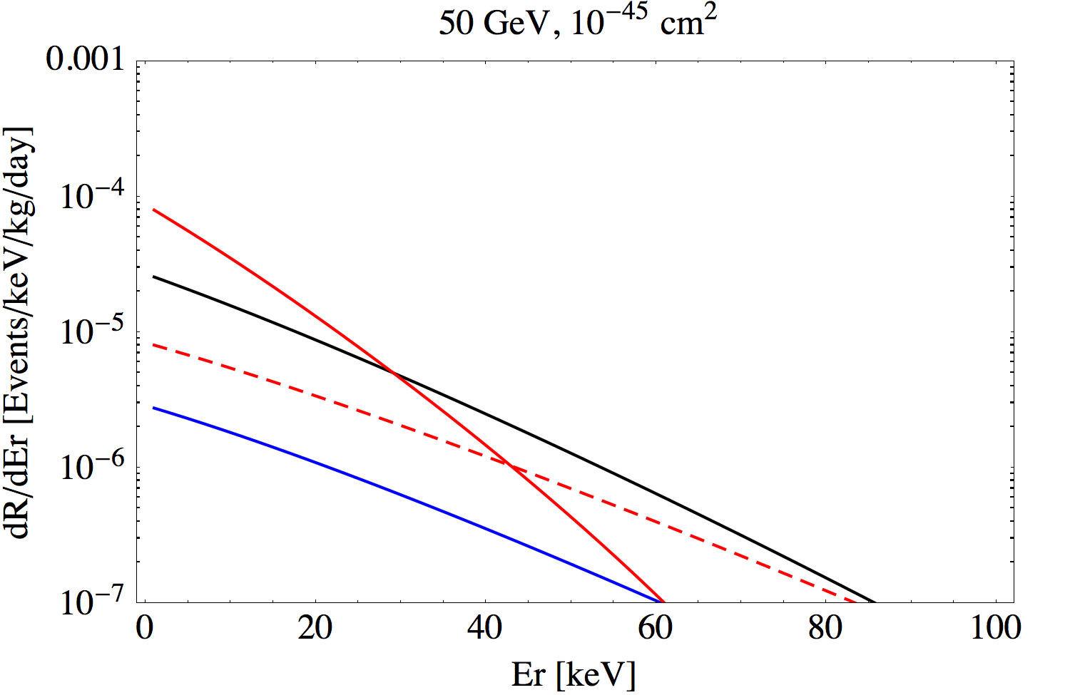
Recoil Spectrum
Xe
Ar
Na
Ge
0.3 events/kg/year in Xe for 10⁻⁴⁵ cm² and 50 GeV/c²

Slide 4
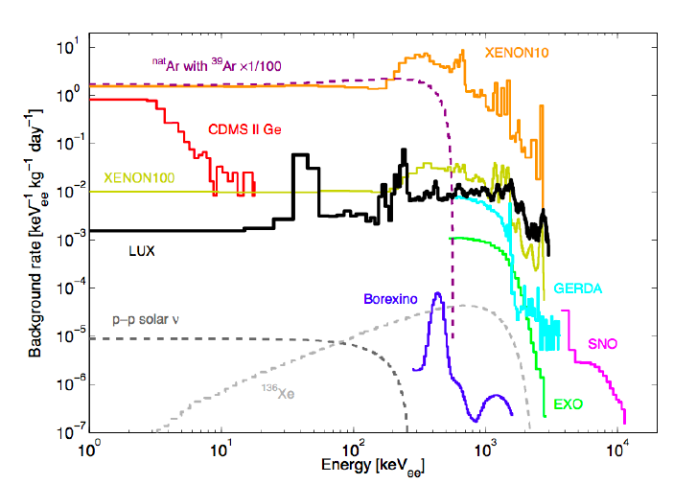
Background in DM, double beta decay and
solar neutrino experiments
Plot by R. Geitskell at DM2014

Slide 5
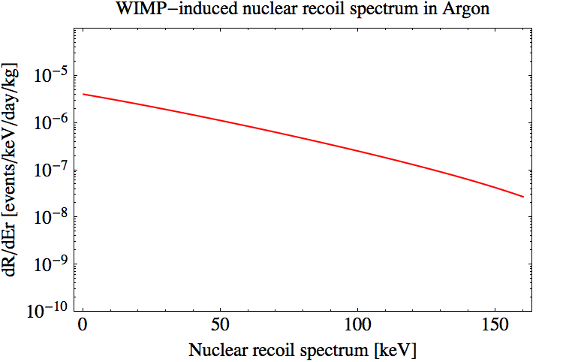
Expected WIMPs Signal in LAr
100 GeV/c² WIMP mass
10⁻⁴⁵ cm² WIMP-nucleon cross section
~ 10⁻⁴ interactions/day/kg
Exposure of 1 ton-year gives about 40 events with these assumptions
Exposure of 50 kg x 3 years gives about 5 events

Slide 6
Why use LAr for Dark Matter?
LAr Positives
LAr Negatives
Bright scintillator with low energy threshold.
  40 photons/keVee; 8-10 pe/keVee possible
Powerful PSD in scintillation signal
  Separates background from ER from WIMP induced NR.
Moderate cryogenic requirements
Good ionization detector for TPC
  Well defined fiducial volume is possible.
  S2/S1 helpful for discrimination.
Easily scalable to large masses.
Liquids and gasses can be radio-pure.
  Internal background reduced by on-line purification.
Cosmogenic radioactive ³⁹Ar in Atmospheric argon (AAr) 1 Bq/kg
  Underground argon (UAr) has low ³⁹Ar (< 6.5 mBq/kg)
AAr is cheap. UAr is not.
Scintillation light at 128 nm.
  Need wavelength shifters, reflectors,
Special PMTs developed
  for low radioactivity PMTs working at LAr temperature

Slide 7
LAr TPC at Work
Upper PMTs array
Upper PMTs array
E field
gas
S1 prompt signal
from LAr
Drift of free e⁻
and delayed
signal in gas S2
liquid
Lower PMTs array
Lower PMTs array
S1 signal from prompt scintillation: measures energy and time of event
S2 late signal: measures position of event in LAr and is proportional to fraction
of charge that escapes recombination

Slide 8
The problem of ³⁹Ar
Ar Naturally present in the atmosphere at 1% level
³⁹Ar formed by cosmic muon interactions
  ⁴⁰K(n,2n)³⁹Ar
³⁹Ar is a β emitter with Q_{β}=565 keV and T_{1/2}=269 years
In Ar from the atmosphere, ³⁹Ar is at the level of 1 Bq/kg
  ~ 9×10⁴ decays/kg/day
  WIMPs(100GeV, 10⁻⁴⁵ cm²) ~ 10⁻⁴ events/kg/day
Notes:
Ar

Slide 9
Underground Argon
In exhaust stream gas (CO₂) of commercial mining facilities Ar at 400-600ppm level
Make on-site preconcentration to ~40,000ppm, then cryogenic distillation at FNAL
Purified depleted argon produced at 0.5kg/day
³⁹Ar depleted at <0.6% level
  ~560 decays/kg/day
  For WIMPs ~ 10⁻⁴ interactions/kg/day
Use LAr scintillation properties to perform background reduction
  Prompt signal PSD shows: 90% n-recoil acceptance with <10⁻⁵ e-recoil leakage

Slide 10
DarkSide background rejection strategy
Screening and selection of detector materials
Identify and reject cosmogenic muons
  Water Cherenkov Detector
Identify and reject radiogenic neutrons from the active mass
  Active veto based on a boron-loaded liquid scintillator
  detector
Two-phase LAr TPC
  Pulse Shape Discrimination
  S2/S1
  3D Fiducial Volume definition to reject surface background
  Underground argon with reduced (> 150) cosmogenic ³⁹Ar

Slide 11
DarkSide program @ LNGS
Scalable technology for a two-phase TPC in LAr
  DarkSide-10 (DS-10)
    10 kg active mass
    Operated in 2012 @ LNGS
    Technical prototype for larger TPC
  DarkSide-50 (DS-50)
    50 kg active mass
    Built inside Borexino CTF Water Tank with active neutron veto
    Launch technology for next generation detectors (ton scale FM)
    In operation since Nov 2013
    Expected WIMP sensitivity 10⁻⁴⁵ cm² with UAr
  DarkSide-G2
    3600 kg fiducial mass
    Can be built inside present DS-50 neutron veto
    Expected sensitivity 10⁻⁴⁷ cm²

Slide 12
DS-50 @ LNGS
Rn-free clean room
(10-15 mBq/m³ in 110 m³)
Used for assembling TPC
and deployment
Rn-free clean room
(< 5 mBq/m³ in 100 m³)
Used for assempling TPC
and deployment
Water Cherenkov muon veto: 10³ m³ H₂O with 76/80 8” PMTs
Boron-loaded liquid scintillator
(50% TMB + 50% PC) as
neutron veto with 108/110 8” PMTs
150kg LAr TPC with 2 x 19
3” PMTs
AAr at present with 1Bq/kg ³⁹Ar
UAr with < 6.5 mBq/kg ³⁹Ar

Slide 13
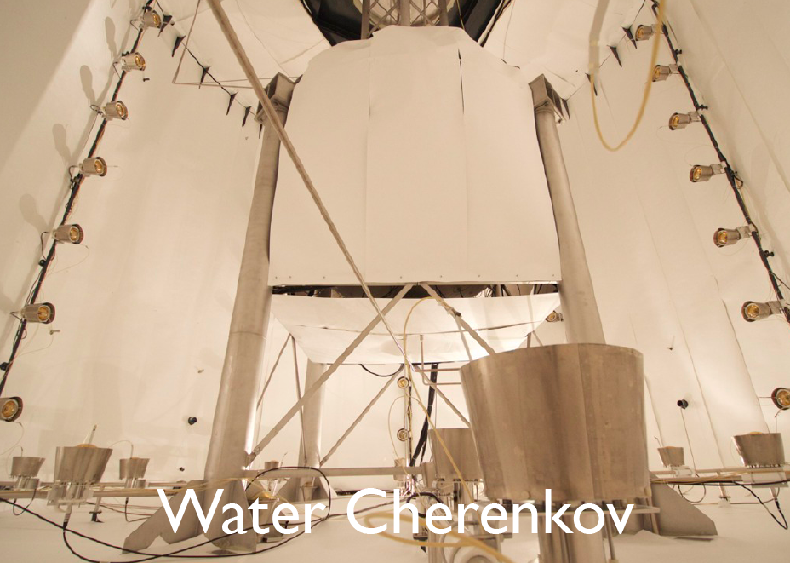

Slide 14
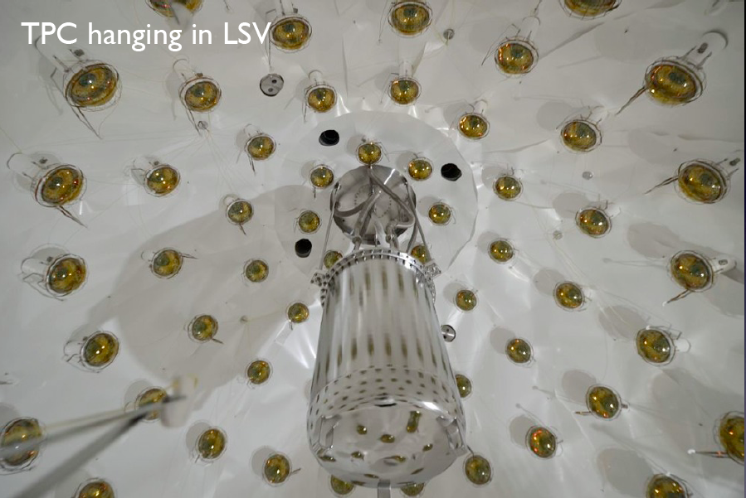

Slide 15
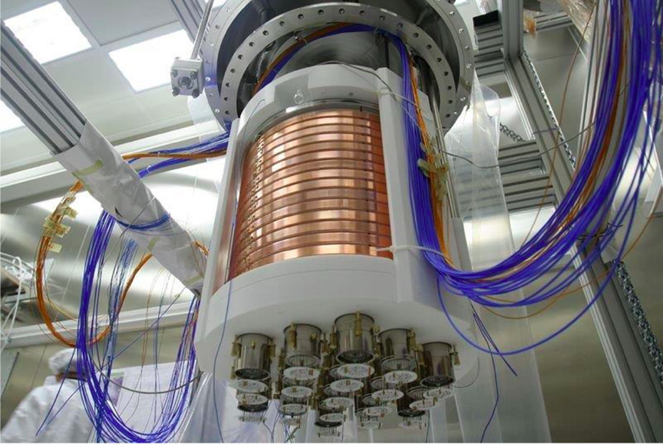

Slide 16
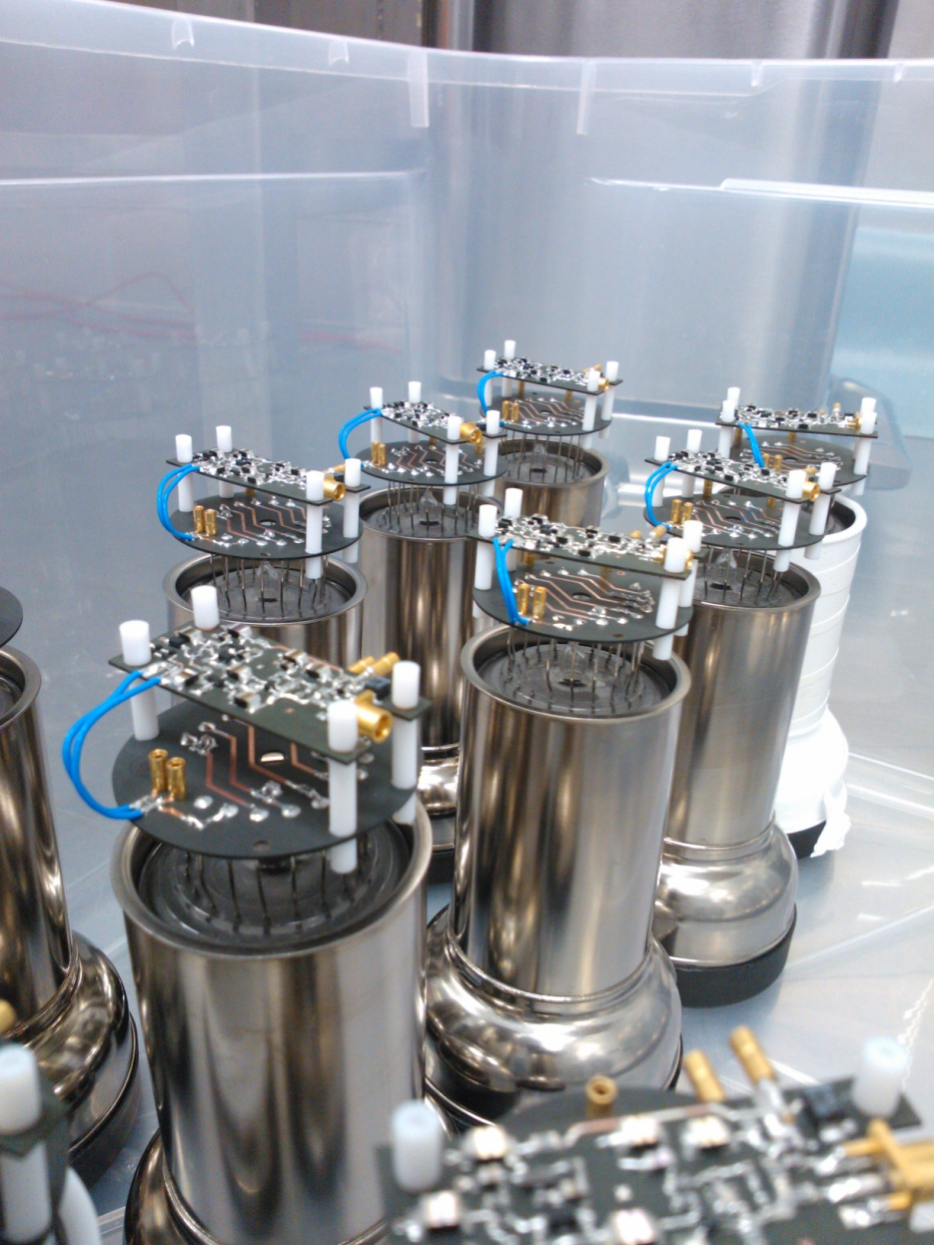
PMTs + Cold-Amps in LAr
R11065 PMTs
PMT Gain = 3 x 10⁵
PMT HV ~ 1200 V
Noise 3 μV on 200 MHz

Slide 17
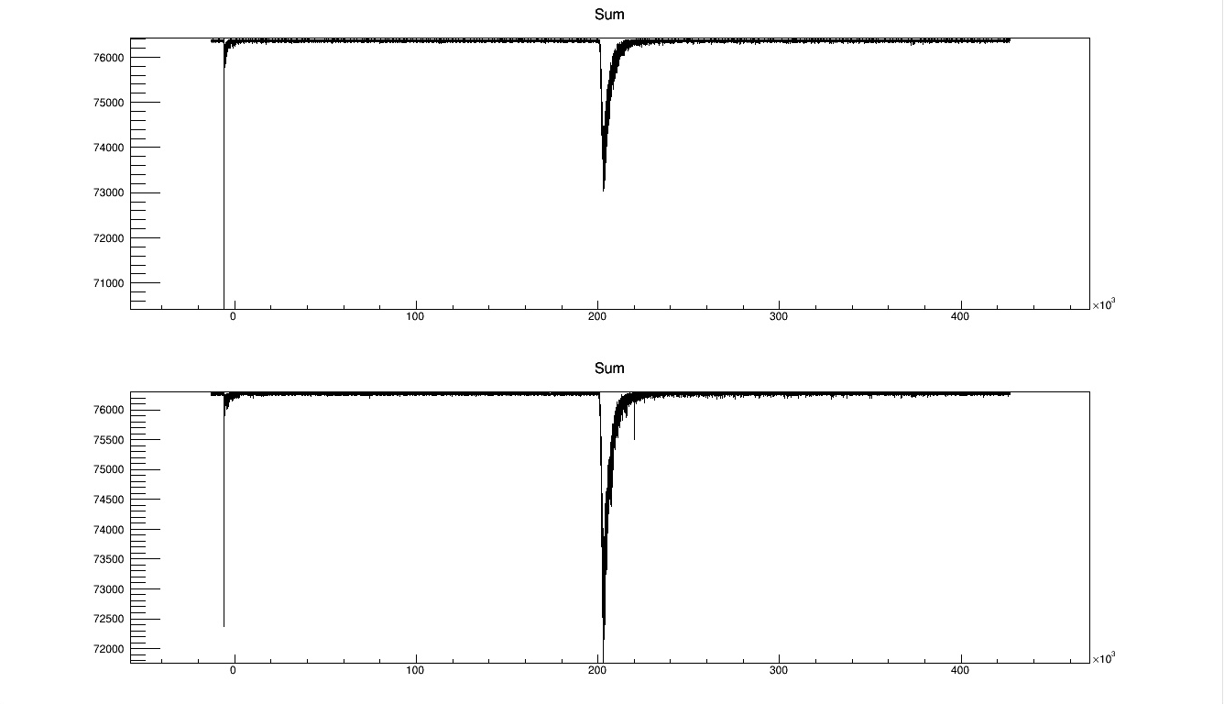
S1 and S2 signals
Lower PMTs array
μs
Upper PMTs array

Slide 18
Trigger: 3PMTs && < 380p.e.

Slide 19
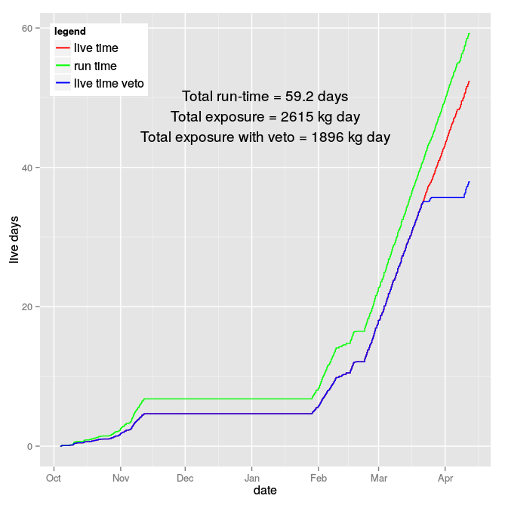
Livetime
DAQ efficiency ~ 95%
~ 40 kg x day / day
6.3 days

Slide 20
Pulse Shape Discrimination in LAr
ER
NR

Slide 21
Scintillation and Ionization Discrimination
ER
S₂ / S₁
NR
F₉₀

Slide 22
Pulse Shape F₉₀
3x10⁷
events
280 kg x day

Slide 23
DS-50 sensitivity with 280 kg x day
DS-50 AAr 1 event sensitivity
70 p.e. threshold
[35 keV_{r}]
LUX 90% CL limit 2013

Slide 24
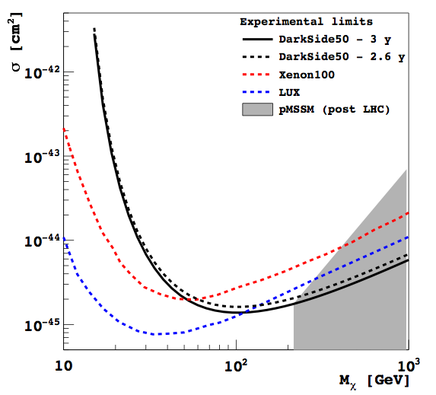
DS-50 expected sensitivity with UAr

Slide 25
Neutron veto
30 tons of boron-loaded liquid scintillator
  50% TMB [ B(OCH₃)₃] + 50% PC + 3 g/l PPO
108 8” PMTs
High reflectivity of inner surface of containment vessel
n-veto expected performance: < 1 event in 3 years after n-veto rejection and TPC cuts

Slide 26
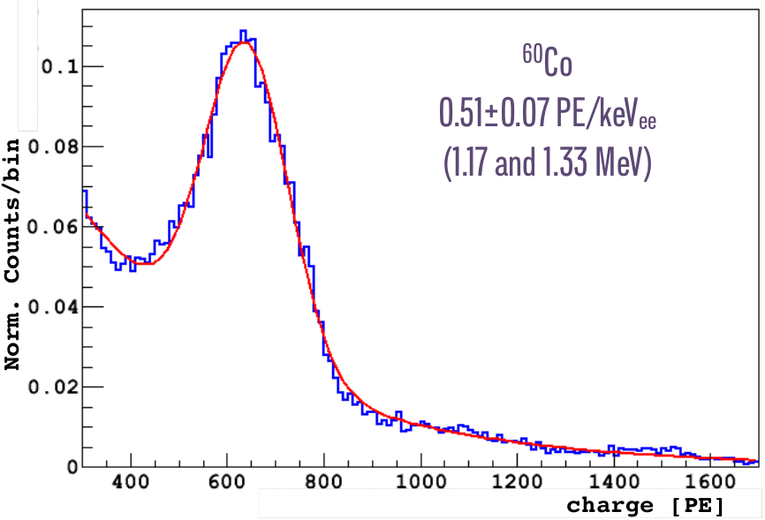
Neutron veto at present
Determined a high ¹⁴C contamination from TMB
  ~10⁻¹³ ¹⁴C/¹²C
  understood origin of contamination
  clear roadmap to fix the issue to obtain <10⁻¹⁵ ¹⁴C/¹²C
High Light Yield measured from ¹⁴C
spectrum, ⁶⁰Co contamination in
steel of cryostat (~ 13 mBq/kg) and
from ²⁰⁸Tl

Slide 27
LAr TPC
In operation S1/S2 mode with 50 kg AAr
Expected 1-2 neutron/month (mainly from measured activity of PMTs) w/o veto cut with R11065 PMTs.
  Veto rejection factor = 100:
  TPC cuts rejection factor = 30
  need a n-veto
In operation with 38 3” R11065 PMTs
  Gain stability 1-2%
  HV: E_{drift} = 200 V/cm, E_{extraction} = 2.8 kV/cm
  Light yield ~ 8 p.e./keVee
  Electron lifetime ~5ms
    To compare with max drift time of ~ 400 μs
  ^{83m}Kr internal calibration (two times) 41.5 keVee sum line

Slide 28
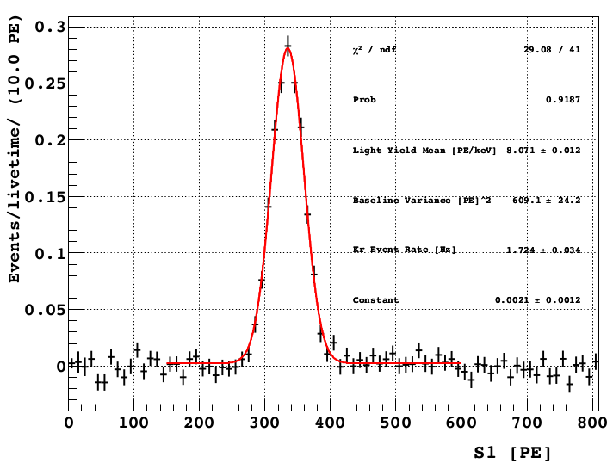
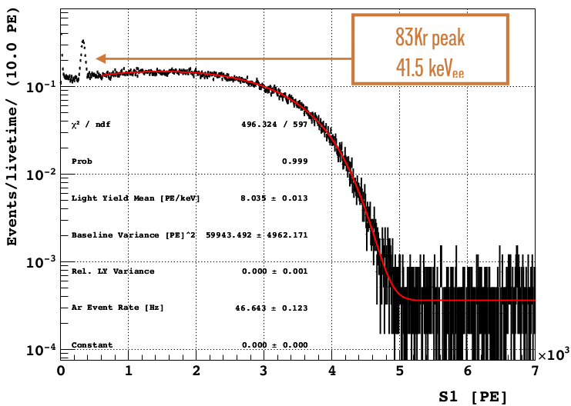
Light yield @ null field
Light Yield ~ 8 pe/keV_{ee}
at null field
^{83m}Kr peak
41.5 keV, T_{1/2}=1.83h
³⁹Ar spectrum
565 keV

Slide 29
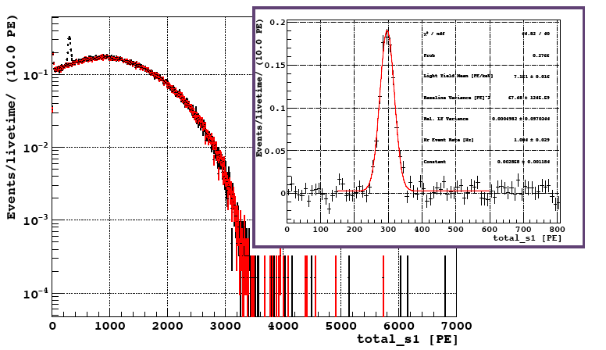
Light Yield @ 200V/cm
8 --> 7 p.e./keVee

Slide 30
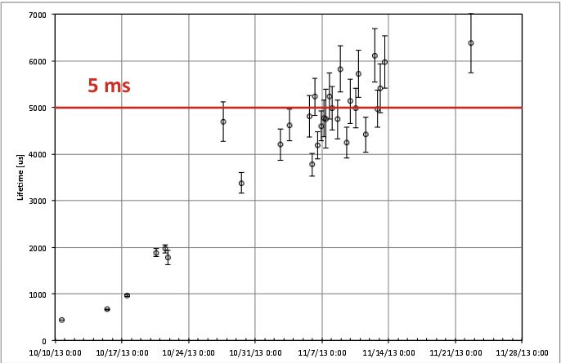
e⁻ life time

Slide 31
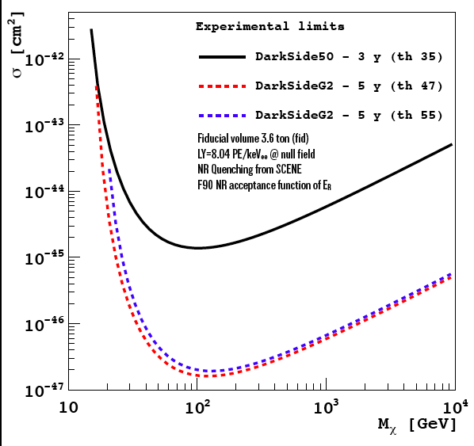
From DS-50 to DS-G2

Slide 32
³⁹Ar spike to probe DS-G2 PSD
DS-G2 will have 3.6 ton fiducial mass and could take data for 5 years (18 ton-year)
At 55 keV_{r} ~ 17 keV_{ee} ~ 120 p.e. the expected ³⁹Ar events in ROI (1 keV above threshold) is 7.4 x 10⁶
Generate this number of events to probe PSD
by means of β sources
³⁹Ar
¹⁴C

Slide 33
Summary of 1st DS-50 data
In operation with AAr since Oct 2013
TPC (AAr), neutron veto and muon veto commissioned
  Analyzed 280 kg x day
  S2/S1 and x-y cut still under development
  neutron veto light yield ~ 0.5 p.e./keVee
  neutron veto scintillator acquired with TPC trigger
  neutron veto scintillator with high ¹⁴C contamination
No background in PSD in upper 50% NR acceptance region in 3x10⁷ events
LY @ null field ~ 8 p.e./keV_{ee}
Rn contamination from Bi-Po < 0.85 μBq/kg_Ar
Already collected data for 2615 kg x day (50kg LAr) as of April 12th
~ 2000 kg x day usable for further background studies

Slide 34
Future Goals
More data with AAr
  ³⁹Ar spike test (more later)
  neutron calibration: deployment system in preparation
  improve fiducialization
Replace PC+TMB with PC:
  By June
Fill with new low ¹⁴C TMB: Sep.
Replace AAr with UAr: Sep.
  reduce ³⁹Ar background by a factor > 150

Slide 35
Spare

Slide 36
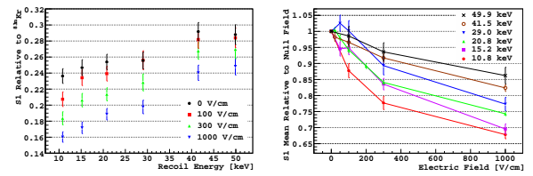
Scene

Slide 37
Baseline
Ch 39, 40 no PMT

Slide 38
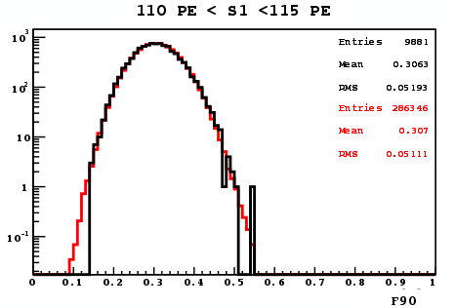
PSD simulation
data
simulation

Slide 39
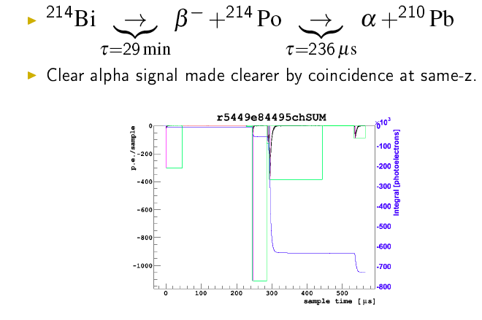
²¹⁴Bi-²¹⁴Po

Slide 40
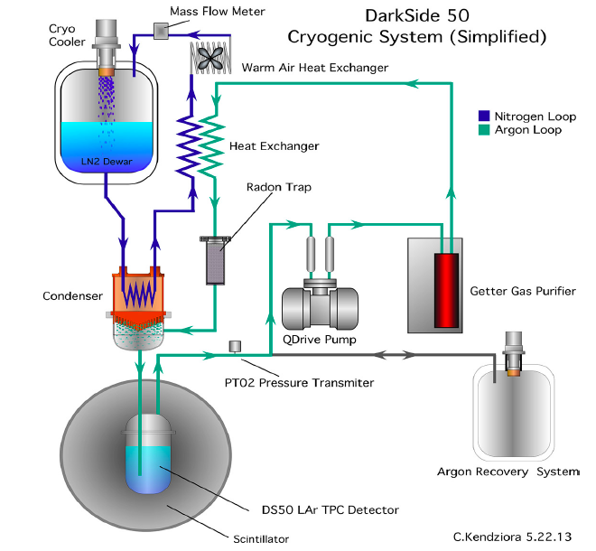
Cryogenic for DS-50 TPC
30 l/min
166K
15.6 psia

Slide 41
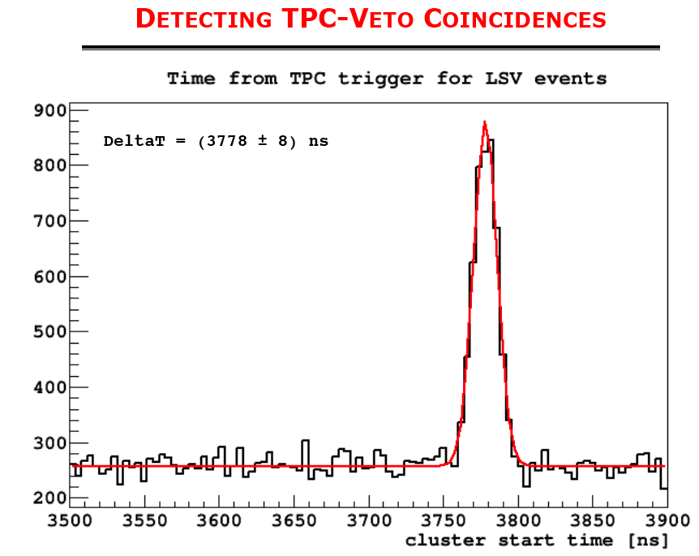

Slide 42
Cosmogenic Neutrons
Flux at Gran Sasso lab:
  2.4 m⁻² day⁻¹
  0.7 m⁻² day⁻¹ for > 10 MeV
Expected rate ~ 3×10⁻³³ /s/atom
WIMPS rate ~ 10⁻³⁴ /s/atom
Neutrons from surrounding rocks
reduced by shielding
In DS-50 3m of water ~ 10⁻³ and 0.04
from 1.5m of liquid scintillator: ~4 ×10⁻⁵
<E_{n}> ~ 90 MeV
Water
LAr TPC
LS
μ-induced neutron

Slide 43
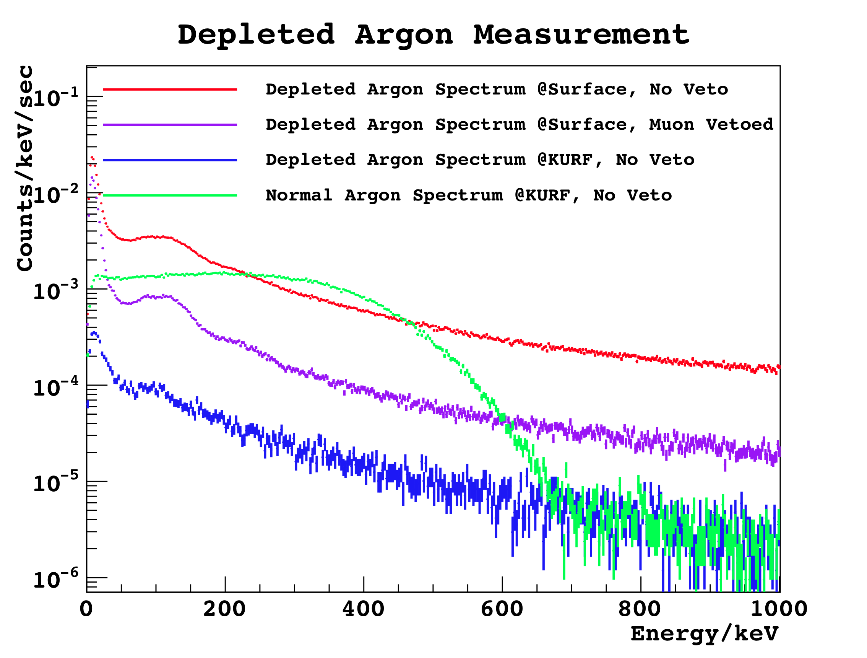
Underground Argon
³⁹Ar depletion factor >10
from direct counting, >50 from
spectral fit with surface detector
In progress study with counting
detector underground at KURF
(1400 m.w.e.) Virginia, USA

