Slide 1
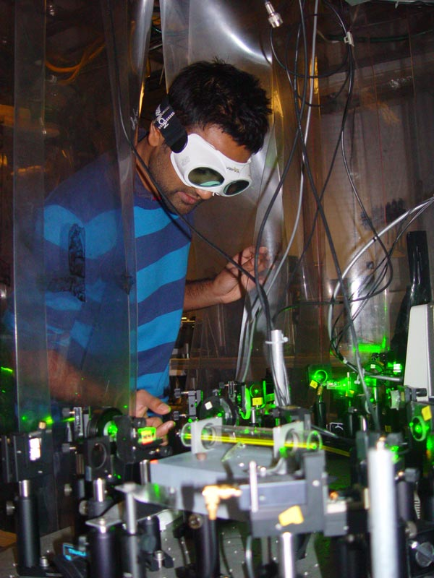
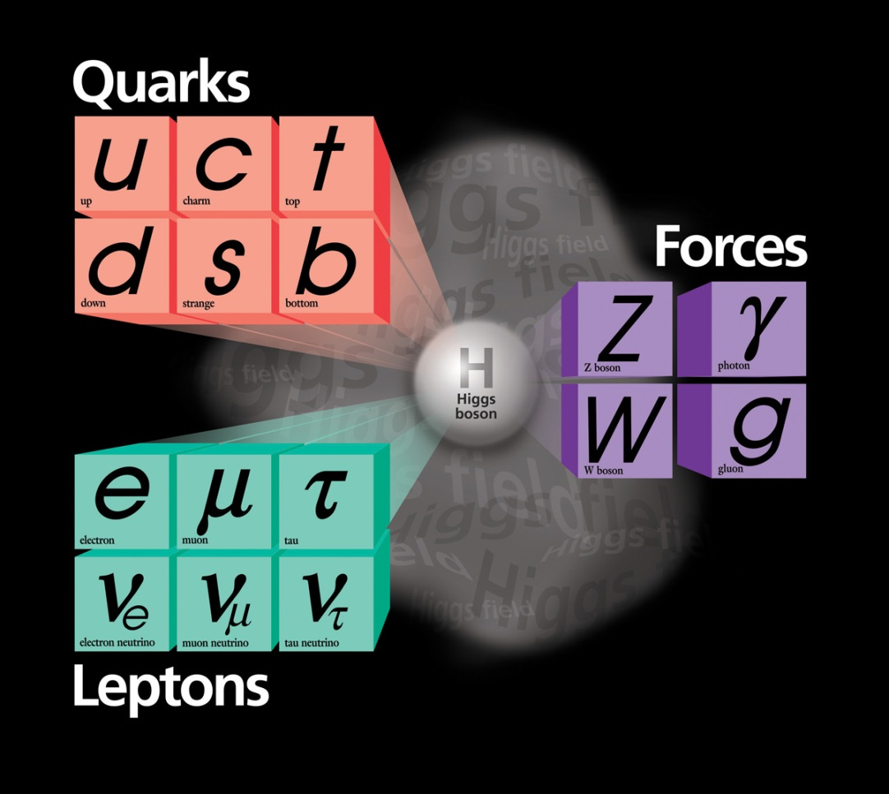
High Precision, Not High Energy
Using Atomic Physics to Look Beyond the Standard Model
Part 1: Impossible Things

Slide 2
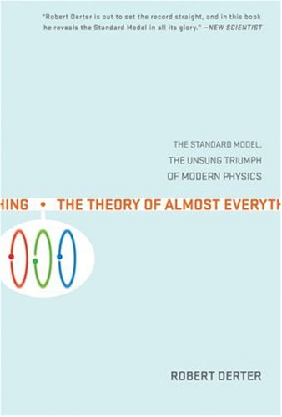
WRONG
Image credit: Fermilab

Slide 3
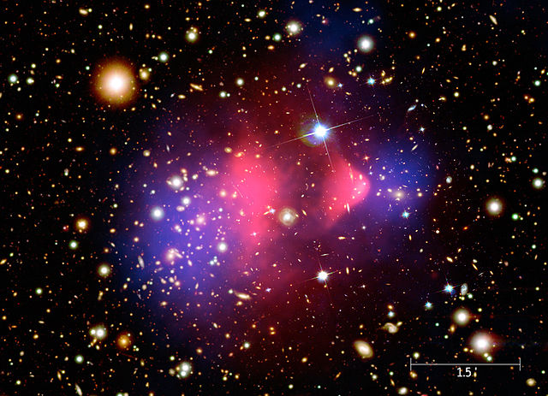
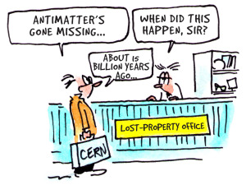
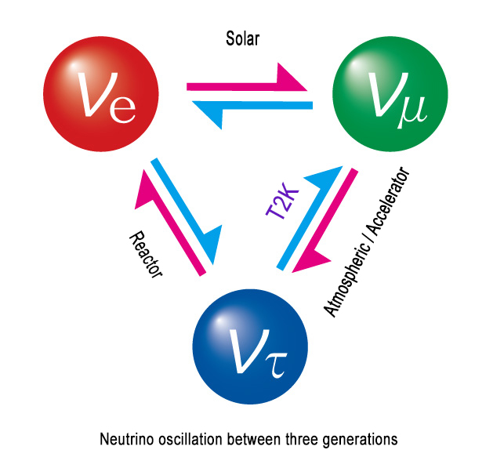
Source: Harvard/ Chandra
Source: CERN Bulletin
Source: J-PARC

Slide 4
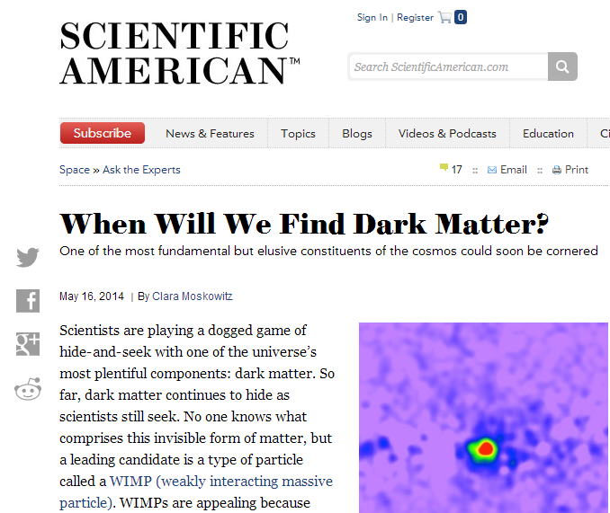
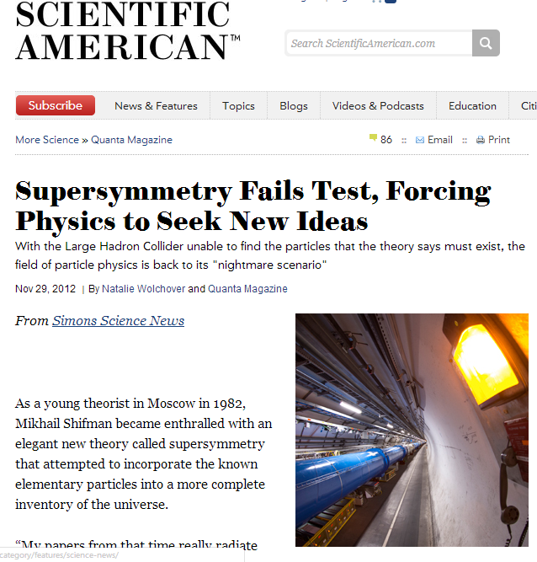
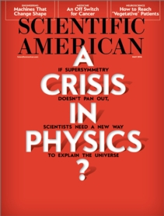
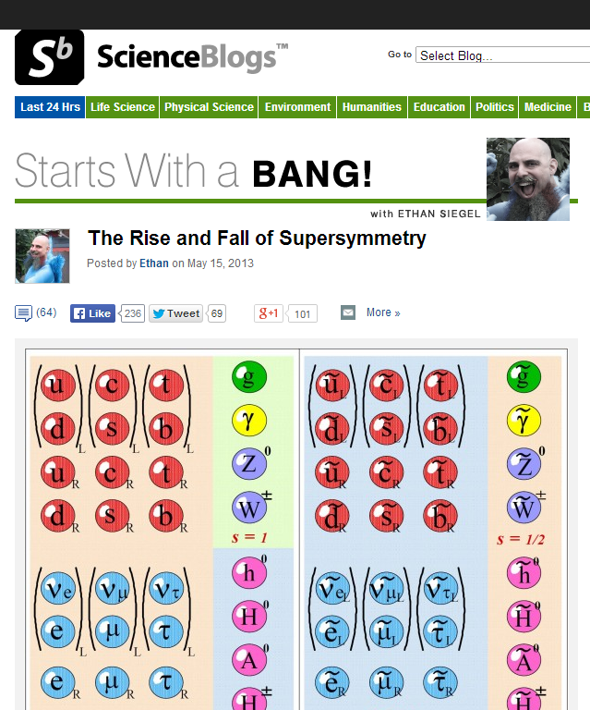
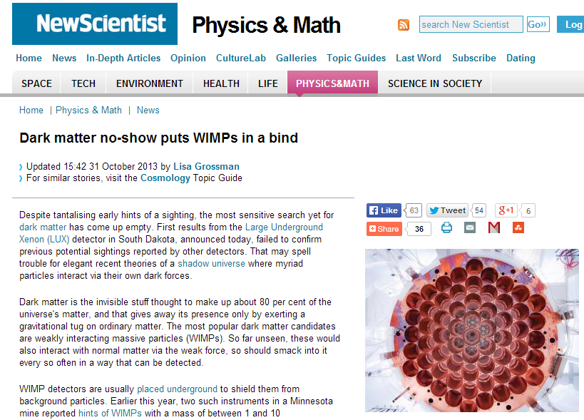
Particle
Physics?

Slide 5
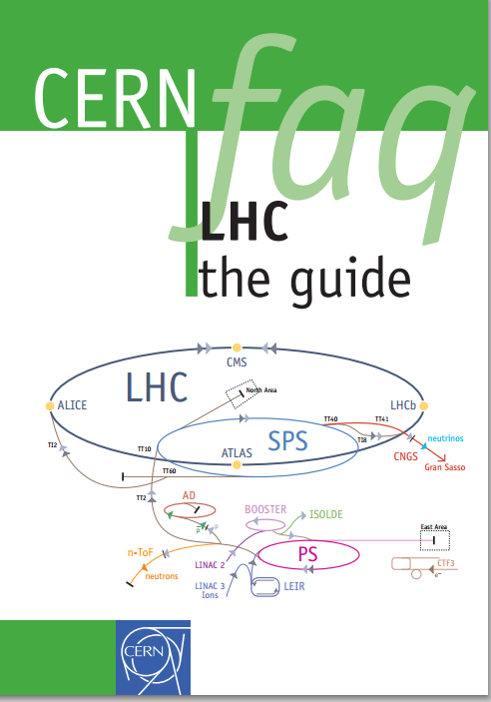
Beyond the Standard Model
Ways to look for new physics:
1) Direct creation
Accelerate particles to near light-speed, convert that energy to matter

Slide 6
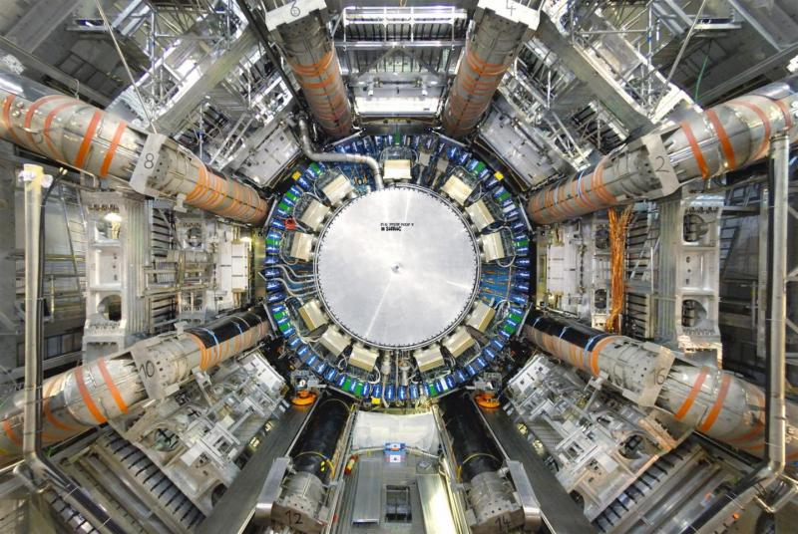
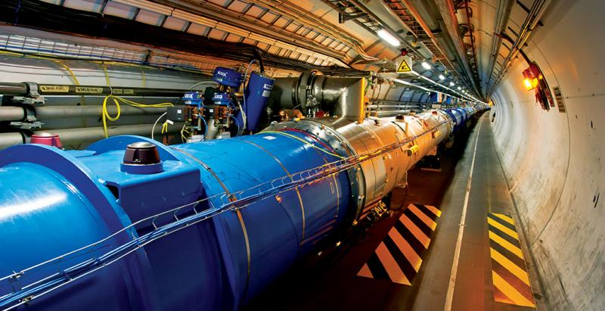
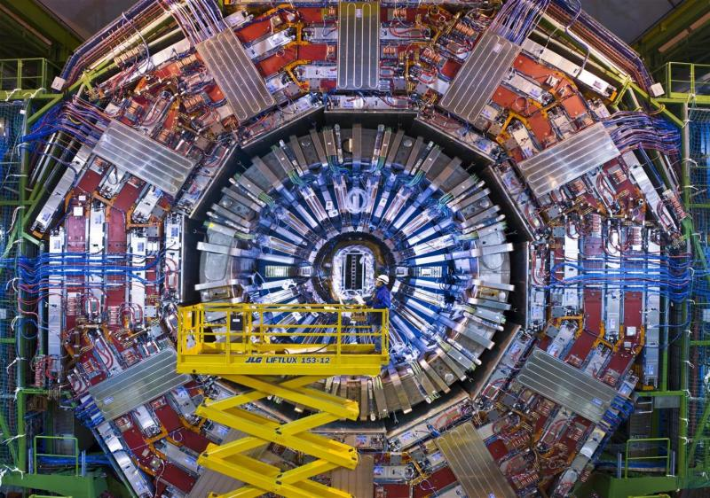
ATLAS
Images: CERN
CMS

Slide 7
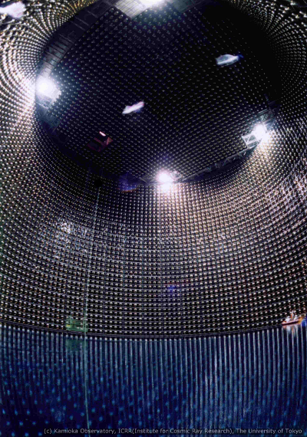
Beyond the Standard Model
Ways to look for new physics:
1) Direct creation
2) Passive detection
Build large detector sensitive to particles of interest, hope one happens by
Image: Super-Kamiokande

Slide 8
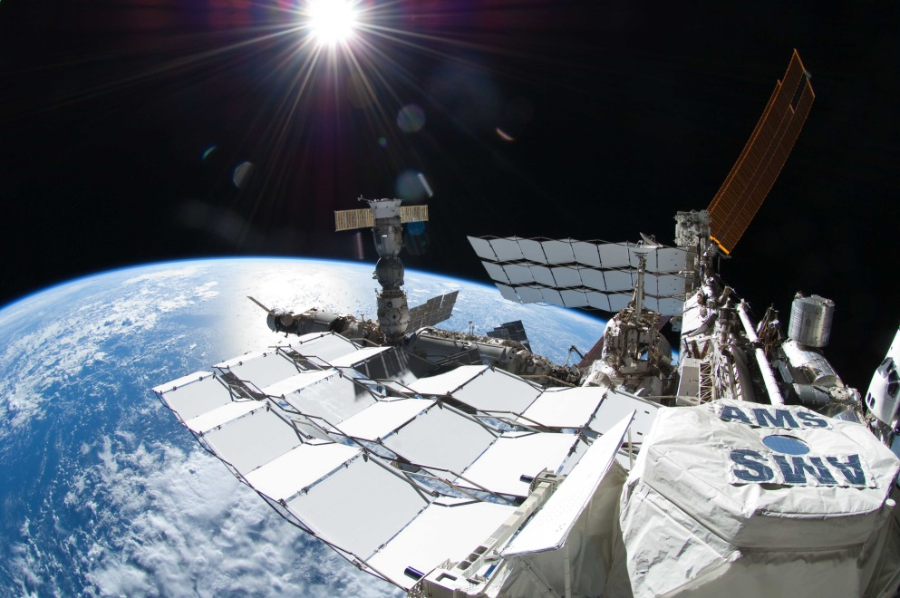
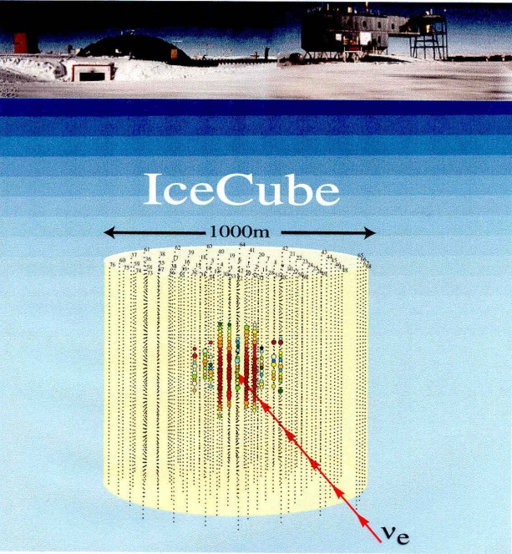

Slide 9
Beyond the Standard Model
Ways to look for new physics:
1) Direct creation
2) Passive detection
3) Precision measurement
Look for exotic physics in relatively mundane systems using precision spectroscopy to measure extremely tiny effects
Image: Mike Tarbutt/ Physics World

Slide 10
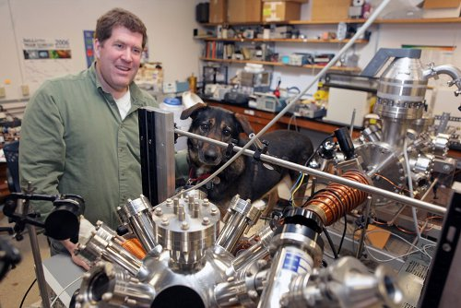
LHC vs AMO
Particle Physics
Atomic Physics
Photo by Matt Milless
Energy scale: ~1TeV
Length scale: ~ 10⁻¹⁹ m
Energy scale: ~1eV
Length scale: ~ 10⁻¹⁰ m
Vast scale mismatch: How do AMO systems detect new physics?
Measuring tiny effects is what we do...

Slide 11
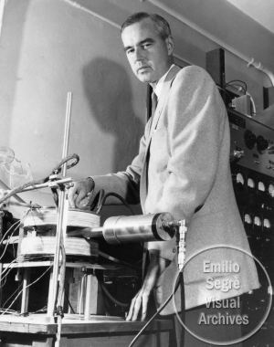
Historical Precedent
~1930, Dirac: Relativistic equation for electron
Predicts energy levels of hydrogen
1947, Willis Lamb, Robert Retherford:
Measure shift between two energy levels that Dirac equation predicts should have same energy
“Lamb Shift” energy: 4.372×10⁻⁶ eV
(out of ~10 eV)
Willis Lamb Image: National Archives and Records Administration, via AIP Emilio Segre Visual Archives
➔ Kick-starts development of QED

Slide 12
QED
Energy of electron depends on interaction with nucleus
N
U
C
L
E
U
S
Feynman picture: exchange photons
Story in pictures:
Photon
Once upon a time, there was an electron moving along through space, and it exchanged a photon with the nucleus, which changed its momentum.
Electron
Time
The End
… Or Is It?
Space

Slide 13
Virtual Particles
Quantum Physics: Everything not forbidden is mandatory
➔ QED story has to include additional effects
N
U
C
L
E
U
S
N
U
C
L
E
U
S
Virtual
Positron
Photon
Virtual
Photon
Virtual
Electron
Electron
Electron Self-Energy
Vacuum Polarization

Slide 14
Lamb Shift
What difference does this make?
(not to scale)
QED effects “smear out” electron position over a small range
Probability
“Pushes” electron farther from nucleus ➔ reduces energy
Distance scale: ~10⁻¹⁶ m
Distance
(1/10th size of nucleus)
➔ Extremely small shift, but detectable
Nobels for Lamb, Kusch, Feynman, Schwinger, Tomonaga…

Slide 15
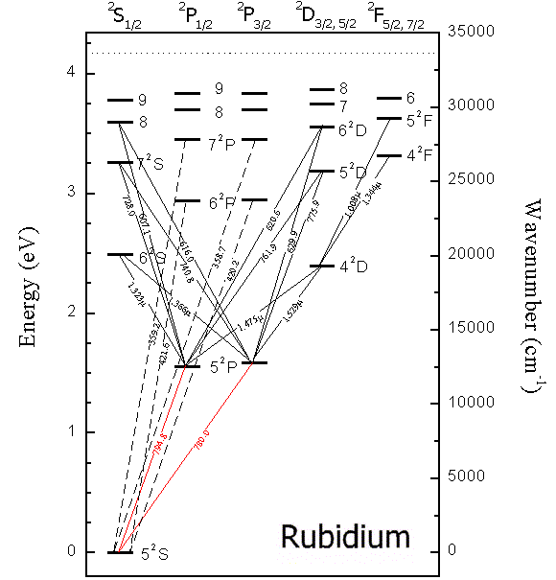
Atomic Structure
States defined by:
Electronic energy
Angular momentum
Spin
Nuclear Spin
Selection rules:
Only certain types of transitions allowed
Control transitions by choosing light properties: frequency, intensity, polarization
Diagram from http://raptor.physics.wisc.edu/download2.htm

Slide 16
Atomic Structure
Selection rules:
Only certain types of transitions allowed
… WHY?
Symmetry, conservation laws
Light carries:
Energy
⬅➔ Frequency
Momentum
⬅➔ Forces
Angular
momentum
⬅➔ Polarization
Diagram from http://raptor.physics.wisc.edu/download2.htm

Slide 17
CPT
Fundamental symmetry transformations:
Charge
Parity
Time
+
+
+
+
+
+
−
−
Physics looks the same under these
…except when it doesn’t

Slide 18
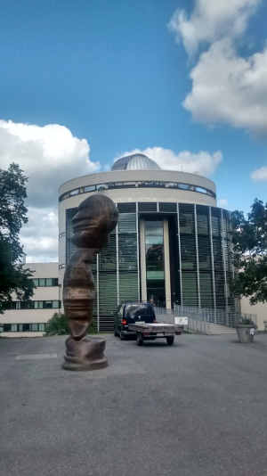
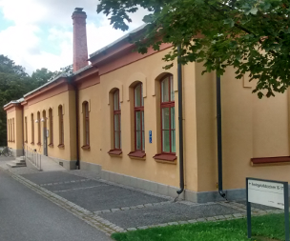
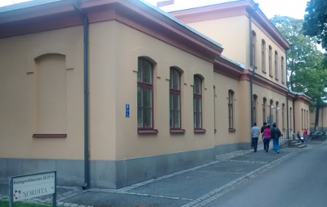
Parity Symmetry
NORDITA

Slide 19
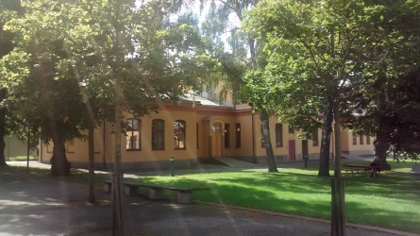
Parity Violation

Slide 20
CPT
Fundamental symmetry transformations:
Charge
Parity
Time
+
+
+
+
+
+
−
−
Physics looks the same under these
…except when it doesn’t

Slide 21
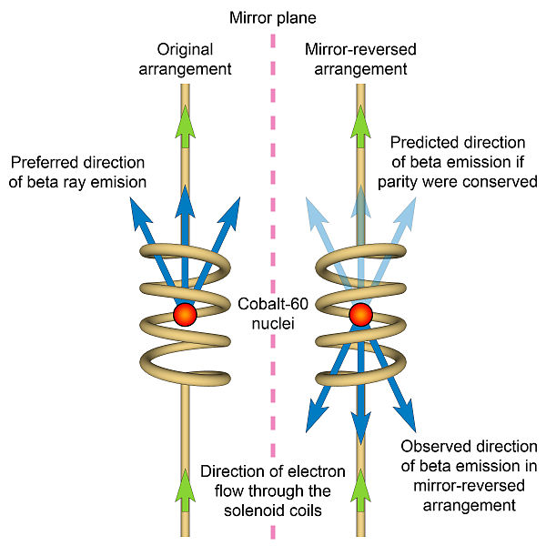
Parity Violation
Chien-Shiung Wu, 1963
http://commons.wikimedia.org/wiki/File:Chien-shiung_Wu_(1912-1997).jpg
http://commons.wikimedia.org/wiki/File:Wu_experiment.jpg

Slide 22
CPT
Fundamental symmetry transformations:
Charge
Parity
Time
+
+
+
+
+
+
−
−
Individual symmetries violated
Product of all three– “CPT” symmetry– preserved

Slide 23
CPT
Fundamental symmetry transformations:
Charge
Parity
Time
+
+
+
+
+
+
−
−
Many atomic selection rules are parity-based

Slide 24
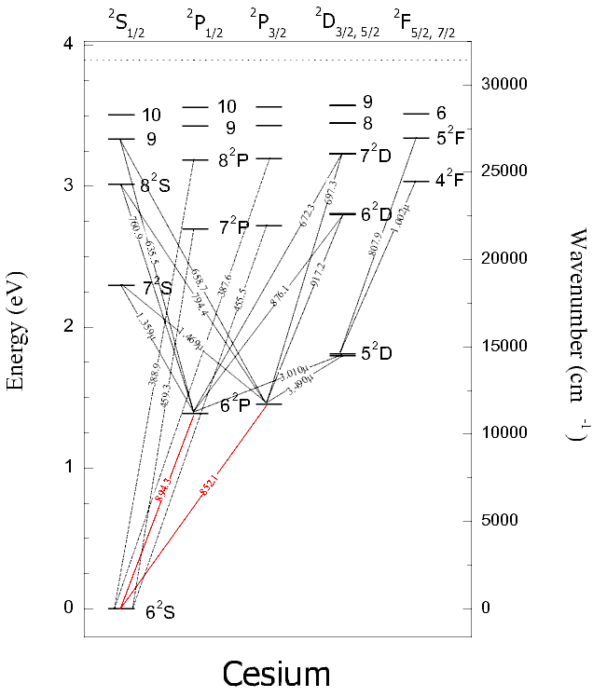
Parity Violation in Atoms
Simplest search for exotic physics:
Look for transitions that shouldn’t happen
Example: 6S→7S in Cs
First measured (in Cs):
1982 Bouchiat et al.

Slide 25
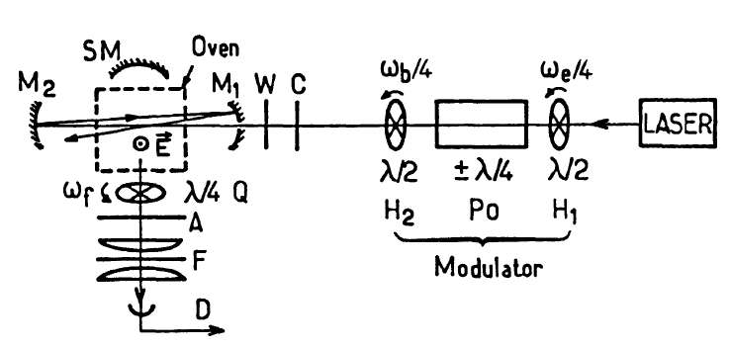
Parity Violation in Cesium
Principle of measurement:
Use green laser to excite forbidden transition
1360 nm
Look at fluorescence from allowed transition
539.4 nm
Technical details:
Apply electric field to define preferred direction
Field mixes states, allowing some transition
Parity violation rotates polarization of light

Slide 26
Parity Violation in Atoms
Simplest search for exotic physics:
Look for transitions that shouldn’t happen
Example: 6S→7S in Cs
First measured (in Cs):
1982 Bouchiat et al.
Current most precise (Cs):
1.5935±0.0056 mV/cm
(Boulder 1997)
➔ 10⁻¹¹ times allowed transition

Slide 27
Atomic Parity Violation and New Physics
Parity violating transitions test electroweak physics
Weak interactions allow parity violation (as in Wu experiment)
➔ compare measured values to SM predictions
➔ Very theory-dependent
Catch-22: Parity violation enhanced in heavy atoms (~Z³)…
…but necessary theory much harder in heavy atoms
Cesium: current best, because it’s a “one-electron” atom

Slide 28
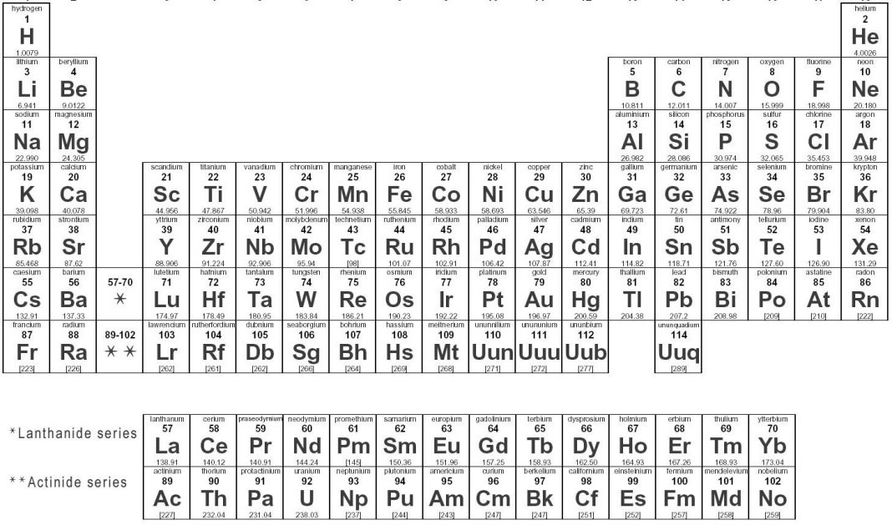
Francium
Atomic theory simpler in “one-electron” atoms➔ alkali metals
➔ Do APV measurements in francium
PROBLEM: No stable isotopes of Fr
Fr

Slide 29
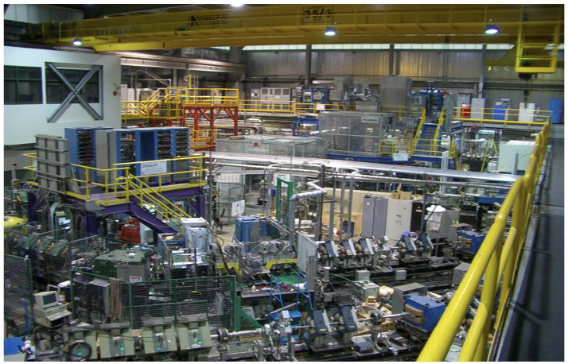
Francium Trapping
Produce Fr isootpes in accelerator at TRIUMF
Laser cool, trap, do spectroscopy
Image source: L. Orozco
http://www.physics.umd.edu/rgroups/amo/orozco/results/2012/CAARI12.pdf

Slide 30
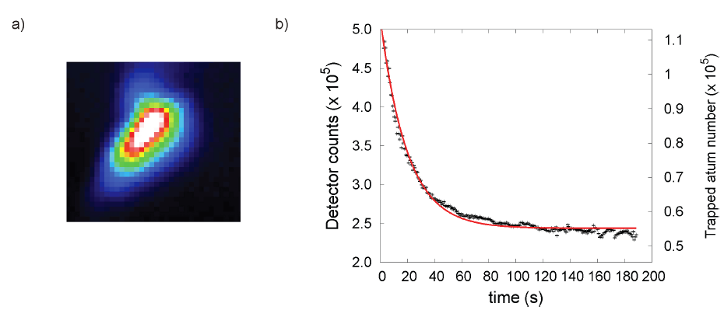
Francium Trapping
100,000 ²⁰⁹Fr atoms
Trapped for ~20s
From Tandecki et al., arXiv:1312.3562 (2013)

Slide 31
Atomic Parity Violation and New Physics
Parity violating transitions test electroweak physics
Weak interactions allow parity violation (as in Wu experiment)
➔ compare measured values to SM predictions
➔ Very theory-dependent
Catch-22: Parity violation enhanced in heavy atoms (~Z³)…
…but necessary theory much harder in heavy atoms
Cesium: current best, because it’s a “one-electron” atom
Other elements have larger APV effects:
Thallium, Bismuth, Ytterbium,…

Slide 32
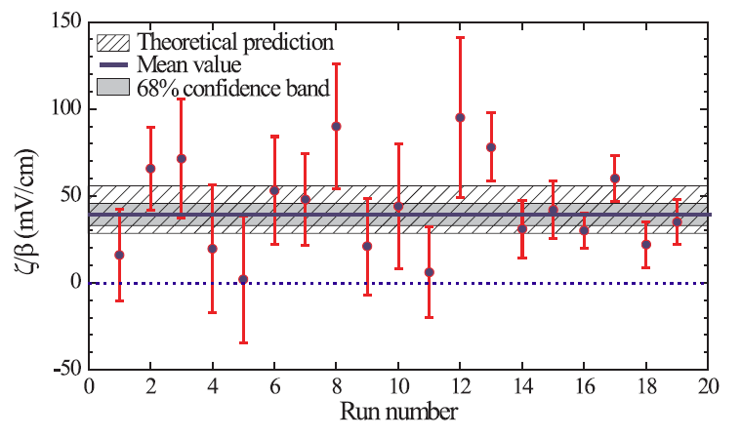
Parity Violation in Yb
Budker group at UC-Berkeley, 2009
100x bigger
APV than Cs
From Tsigutkin et al., PRL 103, 071601 (2009)

Slide 33
Parity Violation Prospects
No signs of new physics
…yet
Incremental improvements:
Better measurements
➔ steady technical improvements
Closely linked
Better theory
➔ dominant source of uncertainty
More drastic changes:
Different atomic systems
Bigger effects in Tl, Yb, Fr, Ra⁺…
Multiple isotopes allow investigation of nuclear effects
Change to measuring frequency shift, rather than probability
…about which more later…

Slide 34
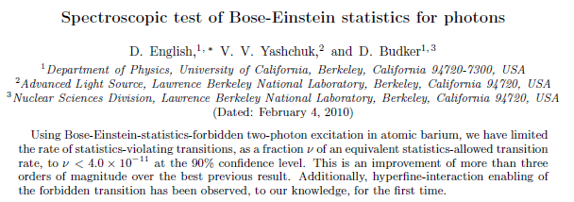
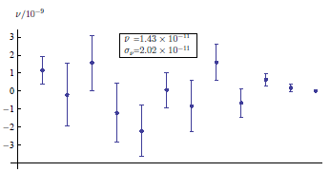
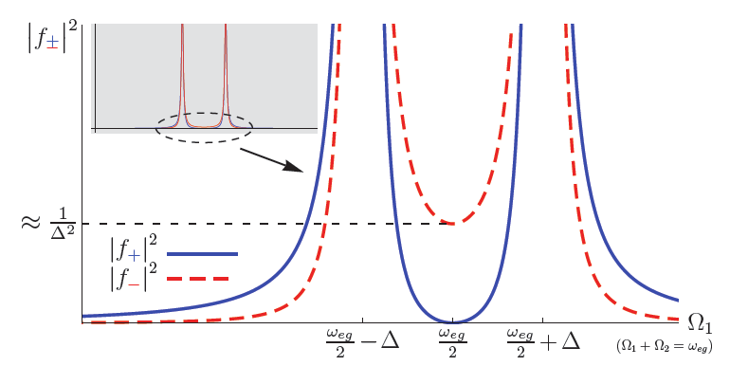
Other Things That Shouldn’t Happen
http://arxiv.org/abs/1001.1771

Slide 35
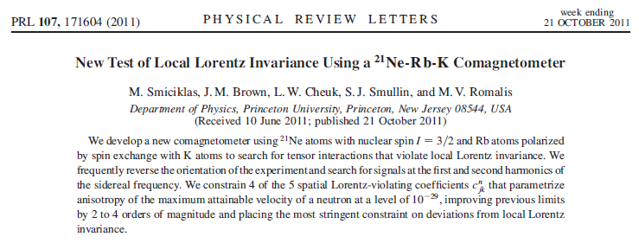
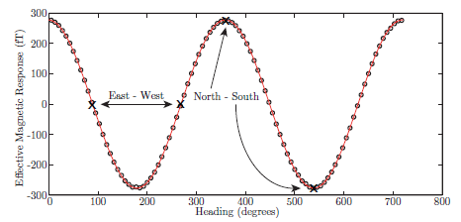
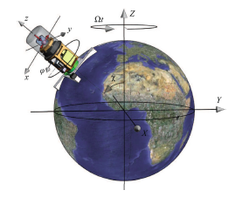
Other Things That Shouldn’t Happen

Slide 36
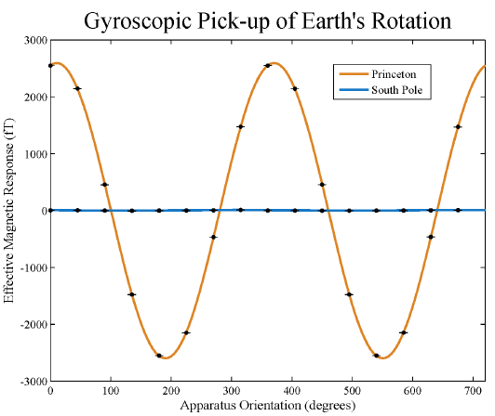
Location, Location, Location
Factor of 26,000
improvement

Slide 37
New Physics from Forbidden Events
Parity-Violating Transitions
➔ Observed, levels consistent with Standard Model
Photon Statistics, other departures from normal
➔ No sign, consistent with Standard Model
Lorentz/ CPT symmetry violation
➔ No sign, consistent with Standard Model
➔ Standard Model holding strong…
… but more stringent tests possible
➔ frequency shift measurements

Slide 39
Names to Conjure With
Experiment
Theory
Michael Romalis
http://physics.princeton.edu/romalis/
Andrei Derevianko
http://www.dereviankogroup.com/
Dmitry Budker
http://budker.berkeley.edu/
Marianna Safranova
http://www.physics.udel.edu/~msafrono/
Luis Orozco
http://www.physics.umd.edu/rgroups/amo/orozco/
Alan Kostelecky
http://www.physics.indiana.edu/~kostelec/faq.html
Larry Hunter
https://www.amherst.edu/people/facstaff/lrhunter/
DISCLAIMER: This is a highly biased selection from a larger
community, and not a complete list by any means

Slide 40
Old Physics
1913: Bohr model
Electrons restricted to special orbits
Absorb/emit light when moving between allowed states
$$E_{n}=− \frac{E_{1}}{n^{2}}$$
Energy of n^{th} state:
Energy of light:
$$hf={|E}_{final}−E_{initial}|$$
Scale: E₁ ~ 10 – 1 eV
f ~ 10¹⁵ – 10¹⁴ Hz
λ ~ 100 – 1000 nm

Slide 41
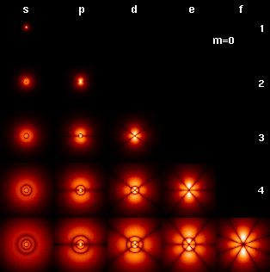
Old Physics
~1930: Fine structure
Additional effects shift energy states
➔ Relativity
➔ “Spin-orbit” interaction
Fine structure constant
$$α=\frac{1}{4πε_{0}} \frac{e^{2}}{ℏc} \sim \frac{1}{137}$$
Scale: ΔE_{fs} ~ Z²α² E ~ 10⁻⁵ – 10⁻² eV
Δf _{fs}~ 10¹⁰ – 10¹³ Hz
Δλ_{fs} ~ 0.01 – 10 nm

Slide 42
Old Physics
~1920’s: Hyperfine structure
Electron, nucleus act like magnets
Spin-spin interaction
Split “spin up” and “spin down”
Important technologies:
“21-cm line” in H: Radio astronomy, NMR
Cs ground state: Atomic clocks, GPS
Scale: ΔE_{hfs} ~ Zα² $\frac{m_{electron}}{m_{proton}}$ E ~ 10⁻⁵ – 10⁻⁸ eV
Δf_{hfs} ~ 10⁷ – 10¹⁰ Hz
Δλ_{hfs} ~ 0.01 – 10 cm

Slide 43
Atoms and Light
Everything we know about atoms and molecules comes from studying how they interact with light
Simplest picture: Fully Quantum
Atoms have discrete energy states
Light is stream of photons with discrete energy
Photon energy = Difference between states
$${|E}_{final}−E_{initial}|=hf$$

Slide 44
Atoms and Light II
Second-simplest picture: Einstein 1917
Three processes:
1) Spontaneous emission
A₂₁
B₁₂
B₂₁
Atoms in higher-energy states emit light, drop down
2) Resonant absorption
Atoms in lower-energy states absorb light, move up
A and B coefficients
3) Stimulated emission
➔ probability of each
Atoms in higher-energy interact with light, emit more, drop down
➔ relationship between

Slide 45
Atoms and Light III
Most complicated picture: Rabi Oscillations
“Semi-classical” treatment:
Atoms have discrete states
Light treated as wave
(Must work when N_{photons} >> 1 )
Qualitative features:
1) Atoms oscillate between ground & excited states
2) Oscillation at “Rabi Frequency” Ω
$$Ω\sim \sqrt{Intensity}$$
3) Atoms in coherent superposition of states

Slide 46
Rabi Oscillations
Slow decay
➔ decoherence
Fast oscillations
➔ Driving

Slide 47
Atoms and Light III
Most complicated picture: Rabi Oscillations
$$Ω\sim \sqrt{Intensity}$$
Rabi oscillations allow complete control of atomic state
➔ Know laser power, know time needed to prepare any arbitrary superposition of states
Key terms:
“π-pulse” ➔ drive all atoms from one state to other
“π/2-pulse” ➔ drive all atoms into equal superposition of two states

Slide 48
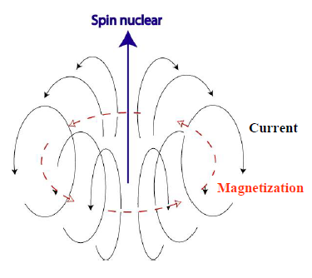
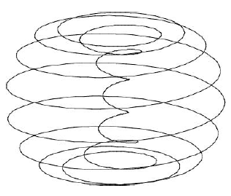
Anapole Moment

