Slide 1
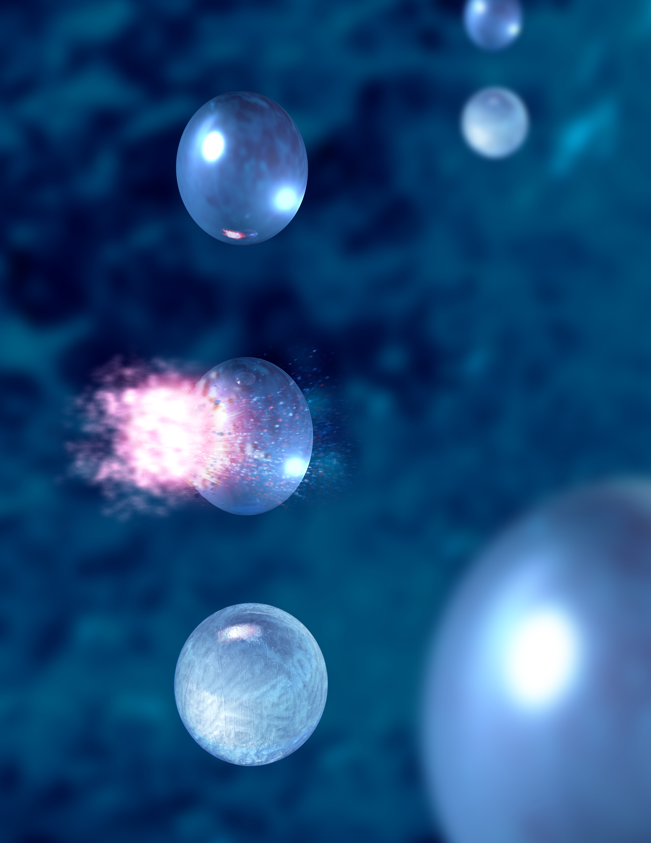
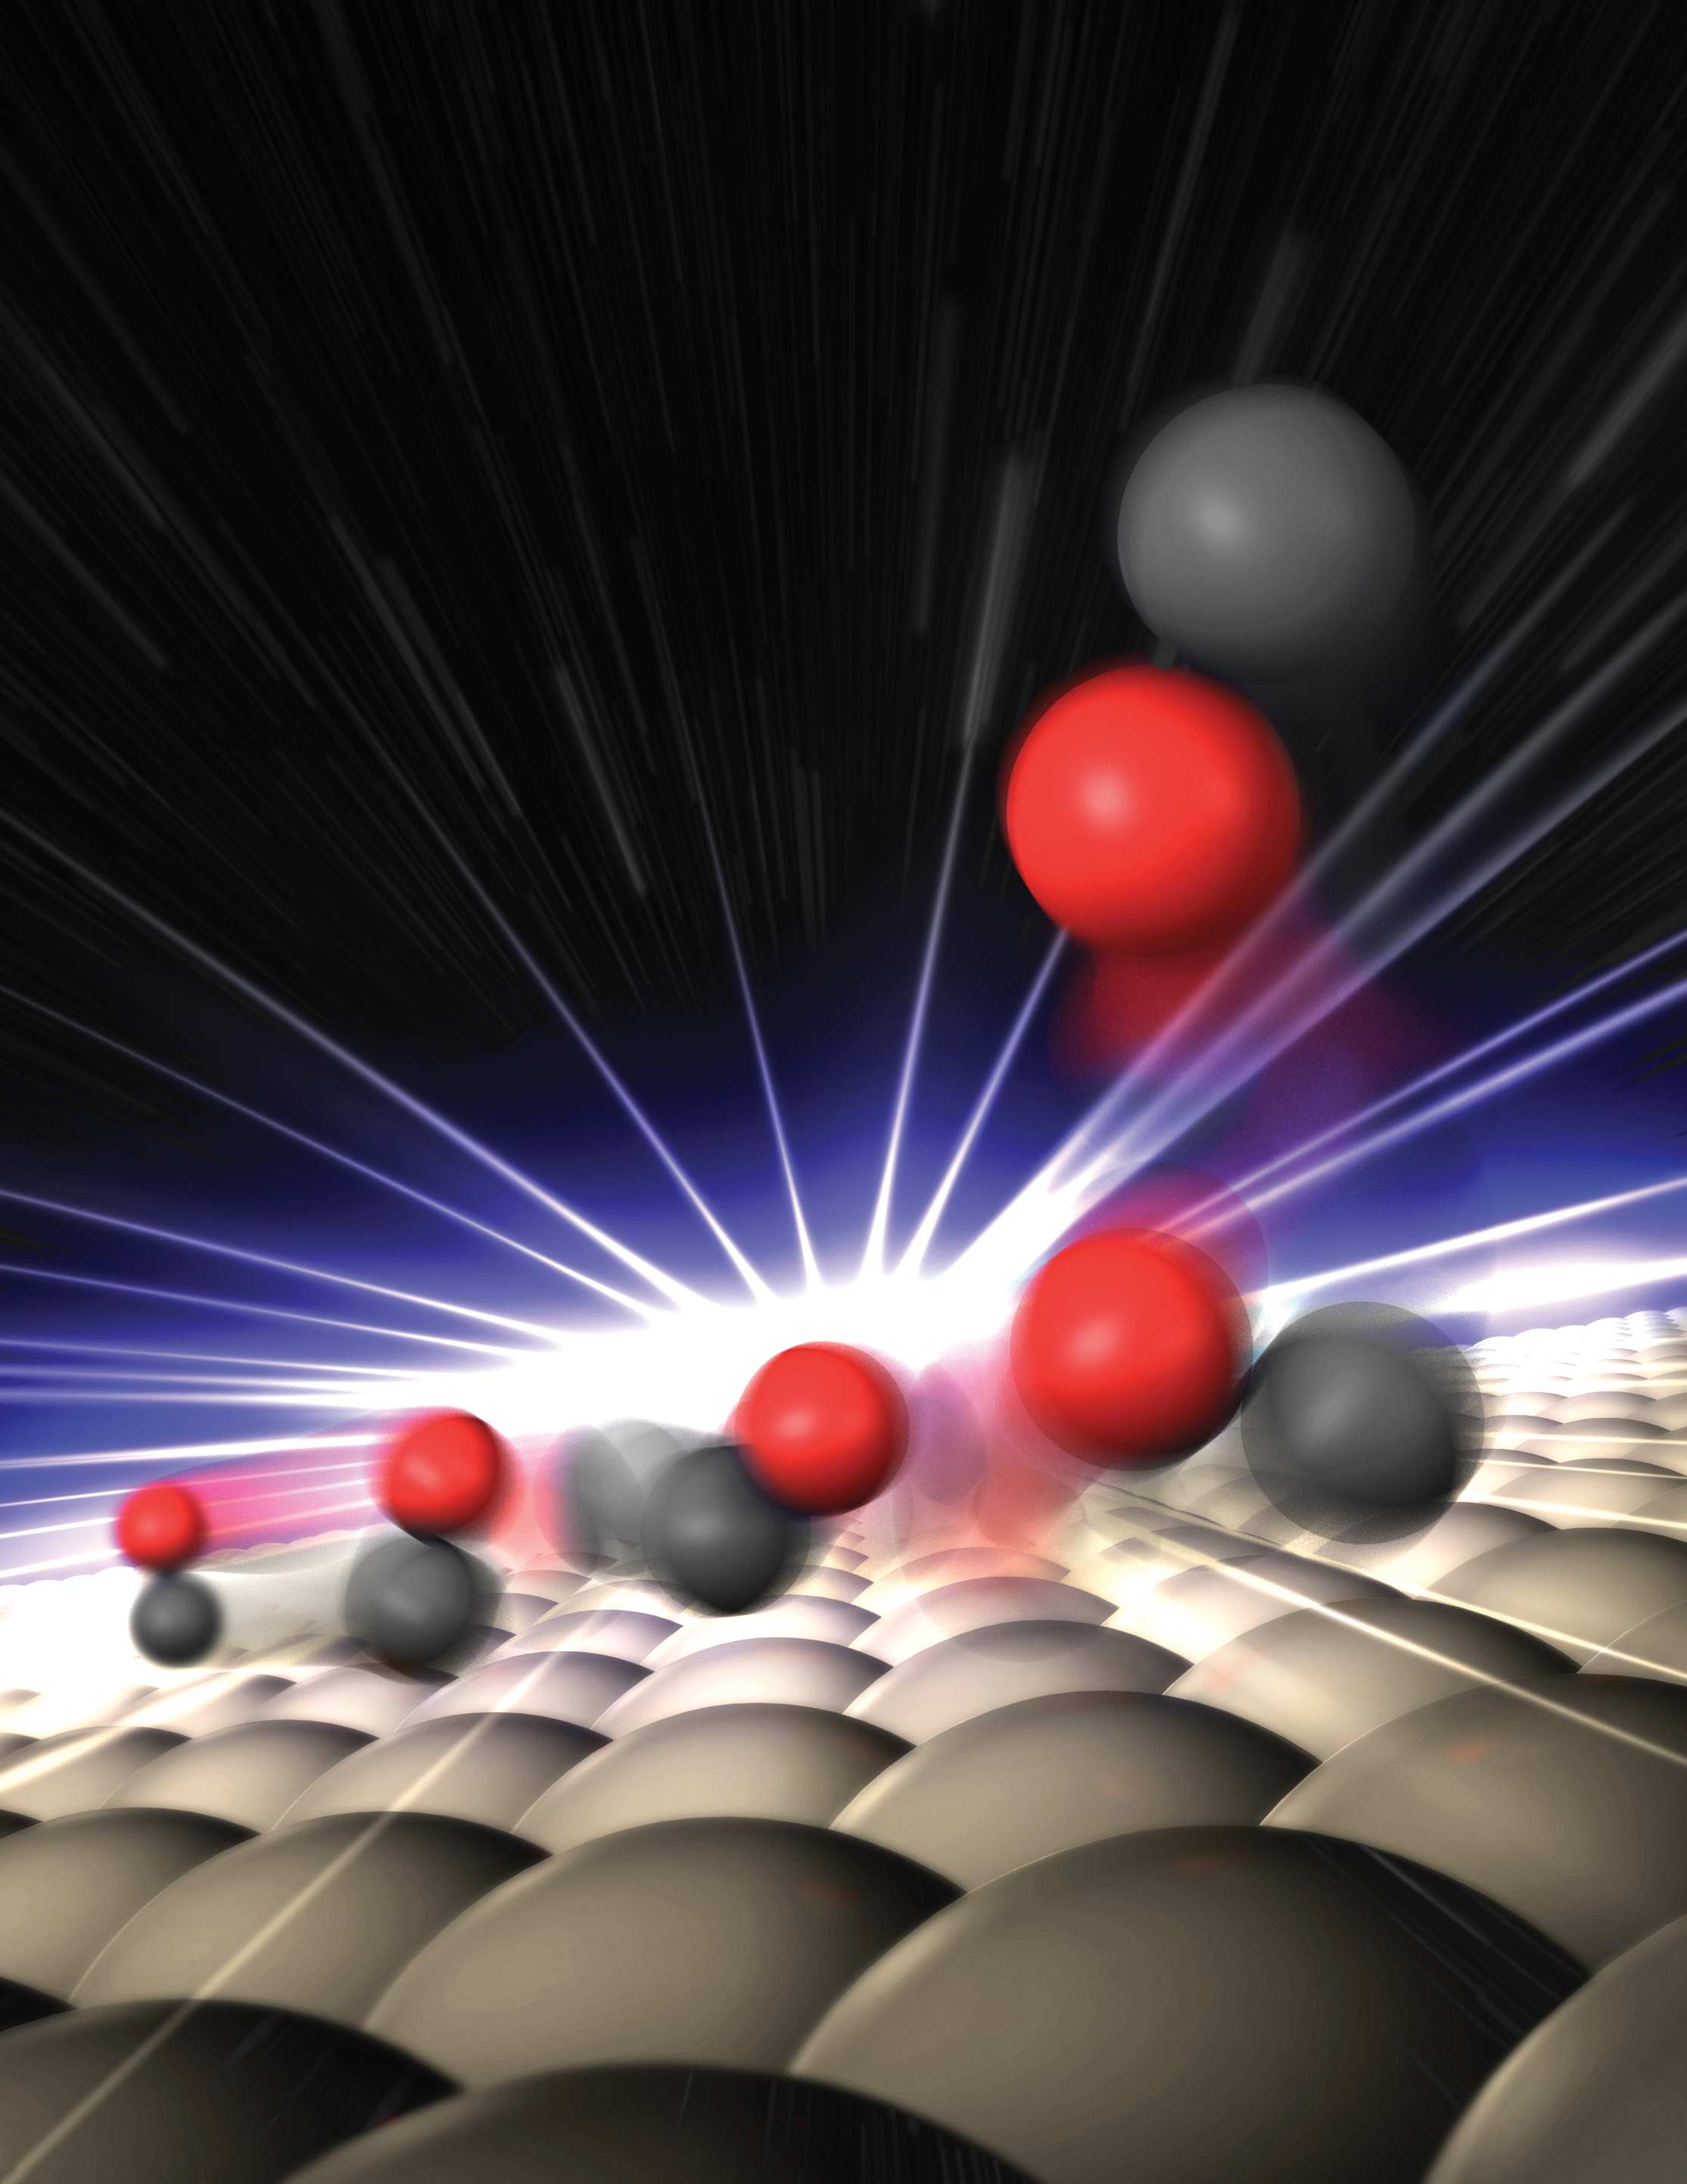
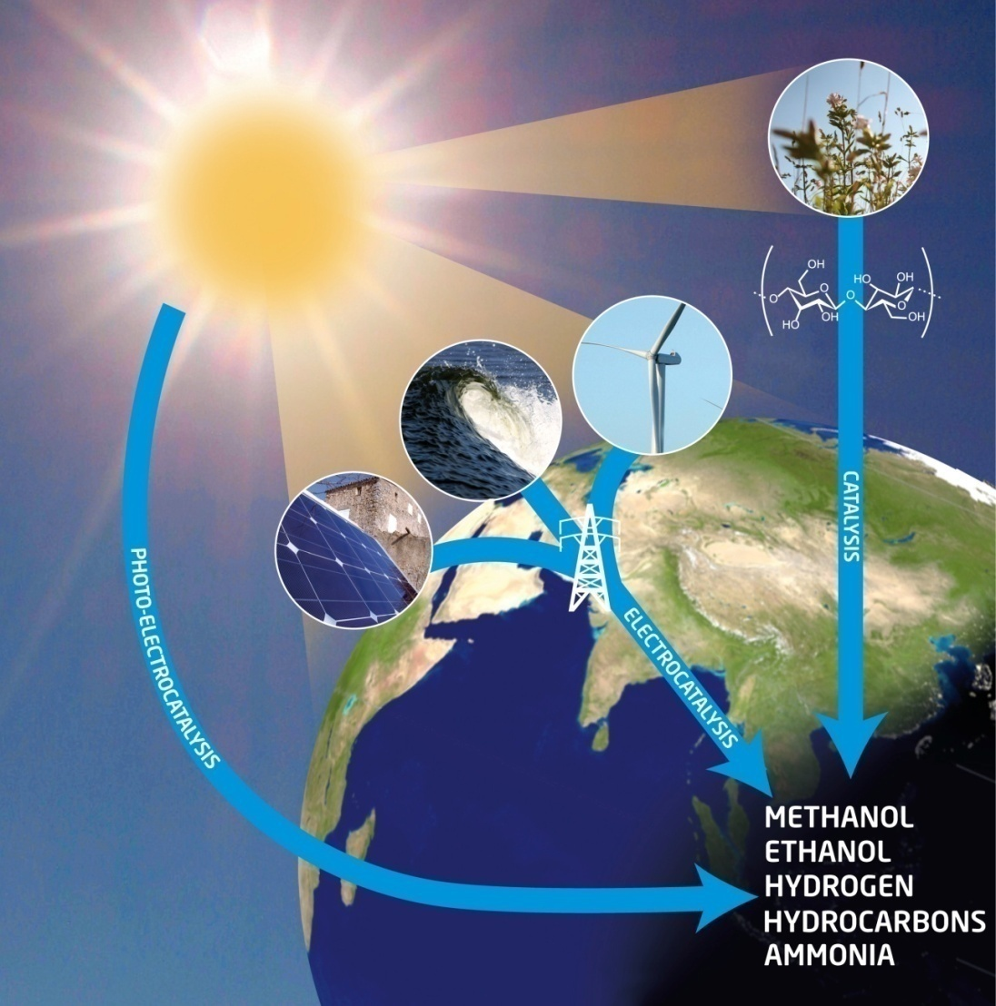


Fundamental Studies of Surfaces and Liquids with X-rays;
Need for New Instrumentations
Anders Nilsson, Chemical Physics, FYSIKUM, SU
Water
Surface Chemistry
Catalysis and Energy

Slide 2
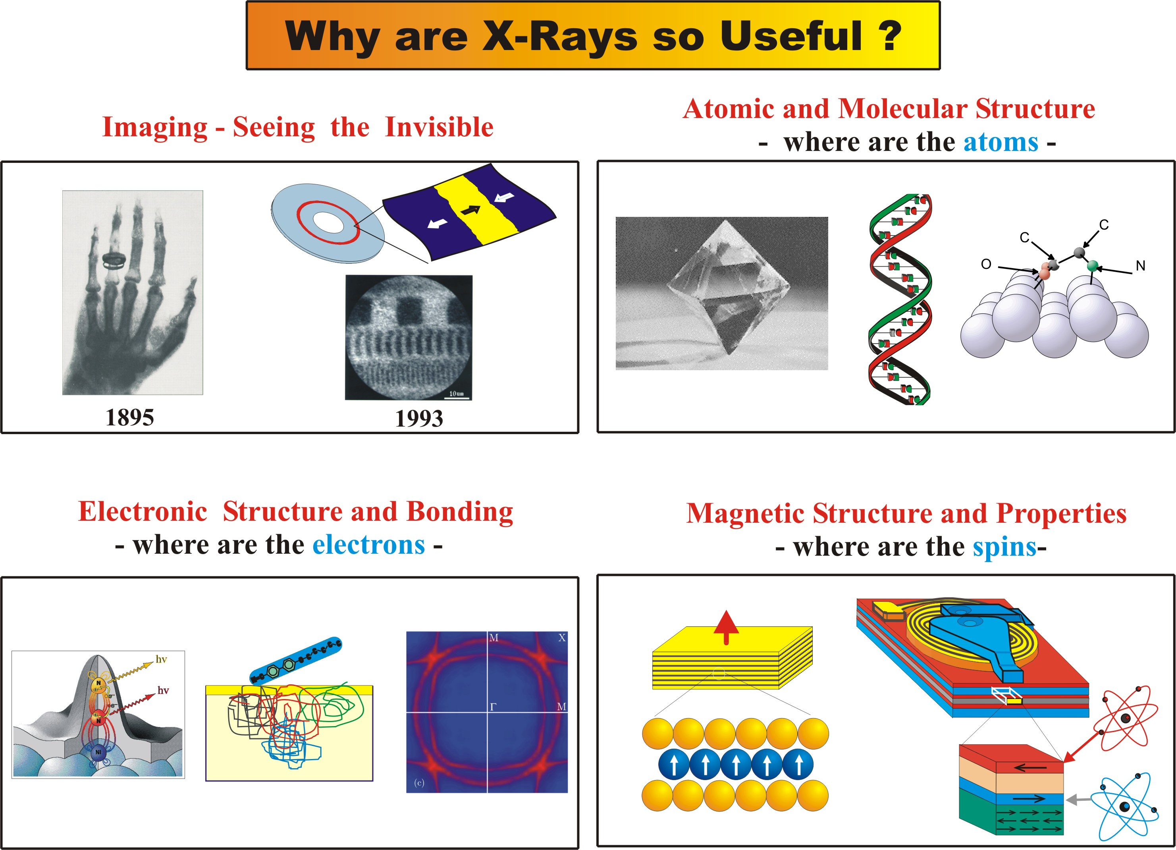

Slide 3
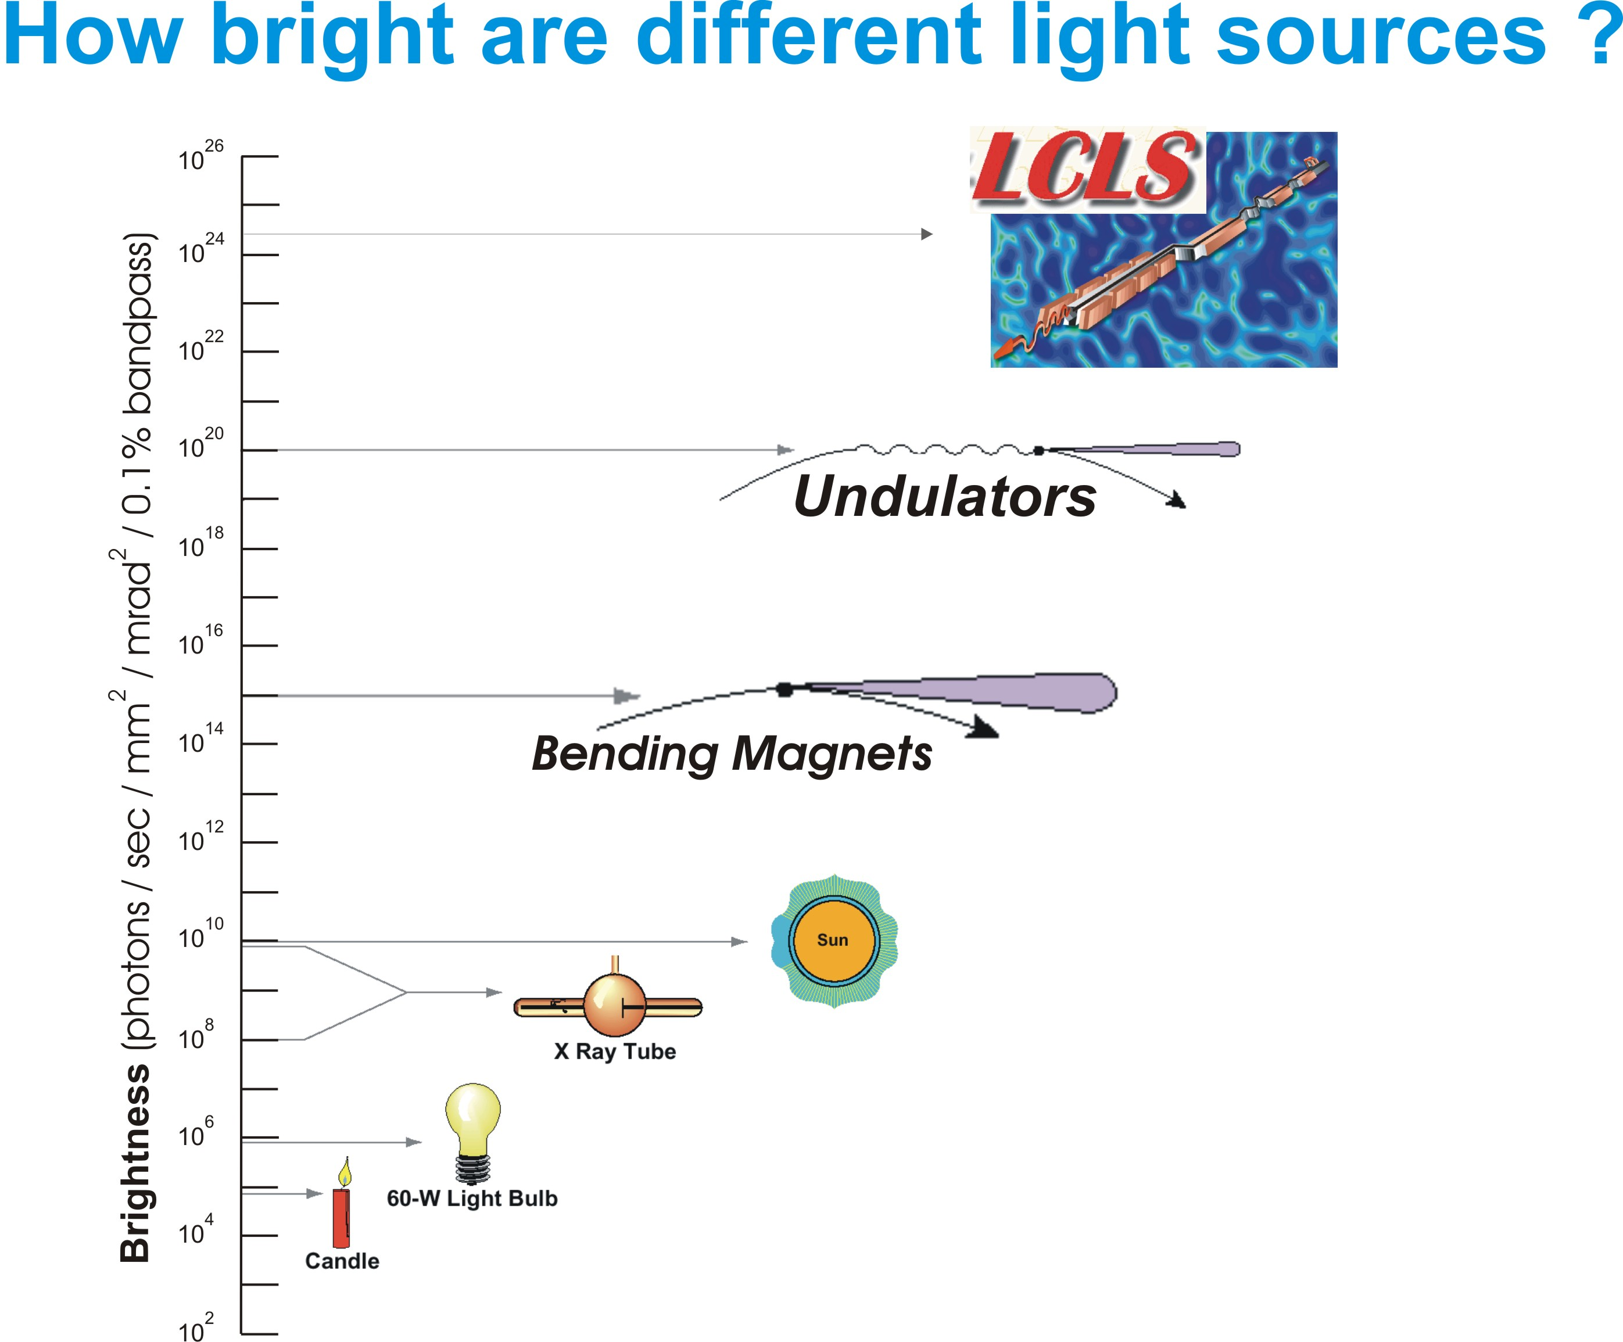

Slide 4
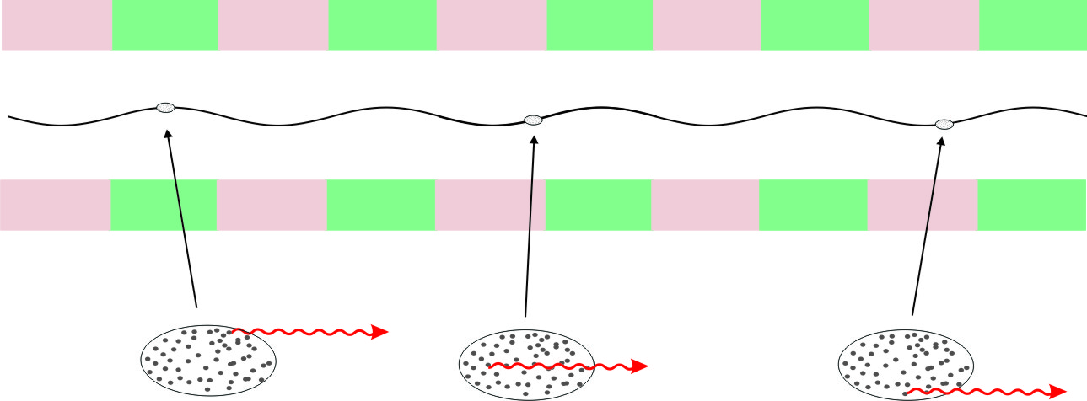
Synchrotron radiation from undulator in storage ring
Electron bunch is “stored” in ring and used over and over…..
electron bunch
~ 1cm long
Each bunch contains N_{e} ~ 10⁹ electrons
…but electrons emit spontaneously
photons not coherent
Intensity limited by independent photon emission – scales as N_{e}

Slide 5
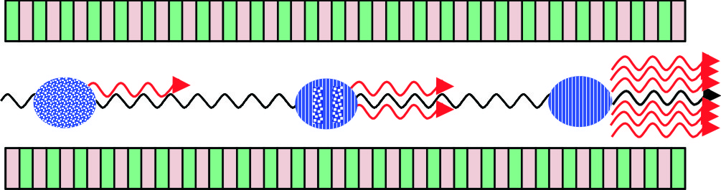
Concept of a free electron x-ray laser
Replace storage ring by a linear accelerator
allows compression of electron bunch – use once, then throw away
Send electron bunch through a very long undulator
very short
bunch length
micrometers
spontaneous photons
from back of bunch
create order
ordered electrons
enhance stimulated
photon emission
amplified photons
completely coherent
Intensity scales as N_{e}² or increased by 10⁹

Slide 6
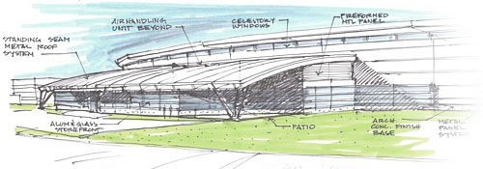
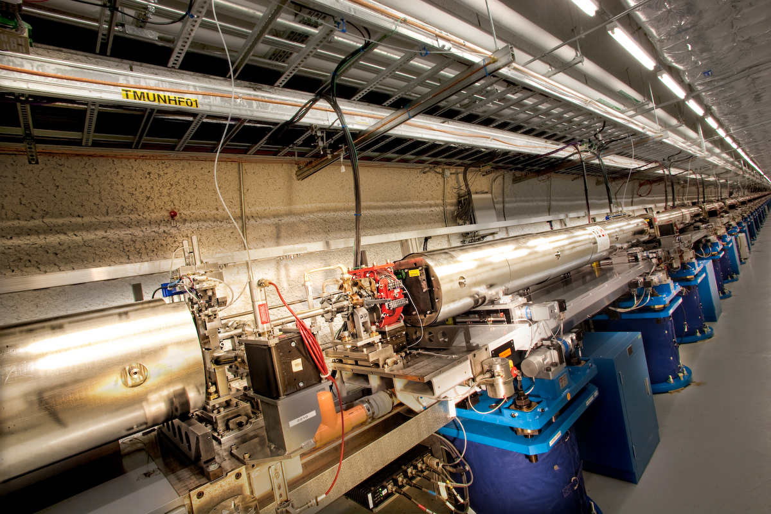
storage rings and x-ray lasers today
Storage
Rings
~ps
~ns
nJ/pulse
NSLS-II
~ms
FELs
~fs
mJ/pulse
LCLS
comparable average power

Slide 7
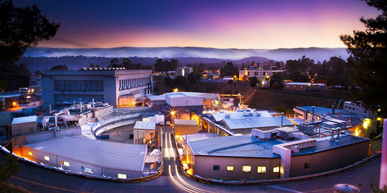
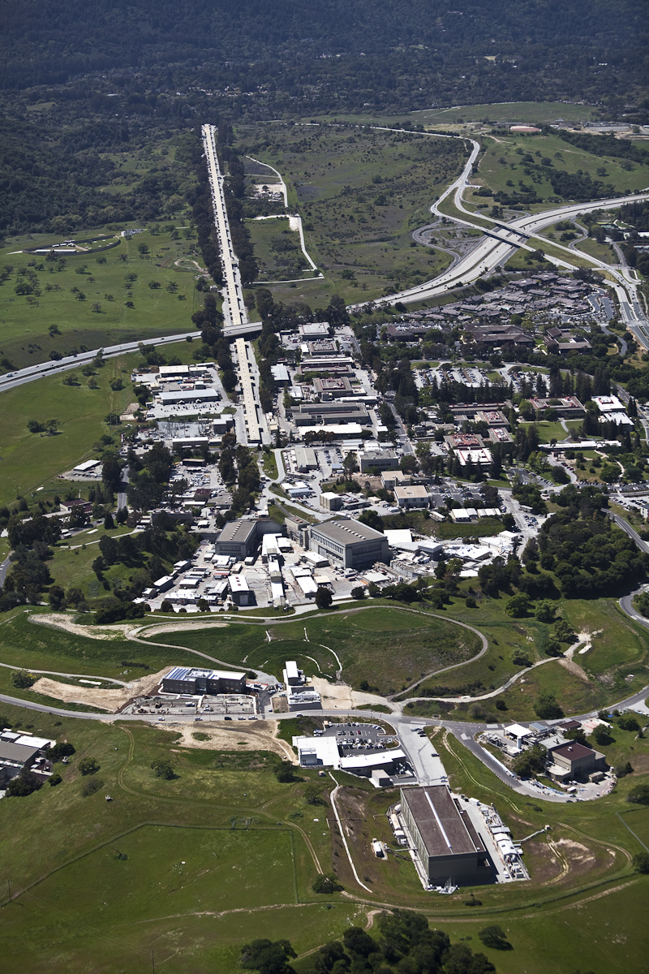
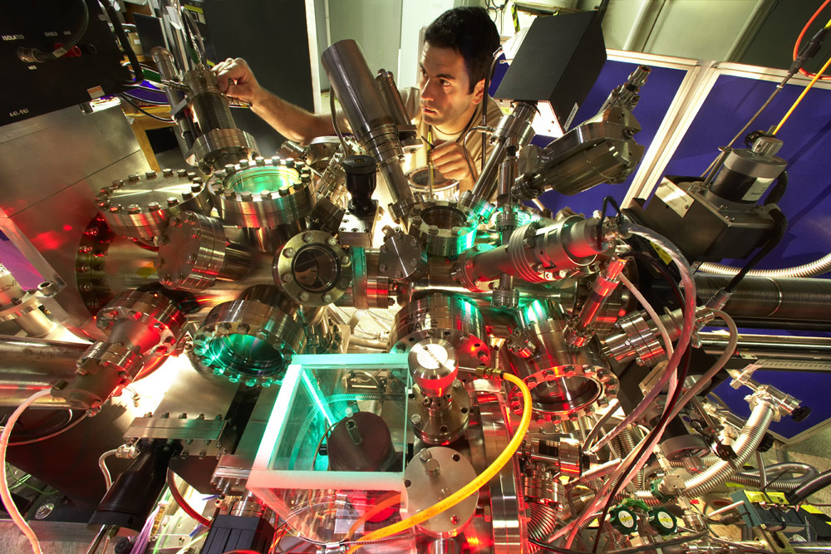
X-ray Facilities at Stanford
Synchrotron Radiation
LCLS X-ray Laser
LCLS uses only
1/3 of linac
electron beam
undulator hall
x-ray production
near hall
3 experiments
far hall
3 experiments

Slide 8
Linac Coherent Light Source
LCLS uses only
1/3 of linac
Electron Energy: 15 GeV
Photon Energy: 0.5-10 keV
Pulse length: 5-500 fs
Flux: 10¹²
Frequency: 120 Hz
E. Bandwidth: 0.1-2%
Machine Length: 2 km
electron beam
undulator hall
x-ray production
near hall
3 experiments
x-ray beam
far hall
3 experiments

Slide 9
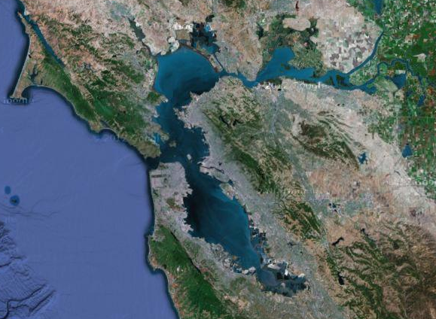
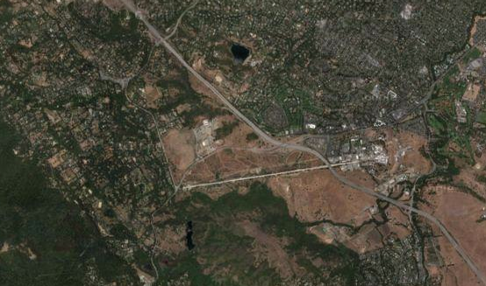
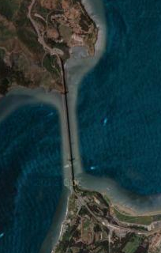
Bay area
Golden Gate
Bridge
LINAC

Slide 10
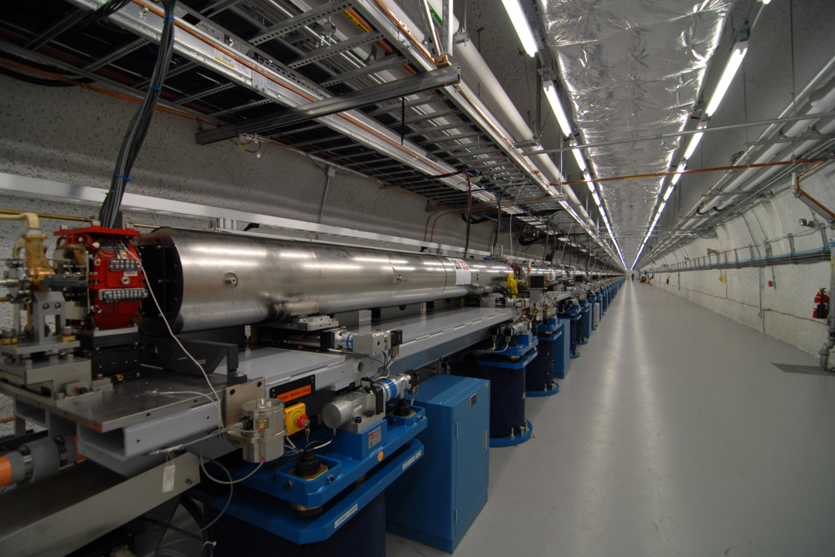
132 meters of FEL undulators

Slide 11
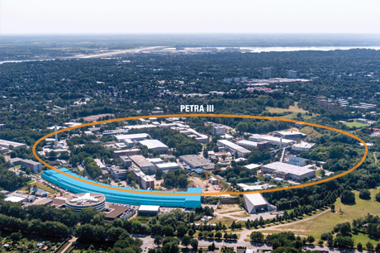
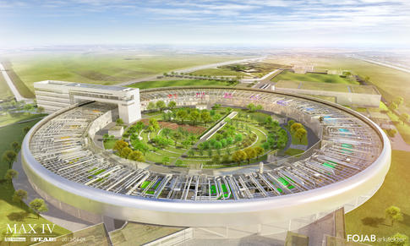
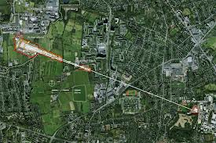
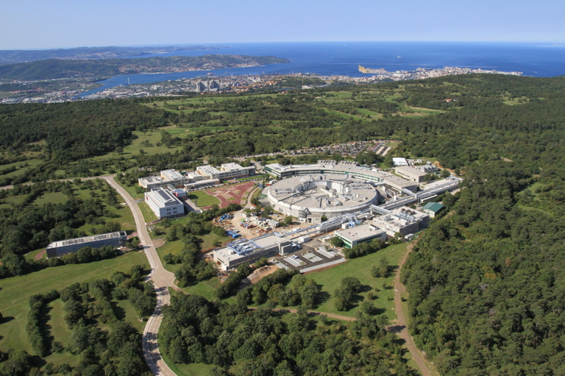
X-ray Facilities of Interest in Europe
SR PETRA in Hamburg
SR MAXIV in Lund
FEL FLASH and XFEL in Hamburg
FERMI in Trieste

Slide 12
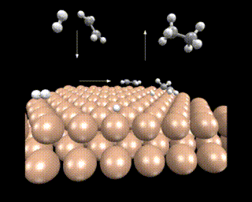
Ammonia feeds the world; Fertilizers
1-2 % of the global energy consumption
N₂+3H₂2NH₃
100
6
Haber Bosch Process
80
5
4
60
Consumption of nitrogen fertilizer
(megaton)
3
World population (billions)
40
2
20
1
Catalysis
0
0
Nobelprize 1918 and 2007
1900
1925
1950
1975
Year

Slide 13
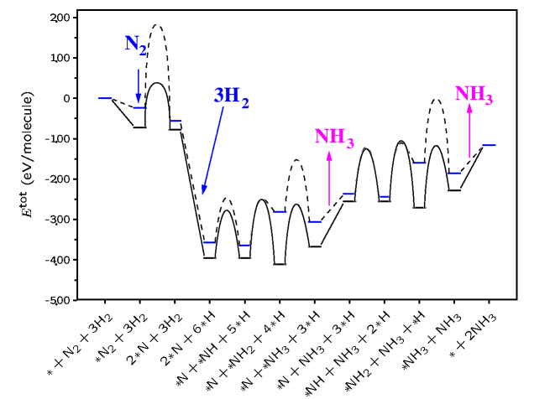
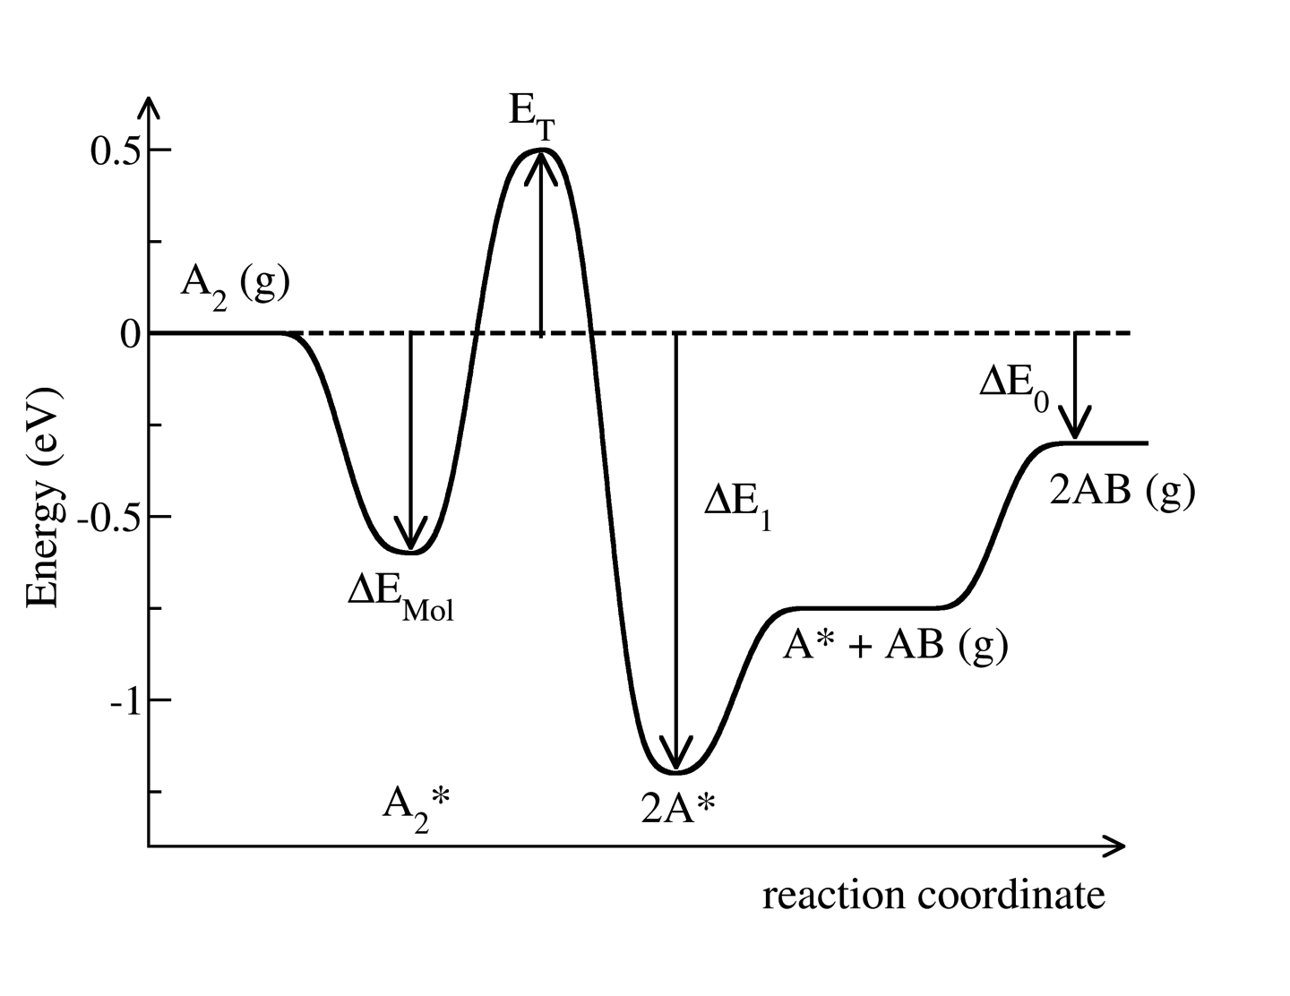
Reaction mechanism
Ru(0001)
step
N₂ + 2* 2N*
H₂ + 2* 2H*
N* + 3H* NH₃
dissociation rate limiting
hydrogenation rate limiting
Bligaard and Norskov in Chemical Bonding at Surfaces and Interfaces; Ed Nilsson, Pettersson and Norskov, Elsevier 2008

Slide 14
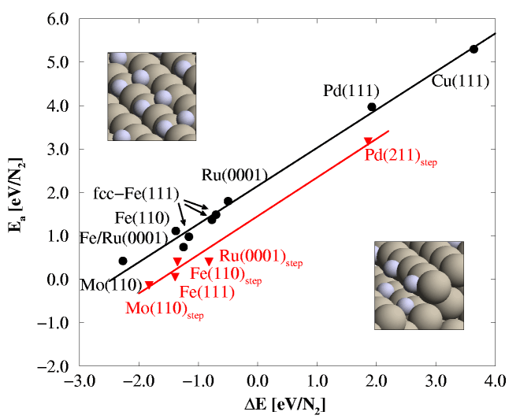
The Brønsted-Evans-Polanyi relation
Barrier for dissociation
Adsorption energy relative N₂
Logatottir, Rod, Nørskov, Hammer, Dahl, Jacobsen, J. Catal. 197, 229 (2001)

Slide 15
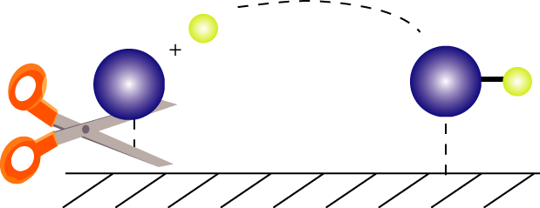
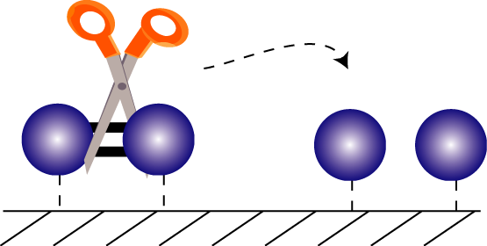
Calculated ammonia synthesis rates
400 C, 50 bar, H₂:N₂=3:1, 5% NH₃
limited by to
strong N adsorption
limited by the N₂
dissociation barrier
Logatottir, Rod, Nørskov, Hammer, Dahl, Jacobsen, J. Catal. 197, 229 (2001)

Slide 16
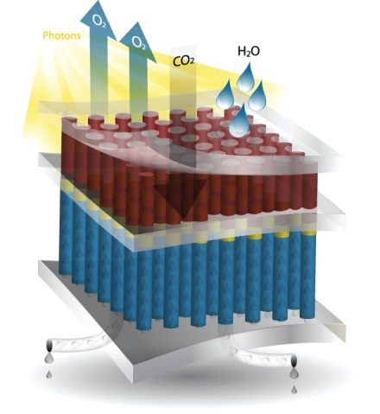
Sustainable fuels
Catalysis is key
  Biomass → fuels
  Electricity → fuels
  Direct sunlight → fuels (artificial photosynthesis)
Novel catalysts needed
  Made from Earth abundant materials

Slide 17
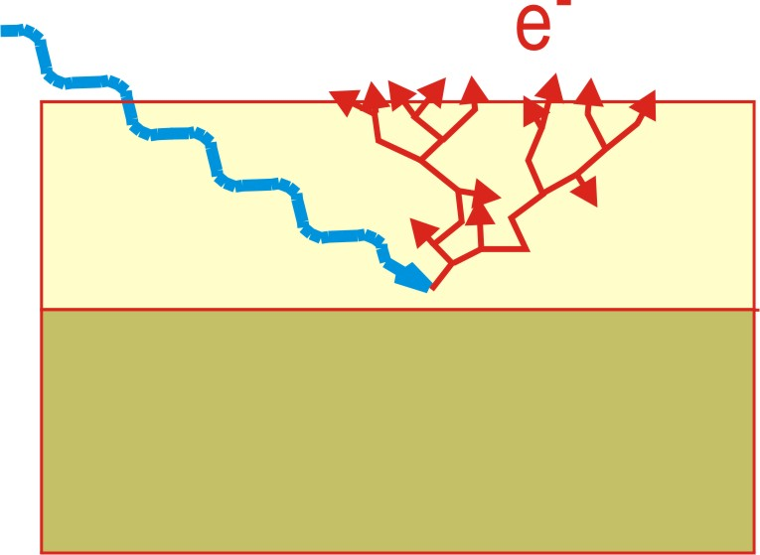
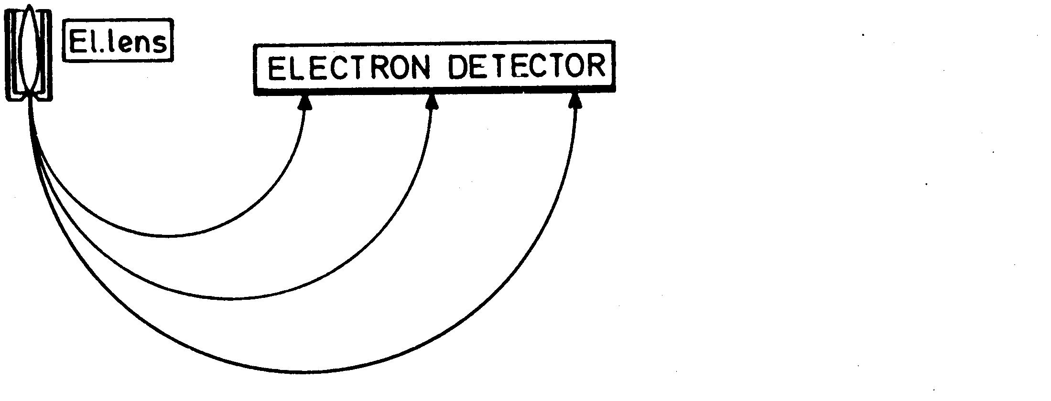
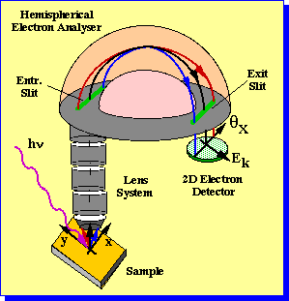
Fotoelektronspektroskopi
Electrons interact strongly
Surface Sensitivity
5-20 Å
Hufner, Photelectron Spectroscopy

Slide 18
Elektronspektroskopi vid höga tryck
Ambient pressure XPS (AP-XPS) at ALS BL 11.0.2
leak valve
H₂O
to pump
to pump
SiN_{x} window,
100 nm thick
spectroscopy chamber
p₀
p₁<< p₀
p₂<< p₁
preparation
chamber
p₀ = UHV…~ Torr
X-rays
Auger, LEED,
plasma gun
e⁻
p₁
sample temperature
100…1000K
p₂
load-
lock
X-rays from synchrotron
p₃
differential pumping
p_{H} ~ 10⁻⁹ p₀
Differentially-pumped electrostatic lens
allows operation at p(H₂O) < 5 Torr
(equilibrium vapor pressure of water at +1 ºC)
hemispherical
analyzer
References: D.F. Ogletree et al., Rev. Sci. Instrum. 73 3872 (2002).
H. Bluhm et al., J. Electron Spectrosc. Relat. Phenom. 150 86 (2006).
Notes:
The experiments were performed at the undulator beamline in the Advanced Light Source,
using a recently developed photoemission spectrometer that can operate at ambient pressures.
There are several requirements to measure XPS spectra at ambient conditions.
Electron spectrometer and the beamline should be kept in UHV.
We use the differentially-pumped lens system with a small nozzle and Silicon nitride window
for this purpose.
In addition, the sample is located very close to the aperture in order to minimize inelastic scattering of photoelectrons in the gas phase.
.

Slide 19
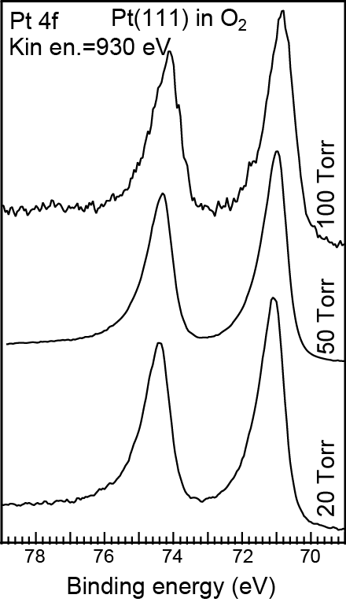
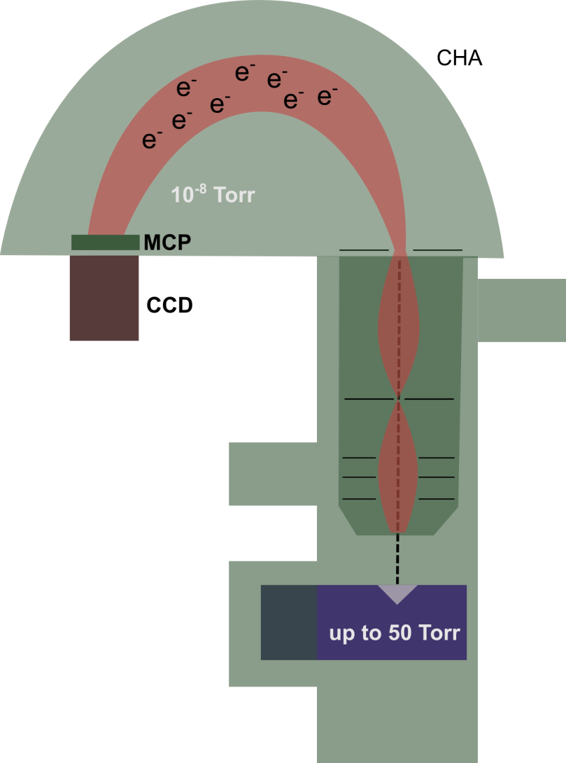
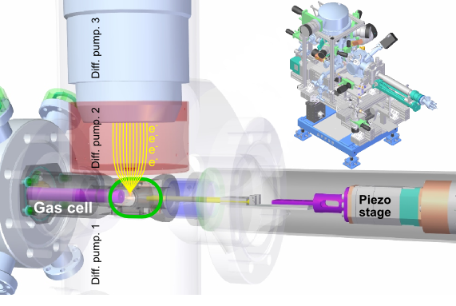
Instrument at Stanford
Kaya, Näslund, Ogasawara, Nilsson, Catal. Today 205, 101 (2013)

Slide 20
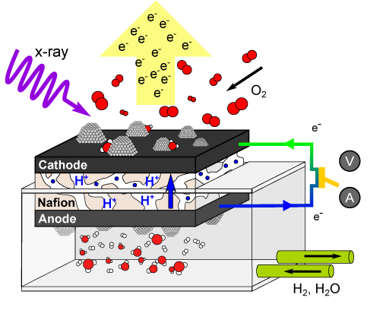
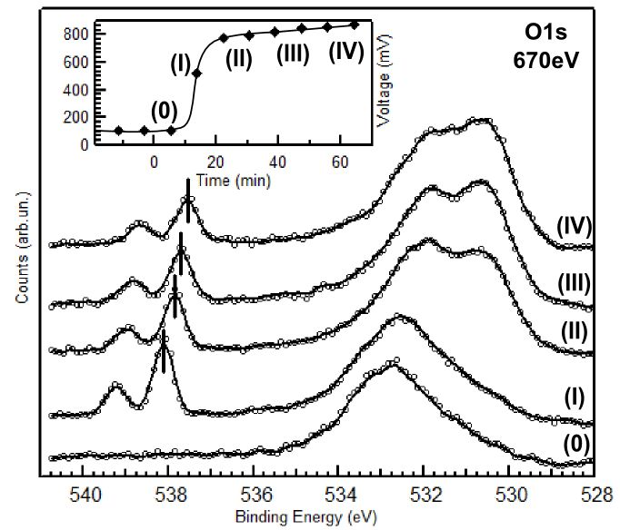
Ambient Pressure XPS: Electrochemical Cell
Demonstration of electrochemical cell
in XPS system
Probing oxygenated species
during the oxygen reduction reaction
r
H. S. Casalongue, S. Kaya, V. Viswanathan, D. J. Miller, D. Friebel, H. A. Hansen, J. K. Nørskov, A. Nilsson and H. Ogasawara, Nature Communication DOI 10.1038/ncomms3817

Slide 21
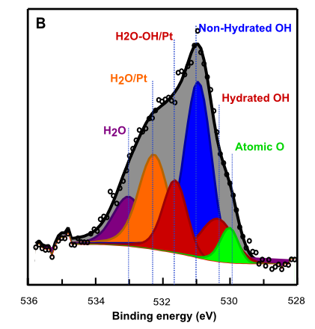
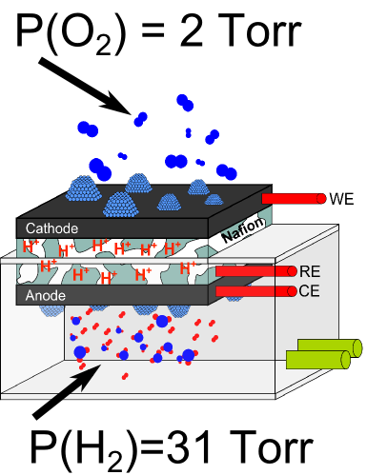
ORR Intermediates During Operating Fuel Cell
Non-hydrated OH at 0.9 V
H. S. Casalongue, S. Kaya, V. Viswanathan, D. J. Miller, D. Friebel, H. A. Hansen, J. K. Nørskov, A. Nilsson and H. Ogasawara, Nature Communication DOI 10.1038/ncomms3817

Slide 22
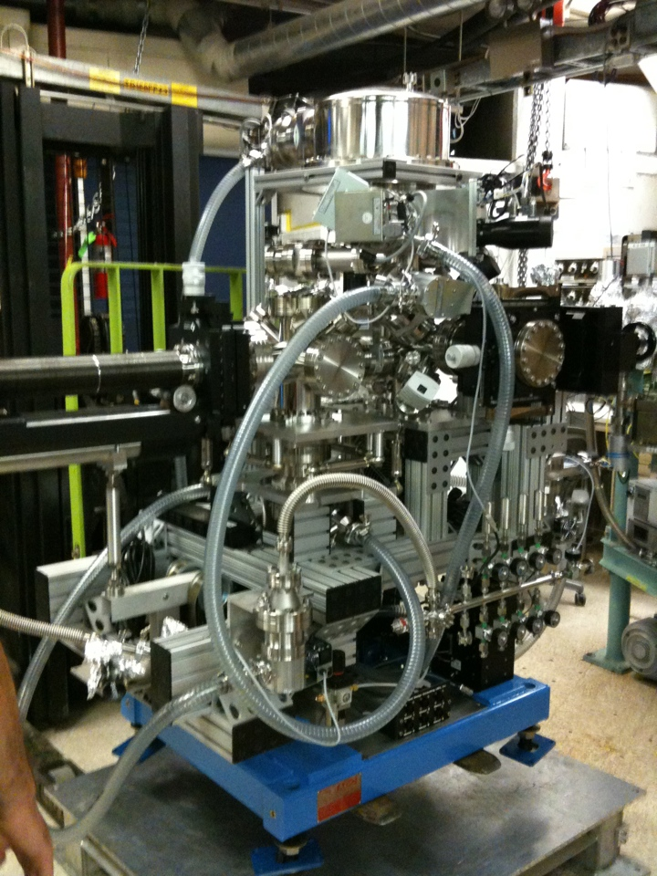
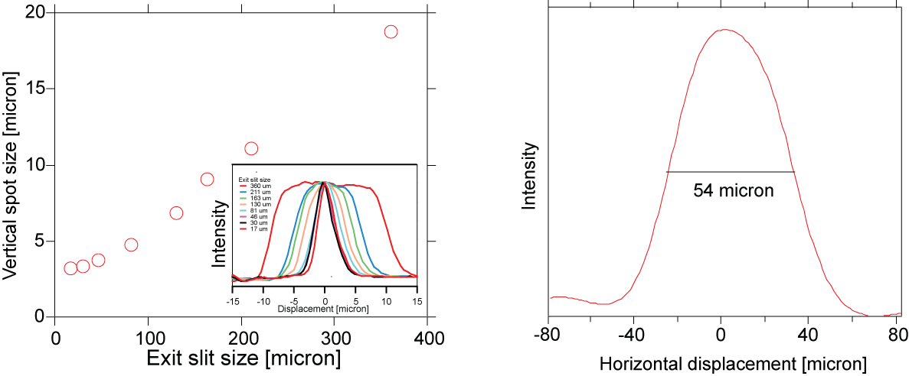
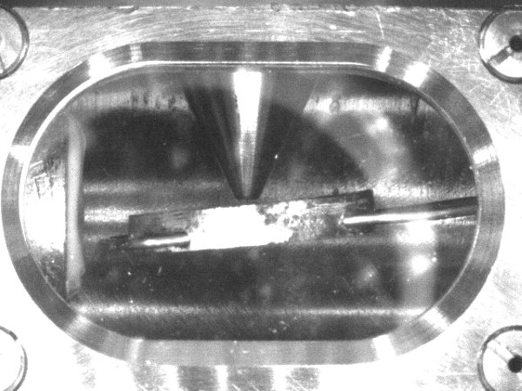
APXPS: Ambient pressure XPS
Chemical state analysis under near reaction condition, ~100 torr
APXPS@BL13-2
5 x differential pumps
Small beam size, ~5(V) x ~50 micron
small orifice
SR beam
sample

Slide 23
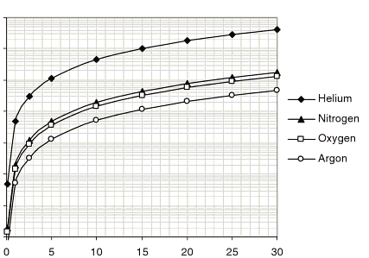
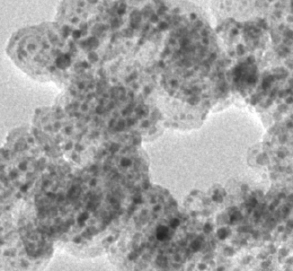
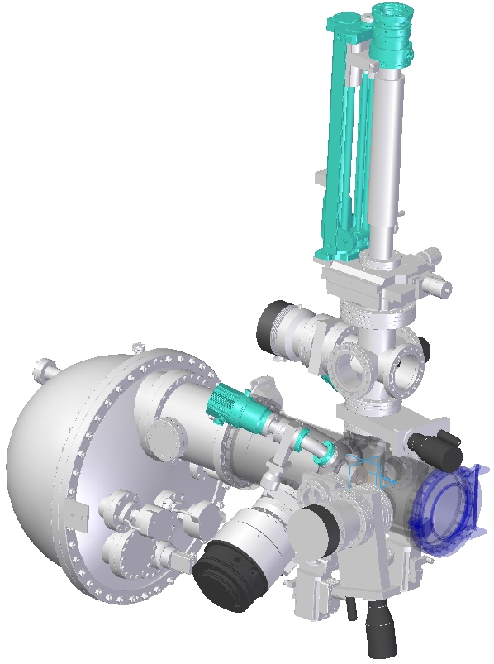
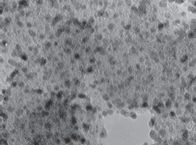
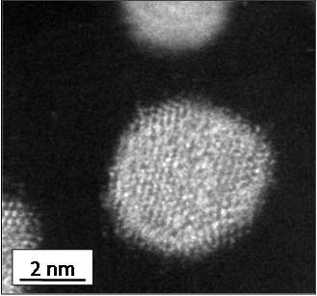
Future: ambient (or atmospheric) pressure ‘hard x-ray’ XPS hard x-ray, high kinetic energy e⁻, long mean free path
10
10
1
1
7500 torr
Elastic mean free path/mm
BL15
0.01
750 torr
0.01
75 torr
e⁻ kinetic energy/eV
BL13-2
0.0001
7.5 torr
0.0001
Electron kinetic energy/kV
new analyzer for ‘hard x-ray’ XPS
Atmospheric pressure, supported metal catalyst
AP ’hard x-ray’ XPS@BL15
$$$: Joint Center for Artificial Photosynthesis (JCAP)

Slide 24
Specifications for new instrument
Goal to Reach a pressure of 10 bar
Develop a new differential pumping system together with Scienta
Transportable
Should also be used for ultrafast studies
First placed at PETRA III in Hamburg and also for FLASH and XFEL usage
When beamline exists at MAXIV it will be placed there

Slide 25
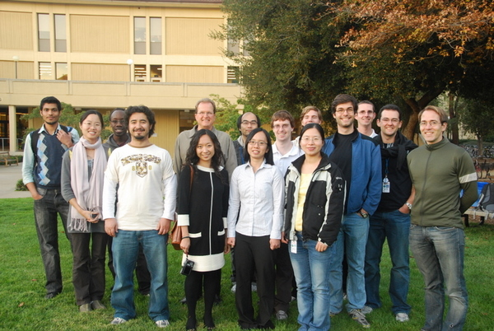
Co-workers
Experiment:
Dr. Daniel Friebel
Dr. Sarp Kaya
Dr. Hirohito Ogasawara
Hernan Sanchez
Daniel Miller
Theory:
Venkat Viswanathan
Jens Nørskov
Funding BES DOE

Slide 26
Real-Time Observation of
Surface Bond Breaking with an X-ray Laser
Science 339, 1302 (2013)
illustration Gregory Stewart SLAC

Slide 27
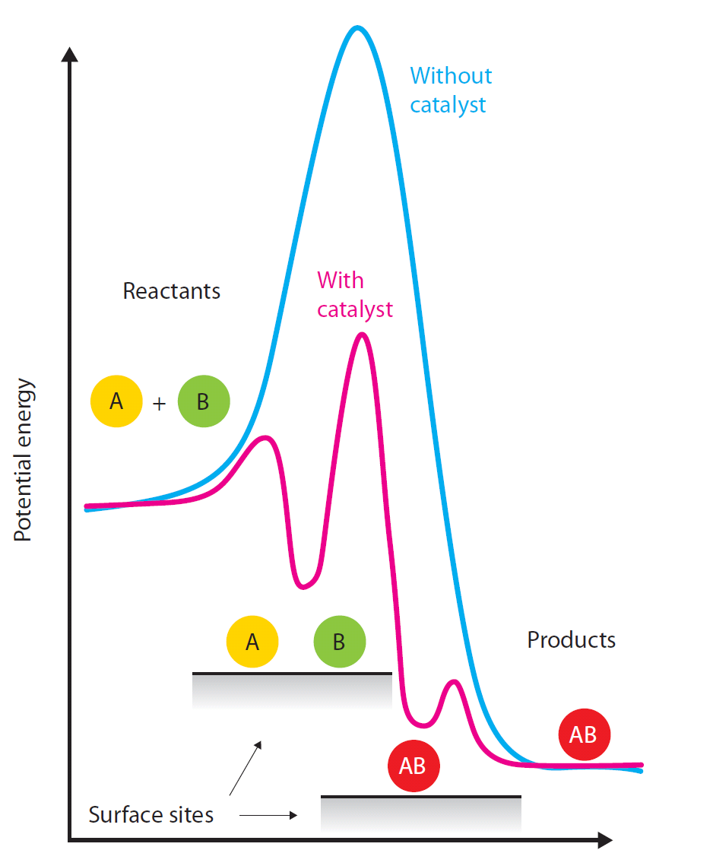
The Catalyst Challenge
Understanding reaction mechanism and dynamics
Notes:
27
Katalysator forklaring + billede fra Ibs artikel

Slide 28
Probing Intermediates ?
Notes:
28
Katalysator forklaring + billede fra Ibs artikel

Slide 29
Probing Transition States ?
Notes:
29
Katalysator forklaring + billede fra Ibs artikel

Slide 30
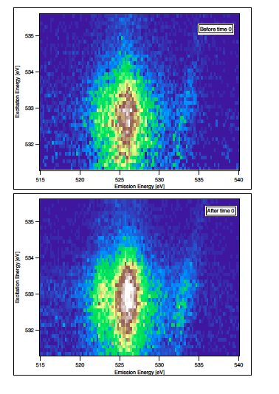
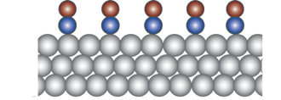
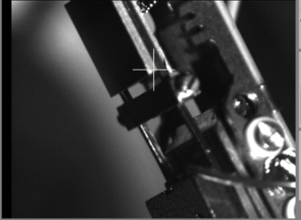
Experimental Set-up
Full RIXS plane
before pump
CO/Ru(001) sample
“A simple experiment”
FEL photon energy
400nm pump laser
X-ray
delay
Fluence 210 J/m²
after pump
x-ray emission energy
Pump-Probe delays between 100 fs to 20 ps
≈ 200-300 fs time resolution
J. Electron Spectr. 187 (2013) 9
photoexcitation resulting in the desorption of CO
400 nm laser pump
Hot electron generation in Ru → heat transfer to CO
Map valence electronic structure changes
by measuring x-ray emission spectra as a function of Laser–FEL delay & FEL energies.
Data set → Pump-probe XES & XAS

Slide 31



Nilsson Group Surface Science Endstation
sample preparation
sputter & anneal
electron spectrometer,
VG Scienta R3000
XPS
“A simple experiment”
X-ray spectrometer,
grazing incidence elliptical grating
XES, fluorescence yield XAS
base pressure: low 10⁻¹⁰ torr
photoexcitation resulting in the desorption of CO
400 nm laser pump
Hot electron generation in Ru → heat transfer to CO
Map valence electronic structure changes
by measuring x-ray emission spectra as a function of Laser–FEL delay & FEL energies.
Data set → Pump-probe XES & XAS

Slide 32



LCLS pump-probe experiments
400 nm fs-laser induced desorption of CO from Ru(0001)
400 nm fs-laser pump
<1ps electronic excitation
>1ps phononic excitation
“A simple experiment”
C. Frischkorn, M. Wolf, Chem. Rev. 106, 4207 (2006)
Previous ultrafast study: C-O vibration (SFG)
This work: Ru-C-O electronic structure (X-ray spectroscopy)
photoexcitation resulting in the desorption of CO
400 nm laser pump
Hot electron generation in Ru → heat transfer to CO
Map valence electronic structure changes
by measuring x-ray emission spectra as a function of Laser–FEL delay & FEL energies.
Data set → Pump-probe XES & XAS

Slide 33

Before and After Pump
XAS
XES
Participator
Shifts towards gas phase (resonant)
d_{π} looses itensity
Participator increases in intensity –
- less connection to surface
π* shifts towards
gas phase position
Science 339, 1302 (2013)

Slide 34

Potential of Mean Force
Large difference in entropy
between chemisorbed state
(perpendicular only)
and molecules in plateau
(free to rotate)
Compute potential of mean
force, W(s), to estimate
free energy
Temperature-dependent
entropic barrier
Two wells: chemisorbed and
precursor state to desorption
(and adsorption)
Entropic barrier
Originally developed by D. J. Doren, J. C. Tully,
Langmuir 4, 256 (1988), J. Chem. Phys. 94, 8428 (1991)
Science 339, 1302 (2013)

Slide 35

CO Desorption from Ru(0001):
Weakly Bound Precursor State
rigid
quasi free
chemisorbed
precursor
1
0
Energy/eV
-1
~30%
~15%
~15%
Precursor state
Science 339, 1302 (2013)

Slide 36
New Instrument
Small UHV instrument that is to transport to different facilities
Low 10⁻¹⁰ torr
One Chamber with two level
Detector for total fluorescence yield
Grating soft x-ray spectrometer
To be used at LCLS, Fermi, XFEL but also FYSIKUM

Slide 37








Collaboration
Ultrafast
Toyli Anniyev, Martin Beye, Ryan Coffee, Martina Dell'Angela,
Alexander Föhlisch, Jörgen Gladh, Tetsuo Katayama, Sarp Kaya, Oleg Krupin, Jerry LaRue, Andreas Møgelhøj, Anders Nilsson, Dennis Nordlund, Jens Nørskov, Hirohito Ogasawara, Henrik Öberg, Henrik Öström, Frank Abild-Pedersen, Lars GM Pettersson, William F Schlotter, Jonas A Sellberg, Florian Sorgenfrei, Joshua J Turner, Martin Wolf, Wilfried Wurth, Honglian Xin
SLAC (SUNCAT, LCLS, SSRL)
University of Hamburg and CFEL, Stockholm University, Helmholtz-Zentrum Berlin, Fritz Haber Institute,

Slide 38


Water denser than ice
Water Probed in Deep Supercooling
Density of the liquid higher than the solid
Sellberg et al. Nature in press

Slide 39

The Blue Planet

Slide 40

Climate Change Water Issues
Access to Clean Water
The Challenge for the World with Climate Change
Gore, Inconvenient Truth

Slide 41


Unusual Properties
Normal liquid
density
dddddddddddd
Water
Ssssssssssssssssssssssss
-50
-25
0
25
50
75
100
Temperature/ °C
Ice floats on top, lower density
At the bottom of the glass is 4 °C water

Slide 42

Anomalous Properties of Water
Isothermal Compressibility
Heat Capacity
Thermal expansion
<(δV)²>=Vk_{B}Tκ_{T}
<(δS)²>=Nk_{B}c_{p}
<(δS δV)>=Vk_{B}Tα
Density fluctuations
Entropy fluctuations
Cross of density and entropy fluctuations
Divergence towards a mysterious temperature of -45 °C
P. Kumar, S. Han, H.E. Stanley, J. Phys.: Condens. Matter 21 (2009) 504108.

Slide 43




X-ray Spectroscopies and Scattering Data
XAS indicates predominant asymmetrical coordination with
fewer H-bonds than in tetrahedral model
Wernet et al., Science 304 (2004) 995
XES shows two motifs: strongly tetrahedral
and very disordered
Tokushima et al., Chem. Phys. Lett. 460 (2008) 387
SAXS shows fluctuating density inhomogeneity
Enhanced upon cooling
Huang et al., PNAS 106, 15214 (2009); 107, E45 (2010);
JCP 133, 134504 (2010)
WAXS shows broad structural distributions
and shell-structure (~12 Å) consistent with
two structural motifs (and with SAXS)
Huang et al. Phys. Chem. Chem. Phys. 13, 19997 (2011)

Slide 44


Summary room temperature to -20 °C
Strongly Distorted is related to local High Density Liquid (HDL)
?
?
?
OH1
OH2
?
?
?
Tetrahedral is related to local Low Density Liquid (LDL)
HDL and LDL fluctuations
Two local structural different motifs
≈1nm length scales at room temperature
Increasing length scale with decreasing temperature
A. Nilsson and L. G. M. Pettersson, Chem. Phys. 389, 1 (2011).

Slide 45

“No-Mans Land” below limit of homogeneous ice formation
Practical Limit for
Water Measurements
--20 to -33 °C
Homogenous
Ice Nucleation
Limit -38 °C
ρ(HDA)=1.17 g/cm³
ρ(LDA)=0.94
ρ(Ih)=0.92
ρ(Ic)=0.92
-45 °C in “no mans land”
Low Density
Amorphous Ice (LDA)
High Density
Amorphous Ice
(HDA)
H. E. STANLEY “Mysteries of Water” Les Houches Lecture, May 1998
Originally Proposed P. H. Poole and H. E. Stanley et.al Nature 360, 324 (1992)

Slide 46

Experimental Setup
Linac Coherent Light Source (LCLS)
Coherent X-ray Imaging (CXI) end station
2D pixel-array detector (CSPAD)
Beam energy: 9.4 keV
Wavelength: 1.32 Å
Pulse duration: 50 fs
Repetition rate: 120 Hz
Flux: 2x10¹² photons/pulse
Focus: 1 and 10 µm²
Droplet injector
Supercooled
water droplets
X-ray pulse
Water
Crystalline Ice
Sellberg et al. Nature 510, 381 (2014)
Notes:
We use the Coherent x-ray imaging end station at LCLS to evaporatively cool water droplets injected into vacuum. The droplets are cooled gradually as they travel further away from the droplet injector, so we can vary the temperature of the droplets by varying the sample-nozzle distance. Each droplet is hit by a single pulse of the FEL, which creates a scattering pattern on a 2D pixel-array detector. Our detector consists of 64 application specific integrated circuits combined into four quadrants with a hole for the forward beam. As you can see, some ASICs were missing during our experiment, since it was the second ever performed at CXI, but the majority of the solid angle below 3 Å-1 is captured. The hits are classified on a shot-by-shot basis into two categories based on their scattering patterns: the ones with a broad scattering ring are classified as water-shots, and the ones with sharp Bragg peaks are classified as crystalline ice-shots.

Slide 47

Water Droplet Sources
Gas Dynamics Virtual Nozzle
GDVN
Diameter ~ 9-13 µm
Drop-on-Demand (MicroFab)
DoD
Diameter ~ 40 µm
D. Deponte et al. J. Phys. D: Appl. Phys. 41, 195505 (2008).
Early liquid jet development M. Faubel Z. Physik D 10, 269 (1988)
Sellberg et al. Nature 510, 381 (2014)

Slide 48
Temperature Calibration using Ballistic Evaporation Model
Temperature
Cooling rate
No mans’ Land
227 K
J. D. Smith et al. J. Am. Chem. Soc. 128, 12892 (2006).
I. W. Eames et al. Int. J. Heat Mass Transfer. 40, 2963 (1997).
Sellberg et al. Nature 510, 381 (2014)

Slide 49


Split of the 1st water scattering S(q) peak
LCLS CXI, CSPAD
q
T_{h}
T_{m}
SSRL BL4-2
Rayonix MX225-HE
q
Sellberg et al. Nature 510, 381 (2014)
Notes:
We can derive the structure factor of water as a function of temperature for the data measured at LCLS, and we complement our study with measurements at BL4-2 at the Stanford Synchrotron Radiation Laboratory, where we used a static water sample in a quartz capillary with a known temperature. Here we see the scattering from each detector and in the radial direction which determines the momentum transfer there are two rings present. Looking at the structure factor, we see that it has these two peaks at high temperature that grow sharper and become more well separated as we cool the liquid. If we plot the positions of the two peaks that we denote S1 and S2…

Slide 50

S(q) split is a fingerprint of tetrahedrality of liquid water
r2
~4.5 Å
Changes in the 2nd shell
~2.8 Å
g2
g2 Height of 2nd shell in the O-O Pair Correlation function
Directly related to amount and ordering of tetrahedral water (LDL)
Ricci and Soper, Phys. Rev. Lett. 84, 2881 (2000)

Slide 51
Structure Factor
∆q
r₂
r₁
T_{h}
T_{m}
r₁ = 2.8 Å, r₂ = 4.5 Å
Notes:
Using this setup, we could measure liquid water down to 227 K. Here, we show the derived structure factor of water as a function of temperature for data measured at Linac Coherent Light Source, and we complement our study with measurements at BL4-2 at the Stanford Synchrotron Radiation Laboratory. Here we see that the structure factor has two peaks at high temperature that grow sharper and become more well separated as we cool the liquid. The q-range is insufficient to Fourier transform the data directly to obtain the pair-correlation function, but we may establish through molecular dynamics simulations a relationship between split of the two peaks S1 and S2 and the height of the correlation in the 2nd hydration shell, denoted g2, which is a measure of the tetrahedrality of the liquid.

Slide 52
Quantify the relationship between S(q) Split (Δq) and the tetrahedrality (g2)
Using TIP4P/2005 MD water model
Sellberg et al. Nature 510, 381 (2014)

Slide 53
Experimental variation of the tetrahedrality
g₂ is the 2nd shell distance as a measure of tetrahedrality
LDA
Transition from HDL to a LDL
dominated liquid
At lowest temperatures it is getting quite close to LDA
The transformation is continuous
The transformation is strongly accelerated below 240 K
Sellberg et al. Nature 510, 381 (2014)

Slide 54
2nd Critical Point Model
P. H. Poole et al., Nature 360, 324 (1992)
R. J Speedy J. Phys. Chem. 86, 982 (1982)
Variation with Critical Point at O K
A. C. Angell, Nature 331, 206 (1988)
S. Sastry et al., Phys. Rev. E 53 , 6144 (1996). )

Slide 55
New Instrument
Chamber to detect temperature of droplets based on infrared emission
Pyroelectrick detector or quantum dot detector
Laser for heating the droplets
Challenging development for performing these experiments under pressure
Machine to prepare high pressure ices and probe the liquid in “no-mans land” from below

Slide 56
Coworkers and Funding
Congcong Huang/SSRL
Jonas Sellberg/SUNCAT-Stockholm
Ningdong Huang/SSRL
Ira Waluyo/SSRL
Dennis Nordlund/SSRL
Lars Åke Näslund/SSRL
Hirohito Ogasawara/SSRL
Sarp Kaya/SUNCAT
Tomas Weiss/SSRL
Trevor Mcqueen/SUNCAT
Chen Chen/SUNCAT
Martin Beye/SUNCAT-BESSY
Andreas Mogelhoj/SUNCAT
Jens Norskov/SUNCAT
Philippe Wernet/(SSRLBESSY)
Lars Pettersson/Stockholm
Matteo Cavalleri/Stockholm
Michael Odelius/Stockholm
Michael. Leetma/Stockholm
Mathias. Ljungberg/Stockholm
Thor Wikfeldt/Stockholm
Daniel Schlesinger/Stockholm
Lars Ojamäe/Linköping
Takashi Tokushima/Spring8
Yoshihisa Harada/Spring8
Yuka Horikawa/Spring 8
Shik Shin/Tokyo
Daniel Deponte/CFEL
Andy Martin/CFEL
Andrew Barty/CFEL
Mike Bogan/PULSE
Dmitri Starodub/PULSE
Raymond Sierra/PULSE
Duah Loah/PULSE
Hartawan Laksmono/PULSE
Christina Hampton/PULSE
Uwe Bergmann/LCLS
Jan Feldkamp/LCLS
Sebastian Boutet/LCLS
Garth Williams/LCLS
National Science Foundation (NSF)
Department of Energy (DOE)

