Slide 1
Electromagnetic pickup and kicker structures for particle beam diagnostics and stochastic cooling
F. Caspers (CERN-BE-RF) with many BI related slides from R. Jones
A few words about CERN
An overview of classical non-intercepting electromagnetic sensors used for charged particle accelerators
Examples of Schottky mass spectroscopy of single circulating ions
Stochastic beam cooling, a feedback process based on Schottky signals in the microwave range
Conclusion

Slide 2
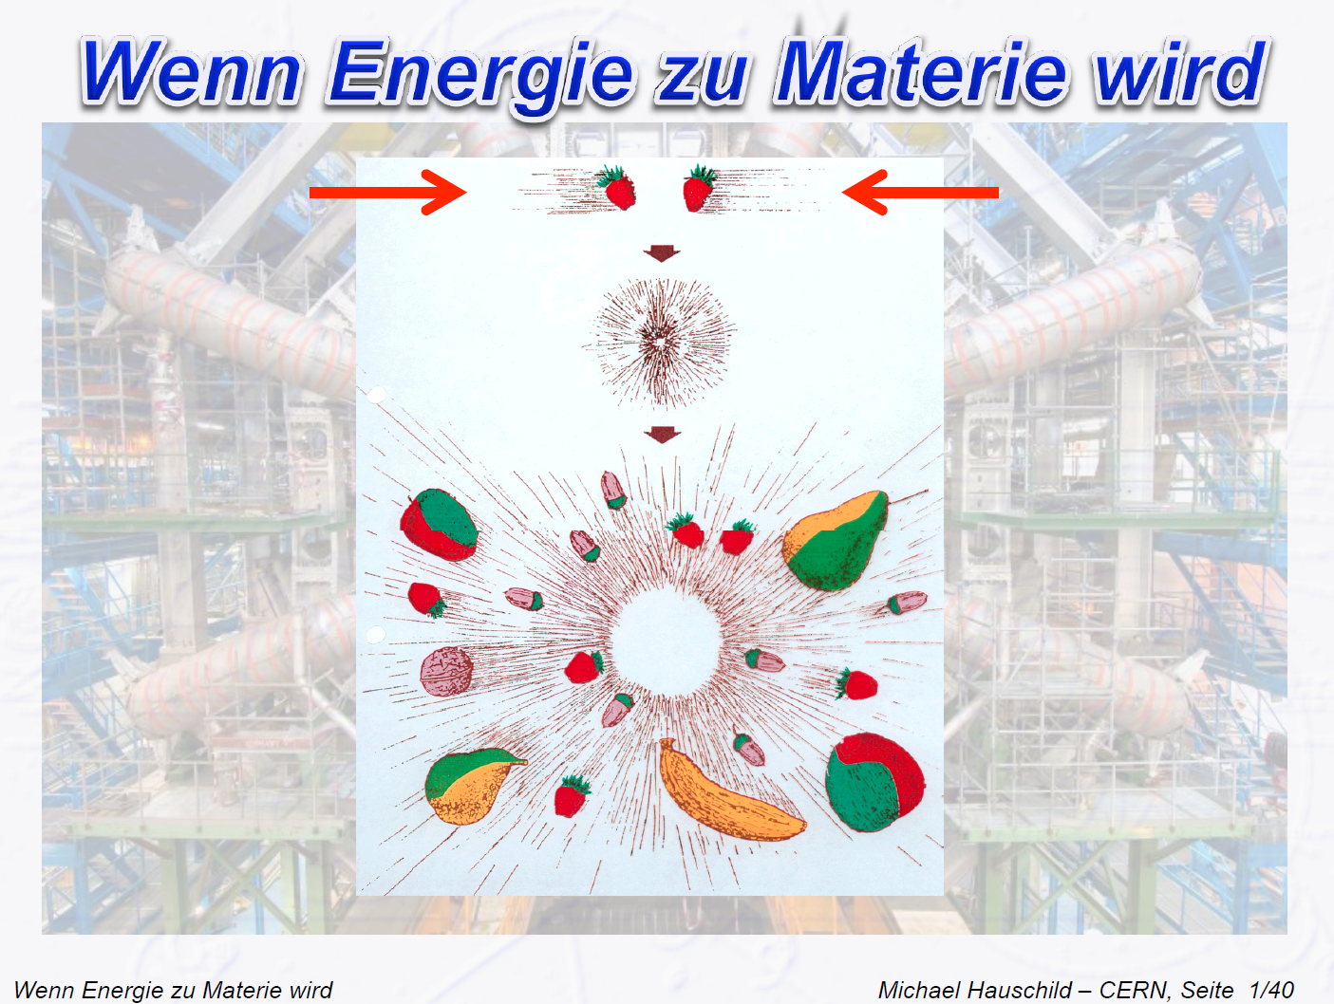
WHEN ENERGY BECOMES MATTER

Slide 3
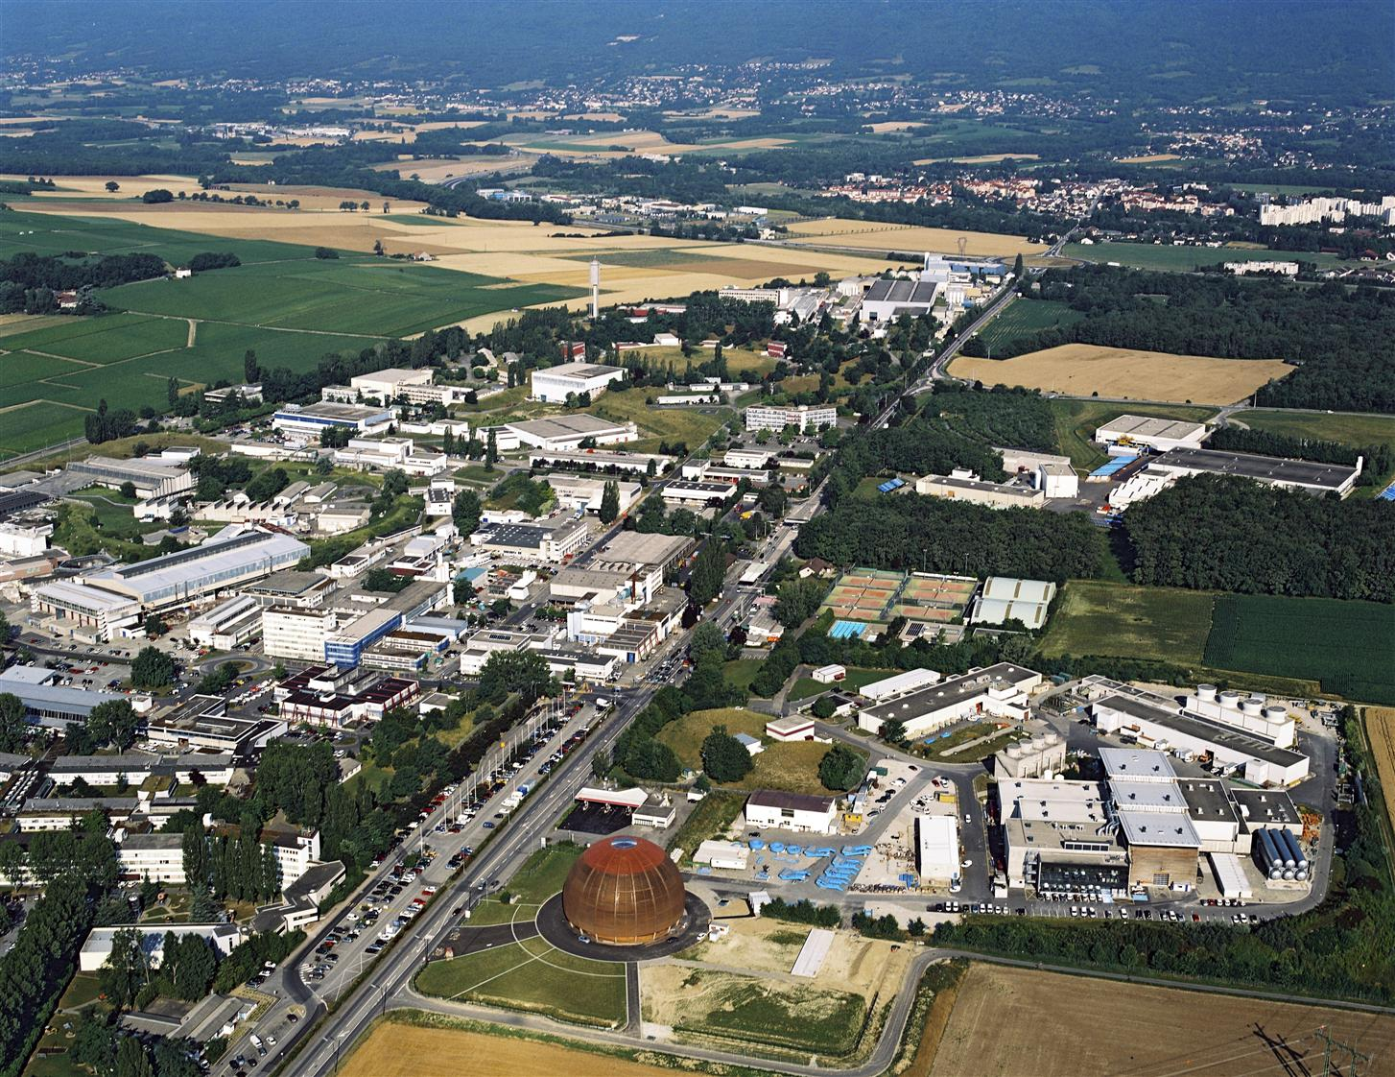
CERN
founded 1954, today > 20 member states;
Up to 10’000 persons working at CERN, including 2250 CERN-personnel;
Annual budget approximately
1000 MCHF (900 M€);
Most accelerators are passing through the Swiss-French border

Slide 4

The LHC at CERN – a huge scientific experiment
The LHC is a particle accelerator with many superlatives:
26,7 km circumference;
4 large and several smaller experiments;
Proton-proton collisions with an energy of 7 TeV (planned) per beam and a maximum luminosity¹ of 10³⁴cm⁻²s⁻¹ for protons;
1232 super conducting dipolmagnets with 2 beam-pipes, each at up to 8.3 Tesla magnetic field, cryogenically cooled to 1.8 K;
For this 96000 Kg of Helium are required…
GVA (GVA airport)
LHC
SPS
France
Switzerland
¹Luminosity is a measure for the “number of collisions”

Slide 5
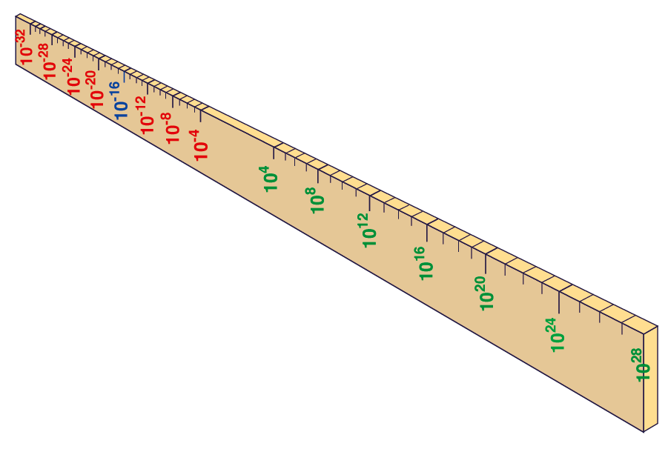
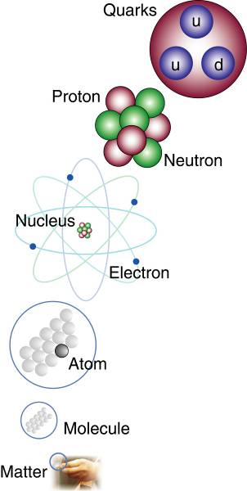
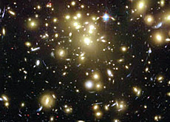


(Big Bang)
Proton
Atom
earth-radius
distance earth/sun
radius of a galaxy
Universum
LHC accelerator
The Higgs-Boson (namend after Peter Higgs ) is considered to “communicate” the mass of elementary particles – it is part of the physical Standardmodel.
Aim of the LHC: the study of the physical laws as they were shortly after the big bang &
Experimental evidence for Higgs-Boson
cm
Notes:
5
60 Grössenordnungen

Slide 6
The CERN accelerator complex

Slide 7
Measuring Beam Position – The Principle
-
+
-
+
-
-
+
-
+
-
+
-
-
+
-
+
-
+
-
-
+
-
+
-
+
-
-
+
-
+
-
+
-
-
+
-
+
-
+
-
+
-
+
+
+
-
-
+
+
-
+
-
+
+
+
-
-
+
+
-
+
-
+
+
+
-
-
+
-
+
-
-
+
-
+
-
+
-
-
+
-
+
-
+
-
-
+
-
+
+
+
+
+
+
+
+
+
+
+
+
+
+
+
+
+
+
+
+
+
+
+
+
+
+
+
+
+
+
+
+
+
+
+
+
+
+
+
+
+
+
+
+
+
+
+
+
+
+
+
+
+
+
+
+
+
+
+
+
+
+
+
+
+
+
+
+
+
+
+
+
+
+
+
+
+
+

Slide 8
Wall Current Monitor – The Principle
V
-
+
-
+
-
-
+
-
+
-
+
-
-
+
-
+
-
+
-
+
-
-
+
-
+
-
+
-
-
+
+
+
-
-
+
+
-
Ceramic Insert
-
+
-
+
+
+
-
-
+
+
-
+
-
-
+
-
+
-
+
-
-
+
-
+
+
+
+
+
+
+
+
+
+
+
+
+
+
+
+
+
+
+
+
+
+
+
+
+
+
+
+
+
+
+
+
+
+
+
+
+
+
+
+
+
+
+
+
+
+
+
+
+
+
+
+
+
+
+
+
+
+
+
+
+
+
+
+
+
+
+
+
+
+
+
+
+
+
+
+
+
+
+
+
+
+
+
+
+
+
+
+
+
+
+
+
+
+
+
+
+
+
+
+
+
+
+
+
+
+
+
+
+
+
+
+
+
+
+
+
+
+
+
+
+
+
+
+
+
+
+
+
+
+
+
+
+
+
+
+
+
+
+
+
+
+
+
+
+
+
+
+
+
+
+
+
+
+
+

Slide 9
Wall Current Monitor – Beam Response
V
C=gap capacity due to ceramic insert and fringe fields
R=external resistor, L =external inductance
R
Response
C
I_{B}
0
0
Frequency
L
I_{B}

Slide 10
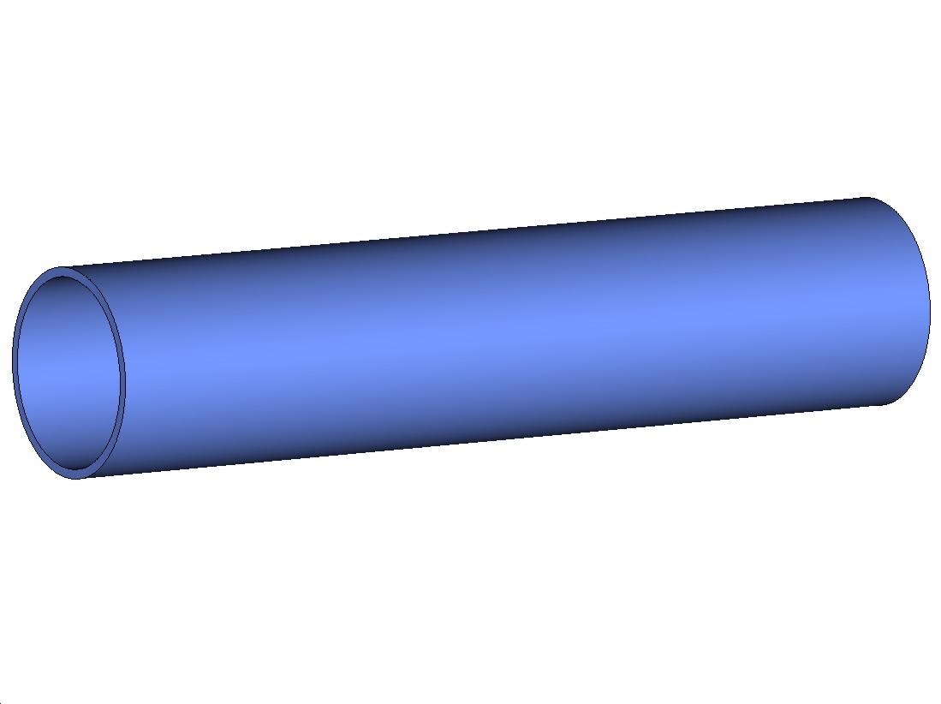
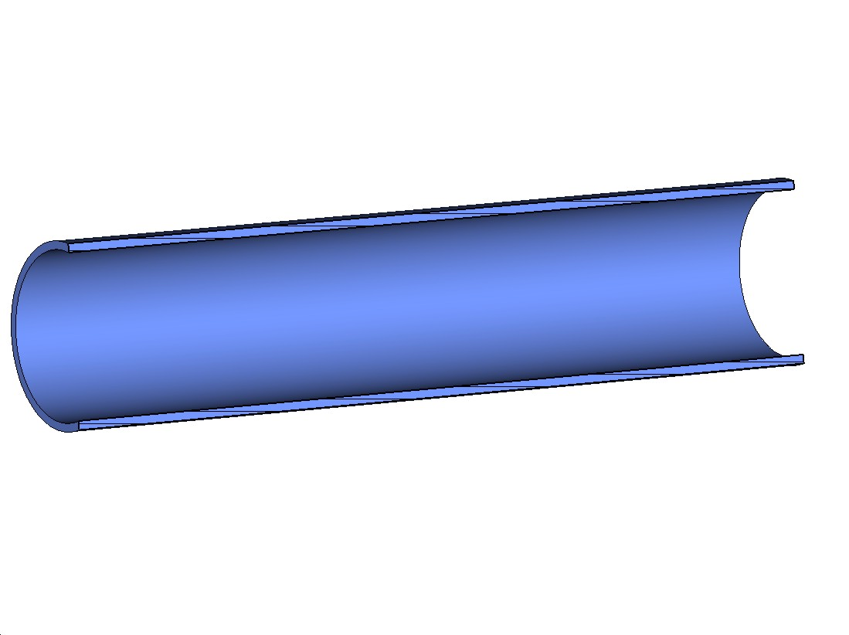
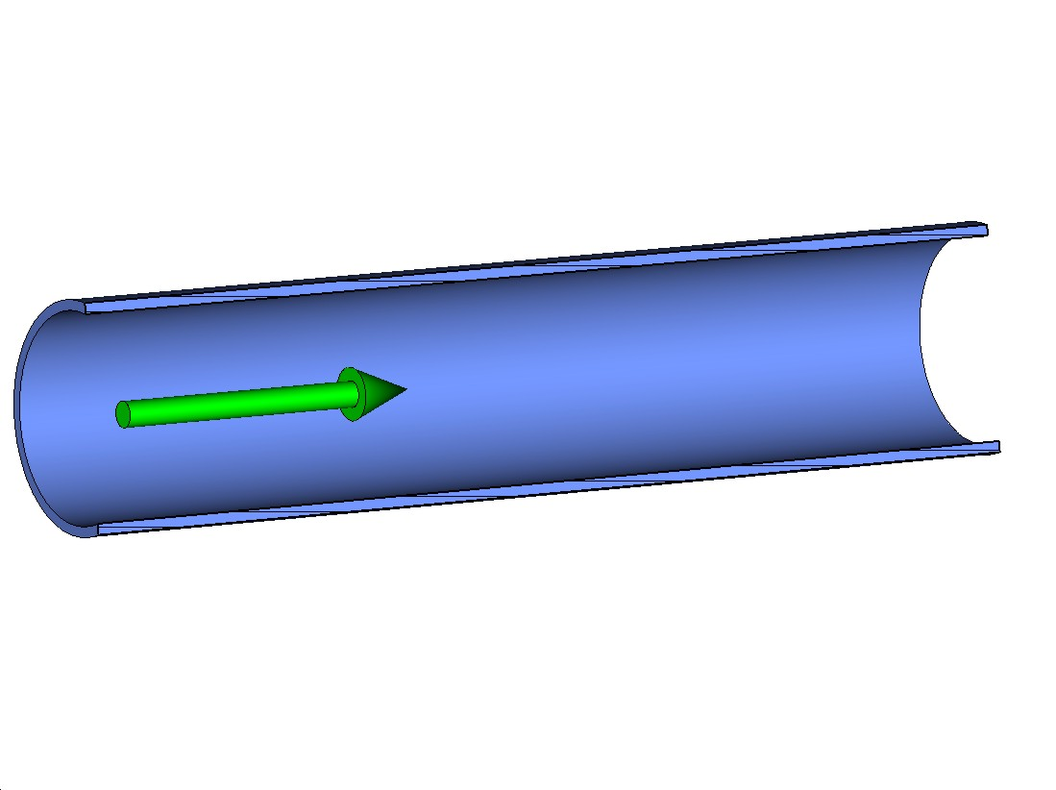
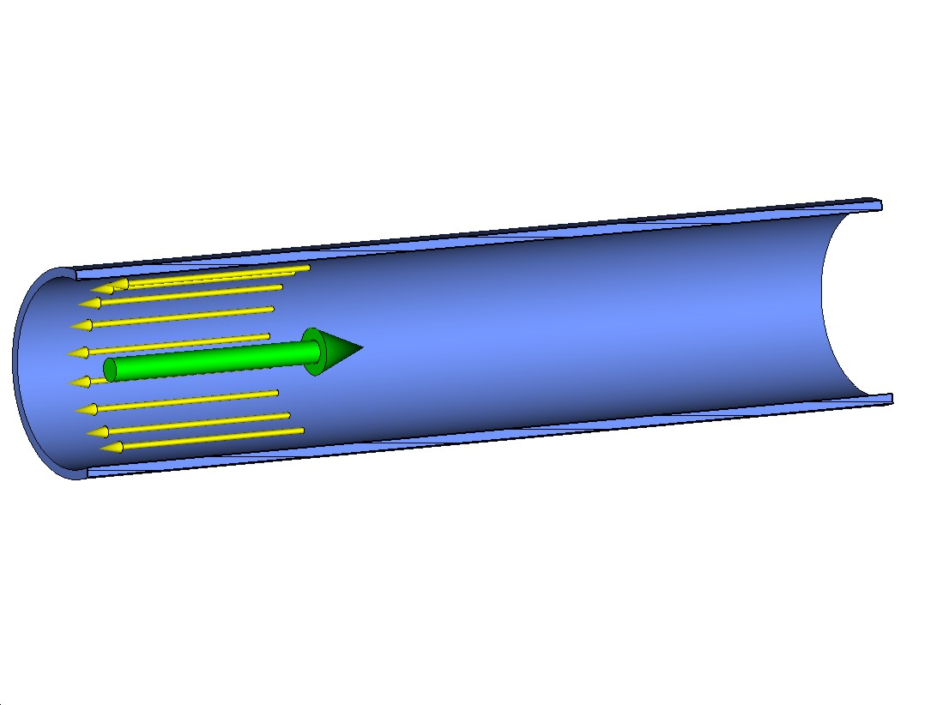
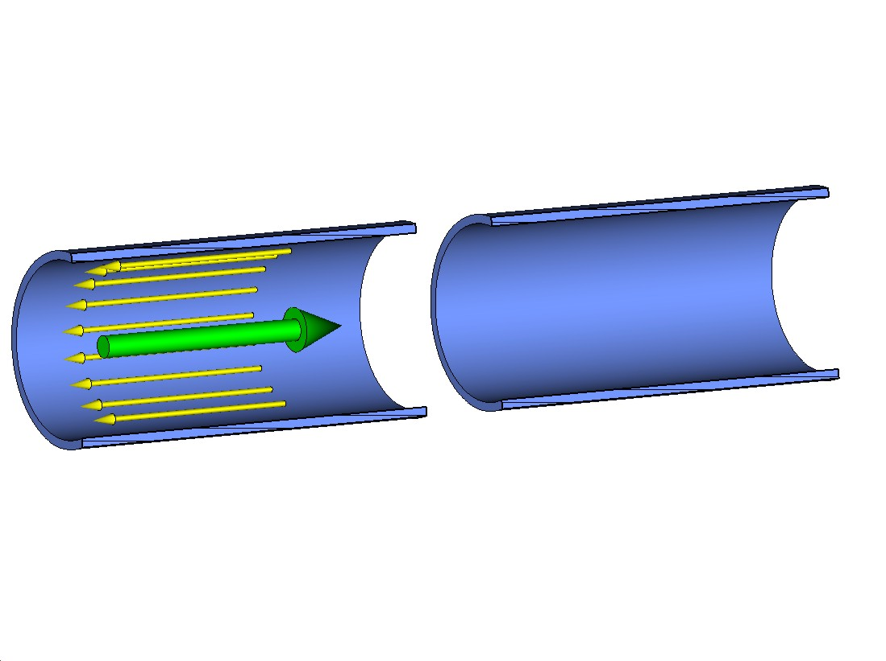
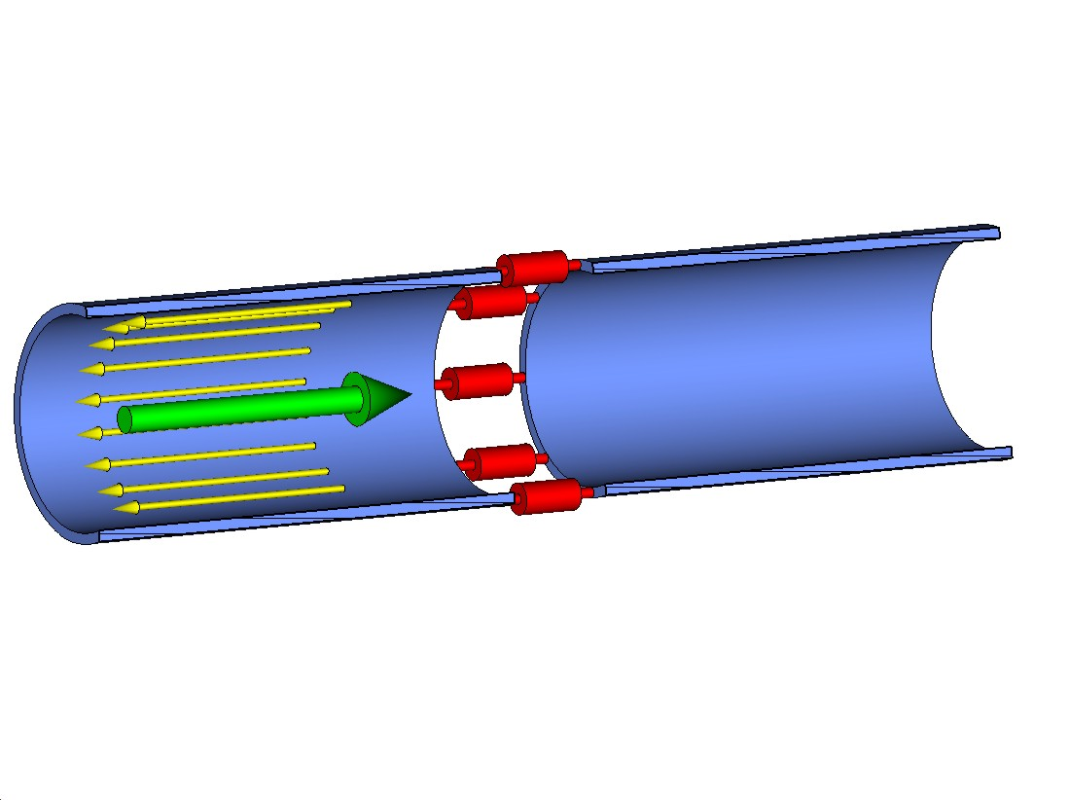
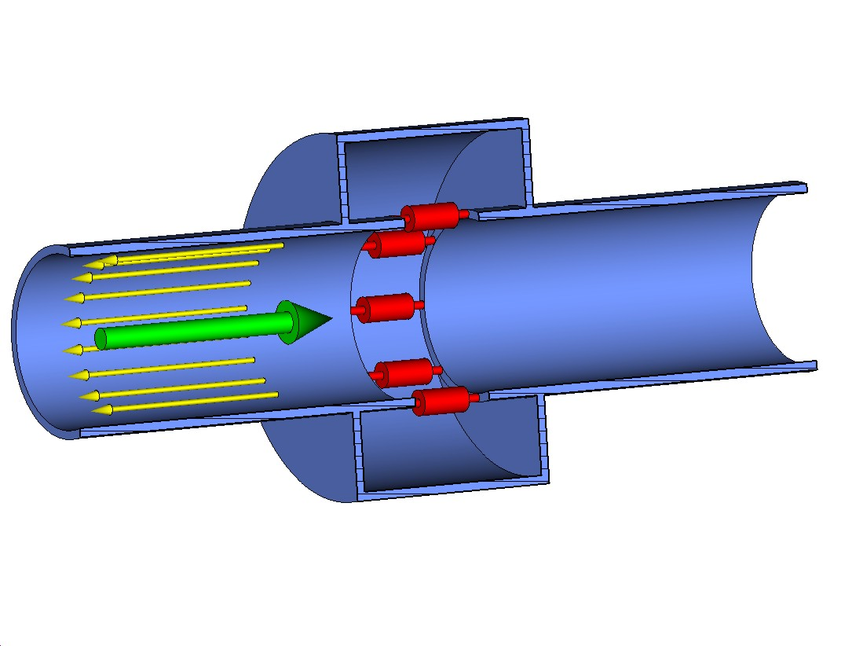
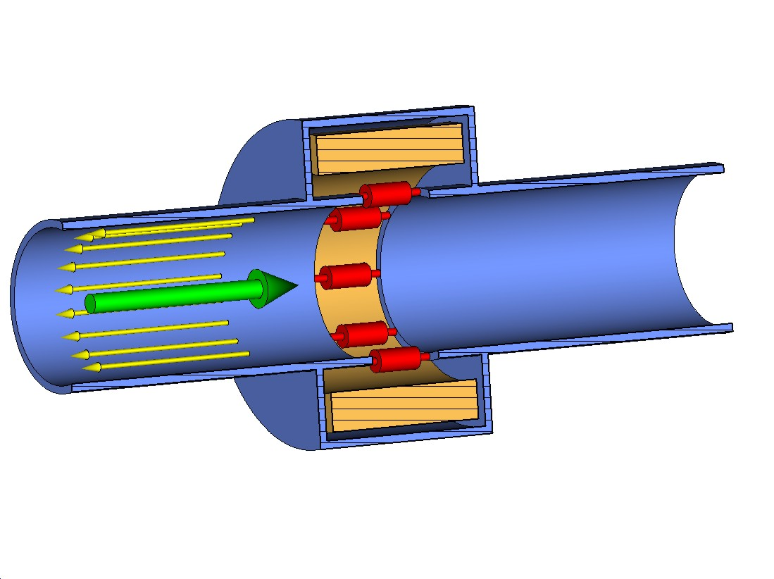
Wall Current Monitor (WCM) principle
The BEAM current is accompanied by its IMAGE
A voltage proportional to the beam current develops on the RESISTORS in the beam pipe gap
The gap must be closed by a box to avoid floating sections of the beam pipe
The box is filled with the FERRITE to force the image current to go over the resistors
The ferrite works up to a given frequency and lower frequency components flow over the box wall

Slide 11
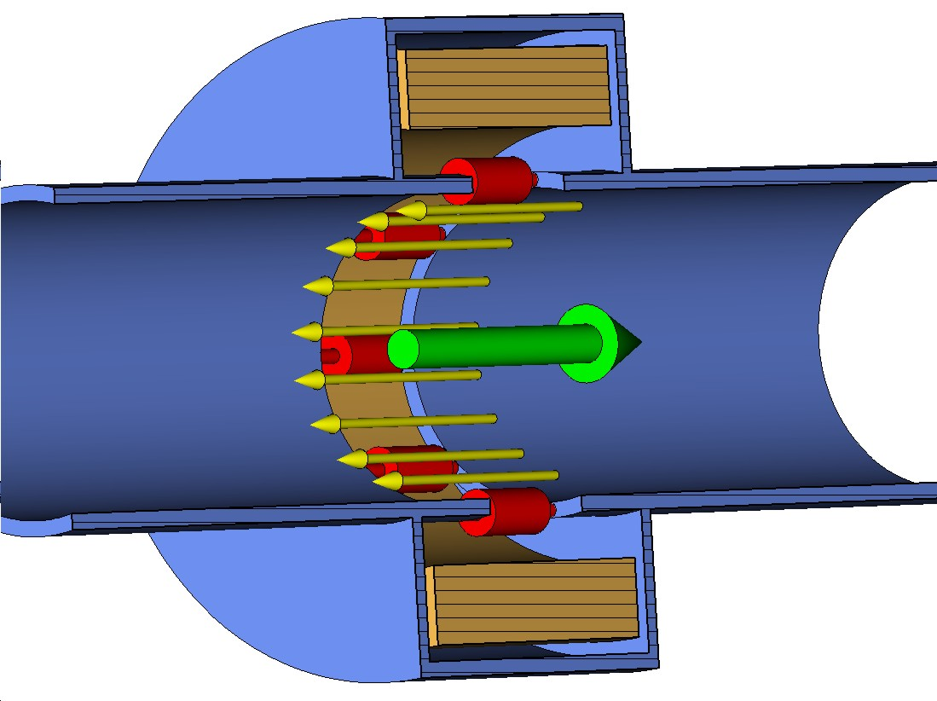
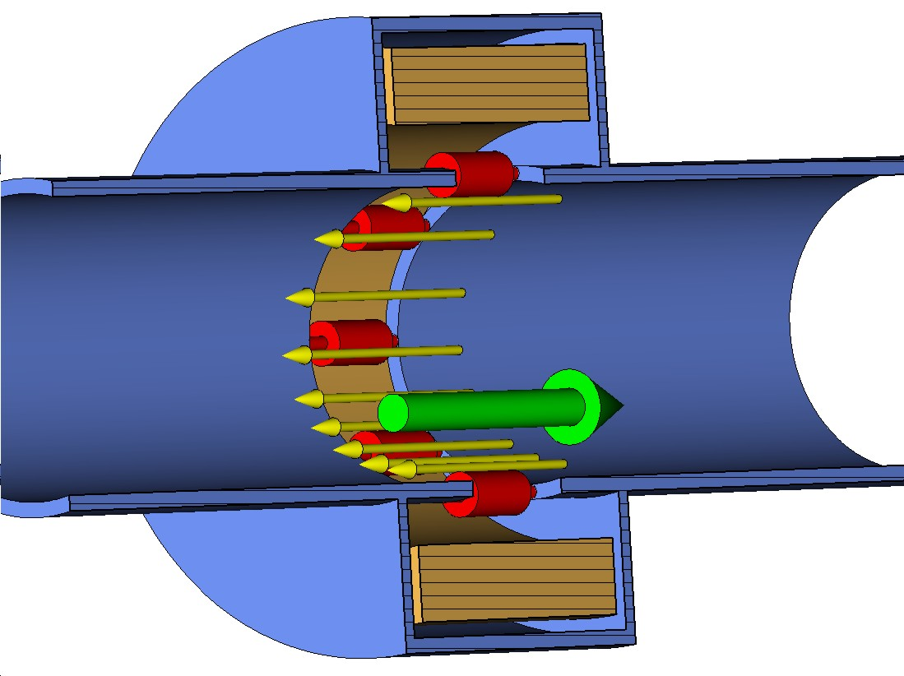
WCM as a Beam Position Monitor
For a centered BEAM the IMAGE current is evenly distributed on the circumference
The image current distribution on the circumference changes with the beam position
Intensity signal (Σ) = resistor voltages summed
Position dependent signal (Δ) = voltages from opposite resistors subtracted
The Δ signal is also proportional to the intensity, so the position is calculated according to Δ/Σ
Low cut-offs depend on the gap resistance and box wall (for Σ) and the pipe wall (for Δ) inductances

Slide 12
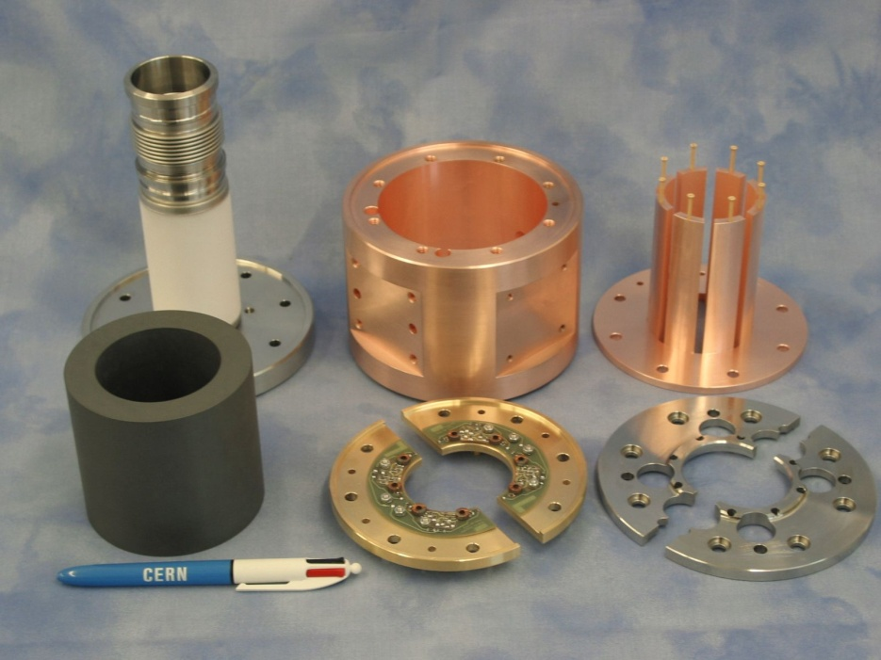
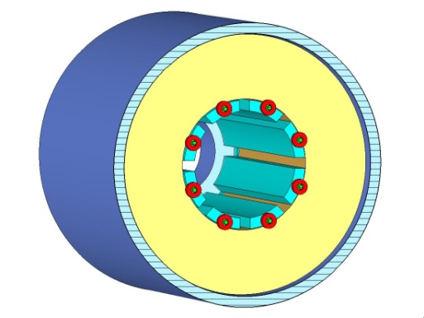
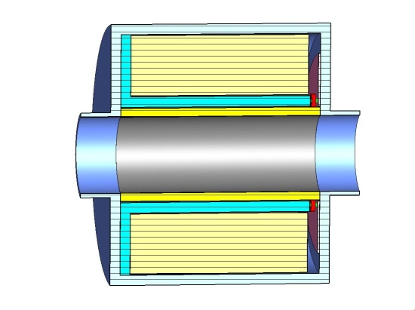
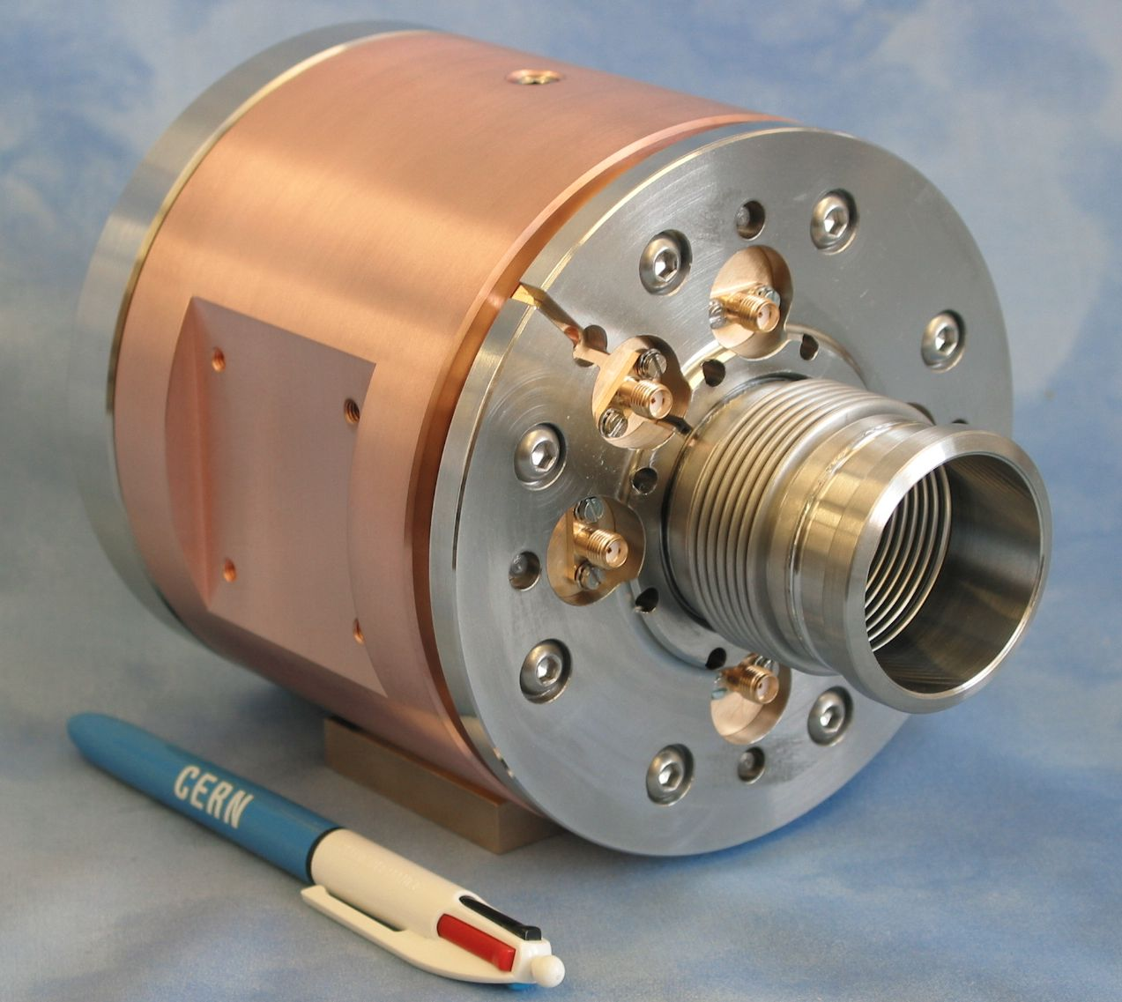
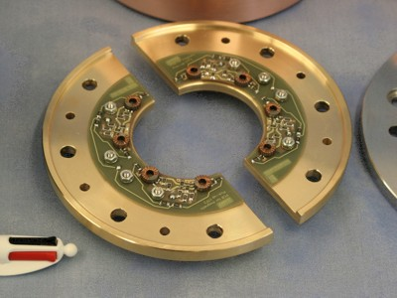
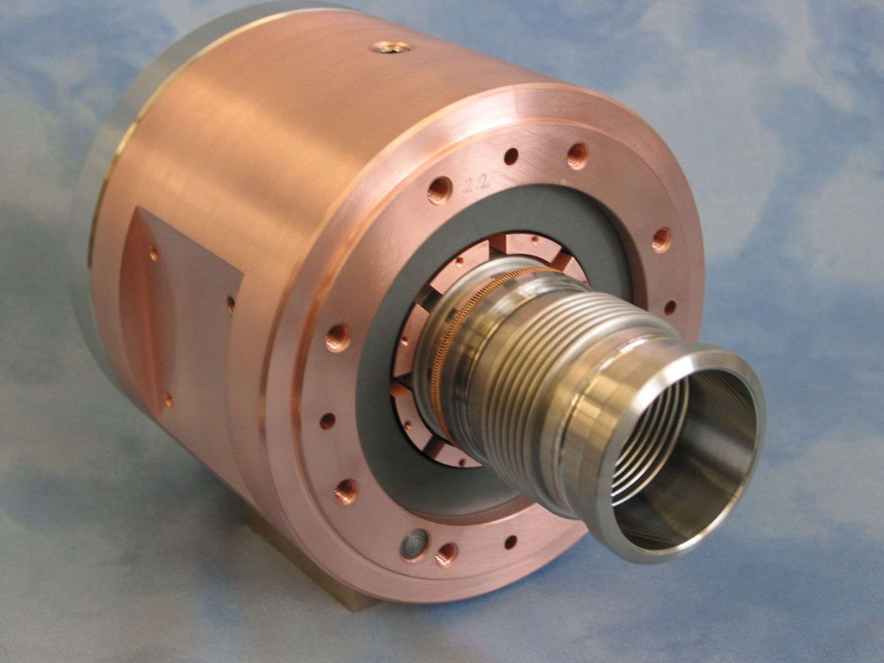
Inductive Pick-Up New Design
The ceramic tube is coated with low resistance titanium layer, resistance:
end-to-end ≈10 Ω, i.e. ≈ 15 Ω/
Primary circuit has to have small parasitic resistances (Cu pieces, CuBe screws, gold plating)
Tight design, potential cavities damped with the ferrite
The transformers are mounted on a PCB and connected by pieces of microstrip lines (minimizing series inductances)

Slide 13
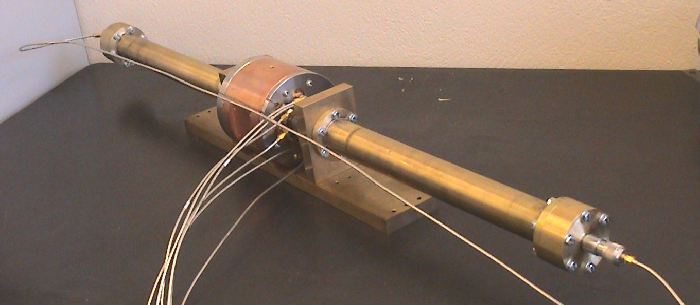
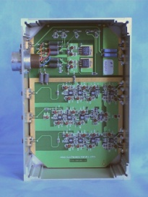
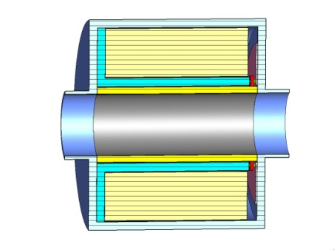

IPU and AHC – Frequency Characteristics
A wire method with a 50 Ω coaxial setup which the IPU is a part
Σ signal – flat to 0.5 dB within 5 decades, almost
6 decades of 3 dB bandwidth (no compensation)
Δ signal – 5 decades (four decades + one with an extra gain for low frequencies)
BW: 300 Hz – 250 MHz (≈ 6 decades)
BW: 1 kHz – 150 MHz (> 5 decades)

Slide 14
Electrostatic Monitor – The Principle
V
-
+
-
+
-
-
+
-
+
-
+
-
-
+
-
+
-
+
-
+
-
-
+
-
+
-
+
-
+
-
+
-
+
-
-
-
+
+
-
-
+
+
-
-
-
-
+
-
+
-
+
-
-
+
-
+
-
+
-
-
+
-
-
-
-
-
+
-
+
+
-
+
-
-
+
-
+
-
+
-
+
-
+
+
+
+
-
+
-
-
+
-
+
+
+
+
+
+
+
+
+
+
+
+
+
+
+
+
+
+
+
+
+
+
+
+
+
+
+
+
+
+
+
+
+
+
+
+
+
+
+
+
+
+
+
+
+
+
+
+
+
+
+
+
+
+
+
+
+
+
+
+
+
+
+
+
+
+
+
+
+
+
+
+
+
+
+
+
+
+

Slide 15
Electrostatic Monitor – Beam Response
C
Response (V)
V_{B}
0
V
0
Frequency (Hz)
R

Slide 16
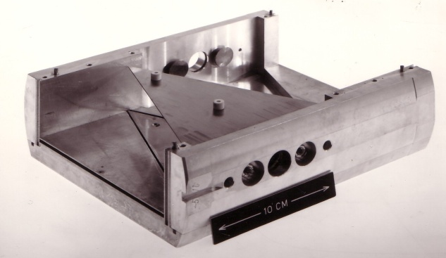
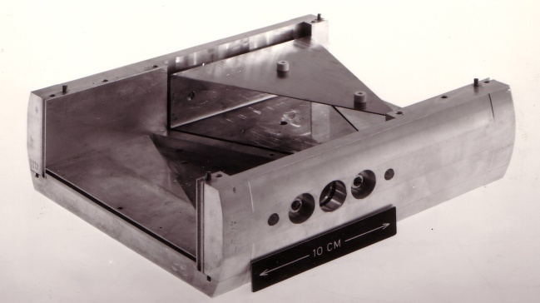
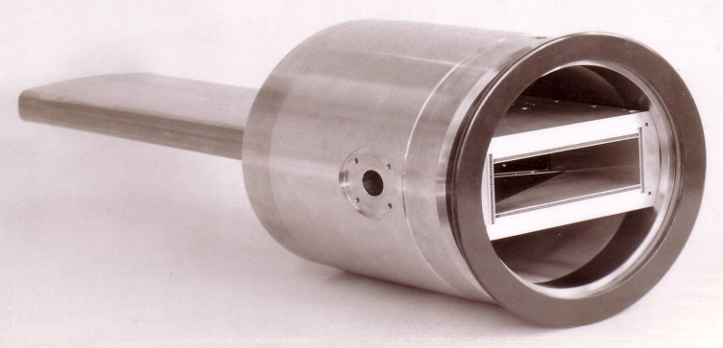
Electrostatic Pick-up – Shoebox
w
Linear cut through a shoebox
Beam
U_{L}
U_{R}
x
Highly Linear
Measurement:
  Induced charges carried away by low-impedance circuit or sensed on a high impedance as a voltage

Slide 17
Electrostatic Pick-up – Button
Variant of electrostatic PU
Low cost ⇒ most popular
Non-linear
  requires correction algorithm
  when beam is off-centre
Transfer Impedance:
  Low frequency cut-off:
Area A
r
Ce = capacity of the pickup electrode to ground
Response (V)
0
Frequency (Hz)
0

Slide 18
Button Frequency & Time Response
Zt=transfer impedance, Q=number of protons per bunch
W= width of the bunch in nanoseconds
N = turns ratio of an
external transformer
Ce = capacity of the pickup electrode to ground
Frequency domain:
  Impedance transformers improve the low frequency levels at the expense of the high frequency
Time domain:
  Differentiated pulse
  Exponential dependence of amplitude on bunch length

Slide 19
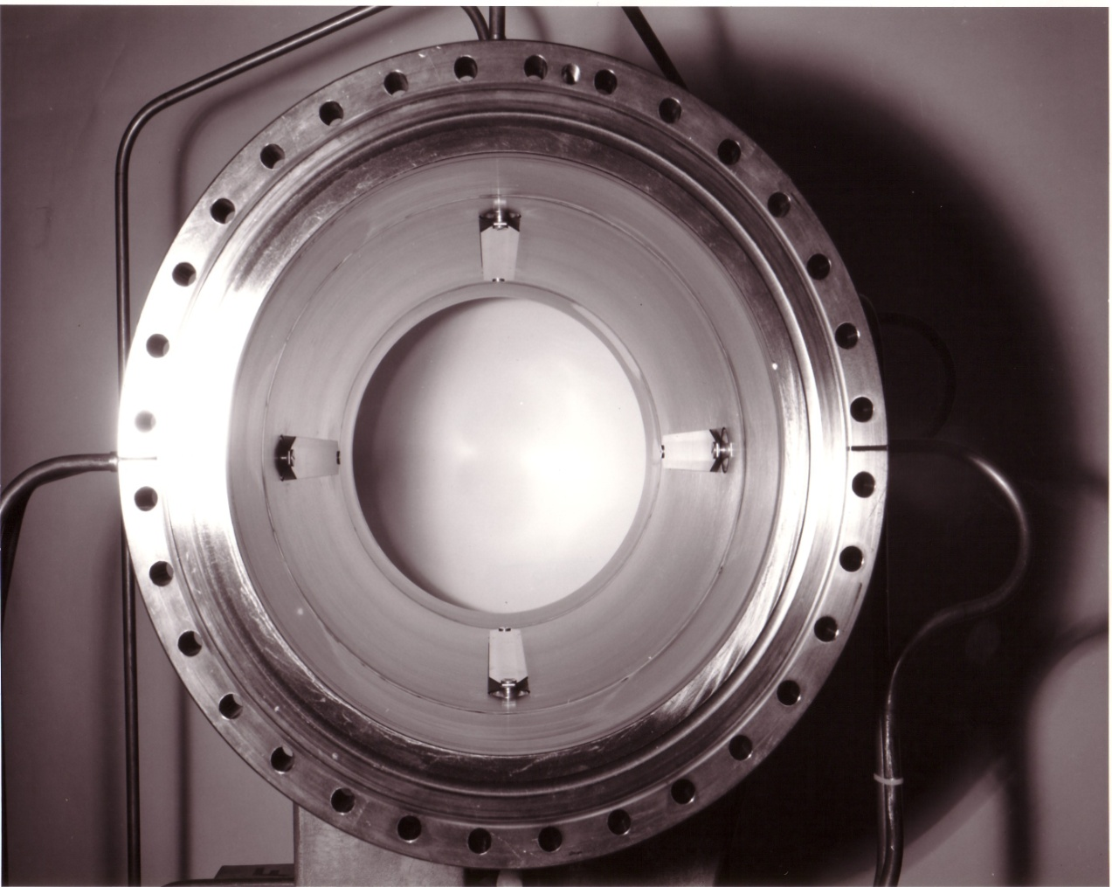
Electromagnetic (Directional) coupler
A transmission line (stripline) which couples to the transverse electromagnetic (TEM) beam field
  Z_{t ∞}= 60 ln[(r+h)/r]
  ≡ Z₀*[a/2π(r+h)]
    Z₀ is the characteristic
    impedance
    a, r, h, l are the
    mechanical dimensions
    t = l/c is the propagation
    time in the coupler
a
r
h

Slide 20
EM Fields & Relativity
E-Field
TEM Wave
+
+
+
1/(βγ)
Static Point
Charge
Moving Point
Charge
Relativistic Point
Charge
Relativistic case: Electric & magnetic fields become transverse to the direction of motion (TEM).

Slide 21
Electromagnetic Stripline Coupler - Principle
+
+
+
+
+
R_{u}
V_{u}
R_{d}
V_{d}

Slide 22
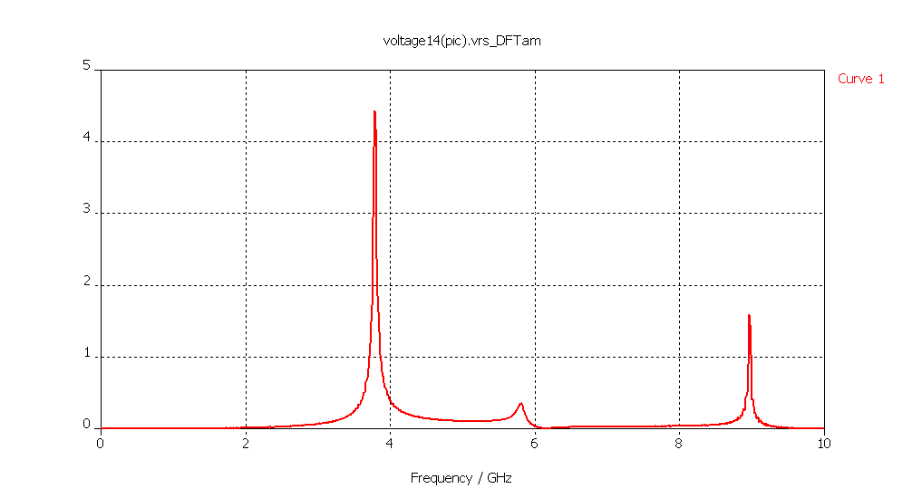
Improving the Precision for Next Generation Accelerators
Standard BPMs give intensity signals which need to be subtracted to obtain a difference which is then proportional to position
  Difficult to do electronically without some of the intensity information leaking through
    When looking for small differences this leakage can dominate the measurement
    Typically 40-80dB (100 to 10000 in V) rejection ⇒ tens micron resolution for typical apertures
Solution – cavity BPMs allowing sub micron resolution
  Design the detector to collect only the difference signal
    Dipole Mode TM₁₁ proportional to position & shifted in frequency with respect to monopole mode
Frequency Domain
TM₀₁
TM₀₁
U / V
TM₀₂
TM₀₂
TM₁₁
TM₁₁
f / GHz
Courtesy of D. Lipka,
DESY, Hamburg
U~Q
U~Qr
U~Q

Slide 23
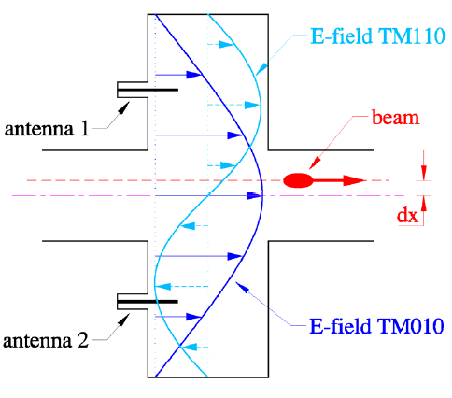
Cavity BPMs
BPM resolution typically limited by problem of taking a difference between large numbers (2 opposing electrodes)
Cavity BPMs have different frequency response for fundamental and difference mode
  Aids in fundamental rejection
  Can give sub-micron resolution.
  BUT:
  Damping time quite high due to intrinsic high Q >>1000
  Poor time resolution (~100ns)
26-03-2007
L. Søby
23

Slide 24
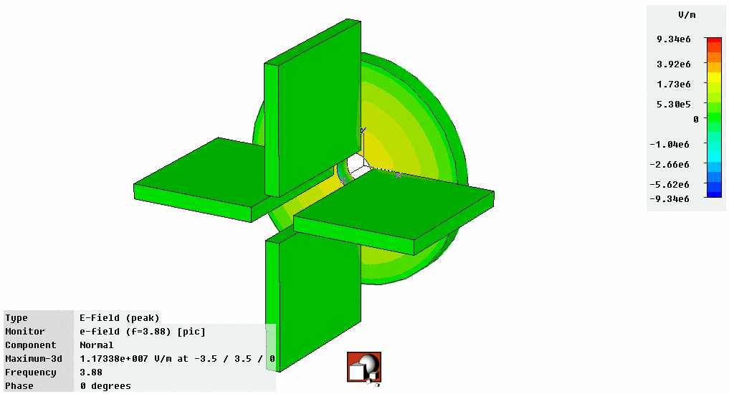
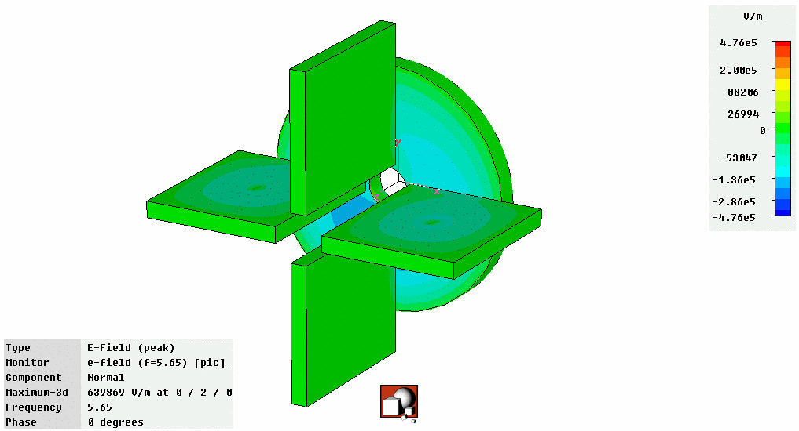
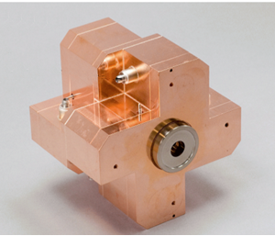
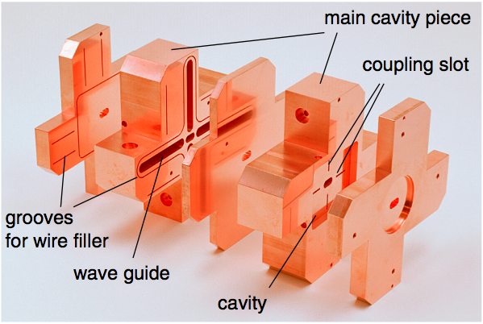
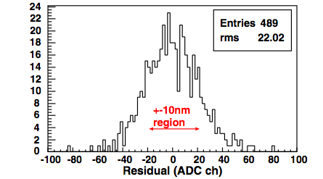
Today’s State of the Art BPMs
Obtain signal using waveguides that only couple to dipole mode
  Further suppression of monopole mode
Prototype BPM for ILC Final Focus
  Required resolution of 2nm (yes nano!) in a 6×12mm diameter beam pipe
  Achieved World Record (so far!) resolution of 8.7nm at ATF2 (KEK, Japan)
Monopole Mode
Dipole Mode
Courtesy of D. Lipka,
DESY, Hamburg
Courtesy of D. Lipka & Y. Honda

Slide 25

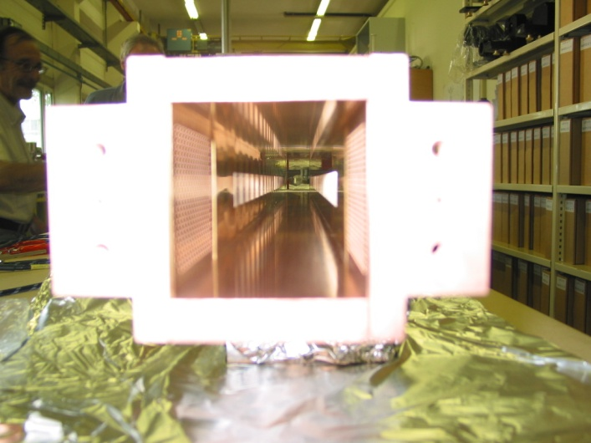
Schottky Measurements
4.8GHz
400MHz
21 MHz
0-22 kHz
BBQ
Acquisition
Electronics
Hybrid
100 MHz
Gate
24 MHz
500 MHz
22 MHz
11 kHz
11 x 400MHz
379MHz
21.4MHz
Forward coupler !
in a certain frequency band
the phase velocity of the
slotted waveguides match
the velocity of the beam
which is very close to c
4.8 GHz Slotted Waveguide Structure
60 x 60 mm aperture x 1.5 meters long
Gated, triple down-mixing scheme to baseband
Successive filtering from bandwidth of 100MHz to 11kHz
Capable of Bunch by Bunch Measurement
LHC OP days – 7th of December 2010 – Evian

Slide 26
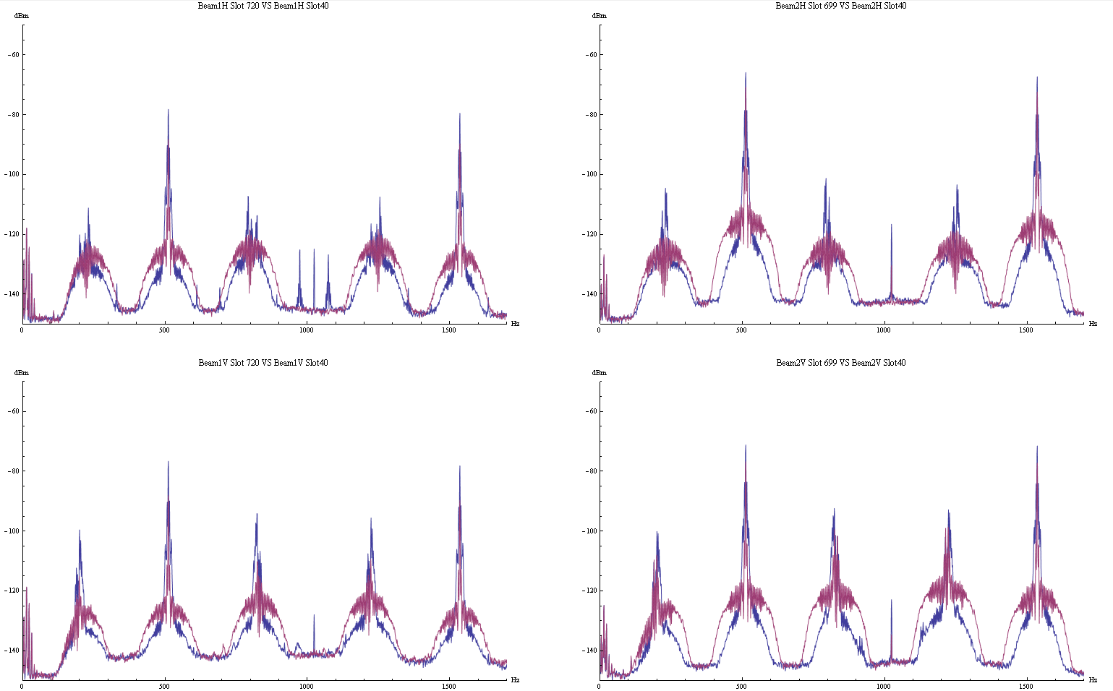
Schottky Measurements
Comparison of Ions and Protons Bunch to Bunch Spectra
Single Bunch Spectrum B1 H and B1V : Prontons vs Ions
Single Bunch Spectrum B2 H and V : Prontons vs Ions
Revolution frequency in LHC
Schottky bands
LHC OP days – 7th of December 2010 – Evian

Slide 27
What type of beam structure do we have?
All rf buckets filled

Slide 28
All RF Buckets Filled (200MHz)

Slide 29
Few RF Buckets Filled (40MHz)

Slide 30
Single Bunch Response

Slide 31
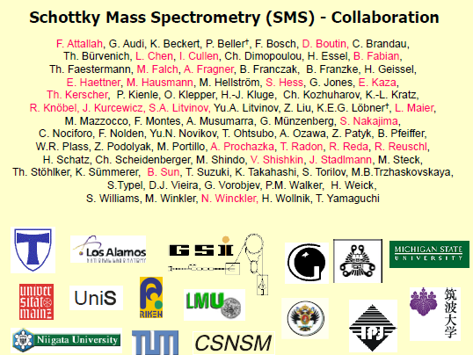
Examples of Schottky mass spectroscopy this and the following 4 slides (S.Litvinov) were provided by P. Kowina (GSI)

Slide 32
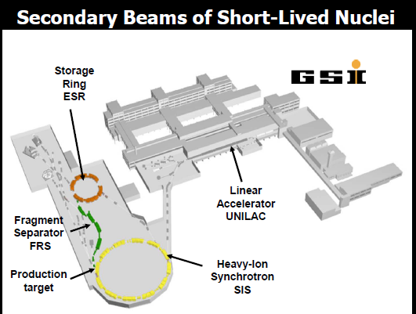
Examples of Schottky mass spectroscopy (2) production storage and cooling of short lived nuclei ( slide by S. Litvinov)

Slide 33
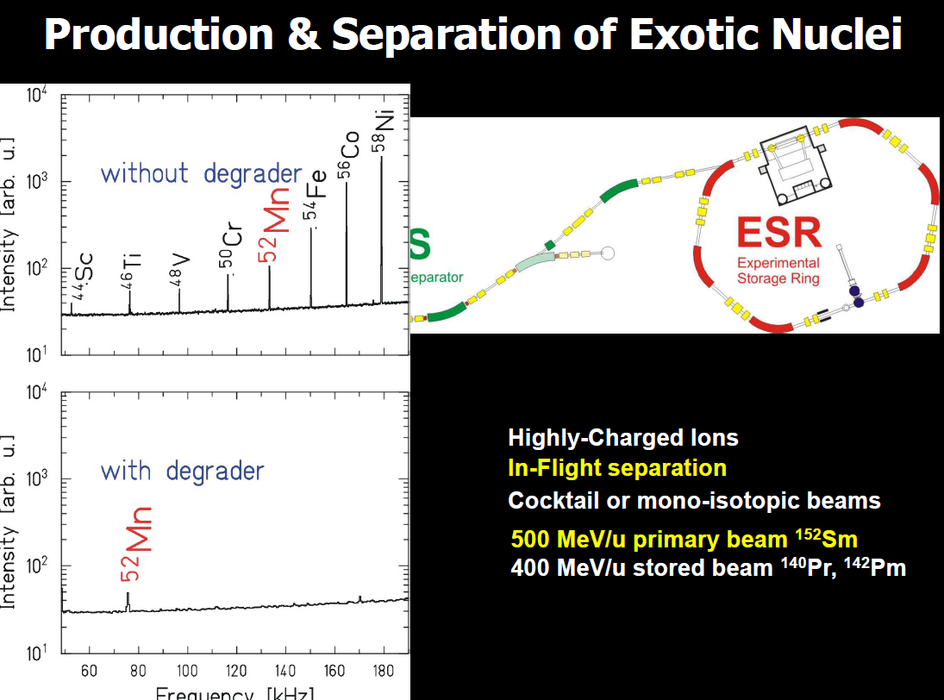
Examples of Schottky mass spectroscopy (3) production storage and cooling of short lived nuclei ( slide by S. Litvinov)

Slide 34
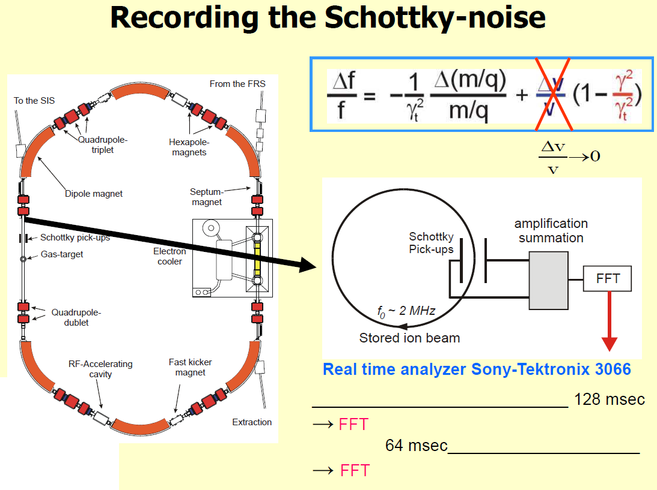
Examples of Schottky mass spectroscopy (4) production storage and cooling of short lived nuclei ( slide by S. Litvinov)

Slide 35
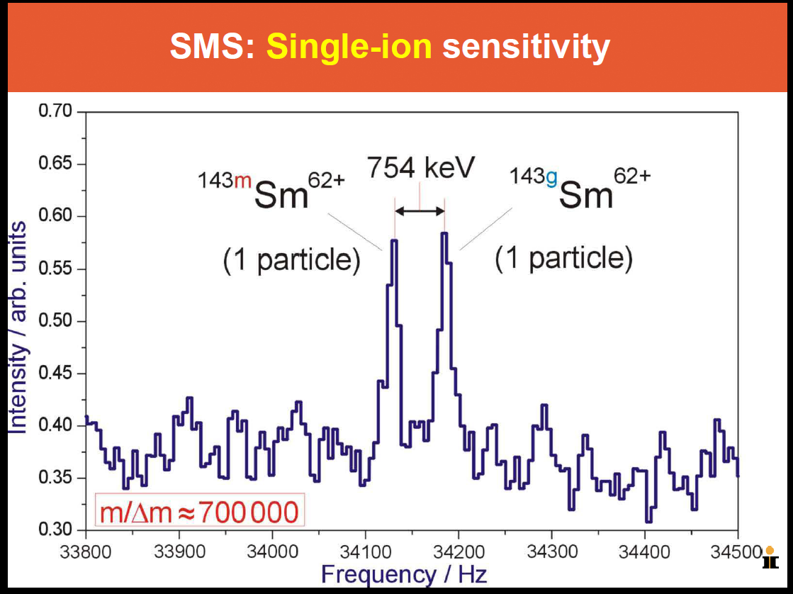
Examples of Schottky mass spectroscopy (5) production, storage and cooling of short lived nuclei ( slide by S. Litvinov)

Slide 36
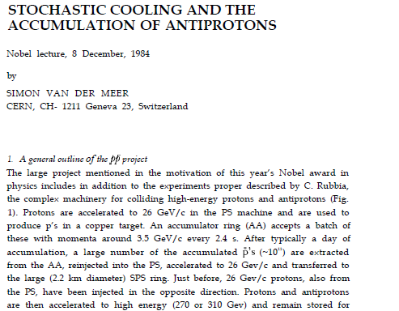
Stochastic beam cooling invented by Simon van der Meer at CERN in 1967, Nobel prize in 1984
The Nobel price was awarded to Carlo Rubbia
and Simon van der Meer for “their decisive
contributions to the large project, which led to the discovery of the field particles W and Z, communicators of the weak interaction".(quote)
and also from the Laudatio:
van der Meer made it possible, Rubbia made it happen.

Slide 37
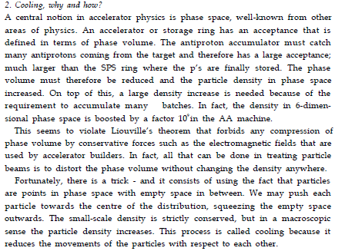
Stochastic beam cooling - why and how the text shown below is part of the Nobel lecture by S. v.d. Meer

Slide 38
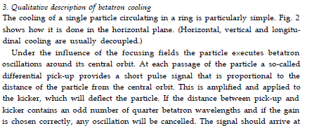
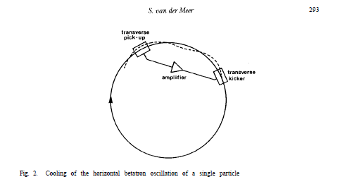
Stochastic beam cooling - hor. cooling the text shown below is part of the Nobel lecture by S. v.d. Meer

Slide 39
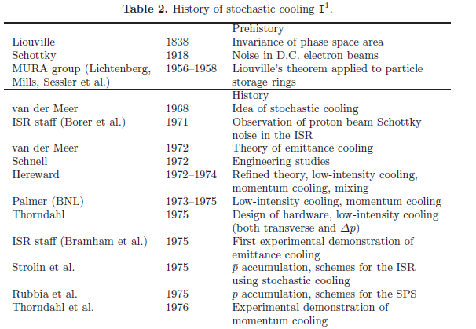
Stochastic beam cooling history – the early days
But not really published

Slide 40
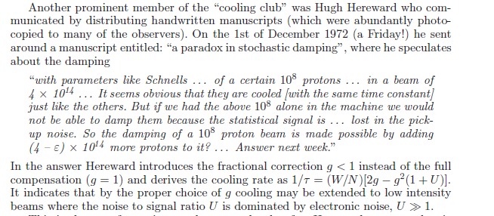
Stochastic beam cooling – theoretical considerations in the beginning
In this period the term damping was still used

Slide 41
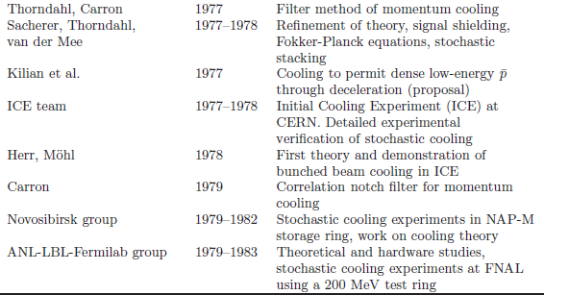
Stochastic beam cooling – the hot 70^{ths}
van der Meer

Slide 42
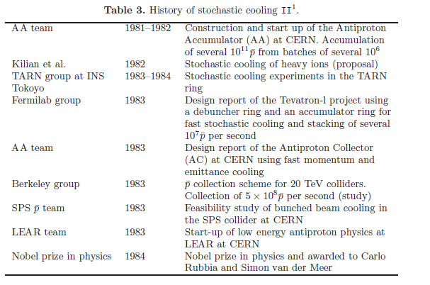
Stochastic beam cooling evolution – mid term history

Slide 43

Stochastic beam cooling history – recent achievements

Slide 44

Stochastic beam cooling – some basic theory
blue traces and dots = particle trajectory and position in phase space before kicker action
red traces and dots = particle trajectory and position after kicker action

Slide 45

Stochastic beam cooling – basic notations

Slide 46

Stochastic beam cooling – what can we observe?

Slide 47
Stochastic beam cooling - summary
Today stochastic cooling is an important tool for charged particle beam conditioning, its used in all 3 planes (horizontal, vertical and longitudinal
Stochastic cooling is applied on coasting (non-bunched ) and bunched HADRON beams, where for bunched beam stochastic cooling large difficulties related to inter-modulation of the front end amplifier had to be mastered
Stochastic cooling systems are in operation at CERN, GSI, FZJ, BNL and Fermilab and further systems are planned for NICA and in the frame of the FAIR project
Stochastic cooling is very suitable to make HOT beam tempered, and electron cooling is very well suited to make tempered beam really cold..approaching the state of beam crystallization…
There exist a considerable number of other particle cooling methods, such as ionization cooling ( proposed for muons with very short lifetime), laser cooling, radiation cooling (leptons) resistive cooling (applied in traps) ..just to give a few examples
Stochastic cooling has permitted to increase the “6 D phase space density” of antiprotons by more than 10 orders of magnitude…(these days)

Slide 48
Conclusion
For beam diagnostics in particle accelerators electromagnetic sensors operating from DC to well beyond the microwave range are and indispensible tool and modern accelerators cannot run without this kind of diagnostic.
Stochastic beam cooling, a combination of microwave based beam diagnostic and correction, has made important contributions to physics. This technique corrects the movements of individual particles. On average each simply charged particle (e.g. proton) passing through a stochastic cooling pick-up just gives off a single microwave photon per passage and can be extracted from the noise by signal observation over many turns
Microwave diagnostic can see a single charged particle circulating in a storage ring and also a single particle (e.g. antiproton) oscillating in a trap.
Microwave diagnostics is also an important tool for different kinds of experiments (e.g. antimatter related) in the vicinity of accelerators.
And last not least: RF and microwave power systems are the indispensible working horse for virtually ALL particle accelerators used these days.

