Slide 1
Simultaneous 0-ν ββ Decay & WIMP Dark Matter Searches and…maybe
Nuclear Recoil Directional Sensitivity at the ton-scale ?
David Nygren

Slide 2
Simultaneous searches?
Next generation projects will be expensive!
Gas phase offers attractive possibilities:
  Remarkably good energy resolution (0ν-ββ)
  Event topology (0ν-ββ & WIMPs)
  Small S2/S1 fluctuations (WIMPs)
  Nuclear recoil direction in dense gas ??

Slide 3
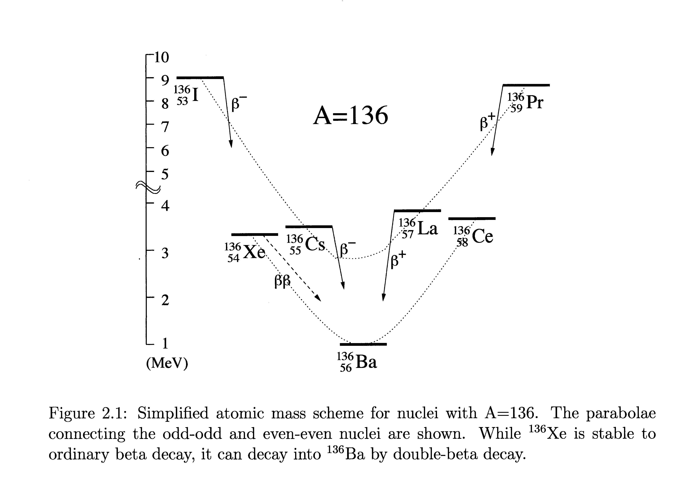
ββ decay: Rare transition between same A nuclei
  Energetically allowed for some even-even nuclei
(Z,A) → (Z+2,A) + e⁻₁ + ν₁ + e⁻₂ + ν₂
(Z,A) → (Z+2,A) + e⁻₁ + e⁻₂
(Z,A) → (Z+2,A) + e⁻₁ + e⁻₂ + χ

Slide 4
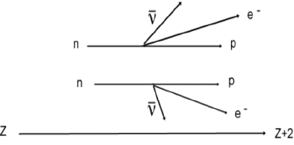
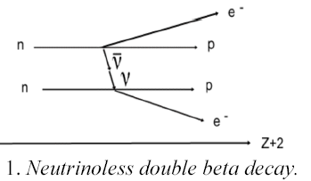
Two Types of Double Beta Decay
2ν ββ
A known standard model process and an important calibration tool
If this process is observed:
Neutrino mass ≠ 0
Neutrino = Anti-neutrino!
Lepton number is not conserved!
0ν ββ
?
Z
Neutrino effective mass
Neutrinoless double beta decay lifetime

Slide 5
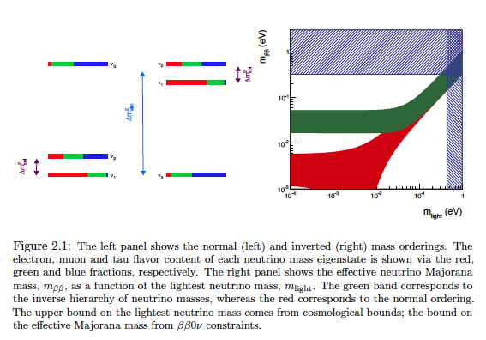

Slide 6
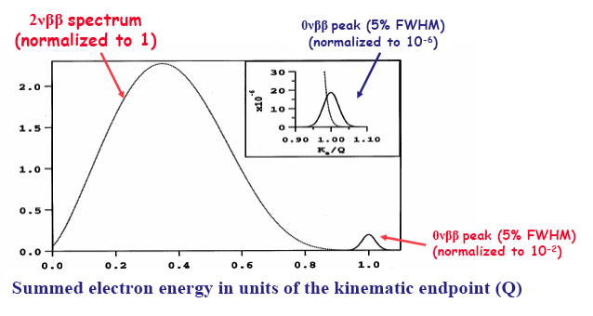
How to search for neutrino-less decay:
Measure the spectrum of the electrons

Slide 7
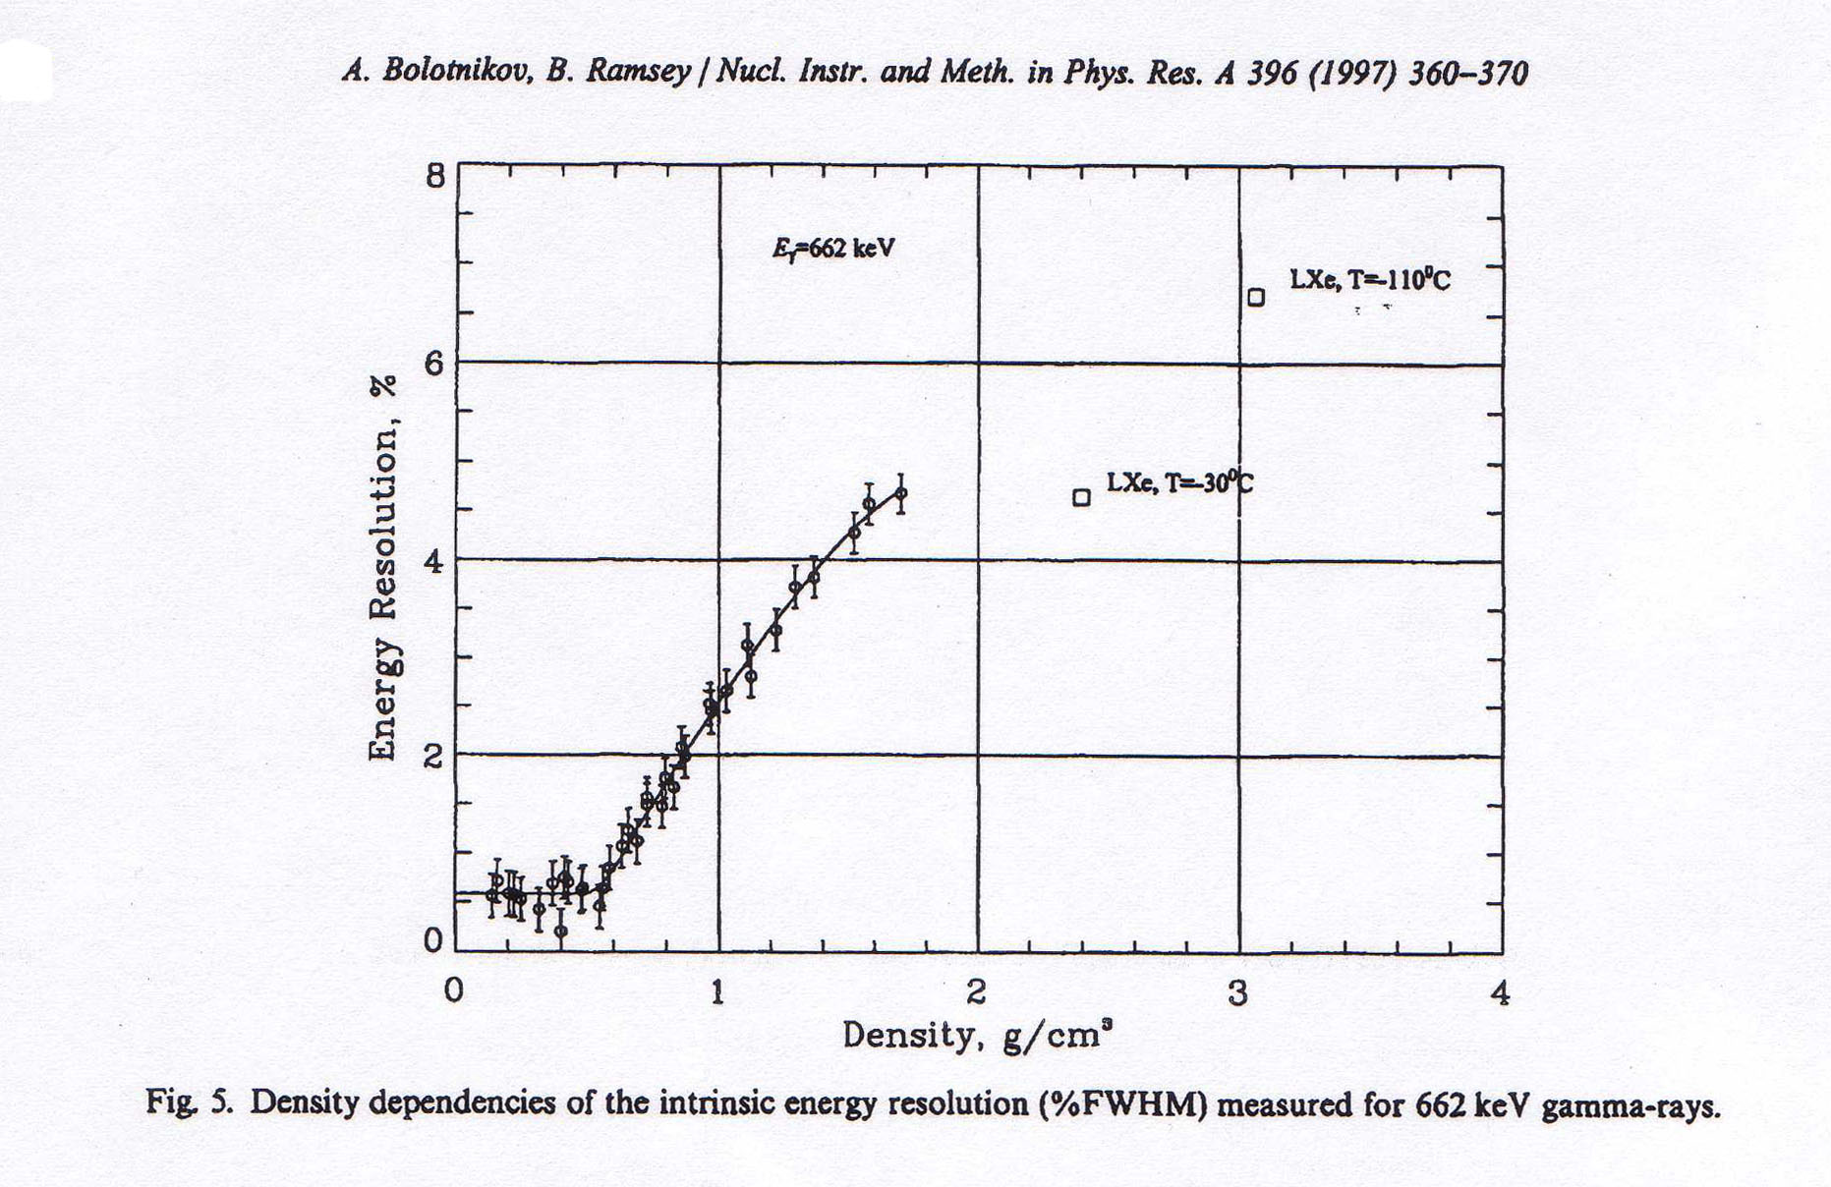
Why Xenon Gas?
Energy resolution in Xenon depends very strongly on density
Here, the fluctuations are normal
Fano factor
F = 0.15
Unfolded resolution:
δE/E ~0.6% FWHM
Very large fluctuations between light/charge!
F ~ 20 !!
Ionization signal only!
For ρ <0.55 g/cm³, energy resolution from ionization is “intrinsic”

Slide 8
Why Xenon Gas?
Energy resolution in Xenon depends very strongly on density
Here, the fluctuations are normal
Fano factor
F = 0.15
Unfolded resolution:
δE/E ~0.6% FWHM
Very large fluctuations between light/charge!
F ~ 20 !!
WIMPs:
Large S2/S1 fluctuations
Ionization signal only!
For ρ <0.55 g/cm³, energy resolution from ionization is “intrinsic”

Slide 9
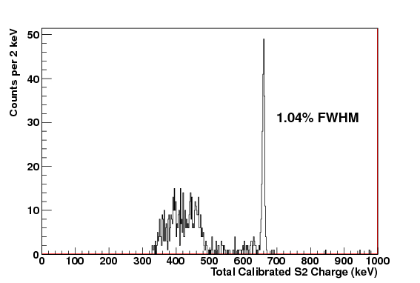
New result: Energy resolution δE/E = 1% FWHM for ¹³⁷Cs 662 keV γ-rays in xenon!
Data from LBNL-TAMU HPXe TPC
This result is important for both 0-νββ & WIMP searches
Ionization signal only
This result shows that fluctuations are “normal” in HPXe

Slide 10
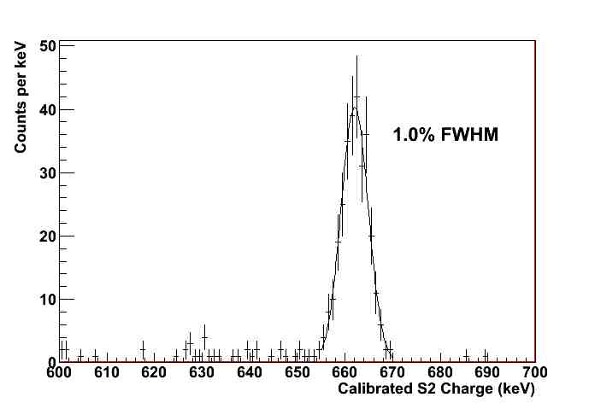
NEXT - DBDM
The peak really is Gaussian,
a world record for xenon
¹³⁷Cs γ-ray: 662 keV

Slide 11
Energy resolution at Q_{ββ} = 2457 keV
δE/E = 2.35 ⋅ (F⋅W/Q)^{1/2}
  F ≡ Fano factor (HPXe) : F = 0.15
  w ≡ Average energy per ion pair: w ~ 25 eV
  Q ≡ Energy deposited from ¹³⁶Xe --> ¹³⁶Ba:
N = Q/w ~100,000 primary electrons
σ_{N} = (F⋅N)^{1/2} ~124 electrons rms!
δE/E = 0.28% FWHM intrinsic HPXe
Scaling our result: δE/E ≈ 0.5% FWHM @ Q_{ββ}
Notes:
Only about x3 worse than Ge diodes!

Slide 12
Asymmetric TPC with “Separated functions”
Virtual Fiducial surface
Transparent -HV cathode
Electroluminescent plane
Energy plane
Energy & primary scintillation signals recorded here, with PMTs
electrons
EL signal created here
Tracking
performed
here, with
SiPM array
ions
Operating pressure:
10 -15 bars
Field cage: teflon
Notes:
Electroluminescence is noiseless

Slide 13
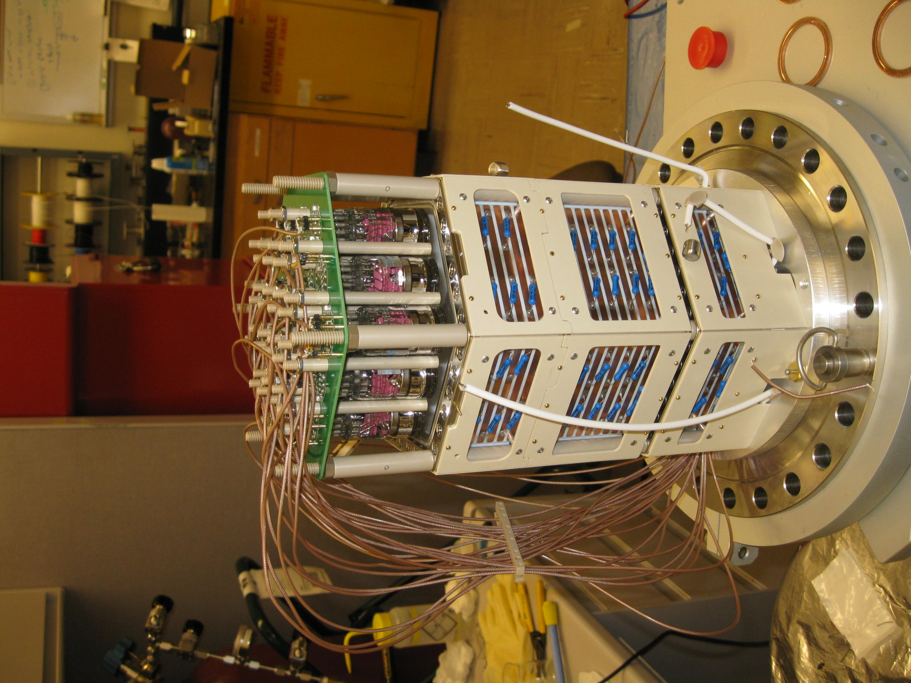
NEXT - DBDM
Field cages/Light cage
PTFE with copper stripes
19 PMTs and PMT bases
Electroluminescence region
10 kV across a 4 mm gap
13

Slide 14
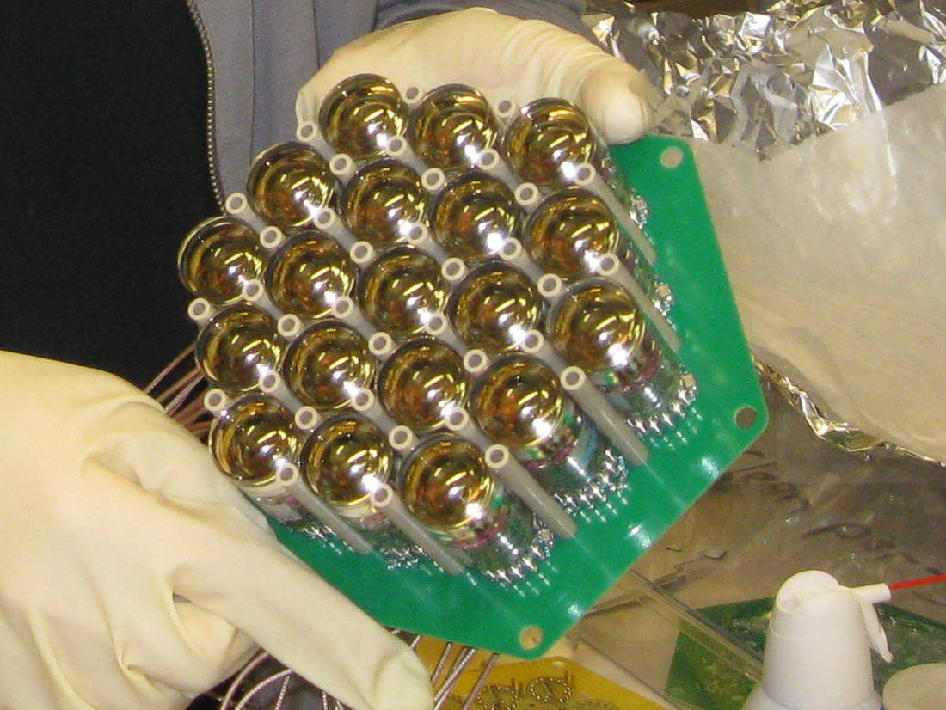
PMT Array: inside the pressure vessel
Quartz window 2.54 cm diameter PMTs
TIPP 2011
14

Slide 15
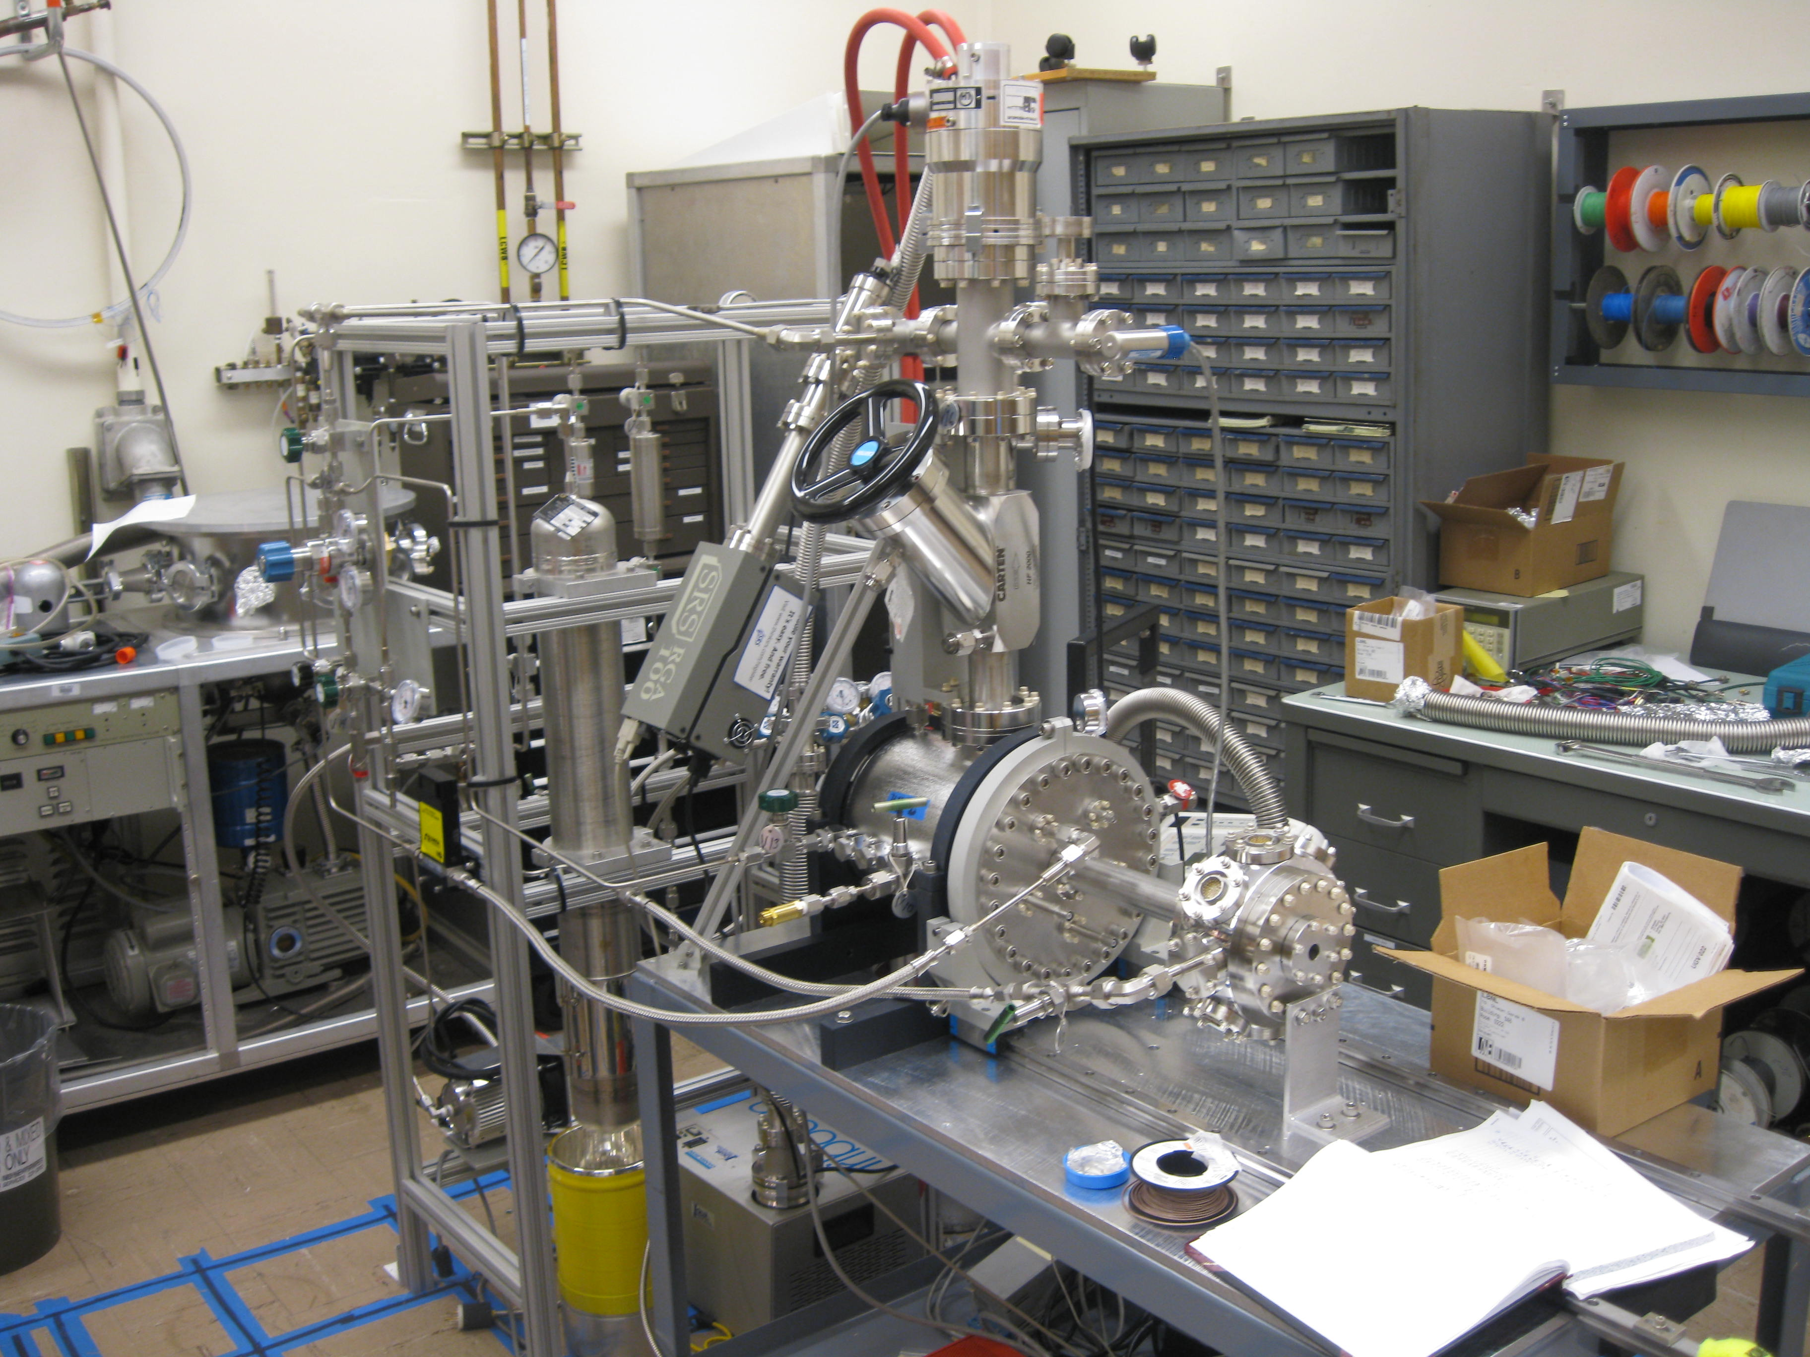
NEXT - DBDM
TIPP 2011
15

Slide 16
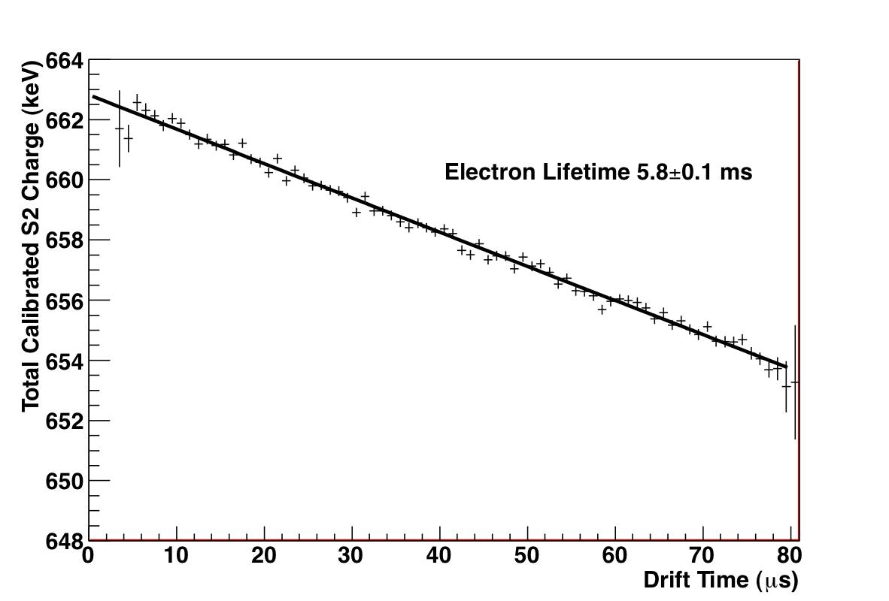
Attenuation of electrons during drift: small, but non-negligible
Parts/thousand
corrections for
attenuation are
modest, and can
be made with an
insignificant
contribution to
energy error.

Slide 17
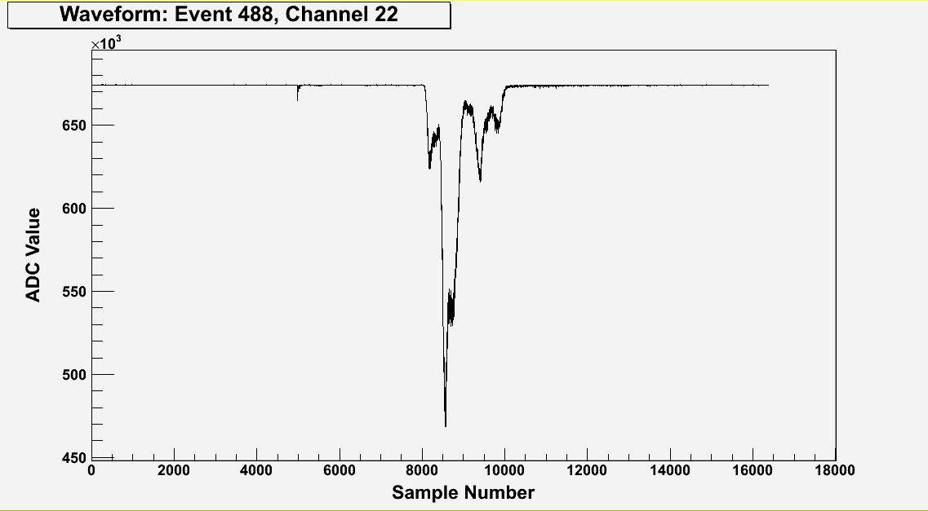
A typical ¹³⁷Cs γ waveform (sum of 19 PMTs)
~300,000 detected photoelectrons
Primary Scintillation (S1)
T0 of event
Electroluminescence (S2)
structure reflects topology
Drift Time:z-position
(~0.01mm/sample)
Drift velocity ~1 mm/ms
TIPP 2011
17
10ns/sample

Slide 18
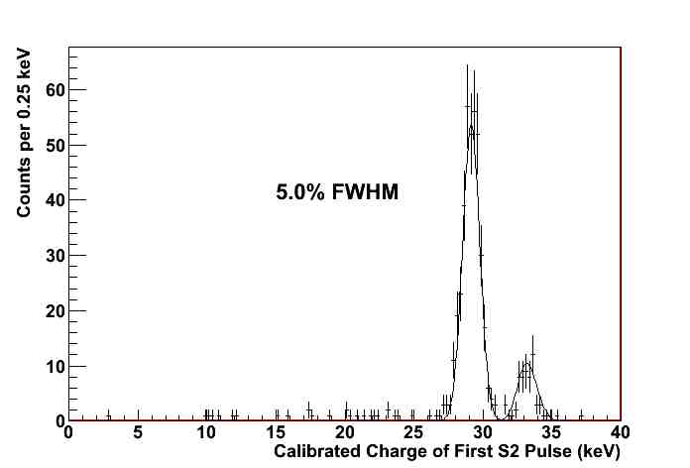
The x-ray peaks - around ~30 keV
Data: NEXT-DBDM

Slide 19
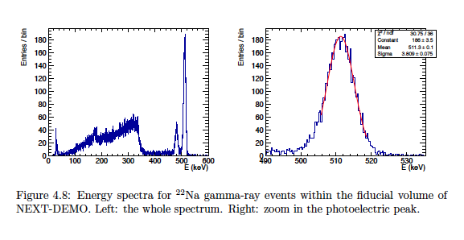
NEXT-DEMO (IFIC-Valencia)

Slide 20
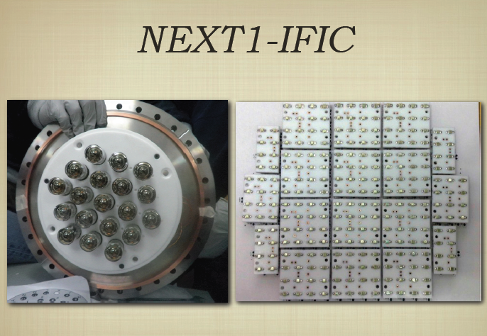
Tracking: PMTs → SiPMs
NEXT-DEMO (IFIC, Valencia)

Slide 21
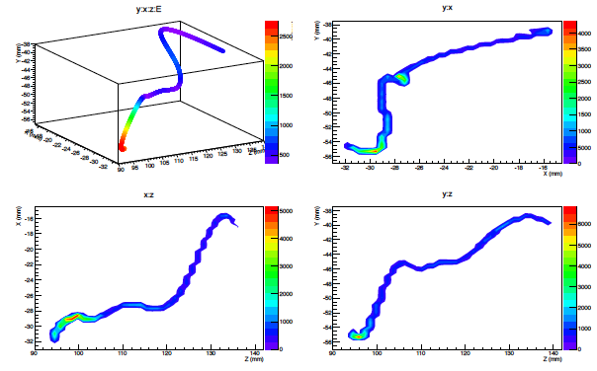
Real track from ¹³⁷Cs γ-ray – reconstructed with SiPMs
NEXT-DEMO IFIC, Valencia

Slide 22
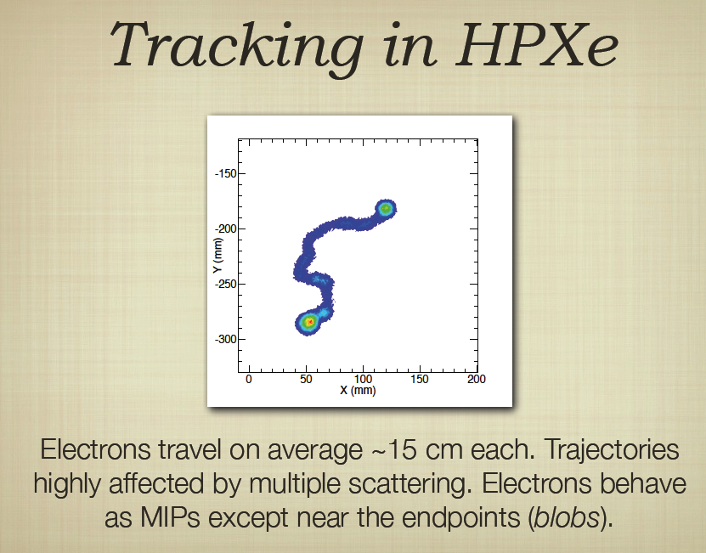
ββ decay:
“spaghetti with two meatballs”
Operating pressure: 10 - 15 bars

Slide 23
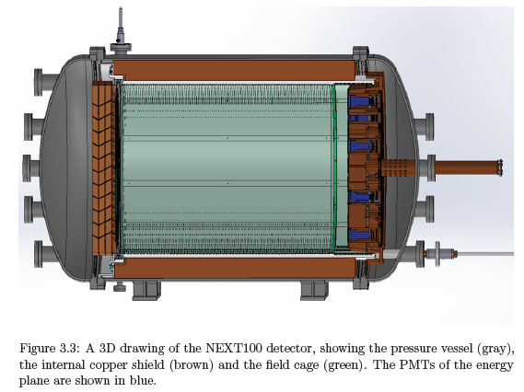

Slide 24
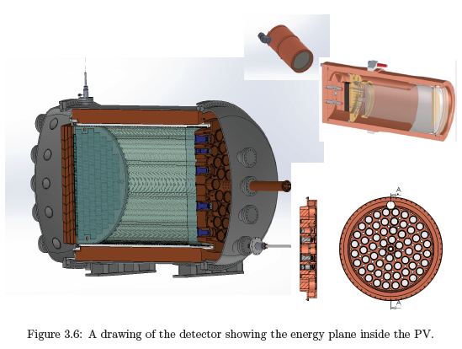

Slide 25
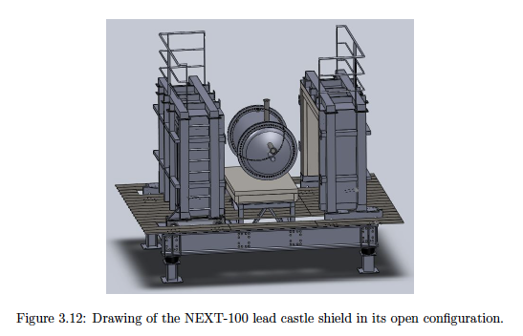

Slide 26

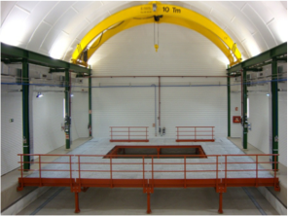
NEXT at Laboratorio Subteranneo de Canfranc (LSC), Spain
The experiment will be located at Hall A at the LSC. Working platform and basic gas system already in place.

Slide 27
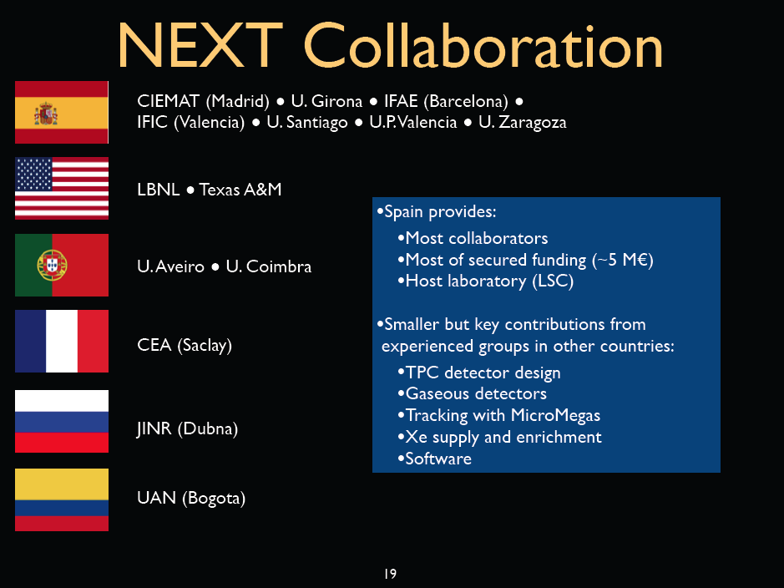
 ISU  UNM
Spain provides:
Most of the collaborators
Most secured funding
Host Laboratory - LSC
Key contributions from international groups
Engineering and integration
TPC expertise
high-pressure gas detectors
Xenon supply & enrichment

Slide 28
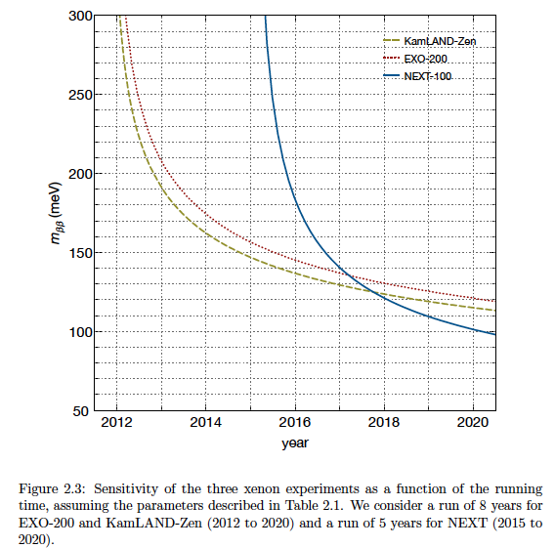

Slide 29
Pure xenon gas: 0ν- ββ :
Excellent energy resolution verified by NEXT at 30, 511, 662 keV for energetic electrons
Nature of neutrino: Majorana – Dirac?
  Clearly, this is the province of HEP !
  Office of Management & Budget:
    “Redundant effort by Nuclear and HEP in DOE exists”
    Decree: “0ν- ββ belongs to DOE Nuclear Physics only”
    Exception: R&D for nEXO can be supported by HEP
Notes:
0.01 to 0.05 ckky expected backgrounds in simulation

Slide 30
Dark Matter Search with HPXe
The superb energy resolution available, in principle, also helps the WIMP search
  Intrinsic S2/S1 fluctuations are much smaller
  → much better recoil discrimination
Gas phase xenon permits:
  molecular additives at convenient fraction
  density optimization essential for directionality
Notes:
Beneficial for 0ν-ββ, too

Slide 31
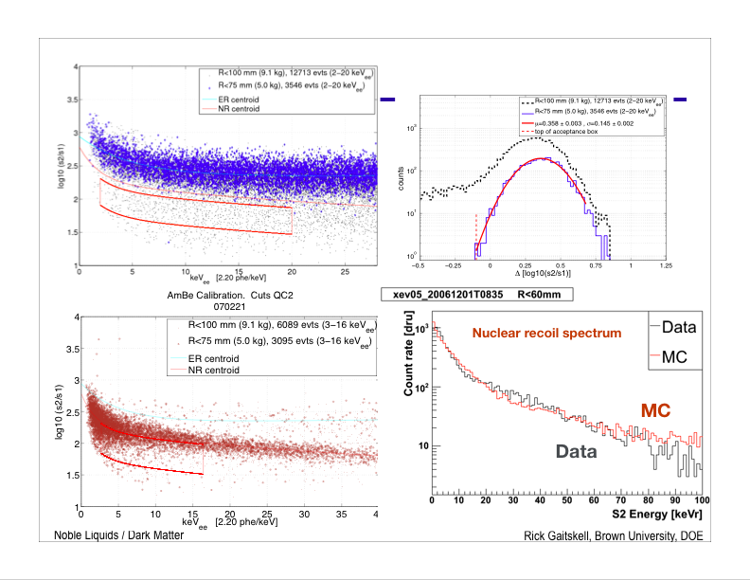
S2 = Primary ionization signal
S1 = Primary scintillation signal
Xenon10 – LXe data
Gamma events (e - R)
Log₁₀ S2/S1
γ events show large S₂/S₁ fluctuations at all energies, not improving with energy
Neutron events (N - R)

Slide 32
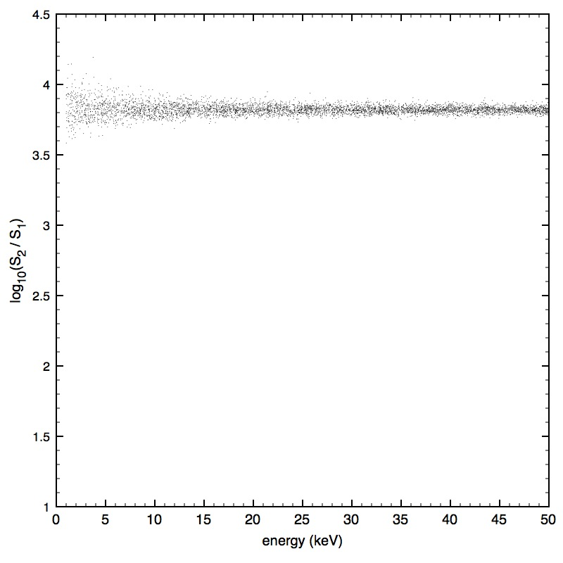
Simulation: electron recoils in pure HPXe, F = 0.15, !0% optical efficiency
Simulation!
S2 = ionization signal = Q
S1 = scintillation signal = L
Plot by Justo Martin-Albo,
IFIC, Valencia

Slide 33
Simulation: electron recoils in pure HPXe, F = 0.15, !0% optical efficiency
Simulation!
Nuclear recoils here?
S2 = ionization signal = Q
S1 = scintillation signal = L

Slide 34
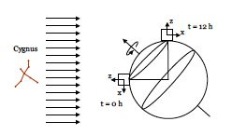
Directional sensing for nuclear recoils?
A sidereal variation of “WIMP wind from Cygnus”
WIMPs: <V> ~ 220 km/s
earth’s velocity: ~230 km/s
Substantial anisotropy in nuclear recoils should be observable:
Back/forward: ~10
Notes:
Anisotropy of recoils is substantial
Sidereal day 1/366 different from solar diurnal day

Slide 35
Today’s techniques
All current approaches attempt to visualize the nuclear recoil track:
  Nuclear Emulsions (expanded optical readout!)
  D³ (low-pressure TPC: GEM + pixel ASIC)
  DMTPC (low-pressure TPC: CF₄ optical CCD)
  DRIFT (low-pressure TPC: CS₂⁻, CF₄, MWPC )
  MIMAC (low-pressure TPC: CF₄ + μMegas )
  NEWAGE (low-pressure TPC – Gem, μ-dots )

Slide 36
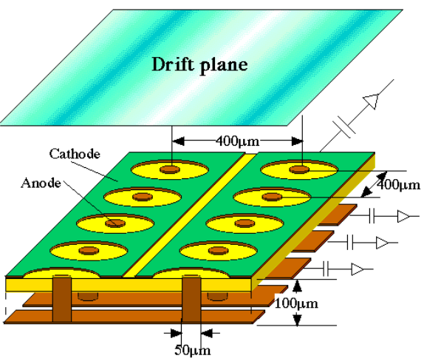
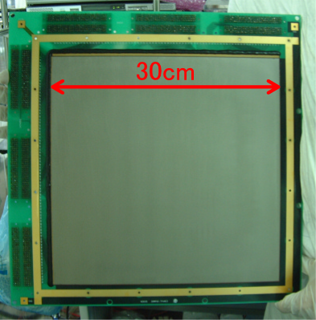
NEWAGE – NEW generation WIMP-search with Advanced Gaseous tracking device Experiment
Started = 2002, Japan
Underground in Kamioka, Japan in 2007
Current operating detector = NEWAGE-0.3a
Technology = TPC with GEM + μPIC readout
xyz resolution = 0.4 mm each & absolute in xy
Target = 152 Torr CF₄
Fiducial volume = 15.5 liters
F mass = 9.79 g
Limit setting threshold = 140 keVr (100 keVr demonstrated)

Slide 37
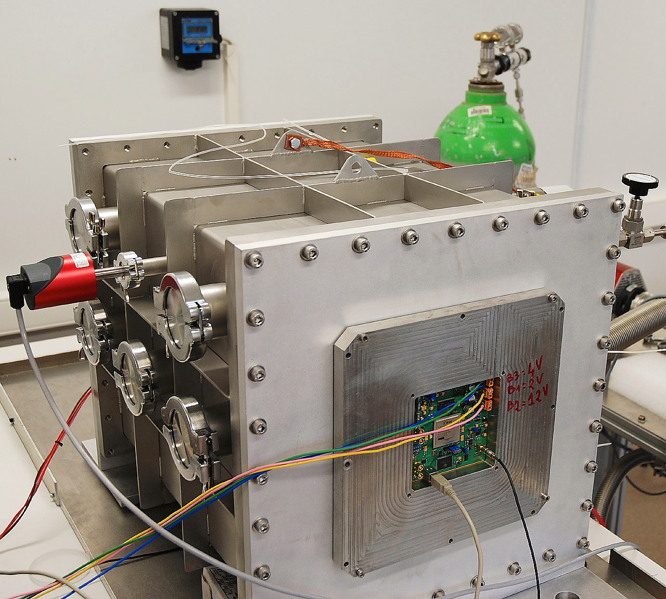
MIMAC– MIcro-tpc MAtrix of Chambers
Started = 2005, France
Underground in Modane, France in June 2012
Current operating detector = MIMAC prototype Bi-Chamber
Technology = TPC with micromegas + pixel readout
xyz resolution = 0.35 mm each & absolute in xy
Target = CF₄ + 30% CHF₃ @ 37.5 Torr
Fiducial volume = 5 liters
F mass = 1.0 g
Limit setting threshold = 20 keVr

Slide 38
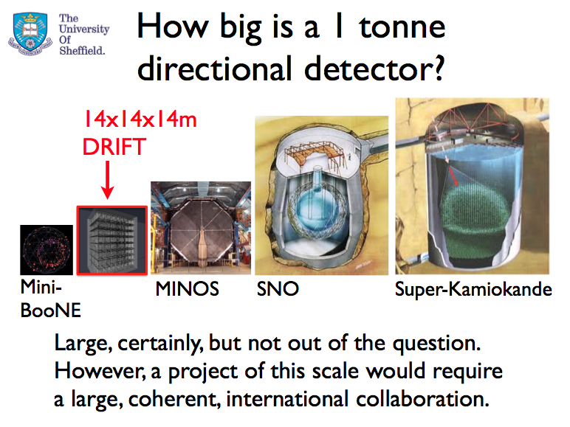
Facility Expansion Plans...
(From Jocelyn Monroe...)

Slide 39
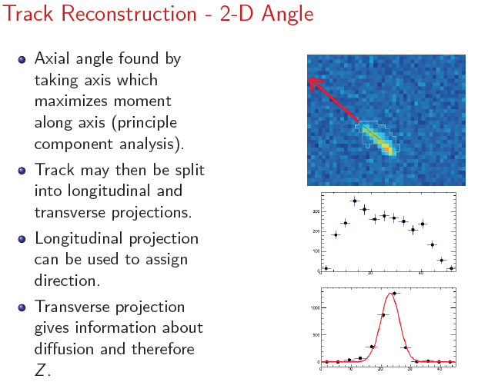
DM-TPC
313 keV energy

Slide 40
Instrumentation needs for
Directional Dark Matter Detection
Active mass must increase to confront limits provided by evolving direct detection limits
  10’s of grams → 100’s of kg → ton ?
  Track “visualization quality”
    “Head-tail” down to low energies?
    Rejection of electron recoils?
New approach needed!

Slide 41
Directionality in nuclear recoils
Columnar recombination (CR) can be sensitive to the angle between a highly ionizing track and an electric field E;
  Recombination signal: scintillation
For a given event energy, more recombination would yield more scintillation, less ionization
Therefore, a comparison – event by event – of ionization/scintillation is a measure of CR
Notes:
in xenon: 173 nm VUV – Challenging in large systems!

Slide 42
What is Columnar Recombination?
Columnar Recombination (CR) occurs when:
    A drift electric field E exists;
    Tracks are highly ionizing;
    Tracks display an approximately linear character;
    The angle α between E and track is small:
track
E
E
α
track
Substantial CR
~Small CR
Notes:
Electrons have to drift past the ion column, which is waiting to grab them.

Slide 43
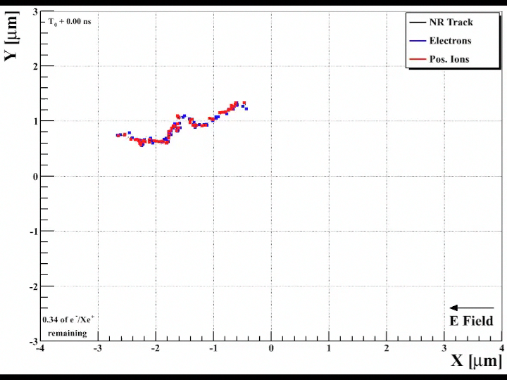
α = 10°

Slide 44
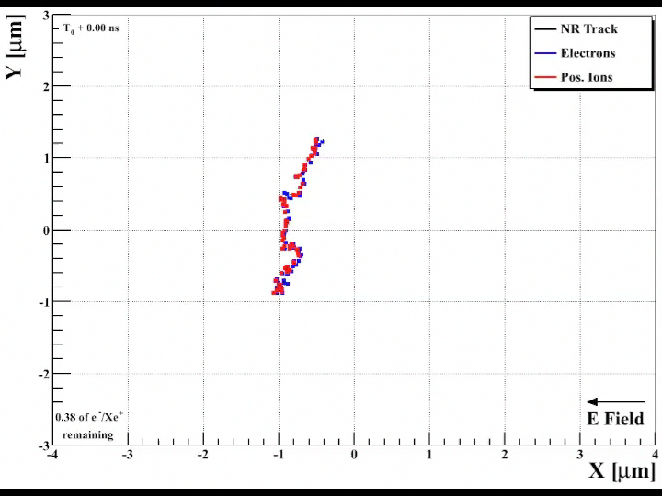
α = 80°

Slide 45
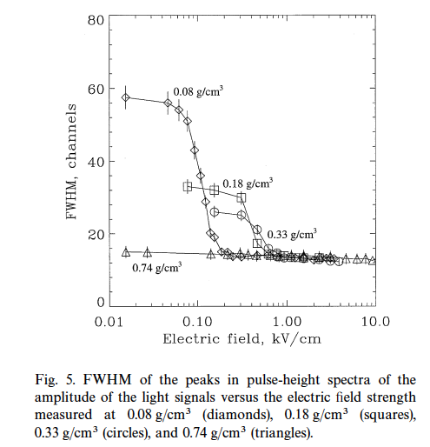
CR Exists!
Evidence for columnar recombination in
α-particle tracks in dense xenon gas.
FWHM depends on
E-field and density!
Bolotnikov & Ramsey
NIM A 428 (1999)
pp 391-402
G. C. Jaffe:
Annalen der Physik, 42, p 303, (1913)

Slide 46
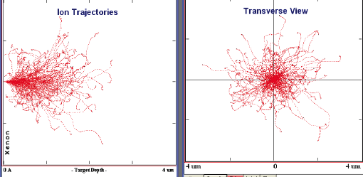
Directionality ??
SRIM: 200 Xenon 30 keV nuclear recoil events in HPXe Xenon – unweighted by energy loss

Slide 47
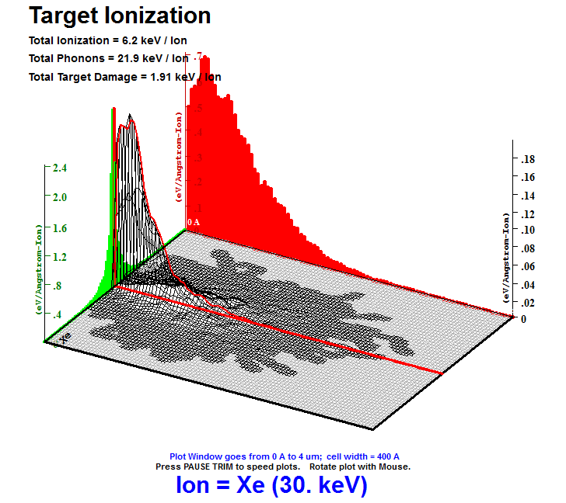
30 keV Xe ions in 10 bars xenon gas
SRIM simulations:
Verified for solids to ~5%, not guaranteed for simulations in gas
Nuclear recoils are messier than α-particles

Slide 48
What is the optimum Xe density?
Define (electrostatic) Columnarity: C
C = R/r₀
R = the nuclear recoil track range
r₀ = Onsager radius r₀ = e²/ε E, where E is electron energy (usually taken as kT)
  in xenon gas for ρ ≈ 0.05 g/ cm³:
    R₀ ~ 70 nm
    R ~ 2100 nm for 30 keV nuclear recoil
    C ≈ 30 in this example
    Onsager spheres overlap ! → “Onsager tube”

Slide 49
Columnarity is key
We want C to be fairly large, i.e. C > 10
This condition is probably met for KE ≥ 20 keV in xenon gas for ρ ≈ 0.05 g/ cm³, or less
  Hopeless for liquid xenon density: 3.1 g/ cm³
Figure of Merit M = V_{det}/V_{track} = 10¹⁷ per m³
For low density TPC approach: M = 10⁸
CR M is better than low-density TPC by ~10⁹

Slide 50
How to maximize a CR signal…
Tracks are short… don’t let electrons escape!
Signals are small… don’t waste them!
A lot of energy goes into primary excitations
  Excitations contribute nothing to directionality!
  Use the Penning effect: convert excitations to ionization, which can contribute to a CR signal!
Use the same molecule to cool the electrons
  Thermal electrons recombine more efficiently

Slide 51
How to maximize a CR signal…
Maximize your optical detection efficiency:
  Gas detector will be big relative to liquid, solid
    can’t have PMTs everywhere – what to do?
  Use wavelength-shifting plastic: 100% coverage
    WLS plastic has ~0 efficiency at 173 nm of xenon
  Make your CR signal optimally matched to wavelength-shifting plastic: ~300 nm optimum
    Wavelength-shifting must happen in the gas!

Slide 52
  How to maximize a CR signal…
  The presence of a Penning molecular additive in the gas automatically induces charge exchange
    All ions become Penning Molecular ions
    All recombination occurs with molecular ions
  Miracle needed: Penning molecule must display efficient UV fluorescence at ~300 nm
  Providence: trimethylamine (TMA)
    Strong (indirect) evidence of Penning effect in xenon
    Is known to fluoresce very efficiently at ~300 nm !!!
Notes:
triethylamine (TEA) –may not be a Penning molecule?

Slide 53
Scenario
“S1” signal may display strong columnar recombination
    A substantial effect for nuclear recoils (~100x minimum ionizing)
    A negligible effect for electron recoils (~1x minimum ionizing)
This may provide a way to “see” WIMP directionality without direct imaging of nuclear recoil tracks
  Density restriction on gas is moved to ~10 bars
  X100 increase relative to low density TPC concept
  Drift length restriction due to diffusion is removed
  Simpler spatial detection requirements at anode plane
  Larger monolithic detector possible, x10 – 100 volume
Several hundred kg active mass possible, if true!

Slide 54
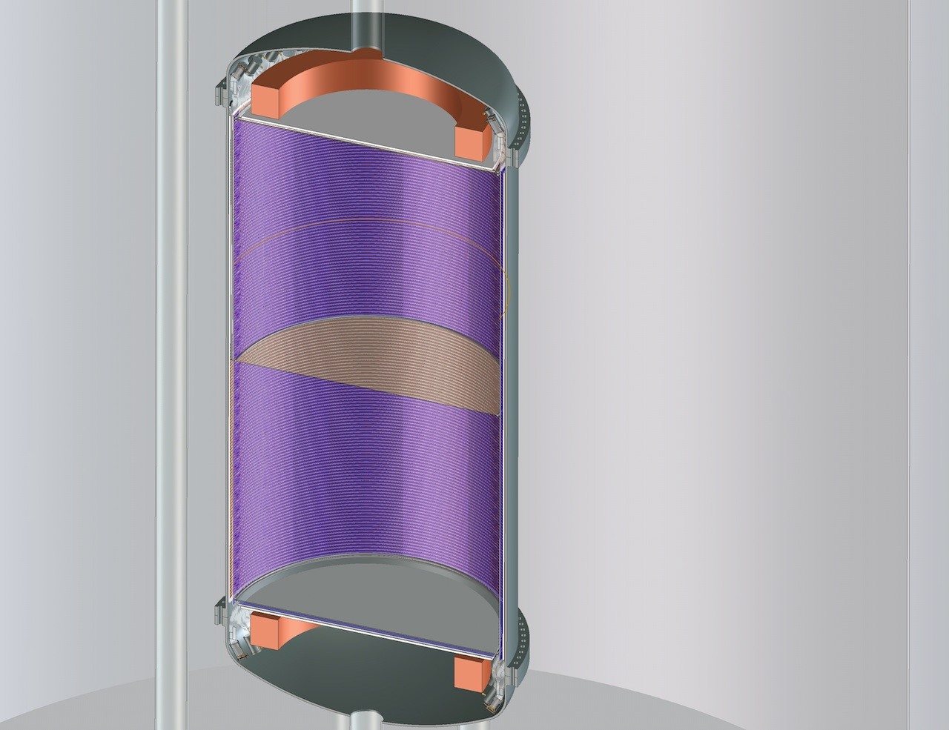
Size: 2+ meter diameter
2 x 2.5 meter drift length
With E-field in opposing directions, a “head-tail” effect might show up
Notes:
Head-tail effect?

Slide 55
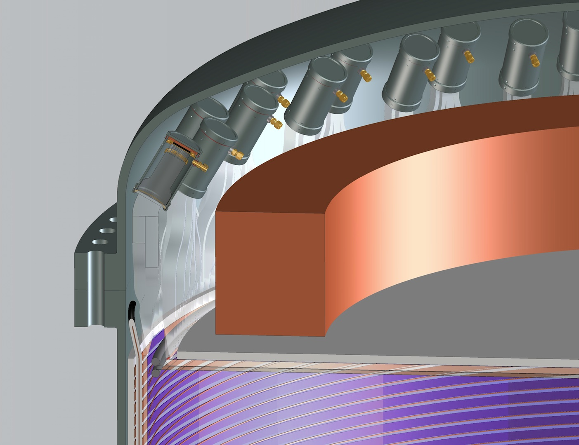

Slide 56
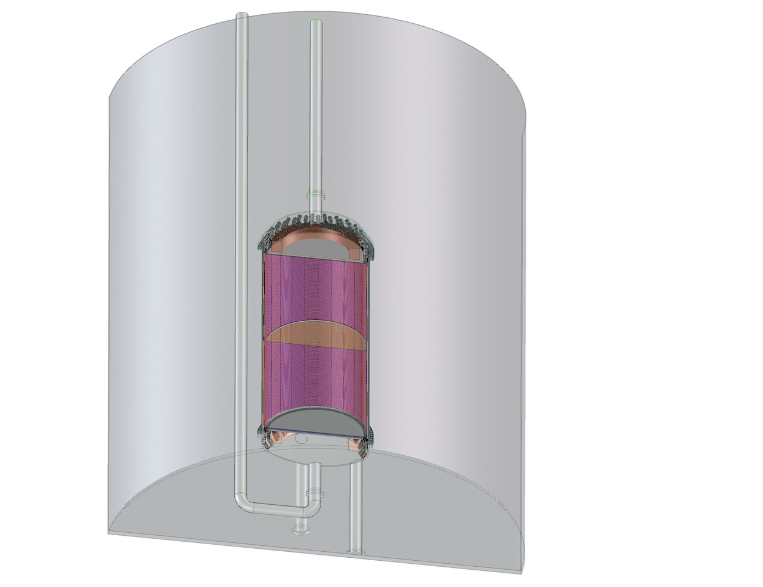
Large, but maybe not too large…

Slide 57
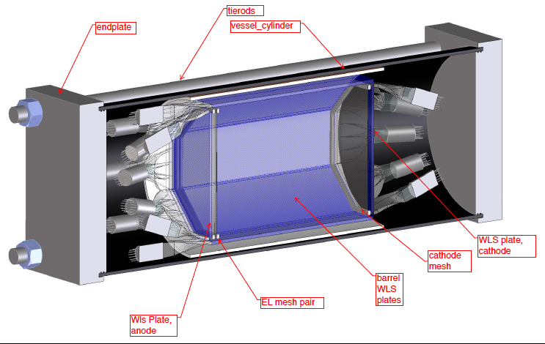
OSPREY: “Opportunities for Superior Performance in Rare Event Yields”
S2/S1 responses
“WIMP directionality”

Slide 58
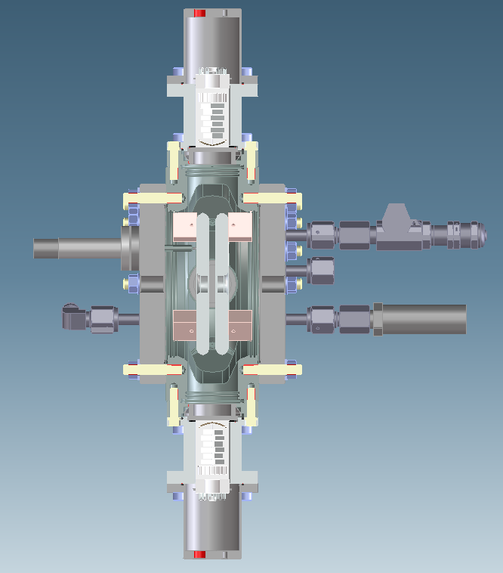
the “TEA-pot”
Basic responses measurements:
A parallel-plate ionization chamber with optical sensing, using 4 PMTs that look at the gap from the sides
We will measure both light and charge as functions of density, electric field, and fraction of TMA/TEA,

Slide 59
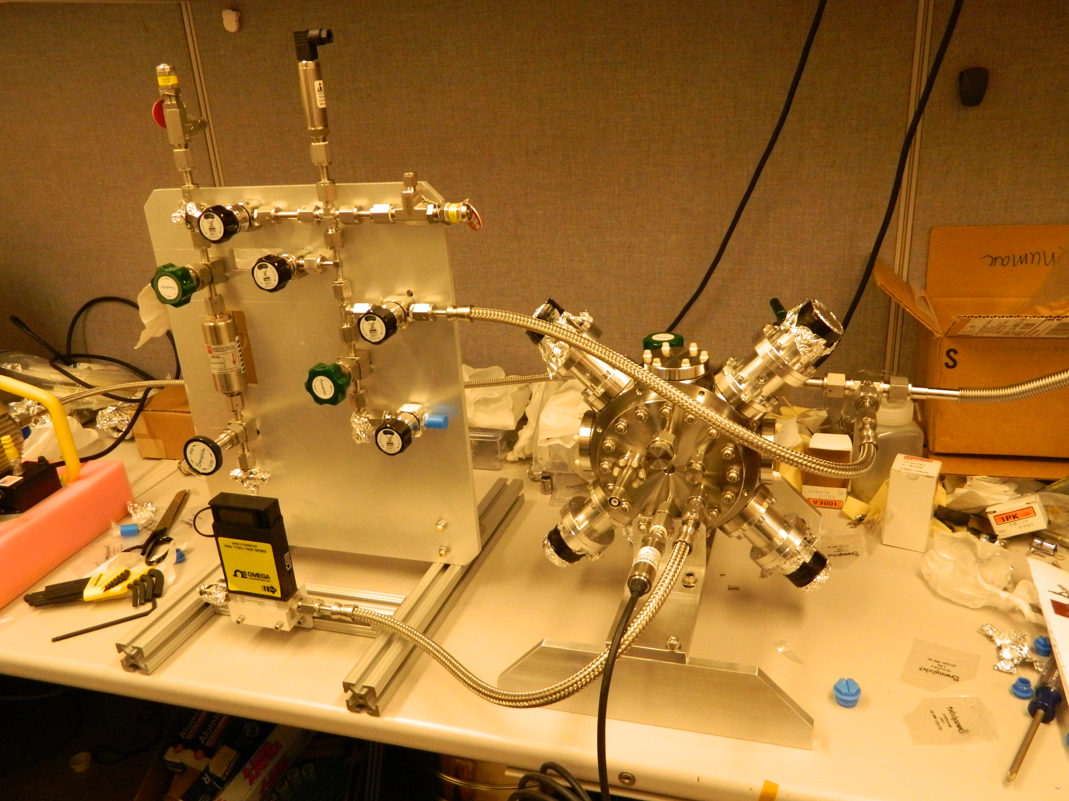

Slide 60
Perspective
Is this a true story, or a fairy tale?
  At least, serves as imagination stretcher…
Plausible at each step, but unknowns exist:
  Penning efficiency of TMA?
  Fluorescence efficiency of TMA in recombination?
  Rate of ionic charge exchange fast enough?
  Cooling rate of electrons after ionization?
Simulation and experimental effort starting…

Slide 61
Perspective –
Gas phase offers superb energy resolution, event visualization, and flexibility in operation
EL gain stage is a key element for near-intrinsic energy resolution for 0ν-ββ search and low energy signals
Small energy partition fluctuations imply superb S2/S1 discrimination between electron and nuclear recoils
Directionality signal for WIMP search at 100’s of kg in monolithic detector may exceed current reach by >1000

Slide 62
Thank you

Slide 63
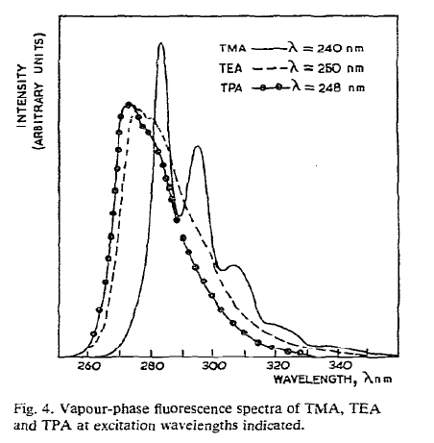

Slide 64
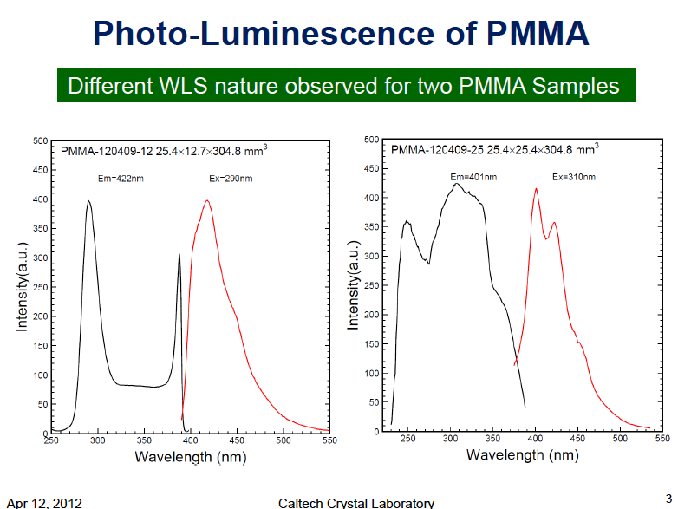

Slide 65
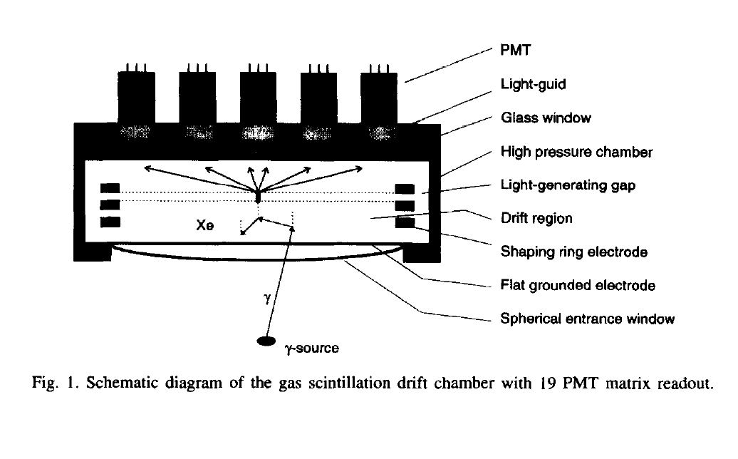
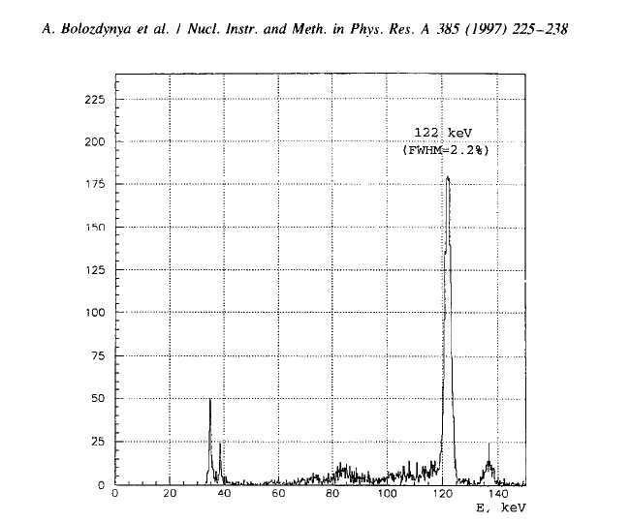
Electroluminescence in 4.5 bar of Xenon
2.2% FWHM resolution corresponds to
δE/E = 5 x 10⁻³ FWHM
-- if naively extrapolated to
Q_{ββ} of 2.5 MeV

Slide 66
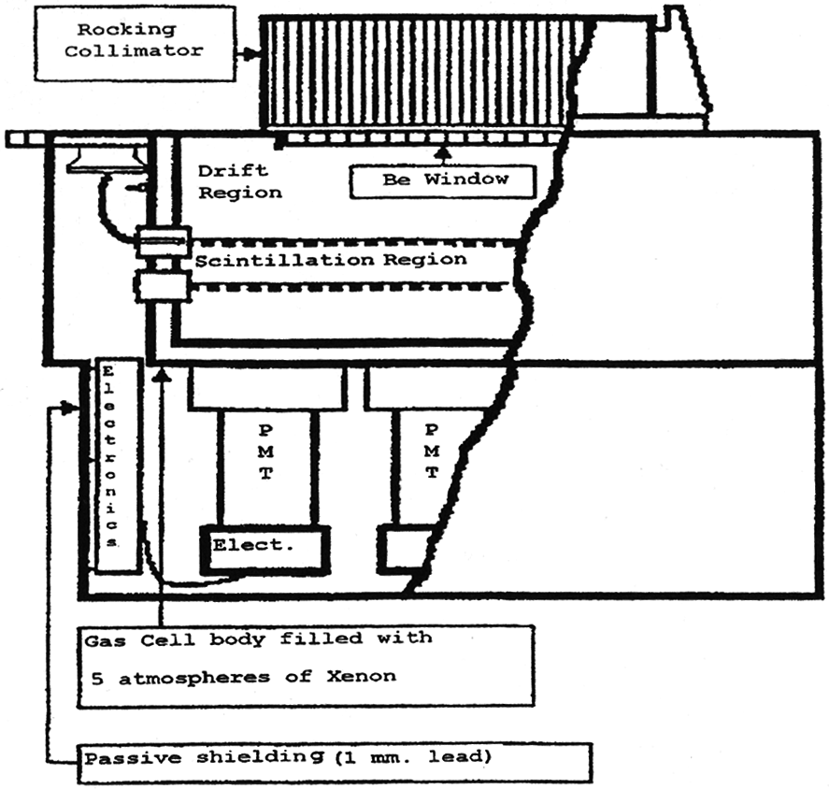
Beppo-SAX satellite: a HPXe TPC in space!

Slide 67
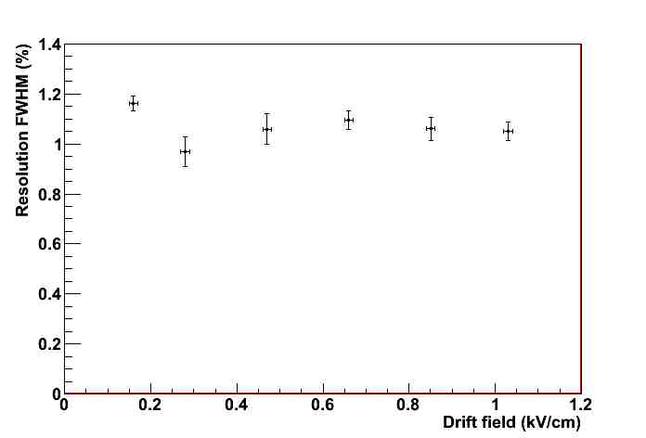
Data: NEXT-DBM

Slide 68
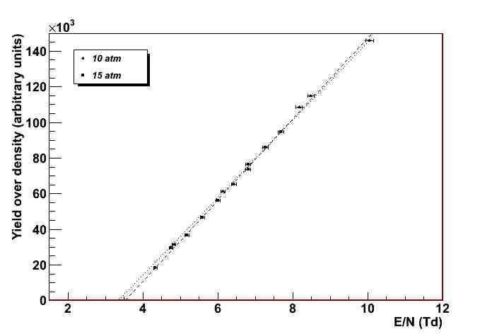
Data: NEXT-DBM

Slide 69

Gaussian behavior persists at x10 number of events
➔ Superb electron-nuclear recoil discrimination!
➔ Efficient use of active mass – no brutal cuts

Slide 70


D³ Concept
Focusing idea
Are diffusion effects benign?

Slide 71
D³ – Directional Dark Matter Detector
Started = 2008, US, LBNL + Hawaii
Current operating detector = D³ micro prototype
Technology = TPC with GEMs + ATLAS FE-I3 pixel chip and ATLAS pixel readout electronics.
xyz resolution = 0.05 mm, 0.4 mm, ~0.15 mm & absolute in xy
Target = CF₄ ? CS₂ ?
Fiducial volume = 3 liters
Limit setting threshold = ?
Acknowledgment:
Sven Vahsen UH,
John Kadyk LBNL

Slide 72


Slide 73

DMTPC Concept
CF₄ is a fast, low diffusion gas, which scintillates in IR –
Notes:
but it also attaches electrons in gain region, degrading statistical quality of signal

Slide 74


DM-TPC – Dark Matter TPC
Started = 2007, US
Underground in WIPP, USA in 2011
Current operating detector = DMTPC 10 liter
Technology = TPC with micromegas + light and charge readout
xyz resolution = 0.256 mm & absolute in xy, Δz coming
Target = CF₄ @ 75 Torr
Fiducial volume = 9.18 liters
F mass = 2.85 g
Limit setting threshold = 80 keVr

Slide 75


“10L” @ WIPP
“4-shooter” @ MIT

Slide 76


DRIFT – Directional Recoil Identification From Tracks
Started = 1998, US/UK
Underground in Boulby, England in 2001
Current operating detector = DRIFT-IId
Technology = Negative ion TPC with MWPC wire readout
xyz resolution = 2 mm, ~<2mm, 0.2 mm, no absolute
Target = 30 Torr CS₂ + 10 Torr CF₄
Fiducial volume = 800 liters
F mass = 33.3 g
Limit setting threshold = 50 keVr
Slide: Dan Snowden-Ifft

Slide 77


Good background rejection in low-density TPCs

Slide 78
Directional Progress – Radon Progeny Recoil (RPR) Background
Holy grail = Fiducialization in z
α
-
-
α
-
-
-
-
-
-
20 μm
²²²Rn
²¹⁸Po⁺
²¹⁸Po
²¹⁴Pb⁺
-
Range = 14 μm
……………………………………………………………………….
……………………………………………………………………….
……………………………………………………………………….
²¹⁸Po
-
²¹⁴Pb⁺

Slide 79


Slide 80


THE NEXT-100 DETECTOR
NEXT-100 Technical Design Report, arXiv:1202.0721

Slide 81
Real track from ¹³⁷Cs γ-ray – reconstructed with SiPMs
NEXT-DEMO IFIC, Valencia

