Slide 1
Modeling the human brain
Christer Svensson
Modeling the human brain, KTH 13-02-21

Slide 2
Introduction
The brain, or the central nervous system (CNS), is extremely
complex – there is no limit on what can be read or said about it.
Therefore, I must constrain my objective:
“Understand” the brain in an information processing context
So, I seek a model of the central nervous system which is
reasonable and comprehensive. We need to understand how
information is transported, processed and stored. In “information”
I include algorithms, knowledge and skills.
This is closely related to how the brain is developed (designed).

Slide 3
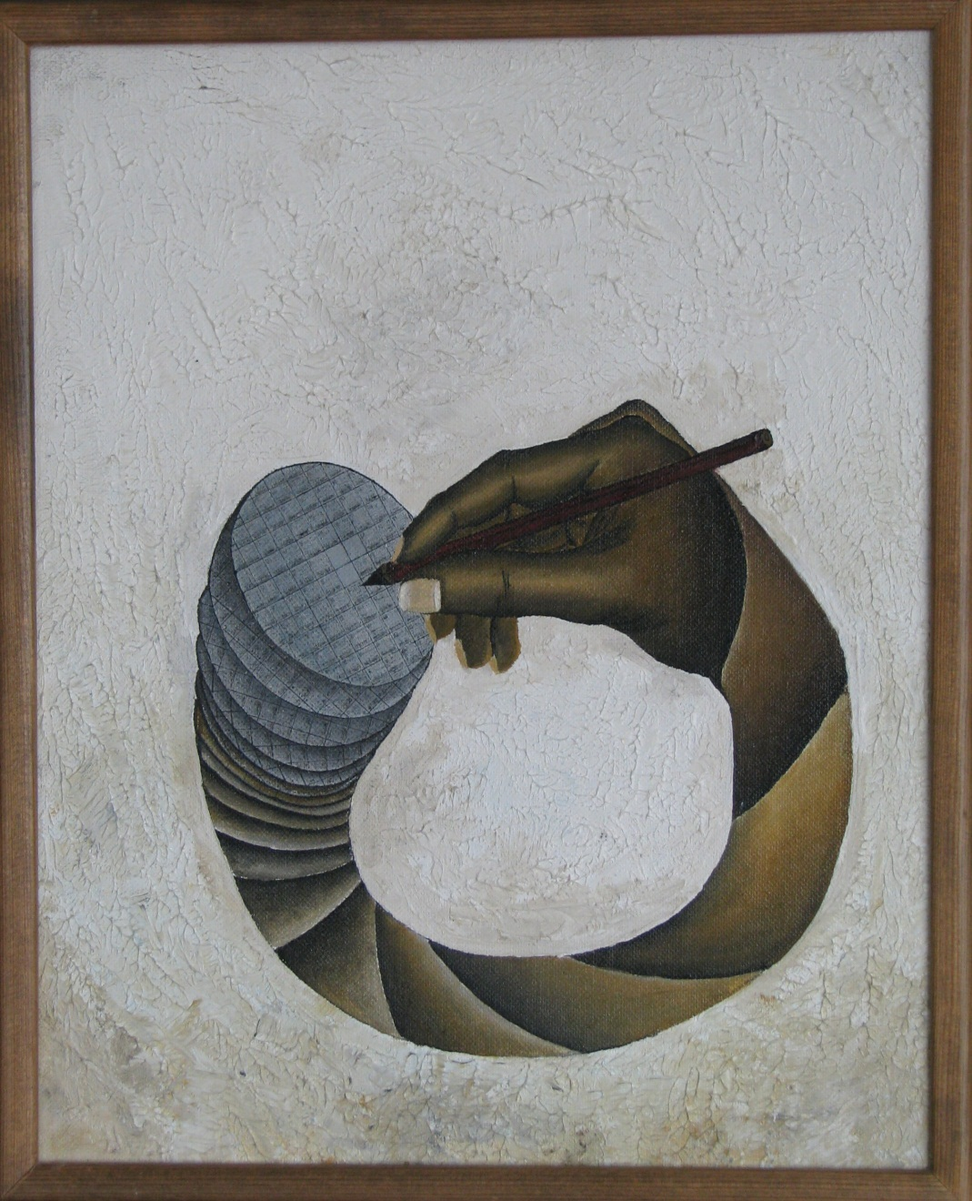
Introduction
VLSI ↔ CAD
Silicon chip evolution is
characterized by utilizing
computers to develop next
generation chips and computers
Similarly, brain developes itself
Staffan Gustafsson 1983, ”Rita på kisel”

Slide 4
Introduction
A reasonable model of CNS must be fully compatible with
Physics (including information theory)
Chemistry
Biology (including evolution)
CNS context (body, physical and social context)
Biology, two forms of evolution:
Evolution of the species (through natural selection; Phylogenesis)
Evolution of the individual (from conception to death; Ontogenesis)

Slide 5
Introduction
Classically, CNS have been considered static with
minor changes occurring over time.
Compare the cellular neural network (CNN) models, based on highly interconnected cells with variable interconnect strength.
Recent research rather indicates that CNS is highly dynamic
referred to as neural plasticity

Slide 6
Introduction
I will discuss this topic by formulating a series of
hypotheses of the development and function of the CNS.
BUT, let me start by introducing some well established facts about
the CNS.

Slide 7
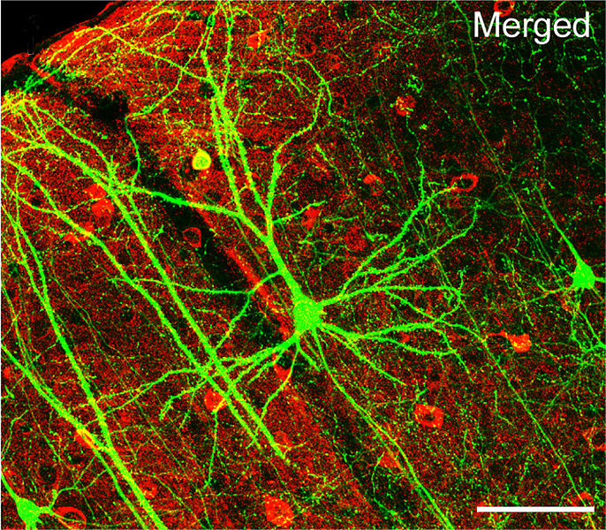
Introduction, some basics
CNS is built from neurons.
A neuron comprises a cell body,
an axon and a dendrite trees.
Information flow is unidirectional
from the dendrite tree, via the
body to the axon.
Information transport within the
neuron is electrochemical
Dendrite tree
Cell body
Axon
Wikipedia

Slide 8
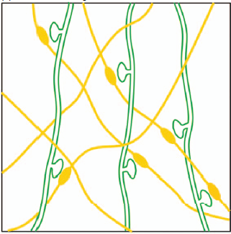
Introduction, some basics
Neurons are interconnected via
synapses, connecting axons
with dendrites.
Information transport inside the
synapse is chemical.
Synapses have different strengths.
Synapses may be excitatory or
inhibitory
dendrites
axons
synapse
spine
(Fu 2011)

Slide 9
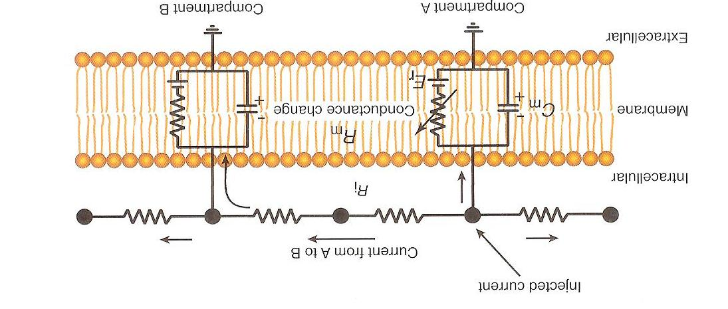
Introduction, some basics
Model of the cell membrane (for example along the axon)
The R, C and the voltage dependent conductance leads to an
active wave transport of waveforms along the axon
By surrounding the axon by fatty cells (myelin layer)
the velocity increases

Slide 10
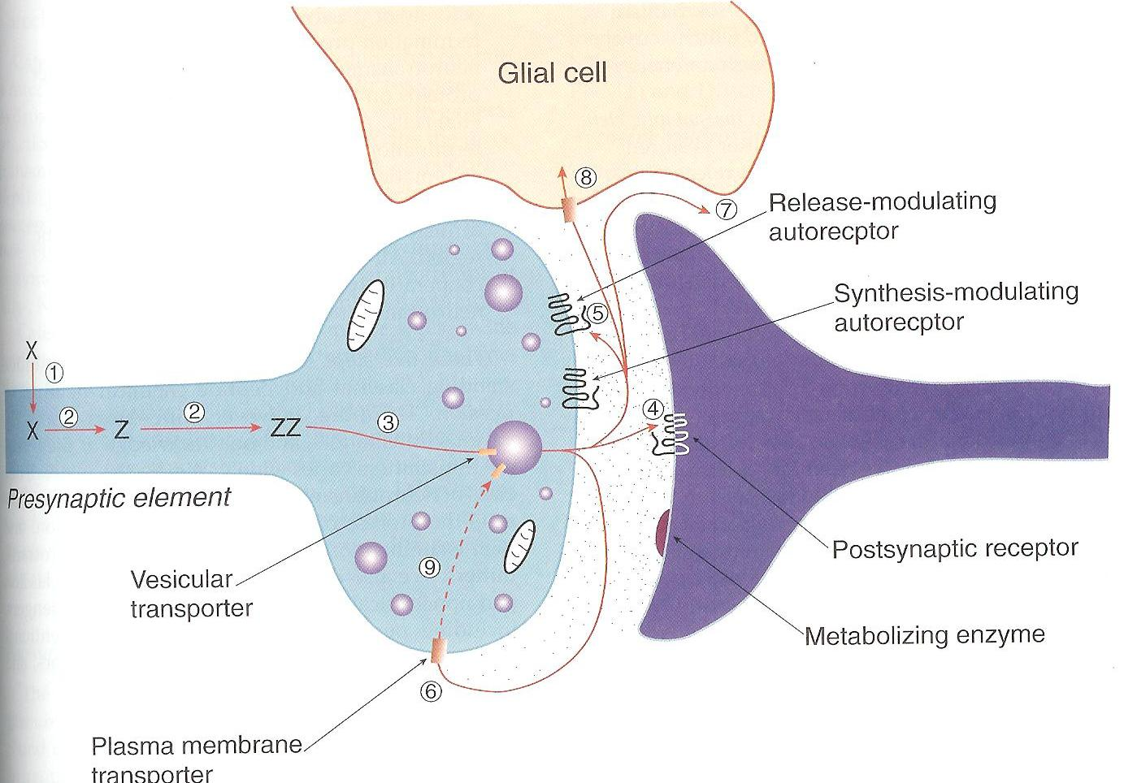
Introduction, some basics
Model of the synapse
Presynaptic element, synaptic cleft, postsynaptic element
Neurotransmitters are
released from vesicles,
transported through cleft
and absorbed by receptor
Absorbtion make receptor
change membrane voltage

Slide 11
Introduction, some basics
CNS structure (circuits) constitutes both function and memory (algorithms, knowledge, and skills) .
Synapse strength is increased by high activity.
Increase of synapse strength through activity is the simplest
form of learning and memory (Hebbian learning, Hebb 1949)
More advanced experiments: Kandel, Nobel prize 2000

Slide 12
Introduction, some basics
Kandel, 1970
Experiments on giant neurons in Aplysia (a sea snail)
Short term memory via strengthening of synapses via interneurons (process includes enhancement of neurotransmitter release via Kinase A)
Long term memory via growth of new synaptic connections.
This requires protein synthesis via the cell nucleus and its mechanisms for gene expression (process initiated by migration of Kinase A to cell nucleus)

Slide 13
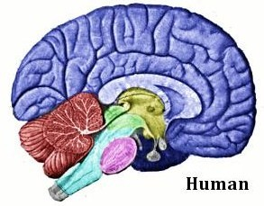
Introduction, some basics
Example of neural architecture, cerebral cortex
Basic unit: Cortical column; 5000 neurons
Grey matter
6 layers (I-VI)
White matter
Flattened cerebral cortex, totally 2000cm² x 2.5mm
Totally about 2·10¹⁰ neurons, 10¹⁴ synapses
White matter: axons (10⁷ axons/cm²)
I estimate 20,000 axons passing each column
Cerebral cortex

Slide 14
Introduction, some basics
From what has been said so far:
Information transport – seems quite clear
Electrochemical in axons and dendrites; chemical in synapses
Information processing – seems relatively clear
Nonlinearly weighted sums of incoming data
Information storage – still enigmatic
Short term maybe clear, chemical changes in synapses
Long term requires changes in CSN structure

Slide 15
Selective Stabilization Hypothesis
First hypothesis: selective stabilization hypothesis, formulated by Changeux and Danchin 1973:
The genetic program directs the proper interaction between
neurons. Several contacts form at the same site.
The early activity of the circuits, spontaneous (in embryo) and evoked (after birth), increases the specificity of the system by reducing redundancy.
Alternative terms: synaptic elimination, synaptic epigenesis,
neuron plasticity, neuronal Darwinism (Edelmann 1987)

Slide 16
Selective Stabilization Hypothesis
During ontogenesis (CNS development from conception) various parts of the CNS grows as any other organ .
Types of neurons, approximate number of neurons, size and form of the part are genetically controlled (self-organization under a genetic rule set).
BUT, interconnections between neurons are controlled by the actual environment. For CNS this means under control of internal and external neuronal signals

Slide 17
Selective Stabilization Hypothesis
During ontogenesis and adulthood each neuron is plastic
The dendrite tree is continuously growing and retracting, forming and retracting synapses with passing axons. This process is controlled by synapse activity through selective stabilization and destabilization.
(Changeux’ original motivation: genetic information is far from sufficient to describe CNS complexity)

Slide 18
Selective Stabilization Hypothesis
Direct evidence of microscopic plasticity
Classical case: Muscle innervation. Number of motor axons contacting a muscle fiber is reduced from 4-6 to 1 in early development of mouse. Interpreted as a refinement of the system
Postnatal day 7, 8 and 9 of a transgenic muse; neuromuscular junctions

Slide 19
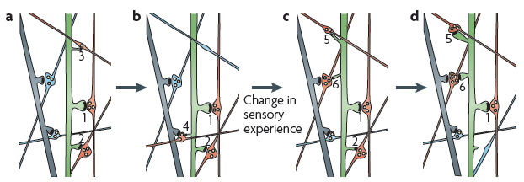
Selective Stabilization Hypothesis
Direct evidence of microscopic plasticity
Experimental observation of spine and synapse formation and elimination in adult mouse neocortex in vivo. (Holtmaat et al 2008). Time scale: minutes – days. Whisker trimming as experience input.
Green: dendrite, blue, red: axons. a,b) red contacts green, weak contacts retracts (3)
c,d) New spontaneous spines (2,5) retract or stabilize as a result of experience

Slide 20
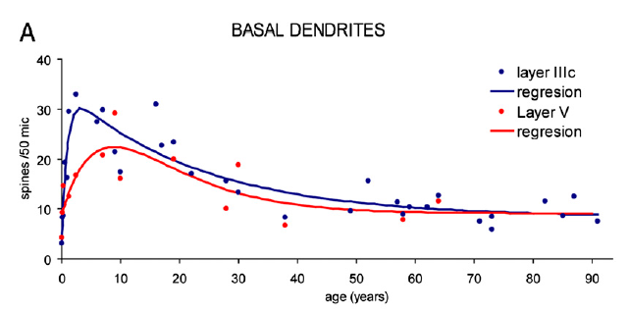
Selective Stabilization Hypothesis
Direct evidence of microscopic plasticity
In humans the process of significant
synaptic elimination proceeds to
≈30 years of age (Patanjek et al 2011)
A general conclusion
The detailed CNS structure (“circuit diagram”) is formed during growth under influence of experience.
This process proceeds under adulthood with declining pace

Slide 21
CNS dynamics
During growth.
Neurons are created (under genetic control).
Neurons grow axons which are directed towards other neurons (sometimes very long distances; under genetic and experience control)
Dendrites and spines continuously grow and retract forming and eliminating synapses (under experience control)
During adulthood.
Neurons and axons are mainly stable
Dendrites and spines still grow and retract, forming and eliminating synapses

Slide 22
CNS dynamics
The change from growth to adulthood is gradual (all life).
The combined genetic and experience control leads to critical periods.
(Classical example: stereoscopic vision can only be learned before 6 months of age: neonatal cataract must be corrected before 6 months of age)
During growth, passive experience is sufficient to create neuronal imprint, during adulthood, experience must be accompanied by attention to create imprint.

Slide 23
CNS dynamics
Speculation:
Imprints during growth engage axonal structure, which leads to very stable (lifelong) memory (during dendrite growth and retraction a specific connection can be eliminated but also recreated)
Imprints during adulthood occur only via dendrite structure and is less stable. May stabilize through slow changes in axonal structure, possibly supported by slow neurogenesis in hippocampus

Slide 24
Neuronal reuse hypotheses
Second hypothesis: Neuronal recycling hypothesis, Dehaene 2004
(Also termed neural reuse)
Innate structures can be reprogrammed to new skills
(Innate includes the effects of “natural” child experience)
New skills can be developed from old ones:
During development of the individual (ontogenesis, fast)
Carried over socially

Slide 25
Neuronal reuse hypotheses
Example of neural reuse
Reading is obviously a skill that can not have be developed through evolution. So how can we acquire such a complicated skill?
Our vision system contains the skill to characterize primitive shapes as lines with specific tilts and the skill to combine primitive shapes into objects as for example faces.
These skills can be reused for the recognition of letters (primitive shapes) and words (objects) (Dehaene 2004)

Slide 26
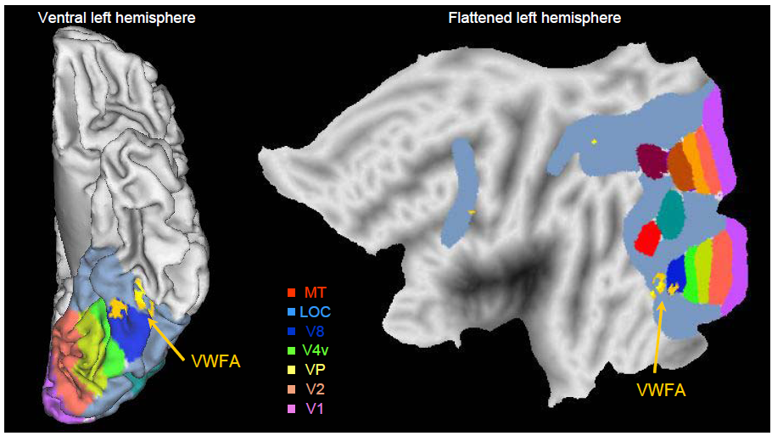
Neuronal reuse hypotheses
From Dehaene 2005

Slide 27
Neuronal reuse hypotheses
Consequences
Neuronal reuse offers a reasonable explanation to the mechanism of the remarkable ability of the human to develop new and advanced skills over evolutionary very short periods of time.
The combined hypotheses of Neural plasticity and Neural reuse offers a reasonable explanation to social/cultural inheritance.
Example: Instead of considering language as a module in the brain,
it is a social /cultural module outside brain, inherited by each individual from its social context.

Slide 28
Neuronal reuse hypotheses
Third hypothesis: Massive redeployment hypothesis, neural reuse hypothesis, M. L. Anderson 2007)
New skills can be developed from old ones:
During evolution of the species (phylogenesis, very slow)
Carried over via genes
I will not consider evolutionary aspects further in this talk

Slide 29
Special skills hypothesis
Fourth hypothesis: Special skills hypothesis (similar to Pre-representations (Changeux 1989), Workings (Bergeron 2008)
A particular part of CNS is characterized by special skills
(genetically controlled envelope + interactive specialization)
This part is then used for basic purposes given by evolution AND reused for new purposes through neuronal reuse

Slide 30
Special skills hypothesis
Example of vision and pattern recognition
As mentioned before:
Our vision system contains the skill to characterize primitive shapes as lines with specific tilts and the skill to combine primitive shapes into objects as for example faces.
This system occupies quite a large part of the human brain.

Slide 31
Special skills hypothesis
Example of spacial maps
Spacial maps in Medial Entorhinal
Cortex (MEC)
A mouse with electrodes moves in
a square compartment (figure).
A single nerve cell fires at certain
positions in the compartment.
Mouse path, cells firing at red
Neuron firing rate vs mouse position

Slide 32
Special skills hypothesis
Example of spacial maps
Grid cells constitutes a geometrical grid
Direction cells constitutes moving direction
Wall cells constitutes an adjacent wall
etc.
Together, we have an advanced skill for spacial mapping

Slide 33
Preliminary conclusions
The original question:
“Understand” the brain in an information processing context
So, I seek a model of the central nervous system which is
reasonable and comprehensive. We need to understand how
information is transported, processed and stored. In “information”
I include algorithms, knowledge and skills.
This is closely related to how the brain is developed (designed).

Slide 34
Preliminary conclusions
What we have learned
Basic principles for information transport and processing are reasonably understood
The mechanism of storage is most reasonably modeled as part of the continues development of the CNS from conception to death
The mechanism of design constitutes two parts, phylogenesis through natural selection and ontogenesis through self learning

Slide 35
Preliminary conclusions
Some consequences of the present picture
Algorithms, knowledge and skills are defined by the actual structure (circuits) of CNS
This structure results from a combination of genetic information and individual experiences from conception to death
As CNS structure is a result of each individuals social context, the culture of a society is defined by the common CNS structure of the individuals constituting that society

Slide 36
Preliminary conclusions
Some consequences of the present picture
Scientific models of the world are based on the basic skills of CNS.
Example : Both in mathematics and in physics we use geometric models (coordinate systems, vectors, n-dimensional spaces) because our brain has a special skill to manage spacial models.

