Slide 1

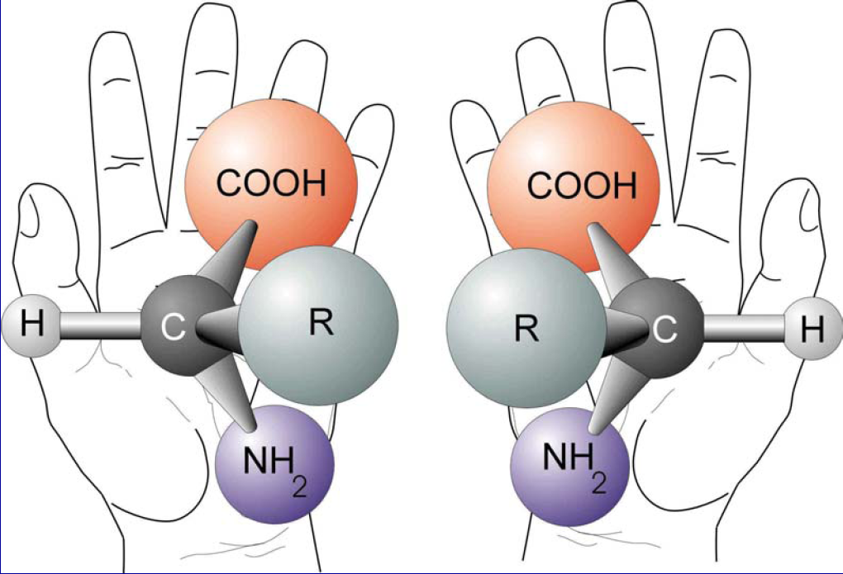
Multiple chiral bands associated with the same strongly asymmetric many-particle nucleon configuration
O. Shirinda and E. A. Lawrie
National Research Foundation, Nuclear Physics department, iThemba LABS, P.O Box 722, Somerset West 7129, South Africa
A structure is chiral if its image in a mirror plane cannot be brought to coincide with itself

Slide 2
Contents
Chirality: Favourable conditions for chirality
Fingerprints of chiral partner bands
Previous theoretical studies
Aim of this study
MPR model calculations performed for the partner bands in A ~ 100, 130 and 190 mass regions
Results and discussion
Summary

Slide 3
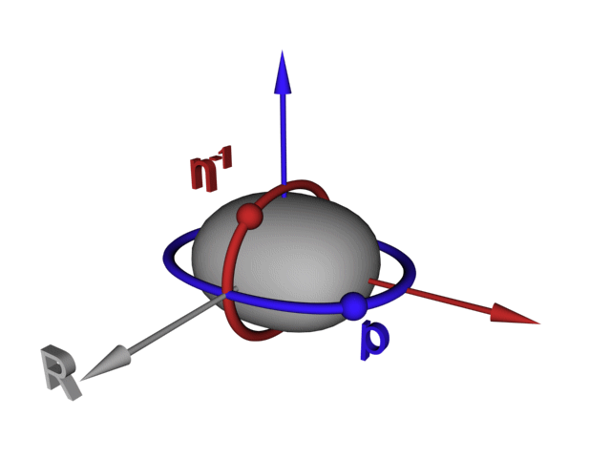
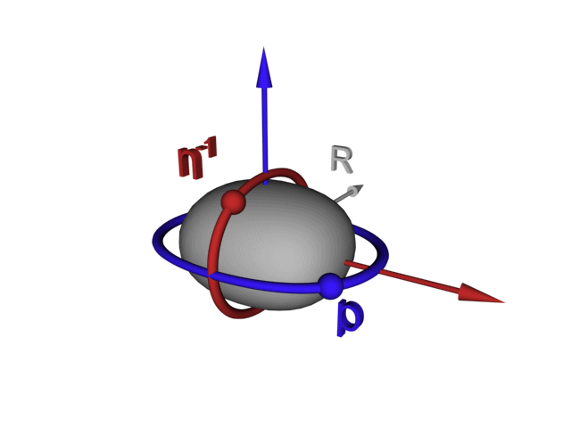
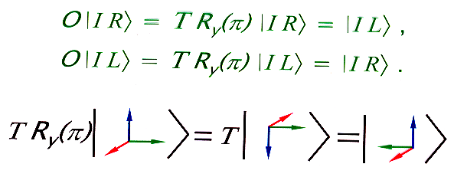
Chirality in nuclear systems
For chirality to be realized in nuclear system, three mutually perpendicular angular momenta needed or aplanar orientation of the total angular momentum [S. Frauendorf, J. Meng, Nucl. Phys. A 617, 131 (1997); S. Frauendorf, Rev. Mod. Phys. 73, 463 (2001)]
LHS
RHS

Slide 4
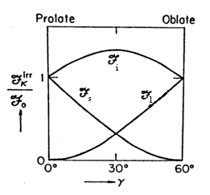
Favourable conditions for chirality
Aplanar orientation of the total angular momentum and stable triaxial nuclear shape
ΔI = 1 rotational bands built on two- or multi-quasiparticle configuration, where one quasiparticle has predominantly particle nature (bottom of a high j-shell) and the other one has hole nature (top of a high-j shell).
For aplanar orientation:
along the short nuclear axis – j_{p} of the valence particle(s) (bottom of a high-j shell)
along the long nuclear axis – j_{h} of the valence hole(s) (top of a high-j shell)
along the intermediate nuclear axis – R_{c} of the core at γ = 30⁰
Irrotational moments of inertia :
S. Frauendorf, J. Meng, Nucl. Phys. A 617, 131 (1997); S. Frauendorf, Rev. Mod. Phys. 73, 463 (2001)

Slide 5
Fingerprints for ideal chiral partner bands
Theoretical (suggested) fingerprints
degenerate ∆I = 1 partner bands with the same parity
i.e. all measurable properties such as excitation energy, transition probabilities, alignments, moment of inertia, etc. of the partner bands are the same within certain spin interval. [S. Frauendorf, J. Meng, Nucl. Phys. A 617, 131 (1997); S. Frauendorf, Rev. Mod. Phys. 73, 463 (2001)]
Band 2
Band 1
I+7
I+7
I+6
I+6
I+5
I+5
B(M1)_{out}
I+4
I+4
I+3
I+3
I+2
B(E2)_{in}
I+2
B(E2)_{in}
B(M1)_{in}
I+1
B(E2)_{out}
I

Slide 6
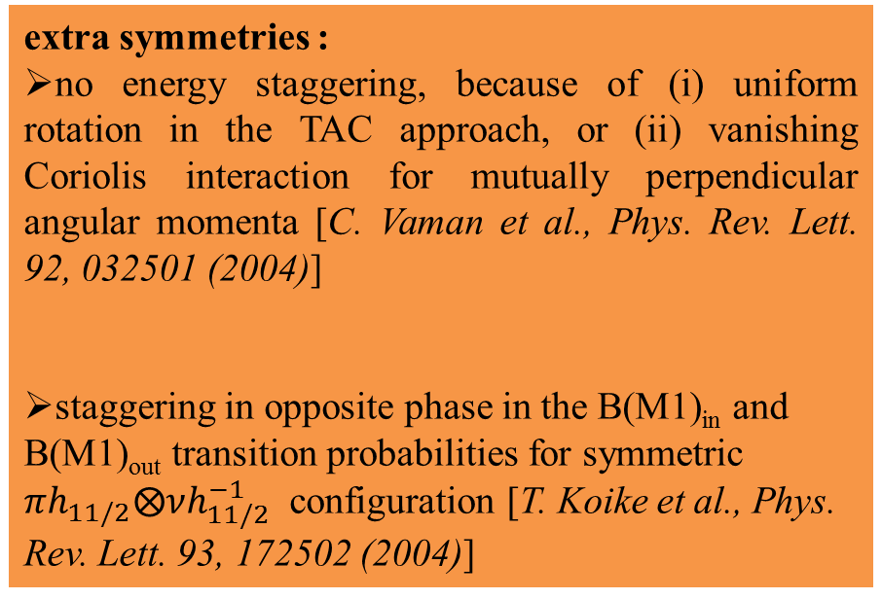
Fingerprints for ideal chiral partner bands
extra symmetries :
no energy staggering, because of (i) uniform rotation in the TAC approach, or (ii) vanishing Coriolis interaction for mutually perpendicular angular momenta [C. Vaman et al., Phys. Rev. Lett. 92, 032501 (2004)]
staggering in opposite phase in the B(M1)_{in} and B(M1)_{out} transition probabilities for symmetric $πh_{11/2}⨂νh_{11/2}^{−1}$ configuration [T. Koike et al., Phys. Rev. Lett. 93, 172502 (2004)]
S(I) = [E(I)-E(I-1)]/2I
S(I)
I
In our recent work, we have found that these extra symmetries originally derived for strongly broken chirality are unreliable for identifying chiral bands in real nuclei [O. Shirinda and E.A. Lawrie, Eur. Phys. J. A 48, 118 (2012)].

Slide 7
Previous theoretical studies
The existence of multiple chiral bands MχD with large triaxial deformation, but different particle-hole configuration was proposed in a single nucleus (e.g. see Ref. [J. Meng et al., Phys. Rev. C 73, 037303 (2006)]).
The MχD existence has been experimentally confirmed in ¹³³Ce [A.D. Ayangeakaa et al., Phys. Rev. Lett. 110, 172504 (2013)].
Multiple chiral bands in 133Ce were associated with these two configurations, i.e. and

Slide 8
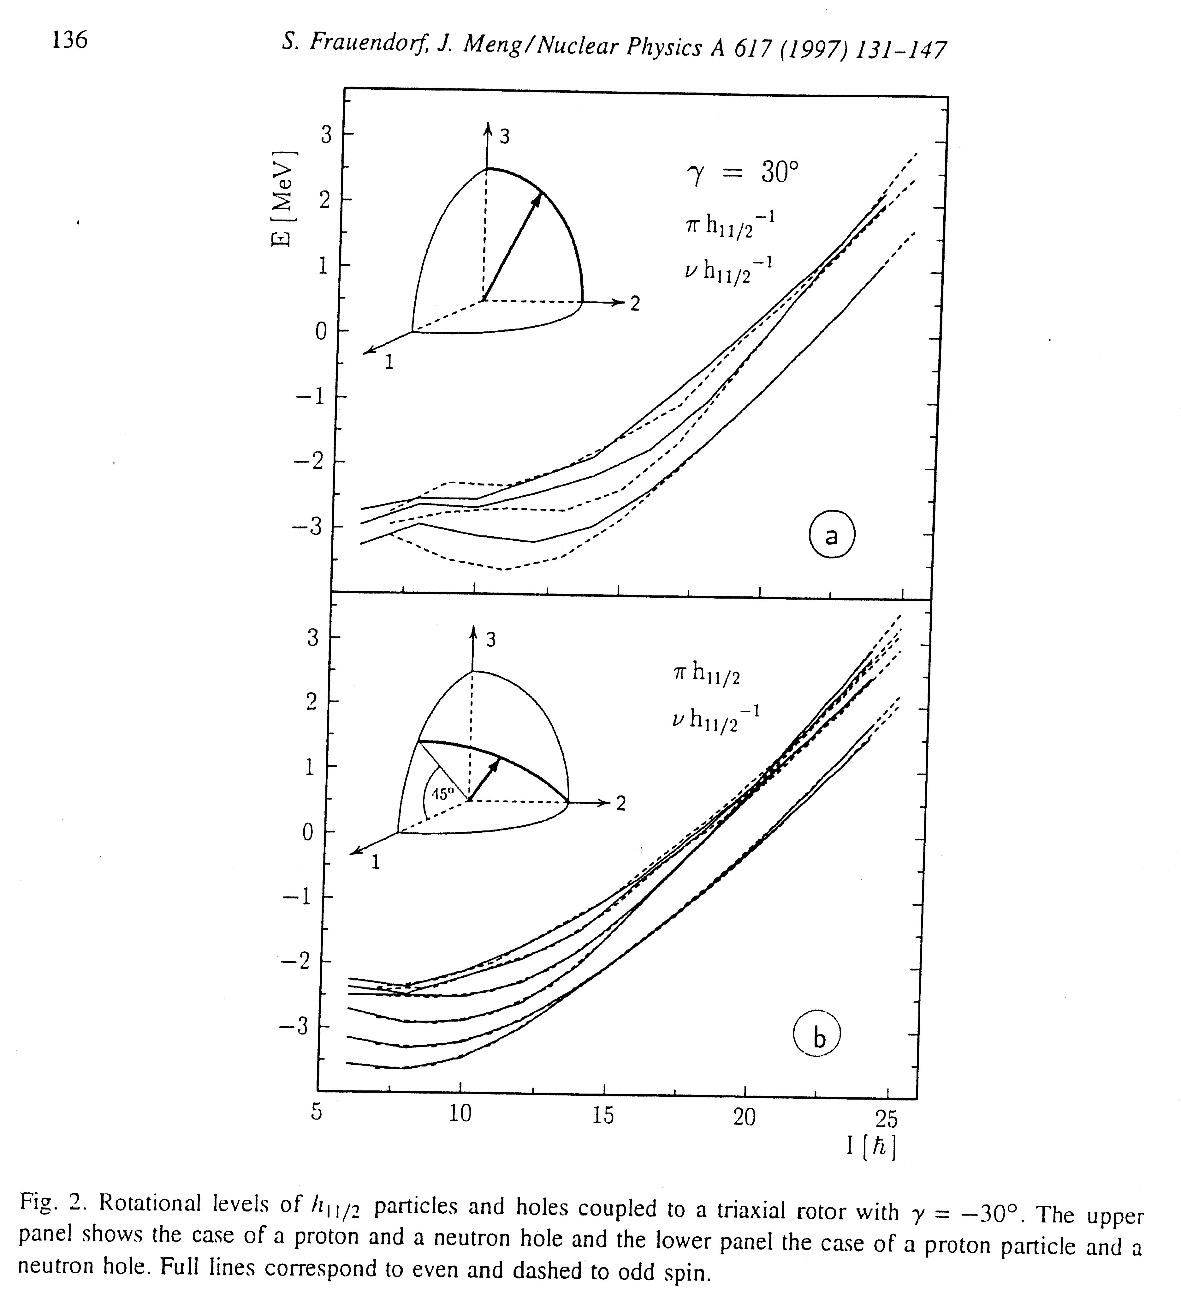
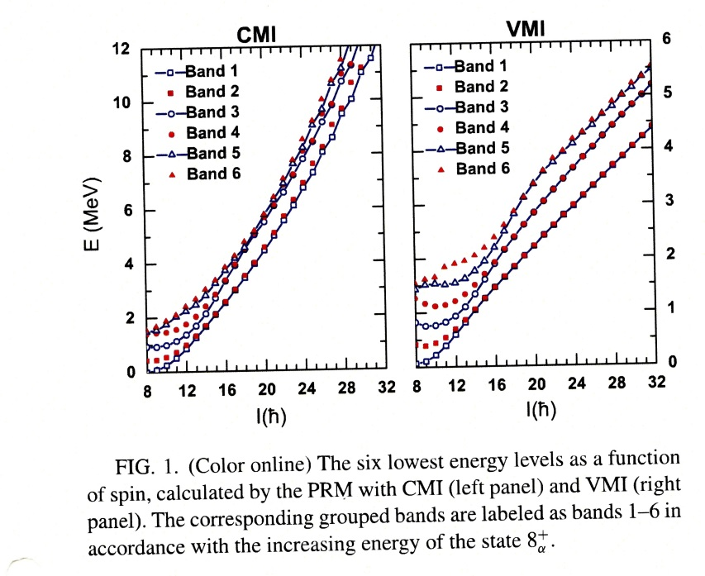
Previous theoretical studies cont.
It was also found that more than one pair of chiral bands may exist in a nucleus with the same two-quasiparticle configuration [S. Frauendorf, J. Meng, Nucl. Phys. A 617 131 (1997); Q.B. Chen et al., Phys. Rev. C 82, 067302 (2010)].

Slide 9
Previous theoretical studies cont.
therefore:
Contrary to MχD that differ from each other in their particle-hole configurations and may correspond to different triaxial deformations. We then investigated the existence of multiple chiral bands built on the same configurations using the multi-particle-plus-triaxial rotor (MPR) model.
Recently the MχD existence for multiple chiral bands associated with the same nucleon configuration has been experimentally confirmed in ¹⁰³Rh [I. Kuti et al., Phys. Rev. Lett. 113, 032501 (2014)].
Multiple chiral bands in 103Rh were associated with this configuration, i.e.
In 103Rh three pairs of chiral bands were observed

Slide 10
Aim of this study
The objectives of this study:
The present work studies the existence and properties of multiple chiral bands built on the same many-particle nucleon configuration in A ~ 100, 130 and 190.
We have used the MPR model to calculate chiral bands associated with many-particle nucleon configurations in A ~ 100, 130 and 190 [B.G. Carlsson and I. Ragnarsson, Phys. Rev. C74, 044310 (2006)].
The energy spectra, angular momentum components, K-distributions, the expectation value of the angles between the proton, neutron and rotation angular momenta are examined for the first four lowest bands built on strongly asymmetric many-particle nucleon configuration (i.e. 3- or 4-quasiparticle)

Slide 11
Chiral candidates associated with many-particle nucleon configuration in the A ~ 100, 130, 190 mass regions
J. Timar et al., Phys. Rev. C 73, 011301(R) (2006); Phys. Lett. B598, 178 (2001)
J.A. Alcantara-Nunez et al., Phys. Rev. C 69, 024317 (2004)
A ~ 100
^{103,105}Rh
A ~ 130
¹³⁵Nd
S. Zhu et al., Phys. Rev. Lett. 91, 132501 (2003)
A ~ 190
¹⁹⁴Tl
P.L. Masiteng et al., Phys. Lett. B 719, 83 (2013); Eur. Phys. J. A 50, 119 (2014)

Slide 12
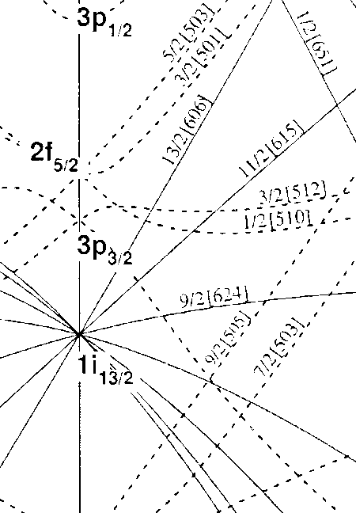
Parameters for MPR calculations (optimized to
ensure chiral geometry)
Standard parameters for the Nilsson potential
Core parameters:
Quadrupole deformation ε₂ = 0.15 in A = 190, ε₂ = 0.225 in A = 100, 130
triaxiality parameter γ equal/close to 30⁰
Moments of inertia – Irrotational flow
Valence odd proton and odd neutron:
Fermi levels near the bottom and top of a high-j shell
Configuration space:
Realistic – configuration space contains at least 5 orbitals for the proton and for the neutron close to Fermi level
Results for the calculations in A ~ 100, 130 and 190 mass regions with strongly asymmetric many-particle nucleon configurations are discussed.

Slide 13
Calculations for the A ~100, 130, 190 mass regions
Band A
Band B
Band C
Band D
Realistic 3- and 4-quasiparticle configuration:
The calculation yielded several bands associated with the configuration of interest. The near degeneracy in these two pairs of chiral bands is worse, but still present
The four bands group differently for γ = 30⁰ and γ =20⁰, 40⁰
For γ = 30⁰ two distinct pairs of chiral bands are found and identifiable
While for γ = 20⁰ and 40⁰ one of the bands is well separated and lies at a lower energy, while the other three group together with similar excitation energy

Slide 14
Calculations for the A ~100, 130, 190 mass regions cont.
Band A
Band B
Band C
Band D
Therefore the calculations predict multiple chiral bands built on the same many-particle nucleon configuration for γ = 20⁰, 30⁰ and 40⁰ in A = 100, 130 and 190 mass regions.
These calculations also indicate that for less triaxiality, the second pair of chiral bands in more near-degenerate as compared to the first pair.
Does the four bands have a 3-dimensional chiral geometry?

Slide 15
Projections of the j_{p}, j_{n} and j_{R}
A ~100 mass region
Band A
Band B
Band C
Band D
Major contribution for j_{R} is along the intermediate y-axis, that of j_{p} is along the long z-axis, and that of j_{n} is along the short x-axis
Therefore the three-quasiparticle bands have predominantly chiral geometry

Slide 16
Projections of the j_{p}, j_{n} and j_{R} cont.
A ~130 mass region
Band A
Band B
Major contribution for j_{R} is along the intermediate y-axis, that of j_{n} is along the long z-axis, and that of j_{p} is along the short x-axis
Band C
Band D
Therefore the three-quasiparticle bands have predominantly chiral geometry

Slide 17
Projections of the j_{p}, j_{n} and j_{R} cont.
A ~190 mass region
Major contribution for j_{R} is along the intermediate y-axis, that of j_{n} is along the long z-axis, and that of j_{p} is along the short x-axis
Band A
Band B
Band C
Band D
Therefore the three-quasiparticle bands have predominantly chiral geometry

Slide 18
Average angles between j_{p}, j_{n} and j_{R} in the A ~100, 130, 190 mass regions
Band A
Band B
Band C
Band D
all the angles between the individual angular momenta are larger than 35⁰, thus the systems are predominantly chiral

Slide 19
Projections of I in the A ~100, 130, 190 mass regions cont.
Band A
Band B
Band C
Band D
The total angular momentum has major contributions from the j_{p}, j_{n} and j_{R}. Thus the systems have aplanar total angular momentum.

Slide 20
K-distributions for total angular momentum I
A ~100 mass region
One can better evaluate the magnitude of the possible non-chiral contributions to the wave functions by looking at the distributions of the projections of the total angular momentum along the three nuclear axes.
Each distribution peaks at the most likely projection of the total angular momentum
Optimal conditions for forming a 3-dimensional system occur at I ~ 16.5, where all the three projections have maxima at non-zero projections

Slide 21
K-distributions for total angular momentum I cont.
A ~100 mass region
Each distribution peaks at the most likely projection of the total angular momentum
Optimal conditions for forming a 3-dimensional system occur at I ~ 16.5, where all the three projections have maxima at non-zero projections

Slide 22
K-distributions for total angular momentum I cont.
A ~130 mass region
Each distribution peaks at the most likely projection of the total angular momentum
Optimal conditions for forming a 3-dimensional system occur at I ~ 17.5, where all the three projections have maxima at non-zero projections

Slide 23
K-distributions for total angular momentum I cont.
A ~130 mass region
Each distribution peaks at the most likely projection of the total angular momentum
Optimal conditions for forming a 3-dimensional system occur at I ~ 17.5, where all the three projections have maxima at non-zero projections

Slide 24
K-distributions for total angular momentum I cont.
A ~190 mass region
Each distribution peaks at the most likely projection of the total angular momentum
Optimal conditions for forming a 3-dimensional system occur at I ≥ 24, where all the three projections have maxima at non-zero projections

Slide 25
K-distributions for total angular momentum I cont.
A ~190 mass region
Each distribution peaks at the most likely projection of the total angular momentum
Optimal conditions for forming a 3-dimensional system occur at I ≥ 23, where all the three projections have maxima at non-zero projections

Slide 26
Summary
The calculations predict that multiple chiral bands built on the same strongly asymmetric many-particle nucleon configuration in a single nucleus can also exist
The geometry of the system is found to predominantly chiral and persist up to high spin
For strongly asymmetric many-particle nucleon configuration the layout of the four bands is different for maximal and less triaxial nucleus.
For less triaxial nucleus, i.e. γ = 20⁰ or 40⁰, one of the bands is well separated and lies at a lower excitation energy, while the other three group together with similar excitation energy
Furthermore these calculations indicate that for less triaxiality, the second pair of chiral bands in more near-degenerate as compared to the first pair.

Slide 27
THANK YOU
NDI A LIVHUWA

Slide 28
B(M1) and B(E2) transition probabilities
A ~ 100 mass region

