Slide 1


Hidden pseudospin and spin symmetries in nuclei
NORDITA workshop “Chiral Bands in Nuclei”
Haozhao Liang （梁豪兆）
RIKEN Nishina Center, Japan
April 20, 2015
In collaboration with
Professor Jie Meng, Peking University, China
Professor Shan-Gui Zhou, Institute of Theoretical Physics, CAS, China

Slide 2
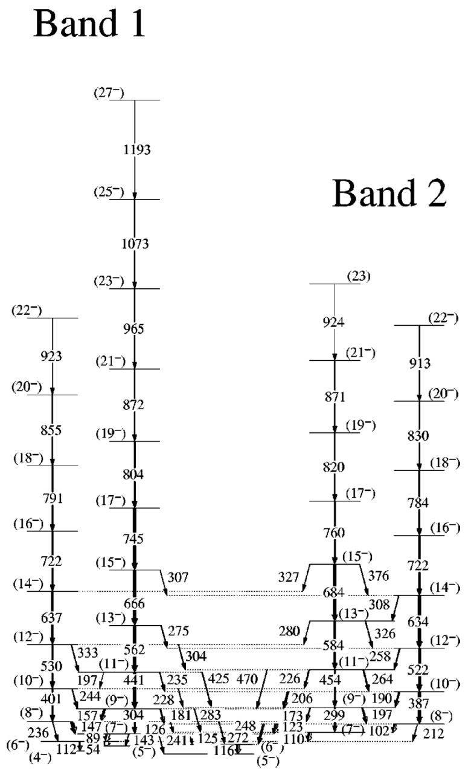
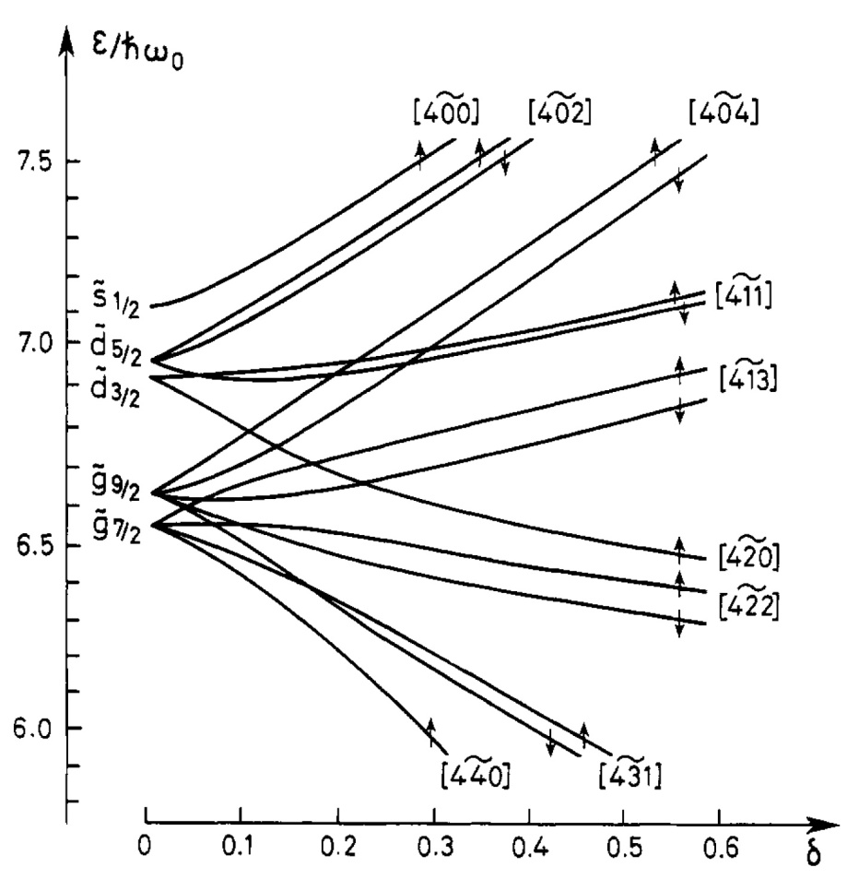
Pseudospin partner bands
Single-particle states
as pseudospin doublets
Bohr, Hamamoto, Mottelson, Phys. Scr. 26, 267 (1982)
Partial level scheme of ¹²⁸Pr
Petrache et al., PRC 65, 054324 (2002)
¹⁸⁶Ir (1997); ¹⁰⁸Tc (2008); ¹⁸⁹Pt (2009) ……

Slide 3
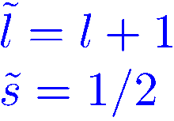
Nuclear single particle level scheme
184
Large spin-orbit splitting
Near degeneracy of some doublets
Pseudo-orbit angular momentum
Accidental or of symmetry, i.e., pseudospin symmetry (PSS)?
4s
3d
2g
2g_{9/2}
1i_{11/2}
1i
126
3p
2f
2f_{7/2}
1h_{9/2}
1h
82
3s
2d
2d_{5/2}
1g_{7/2}
1g
50
2p
2p_{3/2}
1f_{5/2}
1f
28
20
(n+1, l, j = l+1/2)
(n , l+2, j = l+3/2)
2s
2s_{1/2}
1d_{3/2}
1d
1p
8
1s
2
Arima, Harvey, Shimizu, PLB 30, 517 (1969)
Hecht, Adler, NPA 137, 129 (1969)
Courtesy of S.G. Zhou

Slide 4
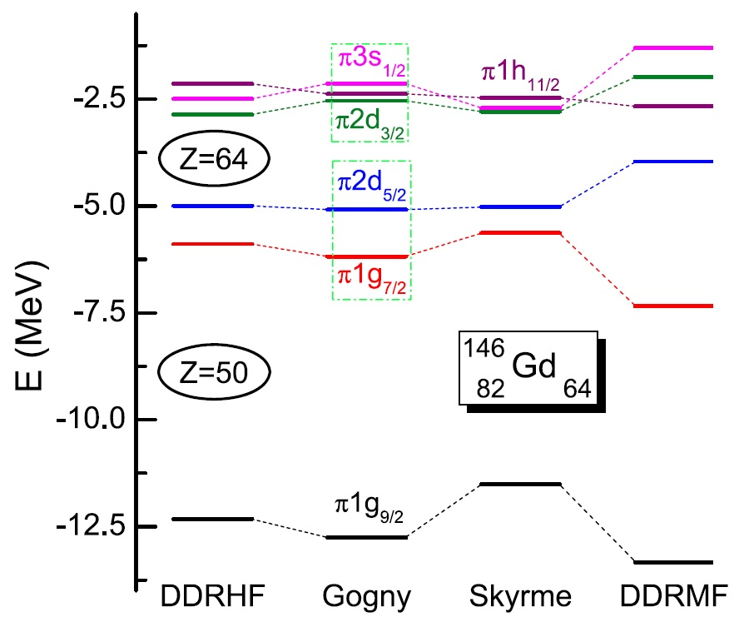
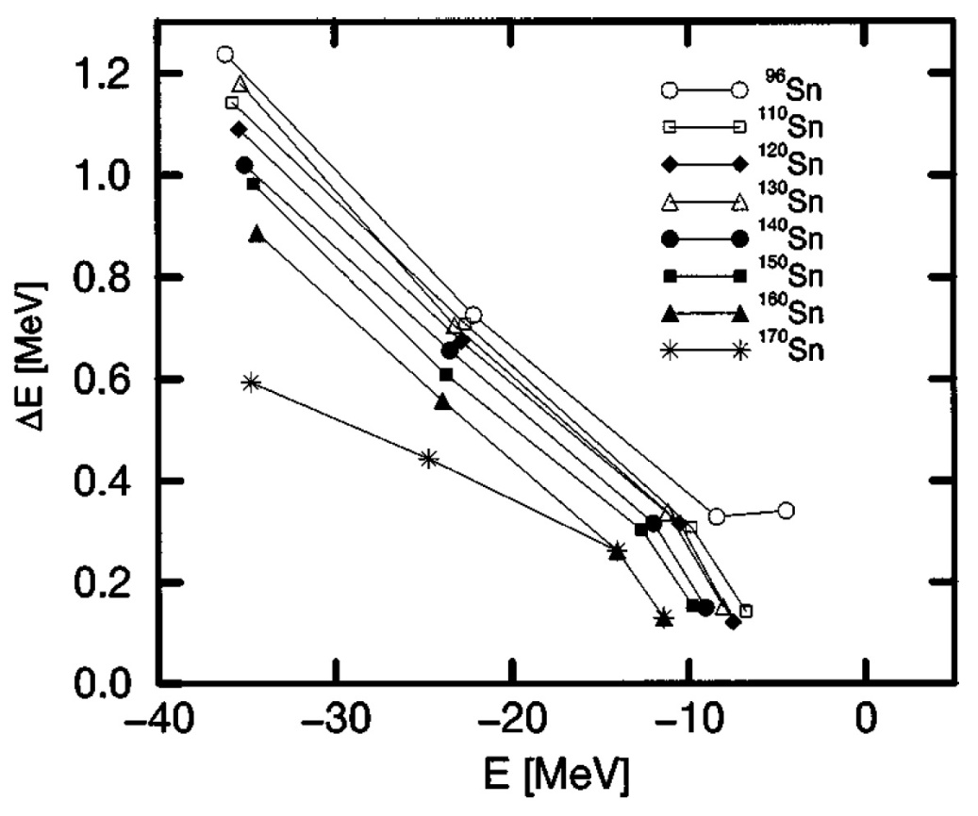
PSS in shell structure evolutions
Proton single-particle energies for ¹⁴⁶Gd
Long, Nakatsukasa, Sagawa, Meng, Nakada, Zhang,
PLB 680, 428 (2009)
Pseudospin-orbit splitting in Sn isotopes
Meng, Sugawara-Tanabe, Yamaji, Arima,
PRC 59, 154 (1999)
Splitting of both spin and pseudospin doublets play important roles in the shell structure evolutions.

Slide 5
Contents
Introduction
General Features
  Dirac and Schrödinger-like equations
  Analytical solutions at PSS limit
  PSS breaking in realistic nuclei
PSS and SS in Various Systems and Potentials
  From stable nuclei to exotic nuclei
  From non-confining potentials to confining potentials
  From local potentials to non-local potentials
  From central potentials to tensor potentials
  From bound states to resonant states
  From nucleon spectra to anti-nucleon spectra
  From nucleon spectra to hyperon spectra
  From spherical nuclei to deformed nuclei
Open Issues on PSS and SS
  Perturbative or not
  Intruder states
  SUSY and SRG
Summary and Perspectives
Liang, Meng, Zhou, Phys. Rep. 570, 1-84 (2015)

Slide 6
Contents
Introduction
General Features
  Dirac and Schrödinger-like equations
  Analytical solutions at PSS limit
  PSS breaking in realistic nuclei
PSS and SS in Various Systems and Potentials
  From stable nuclei to exotic nuclei
  From non-confining potentials to confining potentials
  From local potentials to non-local potentials
  From central potentials to tensor potentials
  From bound states to resonant states
  From nucleon spectra to anti-nucleon spectra
  From nucleon spectra to hyperon spectra
  From spherical nuclei to deformed nuclei
Open Issues on PSS and SS
  Perturbative or not
  Intruder states
  SUSY and SRG
Summary and Perspectives
Liang, Meng, Zhou, Phys. Rep. 570, 1-84 (2015)

Slide 7
Contents
Introduction
General Features
  Dirac and Schrödinger-like equations
  Analytical solutions at PSS limit
  PSS breaking in realistic nuclei
PSS and SS in Various Systems and Potentials
  From stable nuclei to exotic nuclei
  From non-confining potentials to confining potentials
  From local potentials to non-local potentials
  From central potentials to tensor potentials
  From bound states to resonant states
  From nucleon spectra to anti-nucleon spectra
  From nucleon spectra to hyperon spectra
  From spherical nuclei to deformed nuclei
Open Issues on PSS and SS
  Perturbative or not
  Intruder states
  SUSY and SRG
Summary and Perspectives

Slide 8

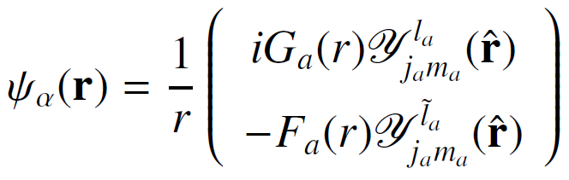
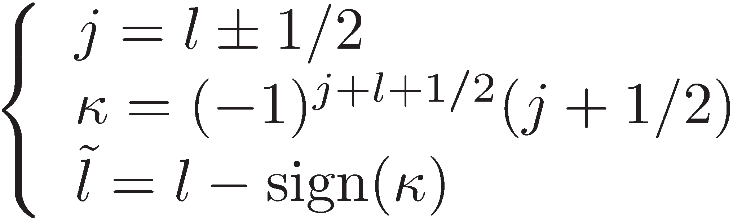
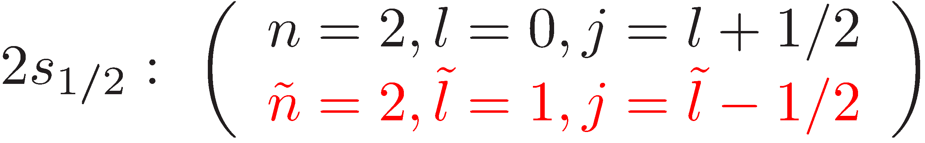
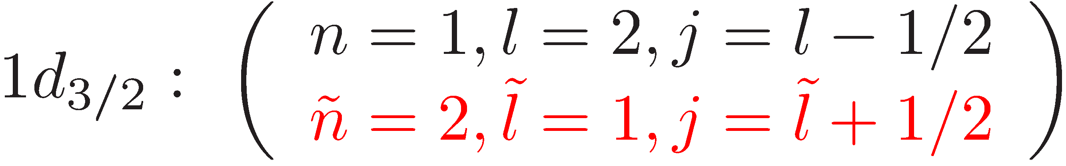
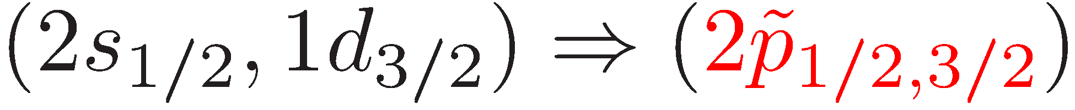
Pseudo quantum numbers & lower component
Equation of motion for nucleons: Schrödinger / Dirac equations
What is ?
Dirac spinor:
Relations of quantum numbers:
is the orbital angular momentum of the lower component of the Dirac spinor.
Ginocchio, PRL 78, 436 (1997)

Slide 9
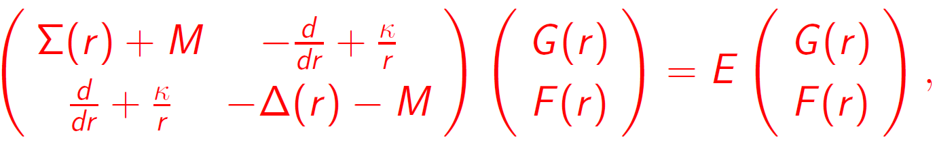
Dirac and Schrödinger-like equations
Dirac equation
where

Slide 10
Nuclear potentials in relativistic models
The scalar and vector potentials are both very big in amplitude, but with opposite signs: S(r) < 0 & V(r) > 0.
This results in a shallow Fermi sea and a deep Dirac sea, the latter is responsible for the large spin-orbit coupling.
V + S ≈ 70 MeV
V - S ≈ 700 MeV
Courtery of P. Ring

Slide 11

Dirac and Schrödinger-like equations
Dirac equation
where
Schrödinger-like equation for the lower component
with
Meng, Sugawara-Tanabe, Yamaji, Ring, Arima, PRC 58, R628 (1998)

Slide 12
Contents
Introduction
General Features
  Dirac and Schrödinger-like equations
  Analytical solutions at PSS limit
  PSS breaking in realistic nuclei
PSS and SS in Various Systems and Potentials
  From stable nuclei to exotic nuclei
  From non-confining potentials to confining potentials
  From local potentials to non-local potentials
  From central potentials to tensor potentials
  From bound states to resonant states
  From nucleon spectra to anti-nucleon spectra
  From nucleon spectra to hyperon spectra
  From spherical nuclei to deformed nuclei
Open Issues on PSS and SS
  Perturbative or not
  Intruder states
  SUSY and SRG
Summary and Perspectives

Slide 13
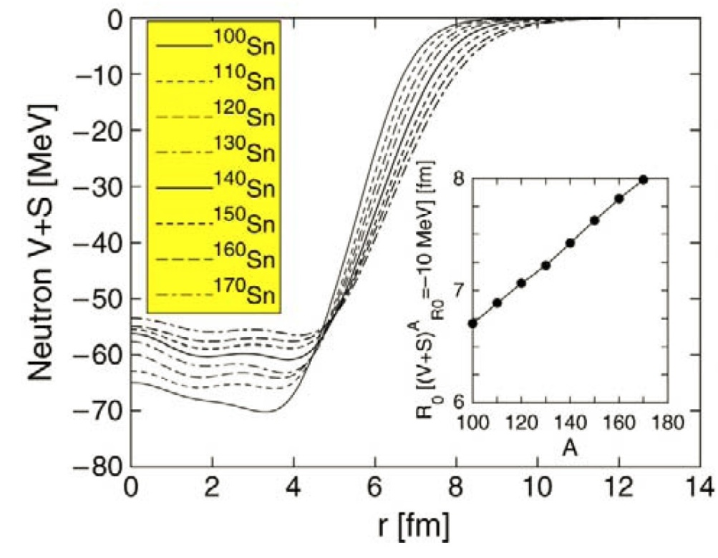
From stable nuclei to exotic nuclei
If Σ(r) = 0 or dΣ(r)/dr = 0, the PSS is exactly conserved, i.e., the PSS doublets are degenerate.
Meng, Sugawara-Tanabe, Yamaji, Ring, Arima, PRC 58, R628 (1998)
Meng, Sugawara-Tanabe, Yamaji, Arima, PRC 59, 154 (1999)

Slide 14
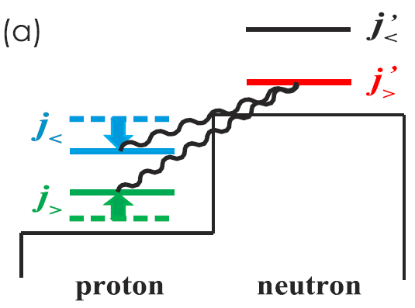
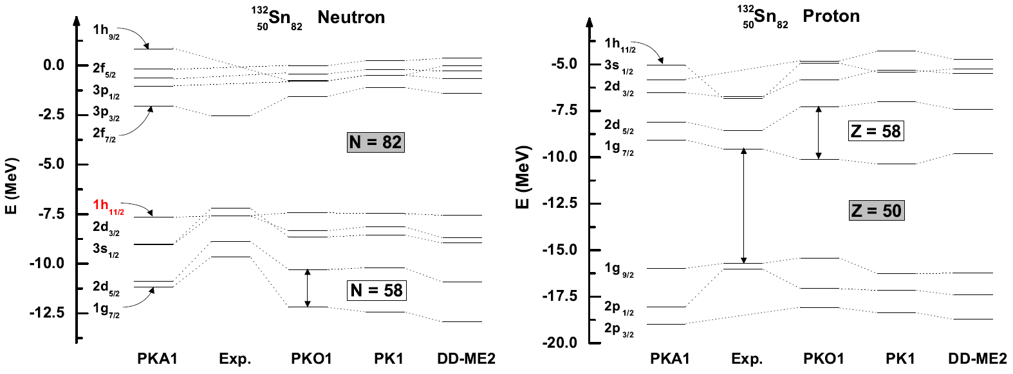
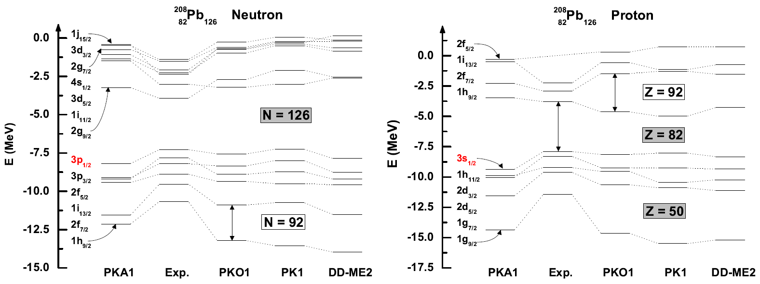
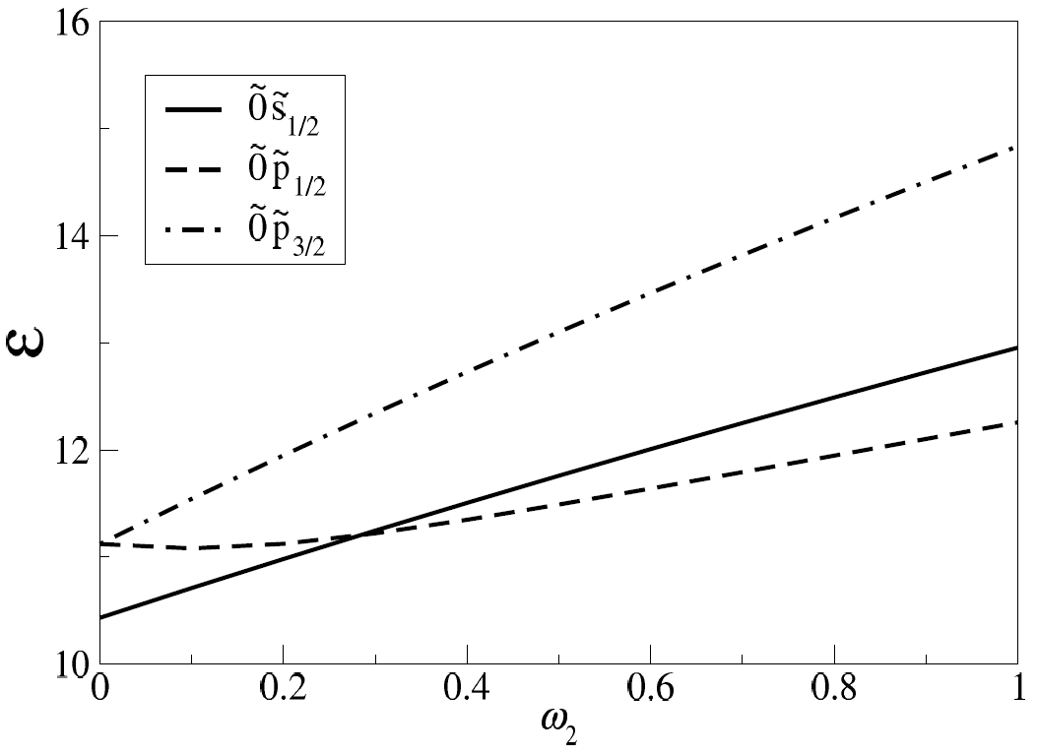
From central potentials to tensor potentials
Otsuka et al., PRL 95, 232502 (2005)
Lisboa et al., PRC 69 024319 (2004)
Long, Sagawa, Giai, Meng, PRC 76, 034314 (2007)
The pseudospin-oribt splittings decrease when the strengths of tensor interactions increase.

Slide 15
Nuclear potentials in relativistic models
The scalar and vector potentials are both very big in amplitude, but with opposite signs: S(r) < 0 & V(r) > 0.
This results in a shallow Fermi sea and a deep Dirac sea, the latter is responsible for the large spin-orbit coupling.
V + S ≈ 70 MeV
V - S ≈ 700 MeV
Courtery of P. Ring

Slide 16
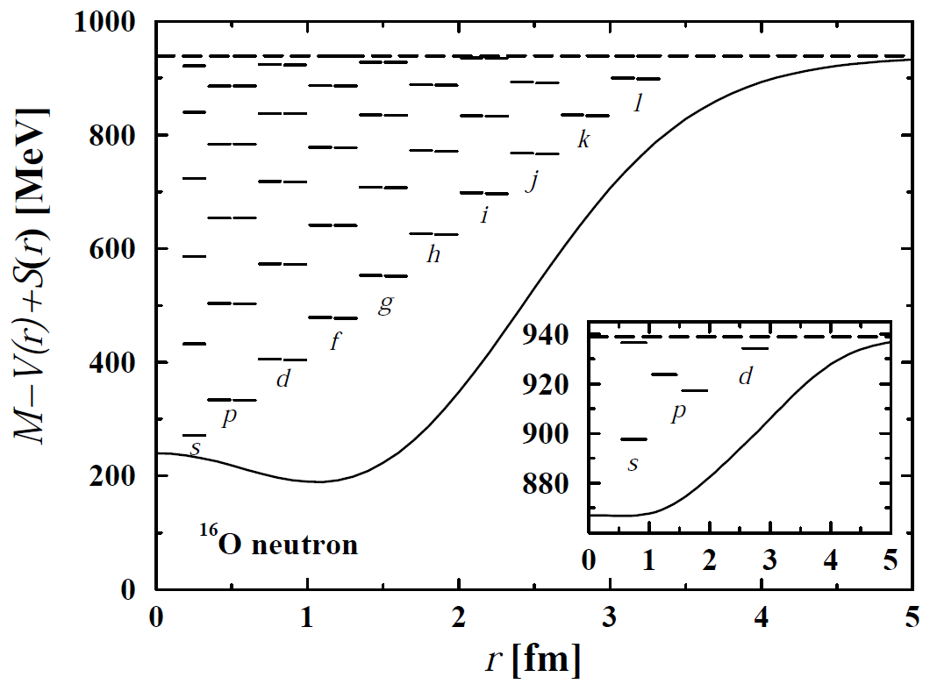
From nucleon spectra to anti-nucleon spectra
If Σ(r) = 0 or dΣ(r)/dr = 0, the spin symmetry (SS) in anti-nucleon spectra is exactly conserved.
The SS in single-anti-nucleon spectra is much better developed than that of PSS in single-nucleon spectra.
Zhou, Meng, Ring, PRL 91, 262501 (2003)
He, Zhou, Meng, Zhao, Scheid, EPJA 28, 265 (2006)
HZL, Long, Meng, Giai, EPJA 44, 119 (2010)

Slide 17
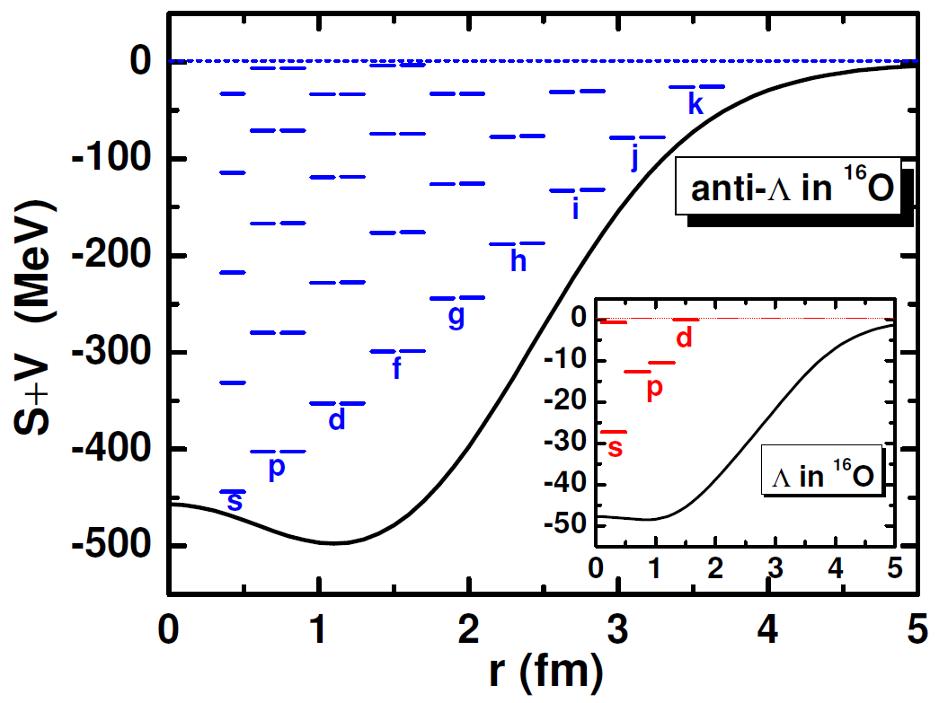
From nucleon spectra to hyperon spectra
Due to the additional strangeness degree of freedom, it is expected that the annihilation probability of an anti-hyperon in a normal nucleus is much smaller than that of an anti-nucleon.
Song, Yao, Meng, Chin. Phys. Lett. 26, 122102 (2009)
Song, Yao, Chin. Phys. C 34, 1425 (2010)
Song, Yao, Meng, Chin. Phys. Lett. 28, 092101 (2011)

Slide 18
Contents
Introduction
General Features
  Dirac and Schrödinger-like equations
  Analytical solutions at PSS limit
  PSS breaking in realistic nuclei
PSS and SS in Various Systems and Potentials
  From stable nuclei to exotic nuclei
  From non-confining potentials to confining potentials
  From local potentials to non-local potentials
  From central potentials to tensor potentials
  From bound states to resonant states
  From nucleon spectra to anti-nucleon spectra
  From nucleon spectra to hyperon spectra
  From spherical nuclei to deformed nuclei
Open Issues on PSS and SS
  Perturbative or not
  Intruder states
  SUSY and SRG
Summary and Perspectives

Slide 19
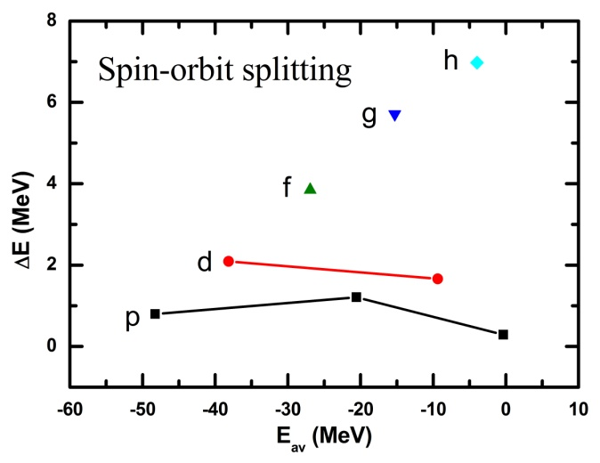
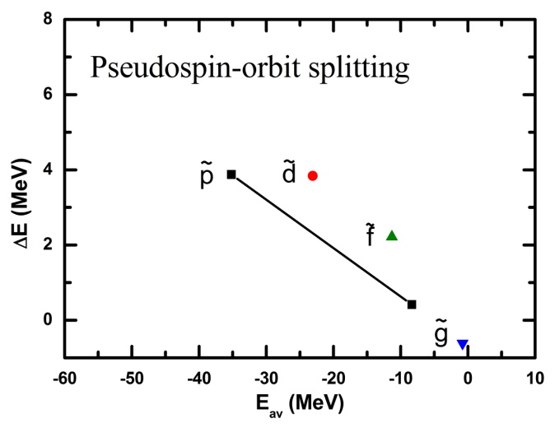
Triggers for recent progress
Schrödinger-like equation for the lower component
with
At the PSS limit, Σ(r) = 0 or dΣ(r)/dr = 0,
  There are no bound states in single-nucleon spectra.
  There are bound states only in single-anti-nucleon spectra.
There exist singularities in 1/M₋ for the bound states.
Effective Hamiltonian is not Hermitian, i.e., perturbation theory can NOT be applied.

Slide 20
Triggers for recent progress
Schrödinger-like equation for the lower component
with
At the PSS limit, Σ(r) = 0 or dΣ(r)/dr = 0,
  There are no bound states in single-nucleon spectra.
  There are bound states only in single-anti-nucleon spectra.
There exist singularities in 1/M₋ for the bound states.
Effective Hamiltonian is not Hermitian, i.e., perturbation theory can NOT be applied.
Selected recent progress
PSS in the single-particle resonant states Lu, Zhao, Zhou, PRL 109, 072501 (2012)
PSS with similarity renormalization group (SRG) Guo et al., PRL 112, 062502 (2014)
PSS with SRG, supersymmetric (SUSY) quantum mechanics, and perturbation theory HZL et al., PRC 83, 041301(R) (2011) ; HZL et al., PRC 87, 014334 (2013)

Slide 21
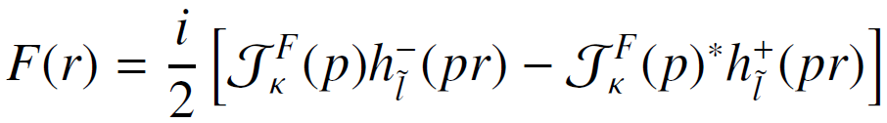

i) PSS in resonant states
Schrödinger-like equation for the lower component
At r → ∞ (neutron states)
Zeros of Jost functions correspond to bound states, resonant states, ...
At the PSS limit,
Lu, Zhao, Zhou, PRL 109, 072501 (2012)

Slide 22
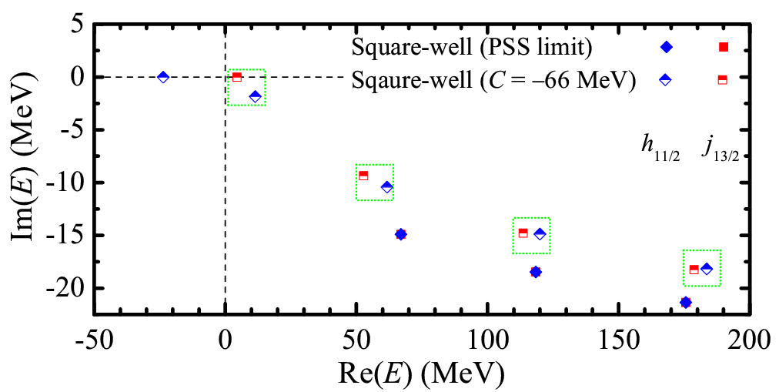
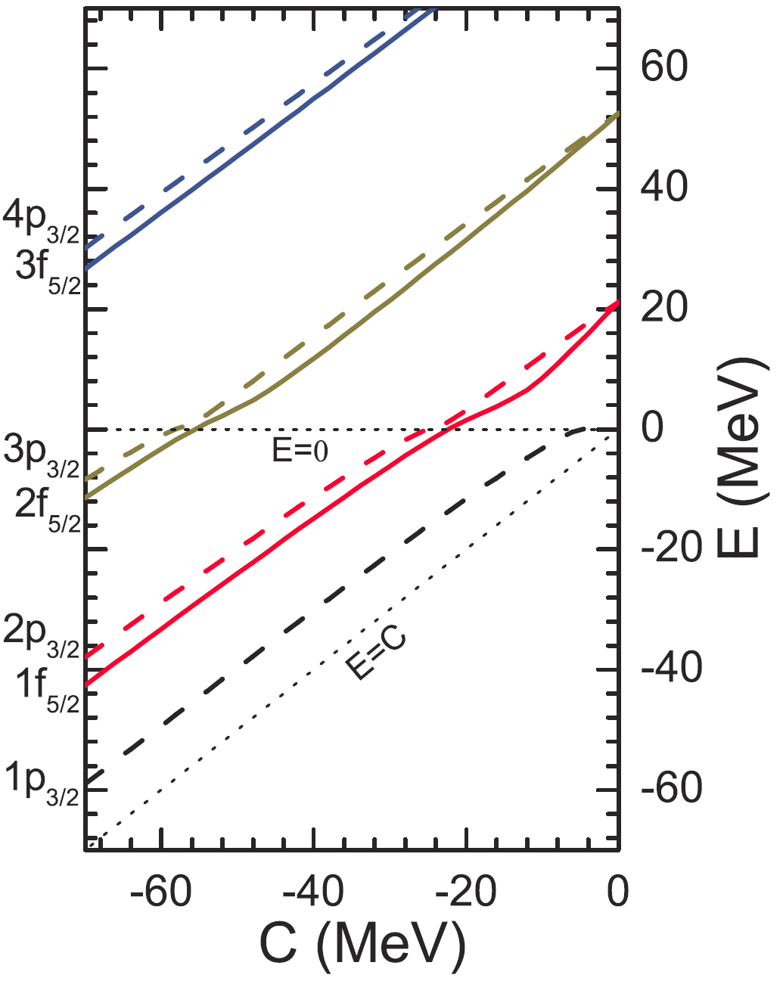
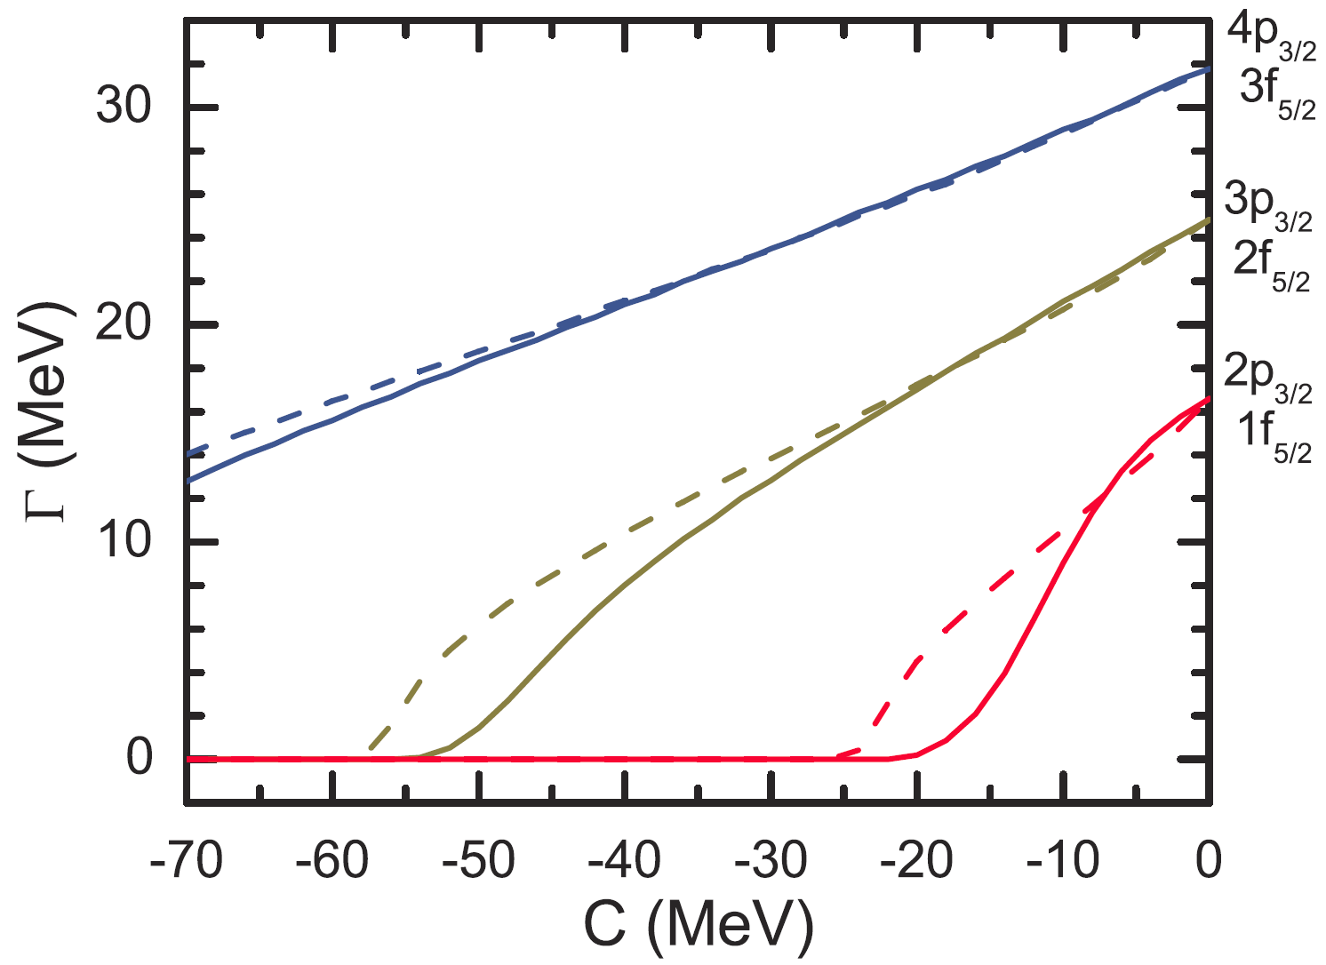
An example: Square-well potentials
C
+M
D
−M
Lu, Zhao, Zhou, PRL 109, 072501 (2012)
Lu, Zhao, Zhou, PRC 88, 024323 (2013)

Slide 23


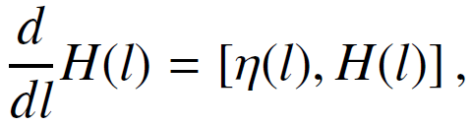
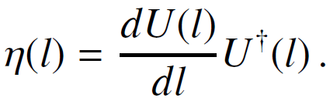
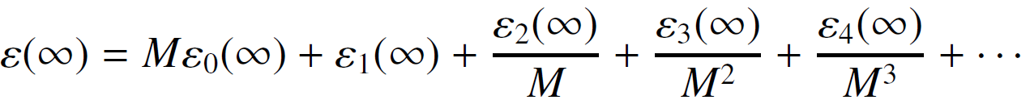
ii) PSS with SRG
Similarity renormalization group (SRG)
Wegner, Ann. Phys. 506, 77 (1994)
Phys. Rep. 348, 77 (2001)
Bylev and Pirner, PLB 428, 329 (1998)
Start with the initial Hamiltonian H
Introduce a unitary transformation
The flow equation with the anti-Hermitian generator
The off-diagonal part o(l) = 0 as l → ∞, the diagonal part in a series of 1/M
Higher orders of Foldy-Wouthuysen non-relativistic reduction

Slide 24
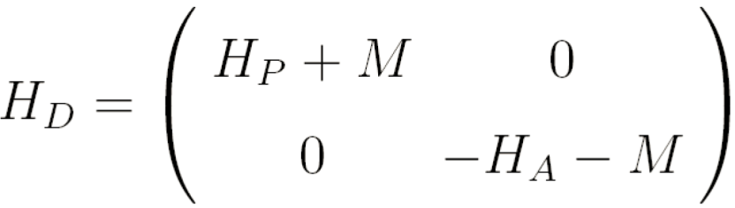
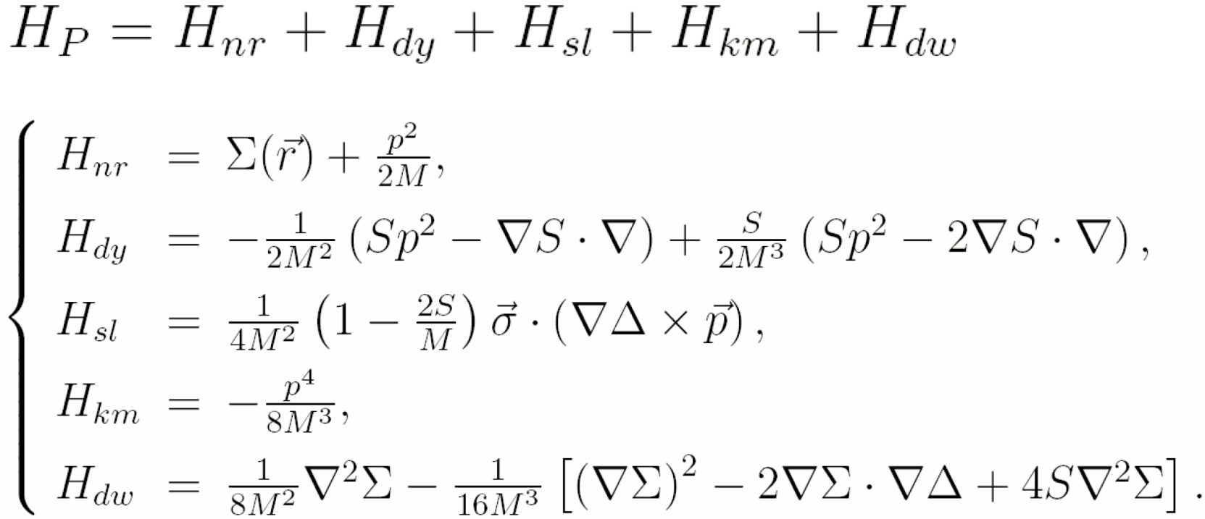
SRG for Dirac Hamiltonian
Dirac Hamiltonian H
After SRG,
with
Guo, PRC 85, 021302(R) (2012)
Li, Chen, Guo, PRC 87, 044311 (2013)
Guo et al., PRL 112, 062502 (2014)
Every operator is Hermitian.

Slide 25
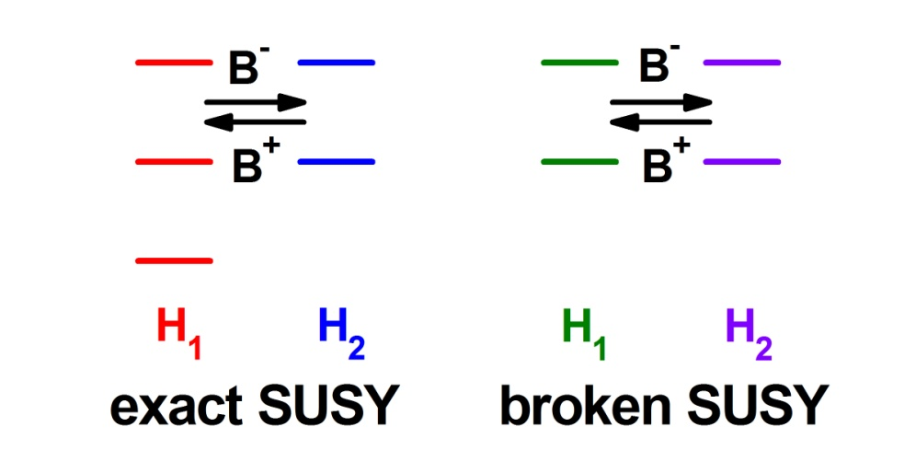
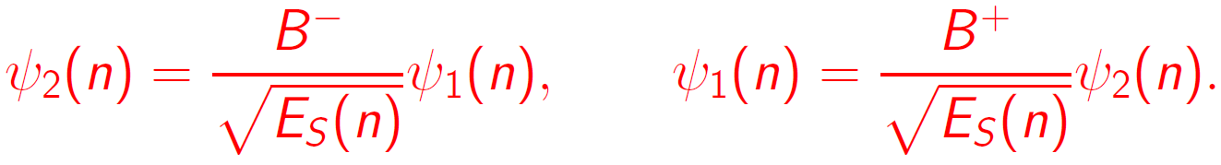
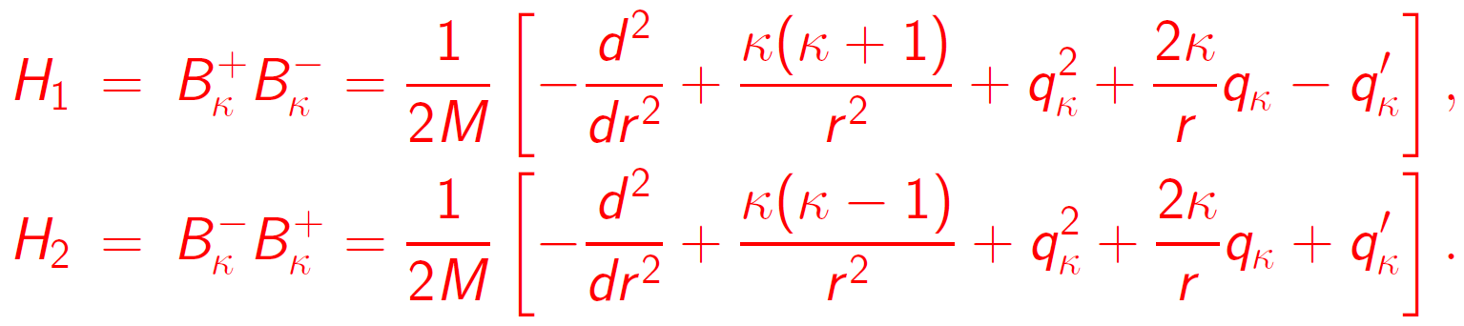
iii) PSS with SRG, SUSY, & perturbation
Supersymmetric (SUSY) quantum mechanics
Hamiltonian and its supersymmetric partner
Their spectra and wave functions
Spin and Pseudospin symmetric terms
Typel, NPA 806, 156 (2008)
HZL, Shen, Zhao, Meng, PRC 87, 014334 (2013)

Slide 26
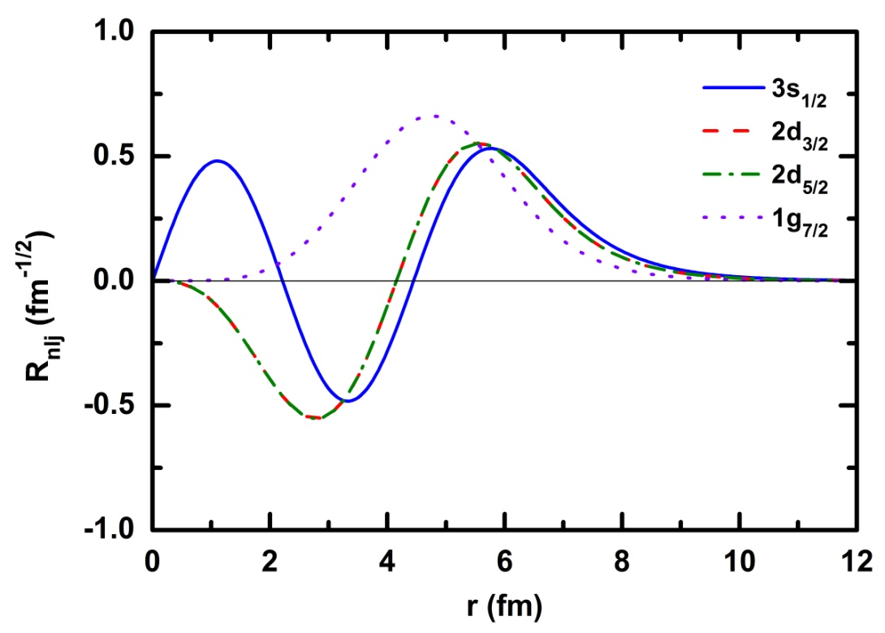
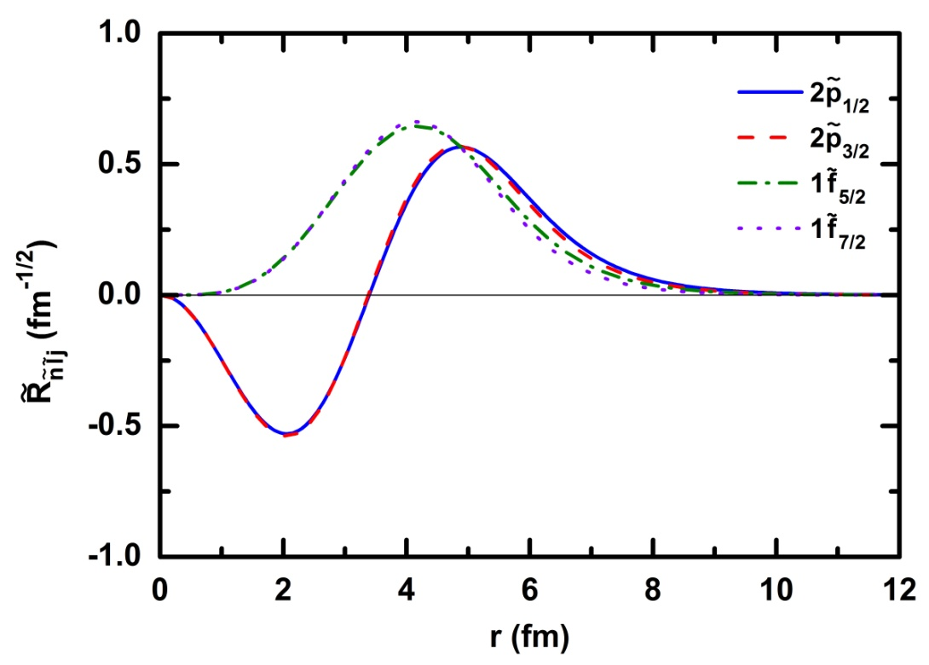
Single-particle wave functions
Single-particle wave functions in H₁ and its SUSY partner H₂
Single-particle wave functions of pseudospin doublets are very different in original Hamiltonian.
But they are almost identical in SUSY partner Hamiltonian.
HZL, Shen, Zhao, Meng, PRC 87, 014334 (2013)

Slide 27
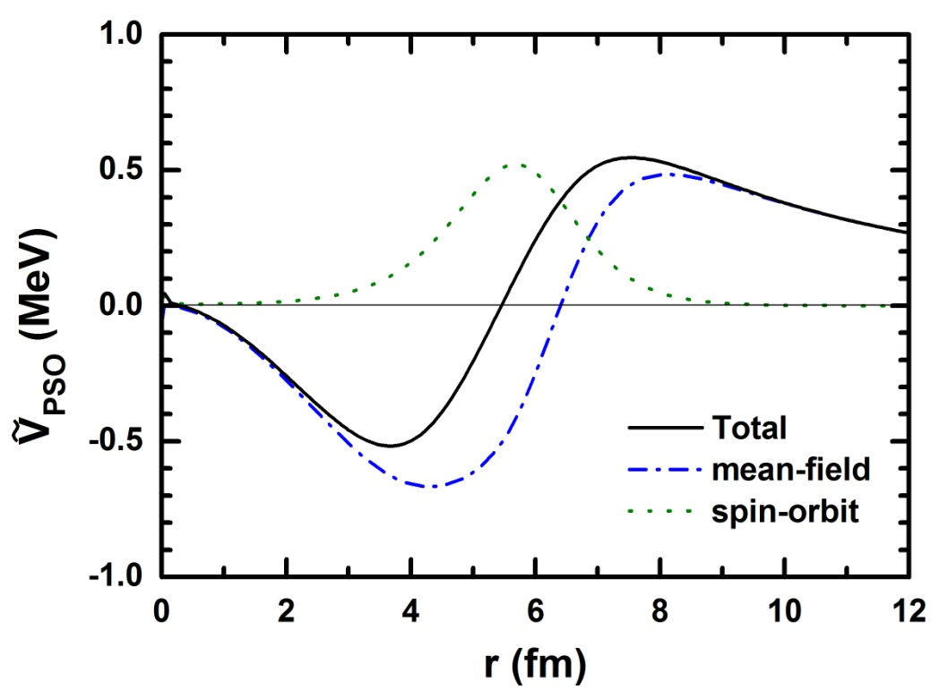
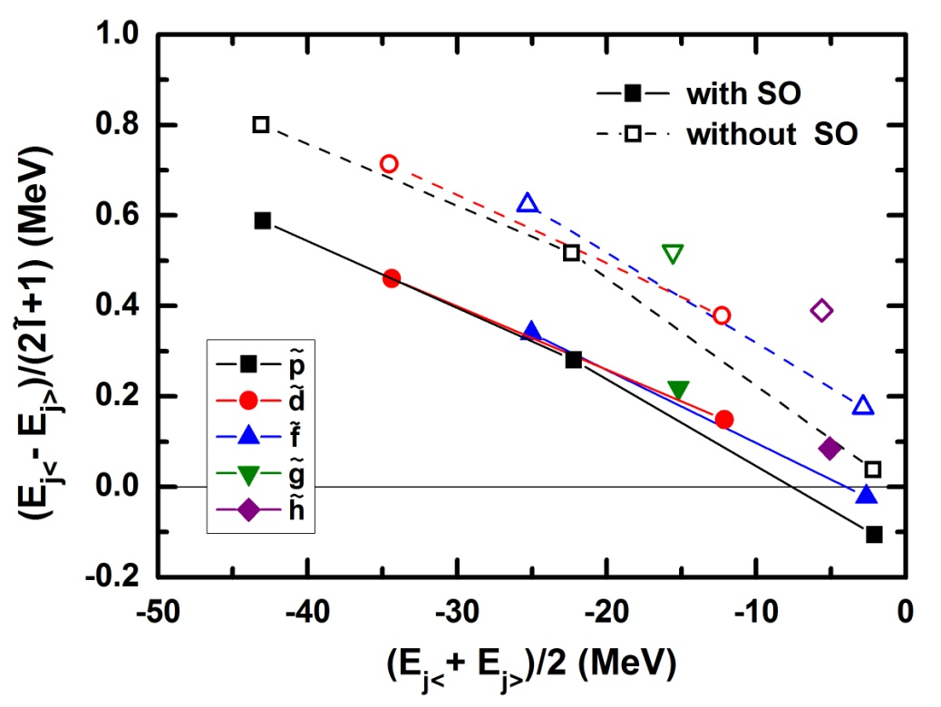
Pseudospin-orbit potential and splitting
Dirac to Schrödinger equations by SRG (1/M order + spin-orbit at 1/M² order)
The origin of PSS deeply hidden in H₁ can be traced in its SUSY partner Hamiltonian H₂.
ΔE_{PSO} become smaller with increasing E_{av} can be interpreted in an explicit and quantitative way.
HZL, Shen, Zhao, Meng, PRC 87, 014334 (2013); Shen, HZL, Zhao, Zhang, Meng, PRC 88, 024311 (2013)

Slide 28
Contents
Introduction
General Features
  Dirac and Schrödinger-like equations
  Analytical solutions at PSS limit
  PSS breaking in realistic nuclei
PSS and SS in Various Systems and Potentials
  From stable nuclei to exotic nuclei
  From non-confining potentials to confining potentials
  From local potentials to non-local potentials
  From central potentials to tensor potentials
  From bound states to resonant states
  From nucleon spectra to anti-nucleon spectra
  From nucleon spectra to hyperon spectra
  From spherical nuclei to deformed nuclei
Open Issues on PSS and SS
  Perturbative or not
  Intruder states
  SUSY and SRG
Summary and Perspectives

Slide 29
Summary and Perspectives
During the past 10+ years, there is various progress on the study of PSS and SS in different systems and potentials, e.g.,
    From stable to exotic nuclei
    From non-confining to confining potentials
    From local to non-local potentials
    From central to tensor potentials
    From bound to resonant states
    From nucleon to anti-nucleon spectra
    From nucleon to hyperon spectra
    From spherical to deformed nuclei
    ......
Open issues
    PSS is perturbative or not?
    The puzzle of intruder states
    PSS with SRG, SUSY, perturbation theory, ……
SUSY quantum mechanics might help to understand some new physics.
Various and concrete experimental evidences for PSS are highly desired!

Slide 30
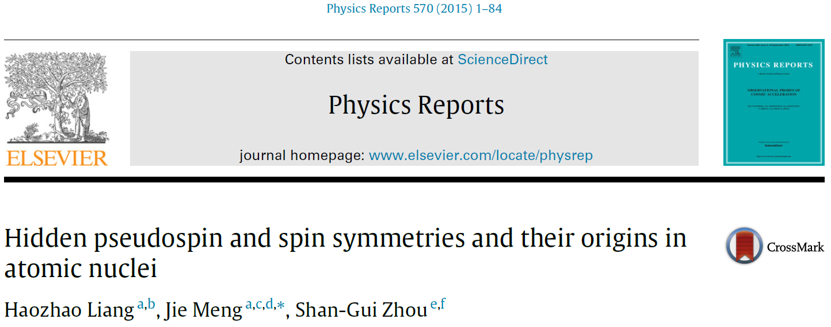
Acknowledgments
We would like to express our gratitude to all the collaborators and colleagues who contributed to the investigations presented, in particular to
A. Arima, T.S. Chen, L.S. Geng, J.N. Ginocchio, J.Y. Guo, X.T. He, R.V. Jolos, A. Leviatan, F.Q. Li, W.H. Long, B.N. Lu, H.F. Lu, P. Ring, H. Sagawa, W. Scheid, S.H. Shen, C.Y. Song, K. Sugawara-Tanabe, H. Toki, N. Van Giai, S. Yamaji, S.C. Yang, J.M. Yao, S.Q. Zhang, Y. Zhang, E.G. Zhao, and P.W. Zhao.
Thank you!
84 pages, 58 figures, 10 tables

