Slide 1









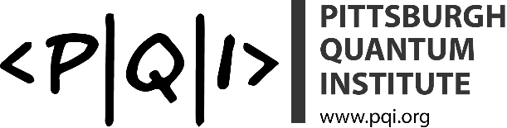
Electron Pairing and Superconductivity in
SrTiO₃-based Nanostructures and Waveguides
Jeremy Levy
Pittsburgh Quantum Institute
Department of Physics and Astronomy
University of Pittsburgh
Nordita Program on Multi-Component and Strongly-Correlated Superconductors
Stockholm, Sweden
4 July 2016
Notes:
Electron Pairing and Superconductivity SrTiO₃-based Nanostructures and Waveguides
The study of strongly correlated electronic systems and the development of quantum transport in nanoelectronic devices have followed distinct, mostly non-overlapping paths. Electronic correlations of complex materials lead to emergent properties such as superconductivity, magnetism, and Mott insulator phases. Nanoelectronics generally starts with far simpler materials (e.g., carbon-based or semiconductors) and derives functionality from doping and spatial confinement to two or fewer spatial dimensions. In the last decade, these two fields have begun to overlap. The development of new growth techniques for complex oxides have enabled new families of heterostructures which can be electrostatically gated between insulating, ferromagnetic, conducting and superconducting phases. We use a scanning probe to “write” and “erase” conducting nanostructures at the buried LaAlO₃/SrTiO₃ interface with a precision of two nanometers. Using this technique, we investigate the phenomenon of electron pairing in SrTiO₃. Low-temperature measurements of sketched single-electron transistors reveal clear signatures of electron pairing, far outside the regime of temperatures and magnetic fields that permit them to become phase coherent and superconducting. Electron pairing without superconductivity is also observed in open ballistic quantum wires that exhibit quantized conductance. An understanding of electron pairing in SrTiO₃-based nanostructures creates new constraints for theory, and raises the prospect that an unconventional “high-temperature” (relative to carrier density) superconductor may be deeply understood.

Slide 2
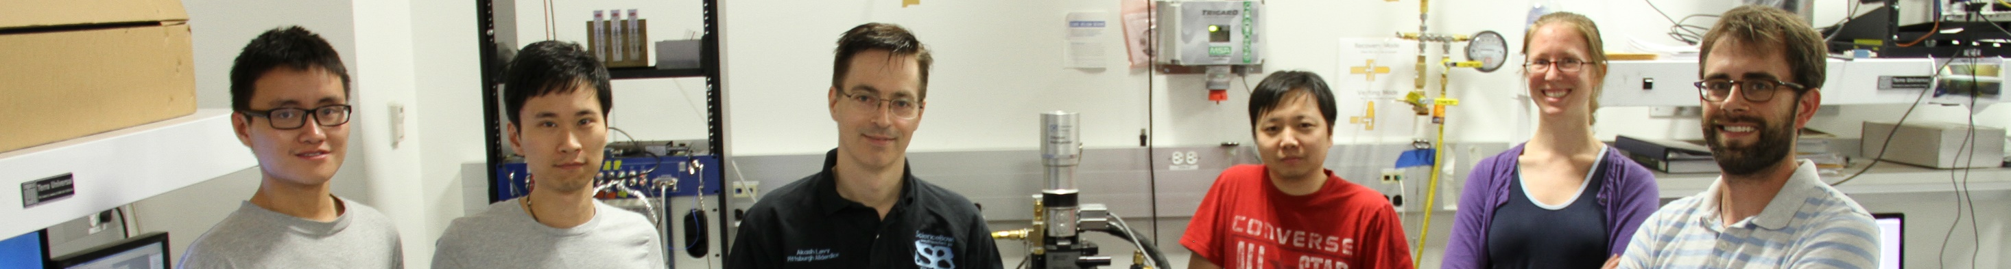
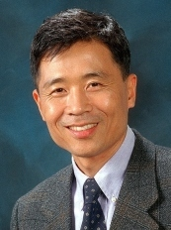
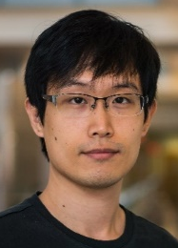
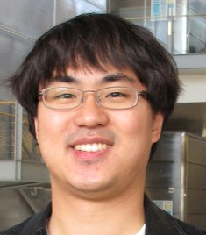

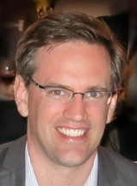
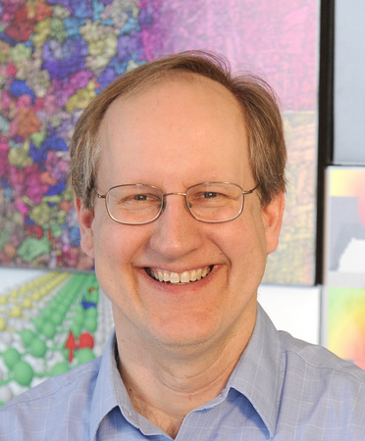
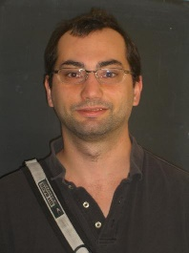

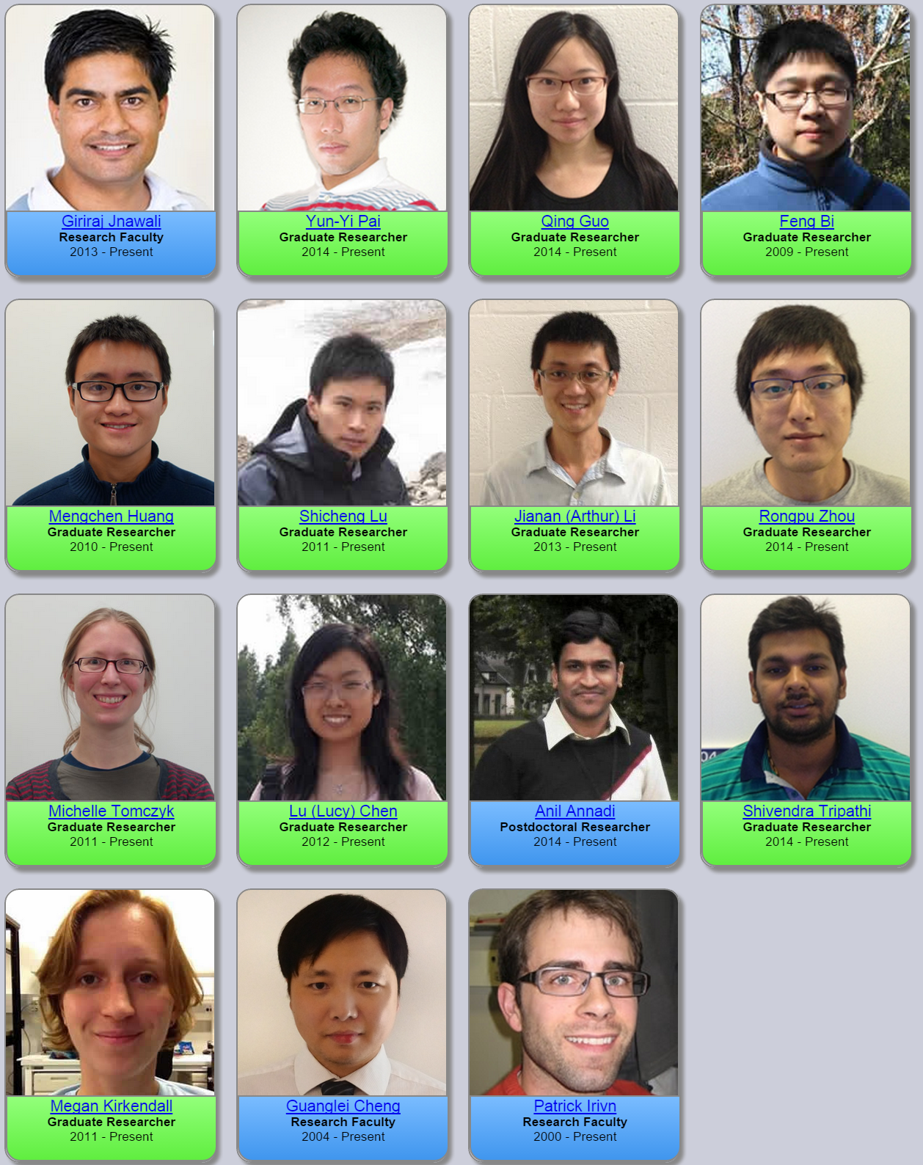
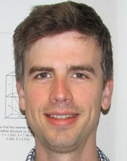
Acknowledgements
Mengchen Huang Shicheng Lu Jeremy Levy Guanglei Cheng Michelle Tomczyk Patrick Irvin
Alexander
Tacla
Andrew Daley
C. Stephen
Hellberg
David Pekker
Anthony
Tylan-Tyler
Megan
Kirkendall
Joshua P.
Veazey
Anil
Annadi
Chang-Beom
Eom
Hyungwoo
Lee
Sangwoo
Ryu
U. Wisconsin-Madison
U. Strathclyde
NRL
U. Pittsburgh

Slide 3
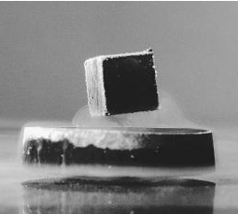
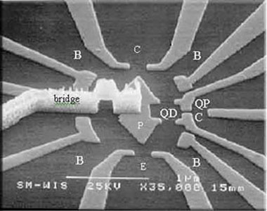
Correlated Nanoelectronics
Combine the rich phenomena of
correlated oxides with the paradigm of semiconductor nanostructures
Complex oxides add richness to mesoscopic devices
http://www.weizmann.ac.il/condmat/imry/content/images-selected-nano-systems
Mesocopic devices reveal properties of oxides
Correlated Oxides: superconductivity, magnetism, ferroelectricity, ferroelasticity,…
Semiconductor nanoelectronics: Quantum transport, single electron charge/spin devices,…

Slide 4
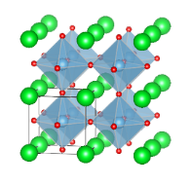
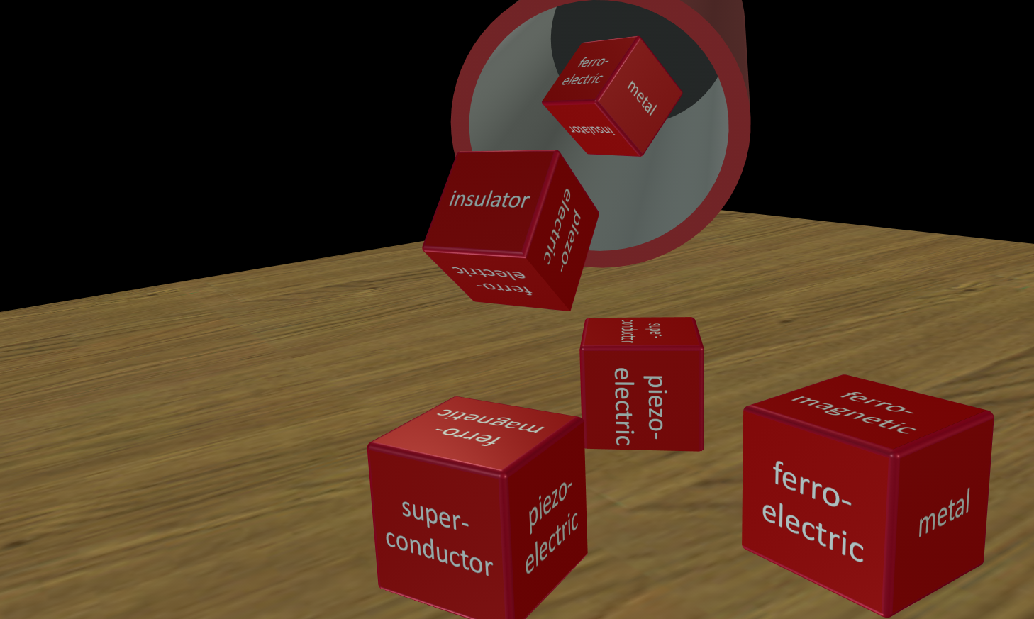
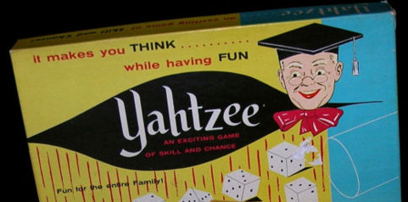
Oxide Yatzhee
SrTiO₃
Edition!
oxide
“The complexities of the crystal structure, lattice waves, band structure, transport properties, impurity electrons and superconductivity have inspired the comment: ‘if SrTiO₃ had magnetic properties, a complete study of this material would require a thorough knowledge of all of solid state physics.’”
--Marvin L. Cohen, in Superconductivity, vol. 1, R. D. Parks, Ed. (New York, 1969).

Slide 5
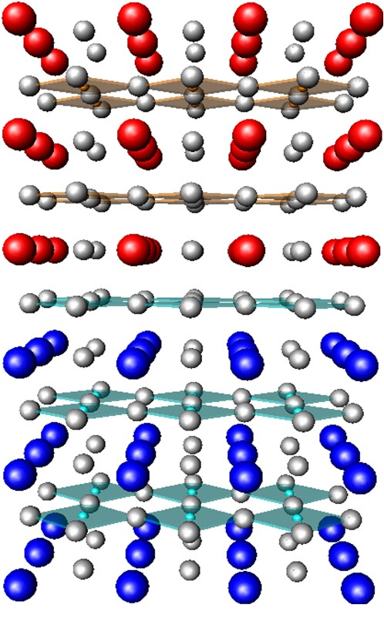
Emergent Phenomena at Oxide Interfaces
High-mobility 2DEG
  Ohtomo and Hwang, Nature (2004)
Metal-insulator transition
  Thiel et al, Science (2006)
Superconductivity
  Reyren et al, Science (2007);
  Caviglia, Nature (2008)
Magnetism
  Brinkman et al, Nature Materials (2007)
Tunable Spin-Orbit Coupling
  Caviglia et al, PRL. (2010);
  Ben Shalom et al, PRL (2010)
Nanostructures
  Cen et al, Nature Materials (2008)
Nanodevices
  Cen et al, Science (2009)
Notes:
Emilio Artacho gave a nice introduction on Wednesday.

Slide 6
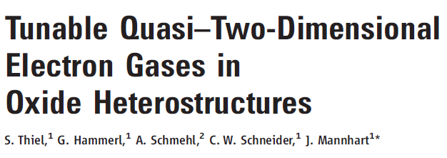
Interface <3 unit cells LaAlO₃ is insulating
Interface >3 unit cells LaAlO₃ is conducting
Interface =3 unit cells LaAlO₃ can switch!

Slide 7
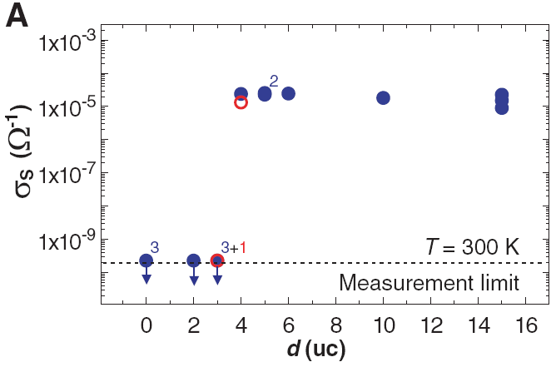
Interface <3 unit cells LaAlO₃ is insulating
Interface >3 unit cells LaAlO₃ is conducting
Interface =3 unit cells LaAlO₃ can switch!

Slide 8
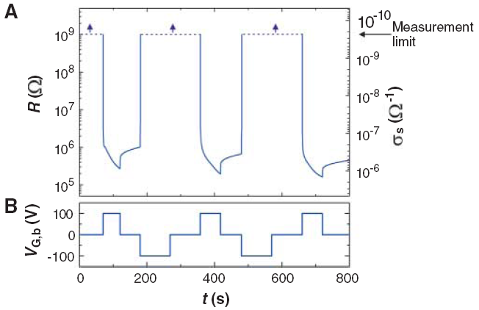
conducting
insulating
Interface <3 unit cells LaAlO₃ is insulating
Interface >3 unit cells LaAlO₃ is conducting
Interface =3 unit cells LaAlO₃ can switch!

Slide 9
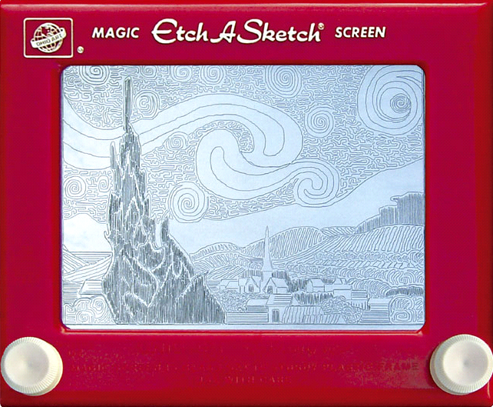
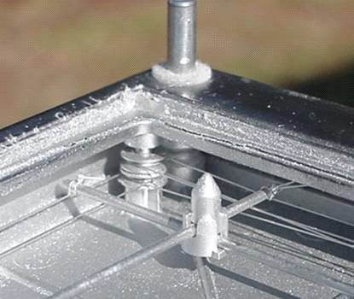
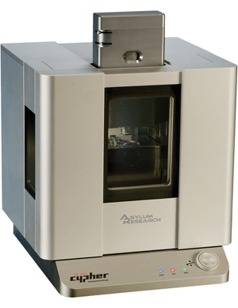
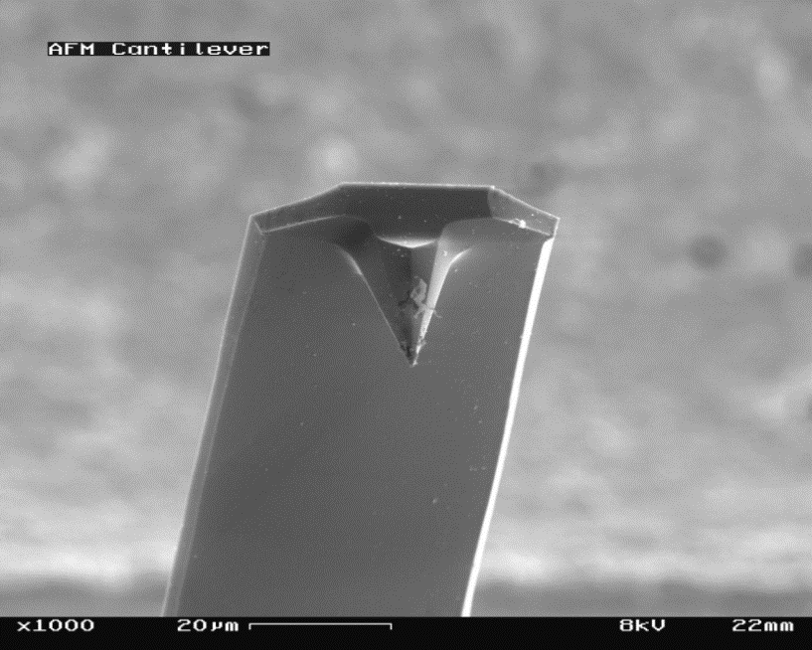
Etch-a-Sketch Nanoelectronics
Toy
Tool

Slide 10
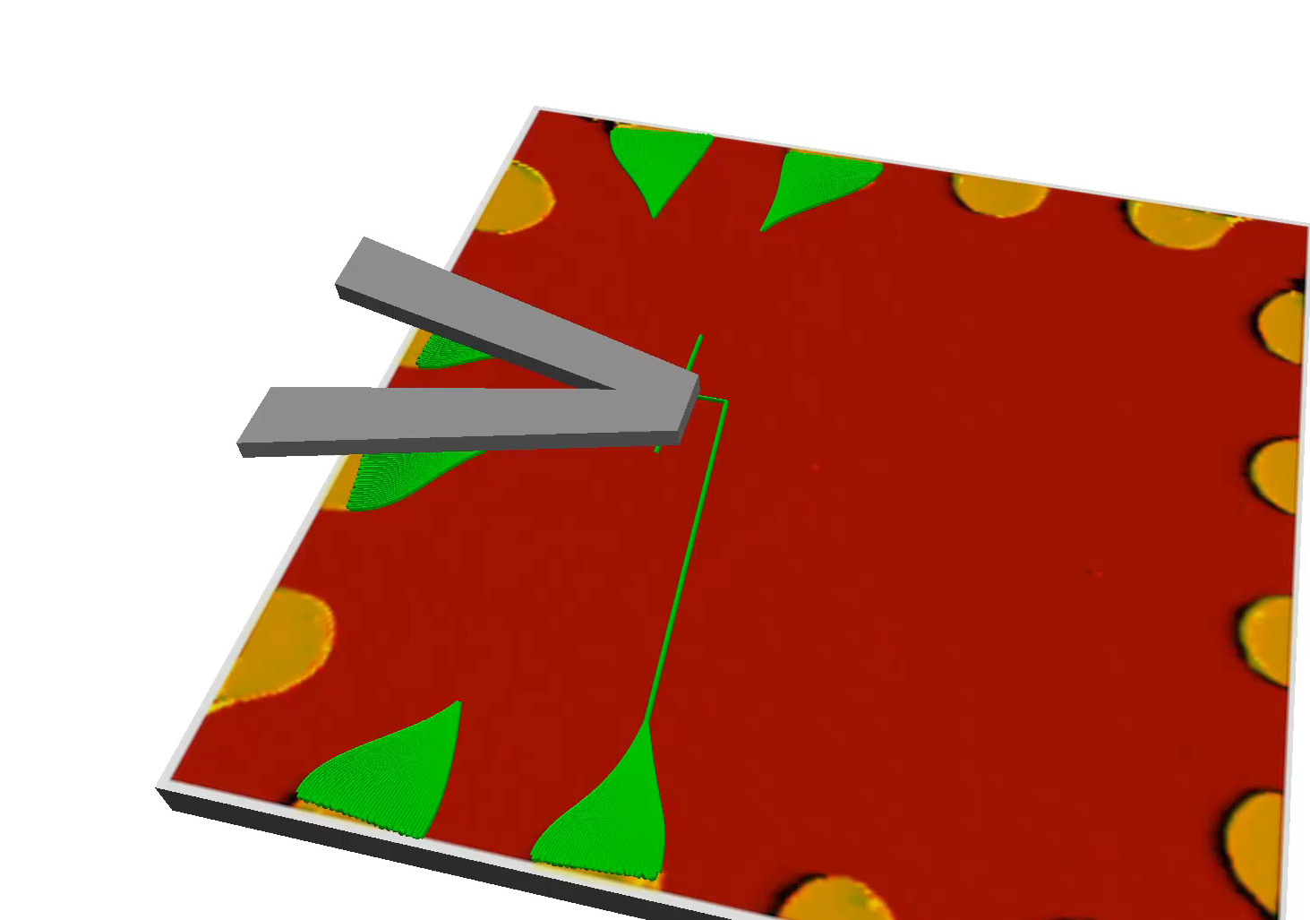
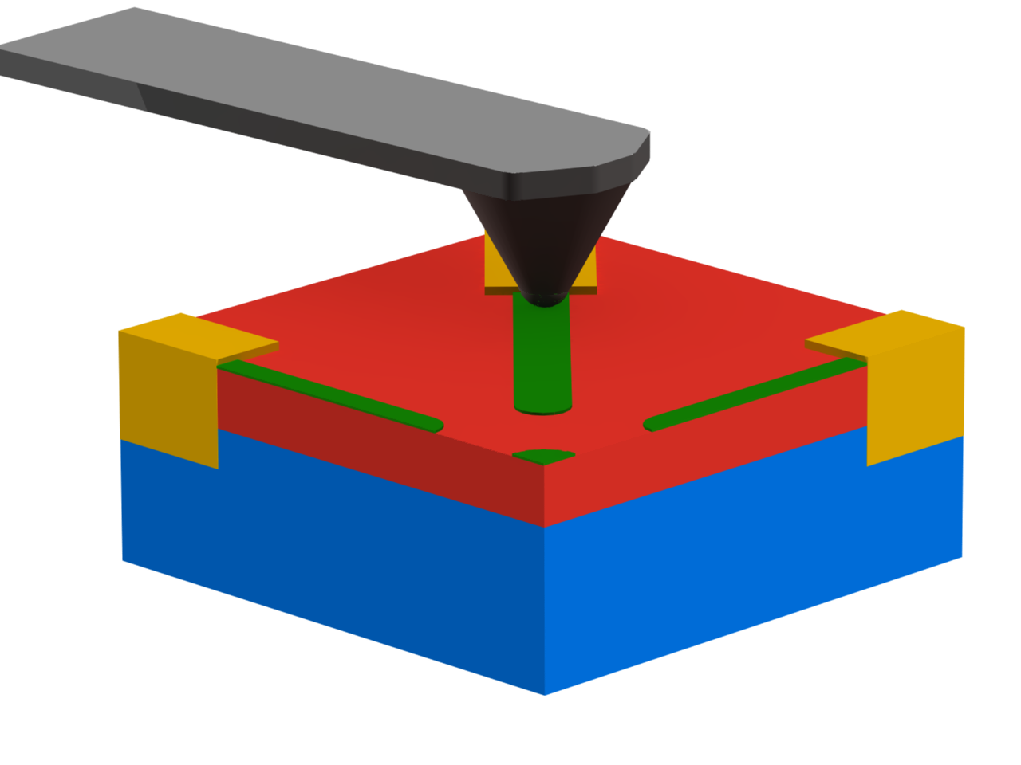
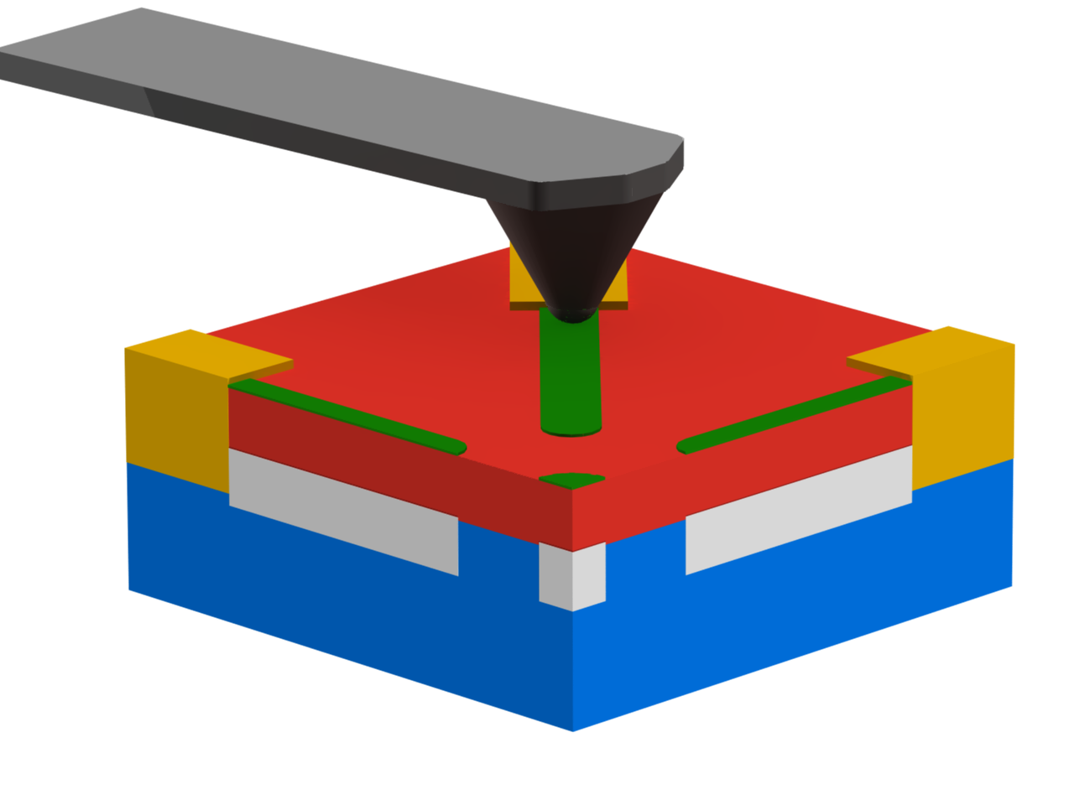
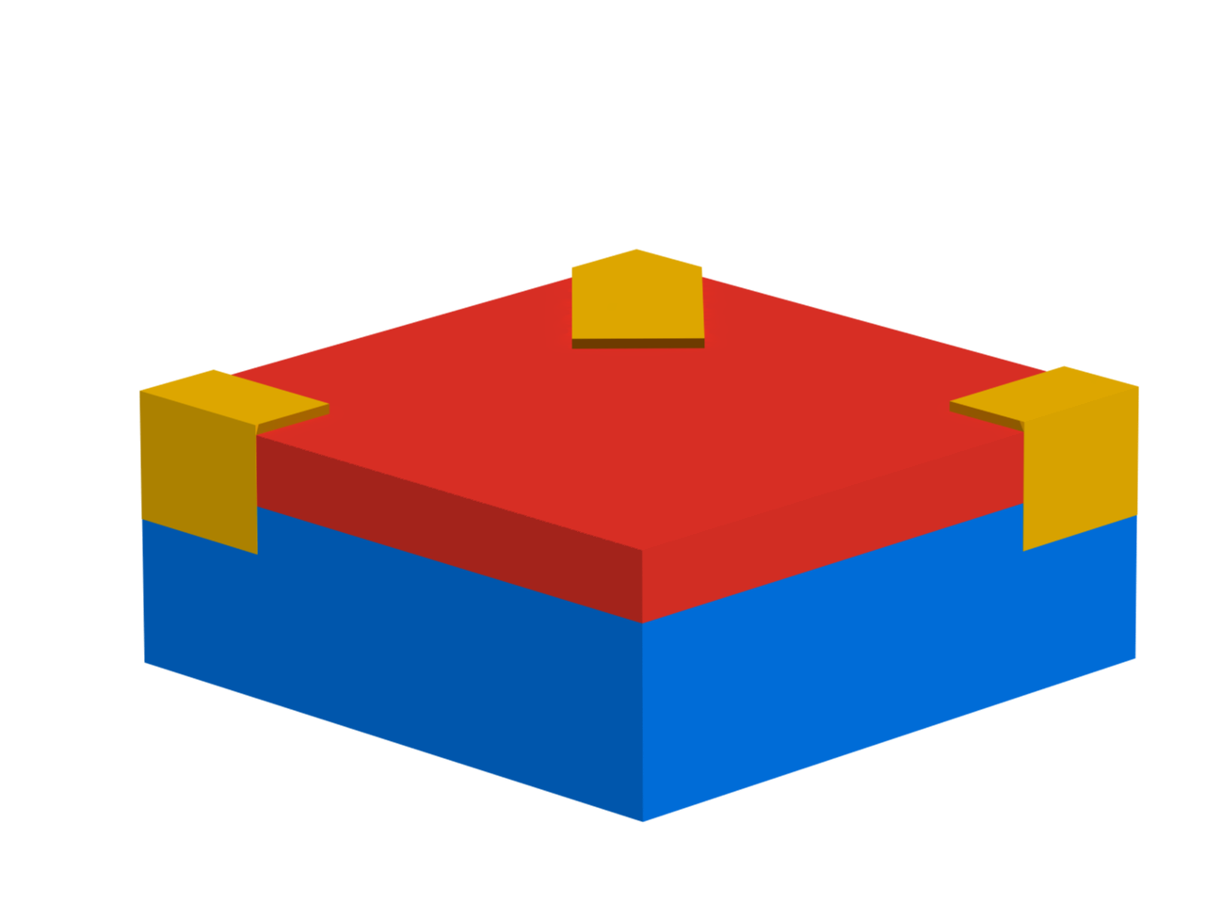
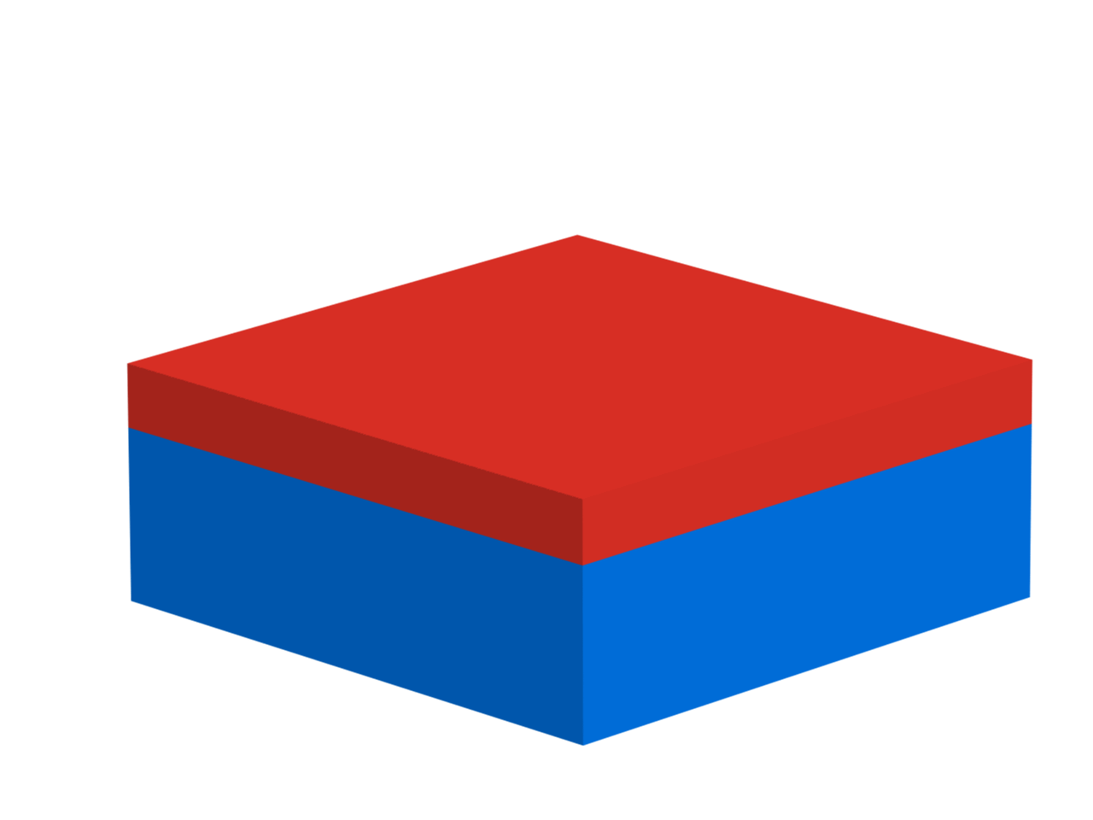

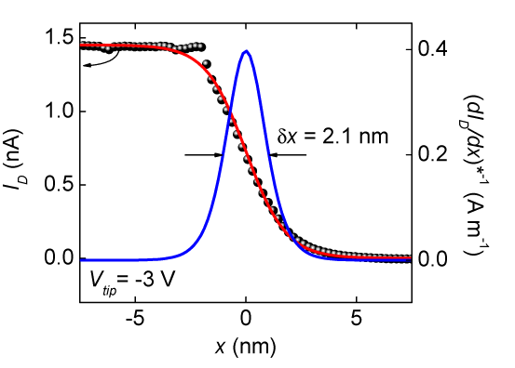
LaAlO₃/SrTiO₃ Nanostructures
Conductive AFM tip
V_{tip}>0 writes
V_{tip}
protons
V_{tip}<0 erases
+
+
≥ 2 nm
+
+
Ti/Au
+
+
+
+
+
+
+
+
+
+
+
LaAlO₃
+
+
-
interface
contact
+
-
-
V_{tip}=3 V
n ~ 10¹³ cm⁻²
-
-
-
SrTiO₃
1.2 nm
electrons
barrier
C. Cen et al, Nature Materials 7, 298 (2008). C. Cen et al, Science 323, 1026 (2009)

Slide 11
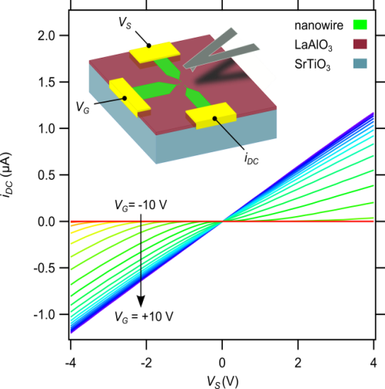
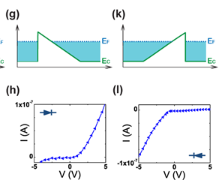
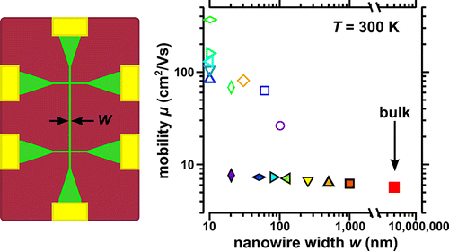
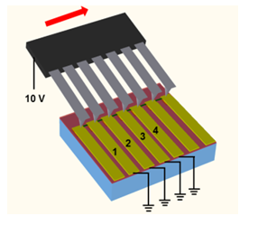
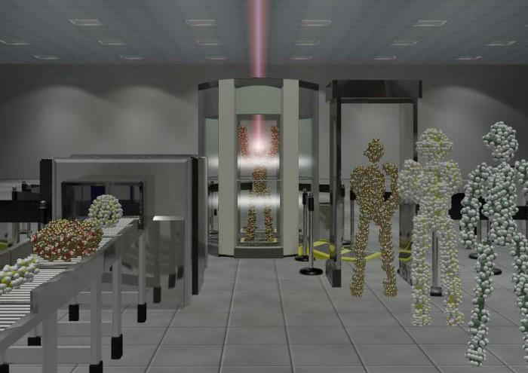
Oxide Nanoelectronics On Demand
SketchFET Transistors
Nanoscale Diodes
Nanoscale Photodetector
Cen et al., Science 6, 343 (2009)
Bogorin et al., APL 97, 013102 (2010)
Irvin et al, Nature Photonics 4, 849 (2010)
Multiple Tip Lithography
Anomalous High Mobility @ RT
Molecular-Scale THz Spectroscopy
Ma et al., Nano Lett 13, 2884 (2013)
Jnawali et al., APL 106, 211101 (2015)
Li et al., IEEE Trans. Nano. 12, 518 (2013)
Irvin et al., Nano Letters 13, 364 (2013)

Slide 12
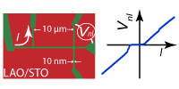
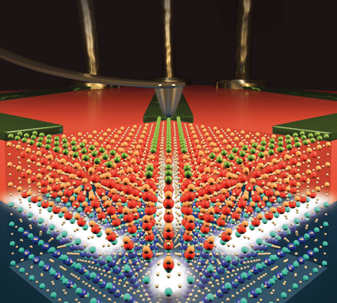
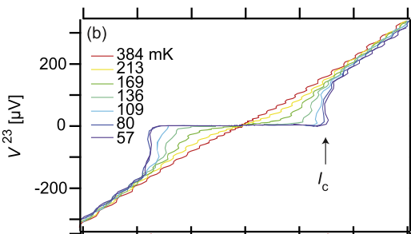
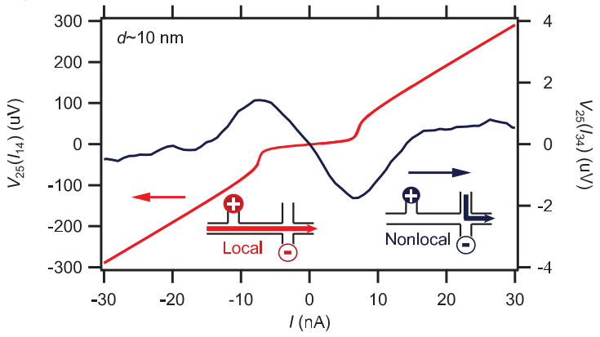
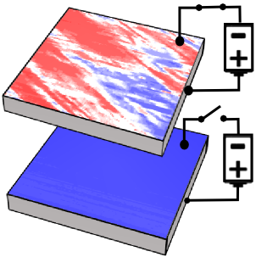
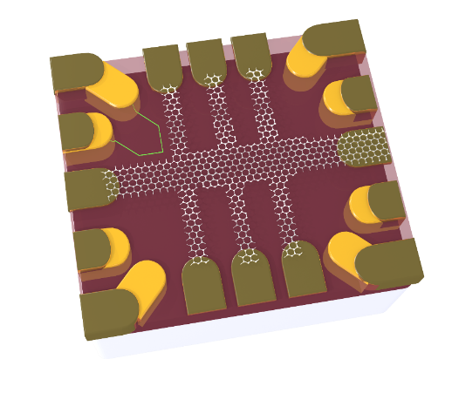
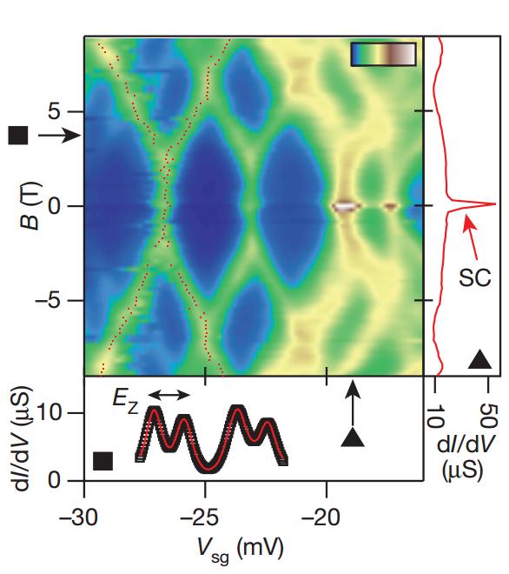
Oxide Nanoelectronics On Demand
Single Electron Transistor
Reconfigurable Superconducting Nanoelectronics
Nonlocal Transport
Veazey et al, Nanotechnology
24, 375201 (2013)
Cheng et al, PRX 3, 011021 (2013)
Cheng et al, Nature Nano 6, 343 (2011)
Veazey et al, EPL 103, 57001 (2013)
Electronically Controlled Ferromagnetism @ RT
Graphene-Complex Oxide Heterostructures
Electron Pairing without Superconductivity
Bi et al, Nature Communications
5, 5019 (2014)
Huang et al, APL Materials 3, 062502
(2015)
Cheng et al, Nature 521, 196 (2015)

Slide 13
Electron Pairing Without Superconductivity
Nature 521, 196 (2015)

Slide 14
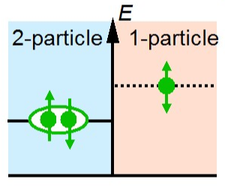
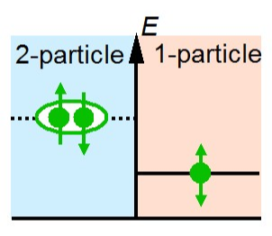
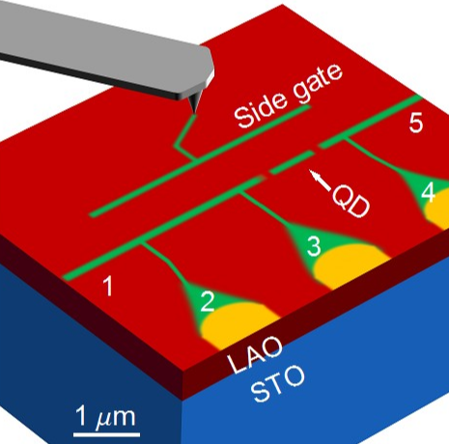
Electron-Electron Interactions
Attractive interactions (U<0) lead to electron pairing and superconductivity
Repulsive interactions (U>0) associated with Mott insulator, Wigner crystal (and possibly high-Tc SC)
Strategy: probe electron-electron interactions in LAO/STO quantum dot
U<0
U>0

Slide 15
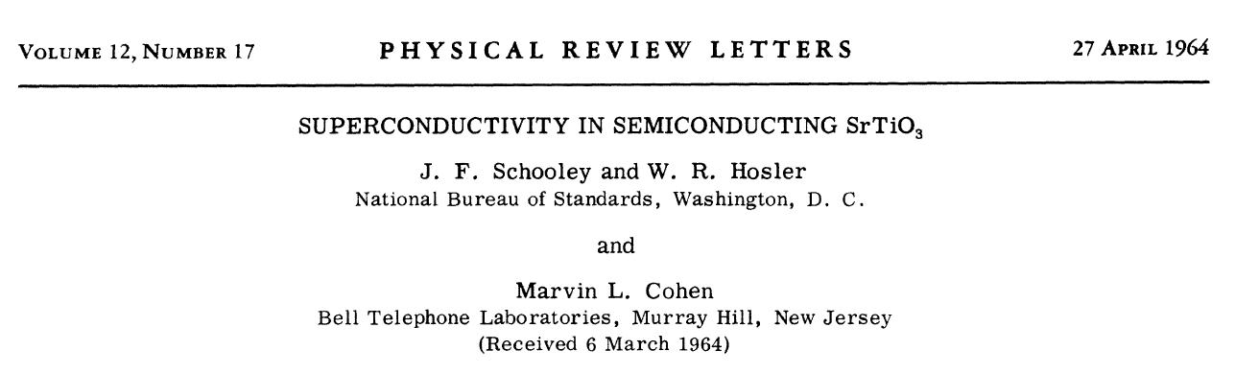
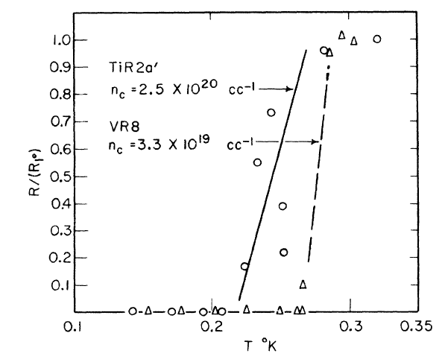
SrTiO₃: The First Superconducting Semiconductor

Slide 16
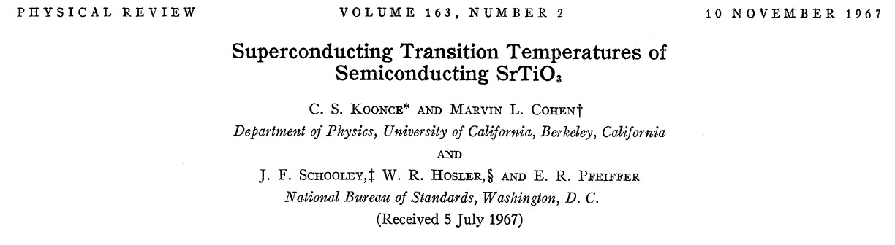
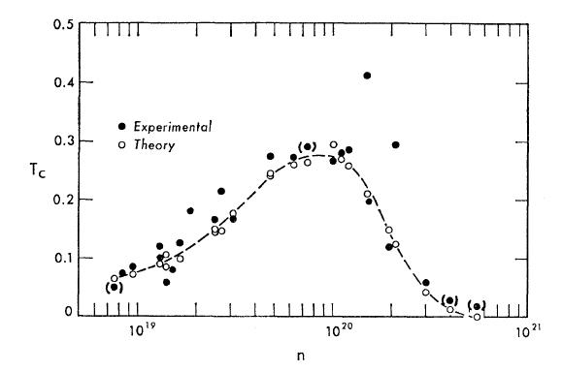
“…the non-monotonic temperature dependence bears a striking resemblance to high temperature superconductors—which will be discovered twenty years from now.”

Slide 17
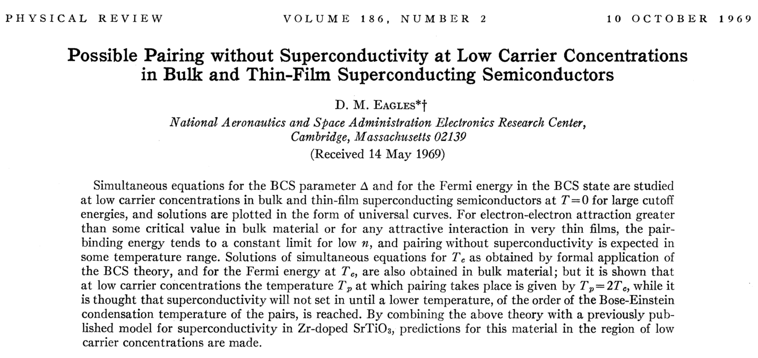
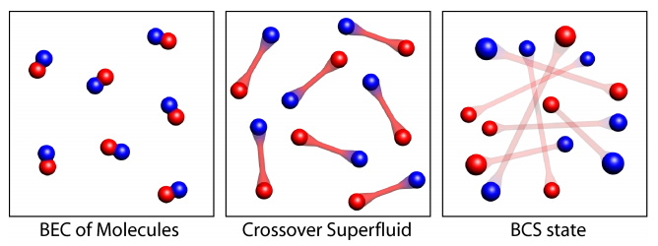
BEC-BCS Crossover
Notes:
David M. Eagles

Slide 18
Fast-forward to the present…

Slide 19





Pseudogap phase in LAO/STO
Nature 502, 528–531 (2013)

Slide 20
SrTiO₃ Single-Electron Transistor
Mesocopic devices reveal properties of oxides

Slide 21
Transport in a single-electron transistor (SET)
Single-electron transistor
Energy “Ladder”
Resonant Tunneling
Conductance
µ_{s}
µ_{d}
E_{c}
E_{c}+ε
E_{c}+ε
V_{gate}
E_{c}
V_{sd}
V_{gate}
Ec = Coulomb energy
ε = orbital energy
Cheng et al, Nature 521, 196 (2015)

Slide 22
Magnetic field dependence in a SET
V_{sd}
B=0 T
Single particle energy levels
V_{sg}
V_{sd}
Finite B
ε
V_{sg}
E_{c}
E
B
B=0
Non-zeroB
E_{c}
E_{c}+ε
V_{sg}
Cheng et al, Nature 521, 196 (2015)

Slide 23

Device schematic and transport characteristics
T=50 mK
w=5 nm
Low electron density High electron density
Cheng et al, Nature 521, 196 (2015)
Notes:
In transport, we see diamonds-shaped regions of no conductance, but in a field, instead of just changing size, we see a doubling of the diamonds. If we look at the positions of the conductance peaks as a function of the magnetic field, we see that at low fields, the peak spacing is insensitive to field, then at some finite critical field, the peaks begin to split.

Slide 24
Emergence of new diamonds
T=50 mK
0T
1T
2T
3T
4T
Cheng et al, Nature 521, 196 (2015)
Notes:
Let’s briefly take a closer look at what these splittings mean for transport. At zero field here we see three diamonds and two peaks. The two peaks begin to broaden at 2T, and by 3T we see that each peak has begun to split, with small islands emerging between them. By 4T these islands have grown into new diamonds.

Slide 25

Emergence of new diamonds
Zero-bias
conductance
Doubly-degenerate resonances—electron pairs
Pairs split above B=2 Tesla
Cheng et al, Nature 521, 196 (2015)
Notes:
Let’s briefly take a closer look at what these splittings mean for transport. At zero field here we see three diamonds and two peaks. The two peaks begin to broaden at 2T, and by 3T we see that each peak has begun to split, with small islands emerging between them. By 4T these islands have grown into new diamonds.

Slide 26
Electron Pairing Transition
superconducting
Below Bp
  Electrons paired
  No Zeeman shift
Above Bp
  Zeeman splitting
Pairing temperature in range 1-10 Kelvin
Pairing field is 10x larger than H_{c2}/μ_{B}
Cheng et al, Nature 521, 196 (2015)

Slide 27

Attractive Hubbard Model
t=1 meV
U=-0.8 meV
negative
Theory
Experiment
Cheng et al, Nature 521, 196 (2015)

Slide 28


Electron Pair Generation Gap
T=50 mK
Three distinct electronic phases
Cheng et al, Nature 521, 196 (2015)

Slide 29
Electron Pairing Without Superconductivity
Previously realized only in ultracold atomic gases
Strong pairing mechanism still not understood
  Bipolarons?
  Negative-U centers?
Role of spin-orbit coupling unclear
New opportunities for investigating strong electron correlation in controlled environment
Cheng et al, Nature 521, 196 (2015)

Slide 30

Correlated Electron Waveguides
Complex oxides add richness to mesoscopic devices

Slide 31




Electron Waveguides
Analogous to optical cavity modes
Ballistic electron transport
Quantized conductance: Ne²/h
  N= # of quantum channels
Discrete transverse electronic modes
  Tunable by electronic gating
Quantum Point Contact
Topinka, et al., Science 289, 2323 (2000).
Van Wees et al., PRL 60, 848 (1988).

Slide 32

LaAlO₃/SrTiO₃ Electron Waveguides

Slide 33

Landauer Quantization
L_{B}

Slide 34







LaAlO₃/SrTiO₃ Electron Waveguides
B
Out of plane
Magnetic field
Kinetic energy
Parabolic confinement
$$H=\left(\frac{{−ℏ^{2}\left(∂_{x}−eBy\right)}^{2}}{2m_{x}^{∗}}−\frac{ℏ^{2}∂_{y}^{2}}{2m_{y}^{∗}}−\frac{ℏ^{2}∂_{z}^{2}}{2m_{z}^{∗}}+\frac{m_{y}^{∗}ω_{y}^{2}}{2}y^{2}+\frac{m_{z}^{∗}ω_{z}^{2}}{2}z^{2}\right)σ_{0}−g\frac{μ_{B}}{2}Bσ_{z}$$
$|n,m,σ⟩⊗|k_{x}⟩$
$$φ_{n,m,k_{x},σ}\left(y,z\right)≡⟨y,z,σ;k_{x}|n,m,σ⟩$$
LAO
$$E_{m,n,σ,k_{x}}=ℏΩ\left(n+\frac{1}{2}\right)+ℏω_{z}\left(2m+\frac{3}{2}\right)−g\frac{μ_{B}}{2}Bσ+\frac{ℏ^{2}k_{x}^{2}}{2m_{x}^{∗}}\left(1−\frac{ω_{c}^{2}}{Ω^{2}}\right)$$
STO
B=6T
Cyclotron frequency
Confining force
Effective frequency
x
$$ω_{c}=\frac{eB}{m_{y}^{∗}}$$
$$ω_{z}=\frac{ℏ}{m_{z}^{∗}𝓁_{z}^{2}}$$
$$Ω=\sqrt{ω_{y}^{2}+ω_{c}^{2}}$$
z
y

Slide 35

LaAlO₃/SrTiO₃ Electron Waveguides

Slide 36
LaAlO₃/SrTiO₃ Electron Waveguides

Slide 37






Avoided Crossings / Re-entrant Pairing
$$|1,0,↑ ⟩$$
Avoided crossing
  Observed between states with same spin
Re-entrant pairing
  Observed between states with opposite spin
Electron pairing field
  B_{p}~1-10 Tesla
$$|0,1,↓ ⟩$$
$$|1,0,↑ ⟩$$
$$|0,1,↑ ⟩$$
$$|0,1,↓ ⟩$$

Slide 38
Summary
Correlated nanoelectronics
Electron Pairing Without Superconductivity
Correlated electron waveguides
B_{p}

