Slide 1



Magnetic penetration depth in disordered
iron-based superconductors
Maxim Dzero
Kent State University

Slide 2




Collaborators
Alex Levchenko
(UW-Madison)
Maxim Khodas
(Hebrew+U. of Iowa)
Maxim Vavilov
(UW-Madison)
Alex Klironomos
(APS->NSF)
jour-ref: PHYSICAL REVIEW B 92, 144501 (2015)

Slide 3
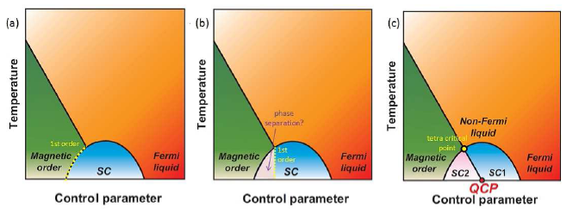
Competing phases in complex materials
First-order transition
Phase diagram: SDW vs. SC. Putative QCP beneath
SC dome?
Experimental
measurements:
London penetration depth (λ)
Specific heat jump (ΔC)
Critical fields H_{c1} and H_{c2}
[Shibauchi, Carrington, Matsuda, Ann. Rev. Cond. Mat. Phys. 5, 113 (2014)]

Slide 4
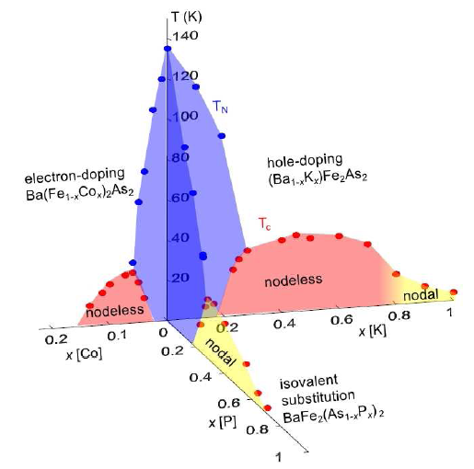
BaFe₂As₂ materials: Co, P & K substitutions
Simplified phase diagram
it does not include spontaneous structural transition: tetragonal to orhorhombic
P-substitution is iso-valent and
such systems are typically very clean
Co-doping adds carriers
and makes system disordered
P vs Co – big difference for λ
P vs Co – not much of a difference for ΔC
Controversy from critical fields measurements

Slide 5
Outline
Magnetic penetration depth
measurements in ‘122’-based alloys
experimental techniques
effects of cobalt and phosphorus substitutions
Uemura plots: effects due to quantum critical point
Quasiclassical theory of superconductivity
doping as a source of disorder
Eilenberger equations for superconductivity
London penetration depth in co-existence region of superconductivity
and spin-density-wave phases

Slide 6

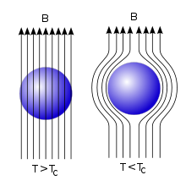
Meissner Effect
Thermodynamics
London penetration depth:
Doping dependence of the penetration depth reflects the changes in the superfluid density

Slide 7
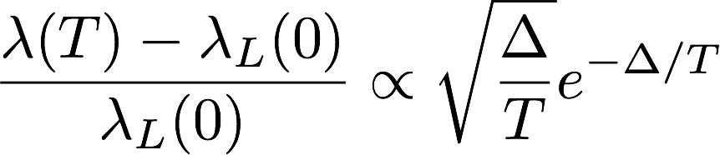
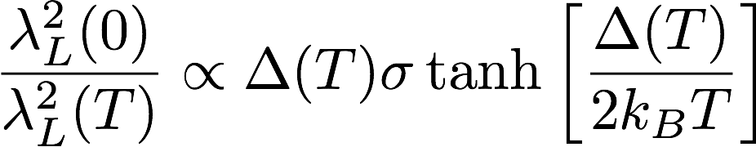
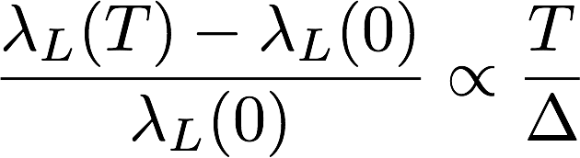
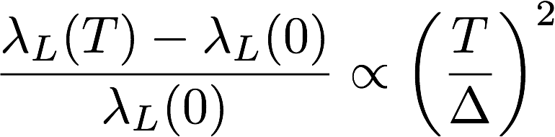
Meissner Effect
Thermodynamics
London penetration depth:
clean s-wave superconductor
dirty s-wave superconductor
d-wave case (nodes!)

Slide 8
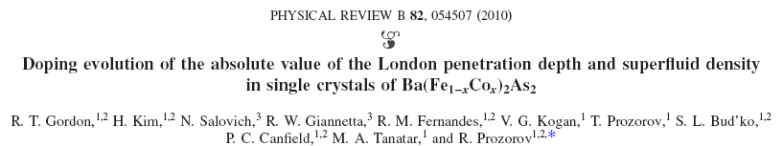
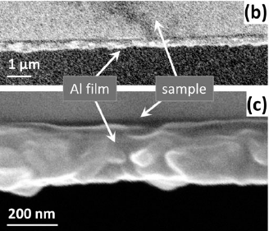
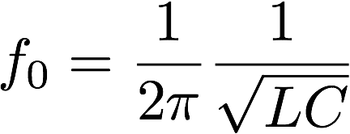


London penetration depth in ‘122’ alloys
Method: tunnel-diode resonator
LC-circuit
operating frequency
Shift in the resonator frequency due to Meissner effect

Slide 9
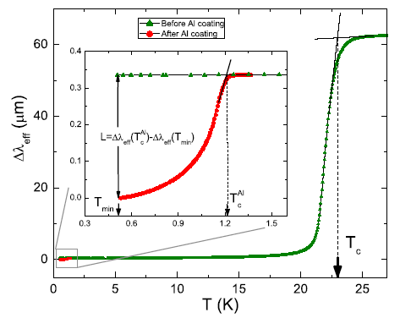
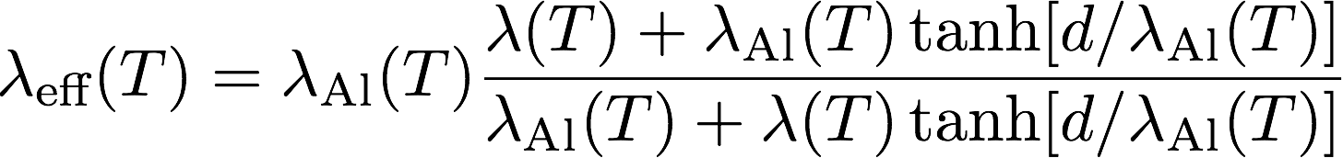
London penetration depth in ‘122’ alloys
Using TDR method changes in the penetration depth can be measured
Resolution ~ few Angstroms
To measure absolute values coating out of conventional superconductor is needed
Effective penetration depth

Slide 10
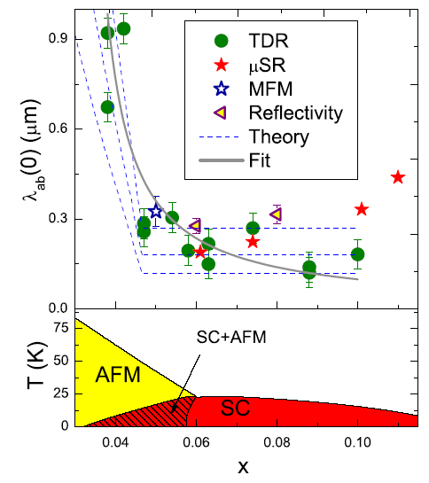
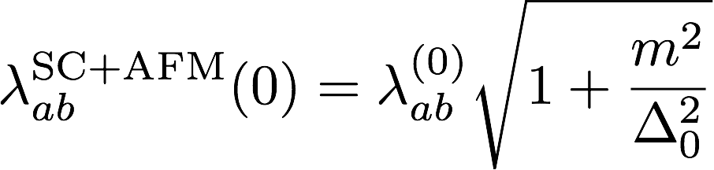
London penetration depth in ‘122’ alloys
Absolute values of the in-plane London penetration depth
Theory fit (no disorder!):
What are the effects of disorder?

Slide 11
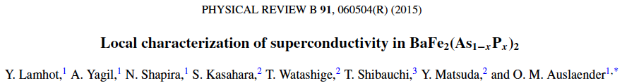
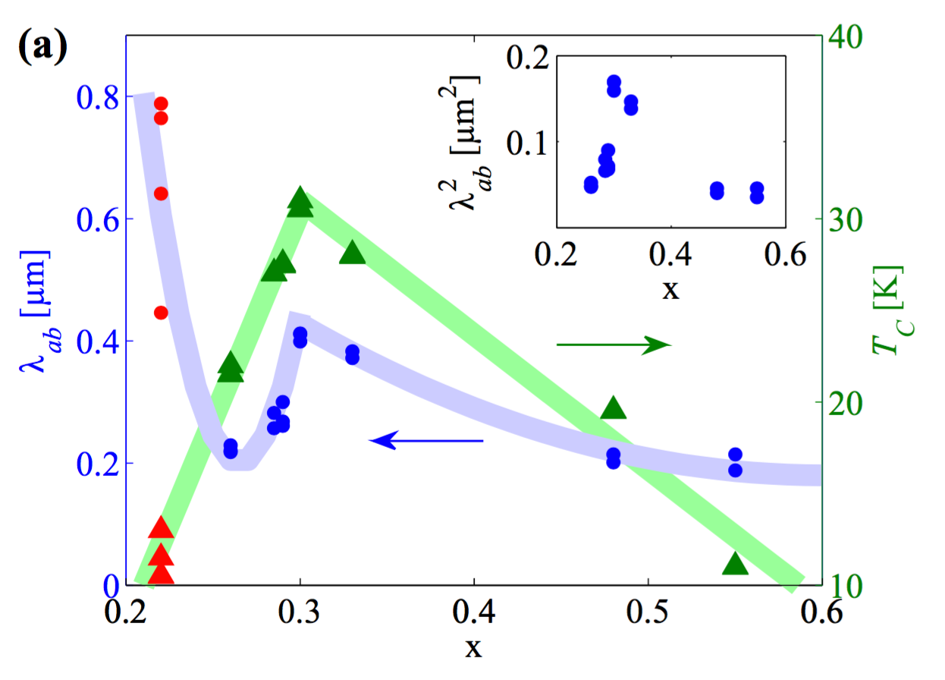
London penetration depth in ‘122’ alloys
Method: magnetic force microscopy (MFM)
Sharp peak in penetration depth @ optimal doping:
signature of the QCP?
Subsequent increase of the penetration depth with decrease in x:
co-existence between
SDW order & superconductivity

Slide 12
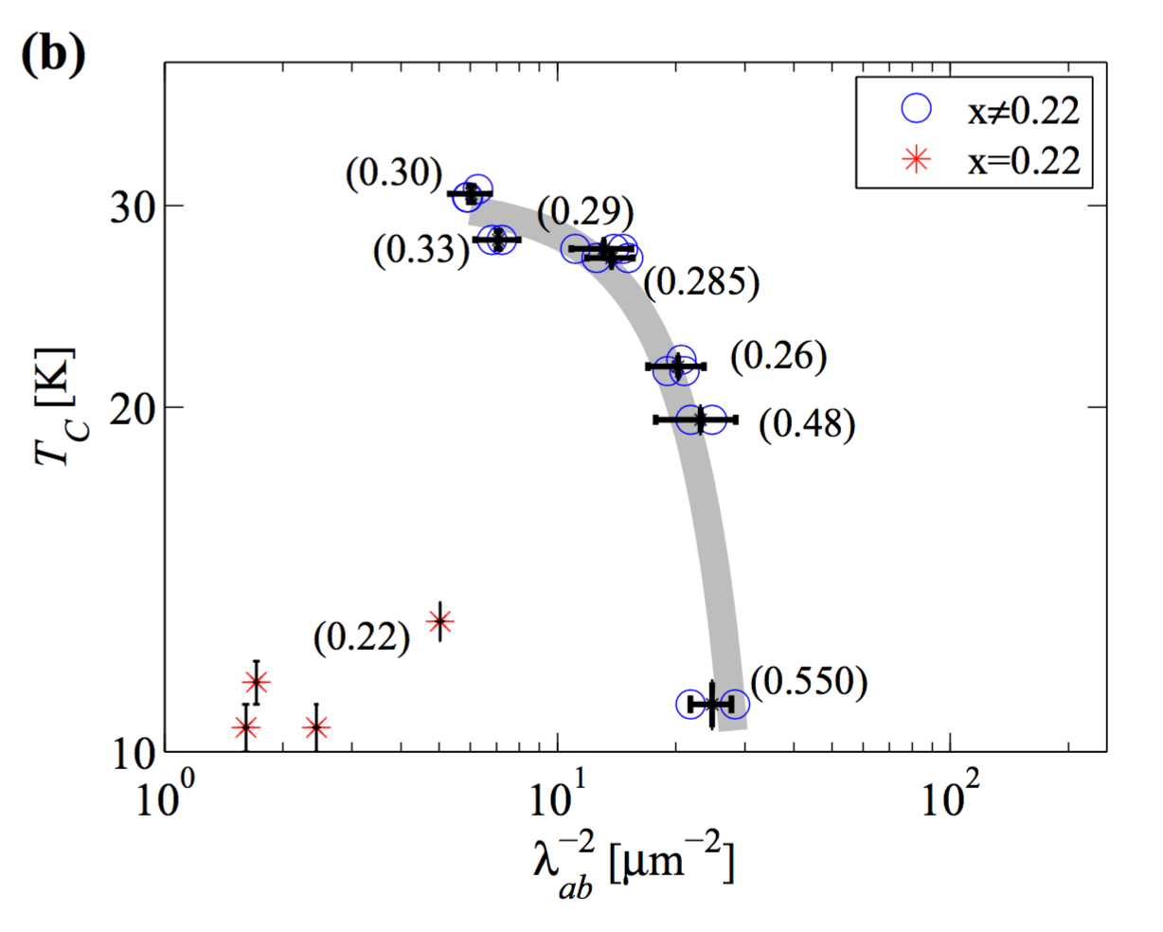
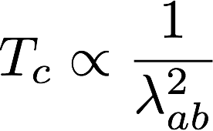
London penetration depth in ‘122’ alloys
Method: magnetic force microscopy (MFM)
Naïve expectation is that
T_{c} must be proportional
to the inverse square of the penetration depth
Not the case here
(except for x=0.22)!

Slide 13

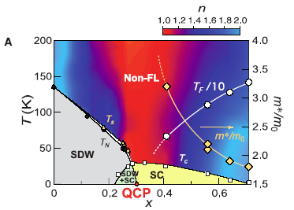
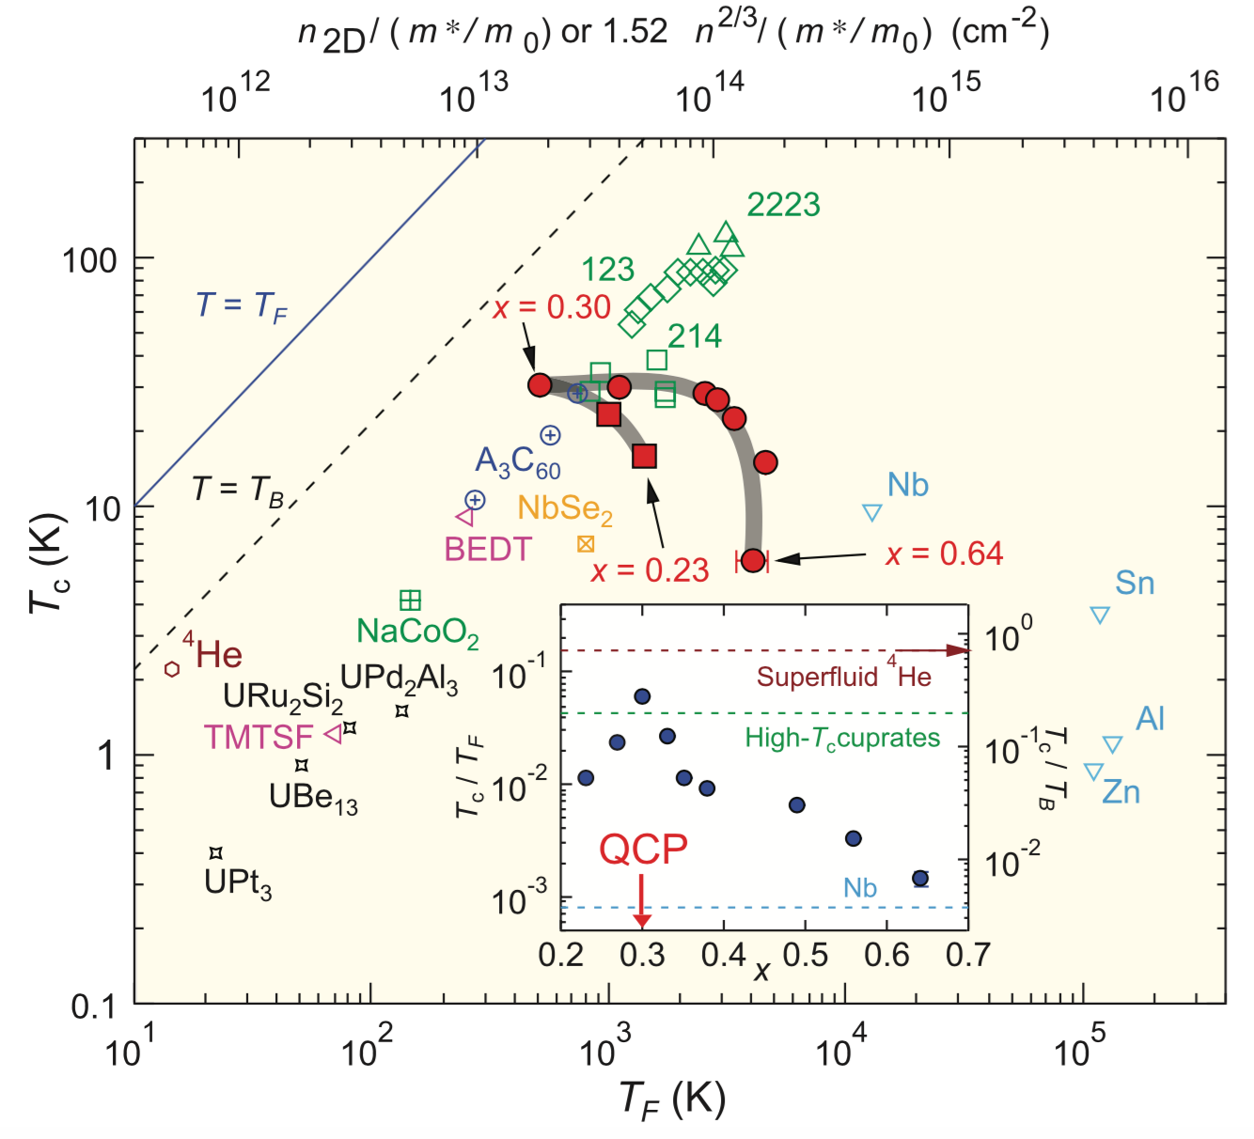
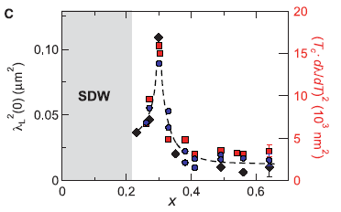
London penetration depth in ‘122’ alloys

Slide 14
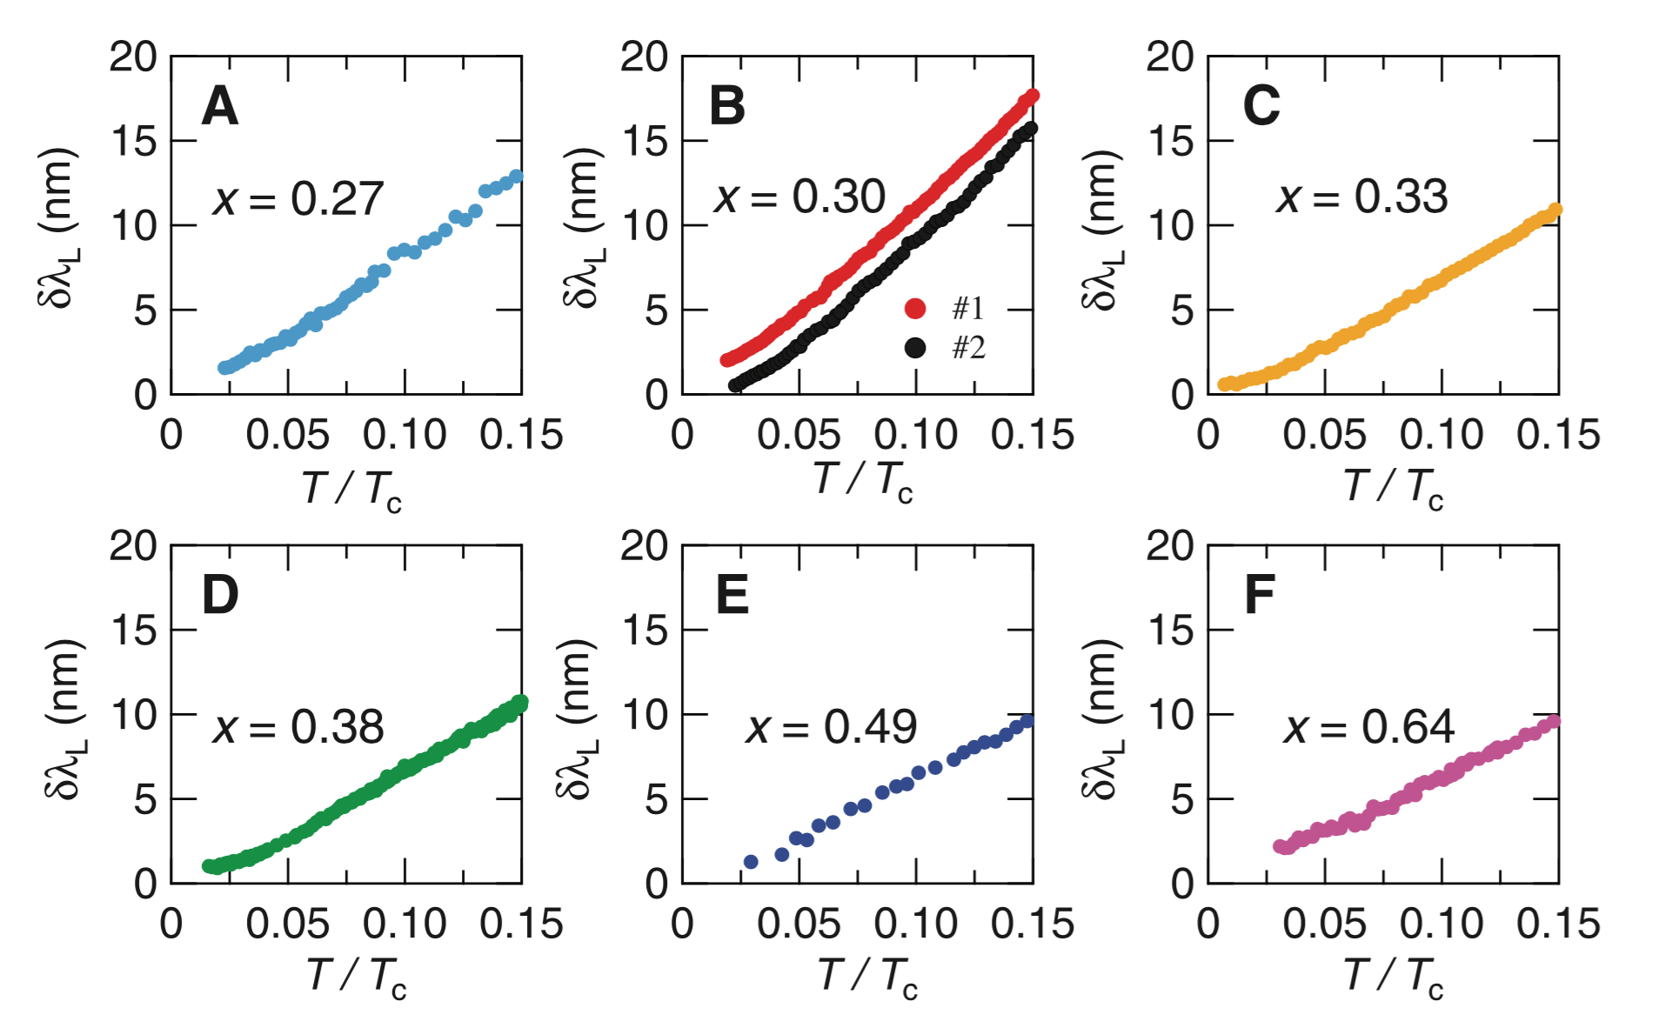
London penetration depth in ‘122’ alloys

Slide 15


London penetration depth in ‘122’ alloys: theory
Disorder & penetration depth @ T=0: ?
Effects of disorder on
Dependence of

Slide 16
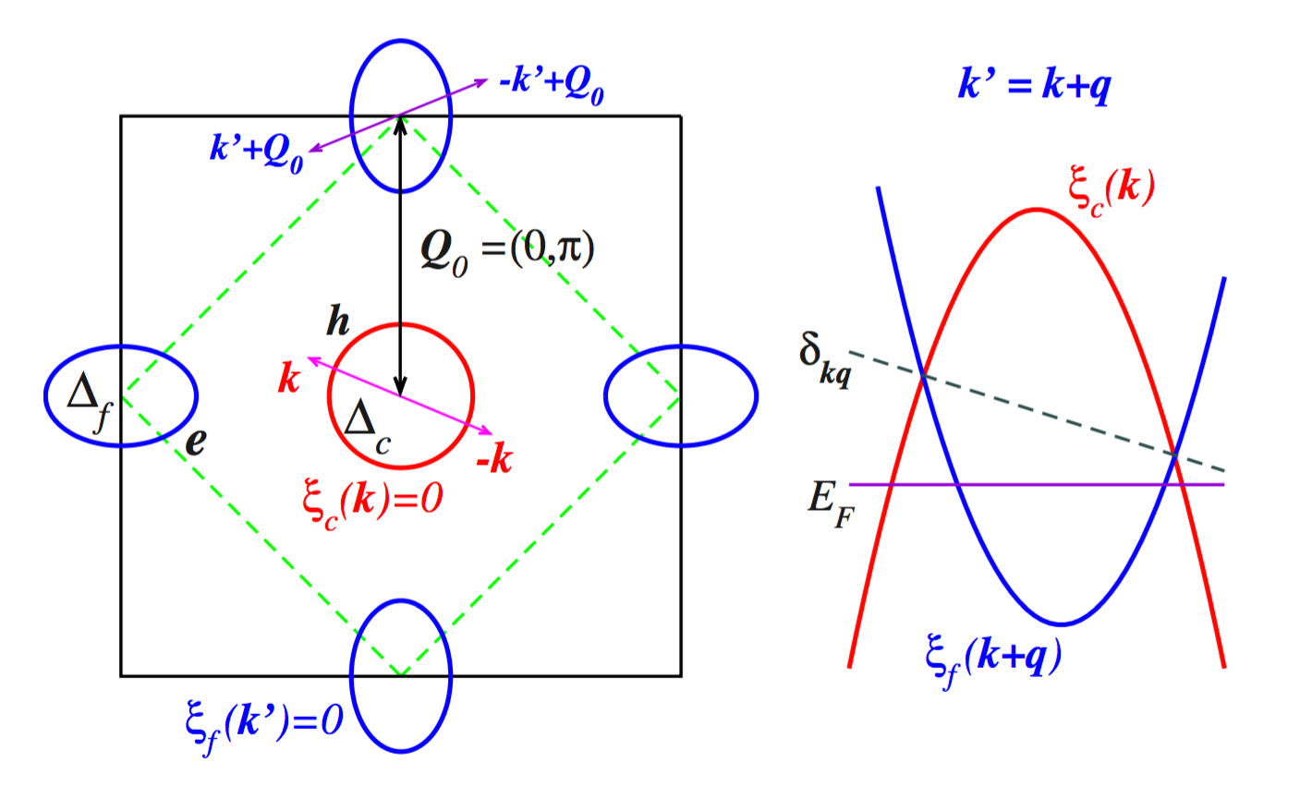
Doping as a source of disorder
Model [M. Vavilov & A. Chubukov, PRB 84, 214521 (2011)]
Two-band model: electron-
and hole-type bands
Interactions: SDW & SC
Approximation: (1) mean-field theory; (2) no mismatch between the Fermi pockets
[Vorontsov,Vavilov, Chubukov, PRB 81, 174538 (2010)]

Slide 17
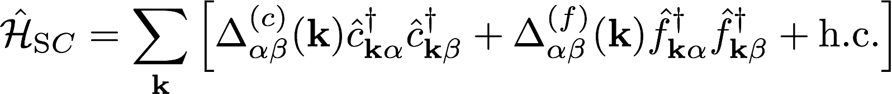
Doping as a source of disorder
Model [M. Vavilov & A. Chubukov, PRB 84, 214521 (2011)]
Two-band model: electron-
and hole-type bands
Interactions: SDW & SC
Approximation: (1) mean-field theory; (2) no mismatch between the Fermi pockets
[Vorontsov,Vavilov, Chubukov, PRB 81, 174538 (2010)]

Slide 18
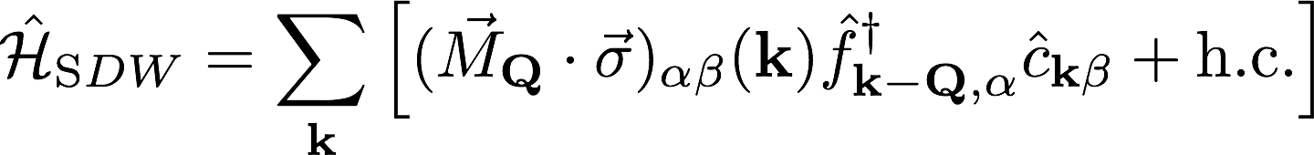
Doping as a source of disorder
Model [M. Vavilov & A. Chubukov, PRB 84, 214521 (2011)]
Two-band model: electron-
and hole-type bands
Interactions: SDW & SC
Approximation: (1) mean-field theory; (2) no mismatch between the Fermi pockets
[Vorontsov,Vavilov, Chubukov, PRB 81, 174538 (2010)]

Slide 19
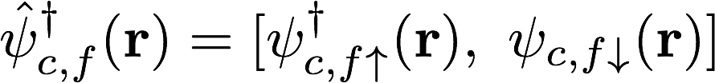
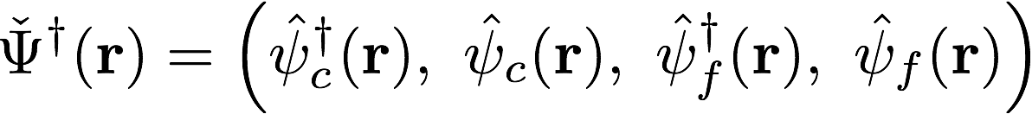
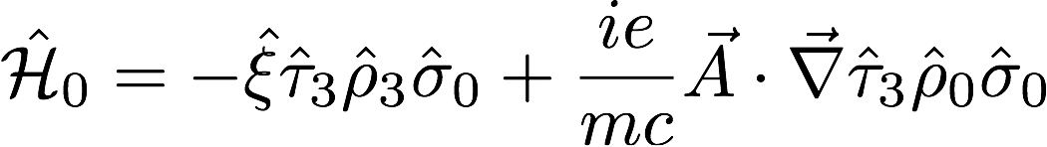
Doping as a source of disorder
Compact form using Gor’kov-Nambu representation
Model Hamiltonian*
*Pauli matrices acting in band, Gor’kov-Nambu and spin spaces

Slide 20
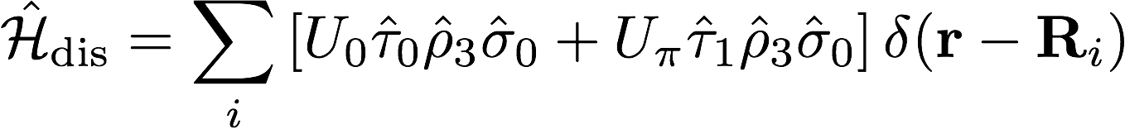
Doping as a source of disorder
Disorder Hamiltonian
Intraband disorder potential: U₀
Interband disorder potential: Uπ

Slide 21


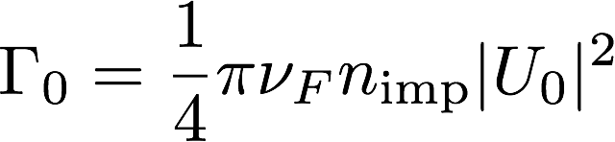
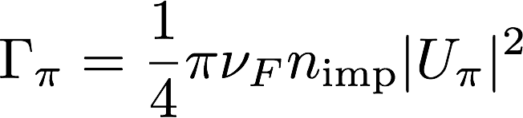
Equations of motion
intraband
interband
Self-energy due to disorder. Born approximation
Scattering rates
[Fernandes, Vavilov, Chubukov PRB 85, 140512(R) (2012)]

Slide 22
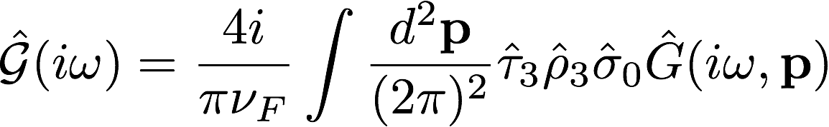
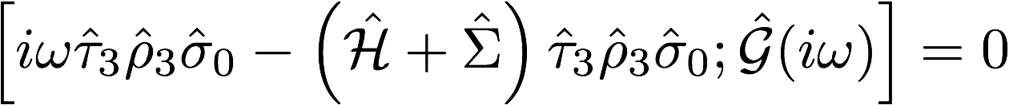


Quasiclassical approximation
Quasiclassical Green’s function
Eilenberger equation
Parametrization:
Normalization condition

Slide 23

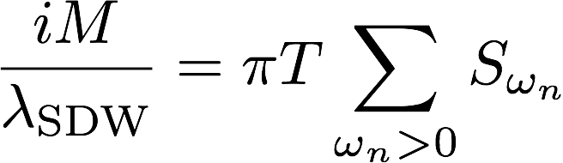
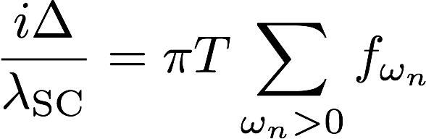
Quasiclassical approximation
Equations of motion
Superconductivity is immune to intraband scattering
Self-consistency equations

Slide 24
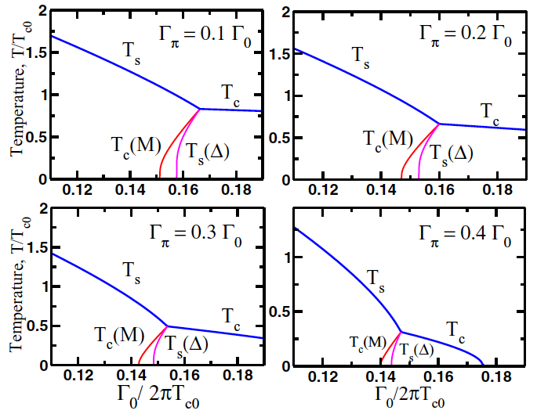
Phase diagram from numerical solution

Slide 25

Phase diagram from numerical solution
Co-existence region
Co-existence region remains robust with respect to the increase in the interband scattering.
No co-existence for

Slide 26

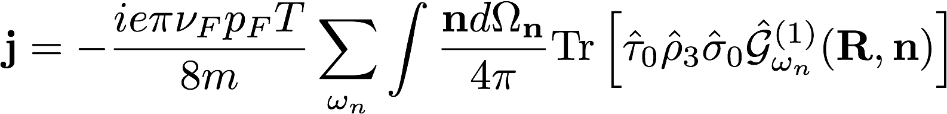
London penetration depth: technicalities
Zero-field Eilenberger function
Correction due to non-zero vector potential
Current density

Slide 27
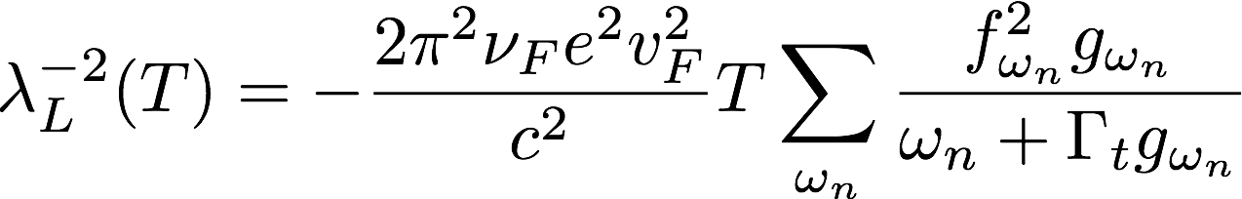
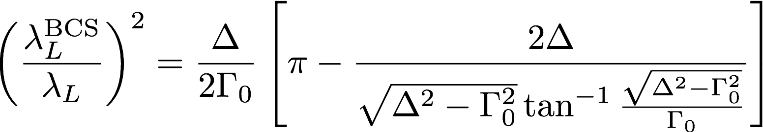

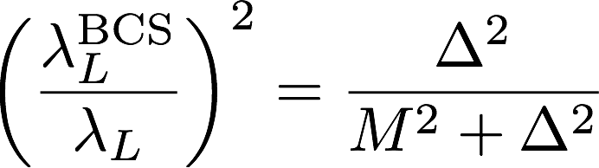

London penetration depth
Correlation function which account for the SDW instability does not enter!
General expression
Limiting cases

Slide 28

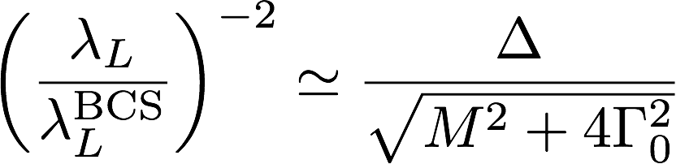

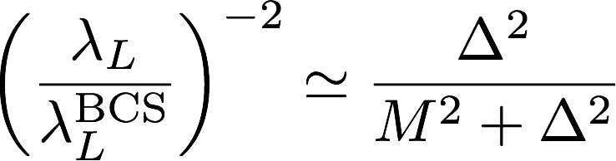
London penetration depth
Peak of the inverse penetration depth at the boundary with the
co-existence region
Low-T limit &
Differs substantially from
the corresponding expression in the clean limit:

Slide 29
London penetration depth
As one increases scattering rate, a system goes from co-existence to purely superconducting state: at the beginning and at the end superconducting order parameter is zero.
“T_{c} vs. (1/λ_{L})²” plot
looks like a loop with given chirality which depends on the interband scattering rate

Slide 30
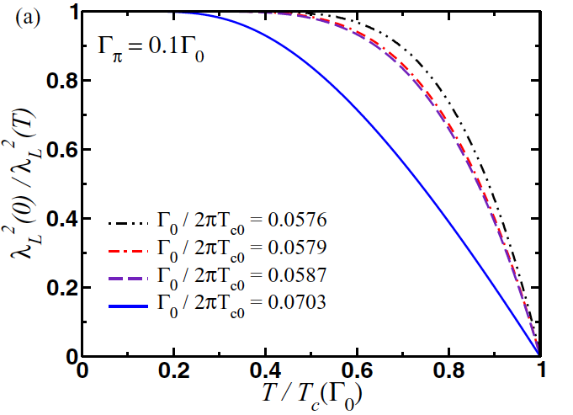
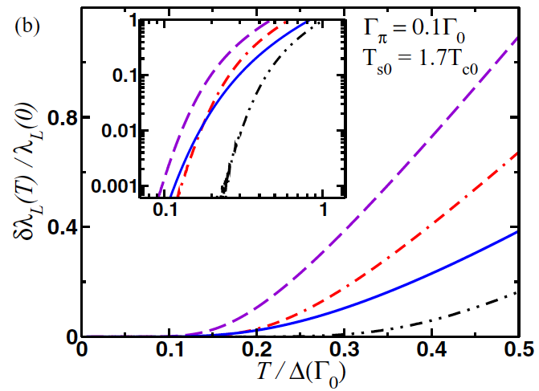

London penetration depth: temperature dependence
Our results are in qualitative agreement with the experimental observations

Slide 31
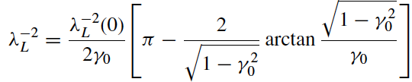




Summary
I. Disordered BCS
(nonmagnetic)
II. Disordered BCS
(nonmagnetic)
III. Clean FeSC
IV. Disordered FeSC (intraband)

Slide 32
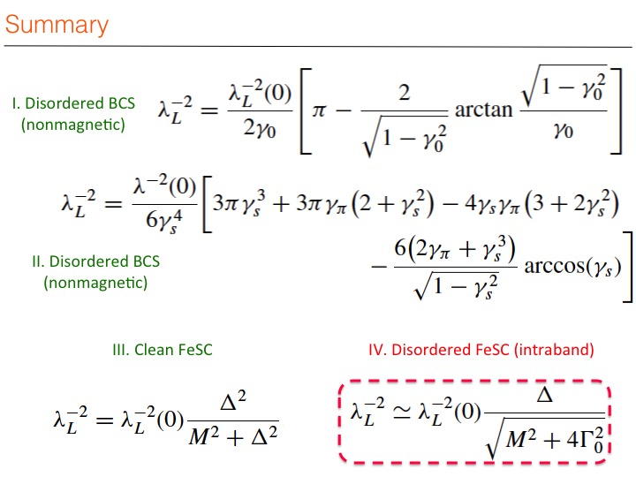
If you want to see more details …
PHYSICAL REVIEW B 92, 144501 (2015)
Thank you for your attention!

