Slide 1

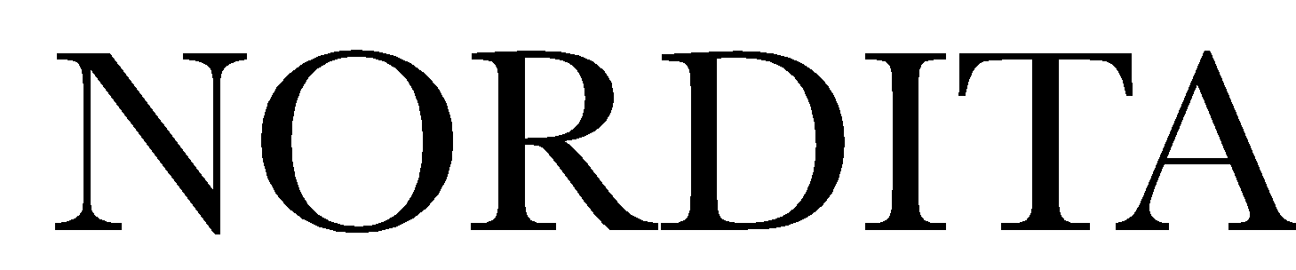





Center for Quantum Materials
Nordic Institute for Theoretical Physics
Superconductivity from
Quantum Criticality:
The dome in SrTiO₃ and the isotope effect
J. M. Edge, YK, U. Aschauer, N. A. Spaldin,A.V. Balatsky PRL 115, 247002
YK, J.-X. Zhu, A.V. Balatsky
PRB 94, 184507
Yaron Kedem
NORDITA, Stockholm
Multi-Component and Strongly-Correlated Superconductors
Nordita Program 27/07/2016

Slide 2
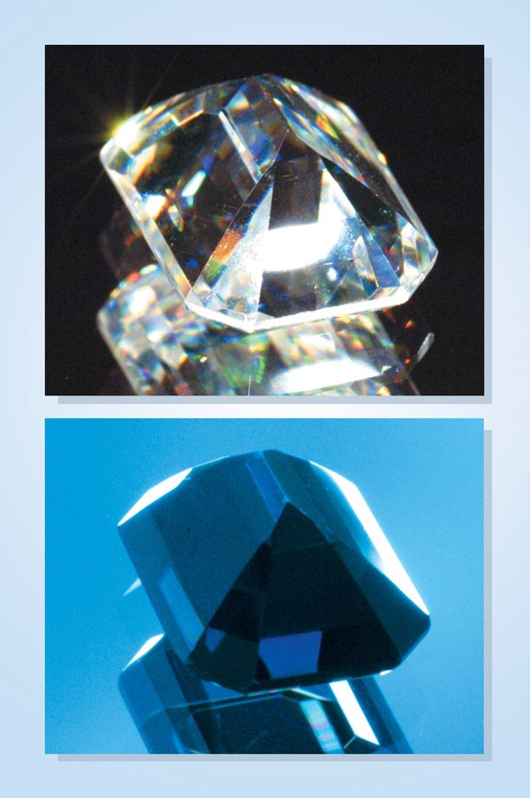
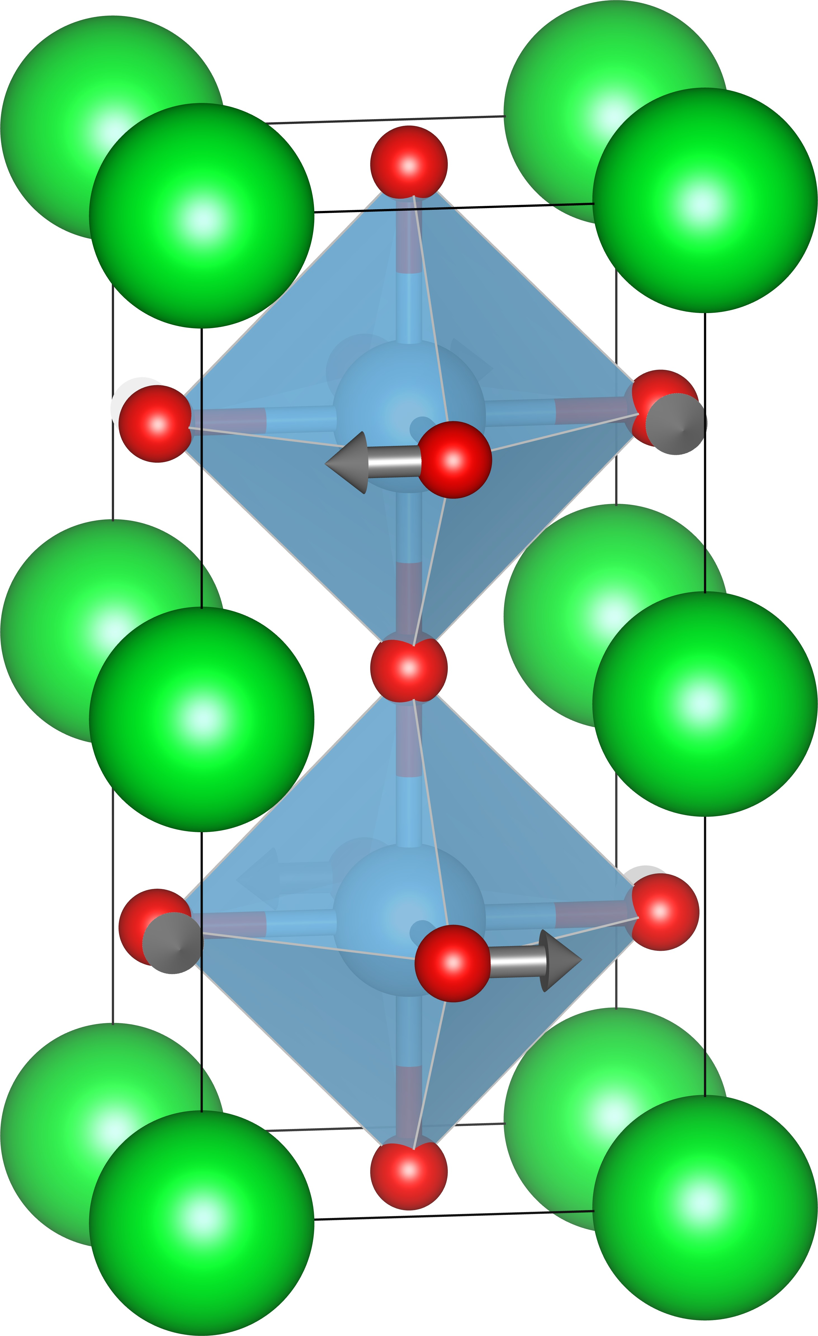
Strontium titanate SrTiO₃
Wide bandgap insulator (∼3eV )
Small amounts of doping makes it metalic
Perovskyte with antiferrodistortive rotations
Nb
SrTiO₃
La
vacancy

Slide 3
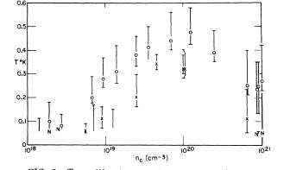
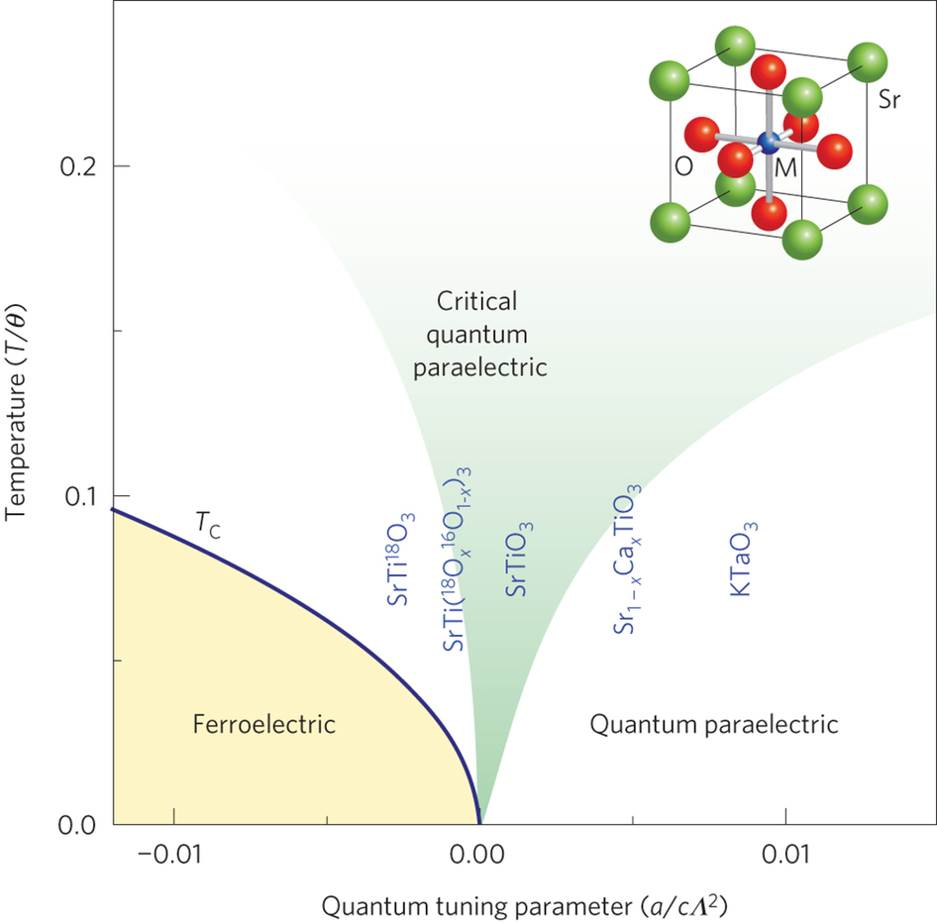
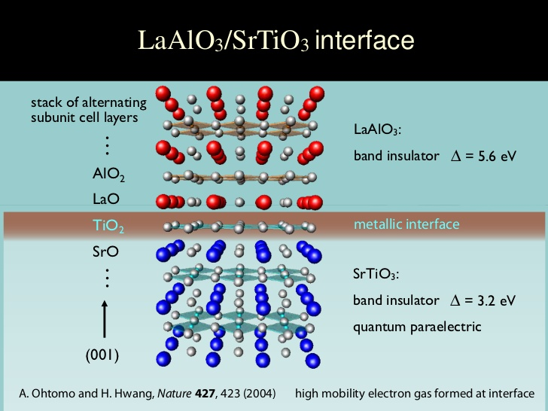
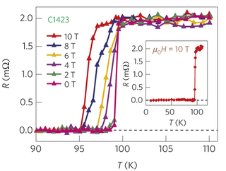
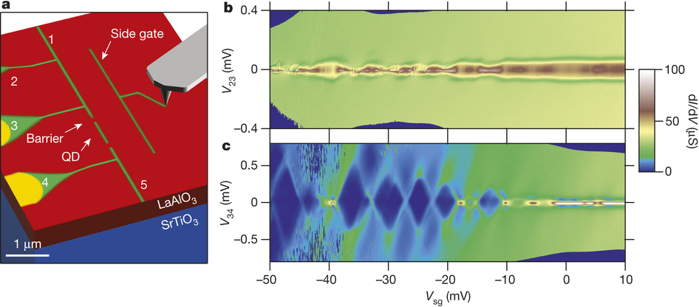
Strontium titanate SrTiO₃
Oldest oxide SC, 1st SC dome
Ferroelectric QCP
This talk
Schooley et. al. PRL 14, 305 (1965)
Rowley et. al. Nat. Phys. 10, 10 (2014))
Many recent interface results:
2DEG in LAO/​STO
SC at 100 K in ​FS/​STO
Pre-Pairing and writable SC wires
Cheng et. al. Nature. 521, 196 (2015))
Ge et. al. Nat. Mat. 14, 285 (2015))

Slide 4
Center for Quantum Materials
Nordic Institute for Theoretical Physics
Outline
Ferroelectric Quantum Critical Point in STO
Quantum model for FE QCP
Effect of doping (explaining the SC dome)
Effect of heavier isotope (Higher Tc, prediction)
Isotope effect and isotope exponent

Slide 5
Center for Quantum Materials
Quantum Paraelectricity in STO
Nordic Institute for Theoretical Physics
Wang and Itoh, PRB 64, 174104 (2001)
Rowley et. al. Nat. Phys. 10, 10 (2014))
We want a microscopic model for the ferroelectric transition with isotopic mass as tuning parameter

Slide 6
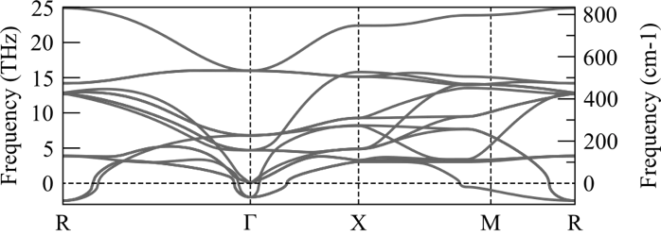
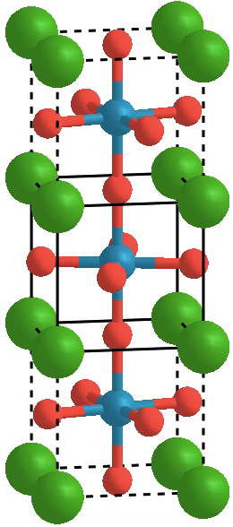
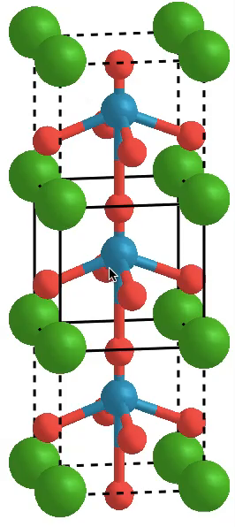
Center for Quantum Materials
Nordic Institute for Theoretical Physics
Structural Modes in SrTiO₃
Images from Ulrich Aschauer
ETH Zürich/University of Bern
.
Phonon band structure from
Ab initio calculations results
in two Instabilities
Antiferrodistortive
rotations
Occur below 110K
Ferroelectric displacement
Do not materialize
(for SrTi¹⁶O₃)

Slide 7

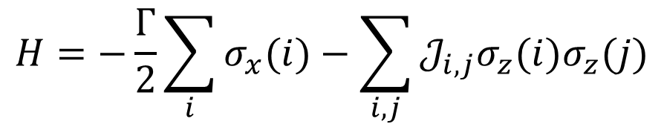
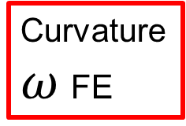
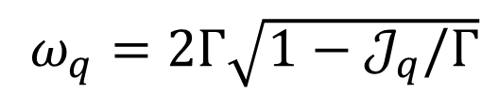
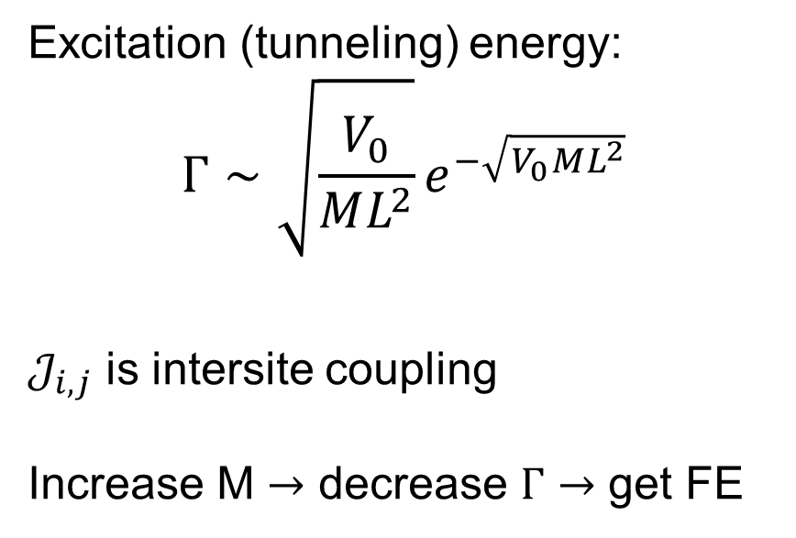

Center for Quantum Materials
Nordic Institute for Theoretical Physics
Quantum Ising Model
$$H=−\frac{Γ}{2}\sum_{i}{σ_{x}(i)}−\sum_{i,j}{𝒥_{i,j}σ_{z}(i)σ_{z}(j)}$$
Temperature
Ferro
Para
$$Γ<𝒥$$
$$Γ>𝒥$$
$ω_{q}=2Γ\sqrt{1−𝒥_{q}/Γ}$
Excitation (tunneling) energy:
$$Γ∼\sqrt{\frac{V_{0}}{ML^{2}}}e^{−\sqrt{V_{0}ML^{2}}}$$
$𝒥_{i,j}$ is intersite coupling
Increase M $→$ decrease $Γ$ $→$ get FE
Curvature
$ω$FE
Tunneling

Slide 8
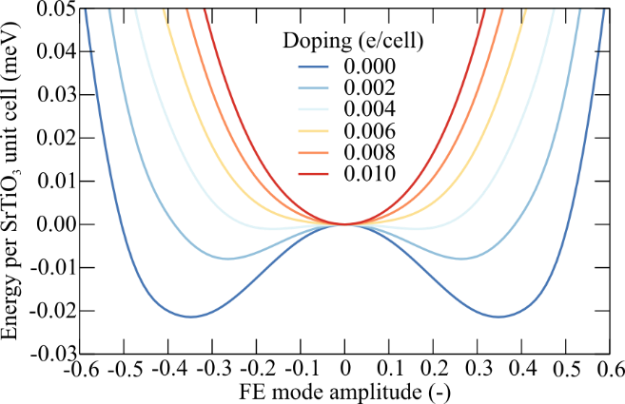
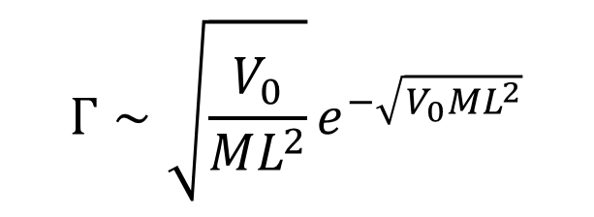
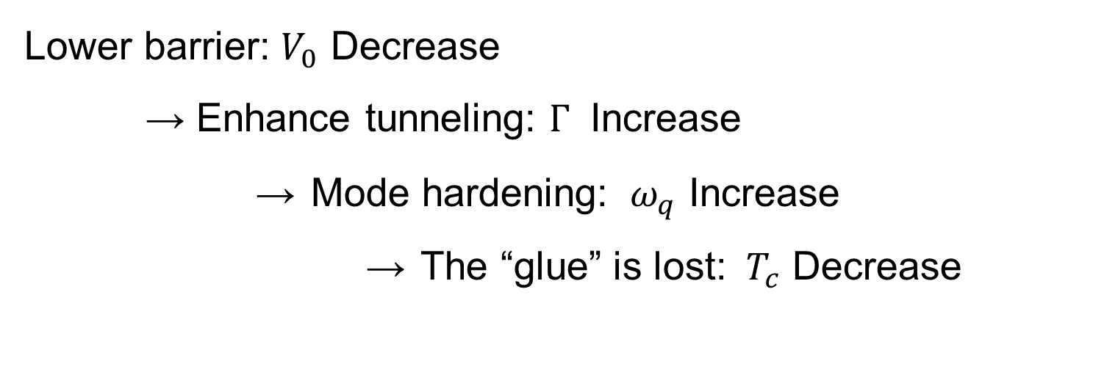
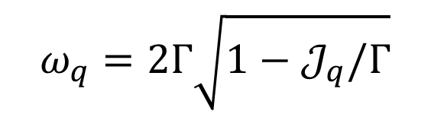
Center for Quantum Materials
Nordic Institute for Theoretical Physics
Doping effect on the Instability
Mobile electrons screen the repulsion and favor the high symmetry positions.
$$Γ∼\sqrt{\frac{V_{0}}{ML^{2}}}e^{−\sqrt{V_{0}ML^{2}}}$$
$$ω_{q}=2Γ\sqrt{1−𝒥_{q}/Γ}$$
Lower barrier: $V_{0}$ Decrease
→ Enhance tunneling: $Γ$ Increase
→ Mode hardening: ${ ω}_{q}$ Increase
→ The “glue” is lost: ${ T}_{c}$ Decrease

Slide 9
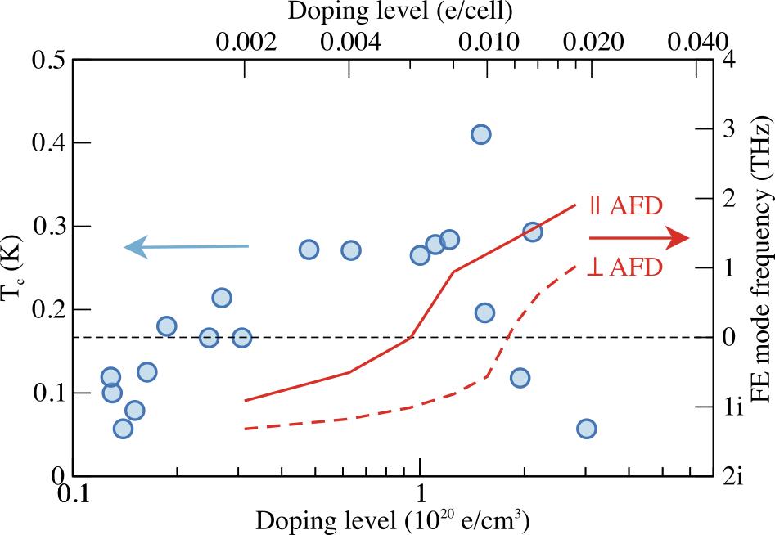
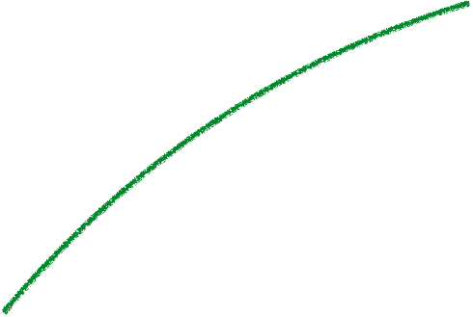
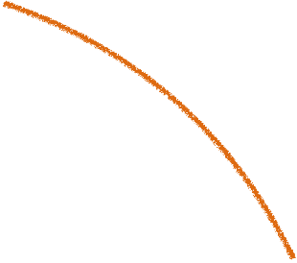
Center for Quantum Materials
Explaining the dome
Experiment (Tc)
More
carriers
Theory (⍵ FE)
due to hardening
Koonce, et al, PR. 163, 380 (1967)
Edge, YK, Aschauer, Spaldin & Balatsky, PRL 115, 247002 (2015)
9

Slide 10
Center for Quantum Materials
Nordic Institute for Theoretical Physics
Phase Diargam

Slide 11
Center for Quantum Materials
Predictions for Isotope replacement
Nordic Institute for Theoretical Physics
- isotope fraction
Higher Tc for heavier isotopes

Slide 12
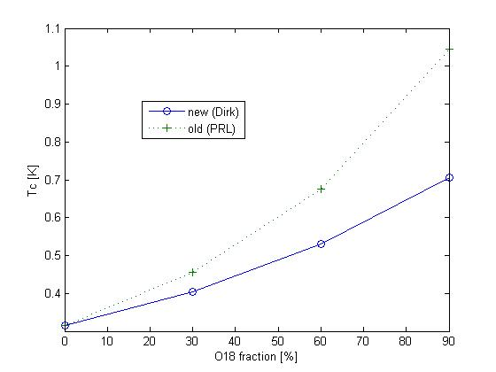

Slide 13
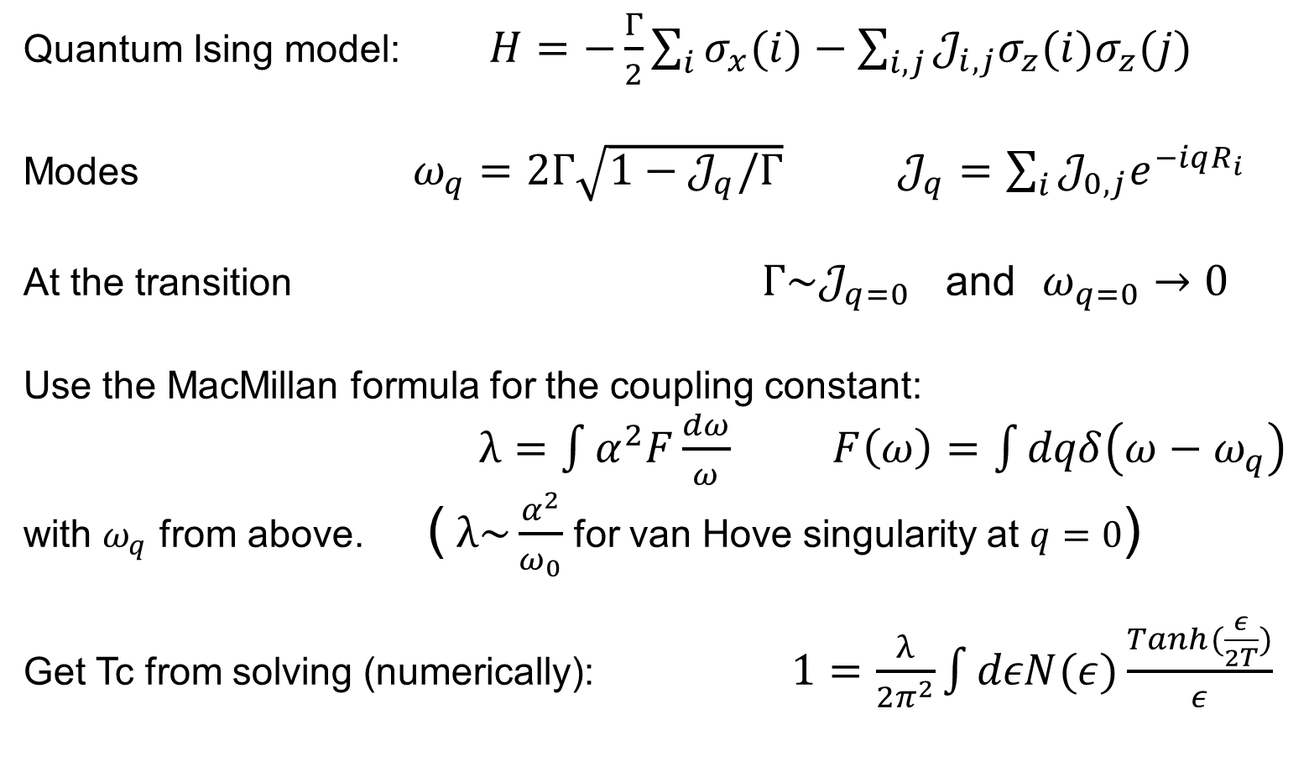
Center for Quantum Materials
Nordic Institute for Theoretical Physics
Calculating Tc
Quantum Ising model: $H=−\frac{Γ}{2}\sum_{i}{σ_{x}(i)}−\sum_{i,j}{𝒥_{i,j}σ_{z}(i)σ_{z}(j)}$
Modes $ω_{q}=2Γ\sqrt{1−𝒥_{q}/Γ}$ $𝒥_{q}=\sum_{i}{𝒥_{0,j}e^{−iqR_{i}}}$
At the transition $Γ\sim 𝒥_{q=0}$ and $ω_{q=0}→0$
Use the MacMillan formula for the coupling constant:
$λ=\int{α^{2}F\frac{dω}{ω}}$ $F\left(ω\right)=\int{dqδ\left(ω−ω_{q}\right)}$
with $ω_{q}$ from above. ( $λ\sim \frac{α^{2}}{ω_{0}}$ for van Hove singularity at $q=0$)
Get Tc from solving (numerically): $1=\frac{λ}{2π^{2}}\int{dεN(ε)\frac{Tanh(\frac{ε}{2T})}{ε}}$

Slide 14
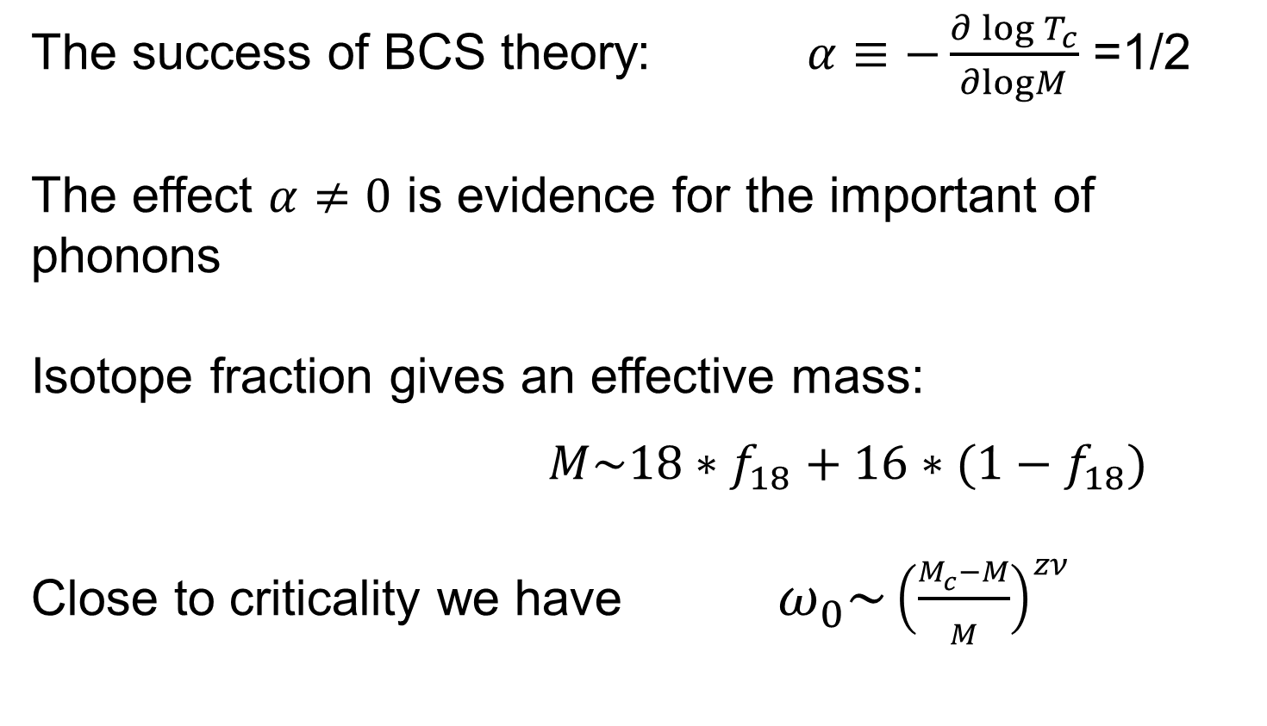
Center for Quantum Materials
Nordic Institute for Theoretical Physics
Isotope Exponent
The success of BCS theory: $α≡−\frac{∂\log{T_{c}}}{∂logM}$ =1/2
The effect $α≠0$ is evidence for the important of phonons
Isotope fraction gives an effective mass:
$M\sim 18∗f_{18}+16∗(1−f_{18})$
Close to criticality we have $ω_{0}\sim {\left(\frac{M_{c}−M}{M}\right)}^{zν}$

Slide 15
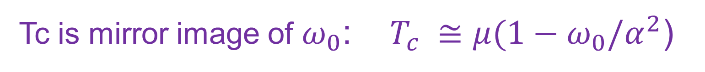
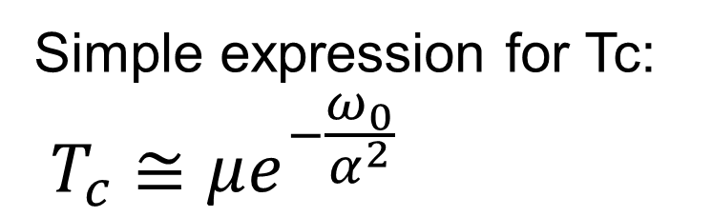
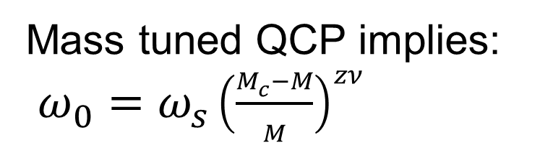
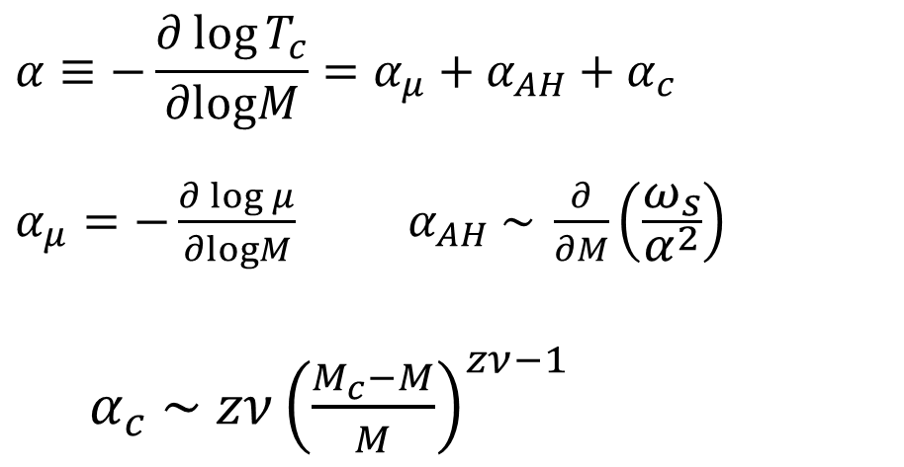
Center for Quantum Materials
Nordic Institute for Theoretical Physics
Isotope Exponent
Simple expression for Tc:
$$T_{c}≅μe^{−\frac{ω_{0}}{α^{2}}}$$
Mass tuned QCP implies:
$ω_{0}=ω_{s}{\left(\frac{M_{c}−M}{M}\right)}^{zν}$
$$α≡−\frac{∂\log{T_{c}}}{∂logM}=α_{μ}+α_{AH}+α_{c}$$
$α_{μ}=−\frac{∂\log{μ}}{∂logM}$ $α_{AH} \sim \frac{∂}{∂M}\left(\frac{ω_{s}}{α^{2}}\right)$
$α_{c} \sim zν{\left(\frac{M_{c}−M}{M}\right)}^{zν−1}$
Tc is mirror image of $ω_{0}$: $T_{c} ≅μ(1−{ω_{0}/α}^{2}$)

Slide 16
Center for Quantum Materials
Nordic Institute for Theoretical Physics
Conclusions
Developed a model for QCP and SC due to ferroelectric fluctuations
Dependency on doping explain the SC dome in SrTiO₃
New prediction: Higher Tc for heavier isotopes
Connection between the critical exponent of the QCP and the isotope exponent of SC

