Slide 1
The Present and Future of Neutrino-Less Double-Beta Decay Experiments:
Frank Avignone
University of South Carolina
July 3rd 2017
Advances in Theoretical Cosmology in Light of Data
NORDITA 3-28 July 2017
Stockholm, Sweden

Slide 2
Double-Beta Decay

Slide 3
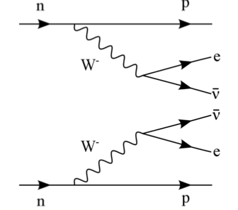
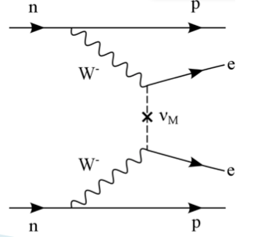
Double-Beta Decay Diagrams
“The only practical way to demonstrate that neutrinos are Majorana particles, is with 0-neutrino double-beta decay.” B. Kayser
Two-neutrino Double-Beta Decay
0-neutrino Double-Beta Decay

Slide 4
0νββ-Decay, what could we learn from it ?
0νββ-decay is the only practical way to determine if neutrinos are Majorana particles. Leptogenesis?
A measurement of the 0νββ-decay half life, combined with neutrino oscillation data, cold be used to determine the masses of all three neutrino mass eigenstates.
The observation of 0νββ-decay would violate lepton-number conservation.

Slide 5
Ancient History

Slide 6
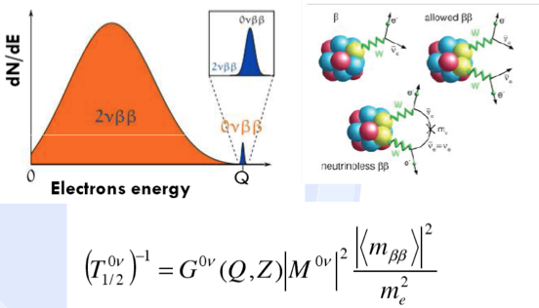
Double-Beta Decay Cartoons

Slide 8
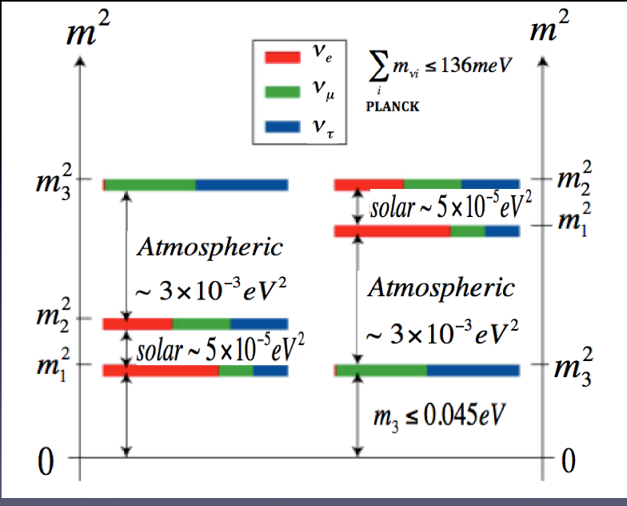
What do we know about Neutrinos
from Neutrino Oscillation Experiments and Cosmology Data
Solar
Atmospheric
Accelerator

Slide 9
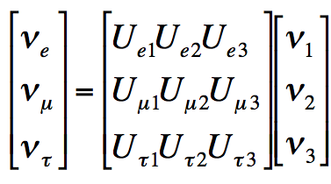
Neutrino Mass Eigenstate to Flavor Transformation

Slide 10
Mixing angles from Neutrino-Oscillation Experiments

Slide 11
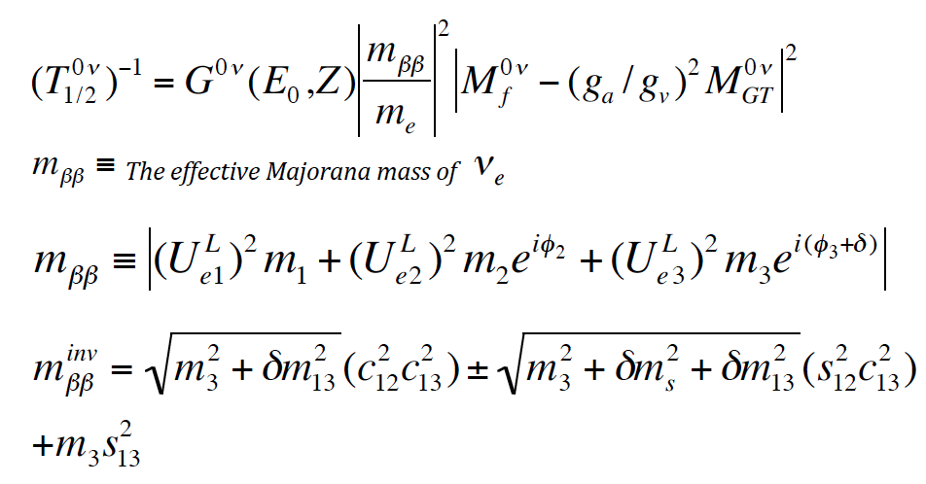
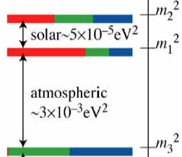
The Half Life and The Effective Majorana Mass of the Electron Neutrino

Slide 12
Neutrino Oscillation Data and the Possible Values of the Effective Majorana Mass of the Electron Neutrino

Slide 13
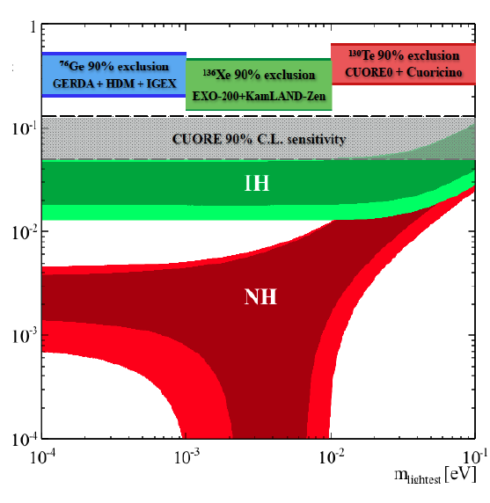
PLANCK

Slide 14
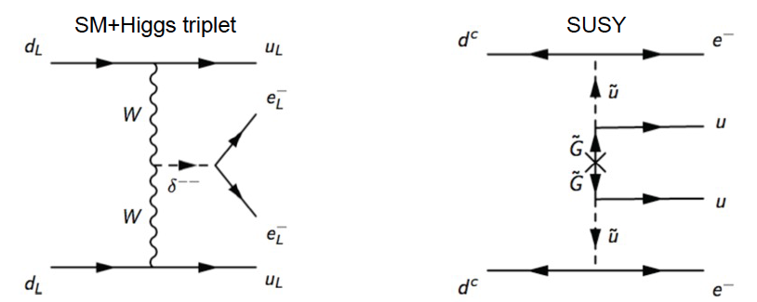
The Possibility of Exotic Mechanisms Beyond the Standard Model: Heavy Neutrinos, Non-Standard Higgs Particles and Super-Symmetric Particles
What can we say about 0νββ-decay if the process is a non-standard
Particle exchange as depicted above?

Slide 15
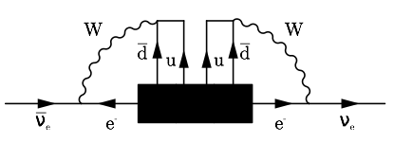
The Black Box Theorem of Schechter and Valle
“All decay modes that engender 0-neutrino double-beta decay require that the neutrinos involved are Majorana particles.”
J. Schechter and J.W.F Valle, Physical Review D 25, 2951 (1982).
Boris Kayser and S. Peter Rosen (Unpublished).

Slide 16
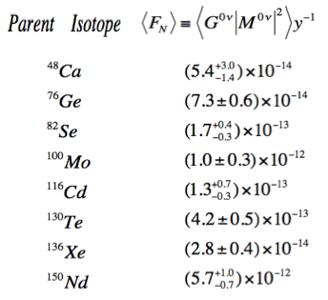
Nuclear Physics Figure of Merit F_{N}

Slide 17
Nuclear Structure Models for Calculating ονββ-Decay Nuclear Matrix Elements
The Interacting Boson Model (IBM)
The Renormalized Quasi-Particle Random Phase Approximation
(R-QRPA
The Proton-Neutron Pairing QRPA (pnQRPA)
The Independent Particle Shell Model (ISM)

Slide 18
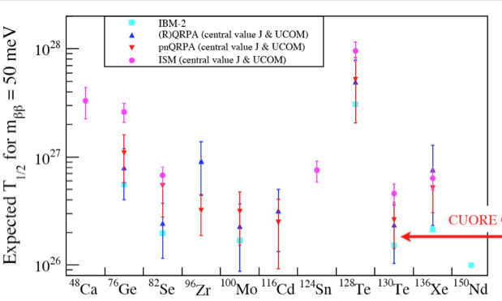
The importance of Nuclear Matrix Elements
ISM
IMB

Slide 19
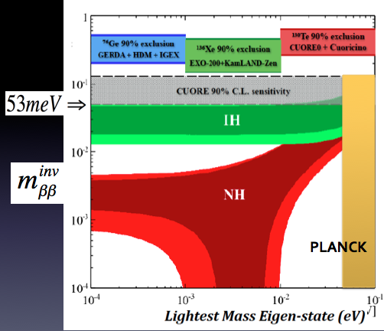

Slide 20
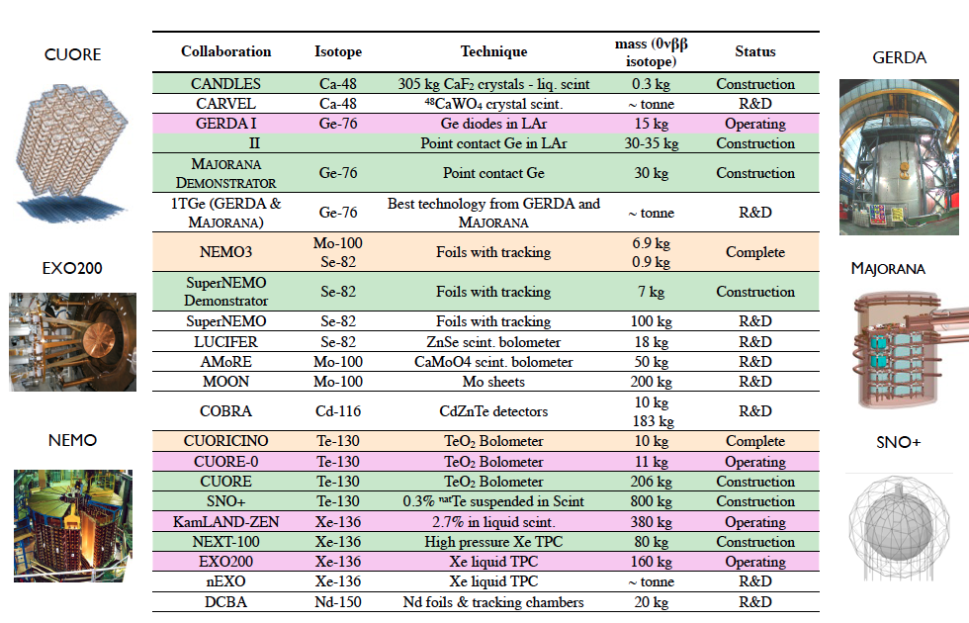
Neutrino less Double-Beta Decay Experiments Galore

Slide 21
Available Experimental Techniques for
Double-Beta Decay Experiments
Ionization Detectors- GERDA, MAJORANA, LEGEND (⁷⁶Ge)
Scintillation Detectors- SNO+ (¹³⁰Te); KamLAND Zen (¹³⁶Xe)
Time-Projection Chambers- EXO, nEXO, NEXT (¹³⁶Xe)
Tracking Chambers- NEMO, SuperNEMO (⁸²Se)
Cryogenic Bolometry- CUORICINO,CUORE-0, CUORE, (¹³⁰Te), CUPID-0 (⁸²Se)

Slide 22
The MAJORANA DEMONSTRATOR in the Sanford Underground Research Facility, Lead, South, Dakota

Slide 23
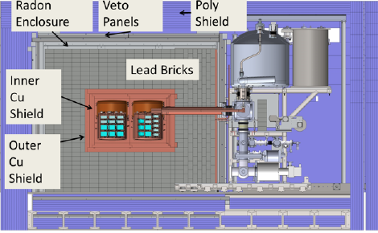
The MAJORANA DEMONSTRATOR

Slide 24
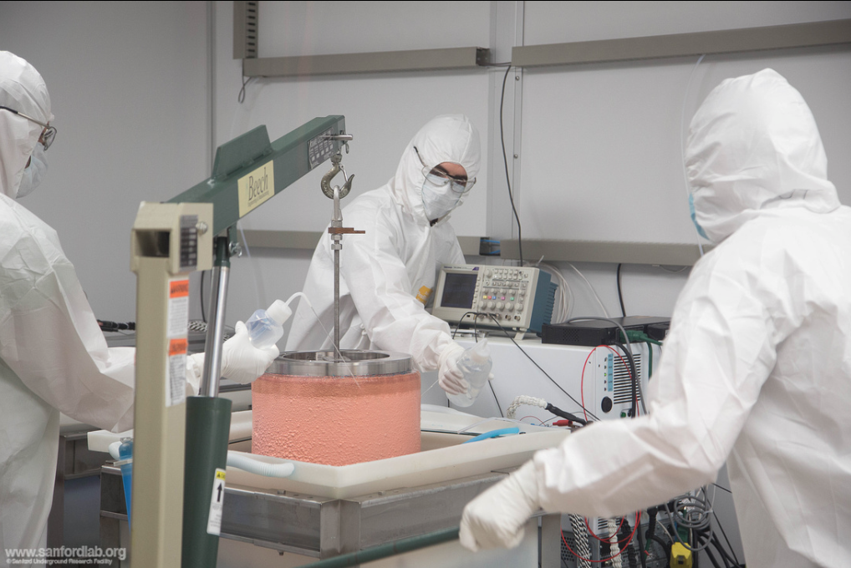
Copper Components Electroformed Underground

Slide 26
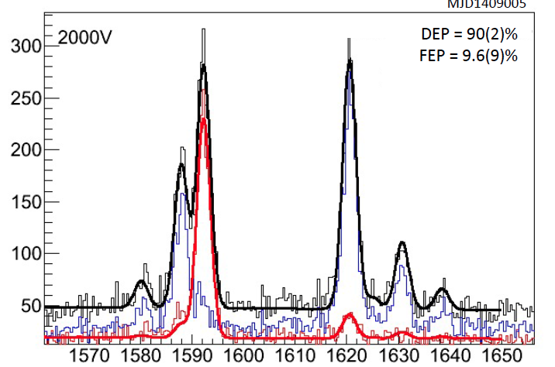
Background Reduction by Pulse-Shape Analysis

Slide 27
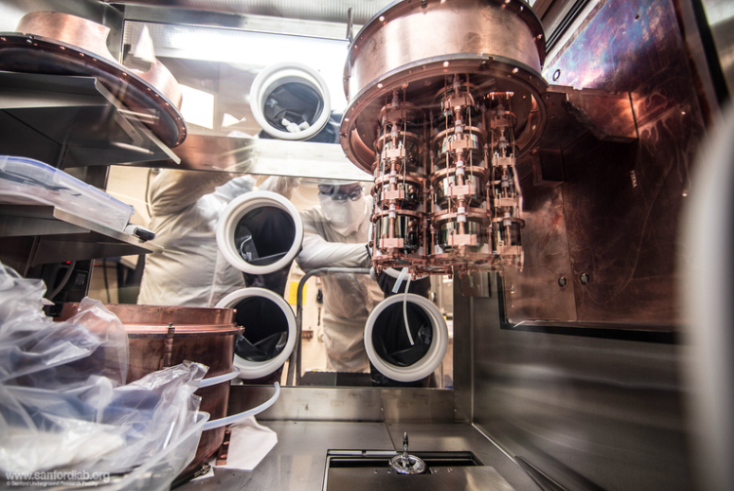
A MAJORANA DEMONSTRATOR Array

Slide 28
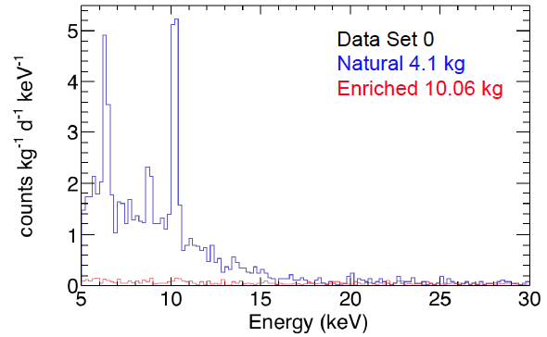
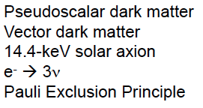
Background Reduction by Quality Control of Germanium Processing and Time Above Ground.

Slide 29
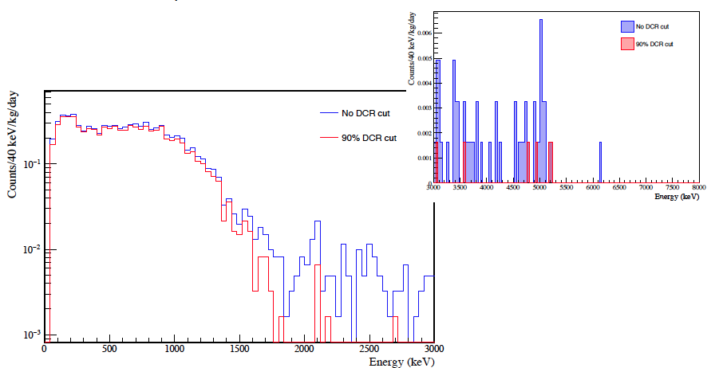
The Effect of Delayed Charge Recovery

Slide 30
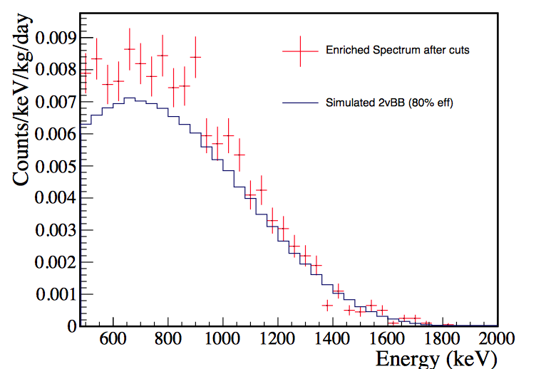
Measured 2νββ-Spectrum from Early Data of the MAJORANA DEMONSTRATOR

Slide 31
The Germanium Detector Array: GERDA
Laboratori Nazionali del Gran Sasso

Slide 32
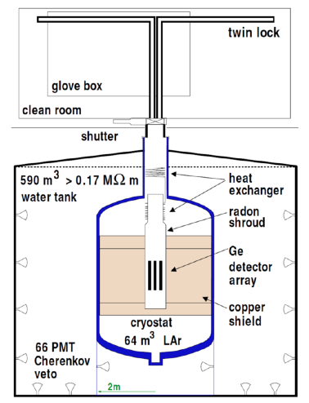
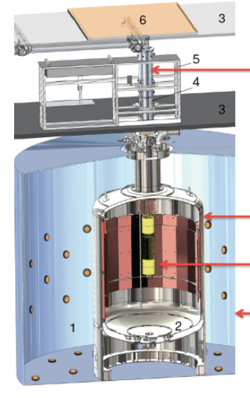
The GERDA Ge Array in Liquid Argon

Slide 33
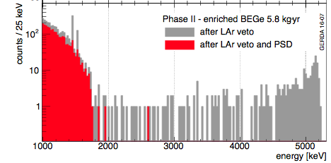
Results Given in Nature 544 (2017) 47 6 April 2017
T1/2 (⁷⁶Ge) >5.3 x 10²⁵ y; 90% CL
Background ~ 10⁻³ Counts/kg/keV/y
M_{ββ} < 135-250 meV

Slide 34
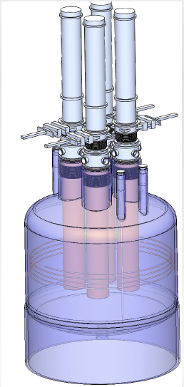
LEGEND: Large Enriched Germanium Experiment
for Neutrino less ββ Decay
MAJORANA and GERDA join with a total of 200-kg of enriched detectors
Utilize the existing GERDA facility at LNGS
Start collaboration in 2020
Reduce background by a factor of 5 relative to GERDA
Reach sensitivity of 10²⁷ year half life
And a sensitivity in effective Majorana mass of the electron neutrino: m_{ββ} ~ 30-60 meV.

Slide 35
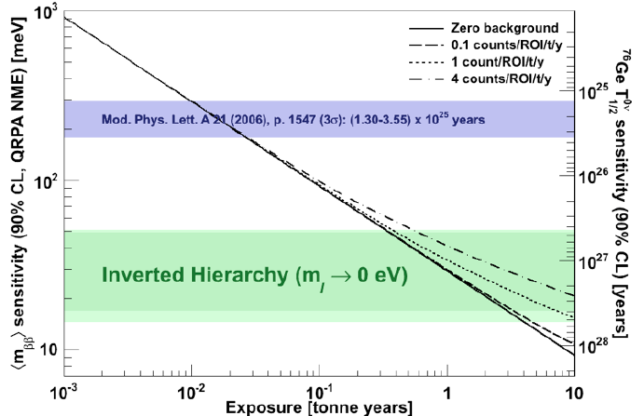
Sensitivity of ⁷⁶Ge Neutrino less ββ-Decay Experiments

Slide 36
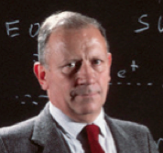
Cryogenic Detection Techniques for 0νββ-Decay
Cryogenic Underground Observatory for Rare Events: CUORE
Ettore Fiorini

Slide 37
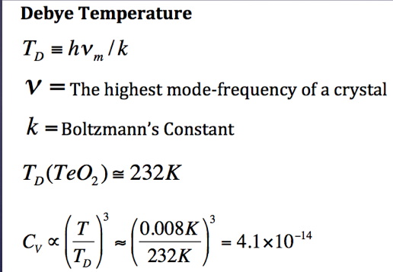
Bolometric Detector Principles

Slide 38
The CUORE Bolometers

Slide 39
Thermister Parameters

Slide 40
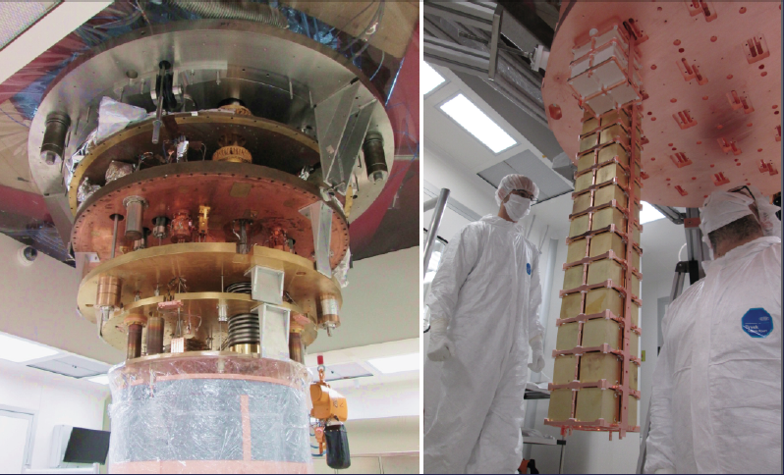
The Dilution Refrigerator Mixing Chamber and Hanging the first CUORE Tower

Slide 41
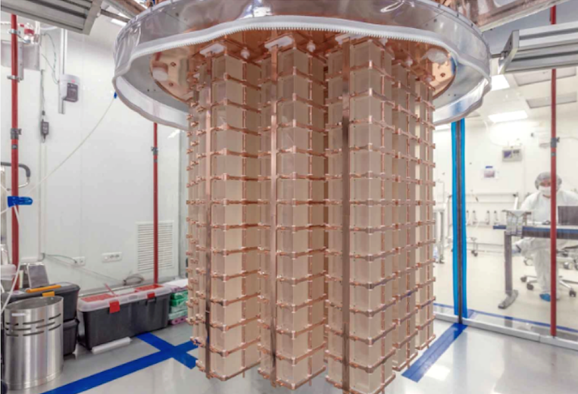
The Full CUORE Array: 19 Towers, Fifty two, 750 g Bolometers per tower, 988 bolometers, 740 kg of
Natural TeO_{2,} or 200 kg of ¹³⁰Te.

Slide 42
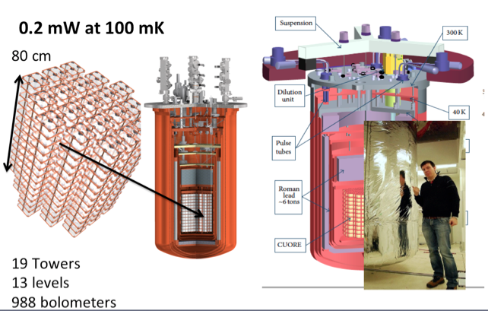
CUORE in I Laboratori Nazionali del Gran Sasso
(LNGS) in Assergi, Italy

Slide 43
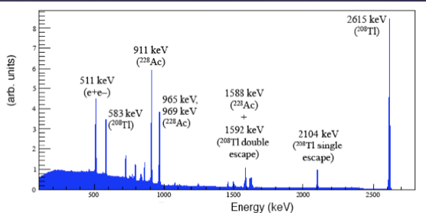
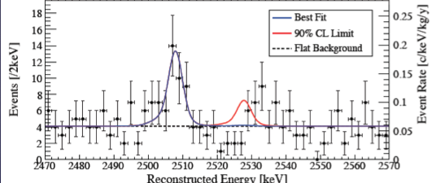
CUORE-0: One CUORE-Like Tower; 11 kg of ¹³⁰Te
Phys. Rev. Lett.,115, 102502 (2015

Slide 44
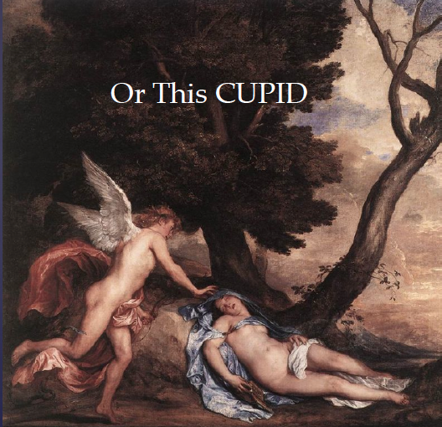
CUPID: CUORE with Particle Identification

Slide 45
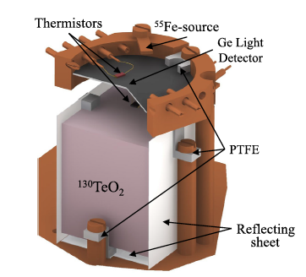
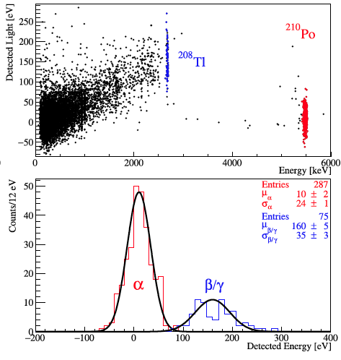

Slide 46
Physics Letters B 767 (2017) 321-329

Slide 47
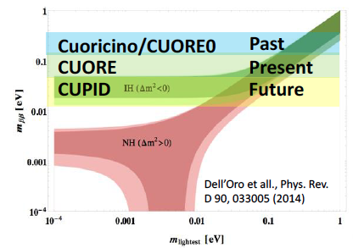
How Far could Enriched CUORE with particle ID go?
Planck

Slide 48
Neutrino less Double-Beta Decay Experiments Galore

Slide 49
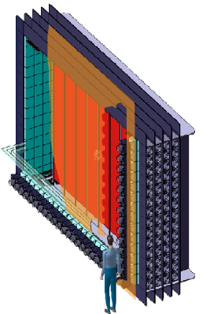
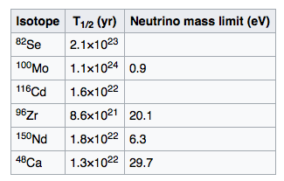
The SuperNEMO Tracking Chamber Experiment

Slide 50
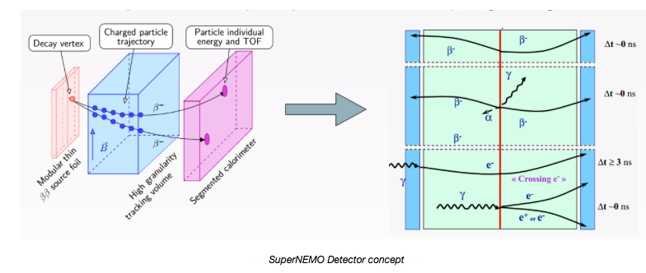
SuperNEMO Basic Concept

Slide 51
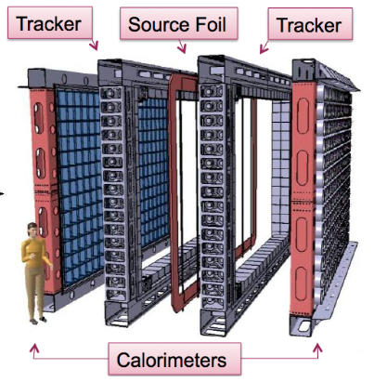
SuperNEMO will have 20 Modules, Each with 5kg of Enriched isotope. The first will be ⁸²Se. Expected Sensitivity: 10²⁶ y, or m_{ββ} ~50-100 meV.

Slide 52
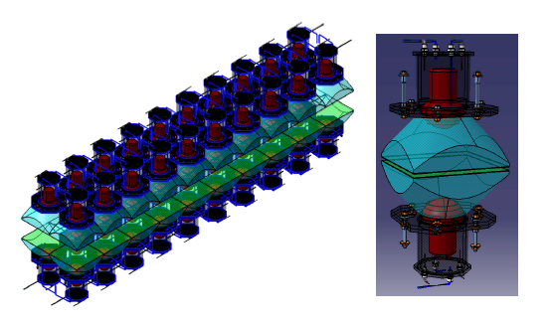
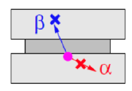
Each SuperNEMO Foil is Tested in the BiPo Facility in El Laboratorio Subterranio del Canfranc (LSC) in Canfranc, Spain in the Pyrenees Mountains.

Slide 53
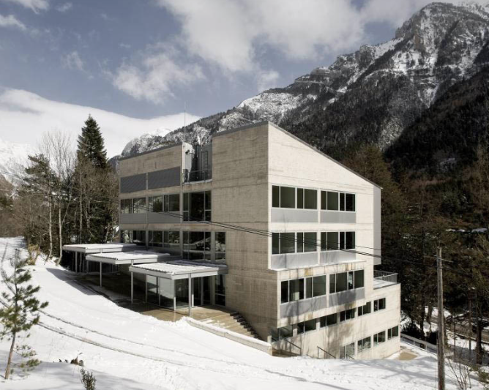
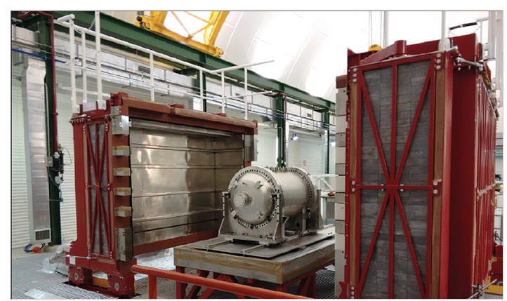
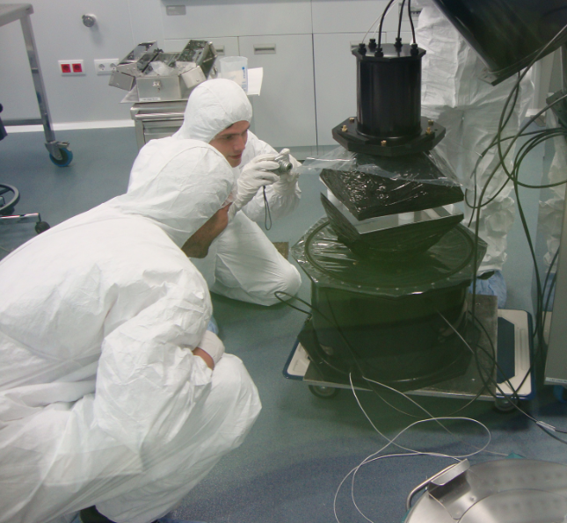
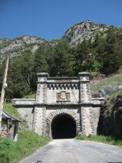
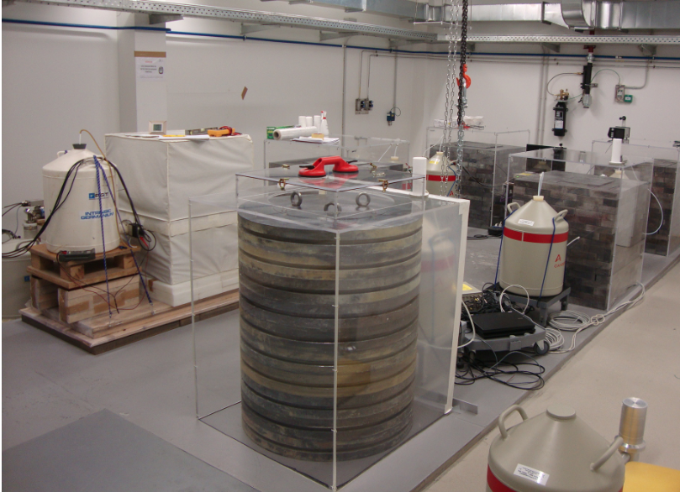
Laboratorio Subterranio del Canfranc,
Aldo Ianni Director

Slide 54
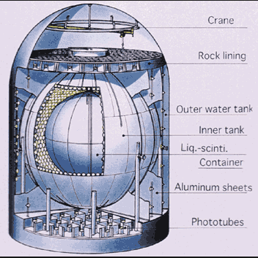
The KamLAND-Zen 0νββ-Decay Experiment
Xe Enriched in ¹³⁶Xe
Xe dissolved in liquid scintillator
Contained in an inner balloon inside of the KamLAND ν-detector
320 kg of Xe, enriched to 90% in ¹³⁶Xe: Phase-I
380 kg for Phase-II

Slide 55
Advantages of using KamLAND for 0νββ-Decay
Relatively low cost; quick start
1200 m³; low BG: U( 3.5 x 10⁻¹⁸ g/g, Th (5.2 x 10⁻¹⁷ g/g
Well shielded from external γ-rqys.
Highly Scalable, Xe-loaded scint-ator can be purified
Mini-balloon replaceable with larger one
Good background identification.

Slide 56
Final Published Phase-II KamLAND-Zen Spectrum

Slide 57
Phase1 and 2 Combined: T_{1/2}(0νββ)=1.07 x 10²⁶ y
Corresponding to: m_{ββ} < (61-165) meV

Slide 58
KamLAND-Zen Status
KamLAMD-Zen with 750 kg of enriches Xe will start in 2017.
Target sensitivity m_{ββ} below 50 meV.
KamLAND-Zen with 1000kg of enriched Xe was proposed and is on the master plan of the Science Council of Japan.
New improvements in light collection (factor of 4) reduces the interference of 2νββ-decay
Target sensitivity for 1000 kg experiment ~ 20 meV

Slide 59
The Sudbury Neutrino Observatory and SNO+

Slide 60
The Sudbury Neutrino Observatory evolves from a Solar Neutrino Detector to a 0νββ-Detector, SNO+
Art McDonald shared the 2015 Nobel Prize for the discovery of Neutrino Oscillations. He oversaw the construction of SNO and the SNO Experiment.

Slide 61
The Parameters of the Experiment
Initial SNO+, 3.9 tons of natural Te (~1.3 tons of ¹³⁰Te
Form an oganometallic compound of Te and butanediol dissolves in Lab scintillator.
After 5 years of data, T_{1/2}(0νββ,¹³⁰Te) > 1.96 x 10²⁶ y.
Corresponds to: m_{ββ} < ( 38-92 meV)

Slide 62
The Expected Background Spectra for SNO+
0νββ ¹³⁰Te
2527.5 keV

Slide 63
Time Line for SNO+
2017: Scintillator Plant Commissioning with LAB Scintillator filling at the end of 2017
2018: Tellurium Purification and Synthesis
2018: Systems Installation Completed,
Leading to Te Purification and Te Loading, Late 2018
2019: Begin 0νββ-Decay Data Collection
Te Purification System
as of May 2017

Slide 64
SNO+ Predicted Result, but Compared to Other Old Results

Slide 65
Time-Projection Chamber ¹³⁶Xe Experiments
The Enriched Xenon Observatory: EXO, and nEXO

Slide 66
Time-Projection Chambers

Slide 67
EXO-Program: (1) use liquid Xe, (2) Build and Operate EXO-200 (100 kg fiducial), (3) Build ton-scale detector, (4) Explore possibility of tagging final state Ba atom.

Slide 68
EXO-200: T_{1/2}(0νββ:¹³⁶Xe) > 1.1 x 10^{25 y}
m_{ββ} > (190-450) meV

Slide 69
nEXO, Proposed Tonne-Scale Liquid Xe TCP

Slide 70
Q_{ββ}(¹³⁶Xe)=2480 keV

Slide 71
nEXO running for 5 years m_{ββ} ≤ (8-19) meV
Run nEXO for 10 years: m_{ββ} ≤ (6.5-15) meV

Slide 72
Conclusions: Experimental 0νββ-decay is a very active field; we discuss 6 operating experiments.

Slide 73
Expected Physics Reach of Present and
Near Future 0νββ-Decay Experiments

Slide 74
CONCLUSIONS
The 0νββ-decay process is the only practical way to establish that neutrinos are Majorana particles.
If they are Majorana particles , this would imply the possibility of leptogenesis.
Neutrino less ββ-decay would violate lepton number conservation.
Experimental 0νββ-decay half-life sensitivity has increased by a factor of 2.5×10³ in a little more than 30 years.
There are 6 or 7 experiments that are accelerating the progress towards covering the neutrino-mass inverted hierarchy.

