Slide 1
Self-Consistently Modeling the Chromospheric Response to Flare-Accelerated Electrons and Return Currents
Joel Allred (NASA/GSFC)
Adam Kowalski (NASA/GSFC & U MD)
Meriem Alaoui (NASA/GSFC & CUA)

Slide 2
Maintains charge neutrality
Brings particles back into the acceleration area, a potential solution to the Number Problem.
Alters the non-thermal particle spectrum and thus the bremsstrahlung X-ray spectrum.
Must be considered in the interpretation of RHESSI spectral observations!
Reconnection and
Particle Acceleration
Return Current

Slide 3
Can ions neutralize the beam?
Hurford et al. (2006)

Slide 4
Return currents can be observed in X-ray spectral flattenings
slide from Meriem Alaoui

Slide 5
Example flattening
slide from Meriem Alaoui

Slide 6
We can use observed potential drop to estimate plasma resistivity
Observed resistivity often > 10³ Spitzer!
slide from Meriem Alaoui

Slide 7
Modeling Return Currents
Assume return current neutralizes beam current:
J_{rc} = -J_{e}
This produces an electric field which decelerates the injected beam particles.
ε = η J_{rc}
Nonlinearly, couples RC losses with beam particle distribution.
Beam of electrons has electric current, J_{e} = e⁻ F.
Assume return current balances accelerated particle current; J_{rc} = J_{e}
ε = e⁻ η J so dE/dx = - e⁻ ε = -e² η F

Slide 8
Solve a kinetic equation to obtain the particle distribution function which self-consistently includes energy losses and pitch-angle scattering due to:
  Coulomb collisions.
  Synchrotron emission
  Magnetic-mirroring
  Return Currents
  Relativistic effects
Assume energy lost by the distribution is gained by the ambient plasma as heat.
Depend on magnetic field model

Slide 9
Formulate Relativistic Fokker-Planck Equation in 1.5D.
Includes energy loss and pitch angle scattering due to:
Coulomb collisions
Synchrotron losses
Magnetic mirroring
Return currents

Slide 10
RADYN – 1D Radiation Hydrodynamics
Spitzer thermal conduction with Smith & Auer (1980) limit.
Resolved transition region (grid cell spacing <10 m; Δt < 10⁻⁵ s)
Solves radiative transfer equation in:
  Optically thick LTE conditions (photosphere and below)
  Optically thick non-LTE conditions (chromospheric transitions)
  Optically thin conditions (transition region and corona)
Particle transport modeled using Fokker-Planck kinetic theory.
  Includes Return Current. Important!
Non-equilibrium ionization calculated for chromospheric transitions, including the transitions from direct collisions with beam particles.
Allred et al. 2015 (ApJ 809 104); Kennedy et al. (2015); Rubio da Costa (2015, 2016); Kerr et al. (2016); Kowalski et al. (2015, 2016)

Slide 11
Impulsive Heating
2011-02-15 X1 Flare

Slide 12
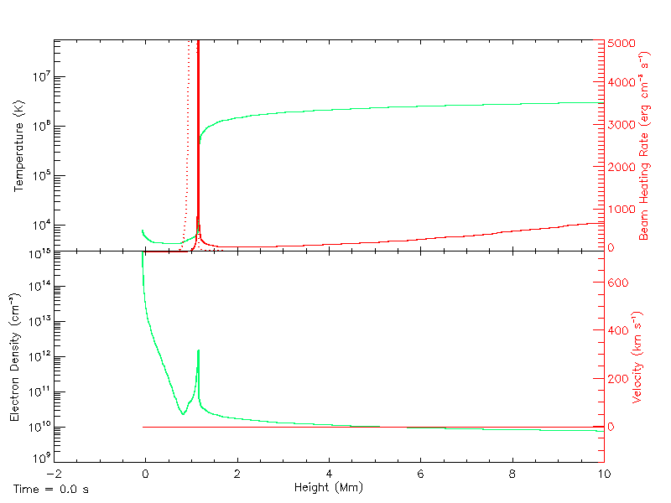


Slide 13
IRIS Observables: Doppler Velocities

Slide 16
Velocity vs. Temperature
Lasts the duration of beam heating.

Slide 17
Flaring Line Temporal Response

Slide 18
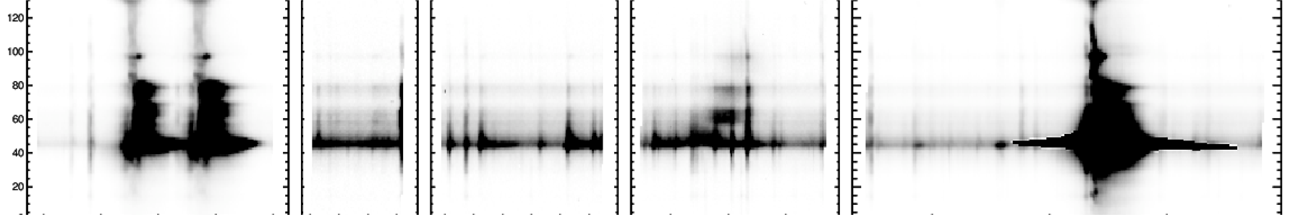
FUV Continuum
FUV continuum becomes much stronger (factors > 100) in flares
Phillips & Doyle (1992) showed FUV continuum around 1400 correlated with C II & C IV emission lines
IRIS shows good spatial correlation between C II, Si IV and continuum
Slide from Peter Young

Slide 19
FUV Continuum

Slide 20
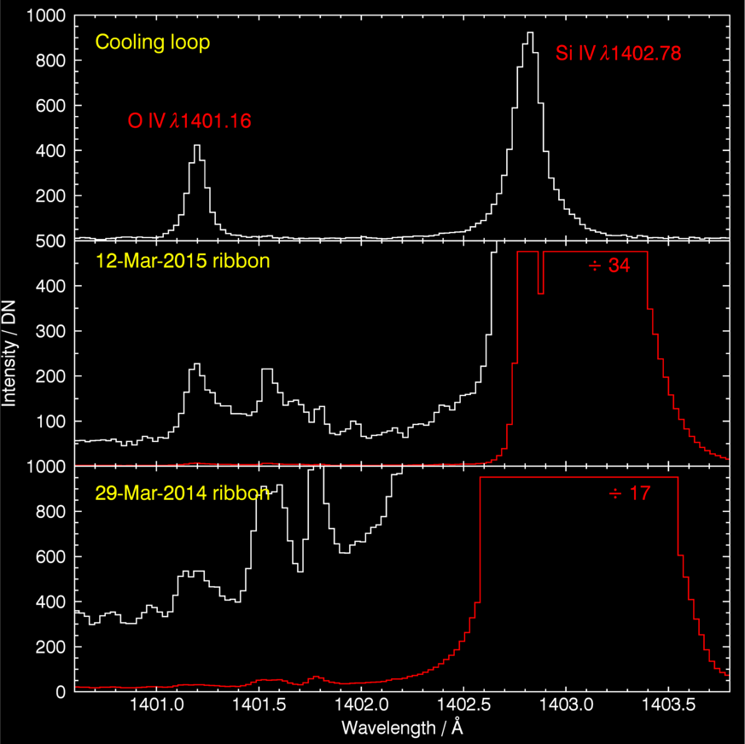
Can the behavior of the O IV lines (1397-1406 Å) be modeled?
O IV is a little hotter than Si IV.
O IV 1401.16 is close to Si IV 1402.77 and is typically 3-10
In flares the line can be > 1000 times weaker
Just a density effect? or non-equilibrium a factor?
Slide from Peter Young

Slide 23
Conclusions
Much can be learned from 1D simulations
Return currents can dramatically affect the flaring non-thermal particle distribution.
These effects must be included when determining a beam spectrum from X-ray spectral observations. For example, from RHESSI observations.
We can use these simulations to understand:
  The Doppler shifts observed in Fe XXI and Si IV by IRIS.
  O IV forbidden lines suppression, from which we can infer the ambient electron density.
  Much elevated FUV continuum.
Future Work:
  Combine many 1D simulations to produce a more comprehensive “3D” simulation of a full flare. (e.g., Rubio da Costa et al. 2016)
  Include protons and other heavies.

Slide 26
5. FUV Continuum: 1 Loop

Slide 27
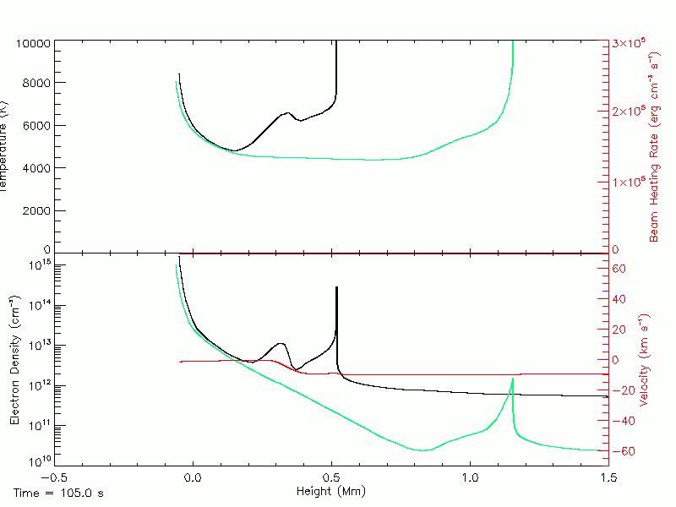
6. Anomalously Cool Material

