Slide 1
Wave heating of the partially-ionised solar atmosphere
S. Shelyag, E. Khomenko, A. de Vicente, D. Przybylski
Northumbria University, UK
IAC, Spain
Monash University, Australia

Slide 2
Introduction
What creates the temperature structure of the solar atmosphere?
I don’t know, but there are things to look at. Especially in the simulations.

Slide 3
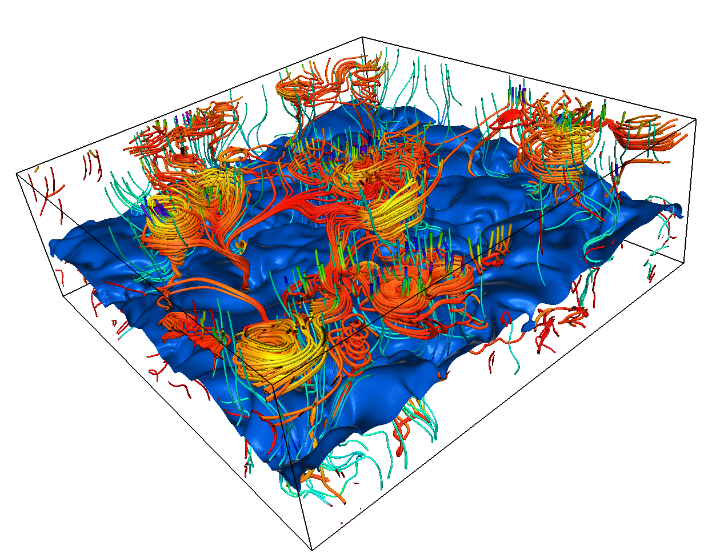
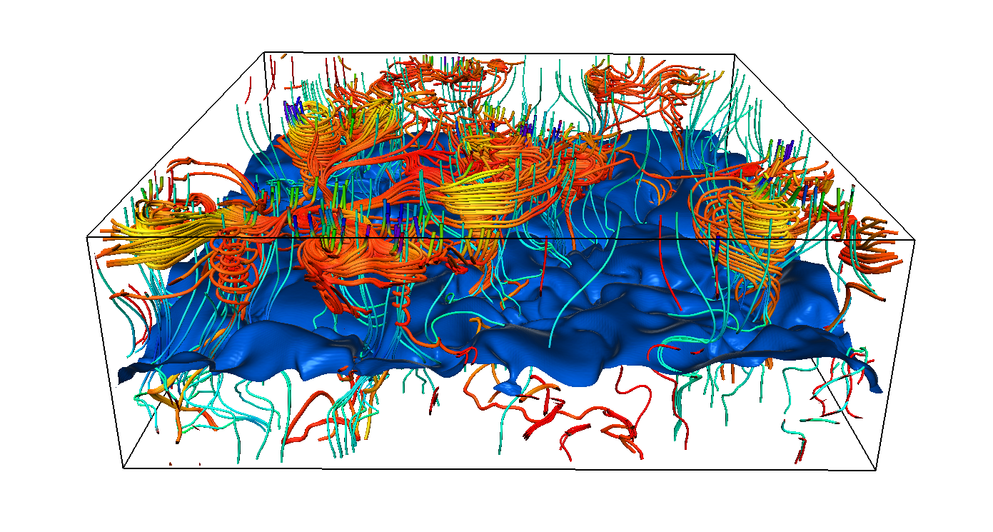
Vortices in intergranular lanes
-MURaM code (Vögler et al 2005): CZ + atmosphere
Domain size is 12x12x3.2 Mm resolved by 480x480x320 grid cells
Reaches about 1200 km above the continuum formation layer, covering photospheric lines formation depth range; various top boundaries
50G / 200G unipolar initial magnetic field / bottom-boundary B advection
Photospheric vortices generation and their links to strong photospheric magnetic fields were described in Shelyag et al 2011.
Velocity field lines show vortex structures in strong magnetic field regions.
Single-fluid MHD: magnetic field is frozen into plasma.
Why the magnetic field lines do not show the same vortex structures?

Slide 4
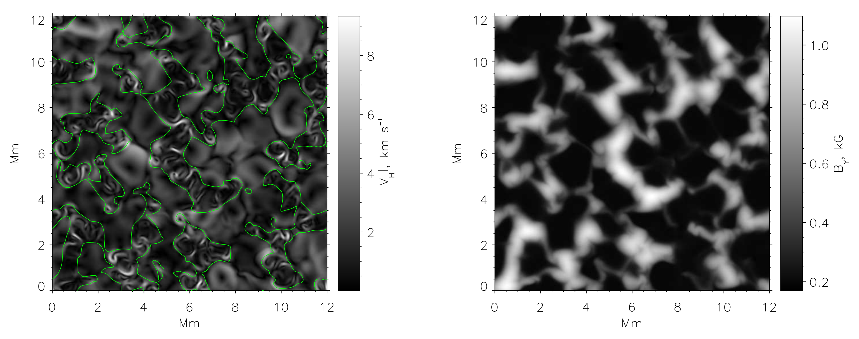
Simulated vortices
Horizontal vortices appear in the intergranular lanes in the upper photosphere, co-located with intergranular magnetic field concentrations. Note that velocities can be higher than in granular flows.
Image from Shelyag et al. (2011)

Slide 5
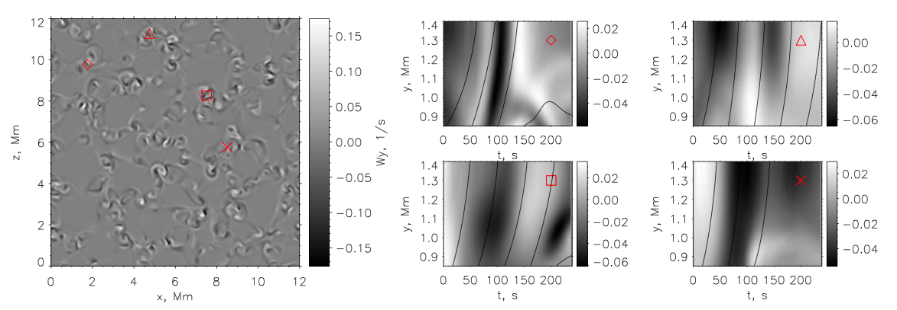
Alfvén waves
To identify wave types, we plot time-distance diagrams for vertical component of the vorticity in vortex structures. Also, overplot tracks for test particles moving with the local time-dependent Alfvén speed.
Shelyag et al, ApJL 2013
The domain is filled with the structures exhibiting rapid vertical propagation of vorticity perturbation.
Alfvén speed can reach 70 km/s, normally about 40 km/s in higher photosphere in the magnetic field regions. Flow speeds never exceed 5-15 km/s. Propagation of vorticity perturbation cannot be explained with flows. It propagates with Alfvén speed.
“Vortices” do not generate Alfvén waves: they look like they are Alfvén waves themselves.

Slide 6
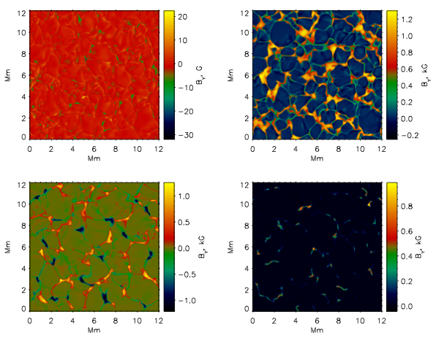
Poynting flux: peculiar feature or general property of the photosphere?
10G horizontal
200G vertical
200G mixed
10G vertical
Image from Shelyag et al. (2012)

Slide 7
Net Poynting flux, different B configurations
Image from Shelyag et al. (2012)

Slide 8
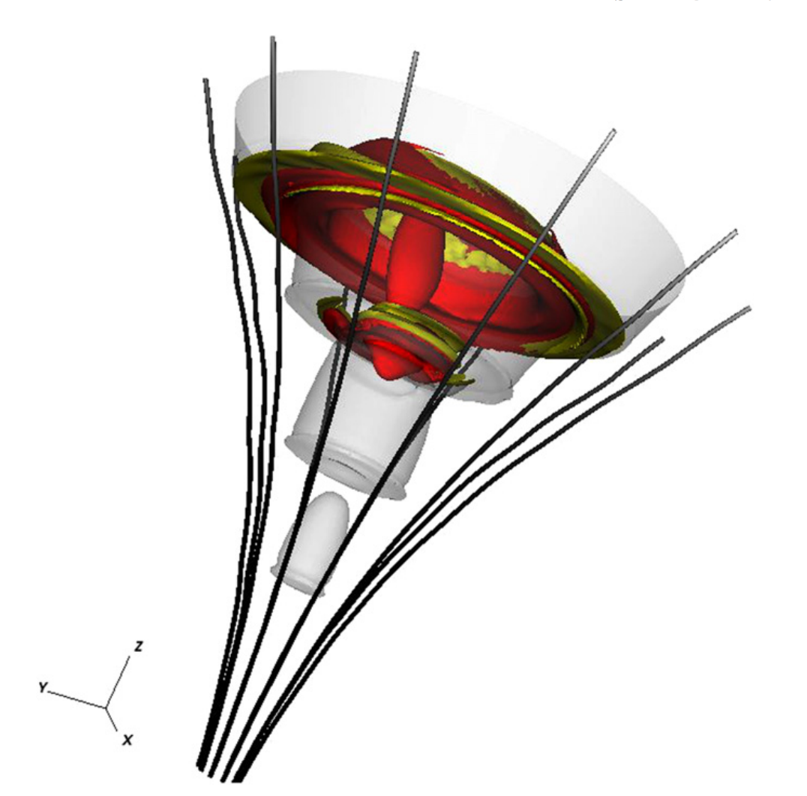
Ambipolar diffusion:
Arber et al 2016 reiterate:
AD can be an answer.
The internal energy conservation:
Schlüter-Temesvary magnetic field (not current-free)
Generalised Ohm’s law (Ohmic and ambipolar terms included):
“ambipolar resistivity”, ξ – neutral fraction
Includes collision frequencies and densities

Slide 9
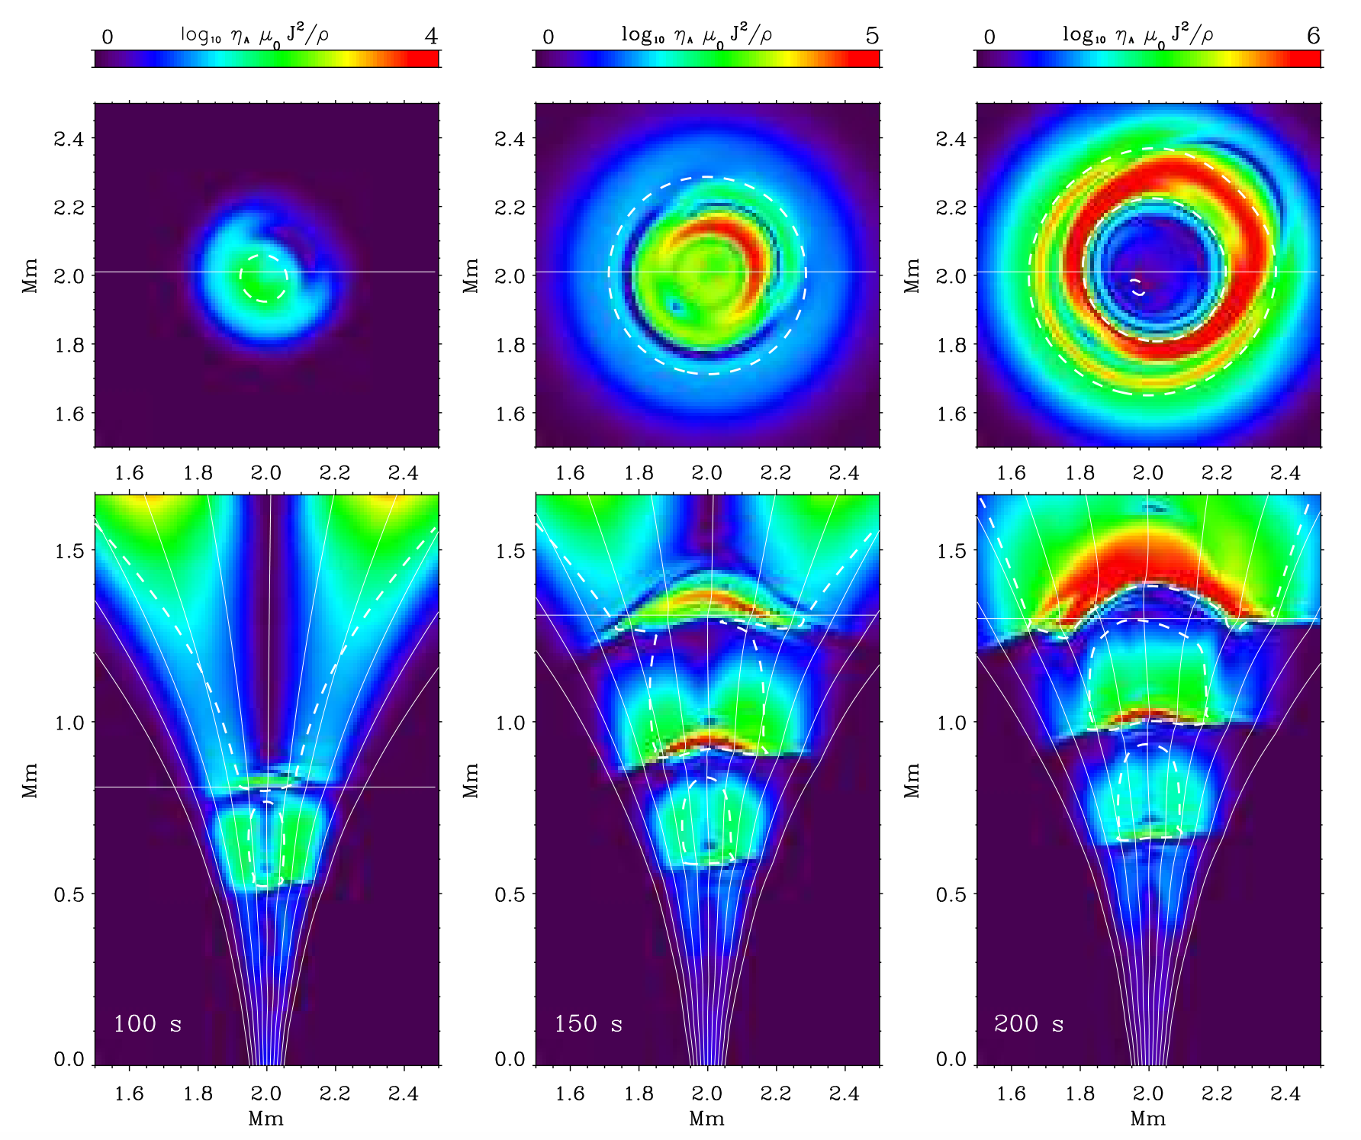
Perpendicular currents
We use a periodic off-axis perturbation with f=25 mHz – similar to what we see in magneto-convection simulation.
“Ambipolar” heating term

Slide 10
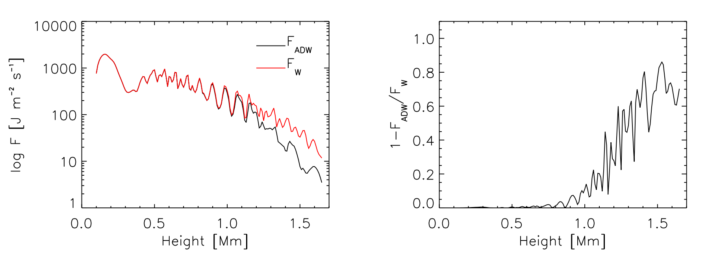
Poynting flux absorption
We perform three simulations: AD, W, AD+W. AD+W includes ambipolar diffusion and oscillatory source. W does not include ambipolar diffusion.
The result is we get up to 80% absorption of Poynting flux in the chromosphere at 25 mHz.

Slide 11
Ways for observations
1
2
Tracking horizontal motions in the solar photosphere/chromosphere. Bright points/chromospheric swirls.
Off-disk-center spectropolarimetry. Horizontal motions become line-of-sight motions.

Slide 12
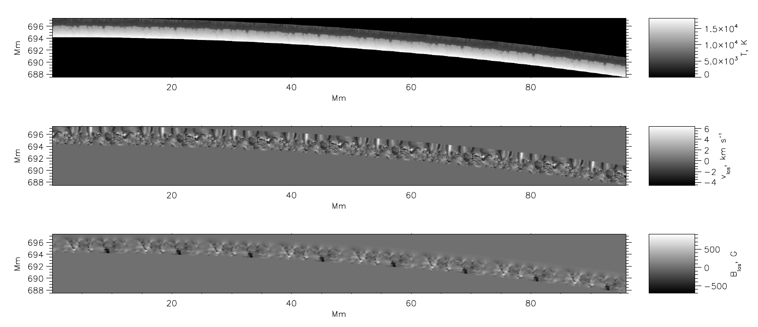
The limb simulation
16 MURaM models are stacked together and then curved to make the “spherical” (cylindrical, in fact) solar surface. Velocity and magnetic field are recalculated accordingly.
Shelyag, ApJ, 2015

Slide 13
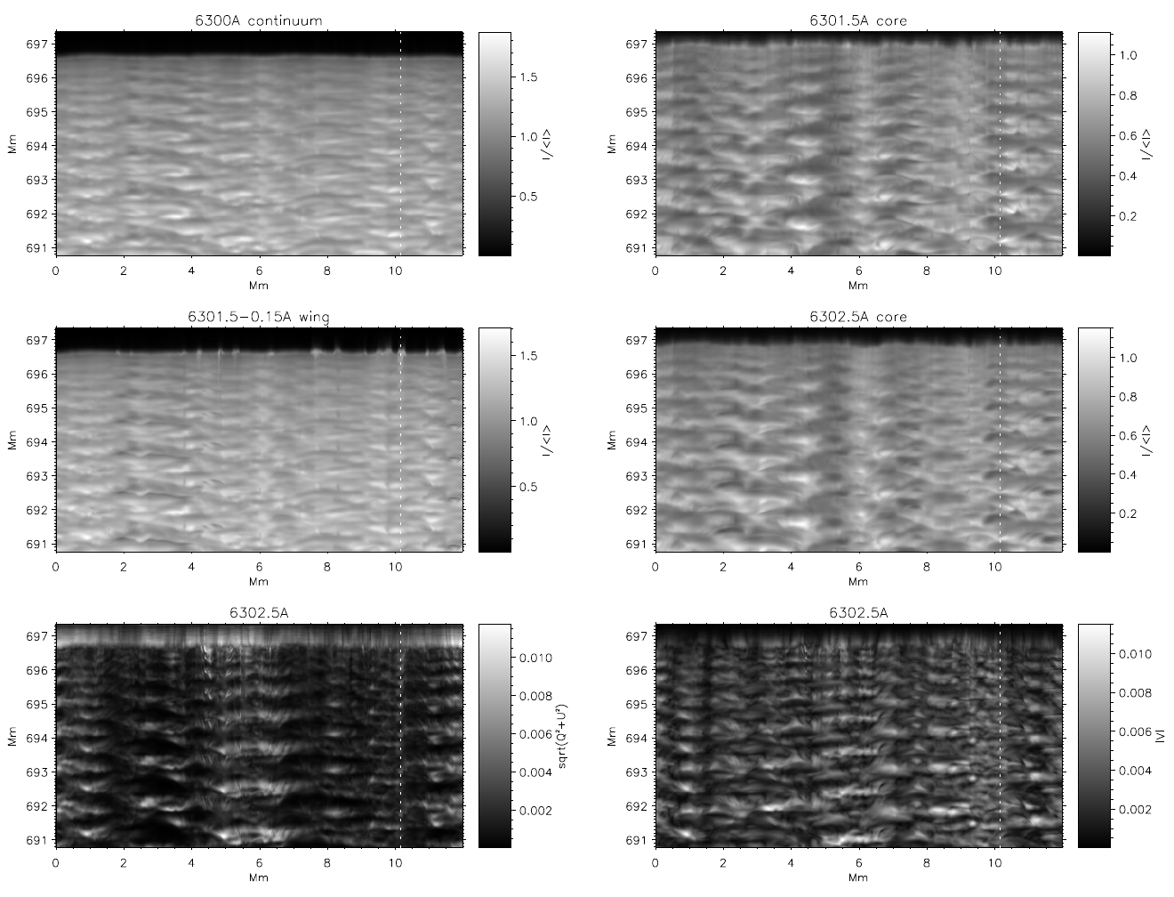
Simulated limb, images
Shelyag, ApJ, 2015

Slide 14
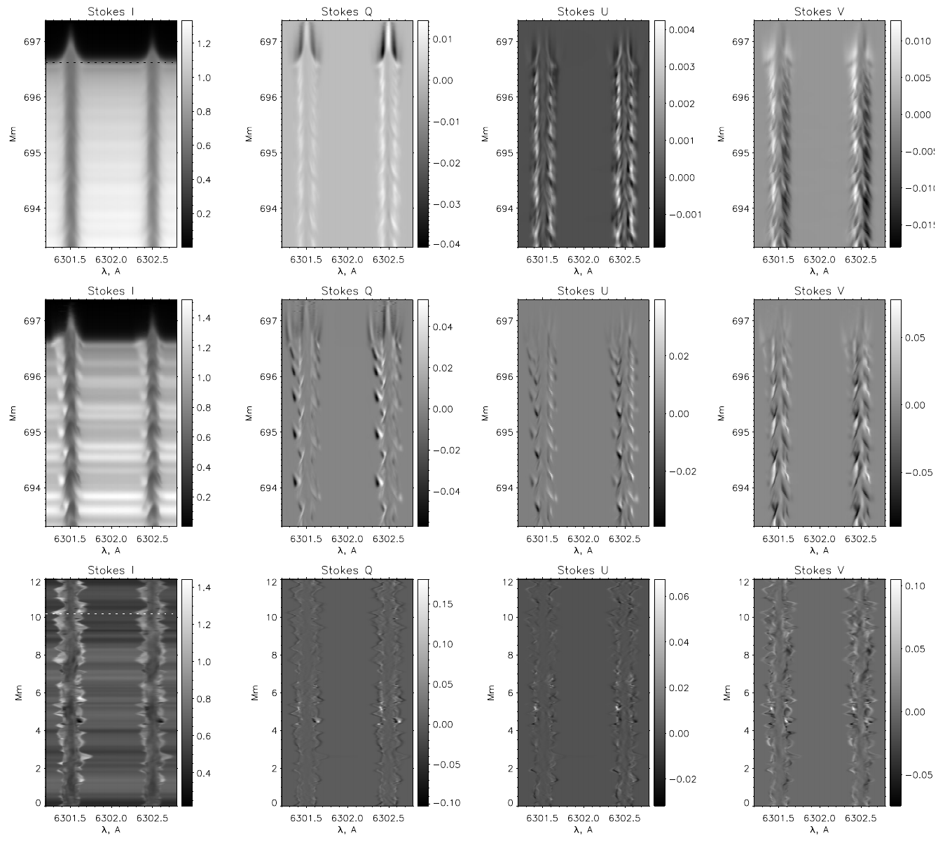
Simulated limb, slits
Shelyag, ApJ, 2015

Slide 15
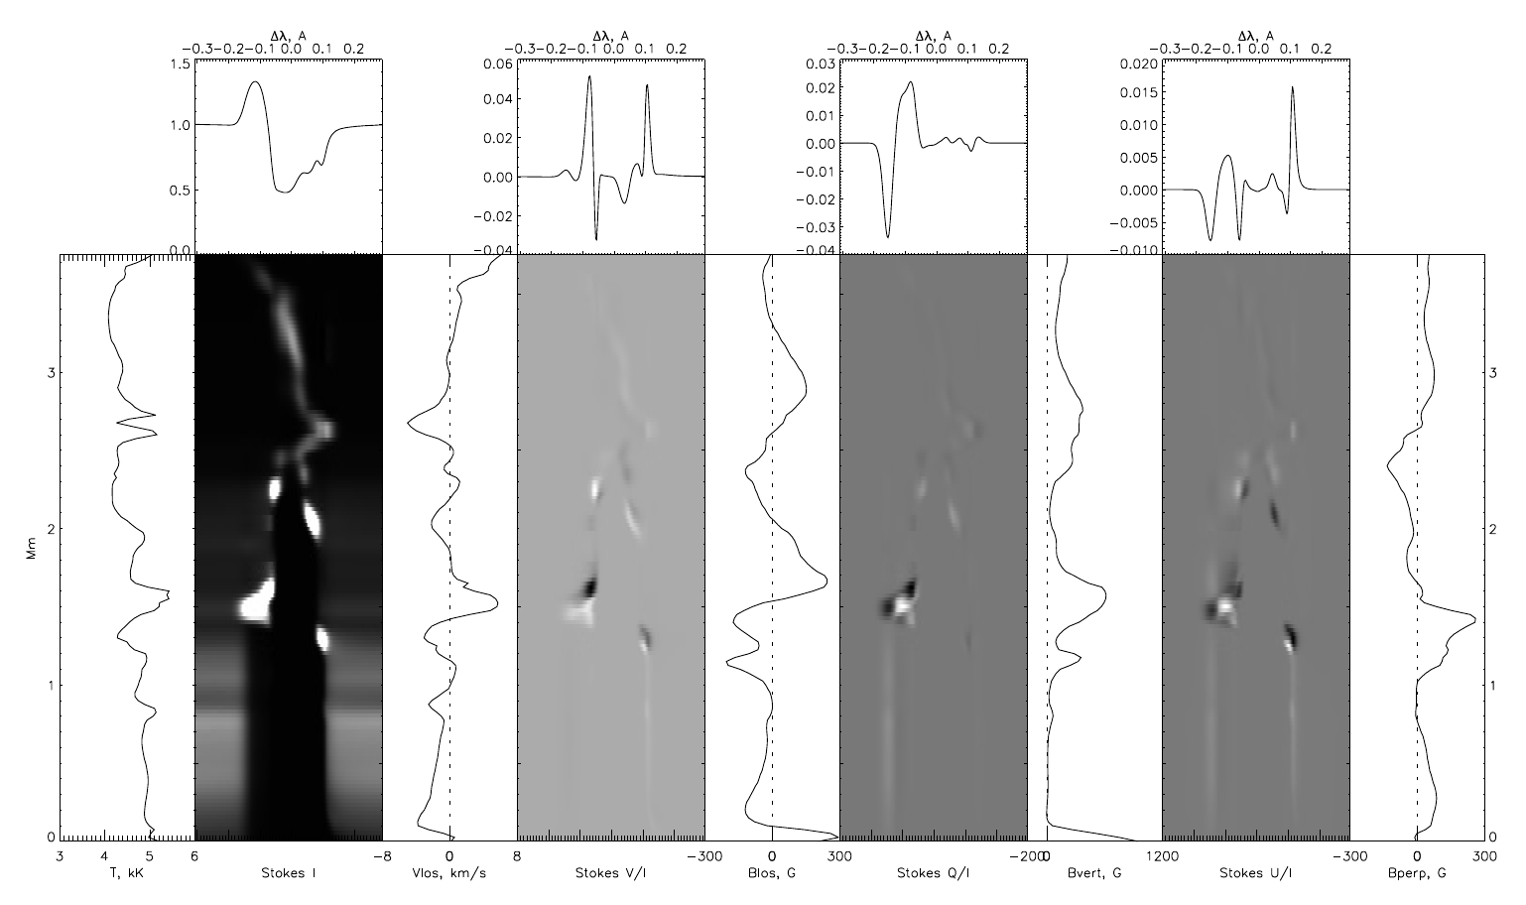
Simulated limb, 6302A FeI response functions
Shelyag, ApJ, 2015

Slide 16
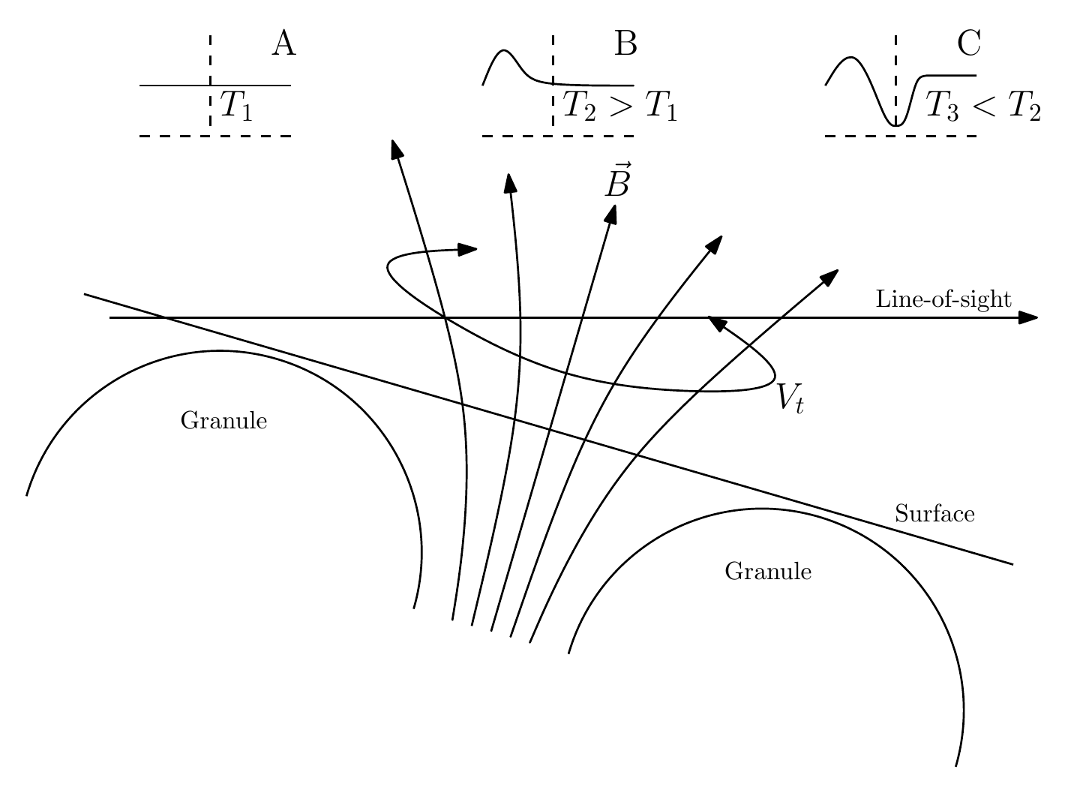
How the emission-absorption profiles are formed
Here, absorption-emission profiles are formed in three stages: (A) – continuum formation, (B) – Doppler-shifted emission profile in the positive T-gradient with torsional flow, (C) – normal absorption profile.
Shelyag, ApJ, 2015

Slide 17
Conclusions
It is possible to absorb significant part of the energy produced in the convection zone just by ambipolar diffusion.
There are many questions though: no radiative losses included, no frequency study yet.
Still, it is unclear if waves are enough to create the chromosphere.

Slide 18
The end

