Slide 1

Using CO line ratios to trace the physical properties of molecular clouds
Cardiff University
Camilo H Peñaloza,
Paul C. Clark
Heidelberg ITA
Simon C.O. Glover, Ralf Klessen

Slide 2

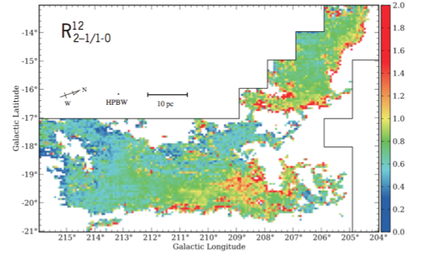
Motivation
Galactic: Trace the different structural layers of the cloud
Extragalactic: Give validity as a conversion factor
Nishimura et al (2015)

Slide 3
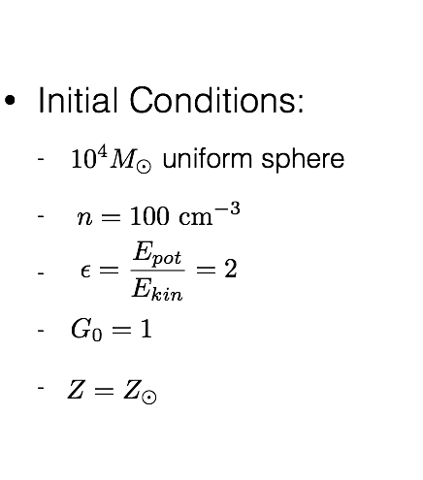
Initial Conditions
Nishimura et al (2015)

Slide 4
How we do simulations
Hydrodynamics:
  Modified version of GADGET-2
  Time dependent chemistry
  Attenuation of the ISRF (TreeCol)
  No magnetic fields
  No feedback
  Stop before SF
Radiative Transfer:
  RADMC-3D
  CO’s first two rotational transition lines
  AMR-grid (Accounts for all SPH particles)

Slide 5
Synthetic Observations

Slide 6
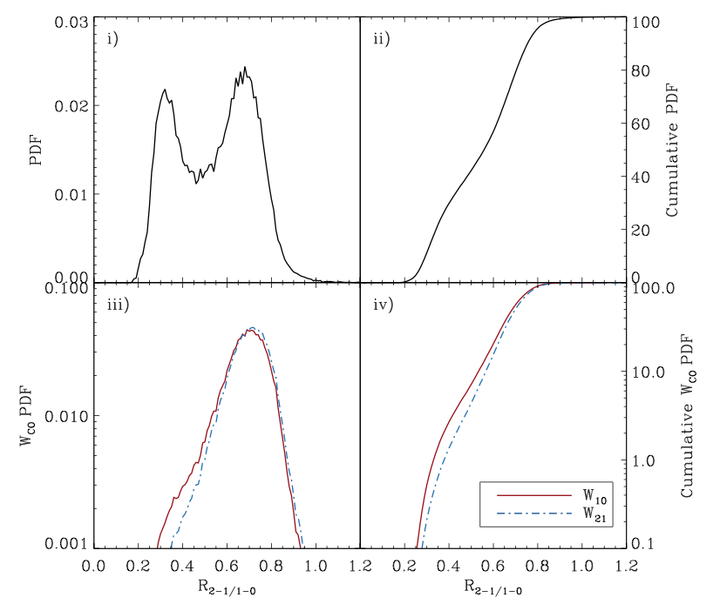
Bimodal Distribution

Slide 7
R vs physical properties

Slide 8
R vs physical properties

Slide 9
R vs physical properties
COLD AND DENSE
WARM AND DIFFUSE

Slide 10

Opacity Maps

Slide 11
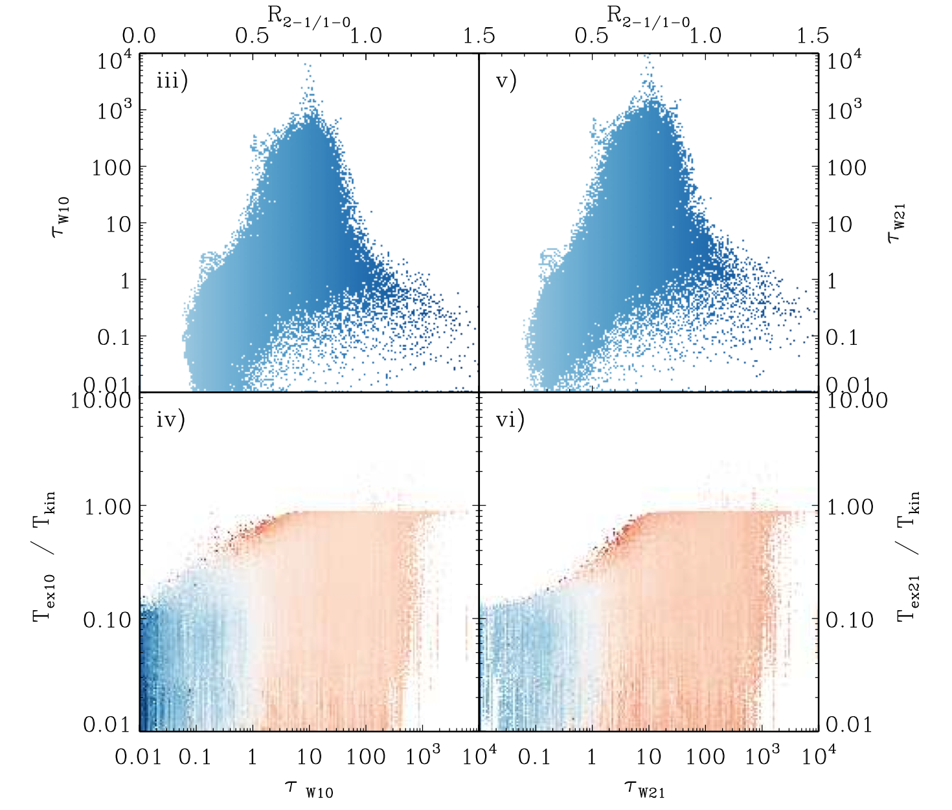
R vs τ

Slide 12
R vs τ

Slide 13
R vs τ
Sub-thermally excited
A mix between sub-thermal and thermalized gas

Slide 14
Conclusions so far
R has a bimodal distribution with two main peaks, at R≈ 0.7 and R≈ 0.3.
The high ratio peak traces the cold ( ), dense ( ) and optically thick gas.
The low ratio peak traces the diffuse ( ), warm ( ) and optically thin molecular gas.
This is a consequence of the physical conditions and state of the surrounding gas
Caveat: only one cloud!!

Slide 15
More Clouds!
SFR Proxy
 | n (cm⁻³) | M_{sol} | α_{vir} | UV | CR
#1 | 100 | 10⁴ | 0.5 | 1 | 1 | Molecular
#2 | 100 | 10⁴ | 0.5 | 1 | 0.3 | Molecular
#3 | 100 | 10⁴ | 0.5 | 10 | 10 | Molecular
#4 | 100 | 10⁴ | 0.5 | 100 | 100 | Molecular
#5 | 100 | 10⁵ | 0.5 | 1 | 1 | Molecular
#6 | 100 | 10⁵ | 0.5 | 10 | 10 | Molecular
#7 | 100 | 10⁵ | 0.5 | 100 | 100 | Molecular
#8 | 100 | 10⁵ | 0.5 | 1 | 1 | Atomic
#9 | 100 | 10⁵ | 0.5 | 100 | 100 | Atomic
#10 | 10000 | 10⁵ | 0.5 | 100 | 100 | Molecular
#11 | 10000 | 10⁵ | 2 | 100 | 100 | Moelcular

Slide 16
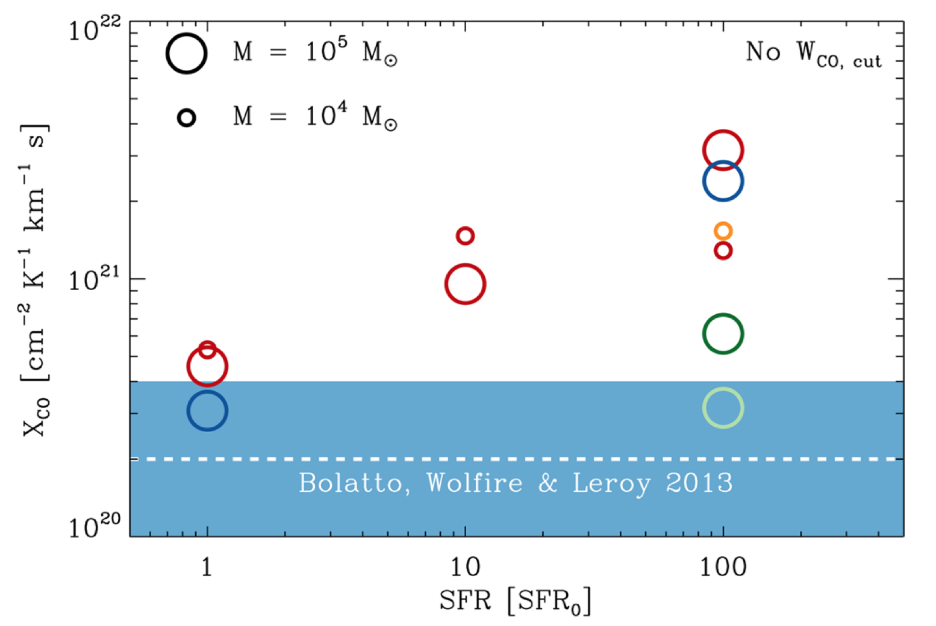
Extragalactic Scale
Clark & Glover 2015
So we are fairly OK!

Slide 17
Finally!
On a local level R can allow to distinguish the different layers of GMCs and the state of the gas
On a global level we need to be cautious on how we convert integrated intensities and what the biases are depending on environmental conditions
Synthetic observations can help us test and calibrate our observational techniques

Slide 18
THANKS ☺

Slide 19
Can we see it?

