Slide 1
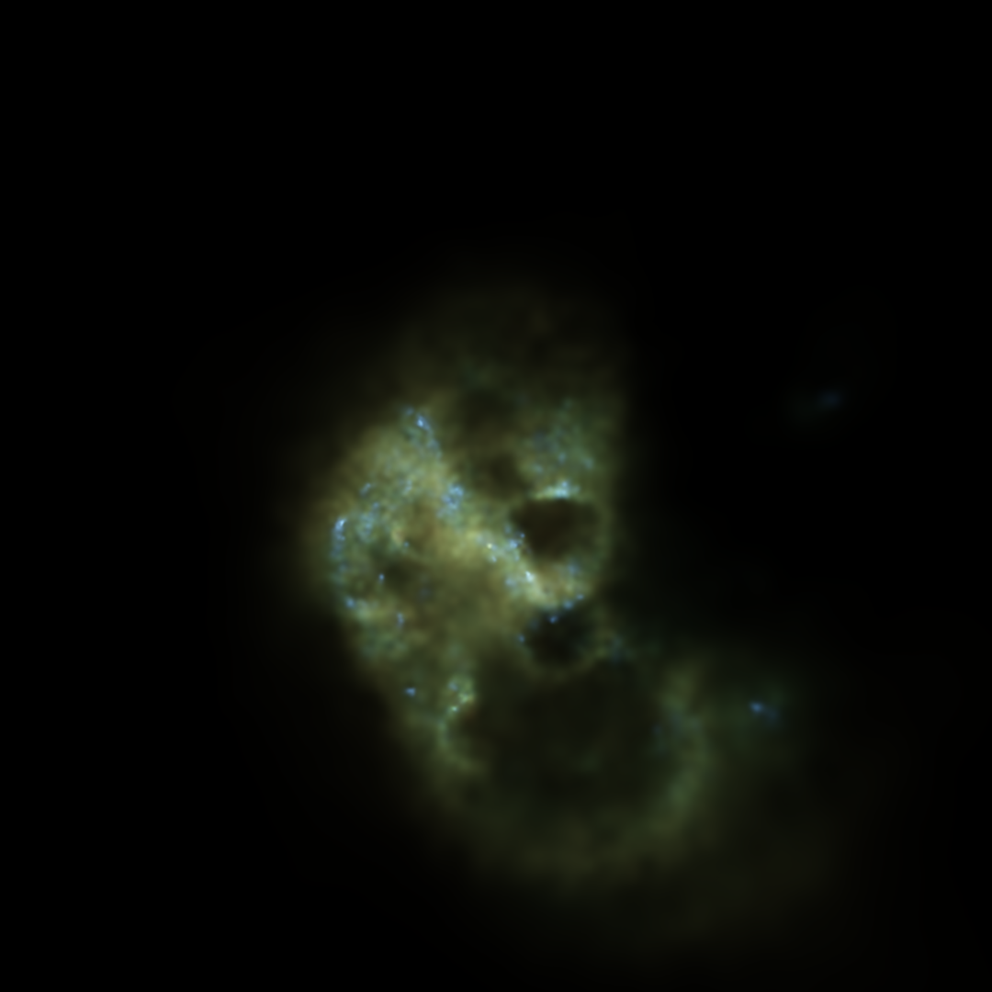
Simulations of realistic dwarf galaxies including Pop III feedback
Robbert Verbeke¹
Bert Vandenbroucke Sven De Rijcke
Ghent University
¹Robbert.verbeke@ugent.be
@Rbhfd
How Galaxies form Stars – August 24 2016

Slide 2
ΛCDM
Standard model for cosmology
Dwarf regime
“Missing satellites”
“Too big to fail”
“Planes of satellites”
Dwarfs are ideal testbeds for cosmological and galaxy formation models

Slide 3
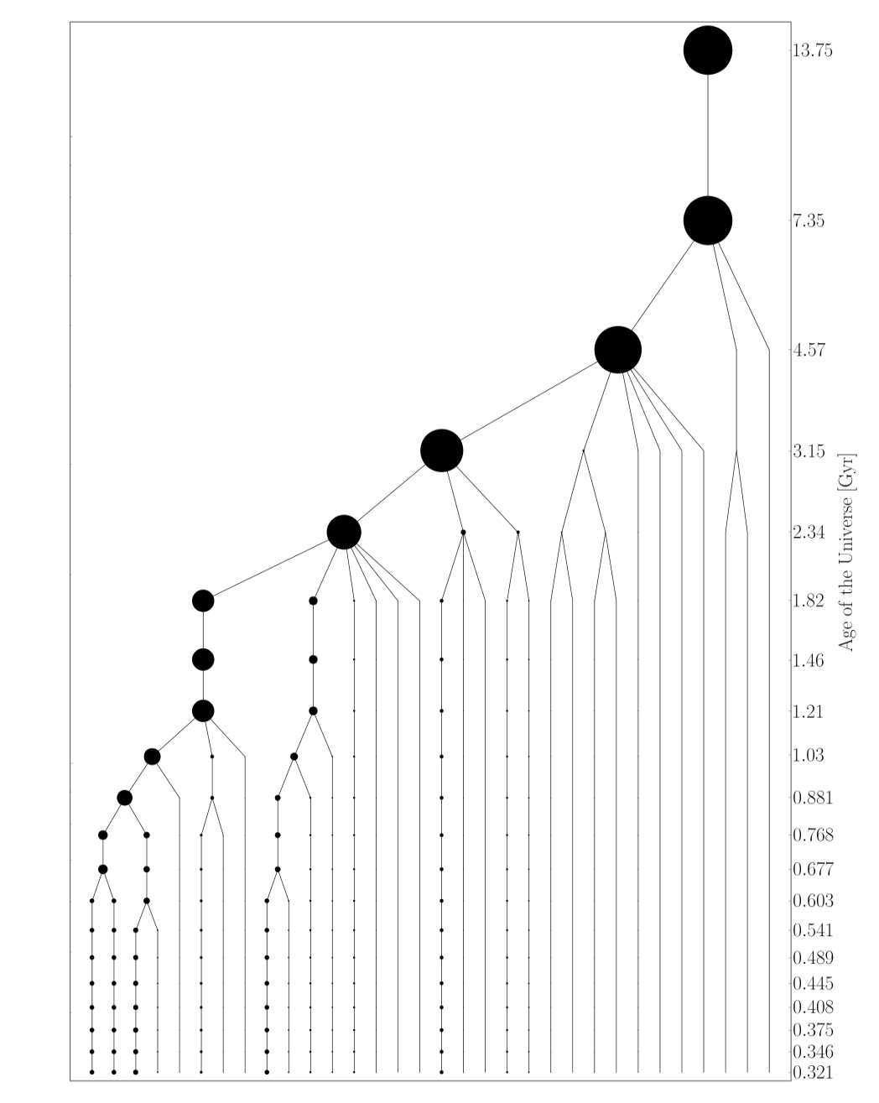
Models Of Realistic dwarfs In Action
MoRIA
Gadget-2 (N-body/SPH) (Springel et al. 2005)
Dwarf galaxy scale
High resolution (10³⁻⁴ M⊙, 5-15 pc)
Cosmologically motivated merger tree (Cloet-Osselaer et al. 2014)
Star formation
Gas cooling and heating (De Rijcke et al. 2013)
Feedback from supernovae and UV radiation from massive stars
Chemical enrichment
Heating by cosmic UV background

Slide 4
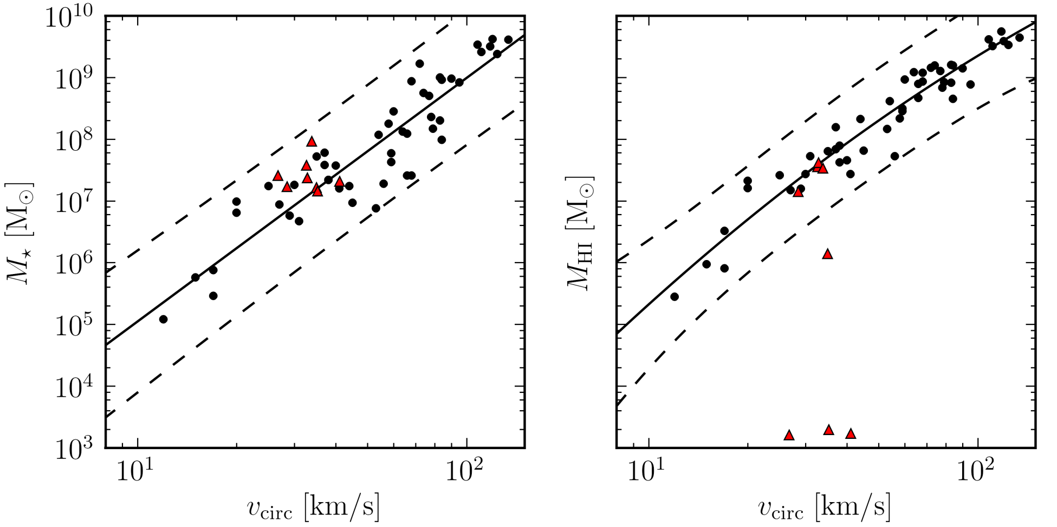
Baryonic Tully-Fisher relation
DM halos with v_{c} ≲ 30 km/s should not contain neutral gas (e.g. Sawala et al. 2014b)
v_{c} predicted from matter distribution

Slide 5
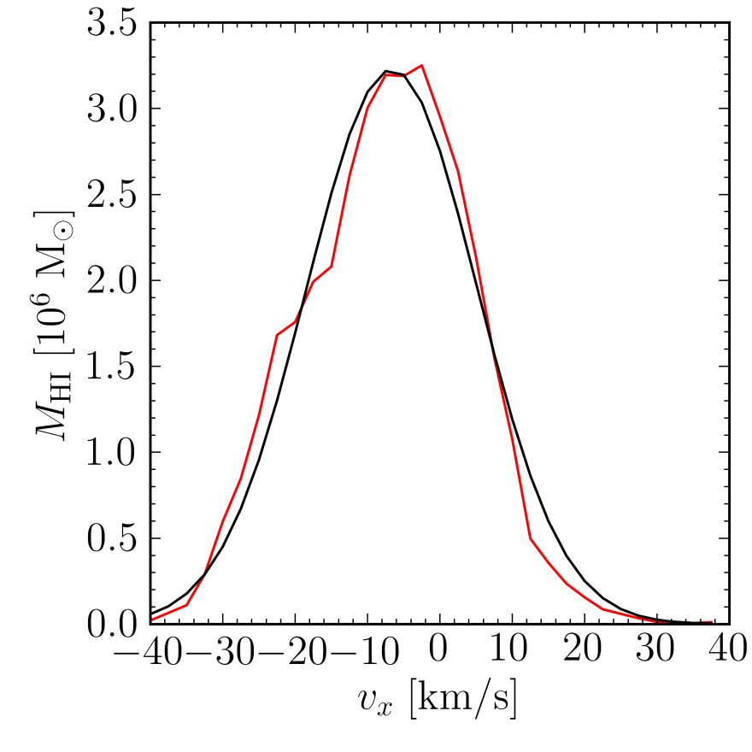
Mock observations
Mock HI spectrum: v_{c} = W₂₀/2

Slide 6
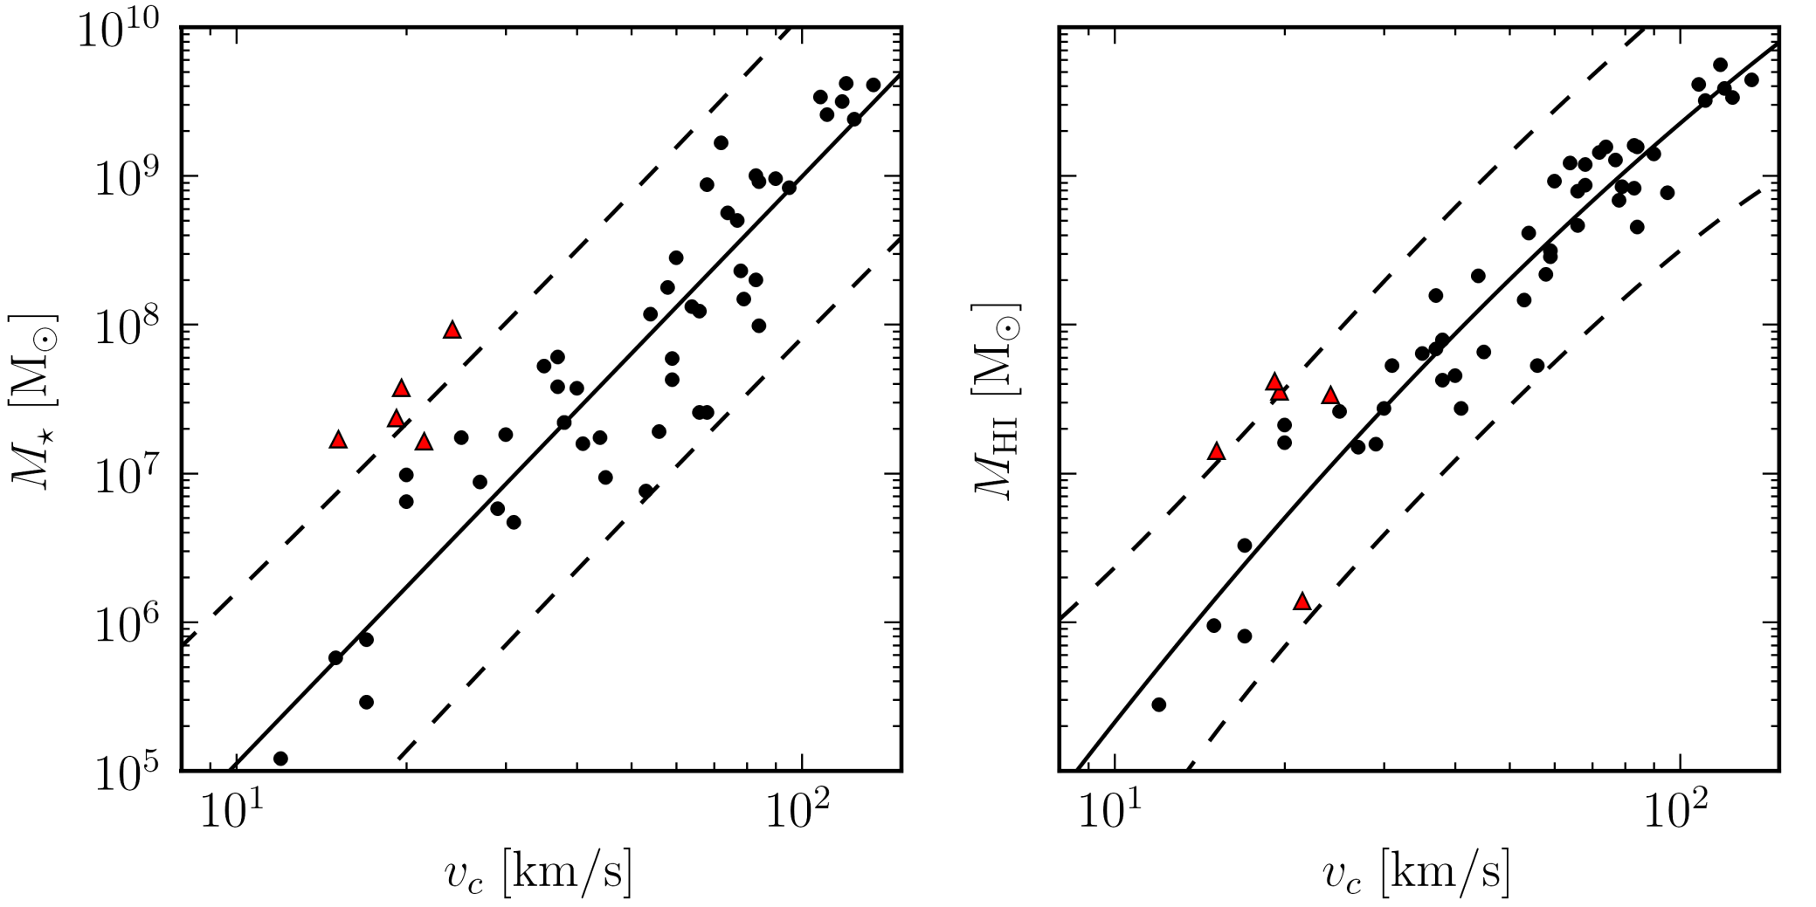
Mock observations
Mock HI spectrum: v_{c} = W₂₀/2

Slide 7
First stars
Out of pristine, unenriched gas
Top-heavy IMF: 0,7 – 300 M⊙ (Susa et al. 2014)
[Fe/H] < -5
4 x more SNII energy
40 x more UV radiation from massive stars
Lower star formation at early times

Slide 8
Baryonic Tully-Fisher relation

Slide 9
Baryonic Tully-Fisher relation

Slide 10
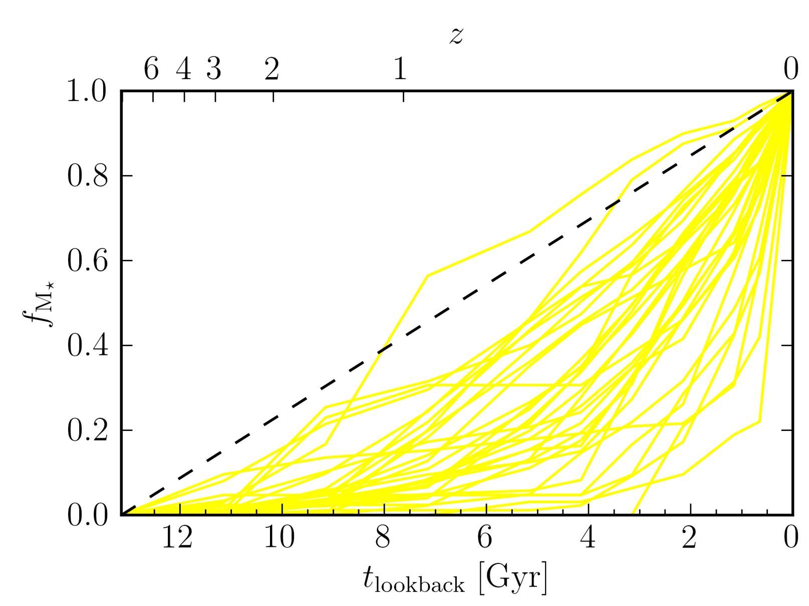
Star formation histories
Broad range of star formation histories is reproduced

Slide 11
Star formation properties

Slide 12
M*-M_{halo}

Slide 13
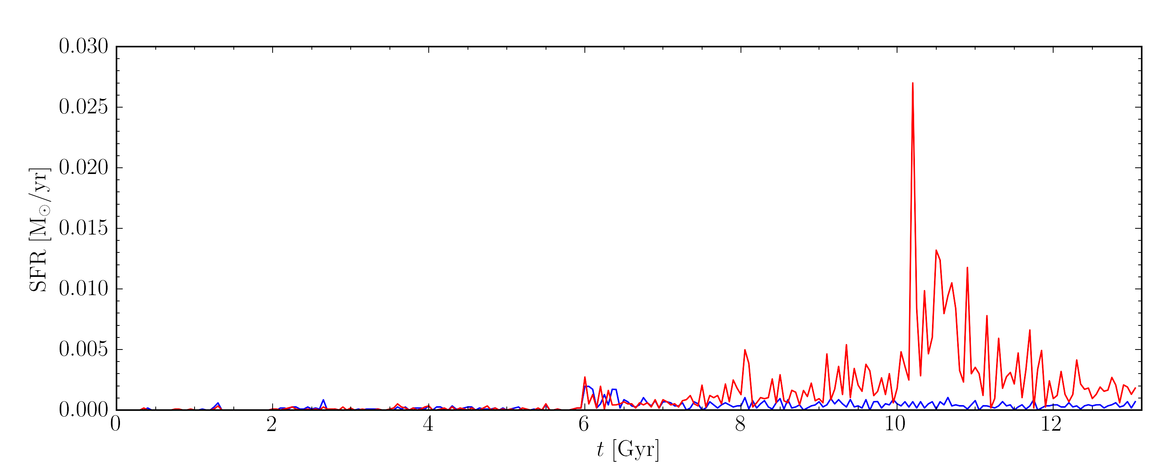
Blue Compact Dwarfs
Triggering mechanism?
Gaseous infall (Verbeke et al. 2014)
Tidal interaction
Merger

Slide 14
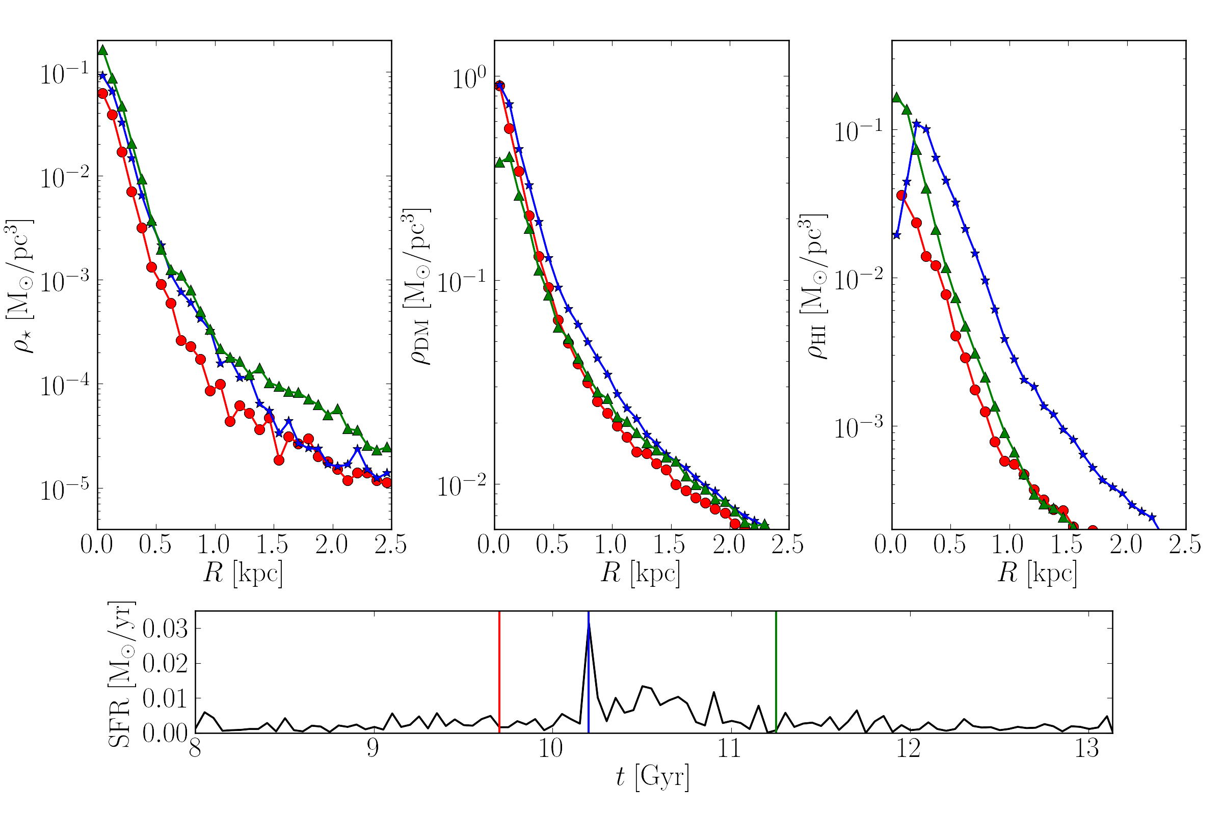
BCDs

Slide 15
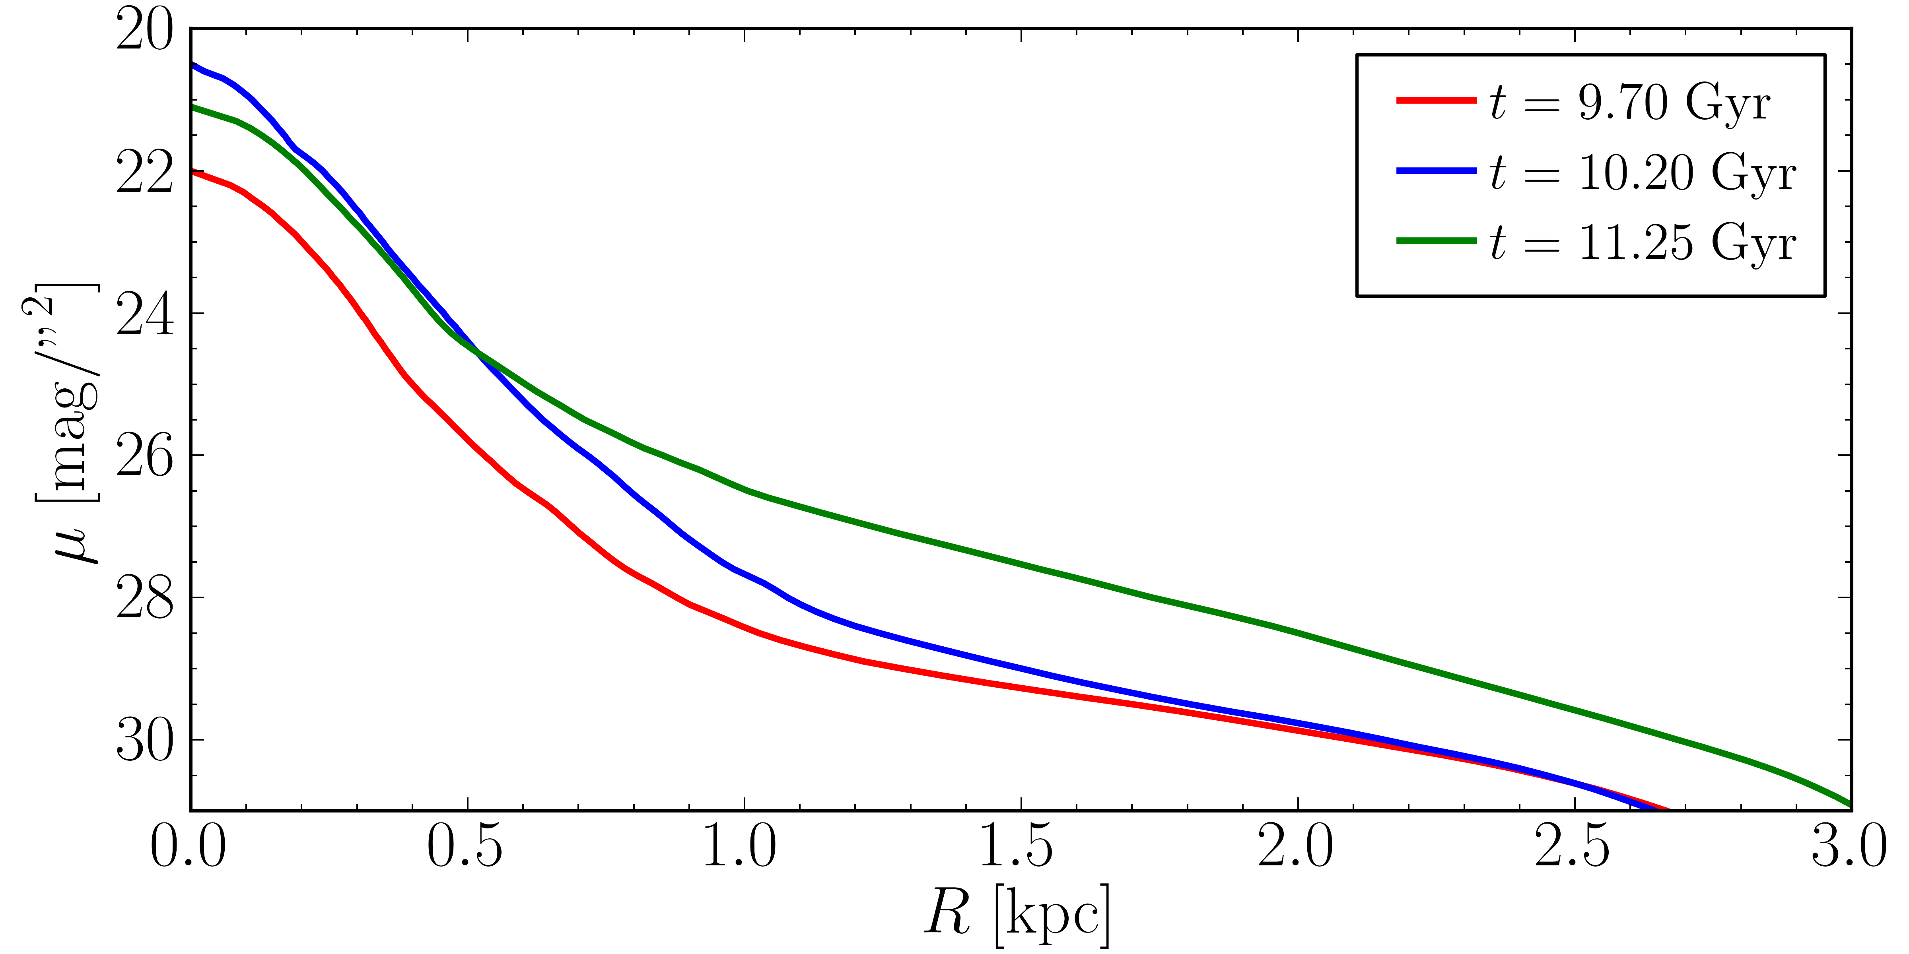
BCDs – Surface Brightness Profiles

Slide 16
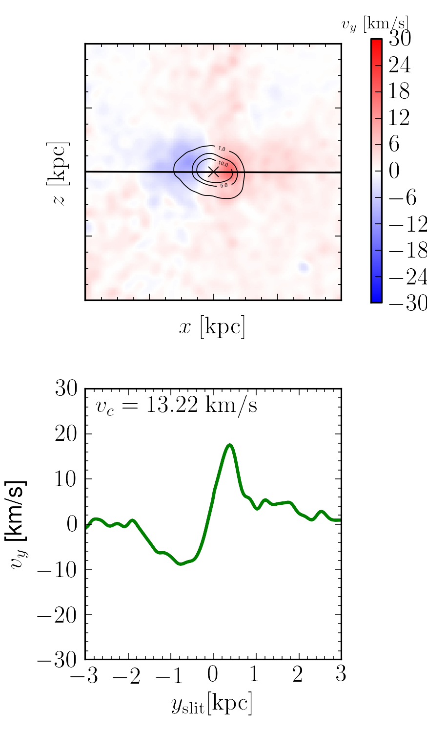
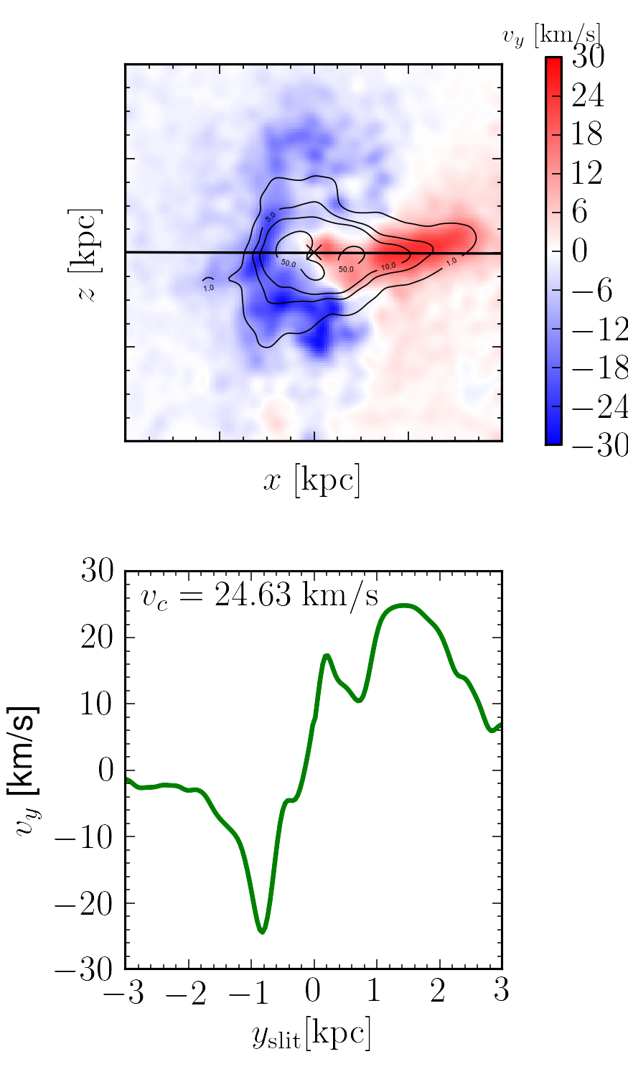
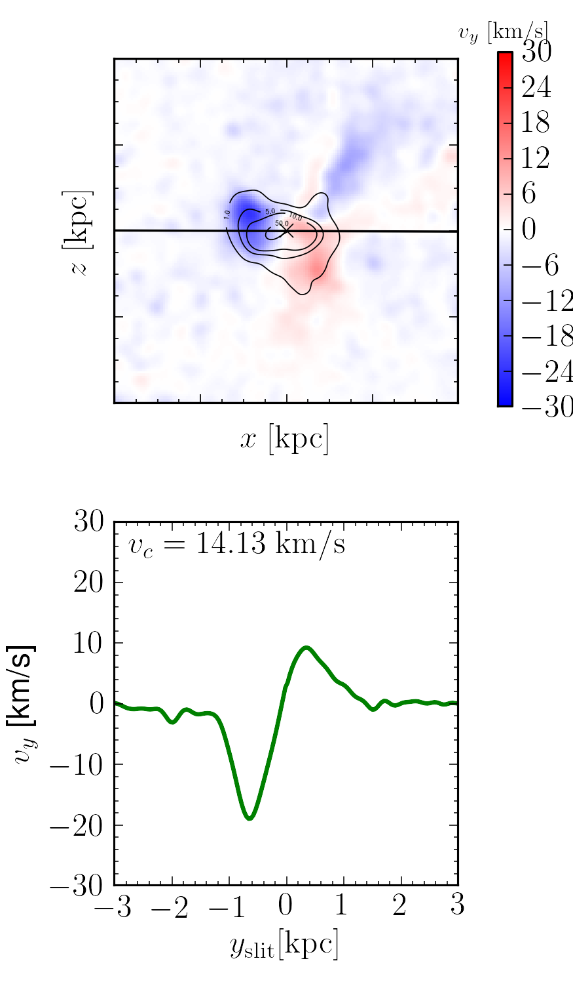
BCDs – Velocity curves

Slide 17
Summary
Dwarf galaxies are a challenge for ΛCDM
Advanced models are necessary
Way of producing mock observations is crucial
Realistic dwarfs can be simulated
Our MoRIA simulations can be used to investigate other open questions in astrophysics & cosmology
Verbeke, Vandenbroucke & De Rijcke (2015)
Vandenbroucke, Verbeke & De Rijcke (2016)

