Slide 1
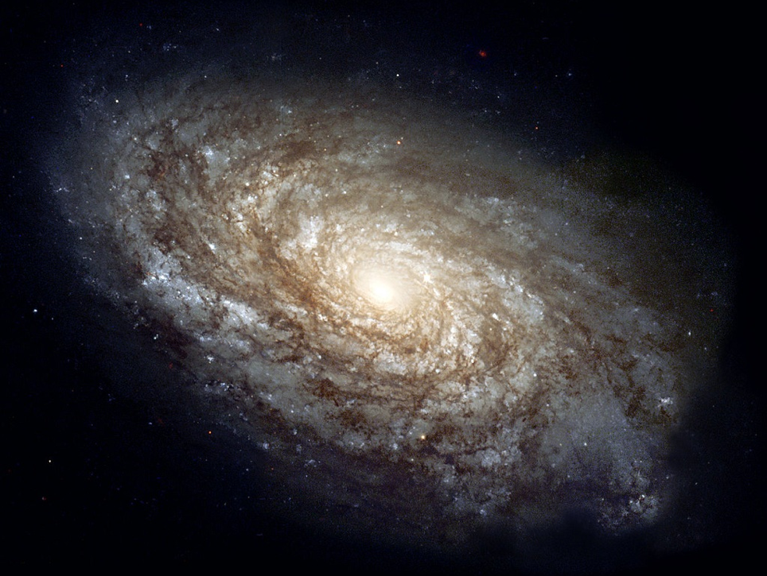
Characterizing Dust Attenuation in Local Star Forming Galaxies
Andrew Battisti – UMass
Daniela Calzetti – UMass
Ranga-Ram Chary – Caltech
NGC 4414
How Galaxies Form Stars – 2016
Credit: AURA/STScI/NASA/ESA

Slide 2
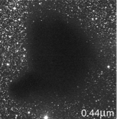
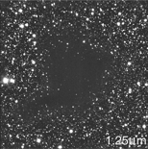
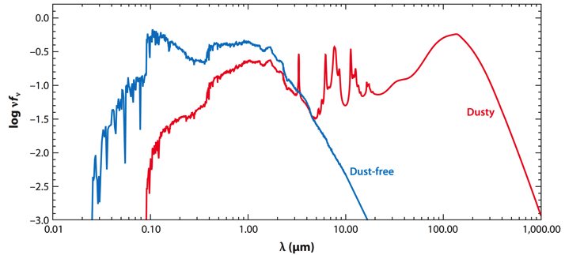
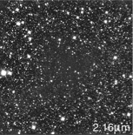
Impact of Dust on Science
Barnard 68
Dust alters spectral energy distributions (SEDs)
Wavelength dependent, blue affected more
Galactic impact: star class., distances, etc.
Extragalactic impact: photo-z, galaxy properties (e.g., M*, SFR), etc.
UV
Opt
IR
Credit: ESO
Conroy 2013
Notes:
Impact on SEDs is nicely illustrated by this figure; shows a SFG without dust in blue and the same galaxy with a significant amount of dust in red. From this you can get a sense for how if you only have rest-frame UV/Opt (high-z) you can derive drastically different properties.

Slide 3
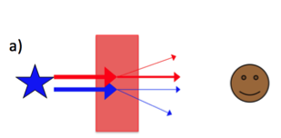
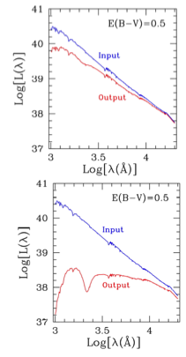
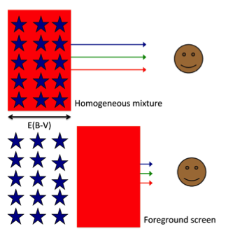
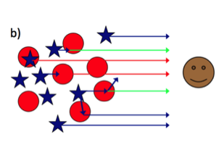
Dust in Distant Galaxies
Unable to resolve stars, must use diffuse light
Diffuse light can scatter into line of sight
Attenuation = Absorption + Scattering out of line-of-sight + Scattering into line-of-sight
Strongly dependent on star/dust geometry
Galactic
Extinction
Extragalactic
Attenuation
Calzetti 2013
Notes:
How do we go about studying dust in other galaxies?

Slide 4
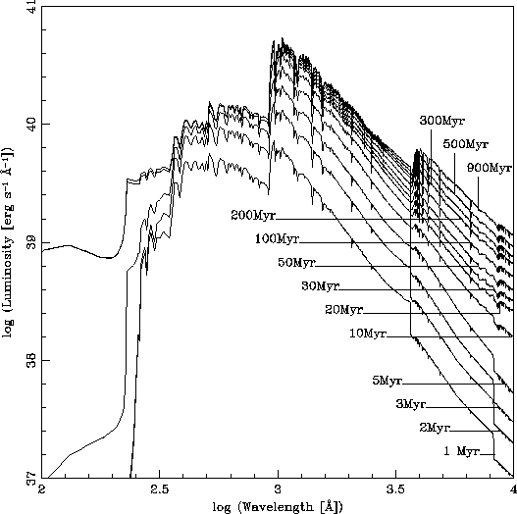
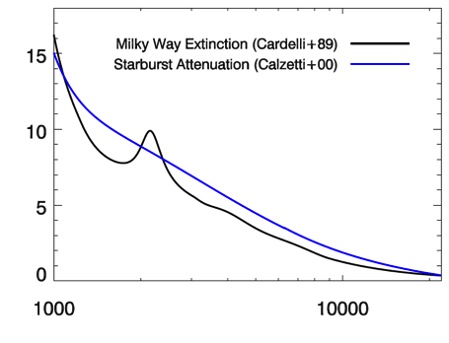
Attenuation vs. Age
Galaxy = Collection of many stars with different ages
No “intrinsic” galaxy SED → More difficult to characterize dust
Star-forming galaxies share similar UV SEDs
Selective
Attenuation
Normalization
UV
Opt
Leitherer+1999
4000Å break
UV
Opt
NIR
log[Luminosity (erg s⁻¹ Å⁻¹)]
Nearly identical
V=5500Å
k(λ)
R_{V}(SB) = 4.05
Continuous
SFR
R_{V}(MW) = 3.1
log[Wavelength (Å)]
Wavelength (Å)
Notes:
Ideal Study: want background object with known spectrum

Slide 5
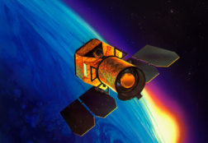
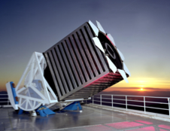
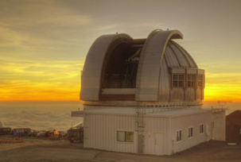
Improving our Understanding
Nearly all studies use starburst attenuation curve (only 39 galaxies!)
Appropriate for other galaxies? Does it vary with galaxy properties?
Need large samples to address these questions
GALEX (UV), SDSS (Optical+spect.), UKIDSS & 2MASS (NIR)
Select SFGs from optical emission line diagnostics
Aperture match data (4.5’’)
Final sample – 9,813 star-forming galaxies (z < 0.1)
UKIRT
GALEX
SDSS
Notes:
Our sample has avg Halp EW are less than half the values of the Calzetti sample (proxy for sSFR)
BPT: [OIII]/Hbeta vs [NII]/Halpha

Slide 6
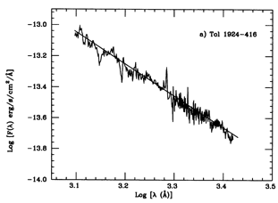
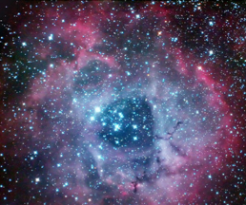
Characterizing Attenuation
UV slope, β (1250–2600Å)
Reddening of stellar continuum
Influenced by stellar age
Balmer optical depth, τ_{B}^{l}
Reddening of ionized gas
Not influenced by stellar age
Proxy for dust content
log[ F_{λ} (erg/s/cm²/Å)]
Calzetti+(94)
log[Wavelength (Å)]
HII Region
Notes:
Case B Recombination: optically thick to Lyman series photons

Slide 7
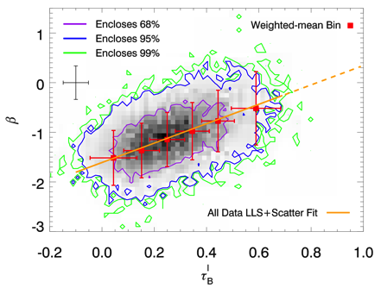
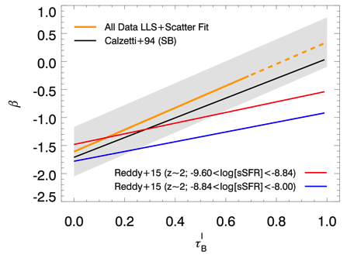
Constraining Geometry (Stars/Dust)
Expect different trends between β – τ_{B}^{l}
Linear behavior → foreground dust dominates
However scatter is large: σ_{int} = 0.44
Redder UV
More Dust
Battisti+2016
Notes:
Geometry tells us how to go about deriving the attenuation curve

Slide 8
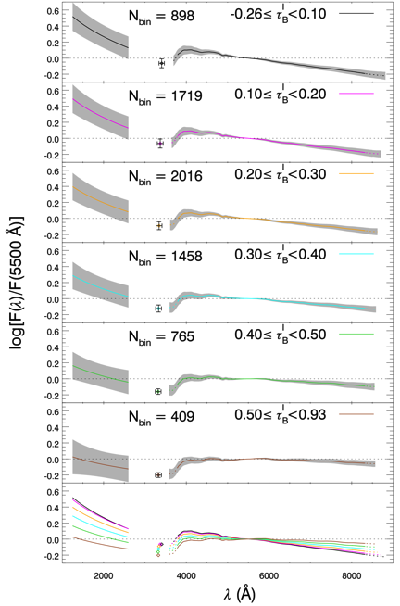
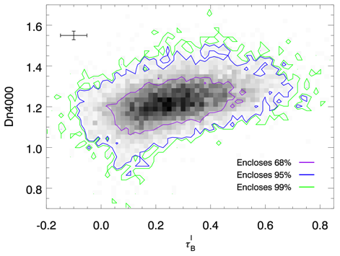
Derive Attenuation
F₁
F₂
F₃
F₄
F₅
F₆
Create templates as function of τ_{B}^{l}
N(1.1<D_{n}4000<1.3) = 7265
Older Avg. Population
Need small age window
1 2 3 4 5 6
Normalized at 5500Å
More Dust
Battisti+2016
Notes:
Red lines denote region of Dn4000 being considered here for deriving attenuation curve. This is important to ensure similar average ages for the template spectra (on right). The trend off older galaxies having more attenuation causes an artificially larger amount of attenuation

Slide 9
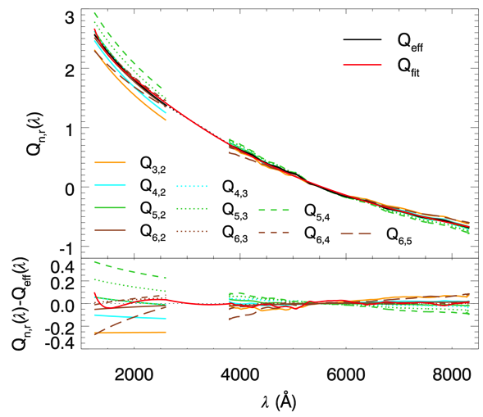
Selective Attenuation Curve
Normalized
at 5500Å
Behavior of foreground geometry
Battisti+2016
Notes:
Using the average of the selective attenuation of the templates, we get an effective curve.

Slide 10
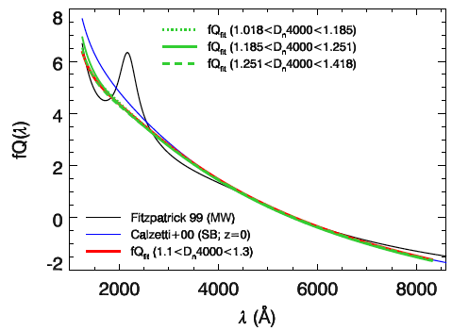
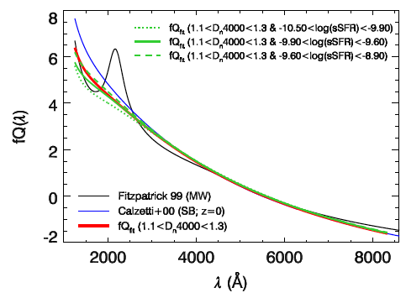
Attenuation Curve Variation
Separate sample by physical prop. (D_{n}4000, sSFR, M*, [O/H])
Curves remain similar!
Battisti+2016
Notes:
f varies by ±0.5

Slide 11
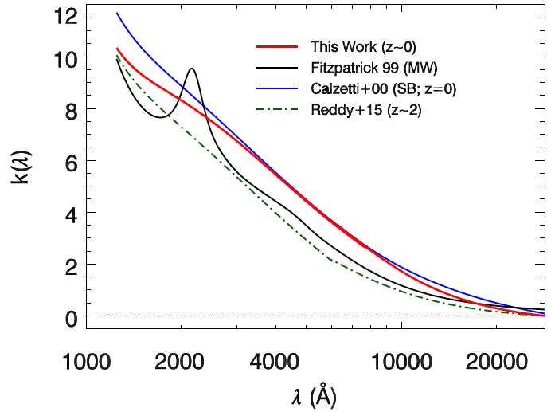
Total Attenuation Curve
~10% difference from SB in FUV
Preliminary
R_{V} = 4.0 ± 0.4
(determined from NIR)
Battisti+(in prep.)
Notes:
Similar to SB curve, no significant 2175Å feature, but shallower FUV (NIR). Similar differential reddening ( f = 2.40). R_{V} = 4.0 +/- 0.4
Variation is relatively small over the range of properties we examine.

Slide 12
Summary
Local SFGs well described by a single attenuation curve
Total attenuation curve, k(λ), similar to SB galaxies
Shallower UV (~10% in FUV)
Examined variation when separating by galaxy property
Only minor differences in shape
In Progress…
Examine variation in R_{V} with galaxy property
Constrain scatter in β – τ_{B}^{l} relation (multi-component dust?)
Examine the influence of inclination on attenuation

