Slide 1
The DISPATCH Code Framework for Exascale Multi-Physics Simulations
The DISPATCH Code Framework for Exascale Multi-Physics Simulations
NORDITA, August 28, 2017
Åke Nordlund, Jon Ramsey, Michael Küffmeier, Andrius Popovas
Klaus Galsgaard, Frederik Clemmensen, Nichlas Sølvtofte, Steffen Filtenborg
Niels Bohr Institute / STARPLAN, University of Copenhagen

Slide 2
The DISPATCH Code Framework for Exascale Multi-Physics Simulations
NORDITA, August 28, 2017
Åke Nordlund, Jon Ramsey, Michael Küffmeier, Andrius Popovas
Klaus Galsgaard, Frederik Clemmensen, Nichlas Sølvtofte, Steffen Filtenborg
Niels Bohr Institute / STARPLAN, University of Copenhagen

Slide 3
The DISPATCH Code Framework for Exascale Multi-Physics Simulations
NORDITA, August 28, 2017
Åke Nordlund, Jon Ramsey, Michael Küffmeier, Andrius Popovas
Klaus Galsgaard, Frederik Clemmensen, Nichlas Sølvtofte, Steffen Filtenborg
Niels Bohr Institute / STARPLAN, University of Copenhagen

Slide 4
The DISPATCH Code Framework for Exascale Multi-Physics Simulations
NORDITA, August 28, 2017
Åke Nordlund, Jon Ramsey, Michael Küffmeier, Andrius Popovas
Klaus Galsgaard, Frederik Clemmensen, Nichlas Sølvtofte, Steffen Filtenborg
Niels Bohr Institute / STARPLAN, University of Copenhagen

Slide 5
Introduction: The Exa-Scale Challenge … and Inspiration
The Challenge: To be able to utilize computing systems capable of ~10¹⁸ fl/s
Recognize this: Exascales means parallelizing over ~100 million cores (!)
… because most MHD and PIC codes (necessarily) run at only a few % of peak
… and those that do not typically just spend more work per unit code time
Also: only a few teams will get access to the initial exascale systems
… be prepared to try to be one of them – and be prepared also to fail !
The Inspiration: Can some of the methods needed help us here and now?
Preparing for exascales is very much about re-thinking the current approach
… and that may trigger developments that have immediate benefits !

Slide 6
Introduction: What’s this about “a few % of peak” ?
Empirical Evidence: Essentially no code today does > 1 million cell-updates/s/core
But an MHD advance takes at most a few 10³ flops per cell-update
Peak speed of e.g. a vintage Intel Ivy Bridge is 45 Gfl/s/core (16 SP/cycle)
Peak speeds of later generations 2-4 time more flops/cycle possible
A million cell-updates/s/core means of the order only 1-2 Gfl/s
Can we improve on this ?
… at most by factors of a few !
… and mostly by doing “more work per update” !

Slide 7
Introduction: So, what about PIC codes ?
Marginally “better”: PIC codes can potentially use more flops per second
By utilizing cache more efficiently – since memory access is the bottleneck
BUT: Large-scale (“phenomenon global”) PIC simulations cost ~1000 times MHD
We are lulled by the advance of MHD modelling to think PIC will follow
… it will, but 10 Moore-doublings (15 years) later !
… unless we change something, drastically !!

Slide 8
Introduction: The Exa-Scale Challenge … and Inspiration
The Inspiration: Can some of the methods needed help us here and now?
Preparing for exascales is very much about re-thinking the current approach
… and that may trigger developments that have immediate benefits !

Slide 9
The Role of the DISPATCH Framework
Background: Grew out of effort to reach exa-scales with less effort
Using an entirely new approach to parallelization
Applies to both MHD and PIC, and any other method (e.g. VLASOV)
Result: Out of this effort came a tool to boost performance greatly here-and-now
As a result of the new approach
Which – essentially trivially – also allows multiphysics:
E.g.: combine MHD/PIC/VLASOV in the same experiment

Slide 10
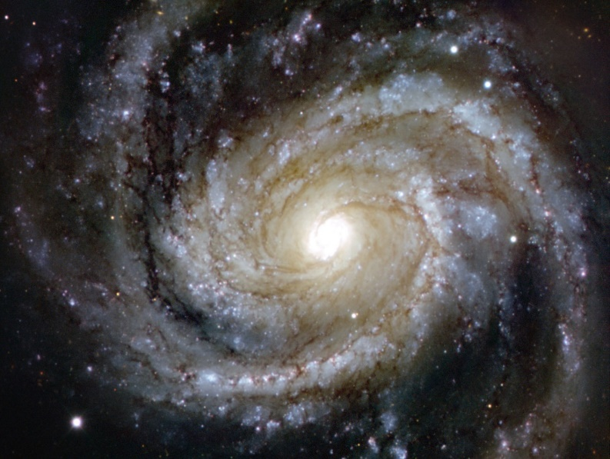
DISPATCH: Exa-scale features with immediate benefits
Basic concepts and ideas
Task based scheduling
Local time steps
Moving AMR patches
Object hierarchy
Patches, solvers, experiments
Scenes, components
Code components
OpenMP tasks, local neighborhood MPI, load balancing
Current application examples
Solar physics, star formation, protoplanetary disks & planet formation

Slide 11
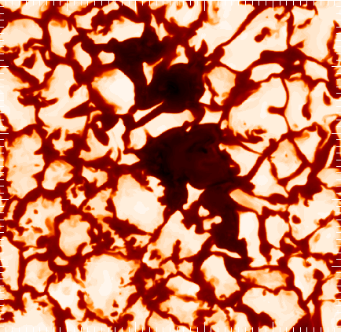
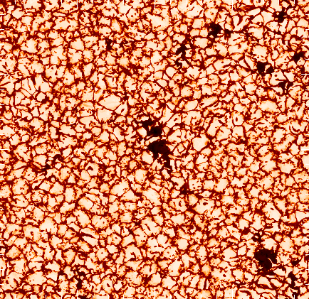
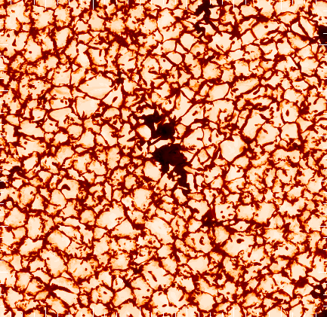
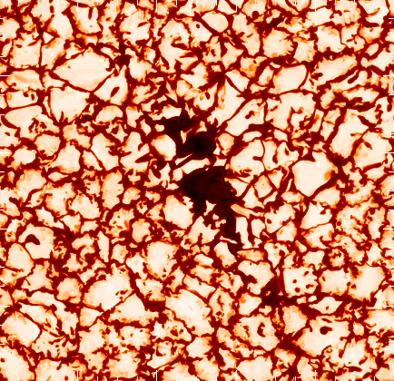
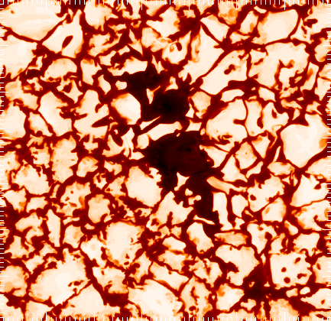
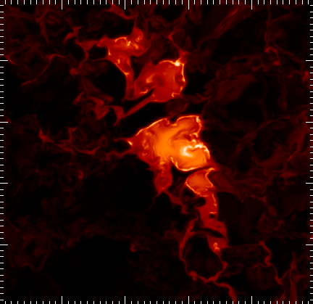
Example of gains from using local time steps
This is a unigrid example, with 2016 x 500 x 2016 grid points, for modeling solar magneto-convection
The fast mode speed is extremely intermittent in solar active regions, and hence the update cost is concentrated to a few spots horizontally, and there the update cost is large only at the very surface.
Hence a very large cost reduction can be achieved with local time steps ; in the cases shown here, the local time step advantages is in the range 30-100, depending on the size of sunspots.
[ This has previously been handled to some extent by artificially & inconsistently limiting the fast mode speed]
This small region near the top has
exceedingly high update cost …
Cost factor: Top view
Cost factor: Side view

Slide 12
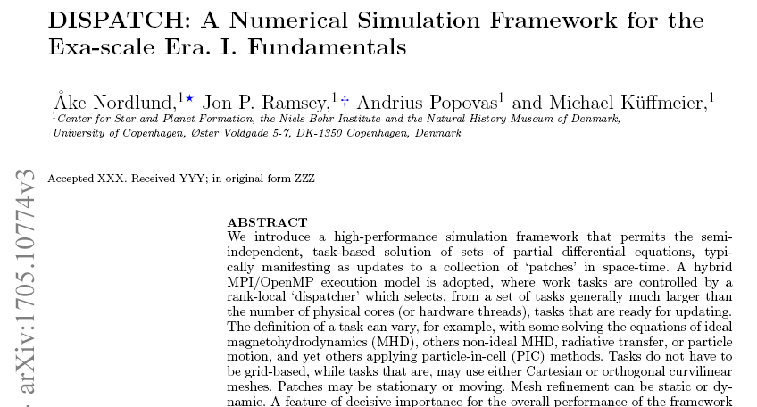

Slide 13
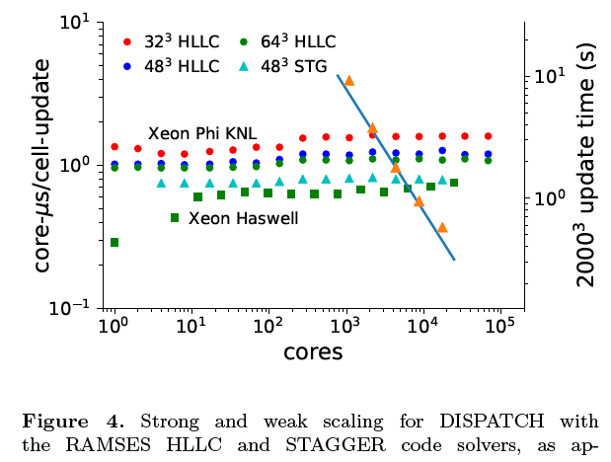
DISPATCH Scaling

Slide 14
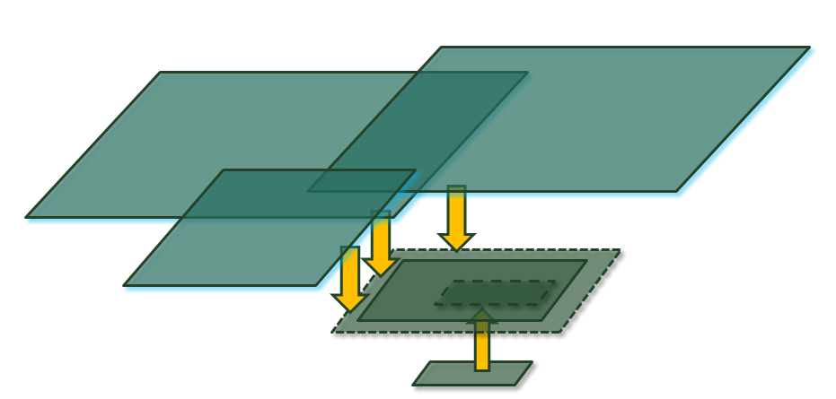
The DISPATCH name
The keys to the scaling properties are encoded in the name:
Using a DISPATCHer to spawn semi-independent OpenMP processes, which are not forced to be locked together in time, nor are they forced to exist in grid-locked arrangement in space!
The result is a number of DISconnected PATCHes, each of which has its own “task” definition, which is responsible for its evolution. Patches interact via
Downloading of guard zone data from neighboring patches
Uploading of interior data, from patches that have higher quality data
Retaining several time slices for interpolation in time

Slide 15
DISPATCH breaks with traditions, to achieve ~unlimited scaling:
Use asynchronous evolution of sub-domains (patches)
Allow moving patches – small Cartesian meshes with bulk motion
Use local time steps; determined independently for each patch
Use task-based scheduling, via OpenMP inside nodes
Use neighborhood-limited MPI between nodes
Use any preferred solver inside patches, balancing speed against quality and guard zone requirements
Can include Multiple-Domain-Multiple-Physics
e.g. PIC codes for kinetic simulations inside MHD
dust+gas dynamics
…

Slide 16
Object Orientation
Simplifies coding a lot, via
inheritance
data hiding
extension of objects
Example code snippets follow

Slide 17
dispatch.f90
USE …
call mpi%init
call io%init
allocate (experiment)
call experiment%init
do while (experiment%task_list%n > 0)
call experiment%task_list%update
end do
call mpi%end

Slide 18
Main event loop – the heart of the code
SUBROUTINE update (self) ! task list update method
class(task_list_t):: self ! task list
!...............................................................
class(link_t), pointer:: head ! nodes in the list
class(task_t), pointer:: task ! task pointer
!...............................................................
head => self%queue ! queue start
self%queue => self%queue%next_time ! update the link
self%nq = self%nq-1 ! decrement queue count
call self%check_mpi ! check incoming MPI
task => head%task ! oldest task
call task%update ! update the task
call self%check_nbors (head) ! any nbor ready?
if (task%time > task%end_time) then ! finished:
call self%remove_task (task) ! remove from self
else ! not finished:
call task%clear(bits%ready) ! needs new check
end if
END SUBROUTINE update
Nbors can by definition only
become executable when one of the their nbors updates

Slide 19
Composite experiment: envelope, star, disk, planet …
!-----------------------------------------------------------------------------
! “Envelope", could be MHD component, or dust + pebbles composite
!-----------------------------------------------------------------------------
allocate (envelope)
call envelope%init ('the envelope')
self%task_list => envelope%task_list
!-----------------------------------------------------------------------------
! Create a star object, initialize it, and add its task to the task list
!-----------------------------------------------------------------------------
allocate (star)
call star%init ('the central star')
call self%task_list%append (star) ! a star is a single task
!-----------------------------------------------------------------------------
! Create a planets component, initialize it, and append its task list
!-----------------------------------------------------------------------------
allocate (planets)
call planets%init ('a few embryos')
call self%task_list%append_list (planets%task_list)

Slide 20
Object task hierarchy, task_lists, components, scenes
“cartesian”: builds task list
type, public:: cartesian_t
type(task_list_t):: task_list
real(8):: size(3)
integer:: dims(3)
contains
procedure:: init
...
end type
SUBROUTINE init (self)
class(cartesian_t):: self
...
do iz=1,dims(3)
do iy=1,dims(2)
do ix=1,dims(1)
allocate (task)
call task%init
...
call self%task_list%append(task)
end do
end do
end do
END SUBROUTINE
Basic “list”: triply linked list
type, public:: link_t
type(link_t), pointer:: next, prev
type(link_t), pointer:: next_time
type(link_t), pointer:: nbor
class(task_t), pointer:: task
...
end type
type, public:: list_t
type(link_t), pointer:: head, tail
type(link_t), pointer:: queue
...
contains
procedure:: append
procedure:: remove
procedure:: add_nbors
procedure:: queue_by_time
...
end type
Task hierarchy: basic “task”
type, public:: task_t
integer:: id, status, …
real(8), pointer:: position(:,:)
real(8), pointer:: t(:), dt(:)
integer, pointer:: iit(:)
...
contains
procedure:: init
procedure:: update
...
end type
“scenes, components”:
USE galaxy
USE gmc
USE accretion_disk
USE star
USE planet
SUBROUTINE init (self)
class(scene_t):: self
...
call galaxy%init
self%task_list => galaxy%task_list
do i=1,galaxy%n_gmc
call gmc%init
self%task_list%append_list%gmc%task_list
end do
...
END SUBROUTINE
“task_list”: heart of dispatcher
type, public, extends(list_t):: task_list
...
contains
procedure:: execute
procedure:: update
...
end type
SUBROUTINE execute (self)
class(task_list_t):: self
...
!$omp parallel
do while (self%n > 0)
call self%update
end do
!$omp end parallel
END SUBROUTINE
“patch” adds mesh, memory, …
type, public, extends(task_t):: patch_t
class(mesh_t), pointer:: mesh
real, dimension(:,:,:,:,:,:), pointer:: mem
...
contains
procedure:: init
procedure:: update
...
end type
“solver” adds specific method + params
type, public, extends(patch_t):: mhd_t
real:: courant_number
type(timestep_t):: timestep
...
contains
procedure:: init
procedure:: update
...
end type
“experiment” adds specific IC, BC,
type, public, extends(patch_t):: experiment_t
...
contains
procedure:: init
procedure:: update
end type
SUBROUTINE init (self)
USE initial_mod
call self%patch_t%init
call initial_t%init
...
END SUBROUTINE init

Slide 21
Task based OpenMP on each node

Slide 22
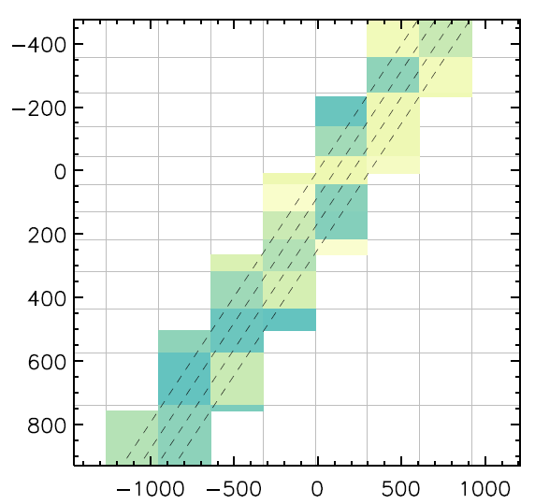
MPI Communication: Nearest neighbors (NBORS) only
NBOR is a generalization of
physical neighbor to logical
neighbor: Any task or rank
that depends on and / or
influences another task or
rank

Slide 23
Interior, Boundary, and Virtual patches
V
V
V
V
V
V
V
B
B
B
V
V
V
B
B
B
V
V
V
V
V
V
V
B
B
I
I
B
V
B
I
I
B
V
V
B
A boundary patch on one rank is a virtual patch on another rank, and conversely
For simplicity, virtual patches are COMPLETE copies of boundary patches, even if only guard cells are needed – simplifies load balancing

Slide 24
Pro-active message passing – sender side MPI
When a thread has updated a boundary patch,
[ boundary patch: has >0 neighbor patches owned by different MPI ranks ]
OMP threads collaborate to:
pack the task data into allocated buffers, and …
send the buffers to the owners of neighboring virtual patches
add the requests to a send_queue
check the send_queue for completed sends
deallocate the corresponding buffers

Slide 25
Sender side MPI
Send buffers to virtual patch owners:
call copy_to_buffer (patch, mesg%buffer)
...
nbor => patch%nbor_list
do while (associated(nbor))
rank = nbor%patch%rank
if (rank /= my_rank) then
call MPI_ISEND (mesg%buffer, nwords, MPI_REAL, rank, …)
call add_mesg (send_list, mesg)
end if
nbor => nbor%next
end do

Slide 26
Messages are processed across OMP threads
buffer
send_list
deallocate buffer
patch updated
remove from list
message buffer allocated, copied to, sent, deallocated when done
pack data
send message
send complete?
list handling
thread 1
thread 1
thread 7
thread 7
OMP collaboration: message sent by one thread, cleared by another

Slide 27
Receiver side MPI
Gather incoming messages into a recv_list:
call MPI_IMPROBE (MPI_ANY_SOURCE, MPI_ANY_TAG, flag, msg, …)
do while (flag)
call MPI_GET_COUNT (stat, MPI_REAL, nbuf, ierr)
allocate (mesg)
...
call MPI_IMRECV (mesg%buffer, nbuf, MPI_REAL, msg, req, …)
...
call add_mesg (recv_list, mesg)
call MPI_IMPROBE (MPI_ANY_SOURCE, MPI_ANY_TAG, flag, msg, …)
end do

Slide 28
Pro-active message passing – RECEIVER SIDE
mesg_list
unpack_list
virtual patch
message
update
ready queue
data for a virtual patch coming in, being processed, and used:
incoming MPI
completed?
unpack!
check wait_queue
select
thread 1
thread 5
thread 5
thread 2
thread 7
OMP collaboration ensures that data becomes available ASAP

Slide 29
Load and Communication Balance
Suppose one has the freedom to move small units of load around among ranks at will
This is the case upfront in DISPATCH, per the previous slide
In RAMSES (or any code based on a H-P curve), one is restricted to balance load along the one-dimensional distribution along the curve
This does not necessarily minimize the total communication load, since communication is required to many other ranks also
In fact, it is quaranteed to, in all practical cases, this does not minimize the communication load, since one has only two “neighbors” to negotiate with
Even if load can be shipped around at will, there is nevertheless an impact from communication, so one needs to optimize communication balance, and at the same time maintain load balance

Slide 30
Patch naming conventions
Interior patches have all neighbors on the local MPI rank …
Boundary patches have at least one neighbor virtual patch
Virtual patches (VPs) are copies of patches from other MPI ranks
Interior patches can be updated if their neighbors are up-to-date
Boundary patches can be updated when virtual patches are up-to-date
Virtual patches are updated (copied over) from their own MPI rank
Each patch has a linked list of neighbor & overlapping patches
V
V
V
V
V
V
V
B
B
B
V
V
V
B
B
B
V
V
V
V
V
V
V
B
B
I
I
B
V
B
I
I
B
V
V
B

Slide 31
Load balancing = changing virtual patches to boundary patches
E
V
V
V
V
V
E
B
B
B
V
V
B
B
B
V
E
V
V
V
V
V
B
B
I
I
B
V
B
I
I
B
V
V
B
E
V
V
E
E
V
V

Slide 32
Load balancing = changing virtual patches to boundary patches
E
V
V
V
V
V
V
B
B
B
V
B
V
B
B
B
V
E
V
V
V
V
V
B
B
I
I
B
V
B
I
I
B
V
V
B
V
V
V
V
E
V

Slide 33
Load balancing = changing virtual patches to boundary patches
E
V
V
V
V
V
V
B
B
B
V
B
V
B
B
B
V
E
V
V
V
V
V
B
B
I
I
B
V
B
I
I
B
V
V
B
V
V
V
V
V
B

Slide 34
Load balancing = changing virtual patches to boundary patches
E
V
V
V
V
V
V
B
B
B
V
B
B
B
B
V
V
V
V
V
V
V
B
B
I
I
B
V
B
I
I
B
V
V
B
V
V
V
V
V
B
I
The number of patches has increased with 3
on the local rank

Slide 35
Load balance should be dynamic and constantly active
May be based on several criteria
Time skew between MPI ranks; should be kept in approx sync
Size of “ready queues” on different ranks
Smoothness of interface between ranks
I
I
I
I
I
I
I
I
I
I
I
I
B
I
I
I
I
I
I
I
I
I
I
I
I
I
I
I
I
I
I
I
I
B
I
I
I
I
I
I
I
I
I
I
I
I
I
I
I
I
I
I
I
I
I
I
I
I
I
I
I
I
I
I
I
I
I
I
I
I
I
II
I
I
I
I
I
I
I
I
I
I
I
I
I
B
B
B
B
B
B
B
B
B
B
B
B
B
B
B
B
B
B
B
B
B
B
I
I
B
I
I
I
I
I
I
I
I
I
I
I
I
B
I
I
I
I
I
I
I
I
I
I
I
I
I
I
I
I
I
I
I
I
B
I
I
I
I
I
I
I
I
I
I
I
I
I
I
I
I
I
I
I
I
I
I
I
I
I
I
I
I
I
I
I
I
I
I
I
I
I
II
I
I
I
I
I
I
I
I
I
I
I
I
I
B
B
B
B
B
B
B
B
B
B
B
B
B
B
B
B
B
B
B
B
B
B
I
I
I
Notes:
20 min mark

Slide 36
Let’s use color for ranks …
So, what are these numbers?
0
0
0
0
0
0
0
0
0
0
0
1
4
0
0
0
0
1
3
2
1
0
0
3
2
1
0
0
0
0
0
0
0
0
0
0
0
0
0
0
0
0
0
3
0
0
3
2
1
3
4
3
1
0
1
2
0
0
1
0
1
3
4
4
3
1
2
4
2
3
4
1
3
0
2
3
4
1
0
1
4
2
3
4

Slide 37
Number of virtual neighbors = direct measure of communication needs
0
0
0
0
0
0
0
0
0
0
0
1
4
0
0
0
0
1
3
2
1
0
0
3
2
1
0
0
0
0
0
0
0
0
0
0
0
0
0
0
0
0
0
3
0
0
3
2
1
3
4
3
1
0
1
2
0
0
1
0
1
3
4
4
3
1
2
4
2
3
4
1
3
0
2
3
4
1
0
1
4
2
3
4

Slide 38
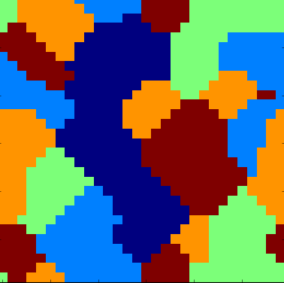
Prototyping Load Balancing
To try out algorithms, we’ve used Python code for prototyping
Using a two-dimensional periodic space makes graphics easy
Each cell in 2-D space represent a “task” and communication point
Only nearest neighbors neeed to communicate
Still completely general – a memory location may appear multiple times
The figure shows an example:
rank work reasonably well kept together
but there are multiple orange patches
and two isolated brown cells

Slide 39
Cellular automaton rules: background
After some experimentation, it became clear that
Reducing communication load often is easier if one – temporarily – accepts a slight load imbalance, since …
this gives many more possible “moves”
This is easily corrected afterwards, since …
many “moves” change load balance but conserve communication balance
for example a “corner move”

Slide 40
Corner move
1
0
0
0
0
0
0
0
1
3
3
2
0
0
3
4
4
3
5
2
3
3
3
1
2
3
2

Slide 41
Corner move
1
0
0
0
0
0
0
0
0
2
3
2
1
0
3
3
4
3
5
2
3
3
3
3
2
1
4
No change in sum total communications, since we’re just moving a corner

Slide 42
Corner cut
1
0
0
1
4
0
0
0
1
3
3
2
0
0
3
4
4
3
5
2
3
3
3
4
1
2
3

Slide 43
Corner cut
0
0
0
1
4
0
0
0
1
3
2
1
0
1
3
4
4
4
3
1
3
4
2
4
1
2
3
A “corner cut” reduces communications with 7-3 = 4 units

Slide 44
Advantageous moves
There are two broad classes of favorable moves
Reducing the number of ‘color patches’ (= patch groups owned by the same rank) is very favorable
Making the ‘color patches’ rounder – removing corners is also favorable
The end result of playing this game, which can be made to rely on only neighbor info (piggy-backed on boundary patch communications) is, as one would expect, a collection of roundish color patches, one color patch per rank

Slide 45
Cellular automaton rules
The rules implemented in the Python code example are:
For each patch, try (=check the consequenc of) changing its color (rank) to each of the neighboring colors, and accept change to the best one (if any) – the metric is the total number of virtual pathes – ignoring temporarily possible worsening of the load balance
the load balance of course cannot get worse by more than one patch per patch
For each patch, try changing its color (rank), and choose the change (if any) that best improves the load balance, under the constraint not to make the communication balance worse
The two steps should alternate; one or the other being performed for every patch udpate

Slide 46
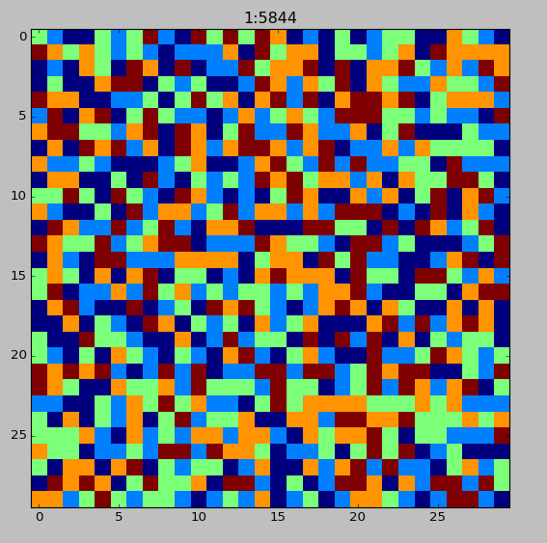
Load & communication balance
The Python animation shows the result of simultaneously running:
1st procedure reducing communications
Interchanging “boundary” and “virtual” roles
temporarily introduces a small imbalance
2nd procedure evens out the load, while avoiding to increase communications
Operates independent of the 1st procedure
Uses only local information
Swap “boundary” and “virtual” roles
Both procedures are entirely local, requiring no global information
900 tasks, randomly
distributed on 5 ranks (colors)

Slide 47
The MHD+PIC Challenge: Case in point – the Sun
Notes:
Frederik - Solar flare - space weather - electric grid on earth - Sun - plasma - what we want to describe

Slide 48
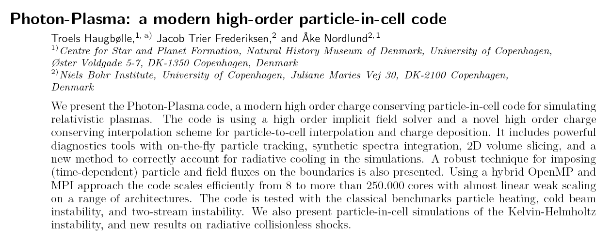

Slide 49
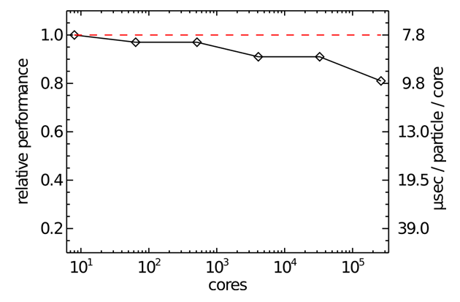
PhotonPlasma / PPcode (public domain version)
Copenhagen PhotonPlasma Particle-in-Cell Code
Includes particle-interactions
Modular: also scattering, pair creation & annihilation, ...
MPI-parallelized
Scales to hundreds of thousands of cores:

Slide 50
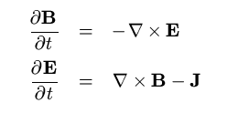
PhotonPlasma/PPcode: Sequence of steps
Collect contributions to J from all (charged) particles
Advance B and E with the Maxwell equations
Interpolate B and E to (charged) particles
Move particles, using B and E
Perform particle interactions (collisions, ionization, ..)

Slide 51
Meshes and Particles
Fields are represented on staggered meshes
High (6th) order curl() operators; no interpolations needed
Conserving div(B)
Largest experiment so far: 2518 x 1436 x 923 = 3.3 10⁹ cells
Particles and species
Particles: about 10-50 particles per cell
Species: electrons, protons, ions, photons, …
Largest experiment so far: 136 billion particles
262,144 cores for 36 hours on the JUGENE system in Jülich

Slide 52
PIC/MHD Cost Comparison
MHD codes, cost per cell
On Intel Nehalem, IBM Power-6, and similar CPUs
Costs of the order 2-10 microseconds per cell-update
Depending on equation-of-state, radiative transfer, …
Particle-in-cell (PIC) codes
On similar CPUs
Costs of the order 1 microsecond per particle-update
Need 30-60 particles per cell
Naïve bottom line: only about x10 speed difference
However: do not forget time step & physical scales constraints !

Slide 53
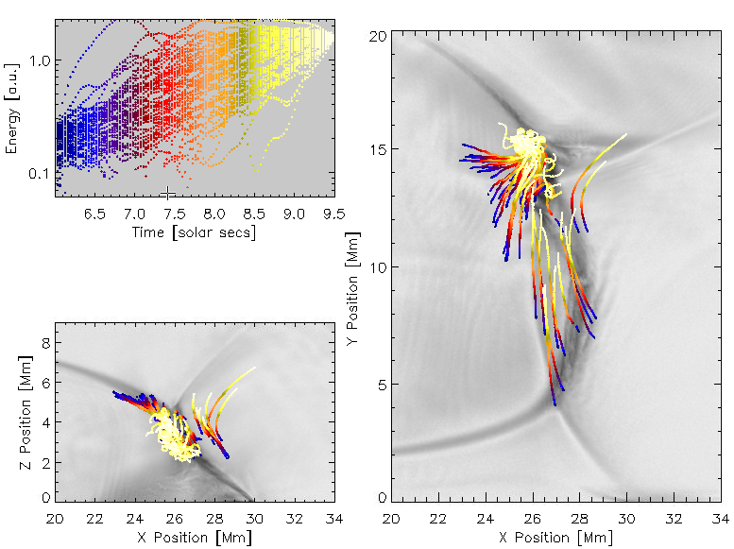
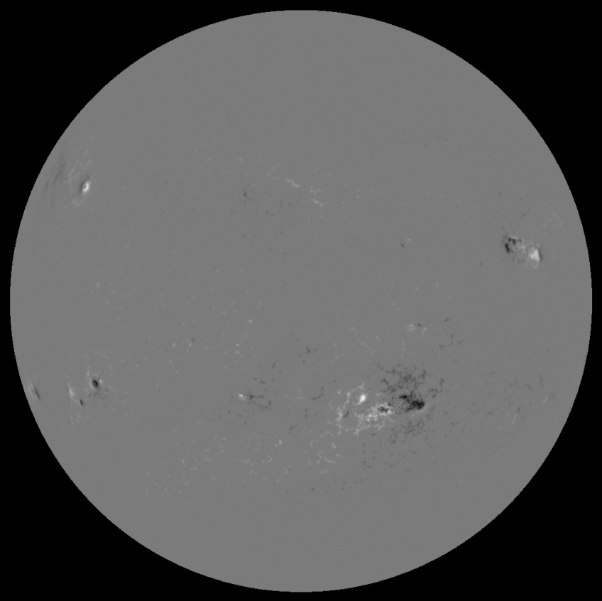
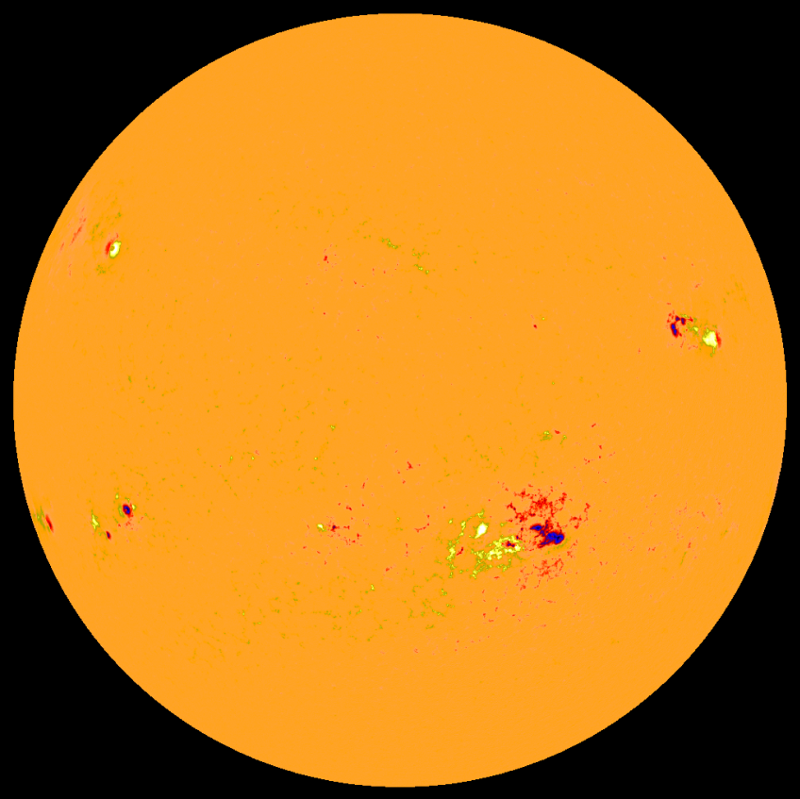
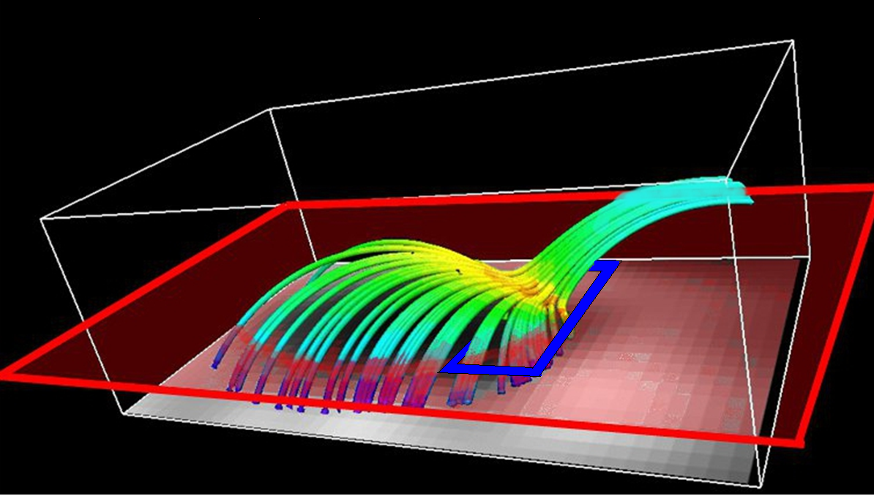
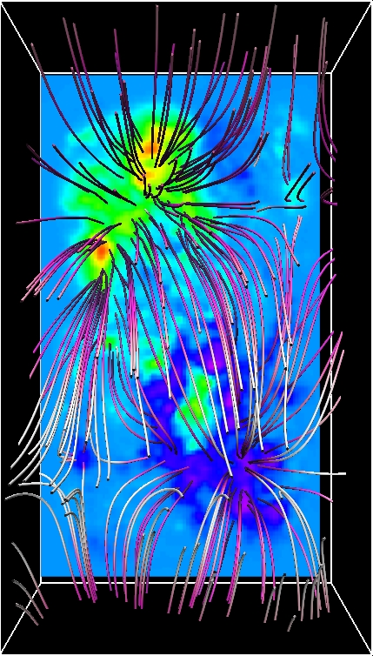
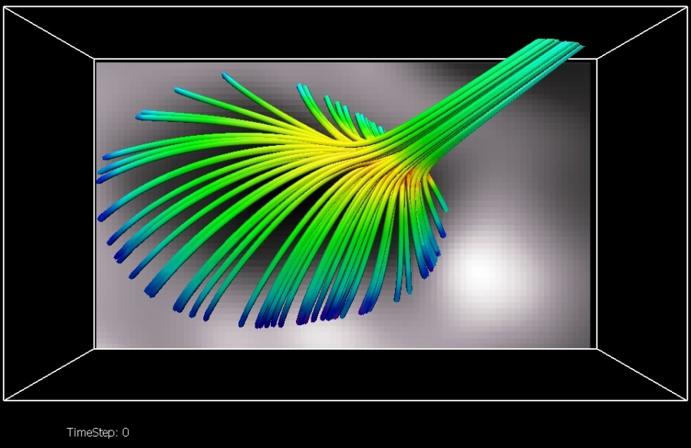
MHD/PIC Solar Modeling
SOHO magnetogram
SOHO cut-out
Potential field
MHD model
PIC-cutout
Sliced current sheet
Accelerated particles

Slide 54
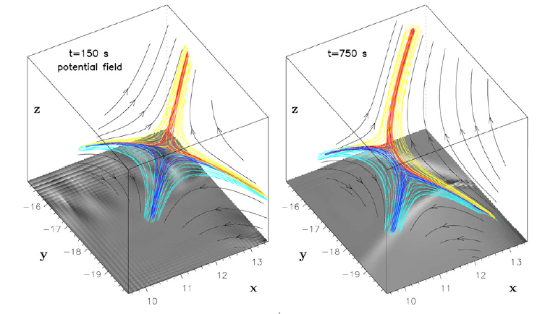
AR 10191, Nov 2, 2002
Parasitic polarity ⇒ magnetic null point
Gave rise to a Class C flare around 2pm
Masson, Aulanier et al (2008, 2009) studied an MHD model of the null point region
MHD + PIC study:
Baumann, Galsgaard, ÅN (2012)
Baumann, Haugbølle, ÅN (2012)
Masson et al, 2009

Slide 55
Initial state, side view

Slide 56
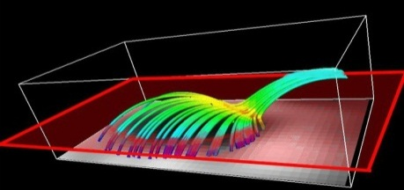
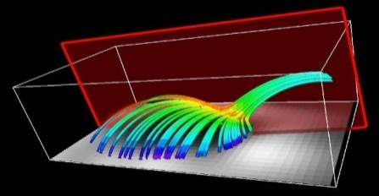
Current Density in Null Planes

Slide 57
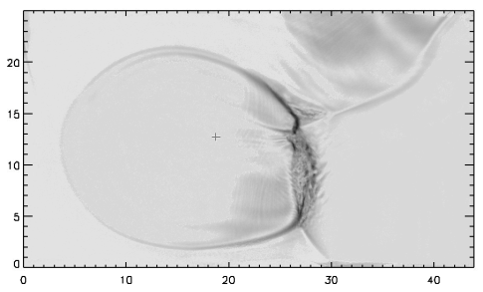
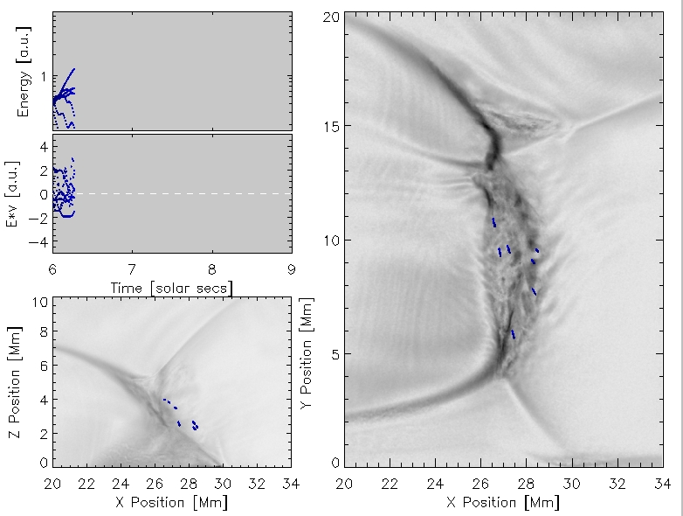
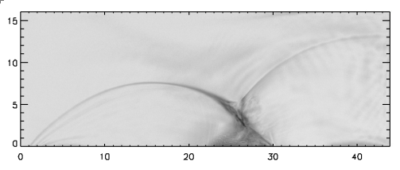
Tracing Particles in the Power Law Tail
X - Y Plane
X - Z Plane

Slide 58
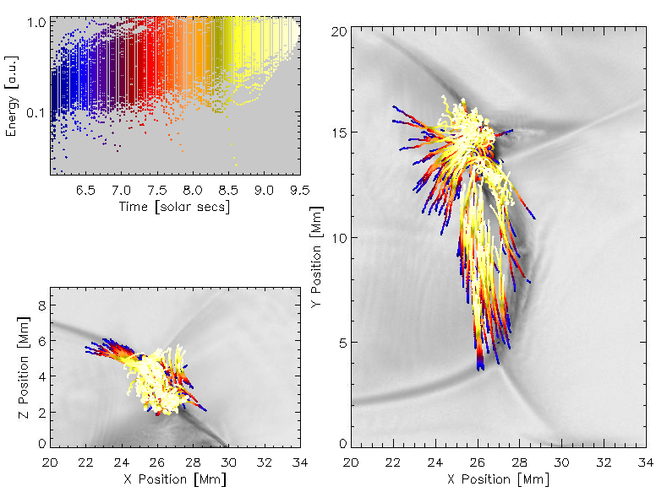
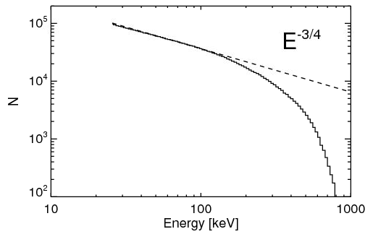
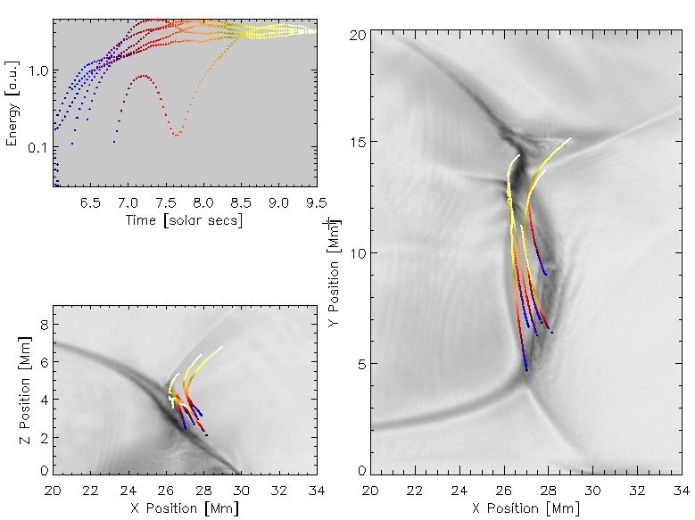
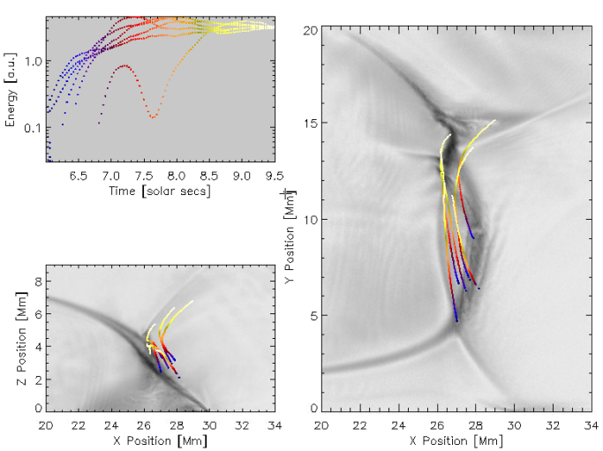
Lower energy power law particles occur in essentially the same region

Slide 59
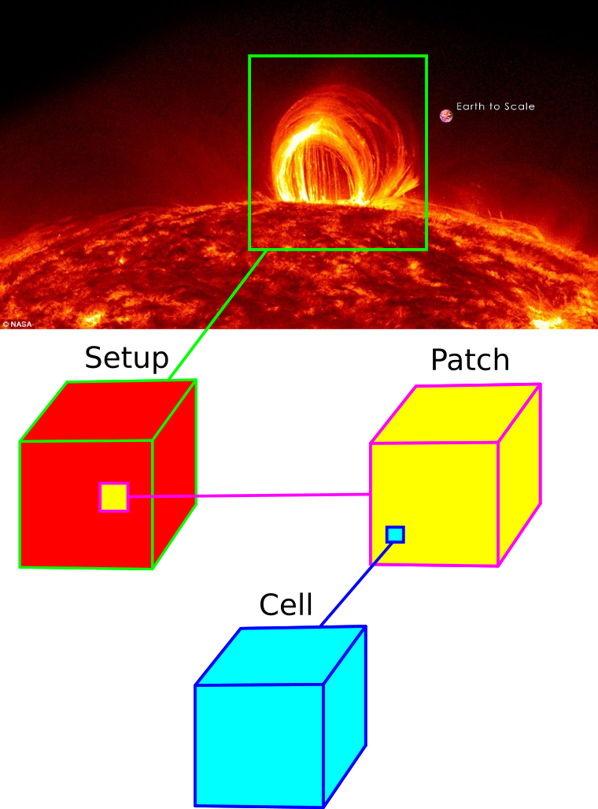
DISPATCH framework with MHD & PIC solvers
NBI/CPH masters project
by Frederik Clemmensen
and Nichlas Sølvtofte
Notes:
Frederik - Dispatch framework - Incorporate PPcode, PIC-solver - Patches - possibilities (dt, solvers) - (skip - boundaries, setup (periodic, stratified) ) - patch boundaries

Slide 60
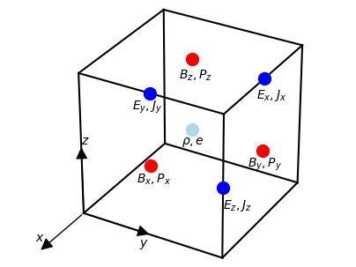
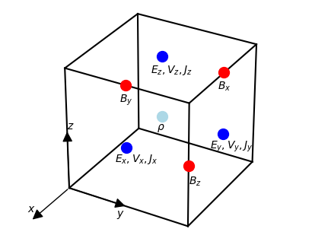
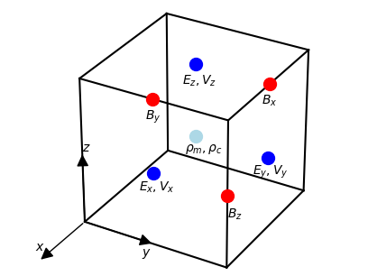
Dispatch framework with MHD & PIC solvers
Stagger
Final unit mesh
PIC
Notes:
Nichlas - Solvers (Variables: stagger (fields)/ pic (particles -> fields)) - data cubes - stagger mesh changed

Slide 61
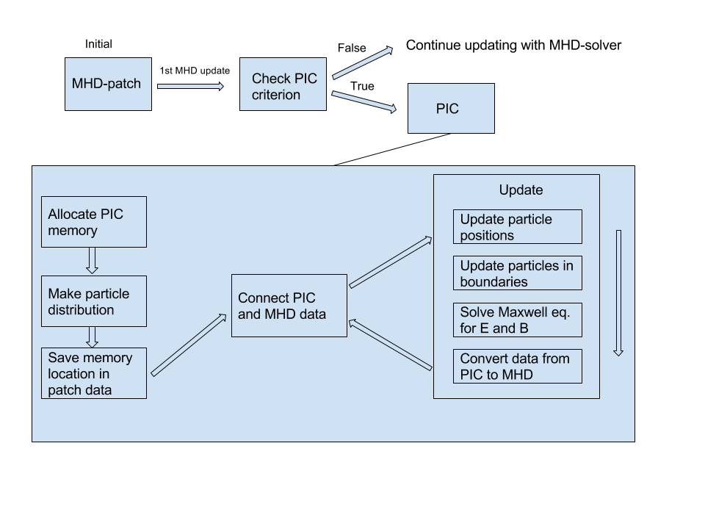
Combining the codes
Notes:
Nichlas - introduction to figure - not code snippets but overall idea

Slide 62
Combining the codes
Notes:
Nichlas - 1st update, check - refine_mod - including pic patch, how, where

Slide 63
Combining the codes
Copy patch
Initialize PIC variables
Notes:
Nichlas - match patch coords - allocate pic vars and sets species / particle per cell

Slide 64
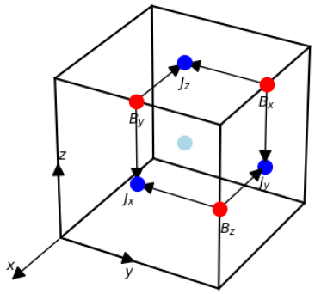
Combining the codes
electric current
bulk
Notes:
Nichlas - Particle distribution from MHD data - convert vars - number density, current, particle velocity (omega - linear momentum - electrons faster), E-field, temperature

Slide 65
Combining the codes
PIC
Stagger
Memory location
Bx(Stagger)
Bx(PIC)
Stagger
PIC
Notes:
Nichlas - Pic -> stagger (same vars) - stagger -> pic (new vars)

Slide 66
Combining the codes
PIC
Stagger
Notes:
Frederik - Pic -> stagger (make sure they are connected) - allocate sources (J, B) - begin the update circle

Slide 67
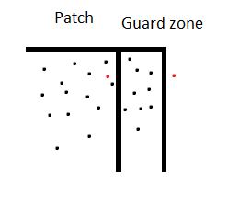
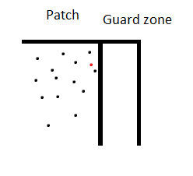
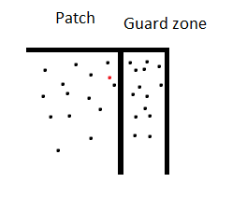
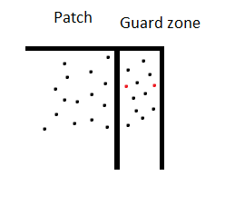
Combining the codes
Notes:
Frederik - Move particles - because dont care about leavers (statistically same), remove / add particles in boundaries- solve Maxwell

Slide 68
Combining the codes
Update
Notes:
Frederik - conversion of vars - deallocate sources - update circle

Slide 69
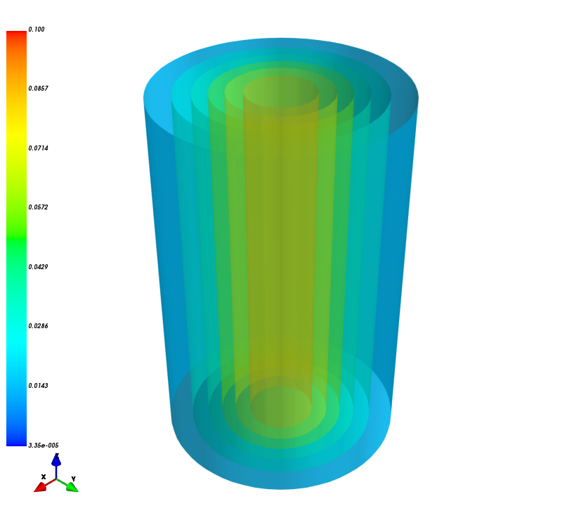
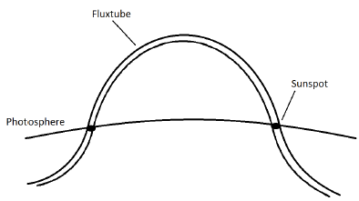
Testing the interface - conversion and boundaries
Notes:
Nichlas - Introducer fluxtube, steady state, ligninger, mhd plot

Slide 70
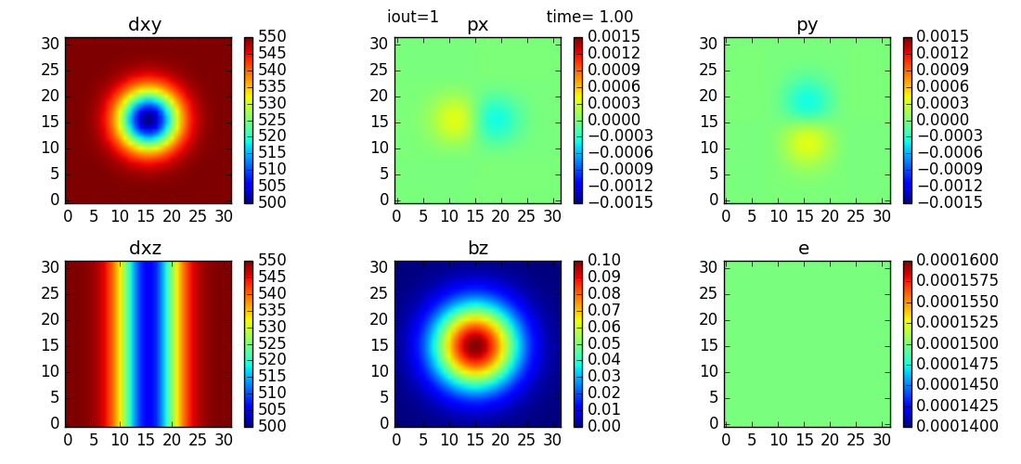
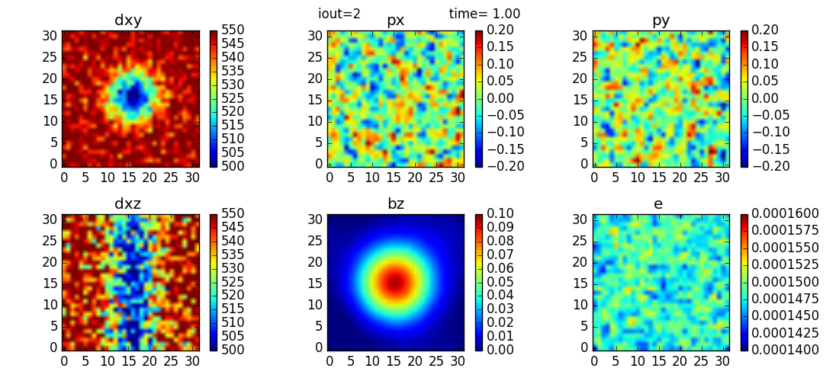
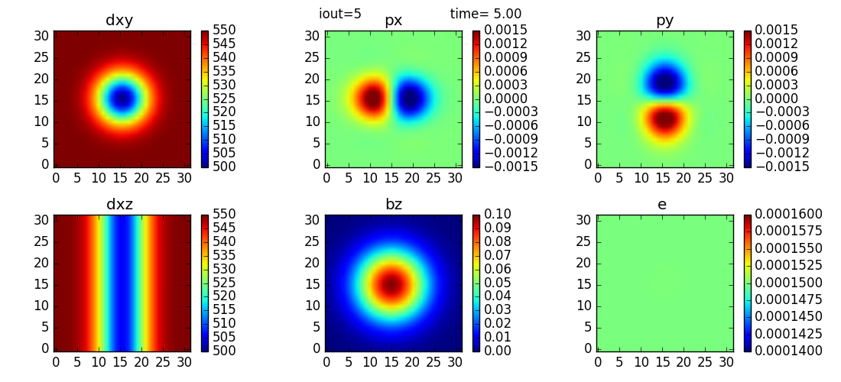
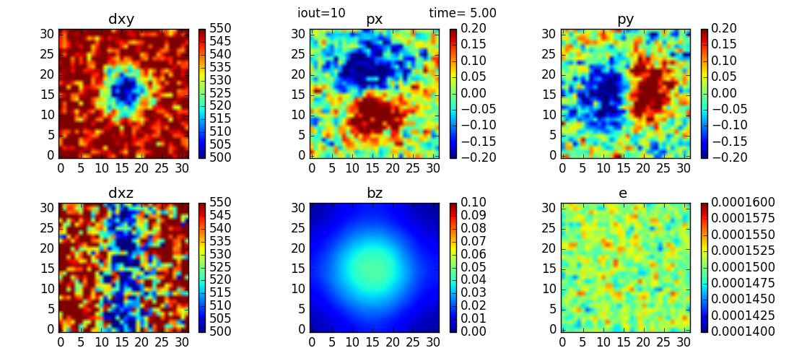
Testing the interface - conversion and boundaries
MHD
PIC
Notes:
Nichlas - MHD / PIC (ikke dem fra rapporten, patch er 6 gange mindre nu) - summed in z to reduse noise - (gyro radius ~ 0.8) - PIC diffuses - Run times

Slide 71
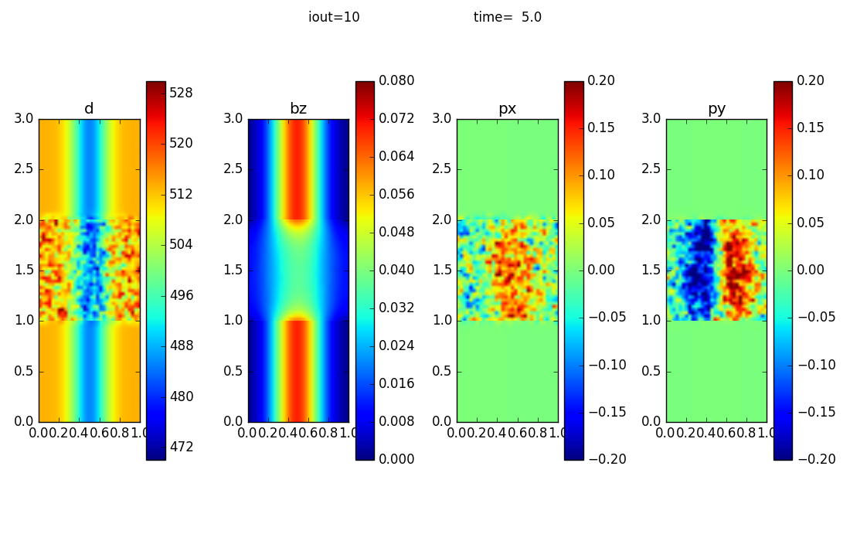
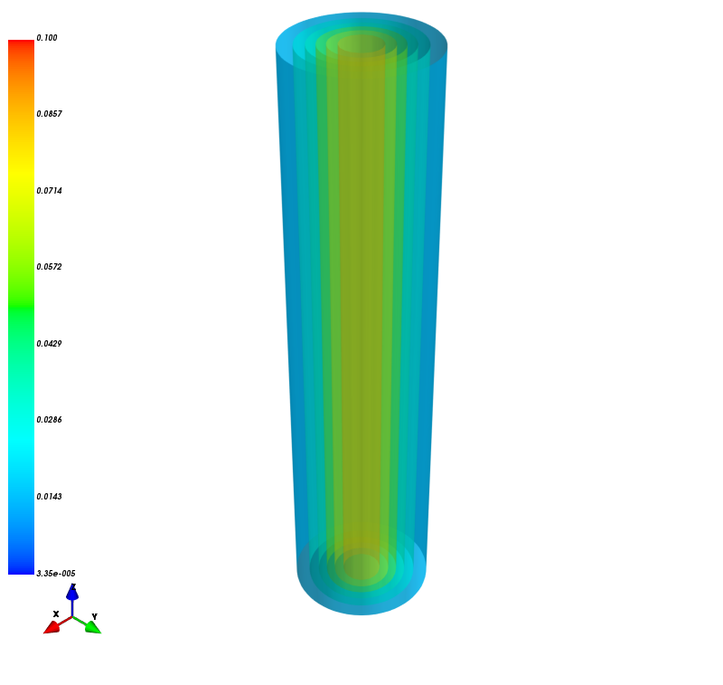
Testing the interface - conversion and boundaries
Cells: 25^3
Part/cell: 270
Cells: 32^3
Part/cell: 100
Cells: 50^3
Part/cell: 16
Notes:
Frederik - Compare 3 setups (cells, p/c, const particles ~3e6 + timestep diff (resolution)) - noise / diffusion

Slide 72
Test application: Solar Bright Points via Parasitic Polarity
Galsgaard et al., 2017
Notes:
Frederik - What is bright point (x-ray, magnetogram, extrapolate normal component) - why PIC: stress null point, strong E, particle acc - VAPOR TIME (plane - b_lines - null-point - iso

Slide 73
Test application: Solar Bright Points via Parasitic Polarity
A single PIC patch is inserted at the location of the magnetic null point, with two-way coupling.
The electric field that exists in the neighborhood of the null point causes rapid particle acceleration
Notes:
Nichlas - Non-Maxwell, no collisions - v-hat increase - particle acceleration

Slide 74
The MHD+PIC Challenge: Case in point – the Sun

Slide 75
Summary, DISPATCH code framework (cf. arXiv)
Object orientation allows:
Multiple-physics + construction of hierarchical scenes = coupled simulations
Modular built-in solvers: HLLC, HLLD, Zeus, Stagger, …
Simple coupling to external solvers: PIC, Bifrost, …
Large gains in computing time arising from
Vectorization and cache efficiency ⇒ 1 core-μs/cell-update on KNL
Local time steps ⇒ factor 5-50 speed-up in realistic cases
Moving mesh ⇒ additional speed-up, especially in accretion disks
Task based OpenMP scheduling ⇒ flat KNL performance per core
Nearest neighbor MPI communication ⇒ in principle unlimited scaling

Slide 76
Thanks for your attention !

