Slide 1


Max Planck Institute
for Chemical Physics of Solids
Experimental searches for electronic hydrodynamics
Andy Mackenzie
Max Planck Institute for Chemical Physics of Solids, Dresden, Germany
School of Physics & Astronomy, University of St Andrews, Scotland

Slide 2
Max Planck Institute
for Chemical Physics of Solids
Collaborators
Maja Bachmann, Arthur Barnard, David Goldhaber-Gordon, Sean Hartnoll, Seunghyun Khim, Phil King, Markus König, Pallavi Kushwaha, Federico Mazzola, Philip Moll, Joel Moore, Nabhanila Nandi, Thomas Scaffidi, Burkhard Schmidt, Aaron Sharpe and Veronika Sunko
Max Planck Institute for Chemical Physics of Solids, Dresden
University of St Andrews
Stanford University
UC Berkeley
Notes:
Here are my collaborators, mainly from Dresden and St Andrews on the experimental side, but I am also happy to acknowledge some nice discussions that I have had with a number of the people at this meeting.

Slide 3
Max Planck Institute
for Chemical Physics of Solids
Collaborators
Maja Bachmann, Arthur Barnard, David Goldhaber-Gordon, Sean Hartnoll, Seunghyun Khim, Phil King, Markus König, Pallavi Kushwaha, Federico Mazzola, Philip Moll, Joel Moore, Nabhanila Nandi, Thomas Scaffidi, Burkhard Schmidt, Aaron Sharpe and Veronika Sunko
Max Planck Institute for Chemical Physics of Solids, Dresden
University of St Andrews
Stanford University
UC Berkeley
Notes:
Here are my collaborators, mainly from Dresden and St Andrews on the experimental side, but I am also happy to acknowledge some nice discussions that I have had with a number of the people at this meeting.

Slide 4
Max Planck Institute
for Chemical Physics of Solids
Contents
1. Introduction: hydrodynamic flow and challenges for electrons
2. Unusual metal physics of delafossites and a viscous contribution to
transport in zero magnetic field in PdCoO₂
3. Electron flow in PdCoO₂ in applied magnetic fields; separating
ballistics from hydrodynamics (or trying to!)
4. Conclusions
Notes:
Here are my collaborators, mainly from Dresden and St Andrews on the experimental side, but I am also happy to acknowledge some nice discussions that I have had with a number of the people at this meeting.

Slide 5
Fluid flow through an empty 2D channel
What happens when we drive a classical incompressible fluid through a ‘2D pipe’ by applying a pressure gradient along x?
y
x
Fluid velocity is greater in the middle of the channel than at the edges
The only transfer of momentum to the outside world is at the edges
We parameterise the strength of the coupling of the fluid to itself along y with the shear viscosity, η. Often this is quoted as a kinematic viscosity η_{K} = η/ρ where ρ is the density.

Slide 6
Why is electron hydrodynamics a challenge? Electrons flowing in a standard solid are far from the hydrodynamic regime
W
Unlike the fluid in the empty tube, electrons in solids have many ways of making collisions in the bulk that relax the momentum to the solid.
‘Squalid state physics’ – 99.9999% of materials we work with are so dirty that electronic hydrodynamic corrections are negligible.
In the standard theories of metals they are ignored altogether.

Slide 7
The 0.00001%
R.N. Gurzhi, JETP 44, 771 (1963); Usp. Fiz. Nauk 94, 689 (1968)
Key point introduced by Gurzhi: In solids, hydrodynamic effects can be parameterised in terms of the relationship between three length scales: momentum relaxing mfp l_{MR}, momentum conserving mfp l_{MC} and sample dimension (here W).
l_{MR}
W
l_{MC}
l_{MR} << l_{MC},W
l_{MC} << W << l_{MR}
Standard ohmic theory applies;
R is determined entirely by solid resistivity ρ and usual geometrical factors
Hydrodynamic theory applies; R is determined entirely by fluid viscosity η, boundary scattering and ‘Navier-Stokes’ geometrical factors
Pioneering measurements on microfabricated narrow 2DEG channels:
L.W. Molenkamp & M.J.M de Jong , Phys. Rev. B 49, 5038 (1994)

Slide 8
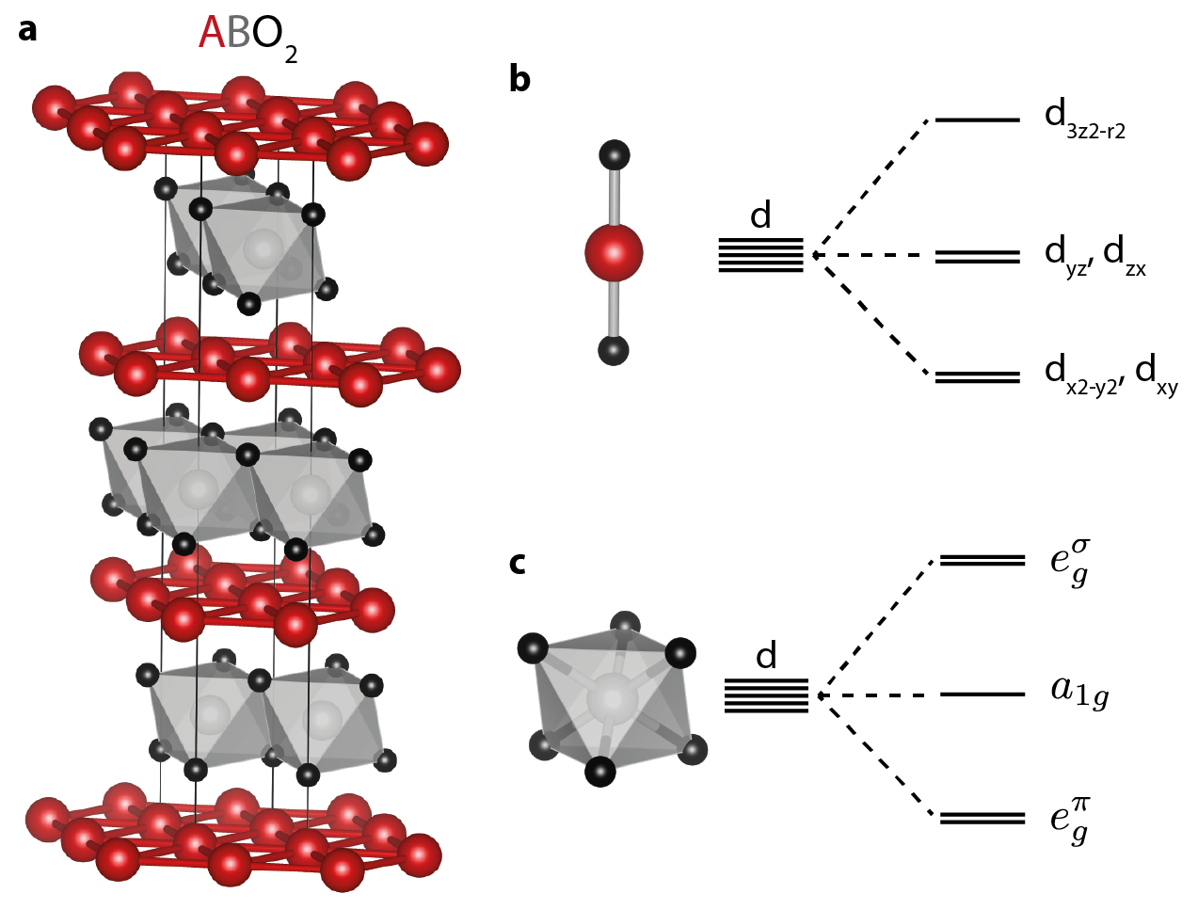
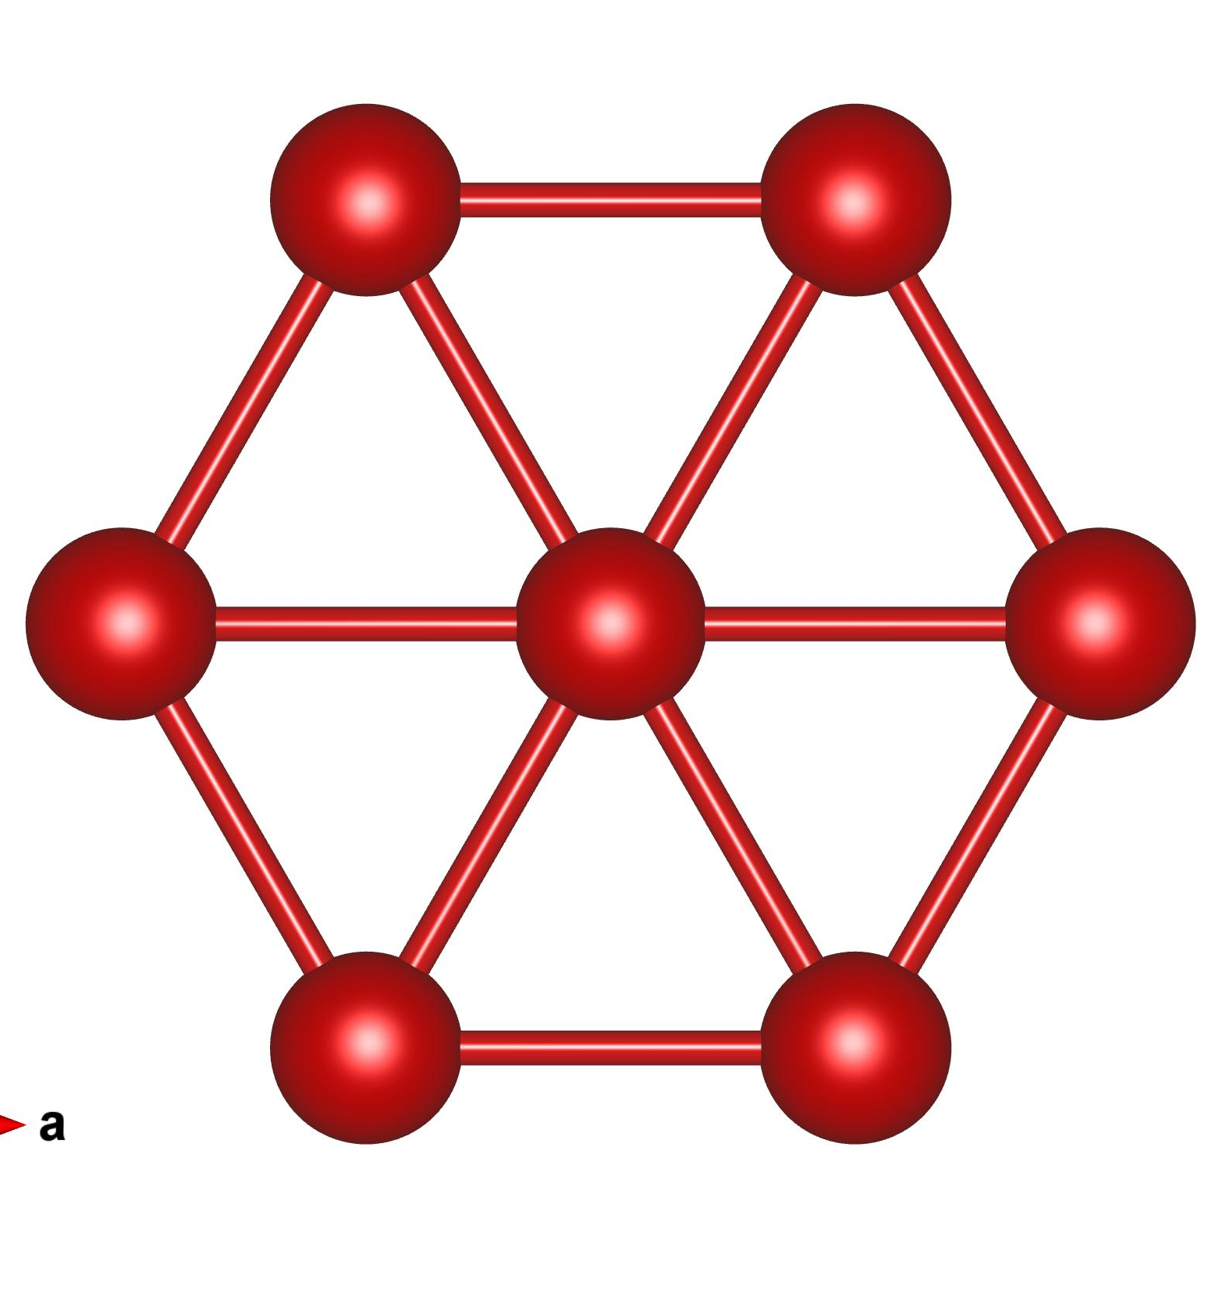
Can hydrodynamic effects be observed in a true metal?
l_{MC} << W << l_{MR}
Recall hydrodynamic condition:
Looks extremely difficult: Must often work far below T_{F} so l_{ee} is very long, and e-e Umklapp is in principle efficient. Expectation is that l_{MC} >> l_{MR}.
However, delafossites seem not to be standard metals.
A site: Pd or Pt
CoO₂ octahedra
Non-magnetic low-spin Co³⁺

Slide 9
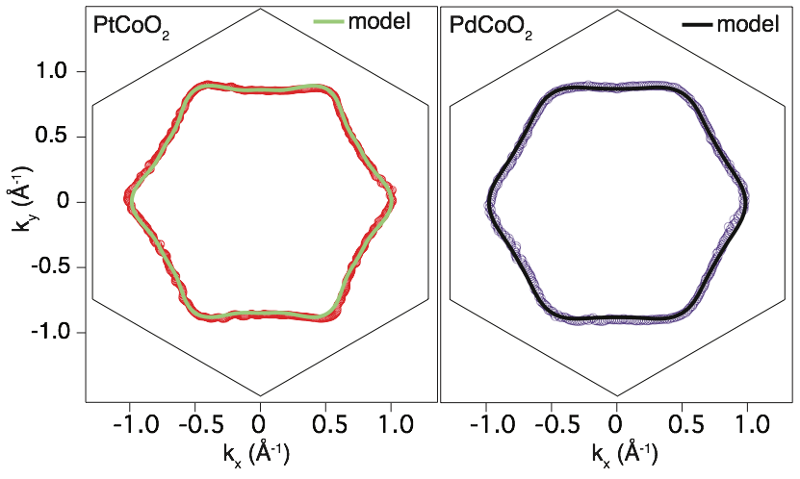
PdCoO₂ and PtCoO₂: simplicity of electronic structure
Single Fermi surface sheets, experimentally established from angle-resolved photoemssion and de Haas-van Alphen effect measurements.
H.J. Noh et al., Phys. Rev. Lett. 102, 256404 (2009)
C.W. Hicks et al., Phys. Rev. Lett. 109, 116401 (2012)
P. Kushwaha, V. Sunko et al., Science Advances 1, 1500692 (2015)

Slide 10
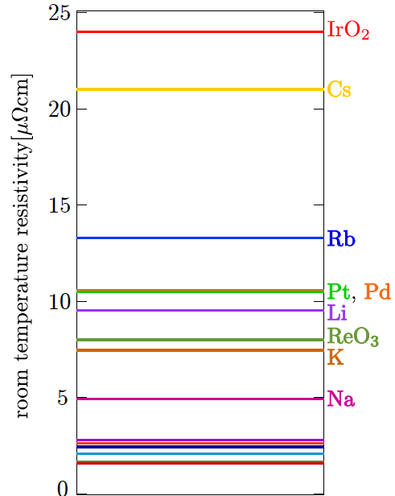
PdCoO₂ and PtCoO₂: record-breaking conductivity

Slide 11
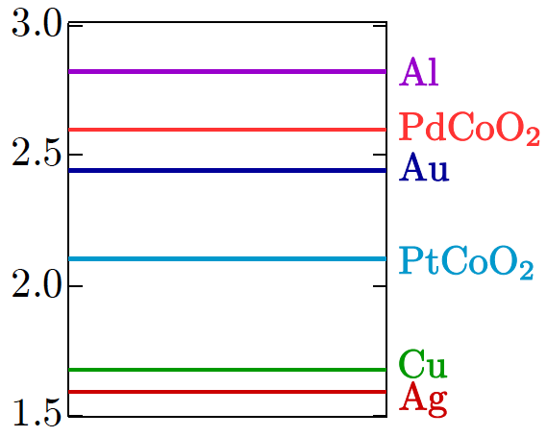
PdCoO₂ and PtCoO₂: record-breaking conductivity

Slide 12
PdCoO₂ and PtCoO₂: record-breaking conductivity
Carrier concentration of delafossites is about a factor of three smaller than that of monovalent elemental metals

Slide 13
PdCoO₂ and PtCoO₂: record-breaking conductivity
Highest room T relaxation times of any known metals.
0

Slide 14
Enormous low temperature conductivity and huge mean free paths
Room temperature resistivity about 2.5 μΩcm
PdCoO₂
Large anisotropy: resistivity perpendicular to planes approximately 10³ higher
Some evidence for phonon drag which could lead to extra momentum-conserving processes
Low temperature resistivity a few nΩcm: in-plane mean free paths of tens of microns!
APM, Rep. Prog. Phys. 80, 032501 (2017)

Slide 15
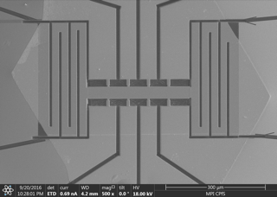
Clean fabrication - focused ion beam sculpting
300 μm
Crystals of PdCoO₂ grow 10-20 μm thick
Focused ion beams can be used to sculpt out arbitrary geometries; beyond a 10-20 nm damage layer this process is clean.

Slide 16
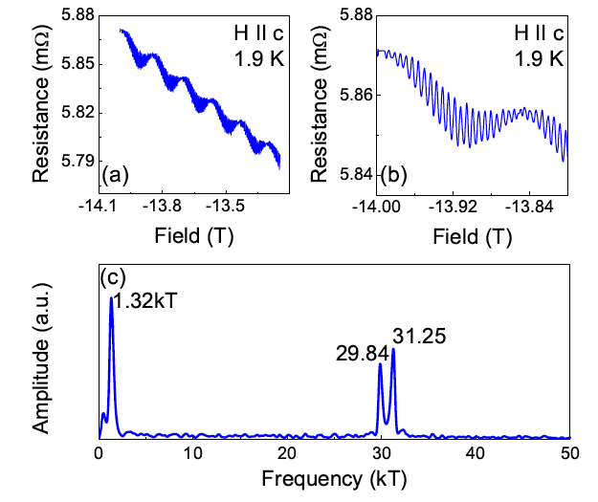
Clean fabrication - focused ion beam sculpting
300 μm
Our group’s first experiment: Successively narrow the channel in factors of 2, measuring the resistance after every step.
Result: Width evolution in zero applied field that matches expectation for significant viscous contribution to flow.
P.J.W. Moll, P. Kushwaha, N. Nandi, B. Schmidt and A.P. Mackenzie, Science 351, 1061 (2016)
Shubnikov-de Haas oscillations from long, narrow meander track of PdCoO₂

Slide 17
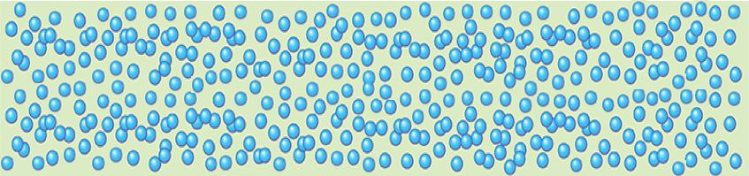
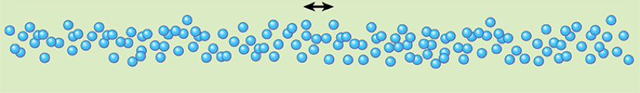
Three limiting regimes to consider
Ohmic:
l_{MR} << l_{MC},W
Hydrodynamic:
l_{MC} << W << l_{MR}
Diffuse-ballistic (like a ‘Knudsen’ regime):
W << l_{MC}, l_{MR}
Philosophy of field-dependent measurements: Add a fourth length scale, the cyclotron radius r_{c} = hk_{F}/eB and use it to tune through the above regimes.
Lesson learned in the process: The overlap between the three regimes is much broader than it looks when one writes down these neat-looking classifications!

Slide 18
A blast from the past – transverse electron focusing

Slide 19
A blast from the past – transverse electron focusing

Slide 20
A blast from the past – transverse electron focusing

Slide 21
A blast from the past – transverse electron focusing

Slide 22
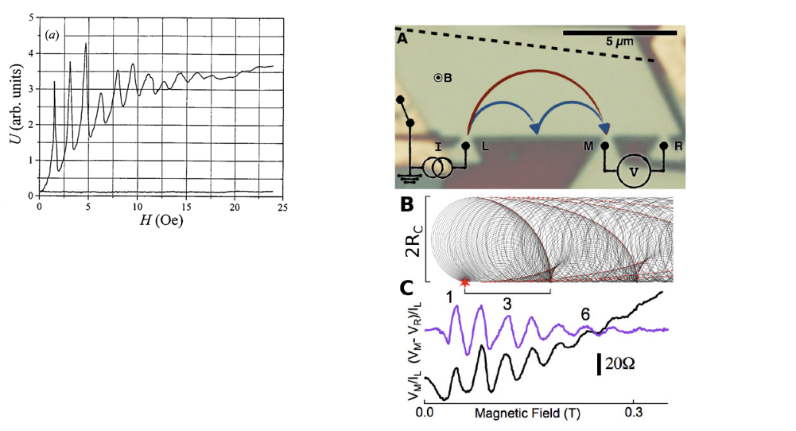
Seen in other famous ultra-high purity materials
Elemental metals and semi-metals (here Bi) in the 1970’s and 1980’s
… and of course graphene
V.S. Tsoi et al., Rev. Mod. Phys. 71 (1991)
e.g. M. Lee et al., Science 353, 6307 (2016)

Slide 23
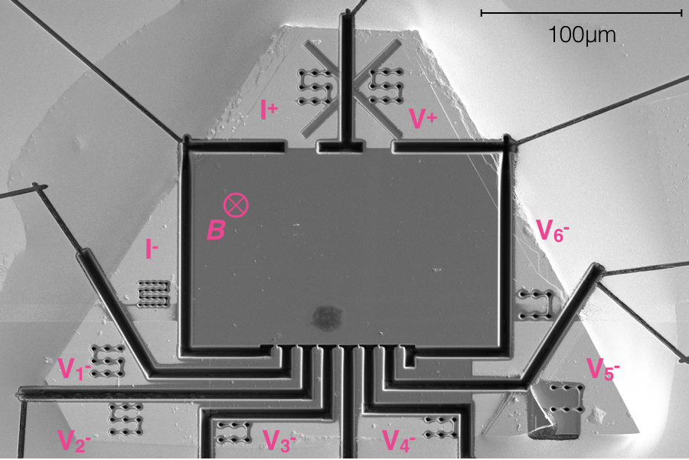
First working device in PdCoO₂
10 μm contact separation

Slide 24
Voltage contact 10 μm from current injection point

Slide 25
Voltage contacts 10 then 20 μm from current injection point
Direct evidence that the ballistic mean free path in this device is greater than 20 μm

Slide 26
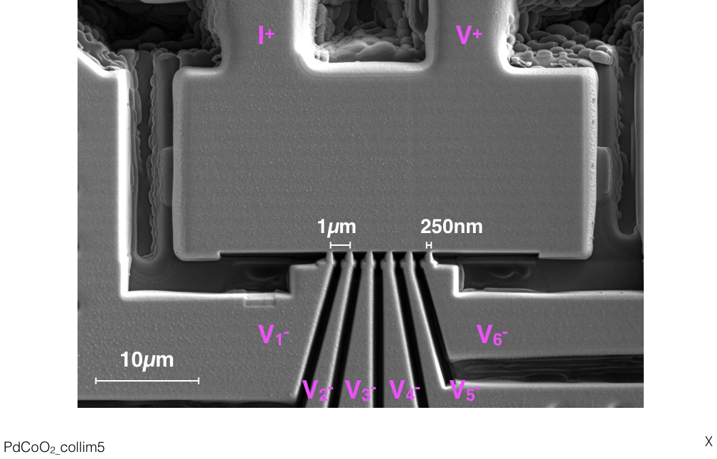
Finer FIB-craft (Maja Bachmann)

Slide 27
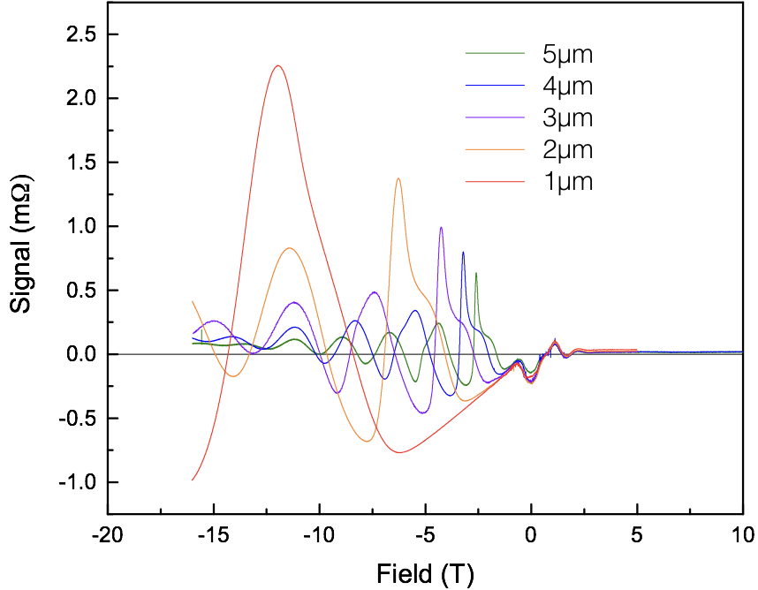
Extremely high resolution data with structure and….
Negative voltage observed at zero applied field

Slide 28
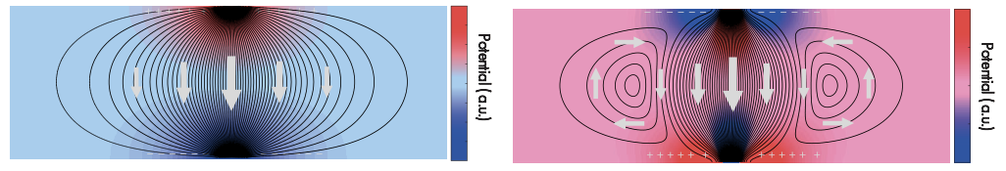
Negative voltage at zero field significant in hydrodynamic context
Ohmic flow
Viscous flow
L. Levitov and G. Falkovich, Nature Physics 12, 672 (2016)
Negative voltages observed in graphene devices with similar contact spacings (though a slightly different measurement configuration to our usual one).
D. A. Bandurin et al., Science 351, 1055 (2016)

Slide 29
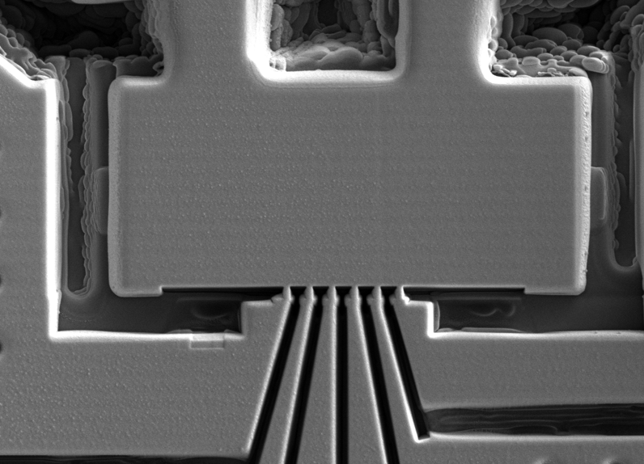
Explicit measurements in the ‘graphene configuration’
V
Viscous flow
I

Slide 30
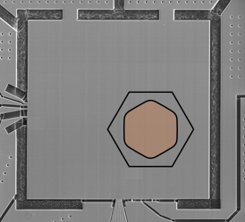
Structure of peaks depends on direction of injection
180 μm

Slide 31
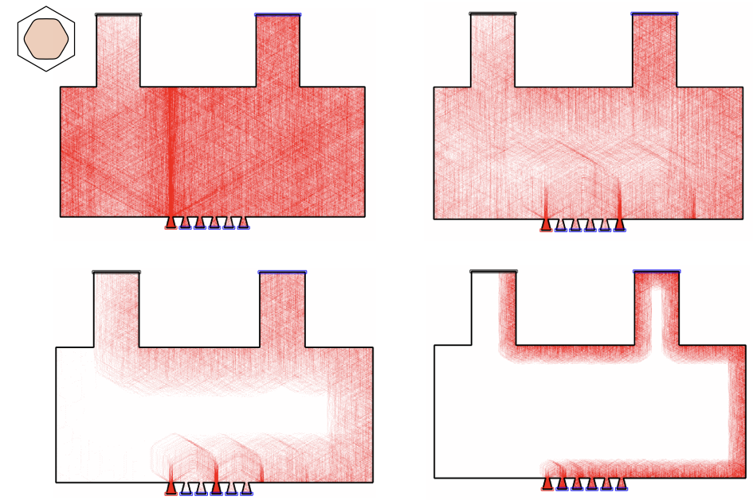
Ballistic simulations (Aaron Sharpe, Arthur Barnard, David Goldhaber-Gordon) ….

Slide 32
…. do a very good job of matching the data

Slide 33
…. do a very good job of matching the data
Experiment
Theory
The simulations also account for the detailed difference of the peak structure for different injection angles.
Excellent agreement from a simulation that includes no hydrodynamics, with a possible exception near zero field.

Slide 34
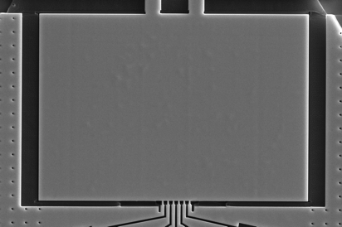
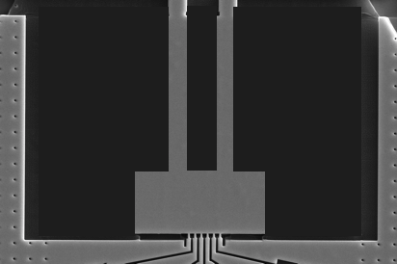
The negative voltage at zero field depends on device size
50 x 35 μm
50 x 35 μm
20 x 10 μm
Probably simply a ballistic effect (though not yet understood and hydrodynamic calculations are still desirable).
20 x 10 μm
It would be interesting to know if sample size effects were checked in the graphene experiments.

Slide 35
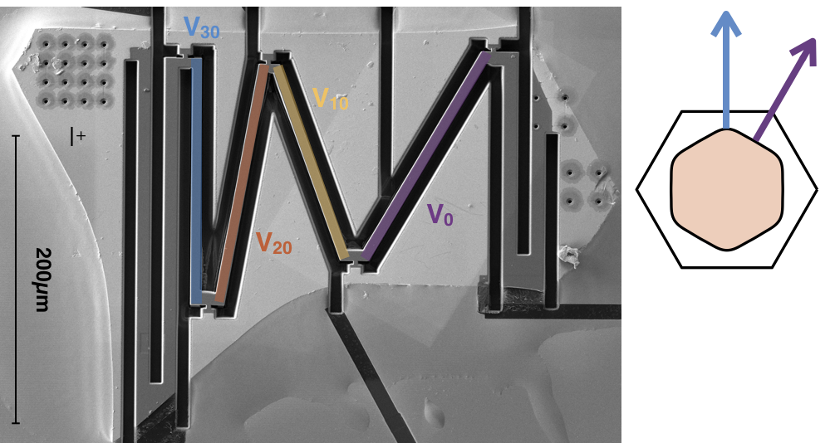
Spin-off from analysis of focusing experiments:
directional ballistics
30∘
50 x 35 μm
0∘
20 x 10 μm

Slide 36
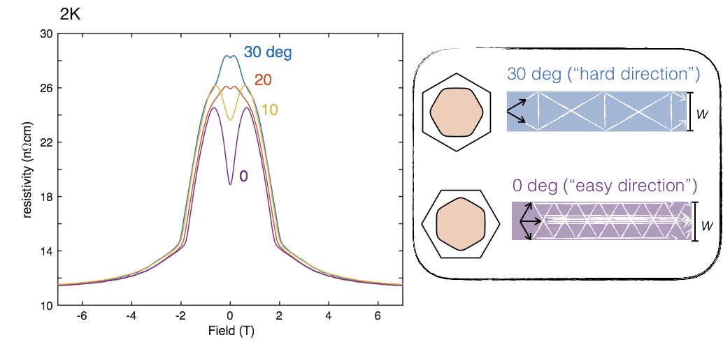
Spin-off from analysis of focusing experiments:
directional ballistics
50 x 35 μm
20 x 10 μm

Slide 37
Magnetoresistance experiments on simple ‘wires’ at high temperatures (Nabhanila Nandi)
Experiment: PdCoO₂ at T = 100K
Navier-Stokes calculation including known W and l_{MR}
21 μm
11 μm
ρ_{xx}^{channel} / ρ_{xx}^{bulk}
7 μm
4 μm
B (T)
B (T)
Care: kinetic calculations have recently been extended to this regime by Thomas Scaffidi and qualitatively similar predictions are made even if the momemtum-conserving scattering is turned off.
We may be seeing a hydrodynamic signal but according to our current understanding this is not a definitive experiment.

Slide 38
Aside: delafossites also host fascinating surface state and magnetic physics leading to fascinating photoemission signals:
Surface states with giant Rashba splitting for transition-metal surface termination in PdCoO₂, PtCoO₂ and PdRhO₂.
Sunko, V. et al, 2017, Nature 549, 492
For Pd or Pt surface terminations, ferromagnetic surface states are observed.
Mazzola F. et al, arXiv:1710.05392
Experiments on bulk spectra from PdCrO₂ in which the Cr-O layers are Mott insulating reveal a spectroscopic signal based on a Kondo lattice-like coupling between Mott and free electron layers
Sunko, V. et al, 2018, preprint

Slide 39
Max Planck Institute
for Chemical Physics of Solids
Conclusions
Observation of hydrodynamic electron flow requires such high purity
that it has only very recently become accessible in naturally occurring materials.
2. Extension of electron hydrodynamic theory to include magnetic field
has opened new lines of experimental investigation.
3. Separating hydrodynamic from ballistic contributions is more subtle
than had previously been thought (by me at least).
4. A new class of directed ballistics will be enabled by the hexagonal Fermi
surfaces of the delafossites.
Notes:
Here are my collaborators, mainly from Dresden and St Andrews on the experimental side, but I am also happy to acknowledge some nice discussions that I have had with a number of the people at this meeting.

