Slide 1



Phonons’ Poiseuille flow
Kamran Behnia
ESPCI
Paris

Slide 2


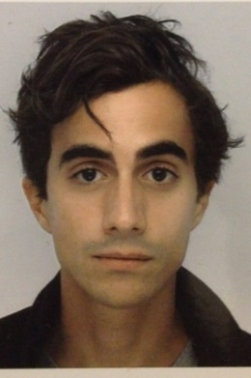
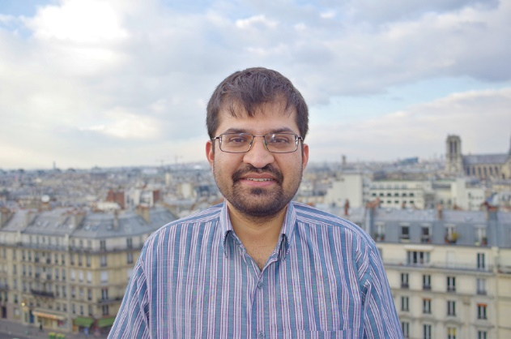





Machida et al. Sci. Adv. 2018
Martelli et al. PRL 2017
Benoît Fauqué, Clément Collignon & Alexandre Jaoui
ESPCI, Paris
Alaska Subedi
Ecole Polytechnique
Yo Machida & Koichi Izawa
Tokyo Institute of Technology
Valentina Martelli, Juio Larrea & Elisa Saitovitch
CBPF, Rio de Janeiro

Slide 3
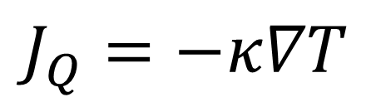
Heat transport in a solid
$$J_{Q}=−κ∇T$$
Resistive wires
Thermometers
Heater
sample
Nodal quasi-particles in superconductors
Neutral excitations in [magnetic] insulators
...
Cold finger

Slide 4
Outline
I. Thermal conductivity of insulators and phonon hydrodynamics
II. Observation of the Poiseuille flow of phonons in two solids
Black Phosphorus (BP)
Strontium titanate (STO)
III. A boundary to thermal diffusivity?
IV. Electron hydrodynamics and WP₂

Slide 5
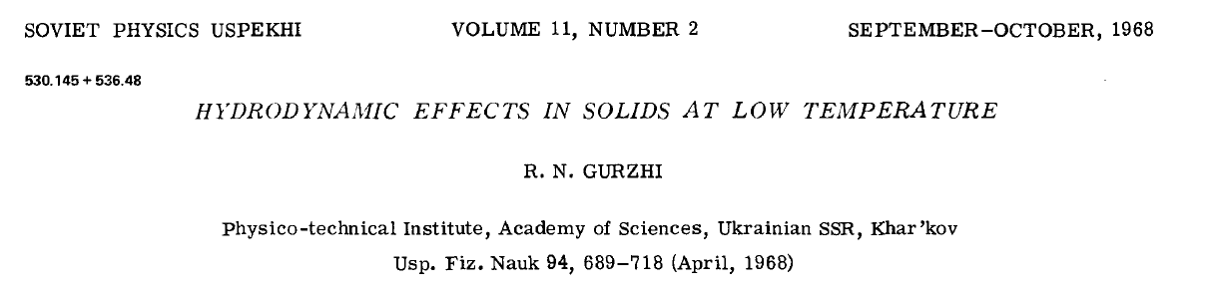
The phenomena of thermal conductivity of insulators and the electrical conductivity of metals have specific properties: in both cases the total quasi-particle current turns out to be non-vanishing. ..it follows that when only normal collisions occur in the system, there could exist an undamped current in the absence of an external field which could sustain it.
If collisions are mainly NORMAL (not UMKLAPP), then viscosity sets the flow rate!

Slide 6
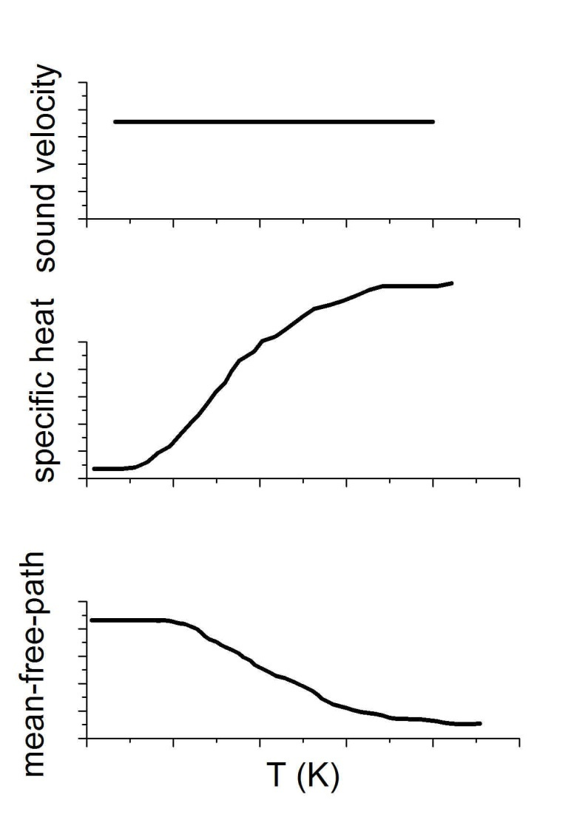
Thermal conductivity of insulators
κ = 1/3 C v l
Vandersande & Wood 1986

Slide 7
Quite successful at high temperature

Slide 8
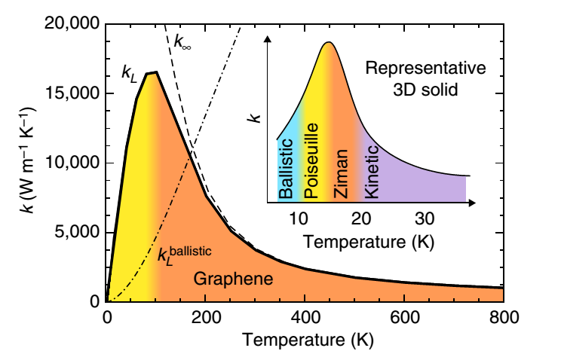
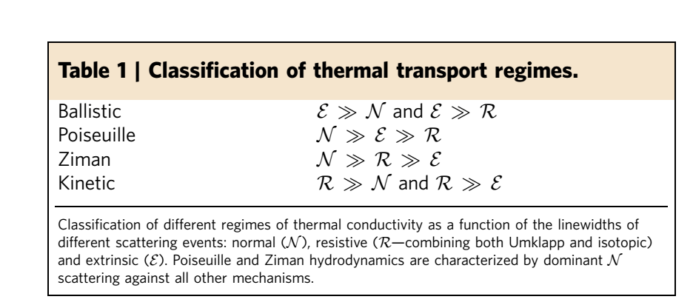
Phonon hydrodynamics
A. Cepellotti et al., Nature Comm. 2014

Slide 9
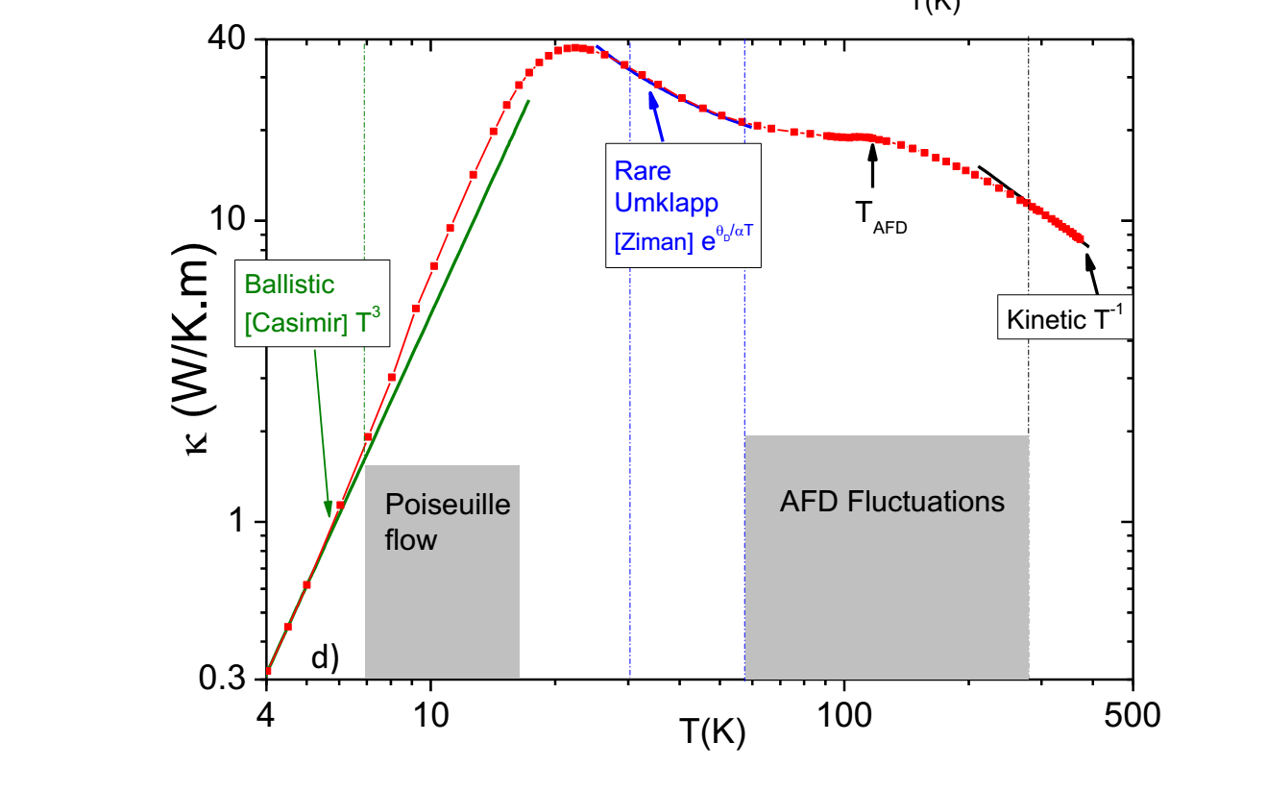
Thermal conductivity of strontium titanate
Martelli et al. PRL 2017

Slide 10
Experimental observations of Poiseuille flow
He³ (Thomlinson 1969)
He⁴ (Mezhov-Deglin 1965)
Bi (Kopylov 1971)
H (Zholonko 2006)
Black P (Machida 2018)
SrTiO₃ (Martelli 2018)

Slide 11
The hydrodynamic regime is fragile!

Slide 13
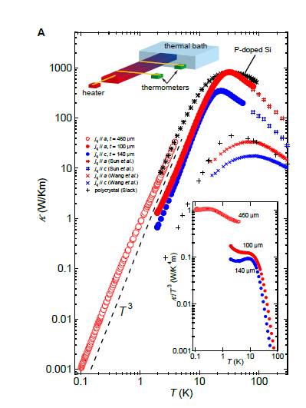
Black phosphorus
Three signatures of Poiseuille flow [4K <T<12 K]:
Faster than T³ thermal conductivity
Non-monotonous mean-free-path
Size-dependent Knudsen minimum
Machida et al. Sci. Adv. 2018

Slide 14
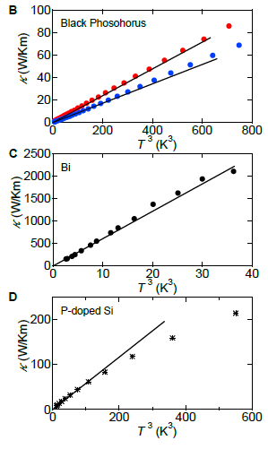
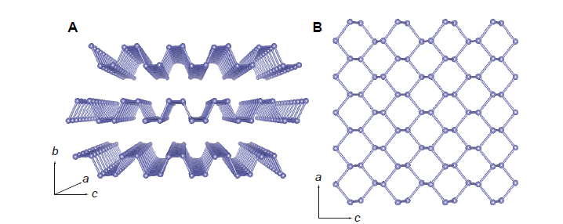
Black phosphorus
Thermal conductivity becomes faster than T³

Slide 15
The temperature dependence of mean-free-path shows a local peak!
In this hydrodynamic regime :
Momentum-consevering scattering FAVORS the flow!
Hence warming increases the mean-free-path!

Slide 16
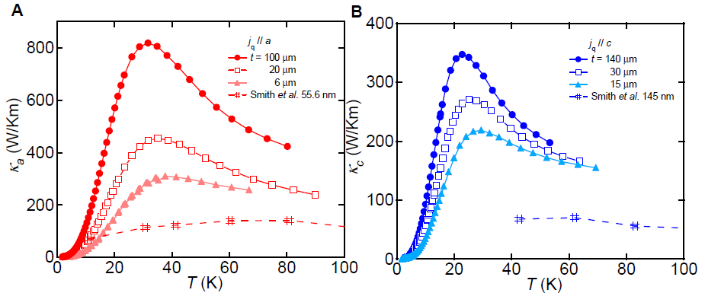
Size dependence of thermal conductivity in black P
Persists beyond ballistic and hydrodynamic limits
Points to ballistic heat carriers even in the umklapp regime!
No superlinear size dependence in the Poiseuille limit.

Slide 17
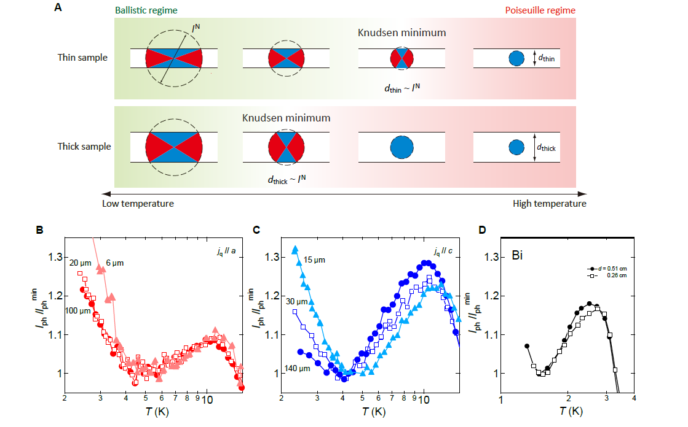
The Kundsen minimum is size-dependent!

Slide 18
Why black P, why Bi? and not Si?
P. A. Littlewood, 1980
Structural instability

Slide 19
Why black P, why Bi?
Structural instability

Slide 20
Black P vs. silicon

Slide 21
Strontium titanate
Antiferrodistortive
Ferroelectric

Slide 22
Two soft modes

Slide 23
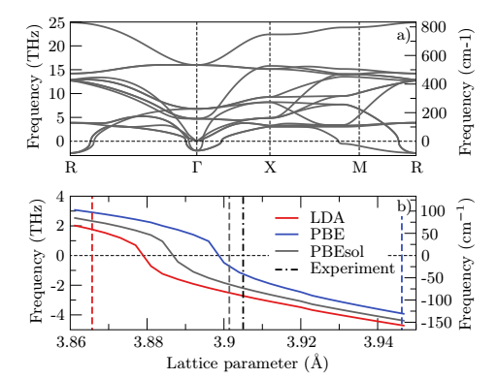
Ab initio theory: this solid cannot be!
Uschauer and Spaldin, JPCM 2015
Imaginary phonon frequencies!
Owes its very existence to zero-point quantum fluctuations!

Slide 24
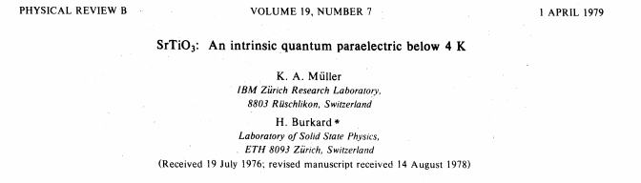
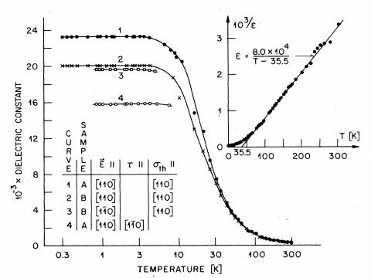
The dielectric coefficient becomes as large as 20000ε₀!

Slide 25
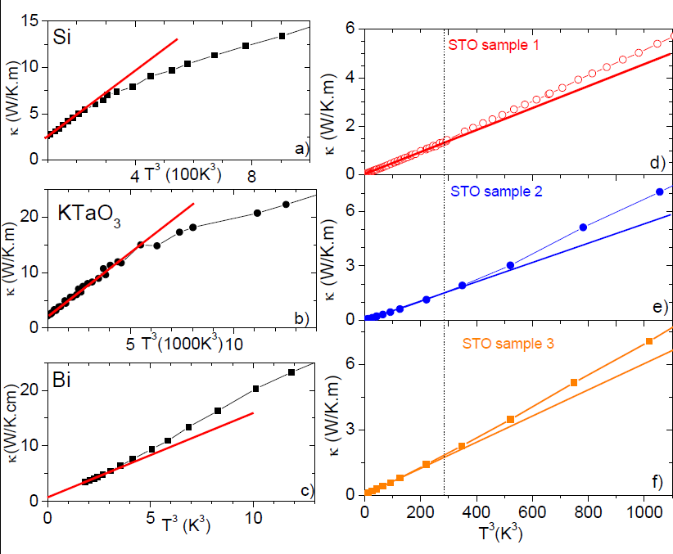
Hallmark of Poiseuille flow: faster than T³ thermal conductivity
Martelli et al. PRL 2017

Slide 26
But specific heat is also faster than T³
Martelli et al. PRL 2017
Yet, there is a Knudsen minimum followed by a Poiseuille peak!

Slide 27
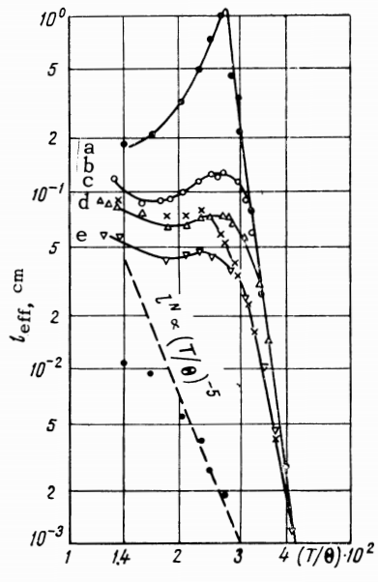
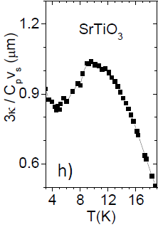
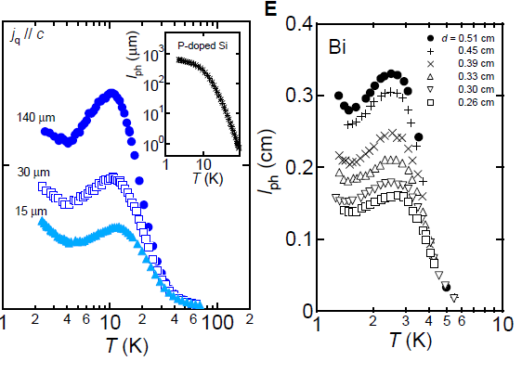
Non-monotonic temperature dependence of the effective mfp in four solids
⁴He
Black P

Slide 29
Revisiting bismuth

Slide 31
A boundary to thermal diffusivity?

Slide 32
High temperature

Slide 34
Specific heat and thermal conductivity

Slide 35

Extracted thermal diffusivity
$$D={sv}_{s}^{2}τ_{p}$$

Slide 36
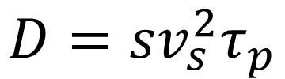
Is there a boundary to thermal diffusivity of insulators?
$$D={sv}_{s}^{2}τ_{p}$$
For all known materials, s>1
Reminiscent of Hartnoll’s boundary for incoherent metals

Slide 38
Remarks on hydorynamics of electrons

Slide 39
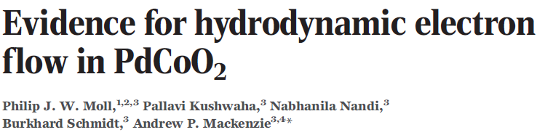
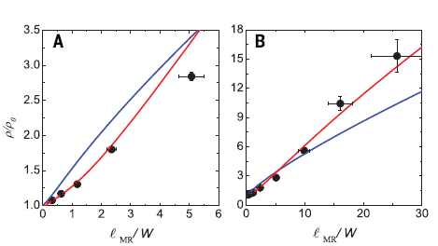
Changing the sample size by a factor of 75 leads to a thirty percent discrepancy with the expectations of standard theory neglecting momentum-conserving collisions!

Slide 40
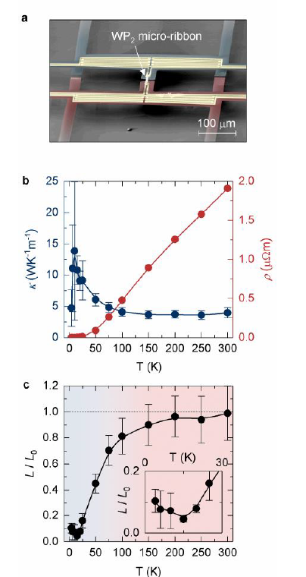
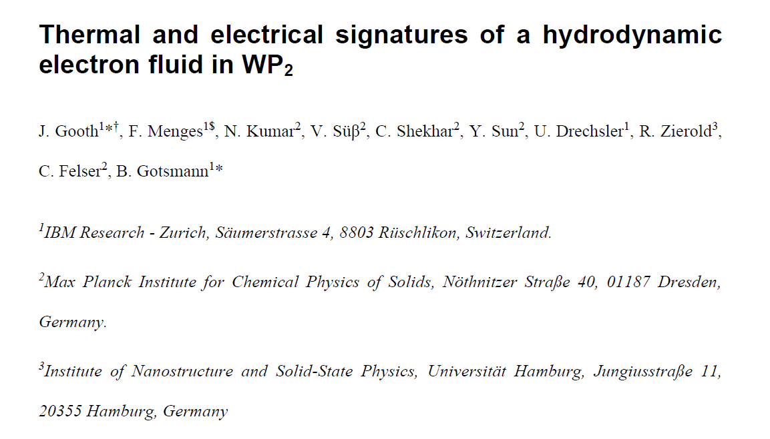
arXiv:1706.05925

Slide 41
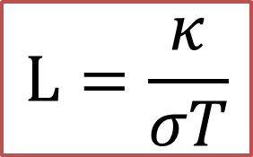
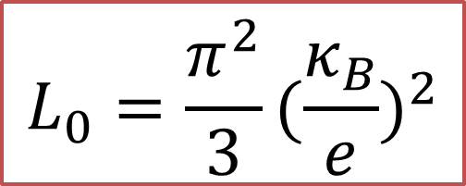
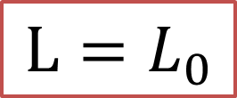
The Widemann-Franz law
$$L=\frac{κ}{σT}$$
$$L=L_{0}$$
Lorenz number
$$L_{0}=\frac{π^{2}}{3}(\frac{κ_{B}}{e})^{2}$$
Sommerfeld number
=2.45 10⁻⁸W Ω / K²
Ratio of quanta of charge and entropy!
Why power of two? Because the quanta are present in both force AND flux!
Why π²/3 ? Sommerfeld!

Slide 42

inelastic scattering
Vertical (small-angle) scattering efficiently decays heat current, but not charge current!
A pondering factor for momentum current:
$$1−\cos{Θ}$$

Slide 43
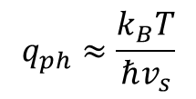
i)Electron-phonon scattering
Electric resistivity is expected to vary as T⁵
Thermal resistivity is expected to vary as T³
As the temperature decreases, the typical wave-vector of phonons decreases.
$$q_{ph}≈\frac{k_{B}T}{ℏv_{s}}$$
The relative weight of low-q scattering increases wit decreasing temperature.

Slide 44




ii)Electron-electron scattering
Electric resistivity is expected to vary as T²
Thermal resistivity is expected to vary as T²
The weight of low-q scattering does not change with temperature!
$$WT=W_{0}+BT^{2}$$
$$ρ_{0}=W_{0}$$
but
$$A≠B$$
$$ρ=ρ_{0}+AT^{2}$$

Slide 45

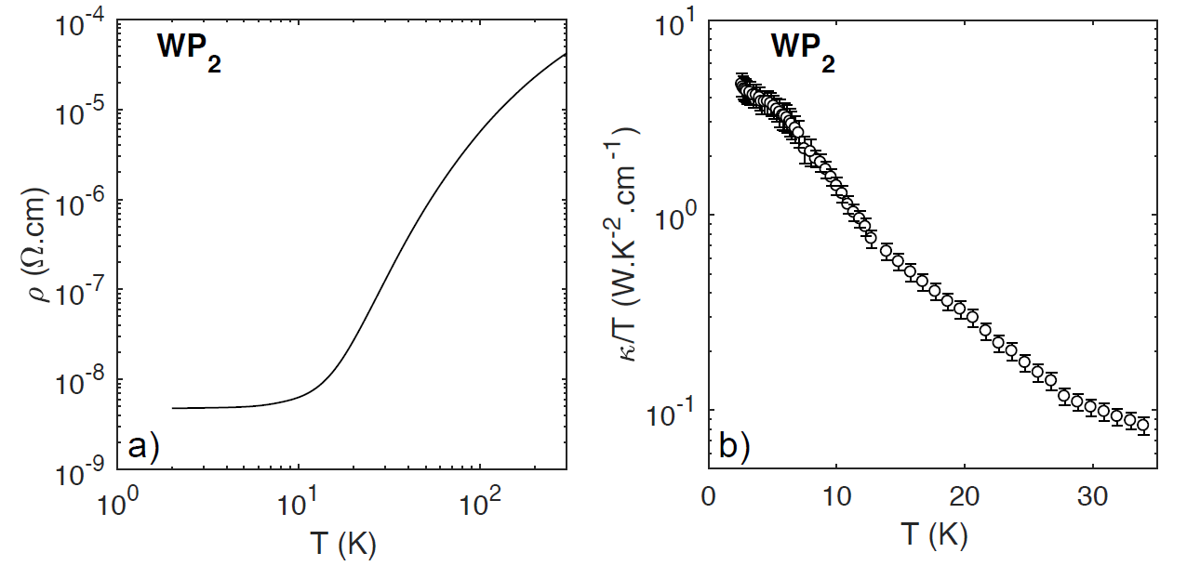
arXiv:1806.04094

Slide 46
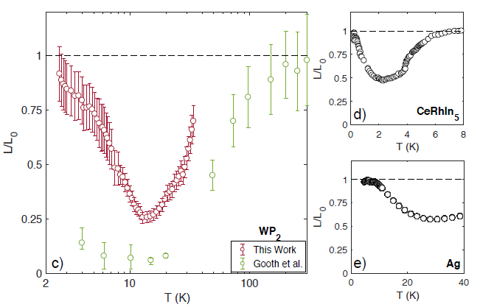
There is indeed a large finite-temperature deviation!

Slide 47
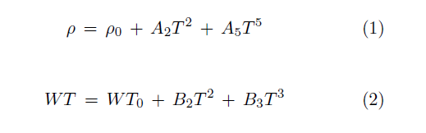
Quantifying distinct components
By fitting the data one quantifies :
A₂ and A₅ in ρ(T)
B₂ and B₃ in WT (T)
B₂ is almost FIVE times larger than A₂

Slide 48
Quantifying distinct components
The B₃/A₅ ratio is similar in WP₂ and in Ag!
The electron-phonon scattering in NOT anomolously enhanced in the thermal channel!

Slide 49
Electron-electron (and not electron-phonon) scattering is driving this!
These collisions amplify B₂, but not for A₂
Abundant small-q electron-electron scattering would explain the mismatch!
Collision rate
q

Slide 50
What sets the mismatch between T-square prefactors in a given solid?
Material | ρ₀ (nΩcm) | A₂ (pΩcmK⁻²) | B₂(pΩcmK⁻²) | A₂/B₂
WP₂ | 4 | 17 | 76 | 0.22
W | 0.06 | 0.9 | 6.2 | 0.15
Ni | 3 | 25 | 61 | 0.4
UPt₃ | 200 | 1.6 10⁶ | 2.4 10⁶ | 0.65
CeRhIn₅ | 37 | 2.1 10⁴ | 5.7 10⁴ | 0.4
Theoretical answers:
Herring (1967): The ratio is quasi-universal and of the order of 0.4!
Li & Maslov (unpublished) : No boundary! It can become arbitrarily small!

Slide 51
What about electron hydroynamics?
T-square electrical resistivity (A₂) quantifies momentum-relaxing collisions
T-square thermal resistivity (B₂) quantifies momentum-conserving collisions
Comparing their ratio , one can see if there is a hydrodynamic window!

Slide 52
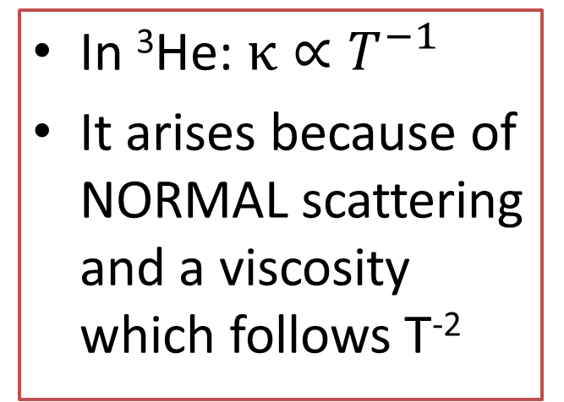
In ³He: $κ∝T^{−1}$
It arises because of NORMAL scattering and a viscosity which follows T⁻²

Slide 53
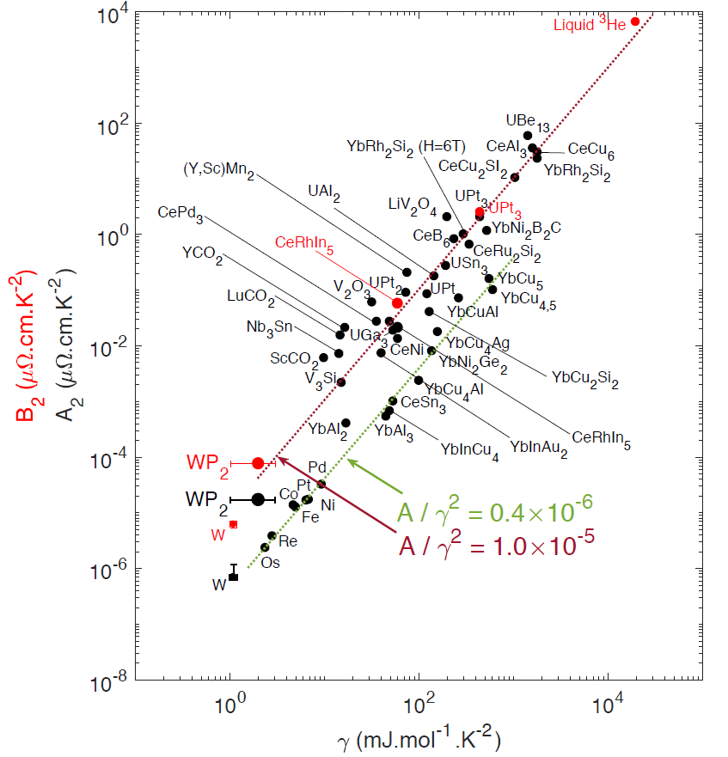
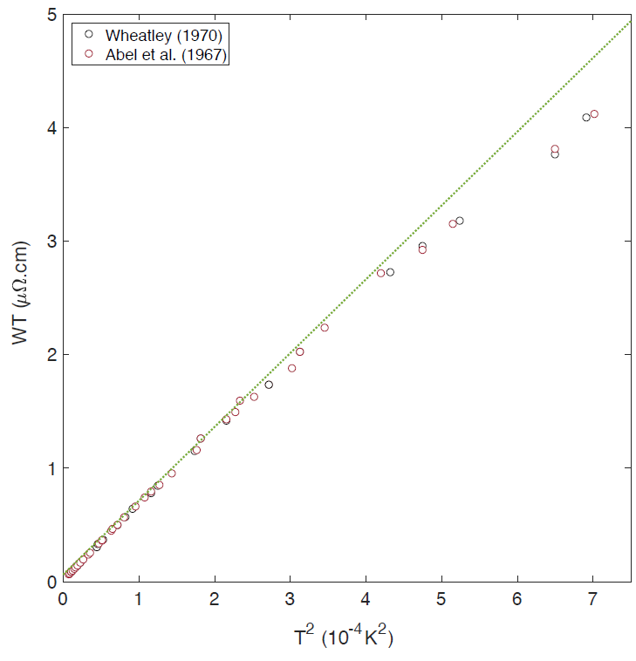
Putting ³He on Kadowaki-Woods
In our notations, this i$mplies that in 3He, WT∝T^{2}$
³He

Slide 54
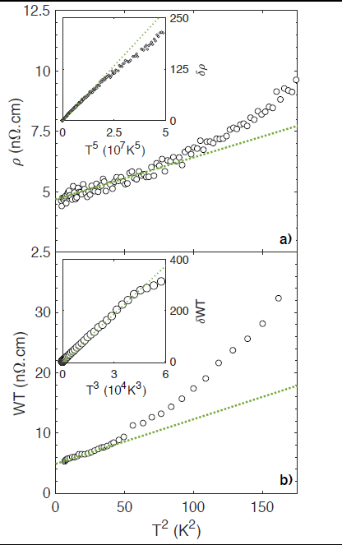
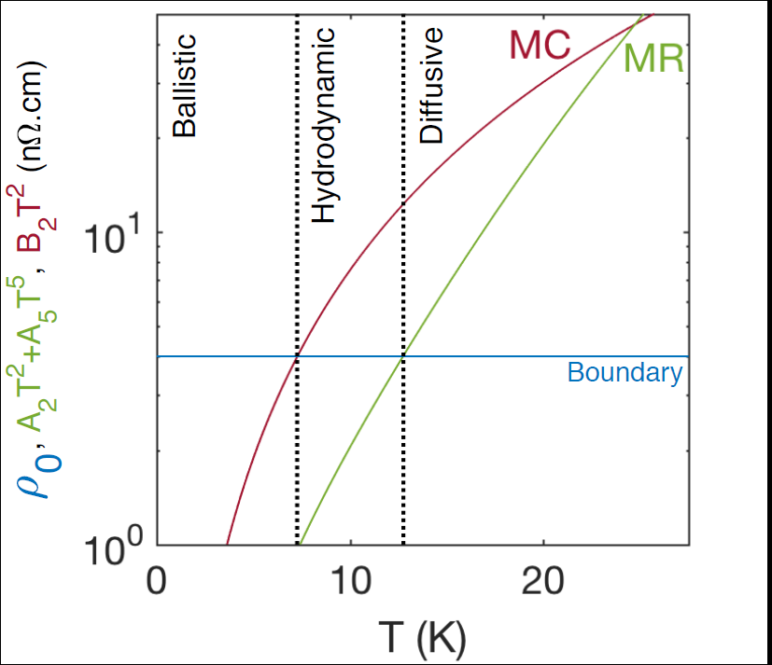
Is there a hydrodynamic window for electrons?
Momentum-conserving collisions can be quantified thanks to B₂T²!

Slide 55
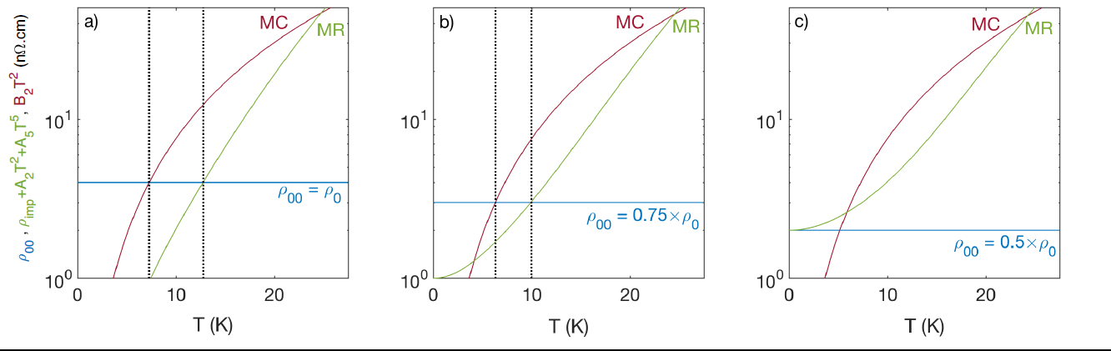


But, it is extremely fragile!
Residual resistivity , ρ₀ , has a boundary ρ₀₀ , and an impurity, ρ_{imp} , component!
$$ρ_{0}=ρ_{00}+ρ_{imp.}$$
If
$$ρ_{00}=ρ_{imp.}$$
The window closes!
Future studies on sample with different sizes will tell!

Slide 56
Summary
Phonon heat flow in Black P becomes hydrodynamic below the peak thermal conductivity
Poiseuille flow requires dominance of normal scattering, favored by proximity to structural instability.
A universal boundary to thermal diffusivity?
The temperature window for electron hydroynamics is linked to the mismatch in T-square resistivity prefactors.

