Slide 1

Hydrodynamics
for perfect fluids
without boosts
Jan de Boer, Jelle Hartong, Watse Sybesma, Niels Obers, Stefan Vandoren
Notes:
Enthousiasme!!

Slide 2
Motivation
Hydrodynamics is widely applicable theory (on right length scales)
Symmetries underlying Navier-Stokes equations
Temporal and spatial translations
Spatial rotations
Boosts
Particle number conservation
Notes:
Tap-water, quark gluon plasma, the universe
Navier-Stokes equation
Non-Newtonian
Galilean vs Lorentz
Bargmann vs Poincaré

Slide 3
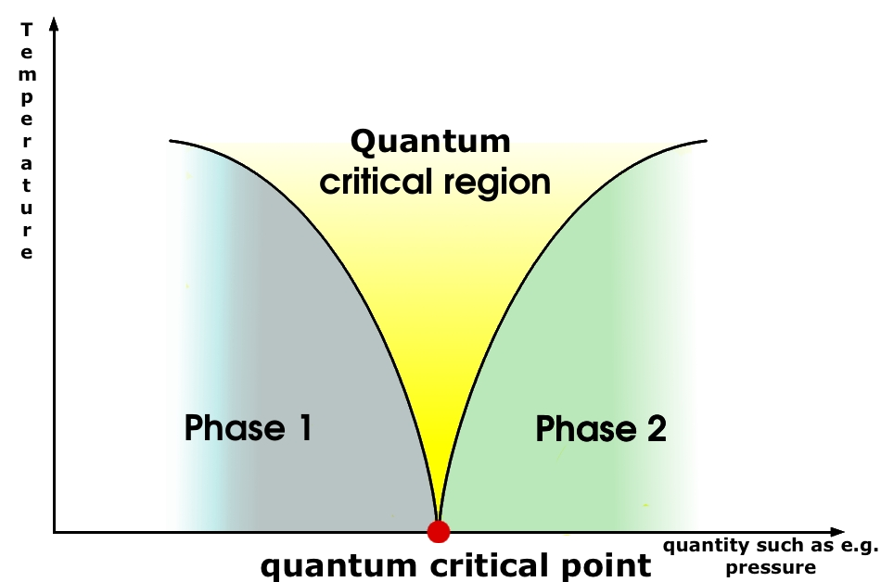
Motivation
critical systems
electrons in a background
Flocks
anisotropic scaling
Temporal and spatial translations
Spatial rotations
Anisotropic scaling
[e.g. J. Toner, Y. Tu, and S. Ramaswamy 2005]

Slide 4

Outline
Motivation
Thermodynamics and hydrodynamics
Lifshitz gas
Beyond perfect
Notes:
Organizatory slide

Slide 5
Thermodynamics and hydrodynamics
Grand canonical partition sum
Grand potential
Notes:
Thermo in equilibrium grand canonical ensemble

Slide 6
Thermodynamics and hydrodynamics
Identities
New thermodynamical quantity
Dimension of mass density
Notes:
Gibbs-Duhem and Euler relation
Assuming translation and rotation symmetry, the average momentum (density) must be proportional to the velocity
New thermodynamic function ρ that must be computed! Dimension: mass density

Slide 7
Thermodynamics and hydrodynamics
Absence of Lorentz boost:
Perfect fluid energy-momentum tensor without boosts
Galilean Boost (Bargmann):
Lorentz boost (Poincaré):
Notes:
current
new fluid variable related to ρ.

Slide 8
Thermodynamics and hydrodynamics
Conservation of energy-momentum tensor and particle current:
Particle number conservation
Entropy density
Isotropic and homogeneous Euler equation
If we invoke Galilean boost symmetry
Notes:
Like a rocket with time dependent mass
Lorentzian case also expression

Slide 9
Thermodynamics and hydrodynamics
Fluctuations for speed of sound
Linearized hydrodynamics
speed of sound
Notes:
At ideal level we can compute the speed of sound. New formula
Momentum space

Slide 10
Outline
Motivation
Thermodynamicsand hydrodynamics
Lifshitz gas
Beyond perfect

Slide 11
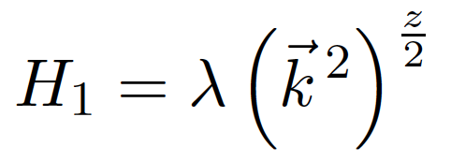
Lifshitz Gas
Hamiltonian
Anisotropic scale invariance
Partition function Boltzmann gas
Notes:
Free energy, Euler relation

Slide 12
Lifshitz Gas
Grand potential
Mass density
Notes:
Look at ensembles

Slide 13
Lifshitz Gas
Speed of sound
Lifshitz Speed of sound
As a check
Notes:
Boltzmann gas
Adiabatic index

Slide 14
Lifshitz Gas
Quantum statistics
Polylogarithm
Consider (for bosons)
Condensate for
Notes:
density of states to rewrite the sum as an integral
We will focus on bosons

Slide 15
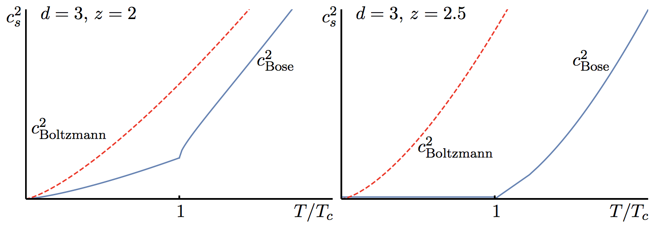
Lifshitz Gas
Speed of sound
Zeta function is zero for argument between zero and one is negative
Notes:
Normally z = 1 and z=2 invisible

Slide 16
Outline
Motivations
Thermodynamics and hydrodynamics
Lifshitz gas
Beyond perfect

Slide 17
Summary and Outlook
A new hydrodynamic theory for isotropic and homogeneous fluids
New speed of sound and Lifshitz gasses
Interacting toy-models to obtain values hydrodynamic quantities
Curved spacetime, derive Kubo’s formula and holography
Notes:
Different channels Kubo

