Slide 1
n-n̅ oscillation sensitivity study in DUNE
Yeon-jae Jwa*, on behalf of the DUNE Collaboration
*Columbia University

Slide 2
Contents
Bound neutron-antineutron oscillation
DUNE: Large-mass liquid argon time projection chamber
n-n̅ oscillation search analysis using machine learning based methods
Preliminary result on n-n̅ oscillation lifetime sensitivity
Yeon-jae Jwa | n-n̅ oscillation sensitivity study in DUNE

Slide 3
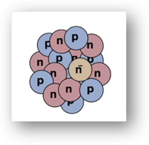
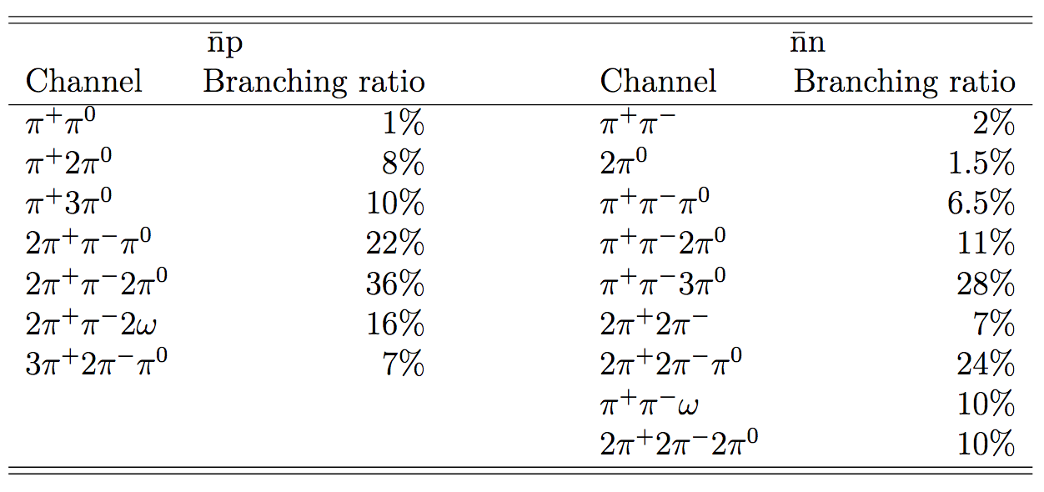
n-n̅ oscillation in ⁴⁰Ar
Neutron’s spontaneous oscillation to anti-neutron violates the baryon number by 2 units, while not violating fundamental gauge symmetries.
In nuclei, bound neutron’s oscillation to an anti-neutron is followed by the annihilation with nearby nucleon.
Oscillated anti-neutron has 21/39 chance of annihilation with neutron, 18/39 chance with proton in ⁴⁰Ar.
(n̅, n), (n̅, p) pairs generate decay products, with high branching ratios to multiple pion states.
Effective BR for Argon, in GENIE (adapted from Super-K)
Yeon-jae Jwa | n-n̅ oscillation sensitivity study in DUNE

Slide 4
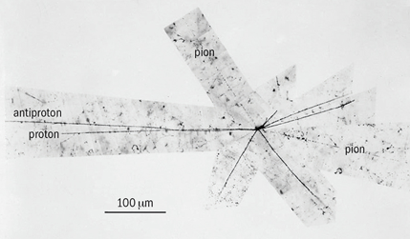
n-n̅ oscillation in ⁴⁰Ar: Event Topology
Multiple pion final state:
Since the outgoing particles’ momentum sum should be nearly zero, the topology of decay products has spherical symmetry and high pion multiplicity, which can be characterized to be ‘star-like’.
Discovery of the antiproton, 1955
Yeon-jae Jwa | n-n̅ oscillation sensitivity study in DUNE

Slide 5
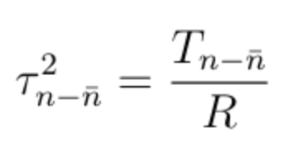
n-n̅ oscillation in ⁴⁰Ar:
Bound-to-free Lifetime Conversion
The bound neutron lifetime to free neutron lifetime are related through the nuclear potential suppression factor R, which depends on the nucleus.
For argon, the suppression factor of ⁵⁶Fe, R = 0.666e23 s⁻¹, could be suitable to use with the extra theoretical uncertainty applied.
The existing strongest limit for n-n̅ oscillation lifetime is from SK n-n̅ oscillation search (2011), which has set the 90% C.L. limit at 1.9e32 yrs for bound neutron lifetime in ¹⁶O, and 2.7e8 s for free neutron lifetime.
Yeon-jae Jwa | n-n̅ oscillation sensitivity study in DUNE
Notes:
Mention nuclear potential;
Slide too wordy

Slide 6
Deep Underground Neutrino Experiment (DUNE)
Next generation neutrino experiment using liquid argon time projection chamber (LArTPC).
Near detector located @ Fermilab, far detector located @ SURF, South Dakota.
Far detector, 1.5km underground, will have 4 modules with 10kton fiducial mass each.
Yeon-jae Jwa | n-n̅ oscillation sensitivity study in DUNE

Slide 7
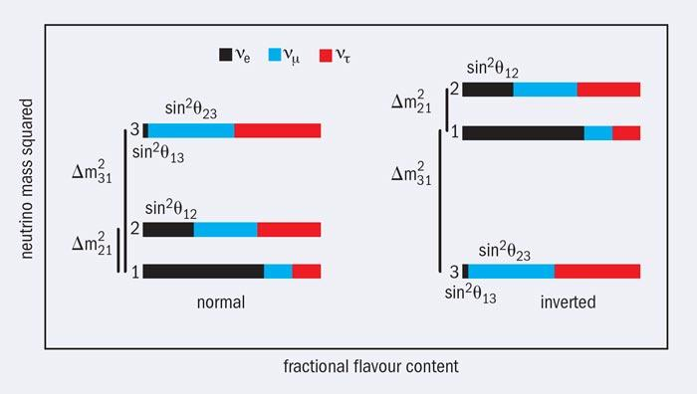
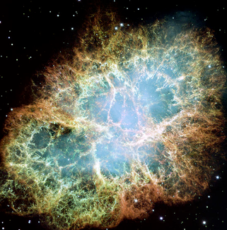
DUNE: Physics Goals
Beam: - Testing CP violation in lepton sector (δ_{CP}=0?)
- Determination of neutrino mass ordering, θ₂₃ octant
Off-beam:
- Atmospheric neutrinos, cosmic rays
- Investigating supernova neutrinos
- Rare physics searches (p-decay, n-n̅ osc., etc.)
Timeline & Collaboration as of Dec. 2018:
- First far detector module installation in 2024, first beam data in 2026
- Over 1100 collaborators, 175 institutions, 32 countries
2 possible neutrino mass orderings
Crab nebula
Yeon-jae Jwa | n-n̅ oscillation sensitivity study in DUNE
Notes:
DUNE’s primary physics goals : beam realted and off-beam(): CPV, 20
So more it’s rather for neutrino oscillation than neutron oscillation.
But we dont build this giant detector for one thing.

Slide 8
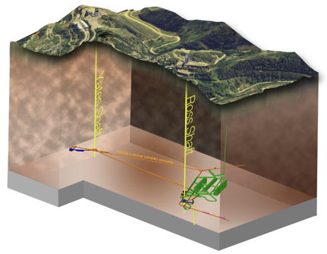
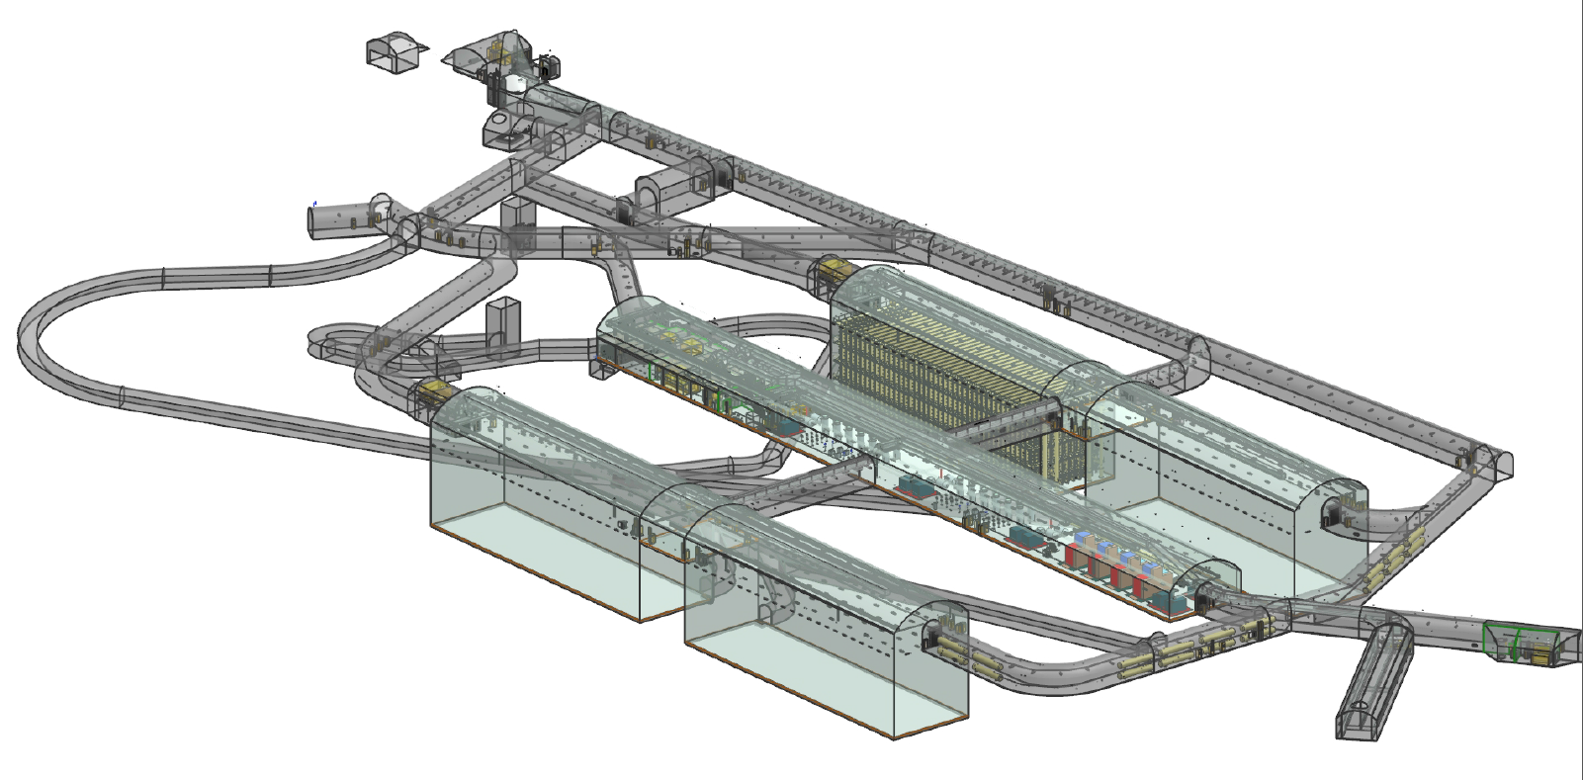
DUNE: Far Detector (FD)
Liquid argon offers 3.317e32 / kt * 40kt = 1.33e34 neutrons.
DUNE FD is shielded from most cosmogenic events.
Millimeter scale spacing of LArTPC wires will allow high quality event reconstruction.
An ideal experiment for searches of rare physics events.
*DUNE FD single-phase design is assumed for this work.
Yeon-jae Jwa | n-n̅ oscillation sensitivity study in DUNE

Slide 9
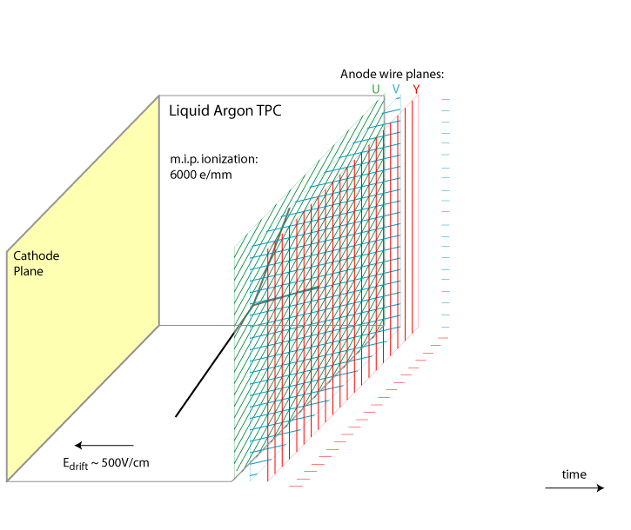
DUNE: Liquid Argon Time Projection Chamber (LArTPC)
Ionization electrons (~dE/dx) are drifted to anode plane assemblies (APAs) by the electric field.
APA has three wire planes with different angular orientations, along the drift-time axis, enables 3D event reconstruction.
Single APA corresponds to 960 collection wires, single module of DUNE FD consists of 150 APAs.
TPC figure
Working principle for LArTPC:
https://www.bnl.gov/newsroom/news.php?a=212860
Yeon-jae Jwa | n-n̅ oscillation sensitivity study in DUNE
Notes:
8. ionization electrons. explanation do it well.
1APA corresponds to our cnn input.
I will bring this up later again, but 960 collection wire for 1 drift time amount of data forms one input for CNN analysis.

Slide 10
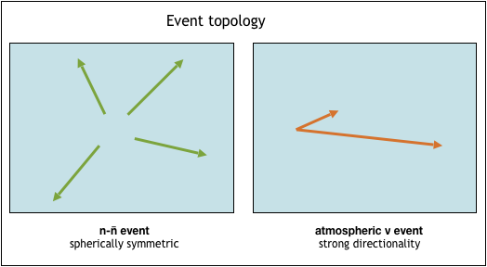
n-n̅ oscillation search in DUNE:
Atmospheric background
Atmospheric neutrino events are considered to be the dominant background for n-n̅ oscillation search in DUNE.
Yet they are assumed to have different topological features, analysis methods making use of topologies are encouraged.
Convolutional Neural Network
*Atmospheric event normalizaion 288.6 events / (kton*year) is used, based on the Barton flux at the Soudan mine for this study.
Yeon-jae Jwa | n-n̅ oscillation sensitivity study in DUNE
Notes:
9. 40 kton once more.

Slide 11
n-n̅ oscillation search in DUNE:
Event Generation for CNN
GENIE neutrino event generator:
Fermi motion, Binding energy, Final state interaction (FSI).
Geant4 based simulation:
Default G4 simulation in dunetpc module.
Detector simulation:
Noise simulation, zero-suppression, produce raw-digit wires.
Reconstruction:
Wire deconvolution is performed on raw waveforms: recob::wire objects
No further reconstruction steps are performed for CNN methods
Yeon-jae Jwa | n-n̅ oscillation sensitivity study in DUNE

Slide 12
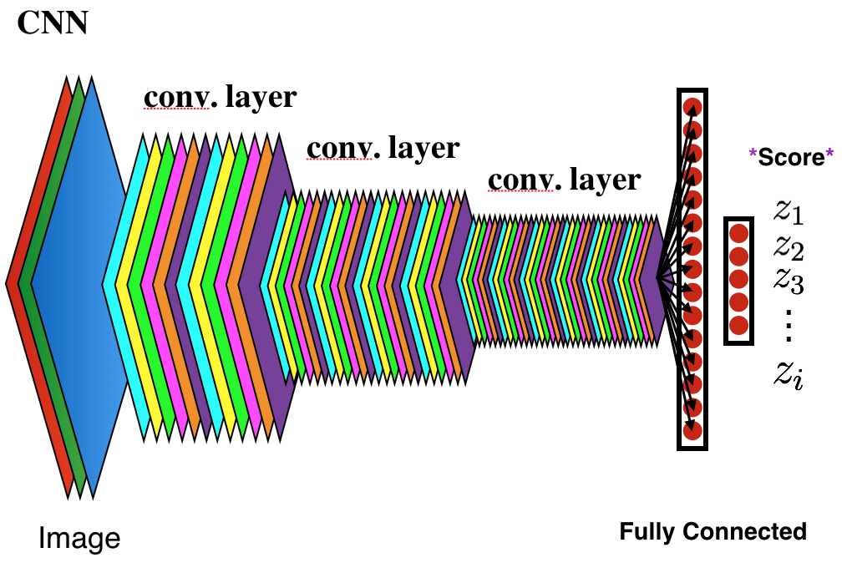
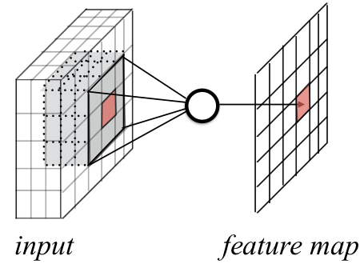
CNN analysis: Methods
Convolutional neural network (CNN) inputs are mapped to feature maps after every convolution layer.
The weight of these mappings are learned through training, by being updated over iterations.
At every iteration, training loss function, a metric of errors from supervised predictions, is evaluated, and the loss is attempted to be minimized over iterations.
Yeon-jae Jwa | n-n̅ oscillation sensitivity study in DUNE
Notes:
11. /Practice/
After every convolution layer, you get this stack of feature maps. And after a number of convolution layers you have prediction as a form of “scores.”

Slide 13
CNN analysis: Methods
CNN input:
4887 time-ticks (1 drift time) and 960 collection plane recob::wire objects (1 APA) are down-sampled by the factor of 8 (time-tick axis), factor of 2 (wire axis), and placed on a 600x600 pixel frame.
Network architecture:
VGG16b, a widely used convolutional neural network with 16 layers, is used for this study supported on Caffe framework. vgg16b
Hyper-parameters:
Hyper-parameters optimizing the learning are handled by ‘solver’, solver
*Hyper-parameters often can have impact on the quality of network training.
Yeon-jae Jwa | n-n̅ oscillation sensitivity study in DUNE
Notes:
12. widely used 16 layers. about vgg16b.

Slide 14
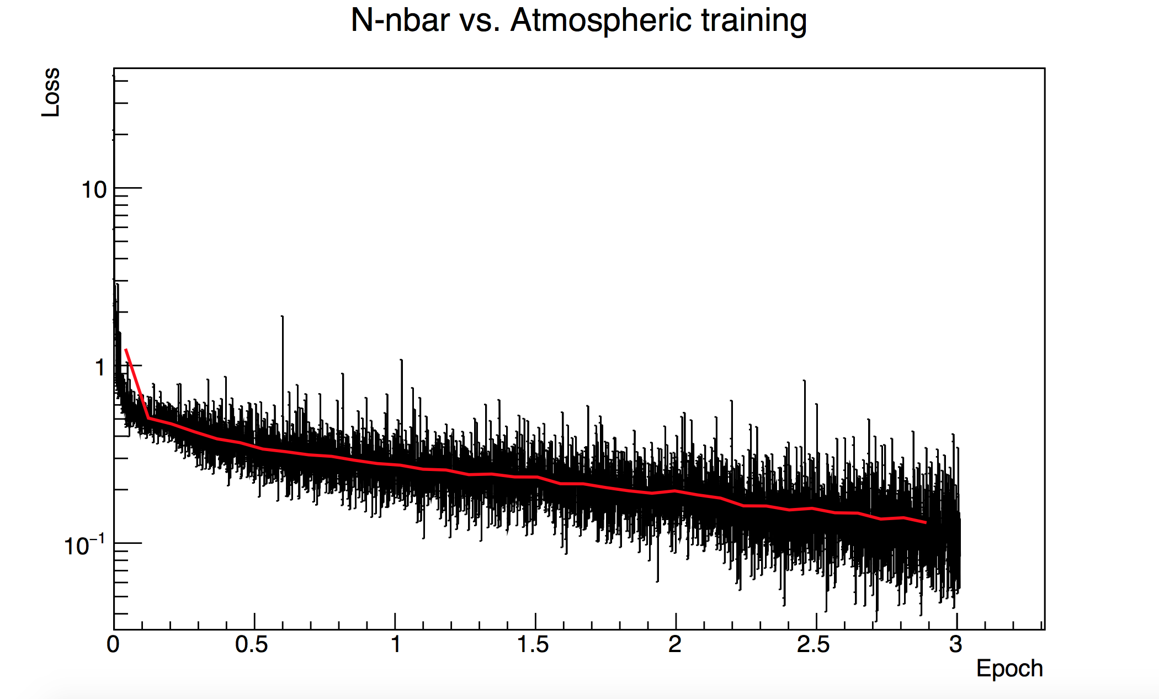
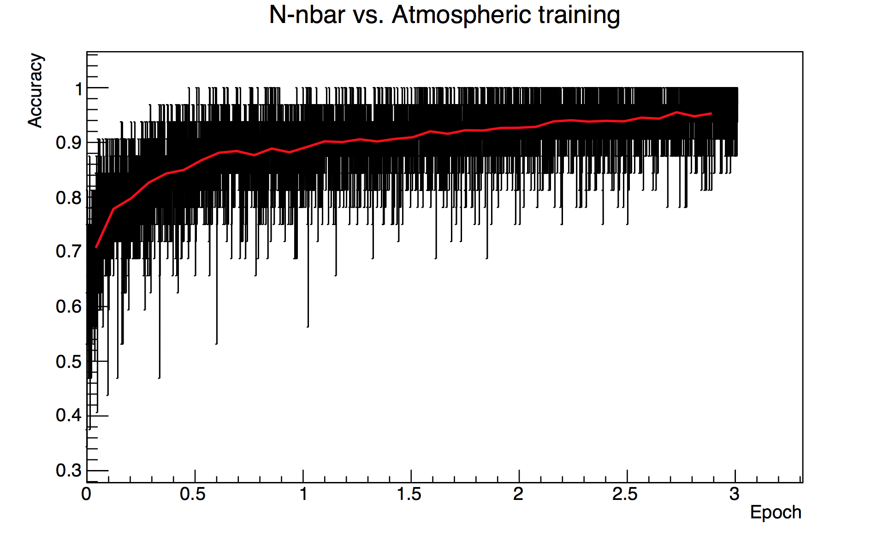
CNN analysis: Network Training, Validation
Loss
Accuracy
Iterations/Sample size
Iterations/Sample size
~38k images are used for n-n̅ osc. and atmospheric each for the network training.
The trained network is validated on a separate set of samples with validation accuracy 0.8983.
Yeon-jae Jwa | n-n̅ oscillation sensitivity study in DUNE
Notes:
13. Axis are difficult to read.

Slide 15
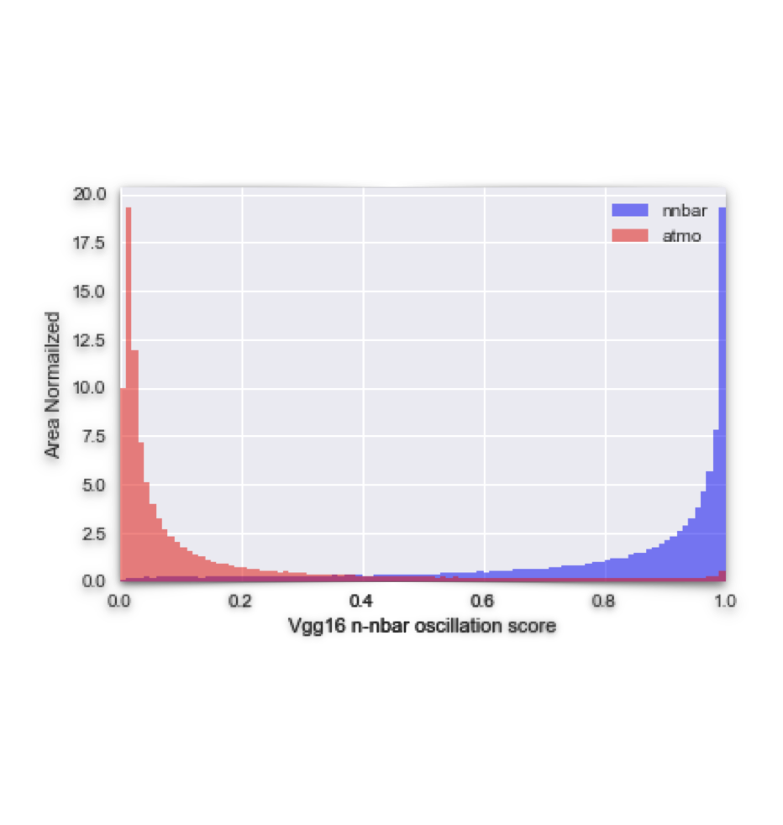
CNN analysis: Network Performance
The inference was performed on ~390k atmospheric events, ~107k n-n̅ oscillation signal events using the validated network.
Selecting signal events over background events can be carried out by applying CNN score cut.
Background-like Signal-like
Yeon-jae Jwa | n-n̅ oscillation sensitivity study in DUNE

Slide 16
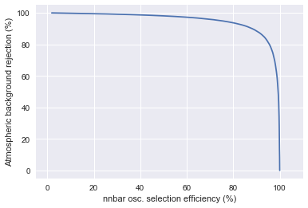
CNN analysis: Network Performance
WORK IN PROGRESS
Score Cut | Signal Efficiency (%) | Background Rejection (%)
0.9 | 54.4 | 97.74
0.95 | 41.22 | 98.60
0.99 | 19.31 | 99.49
0.999 | 6.009 | 99.8327
0.9995 | 4.245 | 99.8773
0.99986 | 2.223 | 99.9315
0.9999 | 1.860 | 99.9428
0.99995 | 1.316 | 99.9587
0.99999 | 0.6142 | 99.9802
Signal efficiencies and background rejection rates from applying different score cuts are obtained.
Yeon-jae Jwa | n-n̅ oscillation sensitivity study in DUNE
Notes:
15. plot from 0 to 100. and put a star on it.

Slide 17
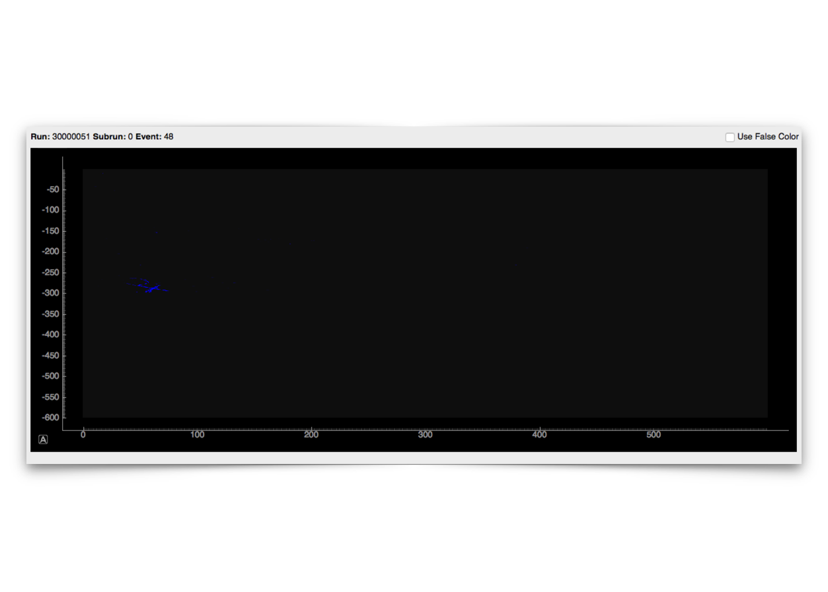
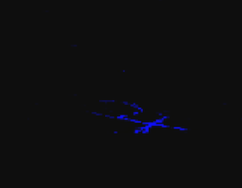
CNN analysis: Network Performance
Wire axis (1 APA)
Time axis
(1 drift time)
Well classified n-n̅ osc. event
run, subrun, event, n-n̅ score
(30000051, 0, 48, 9.9994e-01)
Yeon-jae Jwa | n-n̅ oscillation sensitivity study in DUNE
Notes:
16. collection plane only + circles + zoom in.

Slide 18
CNN analysis: Network Performance
Wire axis (1 APA)
Time axis
(1 drift time)
Well classified atmospheric event
run, subrun, event, n-n̅ score
(20000063, 1, 28, 1.331e-10)
Yeon-jae Jwa | n-n̅ oscillation sensitivity study in DUNE

Slide 19
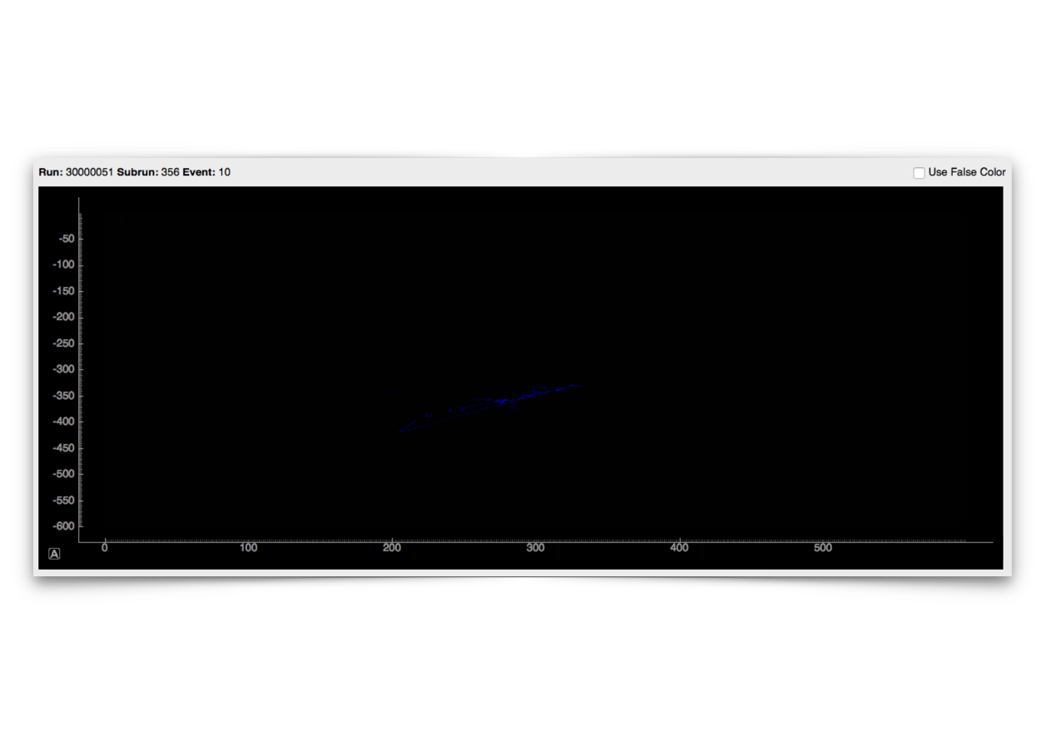
CNN analysis: Network Performance
Wire axis (1 APA)
Time axis
(1 drift time)
Poorly classified n-n̅ osc. event
run, subrun, event, n-n̅ score
(30000051, 356, 10, 7.481e-03)
Yeon-jae Jwa | n-n̅ oscillation sensitivity study in DUNE

Slide 20
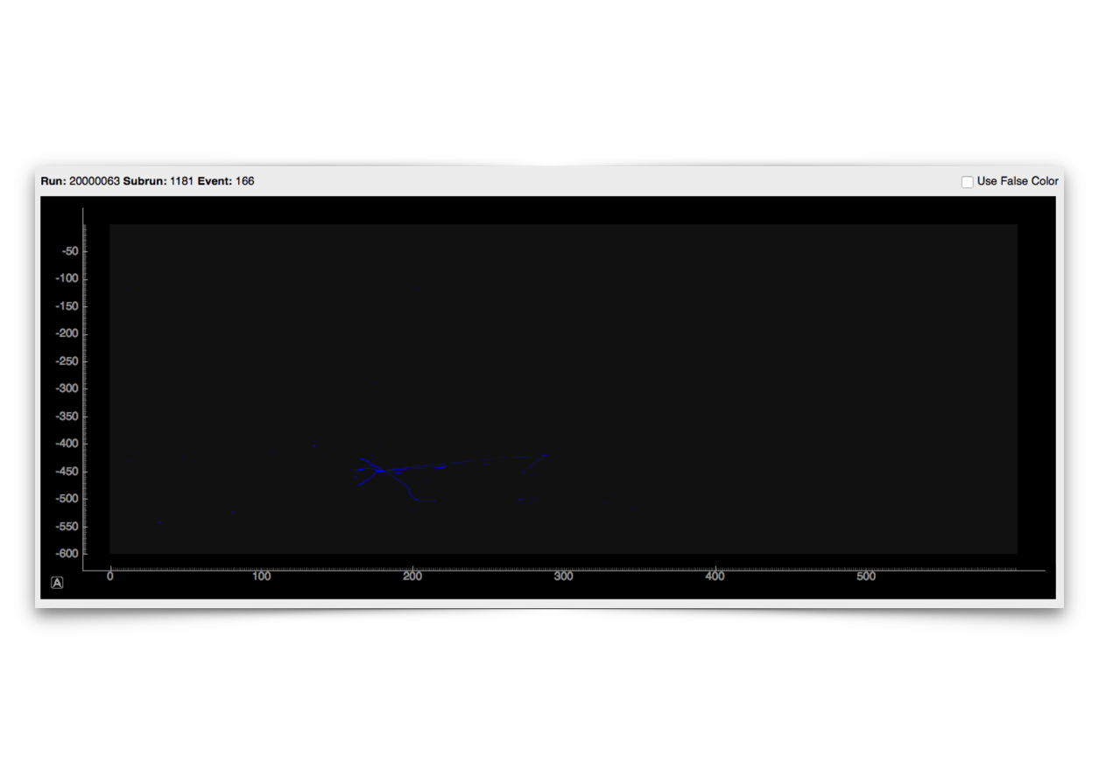
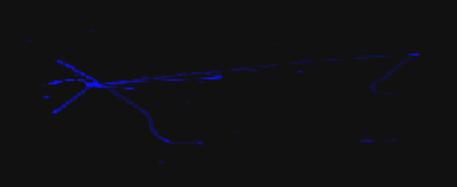
CNN analysis: Network Performance
Wire axis (1 APA)
Time axis
(1 drift time)
Poorly Classified atmospheric event
run, subrun, event, n-n̅ score
(20000063, 1181, 166, 1.00e+00)
Yeon-jae Jwa | n-n̅ oscillation sensitivity study in DUNE
Notes:
Work on transition

Slide 21
CNN analysis : Limit Calculation
With the CNN classification, 90% C.L. limit can be set to 6.6e31 yrs for argon-bound neutron, 1.8e8 s for free neutron using with 40kton, 10 yrs exposure in DUNE.
The uncertainty estimates for exposure, signal efficiency, background efficiency are adopted from Super-Kamiokande n-n̅ oscillation search, conservatively.
WORK IN PROGRESS
Score Cut | Signal Efficiency (%) | Background Efficiency (%)
0.99986 | 2.22 | 99.93
WORK IN PROGRESS
Variables | Exposure | Signal Efficiency | Background Efficiency
Systematic Uncertainties | 3% | 25% | 25%
Yeon-jae Jwa | n-n̅ oscillation sensitivity study in DUNE

Slide 22
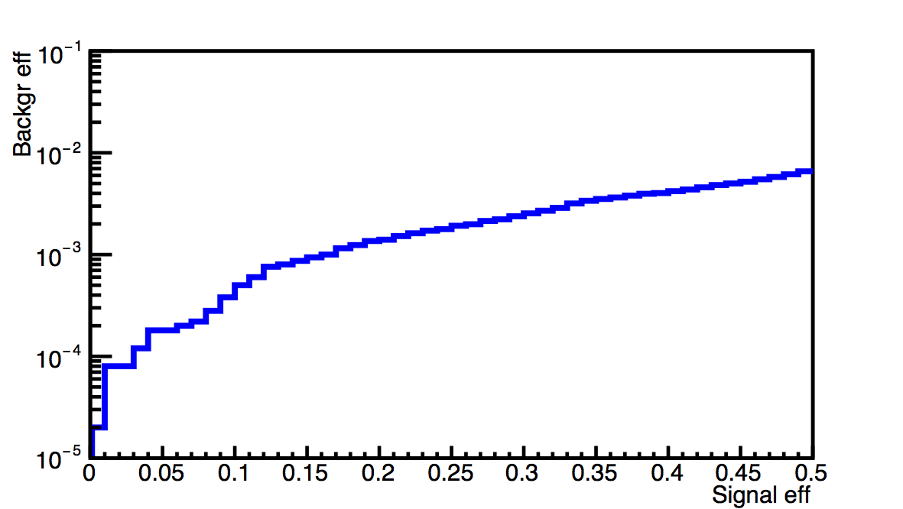
CNN + Boosted Decision Tree (BDT) combination result
with A. Higuera @ University of Houston -
Multivariate analysis using reconstruction kinematic variables.
CNN score can be added to BDT variables.
Using BDT, 8% signal efficiency with 0.02% background efficiency is achieved.
90% C.L. limit for n-n̅ oscillation lifetime is set to 6.44e32 yrs for bound neutron, 5.52e8 s for free neutron.
WORK IN PROGRESS
Yeon-jae Jwa | n-n̅ oscillation sensitivity study in DUNE

Slide 23
Summary and Conclusions
n-n̅ oscillation search sensitivity in DUNE is studied using machine-learning based methods.
Current CNN classification can achieve 99.93% background rejection at 2.22% signal efficiency. This result corresponds to lifetime limit 6.6e31 yrs for argon-bound neutron, 1.8e8 s for free neutron with 10 years of DUNE far detector exposure.
BDT analysis with CNN result accommodated sets lifetime limit at 6.44e32 yrs for argon-bound neutron, 5.52e8 s for free neutron with 10 years of DUNE far detector exposure.
These results are preliminary;
CNN performance improvement is work-in-progress.
Study on systematic uncertainties, truth level study for poorly classified events by CNN should be followed.
Yeon-jae Jwa | n-n̅ oscillation sensitivity study in DUNE

Slide 24
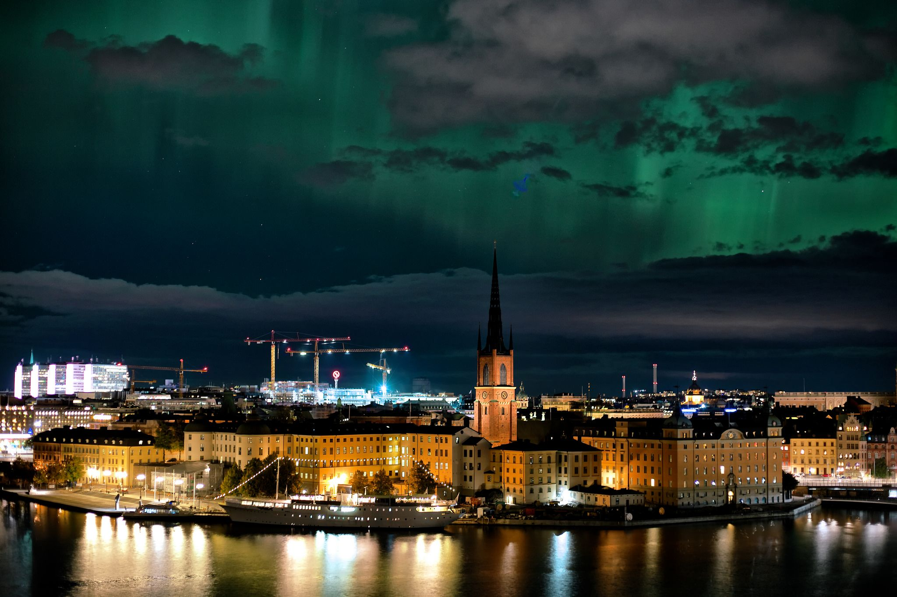
Thank you!

Slide 25
Back up

Slide 26
BDT analysis : Variables
Number of tracks: total number of reconstructed tracks. Reconstruction by PMA.
Number of showers: total number of reconstructed showers. Reconstruction by emshower algorithm.
Track-like visible energy: sum of track-like hits energy.
EM-like visible energy: sum of EM-like hits energy.
Visible energy: sum of the visible energy.
PID of the longest track: PID value of the longest track in the event.
Momentum of the longest track: reconstructed momentum (by range) of the longest track.
Electromagnetic-like visible energy fraction: EM-like visible energy/visible energy.
dE/dx of the most energetic shower.
CNN score: CNN image recognition score.
Yeon-jae Jwa | n-n̅ oscillation sensitivity study in DUNE

Slide 27
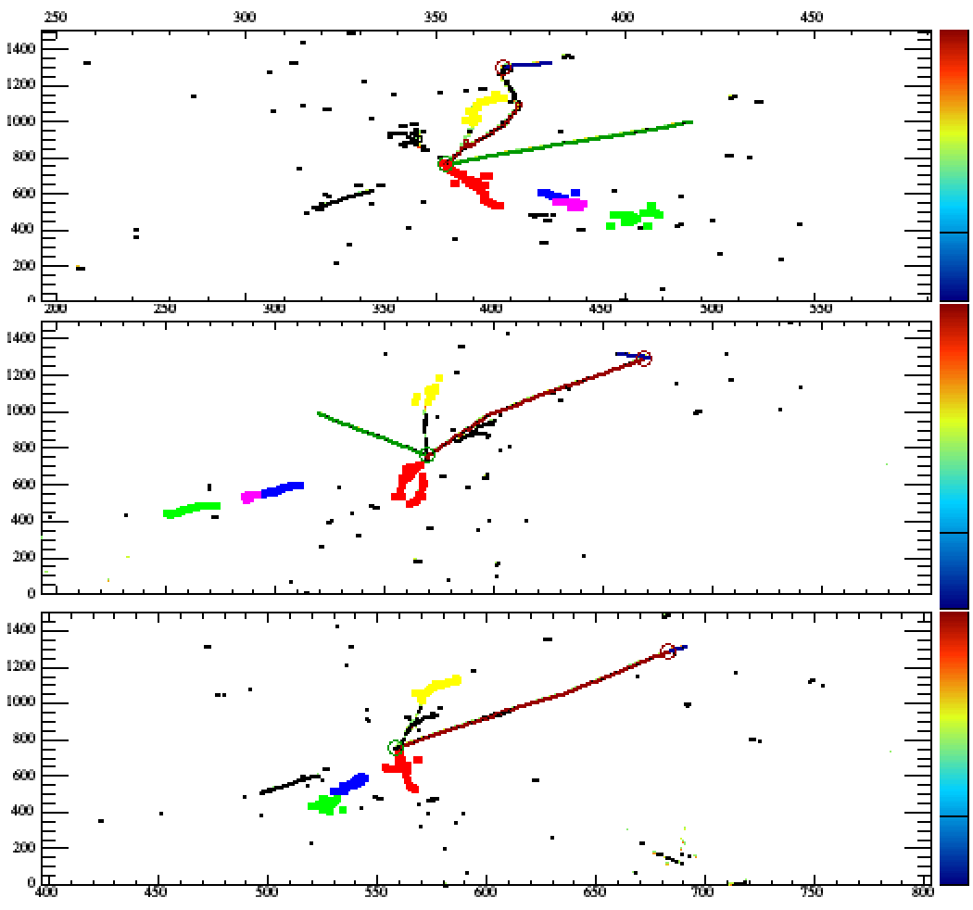
BDT analysis : Signal Event display
Signal event with high BDT response
Yeon-jae Jwa | n-n̅ oscillation sensitivity study in DUNE

Slide 28
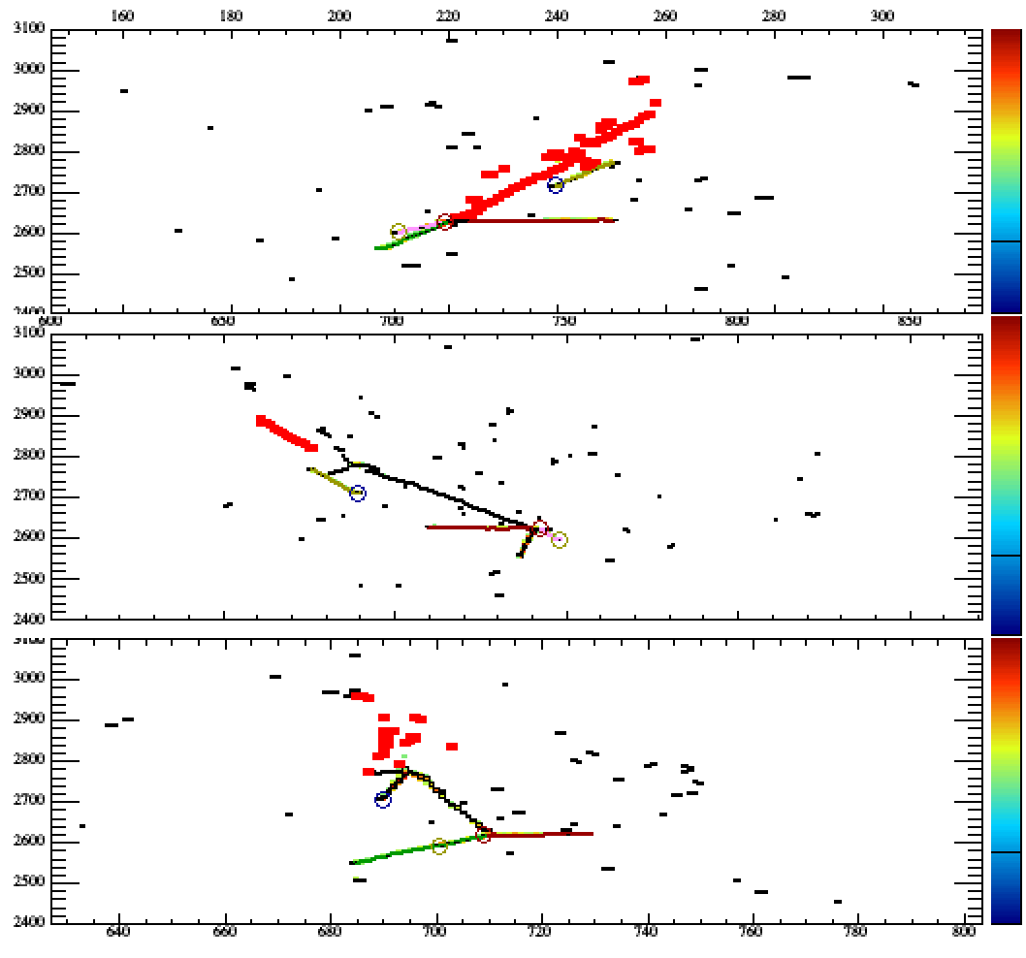
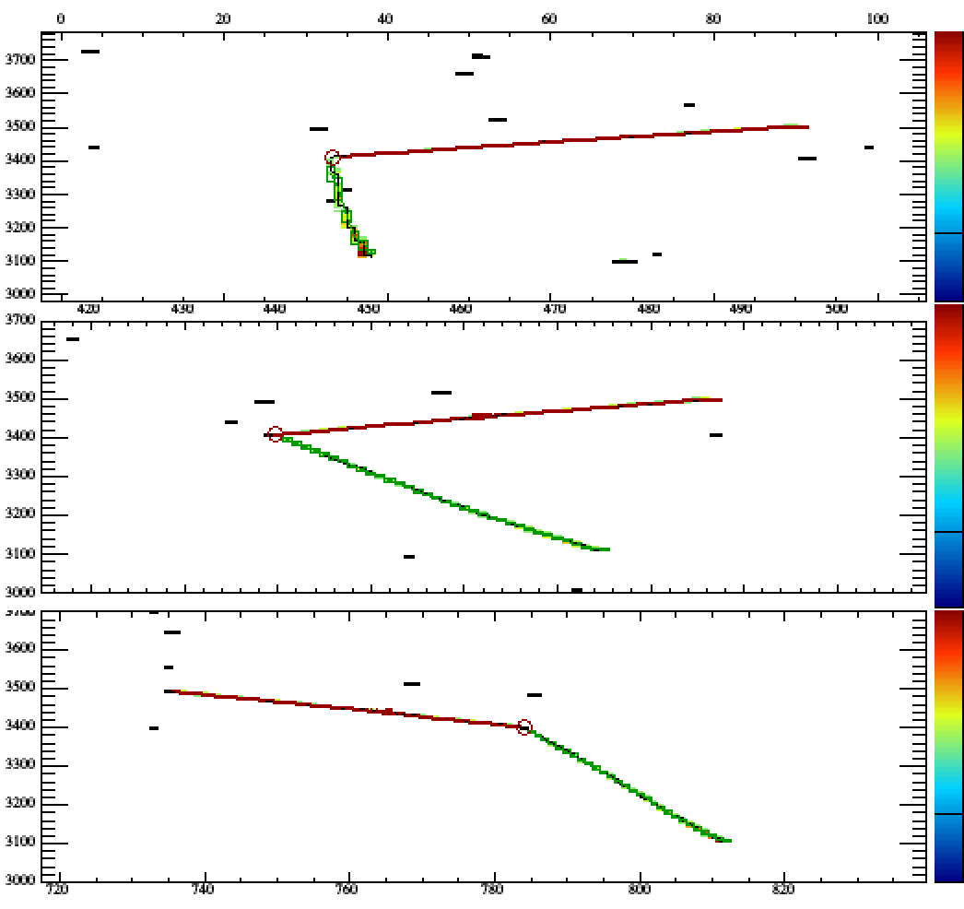
BDT analysis : Background Event display
Background with high BDT response
Background with low BDT response
Yeon-jae Jwa | n-n̅ oscillation sensitivity study in DUNE

Slide 29
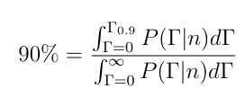
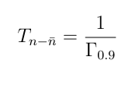
CNN analysis : Limit Calculation
90% C. L. limit of n-n̅ oscillation lifetime can be set for argon-bound neutron and free neuton.
Argon-bound neutron n-n̅ oscillation decay width limit is acquired, under the assumption of no signal observation (n = n_{obs} = # of expected bkg events), by finding the range of integral matching 90% of the integral over the whole decay width.
The lifetime limit of bound neutron is directly given from the decay width and the lifetime relation.
The free neutron n-n̅ oscillation lifetime limit is acquired using conversion factor R = 0.666e23 s⁻¹
Yeon-jae Jwa | n-n̅ oscillation sensitivity study in DUNE

Slide 30
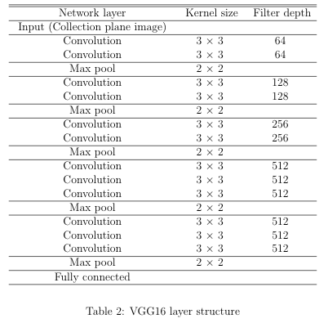
CNN analysis : VGG16b
Yeon-jae Jwa | n-n̅ oscillation sensitivity study in DUNE

Slide 31
CNN analysis : Solver
base_lr: 0.0001
display: 1
lr_policy: "inv"
gamma: 1e-05
power: 0.75
momentum: 0
weight_decay: 0.001
iter_size: 4
snapshot_format: HDF5
rms_decay: 0.9
type: "RMSProp"
Yeon-jae Jwa | n-n̅ oscillation sensitivity study in DUNE

Slide 32
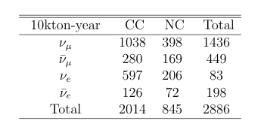
Atmospheric neutrino flux
Yeon-jae Jwa | n-n̅ oscillation sensitivity study in DUNE

