Slide 1
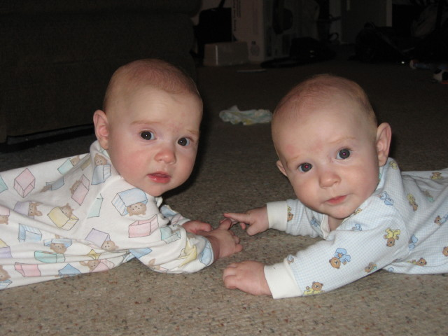
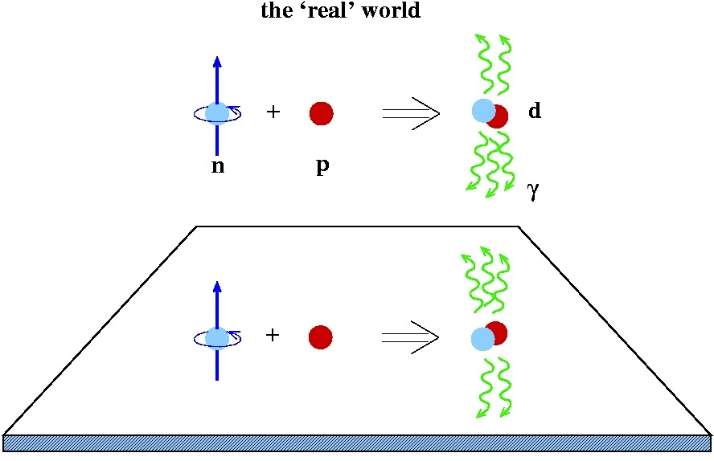

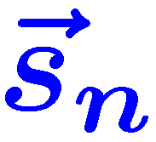
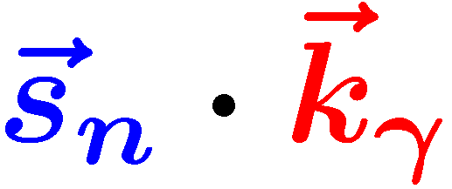

NDTGamma: A pulse-counting
Hadronic Parity Violation experiment
General considerations
  Experimental data
  Cross section / asymmetry
Experimental setup
  NG-C + ³He polarizer
D₂O target + backgrounds
  LANL depolarization measurement
CsI array + counting mode
  Efficiency simulations
  Digital pulse processing
Experimental sensitivity
  Statistical/systematic errors
Madison
Spencer
t
d

Slide 2
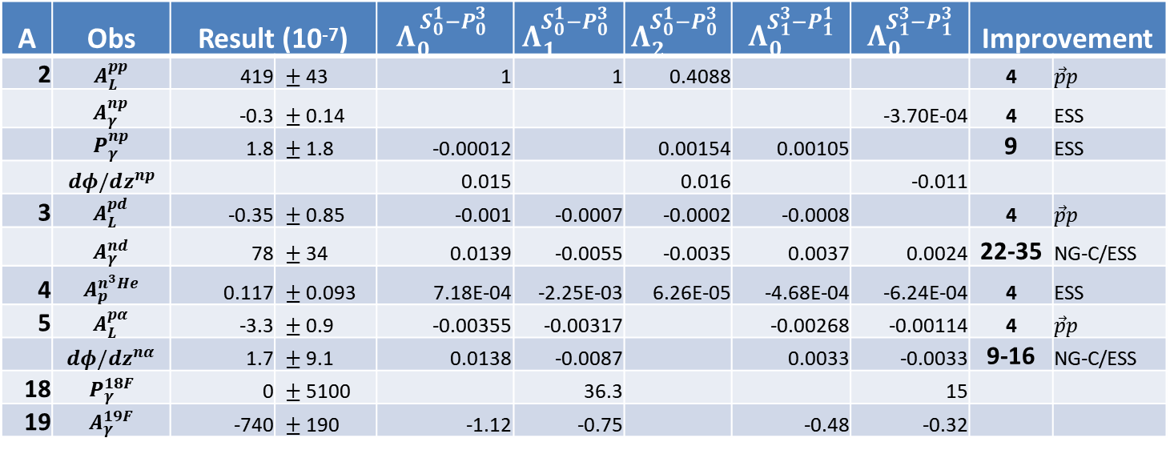

NPDG/n³He are done—what next?
Few-body observables: Haxton & Holstein, PPNP 71, 195 (2013)
A=2: $A_{L}^{\vec{p}p}$, $A_{γ}^{\vec{n}p}$, $P_{γ}^{np}$, $φ_{,z}^{\vec{n}p}$, $A_{p}^{\vec{γ}d}$ A=4: $A_{γ}^{{\vec{n}}^{ 3}He}$
A=3: $A_{L}^{\vec{p}d}$, $A_{γ}^{\vec{n}d}$, $A_{γ}^{n\vec{d}}$, $φ_{,z}^{\vec{n}d}$A=5: $A_{L}^{\vec{p}α}$, $φ_{,z}^{\vec{n}α}$
✓
✓
✓
✗
✗
✓
✗
✗
✓
A | Obs | Result (10⁻⁷) |  | $$Λ_{0}^{{ S}_{0}^{1}−P_{0}^{3}}$$ | $$Λ_{1}^{S_{0}^{1}−P_{0}^{3}}$$ | $$Λ_{2}^{S_{0}^{1}−P_{0}^{3}}$$ | $$Λ_{0}^{S_{1}^{3}−P_{1}^{1}}$$ | $$Λ_{0}^{S_{1}^{3}−P_{1}^{3}}$$ | Improvement
2 | $$A_{L}^{pp}$$ | 419 | $±$43 | 1 | 1 | 0.4088 |  |  | 4 | $$\vec{p}p$$
 | $$A_{γ}^{np}$$ | -0.3 | $±$0.14 |  |  |  |  | -3.70E-04 | 4 | ESS
 | $$P_{γ}^{np}$$ | 1.8 | $±$1.8 | -0.00012 |  | 0.00154 | 0.00105 |  | 9 | ESS
 | $dφ/dz^{np}$ |  |  | 0.015 |  | 0.016 |  | -0.011
3 | $$A_{L}^{pd}$$ | -0.35 | $±$0.85 | -0.001 | -0.0007 | -0.0002 | -0.0008 |  | 4 | $$\vec{p}p$$
 | $$A_{γ}^{nd}$$ | 78 | $±$34 | 0.0139 | -0.0055 | -0.0035 | 0.0037 | 0.0024 | 22-35 | NG-C/ESS
4 | $$A_{p}^{n^{3}He}$$ | 0.117 | $±$0.093 | 7.18E-04 | -2.25E-03 | 6.26E-05 | -4.68E-04 | -6.24E-04 | 4 | ESS
5 | $$A_{L}^{pα}$$ | -3.3 | $±$0.9 | -0.00355 | -0.00317 |  | -0.00268 | -0.00114 | 4 | $$\vec{p}p$$
 | $$dφ/dz^{nα}$$ | 1.7 | $±$9.1 | 0.0138 | -0.0087 |  | 0.0033 | -0.0033 | 9-16 | NG-C/ESS
18 | $$P_{γ}^{18F}$$ | 0 | $±$5100 |  | 36.3 |  |  | 15
19 | $$A_{γ}^{19F}$$ | -740 | $±$190 | -1.12 | -0.75 |  | -0.48 | -0.32

Slide 3
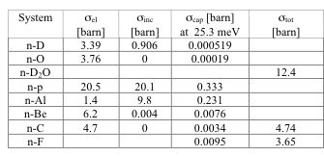
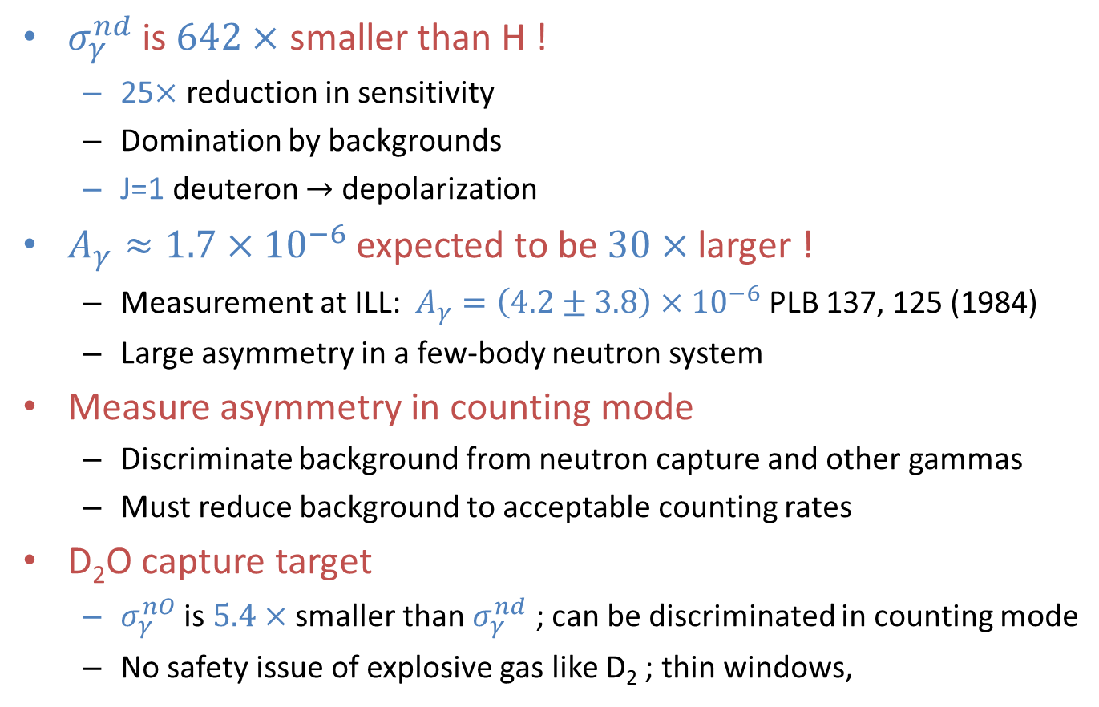
General considerations of NDTG
$σ_{γ}^{nd}$ is $642×$ smaller than H !
  25$×$ reduction in sensitivity
  Domination by backgrounds
  J=1 deuteron $→$ depolarization
$A_{γ}≈1.7×{10}^{−6}$ expected to be$30×$ larger !
  Measurement at ILL: $A_{γ}=\left(4.2±3.8\right)×{10}^{−6}$ PLB 137, 125 (1984)
  Large asymmetry in a few-body neutron system
Measure asymmetry in counting mode
  Discriminate background from neutron capture and other gammas
  Must reduce background to acceptable counting rates
D₂O capture target
  $σ_{γ}^{nO}$ is $5.4×$ smaller than $σ_{γ}^{nd}$ ; can be discriminated in counting mode
  No safety issue of explosive gas like D₂ ; thin windows,

Slide 4
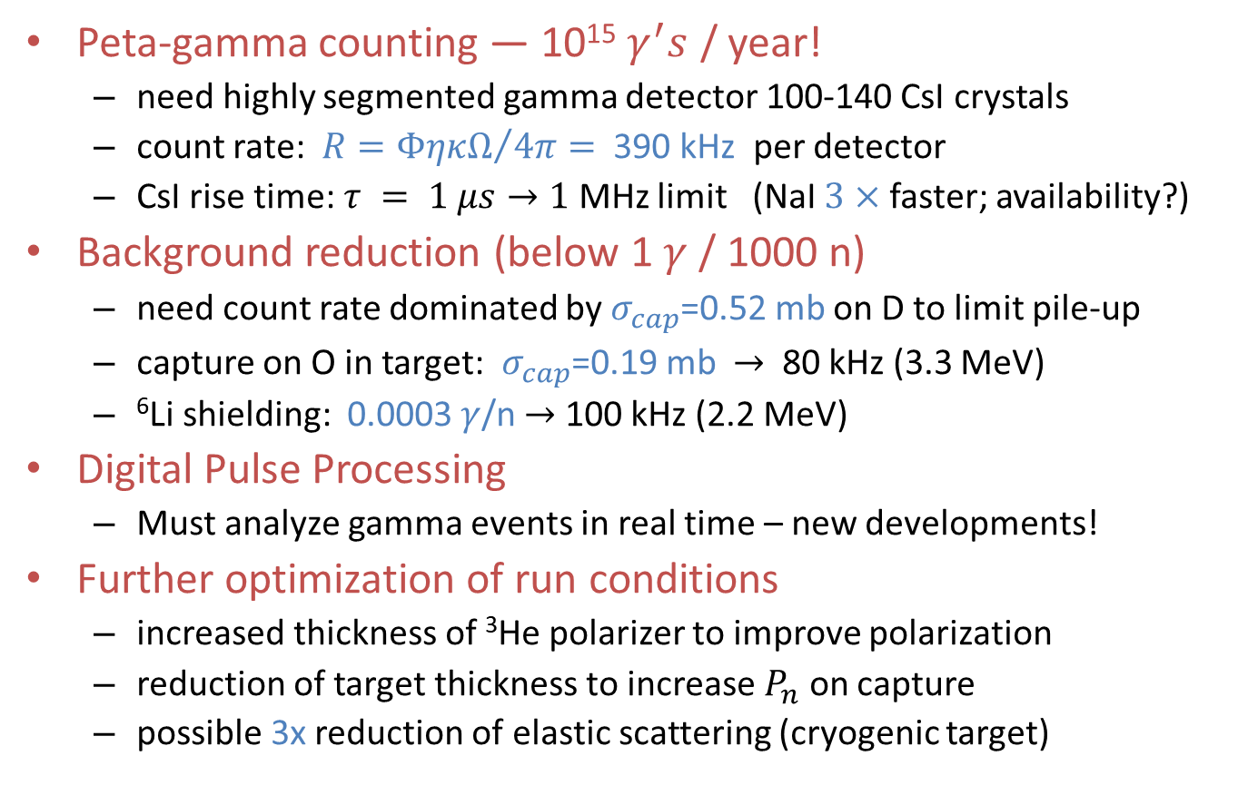
Counting rates
Peta-gamma counting — 10¹⁵ $γ^{′}s$ / year!
  need highly segmented gamma detector 100-140 CsI crystals
  count rate: $R={ΦηκΩ}/{4π}=$ 390 kHz per detector
  CsI rise time: $τ = 1 μs→1$ MHz limit (NaI $3×$ faster; availability?)
Background reduction (below 1 $γ$ / 1000 n)
  need count rate dominated by $σ_{cap}$=0.52 mb on D to limit pile-up
  capture on O in target: $σ_{cap}$=0.19 mb $→$ 80 kHz (3.3 MeV)
  ⁶Li shielding: 0.0003 $γ$/n $→$ 100 kHz (2.2 MeV)
Digital Pulse Processing
  Must analyze gamma events in real time – new developments!
Further optimization of run conditions
  increased thickness of ³He polarizer to improve polarization
  reduction of target thickness to increase $P_{n}$ on capture
  possible 3x reduction of elastic scattering (cryogenic target)

Slide 5
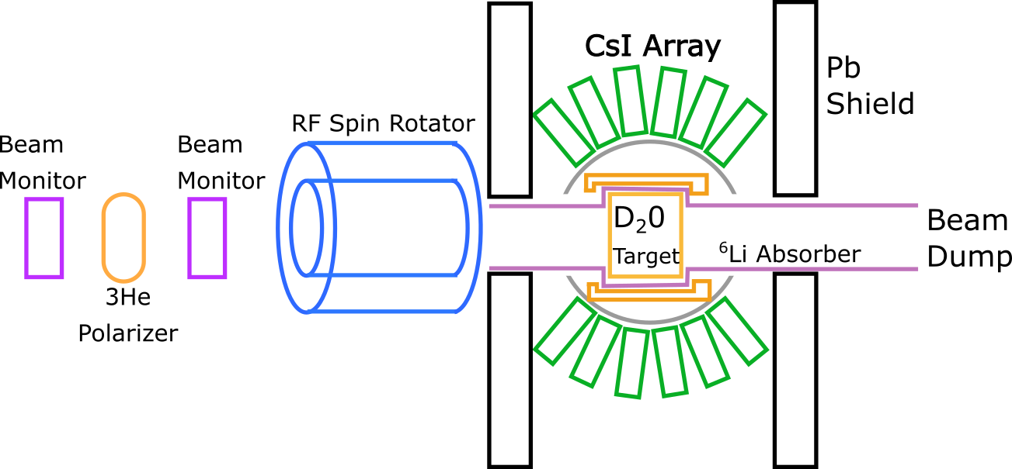
NDTG experimental setup
schematic of component layout
  background-less ³He polarizer
  highly segmented CsI array
  to spread out counting rate
  ⁶Li or ³He shielding essential!

Slide 6

D₂O depolarization measurement
Measurement of $P_{γ}$, Summer 2009 at FP12, LANSCE, LANL
  Compton polarimeter
  resolved spectrum, capture on
  6.26 MeV n+D,
  5.42 MeV n+³²S
Magnetized analyzer for $γ$’s (A. Komives, DePauw University)
  solenoid with a Permendur (copper-nickel-vanadium alloy) core
  3000 A turns, 2.5 T core field, $n_{0}=2.2×{10}^{24}$ cm³, $f=0.077$ e/atom
  Compton scattering cross section $σ_{c}=0.045×{10}^{−24}$ cm²
Magnetic field
Beam monitors
HPGe
D₂O
target
³He polarizer
RF spin flipper
HPGe
Permendur
Compton
analyzer
gamma and neutron shielding

Slide 7
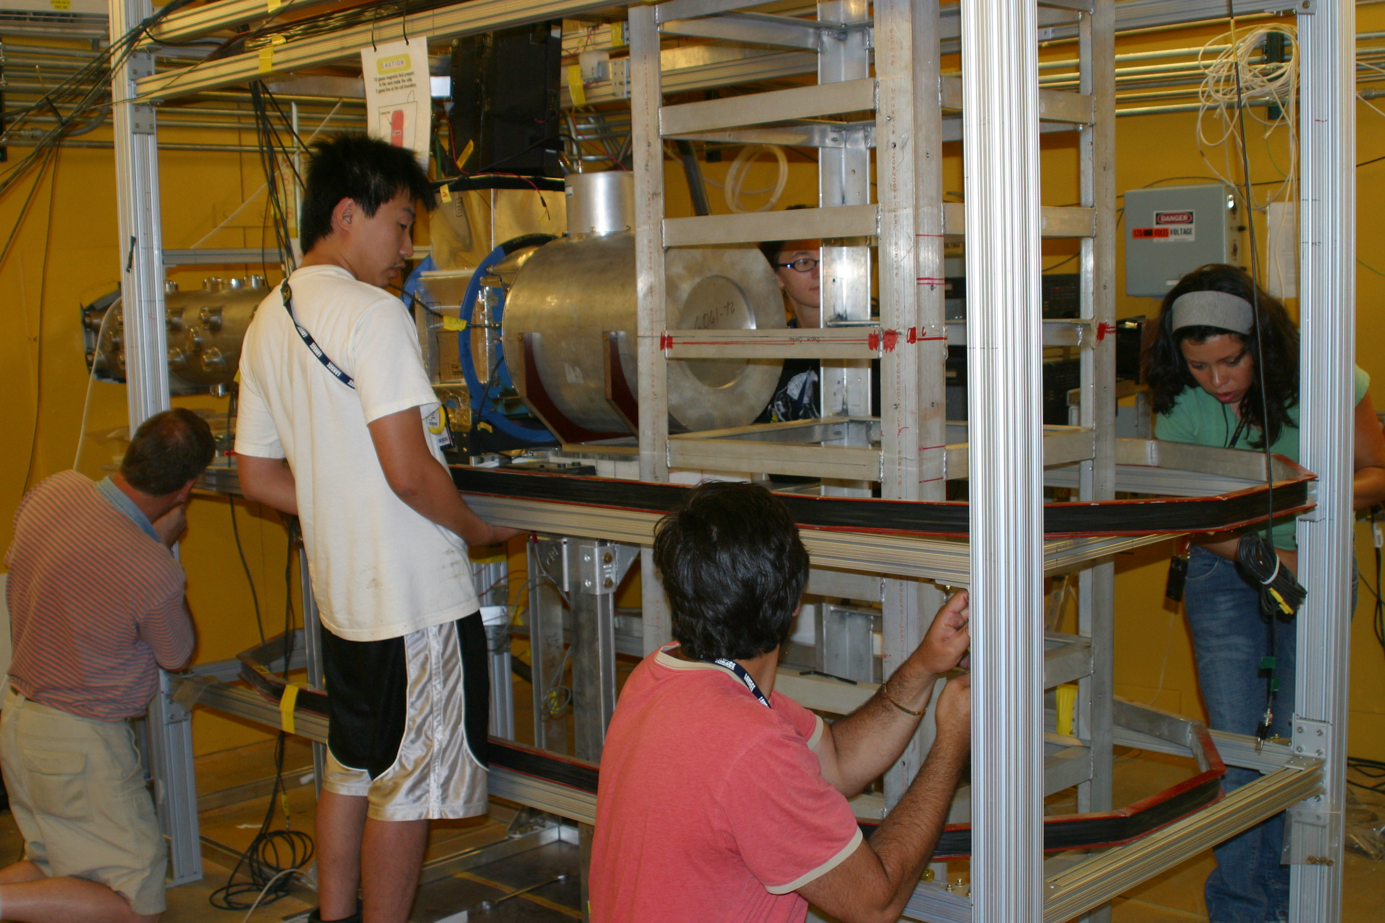
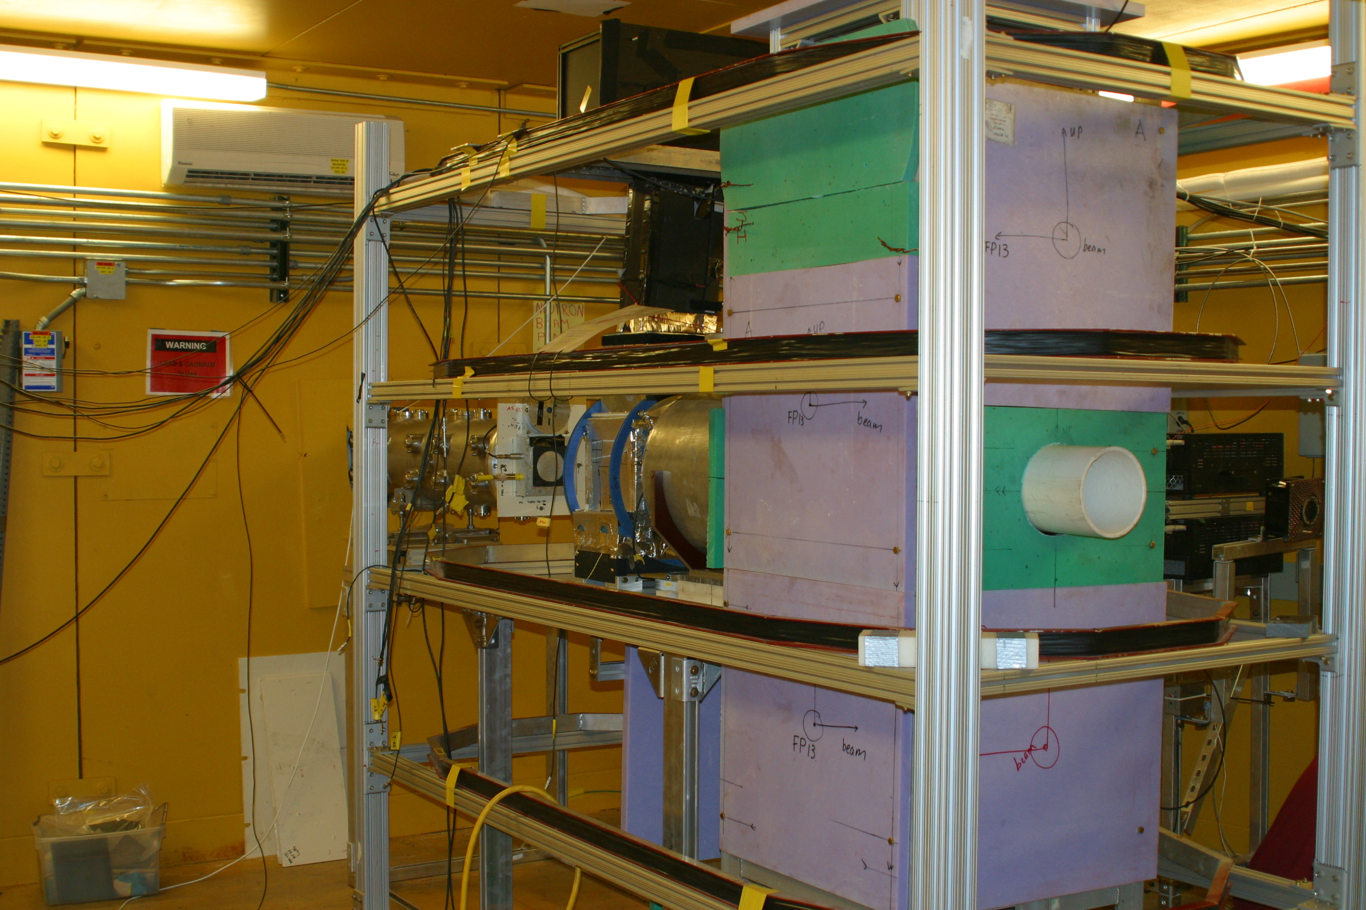
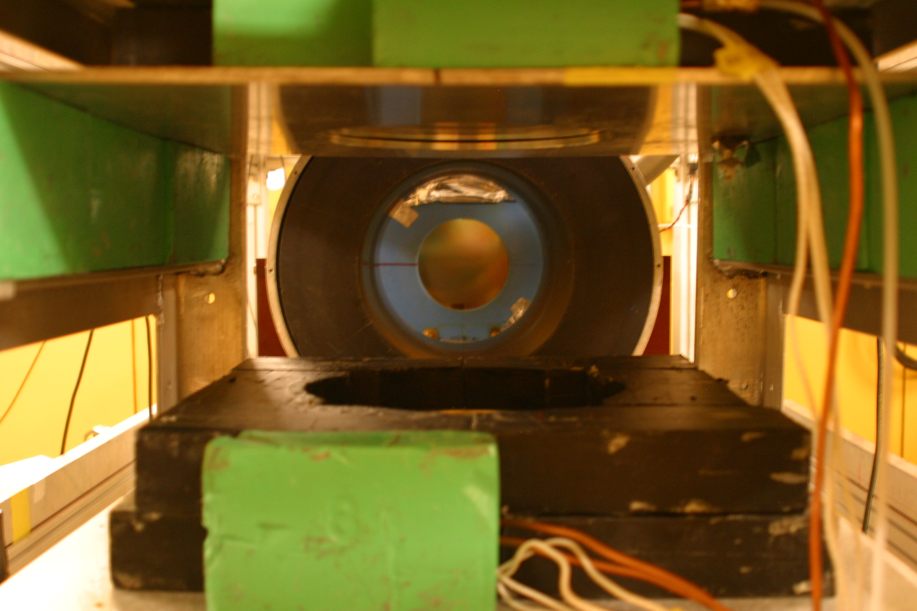
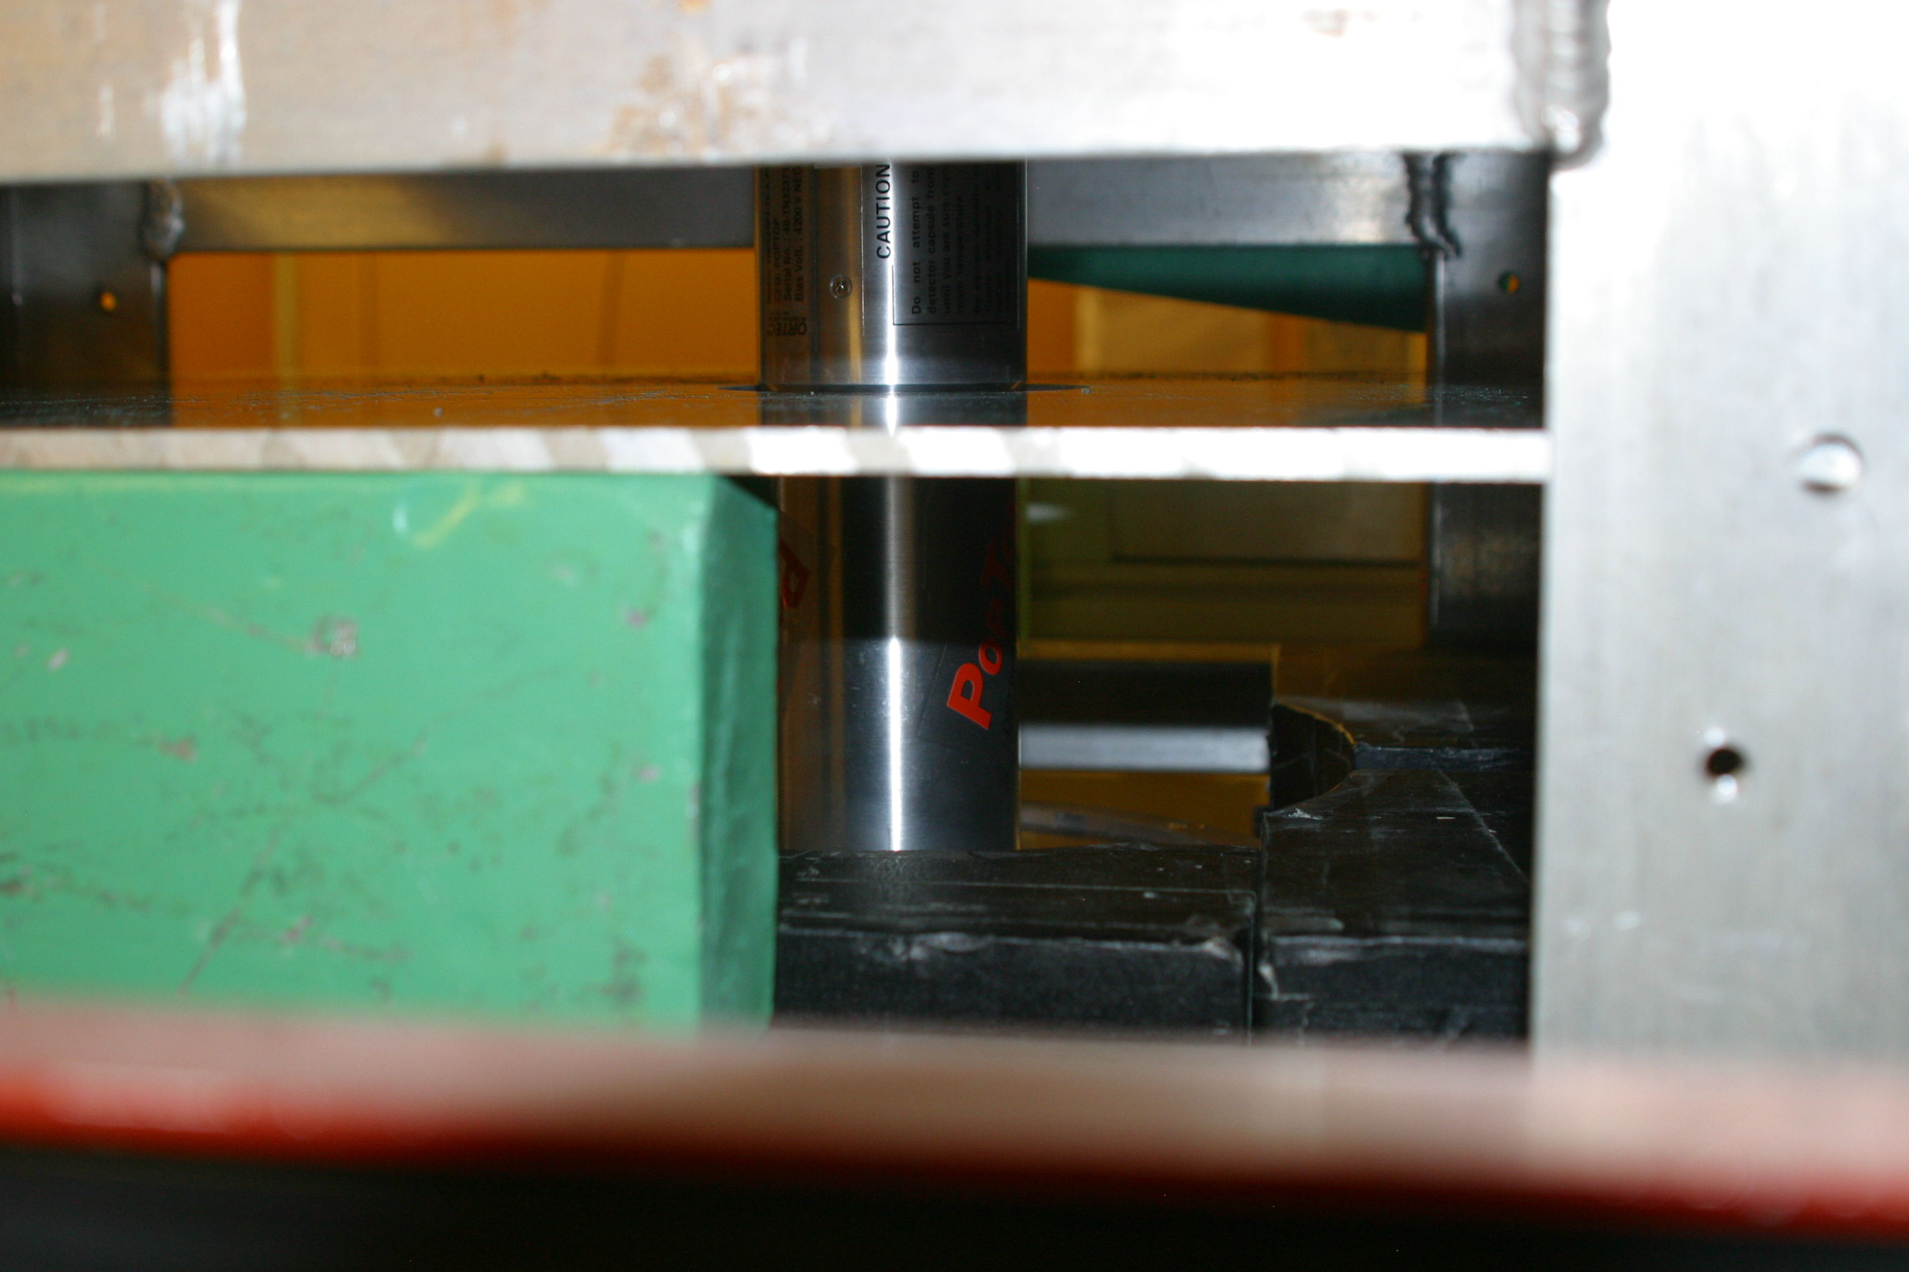
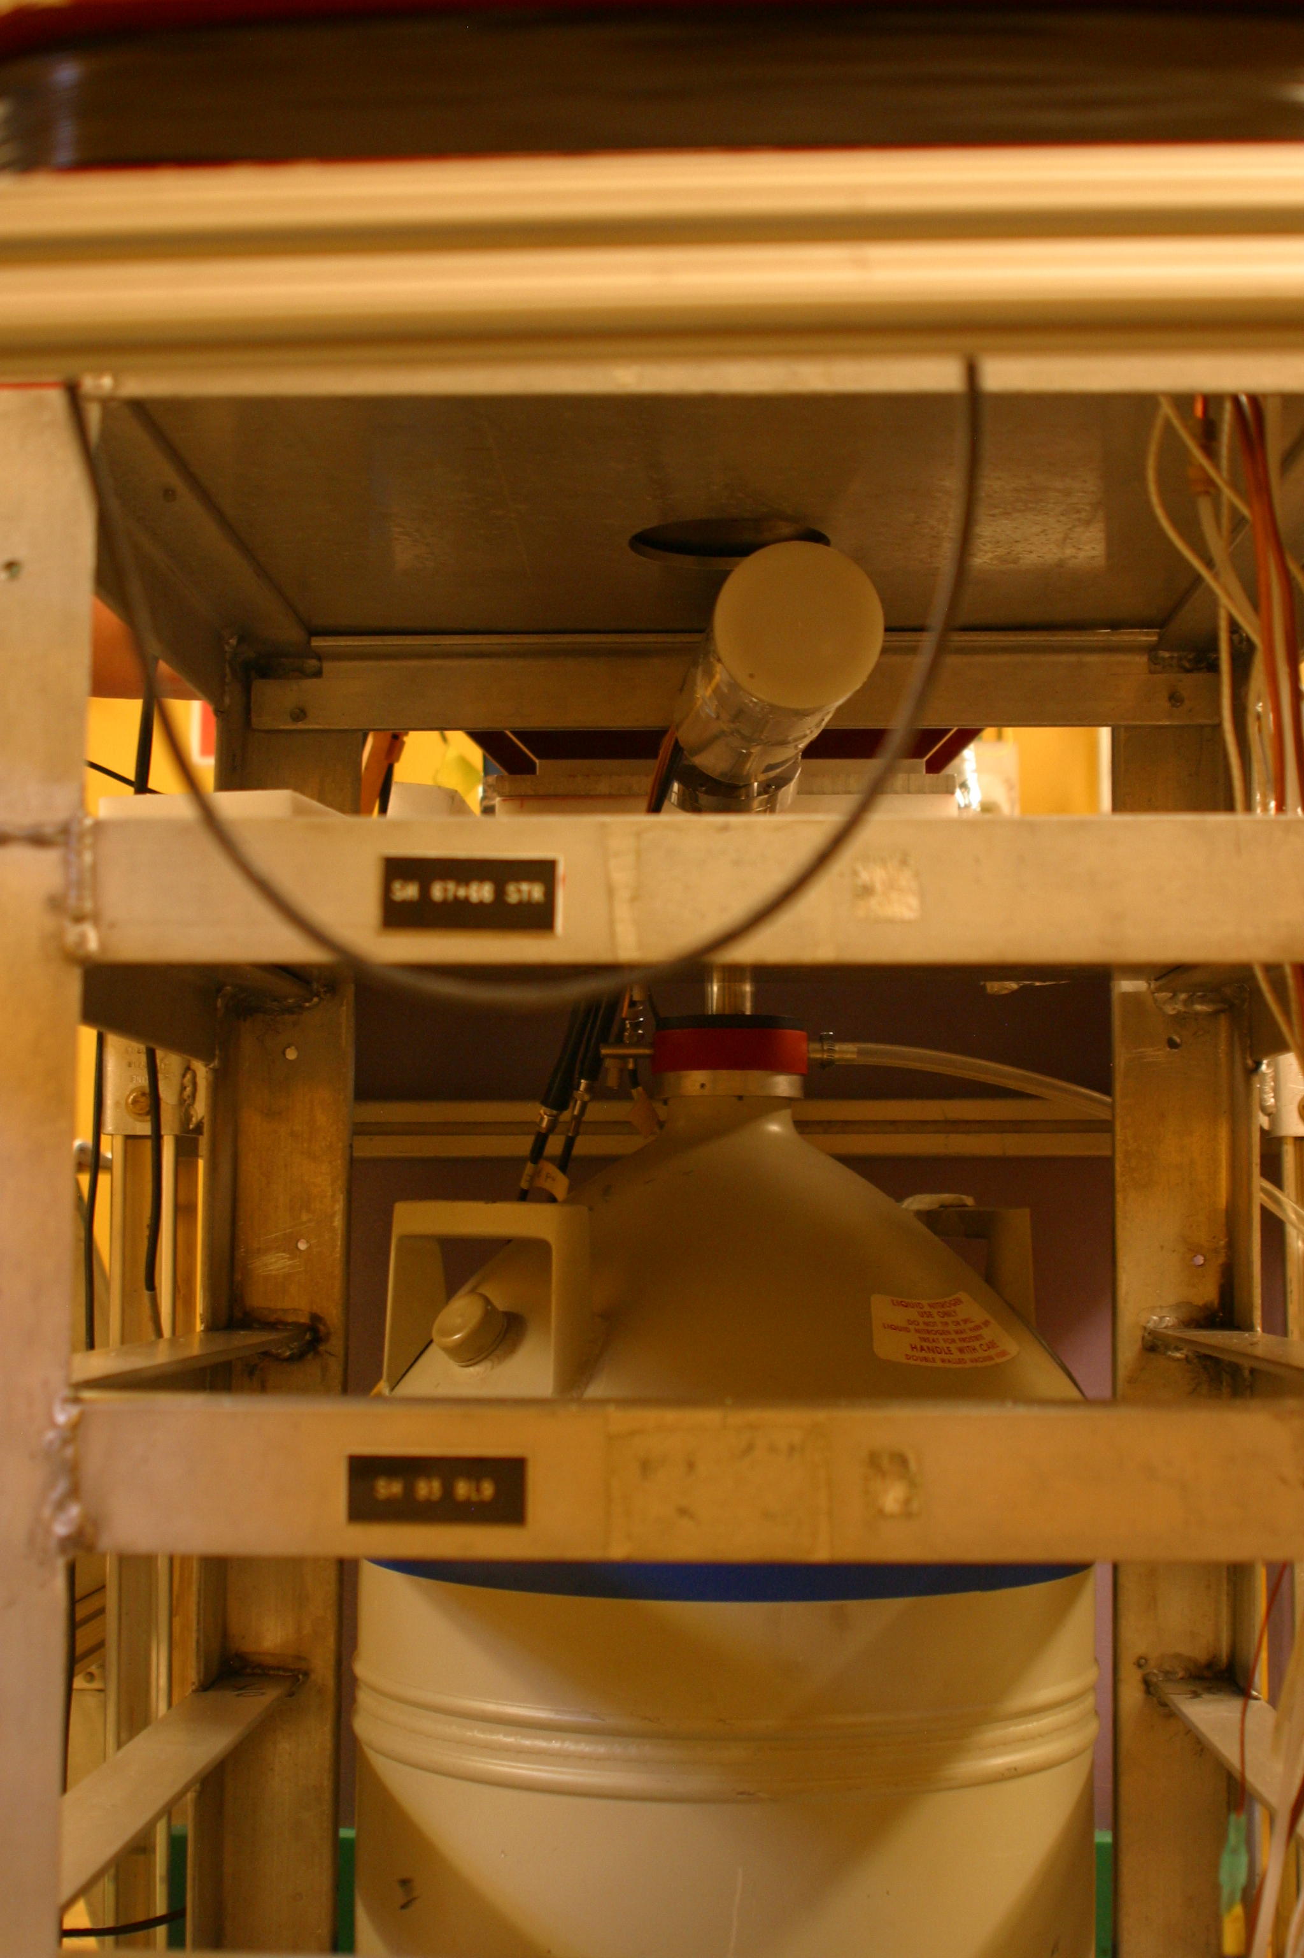
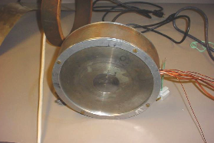
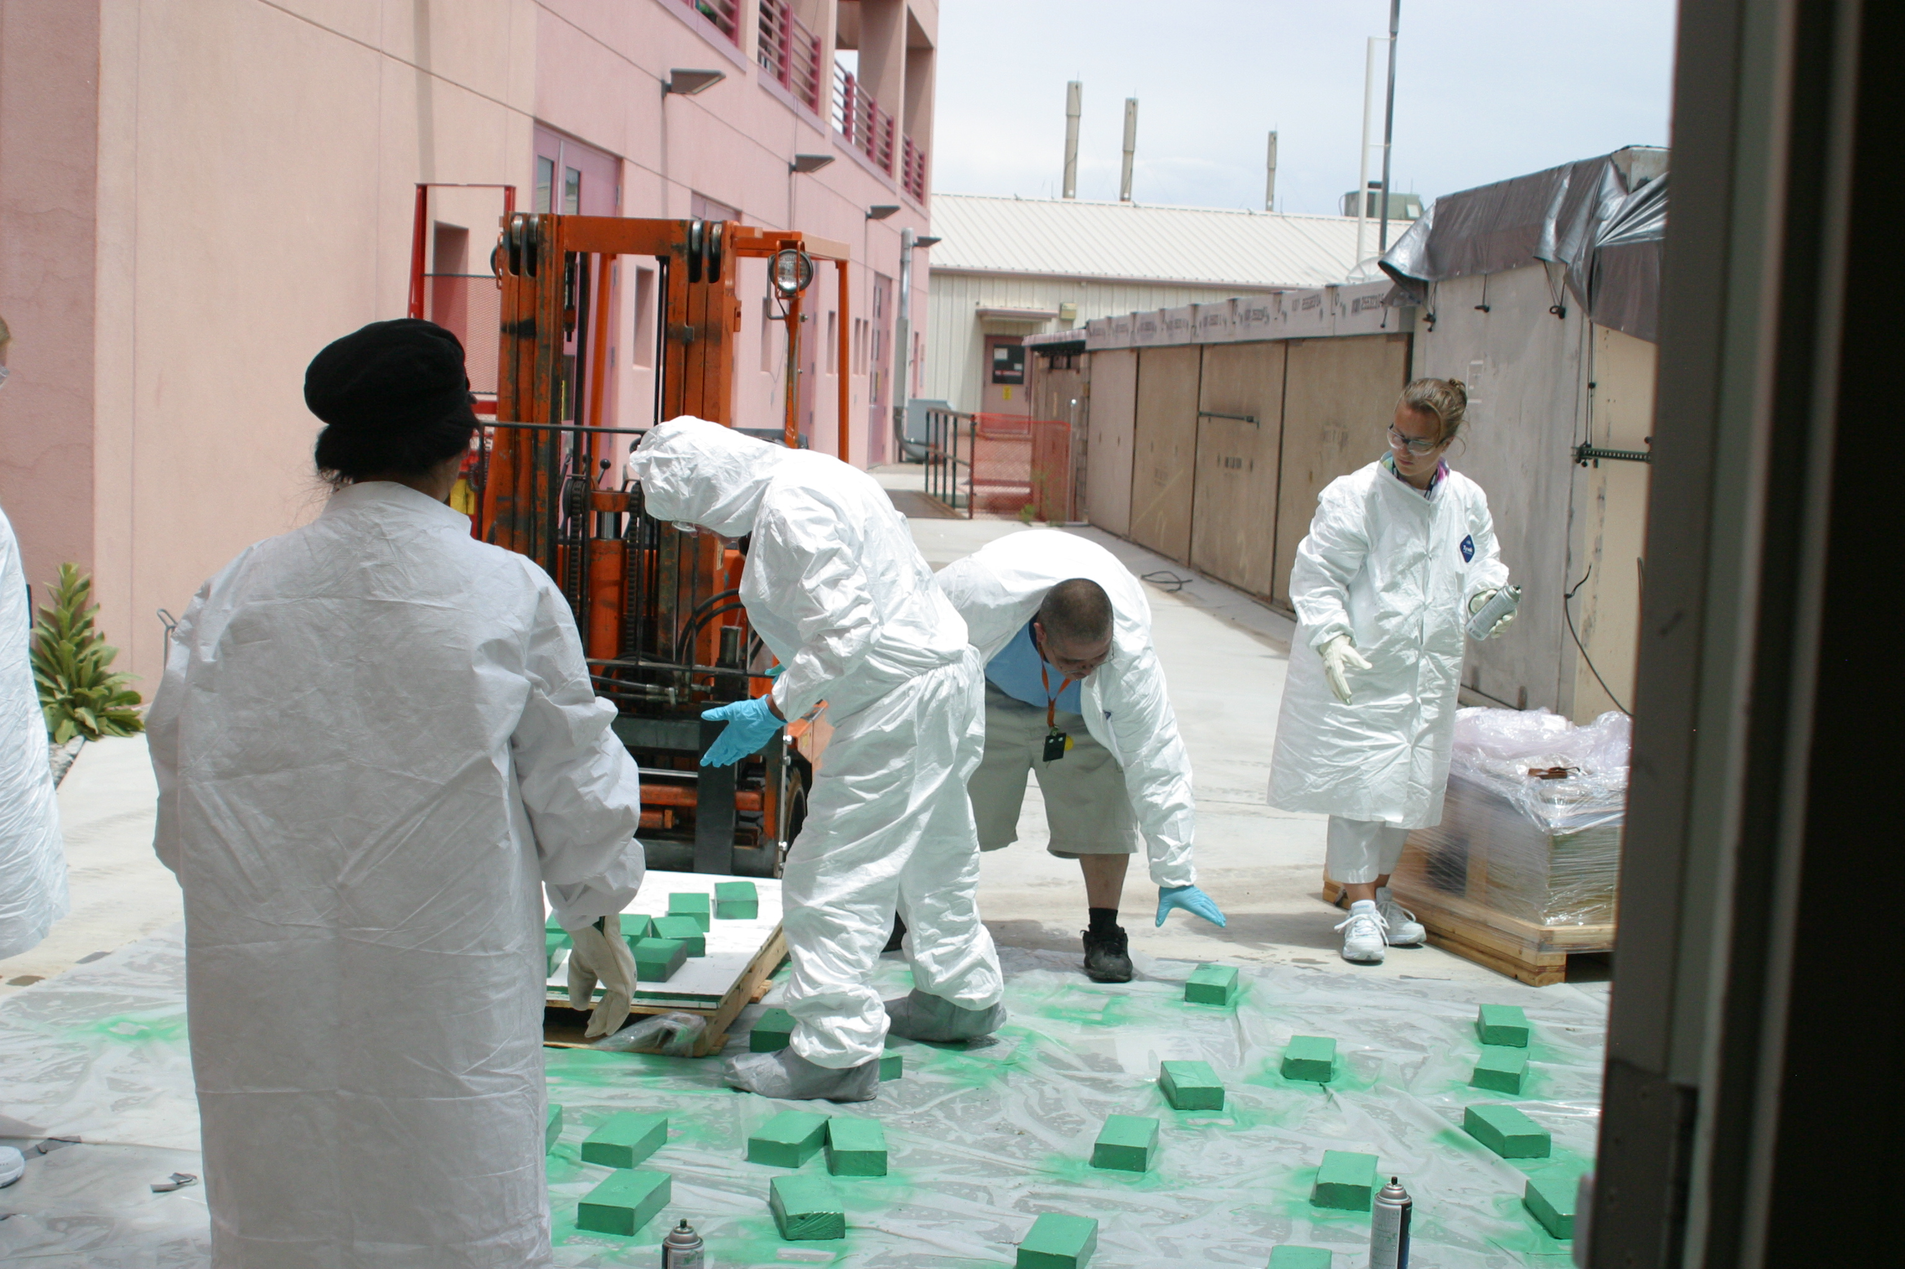
Setup at
LANL

Slide 8

D₂O depolarization measurement
photo-peak asymmetry (Z. Tang, Indiana Univ.):
  $A_{D}=\left(1.80±0.77\right)×{10}^{−3}$ $A_{S}=\left(2.66±0.63\right)×{10}^{−3}$
determination of polarization $P_{n}=\frac{1}{ηR}\frac{N_{+}−N_{−}}{N_{+}+N_{−}}$
  where $R_{D}=−0.42±0.03$ (Phys. Lett. B 205, 215, 1988); $R_{S}=0.50$
  $η$ is the Compton polarimeter efficiency
D₂O
³²S

Slide 9
CsI(Tl) crystals — CLEO II detector
Blucher et al,
NIM A249, 201(1986)
5 x 5 x 30 cm² crystal
relatively slow, but efficient

Slide 10
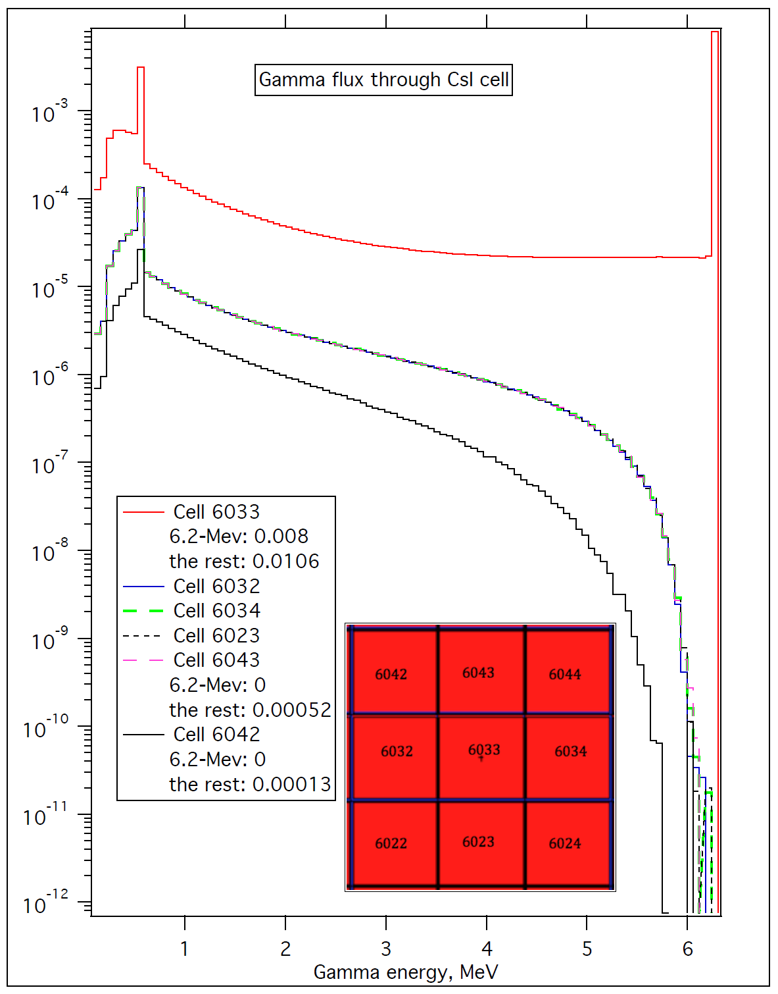
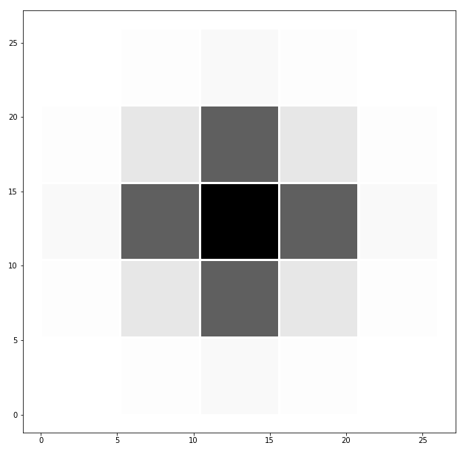

Gamma Detection in CsI array
MCNP simulation (I. Novikov, Western Kentucky University)
  5x5 array of $5×5×30$ cm³ crystals
  unidirectional 6.2 MeV point-source
  $ε$=80.5% photopeak in center crystal
  6.1% leakage through 1 mm of Pb
  285 keV max energy in neighbor

Slide 11
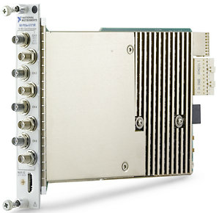
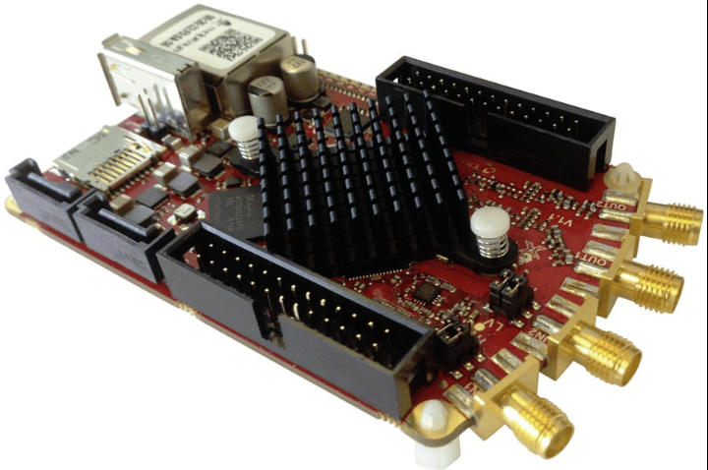
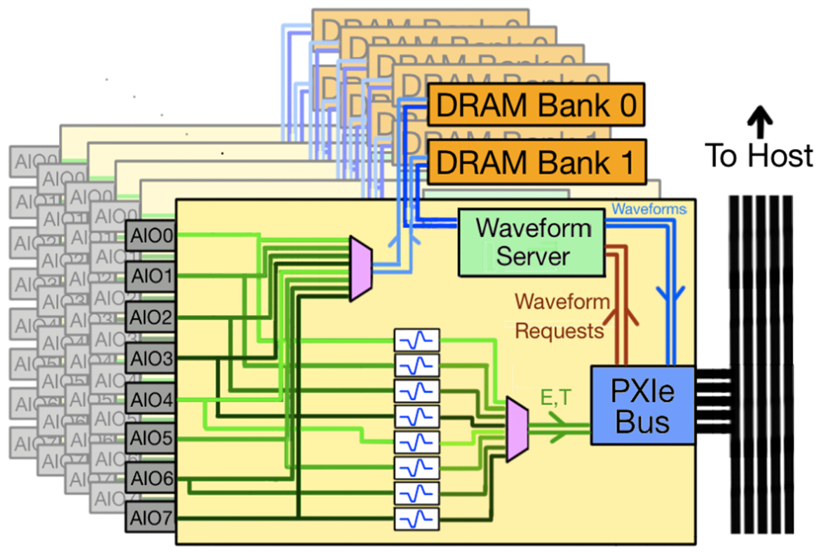
DAQ system
candidate system: Nab DAQ (Aaron Sprow, U. Kentucky) $1500/ch
  user-programmable energy filter and trigger logic onboard FPGA
  for example: to implement energy recovery in pile-up events
low-cost solution: RedPitaya digitizer SOC platform $150/ch
  2 RF input + 2 RF output 75 MHz bandwidth 14 bit, 125 MS/s
  Xilinx Zynq: 2 ARM cores + FPGA; Linux + open source firmware
  trapezoid filter developed (Yuke Wang, University of Kentucky)
NI PXIe-5171R
K7-410T FPGA + 1.5 GB RAM
8 ch, 14 bit, 250 MS/s
LabVIEW FPGA low-threshold trapezoid trigger on ADC
RedPitaya digitizer
Zynq 7010 SoC + 4 GB RAM
2 ADC + 2 DAC @ 14 bit, 125 MS/s

Slide 12




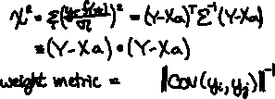
Least Squares Template Fitter
measure noise spectrum
acquire average template
waveforms representing nonlinear variations of signal (pulse-shape)
LSQ inverse of design matrix w/r cross-correlation matrix to project out backgrounds
FIR filter for each response function approximated by piecewise polynomials
calculate X2 in real-time, repeat linear LSQ fit for t0 at minimum X2

Slide 13
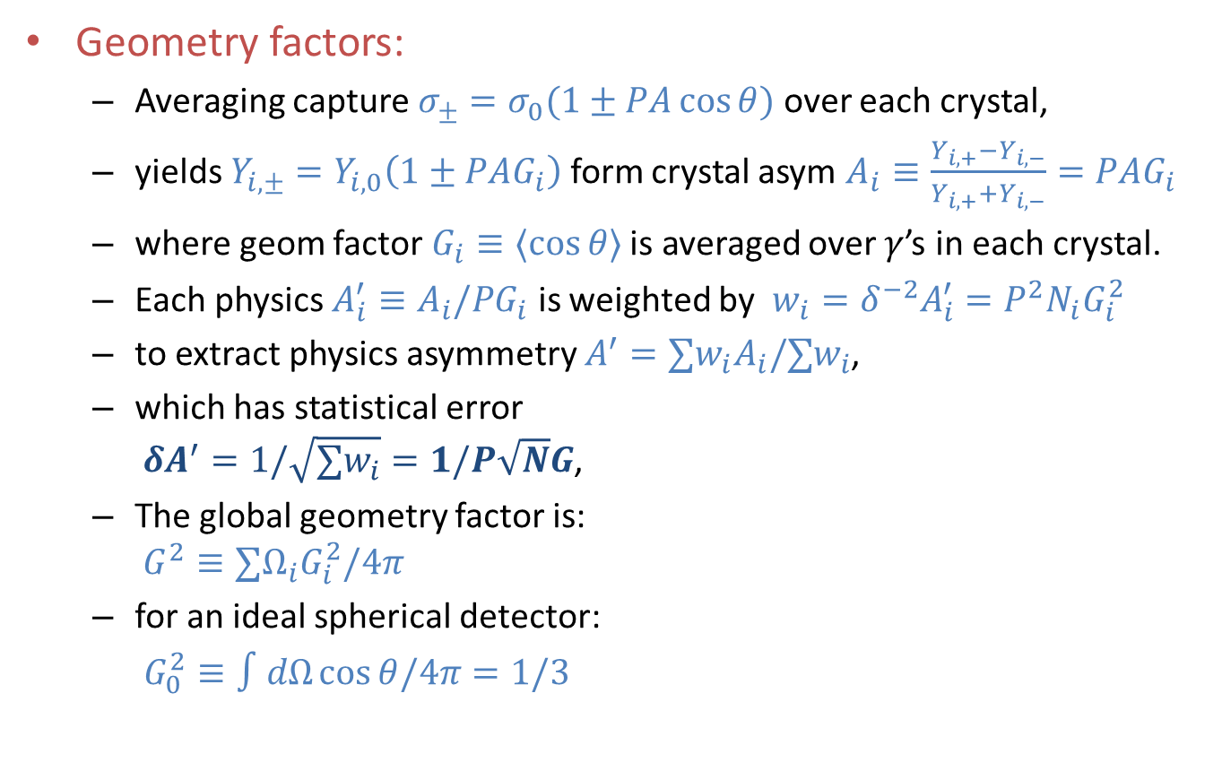
Extraction of Asymmetry
Geometry factors:
  Averaging capture $σ_{±}=σ_{0}(1±PA\cos{θ})$ over each crystal,
  yields $Y_{i,±}=Y_{i,0}\left(1±PAG_{i}\right)$ form crystal asym $A_{i}≡\frac{Y_{i,+}−Y_{i,−}}{Y_{i,+}+Y_{i,−}}=PAG_{i}$
  where geom factor$G_{i}≡〈\cos{θ〉}$ is averaged over $γ$’s in each crystal.
  Each physics $A_{i}^{′}≡A_{i}/PG_{i}$ is weighted by ${w_{i}=δ}^{−2}A_{i}^{′}=P^{2}N_{i}G_{i}^{2}$
  to extract physics asymmetry $A^{′}=∑w_{i}A_{i}/∑w_{i}$,
  which has statistical error
  $δA^{′}=1/\sqrt{∑w_{i}}=1/P\sqrt{N}G$,
  The global geometry factor is:
  $G^{2}≡∑Ω_{i}G_{i}^{2}/4π$
  for an ideal spherical detector:
  $G_{0}^{2}≡∫dΩ\cos{θ/4π=1/3}$
# rings | # crystals | coverage | G / G₀
2 | 52 | 23.5% | 58.9%
4 | 100 | 45.1% | 79.5%
6 | 144 | 65.0% | 91.4%
8 | 180 | 81.2% | 97.3%
10 | 204 | 92.0% | 99.2%
12 | 216 | 97.4% | 99.4%

Slide 14
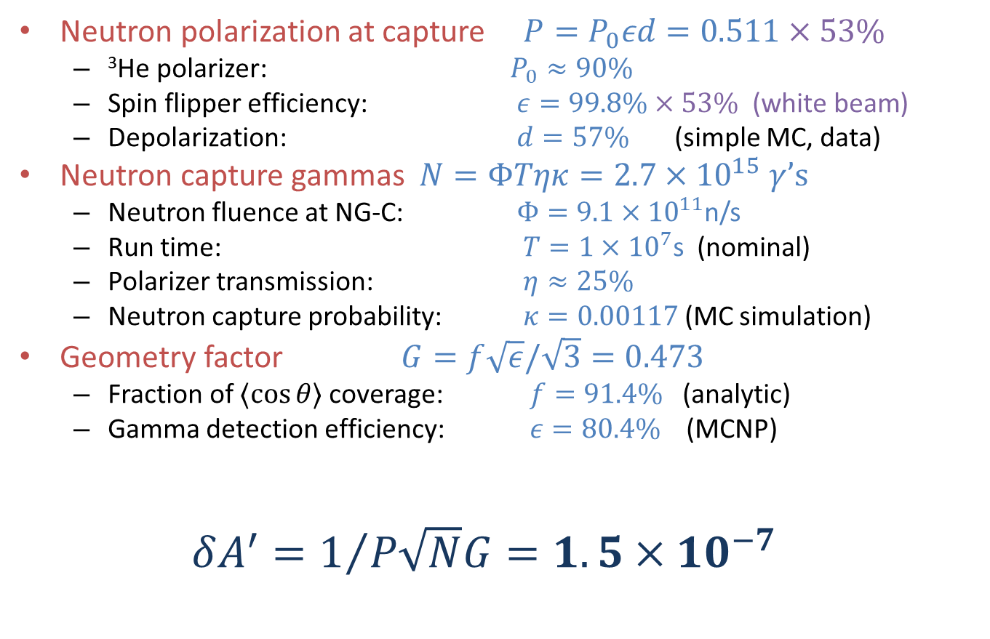
Statistical Sensitivity
Neutron polarization at capture $P=P_{0}εd=0.511×53\%$
  ³He polarizer: $P_{0}≈90\%$
  Spin flipper efficiency: $ε=99.8\%×53\% \text{(}\text{white} \text{beam}\text{)}$
  Depolarization: $d=57\%$ (simple MC, data)
Neutron capture gammas $N=ΦTηκ=2.7×{10}^{15} γ$’s
  Neutron fluence at NG-C: $Φ=9.1×{10}^{11}$n/s
  Run time: $T=1×{10}^{7}$s (nominal)
  Polarizer transmission: $η≈25\%$
  Neutron capture probability: $κ=0.00117$ (MC simulation)
Geometry factor $G=f\sqrt{ε}/\sqrt{3}=0.473$
  Fraction of $〈\cos{θ〉}$ coverage: $f=91.4\%$ (analytic)
  Gamma detection efficiency: $ε=80.4\%$ (MCNP)
$δA^{′}=1/{P\sqrt{N}G}=1.5×{10}^{−7}$

Slide 15
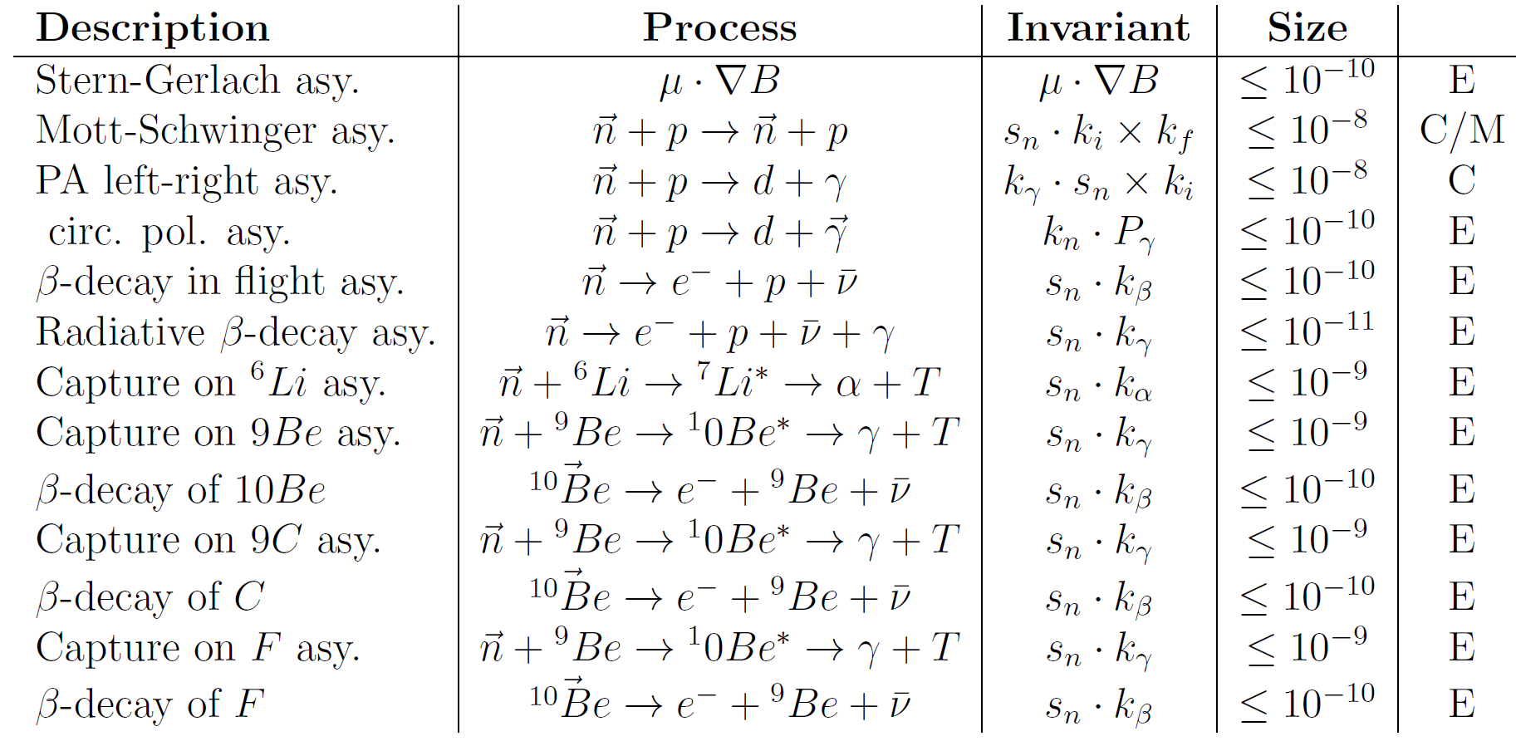

Systematic Errors
Similar to NPDGamma, except counting mode
  cut on $E_{γ}=6.2$ MeV essentially removes background

Slide 16
NDTG Collaboration
J.D. Bowman, S.I. Penttilä (Co-spokesperson), and P. Muller,
Oak Ridge National Laboratory
S. Santra, Bhabha Atomic Research Center
A. Komives (Co-spokesperson), DePauw University
R.C. Gillis, J. Mei, H. Nann, W.M. Snow and Z. Tang,
Indiana University
E. Sharapov, Joint Institute of Nuclear Resesearch (Dubna)
B. Lauss, Paul Scherrer Institut
P.-N. Seo, Triangle Universities Nuclear Laboratory
L. Barrón-Palos (Co-spokesperson), E. Chávez, M.E. Ortiz, A. Huerta, Q.M. Curiel-García, D.J. Marín-Lámbarri, P. Rodríguez Zamora, Universidad Nacional Autónoma de México
C. Crawford (Co-spokesperson), University of Kentucky
M. Dabaghyan, University of New Hampshire

Slide 18
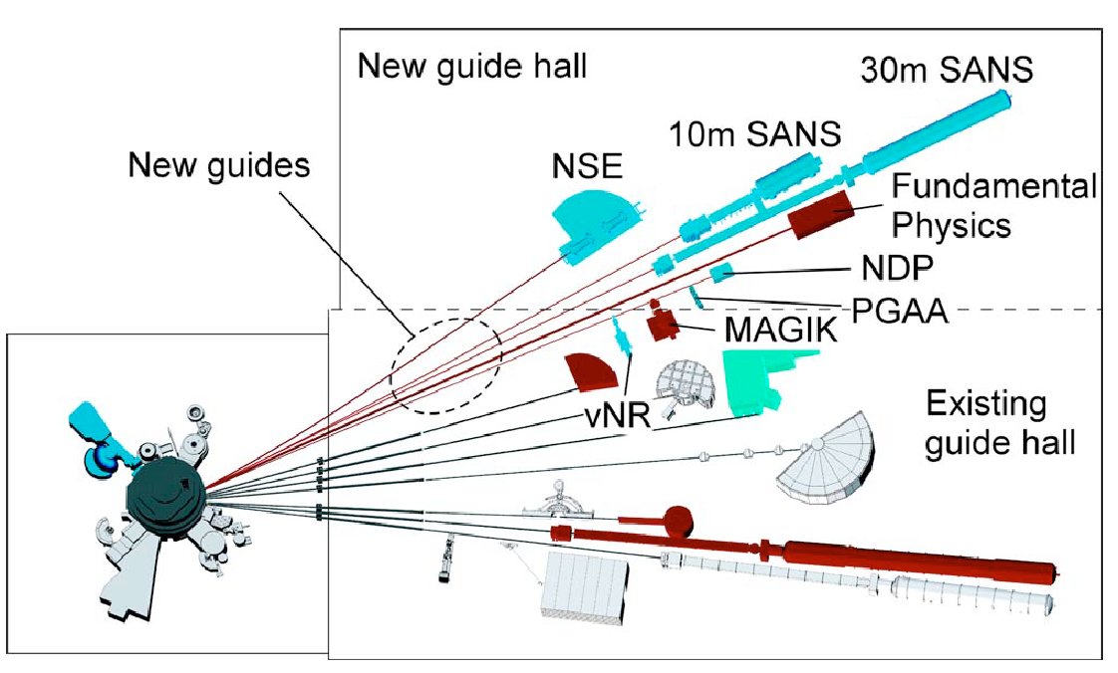
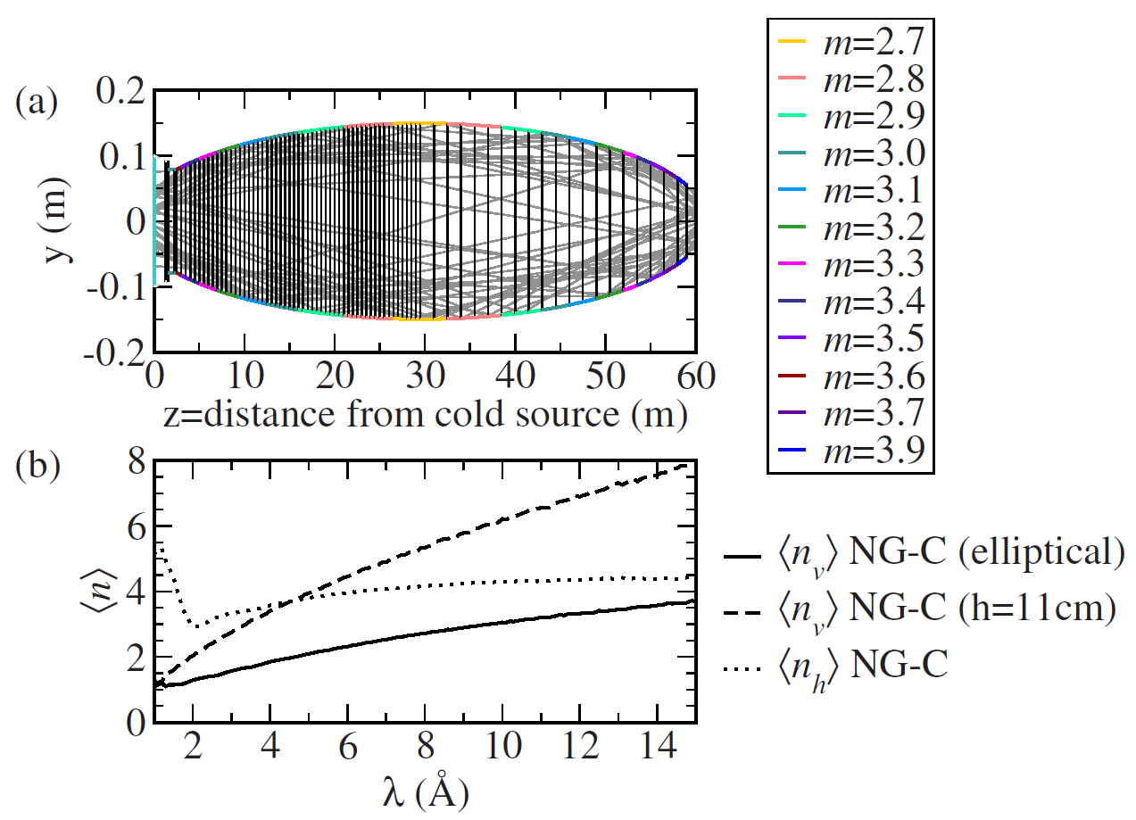
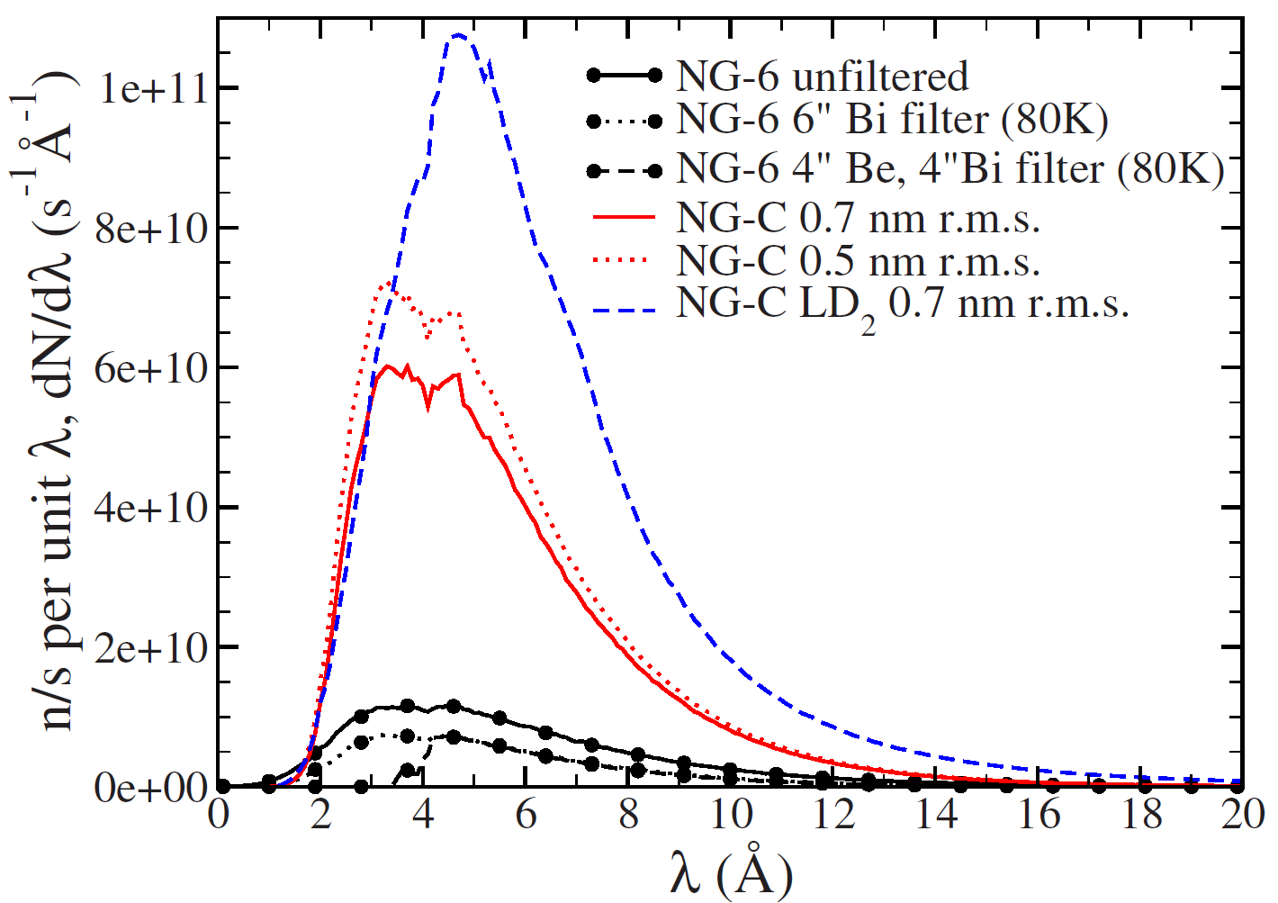
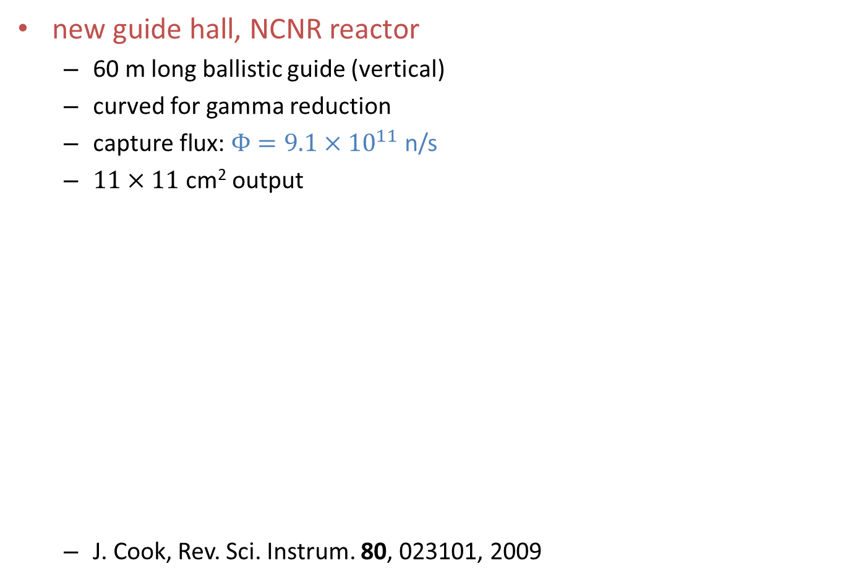
NIST NG-C beamline
new guide hall, NCNR reactor
  60 m long ballistic guide (vertical)
  curved for gamma reduction
  $\text{capture} \text{flux}\text{: }Φ=9.1×{10}^{11}$ n/s
  $11×11$ cm² output
  J. Cook, Rev. Sci. Instrum. 80, 023101, 2009

Slide 19
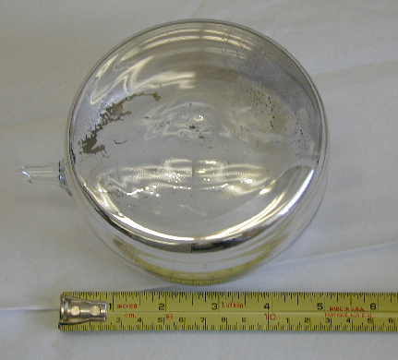
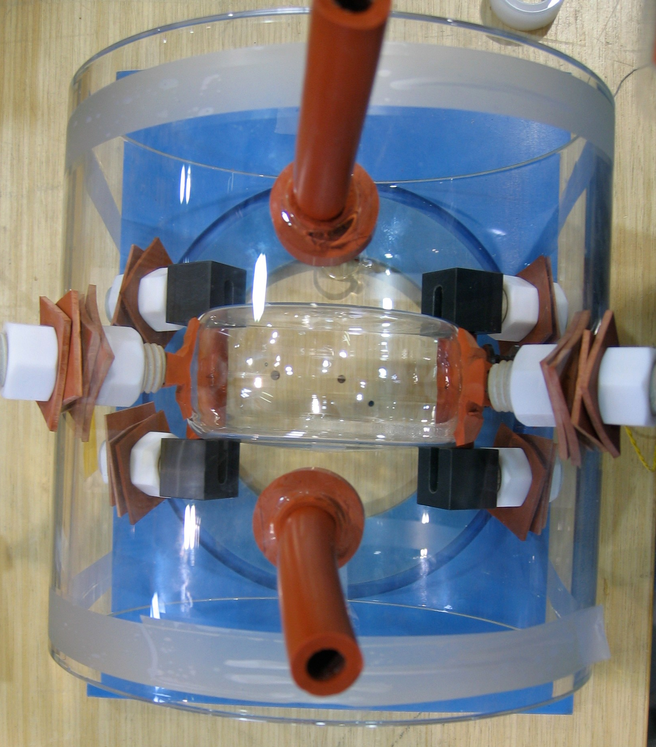
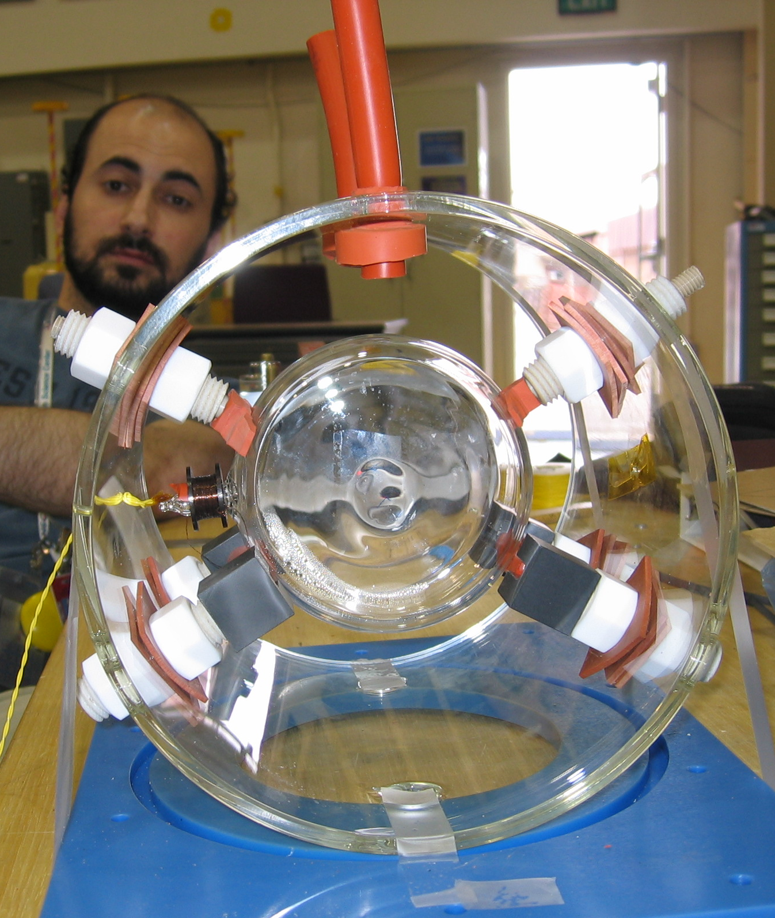
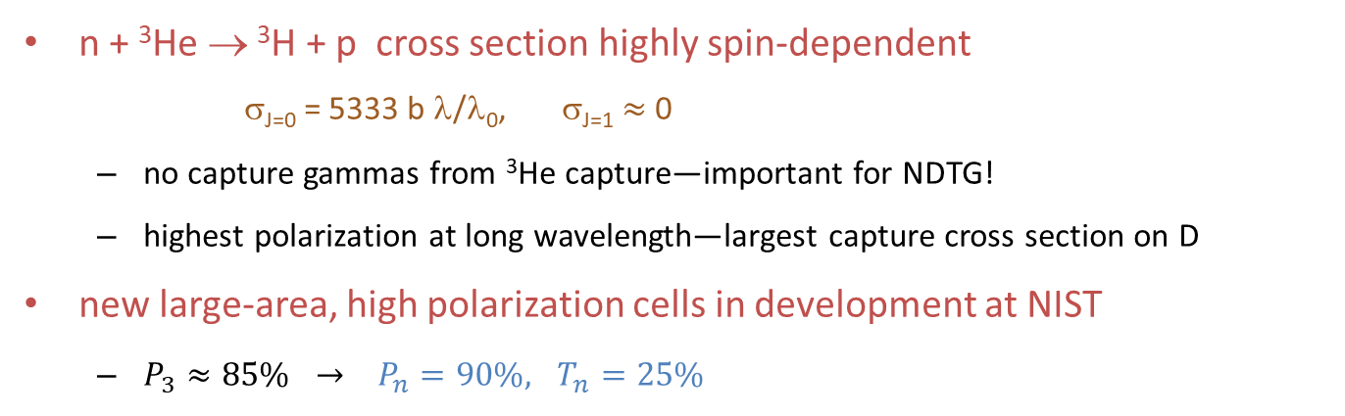
³He neutron polarizer
n + ³He → ³H + p cross section highly spin-dependent
σ_{J=0} = 5333 b λ/λ₀, σ_{J=1} $≈$ 0
  no capture gammas from ³He capture—important for NDTG!
  highest polarization at long wavelength—largest capture cross section on D
new large-area, high polarization cells in development at NIST
  $P_{3}≈85\% → P_{n}=90\%, T_{n}=25\%$
Notes:
The neutrons are polarized by passing them through a polarized ³He cell.
The spin 1/2 ground state of ³He has the wonderful property that spin is carried by the neutron,
since the protons form a closed shell.
Similarly for the neutrons: an oppositely polarized neutron can form an intermediate state
before decaying to tritium and a proton. That is the J=0 state.
In the J=1 state, the neutron spins are both aligned so the cross section is negligible.
Thus only one neutron polarization is transmitted through the ³He cell.
The ³He can be highly polarized through spin-exchange optical pumping.
In the run last December we achieved an average ³He polarization of 57%
This method of polarizing neutrons was chosen for three reasons:
1) The polarization can be reversed simply by reversing the laser polarization.
2) As I’ll show in the next slide, the polarization can be measured at the 0.1% level.
64% polarization at 5 Ang.
Large area, 11 cm in dia, ³He cells are required to cover the beam.
³He spin filter allows a compact experimental setup.
³He spin filter offers an extra spin flip without a change of the B field.
100 W light at 795 nm

Slide 20
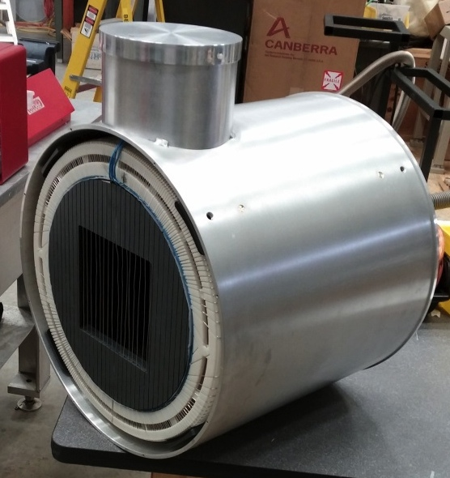
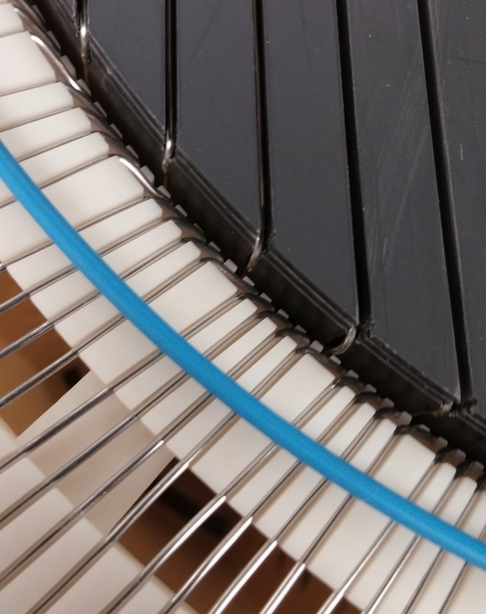
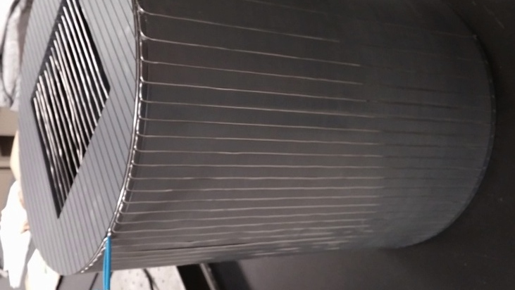
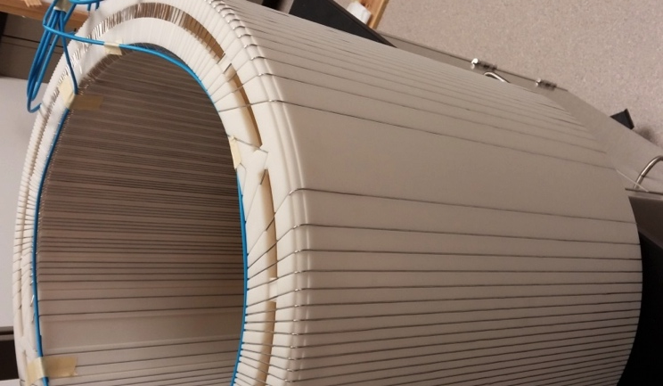
Transverse RF spin rotator
Double-cosine-theta coil
  Fringeless transverse RF field
  Longitudinal OR transverse
  Designed using scalar potential
Univ. Kentucky / Univ. Tennessee

Slide 21
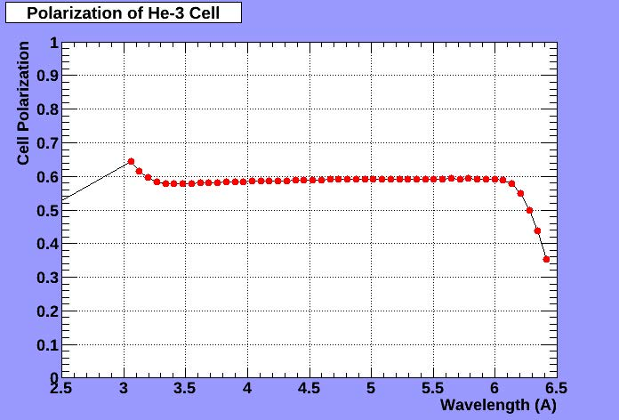
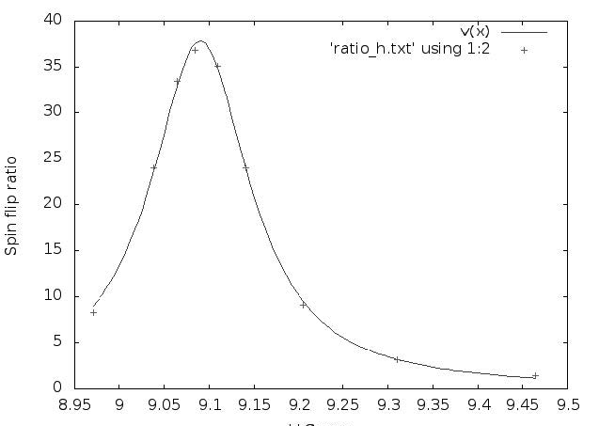
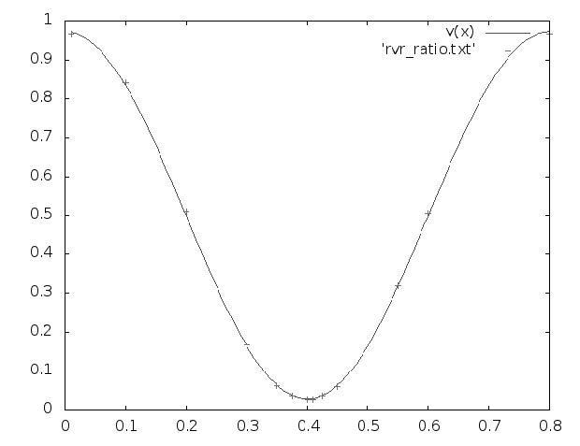
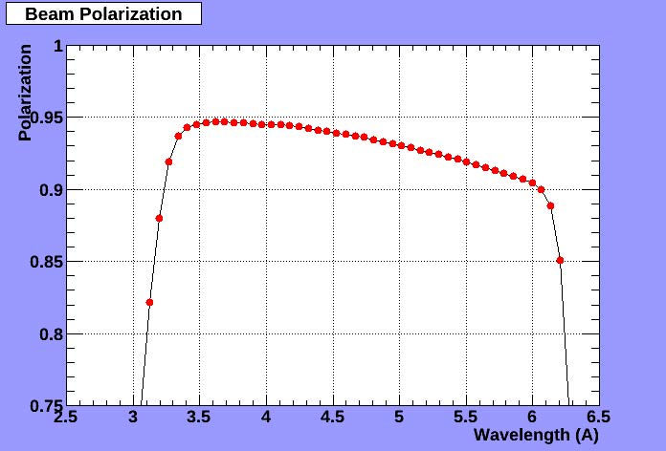
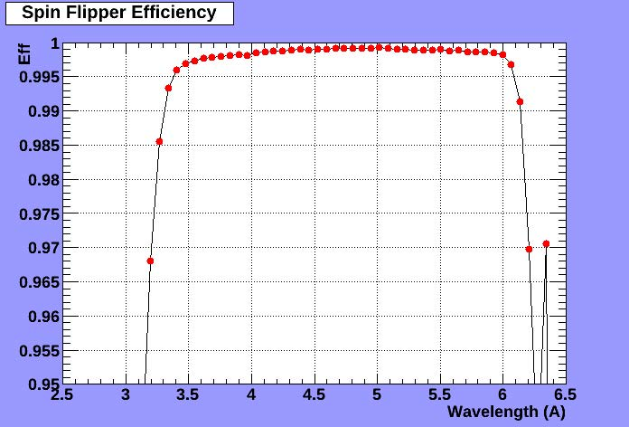
³He transmission polarimetry
C. Hayes, Univ. Tennesse
Larmor
Resonance
Rabi
Oscillation
Polarization of ³He Cell
Beam Polarization
Spin Flip Efficiency

Slide 22
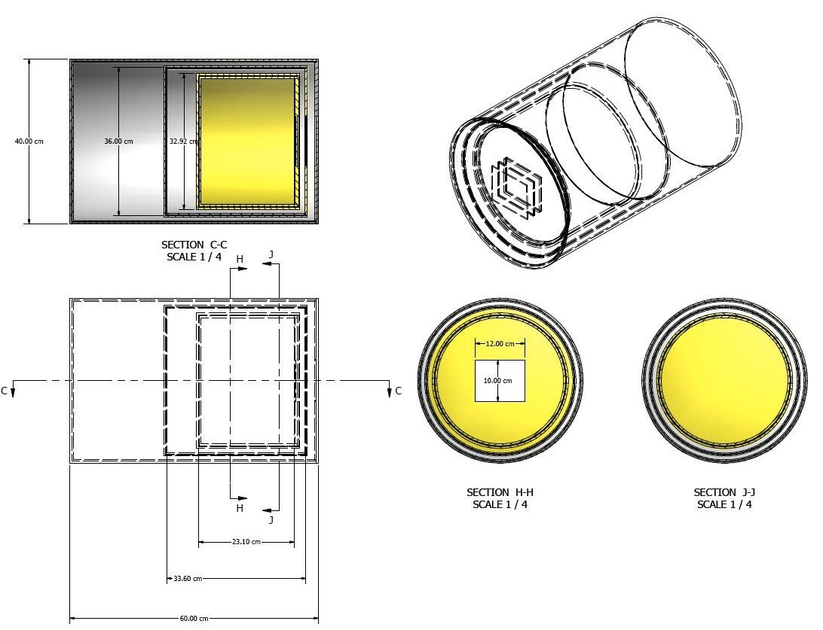
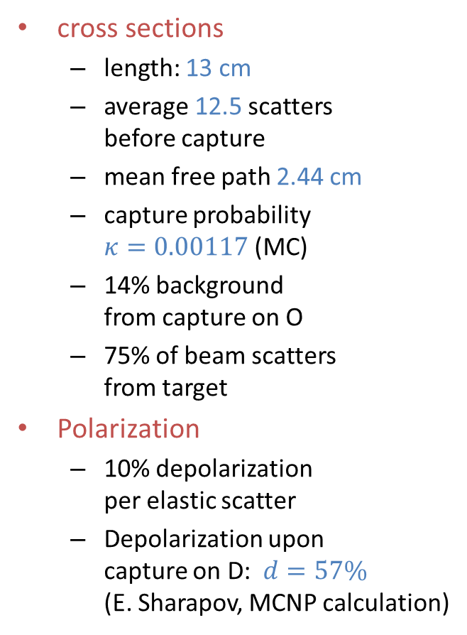
D₂O target design
cross sections
  length: 13 cm
  average 12.5 scatters
  before capture
  mean free path 2.44 cm
  capture probability
  $κ=0.00117$ (MC)
  14% background
  from capture on O
  75% of beam scatters
  from target
Polarization
  10% depolarization
  per elastic scatter
  Depolarization upon
  capture on D: $d=57\%$
  (E. Sharapov, MCNP calculation)

Slide 23
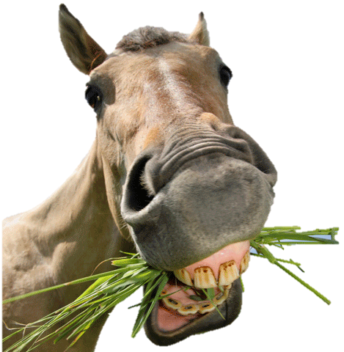


Finite Impulse Response (FIR) Filters
E₁
E₁
E₂
E₂
t₁
t₂
t₁
t₂

Slide 24









Danilov parameters / EFT
Elastic NN scattering
at low energy (<40 MeV)
S-P transition (PV)
S_{z}=±1/2 I₃=±1/2
Antisymmetric in L, S, I
Conservation of J
Equivalent to pion-less
Effective Field Theory (EFT)
in the low energy limit
C.-P. Liu, P.R.C. 75, 065501 (2007)
Haxton & Holstein, P.P.N.P. 7, 1851 (2013)
Notes:
Now days people use the EFT framework to characterize the HWI in a systematic model-independent way,
but as Haxton and Holstein showed, the low energy coupling constants are quite related.
In fact, they published a “Rosetta stone” to relate both theories back to the 5 basic S-P elastic scattering amplitudes.

Slide 25
Sensitivities of few-body reactions
Adelberger, Haxton,
A.R.N.P.S. 35, 501 (1985)
Viviani (PISA), [n-³He]
P.R.C. 82, 044001 (2010)
Notes:
----- Meeting Notes (2013-01-23 09:38) -----
Here are the results of their calculation. You can see the strong I=1 dependence and the two I=0 terms. David went through the existing nuclear PV data and fit for 4 coefficients (ignoring the two other I=1 terms). If you use those values, you see that the total asymmetry is 1.15e-7, with a sizable I=0 contribution of two terms of opposite sign. Even if they completely cancel out, this is one of two linear combinations needed to resolve I=0 terms. Here is the improvement with n3He + NPDG excluding many-body reactions.

Slide 26


Extraction of couplings
Haxton & Holstein, P.P.N.P. 7, 1851 (2013)

