Slide 1
Quasi-3D Visualization Scripting
From rvid_box.pro to rvid_box.py
Shiting Long
13th August, 2019

Slide 2
The Need to Change
From rvid_box.pro to rvid_box.py
The existing toolkit written in IDL including rvid_box.pro is proprietrary software.
Python is generally adopted for data visualization in Pencil-Code.

Slide 3
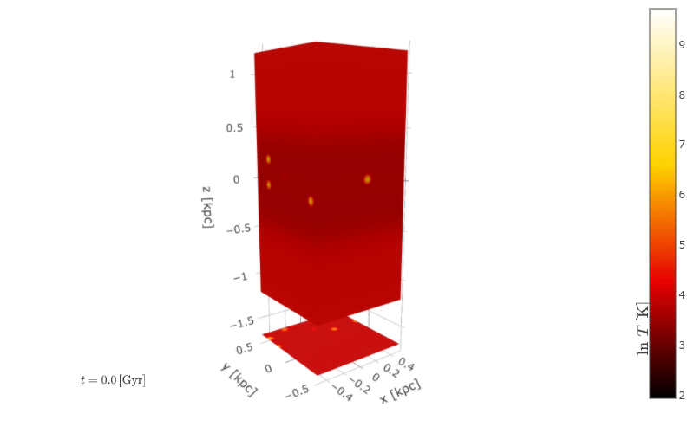
Function of rvid_box.py
Produces a 3D object by combining four 2D slices of Fortran binary data generated from a Pencil-Code simulation.

Slide 4
The Input Data
The input data are four 2D slices containing information on a parameter (e.g. gravity) at a certain time (or during a period) from a given 3D quantity.
The slices include: two in X-Y plane, one in each Y-Z and X-Z plane.

Slide 5
The Output
The output of this script are images showing a projection of the 3D object. One can animate the change of the 3D object within time.
Parameters for tuning the projection are supported.

Slide 6
Workflow
Additional information on 2D slices: field (e.g. temperature, gravity), unit of field, time step, etc.
User defined preferences: scale of data, colorscale, viewpoint, etc.

Slide 7
Graphing Library
Plotly
This script uses Plotly Python for graphing. It provides multiple surface plots which suits the aim of the script best.
https://plot.ly/python/

Slide 8
Thank You!

